Slide 1
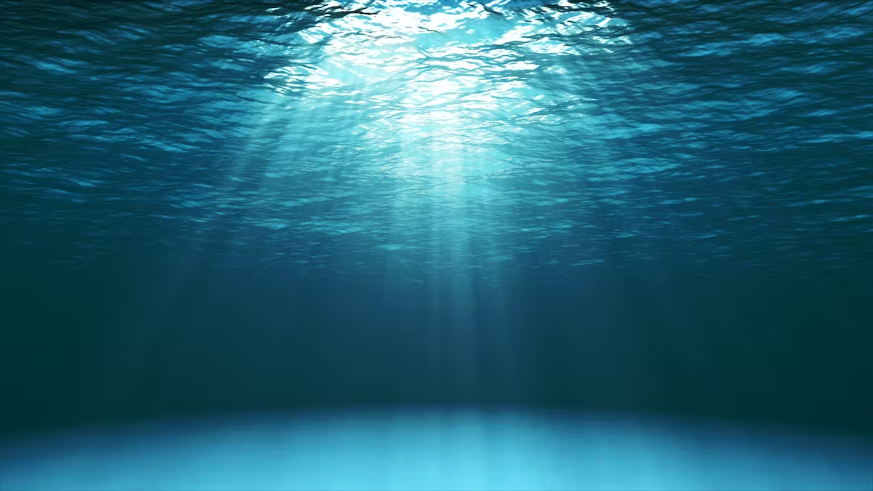




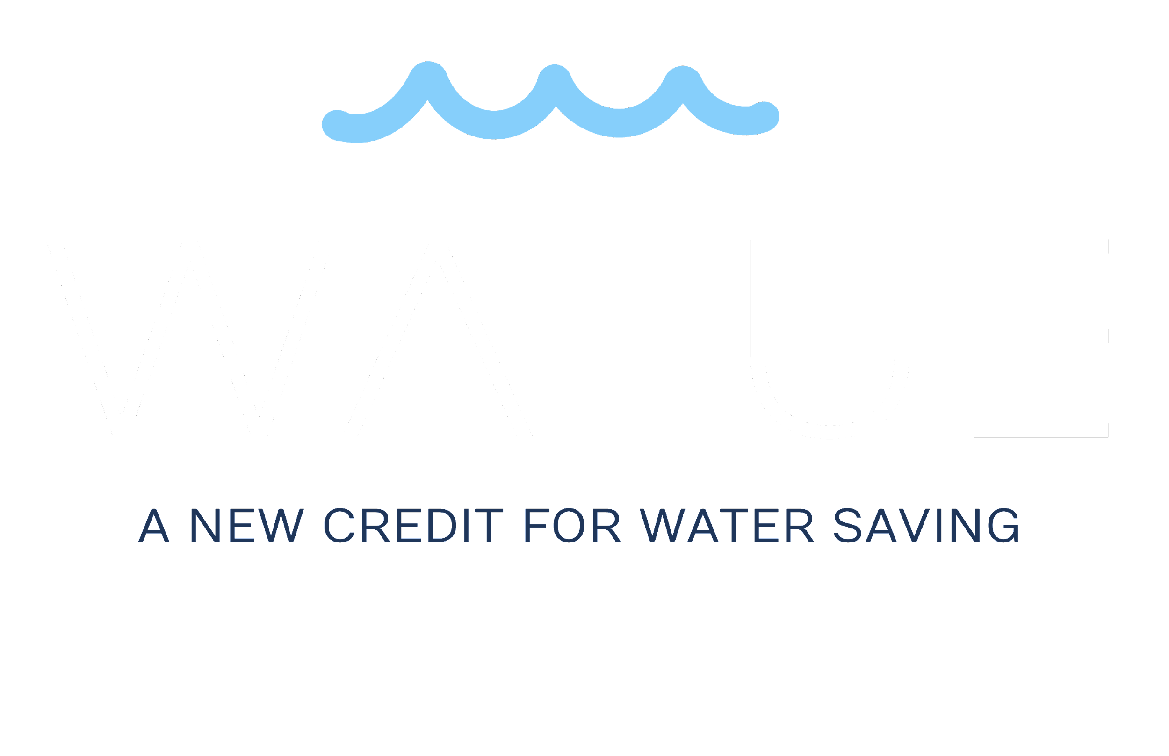

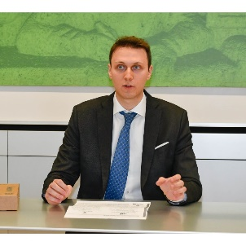

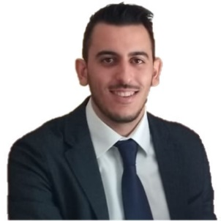
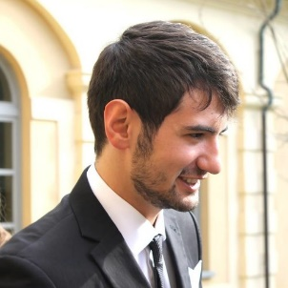
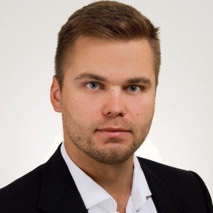
GENEVA, JULY 6th 2023
Designed and run by:
Challenge owner:
Margherita
Marazzini
Nicola
Merci
Agnese Lipari
Elia Grano
Alessio
Follini
Paweł
Chwalewski

Slide 2

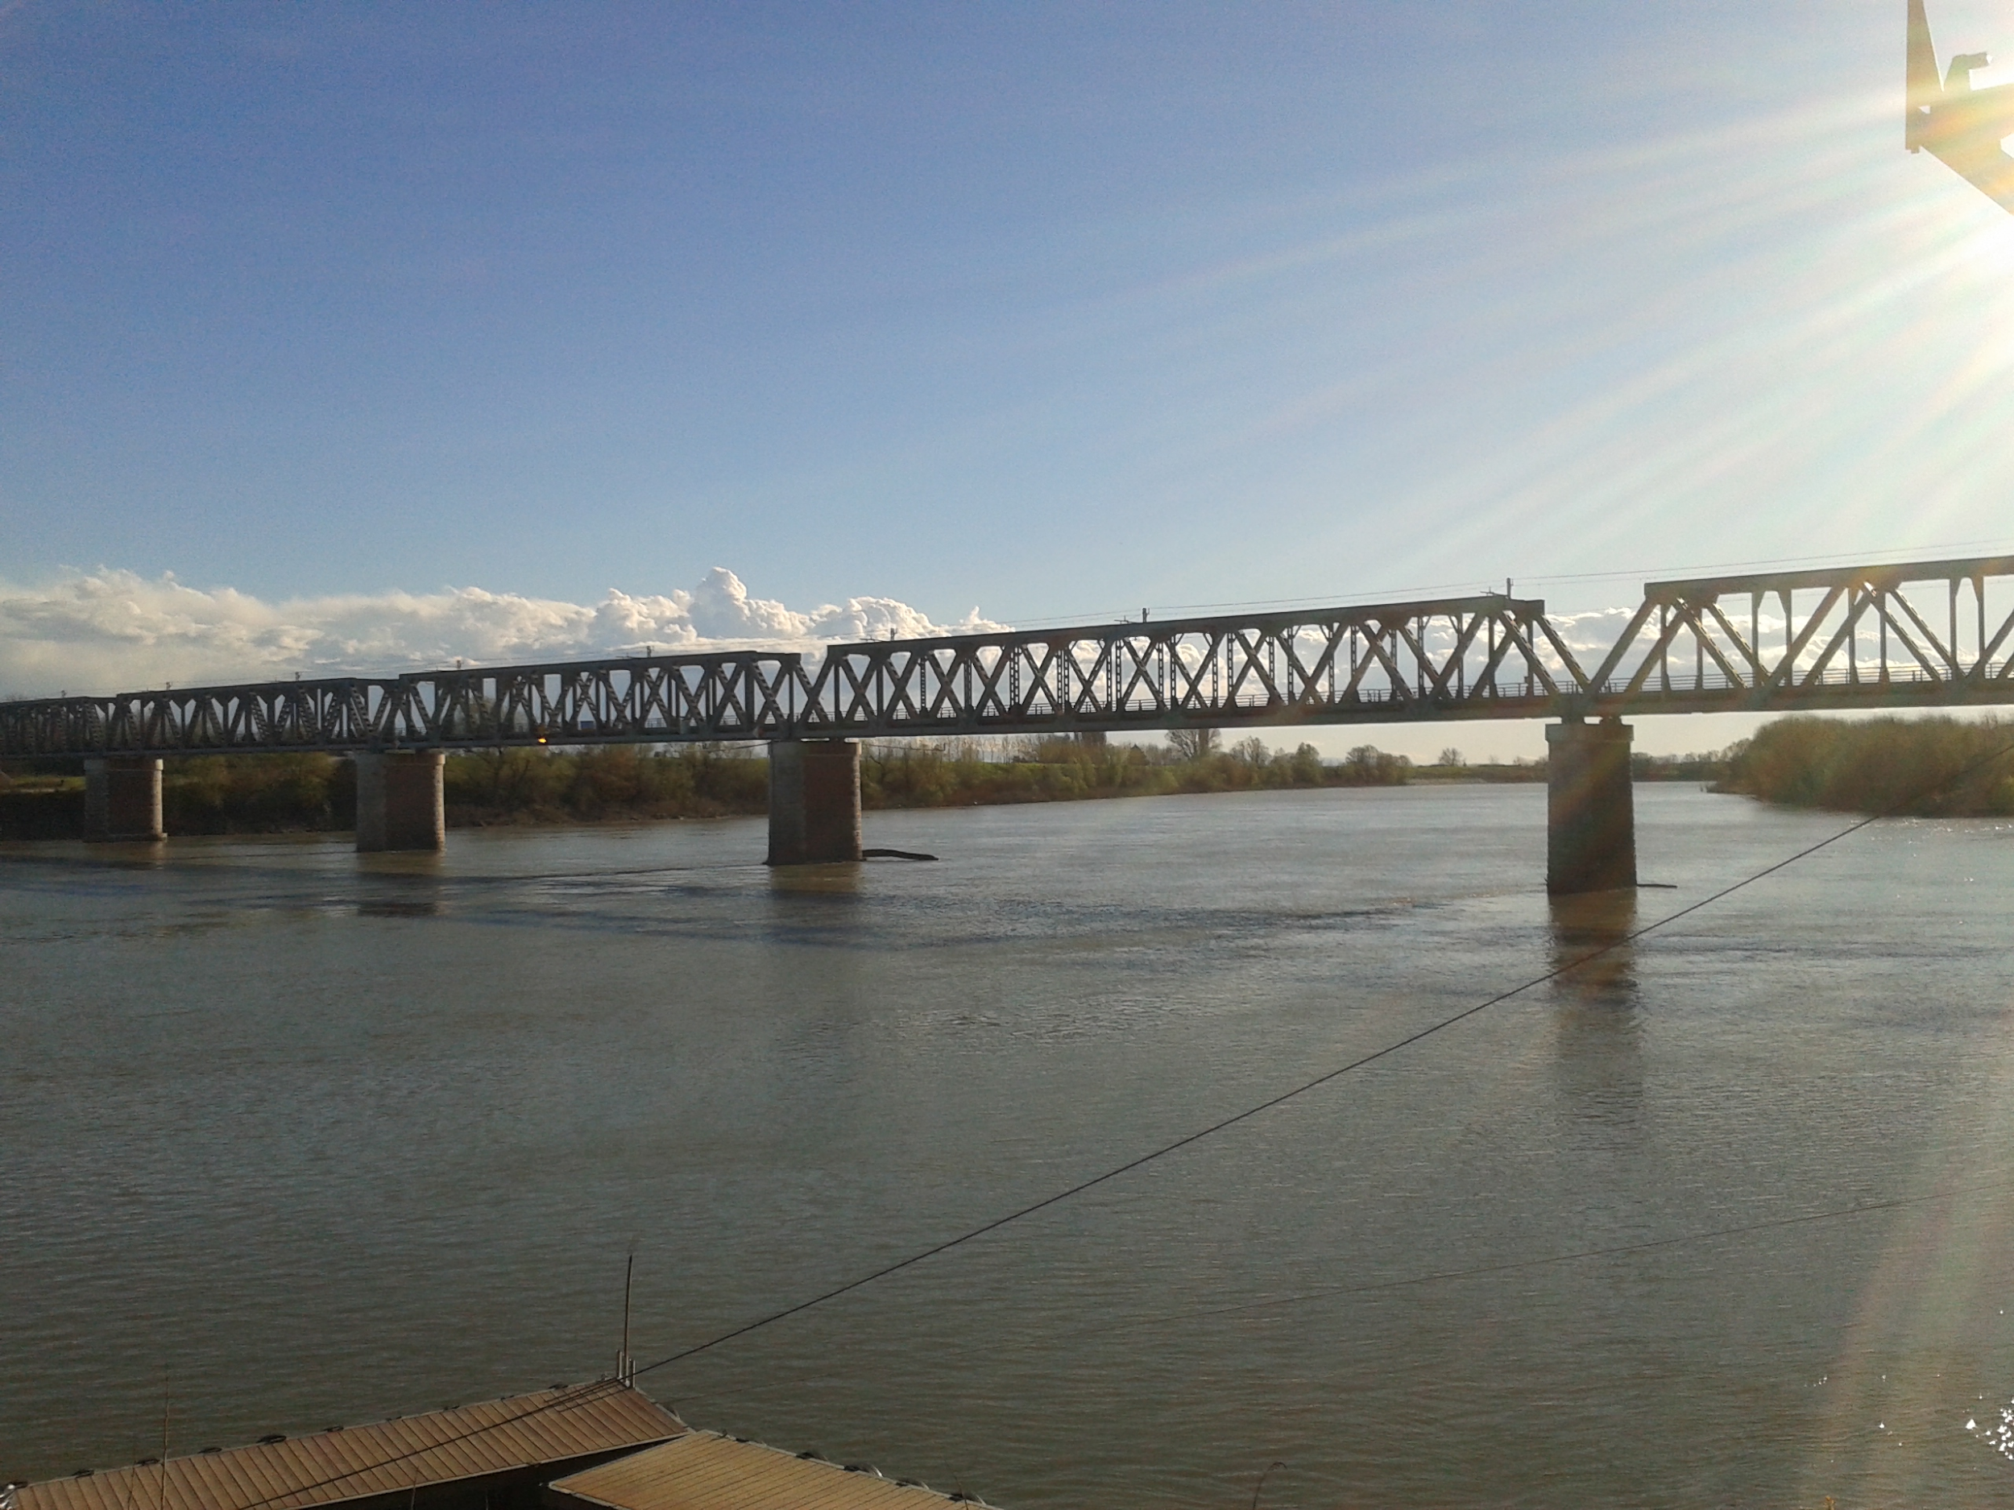
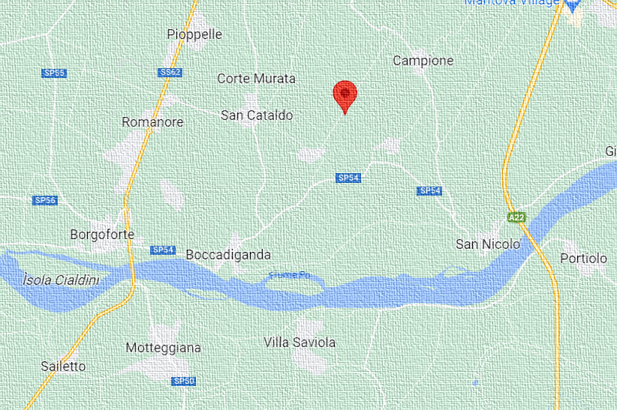
The Po river
My Home
Po River
“When I was a child…”
– Margherita –
Notes:
Good afternoon to everyone. My name is Margherita and I was born in a small town near the Po’ River (you can see my house in this map). When I was a child, I used to go fishing with my grandfather to the Po’ River. But now, years have passed, and no more children will be as lucky as I was to do this simple activity …

Slide 3
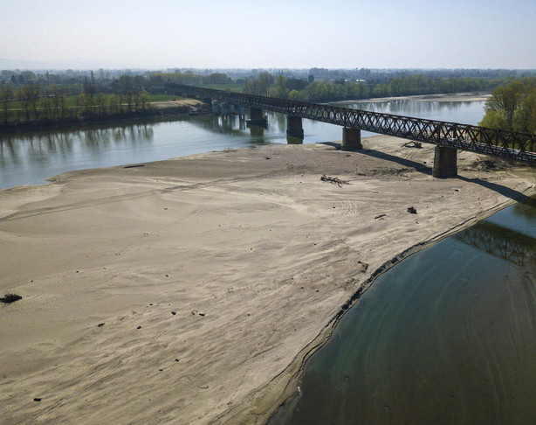
Past
Present
“…There is no more water…”
Notes:
… because now there is no more water.

Slide 4
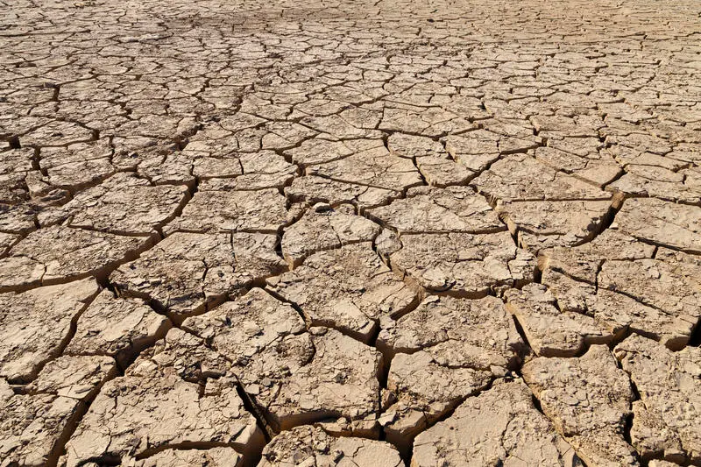

Half of the world’s population could be living in areas facing water scarcity by as early as 2025
Notes:
But mind you, the problem does not affect only Italy. The problem of water is not just about children that cannot fish anymore.
Look at the person next to you, by 2025 one of you will suffer from water scarcity.

Slide 5
Notes:
And this is why we created “Walue”, a new system to save the future of water
A system in which individuals or organizations have the possibility to receive money for saving water; a system where businesses can compensate their water consumption and reduce their water foot-print.
But let’s go in depth and see what “Walue” is …

Slide 6

Water Credit
Certification Software
The Walue
Platform
Notes:
Walue is the combination of three simple elements:
1) Water credits
2) A certification software
3) The Walue platform
A water credit is a digital certificate which represent the saving of a specific amount of water
The certification software is smart system able to validate in real time the amount of water saved and consequently generates water credits
The Walue platform is our digital space where water credits can be:
Exchanged between the different stakeholders
Or obtained by financing projects that aim to save water
And Let's see now how the system works and how water credits can be generated

Slide 7
Notes:
Let's see now how the system works and how water credits can be generated
On one side

Slide 8

Water
Off-setters
Notes:
On one side we have the “water off-setter” that are organisations or individuals that introduce virtuous processes/measures to save water

Slide 9
Water
Off-setters
Water Neutrality Aspirants
Notes:
On the other side we have the “water neutrality aspirant”, who are companies or institutions that are willing to acquire water credits by investing in projects to save water. They can then sell the water credits through our platform or use them (in their sustainability report or plan), as a compensation tool, to reduce their water footprint.

Slide 10
Water
Off-setters
Water Neutrality Aspirants
Notes:
Connecting these two actors is the Walue system that manages the water credit lifecycle: from their generation to their exchange.
And now the question is: who is going to have water credits ?

Slide 11
THE MARKET
Notes:
And now the question is: who is going to have water credits ?
Well we did some simple research and found:

Slide 12





MARKET RESEARCH
242 companies
have joined forces to fight against water scarcity
Notes:
1) Recently, an association called the CEO Water Mandate was established to bring together 242 companies, between the major ones for capitalization, to concretely fight against water stress.

Slide 13

MARKET RESEARCH
242 companies
have joined forces to fight against water scarcity
Investors for 3 trillion $ in assets wrote a letter to push the governments to act
Notes:
2) Furthermore, during the UN water conference in March 2023, many banks and similar investors from all over the world wrote a letter to push the governments to act against water scarcity.

Slide 14


MARKET RESEARCH
242 companies
have joined forces to fight against water scarcity
Investors for 3 trillion $ in assets wrote a letter to push the governments to act
France and Spain
have already imposed water restriction and made available millions of euros to reach their goal
Notes:
3) And in Europe some governments and countries, such as France and Spain have already imposed water restrictions to the population, and made millions of euros available to finance initiatives to save water.
So, we have a market that is ready to invest in solutions to save water … now the question is: Who are gonna be our first water offsetters?

Slide 15
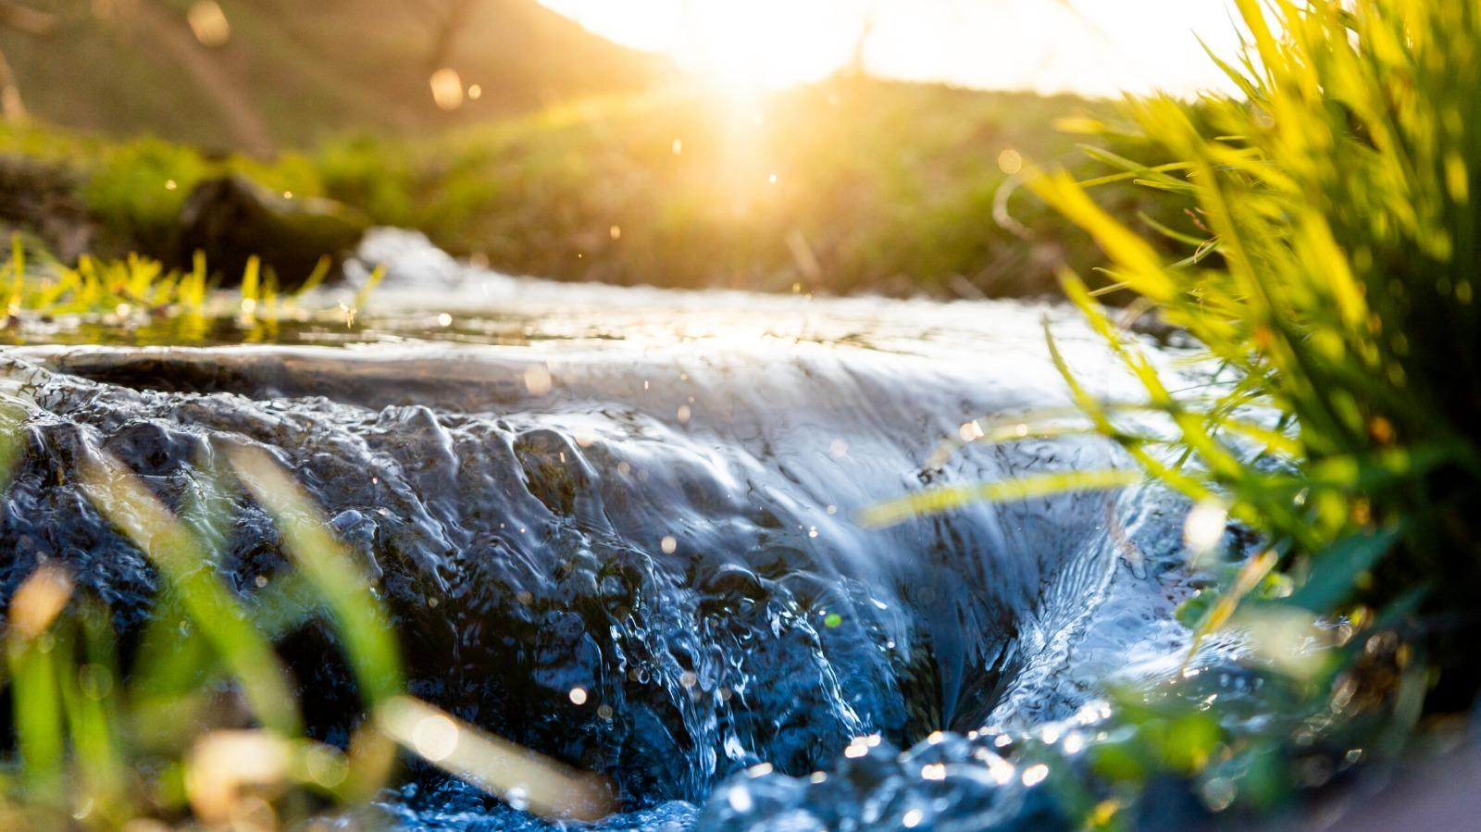

Agriculture accounts for 70% of all freshwater withdrawals
worldwide
Notes:
Well we decided to start from farmers, because agriculture is the industry that globally accounts for 70% of all freshwater withdrawals.
And water is essential for agriculture and agriculture is essential for our survival.

Slide 16
We save the water scarcity issue
in agriculture
Less than 25 % of farmers
would embrace Walue
Notes:
And we did some calculations and we discovered that if less than the 25% of Italian farmers adopted thanks to water credits, methodologies, practices or technologies to save water we would be able to solve in Italy the problem of water scarcity in agriculture.
And we picked Italy only because is the country in Europe with the highest water consumption rate. But just imagine how much water we can save if we go worldwide.
And we strongly believe farmers will embrace Walue because in doing so they not only save water, but they increase their productivity, without almost any/no financial effort.

Slide 17
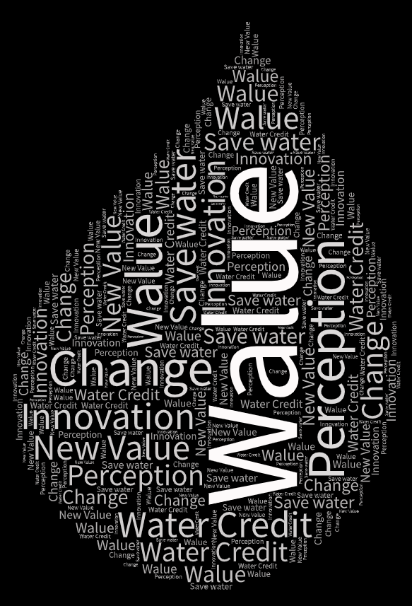
Notes:
But behind water credit there is something more, there is something bigger and extremely fascinating.
All the greatest innovations had one thing in common: they changed the way the world was perceived.
Think about Internet, about cars, about what the greatest minds of the world do here at CERN every day.
Well … thanks to water credit we change the perception the world has of water.
Giving a different value to it: a value that doesn't depend on how much water we use but on how much water we save !
For our nature, we start caring about stuff only when we are losing them.
But acting now we are still in time to change, we are still in time to allow future grandparents to go fishing with their children again.
So everyone here, invest in water credit today if you want water tomorrow.

Slide 18
Invest in water credits today
to have water tomorrow
Notes:
So everyone here, invest in water credit today if you want water tomorrow.

Slide 19
The credit for saving water
Margherita
Marazzini
Nicola
Merci
Agnese Lipari
Elia Grano
Alessio
Follini
Paweł
Chwalewski
Notes:
Thank you!

