Slide 1

DRD Collaboration Progress Overview
International Detector R&D (DRD) Collaboration Progress
DRD1 Gaseous Detectors (TF Convenors: Anna Colaleo (INFN Bari (IT)), Leszek Ropelewski (CERN))
Scientific organisation well defined with eight Technology/Activity Working Groups and work-packages of sub-groups of institutes towards common deliverables, workplans and sharing of resources.
Draft proposal release followed by community meeting to finalise proposal in mid-June with submission in July.
Community meeting: 1st-3rd March 2023 https://indico.cern.ch/event/1245751/
Organisation and workplan at https://indico.cern.ch/event/1214405/
(Also, for RD51 see https://rd51-public.web.cern.ch/)
DRD2 Liquid Detectors (TF Convenors: Jocelyn Monroe (RHUL (GB)), Roxanne Guenette (Manchester (GB)))
Four main work-packages defined with sub-projects.
Technical Areas (TAs) clearly established and supported by community feedback.
Deliverables tables for each TA being finalized. Most FTE/resources/facility (both available and needed) have been collected. Proposal writing underway with goal to have full draft early June.
Community meeting: 20th April 2023 https://indico.cern.ch/event/1214404/timetable/#20230420
Organisation and workplan at https://indico.cern.ch/event/1214404/
*community feedback via RECFA delegates and National Contacts
1
ECFA Detector R&D Roadmap
24th May 2023

Slide 2
DRD Collaboration Progress Overview
DRD3 Solid State Detectors (TF Convenors: Giulio Pellegrini (IMB-CNM-CSIC) (ES)), Nicolo Cartiglia (INFN Torino (IT)))
Detector R&D Themes (DRDTs) define the work-packages with seven Working Groups to organise the proposal deliverables with WG milestones already defined.
First full draft of proposal targeted for end of May, with further iterations on resources estimates with institutes before proposal preparation process aimed to conclude around the end of June.
Community meeting: 22nd-23rd March 2023 https://indico.cern.ch/event/1214410/timetable/#20230322.detailed
Further organisation information at https://indico.cern.ch/event/1214410/
(Also, for RD50 see http://rd50.web.cern.ch/ and for RD42 see https://rd42.web.cern.ch/rd42/)
DRD4 Particle ID and Photon Detectors (TF Convenors: Christian Joram (CERN), Peter Krizan (JSI (SI)))
Community meeting discussed draft collaboration structure.
Work on the proposal and MoU underway for July 2023.
Community meeting: 6th-17th May 2023 https://indico.cern.ch/event/1263731/
Further background at https://indico.cern.ch/event/1214407/
DRD5 Quantum and Emerging Technologies (TF Convenors: Marcel Demarteau (ORNL), Michael Doser (CERN))
Very different and diverse community with many interfaces to other programmes and science areas.
“White paper” document prepared and in circulation for comments until mid-June with LoI targeted for July 2023 with full proposal before the end the year, given specific issues of overlaps etc with funded initiatives outside PP.
Draft of web pages explaining six quantum sensing families at https://doser.web.cern.ch/.
*community feedback via RECFA delegates and National Contacts
2
ECFA Detector R&D Roadmap
24th May 2023

Slide 3
DRD Collaboration Progress Overview
DRD6 Calorimetry (TF Convenors: Roberto Ferrari (INFN Pavia (IT)), Roman Poeschl (Université Paris-Saclay (FR)))
Scientific organisation well advanced with four separate tracks defined and required resources identified including significant test-beam availability after 2025.
Draft proposal ready by start of June, second draft mid-June, target proposal readiness in mid July.
Community meetings: 12th January 2023 https://indico.cern.ch/event/1212696/ and 20th April 2023 https://indico.cern.ch/event/1246381/ .
Organisation, workplan and proposal status at https://indico.cern.ch/event/1213733/
(Also for CALICE see https://twiki.cern.ch/twiki/bin/view/CALICE/WebHome, for Crystal Clear see https://crystalclearcollaboration.web.cern.ch/ and for RD52 see http://www.phys.ttu.edu/~dream/index.html.)
DRD7 Electronics (TF Convenors: Dave Newbold (STFC (GB)), Francois Vasey (CERN))
With TF8, TF9 and “Transversal” topic area with seven Working Groups whose scope depends on the content of other DRD proposals.
Each WG hosts projects to implement its objectives which then need to be aggregated into a coherent proposal to be submitted to DRDC.
Before reaching the proposal an LoI will be submitted in July 2023 which also contains ballpark resource estimates with full proposal before the end of the year.
Community meeting: 14th-15 March 2023 https://indico.cern.ch/event/1214423/timetable/#20230314.
Organisation and planning are also detailed in the draft “Organisation of the DRD7 Collaboration. Version 5”
*community feedback via RECFA delegates and National Contacts
3
ECFA Detector R&D Roadmap
24th May 2023

Slide 4
DRD Collaboration Progress Overview
TF8 Integration (TF Convenors: Frank Hartmann (KIT (DE)), Werner Riegler (CERN))
Survey launched to gauge community appetite for DRD in the areas on 23rd March 2023 to all those who registered interest. Results are returned and have been analysed.
Forum on Tracking Detector Mechanics 2023 31st May to 2nd June seen as opportunity for the mechanics and local colling community to discuss possible interest in forming a DRD for their specific area.
Other TF8 topics seen as equally important to the future of the field and funding mechanisms for these are needed, but they are not thought to be appropriate subjects for a DRD collaboration.
TF9 Training (TF Convenors: Erika Garutti (Hamburg University (DE)), Johann Collot (university Grenoble Alpes (FR)))
Now the topic of the dedicated new ECFA Training Panel
Kick-off meeting on 7th March 2023 with agenda at https://indico.desy.de/event/38365/.
Web pages etc are being constructed at https://indico.cern.ch/event/1270365/.
CERN EP R&D Programme links at: Homepage | ep-rnd.web.cern.ch.
AIDAinnova web pages: https://aidainnova.web.cern.ch/
EURO-LABS information at https://web.infn.it/EURO-LABS/
Task force membership at: https://indico.cern.ch/event/957057/page/20875-panel-members-and-task-forces.
*community feedback via RECFA delegates and National Contacts
4
ECFA Detector R&D Roadmap
24th May 2023

Slide 5
BACK UP

Slide 6
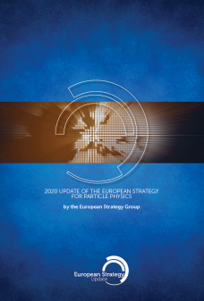
Detector R&D Roadmap as Implementation of EPPSU
European Particle Physics Strategy Update Recommendations
“Main report: “Recent initiatives with a view towards strategic R&D on detectors are being taken by CERN’s EP department and by the ECFA detector R&D panel, supported by EU-funded programmes such as AIDA and ATTRACT. Coordination of R&D activities is critical to maximise the scientific outcomes of these activities and to make the most efficient use of resources; as such, there is a clear need to strengthen existing R&D collaborative structures, and to create new ones, to address future experimental challenges of the field beyond the HL-LHC. Organised by ECFA, a roadmap should be developed by the community to balance the detector R&D efforts in Europe, taking into account progress with emerging technologies in adjacent fields.”
Deliberation document: “Detector R&D programmes and associated infrastructures should be supported at CERN, national institutes, laboratories and universities. Synergies between the needs of different scientific fields and industry should be identified and exploited to boost efficiency in the development process and increase opportunities for more technology transfer benefiting society at large. Collaborative platforms and consortia must be adequately supported to provide coherence in these R&D activities. The community should define a global detector R&D roadmap that should be used to support proposals at the European and national levels."
Extracted from the documents of 2020 EPPSU, https://europeanstrategyupdate.web.cern.ch/
Detector R&D Roadmap process details at: https://indico.cern.ch/e/ECFADetectorRDRoadmap
*community feedback via RECFA delegates and National Contacts
6
ECFA Detector R&D Roadmap
24th May 2023

Slide 7
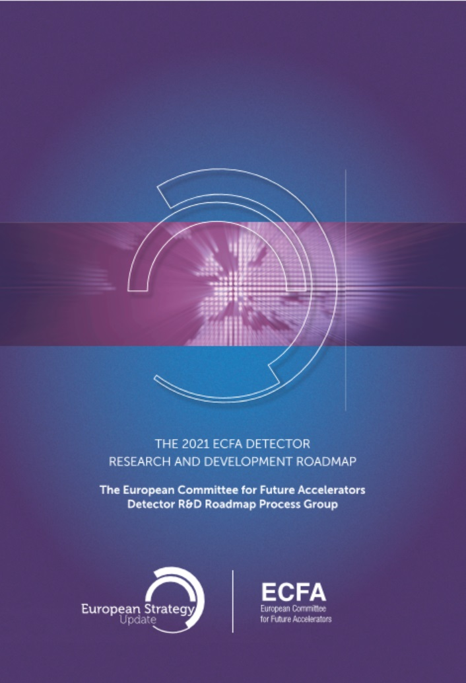
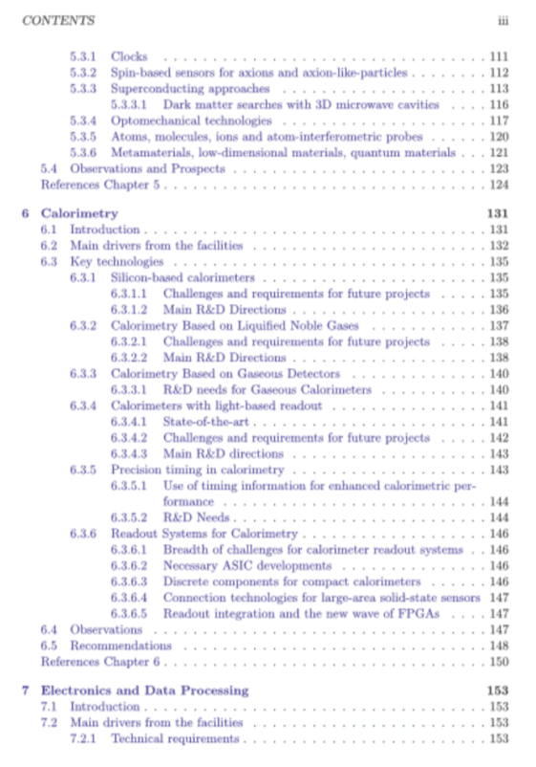
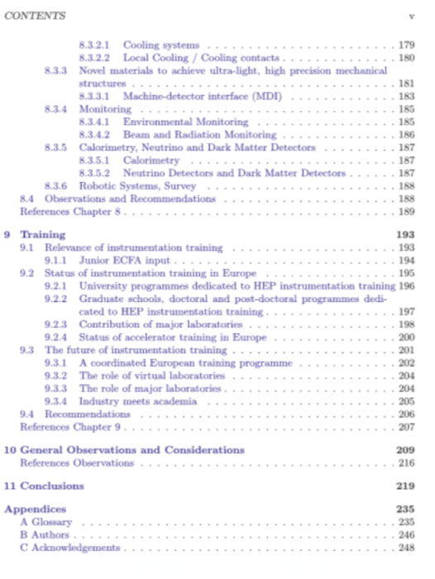
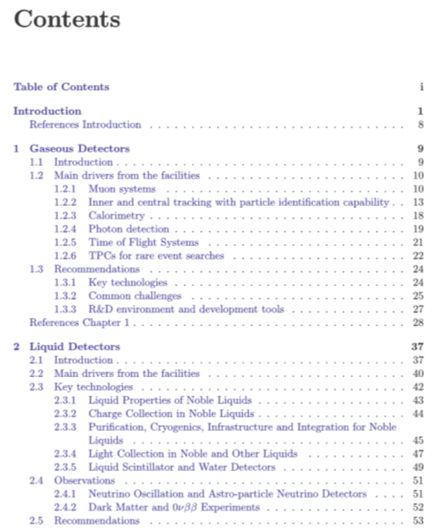
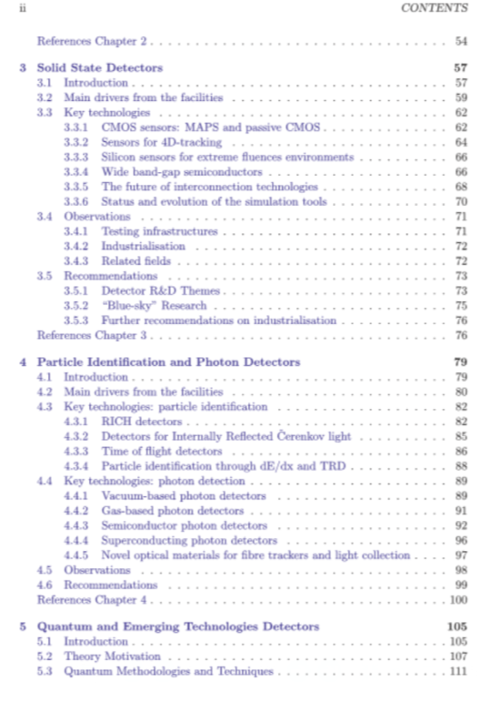
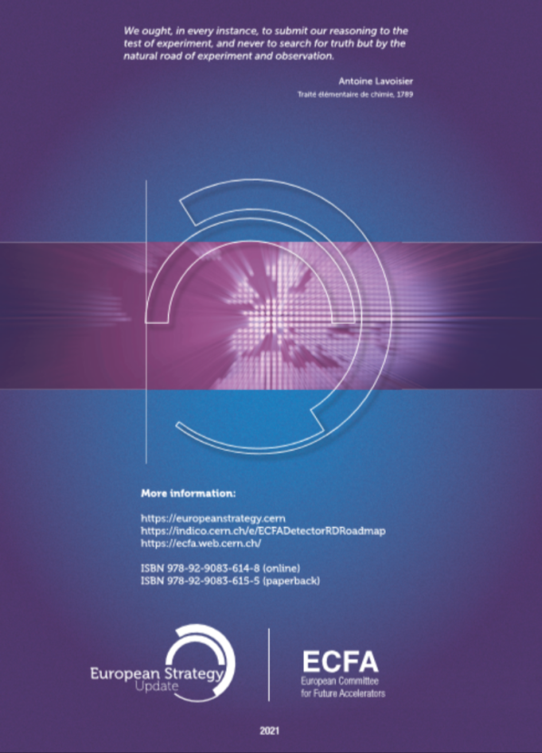
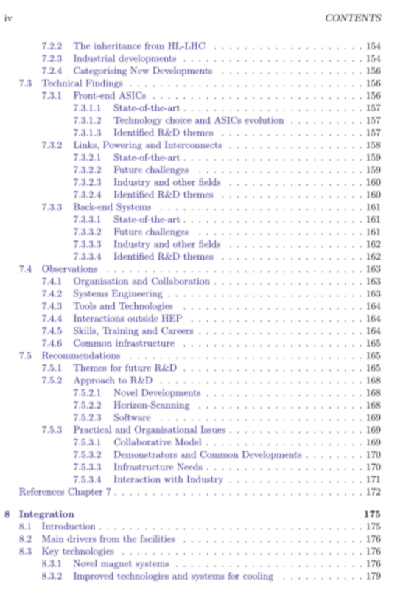
DOI: 10.17181/CERN.XDPL.W2EX
ISBN: 978-92-9083-614-8
Published 21.10.2021
(https://cds.cern.ch/record/2784893)
Also 8 page synopsis document:
https://cds.cern.ch/record/2784893/files/Synopsis%20of%20the%20ECFA%20Detector%20R&D%20Roadmap.pdf
CERN-ESU-017
ECFA/RC/21/510

Slide 8
DRD Proposal Organisation
The organisation of DRDs is expected to be largely up to the relevant communities to define (given their various traditions in the different areas), but it will be important that there is some commonality of language and information provided in the different proposals, to avoid confusing both reviewers and Funding Agencies.
A document “Suggested Guidelines for DRD Proposal Preparation” has been prepared by the chairs of the ECFA Detector Panel which covers many of these aspects, but a number of further points have come up in the recent DRD community meetings.
The language around Memoranda of Understanding (MoUs) has been confused by the use of the term “Light-Weight-MoU” by RD50/51 to describe agreements signed by institutes as collaboration members with commitments which include an annual levy of ~few kCHF/annum for administrative support and collaborative blue-sky R&D.
However, the document CERN/SPC/1190 refers to Memoranda of Understanding (MoUs) in the context of agreements of Funding Agencies to support Strategic R&D through commitments to provide funding through their institutes towards the achievement of the DRD work-package milestones and deliverables.
Furthermore, DRD7 (electronics) will require member institutes to sign Memoranda of Agreement giving a range of agreed practices and possible issues around IP, NDAs etc that will need to be formally defined.
It has been agreed to instead, more generally, use the term MoA for agreements between individual institutes and DRDs such as those for some small annual membership levy per institute.
The preparation of MoUs will require a common format to be developed by CERN as these will be agreements ultimately signed between the Funding Agencies and the host laboratory which also provides the formal programme oversight.
*community feedback via RECFA delegates and National Contacts
8
ECFA Detector R&D Roadmap
24th May 2023

