Slide 1
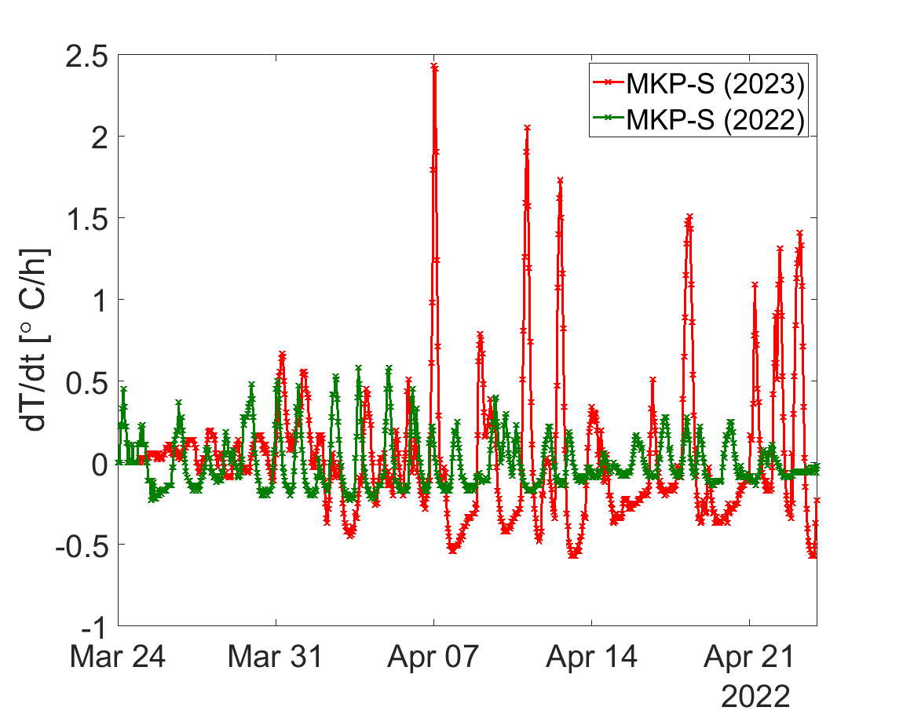
The 4 SPS wire scanner found broken
Time of the last wire scanner breakage
Time of the first newly installed wire scanner breakage

