Slide 1
SPS WS Measurements
C. Vollinger and Michael S. Sullivan for Impedance Working Group
73rd IWG meeting, 25th May 23

Slide 2
First measurement of the SPS Wire Scanner
SY-BI Group provided a WS (hot spare, ready for installation):
Goal of this RF-measurements is to benchmark our simulation results with the correct wire scanner geometry of the hot spare.
In 2017, only the PSB WS was measured and a benchmarking of the SPS WS simulation geometry was not possible due to lack of measurements.
→ First conclusion should be to carry out RF-measurements on all equipment before installation.
Further, we will confirm all suggested mitigation methods, by first installing on this hot spare before their possible installation in TS1.
Comparison between the hot spare geometry and the simulation geometry of 2017 showed that a number of corrections needed to be carried out on the geometry. The former results, however, remain fully reproduceable.
These are: Steel wire to be replaced with carbon wire (and with correct diameter), correction of the fork position, insertion of Macor, removal of the insert of the feed-through,… (see talk of Michael for details).
So far, the hot spare was measured and the first measurement results were used to track the inconsistencies between the hot spare and the simulation model of 2017.
We think that the most critical modes are at 769 MHz (Q ~320), 820 MHz (Q ~2300), and 869 MHz (Q ~250).
Note that for calculating the load on the wire, different modes are contributing then those contributing to the longitudinal impedance. E.g. strong resonances showing up in impedance calculations do not necessarily contribute most to the heating of the wire.
Equally, rather broad resonances which are typically less critical for impedance can contribute a lot to the wire heating.

Slide 3
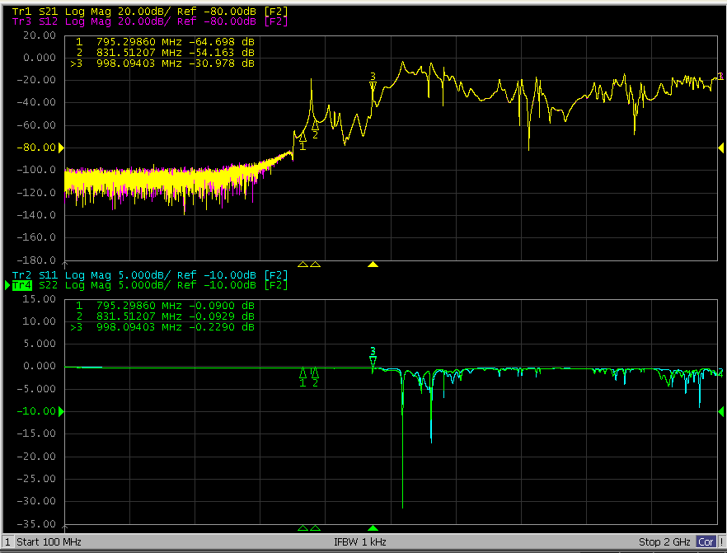
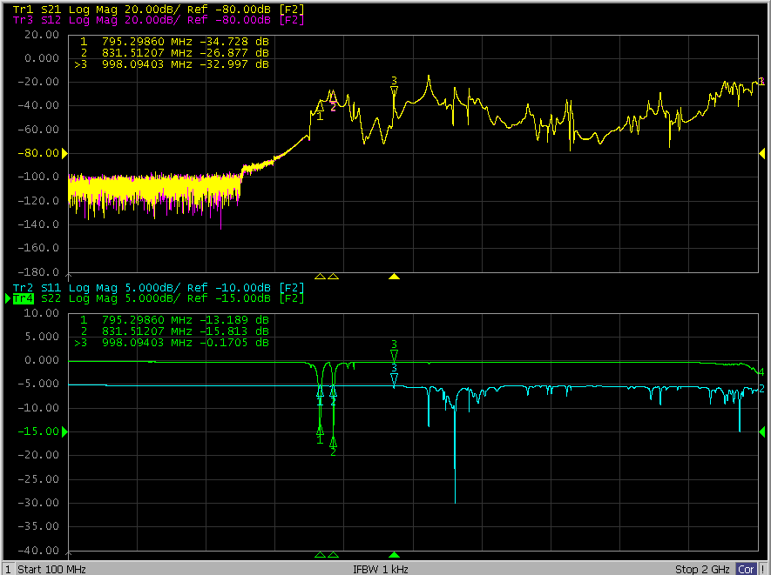
First measurement results of the WS hot spare
Probe measurement of modes of range 1 MHz – 2 GHz with different couplings.

Slide 4
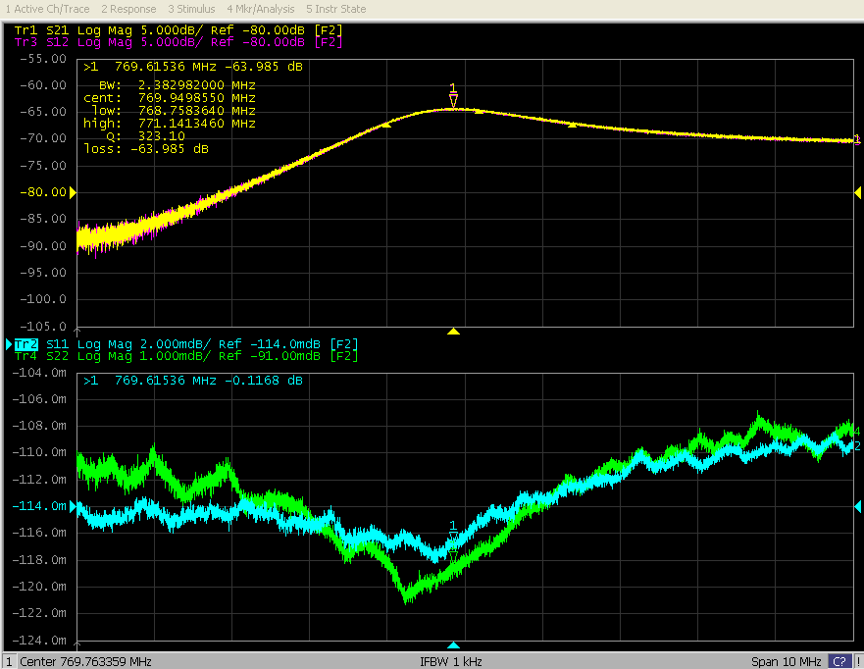
First measurement results of the WS hot spare
Probe measurement of 769 MHz mode giving Q ~320.

Slide 5
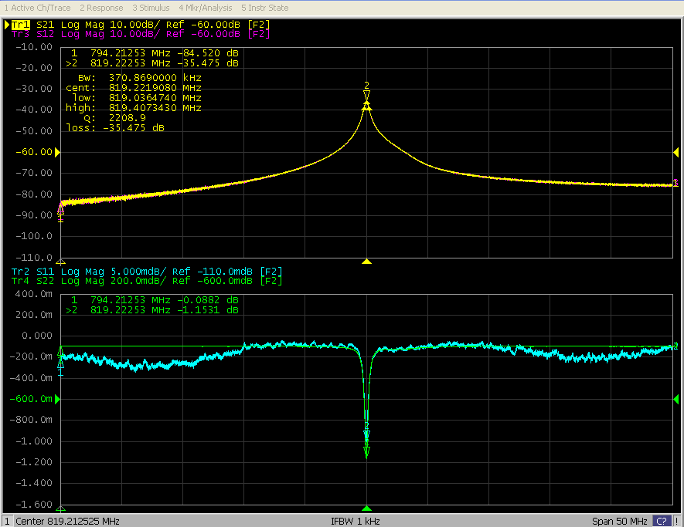
First measurement results of the WS hot spare
Probe measurement of 819 MHz mode giving Q ~2300.
Note that the coupling of probe 2 (S22) could not be further reduced.

Slide 6
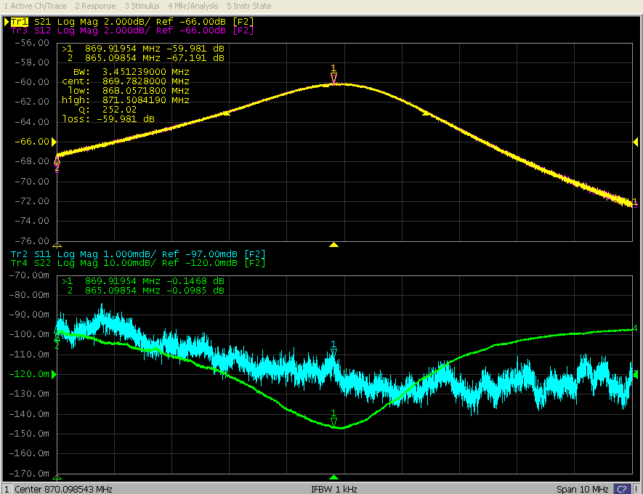
First measurement results of the WS hot spare
Probe measurement of 869 MHz mode giving Q ~250.
Note that the coupling of probe 2 (S22) could not be further reduced.

Slide 7
Conclusions drawn & next steps
RF-measurements were used for benchmarking the simulation results, corrections on the simulation geometry (starting from the 2017 model) were required.
Today, we could excellently reproduce the measured values (see talk of Michael in this TF meeting).
We suggest to complete the RFmeasurements including the possible mitigations
With ferrites on the tank wall, applicable quickly on the horizontal WS geometry (will be done today).
With ferrites inserted via the view port, appears also feasible for the TS in June.
With a modified coupler using the access on the feed-through, reaching into the shaft (currently in simulation).
Others?
For future cases, IWG would like to stress the necessity of RF-measurements on all components before installation.

Slide 8
Thank you for your time!
Comments/Questions?

