Slide 1

SPS Rotary Wire Scanner Task Force Mandate 2023
Ray Veness / SY-BI

Slide 2
Background
All 4 SPS wire scanners saw wire failures in a very short period
  All 4 (BA4, BA5) failed on April 12
  Both BA4 scanners replaced April 19
  Both BA4 scanners failed again April 21/22
Preliminary presentation to IEFC #327 by F.Roncarolo et al.
  https://indico.cern.ch/event/1272497/
Task force proposed to coordinate activities related to these failures
  First meeting May 5
  Four weekly meetings held to-date

Slide 3
Proposed mandate for the SPS Wire Scanner Task Force 2023
The Task Force (TF) will coordinate studies and actions related to the recent wire breakages in the SPS rotary scanners.
Specifically, it will investigate the causes, analyse the failed instruments, and coordinate mitigation measures, both in the instrument design and in operational parameters.
It will report to the IEFC Committee, whilst working closely with IWG and IPP.
The TF is time-limited. In the first instance, it will coordinate the preparation and implementation of possible mitigation measures to be implemented for SPS-TS1 in June. After this, the TF mandate will be reviewed.
The chair is Raymond Veness (SY-BI) and secretary is Nabil El-Kassem (SY-BI). Membership is drawn from the following groups: BE-ABP, BE-OP, EN-MME, TE-VSC, SY-ABT, SY-BI, SY-RF, plus IPP and IWG.

Slide 4
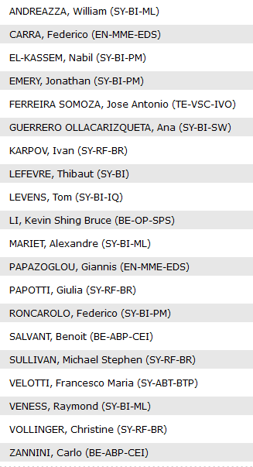
Current Task Force Core Members
Thanks everyone for your availability and reactivity!

