Slide 1
Test result of MBXF1
Michinaka SUGANO (KEK)
KEK
On behalf of CERN-KEK Collaboration for D1 Development for HL-LHC

Slide 2
Outline
Test result of the 1st cycle for MBXF1
  1.9 K Hi-pot test
  Validation of newly implemented varistor
  Training performance
  Energy extraction with varistor
  He gas recovery with an additional storage bag
  Other test items (Joint resistance, RRR measurement)
The results of MFM will be presented in another talk by Kento SUZUKI.

Slide 3
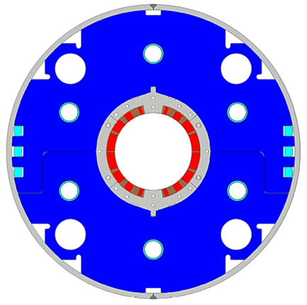
D1 magnet (MBXF)
Beam separation dipole (D1) by KEK
  Design study of D1 for HL-LHC within the framework of the CERN-KEK collaboration since 2011.
  150 mm single aperture, 35 Tm (5.6 T x 6.3 m), Nb-Ti technology.
  Development 2-m long model magnets (3 units) at KEK
Deliverables for HL-LHC
  1 full-scale prototype cold mass (LMBXFP)
  6 series cold masses (LMBXF1-6)
Current status of D1 prototype and series production magnet
  MBXFP1 : In preparation for the horizontal test at CERN
  MBXF1: The 1st test cycle was completed. The 2nd test cycle is being conducted.
  MBXF5: Magnet assembly has been almost completed in Hitachi.
  MBXF2: Coil winding and curing was completed.
This slide

Slide 4
Remaining issues in the KEK test facility
Sufficient energy extraction with the allowable maximum voltage and complete He gas recovery is needed.
Dump resistors of 25 mΩ or 50 mΩ were used for the cold test of MBXFP1.
  25 mΩ: Insufficient energy extraction resulted in incomplete He gas recovery.
  50 mΩ: The maximum voltage exceeded the allowable limit of 600 V for the
  DCCB of the power converter. Training above 106% of the nominal
  current could not be performed.
Target: Maximum voltage < 600 V at the ultimate current
Magnet dissipation energy < Safety limit = 1.6 MJ
(Max. experienced energy in the cold test of MBXFP1)
To satisfy these targets, varistor and additional He gas bag were implemented before the cold test of MBXF1.

Slide 5
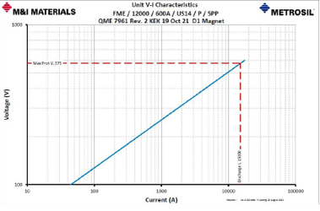
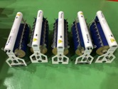
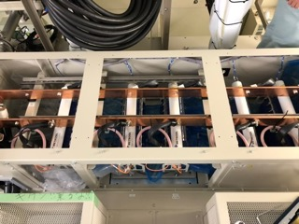
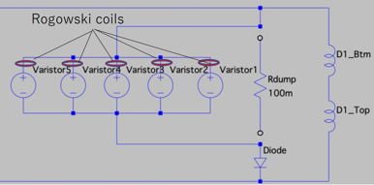

Installation of the new EE system: Varistor
Non-linear resistor: varistor (Metrosil®)
  Composed of SiC disks
  C=32.01
  β =0.3
Technical meetings with CERN experts had been held twice so far, and some concerns attributed to “parallel connection scheme” were raised
  Imbalance of the circuit current
  Imbalance of the turn-on time
KEK had proposed a “gradual powering plan” to check the EE system and setup for monitoring current imbalance using Rogowski coils (PEM Ltd.)
$$V=C×I^{β}$$

Slide 6
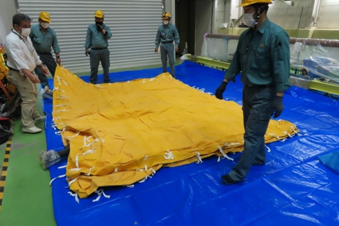
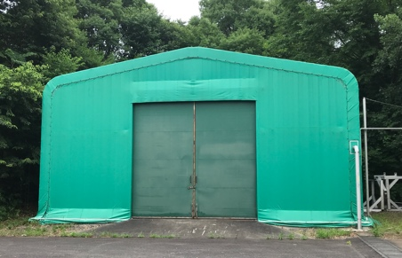
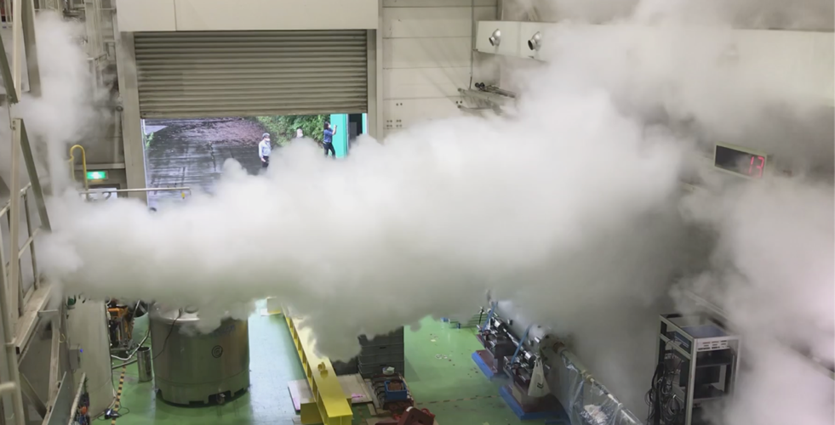
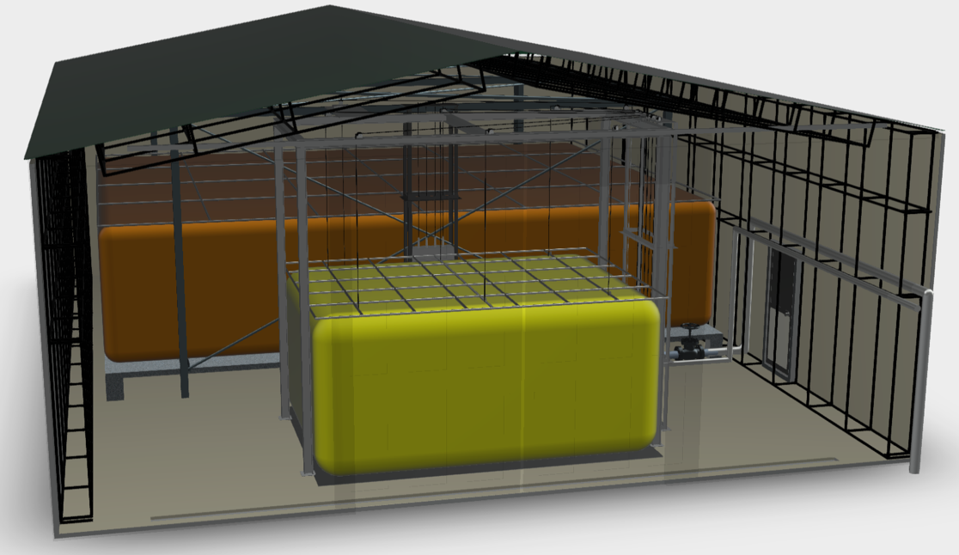
Additional Helium Gas Storage Bag
Recall
Limitation of helium gas recovery at quenches of MBXFP1.
Present capacity: 280 m³ (#2: 80 m³, #4: 200m³)
Helium gas at 13.23 kA w/ Varistors: 294 m³ (prediction)
Plan: new Helium gasbag (#4b, 40 m³)
  Total capacity: 320 m³ > 294 m³
  #4b Gasbag to be installed next to #4 Gasbag in the same tent warehouse
  The gasbag is already available. The drawings are being prepared in a rush.
Reported at the 5th D1 SC
#4 gasbag 200 m³
In the event of MBXFP1 quench
NEW #4b gasbag 40 m³

Slide 7
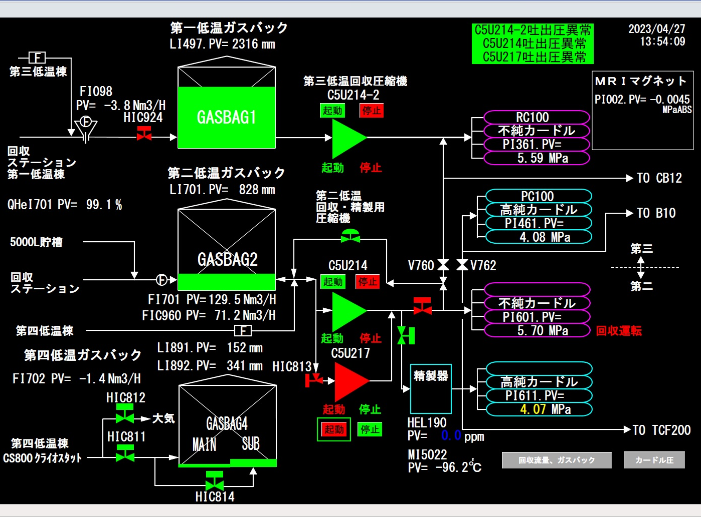
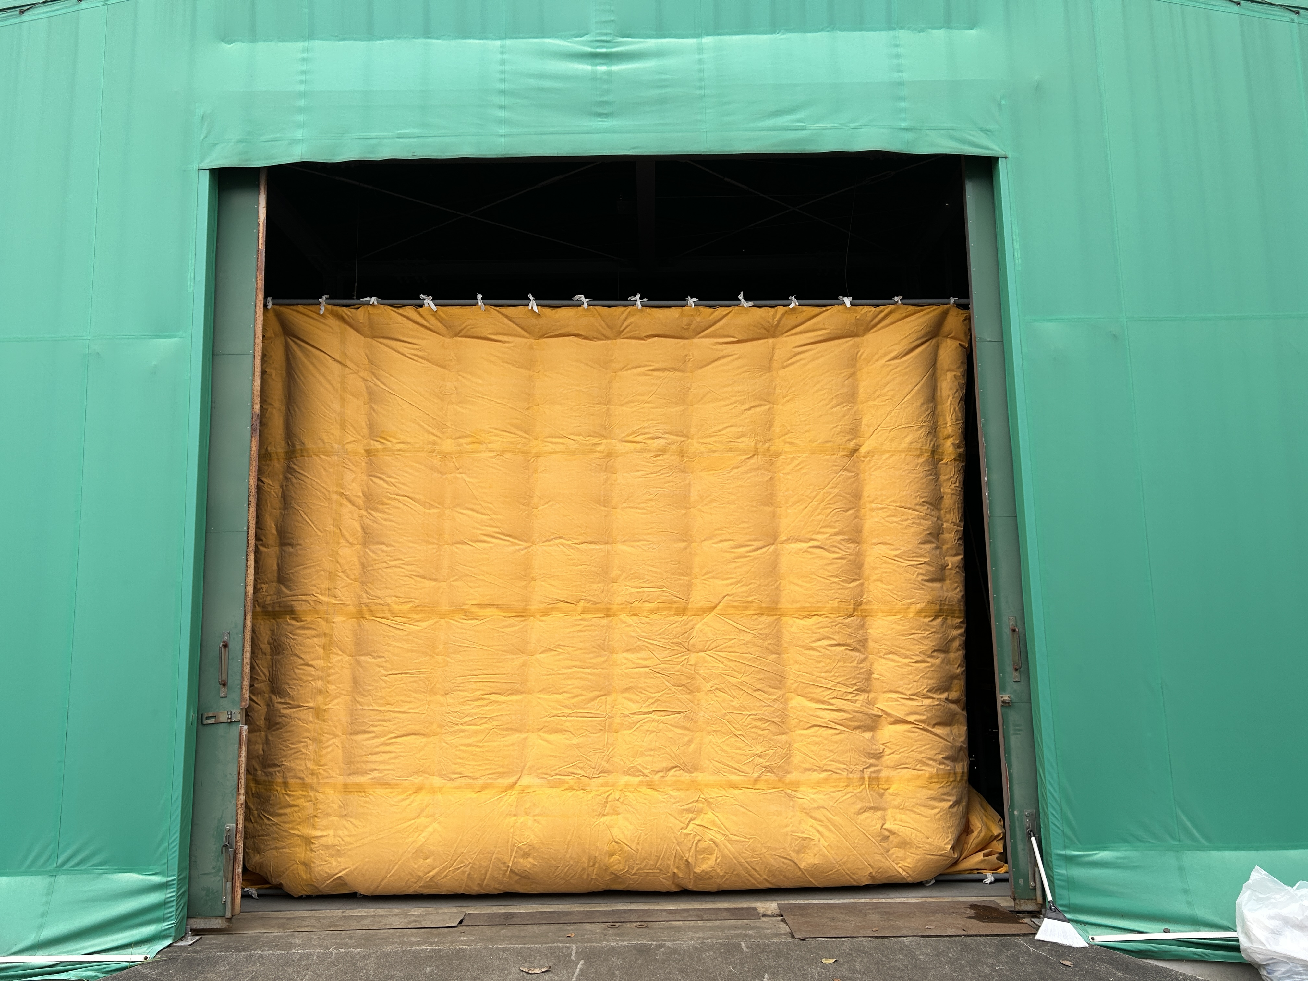
Additional Helium Gas Storage Bag
New Helium gasbag (#40-sub, 40 m³):
  construction and system commissioning completed in March 2023.
In operation for MBXF1 powering test.

Slide 8
Test schedule
Insertion of MBXF1 into the vertical cryostat: April 7
1st test cycle
  Cool-down: April 12 – 17
  1.9 K Hi-pot test: April 17
  System check: April 18 – 26
  MFM at 3 kA: April 19
  Training: April 27 – May 2
  MFM: May 10 – 17
  Current holding at the ultimate current: May 18
  Warm-up: May 18 – 26
2nd test cycle
  Cool-down: May 28 – 31
  1.9 K Hi-pot test: June 1
  System check: June 2
  MFM at 3 kA: June 2
  Training: June 5
  MFM: June 6 –

Slide 9
Test items
1.9 K Hi-pot test
  Coils to ground: max 1.3 kV
  Heater to coils: max 2.3 kV
  R14: The magnet shall fulfil the electrical test requirements during assembly and at 1.9 K.
System check with Metrosil varistors
MFM at 3 kA
Training up to the ultimate current
  R1: Ramp to the ultimate current with ramp of 12 A/s and flattop for 4 hours.
  R21: Ramp to and from the ultimate current at ±30 A/s
MFM up to the nominal current
  Perform Z-scan field measurement at [687, 1k, 3k, 5k, 7k, 9k, 10k, 11k, 12k, 11k, 10k, 9k, 7k, 5k, 3k, 1k, 687] A.
  Perform DC-loop at the magnetic center.
  Splice joint resistance and inductance measurements along with the field measurement.
  R8: The integral multipoles of the magnet at 1.9 K and at nominal current shall target the range “upper limit, lower limit” as defined in Table 1.
  R19: Each internal splice shall have an electrical resistance lower than 1 nΩ at 1.9 K.
1.9 K Hi-pot test (only at the end of the 2nd cycle)
Warm-up
  RRR measurement

Slide 10
1.9 K Hi-pot test
Hi-pot test was performed after cool-down in the 1st and 2nd cycles.
MBXF1 passed all the following tests.
Criteria: Leak current < 10 μA for 30sec
  Coil-GND: 1.3 kV
  Heater-GND: 2.3 kV
  Between adjacent heater strips: 2.3 kV
Another 1.9 K Hi-pot test will be conducted before the 2nd warm-up.
HV+
HV+
GND
GND
HV+
HV+
GND
GND

Slide 11
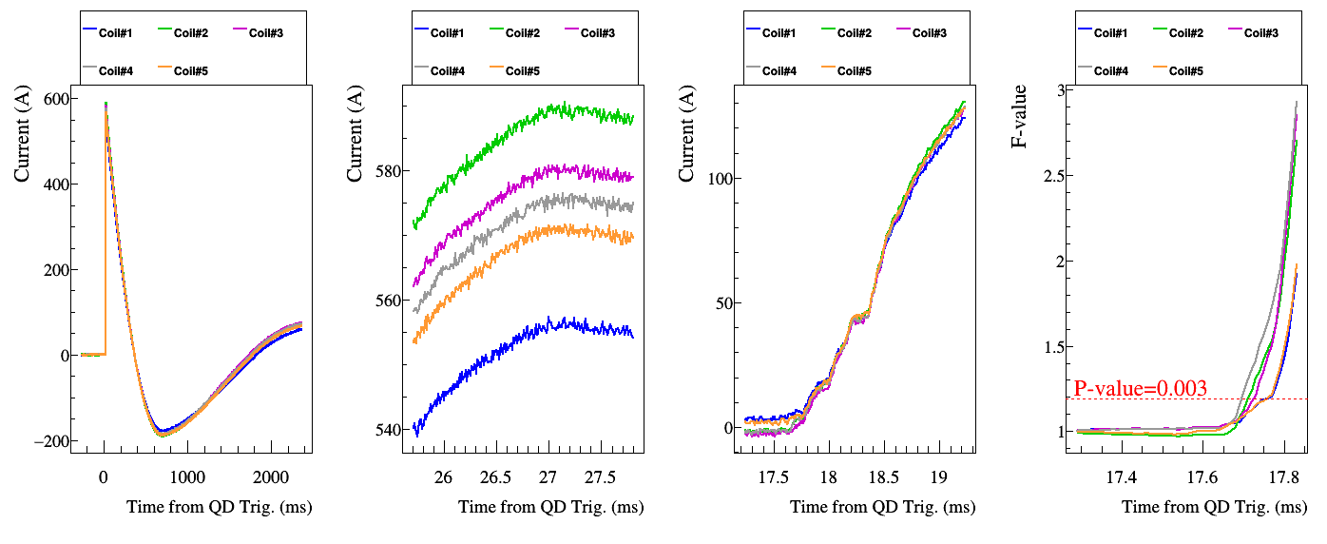
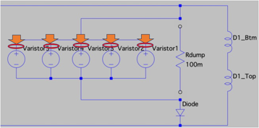
Validation of varistor
3kA shutdown
Current
waveform
Turn-on time
Analysis for determining the turn-on time
Current peak
Signals from Rogowski coils and temperature of SiC disks has been monitored every shutoff/quench event to ensure no sign of imbalance promotion
  At every higher current we perform 3kA shutdown to check reproducibility
In the 1st cycle:
  Current imbalance < 7%
  Turn-on time imbalance < 300 µs
Detailed report can be found :
  https://indico.cern.ch/event/1282199/

Slide 12
Training performance
Quench current of MBXF1
 | Quench # | Run ID | Iq (A)
1st TC | 1 | 69 | 10639
 | 2 | 71 | 11353
 | – | 73 | 12099
 | 3 | 75 | 12260
 | 4 | 77 | 12331
 | 5 | 79 | 12326
 | 6 | 80 | 12559
 | 7 | 82 | 12778
 | – | 86 | 13214
2nd TC | – | 508 | 13213
Temperature: 1.9 K
Ramp rate: 12 A/s or 30 A/s
Quench detection: 0.1 V, 10 msec
Quench protection: QPH and varistor
Quench start location: quench antenna
I_{nominal}
The training quenches started at a lower current with respect to the prototype.
After 2 quenches, the magnet current reached the nominal current.
The ultimate current was attained after 7 quenches.
After thermal cycle, the magnet reached the ultimate current without quench, showing perfect training memory.
I_{ultimate}
I_{ultimate}

Slide 13
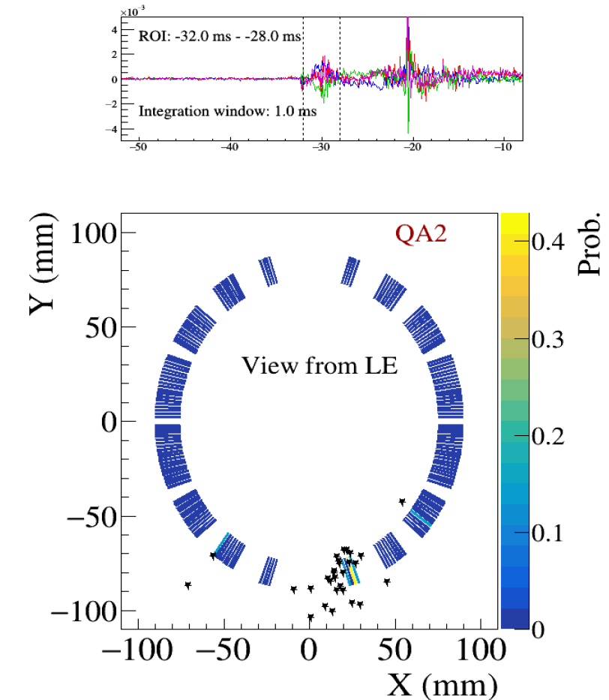
Quench start location
 | Quench # | Run ID | Iq (A) | Quench origin | Longitudinal position by QA | Position
1st TC | 1 | 69 | 10639 | Top coil | 1, 2, 3 | LE
 | 2 | 71 | 11353 | Bottom coil | 2, 3 | LE
 | 3 | 75 | 12260 | Top coil | 9, 10, 11 | RE
 | 4 | 77 | 12331 | Top coil | 4, 5, 6 | SS
 | 5 | 79 | 12326 | Bottom coil | 2 | LE
 | 6 | 80 | 12559 | Bottom coil | 10 | RE
 | 7 | 82 | 12778 | Top coil | 1, 2, 3 | LE
Run 69: I_{q}=11353 A
ID and long. position of quench antennas (QAs)
The quench position was identified by using quench antennas.
The first quench occurred at LE same as MBXFP1. Then the quench origin changed with progressing training. No specific weak point was found.
Normal training behavior was confirmed.

Slide 14
Current holding
30 A/s
Ultimate
Nominal
+ 200 A
Nominal
(MFM)
No quench
The current holding for 4 hours was successfully done at the nominal, nominal +200 A, and the ultimate current. This is the first time of current holding at the ultimate current for more than a half hour including the 2 m-long model magnets.
The ramping-up/down up to the ultimate current with a ramp rate of 30 A/s was also successful.

Slide 15
Measured maximum coil voltage
I_{nominal}
I_{ultimate}
The maximum coil voltage was evaluated by the current shutdown and quench.
Dump resistors of 25 mΩ or 50 mΩ were utilized for MBXFP1.
  R_{dump}=25 mΩ → Insufficient energy extraction
  R_{dump}=50 mΩ → Maximum coil voltage exceeding 600 V below the ultimate current
In MBXF1, the varistors are confirmed to be effective to suppress the maximum coil voltage thanks to their non-linear V-I characteristics.

Slide 16
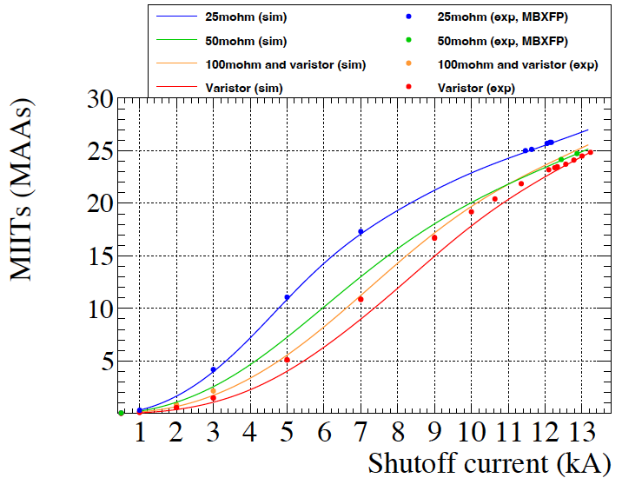
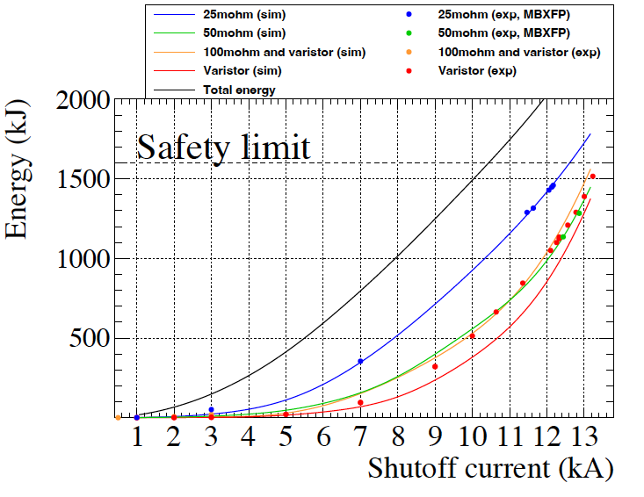
MITTs, magnet dissipation energy
Through the commissioning of the Varistor system, it was found that parameter β has a current dependence and is smaller at lower current.
  It turns out to be the higher MIITs and lower energy extraction at the current below 10 kA wrt the design.
Nevertheless, profit of using the Varistor is obvious: the dissipation energy during the training quenches are significantly reduced wrt R_{dump}=25 mΩ while the maximum voltage is below 600 V.

Slide 17
He gas recovery
Capacity of He gas bag
Shutdown
at I_{ultimate}
Measured evaporated He gas volume at the shutdown at the ultimate current
= 290 m³ (as prediction) < Capacity of the He gas bag = 320 m³
Evaporated He gas could be completely recovered up to the ultimate current. An increase in the capacity of He gas bag was successful.

Slide 18
Joint resistance
Splice joint
Joint resistance was evaluated to be 0.645 nΩ <1 nΩ.

Slide 19
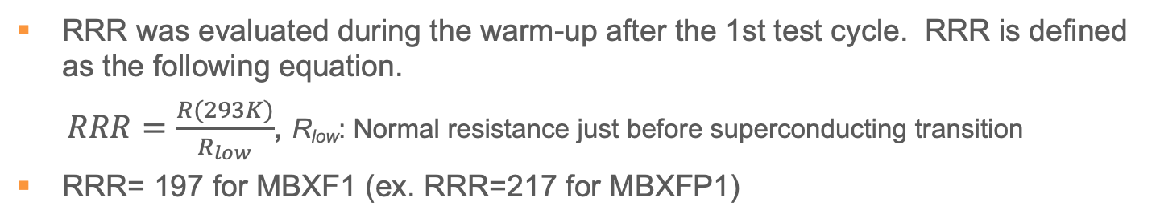
RRR measurement
RRR was evaluated during the warm-up after the 1st test cycle. RRR is defined as the following equation.
$RRR=\frac{R(293K)}{R_{low}}$, R_{low}: Normal resistance just before superconducting transition
RRR= 197 for MBXF1 (ex. RRR=217 for MBXFP1)

Slide 20
Summary
Cold test of the first series production magnet (MBXF1) is being performed at KEK. The results are summarized as follows.
  1.9 K Hi-pot test → Passed
  Successful validation of newly implemented varistor
  Good training performance: 2 quenches to the nominal, 7 quenches to the ultimate
  Reaching the ultimate without quench after thermal cycle, perfect training memory
  Current holding at the ultimate for 4 hours → OK
  Ramp to the ultimate with 30 A/s → OK
  Complete recovery of evaporated He gas in the shutdown at the ultimate
  Joint resistance < 1nΩ → OK
MFM in the 2nd test cycle is ongoing. The 2nd test cycle will be completed in the week of June 12.

Slide 22
Current history
Thermal cycle
Many shutdowns were repeated mainly for the validation test of the varistor.

