Slide 1
Magnetic measurements for the 1st series of D1: MBXF1
Kento Suzuki
WP3meeting, 23.06.07

Slide 2
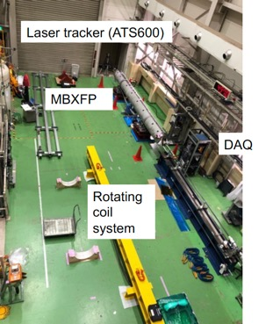
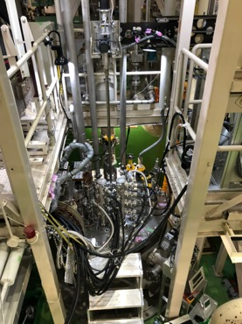
Magnetic measurements at KEK
Horizontal system for warm MM
Vertical system for warm/cold MM

Slide 3
D1 magnetic models
w/o Cryostat | KEK pit | CERN cryostat
Horizontal bench | Vertical test stand - Off-centered by 150mm | Used for design - Centered*
(*) Actual cryostat is off-centerd by 54mm
but not taken into account for our design

Slide 4

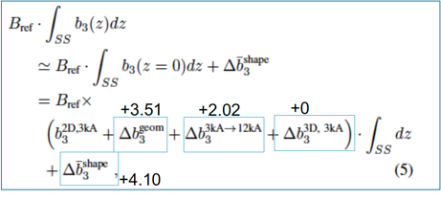

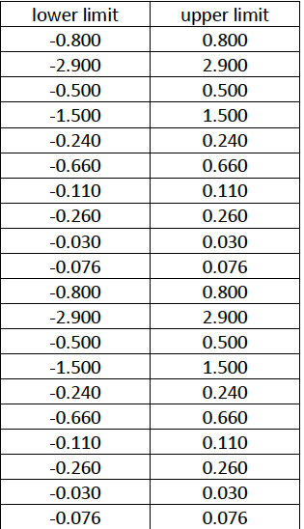
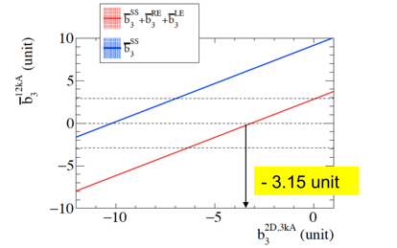
Magnetic design goal for the D1 series
EDMS: 2045899
K.Suzuki et al. IEEE TASC vol30, no.4 June 2020, 4002706
Limit on integral at nominal field
Design
parameter

Slide 5
Magnetic design goal for the D1 series
Cross sectional design tuned
by Roxie
 | Parameters for design
φ1 | 1.1680
φ2 | 27.8471
φ3 | 50.3830
φ4 | 70.7156
α2 | 27.5527
α3 | 52.5639
α4 | 70.3048
Azimuthal insulation thickness (mm) | 0.1297
1.9K, 3kA
b3 | -3.15011
b5 | -2.99980
b7 | 0.01068
b9 | 0.03186
b11 | 0.09035
b13 | -0.64140
b15 | -1.07244

Slide 6
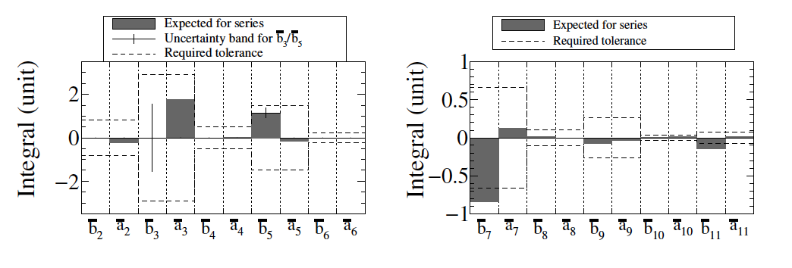
Magnetic design goal for the D1 series
Cross sectional design tuned
by Roxie
Expected field integral at CERN cryostat
K.Suzuki et al. IEEE TASC vol.32, no.6 Sept 2022, 9000407
 | Parameters for design
φ1 | 1.1680
φ2 | 27.8471
φ3 | 50.3830
φ4 | 70.7156
α2 | 27.5527
α3 | 52.5639
α4 | 70.3048
Azimuthal insulation thickness (mm) | 0.1297
1.9K, 3kA
b3 | -3.15011
b5 | -2.99980
b7 | 0.01068
b9 | 0.03186
b11 | 0.09035
b13 | -0.64140
b15 | -1.07244

Slide 7
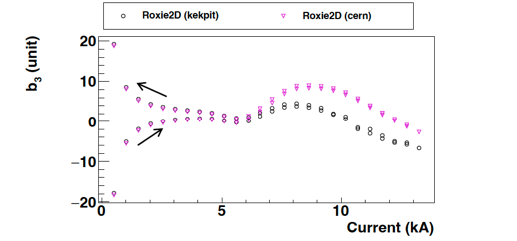
Remark I: Environmental effect
CERN cryostat
KEK pit
b₃ vs longitudinal pos.
Opera3D
~6 units
b₃ vs current
~6 units
Roxie2D

Slide 8
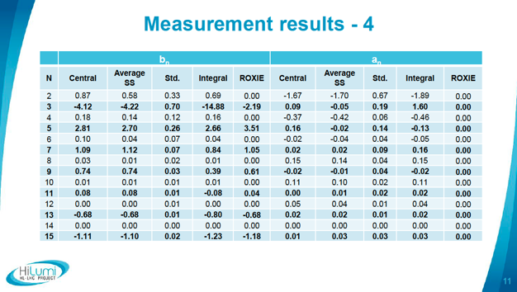
Remark II : Contribution from “coil-end field”
https://indico.cern.ch/event/1269740/contributions/5378345/attachments/2644433/4577520/2023-03-22_Room%20temperature%20magnetic%20measurements%20of%20D1%20cold%20mass%20prototype.pdf
By Mariano Pentella
RE
LE
SS
Prototype result at KEK (1.9K, 12.11 kA)
Prototype result at CERN (warm)
Discrepancy observed at coil end, resulting in negative offsets to the b₃ integral

Slide 9
Test schedule
MBXF1 reception : 3/16
Horizontal MM (I=15A): 3/17 – 3/24
Vertical MM in the 1st thermal cycle :
  Room temperature (I=10A) : 4/10
  1.9 K temperature (I=687A-12110A) : 5/10 – 5/16

Slide 10
Test schedule
MBXF1 reception : 3/16
Horizontal MM (I=15A): 3/17 – 3/24
Vertical MM in the 1st thermal cycle :
  Room temperature (I=10A) : 4/10
  1.9 K temperature (I=687A-12110A) : 5/10 – 5/16

Slide 11
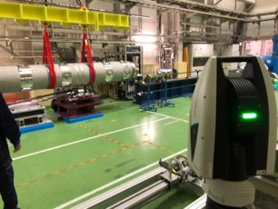
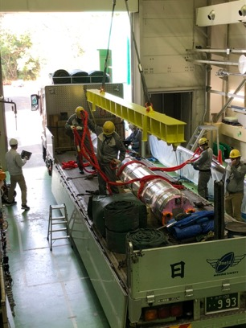
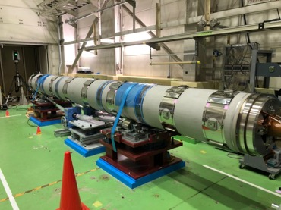
Preparation work during horizontal MM (3/17)

Slide 12
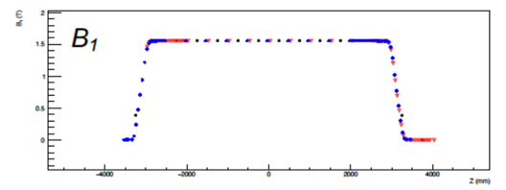
Rotating coil for the horizontal MM
LE
Common layout with the vertical MM system
  A long coil (500mm) sandwitched by two short ones (50mm)
  Long coil for integral measurement
  Short coils for profile measurement
Measurement procedure : EDMS 2747312
  https://edms.cern.ch/document/2747312/1
Expected coverage:
Short (LE-side)
Long
Short (RE-side)
RE

Slide 13
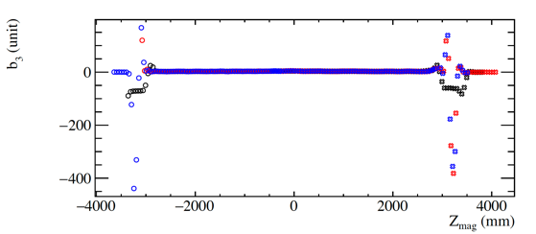
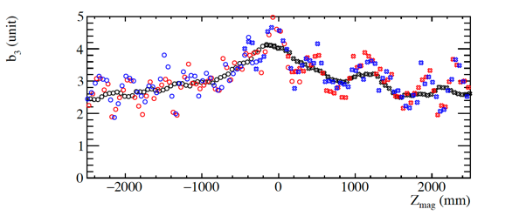
Measured b₃ profile
The first check of the field profile along the entire coil of MBXF1
b₃ in the SS has a ’bump’ and a peak around the magnet center
Variation of ±0.8 units observed for the SS in the long coil measurement
  This is not the first feature in the full-scale magnet
  Similar feature was confirmed in the prototype too (see backup)
short (RE, 50) long (500) short (LE, 50)
±0.8 units
Straight section (SS): -2500 - +2500

Slide 14
FQ table of MBXF1 for room temperature
RE: -3505 mm - -2505 mm
SS: -2505 mm - 2495 mm
LE: 2495 mm - 3995 mm
Central: -255 mm - 245 mm

Slide 15
Comparison with prototype and prediction (Roxie2D)
- 4.5 units increase was observed in b₃, which is higher than Roxie2D’s expectation
3.3 units offset was observed in a2, which was already confirmed and reported in the previous WP3 meeting (23.02.10)
Good improvement observed for the other harmonics

Slide 16
Test schedule
MBXF1 reception : 3/16
Horizontal MM (I=15A): 3/17 – 3/24
Vertical MM in the 1st thermal cycle :
  Room temperature (I=10A) : 4/10
  1.9 K temperature (I=687A-12110A) : 5/10 – 5/16

Slide 17
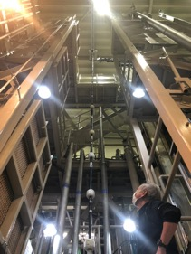
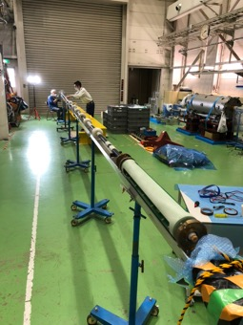
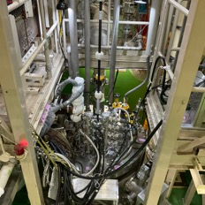
Vertical Magnetic Measurement System
Short (LE, 50)
Short (RE, 50)
10m long
Long (500)
Shaft extension work
Short (LE)
Long
Short (RE)
2021 May
PCB design
  Common layout with the horizontal one
Shaft extension was completed before the prototype test
  Attached a 1.7m-long extension to enlarge the measurement coverage for the full scale (7m-long) magnet

Slide 18
Test schedule
MBXF1 reception : 3/16
Horizontal MM (I=15A): 3/17 – 3/24
Vertical MM in the 1st thermal cycle :
  Room temperature (I=10A) : 4/10
  1.9 K temperature (I=687A-12110A) : 5/10 – 5/16

Slide 19
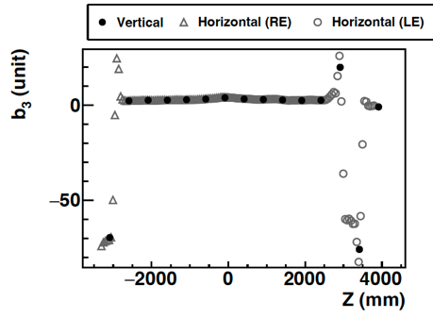
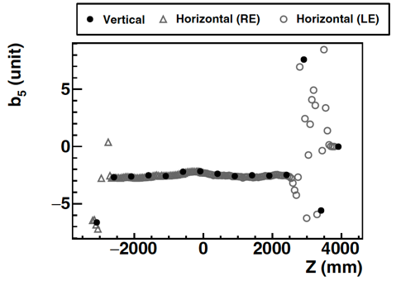
Comparison w/ horizontal results -b3 / b5 profile
- Measured profiles are consistent with the horizontal results

Slide 20
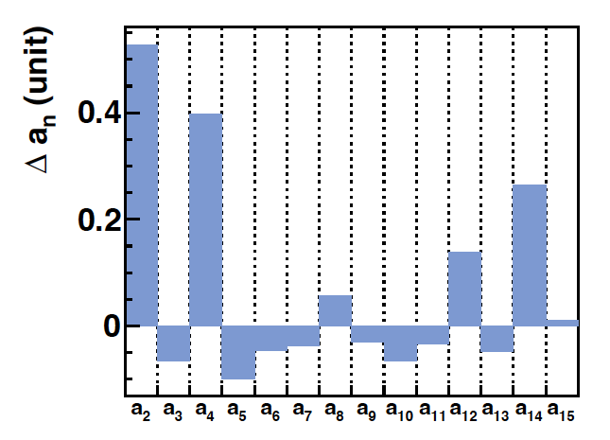
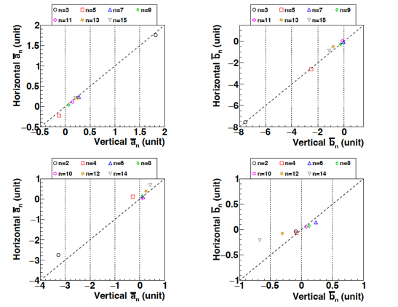
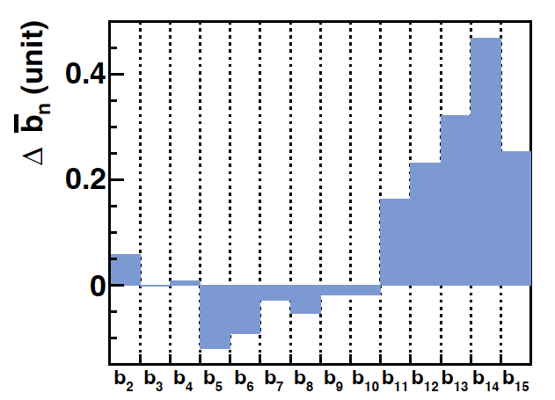
Comparison w/ horizontal results
Integral
- Differences of measured harmonics are within 0.5 units

Slide 21
Test schedule
MBXF1 reception : 3/16
Horizontal MM (I=15A): 3/17 – 3/24
Vertical MM in the 1st thermal cycle :
  Room temperature (I=10A) : 4/10
  1.9 K temperature (I=687A-12110A) : 5/10 – 5/16

Slide 22
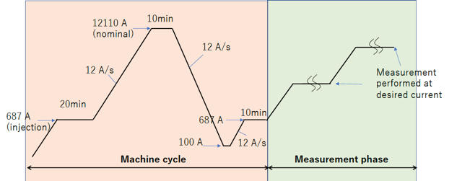
Measurement procedure
Before the measurements we perform ’Pre-cycle’ so the NbTI cable experiences its magnetization up to the nominal field
Ramp rate, which was originally set to 10 A/s, was changed to 12A/s according to the HL-LHC circuit parameters^{(*)}
  Accordingly out test plan was modified
(*)https://cds.cern.ch/record/2298764/files/CERN-ACC-2017-0101_revised.pdf

Slide 23
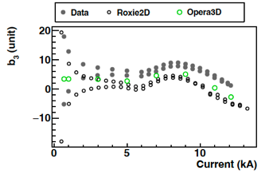
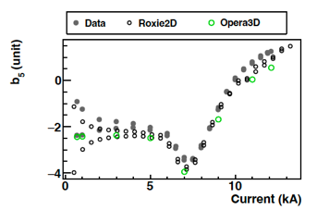
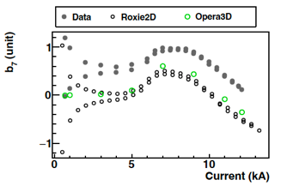
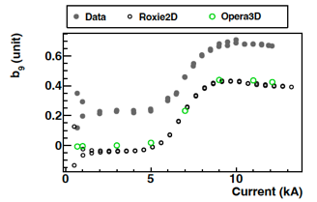
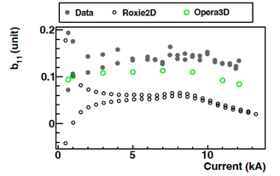
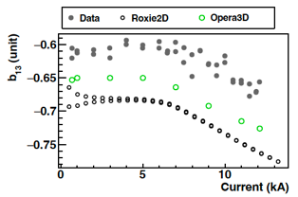
DC loop at the Z center for allowed normal (n=3-13)

Slide 24
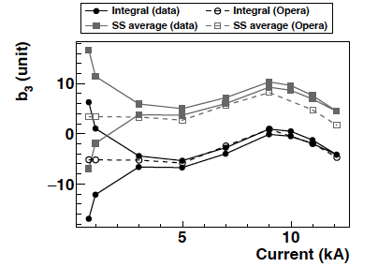
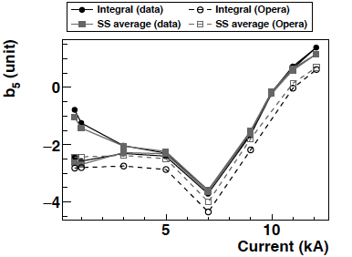
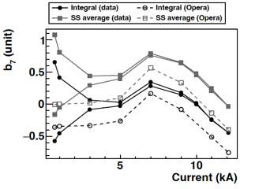
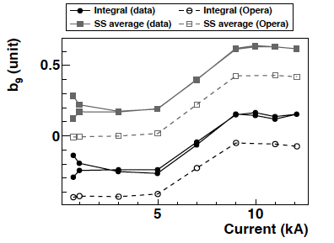
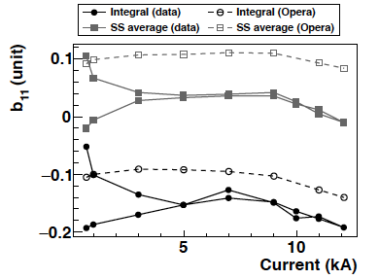
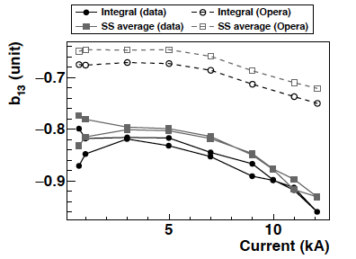
Integral loop for allowed normal (n=3-13)

Slide 25
FQ table of MBXF1 for I_{nominal} (12.11kA)
RE: -3353 mm - -2853 mm
SS: -2853 mm - 2648 mm
LE: 2648 mm - 4148 mm
Central: -250 mm - 250 mm

Slide 26
b₃ Summary
Error band defined by comparison between proto. and simulation

Slide 27
b₅ Summary

Slide 28
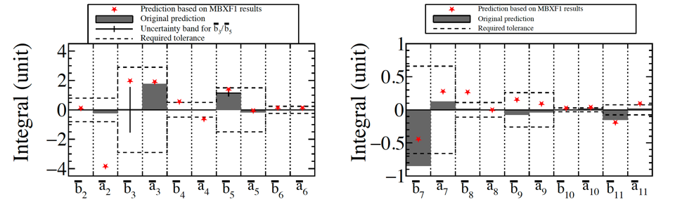
Predicted FQ in the LHC cryostat
- Almost all the harmonics are within the requirement !

Slide 29
Plan for MBXF MM
MBXF1
  After the 2nd thermal cycle we plan to perform the horizontal MM to confirm reproducibility
    July 2023
MBXF5
  The horizontal MM is planned after the reception, foreseen in this summer.
    Detailed schedule will be decided later
MBXF2
  The warm MM is planned after yoking but ground insulation issue is not fixed yet
    Detailed schedule will be decided later

Slide 30
Summary
The first magnetic measurements at the KKE test benches were completed for both room and 1.9 K temperatures.
Measured multipoles (integral) were comparable with the predictions by Opera, except for a₂ which is slightly bigger than expectation (-3.8 units)
The multipoles (integral) in the LHC cryostat were estimated based on the MBXF1 results, most of which were confirmed to be within tolerance
The detailed MM plans for MBXF5 and MBXF2 will be decided later.

Slide 31
Thank you

Slide 32
Supplement

Slide 33
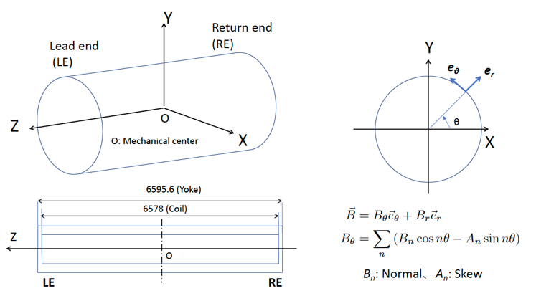
Definition of coordinate

Slide 34
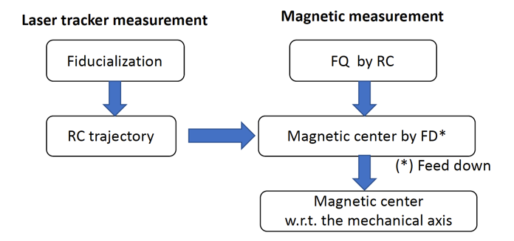
Analysis method and outcome in horizontal MM
Multipole measurement
Longitudinal magnetic center w.r.t. Mechanical center
Transverse magnetic center w.r.t. Mechanical axis

Slide 35
Analysis method (cont’d)
BG elimination
  Direct subtraction (= waveform subtraction) since MBXF1
Vs
Dipole + BG field
Vs
BG field
I=15A
I=0A
-
=
t
t

Slide 36
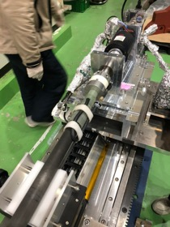
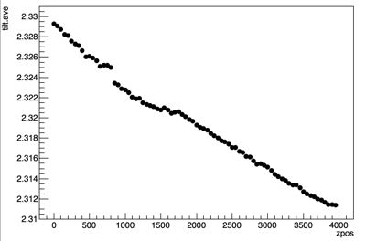
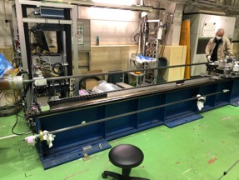
Inclination angle of the mover stage
NA2-10
NA2-10 signal along the stage
-> Magnet
Mover stage
ΔV=18mV ~ 1.6 mrad
Change in the inclination angle of the stage affects a1 measurement and thus it was used as correction for analysis

Slide 37
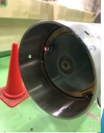
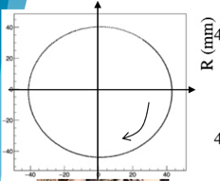
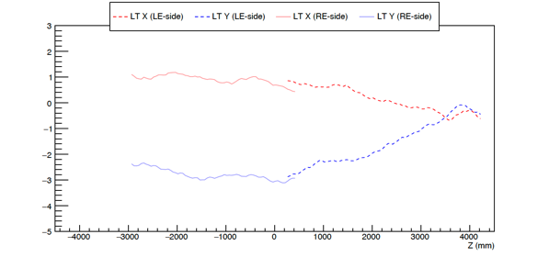
Determination of probe position (X,Y)
Probe position in transverse was measured through a 0.5” SMR mounted on the probe head and a laser tracker
The position was then transferred to the feed down analysis for determination of the magnetic center
Probe trajectory
Mechanical axis
RE←
→ LE

Slide 38
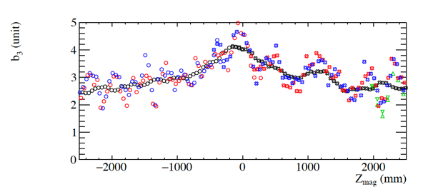
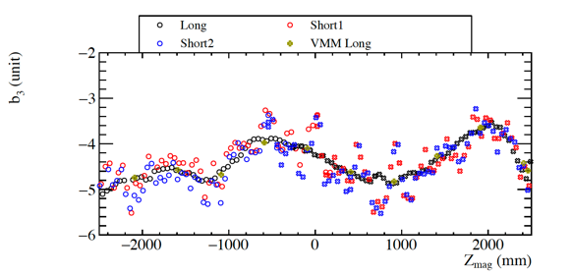
About b3 structure
+/- 1.5 unit (short)
+/- 0.8 unit (long)
MBXF1
short2 (50) long (500)
short1 (50), portable (80)
Horizontal (Long)
Vertical (Long, warm,1st cycle )
MBXFP
+/- 0.8 unit (long)

Slide 39
Horizontal MM results II – Integral

Slide 40
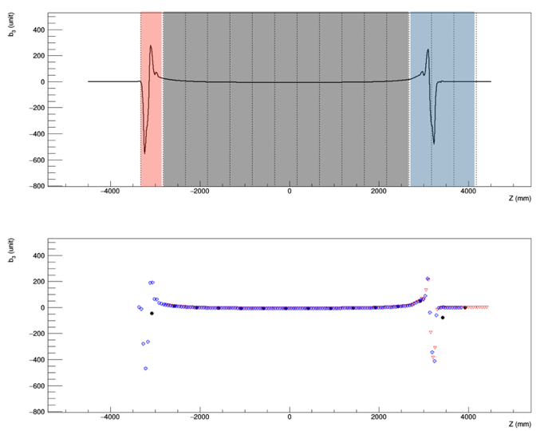
Measurement coverage
RE
b₃ (unit)
RE
LE
Z (mm)

Slide 41
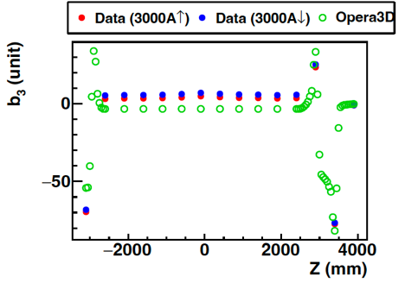
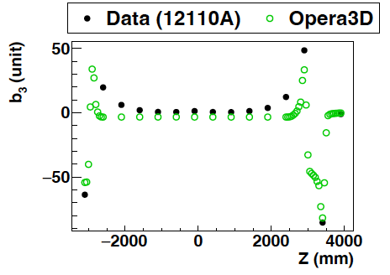
Z-scan result

Slide 42
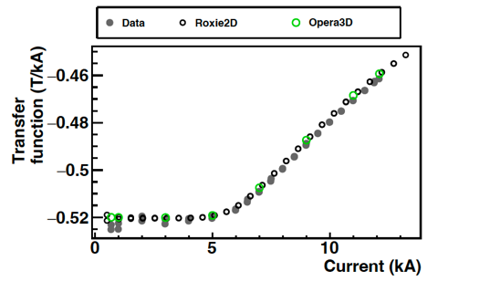

Transfer function (T/kA, T・m/kA)

