Slide 1
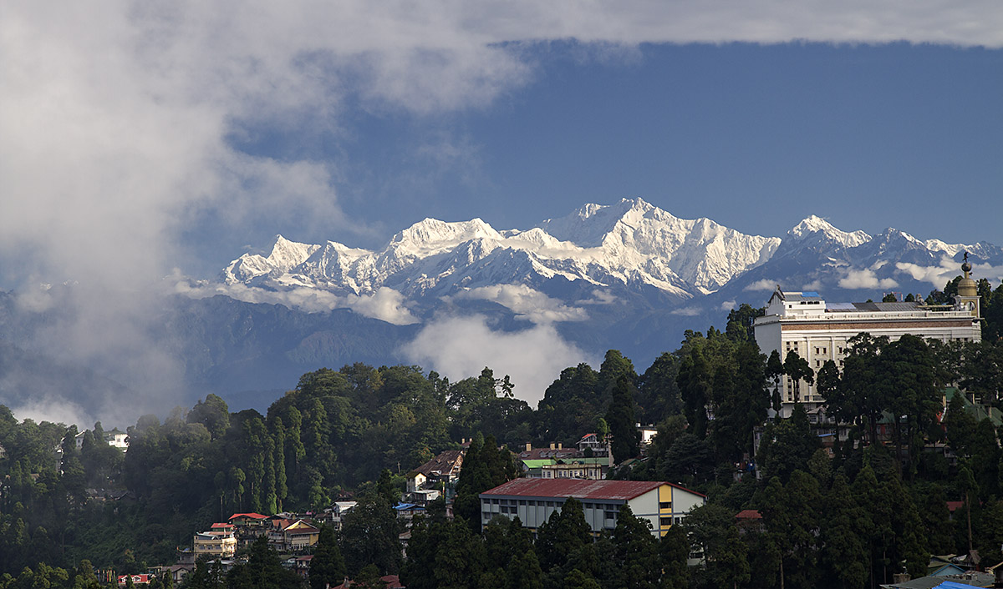

Slide 2


Probing the Dark Universe and Primordial Gravitational
Waves with Atomic Beams
Matter-wave Atomic Gradiometer Interferometric Sensor (MAGIS-100
June 15, 2023
CERN BE-ABP Seminar

Slide 3





Fermilab DOE
Probing the Dark Universe and Primordial
Gravitational Waves with Atomic Beams
Matter-wave Atomic Gradiometer Interferometric Sensor
(MAGIS – 100)
Swapan Chattopadhyay
UC Berkeley and Fermilab
June 15, 2023
CERN BE-ABP Seminar

Slide 4
ACKNOWLEDGEMENTS
Many thanks to Dr. Yannis Papaphilippou and Dr. Gianluigi Arduini for inviting me to give this special seminar.
Thanks to MAGIS-100 collaboration colleagues, especially the institutional principals:
Jason Hogan (Stanford, USA) , Spokesperson
Rob Plunkett (Fermilab, USA) , Project Manager
Swapan Chattopadhyay (Fermilab/Stanford, USA), Founding Principal
Tim Kovachy (Northwestern U., USA)
Sergei Nagaitsev (U. Chicago, USA)
Ariel Schwarzman (SLAC/Stanford, USA)
Ian Shipsey (Oxford, UK)
Val Gibson (Cambridge, UK)
Jon Coleman(Liverpool, UK)
Surjeet Rajendran (John Hopkins U., USA)
(Jeremiah Mitchell , my ex-PhD student, now at Cambridge, UK)

Slide 5
OUTLINE
Introduction
2. Challenges “Beyond the Standard Model” of Particle Physics and Cosmology:
→ Cosmic Archaeology of “weak signals” from “Early”/ “Dark” universe
3. Exploiting Quantum Superposition/Entanglement:
→ Atomic Interferometric Probe of the “Early Universe” /”Dark Sector”
4. Atom Interferometry:
→ A Tutorial
5. MAGIS-100 Experiment
6. Background and History → The US “Quantum Initiative” : QuantISED Pgm

Slide 6
https://magis.fnal.gov
ATOMS in FREE FALL
The Matter-wave Atomic Gradiometer Interferometric Sensor, also known as MAGIS-100, is a Quantum Sensor under construction at Fermilab that aims to explore fundamental physics with a 100-meter-long atom interferometer. This novel detector will search for
ultralight dark matter;
test quantum mechanics in new regimes; and
pave the way for future gravitational wave detectors.
The detector will be housed in a 100-meter-deep shaft at Fermilab that was constructed for a neutrino experiment many years ago. To explore aspects of quantum physics, scientists will drop groups of atoms down a vacuum tube, followed by beams of laser light.
MAGIS-100 combines established techniques from state-of-the-art 10-meter-scale atom interferometers with the latest technological advances of the world’s best atomic clocks. In addition to enabling new quantum experiments, MAGIS-100 will provide a development platform for a future kilometer-scale detector that would be sensitive enough to detect gravitational waves from known sources.

Slide 7
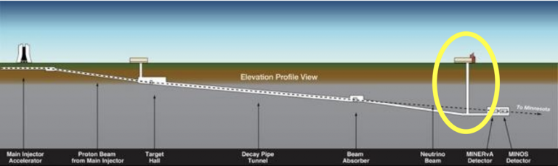

MAGIS-100 @ Fermilab:
An element in the national program
DOE HEP-QIS QuantISED
https://arxiv.org/abs/2104.02835

Slide 8
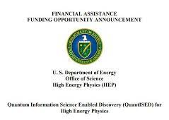




Funding

Slide 9
STANDARD MODEL
of
PARTICLE PHYSICS and COSMOLOGY

Slide 10
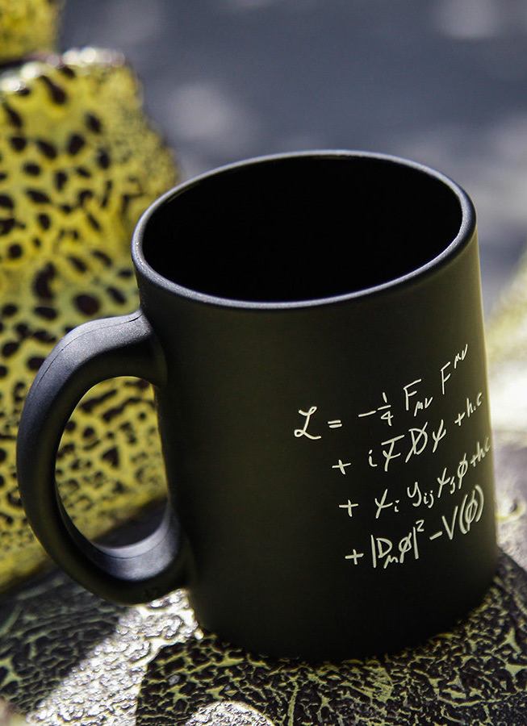
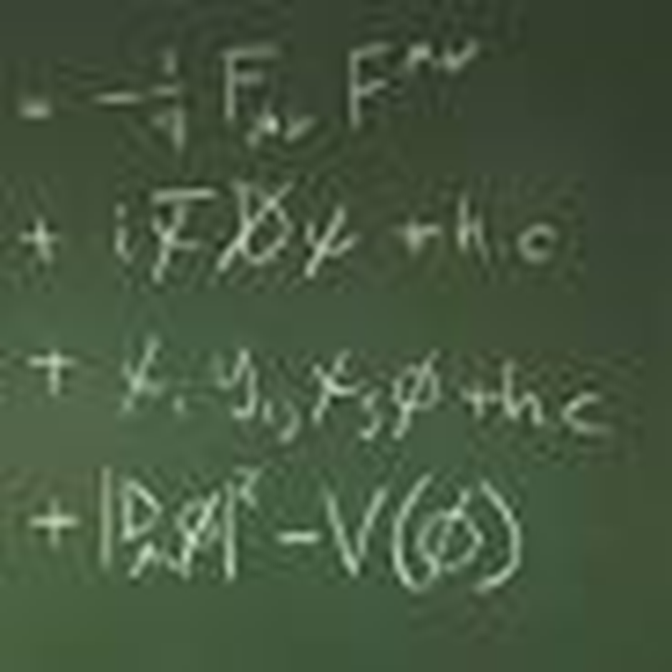
Standard Model Lagrangian

Slide 11
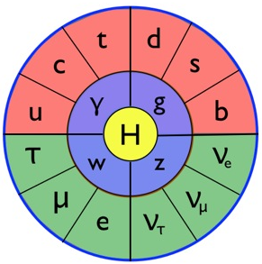
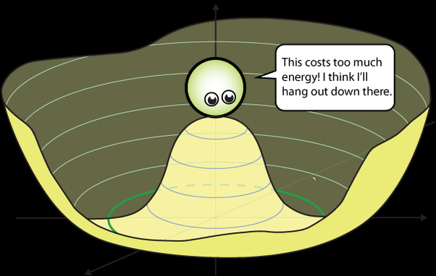
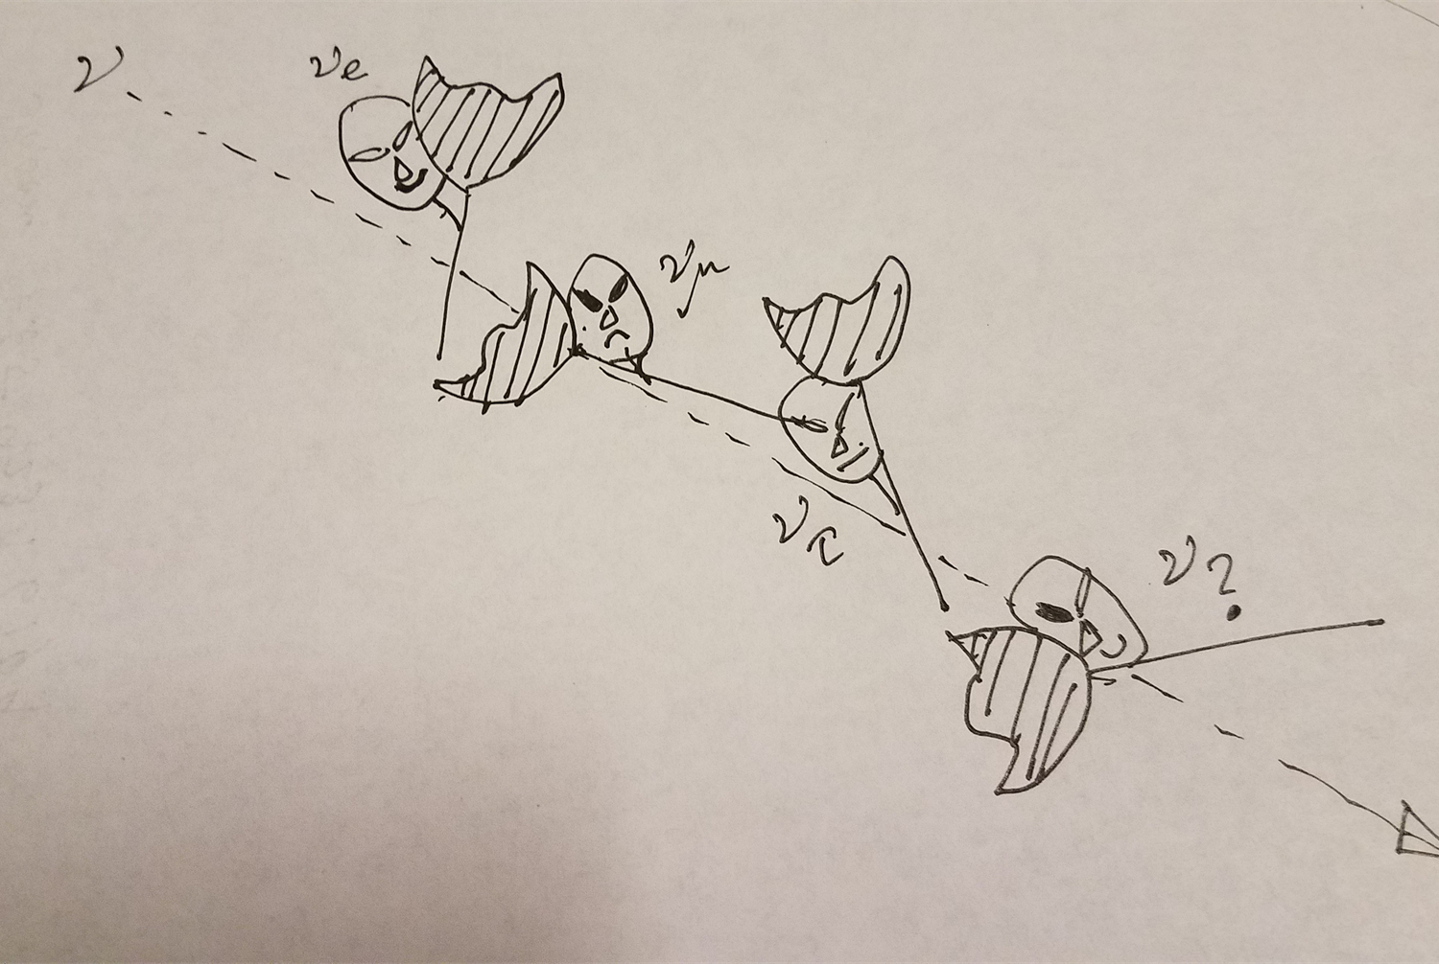
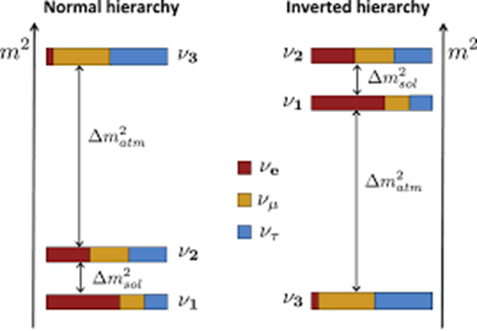
The Standard Model Mandala: Least understood: “mysterious” Higgs and “elusive”Neutrinos
To advance understanding of Higgs, need even higher energy colliders than available today:
FCC (CERN plan or elsewhere), ILC/CLIC,..
To advance understanding of Neutrinos, need higher power proton accelerators for long-baseline Neutrino experiments:
→ Y2K (Japan) and DUNE/PIP-II (US)

Slide 12
CLASH OF THE TITANS
The United States and Japan are embarking on ambitious efforts to wring a key secret of the universe from the subatomic phantoms known as neutrinos
Science 29 SEP 2022 by ADRIAN CHO

Slide 13
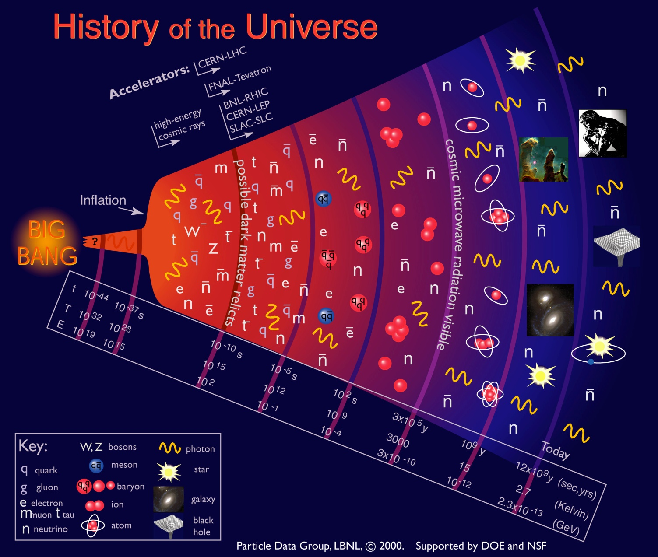
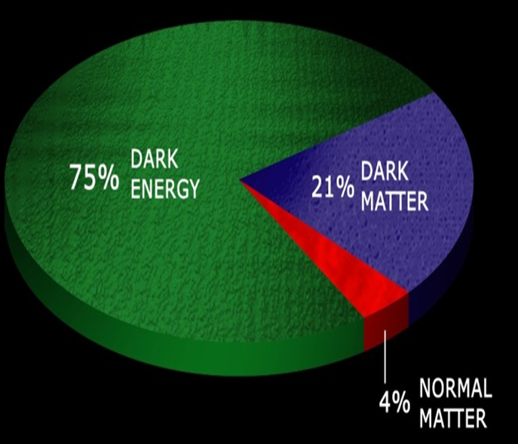
Telescopes to the early universe
Reaching the energy scale in the laboratory to simulate the earlier times and higher energies in the Universe’s evolution is daunting!
But, the “signals” are all there in the space-time of our laboratories,
albeit as very weak “tremors” and “fossils” from the Big-Bang early universe! Need “Cosmic Archaeology”!
now
Big
Bang

Slide 14
Current Estimate of the
Mass-Energy Budget of the Universe

Slide 15
PHYSICAL MEASURE of the DARK SECTOR:
DARK MATTER/ENERGY and FORCE ESTIMATES
Ω_{DE}
= 6.3×10⁻¹⁰ Jm⁻³
Corresponds to energy density of a static electric field:
E = 12 V/m (Dark Energy)
“Dark Matter” density is even higher implying:
E ~ 10 kV/m !! (Dark Matter)
Must look for “AC”-effects (fluctuations) on a fixed background!
Ω_{DM}
~ 4×10⁻¹⁰ Nm⁻² → Measurement of Casimir effect (1996)
~ 1.3×10⁻¹⁰ Nm⁻² → Cold cathode ionization gauge

Slide 16
Probing the Very “Early” Universe and the “Dark” Universe: via Atomic Beam Interferometry
Detection of Stochastic Low Frequency Gravitational Wave Background from the “Early” universe of the “Big-bang Era” (Inflation or other contributors of space-time metric perturbations/fluctuatiions
+
Perturbed Atomic Transitions via Coupling of the Standard Model Sector (i.e. QCD, fine structure constant in QED, etc.) with the “Dark” sector

Slide 17
The Problem of Dark Matter
bosonic
WIMPs
10⁻⁴³ GeV
10⁻²² eV
100 eV
10² GeV (SM)
10⁴⁸ GeV (MACHO)
Fit in visible galaxy
One Possibility: Same scale as visible galaxy for Dark Matter?
Dark Sun, Other Dark Stars, Dark Milky Way Galaxy,..??
Many Generic Conceptual/Theoretical Candidates:
Hidden Sector Photons, Axions, Massive Vector Bosons, Relaxions, ….
How do we search for them? → AC Effects of Dark Matter:
→ ** I. On Photons (Sensitive and Precise Coupling to “alpha”~ 1/137)
II. On Electrons/Nucleons ( SQUIDS : Materials with Special NMR properties)
** I will only address this aspect.

Slide 19
Recent references of DM Ultralight Scalar coupling to Standard Model sector

Slide 20
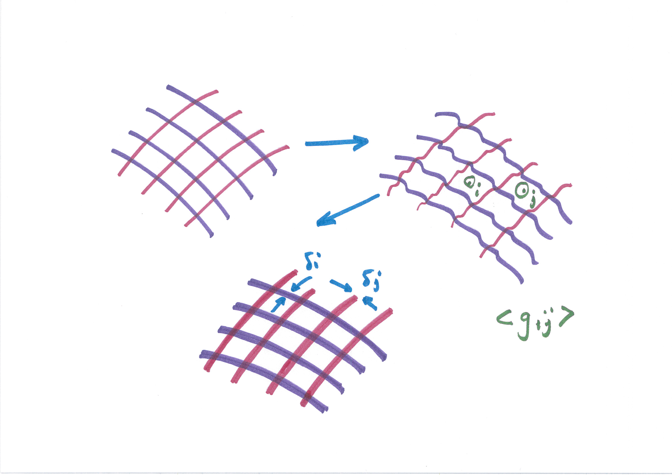
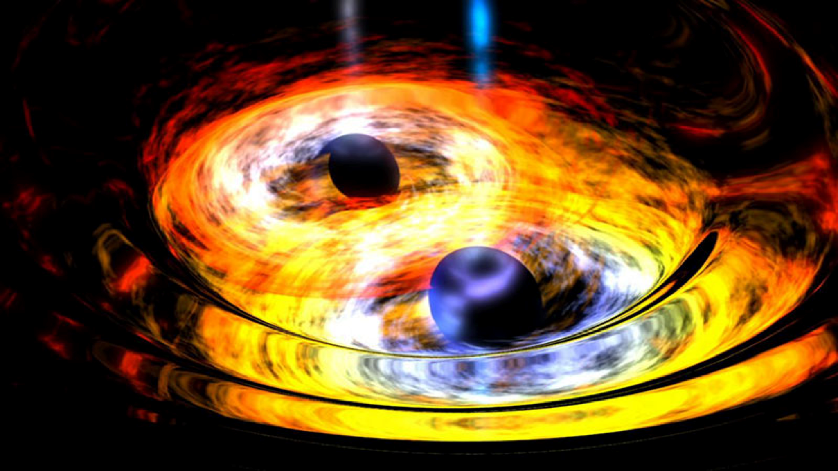
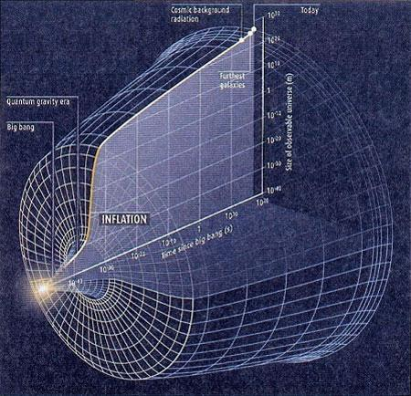
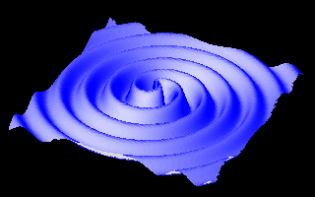
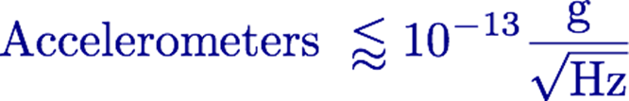
Probing the Very Early Universe and the “Dark” Universe: via Atomic Beam Interferometry
Detection of Stochastic Low Frequency Gravitational Wave Background from the “Inflationary” Era + Perturbed Atomic Transitions via Coupling of the Electromagnetic Sector (i.e. fine structure constant) with the “Dark” sector
Strain: (dl/l) ~10E-25 @ 1 Hz?? Here we need a lot of hand-holding from theoretical astrophysicists and cosmologists

Slide 21

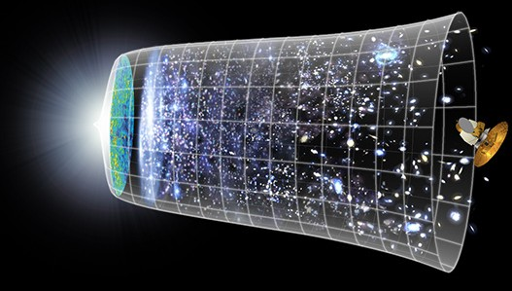
Gravitational Wave Spectrum
CMB
LISA
new sensors
10⁻² Hz 10⁻¹ Hz 1 Hz 10
LIGO
10⁻¹⁸ Hz
10⁻⁴ Hz 10⁻³ Hz
Hz 10² Hz
10³ Hz
Gravitational radiation in the mid-band falls in a gap between the lower and upper reaches of earth-based LIGO and space-based LISA

Slide 22
TUTORIAL
on
ATOM INTERFEROMETRY

Slide 23
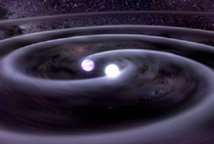

GW detection with atoms playing both roles: clock and inertial reference
frequency
L (1 + h sin(ωt ))
strain
Measure differential acceleration between two inertial masses
 | LIGO | Atom Interferometry
Proof mass | Suspended end mirrors | Freely falling atoms
Proof mass separation | Laser interferometry | Light flight time
Reference | 2nd interferometer arm | Atomic phase (clock)

Slide 24
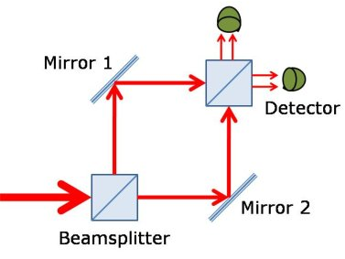
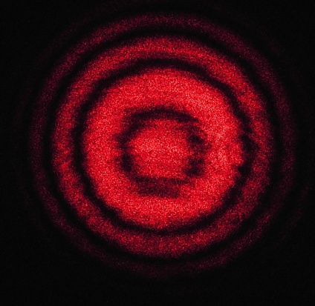
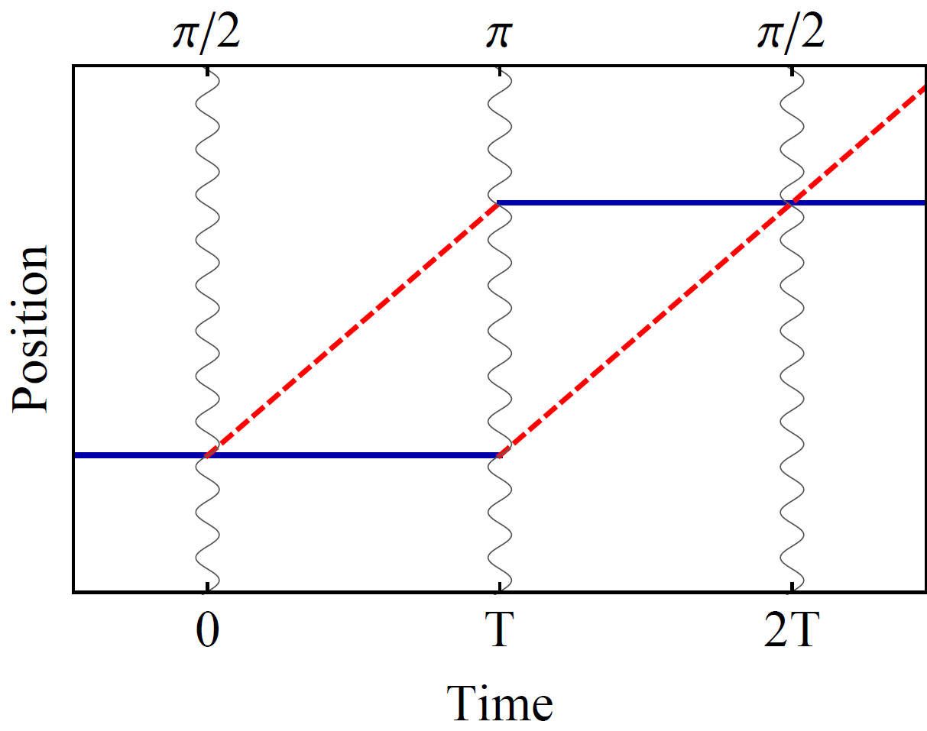
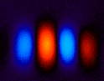
Atom interference (via atomic optics)
Light interferometer
Light
Light fringes
Atom interferometer
Beamsplitter
Atom fringes
Atom
Beamsplitter
Mirror
http://scienceblogs.com/principles/2013/10/22/quantum-erasure/
http://www.cobolt.se/interferometry.html

Slide 25
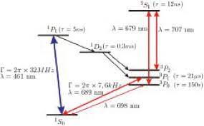
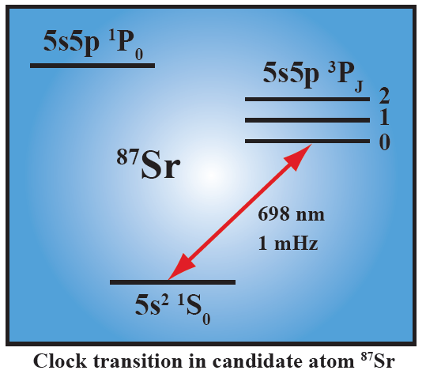
MAGIS-100 will use Strontium atoms --- the best atomic clocks to date

Slide 26

Atom optics using light
(1) Light absorption:
Rabi oscillations
ħk
v = ħk/m
(2) Stimulated emission:
ħk
Time
In practice, typically 2-photon Raman or Bragg transitions

Slide 27
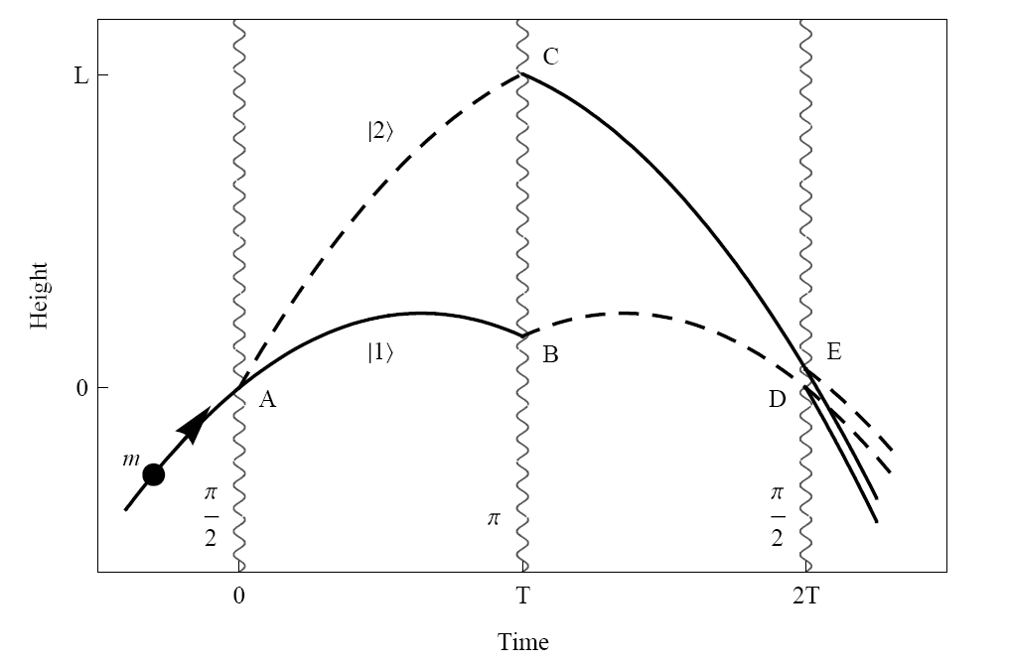
Light Pulse Atom Interferometry
Long duration
Large wavepacket separation

Slide 28
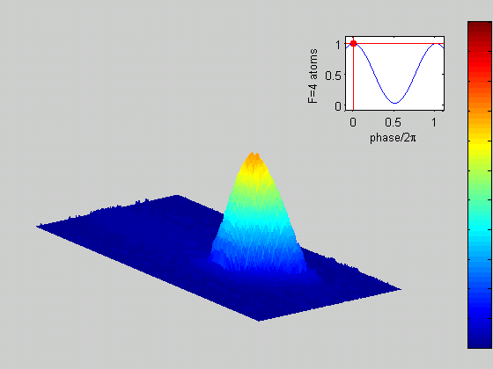
Light Pulse Atom Interferometry:
0.5 m separated in Stanford 10 meter experiment
π/2 pulse
“beamsplitter”
Beamsplitter
Position
“mirror”
Atom
Beamsplitter
π pulse
Mirror
Time
“beamsplitter”
π/2 pulse
|p >
Interior view
|p+k>

Slide 29
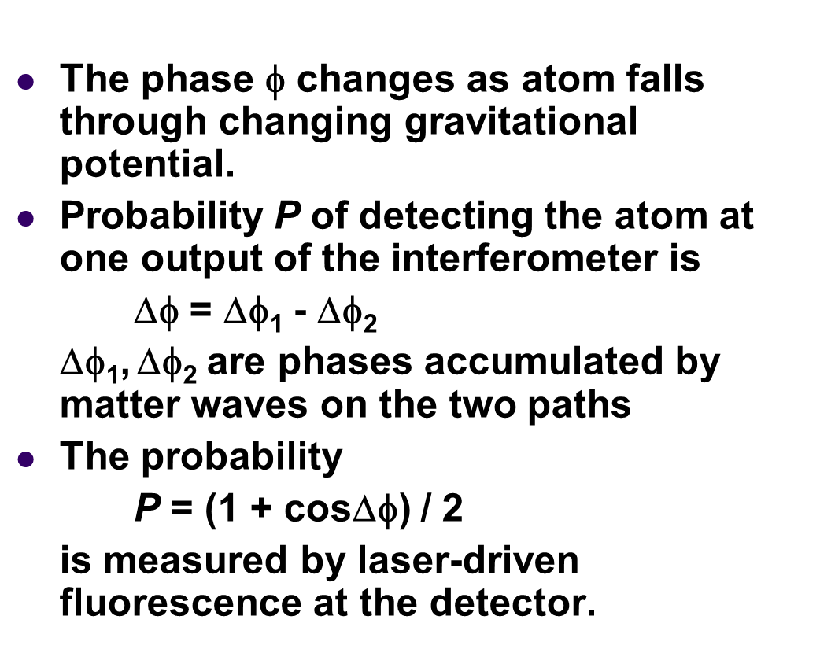
Wave function of atom has phase factor exp(iφ)
The wavefunction
Phase
~ k.z ~ k.g.
10 m rise/fall ~1 s
100 m rise/fall ~ 3.2s
1000 m rise/fall ~ 10 s
T²
1-5 m separation possible in 100
meter experiment (10-50 cm already achieved at Stanford with 10 m interferometer)

Slide 30
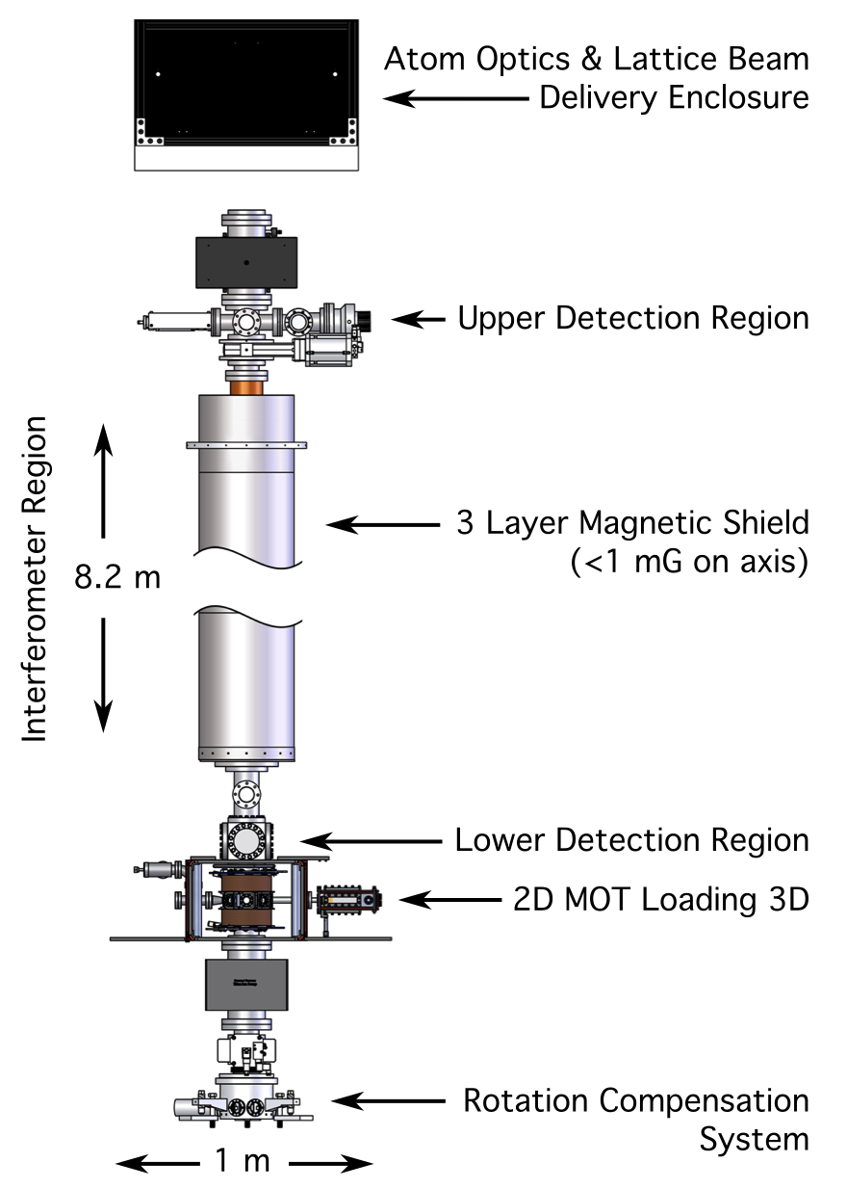
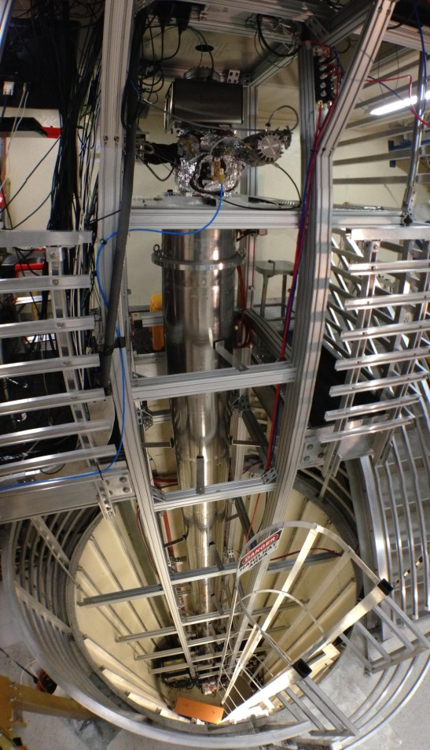
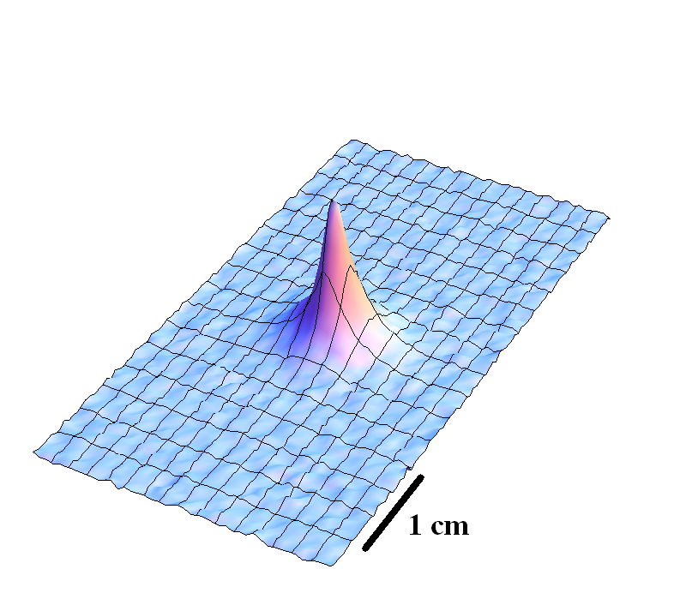
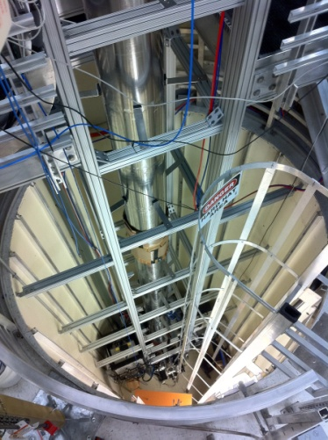
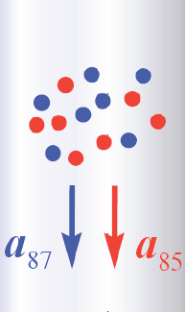
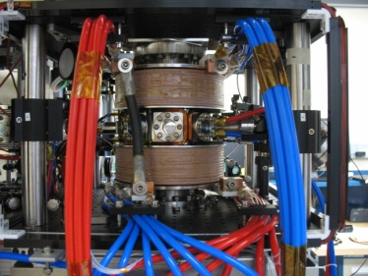
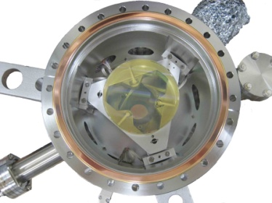
10 meter scale atomic fountain at Stanford
< 3 nK

Slide 31

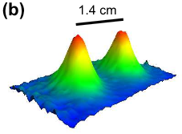
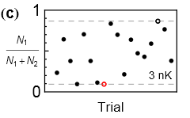
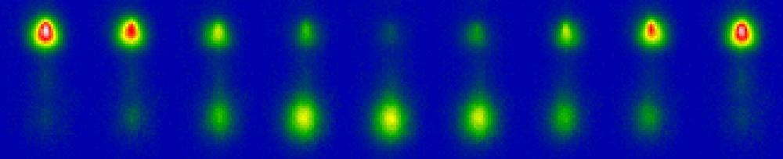

Interference at long interrogation time
Port 1
Port 2
Wavepacket separation at apex (this data 50 nK)
2T = 2.3 seconds
1.4 cm wavepacket separation
Interference (3 nK cloud)
Dickerson, et al., PRL 111, 083001 (2013).

Slide 32
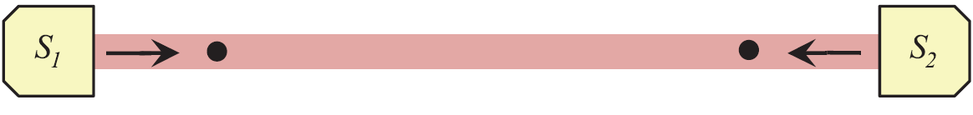
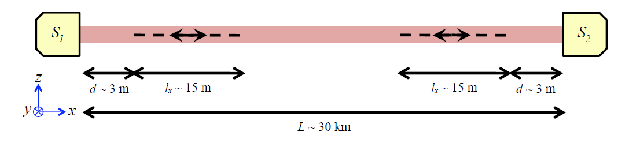
Clock gradiometer
Clock - Single photon transitions in clock atoms (e.g., Sr, Yb, …)
Gradiometer - Compare two separated clock atoms
Inertially sensitive (e.g., accelerometer pulse sequence)
Common laser phase noise
Common interferometer laser beam
Atoms
Atoms
Laser
Laser
Measurement baseline

Slide 33



Simple Example: Two Atomic Clocks
Atom clock
Atom clock
Phase evolved by atom after time T
Time

Slide 34


Simple Example: Two Atomic Clocks
GW changes light travel time
Time
Atom clock
Atom clock

Slide 35


Phase Noise from the Laser
The phase of the laser is imprinted onto the atom.
Laser phase noise, mechanical platform noise, etc.
Laser phase is common to both atoms – rejected in a differential measurement.

Slide 36
Differential atom interferometer response
Excited state phase evolution:
Two ways for phase to vary:
Dark matter
Gravitational wave
Each interferometer measures the change over time T
Laser noise is common-mode suppressed in the gradiometer
Graham et al., PRL 110, 171102 (2013).
Arvanitaki et al., arXiv:1606.04541 (2016).
Notes:
Differential atomic clock

Slide 37
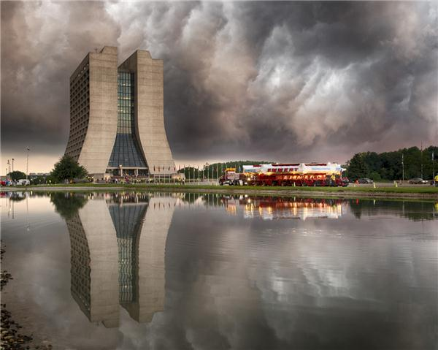
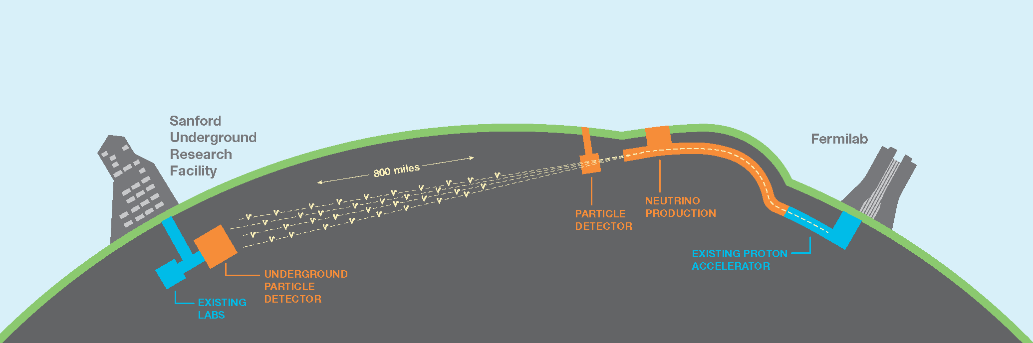
LBNF-DUNE @ Fermilab houses 4 km vertical shaft

Slide 38
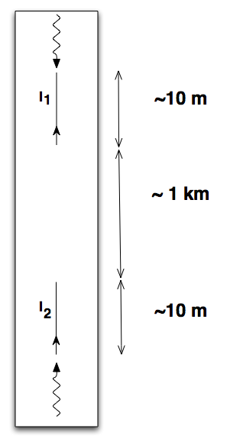
Dark Energy and Gravitational Wave Detection with Accelerometers
Gravitational waves @ 1 Hz could open the window for direct tests of cosmic inflation, frequency range inaccessible to LIGO/LISA. Atomic interferometers can also be sensitive detectors of “dark” energy.
EXAMPLE:
Two 10 m atom interferometers at either ends of a mine shaft. Both interferometers will be operated by common lasers. Signal scales with length ~ 1 km between interferometers.
Allows free fall time ~ 1s. Maximally sensitive in the
1 Hz band.
→ POSSIBILITIES in the Sanford Lab where
DUNE long-baseline neutrino experiment
will be carried out by a global team using
high powered beams from Fermilab sent
to underground detectors with a vertical
shaft of a few kilometers.

Slide 39
Hence “dark” sector and gravitational wave background search using Atomic Beam Interferometers at Fermilab.
Early Explorations at Fermilab
Precision Neutrino science in deep underground facilities a Core Competency of Fermilab.
An vertical underground shaft a few kilometers long already exists at the Sanford Lab housing the DUNE experiment.
A 100 meter tall NuMI shaft already exists in the MINOS facility which can be carefully examined for an intermediate experiment.

Slide 40

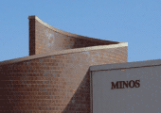
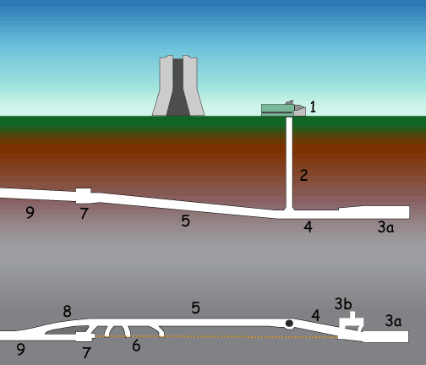
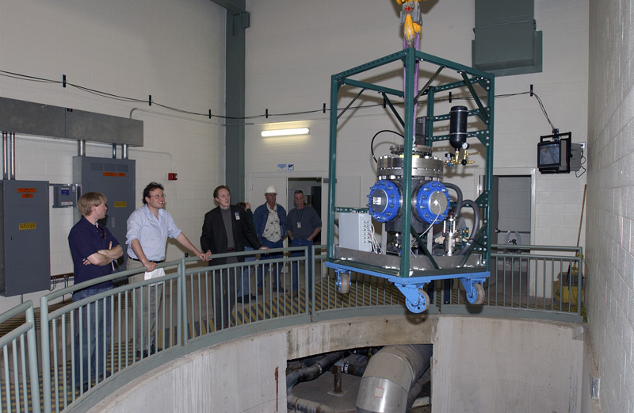
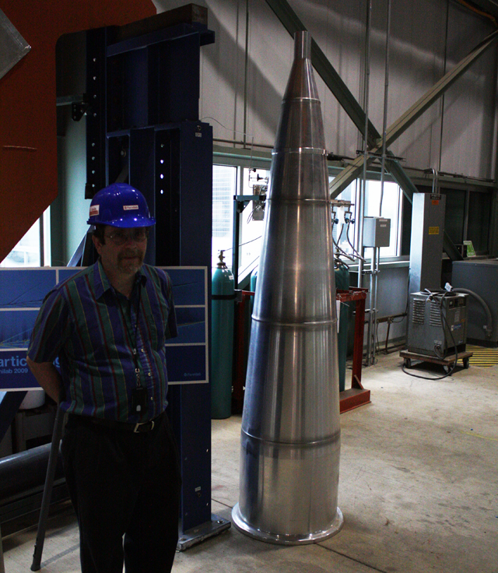
105 meter tall NuMI shaft in the MINOS

Slide 41
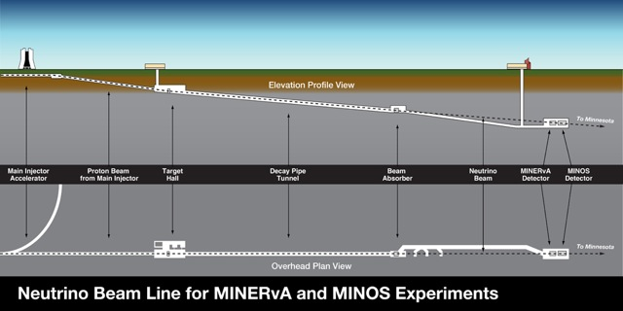
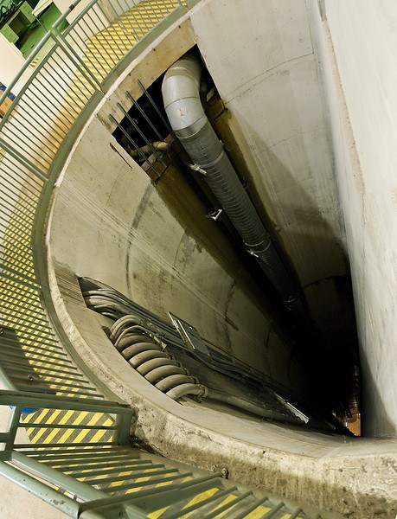
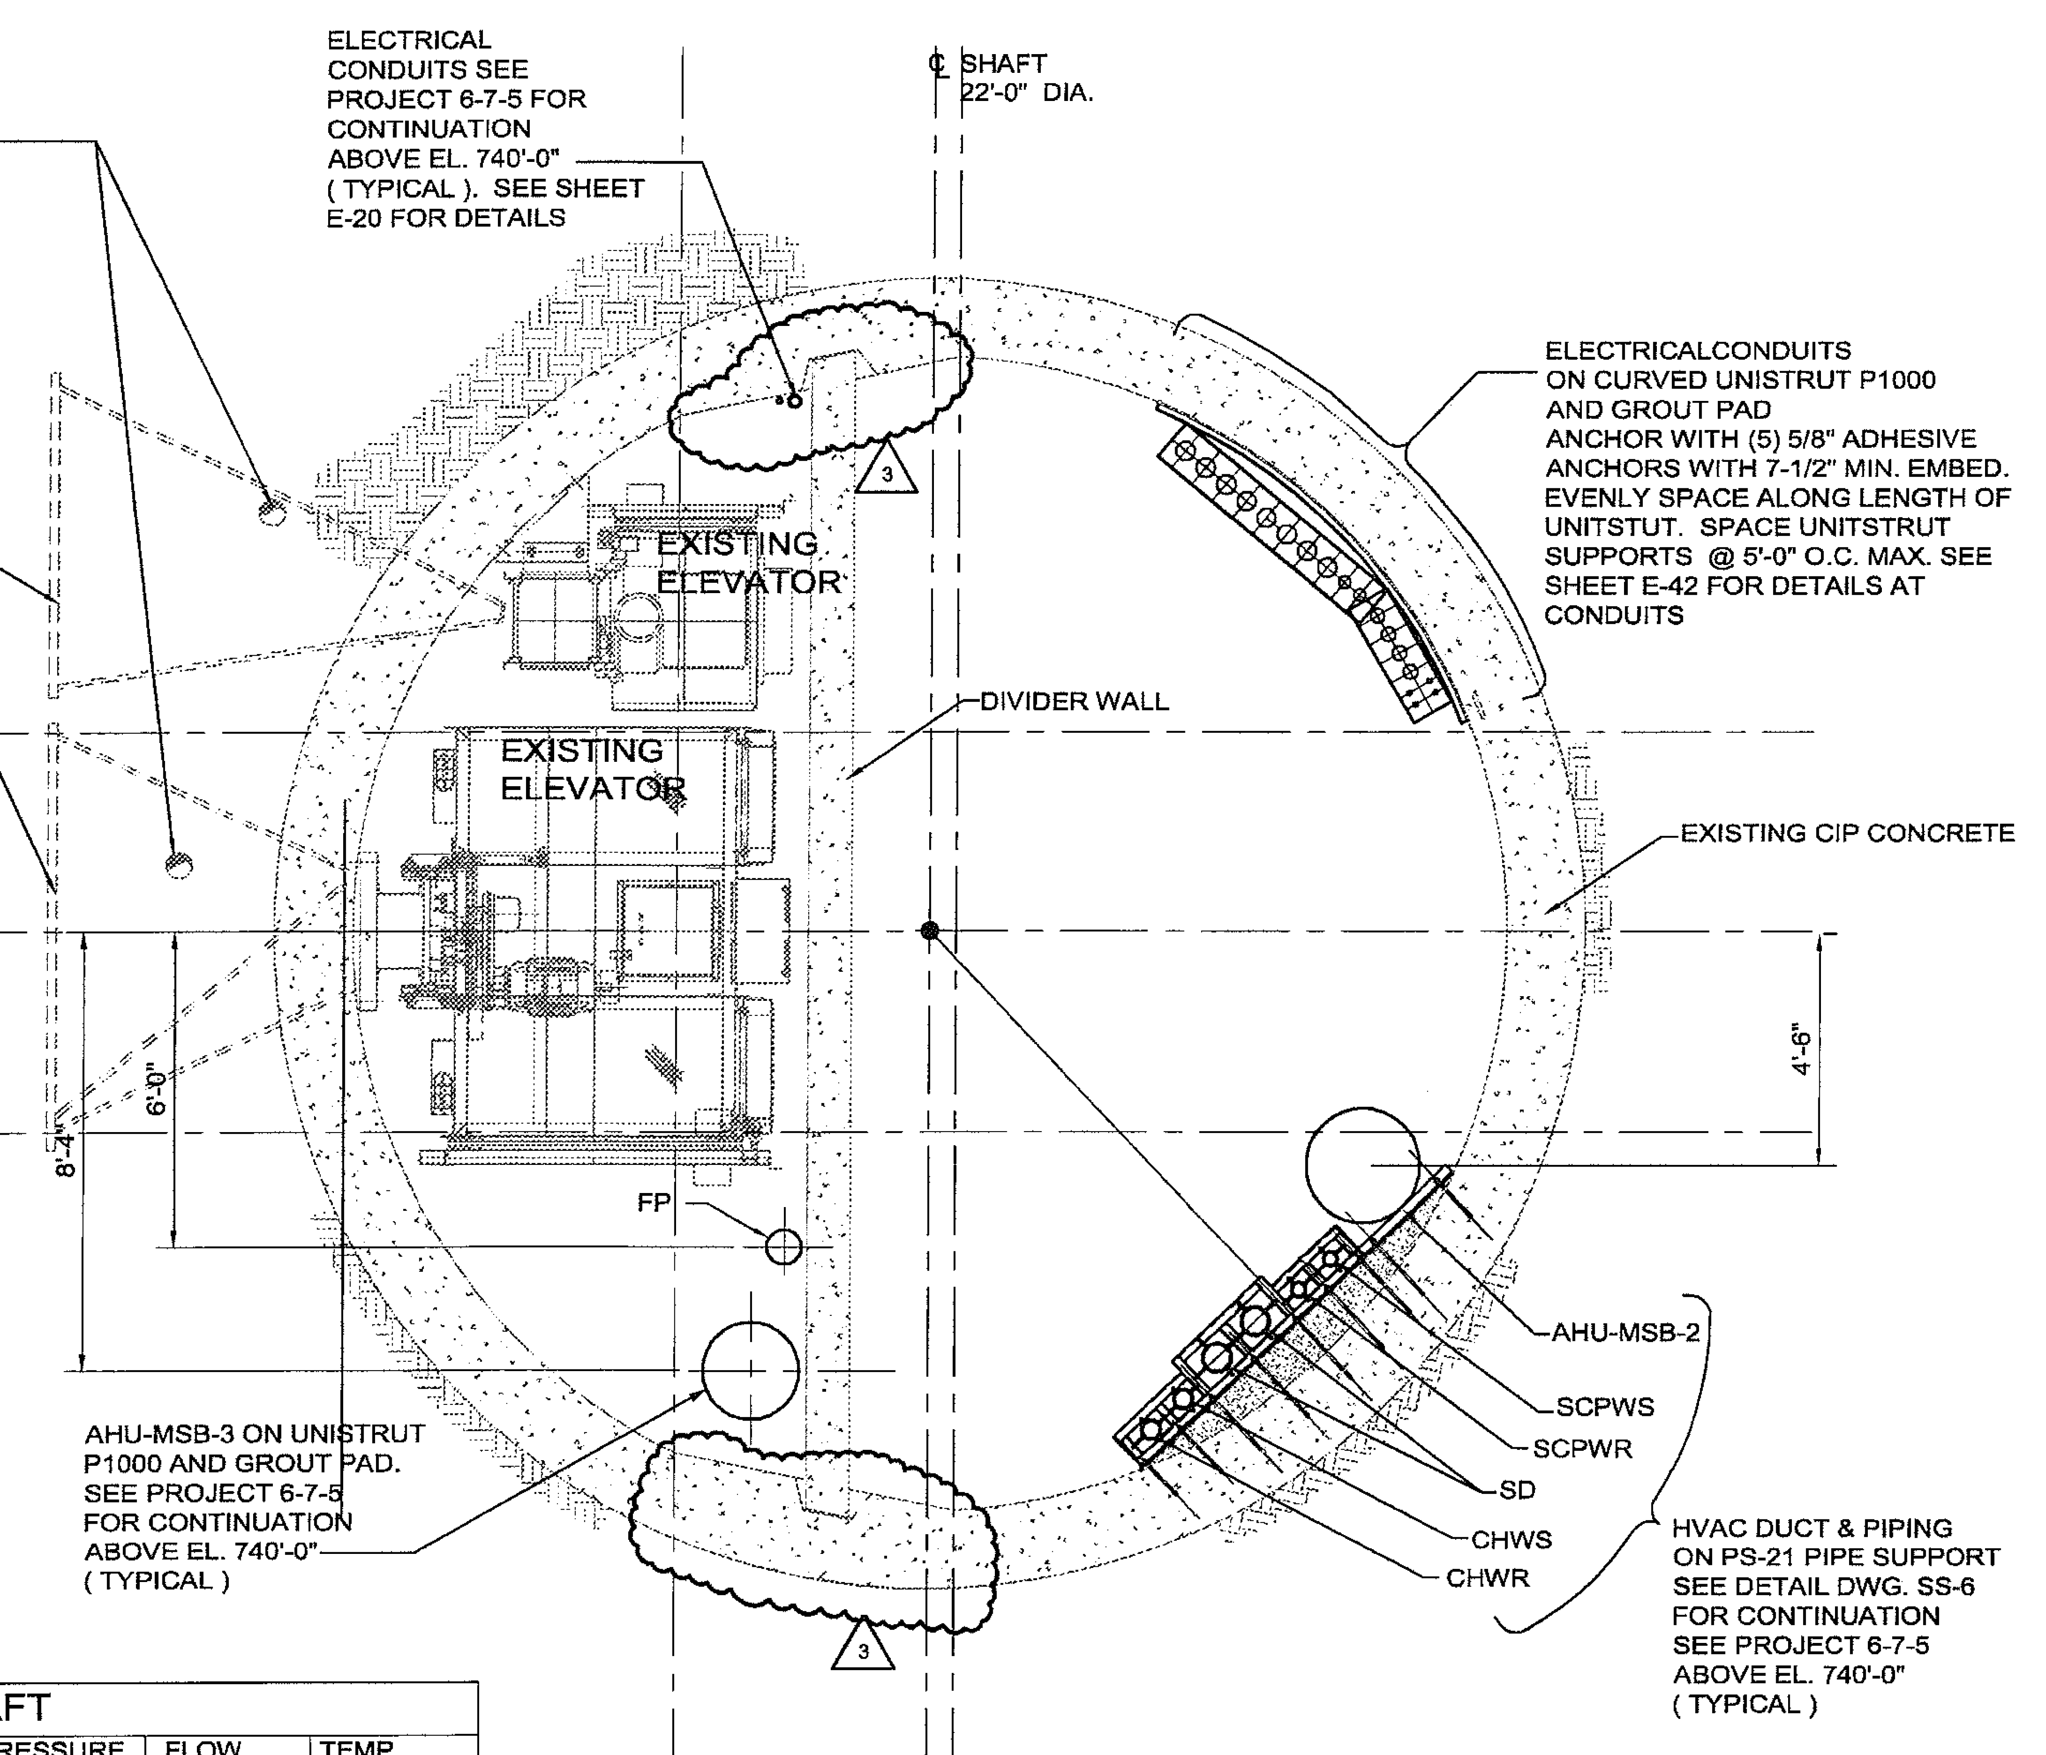
MAGIS-100 detector at Fermilab
Source 1
50 meters
100 meters
Source 2
50 meters
Source 3
Detector modes of operation
Max drop time >3 seconds (sources 1,2)
Max free fall with launch (sources 2,3)
Max baseline (sources 1,3)
Newtonian noise rejection (sources 1,2,3)
Extreme QM, 4 - 9 s (drop 1 or launch 3)

Slide 42
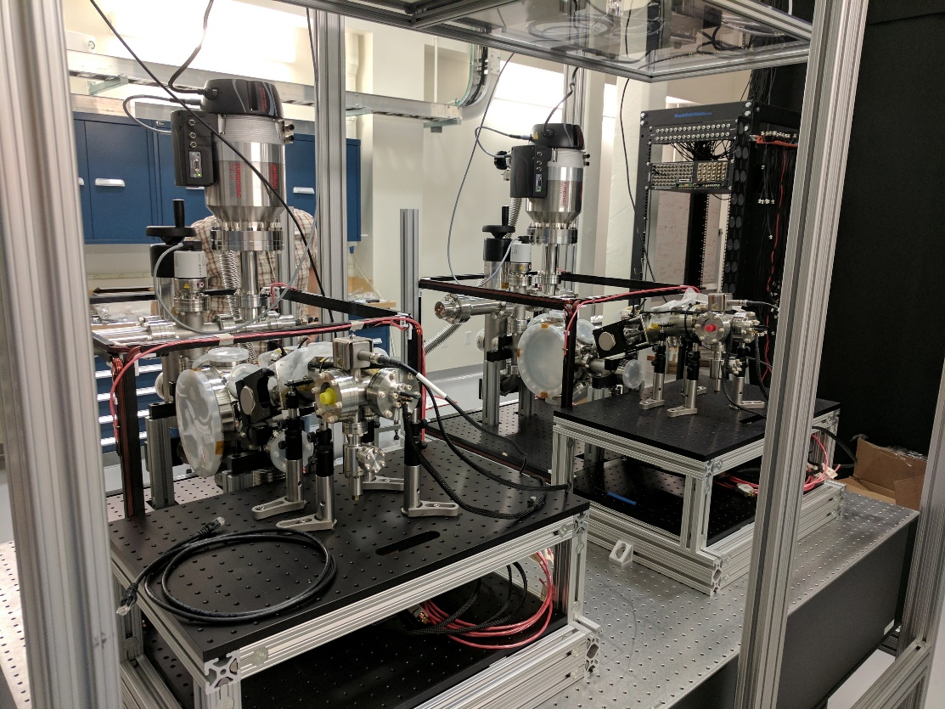
Stanford 10-meter MAGIS prototype
Two assembled Sr atom sources
Sr gradiometer CAD
(atom source detail)

Slide 43


Stanford 10-meter MAGIS prototype
Complete vacuum system w. coils
Sr gradiometer CAD
(atom source detail)
Optics frame

Slide 44
MAGIS-100 Experiment
17 modules, each with magnetic shielding, vacuum pipe, current-carrying wires for generating bias magnetic field
Three Sr atom sources over 100 m baseline, local optical lattices can launch atoms from each source
High-power laser system with agile frequency control, spatially filtered beam mode, and precisely controlled pointing
Construction and testing of subsystems underway
Abe et al., Quantum Science and Technology (2021)

Slide 45

At Stanford Set-up

Slide 46



Typical Atom Trap as Source
A cloud of ultra-cold atoms
Temp ~ 5μk
17 x 10⁶ Atoms
A Portable Atom Trap built at a university lab → Today’s record 50 pico-Kelvin with number of trapped atoms ~ 10⁸
Still needs improvement in stability, lifetime and repetition rate for being useful in interferometric detection of gravitational background or “dark” energy

Slide 47



Atom sources
Up to 1,000lb weight.
Top, middle, and bottom of shaft.
Very tight fit, last components installed.
Approximate cost $1M each.
Atom source detail.
Bottom atom source and retroreflective mirror shown.

Slide 48
CHALLENGES:
Systematic accounting of various noise sources
Gravity Gradient Noise
Environmental Newtonian Noise
Coriolis Effect
Intrinsic Atomic Clock Stability (currently but projected to extend to with 10⁸ free Sr atoms at 50 pK as opposed to much fewer atoms bound in an optical lattice, thus raising ‘shot’ noise)
Laser wave-front “jitter”/noise (equivalent to seismic noise in LIGO)
10⁻¹⁸
10⁻²²

Slide 49




Acceleration (top) and Gravity Gradient Noise (below) at the surface (left) and at the bottom (right) of the MAGIS-100 shaft at Fermilab
MAGIS-100: Matter-wave Atomic Gradiometer Interferometric Sensor to Probe the Dark Sector and Primordial Gravitational Waves
Laser Wavefront Aberrations

Slide 50
Gravity Gradient Noise Suppression
Measurements at multiple heights can strongly distinguish between exponential dependence of GGN signal on depth and a linear dependence
J. Mitchell, TK et al., JINST (2022)

Slide 51
Various Detector Operation Modes
(A): Maximum drop time
(B): Maximum gradiometer baseline
(C): 3 interferometers, useful for characterizing Newtonian gravity gradient noise
(D) Dual isotope mode. Alternative dark matter search mode involving a differential measurement between co-located, simultaneous interferometers with different isotopes of Sr.

Slide 52


Interferometry Laser Beam Delivery
The interferometer beam is relay-imaged over the 10m distance between the laser lab to the top of the shaft via two in-vacuum lenses in a 4f configuration
Tip tilt mirror
Vertical Telescope Lenses
Relay Lens 2
Beam Path
Relay Lens 1
Wall Mounted Optics
After-Fiber Breadboard
Laser Room
The relay imaged beam passes through an optical fiber which converts residual pointing jitter into intensity fluctuations
100-Meter Deep Shaft
A feedback loop will actively stabilize after-fiber laser power
Support
-4f relay imaging beamline in vacuum to transport beam from laser room to 100-meter shaft
-In-vacuum propagation for spatial mode filtering
-Tip-tilt mirror for pointing control
-Telescope to magnify beam to ~1 cm waist

Slide 53
Spatial Filtering via Free Propagation
Intensity profiles of perturbed beams before and after free propagation (simulation)
Difference between perturbed and unperturbed beams after propagation
Just before telescope
Initial beam
Small absorptive disc
Intensity grating

Slide 54
Fiber Noise Cancellation (FNC)

Slide 55
But useful to have two interferometric set-ups to establish correlations of the field

Slide 56

Dark contents of the vacuum and background gravitational wave stochastic background may be sensitive to location

Slide 57


Slide 58
Relative motion in the Galactic Frame establishes long-tern space-time “correlations”
∆φ=0

Slide 59

∆φ≠0…

Slide 60


Ultimate Goal: Establish International Network and beyond
For more details on AION see https://arxiv.org/pdf/1911.11755.pdf
Notes:
US-UK collaboration serves as a testbed for full-scale terrestrial (kilometer-scale) and satellite-based (thousands of kilometres scale) detectors and builds the framework for global scientific endeavor

Slide 63


Testbed for GW sensor
Recent discovery of 150 solar mass black hole merger by LIGO is encouraging as heavier mergers would occur in the mid-band frequency range.
Notes:
As a technology demonstrator, MAGIS-100 is not expected to be sufficiently sensitive to detect known candidate sources of gravitational waves. Nevertheless, within its frequency range it aims to achieve a record sensitivity, improving on the current bounds.
Additionally, the recent discovery by LIGO of a binary black hole merger with a total mass of 150 solar masses motivates further studies of intermediate mass black holes. Earlier observations of such binaries at lower frequencies (including mid-band frequencies) would provide valuable astrophysical insight. Moreover, even heavier black holes than the LIGO observation, hundreds of solar masses and above, would merge in the mid-band. Therefore, this would be the ideal band to discover such black holes, if they exist.

Slide 64








The Team
Mark Kasevich, Peter Graham and Jason Hogan, Stanford
Timothy Kovachy
Northwestern
Surjeet Rajendran
Johns Hopkins
Swapan Chattopadhyay
Fermilab/UC Berkeley
Robert Plunkett
Fermilab
Jonathon Coleman
University of Liverpool, UK

Slide 65




Ariel Schwartzman
SLAC
Ian Shipsey
Oxford, UK
Val Gibson
Cambridge, UK
Sergei Nagaitsev
Jefferson Lab/OFU

Slide 66




Thank You!
For your
Attention!!!!!!!!

Slide 67
EXTRAS
Historical Background of US Quantum Initiatives

Slide 68

DOE
ROUND TABLE
Feb. 25, 2016
Gaithersburg, Maryland
(OHEP, ASCR, BES) including NSF, NIST and OSTP
Cross-cutting Opportunities and challenges at the quantum frontier that includes quantum sensors for HEP, material science and quantum computing

Slide 69


Slide 70
Google, Microsoft, IBM, Harvard, Yale, Stanford, U. Chicago, FNAL, ANL, LBNL, ORNL…all gather on October 18, 2016 at…

Slide 71



Quantum Sensors: APPLICATIONS
→ Searches for New particles/Interactions: “Dark” Matter/Energy ***
→ Probes of the very early universe: Inflationary Cosmology ***
→ Quantum Computers: Quantum Information Science
CRYPTOGRAPHY, MARKET OPTIMIZATION, ARTIFICIAL INTELLIGENCE
→ Bio-Signals (magneto-encephalography): Neuro-science
→ New “strongly correlated” Materials: Material Science of
DESIGNER MATERIALS: “Dirac” and “Weyl” materials for
particle and field detection
→ Detection of “Weak” Environmental Signals: Geo-science
CLIMATE CHANGE SCIENCE
*** I will address these topics with the specific example of atomic beams

Slide 72
National Quantum Program Model
Quantum Initiatives program started in 2018 by US DOE Office of Science and NSF
Distributed across US west coast, east coast and central states
Quantum Program expected to grow to $600 M/year in a few years’ time, pending success of the pilot programs
Mezzo-scale model of 6 to 12 prime research groups across the country including universities and laboratories receiving $ 10 M - $25 M per year for 5 years is already funded in the US starting this year, 2020.

Slide 73


PROSPECTS:
TREMENDOUS POTENTIAL of QUANTUM SENSORS for COSMIC ARCHAEOLOGY
Detector development and particle physics community will benefit from further research investments into the areas of quantum-entangled materials, cavity-qubit entangled electronics, optically entangled atoms etc. to advance the precision detection of exotic particles and fields.
TRAINING THE QUANTUM WORKFORCE!!
Critical for the EDUCATION, TRAINING, ENGAGEMENT of the NEXT GENERATION in the TWENTY-FIRST CENTURY ENLIGHTENMENT!

Slide 74
Thank You!
For your
Attention!!!!!!!!

