Slide 1
FCC-ee Machine detector interface
Alignment STUDIES
02/06/2023, BE-Seminar
Léonard WATRELOT
PhD student, CERN BE-GM-HPA section, SMI, CNAM (Conservatoire National des Arts et Métiers)
Mark JONES (CERN), Mateusz SOSIN (CERN) and Stéphane DURAND (GeF, CNAM)
Many thanks to :
Manuela Boscolo, Francesco Fransesini, Michael Koratzinos, Hélène Mainaud Durand, Mika Masuzawa, Luigi Pellegrino and Vivien Rude
Notes:
Sources :

Slide 2
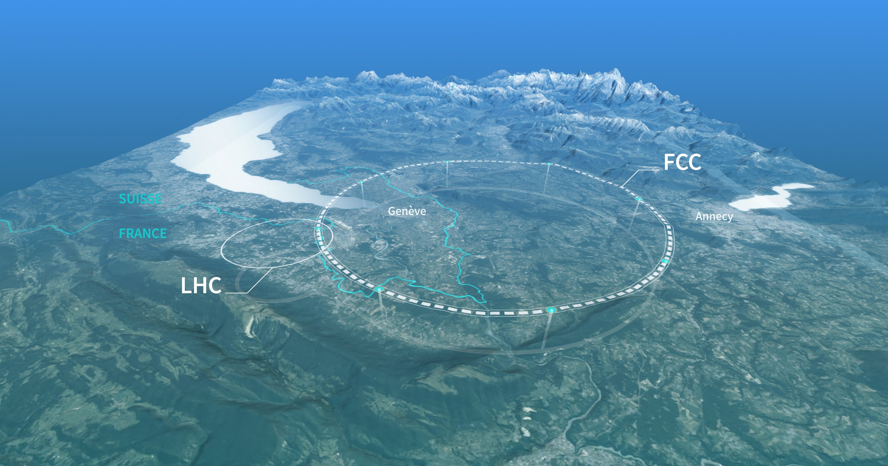
Table of content
02/06/2023, BE-Seminar
Léonard WATRELOT, PhD student, BE-GM-HPA
1
The FCC-ee MDI design
Challenges to face
Alignment strategy proposition
External alignment system
Internal alignment system
Full system implementation
Prototype testing
Discussion
Image: CERN
Notes:
Sources :

Slide 3
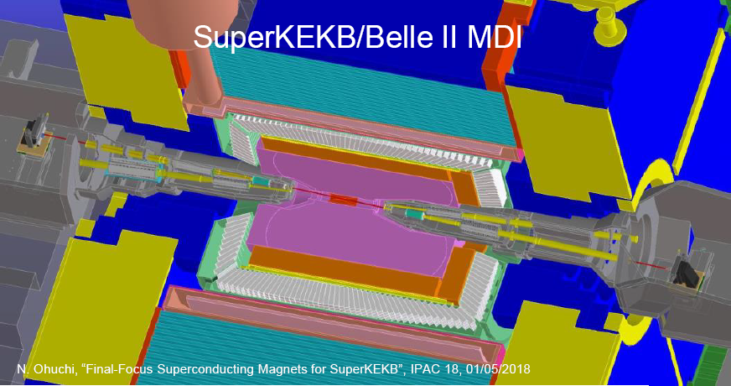
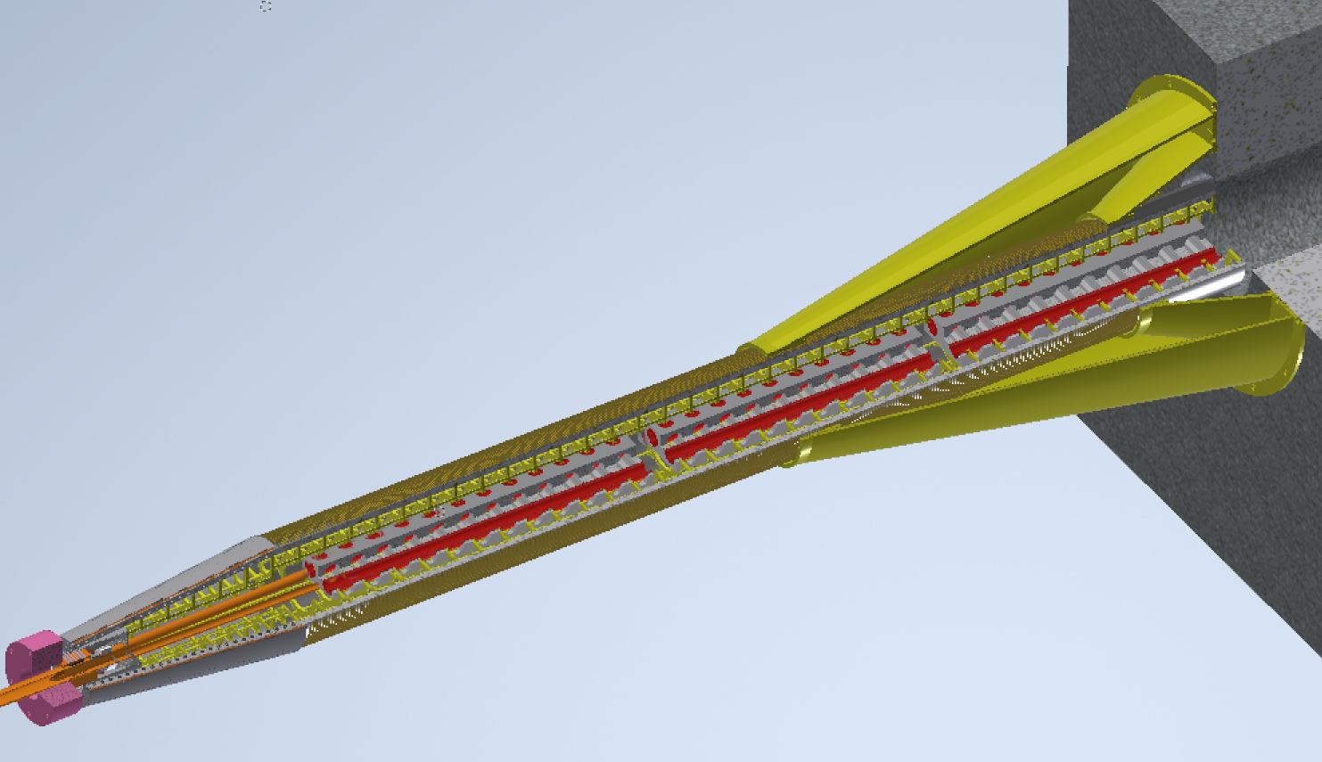
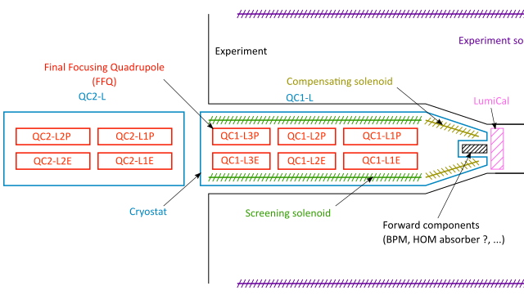
02/06/2023, BE-Seminar
Léonard WATRELOT, PhD student, BE-GM-HPA
2
Design similar to :
The FCC-ee Machine Detector Interface (MDI) design
Crab waist configuration (big crossing angle and small L*) => accelerator components inside the detector
Still a extremely early design which continues evolving
Screening solenoid
Skeleton
Screening solenoid support
Compensation solenoid
Compensation solenoid support
QC1R3p
LumiCal
QC1R3e
QC1R1p
QC1R2p
IP
QC1R1e
QC1R2e
Beam pipe
Design by M. Koratzinos

Slide 4
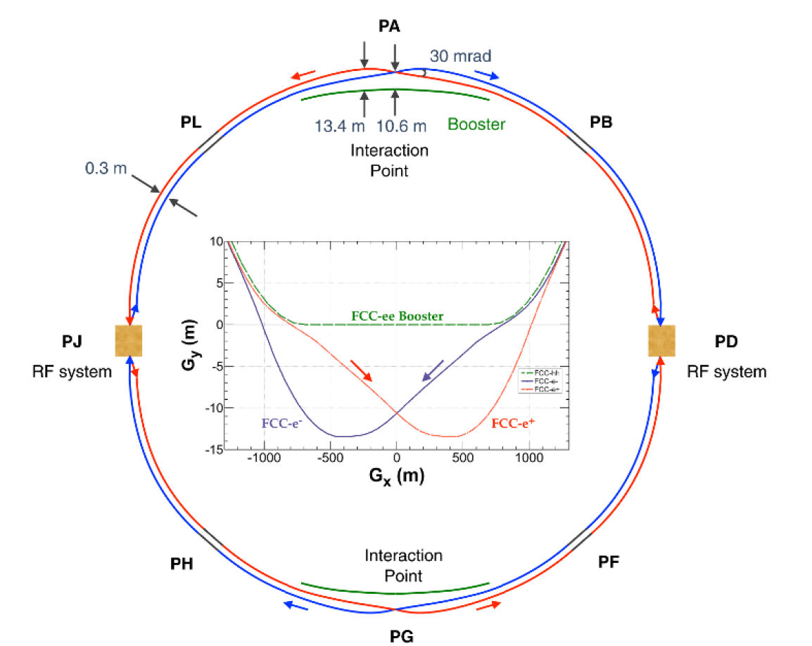
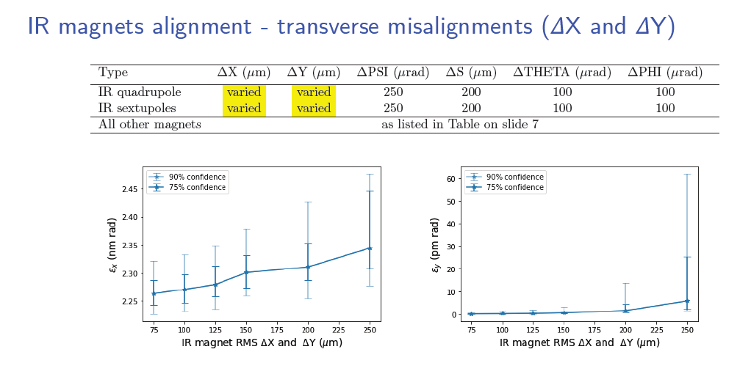
02/06/2022, FCC-week 2022
Léonard WATRELOT, PhD student, BE-GM-HPA
3
Why do we need a precise alignment in the FCC-ee interaction region ?
Maximise performance in terms of integrated luminosity
Maintain the related background at a tolerable level for the experiments (includes minimizing synchrotron radiation)
Minimize emittance blow-up
“Status and plans for optics corrections and emittance performance”,Tessa Charles, Bernhard Holzer, Katsunobu Oide, Frank Zimermann
and the FCC-ee optics team, FCC-week 2021
FCC-ee layout, FCC-ee CDR

Slide 5
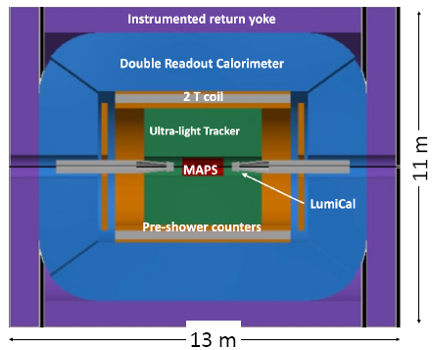
02/06/2023, BE-Seminar
Léonard WATRELOT, PhD student, BE-GM-HPA
4
Why does it need to be more precise than in the rest of the machine ?
Maintain the related background at a tolerable level for the experiments (includes minimizing synchrotron radiation)
“Hole” in the machine => “hole” in the alignment -> align both side precisely so they collide
Continuous alignment
Continuous alignment
“Antennas” in which the alignment depends only on measurements along the line
No stable point or reference at the extremity
FCC-ee CDR

Slide 6
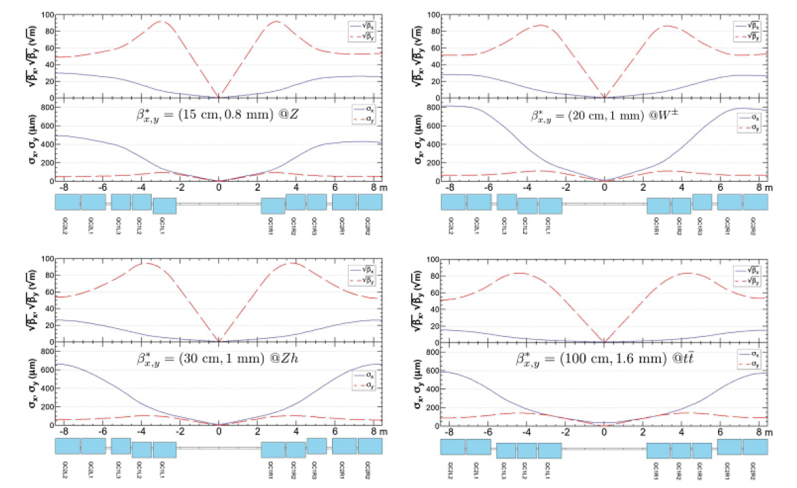
02/06/2023, BE-Seminar
Léonard WATRELOT, PhD student, BE-GM-HPA
5
Why does it need to be more precise than in the rest of the machine ?
Maintain the related background at a tolerable level for the experiments (includes minimizing synchrotron radiation)
“Hole” in the machine => “hole” in the alignment -> align both side precisely so they collide
Minimal beam size in the entire ring + collide as precisely as possible near the center of the experiment
Z
WW
FCC-ee CDR
ZH
tt
FCC-ee CDR

Slide 7
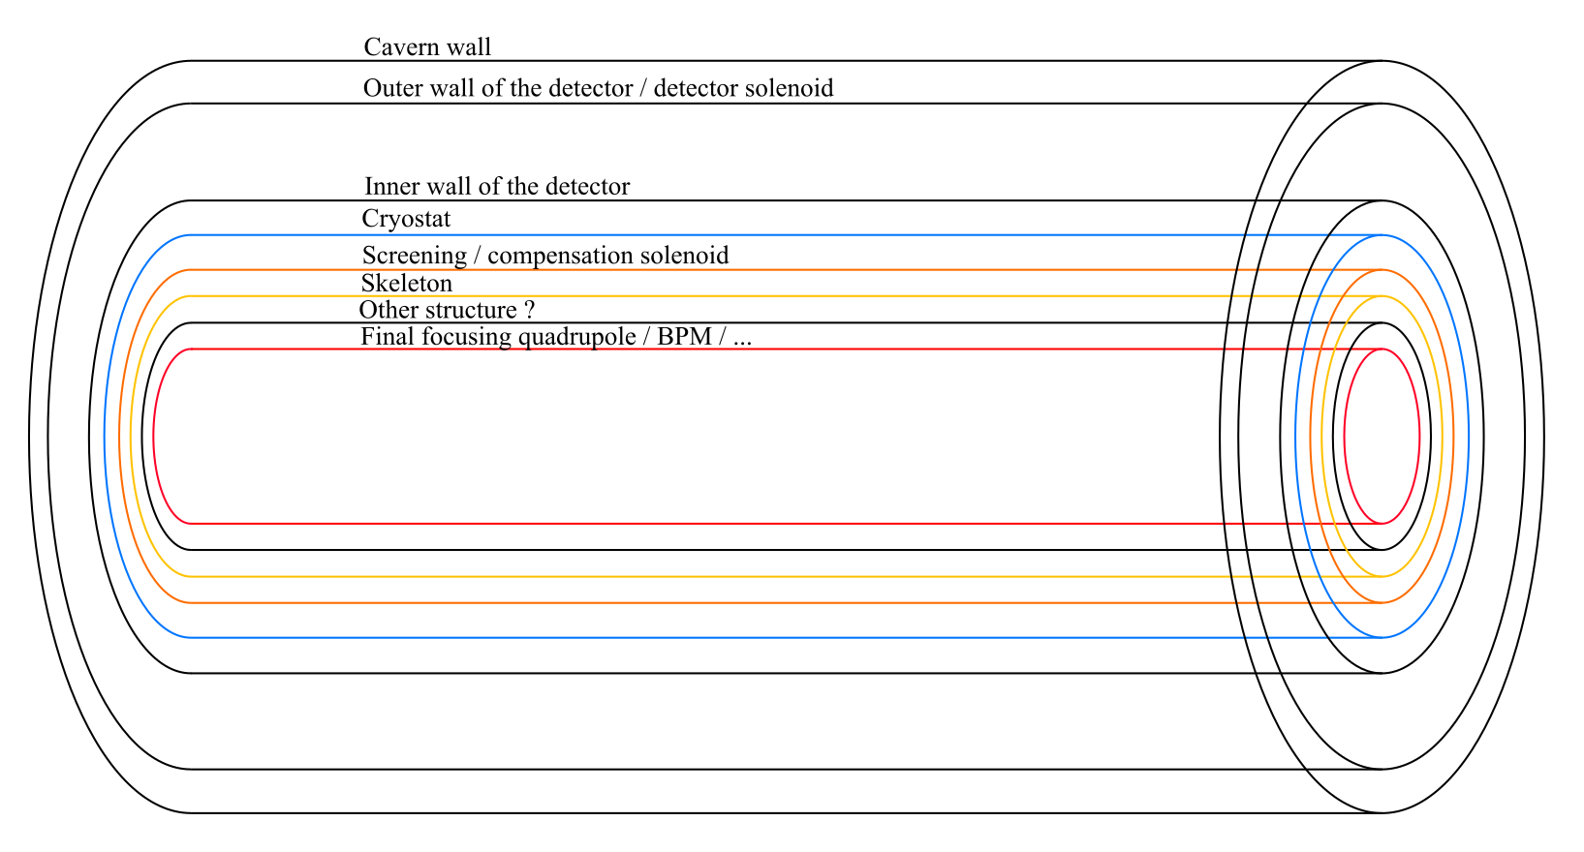
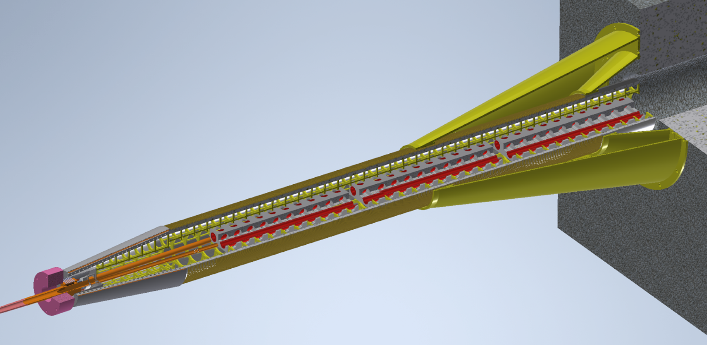
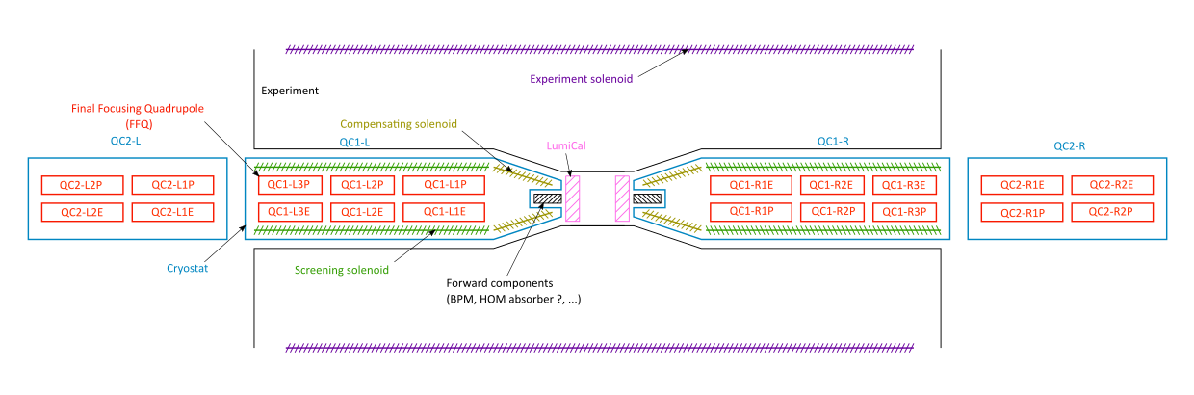
Why is this alignment difficult to do ?
02/06/2023, BE-Seminar
Léonard WATRELOT, PhD student, BE-GM-HPA
6
Design (lot of components to measure, layered design, very little space, design not definitive)
FCC-ee QC1
Design by M. Koratzinos

Slide 8
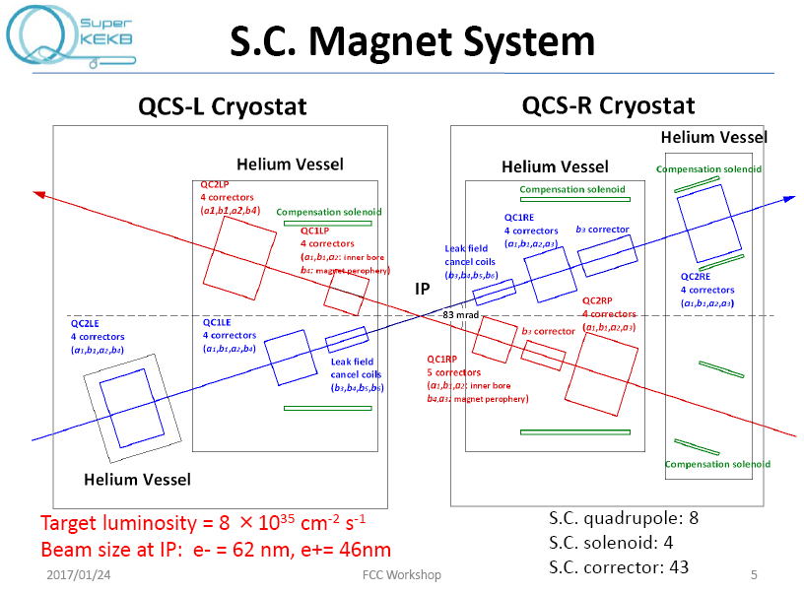
Why is this alignment difficult to do ?
02/06/2023, BE-Seminar
Léonard WATRELOT, PhD student, BE-GM-HPA
7
Design (lot of components to measure, layered design, very little space, design not definitive)
Conditions (cryogenic temperature, radiations, magnetic fields)
FCC-ee QC1
Design by M. Koratzinos
“Superconducting magnet system for SuperKEKB Interaction region”, Norihito Ohuchi, FCC workshop, 24/01/2017

Slide 9
Why is this alignment difficult to do ?
02/06/2023, BE-Seminar
Léonard WATRELOT, PhD student, BE-GM-HPA
8
Design (lot of components to measure, layered design, very little space, design not definitive)
Conditions (cryogenic temperature, radiations, magnetic fields)
Requirements (very tight alignment requirement, especially on Final Focusing Quadrupoles, BPM, Screening and Compensation solenoids, and LumiCal)
Compensation solenoid : Alignment tolerance at ~100 µm + Monitoring
FFQ : Alignment tolerance at 30 µm + Monitoring
Screening solenoid : Alignment tolerance at ~100 µm + Monitoring
LumiCal
Alignment tolerance at 50 µm
w.r.t. the IP (longitudinal)
+ Monitoring
Misalignment tolerances include all possible error sources such as: manufacturing errors, assembly errors, deformation both during/after installation and during operation, magnetic field measurements, metrology measurement, reference network and alignment measurement, anticipated degradation in the alignment over time as a function of ground motion and other effects.
Experience from previous accelerator projects indicates that a reasonable assumption for the relative radial alignment precision can be derived by applying a factor 1/3.
Alignment tolerance at 30 µm => alignment precision required <10 µm

Slide 10
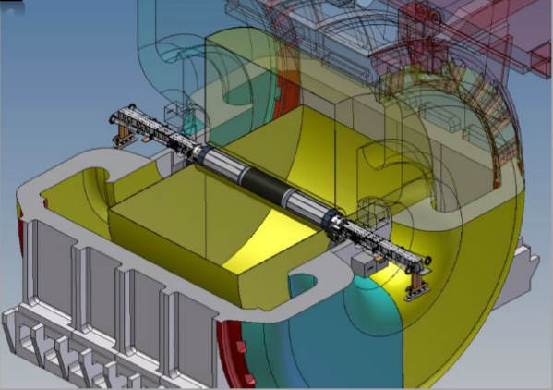
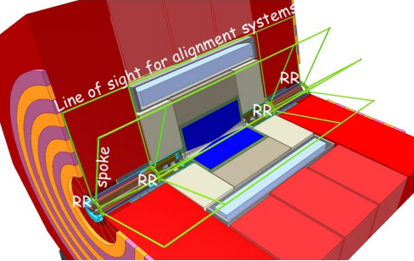
02/06/2023, BE-Seminar
Léonard WATRELOT, PhD student, BE-GM-HPA
9
Hasn’t it been done in the past ? Is there any similar MDI ?
s
DAFNE/KLOE MDI
L. PELLEGRINO, MDI mechanical design, integration and assembly at DAFNE/KLOE with the crab-waist configuration, 3rd FCC-ee MDI workshop, 9-20 September 2019, CERN.
SuperKEKB/Belle II MDI
N. Ohuchi, “Final-Focus Superconducting Magnets for SuperKEKB”, IPAC 18, 01/05/2018
CLIC
CLIC Machine Detector Interface, MDI mini workshop, HKUST IAS, Philip Burrows on behalf of Lau Gatignon, 2020
ILC
Marcel Stanitzki, The SiD Detector – Machine Backgrounds, 01/2020, Hong Kong

Slide 11
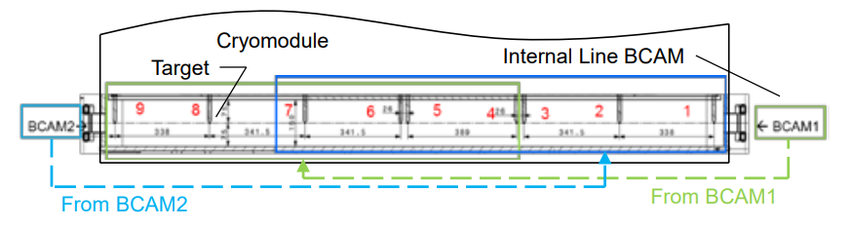
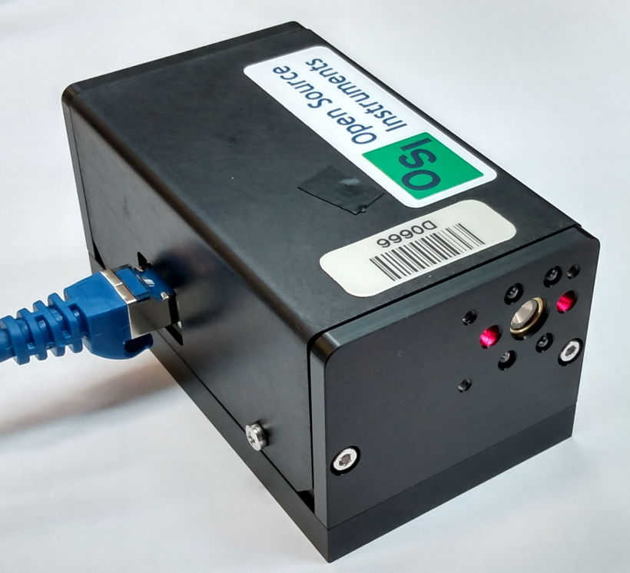
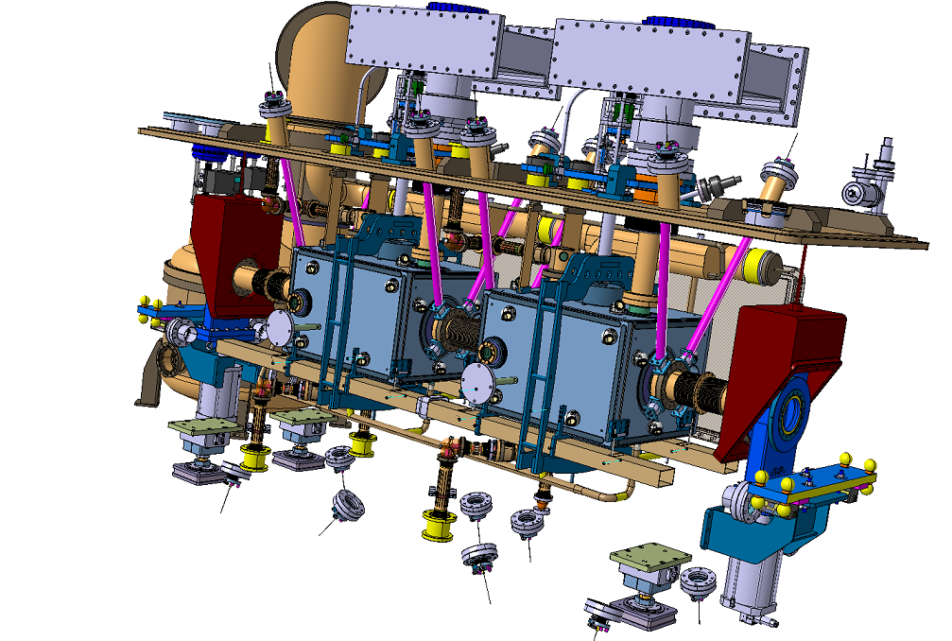
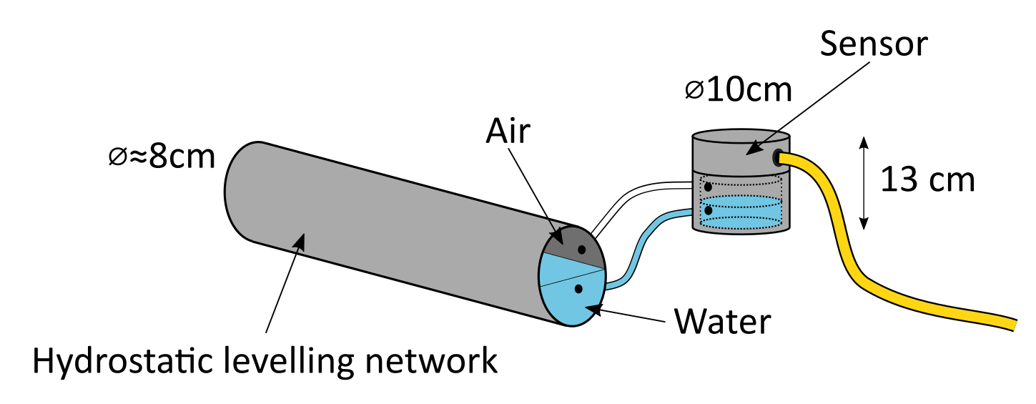
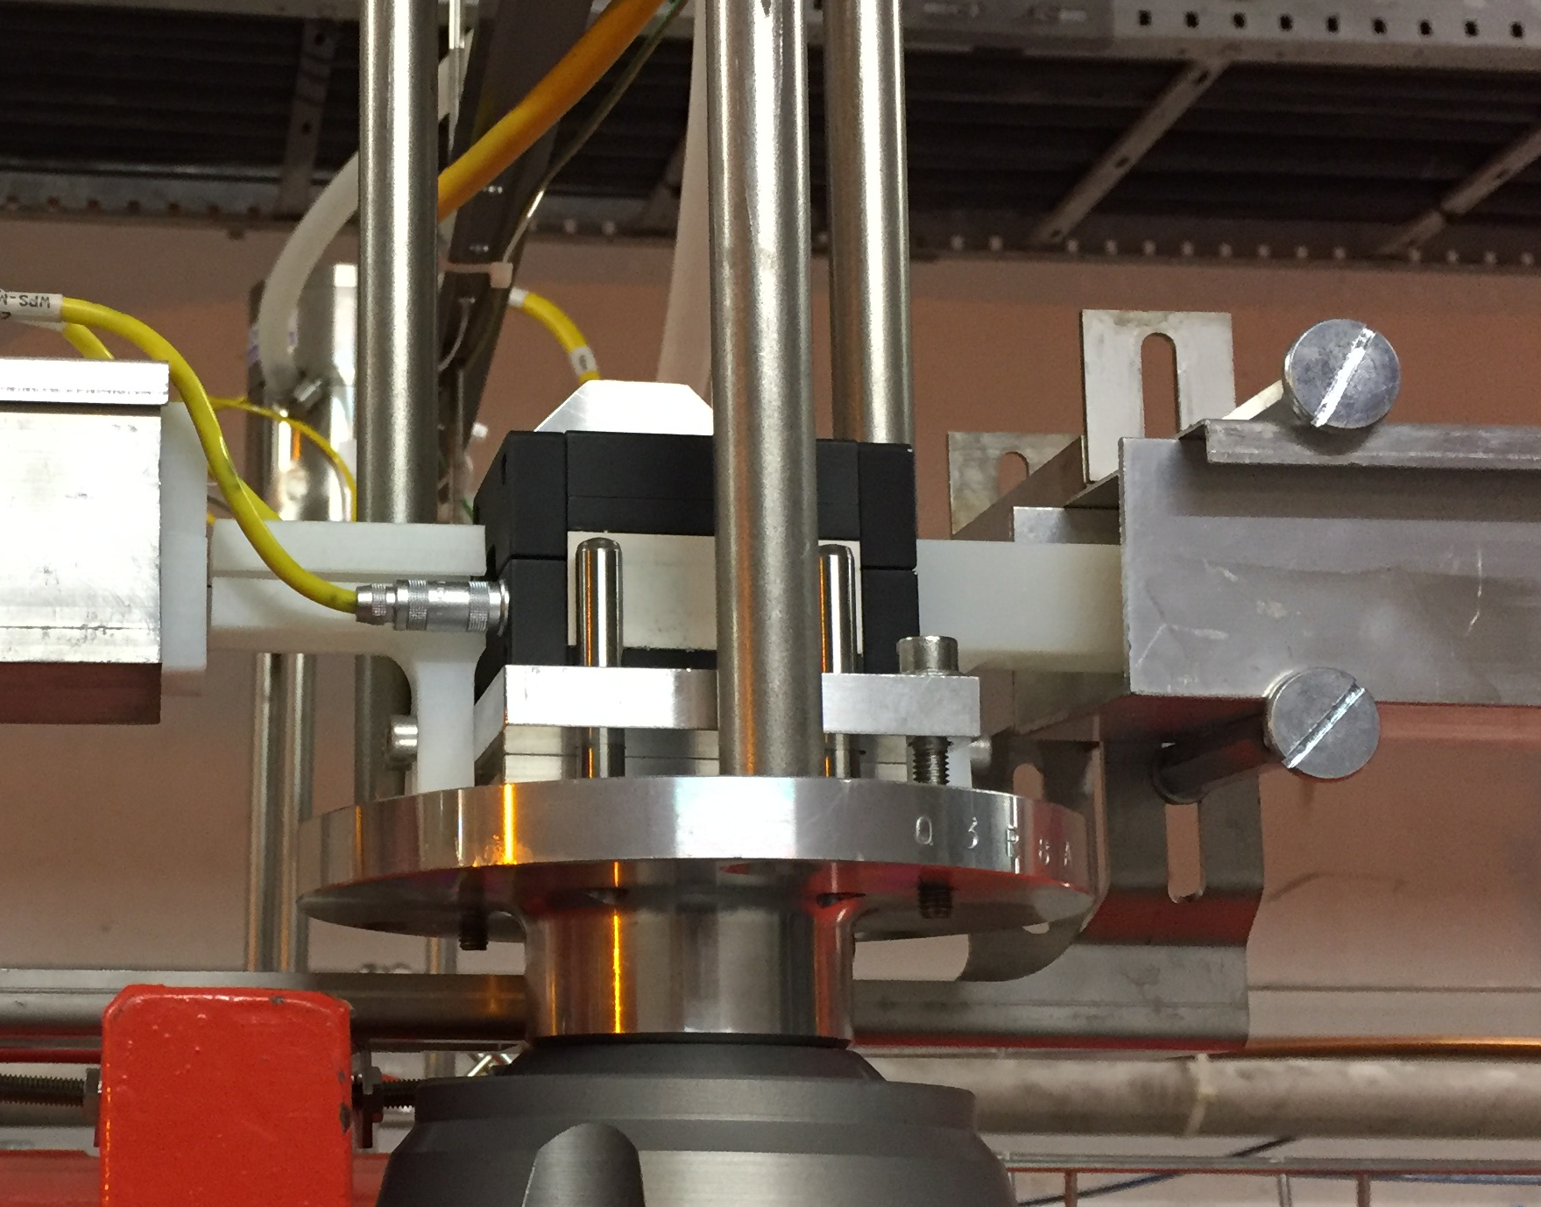
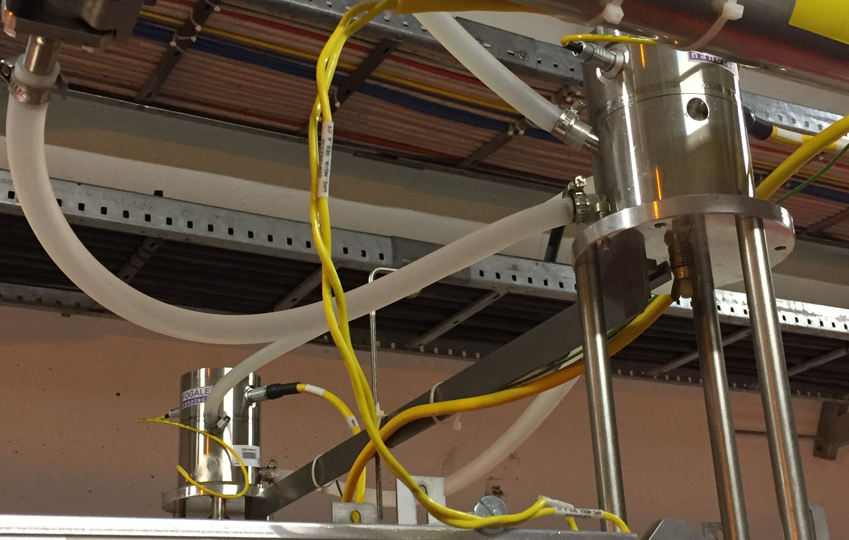
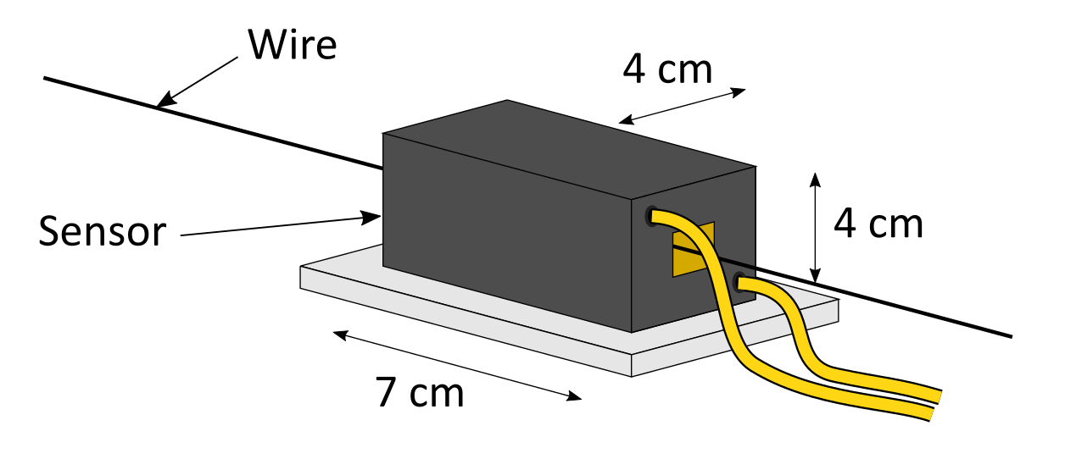
02/06/2023, BE-Seminar
Léonard WATRELOT, PhD student, BE-GM-HPA
10
Can existing sensors do the job ?
Gayde, J-Ch, and Kamugasa, S., "Evaluation of Frequency Scanning Interferometer Performances for Surveying, Alignment and Monitoring of Physics Instrumentation." (2018): WEPAF069.
HIE-ISOLDE alignment and system, technical design and project status, J.-C. Gayde, 2012.
BCAM, Open Source Instrument
Hydrostatic Leveling System (HLS)
Wire Positioning Sensor (WPS)
M. Sosin, A. Herty, J. Rutkowski on behalf of GM-HPA Team
WP15.4 Sensor review, 2021.07.06

Slide 12
02/06/2023, BE-Seminar
Léonard WATRELOT, PhD student, BE-GM-HPA
10
Can existing sensors do the job ?
Gayde, J-Ch, and Kamugasa, S., "Evaluation of Frequency Scanning Interferometer Performances for Surveying, Alignment and Monitoring of Physics Instrumentation." (2018): WEPAF069.
Radiations
HIE-ISOLDE alignment and system, technical design and project status, J.-C. Gayde, 2012.
BCAM, Open Source Instrument
Hydrostatic Leveling System (HLS)
Wire Positioning Sensor (WPS)
M. Sosin, A. Herty, J. Rutkowski on behalf of GM-HPA Team
WP15.4 Sensor review, 2021.07.06

Slide 13
02/06/2023, BE-Seminar
Léonard WATRELOT, PhD student, BE-GM-HPA
10
Can existing sensors do the job ?
Gayde, J-Ch, and Kamugasa, S., "Evaluation of Frequency Scanning Interferometer Performances for Surveying, Alignment and Monitoring of Physics Instrumentation." (2018): WEPAF069.
Radiations
HIE-ISOLDE alignment and system, technical design and project status, J.-C. Gayde, 2012.
BCAM, Open Source Instrument
Hydrostatic Leveling System (HLS)
Wire Positioning Sensor (WPS)
Infrastructure required
M. Sosin, A. Herty, J. Rutkowski on behalf of GM-HPA Team
WP15.4 Sensor review, 2021.07.06

Slide 14
02/06/2023, BE-Seminar
Léonard WATRELOT, PhD student, BE-GM-HPA
10
Can existing sensors do the job ?
Gayde, J-Ch, and Kamugasa, S., "Evaluation of Frequency Scanning Interferometer Performances for Surveying, Alignment and Monitoring of Physics Instrumentation." (2018): WEPAF069.
Radiations
HIE-ISOLDE alignment and system, technical design and project status, J.-C. Gayde, 2012.
BCAM, Open Source Instrument
Hydrostatic Leveling System (HLS)
Wire Positioning Sensor (WPS)
Early design
Infrastructure required
M. Sosin, A. Herty, J. Rutkowski on behalf of GM-HPA Team
WP15.4 Sensor review, 2021.07.06

Slide 15
02/06/2023, BE-Seminar
Léonard WATRELOT, PhD student, BE-GM-HPA
10
Other sensor technology share the same limitations (inductive, ultrasonic …)
Can existing sensors do the job ?
Underlined by the absence of solutions from the CLIC and ILC projects
Gayde, J-Ch, and Kamugasa, S., "Evaluation of Frequency Scanning Interferometer Performances for Surveying, Alignment and Monitoring of Physics Instrumentation." (2018): WEPAF069.
Radiations
HIE-ISOLDE alignment and system, technical design and project status, J.-C. Gayde, 2012.
BCAM, Open Source Instrument
Hydrostatic Leveling System (HLS)
Wire Positioning Sensor (WPS)
Early design
Infrastructure required
M. Sosin, A. Herty, J. Rutkowski on behalf of GM-HPA Team
WP15.4 Sensor review, 2021.07.06

Slide 16
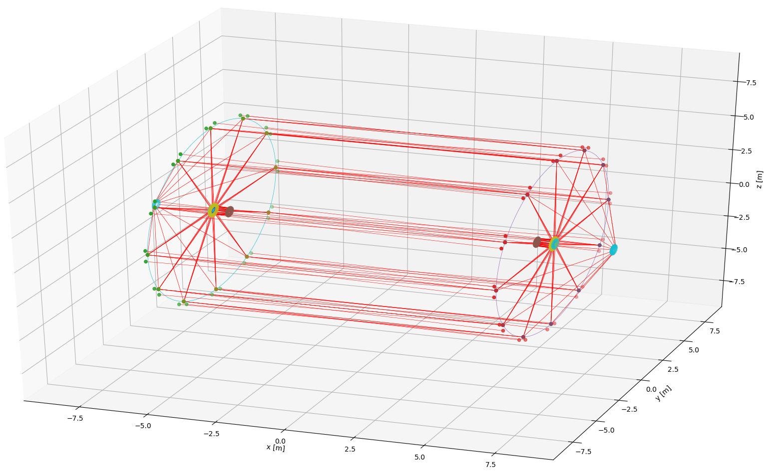
02/06/2023, BE-Seminar
Léonard WATRELOT, PhD student, BE-GM-HPA
11
Proposition of a strategy for the alignment and monitoring of the MDI
Alignment and monitoring system composed of :
  External alignment system
  Internal alignment system
FCC-ee QC1
Design by M. Koratzinos
QC2L
Goals :
Monitor an interface at the end of QC1 to retrieve the position of internal component (monitored thanks to the internal monitoring system).
Monitor the alignment between QC1 and QC2.
Monitor the alignment between the inner components and the experiment solenoid.
Monitor the alignment between the two sides of the experiment.
QC1L
QC1R
QC2R

Slide 17


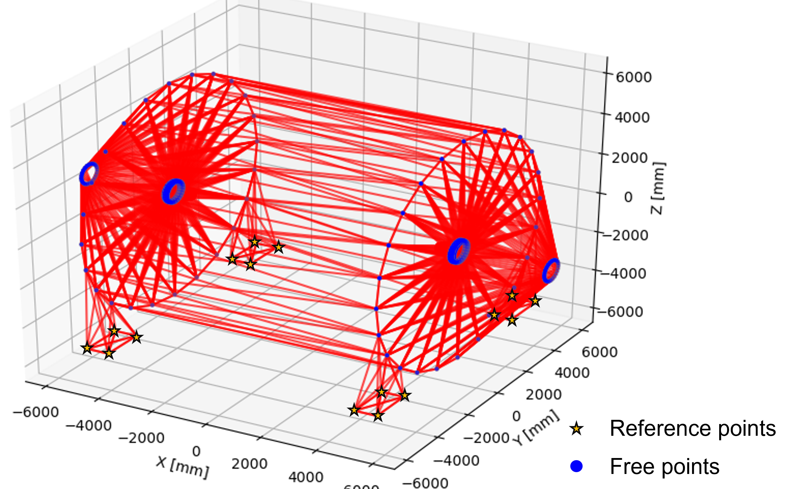
02/06/2023, BE-Seminar
Léonard WATRELOT, PhD student, BE-GM-HPA
12
External alignment and monitoring system
Permanent network of interferometric distance measurements based on Frequency Scanning Interferometry (FSI).
Goals :
Monitoring of the interface at the end of QC1
Monitor the alignment between QC1 and QC2.
Monitor the alignment between the inner components and the experiment solenoid.
Monitor the alignment between the two sides of the experiment.
Optimal network : too much measurements, some (plenty) wont be possible.
Any update on the design would be much welcomed.

Slide 18
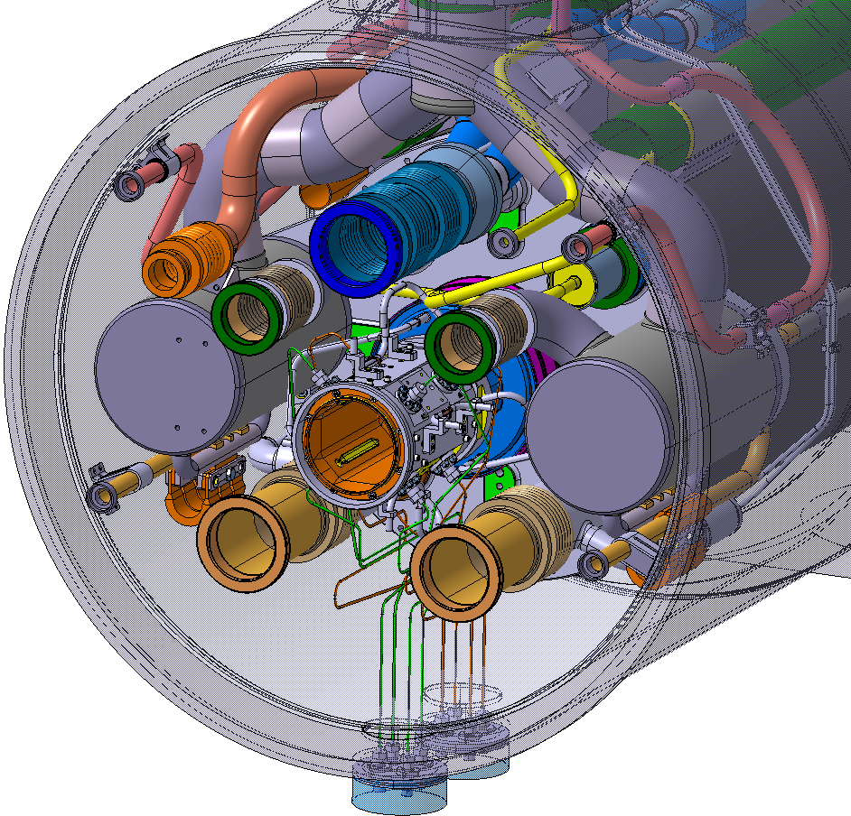
02/06/2023, BE-Seminar
Léonard WATRELOT, PhD student, BE-GM-HPA
13
Internal alignment system
Goal : monitor the deformation extremely precisely over the length of the assembly
Create a network of points accurate enough so another system can measure from it onto the inner components
Interface
Seems not possible to cross or put a hole here for the monitoring system (and numerous holes would be required)

Slide 19
02/06/2023, BE-Seminar
Léonard WATRELOT, PhD student, BE-GM-HPA
13
Internal alignment system
Goal : monitor the deformation extremely precisely over the length of the assembly
Create a network of points accurate enough so another system can measure from it onto the inner components
Interface
So we need to take the long way from the extremity and create a stable reference
Seems not possible to cross or put a hole here for the monitoring system (and numerous holes would be required)

Slide 20
02/06/2023, BE-Seminar
Léonard WATRELOT, PhD student, BE-GM-HPA
13
Internal alignment system
Goal : monitor the deformation extremely precisely over the length of the assembly
Create a network of points accurate enough so another system can measure from it onto the inner components
Interface
So we need to take the long way from the extremity and create a stable reference
Seems not possible to cross or put a hole here for the monitoring system (and numerous holes would be required)
Once we have a well monitored network, we can measure the objects inside

Slide 21
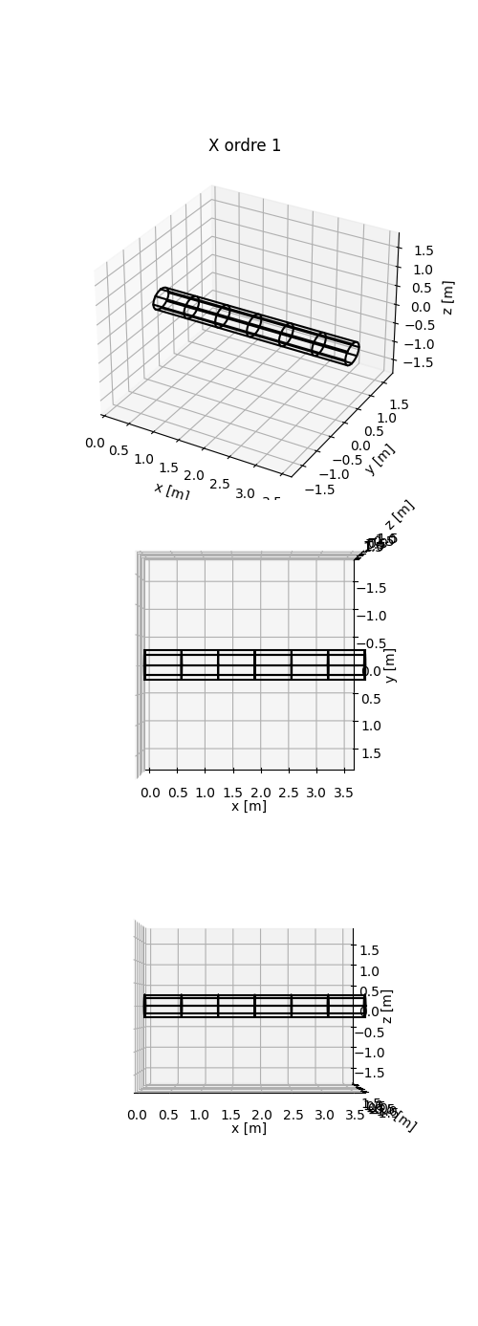
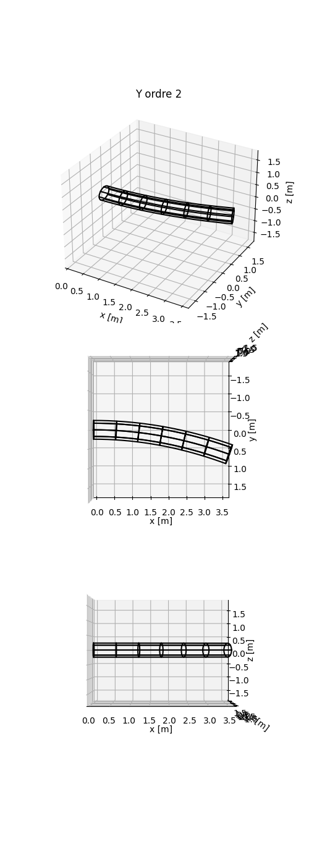
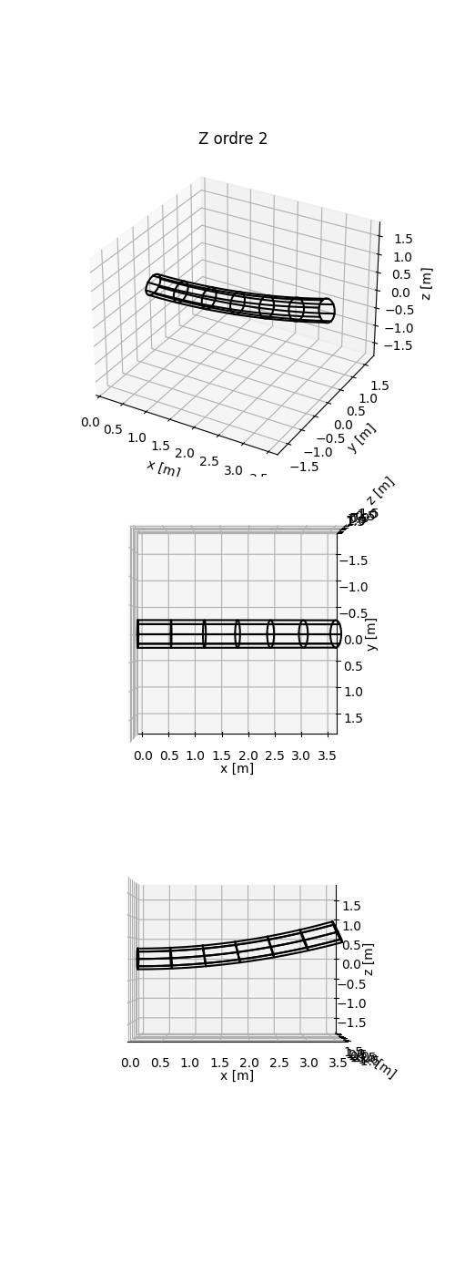
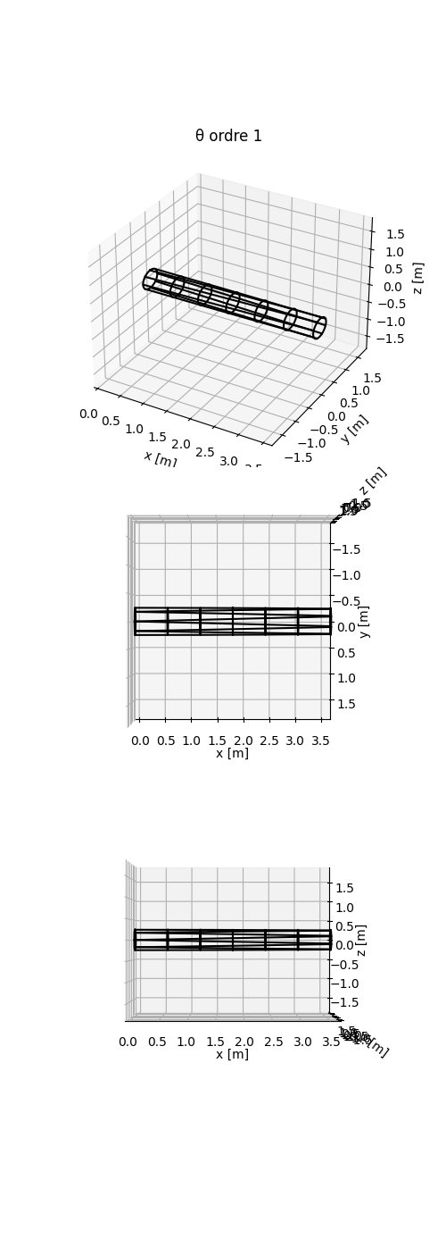
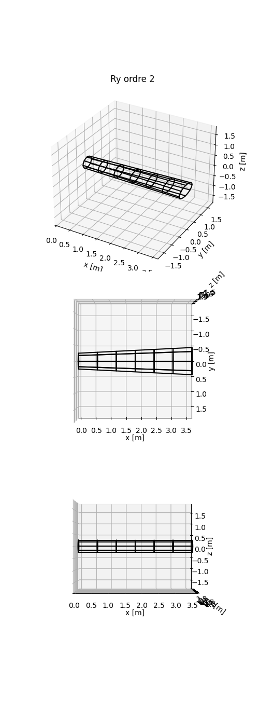
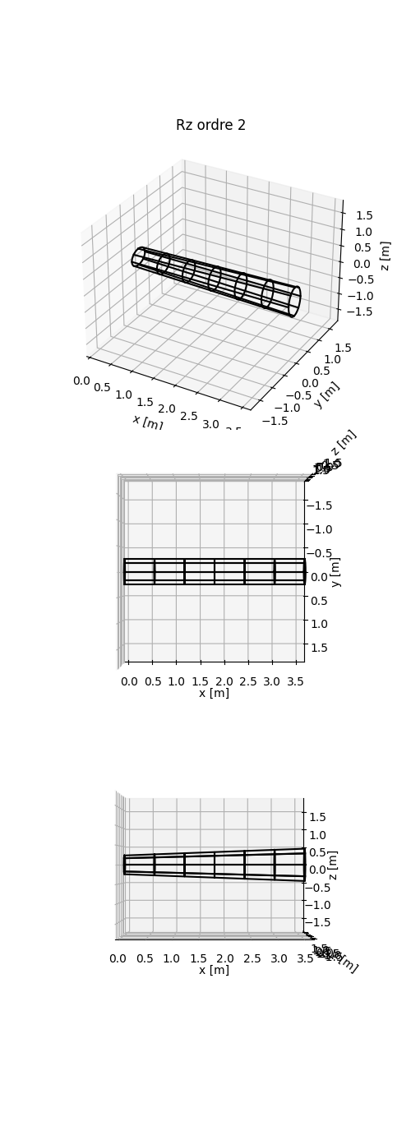
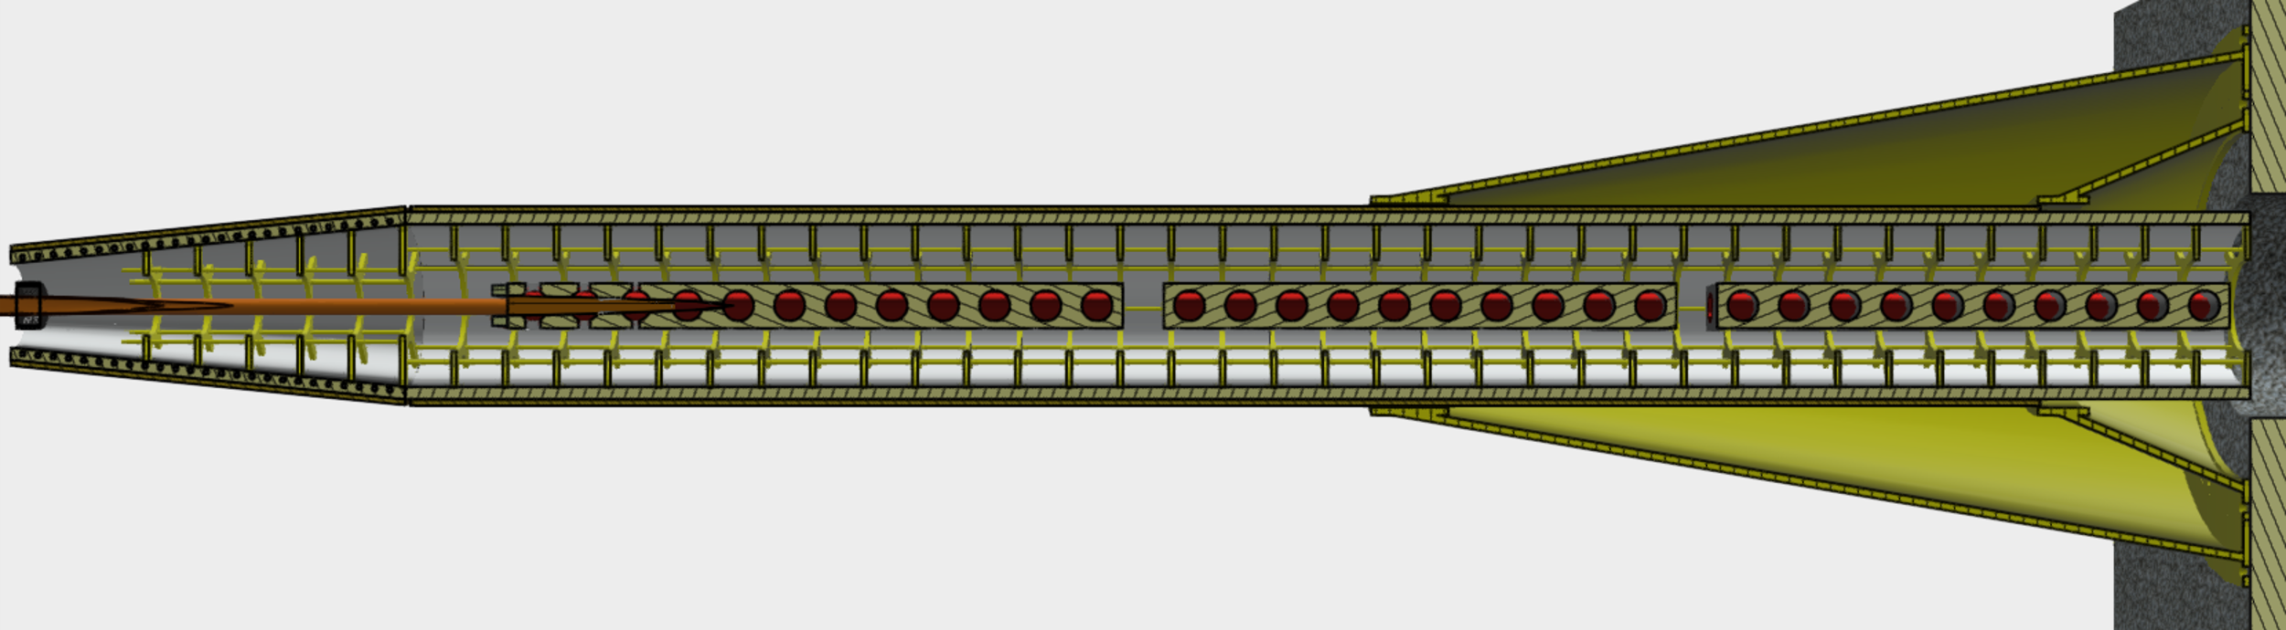
02/06/2023, BE-Seminar
Léonard WATRELOT, PhD student, BE-GM-HPA
14
  Deformation models
Internal alignment system
Goal : monitor the deformation extremely precisely ove the length of the assembly
Create a network of points accurate enough so another system can measure from it onto the inner components
Deformation monitoring system + distance measurement system
Cylinder of which the deformation is well known and from which we will measure the inner components
Design by M. Koratzinos
Measurement on the inner components
Measurement system waiting for design update.

Slide 22
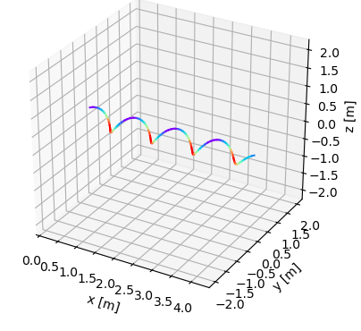
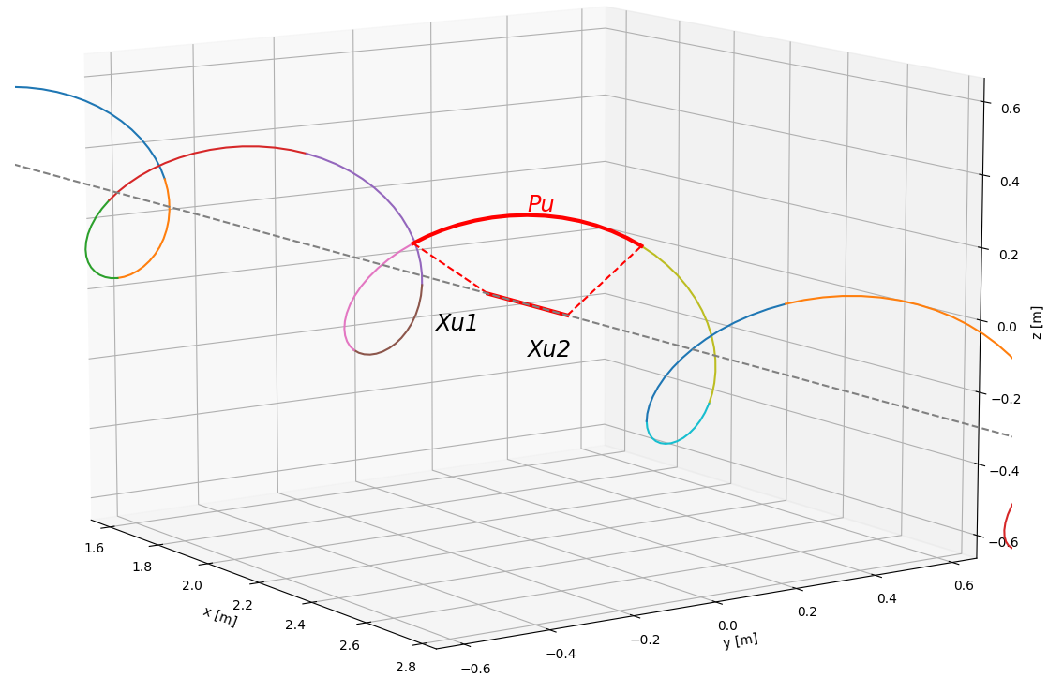
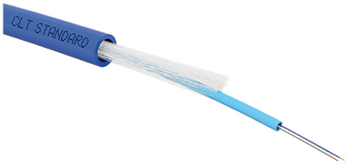
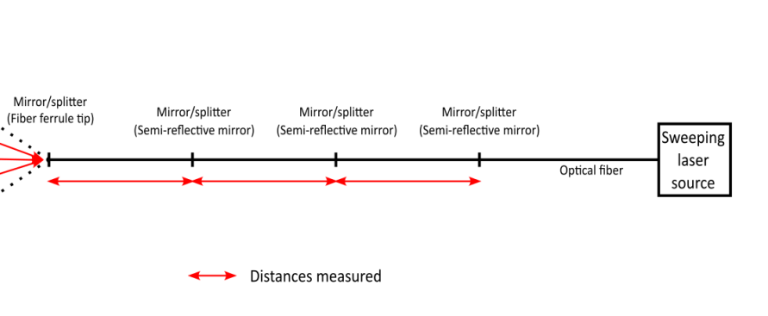
02/06/2023, BE-Seminar
Léonard WATRELOT, PhD student, BE-GM-HPA
15
https://iopscience.iop.org/article/10.1088/1361-6501/acc6e3
Deformation monitoring
Optical fiber placed in a helix shape, separated in portion by semi-reflective mirrors, which can be simultaneously and independently measured
Helixes defined by their length, radius, step, number and position of portions
Two technology available for such measurements :
  SOFO (Surveillance d’Ouvrage par Fibre Optique) (locked at a prototype state)
  In-line multiplexed and distributed FSI measurement (in development at CERN)

Slide 23
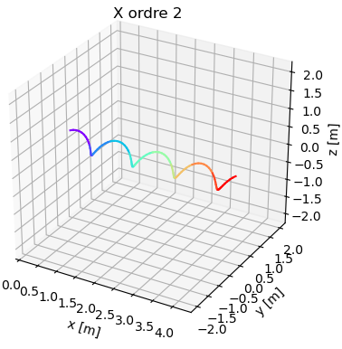
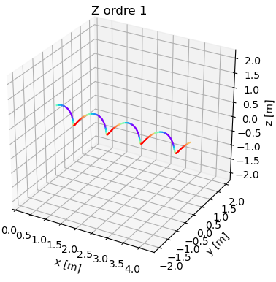
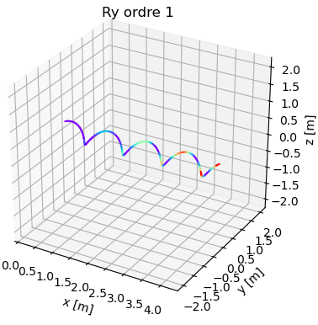
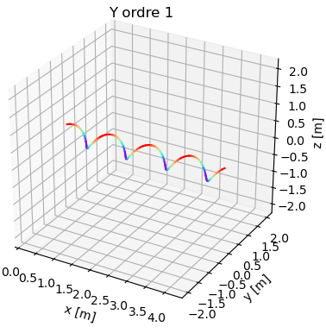

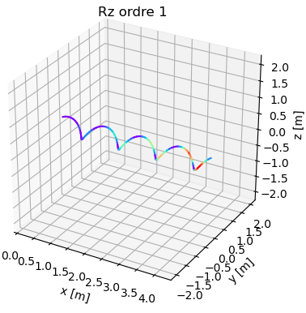
02/06/2023, BE-Seminar
Léonard WATRELOT, PhD student, BE-GM-HPA
16
https://iopscience.iop.org/article/10.1088/1361-6501/acc6e3
Deformation monitoring
Ø
Ø

Slide 24
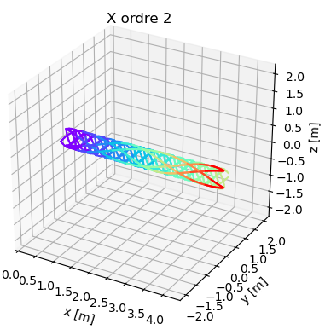
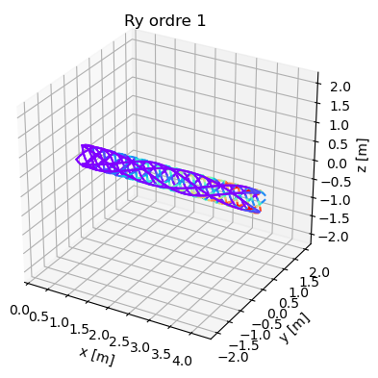
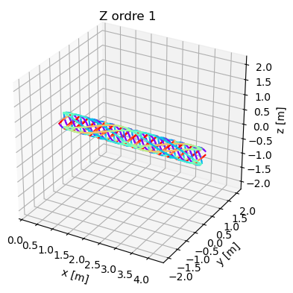
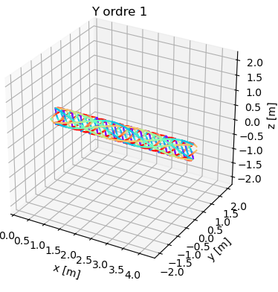
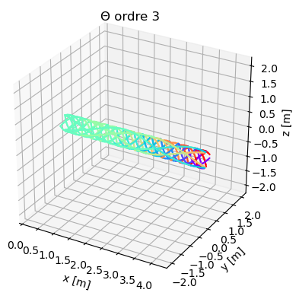

02/06/2023, BE-Seminar
Léonard WATRELOT, PhD student, BE-GM-HPA
17
https://iopscience.iop.org/article/10.1088/1361-6501/acc6e3
Deformation monitoring
Ø
Ø

Slide 25
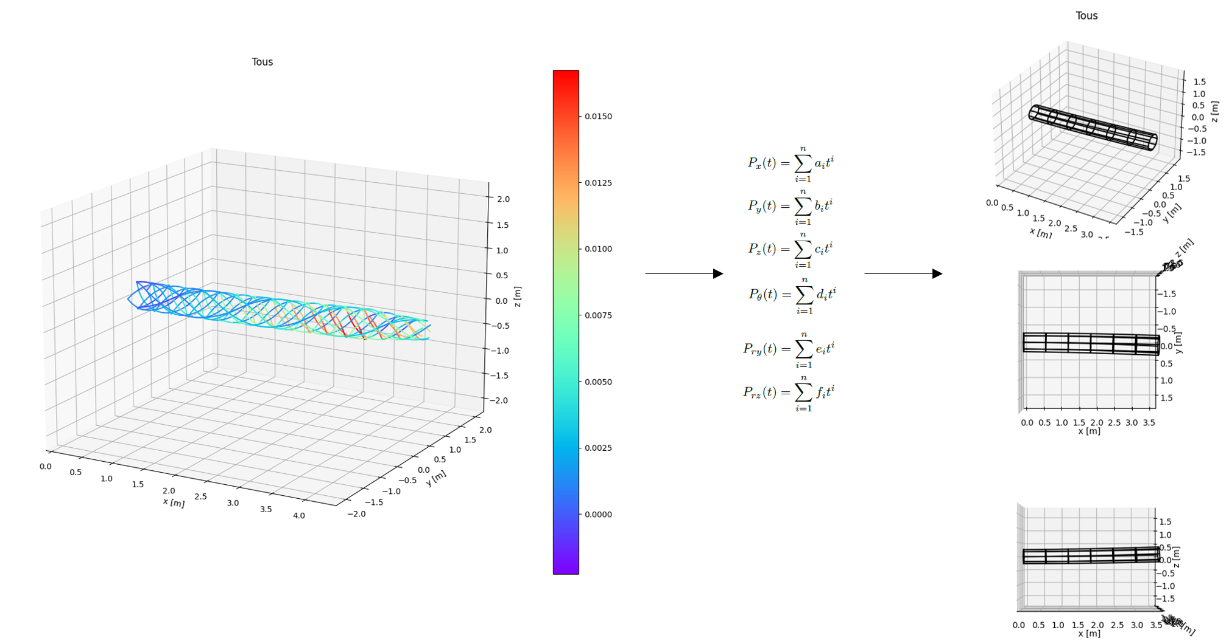
02/06/2023, BE-Seminar
Léonard WATRELOT, PhD student, BE-GM-HPA
18
https://iopscience.iop.org/article/10.1088/1361-6501/acc6e3
Cylinder deformations
Deformation monitoring
Least square adjustment
Helixes observations
(= 3D lengths of portions)
+ equation of portion length as function of the deformation polynomials
Simulations shown micrometric accuracy
To be confirmed by a prototype

Slide 26
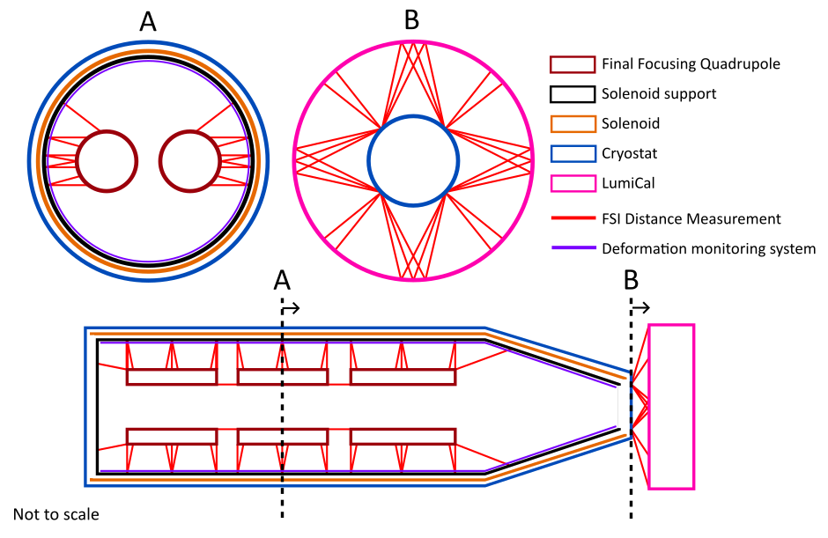
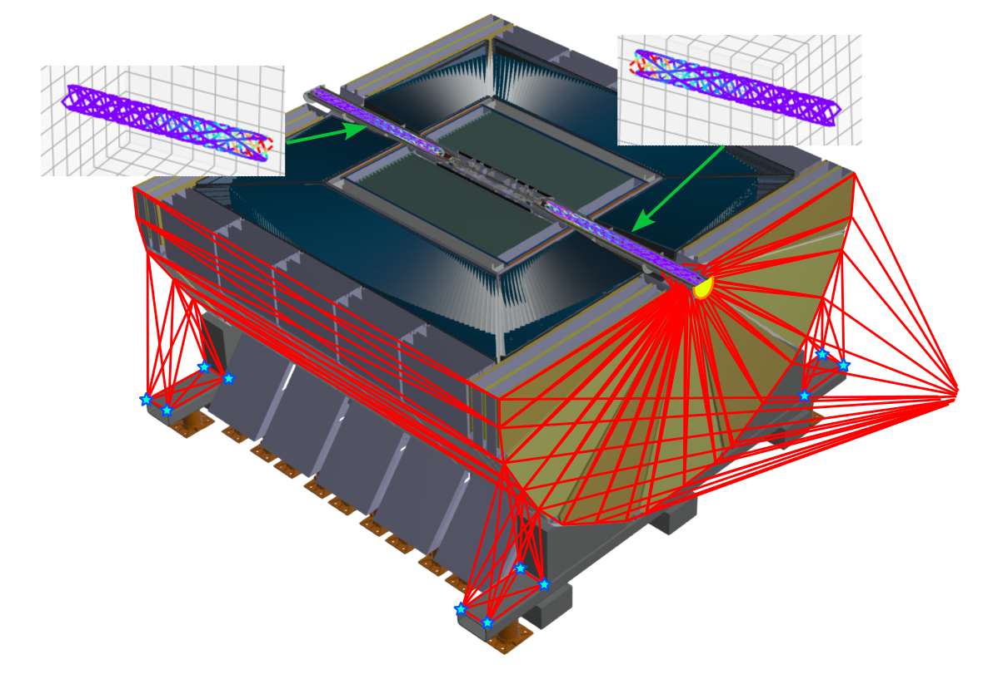
02/06/2023, BE-Seminar
Léonard WATRELOT, PhD student, BE-GM-HPA
19
Full alignment and monitoring system
Simulations shown micrometric accuracy for the alignment between final focusing quadrupoles on both sides.
To be refined with upcoming updates of the detector design.

Slide 27
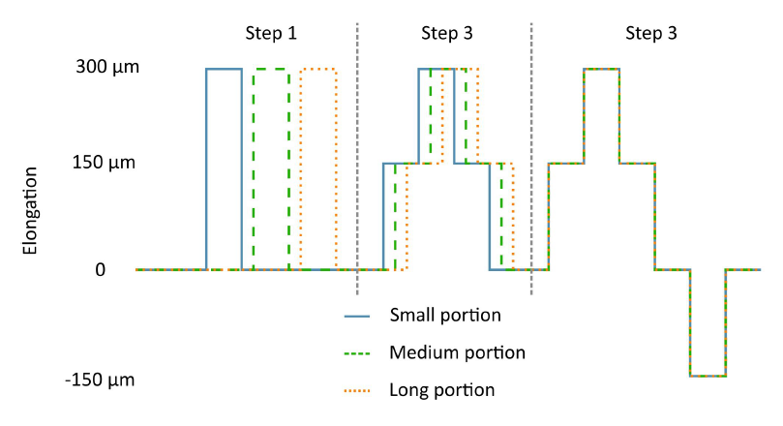
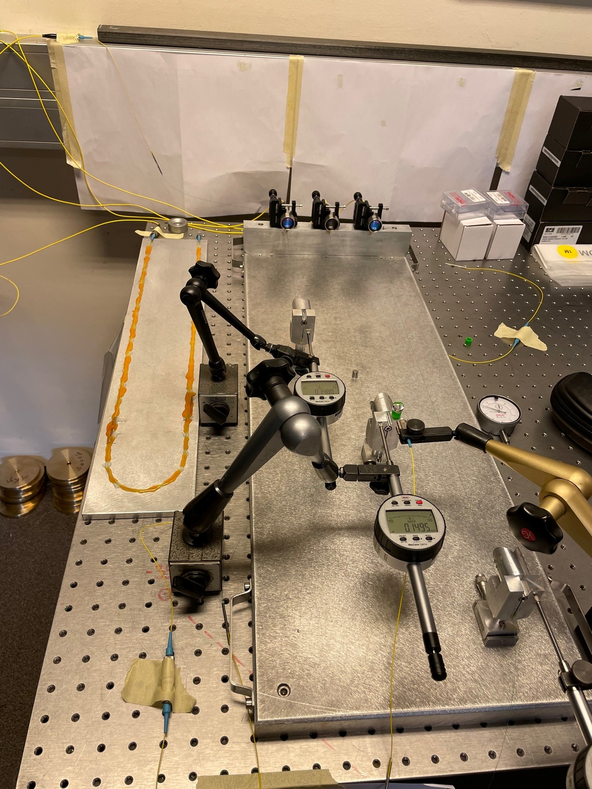





02/06/2023, BE-Seminar
Léonard WATRELOT, PhD student, BE-GM-HPA
20
Prototype testing
A
Deformation test
A
B
C
B
D
C

Slide 28




02/06/2023, BE-Seminar
Léonard WATRELOT, PhD student, BE-GM-HPA
21
Alignment strategy proposal
The MDI alignment system could be seen as a standalone backbone, on which sub-system alignment systems could connect.
Gibson, S. M., et al. "Monitoring the heart of ATLAS using Frequency Scanning Interferometry." Proceedings of the Eighth International Workshop on Accelerator Alignment, CERN, Geneva. 2004.
Aefsky, S., et al. "The optical alignment system of the ATLAS muon spectrometer endcaps." Journal of Instrumentation 3.11 (2008): P11005.
- Layout of the alignment system in the silicon detector modules in the ATLAS SemiConductor Tracker.
- Use of Frequency Scanning Interferometry.
- Relative alignment of the detector parts up to bellow 50µm
- Layout of the alignment system in one muon spectrometer endcap.
- Use of optical alignment systems.
- Relative alignment of the detector parts up to bellow 100µm
Thanks to the detectors it is possible to measure the position of the IP and/or the position of the beam (relatively accurately with respect to the detector part)
This could be linked with the alignment system installed on the accelerator, allowing to link the position of the IP, the LumiCals and the FFQ.
Would be a win-win to link with relative measurement the machine and the detector (especially for the dense FCC-ee MDI).

Slide 29


02/06/2023, BE-Seminar
Léonard WATRELOT, PhD student, BE-GM-HPA
22
The EUCLID VIS Read-out Shutter Unit, which will operate in space (very similar to conditions inside the MDI)
Re-adjustment system
Interest of having a system able to move one or multiple element without requiring to disassemble the entire QC1 ?
Not necessary to be accurate at 10 μm, a system able to correct major displacements ~0.2 mm to 1mm (due to transport, gravity deformation, movement during cool down, intense magnetic fields …) would be already extremely convenient.
Not necessary to work at cryogenic temperatures only at room temperature would be already extremely convenient.
Not necessary to be able to work during the run of the machine, during shut downs would be already extremely convenient.
Larchevêque, C., et al. "The Euclid VIS read-out shutter unit: a low disturbance mechanism at cryogenic temperature." arXiv preprint arXiv:1801.07496 (2018).
Universal Alignment Platform Tests, Kacper Widuch, Vivien Rude BE-GM-HPA 2021-03-11
A lot of possibilities are open, from the system working only at warm temperature allowing a re-adjustment to the 0,1mm level of major components at the end of shut downs, to the system able to realign in real time and during the run of the machine the cold components to the micrometer level.
Systems to work in these conditions exist, the difficulty is to quantify their advantage compared to a loss of luminosity due to any misquantified misalignment value or to the need to dismount, disassemble, realign, reassemble and remount the assembly.

Slide 30
02/06/2023, BE-Seminar
Léonard WATRELOT, PhD student, BE-GM-HPA
23
Conclusion
Listing of the challenges in the FCC-ee MDI
Study of existing systems in similar MDI
Study of existing sensors
Proposition for a new system
  External alignment system
  Internal alignment system
Simulations
Prototype testing
Discussion

Slide 31
Thank you for your attention
02/06/2023, BE-Seminar
Léonard WATRELOT, PhD student, BE-GM-HPA
24
Notes:
Sources :

Slide 32
Spares
02/06/2023, BE-Seminar
Léonard WATRELOT, PhD student, BE-GM-HPA
25
Notes:
Sources :

Slide 33

02/06/2023, BE-Seminar
Léonard WATRELOT, PhD student, BE-GM-HPA
26
Coordinate system definition
Deformations are defined in the (O, 𝑂𝑥, 𝑂𝑦, 𝑂𝑧) Euclidean system linked to the interface plate, shown in Figure 11. The origin of this system is the centre of the plate, the 𝑂𝑥 is perpendicular to the plate (and ideally is the bisector of the crossing angle between the two beams), 𝑂𝑦 is the intersection of the plane of the plate and the plane formed by the incoming and outgoing beams and 𝑂𝑧 is the last vector in order to form an oriented orthogonal system.
z
x
y

Slide 34







02/06/2023, BE-Seminar
Léonard WATRELOT, PhD student, BE-GM-HPA
27
Deformation model
Polynomial (classic model, easy to manipulate)
6 polynomial of degree 4
  Elongation
  Radial deformation (horizontal)
  Radial deformation (vertical)
  Torsion
  Radius deformation (horizontal)
  Radius deformation (vertical)

Slide 35









02/06/2023, BE-Seminar
Léonard WATRELOT, PhD student, BE-GM-HPA
28
Deformation monitoring : distance measurements
Gayde, J-Ch, and Kamugasa, S., "Evaluation of Frequency Scanning Interferometer Performances for Surveying, Alignment and Monitoring of Physics Instrumentation." (2018): WEPAF069.
Advantages :
- Usual distance measurement
- Rather simple equations
Disadvantages :
- Takes a lot a space in the cryostat
Rather difficult to implement
Lot of R&D required
It has been put aside for now as it is less realistic than the other system and easier to come back on if needed (simpler equations)

Slide 36



02/06/2023, BE-Seminar
Léonard WATRELOT, PhD student, BE-GM-HPA
29
Additional implementation : multiple helixes and realistic intersection
X
Automatic intersection computation and automatic modification of the radius for helixes going above another one.
Automatic position determination of the retroreflectors along the fibers, in order to have different lengths and a homogeneous coverage along the cylinder length.

Slide 37


02/06/2023, BE-Seminar
Léonard WATRELOT, PhD student, BE-GM-HPA
30
“Final Focusing quads misalignment (QC1_1-QC1_3 and QC2_1-QC2_2) (if not respected, beams do not collide):
  Geodesy : transverse shift of FF quads with sigma xy= 25µm
  vibrations : transverse shift of FF quads with sigma xy= 0.1µm
IR BPM misalignment (if not respected, beams do not collide) :
  geodesy : transverse shift of BPM with sigma xy= 25µm
  vibrations : errors of BPM reading with sigma xy= 0.1µm”
Known precision requirements for the inner components
“ The distance between the two calorimeters has to be measured to 110 µm”
“Distance LumiCal/ nominal IP to be controlled/ measured to ~50µm level”
“IR quadrupoles and sextupoles (75µm in radial and longitudinal, 100µrad roll), BPM (40µm in radial and 100µrad for the roll relative to quadrupole placement).”
Drawing by Mike Koratzinos
“Internal misalignment should be better than 30µm”
“For a 1mrad tilt of the detector solenoid (wrt the rest of the system – beam, screening and compensation solenoid) the corresponding uncorrected distortion is unacceptably large.”
“Measurement of the component's position inside the detector is needed”
“Alignment accuracy of SC magnets = 100µm”

Slide 38


DAΦNE/KLOE MDI
03/02/2020, Technology for Nanobeam Workshop
Léonard WATRELOT, PhD student, BE-GM-HPA
31
L* = 0.3 m
$θ_{cross}$ = 50 mrad
Beam size :
${{\text{σ}}^{∗}}_{x}$ = 250 µm
${{\text{σ}}^{∗}}_{y}$ = 3.1 µm
${\text{σ}}_{z}$ = 15 mm
Alignment aim :
~ 100 µm
Alignment (strongly summarized)
1. Alignment of the elements on the girder (part of the cylinder) thanks to a laser tracker.
L. PELLEGRINO, MDI mechanical design, integration and assembly at DAFNE/KLOE with the crab-waist configuration, 3rd FCC-ee MDI workshop, 9-20 September 2019, CERN.
2. Installation of the cylinder inside the experiment, and re-alignment of the articulated cylinder thanks to laser tracker target supports and screws.
3. Occasional partial check, can’t be regular because of obstacles on the lines of sight of the laser tracker targets (cables, pipes …)
Luigi Pellegrino and Giancarlo Sensolini

Slide 39




SuperKEKB/Belle II MDI
03/02/2020, Technology for Nanobeam Workshop
Léonard WATRELOT, PhD student, BE-GM-HPA
32
L* = 1.22 m HER
$θ_{cross}$ = 83 mrad
Beam size :
${{\text{σ}}^{∗}}_{x}$ = 10.7µm
${{\text{σ}}^{∗}}_{y}$ = 0.062 µm
${\text{σ}}_{z}$ = 6 mm
Alignment aim :
~ 100 µm
Alignment (strongly summarized)
Pre-alignment of the components before installing them in the cryostat, fiducialization.
Alignment of the cryostat (QCS) with respect to the beam line.
Arimoto, Yasushi, et al. "Magnetic measurement with single stretched wire method on SuperKEKB final focus quadrupoles." IPAC'19, Melbourne, Australia, 19-24 May 2019
3. Installation of the cryostats inside the experiment.
4. Check of the position of the inner magnets thanks to the Single Stretched Wire (SSW) method coupled with capacitive measurement between the cryostat and the experiment before the run of the machine.
L* = 0.76 m LER
$θ_{cross}$ = 83 mrad
Beam size :
${{\text{σ}}^{∗}}_{x}$ = 10.1 µm
${{\text{σ}}^{∗}}_{y}$ = 0.048 µm
${\text{σ}}_{z}$ = 5 mm
Alignment aim :
~ 100 µm
Final correction on the beam thanks to corrector magnets.
Many thanks to Mika Masuzawa for all the information on SuperKEKB alignment.
N. Ohuchi, “Final-Focus Superconducting Magnets for SuperKEKB”, IPAC 18, 01/05/2018
Arimoto, Yasushi, et al. "Magnetic measurement with single stretched wire method on SuperKEKB final focus quadrupoles." IPAC'19, Melbourne, Australia, 19-24 May 2019

Slide 40








LHC/ATLAS MDI
03/02/2020, Technology for Nanobeam Workshop
Léonard WATRELOT, PhD student, BE-GM-HPA
33
L* = 23 m
$θ_{cross}$ < 200 µrad
Beam size :
${{\text{σ}}^{∗}}_{x}$ = 16.6 µm
${{\text{σ}}^{∗}}_{y}$ = 16.6 µm
${\text{σ}}_{z}$ = 7.5 cm
Summary of MDI challenges
L* = 23 m
$θ_{cross}$ = 285 µrad
Beam size :
${{\text{σ}}^{∗}}_{x}$ = 16.7 µm
${{\text{σ}}^{∗}}_{y}$ = 16.7 µm
${\text{σ}}_{z}$ = 75 mm
Alignment aim :
~ 100 µm
Alignment (strongly summarized)
Hydrostatic Leveling System (HLS)
Distance Offset Measurement Sensor (DOMS)
Wire Positioning Sensor (WPS)
Remotely Controlable Actuators

Slide 41



CLIC MDI
03/02/2020, Technology for Nanobeam Workshop
Léonard WATRELOT, PhD student, BE-GM-HPA
34
L* = 3.5 m 500 GeV
$θ_{cross}$ = 20 mrad
Beam size :
${{\text{σ}}^{∗}}_{x}$ = 0.202 µm
${{\text{σ}}^{∗}}_{y}$ = 0.0023 µm
${\text{σ}}_{z}$ = 0.072 mm
Alignment aim :
~ 10 µm
No solution found yet.
The problem has evolved throughout the years :
- Only one detector
- QD0 have been removed from the experiment
2 µm pre-alignment over 500m (L*=3,5m)
=> 10 µm pre-alignment over 500m (L*=3,5m)
=> 10 µm pre-alignment over 500m (L*=6,5m)
Proposed solution
QD0 sticks far in the detector and requires :
- stable support
- Power, cooling
- Antisolenoid
- Vacuum elements
- Access, connection disconnection
L* = 3.5 m 3TeV
$θ_{cross}$ = 20 mrad
Beam size :
${{\text{σ}}^{∗}}_{x}$ = 0.040 µm
${{\text{σ}}^{∗}}_{y}$ = 0.001 µm
${\text{σ}}_{z}$ = 0.044 mm
Alignment aim :
~ 10 µm
Attempt :
Monitoring QD0 thank to zerodur rods and optical alignment system inside the detector. But it was not shown to work.
CLIC Machine Detector Interface, MDI mini workshop, HKUST IAS, Philip Burrows on behalf of Lau Gatignon, 2020
Notes:
Sources :

Slide 42


ILC MDI
03/02/2020, Technology for Nanobeam Workshop
Léonard WATRELOT, PhD student, BE-GM-HPA
35
L* = 3.5 m 250 GeV
$θ_{cross}$ = 14 mrad
Beam size :
${{\text{σ}}^{∗}}_{x}$ = 0.516 µm
${{\text{σ}}^{∗}}_{y}$ = 0.0077 µm
${\text{σ}}_{z}$ = 0.300 mm
Alignment aim :
~ 20 µm
Introduction
Roman Poschl, (Selected) MDI Issues of ILD, MDI Workshop at IAS Conference, 01/2020, Hong Kong
L* = 3.5 m 500 GeV
$θ_{cross}$ = 14 mrad
Beam size :
${{\text{σ}}^{∗}}_{x}$ = 0.474 µm
${{\text{σ}}^{∗}}_{y}$ = 0.0059 µm
${\text{σ}}_{z}$ = 0.300 mm
Alignment aim :
~ 20 µm
Marcel Stanitzki, The SiD Detector – Machine Backgrounds, 01/2020, Hong Kong
Similar to the CLIC MDI :
- 2 detectors in push-pull configuration,
- 2 different L*, both < detector size
(And it is still the case)
- Alignment precision of 20 µm as requirement for QD0 prealignment system
Marcel Stanitzki, The SiD Detector – Machine Backgrounds, 01/2020, Hong Kong
Notes:
Sources :
Beam size, crossing angle : Aihara, Hiroaki, et al. "the international linear collider. A global project." arXiv preprint arXiv:1901.09829 (2019).
L* : ILC TDR vol.4
Alignment : Mark Jones, Alignment in the MDI area : CLIC, ILC and HL-LHC solutions as case studies for FCC-ee, FCC-ee MDI workshop 13/09/2019

Slide 43




14/06/2022, 2nd year CST presentation
Léonard WATRELOT, PhD student, BE-GM-HPA
36
Additional implementation
Variable step helixes
Helix installation error models
Ex : Smaller step as it goes forward inside the detector
Punctual step error, but catches with theoretical position
Allow to choose where to have more dense or more precise measurements
Model implemented and working
Punctual step error implying a offset for the rest of the helix length
Additional tests to be done (comparison between full variable step network, hybrid variable and fix step network, full fixed step network)
Easily seen in the least square adjustment residues (lot of redundancy)

Slide 44




14/06/2022, 2nd year CST presentation
Léonard WATRELOT, PhD student, BE-GM-HPA
37
FSI “in-fiber” prototype and first tests
First testing
A prototype of the “in-fiber” FSI have been build and a testing bench assembled to test it.
First tests have been done and additional ones are ongoing.
Gluing
Soldering
Ready to measure

Slide 45

14/06/2022, 2nd year CST presentation
Léonard WATRELOT, PhD student, BE-GM-HPA
38
FSI “in-fiber” prototype and first tests
A
B
C
D
A bench has been assembled
3 independent measuring portions + “regular” in-air measurement at the end
Verification thanks to regular FSI measurements
“Stability bench” made by gluing a fiber to an aluminium plate

Slide 46
14/06/2022, 2nd year CST presentation
Léonard WATRELOT, PhD student, BE-GM-HPA
39
FSI “in-fiber” prototype and first tests
A
A
B
C
B
D
C

Slide 47
14/06/2022, 2nd year CST presentation
Léonard WATRELOT, PhD student, BE-GM-HPA
40
FSI “in-fiber” prototype and first tests
A
Sag
A
B
C
B
D
C

Slide 48
14/06/2022, 2nd year CST presentation
Léonard WATRELOT, PhD student, BE-GM-HPA
41
FSI “in-fiber” prototype and first tests
A
A
B
C
B
D
Difference of refraction index between air and glass
C

Slide 49
14/06/2022, 2nd year CST presentation
Léonard WATRELOT, PhD student, BE-GM-HPA
42
FSI “in-fiber” prototype and first tests
Hyp. : fiber sliding in the protecting sleeve
A
A
B
C
B
D
C

