Slide 1
EP-DT Group Meeting
Welcome/Bienvenue!
June 16, 2022
Burkhard Schmidt

Slide 2
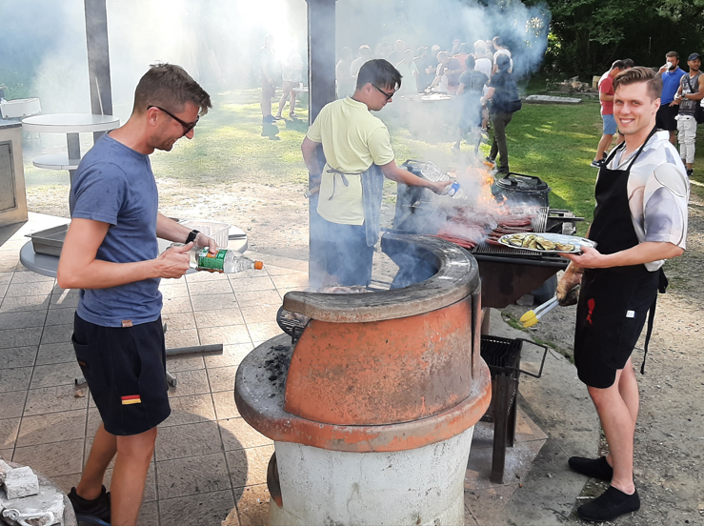
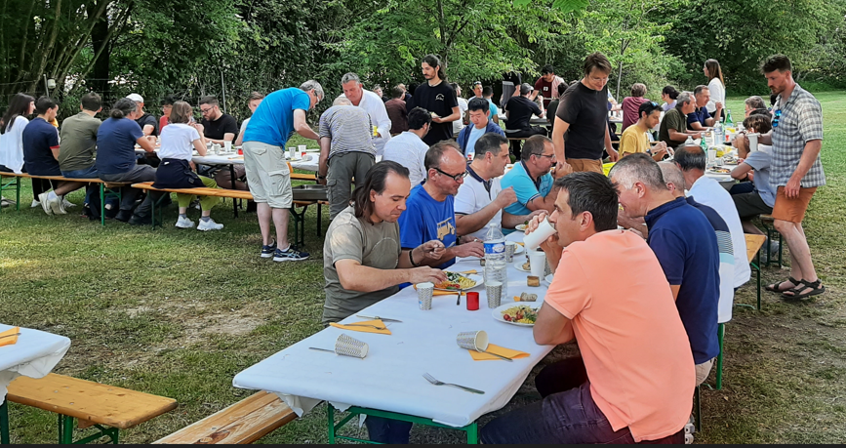
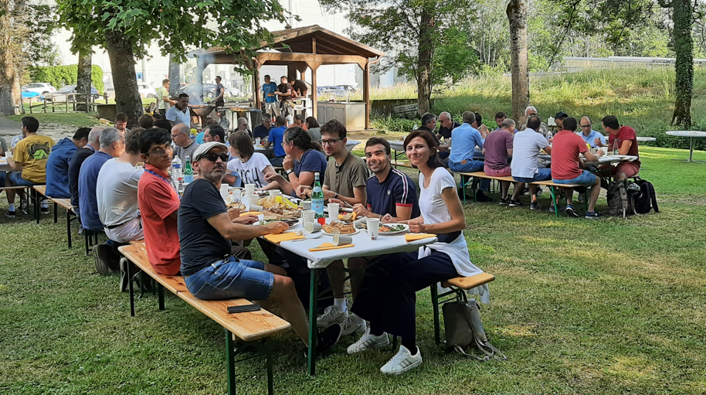
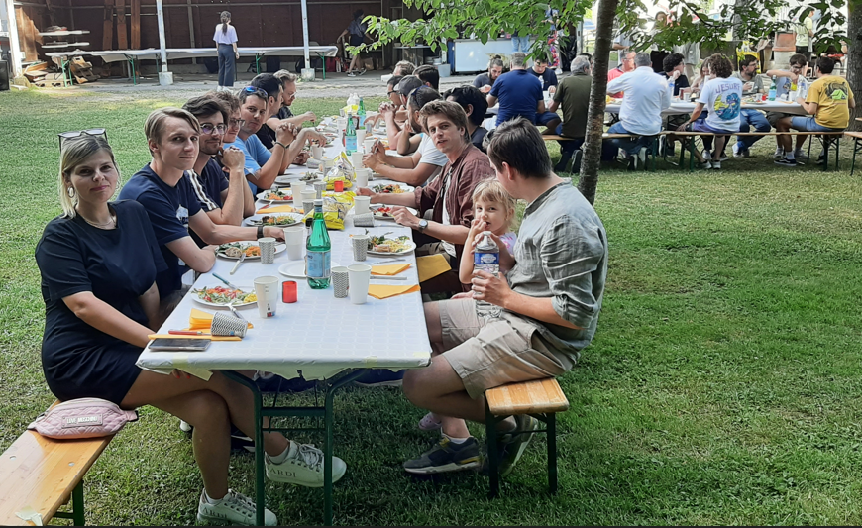
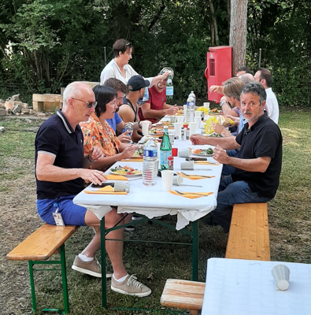
EP-DT Barbeque
Many thanks to all who contributed!

Slide 3
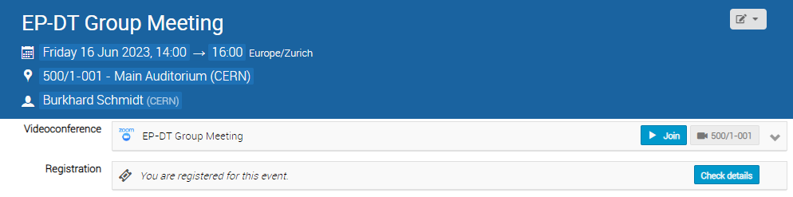
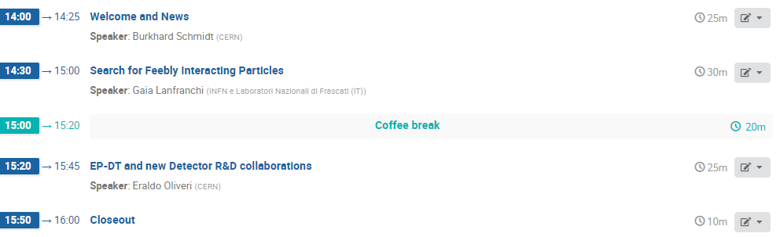

Slide 4
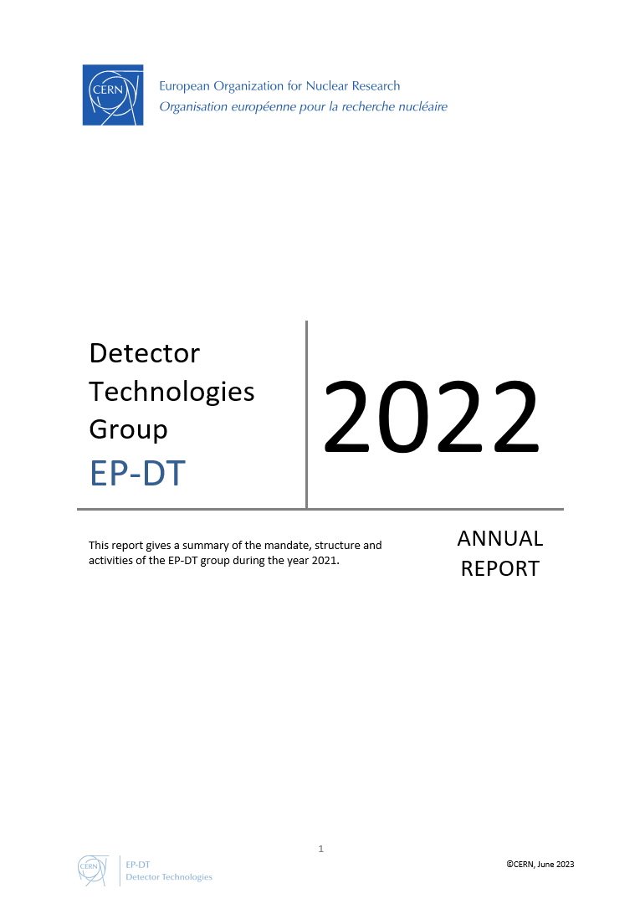
Outline
Overview of the EP-DT group composition
Some of the main activities of the group
on Projects to which we contribute
  Details can be fond in the EP-DT Annual Report
  to be released soon…
Things coming up
  News about building 140+
  Two-factor authentication
Concluding remarks

Slide 5
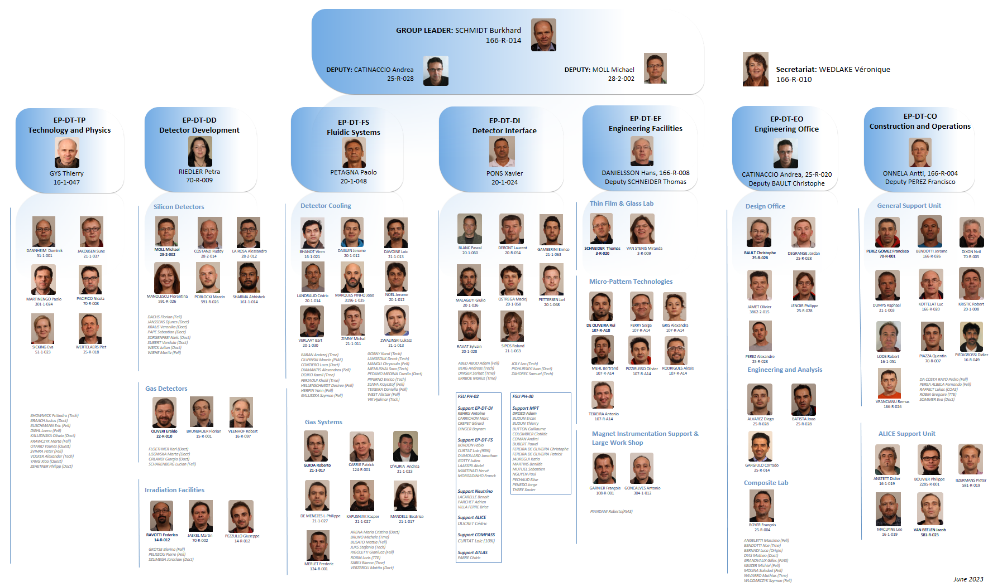
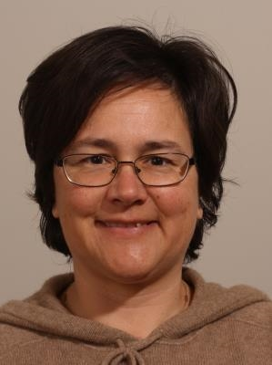
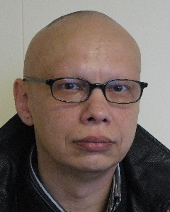
Organigram EP-DT Group
Many thanks to Giovanna for having led and contributed
to the DT-DI section so well over the past 7 years !
Many thanks to Leszek for having led and contributed
to the GDD and RD51 so well over the past 15 years !
http://ep-dep-dt.web.cern.ch

Slide 6
EP-DT Composition and Structure
Section | Persons
Technology &Physics (TP) SL: Thierry Gys | MPE: 13 MPA etc. 5
Detector Development (DD) SL: Petra Riedler | MPE: 18 MPA etc. 10
Fluidic Systems (FS) SL: Paolo Petagna | MPE: 28 MPA etc. 16
Detector Interface (DI) SL: Xavier Pons | MPE: 10 MPA etc. 6
Engineering Facilities (EF) SL: Hans Danielsson | MPE: 12 MPA etc. 1
Engineering Office (EO) SL: Andrea Catinaccio | MPE: 15 MPA etc. 4
Construction & Operations (CO) SL: Antti Onnela | MPE: 19 MPA etc. 2
Personnel | FTE 2023 (2022)
Staff | 84 (87)
Fellows / TTE | 31 (35)
PJAS/COAS | 3 (5)
Doct. Students | 20 (16)
Tech. Students | 11 (10)
Trainees | 9 (3)
FSU PH-02: FSU PH-40: | 16 (16) 16 (13)
Contributing Retirees | 6 (5)
Total | 196 (190)
Comments:
The number of Staff members is reduced slightly, but two more staff will be hired still this year
  1 Staff members (included in the counting) is on long term sick-leave
Many Fellows, DOCT and TECH are affiliated to DT, but are only partially on DT quota.
The Field Support Units PH-02 and PH-40 are crucial to fulfil our mission (~15% of workforce).

Slide 7
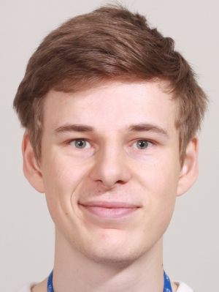
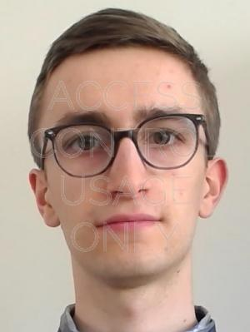
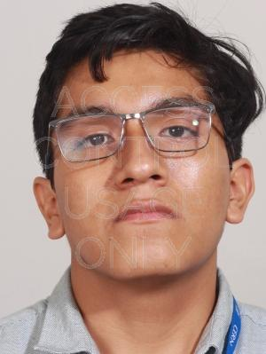
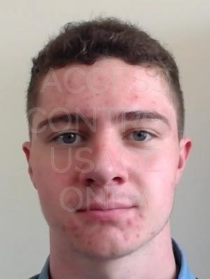
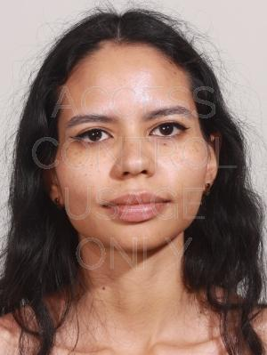
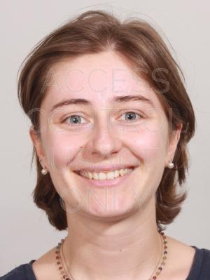
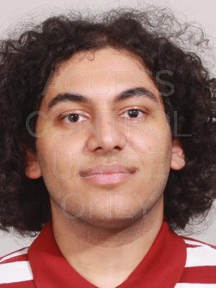
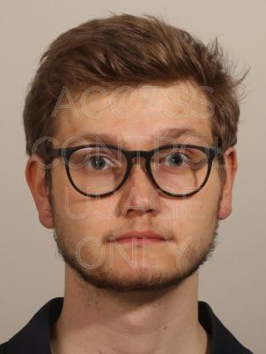
EP-DT Summer Students 2023
Juha William
NUMMI
01.06 to 31.08.
SV Fl. Brunbauer
Elias
St ONGE ARNQVIST
05.06. to 25.08
SV: Moritz WIEHE
Diego
VASQUEZ LEVANO
05.06 to 28.07.
SV: F. RAVOTTI
Zachary
ZAWISZA
12.06 to 11.08.
SV: M. KRAWCZYK
Maria
RAMOS
12.06. to 01.09.
SV: G. RIGOLETTI
Chiara
VOLPATO
12.06 to 08.09.
SV: F BRUNBAUER
Uzay Tan
ISLEK
12.06. to 08.09.
SV: G. RIGOLETTI
Jenan
AMER
19.06. to 11.08.
SV: LEENA DIEHL
Magnus
THOGERSEN
26.06. to 01.09
SV: Justus BRAACH
August Rumle
GERSHOLM BRASK
26.06. to 01.09
SV: K. FLOETHNER
Marianna
GLAZEWSKA
03.07. to 04.09.
SV: Eraldo OLIVERI
Mohammed
NECHIRAWAN
03.07 to 25.08
SV: A. ADEB ABUD
Welcome to EP-DT! We wish a very profitable time at CERN!
We have scheduled three sessions during the summer, in which you will have an opportunity to present your work: July 25, August 8 and August 22 (always AM)
  The aim is to have each time 4 presentations

Slide 8
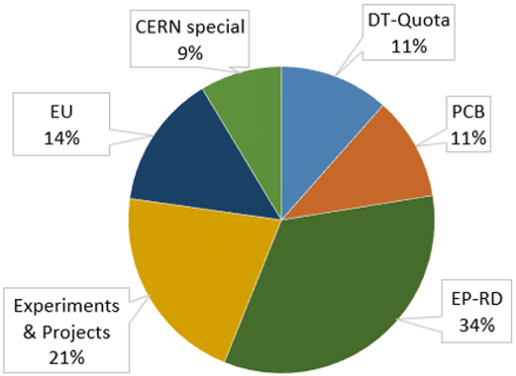
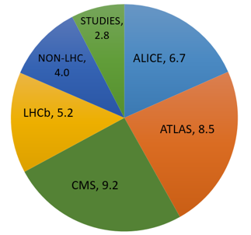
Activities of Staff and Fellows in EP-DT
Involvement of Staff and Fellows
In Projects
Funding Source of Fellows (w/o TTE)
Involvement in projects related to the upgrade of the LHC experiments is more than 80%.
The remaining 20% are shared equally between other experiments and project studies.
DT based Fellows (and Students) are mainly on non-DT resources
Very good collaboration with ATLAS, CMS, NA62 and NP for funding Fellows/Students
Fellows represent 50% of the resources for R&D
  Involvement of DT in EP R&D and the ECFA R&D Roadmap will be shown by Eraldo

Slide 9
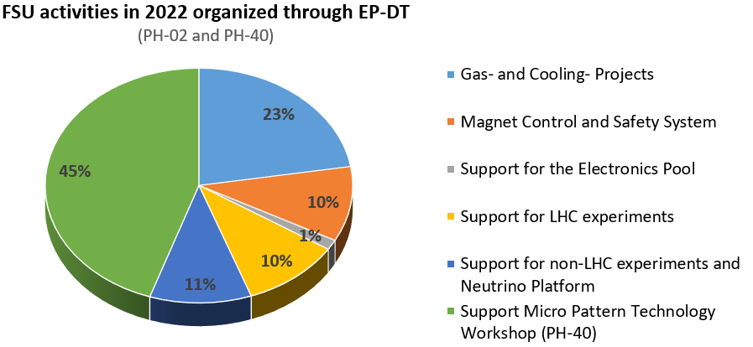
FSU Activities in EP-DT
Total of hours for 2022: ~55,000 hours (~30 FTE) for a cost of about 3 MCHF
FSUs are an important resource to respond to urgent needs of the experiments
A renewal of the contracts is needed as they are in place since 12 years
  A new contract, starting on July 1, is in place for the support of the MPT workshop
  The Invitation to Tender for PH-02 & PH-04 is still under preparation;
    The plan is to start with the new contract in January or April 2024

Slide 10
DT Staff involvement in Services
The involvement in services has been optimized over the past years (10% reduction).
A minimum of Staff involvement (~2FTE) is needed to keep a service operational.
Some of the services are crucial for the world-wide detector physics community, e.g.
the MPT workshop, the Irradiation Facilities, the magnetic field measurement service etc.
Some services are based on Service Level Agreements with the experiments
About 80% of the Staff involved in Cooling Systems is working on Cooling plants for the
ATLAS and CMS Phase II upgrades.

Slide 11
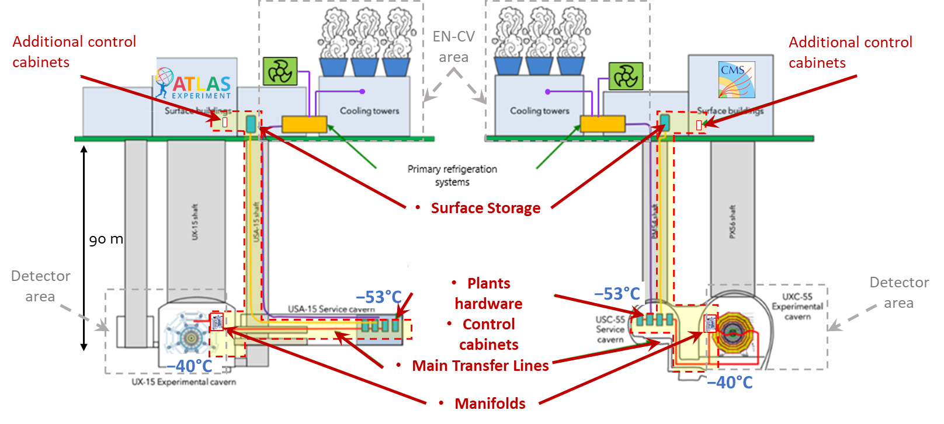
CO₂ Cooling Systems for Phase II upgrades
THE “2PACL SYSTEM”:
16 plants (different sizes)
  9 in CMS (includes one spare)
  7 in ATLAS (includes one spare)
14 accumulators (different volumes)
  8 in CMS
  6 in ATLAS
2 large (10 m³) surface storage vessels
  1 for CMS
  1 for ATLAS
Long cold transfer lines
Distribution manifolds
> 1 MW power form electronics
to be removed
  0.8 MW in CMS
  0.5 MW in ATLAS
T ≤ −45 °C at the accumulator
Total HW investment ~23 MCHF
EP-DT Responsibility: * Design, procurement and installation of Surface storage, Plants HW and Control cabinets
* Supervision on design and procurement of Main Transfer Lines and Manifolds
* Commissioning and M&O of the whole system

Slide 12
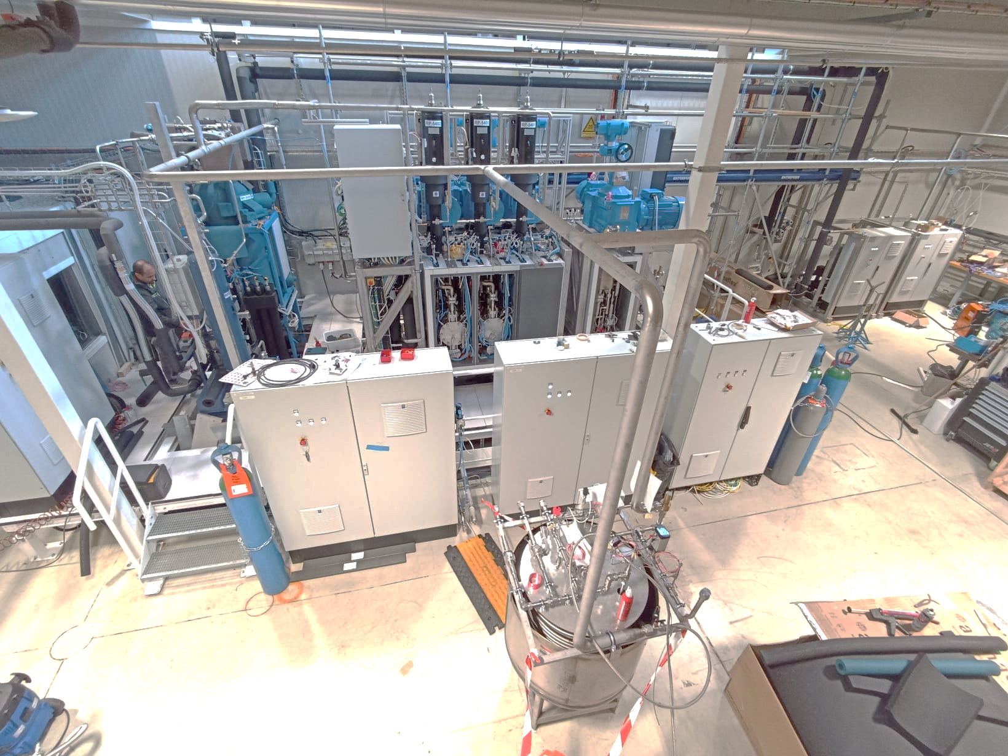
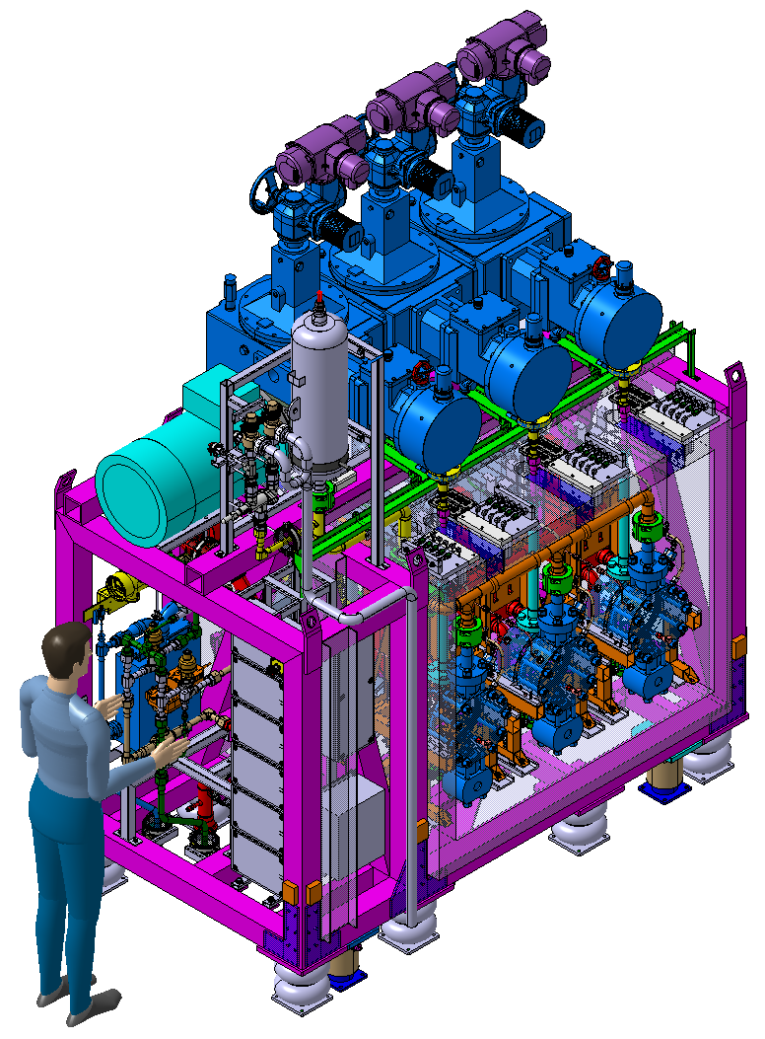
DEMO Cooling Plant
Demo cooling plant
  Full-scale prototype for Phase-2 systems
  100 kW, − 45°C on Accumulator
  − 53°C at pump inlet
Modular design
  Main plant, 3 pumping heads (largest version)
  Backup plant, 3 pumping heads (smallest version)
  Accumulator (shared, as in final system)
  Transfer lines (coaxial)
  Dummy load
  Primary chiller (first prototype of the new R744 transcritical cycle)
  System switchable from “traditional 2PACL” mode to “2-PACL Flow-Through” mode (and back)
R-744 primary
Main plant (3H)
Spare plant (1H)
Transfer line
Accumulator
Dummy load
Control cabinets
Surface storage simulator
DEMO prototype experience and results:
Component selection
Test of novel approaches
Process and design verification
Consolidation of final design for outsourced production
Functional Analysis and parameter tuning
Results led to approval of combined ATLAS/CMS PRR in April
Fine testing continuing in parallel to procurement process
Activity planned until spring 2024

Slide 13

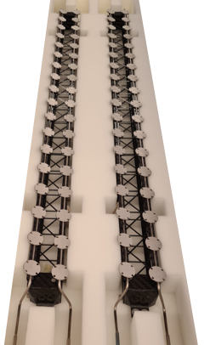
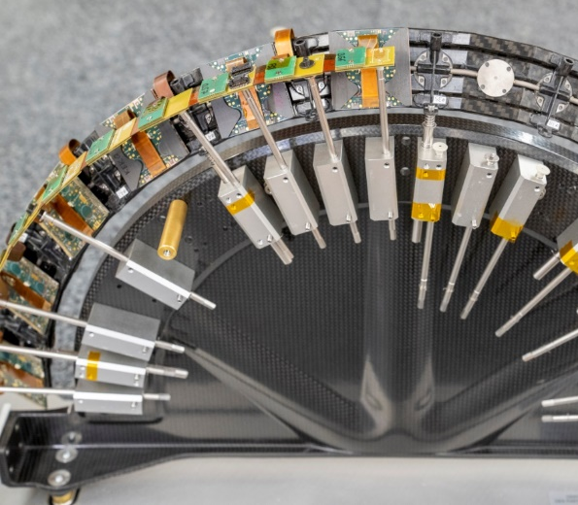
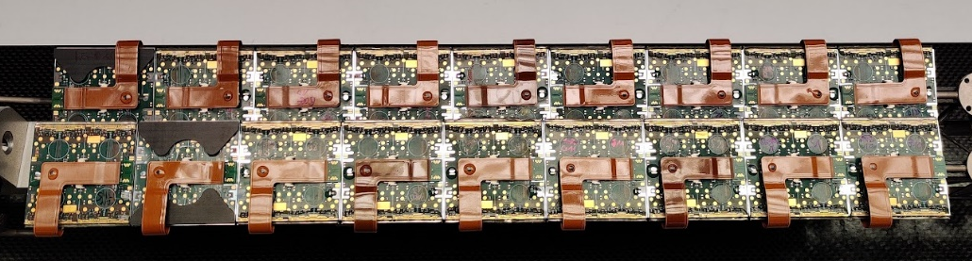
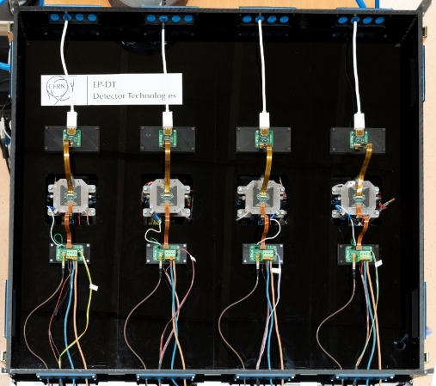
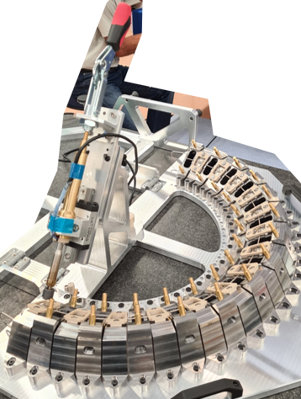
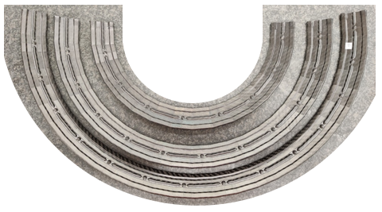

ATLAS Phase II Upgrade: ITk Pixel Outer Barrel
DT Leading role in ATLAS ITk Pixel Outer Barrel Mechanics & Modules
  Module construction, Local Supports, on-detector cooling and global support structures
  Detector assembly and integration (DT commitments extend up to the end of LS3)
  Close collaboration EP-ADE, Université de Genève, Bonn, CPPM and EN-MME
In 2022, significant progress in the Longerons and Inclined Half Rings (IHRs)
  Big step forward in pre-production of bare local supports (production starts in Q3-2023)
  Finished design qualification of loaded local supports (pre-production started in Q2 2023)
Longeron & IHR RD53A Demonstrators
Pre-production Functional Longerons
New IHR Soldering Tool
L2, L3 & L4 Carbon Rings
QC Setup for Module Cells
Diego Alvarez

Slide 14
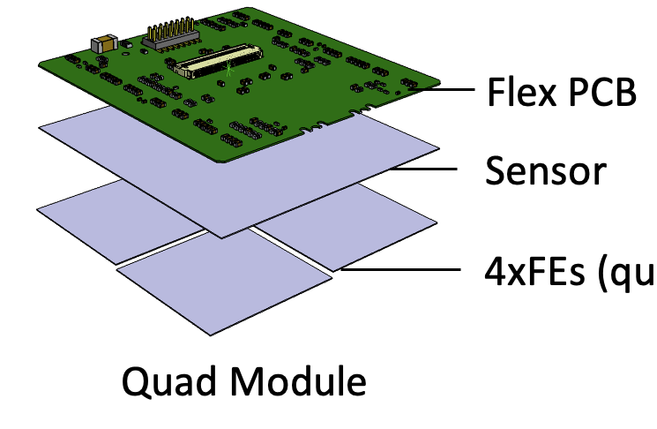
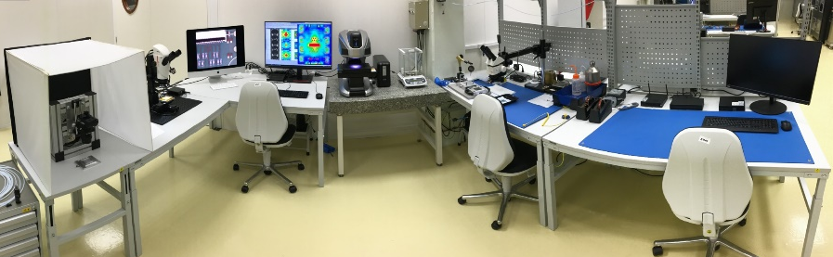
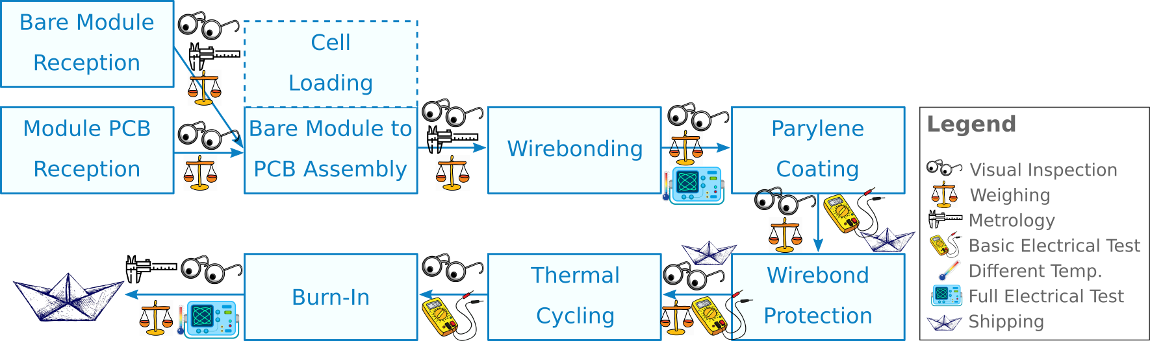
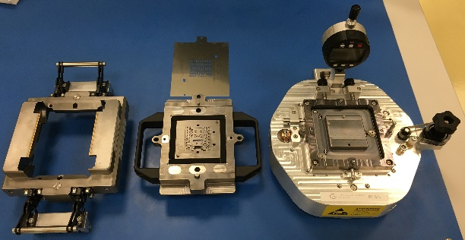
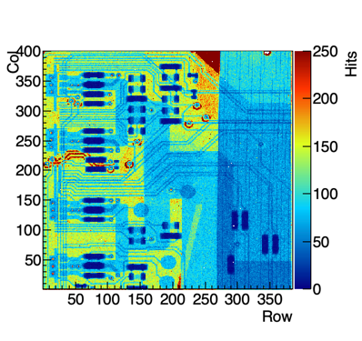
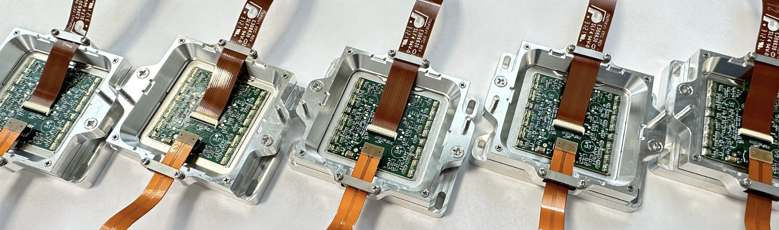
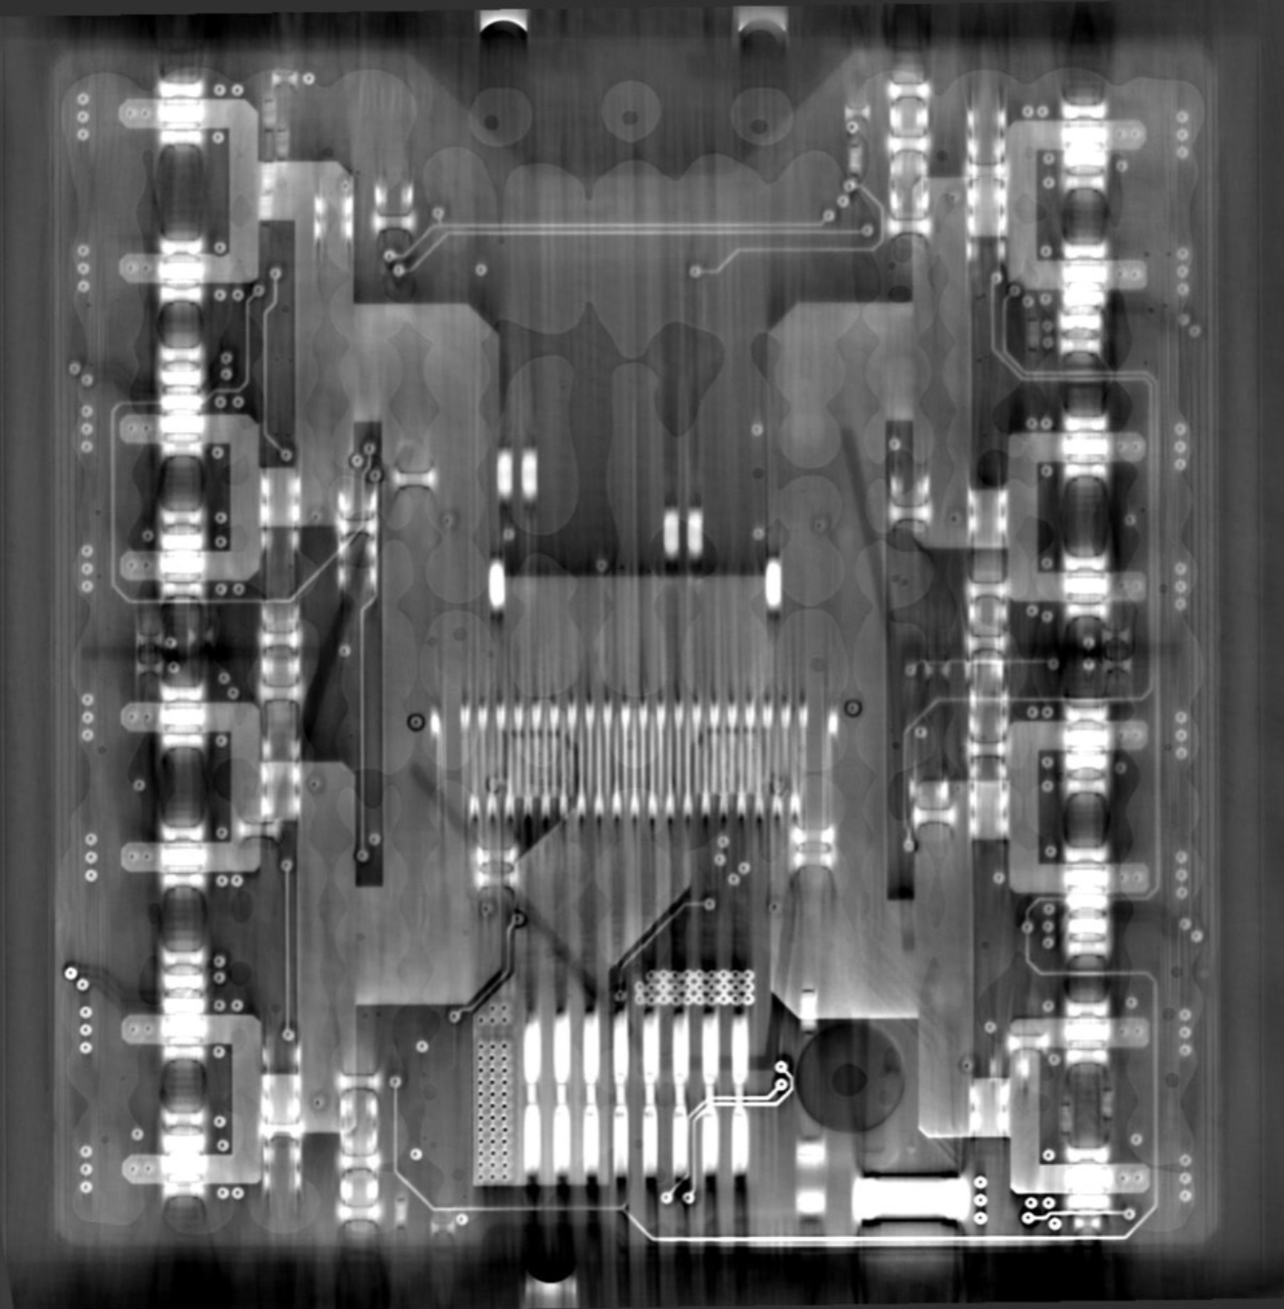
ATLAS ITk Module Production
CERN is one of the production centers for quad modules for the ITk Outer Barrel (up to 1200 modules) – close collaboration between EP-DT and EP-ADE.
Assembly production line established in DSF cleanroom including test setups, inspection systems and assembly tooling.
Module assembly and testing steps
Assembly area in DSF cleanroom
Total number of assemblies built in the last 12 months: 62
35 pre-production ITkPixV1.1 Quad modules
27 ITkPixV1.1 Digital Quad Modules for serial powering, flex design validation, readout studies
Strong contributions towards hybridisation vendor qualifications, module QC and flex pre-production
Module Production Assembly Tooling
QC studies:
CT scan to examine glue spread between sensor & flex
ATLAS ITkPixV1.1 Quad modules
X-ray scan ITkPixV1.1 module (top right chip)
Abhishek Sharma

Slide 15
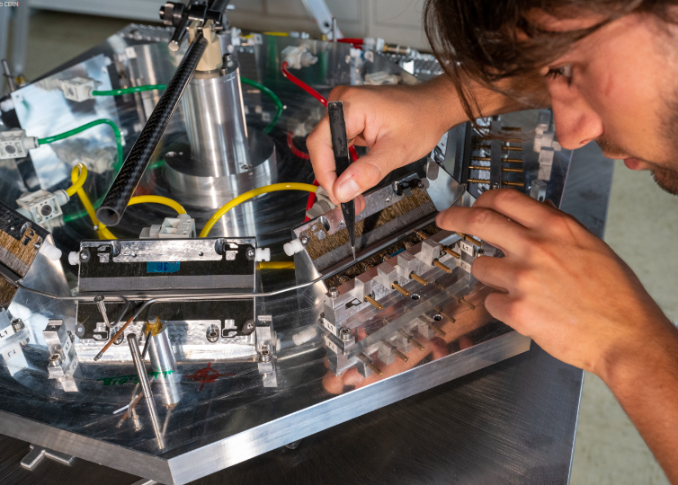
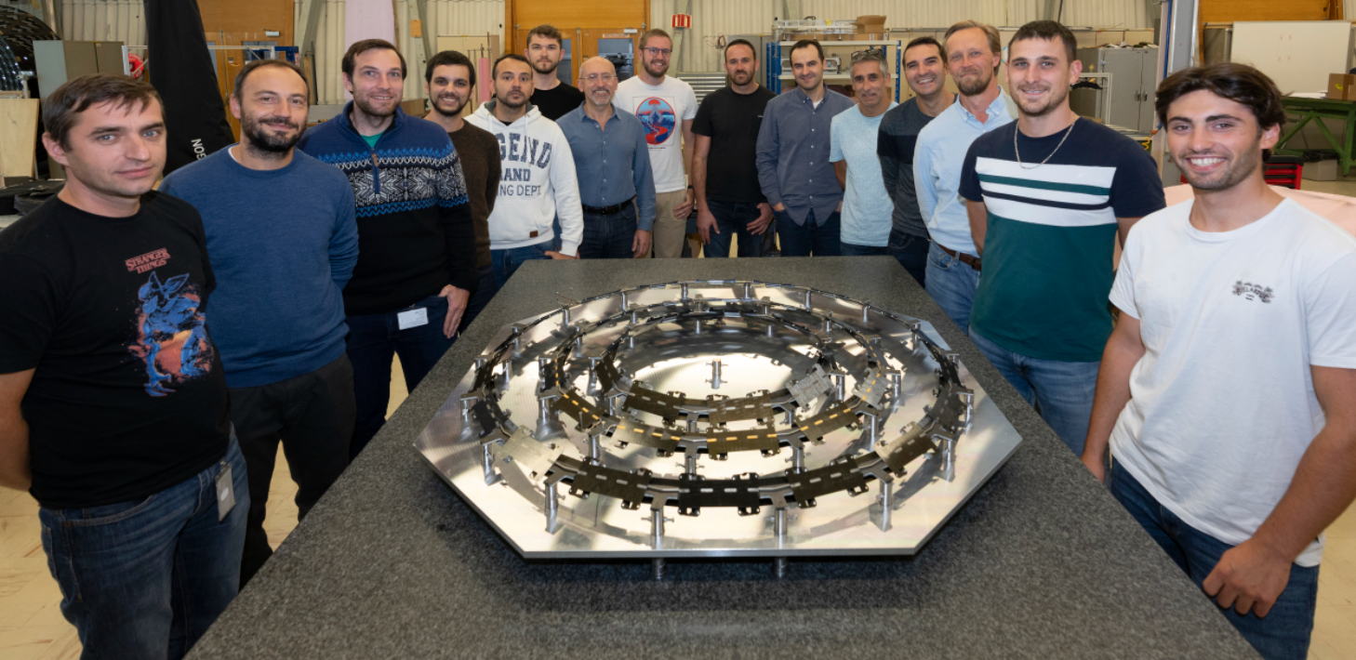
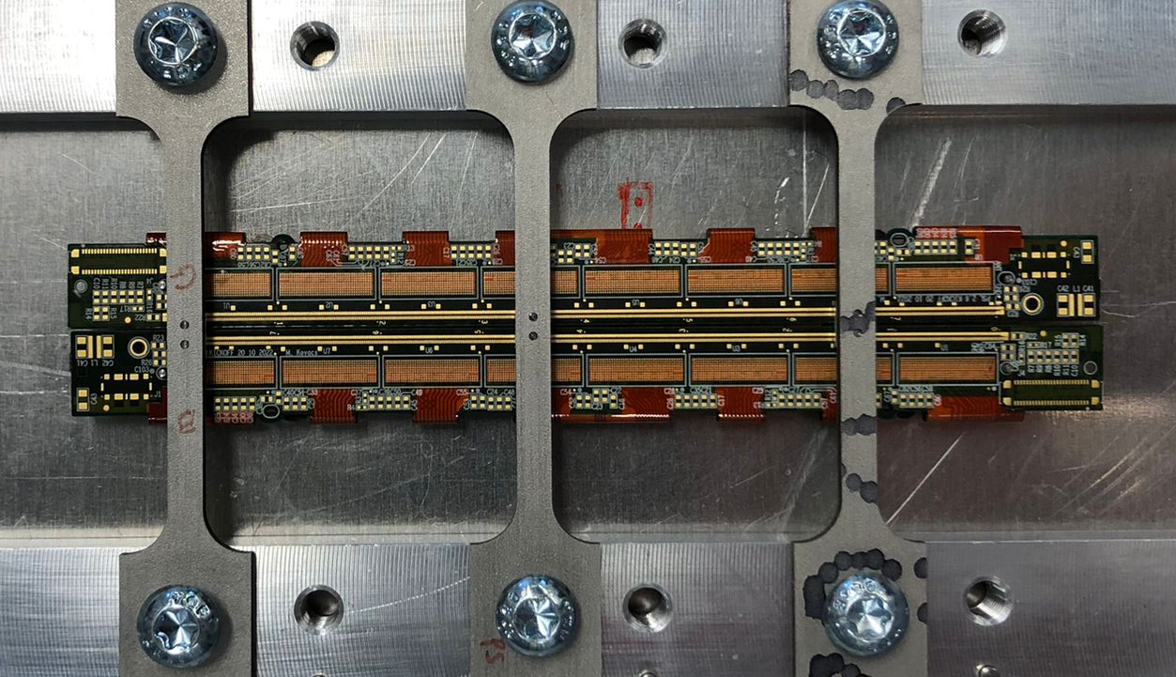
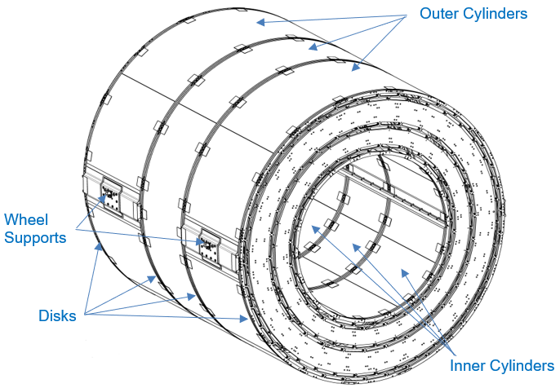
CMS Phase 2 Upgrade Tracker
TBPS: High-precision, low-mass structures & cooling for « tilted » detectors pointing towards beam IP.
9 pre-production Rings completed in 2022 – 2023. Ramping up to series production, to be completed in 2025.
Modules: Quality control of electronic hybrids (10cm x 1cm)
Design & production of jigs, for production use Q3 2023 -
TB2S: Carbon-composite support Wheel (L=2.4m, Ø2.4m)
Design completed in 2023. Now in manufacture in industry.

Slide 16
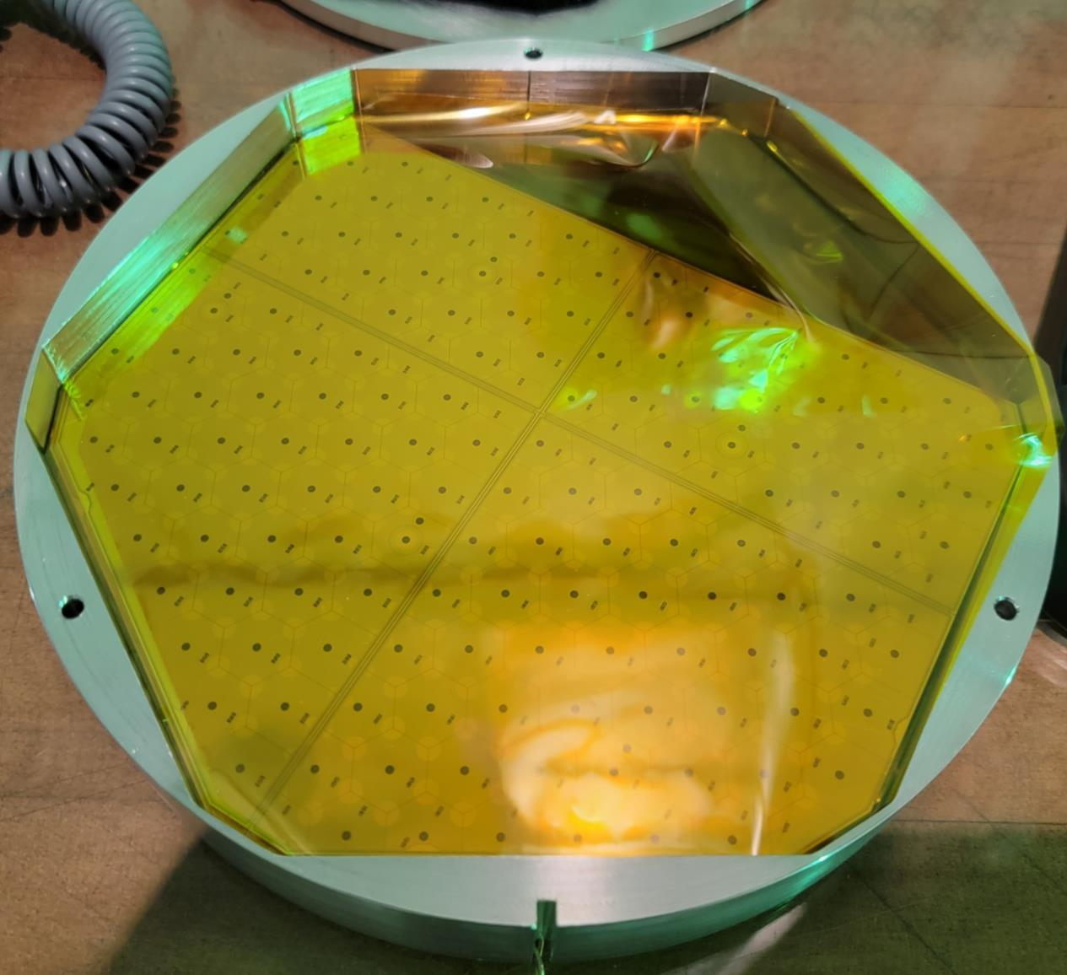
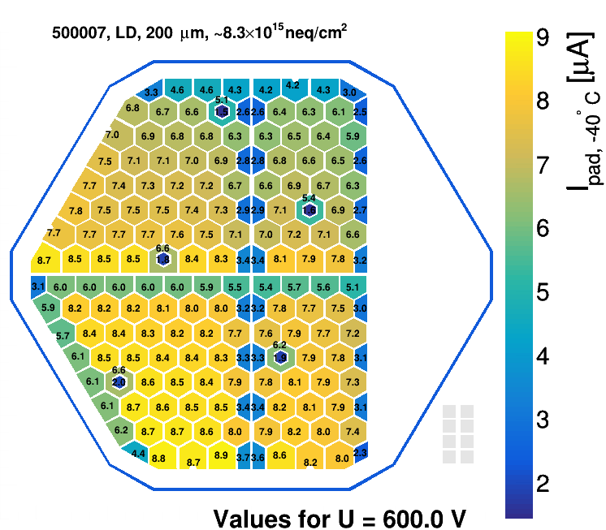
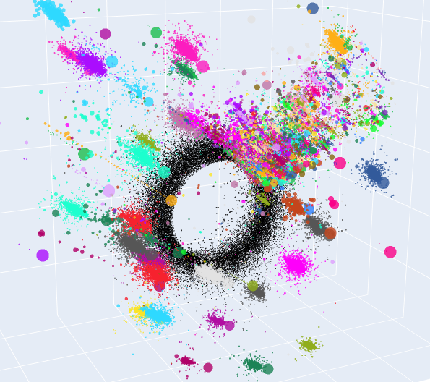
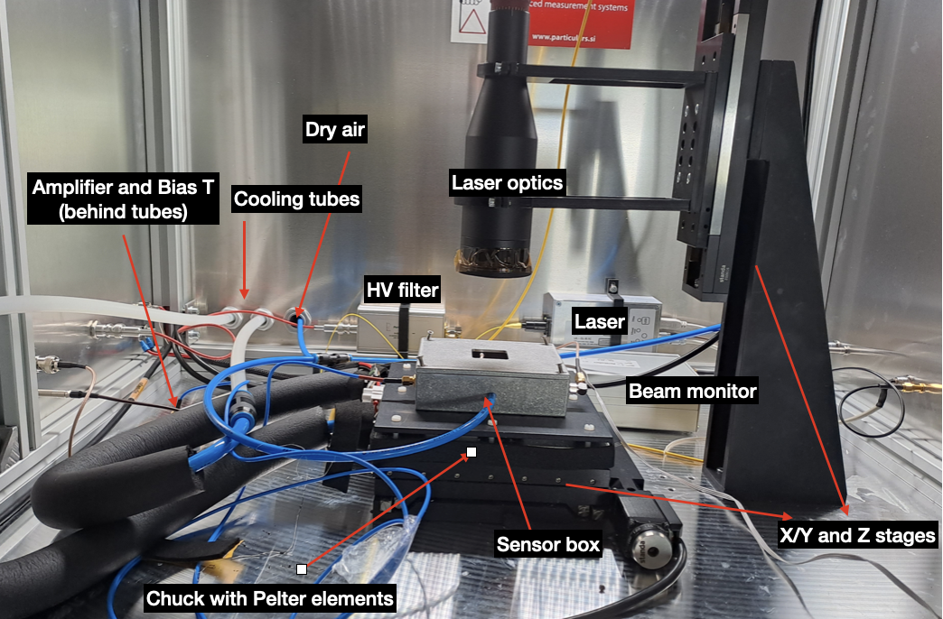
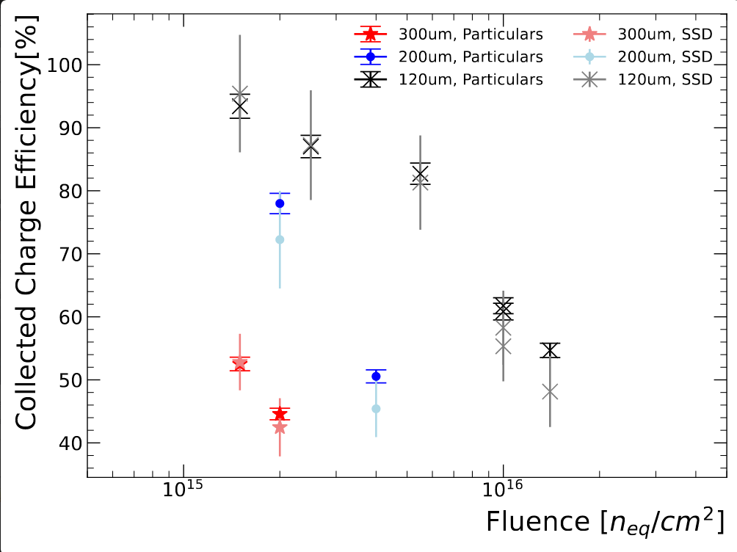
EP-DT – CMS team: main activities for HGCAL
8” Sensor Quality Control
Production phase started, with ~28’000
wafers to be delivered in 2023‒2025
Hub for full-sensor testing infrastructure used in
7 CMS HGCAL institutes
8” sensor neutron irradiation studies covering both full and
new partial sensors (used in border regions of HGCAL)
Test setup development for radiation hardness
(EP R&D funded setup, in collaboration with EP-DT SSD)
Small-sized test structure irradiations: X-ray and neutrons
End-to-end HGCAL event reconstruction using machine-learning algorithms
3. Sensors in irradiation holder
3. Per-cell leakage current @ -40°C
after neutron irradiation
6. Reconstructed showers in
HGCAL endcap
200um, 8x10¹⁵neq/cm²
Region with simulated pileup events
⇒ Promising results for clustering and energy reconstruction w/ and w/o pile up
20cm ≅ 8”
pre-irradiation value: O(1nA)
⇒ Leakage current scales with delivered fluence and cell area, as expected
Black = Noise
Colours = showers
⇒ First combination of particle-flow approach & end-to-end ML-based reconstruction
4. New “Particulars” setup for cold
IV+CV+Charge Collection measurements
5. Charge Collection Efficiency vs. fluence
120μm
200μm
⇒ Agreement between results from established DT-SSD setup and new Particulars setup
300μm
⇒ Results being used for HGCAL optimisation

Slide 17
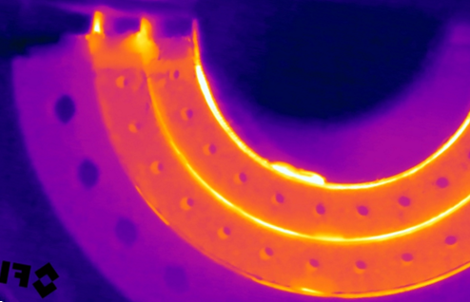
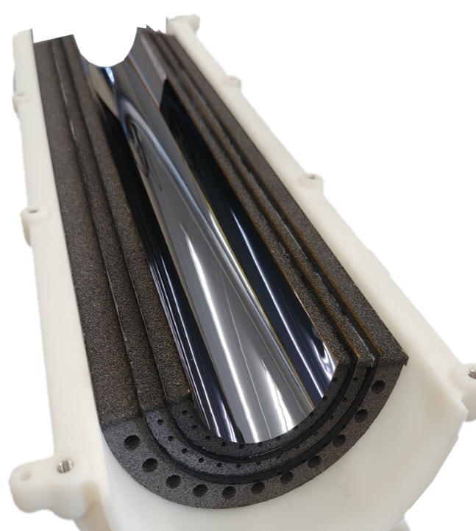

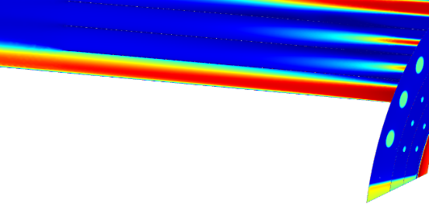


ALICE ITS3 upgrade
ALICE ITS3
Reliable radiators and support structures based on carbon foam for the next generation
of ultralight vertex detectors (MB <0.1%).
IR thermal imaging
of the Carbon foam radiator
EP R&D team & ALICE team
Overall ΔT sensor < 5 °C
Sensor and air <10 °C
Engineering Model Development:
3 silicon layers (40 µm thick)
Layers radius 18, 24, 30 mm
Carbon foam frames/radiators
Cooling performance
Pixel matrix ∼ 0.05 W/cm²
Readout endcap 1 W/cm²
ΔT across sensor < 5 °C
ΔT Sensor and air <10 °C
4m/s< Air speed <8m/sec
Support: Longerons
ERG Carbon RVC @Duocel
ρ = 0.06 kg/dm³, k = 0.033 W/m·K
CFD simulation
of the air flow
in the cooling volume
4m/s< Air speed <8m/s
280 mm
Gas cooling
(Air, N₂)
Support & cooling: Half ring radiators
Allcom K9 standard density
ρ = 0.2-0.26 kg/dm³, k = >17 W/m·K
3D print gas distributors
for flow control
integrated with services

Slide 18





Contributions to LHCb
DT is involved in many subsystems of LHCb, including VELO, RICH, SciFi, Calorimeters, Muon System
Contribution to the Upstream Tracker
UT was closed in March in time for the start of the LHC run

Slide 19




LHCb VELO – Vacuum Incident
Primary vacuum (beam) and secondary vacuum (VELO)
are separated by a thin RF foil
Safety vacuum balance ΔP < 10mbar
Relay failure on January 10, 2023, let to loss of control of protection system
- Safety valve did not open
- Pressure difference went up to ΔP ≈ 200mbar
RF foil deformed towards the beam vacuum
VELO modules and cooling not damaged and operational
Measurement of RF deformation with tomography
VELO modules and RF Foil
VELO will not be fully closed during the 2023 run
VELO will be opened by 16 mm with respect to the nominal fully close position
RF foil will be replaced during the 23/24 YETS

Slide 20
Two-factor authentication
Computer Security is currently rolling out Two-factor authentication (2FA) protection for the accounts of many members of the Organization.
Two-factor authentication is the silver bullet in protecting computing accounts against any kind of abuse.
In our latest phishing campaign in 2022, 2000+(!) people provided their password to a fake login page. 2FA would have protected their accounts from any evil abuse.
Technically this 2FA protection implies that in order to access CERN web applications protected by CERN's new Single Sign-On (SSO), the new CERN SSO will require your 2nd factor about every 12 hours when staying in the same browser session. As today, separate browser sessions on the same or different devices require additional logins.
Some useful links:
  Instructions to configure and set-up 2FA at CERN: https://cern.service-now.com/service-portal?id=kb_article&n=KB0006587
  Outage TG: https://cern.service-now.com/service-portal?id=outage&n=OTG0071297
  2FA FAQ: https://auth.docs.cern.ch/trouble-shooting/2fa-tips/
  "Log in. Click. Be secure": https://home.cern/news/news/computing/computer-security-log-click-be-secure
  « Authentifiez-vous pour cliquer en toute sécurité »: https://home.cern/news/news/computing/computer-security-log-click-be-secure
The suggestion is to proceed as follows:
We fix the target date to e.g. July 4th (people who did not register by then will not be affected and will be contacted later)
Computer Security will send an email to the whole group.
We collect the number of USB-A and USB-C Yubikeys needed for your/our colleagues. Note that not everyone needs one as the Smartphone app might be enough.

Slide 21


Building 140 Project: Site analysis
General analysis of this part of the Meyrin site has been carried out.
General circulation flows are taken into account in the development of the Project Requirements.

Slide 22


Building 140 Status: Project requirements
Update of the space per person in the offices;
All auditoriums gathered in Phase 2;
Different distribution between general common spaces and EP common spaces. Additional space for lactation room and storage;
WC and technical spaces already included in the program;
New cafeteria and entrance hall concept;
Total surface estimated by CCHE
Total surface estimated by CERN after adding 30% for all required spaces for the operation of the building and adding 20% for the construction elements.
Outcome of study done last year:
Total space for EP-DT: Offices: 504m², Lab- and Workshop space: 1258m², Storage: 126m²

Slide 23






DT Bike to Work competition 2023
EP-DT participated with 6 teams (out of 270 CERN wide):
Team led by Soledad
Team led by Enrico
Team led by Justus
Team led by Joao
Team led by Dominik
Team led by Eraldo

Slide 24
Concluding remarks
We are living in very challenging times, from many viewpoints!
We are committed to support the CERN experiments with the resources available, which are very tight.
The collaboration with the teams of the experiments is very good, which is important, as much work is before us, in particular for the Phase II upgrades of ATLAS and CMS.
It is important to maintain the expertise and facilities of EP-DT and the various services.
The age-profile of persons on ICs is
a concern as 30% of the staff will
retire before the end of the decade.
We have to ensure continuity of the
competencies in the DT group!

