Slide 1
How to get to the River City Pier
River Star Princess Cruise leaves the pier around 7:00 pm
Don’t be late!

Slide 2
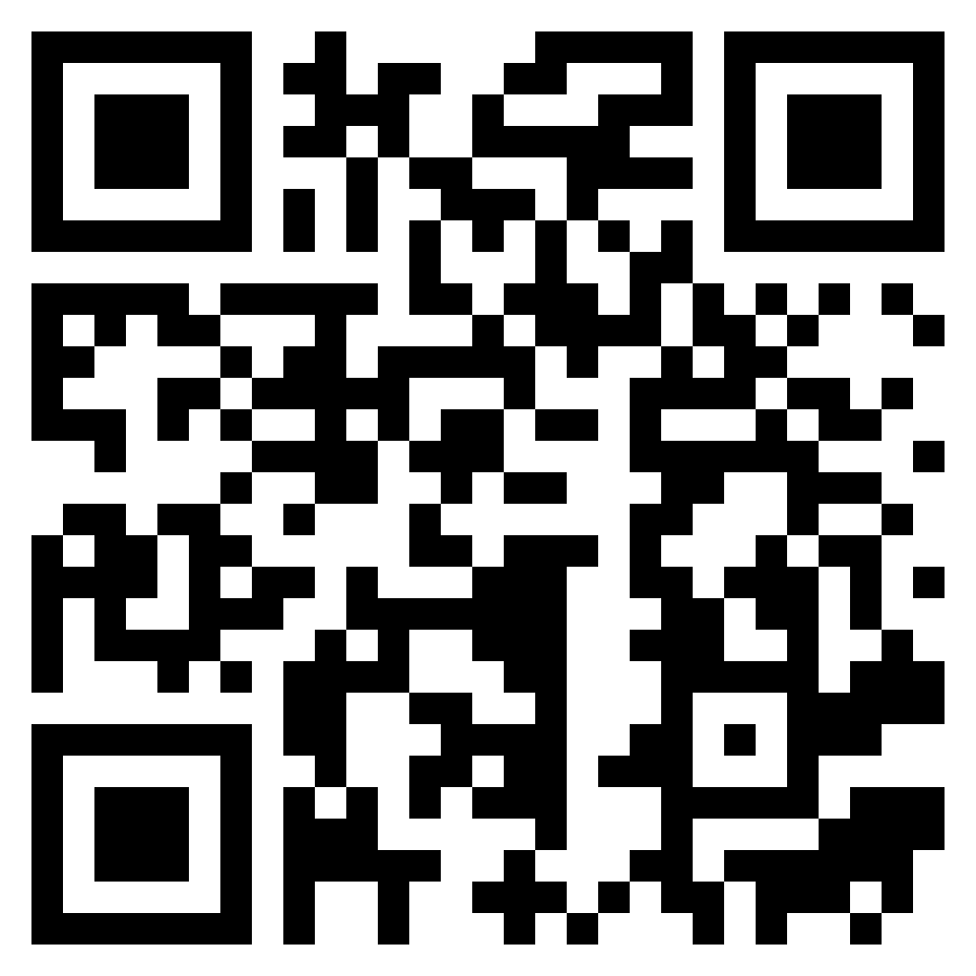
We can either walk/take a bus
If you want to walk

Slide 3
We can either walk/take a bus
Bus number 36/93 in front of the nearest gate
And the last stop is at the hotel so don’t worry about getting lost
You pay for a bus ticket on the bus
You need to say “I’m going to the last stop/River City/Si Phraya” and the prize is 20-40 Baht

Slide 4


