Slide 1

FPCP 2022
Standard Model predictions for kaon decays
Xu Feng
2024.05.29

Slide 2
Outline
Test of first-row CKM unitarity
Inclusion of isospin breaking effects
Rare decays

Slide 3
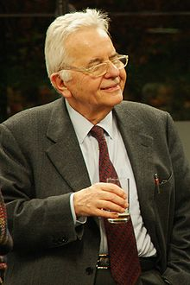
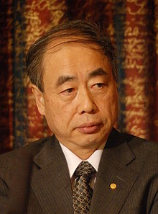
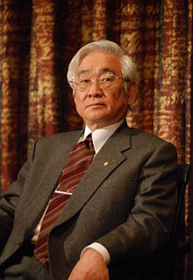
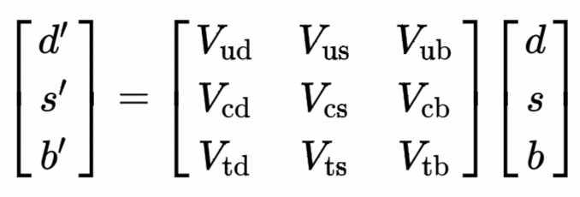

Test of CKM unitarity
In SM, CKM matrix is unitary, describing the strength of flavor-changing weak interaction
Cabibbo Kobayashi Maskawa
Most stringent test of CKM unitarity is given by the first row condition
|V_{ub}|=3.82(24)✖️10⁻³，tiny contribution
[PDG 2022]
|V_{ud}|=0.97373(31), most precise determination from superallowed nuclear beta decays
(also from neutron & π beta decays, but uncertainties are 3 and 10 times larger）
|V_{us}|， most precise determination from kaon decays (K_{l3} + K_{μ2}/π_{μ2})
requires LQCD inputs
(also from hyperon & tau decays, errors are about 3 and 2 times)

Slide 4
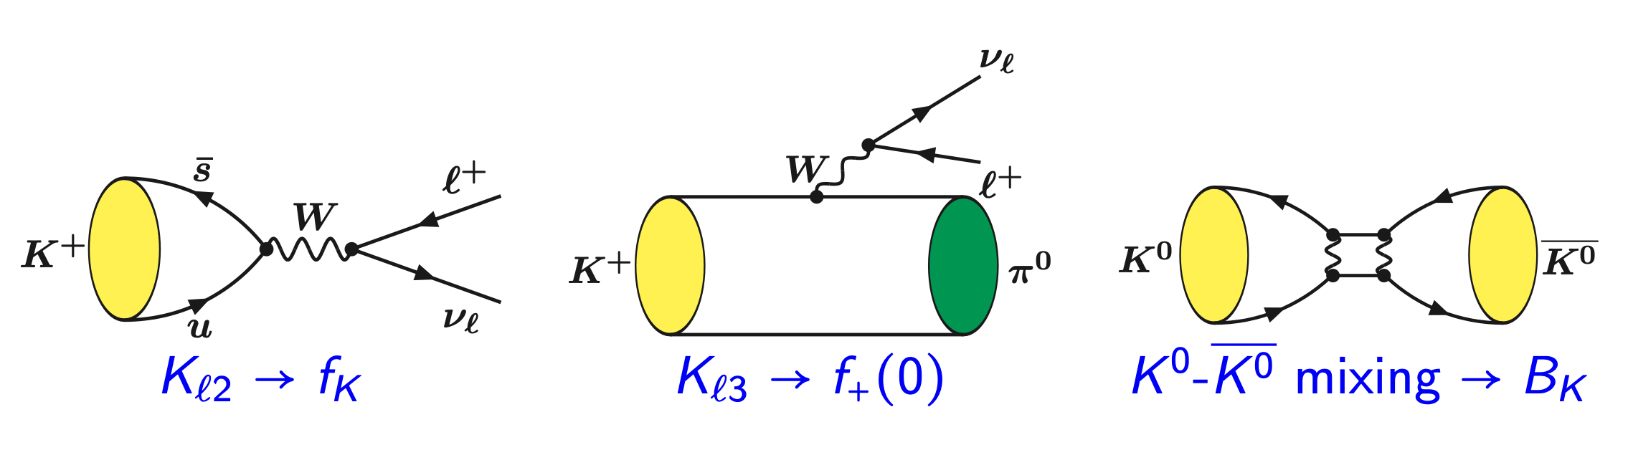
K/π systems provide idea laboratory for lattice QCD Study
Lattice QCD is powerful to study Kaon/pion decays
Nearly no signal/noise problem
Quark field contractions easily performed
Simple final states: purely leptonic, 1 π， 2 π (K→ππ already very challenging!)
Small recoil for hadronic particle in the final state
Long-distance processes: much less low-lying intermediate states
Provide the hadronic matrix elements for precision SM tests

Slide 5
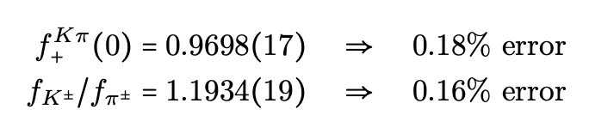
Leptonic and semileptonic decays
Flavor Lattice Averaging Group (FLAG) average, updated on 2023

Slide 6
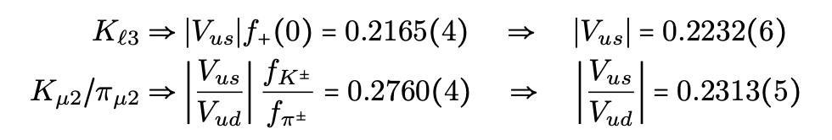



Extraction of V_{ud} and V_{us}
Experimental information from kaon decays [arXiv:1411.5252, 1509.02220]
Use |V_{us}| from K_{l3} + |V_{us}/V_{ud}| from K_{μ2}/π_{μ2}
V_{ud} from nuclear β decay
(more accurate results from N_{f}=2+1+1)
V_{us}/V_{ud} from K_{μ2}/π_{μ2}
Use |V_{us}| from K_{l3} + |V_{ud}| from β decays
V_{us} from Kl3
|V_{us}/V_{ud}| from K_{μ2}/π_{μ2} + |V_{ud}| from β decay
CKM unitarity
Question: Deviation due to |V_{ud}| from β decays, |V_{us}| from K_{l3} or new physics?

Slide 7
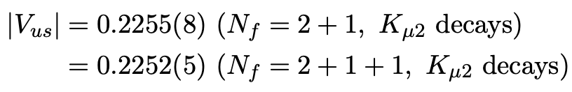
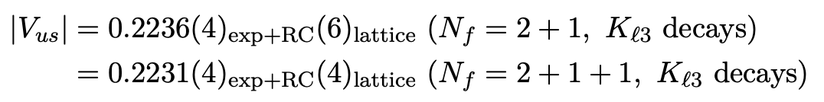
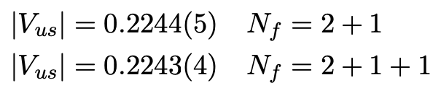


CKM matrix elements quoted by PDG 2022
Use |V_{us}/V_{ud}| from K_{μ2}/π_{μ2} + |V_{ud}| from β decay to determine |V_{us}|
Use |V_{us}| from K_{l3}
2.7 σ
Average yields
Enlarge the error by a scale factor of 2.7 and average N_{f}=2+1 and N_{f}=2+1+1 values
Conservative estimate of |V_{us}| due to the deviation between K_{l3} and K_{μ2} 2.1 σ deviation

Slide 8
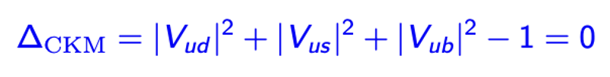
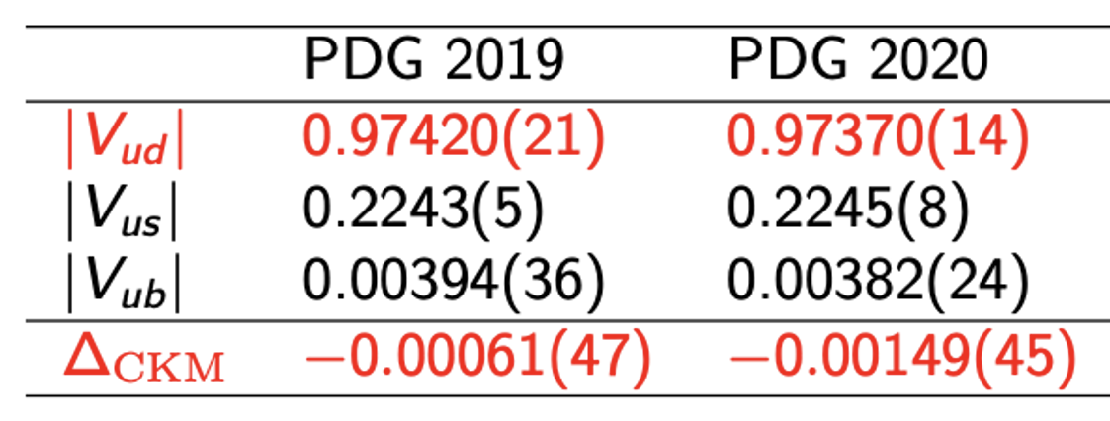
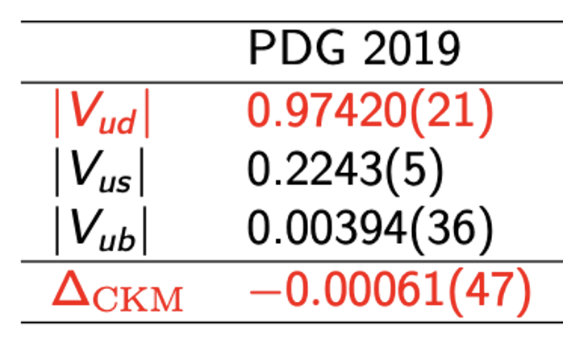
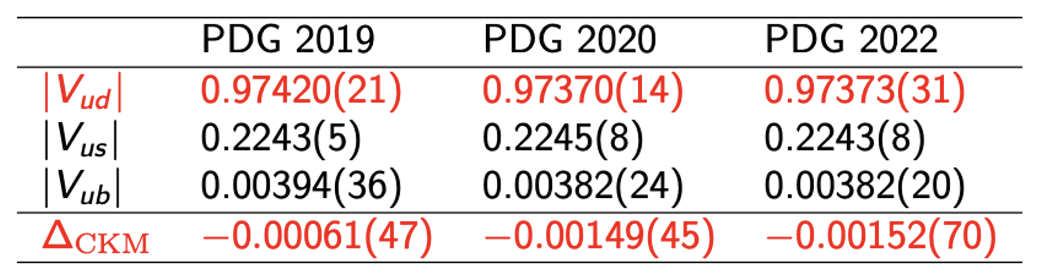
Role played by V_{ud}
Interesting to review the deviation from CKM unitarity changes within recent years
PDG 2019 → PDG 2020 → PDG 2022
PDG 2019 → PDG 2020
PDG 2019
2020 update: 3.3 σ deviation from CKM unitarity due to the update of EWR corrections
2022 update: 2.1 σ deviation only
For V_{ud}, central value nearly unchanged, but uncertainty becomes twice larger
A more conservative estimate of nuclear structure uncertainties
[M. Gorchtein, PRL123 (2019) 042503]

Slide 9
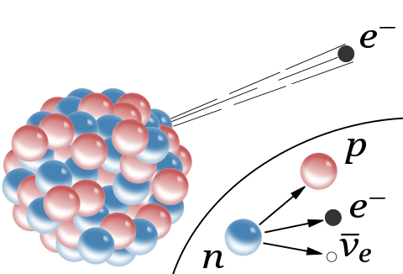
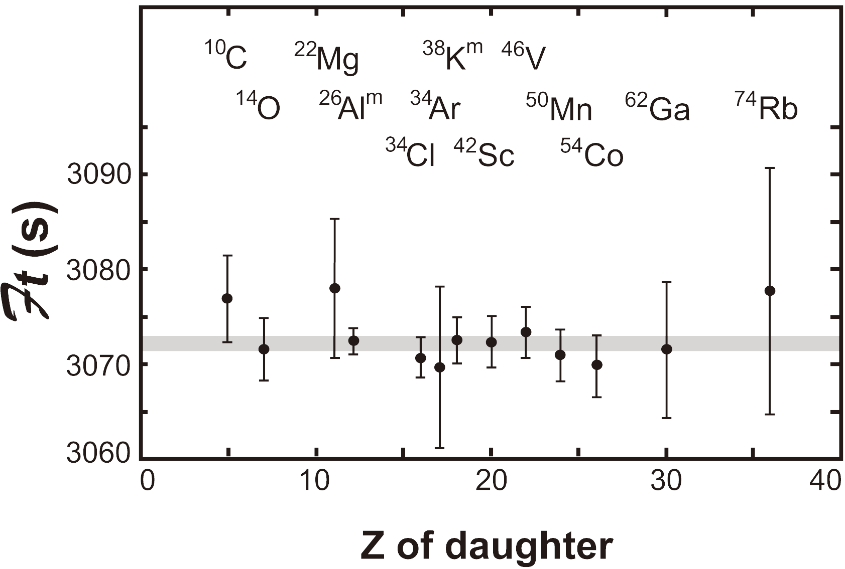
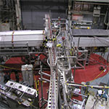
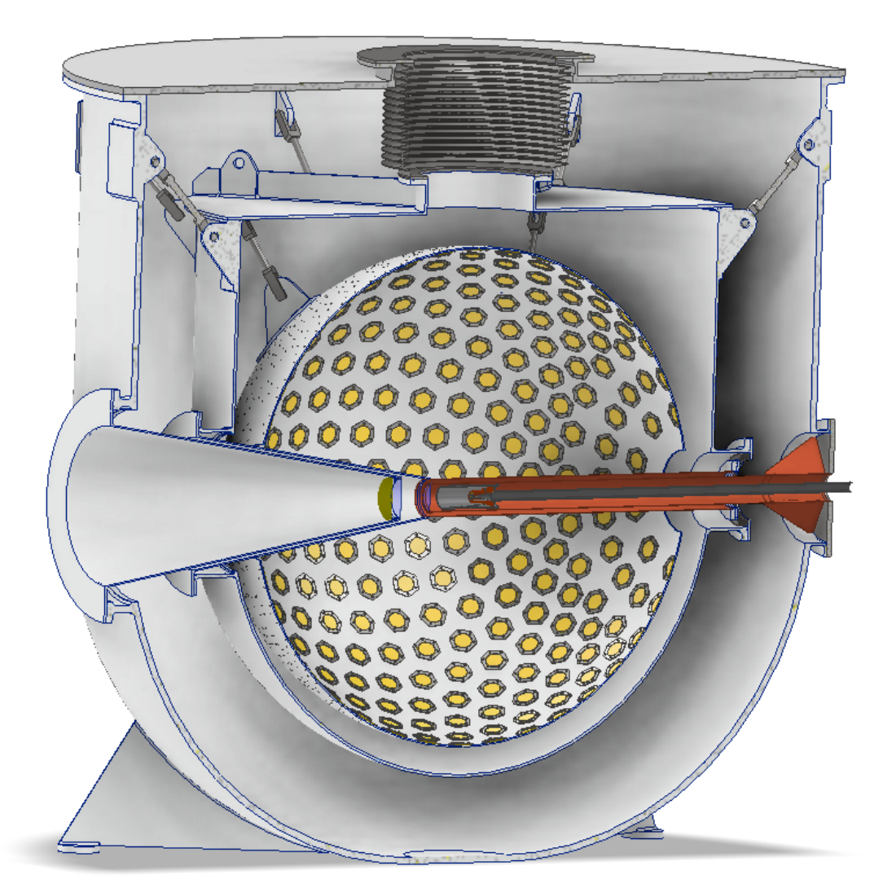
V_{ud} from different measurements
Superallowed nuclear β decays
PIBETA
PIONEER
Super-allowed
Ultra-Cold Neutron
Neutron β decays
Pion β decays

Slide 10
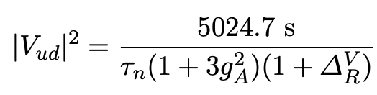

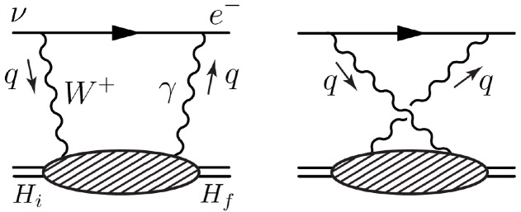
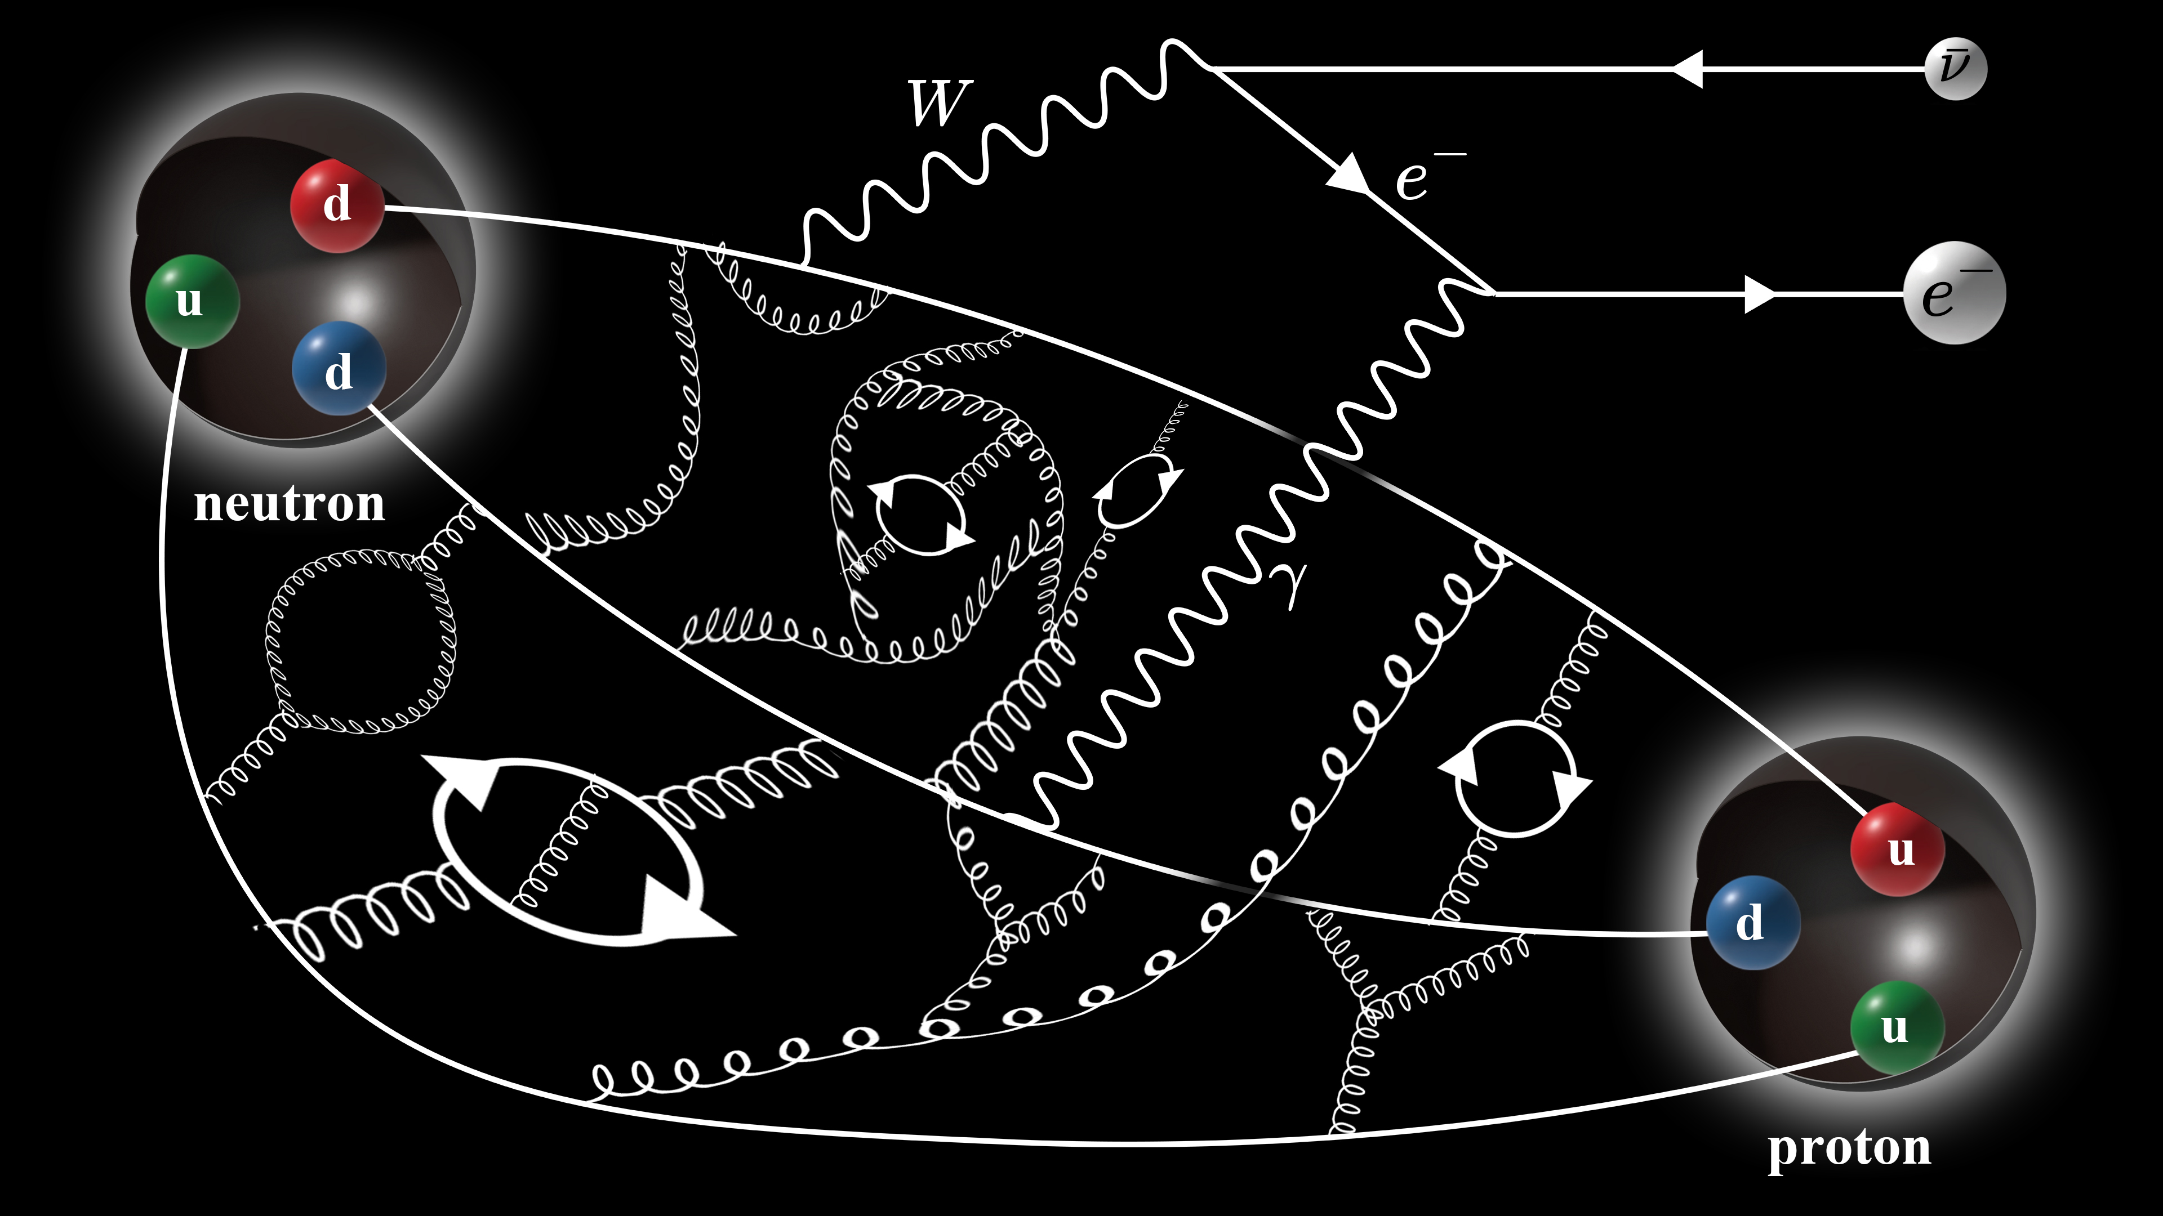
Important uncertainty from γW box diagram
Superallowed nuclear β decays
Neutron β decays
Universal electroweak radiative corrections (EWR)
Based current algebra, only axial γW box diagram is sensitive to hadronic scale
[A. Sirlin, Rev. Mod. Phys. 07 (1978) 573
It dominates the uncertainties in EWR

Slide 11
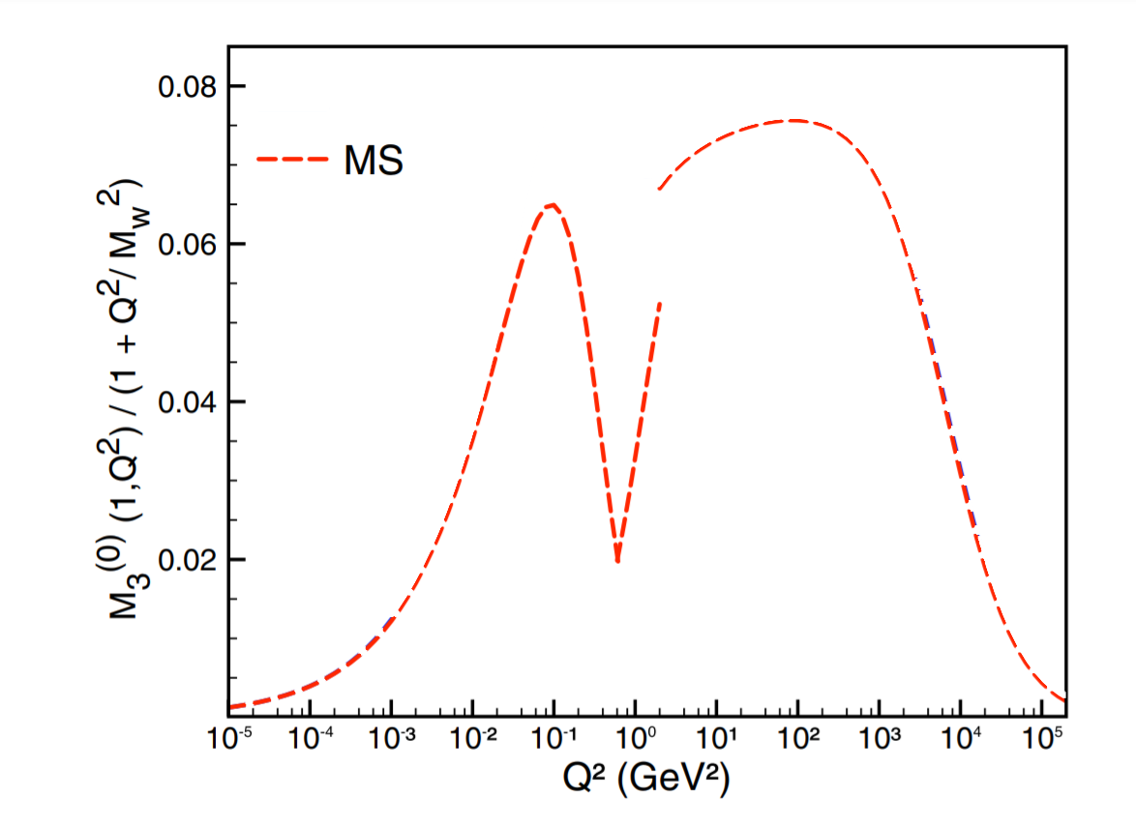
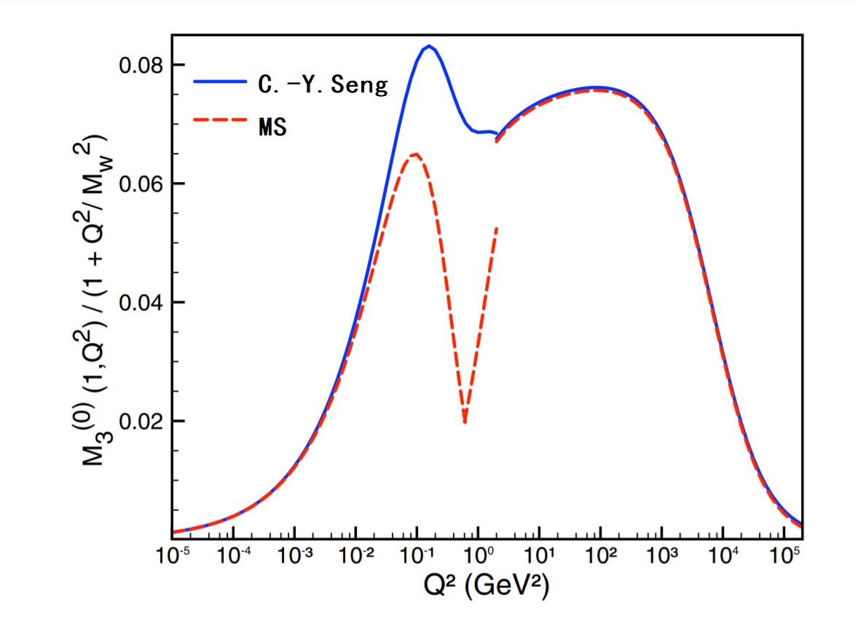
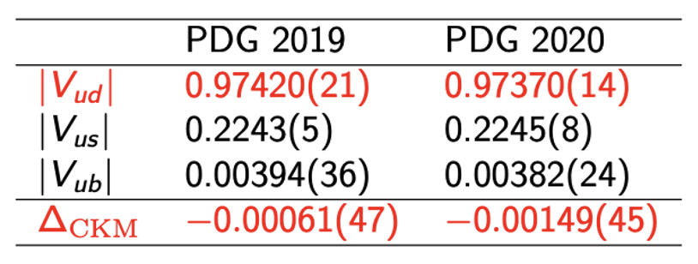
Important uncertainty from γW box diagram
PDG 2019 → PDG 2020
It is responsible for the update of PDG and 3.3 σ deviation in CKM unitarity
[1] Marciano & Sirlin, PRL96, 032002 (2006)
[2] Seng et.al. PRL 121, 241804 (2018)

Slide 12
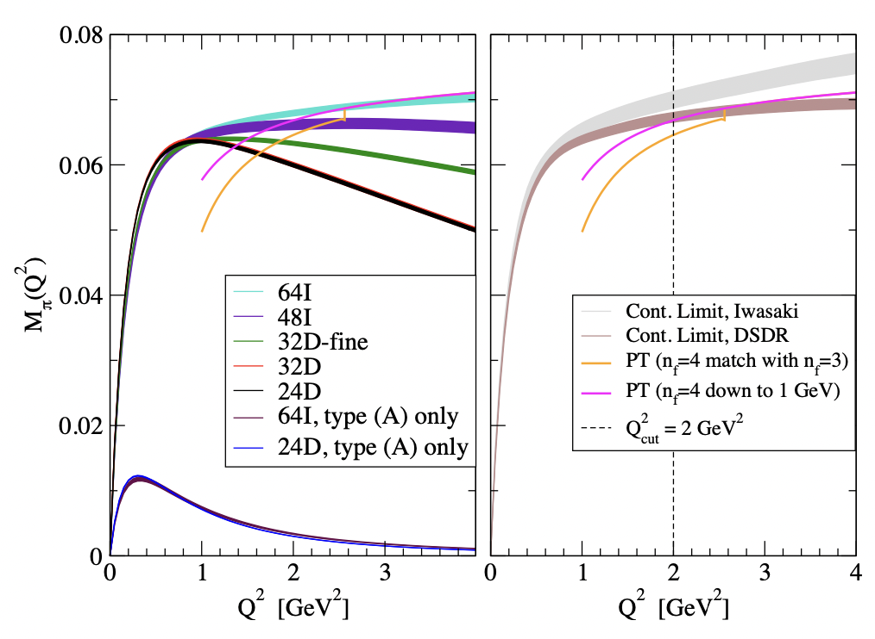
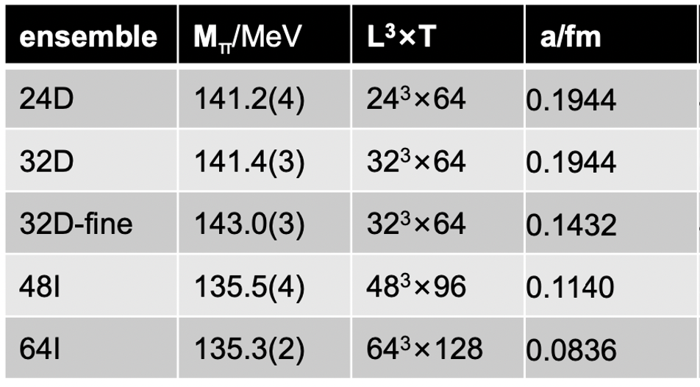
Calculation of γW box diagram from lattice QCD
Use pion β decay to design the calculation strategy
5 DWF ensembles @ physical pion mass
For pion decay, originally use EFT with LECs
Reduce the hadronic uncertainty by a facor of 10
XF, M. Gorchtein, L. Jin, et.al. PRL124 (2020) 19, 192002

Slide 13

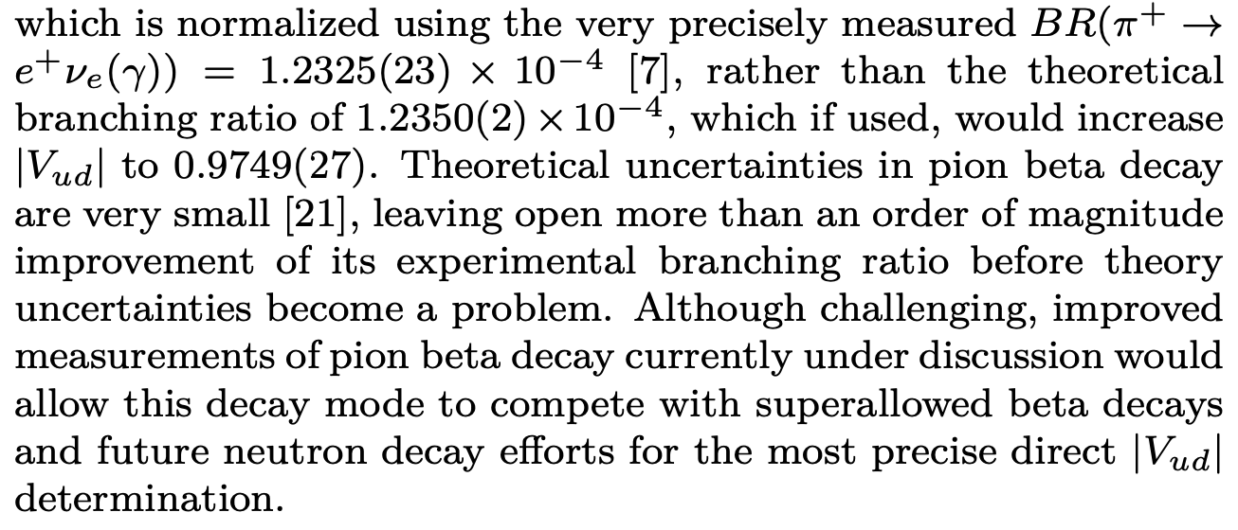
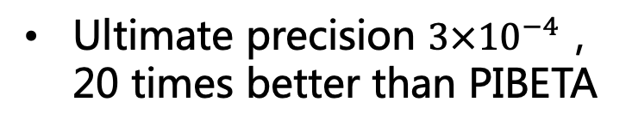
Interplay between theory and experiment
V_{ud} from π β decay
Past Experiment - PIBETA
D. Pocanic et.al. PRL 93 (2004) 181803
Precision 0.6%
XF, M. Gorchtein, L. Jin, et.al. PRL124 (2020) 19, 192002
New Experiment - PIONEER
Main uncertainty arises from exp. measurements
M. Hoferichter, arXiv:2403.18889
Phase I ：π leptonic decays
Phase II+III：π β decays
Ultimate precision $3×{10}^{−4}$，20 times better than PIBETA
Future exp. uncertainty comparable to theoretical one！
PDG 2022, reviewed by E. Blucher & W. J. Marciano

Slide 14
Status for V_{ud}
Superallowed β decays
|V_{ud}|=0.9737(3)
0⁺→0⁺ nuclear beta decays, which are pure vector transition at leading order
Estimate of nuclear structure uncertainties is important
Neutron β decays
|V_{ud}|=0.9737(9)
Free from nuclear structure uncertainties
Nuclear-structure independent radiative correction (RC) is same as superallowed nuclear β decay
Pion semileptonic β decays
|V_{ud}|=0.9739(29)
More difficult to measure pion decays
Theoretically simpler, especially for lattice QCD
Summary
To extract V_{ud} from superallowed decay or neutron β decay
Need a well determined EW radiative corrections

Slide 15
γW box diagram in neutron β decay
Ensemble information
Numerical lattice results
P. Ma, XF, M. Gorchtein, L. Jin, C. Seng, Z. Zhang, PRL132 (2024) 191901
Using lattice input, deviation from CKM unitarity: 2.1 σ → 1.8 σ

Slide 16
Outline
Test of first-row CKM unitarity
Inclusion of isospin breaking effects
Rare decays

Slide 17
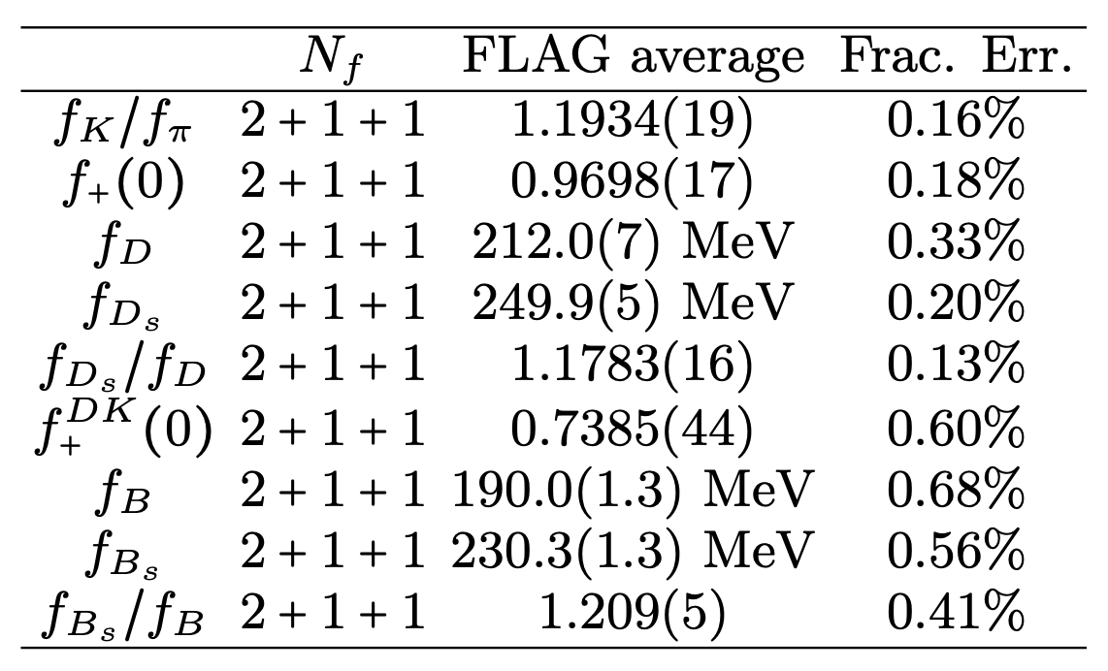
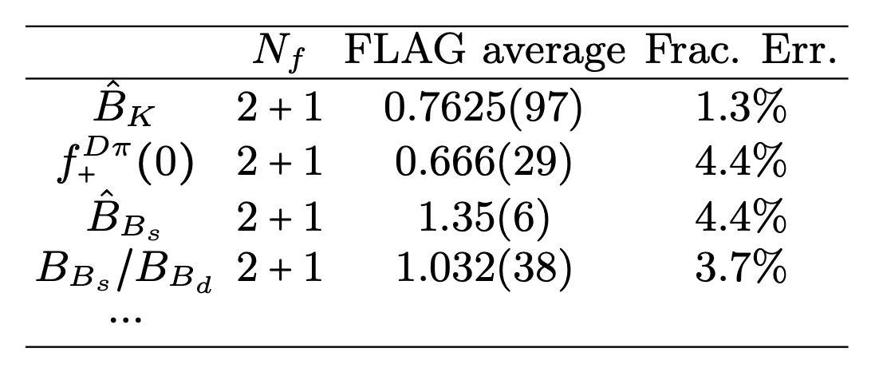
Inclusion of IB effects becomes important
Flavor Lattice Averaging Group (FLAG) average, updated on 2023
FLAG average results
Error < 1%
Error < 5%
Important to study the IB effects

Slide 18
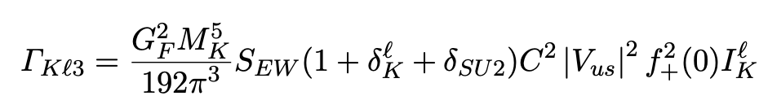
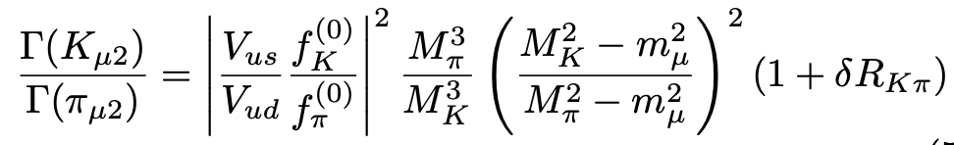
Inclusion of IB effects becomes important
Flavor Lattice Averaging Group (FLAG) average, updated on 2023
LD IB effects, ChPT provides a useful tool

Slide 19


Frontier for lattice QCD – inclusion of IB
For K_{l3} decays
[P. Ma, XF, M. Gorchtein, L. Jin, C. Seng, PRD103 (2021) 114503
So far only a combined analysis with LQCD and ChPT
For K_{μ2}/π_{μ2} decays
1st calculation by RM123-SOTON collaboration @m_{π}≈220 MeV
LQCD
ChPT
vs
[PRL 2018, PRD 2019]
[Cirigliano & Neufeld, PLB 2011]
2nd calculation @m_{π}=139 MeV, m_{π}L=3.863
[P. Boyle et. al., JHEP 02 (2023) 242]
indicating large finite-volume effects
O(1/L): universal and analytical known
O(1/L²): structure dependent, found to be small
O(1/L³): structure dependent, potentially large

Slide 20
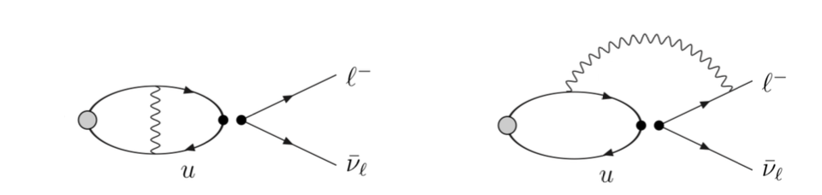


Difficulties to include E&M effects
m_{γ}=0
Long-range propagator enclosed in the lattice box
Power-law finite-volume effects
Various methods proposed to treat photon on the lattice
QED_{L} and QED_{TL} [Hayakawa & Uno, 2008, S. Borsany et. al., 2015]
First two calculations use QED_{L}
Massive photon [M. Endres et. al., 2016]
C* boundary condition [B. Lucini et. al., 2016]
Change photon propagator to make it suitable for lattice

Slide 21
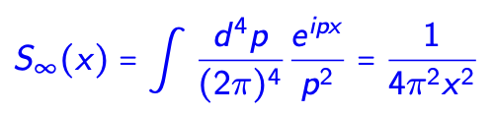
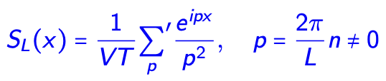
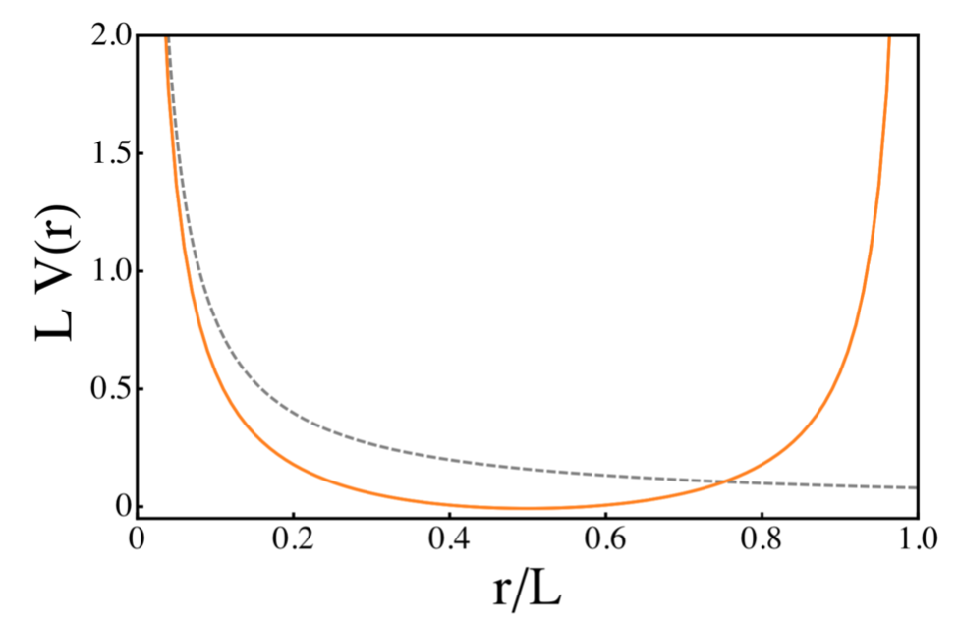
Remove zero mode - QED_{L}
Infinite-volume propagator
Finite-volume propagator
Z. Davoudi, M.Savage PRD90 (2014) 054503]
Power-law (1/L^{n}) finite-volume effect as lattice size L increases

Slide 22
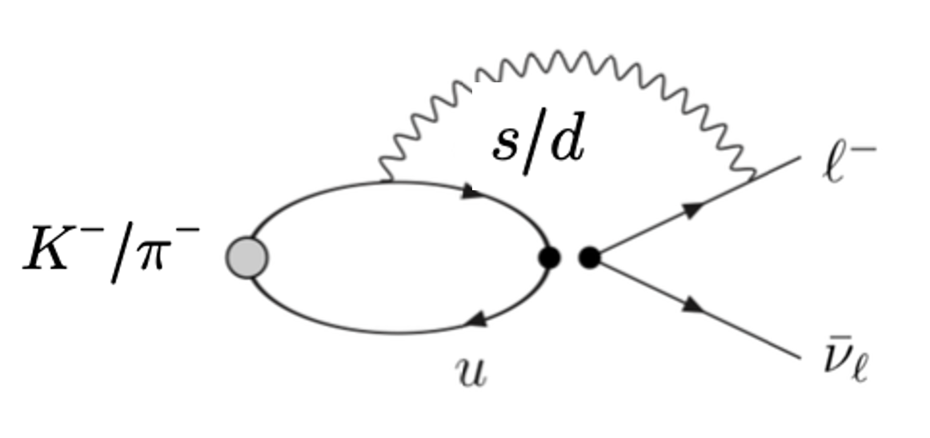
Infinite-volume reconstruction
2
1
XF, L. Jin, PRD100 (2019) 094509
QCD part is localized in a finite volume
QED part is included analytically in the infinite volume
Problem: QCD and QED parts do not match?
Solution:
Only when points 1 & 2 are separated with long distance, finite-volume effects become important
At long distance, single-particle propagation between 1 & 2
Reconstruct the infinite-volume single-particle propagation using the finite-volume one as input

Slide 23
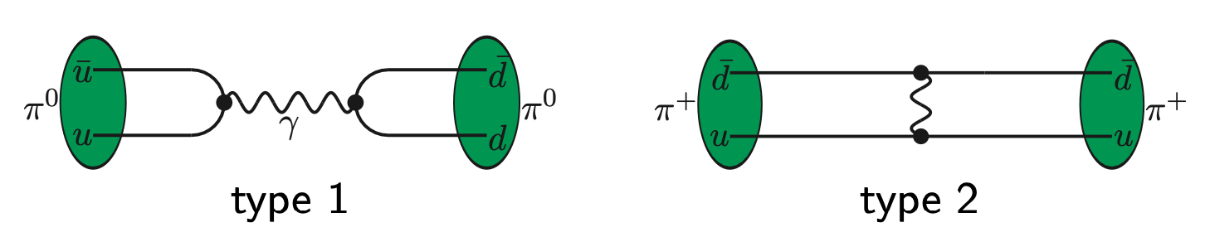


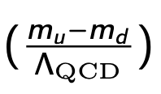
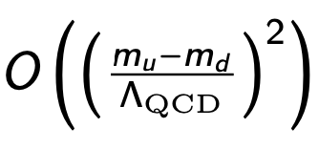
Use QED self energy – pion mass splitting as an example
Isospin breaking effects: EM + strong contributions
Strong IB appear at
Dominated by EM effects
Ideal testing ground to isolate the QED effects

Slide 24
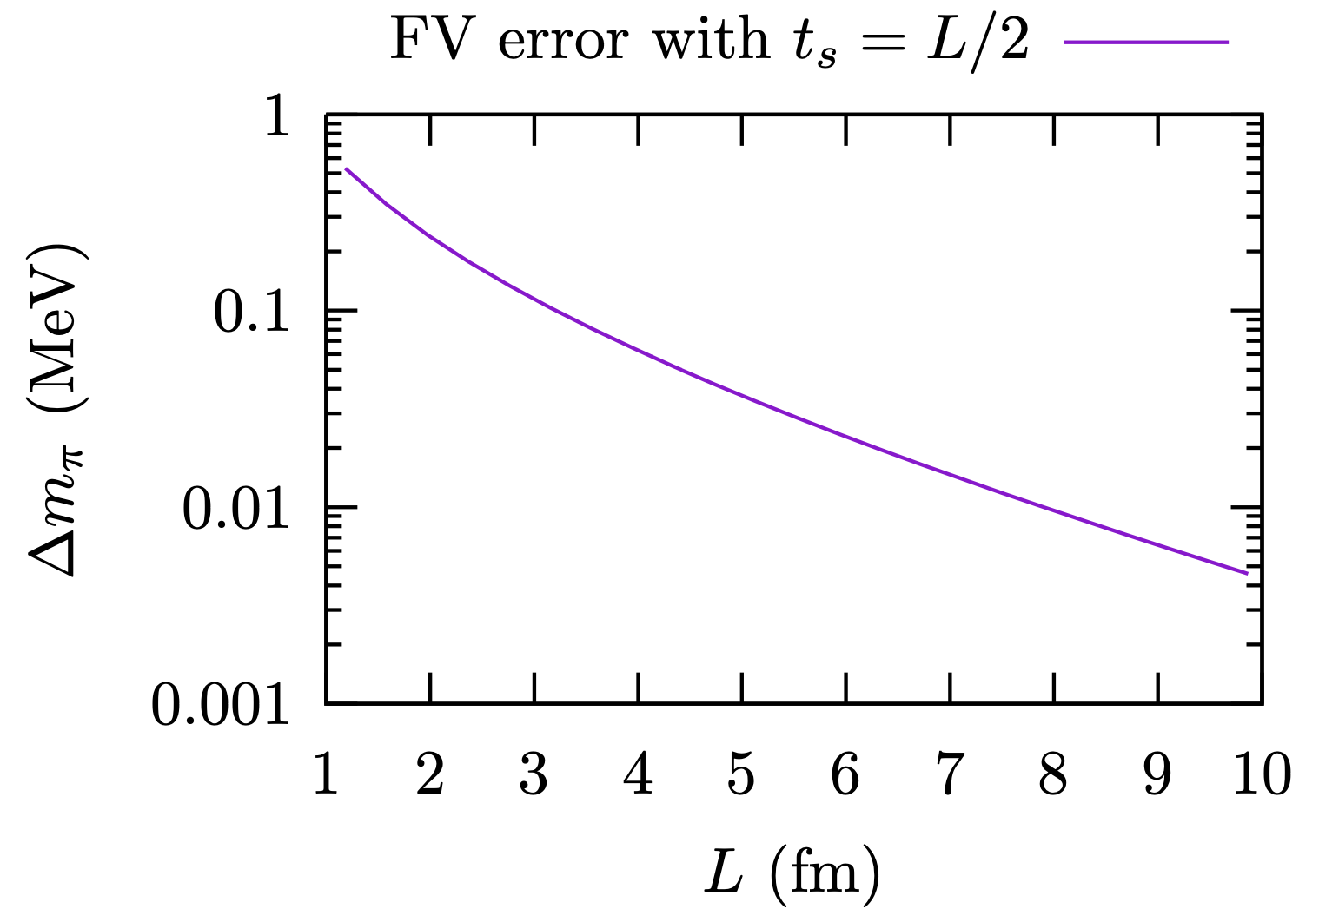
Use QED self energy – pion mass splitting as an example
Finite-volume effects mimicking by scalar QED
FV error exponentially suppressed

Slide 25
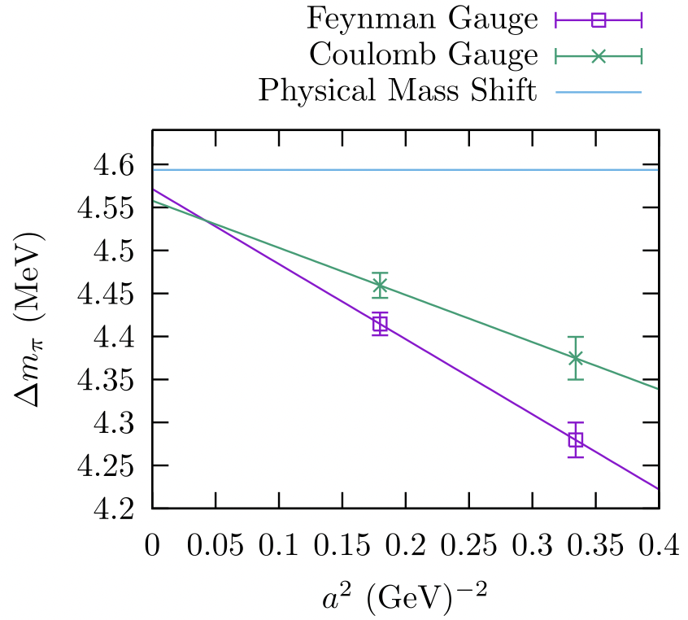
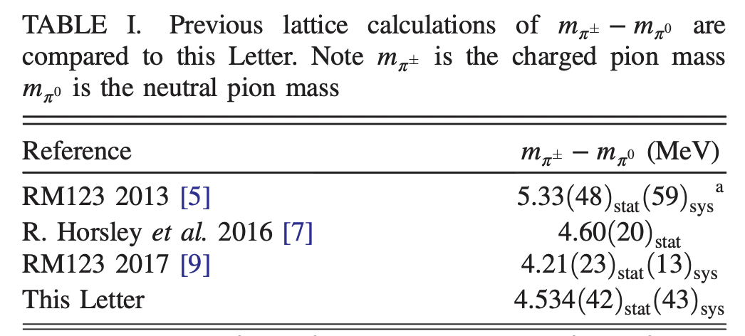
Use QED self energy – pion mass splitting as an example
Numerical calculation
XF, L. Jin, M. Riberdy, PRL128 (2022) 052003
Precision 5-10 times better than previous studies
Method extended from mass splitting to leptonic decay
N. Christ, XF, L. Jin, C. Sachrajda, T. Wang, PRD108 (2023) 014501
Numerical work is under going

Slide 26
Outline
Test of first-row CKM unitarity
Inclusion of isospin breaking effects
Rare decays

Slide 27


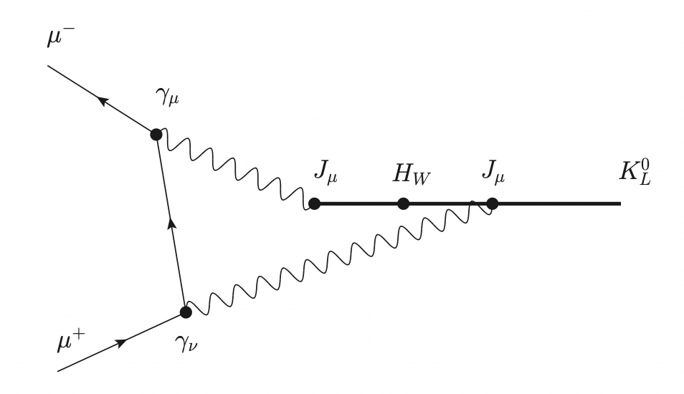

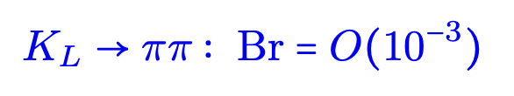
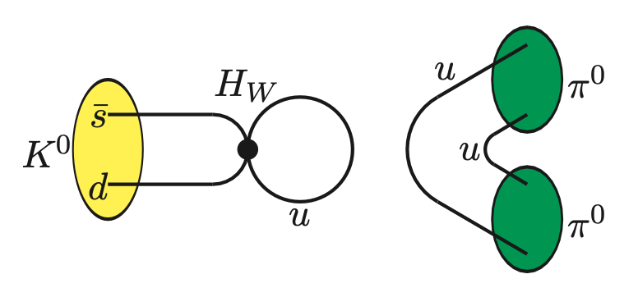
Interesting rare processes

Slide 28
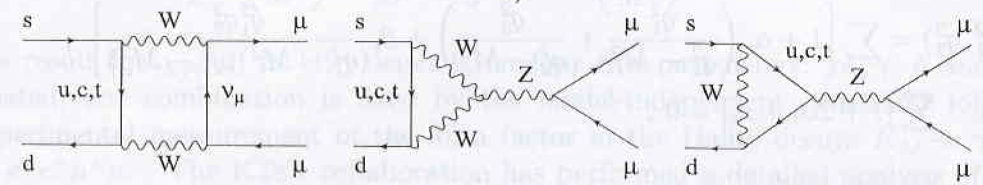
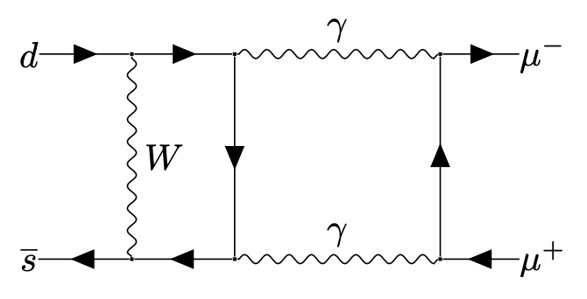
Interesting rare processes (1)
In SM, K_{L}→μ⁺μ⁻ is a FCNC process
SD contribution via W & Z boson exchange, contributes ~12% to BR
M. Gorbahn & U. Haisch, PRL97 (2006) 122002
LD contribution via two-photon exchange is nonperturbative
Imaginary part known from optical theorem and K_{L}→γγ decay rate
Real part is not well understood → largest uncertainty
Cirigliano, Ecker, Neufeld, Pich, Portoles, Rev.Mod.Phys. 84 (2012) 399

Slide 29
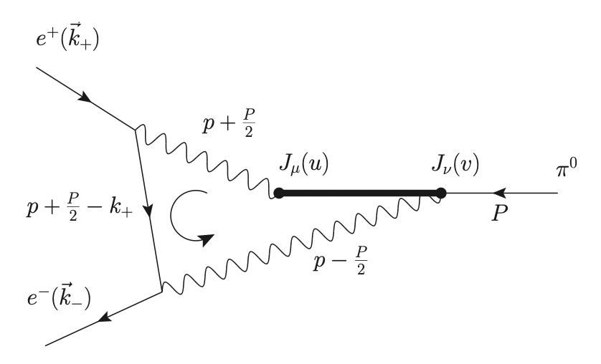
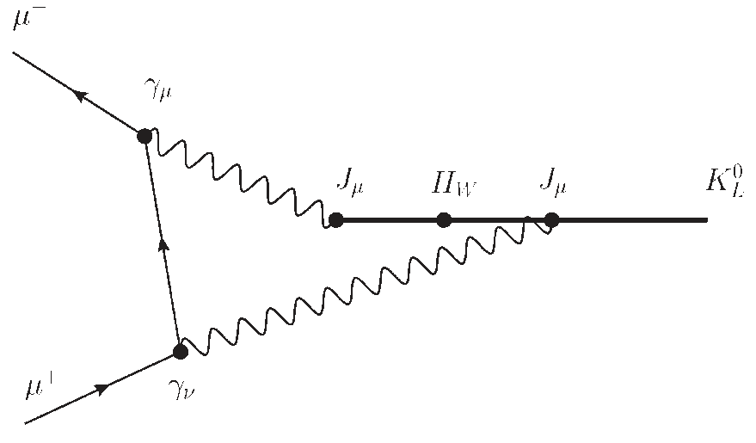


Decay process involves photon and lepton loop
Lattice QCD calculation
$K_{L}→μ^{+}μ^{−}$
$π^{0}→μ^{+}μ^{−}$
5 vertices, 60 different time ordering
4 vertices, 12 different time ordering
Many intermediate states with E<M_{K}
Only two-photon state with E<M_{π}
Hadronic part involves 4pt function
Used to develop methodology

Slide 30


Decay process involves photon and lepton loop
Lattice methodology
Re[A(π→e⁺e⁻)]@m_{π}=140 MeV, RBC-UKQCD
Calculate non-QCD part in Minkowski spacetime
Then Wick rotate to Euclidean spacetime
N. Christ, XF, L. Jin et.al, PRL 130 (2023) 191901
Precision 6-7 times better than exp. measurement
1.8 σ deviation is obtained
Methodology extended to K_{L}→μ⁺μ⁻ and exploratory numerical calculation undertaken
talk by En-Hung Chao at Lattice 2023

Slide 31
Interesting rare processes

Slide 32



Comparison between two rare decay channels
Calculation of
is more challenging than
γ-exchange
Z-exchange diagram involves both vector and axial vector current insertions
In W-W diagram, neutrinos are not connected at 1 point → Dalitz study of the amplitude
SD divergent, requires UV subtraction

Slide 33
Interesting rare processes

Slide 34







Form factor relevant for
Experimental measurement
New results from NA62
[NA62, JHEP 11 (2022) 011]
Hadronic amplitude is described by a form factor
with
Form factor is parameterized as

Slide 35







Exploratory lattice calculation
[N. Christ, XF, A. Lawson, et.al. PRD94 (2016) 114516]
Experimental data + phenomenological analysis yields a₊<0 and b₊<0

Slide 36




Calculation at physical pion mass
2+1 flavor DWF with
Physical pion mass
Three charm quark masses used for extrapolation to physical point
Large statistical error from stochastic estimated quark loops
[P Boyle et.al. PRD107 (2023) L011503 ]

Slide 37
Interesting rare processes

Slide 38




in the Standard Model prediction

Slide 39





Results for charm quark contribution
Charm quark contribution
NNLO QCD [A. Buras, M. Gorbahn, U. Haisch, U. Nierste, JHEP 11 (2006) 002]
Chiral perturbation theory [G. Isidori, F. Mescia, C. Smith, NPB 718 (2005) 319]
First lattice results @ m_{π}=420 MeV, m_{c}=860 MeV [Z. Bai, N. Christ, XF, et.al. PRL118 (2017) 252001]

Slide 40



Short summary
At physical kinematics, calculation is very challenging
Involve light-quark loop → Physical pion mass
Large volume to control FV effects from π
Involve charm-quark loop → Physical charm mass
Fine lattice spacing to control lattice artifacts from charm quark
Need a very large lattice (or new idea?)
From Kaon to hyperon
5.6σ deviation from past experiments
4.2σ deviation from past experiments

Slide 41
Interesting rare processes

Slide 42

K→ππ decays and CP violation

Slide 43

Update of A₀

Slide 44

Update of Re[$ε′/ε$]

Slide 45


Conclusion
Test of first-row CKM unitarity
|V_{ud}| Theory: EWR, Nuclear structure
f₊(0): More lattice calculations for average
Inclusion of isospin breaking effects
An interesting frontier
More studies + new method
Rare decays
[Snowmass 2021, T. Blum et.al., arXiv:2203.10998]
We believe that over the next 5-10 years, lattice QCD will be in a position to produce predictions of a_{s}, a₊, b_{s}, b₊ with uncertainties below the 10 % level
It may not be unreasonable to expect that with continued effort a reduction in errors below the 30% level in five years and below 10 % in ten years may be achieved

