Slide 1



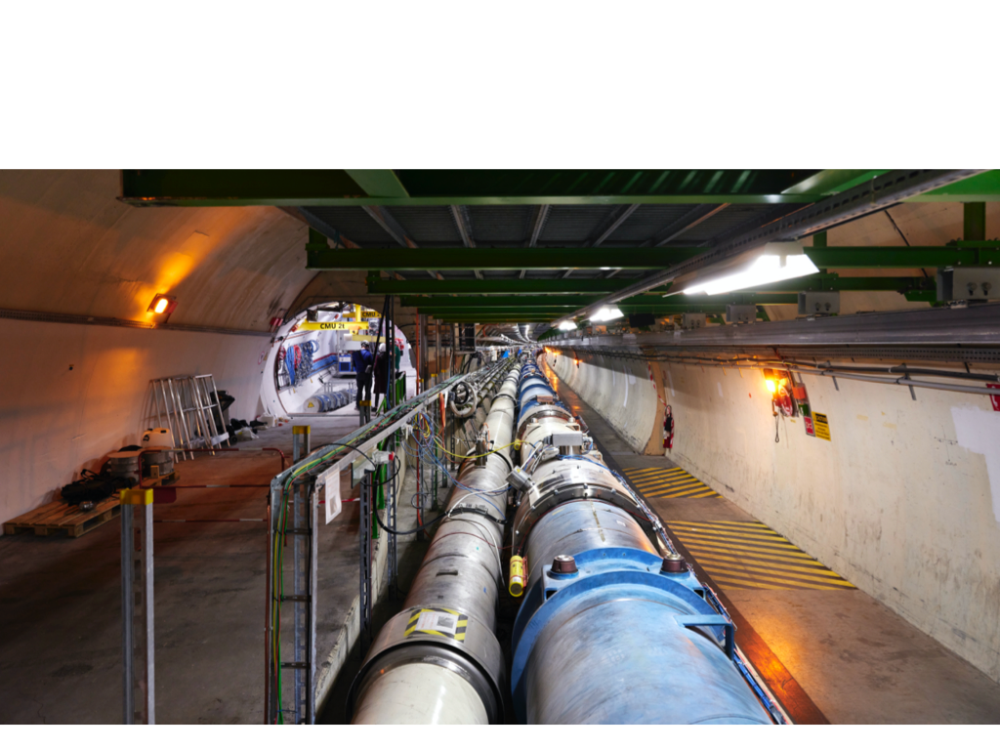

Neutrino experiments at the LHC
Umut KOSE
On behalf of the FASER & SND Collaborations
22nd Conference on Flavor Physics and CP Violation
FPCP 2024, 27-31 May 2024

Slide 2
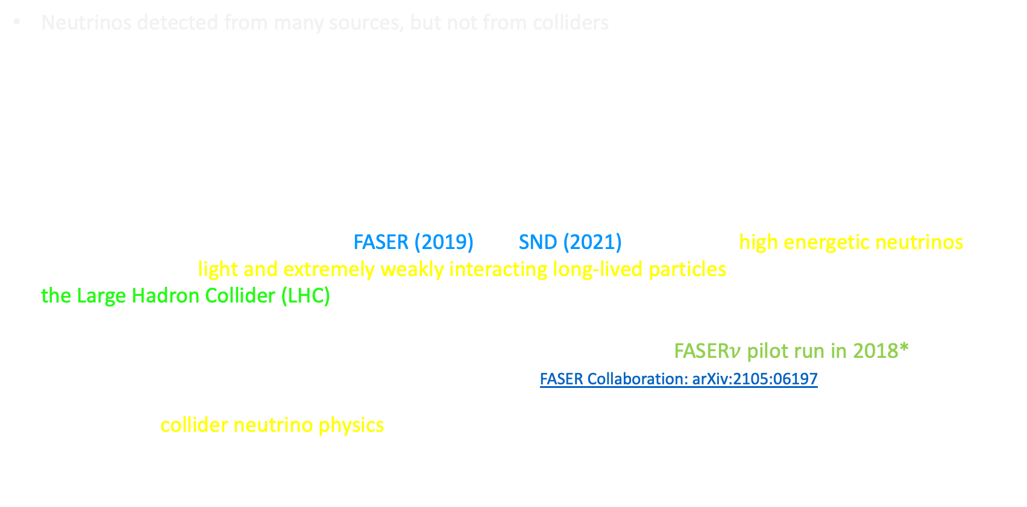
History
Neutrinos detected from many sources, but not from colliders
Neutrinos at collider were considered in 80s and 90s but never realized:
  A. De Rujula, R. Ruckl, Neutrino and muon physics in the collider mode of future accelerators (1984)
  Klaus Winter, Detection of the tau neutrino at the LHC (1990)
  F. Vannucci, Neutrino physics at LHC/SSC (1993)
  A. De Rujula, E. Fernandez, J.J. Gomez-Cadenas, Neutrino fluxes at future hadron colliders (1993)
  H. Park, The estimation of neutrino fluxes produced by proton-proton collisions at √s = 14 TeV of the LHC (2011)
Two experiments were approved: FASER (2019) and SND (2021) to study for high energetic neutrinos as well as to search light and extremely weakly interacting long-lived particles produced in forward region at the Large Hadron Collider (LHC) at CERN
First neutrino interaction candidates at collider/LHC observed by the FASER$ν$ pilot run in 2018* (using 29 kg emulsion-W module, collecting 12.2 fb⁻¹ ) FASER Collaboration: arXiv:2105:06197
A new era in collider neutrino physics allowing to explore unexplored energy region
LHC Run3 physics run started in 2022
* Two FASER$ν$ pilot run in 2018 to study the charged particle flux and for neutrino detections as a proof of principle.

Slide 3
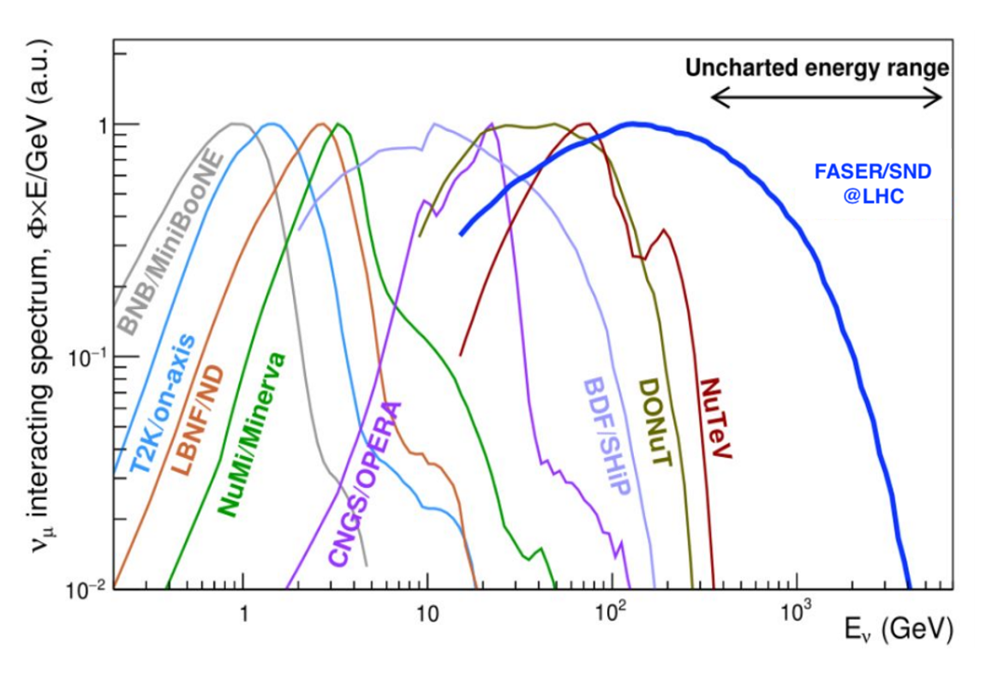
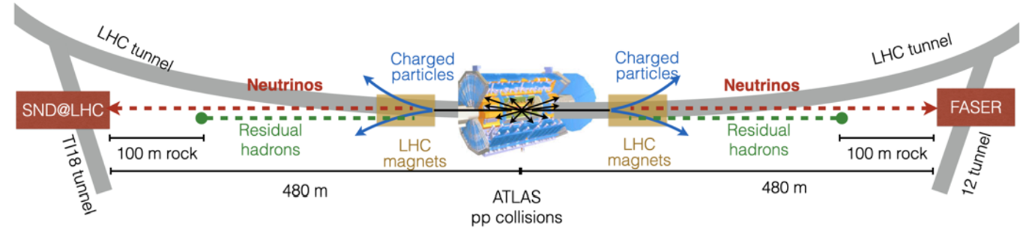

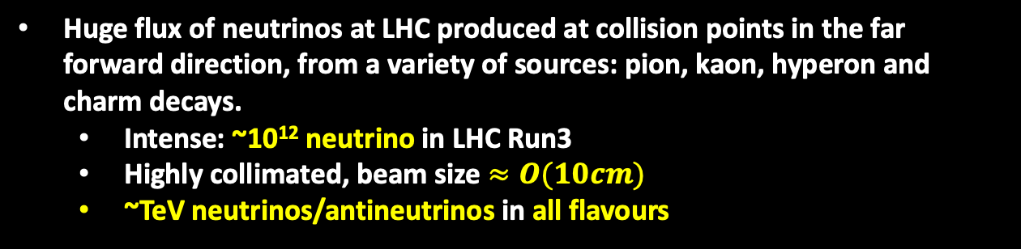
LHC as Neutrino Beam Line
Huge flux of neutrinos at LHC produced at collision points in the far forward direction, from a variety of sources: pion, kaon, hyperon and charm decays.
  Intense: ~10¹² neutrino in LHC Run3
  Highly collimated, beam size $≈O(10cm)$
  ~TeV neutrinos/antineutrinos in all flavours
FASER/FASER$ν$ and SND are dedicated to study unexplored energy regime (TeV neutrinos)
Study production, propagation and interactions of high energy neutrinos
Probing neutrino related models to new physics

Slide 4
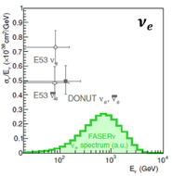
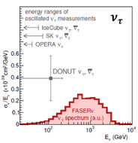
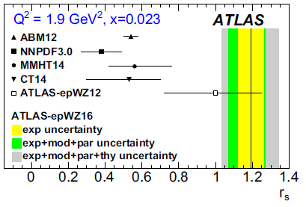
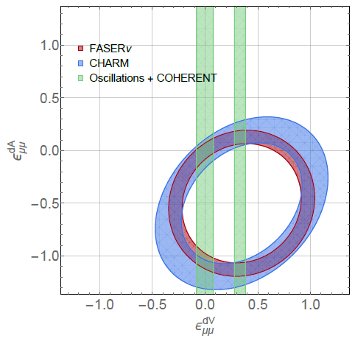
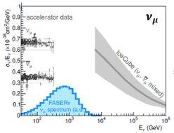
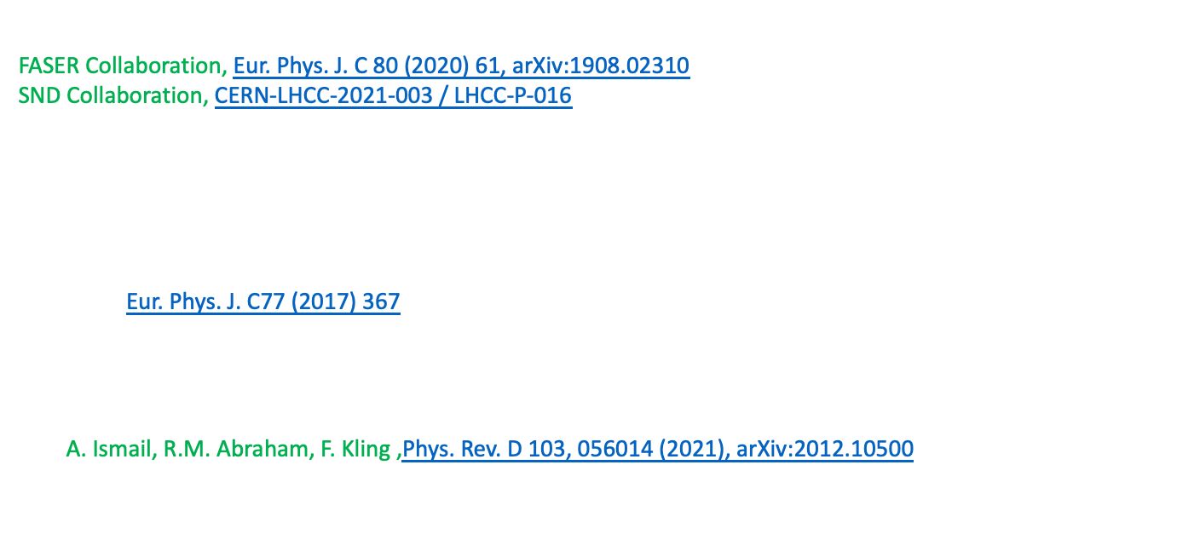
Physics potential: high energy neutrino interactions
Cross section measurements of different flavor at TeV energies.
FASER Collaboration, Eur. Phys. J. C 80 (2020) 61, arXiv:1908.02310
SND Collaboration, CERN-LHCC-2021-003 / LHCC-P-016
Test lepton flavour universality in neutrino interactions by comparing cross-sections
Neutrino CC interaction with charm production (𝜈𝑠→𝑙𝑐):
  Study the strange quark content: $r_{s}=\frac{s+\overline{s}}{2\overline{d}}$
  Probe inconsistency between the predictions and the LHC data
  Eur. Phys. J. C77 (2017) 367
  to date no charmed hadron observed in $ν_{e}CC$ interactions
Search for anomalous b-quark production in neutrino interactions
Neutrino NC measurements could constrain neutrino non-standard interactions. A. Ismail, R.M. Abraham, F. Kling ,Phys. Rev. D 103, 056014 (2021), arXiv:2012.10500
NSI

Slide 5
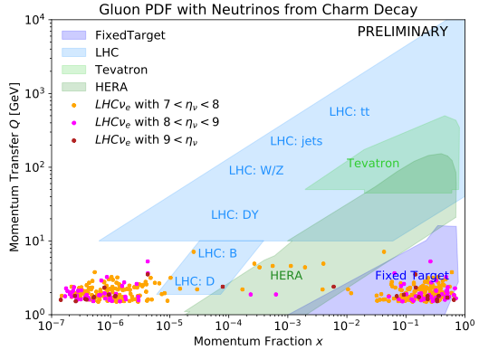
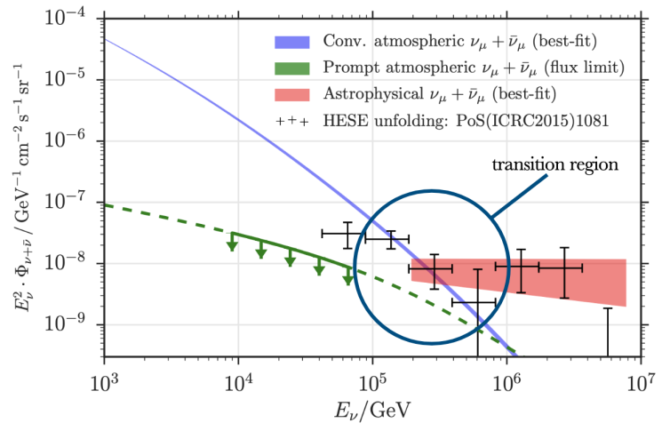
Physics potential: Forward particle production
Neutrinos produced in the forward direction at the LHC originate from the decay of hadrons, mainly pions, kaons, and charm particles.
Forward particle production is poorly constrained by other LHC experiments. Neutrino flux measurement both at SND and FASER will provide complimentary constraints that can be used to validate/improve MC generators.
Neutrinos from charm decay could allow to test transition to small-x factorization, constrain low-x gluon PDF and probe intrinsic charm contributing to QCD → relevant for FCC
Having precise measurements of the cosmic neutrino flux in high energy neutrino telescopes, accelerator measurements of high energy and large rapidity charm production are needed. As 7+7 TeV 𝑝-𝑝 collision corresponds to 100 PeV proton interaction in fixed target mode, a direct measurement of the prompt neutrino production would provide important basic data for current and future prompt atmospheric high-energy neutrino telescopes, such as ICECUBE.
by F. King
prompt atmospheric neutrinos

Slide 6

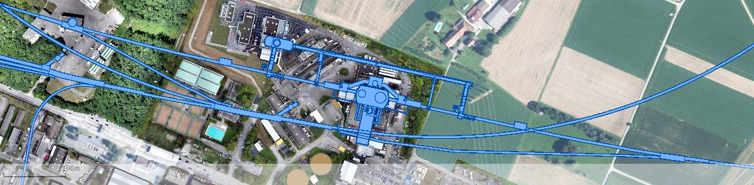
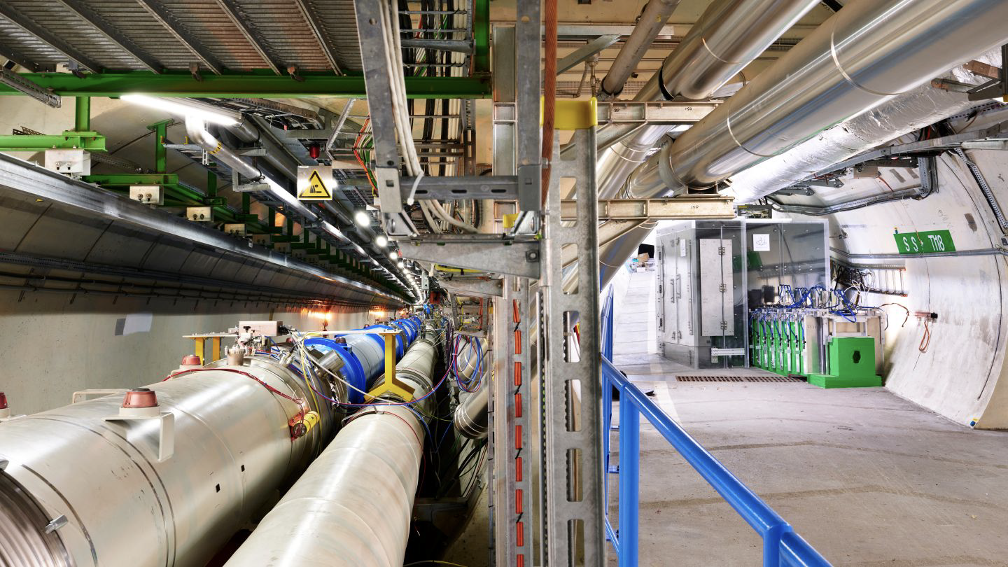

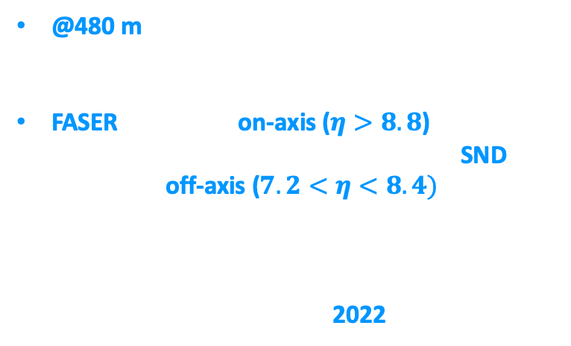
LHC Neutrino Experiments
@480 m away from ATLAS IP
FASER @ TI-12 and SND @ TI-18
FASER located at on-axis ($η>8.8$) along the LoS allows increasing statistics, while SND located at off-axis ($7.2<η<8.4)$ enhances charm contributions
Muon background levels low at both sites
Starting data taking since 2022
TI-18
ATLAS IP
TI-12

Slide 7
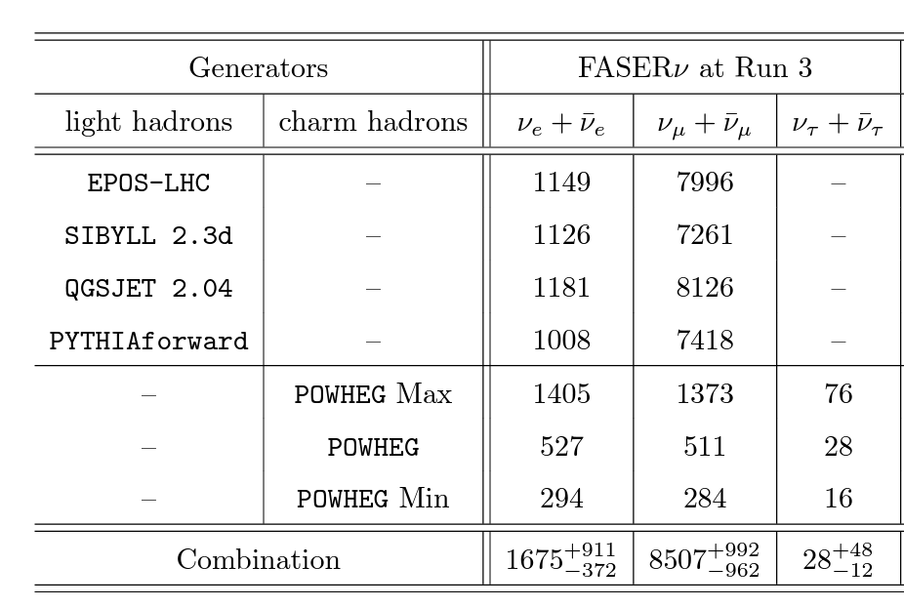
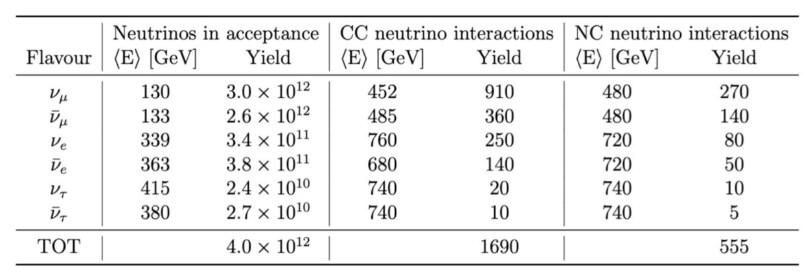
Expected neutrino event rate in LHC Run3
Neutrino production:
  For light hadrons (pions, kaons and hyperons) EPOS-LHC, QGSJET II-04, SIBYLL2.3d, PYTHIA8, DPMJET
  For charm hadrons POWHEG+PYTHIA8, DPMJET
Propagation to detectors BDSIM/FLUKA model of the LHC
Neutrino interactions with tungsten/emulsion GENIE
Propagation in the detector GEANT4
LHC Run3 with an integrated luminosity of 250 fb⁻¹
Neutrino CC interactions
CERN-LHCC-2021-003 / LHCC-P-016
FASER Coll. arXiv:2402.13318
Directly observed $ν_{τ}CC$ interactions: 9 at DONUT and 10 at OPERA experiments

Slide 8
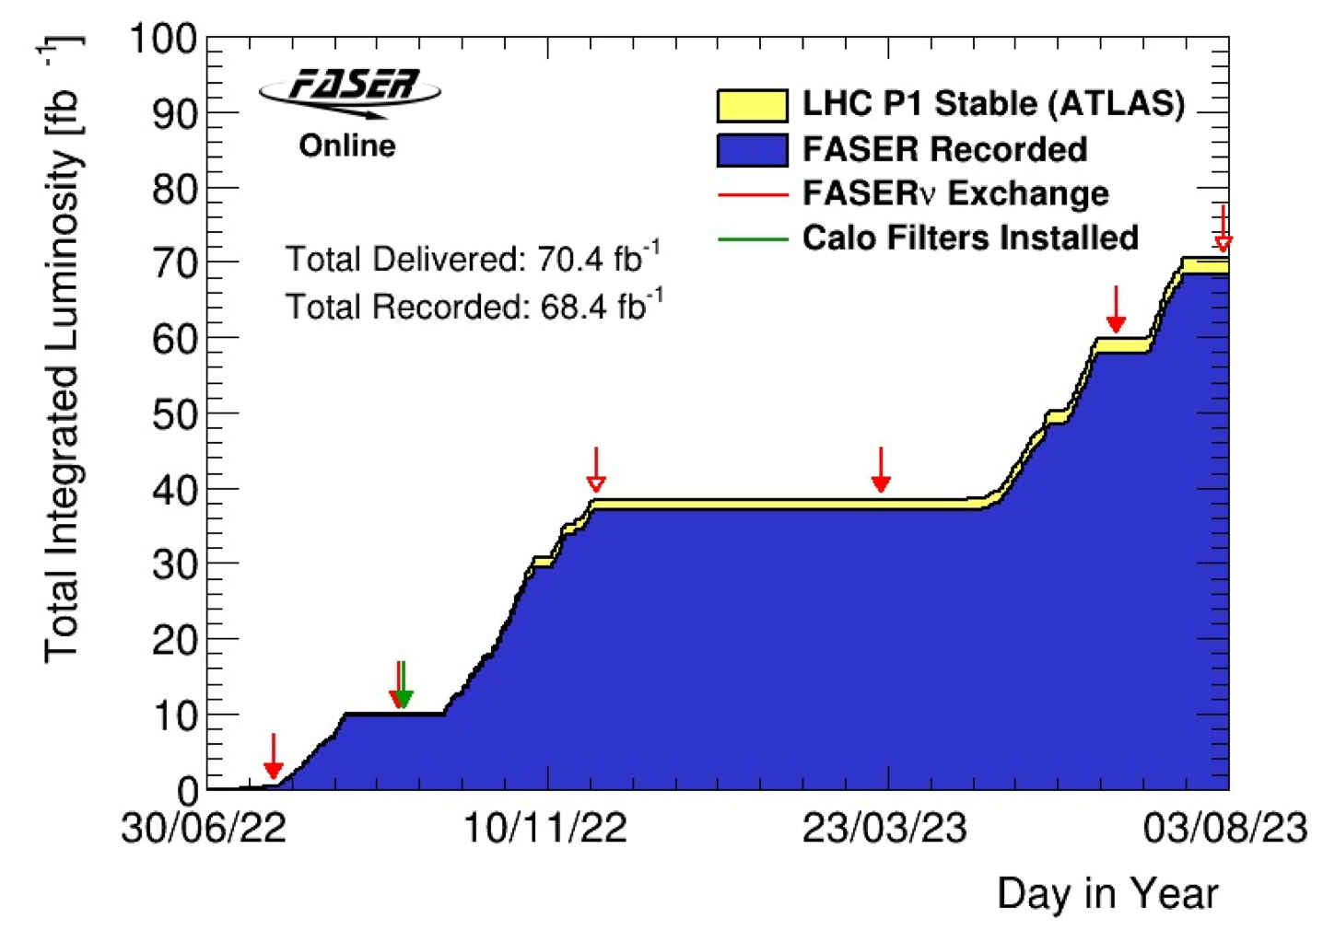
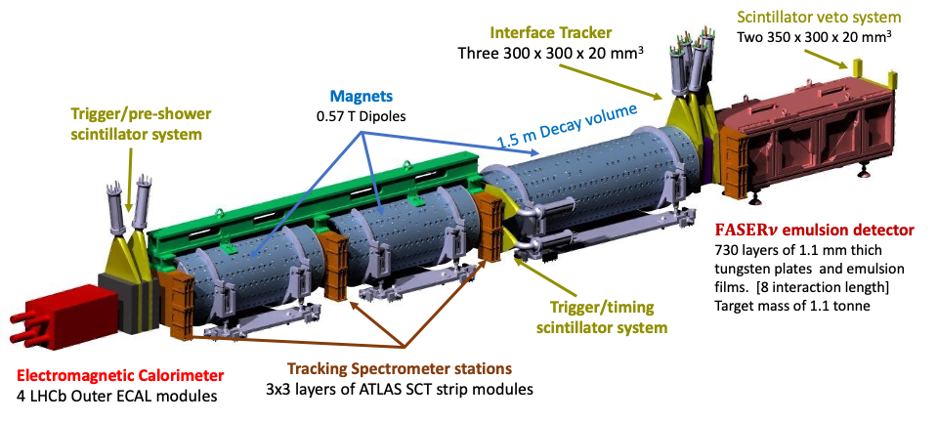
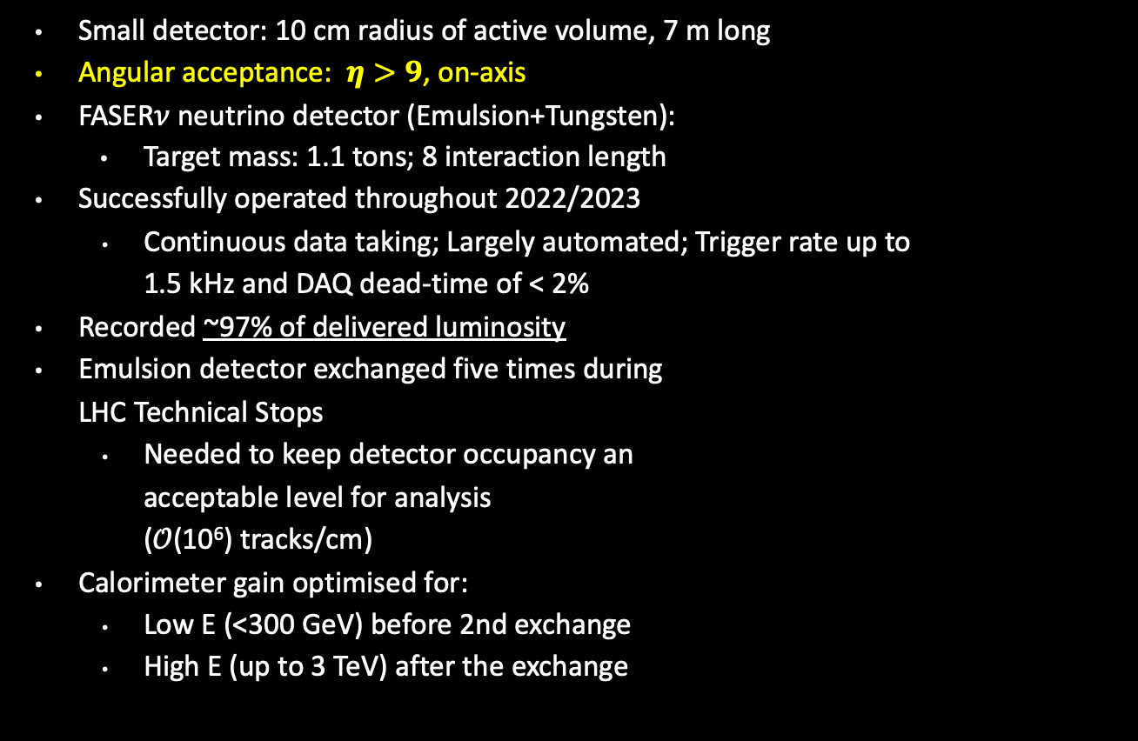
FASER Detector and its operation in LHC Run3
Small detector: 10 cm radius of active volume, 7 m long
Angular acceptance: $η>9$, on-axis
FASER$ν$ neutrino detector (Emulsion+Tungsten):
  Target mass: 1.1 tons; 8 interaction length
Successfully operated throughout 2022/2023
  Continuous data taking; Largely automated; Trigger rate up to 1.5 kHz and DAQ dead-time of < 2%
Recorded ~97% of delivered luminosity
Emulsion detector exchanged five times during LHC Technical Stops
  Needed to keep detector occupancy an acceptable level for analysis (𝒪(10⁶) tracks/cm)
Calorimeter gain optimised for:
  Low E (<300 GeV) before 2nd exchange
  High E (up to 3 TeV) after the exchange
arXiv:2207.11427
Nearly 70 fb⁻¹ of data recorded with data taking efficiency of 97%

Slide 9
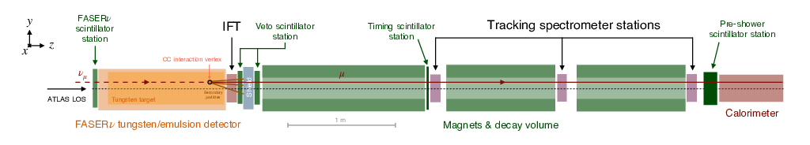
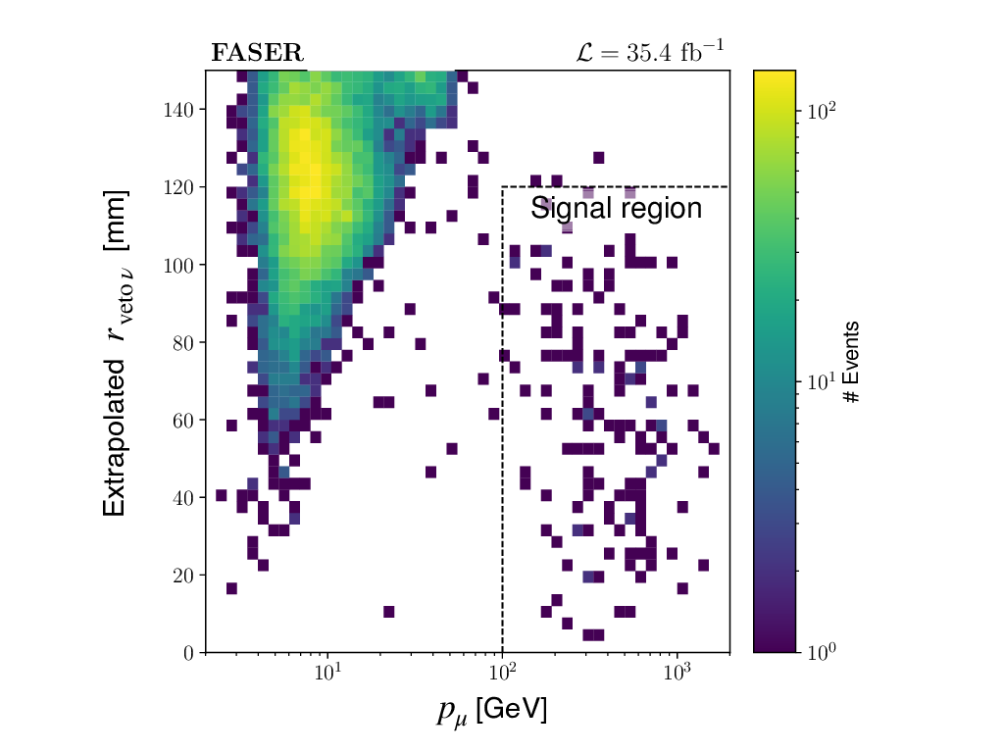
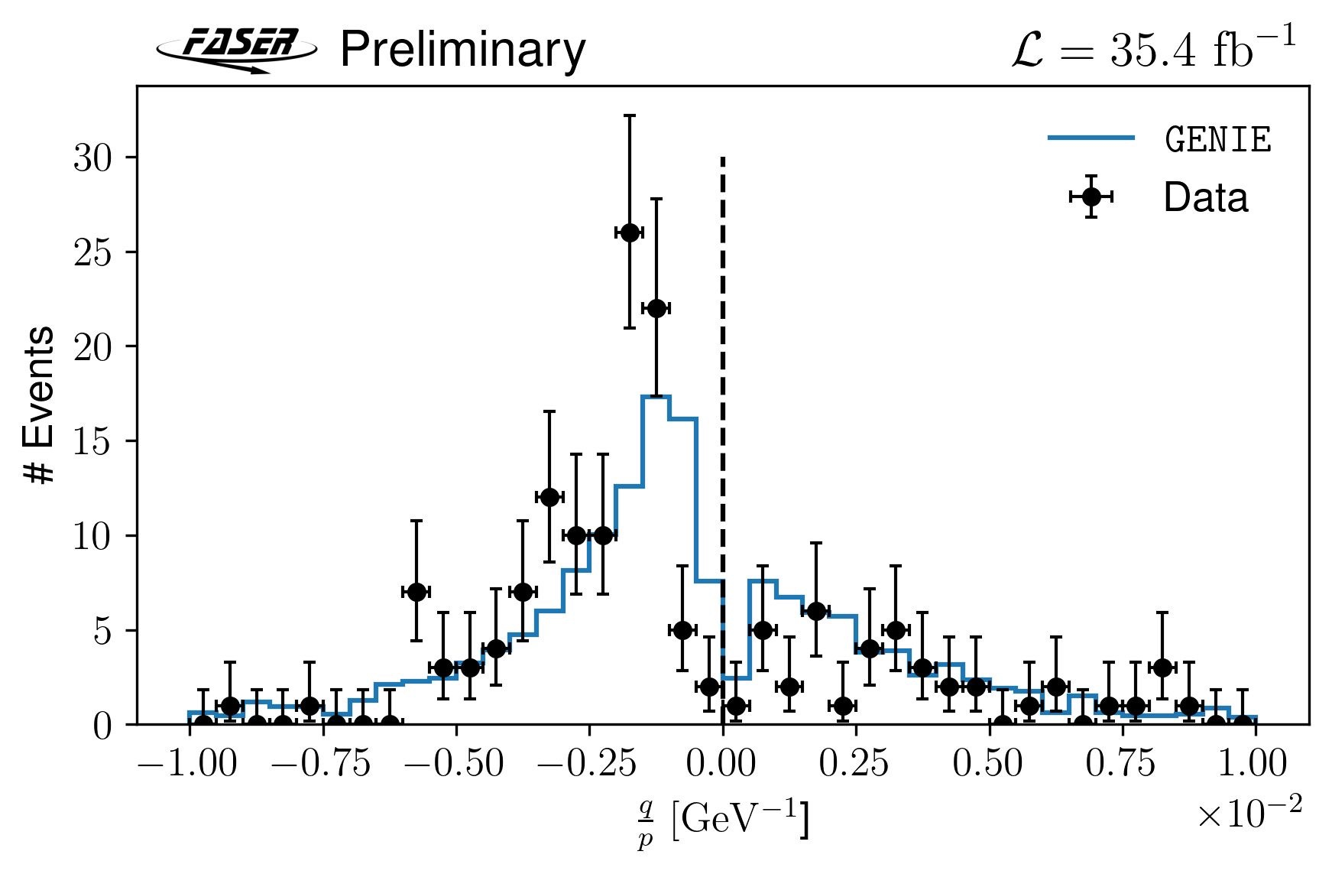
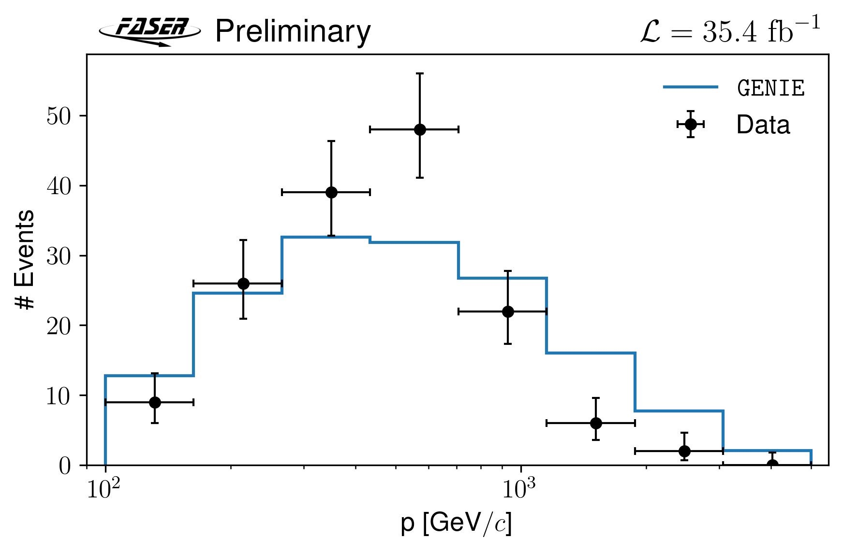



First Direct Observation of Collider Neutrinos with FASER at the LHC
Dataset collected at $\sqrt{s}=13.6 TeV$ from July to November 2022 corresponding to integrated lumiosity of 35.4 fb⁻¹ used for the first direct observation of neutrino interactions using FASER electronic detector.
Expecting $151±41$neutrino events from GENIE simulation
  Uncertainty from difference between generators (DPMJET & SIBYLL).
  No experimental errors were included.
Background:
  Neutral hadrons: $0.11 ±0.06$ events
  Muon scattering: $0.08 ± 1.83$ events
  Veto inefficiency: negligible
Unblinded results:
  $153$ events in the signal region
  Signal significance of $16σ$
$ν_{μ}$
${\overline{ν}}_{μ}$
Phys. Rev. Lett. 131, 031801 (2023)
Notes:
Selection criteria: no activity in the initial scintillator station and at least one MIP’s energy deposition in two additional stations, with consistent timing and pre-shower counter readings.
The main background to neutrino signatures originates from the high energy muons scattering in the tungsten and/or bending in the magnetic field
neutral hadron interactions in FASERν producing charged particles with a momentum of more than 100 GeV.

Slide 10
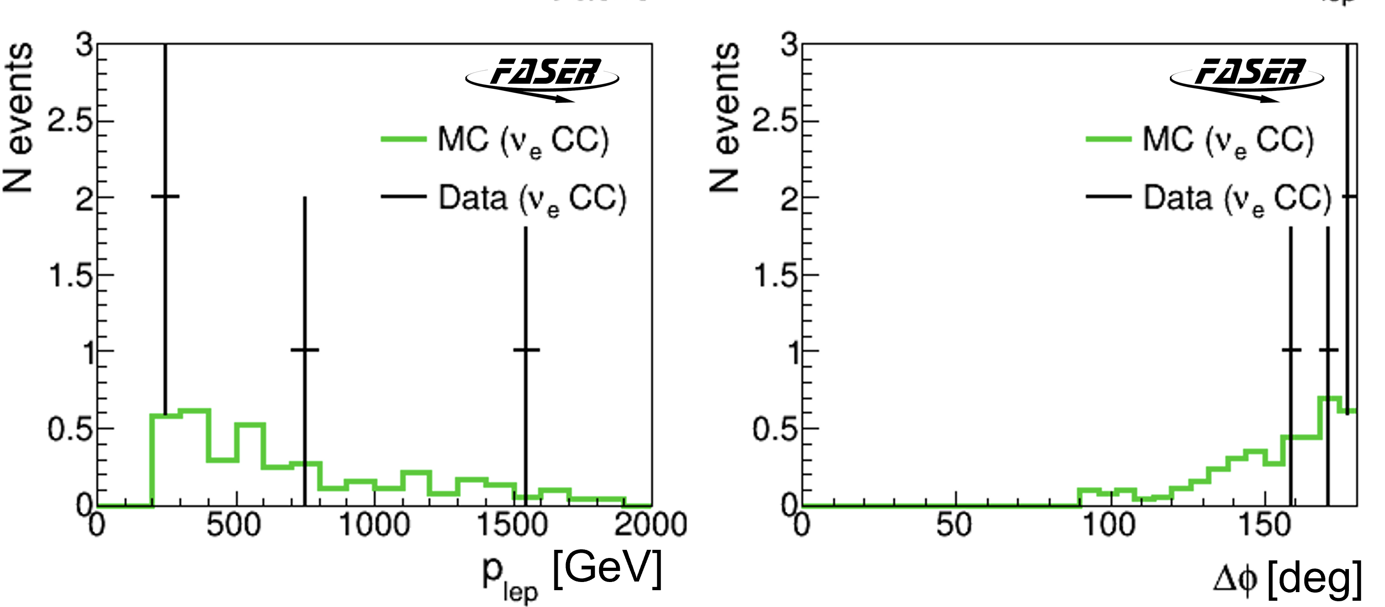
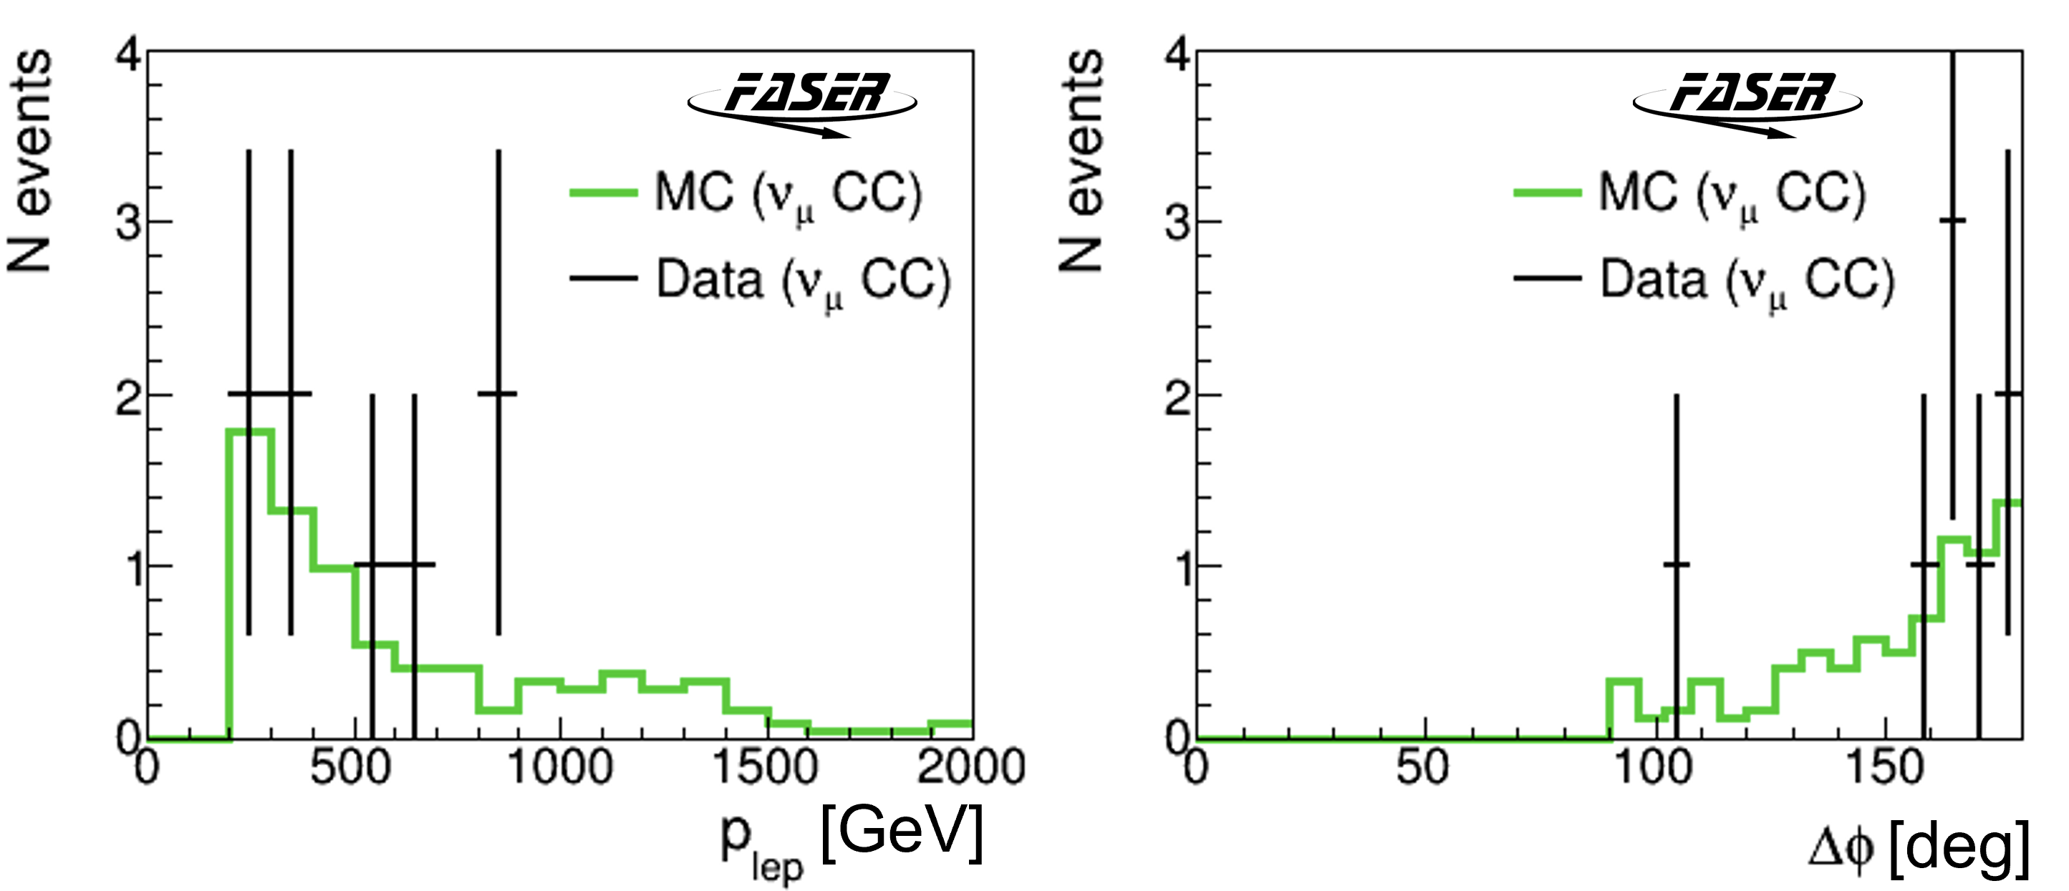
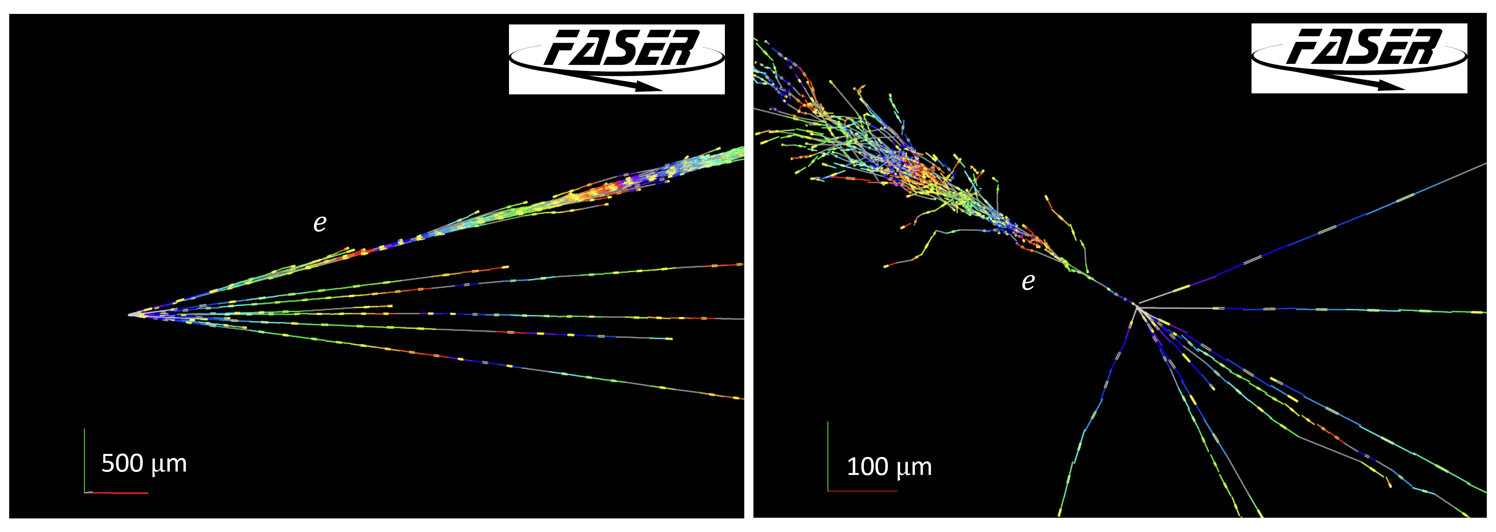
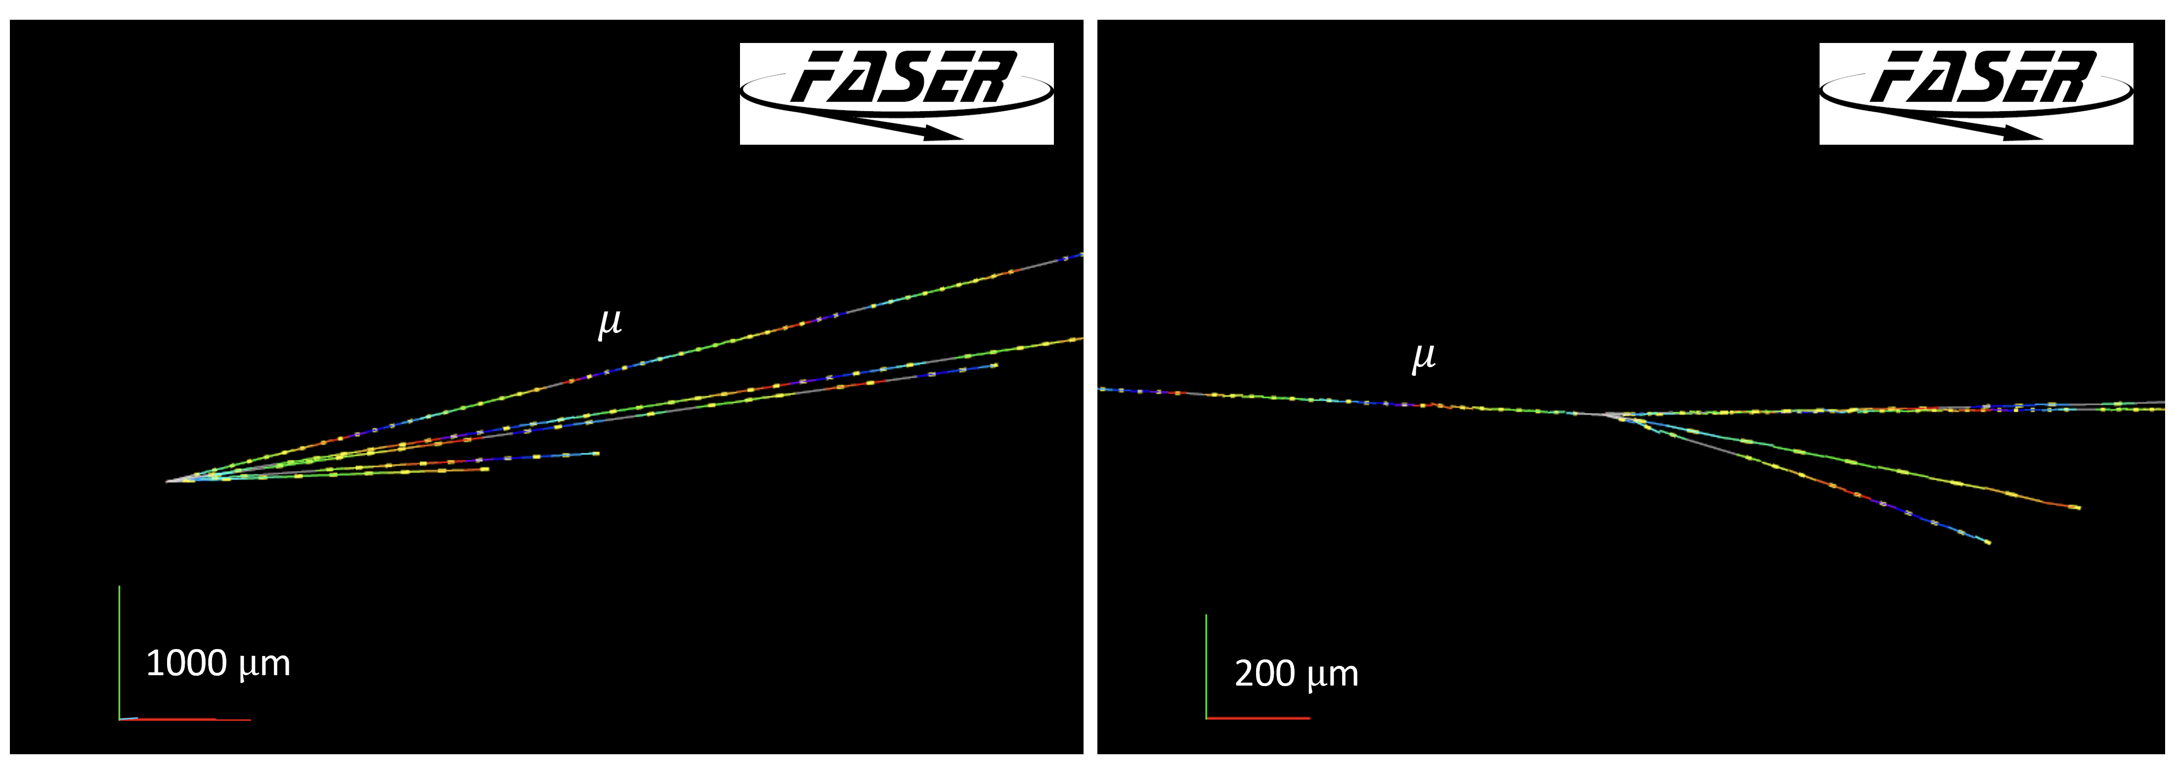
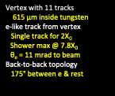
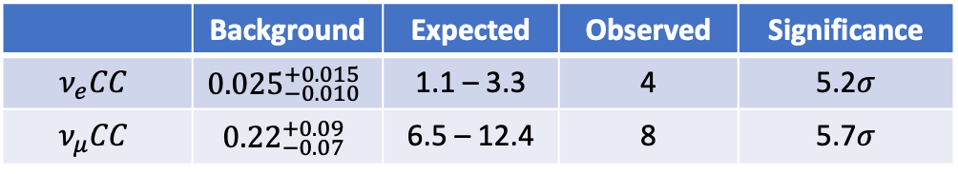
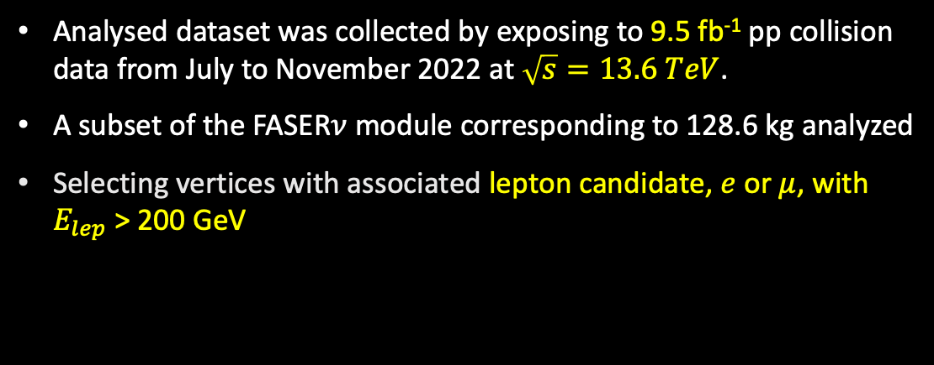
First direct observation of $ν_{e}$interactions at the LHC
Analysed dataset was collected by exposing to 9.5 fb⁻¹ pp collision data from July to November 2022 at $\sqrt{s}=13.6 TeV$.
A subset of the FASER$ν$ module corresponding to 128.6 kg analyzed
Selecting vertices with associated lepton candidate, $e$ or $μ$, with $E_{lep}$ > 200 GeV
arxiV:2403.12520
 | Background | Expected | Observed | Significance
$$ν_{e}CC$$ | $${0.025}_{−0.010}^{+0.015}$$ | 1.1 – 3.3 | 4 | 5.2$σ$
$$ν_{μ}CC$$ | $${0.22}_{−0.07}^{+0.09}$$ | 6.5 – 12.4 | 8 | 5.7$σ$
1.5 TeV
360 GeV

Slide 11
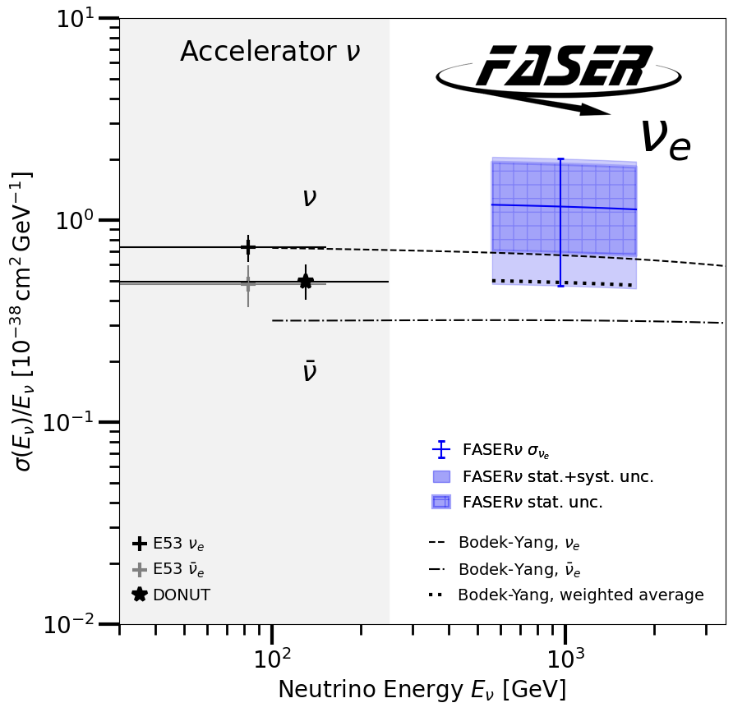
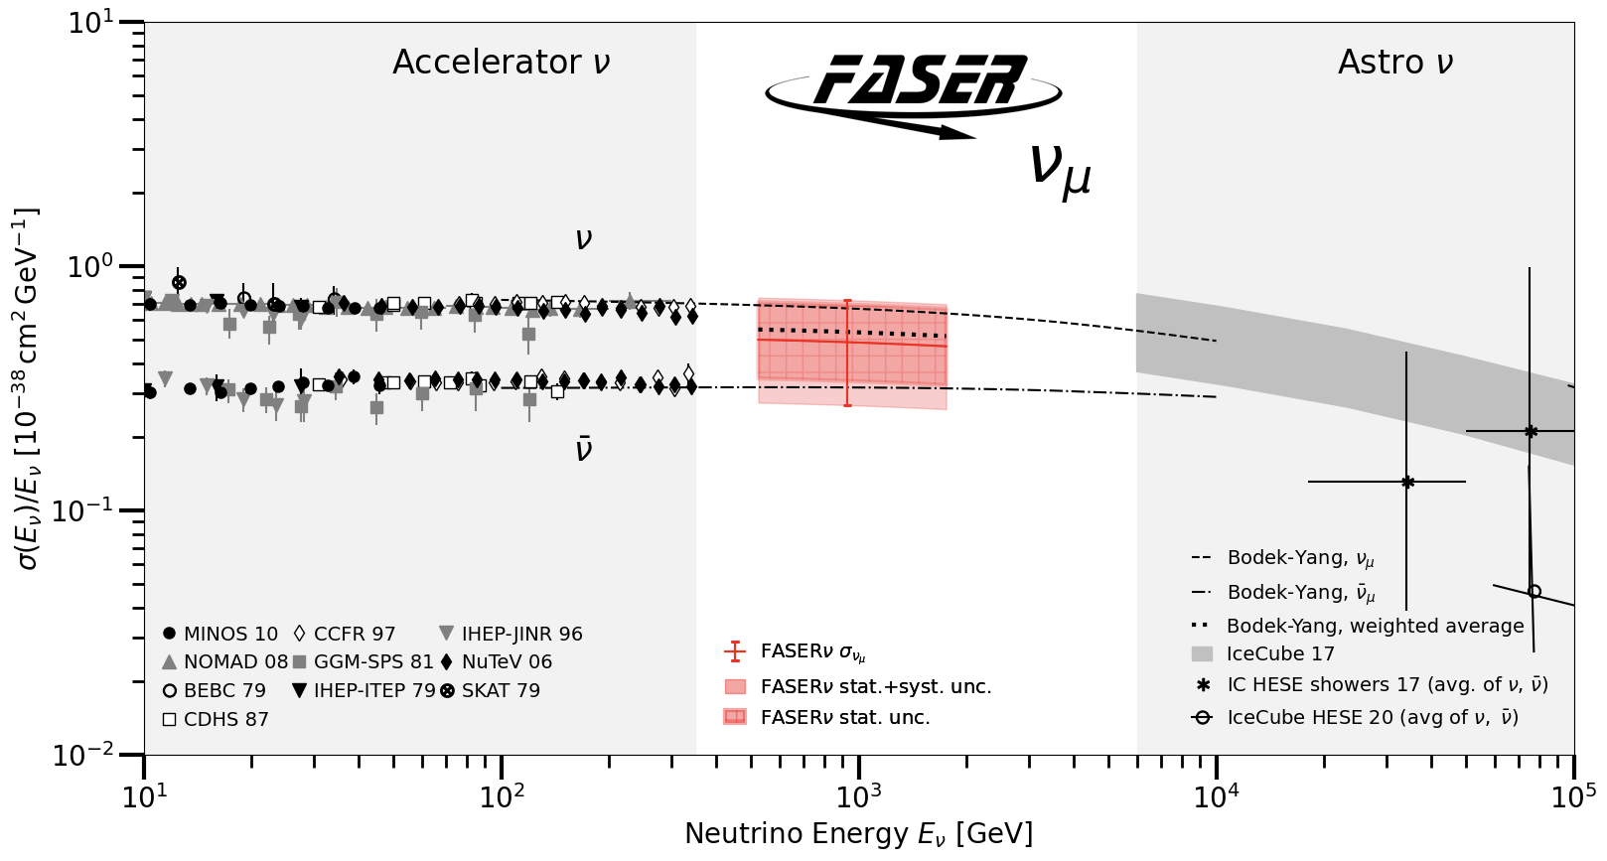
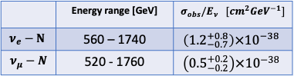
First measurement of the $ν_{e}$ and $ν_{μ}$ interaction cross-sections
The interaction cross-section per nucleon measured over an unexplored energy range
Relative measurement with respect to theoretical curve
2% of the data used
More measurements to come with higher statistics
arxiV:2403.12520
Notes:
The observed events are used for the first measurement of nue and numu interaction cross-section per nucleon over an unexplored energy range.
The results are given as relative measurement with respect to theoretical curve.

Slide 12
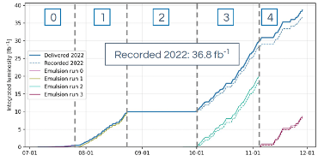
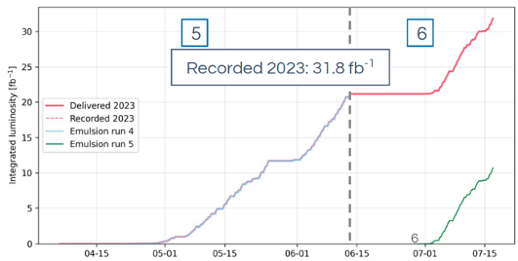
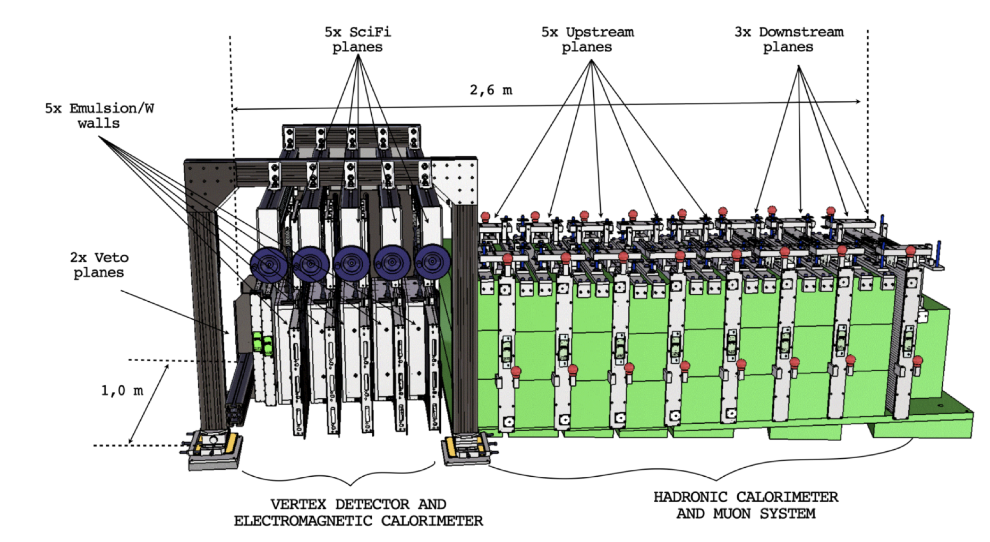

SND Detector and its operation in LHC Run3
Angular acceptance: $7.2<η<8.$4
Target mass: 830 kg, 3 interaction length
Five Emulsion+Tungsten (60 emsulsion films interleaved with 59 tungsten sheets) interleaved with SciFi trackers, followed by hadron calorimeter and muon system
Exchanging 6 times SND emulsion modules
About 68.6 fb⁻¹ of p-p collisions recorded by the electronic detectors, with 97% detector uptime efficiency

Slide 13
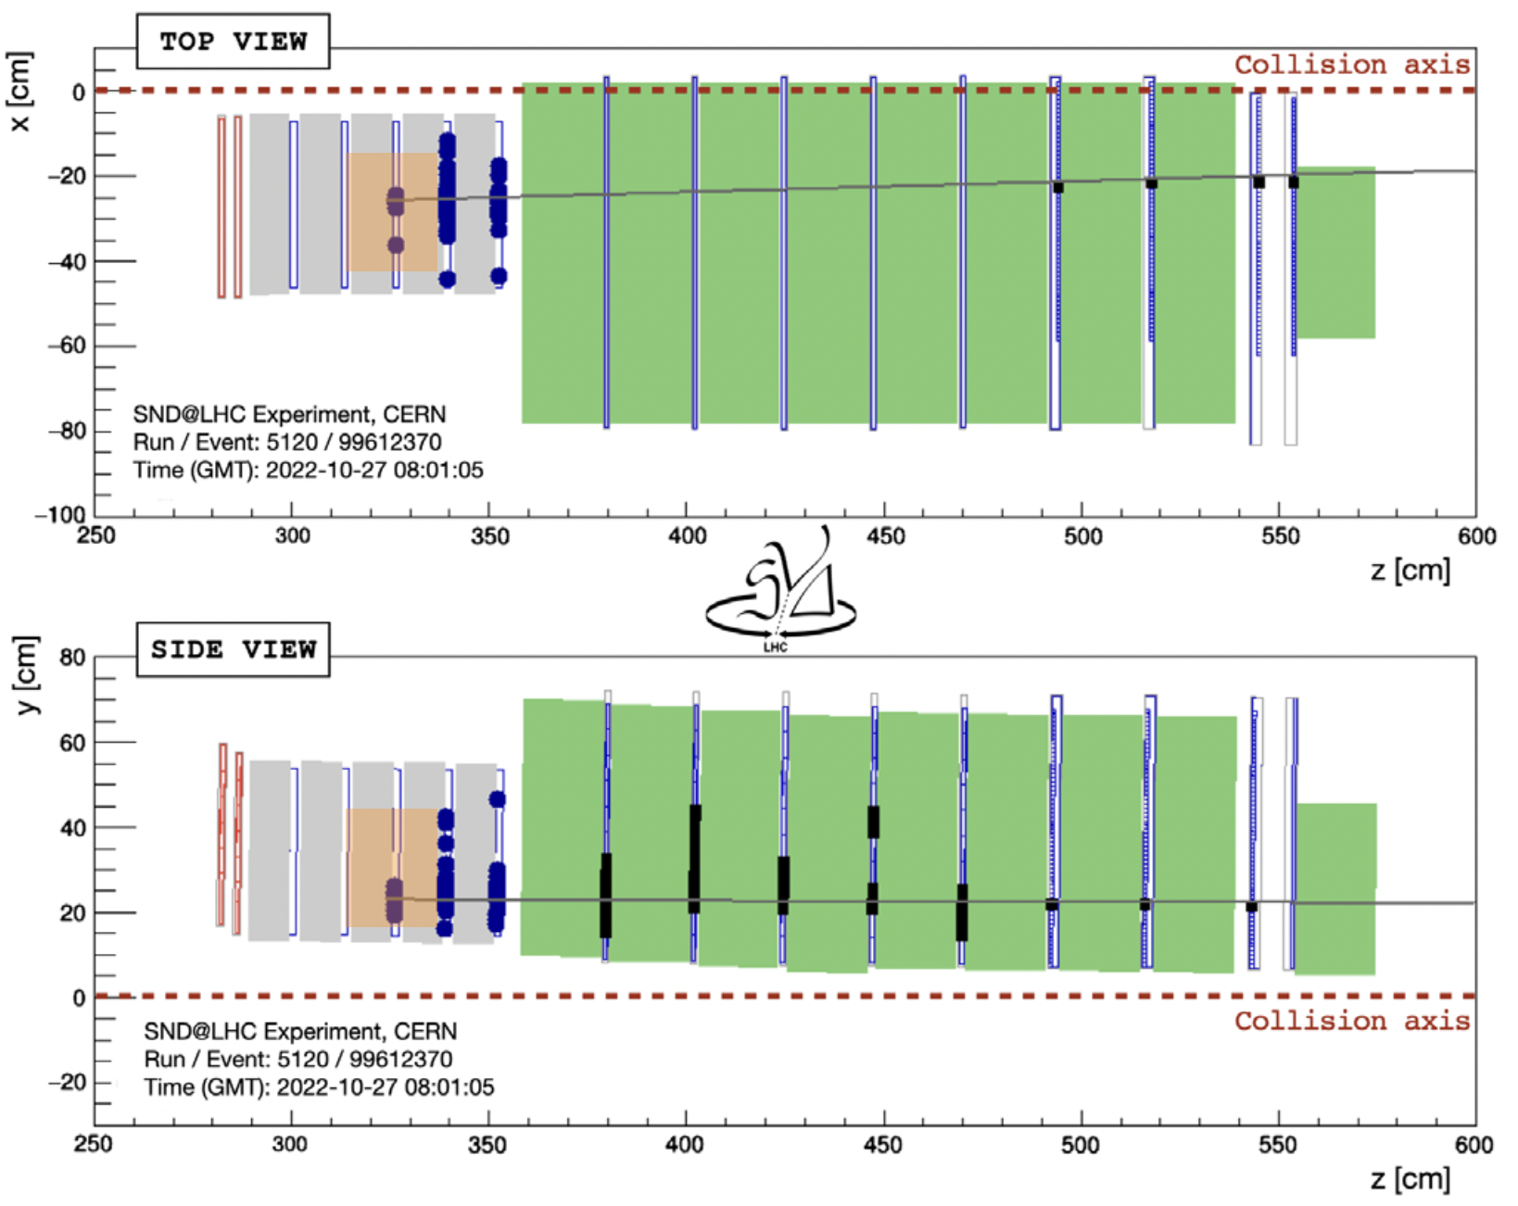
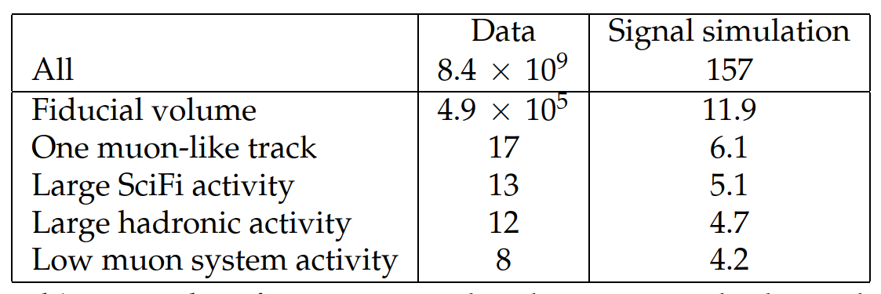
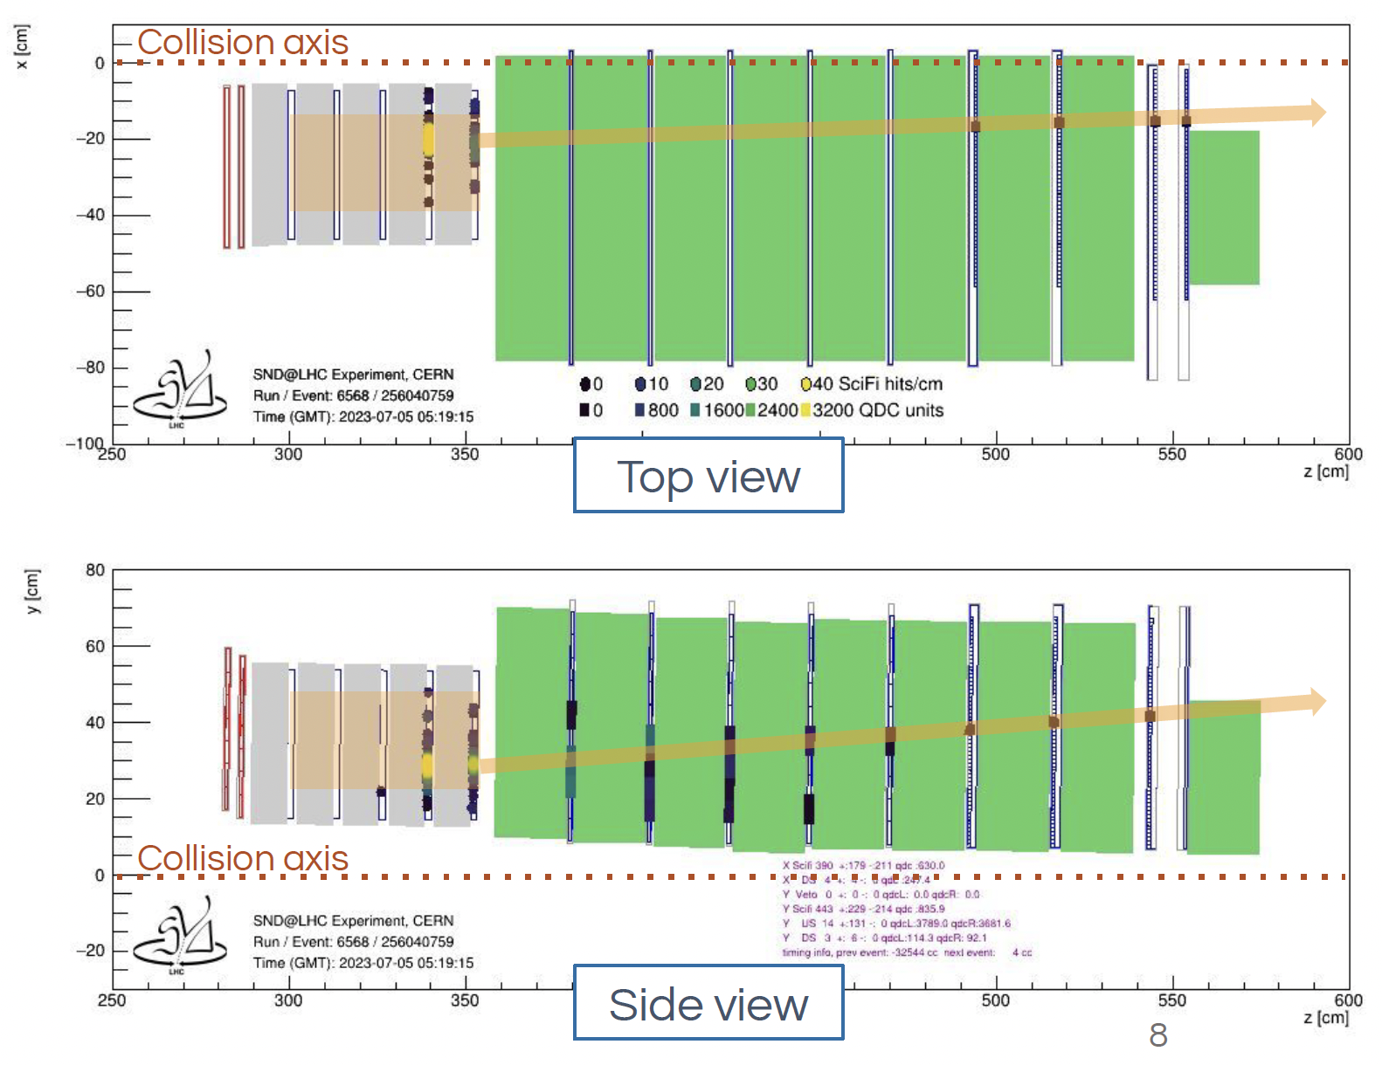
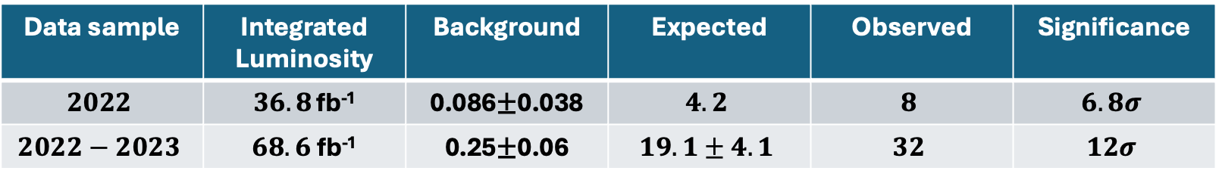

Observation of Collider Muon Neutrinos with SND
2022 data sample: (limited fiducial volume)
  FLUKA/GENIE, 157±37 $ν_{μ}CC$ interactions expected in whole target
  Hits in an inner XY detector region of $25×26$ cm²
  Using Em+W walls of 3 and 4, overall efficiency of 7.5 %
  Selecting events with large hadronic activity in the SciFi and HCAL, selection efficiency of 2.5%
2022-2023 data sample: extending fiducial volume
  Reject events in the first wall, overall signal acceptance 18%
  Large activities on SciFi and HCAL
  One muon track associated to the vertex
  Signal selection efficiency 35%
Phys. Rev. Lett 131, 031802
Notes:
SND Analyzed 2022 data sample by restricting the fiducial volume to an inner detector region. By using EM+W walls of 3rd and 4th, 4.2 events were expected with a background estimation of 0.09 events and 8 events observed with a significance of 6.8sigma. Later on the data sample is enlarged as well as the fiducial volume this time using rejecting only the events in the first wall, in this way the signal selection efficiency increased from 2.5% to 35%. About 19 events expected with a background of 0.25 events and 32 numuCC interactions observed with a significance of 12 sigma.

Slide 14
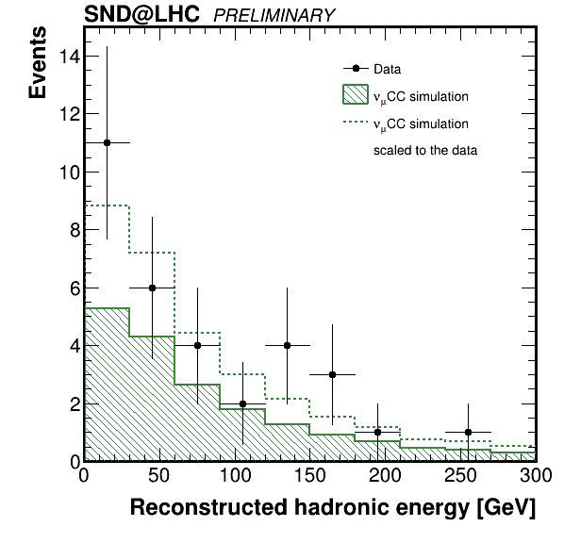
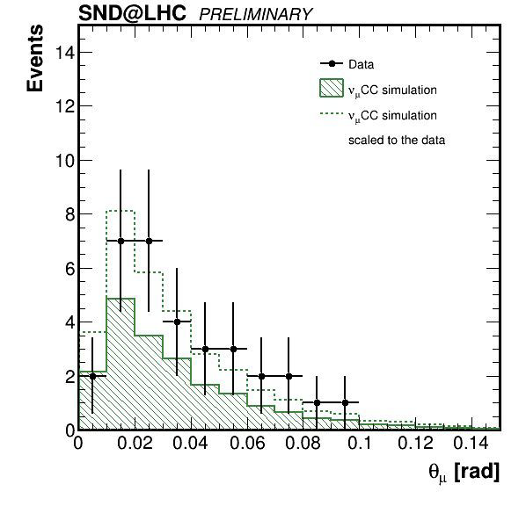
Muon Neutrino event kinematics (2022-2023 data sample)
Kinematics of muon neutrino candidates are in agreement with the signal prediction
Determination of hadronic shower allows for complete reconstruction of event kinematics and neutrino energy → in progress

Slide 15
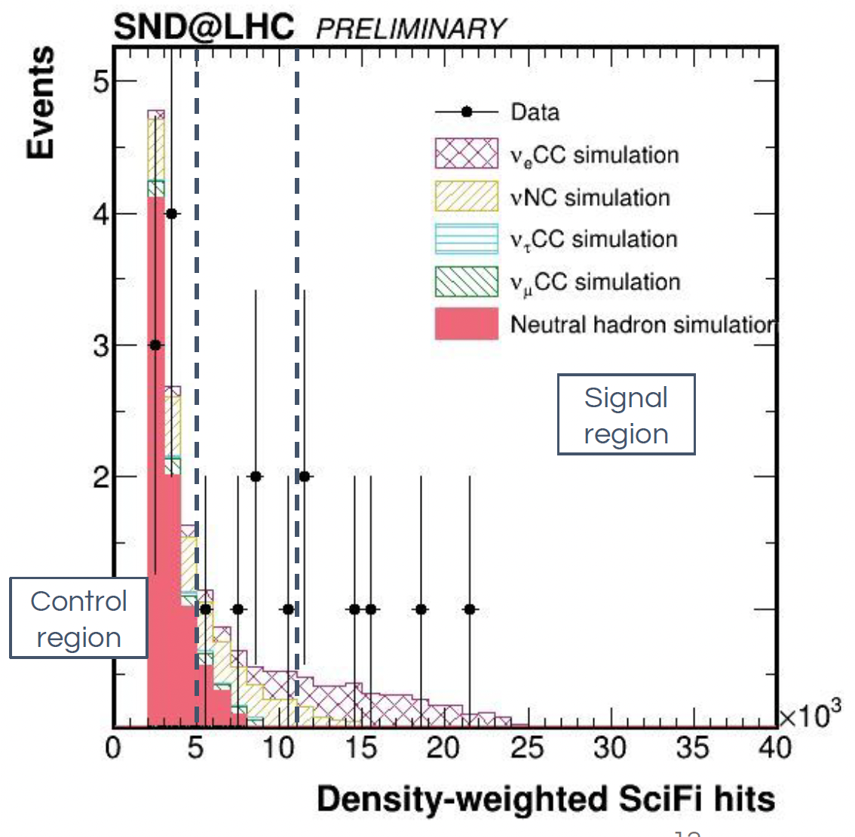
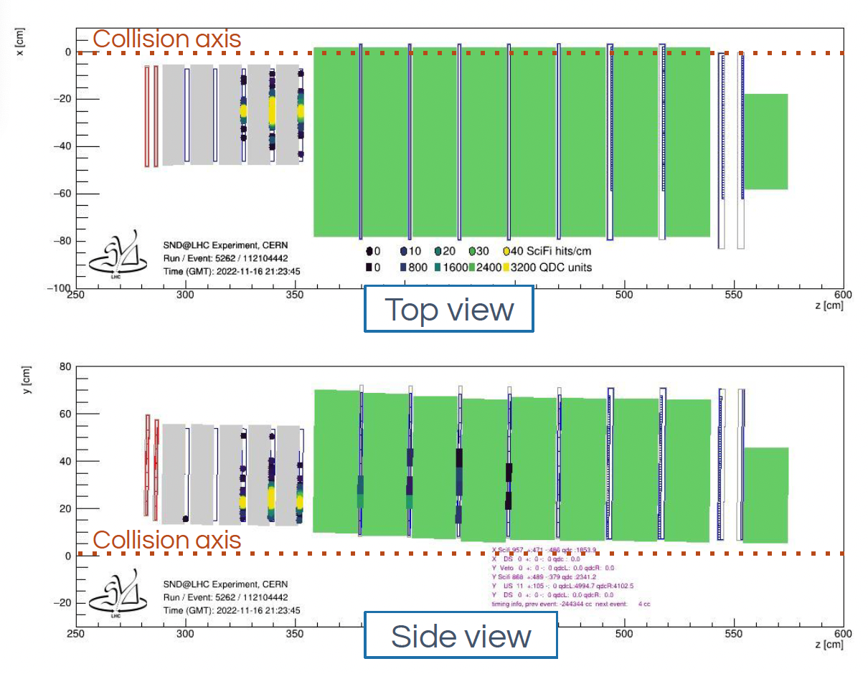

Search for shower like (0$μ$) neutrino events in SND
Signal: $ν_{e}CC$ (+ $ν_{τ}CC 0μ$ ) and NC interactions
Fiducial volume: no hits in veto, and rejecting side entering
→ signal acceptance 12%
Selection: Large activity on SciFi and HCAL, no reconstructable muon, density number of hits larger than 11x10³
→ selection efficiency 42%
Background: Neutral hadron, $ν_{μ}CC$ and $ν_{τ}CC$interactions

Slide 16



$ν_{e}CC$ search in emulsion at SND
Identifying regions with high track density in emulsions
Consistency with the expectation of EM shower development
Search for neutral vertices associated to identified shower
EM shower patterns identified
Vertex association in progress
Example of shower development:
4x4 mm2 region with 100$μ$m binning
Radiation length of W plate: 3.504 mm
Maximum width reached at plate 6.6 X0
Shower profile

Slide 17


LHC Run4
Both FASER and SND expressed their interest in taking data exploring further TeV neutrinos in LHC Run4, with expected total integrated luminosity of 680 fb⁻¹
Expecting to collect 5000 $ν_{e}$, 25000 $ν_{μ}$ and 100 $ν_{τ}$ interactions at FASER$ν$
With the HL-LHC operating at luminosity five times larger than the current run
  frequent replacement of Emulsion/Tungsten modules and require access to service tunnels
  FASER/FASER$ν$ approved, discussion ongoing on possible upgrade of neutrino detector at LHC Run4
  SND submitted Letter of Intent for LHC Run 4 with upgraded detector, AdvSND: replacing emulsion+W with high precision vertex detector using W as target.
Muon Spectrometer
Vertex&ECAL
HCAL
FASER/FASER
Option 1
FASER Coll. arXiv:2402.13318
AdvSND Coll. CERN-LHCC-2024-007

Slide 18







Axion-like particles (ALPs) search in FASER
Sensitive to ALPs produced by B meson decays and decay into two high energy photons (˜TeV) → mass range $50−500 MeV$ and $g_{αWW}\sim {10}^{−5}−{10}^{−3}$GeV⁻¹
Dataset collected at $\sqrt{s}=13.6 TeV$ in 2022 and 2023 corresponding to integrated lumiosity of 57.7 fb⁻¹
Selection: No signal in 5 veto counter and timing scintillator; evidence of EM shower in preshower counters; significant energy deposition (>1.5TeV) in EM calorimeter; in time with LHC
Observed limit
Background: $0.42±0.38$ events from neutrinos,
One event observed in unblinded signal region
Preshower deposit consistent with EM shower
Calorimeter energy of 1.6 GeV
World-leading constraints on ALPs are obtained for masses up to 300 MeV and couplings around 10⁻⁴ GeV⁻¹, testing a previously unexplored region of parameter space.
Conf note: CERN-FASER-CONF-2024-001
Notes:
Calorimeter energy distribution in the preshower and signal region, showing the neutrino background composition, separated according to neutrino flavour.

Slide 19







Dark Photon Search in FASER
Mainly produced at the LHC through $π^{0}→A^{′}γ$, $η→A^{′}γ$ and dark bremsstrahlung $pp→{ppA}^{′}$
FASER is sensitive in parameter space with $m_{A^{′}}∼100 MeV$ and $ε\sim {10}^{−5}$, searching for $A^{′}→e^{−}e^{+}$
Dataset collected at $\sqrt{s}=13.6 TeV$ in 2022 corresponding to integrated lumiosity of 27.0 fb⁻¹
Total background: $(2.3±2.3)×{10}^{−4}$ events (mainly from neutrinos)
No events seen in unblinded signal region
At the 90% confidence level, FASER excludes the region of
$ε∼4×{10}^{−6}−2×{10}^{−4}$ and $m_{A^{′}}\sim 10 MeV−80 MeV$
Phys. Lett. B 848 (2024) 138378

Slide 20






Future programs at the LHC: Forward Physics Facility (FPF)
FPF studied in context of PBC for last 3 years
FPF is proposed new facility to fully exploit the LHC’s physics potential in the forward direction during the HL-LHC era
  BSM physics searches, neutrino physics, QCD and astro-particle physics
High statistics highest energy $ν/\overline{ν}$:
  𝒪(10tonne) detectors with HL-LHC
  𝒪(10⁵) $ν_{e}$, 𝒪(10⁶) $ν_{μ}$ and 𝒪(10⁴) $ν_{τ}$ interactions
  with energies from 𝒪(100) GeV to a few TeV
J. Phys. G 50 (2023) 030501, 1-410
https://cds.cern.ch/record/2851822/
arXiv:2203.05090
Detectors at FPF: AdvSND, FASER2, FASER$ν2$, FLArE and FORMOSA
Notes:
.

Slide 21

Conclusions
High energetic neutrinos (at TeV level) in all flavor are produced in proton-proton collisions at the LHC at forward region
FASER at on-axis ($η>8.8$) and SND at off-axis ($7.2<η<8.$4 ) successfully took data in first year of Run 3 at the LHC
  Experiments already collected about 70 fb⁻¹ in 2022 and 2023, by the end of LHC Run3 reaching 250 fb⁻¹
Neutrino search at LHC
  Opens new window for high-energy neutrino study
  First direct observation of collider neutrinos both on FASER and SND
    153 $ν_{μ}CC$ interactions in FASER spectrometer
    32 $ν_{μ}CC$ interactions in SND electronic detectors
  The first measurement of $ν_{e}N$ and $ν_{μ}N$ charged current interaction cross-sections by FASER$ν$
    Observing for the first time the highest energy, 1.5 TeV, $ν_{e}CC$ interaction
    4 $ν_{e}CC$ and 8 $ν_{μ}CC$ candidates observed in subset of FASER$ν$ data (2% of data)
Search for long-lived particles beyond standard model:
  First results for “Dark Photon” and “Axion-like Particles” search by FASER
Both experiment will continue their exploration at LHC Run4

Slide 22







Thank you
FASER supported by

Slide 23
Back-Up

Slide 24


Physics potential: Beyond standard model physics
The tau neutrino flux is small in Standard Model. A new light weakly coupled gauge bosons decaying into tau neutrinos could significantly enhance the tau neutrino flux.
F. Kling, Phys. Rev. D 102, 015007 (2020), arXiv:2005.03594
In SM, no neutrino oscillations are expected. However, sterile neutrinos with mass ~40 eV can cause oscillations. FASER𝜈 could act as a short-baseline neutrino experiment. FASER Collaboration, Eur. Phys. J. C 80 (2020) 61, arXiv:1908.02310

Slide 25





Lepton Flavour Universality tests
Charm hadron decays contribute to the flux of all three types of neutrinos
  Being at off-axis SND would get more neutrinos from charm hadron decays
  $ν_{τ}+{\overline{ν}}_{τ}$ produced in $D_{s}→τ ν_{τ}$ and subsequent decay of $τ$ lepton
  $ν_{e}+{\overline{ν}}_{e}$ produced in the decay of all charmed hadrons: $D, D^{0}, D_{s}$ and $Λ_{c}$
  $ν_{μ}+{\overline{ν}}_{μ}$ mainly produced in $π, K$ decays
Emulsion detector has excellent flavour identification capabilities
Testing lepton flavour universality with neutrinos by studying the ratios of
event rates $\frac{ν_{e}}{ν_{μ}}$ and $\frac{ν_{e}}{ν_{τ}}$
$$R_{13}=\frac{N_{ν_{e}+{\overline{ν}}_{e}}}{N_{ν_{τ}+{\overline{ν}}_{τ}}}=\frac{\sum_{i}{{\tilde{f}}_{c_{i}}\tilde{Br}(c_{i}→ν_{e})}}{{\tilde{f}}_{D_{s}}\tilde{Br}(D_{s}→ν_{τ})}$$
$$R_{12}=\frac{N_{ν_{e}+{\overline{ν}}_{e}}}{N_{ν_{μ}+{\overline{ν}}_{μ}}}=\frac{1}{1+w_{π/K})}$$
Expected uncertainties:
30% statistical & 20% systematics
Expected uncertainties:
10% statistical & 10% systematics

Slide 26



FASER$ν$ pilot run in 2018
The pilot runs were taken place for charged particles flux measurement and neutrino detection at tunnels TI12 and TI18, 480 m from ATLAS in 2018. Both tunnels are symmetric to ATLAS.
For neutrino detection: ~30 kg mass emulsion:
  Lead (1-mm-thick, 100 layers) and Tungsten (0.5-mm-thick, 120 layers)
  Installed in TI18
  12.2 fb⁻¹ of data collected in Sep - Oct. 2018 (~1. 5months)
18 neutral vertices passed the vertex selection criteria
Expected # of neutrino signal = ${3.3}_{−0.95}^{+1.7}$
Expected # of background = 11.0 events.
The background-only hypothesis is disfavored with a statistical significance of 2.7σ

Slide 27

Emulsion film production to physics analysis in FASER$ν$

Slide 28










FASER$ν$ Detector Performance
BG muon angular distribution (Data)
Angular spread of muon peaks
$$∼0.4 mrad$$
FASER Preliminary
0.5 fb⁻¹
Position resolution ~$300 nm$
20 mrad
Muon momentum measurement by MCS
$$\frac{ΔP^{RMS}}{P}∼0.3 @ 200 GeV$$
$$\frac{ΔE}{E}∼0.25 @ 200 GeV$$
Electron energy reconstruction

Slide 29







FASER$ν$ Analysis
Selection criteria:
Vertex reconstruction with
$N_{track}≥ 5$and $N_{track}(tanθ≤ 0.1) ≥4$
Lepton requirements with
$E_{e}$or $p_{μ}> 200 GeV$ and $tanθ_{e}$ or $tanθ_{μ}>0.005$
Back-to-back topology: $∆φ> 90°$
Selection efficiencies
$$N_{obs}=\frac{Lρl}{m_{nucleon}}\int{σ\left(E\right)φ\left(E\right)ε\left(E\right)dAdE}$$
$ν_{e}$ and $ν_{μ}$CC sections measured in a single energy bin
$σ_{obs}=ασ_{theory}$
The $α$ is measured to be ${2.4}_{−1.3}^{+1.8}$ for $ν_{e}$ and ${0.9}_{−0.3}^{+0.5}$ for $ν_{μ}$
Notes:
The νe and νµ CC cross sections are measured in a single energy bin. The ratio between the cross sections evaluated with the GENIE simulation (σtheory) and with the observed data is defined as a factor α as described by σobs = α·σtheory, assuming that α is common for neutrino and anti-neutrino interactions. The energy range for σtheory was defined as the energy range containing 68% of reconstructed neutrinos using the baseline models, which is 560–1740 GeV and 520–1760 GeV for νe and νµ, respectively.

Slide 30
Neutrino interaction identification

Slide 31


Search for shower like (0$μ$) neutrino events in SND
Neutral hadron background
Define background dominant control region
Scale background prediction to the number of observed events in the control region
  Observed neutral hadron background is 1/3 of the predicted value
Neutrino background:
Muon neutrino CC interactions are the dominant background
Tau neutrino CC interactions
Total expected background: 0.13±0.04 events
Number of observed events: 6
Observation significance 5.8 $σ$
Signal region
control region

Slide 32




Muon Flux measurement in SND
Using SciFi tracker and the Downstream Stations of the muon system
  same fiducial area (31 x 31 ${cm}^{2}$)
Data/MC simulation an agreement at the level of 20-25%
System | Muon flux [${10}^{4} fb/{cm}^{2}$]
Sci-fi | $$2.06±0.01(stat.)±0.12(sys.)$$
Downstream muon system | $$2.02±0.01(stat.)±0.08(sys.)$$
Eur. Phys. J. C (2024) 84: 90

Slide 33


Improving $ν$ background suppression in ALPs search
Resolve diphoton events by upgraded pre-shower calorimeter with high X-Y granularity
6 layers of high-granularity
Si pixels with W absorber
Separate photons at ~200 μm
To be installed before 2025 (Run3)
FASER preshower: CERN-LHCC-2022-006

Slide 34




ALPs selection in FASER
Data: Luminosity of 57.7 fb⁻¹
Signal: Two high energetic photon pairs from ALP decay
No signal in any of the 5 veto scintillators
No signal in the timing scintillator
Evidence of EM Shower in preshower detector
Significant energy deposit in electromagnetic calorimeter
Backgrounds
Neutral hadrons
Large-angle muons
Cosmic events
Neutrinos
The main background in this analysis arises from non-negligible charge current neutrino interactions

Slide 35

ALPs search: event display of selected event
ALPtrino event
No signal in 5 veto and timing scintillators
Preshower
Calorimeter
The waveforms for signals in the scintillators and calorimeter modules are shown in blue.
A clear signal in the second preshower layer equivalent to 146 MIPs can be seen.
The event has been triggered by the calorimeter modules, with an overall reconstructed energy of 1.6 TeV.

Slide 36






Future programs at CERN: Beam Dump Facility/Search for Hidden Particles (BDF/SHIP)
400 GeV protons on W/Mo target: $4×{10}^{19}$ pot/year for 15 years
Expected luminosity > $4×{10}^{45} {cm}^{2}/year$
BDF/SHIP (annually yield)
  $\sim 2×{10}^{17}$ charmed hadrons,
  $\sim 2×{10}^{12}$ beauty hadrons,
  $\sim 2×{10}^{15}$ tau leptons
  $O({10}^{20})$ photons above 100 MeV
  Large number of seutrinos detected with 3tons emulsion-W target: 3500 $ν_{τ}+{\overline{ν}}_{τ}$, $2×{10}^{5}$ $ν_{e}+{\overline{ν}}_{e}$ and $7×{10}^{5}$ $ν_{μ}+{\overline{ν}}_{μ}$
Search for light dark matter and associated mediators, feebly interacting particles (Dark photons, HNL, ALP, etc), neutrino physics (x-section, LFU, etc)
Approved in March 2024
Richardson: BDF/SHIP ECN3, Plenary ECFA meeting, 2023
CERN-SPSC-2022-032 / SPSC-I-258

Slide 37

AdvSND for LHC Run4
  New target design,
  Tungsten as a target
    7 mm or 3.5 mm
  High precision vertex detector
    Silicon strip modules of outer barrel tracker of CMS
    Pixel planes
  Up to 2.6 to 1.7 tons with 100 to 130 Tungsten+Scifi layers
Option 1
AdvSND Coll. CERN-LHCC-2024-007
Discussion within FASER/FASER$ν$ is ongoing on possible upgrade of neutrino detector at LHC Run4

Slide 38




High energy neutrino distribution at the LHC
arXiv:2108.05370v2
FASER Coll. arXiv:2402.13318

Slide 39


FPF physics snapshoot

