Slide 1
Hadronic Decays of Charmed Baryons in
the Topological Diagrammatic Approach
Charmed Baryons
Hai-Yang Cheng
Academia Sinica, Taiwan
In collaboration with Huiling Zhong & Fanrong Xu
Flavor Physics and CP Violation 2024
Bangkok, Thailand
May 27, 2024

Slide 2
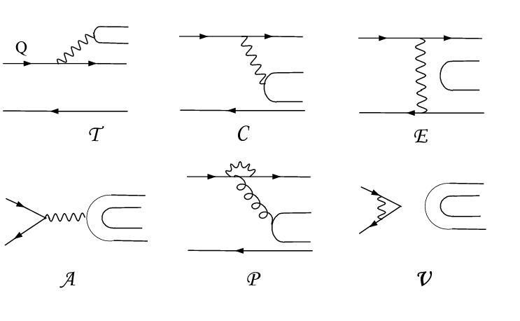
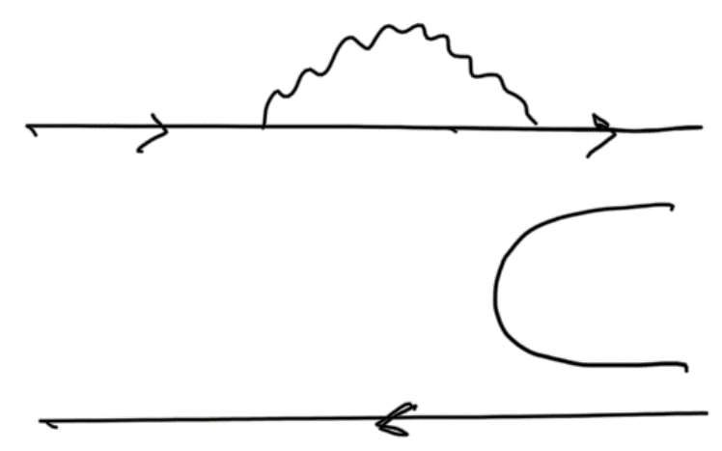
Topological Diagrammatic Approach (TDA)
All two-body hadronic decays of charmed mesons can be expressed in
terms of six distinct topological diagrams [Chau (’80,’83); Chau, HYC (’86)]
(tree)
(color-suppressed)
(exchange)
(annihilation)
H (horizontal W-loop)
(vertical W-loop)
The great merit & strong point of this approach ⇒ magnitude and strong phase of each topological tree amplitude are determined
⇒ Direct CPV at tree level can be reliably estimated, e.g. $D_{s}^{+}→K^{+}η$
DCPV induced by penguin e.g. $D_{ }^{0}→π^{+}π^{−},K^{+}K^{−}$ can be estimated via $P^{LD}=E$
D. Wang (’22)

Slide 3
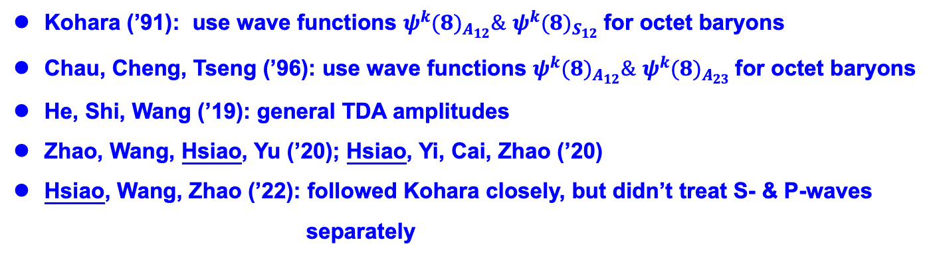
Is the TDA applicable to charmed baryon sector?
Kohara (’91): use wave functions $ψ^{k}(8)_{A_{12}}\&$ $ψ^{k}(8)_{S_{12}}$for octet baryons
Chau, Cheng, Tseng (’96): use wave functions $ψ^{k}(8)_{A_{12}}\&$ $ψ^{k}(8)_{A_{23}}$for octet baryons
He, Shi, Wang (’19): general TDA amplitudes
Zhao, Wang, Hsiao, Yu (’20); Hsiao, Yi, Cai, Zhao (’20)
Hsiao, Wang, Zhao (’22): followed Kohara closely, but didn’t treat S- & P-waves
separately
Unlike IRA (irreducible SU(3) approach), global fits to the measured rates and decay asymmetries in TDA were still absent
Although IRA is very popular in describing charmed baryon decays, TDA is more intuitive, graphic and easier to implement model calculations.

Slide 4
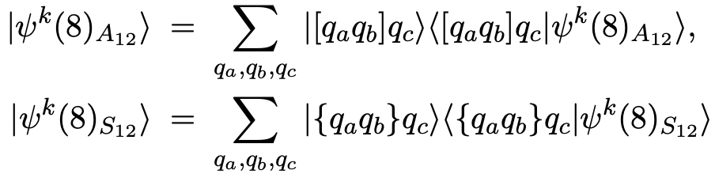
Wave function of octet baryon
1.
antisymmetric at first two quarks
symmetric at first two quarks
$ψ^{k}(8)_{A_{12}}\&$ $ψ^{k}(8)_{S_{12}}$are orthogonal
2.
$ψ^{k}(8)_{A_{12}}\&$ $ψ^{k}(8)_{A_{23}}$are not orthogonal
Kohara (’97)
Nevertheless, physics is independent of the convention one chooses
In this work we follow CCT (’96) to use the $ψ^{k}(8)_{A_{12}}\&$ $ψ^{k}(8)_{S_{12}}basis$

Slide 5
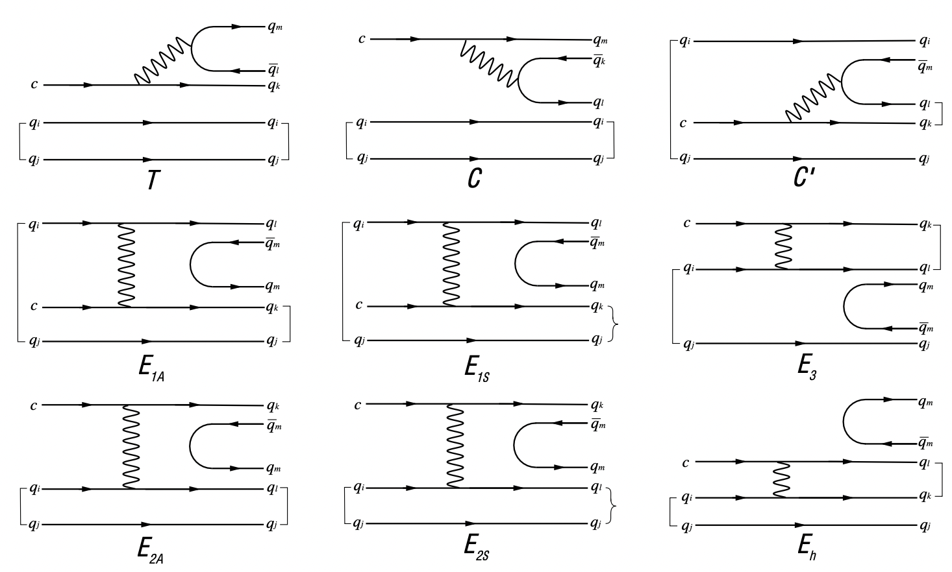

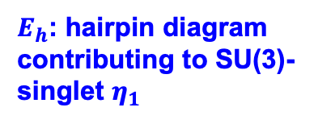
Weak decays of antitriplet charmed baryons: $ℬ_{c}\left(\overline{3}\right)→ℬ\left(8\right)M(8+1)$
Chau, Cheng, Tseng (’96)
KPW theorem
$E_{2A}=−E_{1A}$, $E_{2S}=−E_{1S}$
$E_{h}$: hairpin diagram contributing to SU(3)-singlet $η_{1}$
Korner-Pati-Woo (KPW) theorem: quark pair in a baryon produced by weak interactions is required to be antisymmetric in flavor

Slide 6
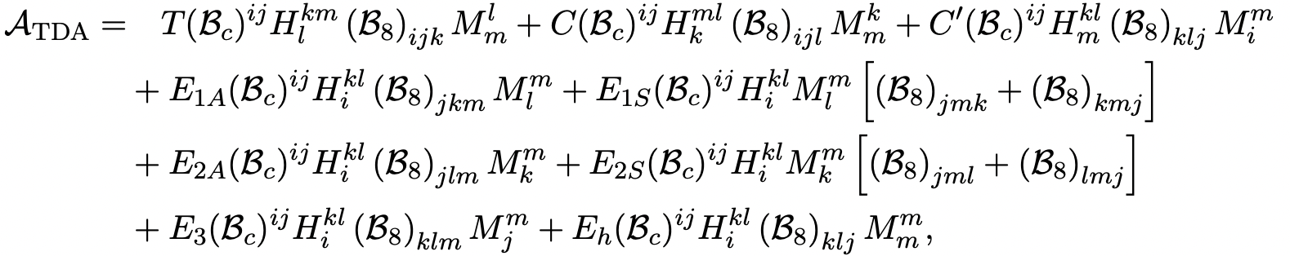
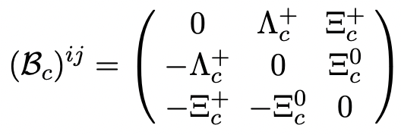
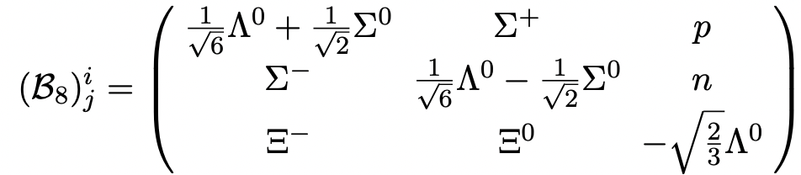

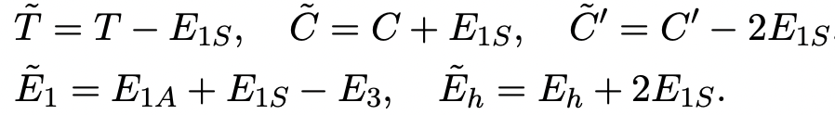
KPW theorem ⟹ $E_{2A}=−E_{1A}$, $E_{2S}=−E_{1S}$
There still exist 2 redundant degrees of freedom through redefinitions
CCT (’96)
⟹ 5 independent topological diagrams and TDA amplitudes
Recall that there are also 5 independent tensor invariants in IRA

Slide 7
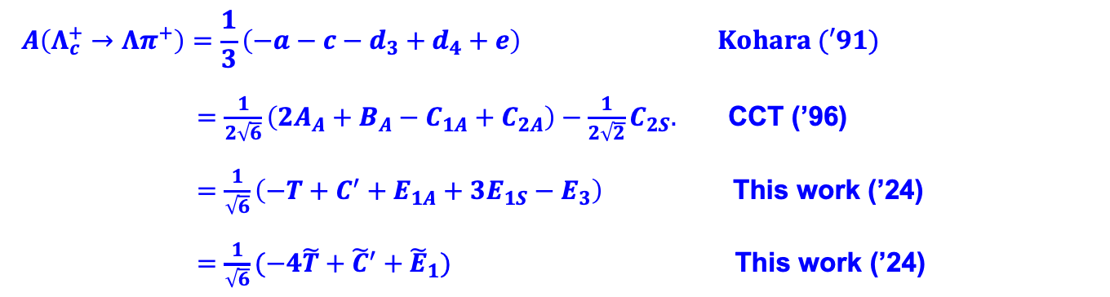
$$A\left(Λ_{c}^{+}→Λπ^{+}\right)=\frac{1}{3}\left(−a−c−d_{3}+d_{4}+e\right) Kohara (′91)$$
$=\frac{1}{2\sqrt{6}}\left(2A_{A}+B_{A}−C_{1A}+C_{2A}\right)−\frac{1}{2\sqrt{2}}C_{2S}.$ CCT (’96)
$=\frac{1}{\sqrt{6}}\left(−T+C^{′}+E_{1A}+3E_{1S}−E_{3}\right)$ This work (’24)
$=\frac{1}{\sqrt{6}}(−4\tilde{T}+{\tilde{C}}^{′}+{\tilde{E}}_{1})$ This work (’24)
Although these TDA amplitudes are equivalent, it is important to use the minimum set of TDA to fit to the data

Slide 8
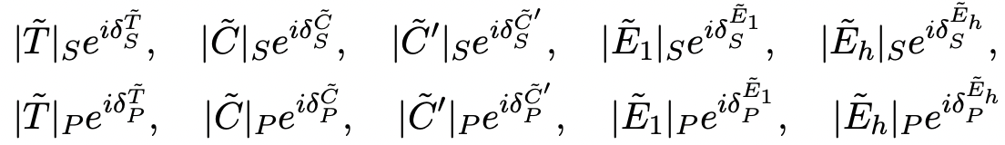
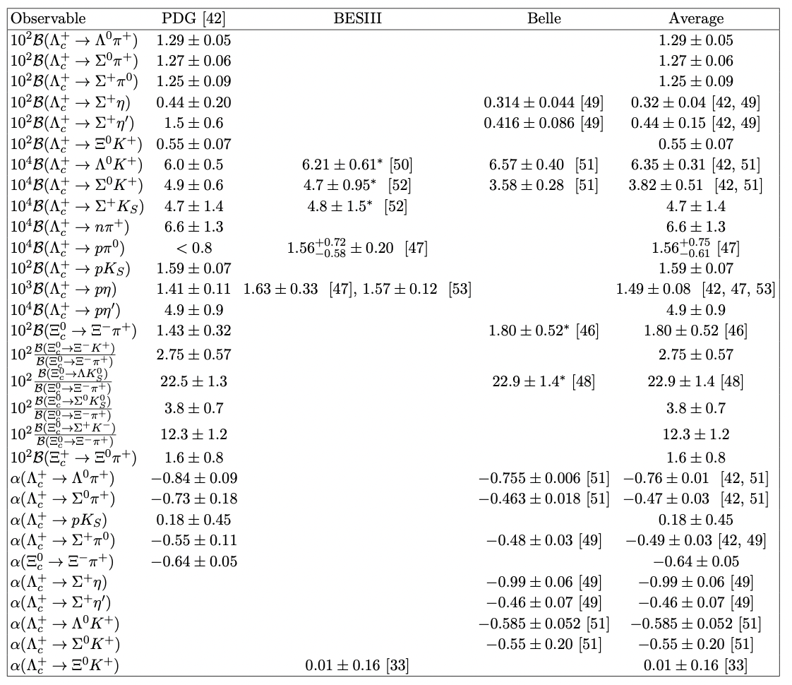

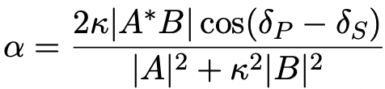
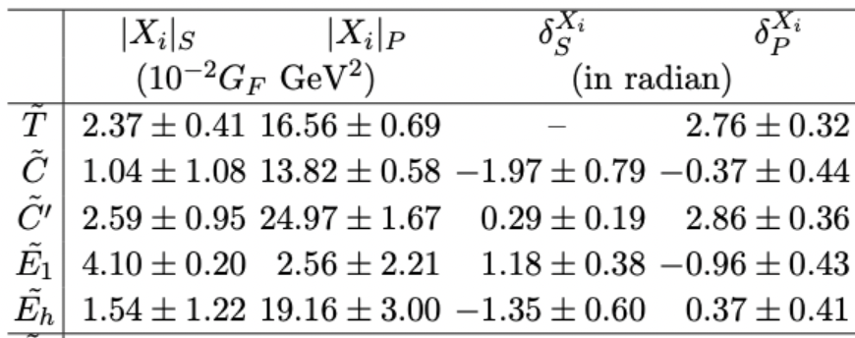

Global Fit
Five TDA parameters: $\tilde{T,}$ $\tilde{C,}$ ${\tilde{C}}^{′}, {\tilde{E}}_{1}, { \tilde{E}}_{h}$ ⇒ 19 unknown parameters
fit to 30 data inputs of BFs and $α′s$

Slide 9
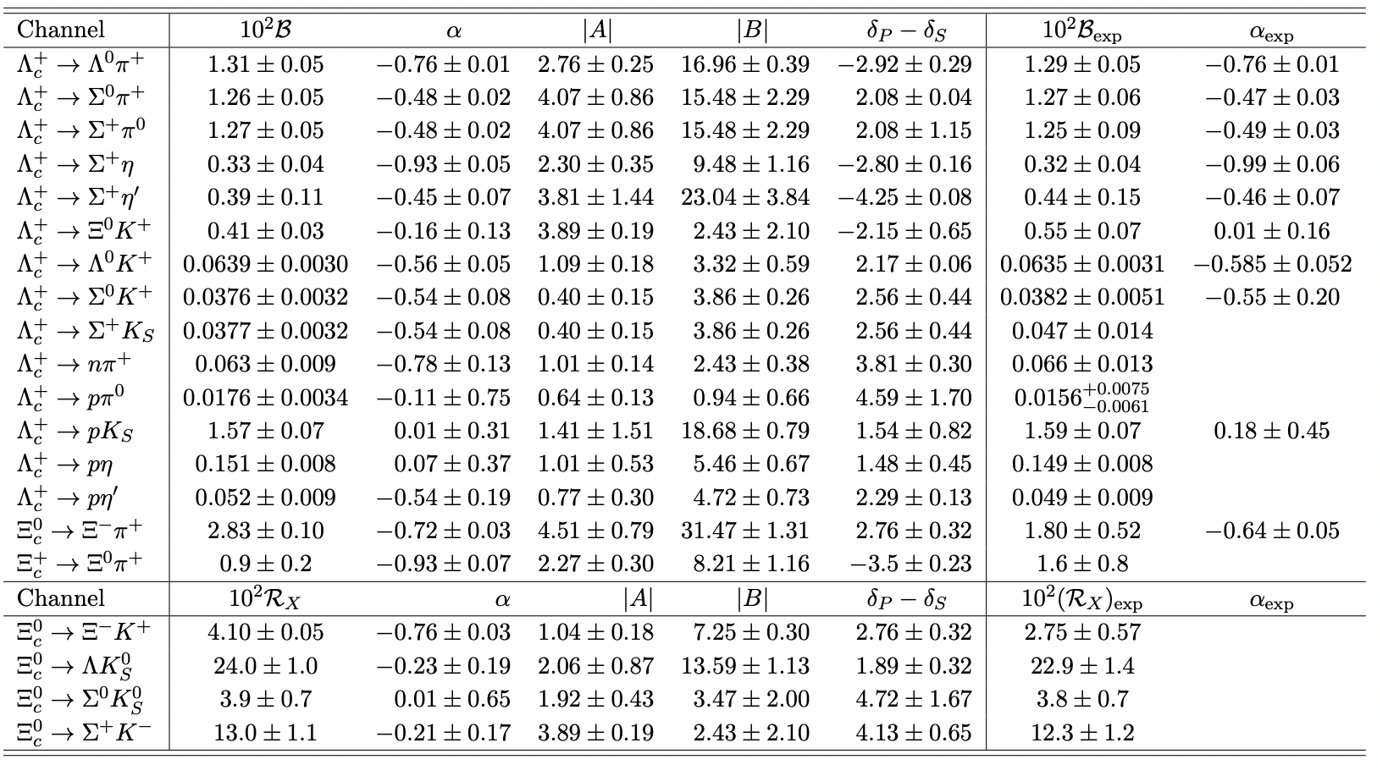

Slide 10
$Λ_{c}^{+}→Ξ^{0}K^{+}$
Theory in 1990s ⇒ small BF & zero $α$ due to smallness of S wave
BF was measured, not that small, $ℬ\left(Λ_{c}^{+}→Ξ^{0}K^{+}\right)=\left(0.55±0.07\right)\%$
In recent studies based on SU(3) ⇒ $α$ is predicted to be of order unity
The puzzle with $α_{ }$ was resolved by BESIII ⇒ $α_{Ξ^{0}K^{+}}=0.01±0.16.$ Phase shifts must be taken into account
PRL, 132, 031801 (2024)
Hence, $α_{Ξ^{0}K^{+}}∝ \cos\left(δ_{P}−δ_{S}\right)∼0.02$
Smallness of $α_{Ξ^{0}K^{+}}$ can be accommodated recently in both IRA and TDA
IRA: Geng et al. 2310.05491
TDA: Zhong et al. 2401.15926, 2404.01359

Slide 11
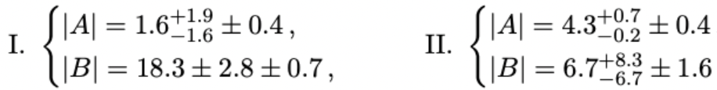





1. $Λ_{c}^{+}→Ξ^{0}K^{+}$
BF & longitudinal decay asymmetry
BESIII
$$ℬ\left(Λ_{c}^{+}→Ξ^{0}K^{+}\right)=\left(0.55±0.07\right)\%$$
$$α_{Ξ^{0}K^{+}}=0.01±0.16$$
Our fit
Solution II preferred
$$α_{Ξ^{0}K^{+}}=−0.16±0.13$$
$$ℬ\left(Λ_{c}^{+}→Ξ^{0}K^{+}\right)=\left(0.41±0.03\right)\%$$

Slide 12


2. $Ξ_{c}^{0}→Ξ^{−}π^{+}$
BF = ($1.80±0.52)\%$ by Belle, $\left(1.43±0.32\right)\%$ by PDG
Our fit
(2.72$±0.09)\%$ by Geng et al. (2310.05491)
support from the sum rule
⇒ $ℬ\left(Ξ_{c}^{0}→Ξ^{−}π^{+}\right)=\left(2.85±0.30\right)\%$
Improved measurement of $Ξ_{c}^{0}→Ξ^{−}π^{+}$is urgently needed

Slide 13
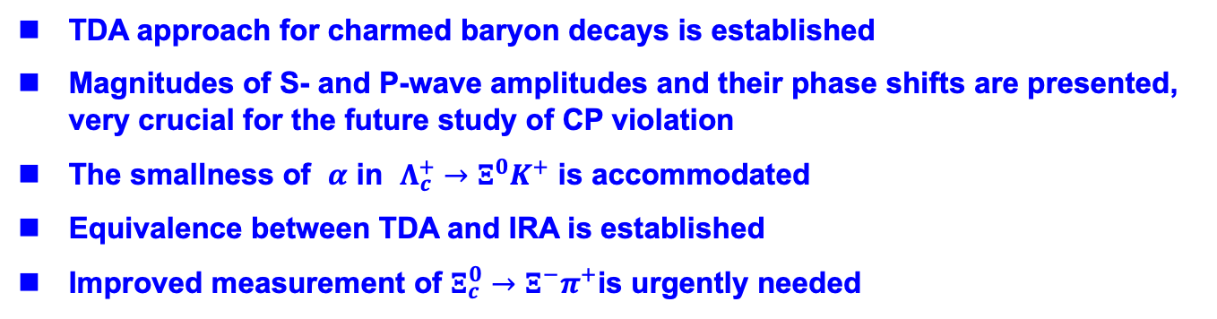
Conclusion
TDA approach for charmed baryon decays is established
Magnitudes of S- and P-wave amplitudes and their phase shifts are presented, very crucial for the future study of CP violation
The smallness of $α$ in $Λ_{c}^{+}→Ξ^{0}K^{+}$ is accommodated
Equivalence between TDA and IRA is established
Improved measurement of $Ξ_{c}^{0}→Ξ^{−}π^{+}$is urgently needed

Slide 14
Back-up slides

Slide 15
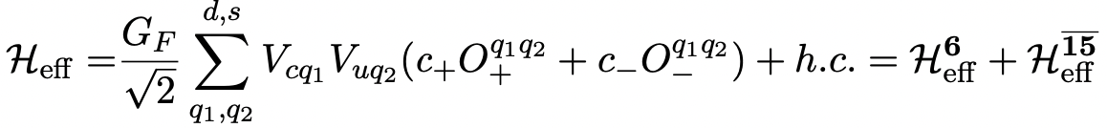
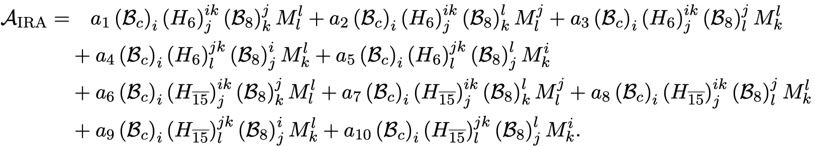

Irreducible SU(3) Approach (IRA)
He, Shi, Wang (’20)
One of the five terms with $H_{6}$ is redundant
Four of the five terms with $H_{\overline{15}}$ are prohibited by the KPW theorem
⇒ five independent SU(3) tensor invariants$a_{1}^{′},$ $a_{2}^{′},$ $a_{3}^{′},$ $a_{4}^{′},$ $a_{9}^{′},$
⇒ equivalence of TDA and IRA is established

Slide 16
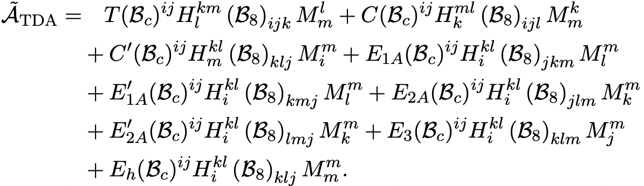
Hsiao, Wang, Zhao (’22)

