Slide 1
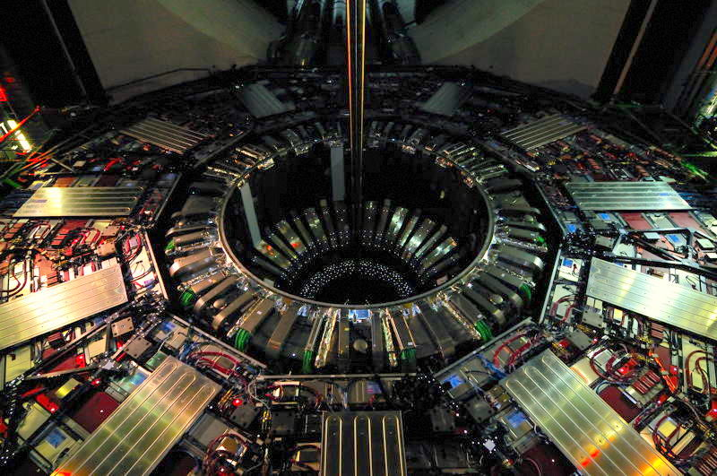
Operation and Performance of the CMS Muon System for LHC Run 3
G. Pugliese
INFN & Politecnico of Bari
On behalf of the CMS Collaboration
ICHEP, Prague 17-24 July 2024

Slide 2
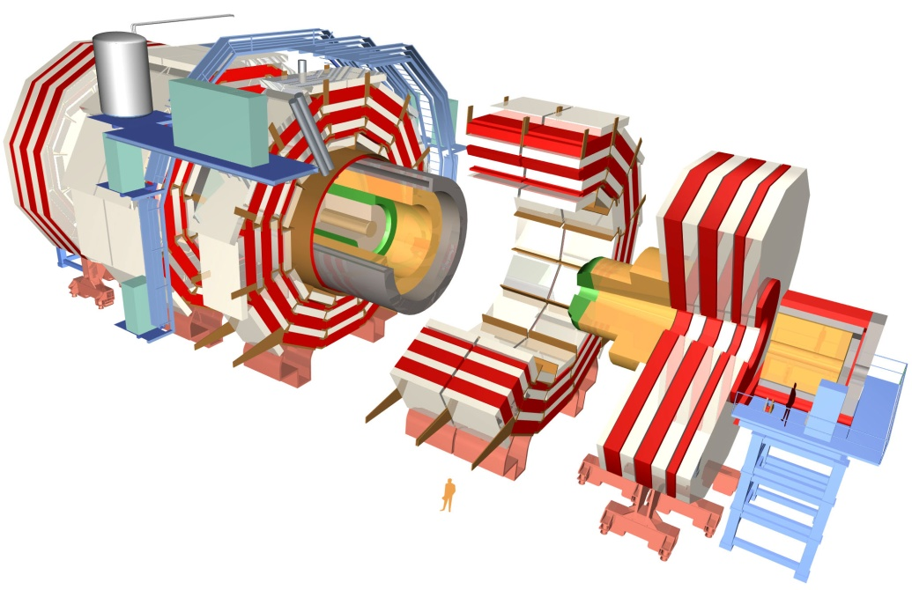
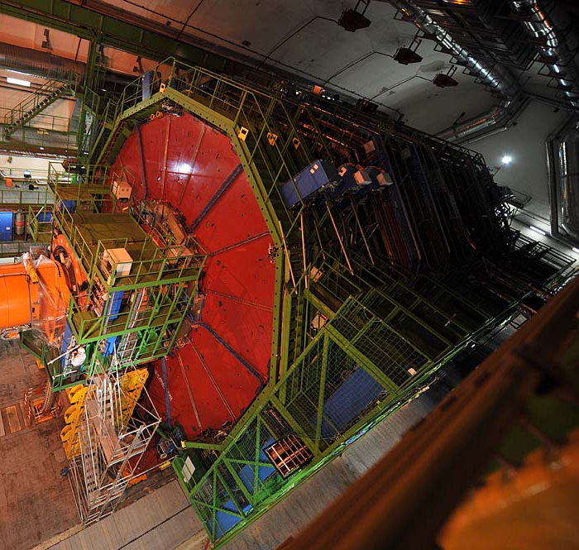
The CMS detector
Endcap
Tracker
Barrel Region
Endcap
Electromagnetic calorimeter
Hadron calorimeter
Steel Return Yoke
Superconducting Solenoid
Niobium titanium coil carrying 18.000 A
Muon Spectrometer
Weight: 14000 t
Length: 28.7 m
Diameter: 15 m
Magnetic field: 3.8 T

Slide 3
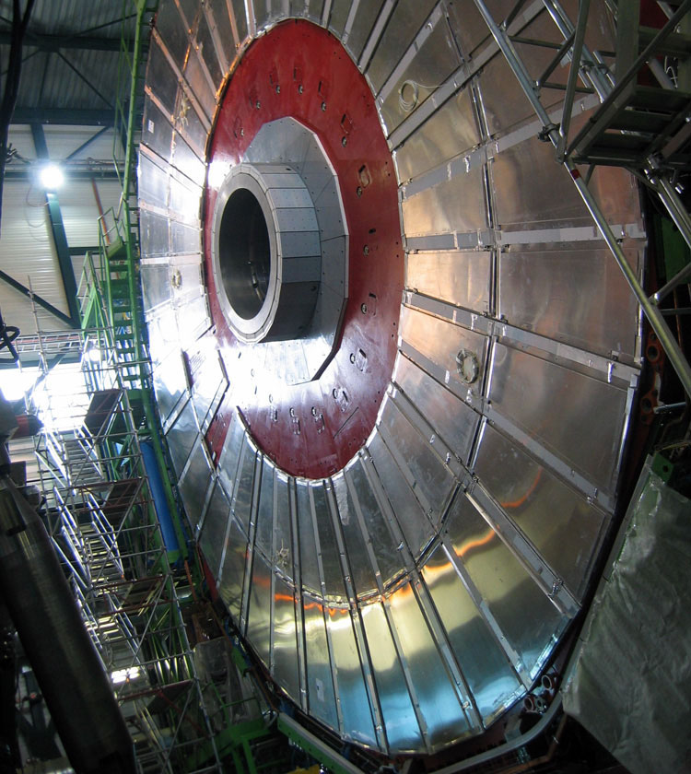
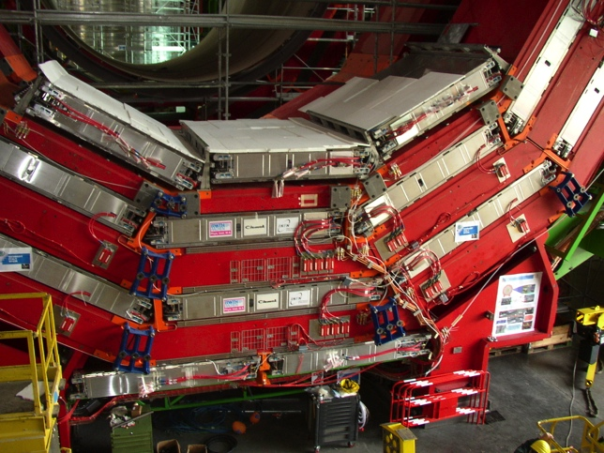
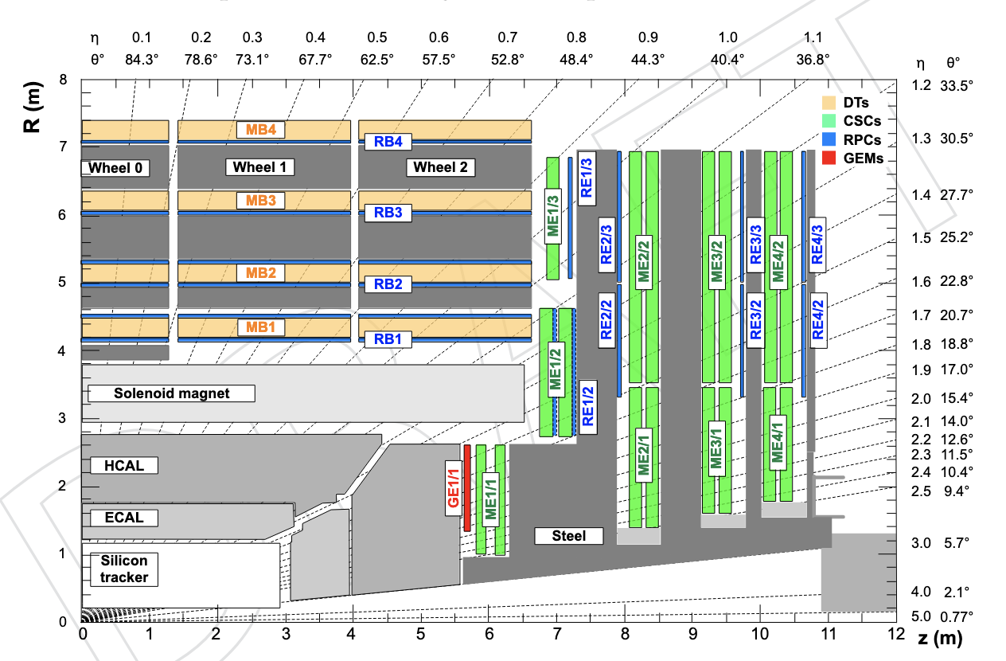
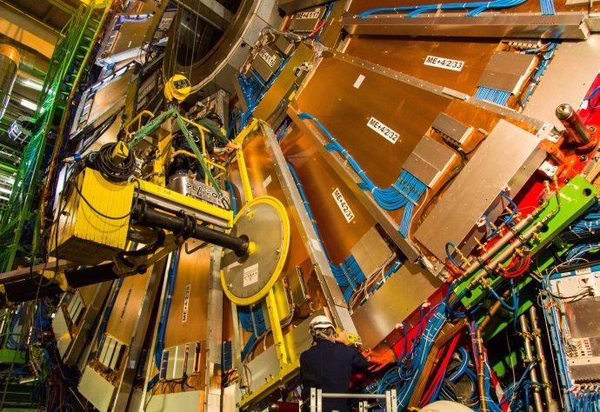
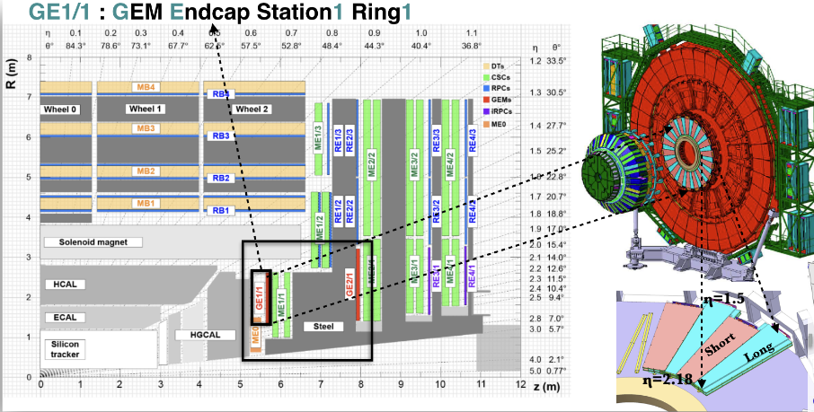
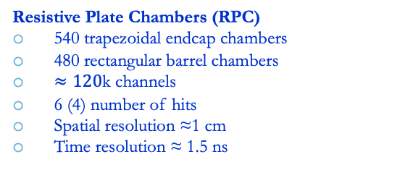
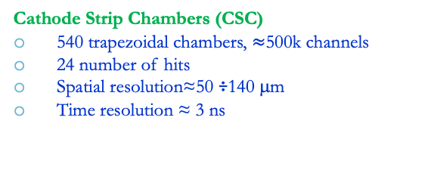
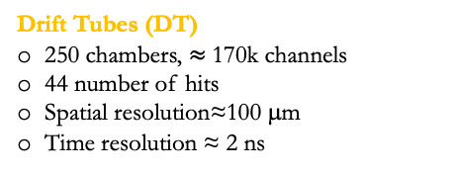
The CMS Muon Spectrometer
four
Muon system: three gaseous technologies for muon identification, timing and momentum measurement
Muon acceptance: |η| < 2.4
Drift Tubes (DT)
250 chambers, $≈$170k channels
44 number of hits
Spatial resolution≈100 μm
Time resolution ≈ 2 ns
Resistive Plate Chambers (RPC)
540 trapezoidal endcap chambers
480 rectangular barrel chambers
$≈120$k channels
6 (4) number of hits
Spatial resolution ≈1 cm
Time resolution ≈ 1.5 ns
Gas Electron Multiplier (GE1.1 installed in 2021):
72 Super-Chambers, consisting of two triple-GEM
2 number of hits
Spatial resolution≈100 mm
Time resolution ≈ 10 ns
Cathode Strip Chambers (CSC)
540 trapezoidal chambers, $≈$500k channels
24 number of hits
Spatial resolution≈50 ÷140 μm
Time resolution ≈ 3 ns
See more results in A. Sharma and S. Buontempo’s talks

Slide 4
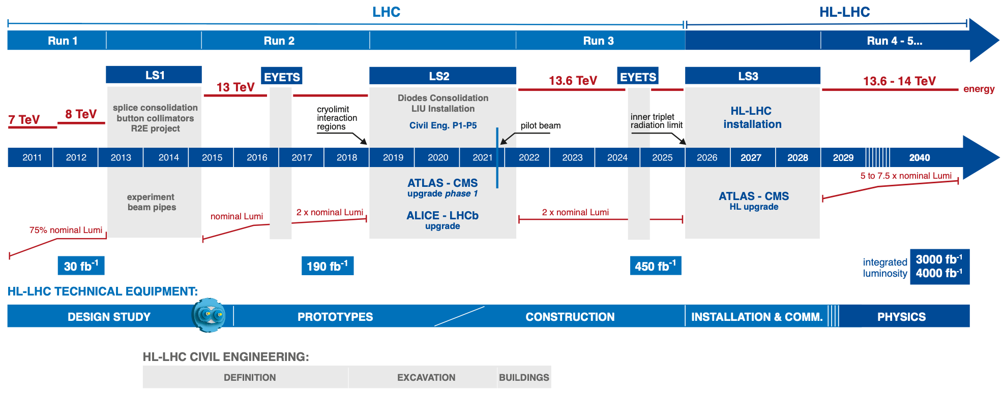
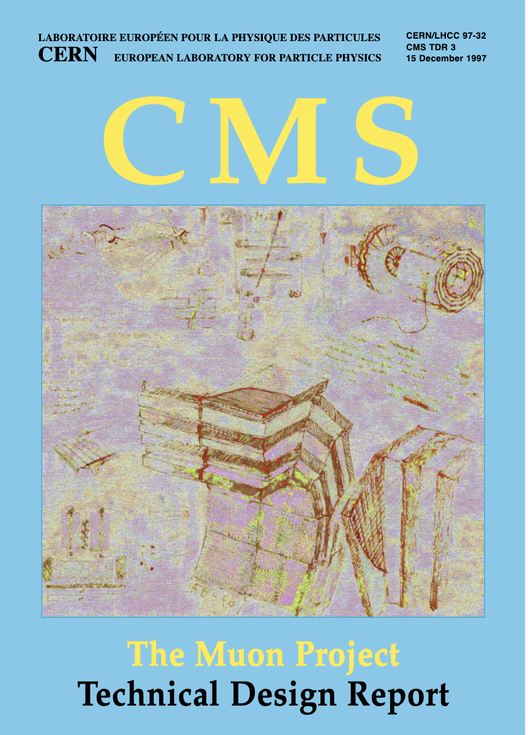

The CMS and LHC schedule
Phase 1
Phase 2
R&D and production
Run 1 & Run 2
2013 The EU Strategy Report for High Energy Physics approved the HL-LHC as priority project
1997 Muon Project TDR
2005-2008 Muons Chambers produced and installed
2017 The Phase-2 Upgrade of the CMS Muon Detector TDR
2010 Start of LHC
2012 Higgs Discovery

Slide 5
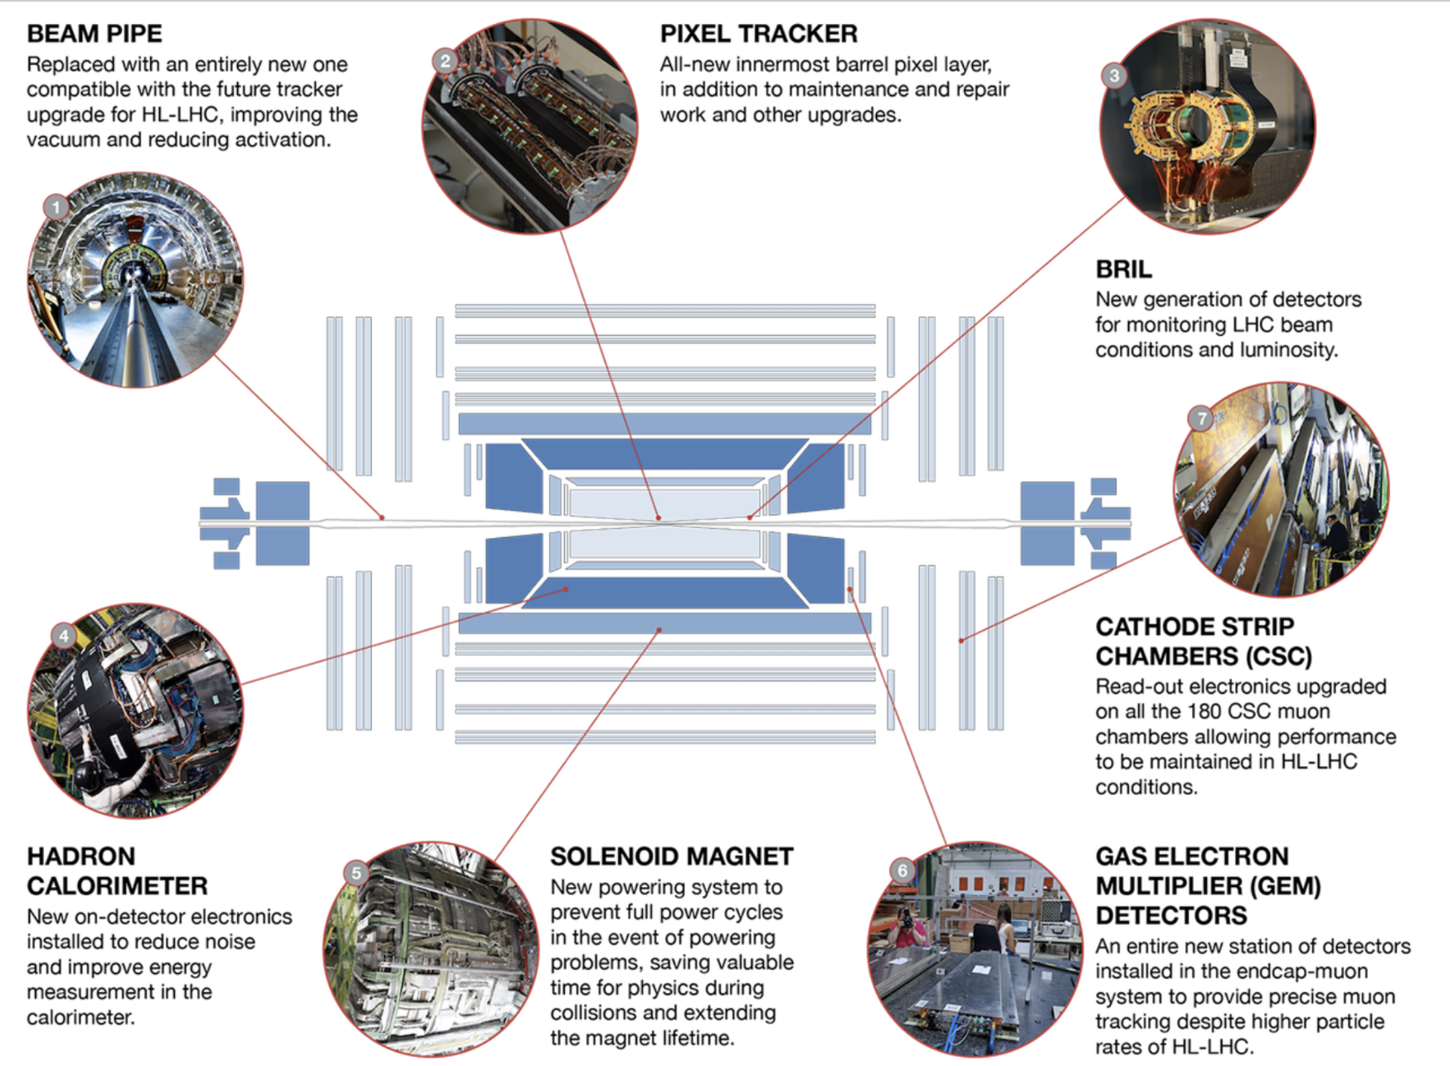
LHC and HL-LHC schedule
Phase 1
Phase 2
Long Shutdown 2 (2019-2021):
Extensive work to upgrade the CMS detector because of the increase of energy and luminosity in Run 3 and beyond
New CSC electronics and GEM chambers in the Muon Spectrometer
https://home.cern/press/2022/CMS-upgrades-LS2
Notes:
Maintenance and repair activities
Hardware interventions to improve detector performance at HL-LHC (anticipating some work needed after LS3)
Installation of Muon and BRIL demonstrators
CMS detector re-commissioned with comic muons, pilot beam, splashes and collisions

Slide 6
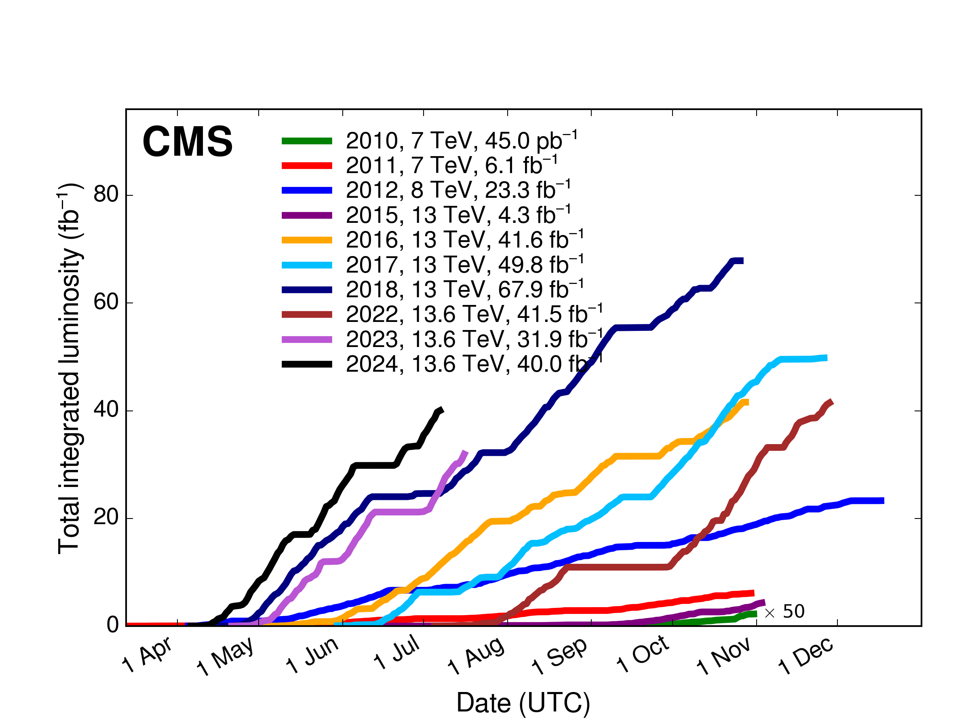
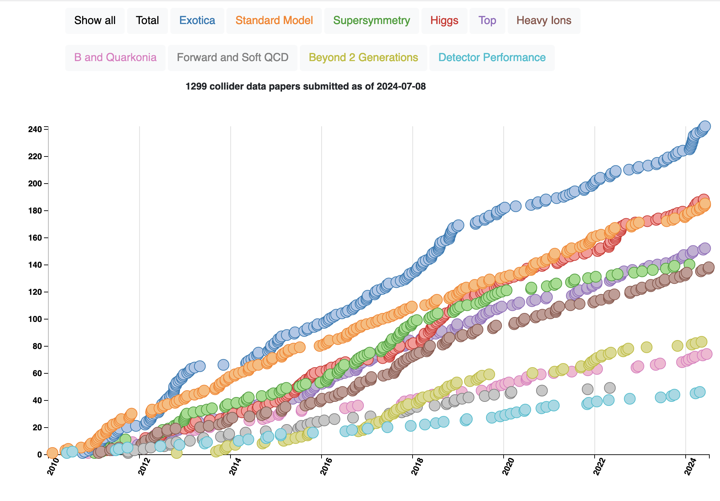
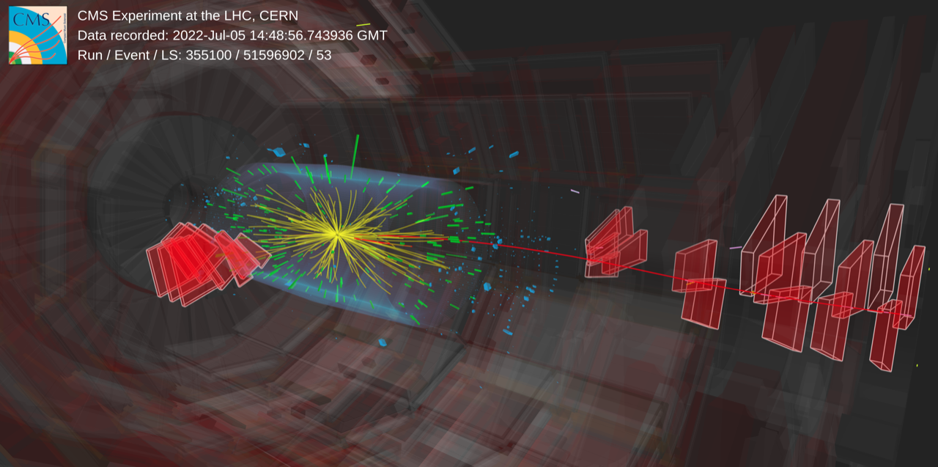
LHC and HL-LHC schedule
Phase 1
Phase 2
5th July 2022: start of Run 3 & first stable beam energy record of 13.6 TeV
Run3
1299 papers published
Notes:
Maintenance and repair activities
Hardware interventions to improve detector performance at HL-LHC (anticipating some work needed after LS3)
Installation of Muon and BRIL demonstrators
CMS detector re-commissioned with comic muons, pilot beam, splashes and collisions

Slide 7
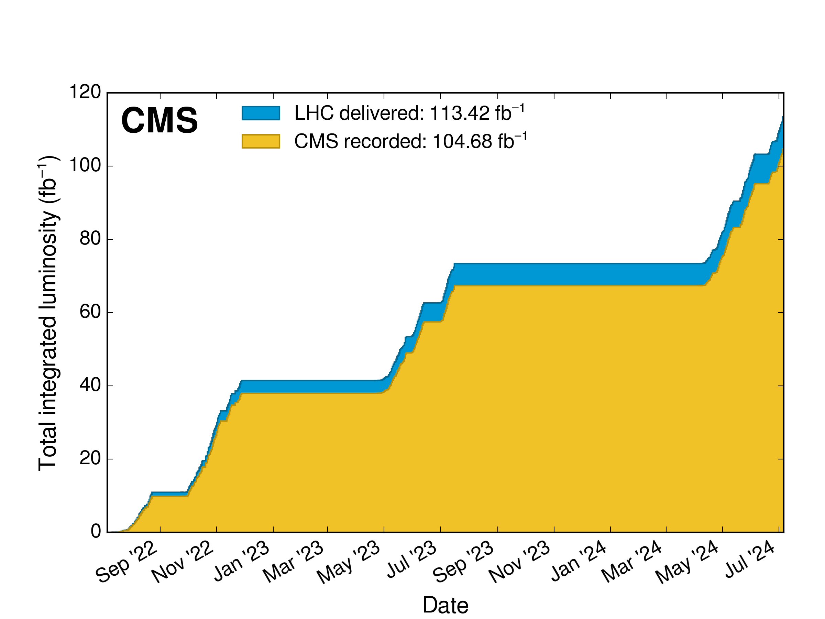
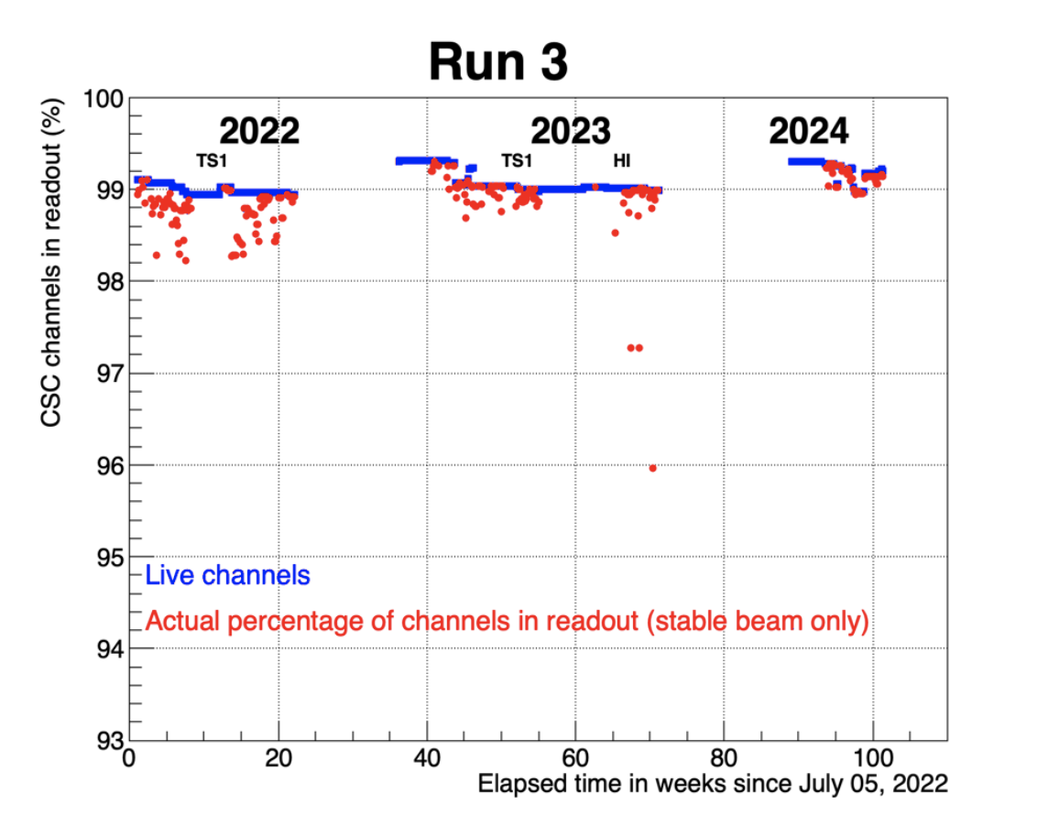
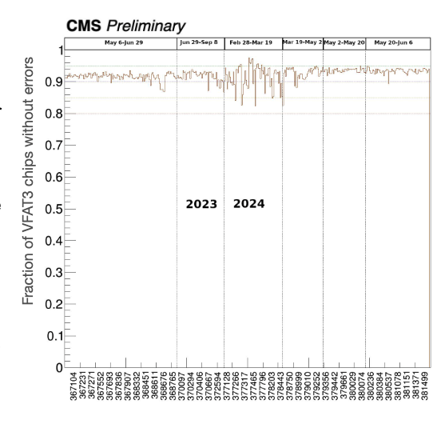
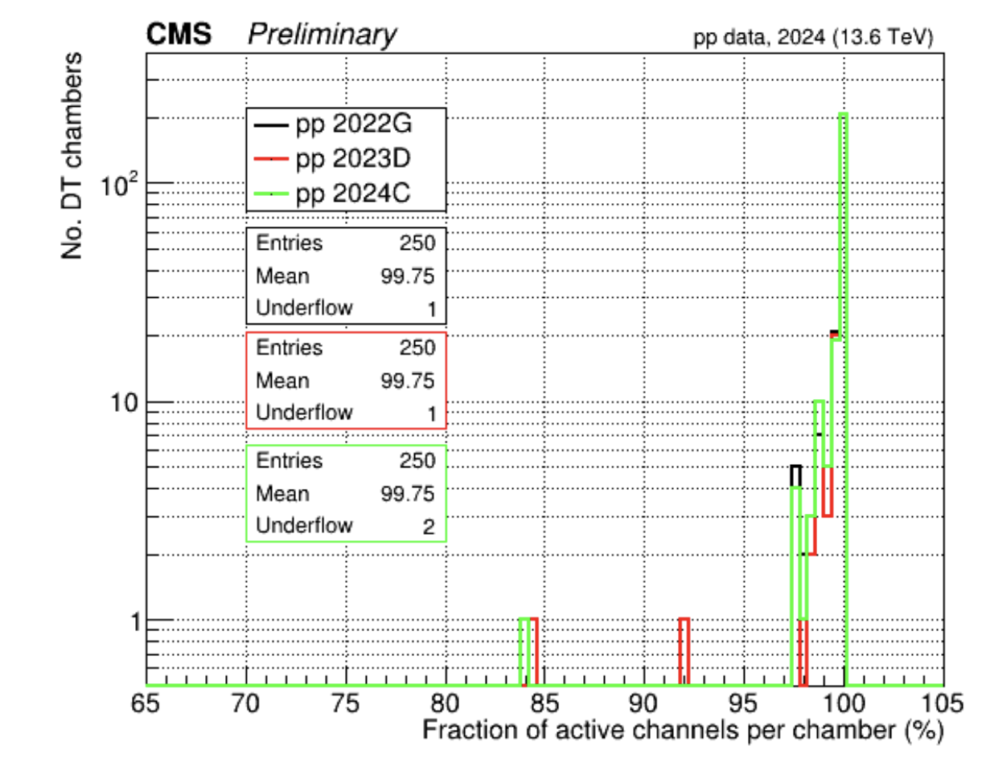
Muon Operation in Run3
Excellent CMS data-taking efficiency >92% in RUN3 physics collisions
Muon System:
  Smooth operation with a minor contribution to Luminosity loss (4%, due to CSC readout)
  Stable active channels fraction:
DT
~98.6%
CSC
~99%
GEM: ~92%
GEM dead channels are mainly due an electronics issue (VTRx outgassing is causing damage in the optical connection) that will be fixed in LS3
Year | 2018 | 2022 | 2023 | 2024
% of RPC active channel | 96.5 | 89.6 | 87.7 | 82.6
Since 2022, all RPC leaky chambers (located only in the Barrel region) have been disconnected to reduce GHG emissions and to use the new RPC recuperation system efficiently
Key to success: prompt intervention of the experts during all beam-off and Technical Access time in case of failure
Notes:
•DT : 98.57 %
•CSC : ~ 99 %
•RPC : ~ 83%
- Barrel : ~ 69%
- Endcap : ~ 99%
•GEM : ~92%
For 2024
Lumi loss
CSC 3.9 % rest negligible
For Run3
CSC 1.7%
GEM 1.0%
DT and RPC negligible
The VTRx photodiode outgassing is causing damage in the optical connection so these channels are dead and we will not be able to fix until LS3
There is a nice explanation of the VTRX problem/solution in the May 2022 EP seminar by Brendan Regnery: https://indico.cern.ch/event/1108957/

Slide 8
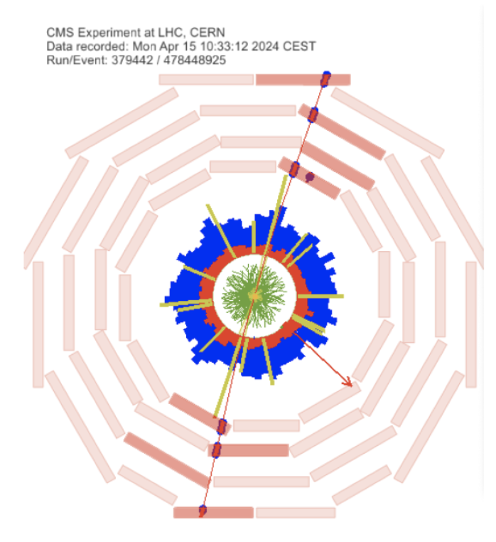
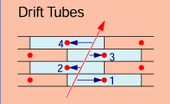
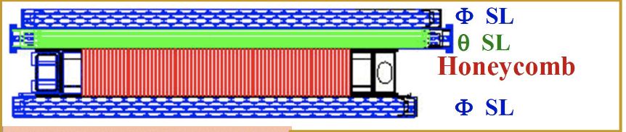
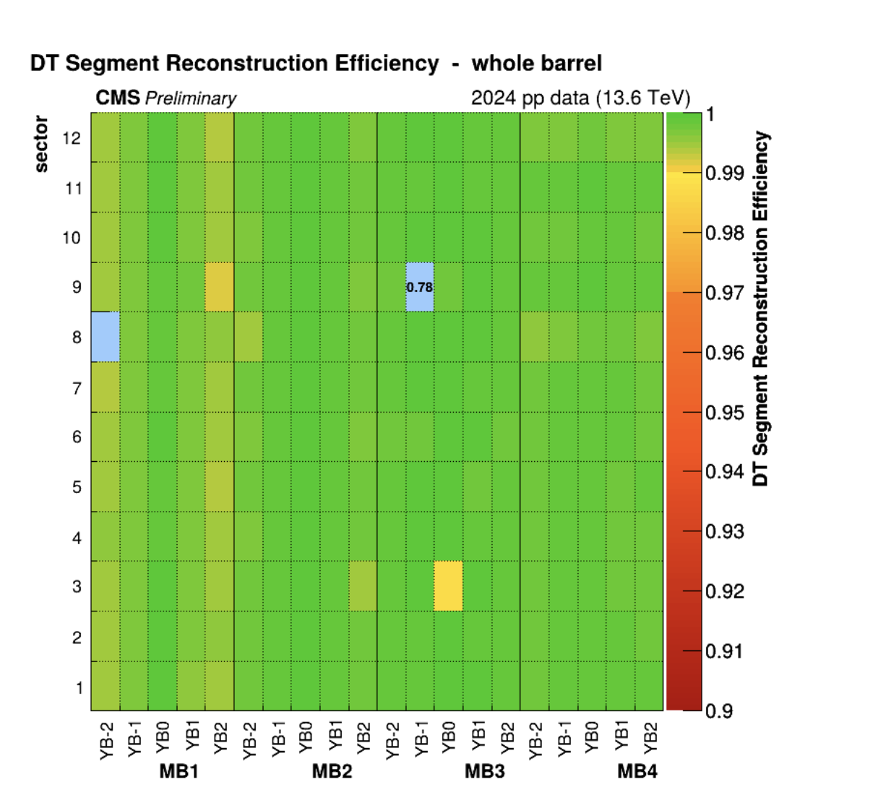
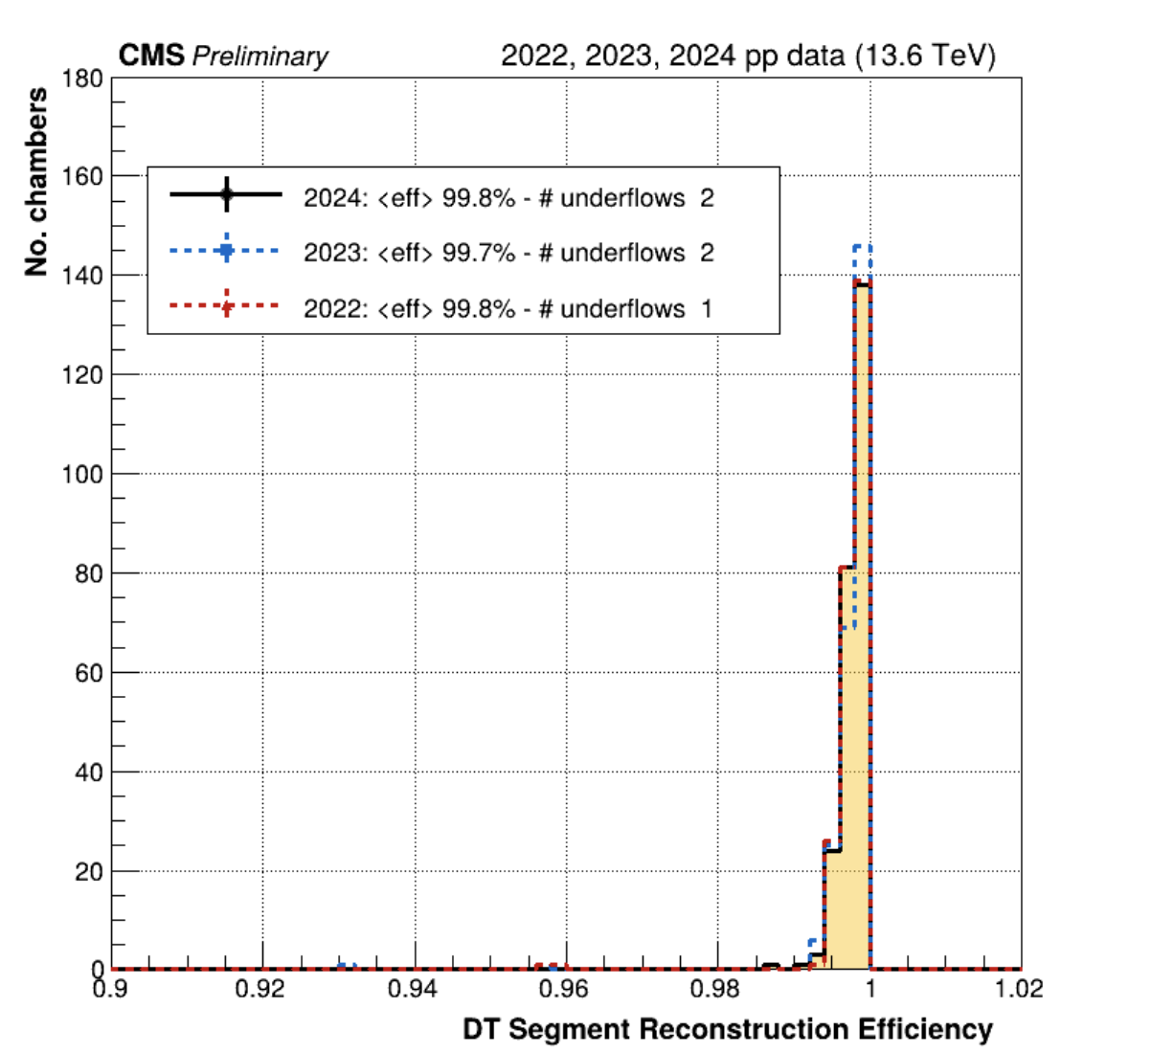
DT Segment Efficiencies in Run 3
Segment efficiency is studied with Tag &Probe method on di-muons
DT segment efficiency: stable in time and more than 99% with few exceptions due to known hardware problems (one chamber in Wheel -2 Sector 8 MB1 is not working because of a gas connection problem and will be fixed over the coming YETS)

Slide 9
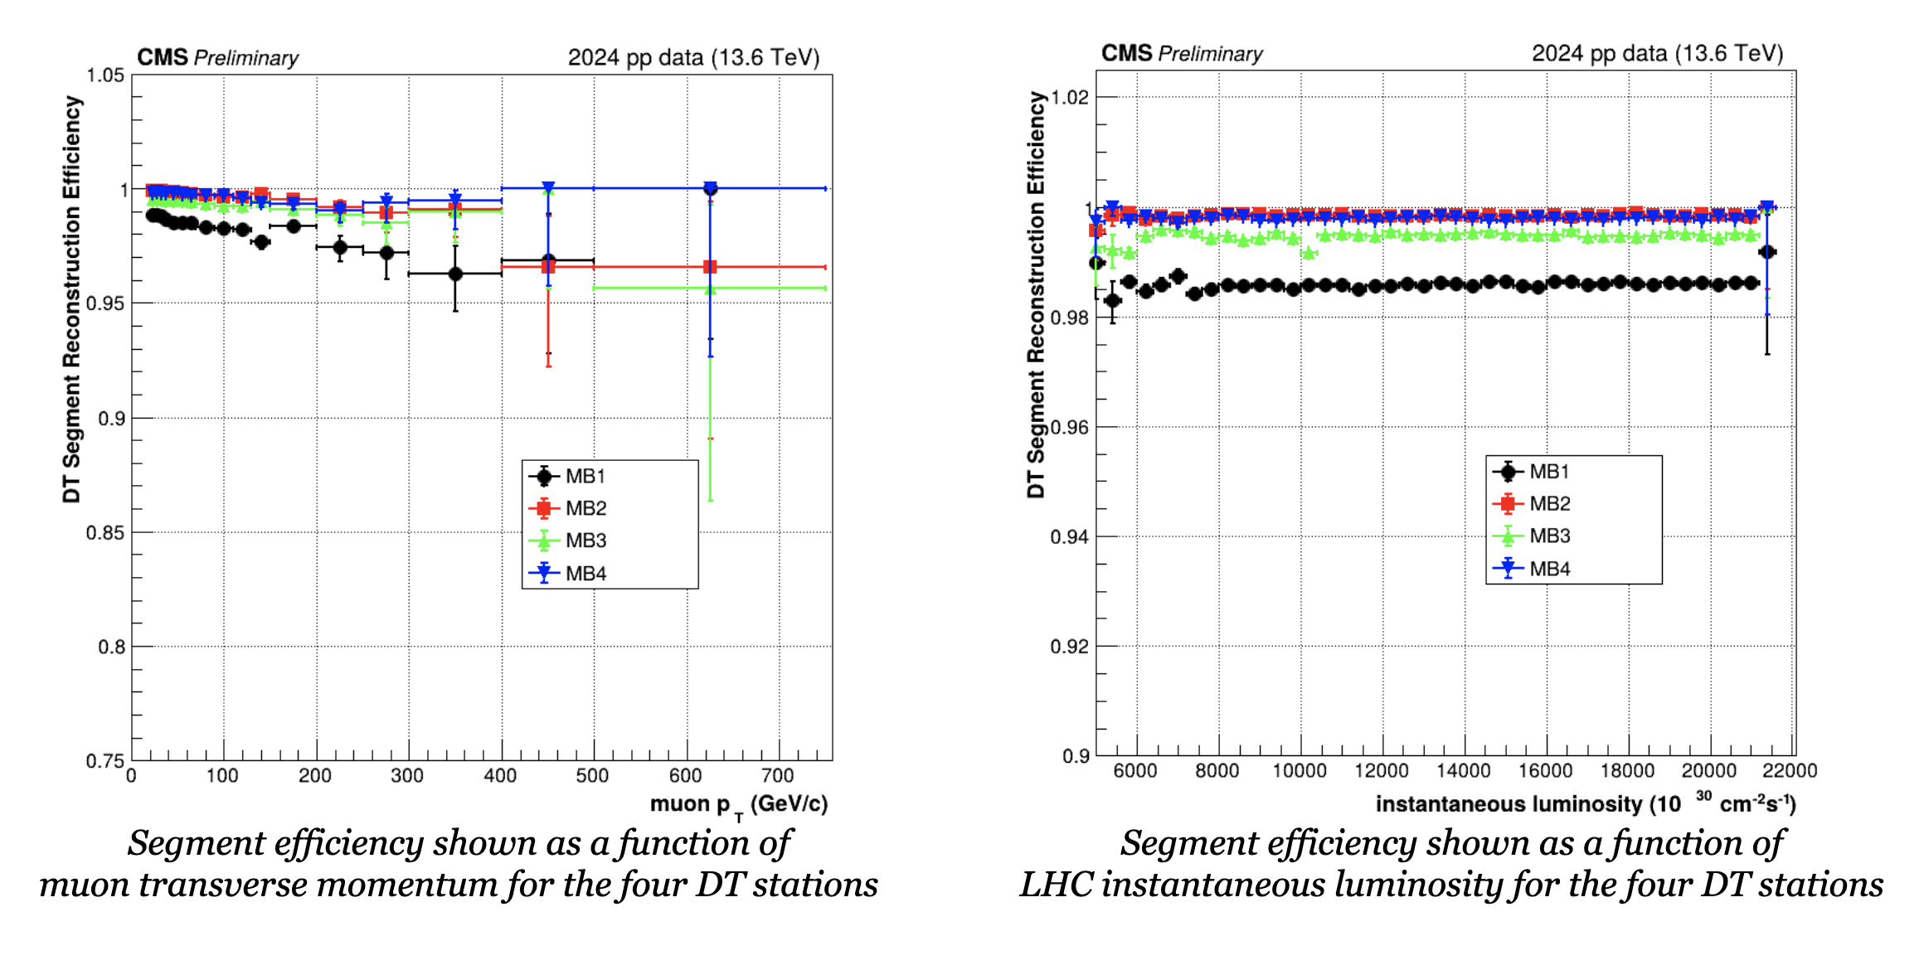
DT Segment Efficiencies in Run 3
Excellent DT segment performance up to the maximum LHC instantaneous luminosity (~2.1*10³³ cm⁻²s⁻¹)
See more results in C. Battilana’s talk

Slide 10
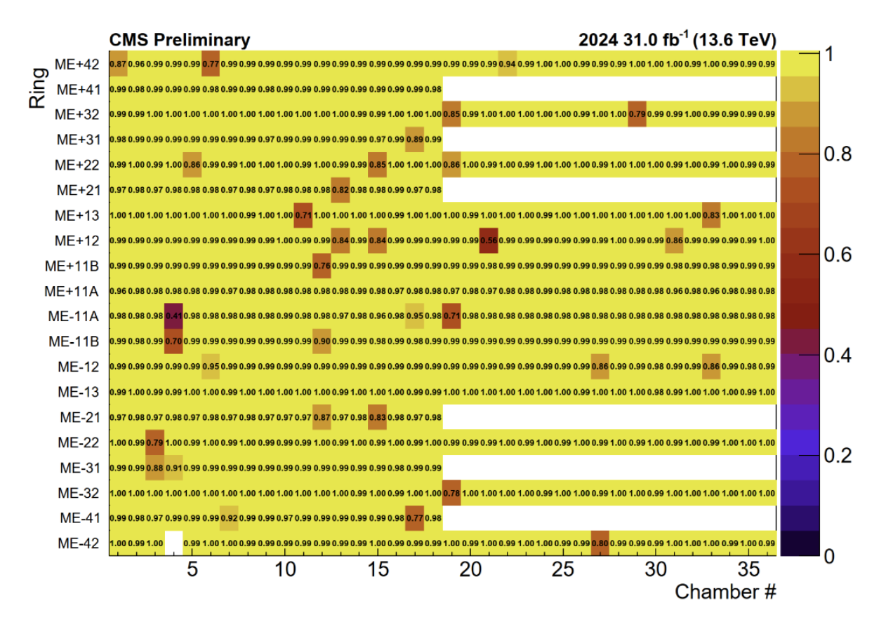
CSC Segment Efficiency in 2024
CSC Segment efficiency: more than 98% of the CSCs is operating at close to 100% efficiency. Few chambers with lower efficiency are due to known reasons (electronics board failures, that cannot be fixed without access to the chambers, or accessional temporary failures

Slide 11
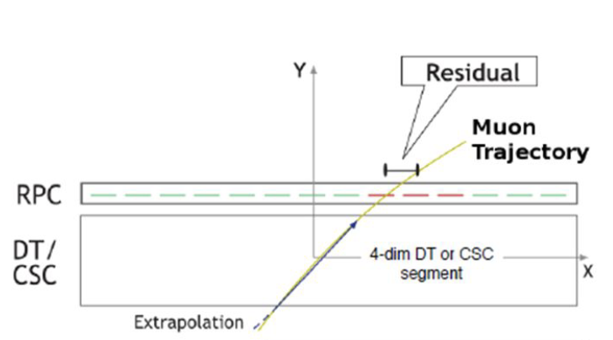
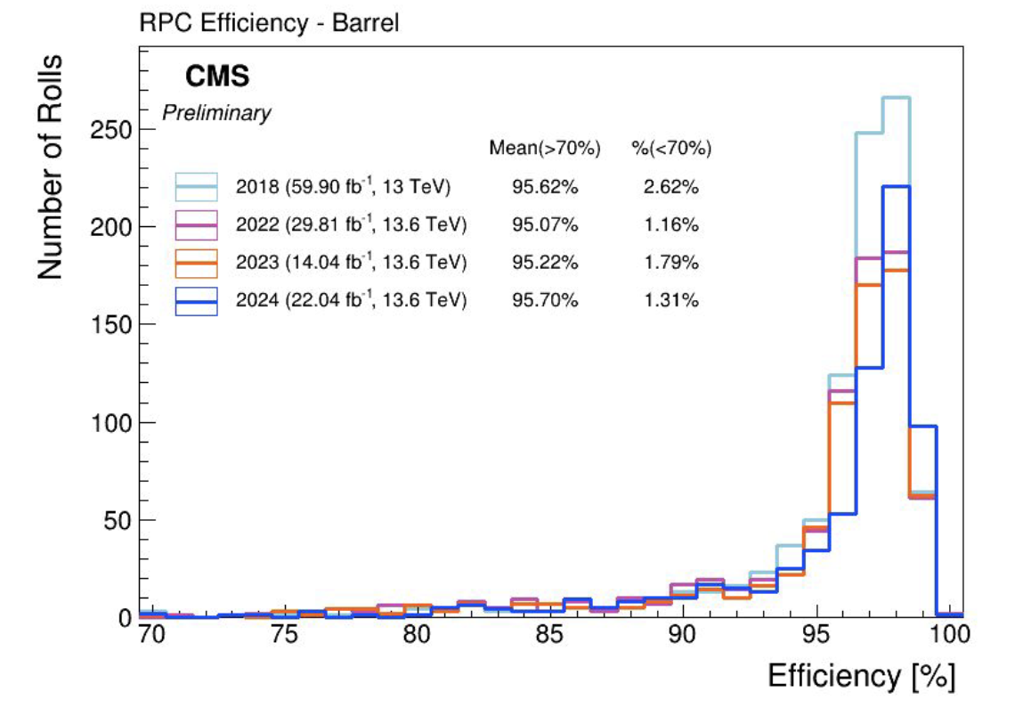
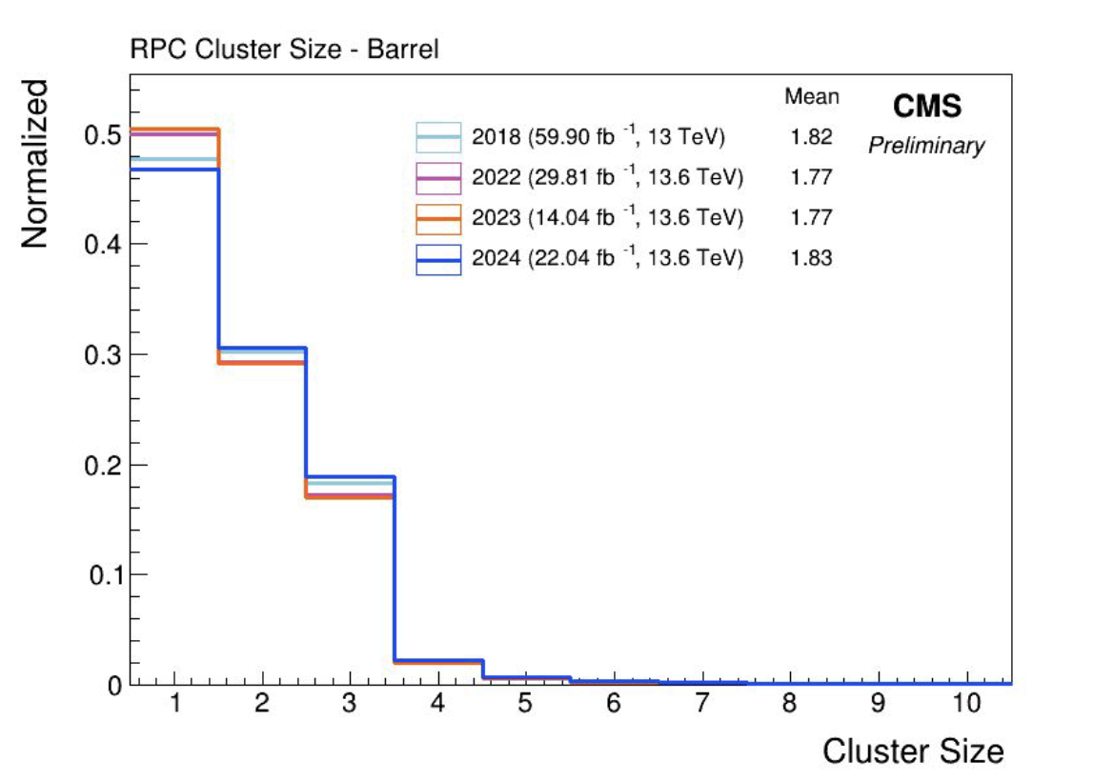
RPC performance in Run 3
(Barrel region)
RPC performance is measured using the Segment Extrapolation Method where DT/CSC Segments (in the Barrel/Endcap) that belong to a standalone muon track with timing corresponding to RPC readout BX windows are selected and extrapolated to the plane of a given RPC
Barrel RPC efficiency and cluster size distributions in Run2 (2018) and Run3 (2022, 2023, and 2024)
Stable Barrel RPC performance in RUN 3 and in agreement with previous LHC Runs

Slide 12
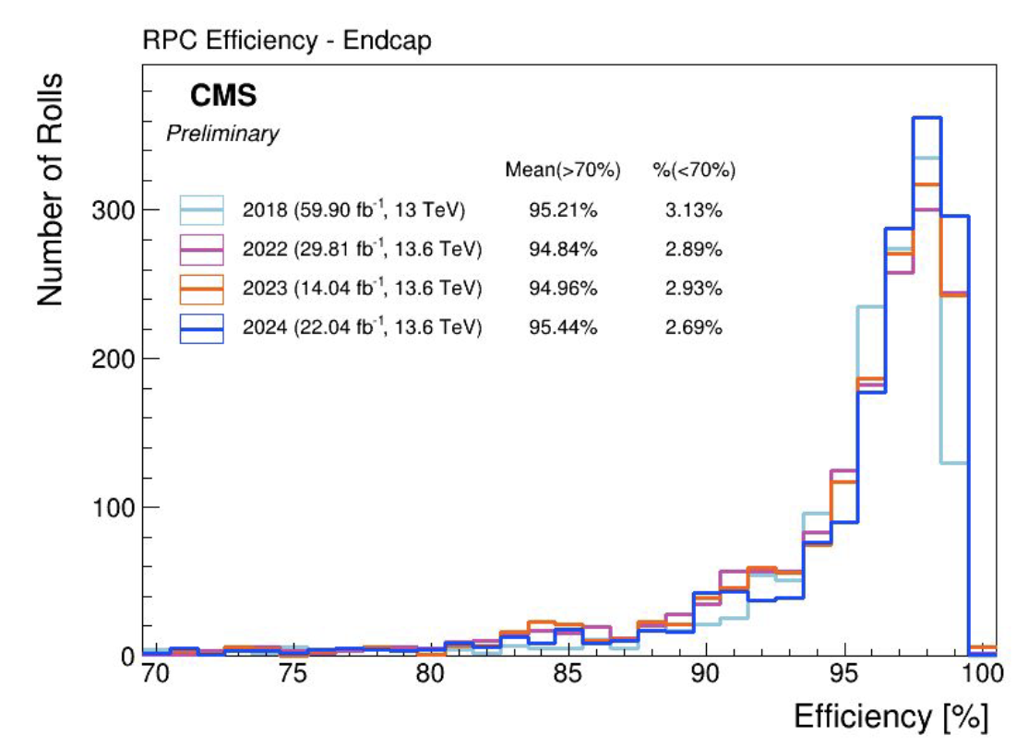
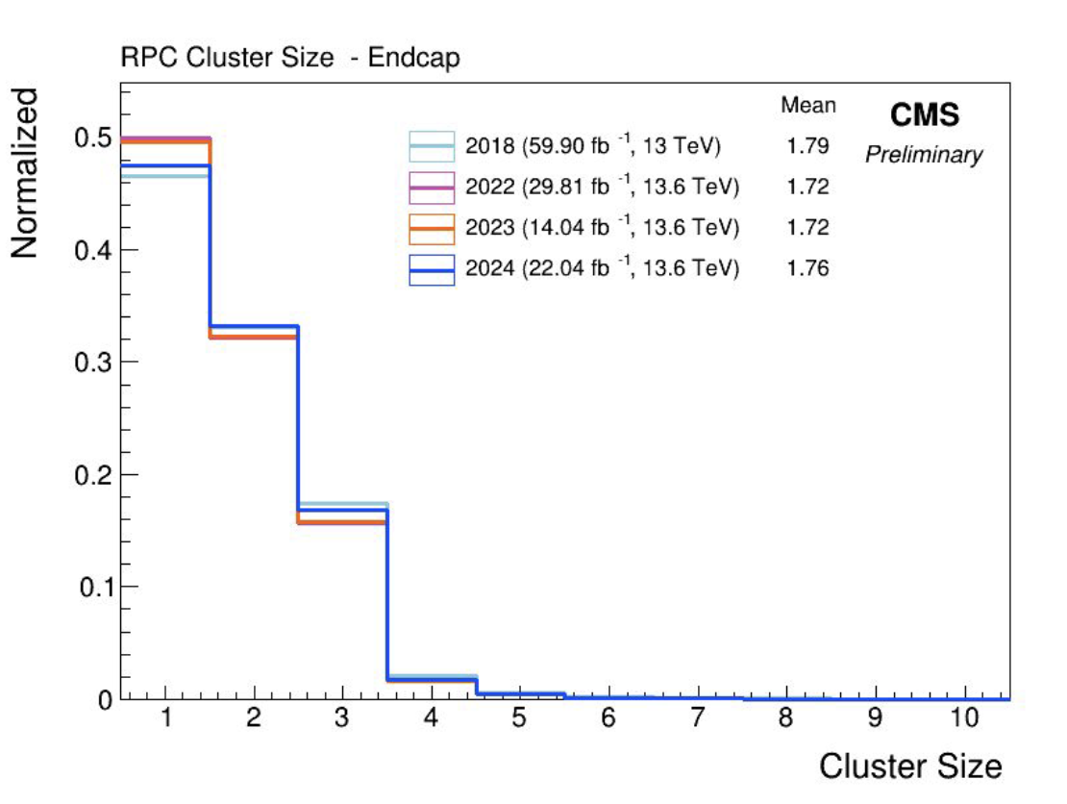
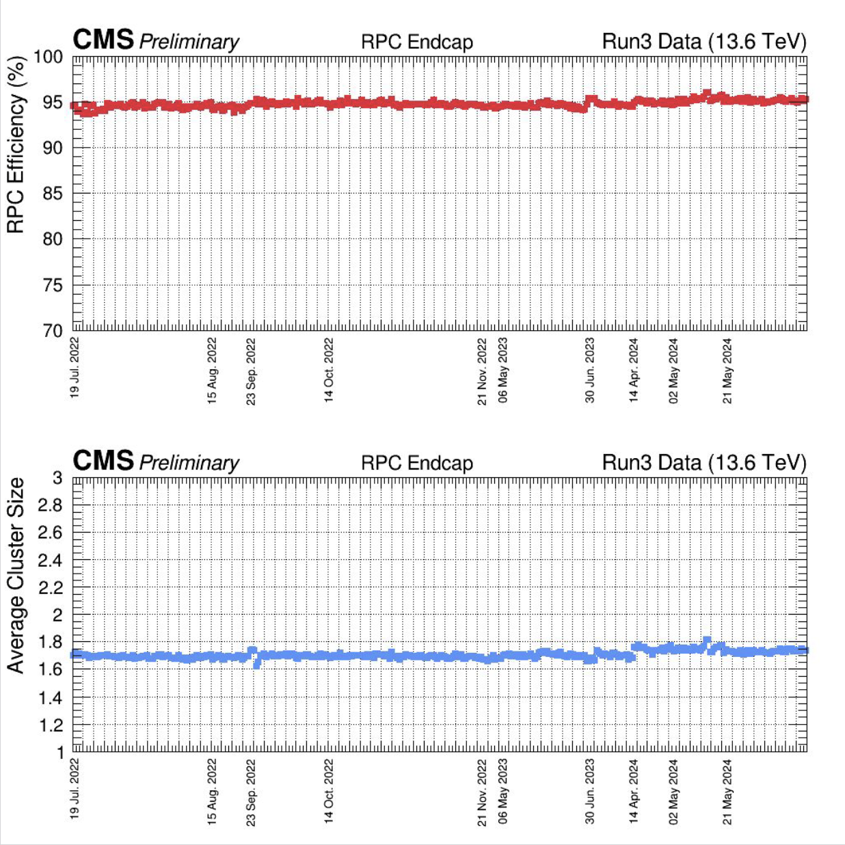
RPC performance in Run 3 (Endcap region)
Endcap RPC efficiency and cluster size distribution in Run2 (2018) and Run3 (2022, 2023, and 2024)
Stable Endcap RPC performance in RUN 3 and in agreement with previous runs

Slide 13
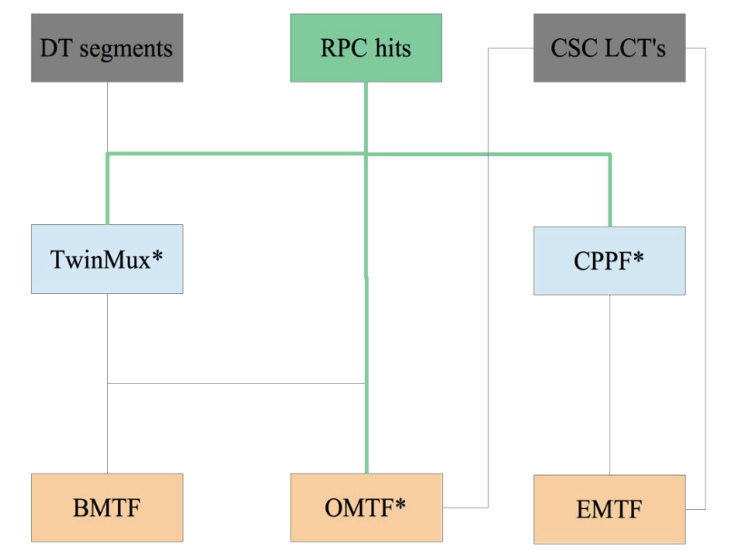
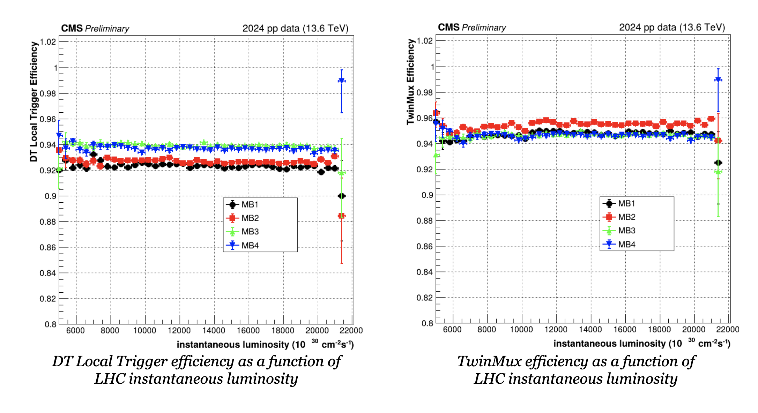
Local trigger and TwinMux performance
In the Barrel region, DT and RPC information is processed in two stages to provide optimal online reconstruction inputs to Level-1 Muon Trigger Track Finders.
In the first layer, TwinMux boards match RPC hit clusters with DT Local Trigger segments in order to:
  recover DT inefficiencies using RPC-only primitives (MB1 and MB2 stations only)
  improve BX identification efficiency by exploiting the RPC's excellent time resolution
DT local trigger and TwinMux efficiency are both stable as a function of LHC instantaneous luminosity
TwinMux efficiency is bigger than the DT local trigger efficiency of:
  ~3% in the MB1 and MB2
  ~1.5% in the MB3 and MB4
Notes:
…. making the best out of DT spatial resolution and RPC time resolution
RPC timing used to assign the bunch-crossing of DT segments without 8 fired layers

Slide 14
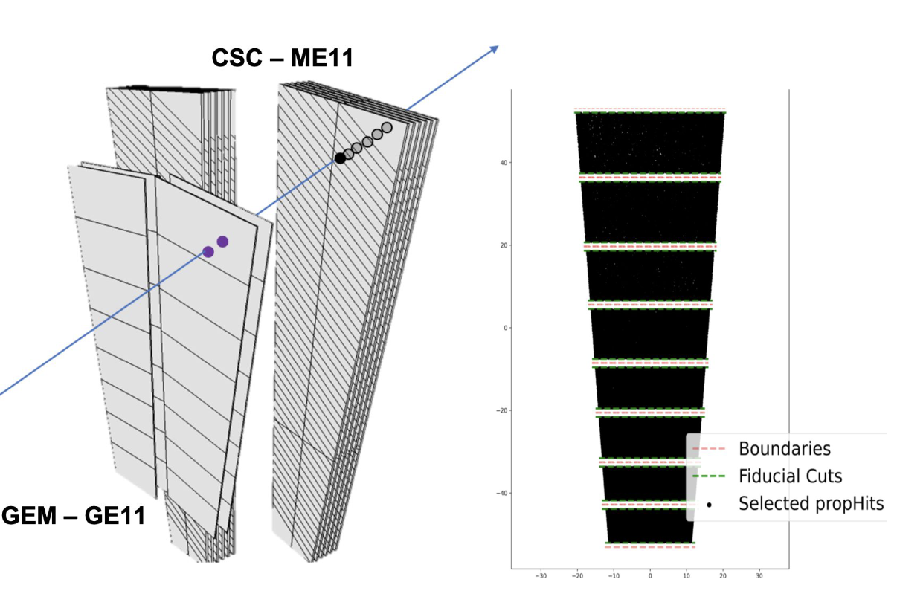
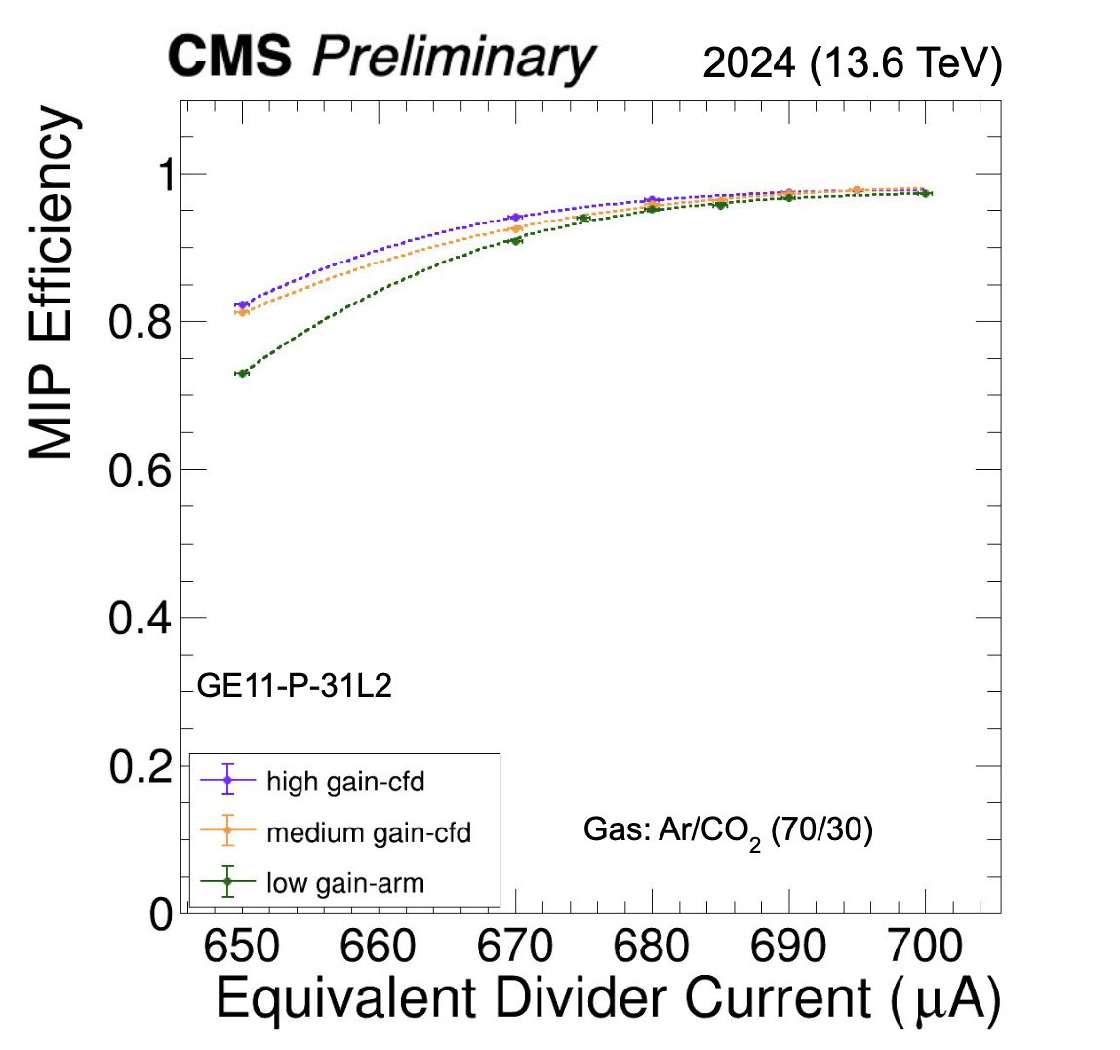
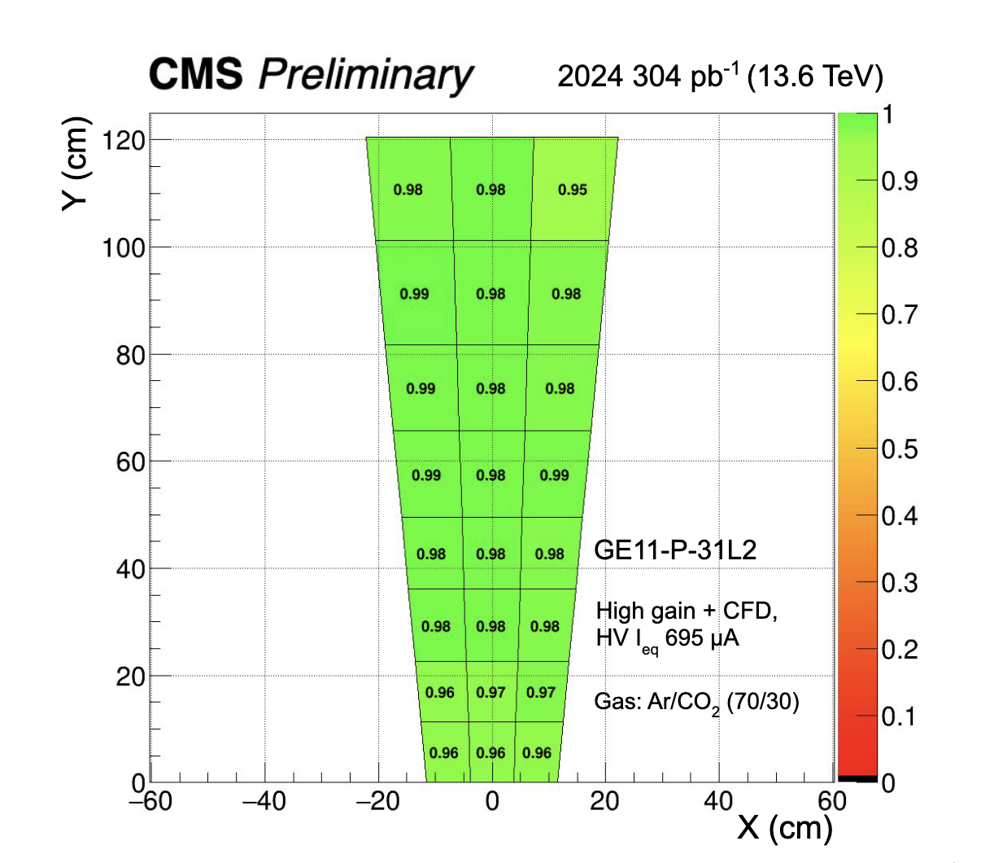
GEM calibration in 2024
Calibration runs were taken in 2024 at different HV settings and Frontend chip (VFAT) configurations:
○ Pre-amplifier [low, medium, high] gain
○ Comparator mode [ARM, CFD].
GEM analysis done using events with standalone (STA) muons (p_{T} > 10 GeV, with at least 15 hits in the muon system, and χ₂ < 5) and with hits in the CSC companion station (i.e. accept a track through GE1/1 only if it contains ME1/1 hits)
GE1/1 efficiency vs. current
GE1/1 efficiency map

Slide 15
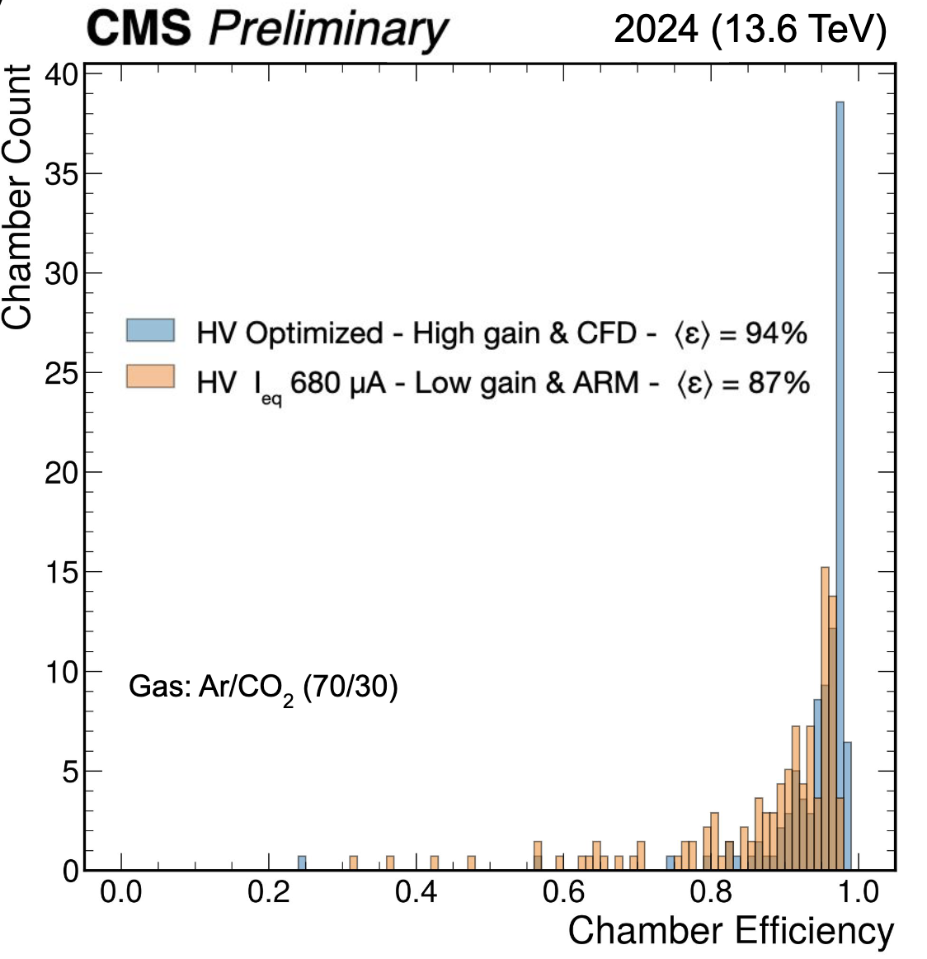
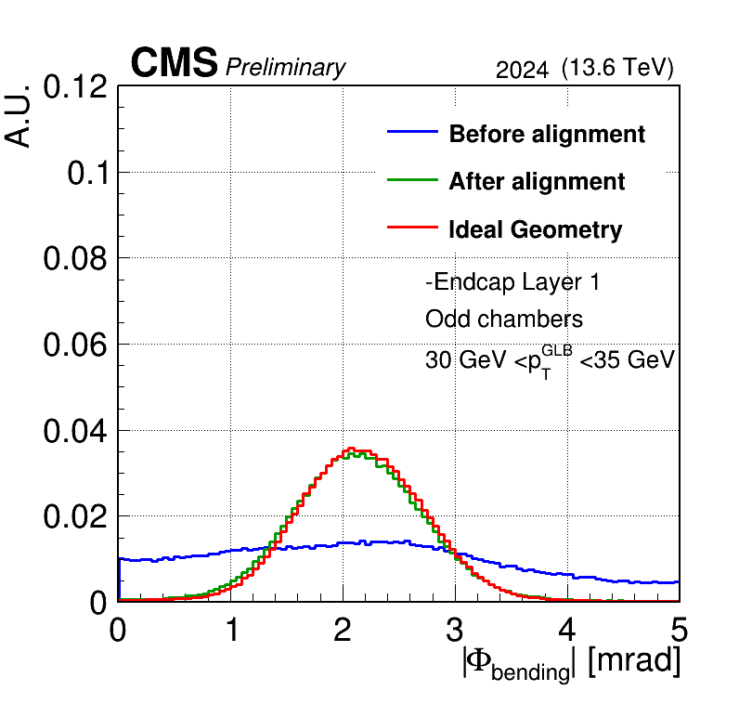
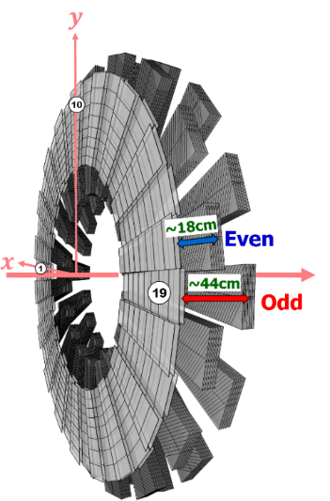
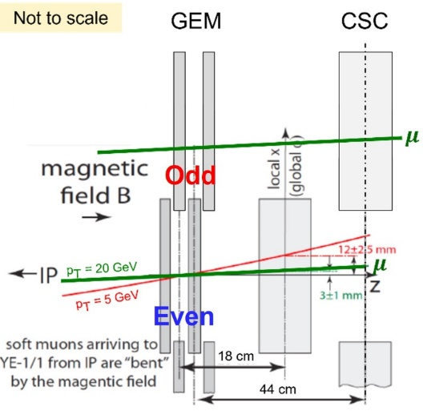
GEM performance in RUN3
A new HV setting was applied in the middle of June 2024
A significant increase in the GE1.1 efficiency has been measured with HV-optimized and High gain Constant Fraction Discriminator
More on GE1.1 operations in S. Calzaferri’s talk
Fully validated the alignment for trigger capability: the Banding Angle distributions after the alignments are close to the ideal case

Slide 16
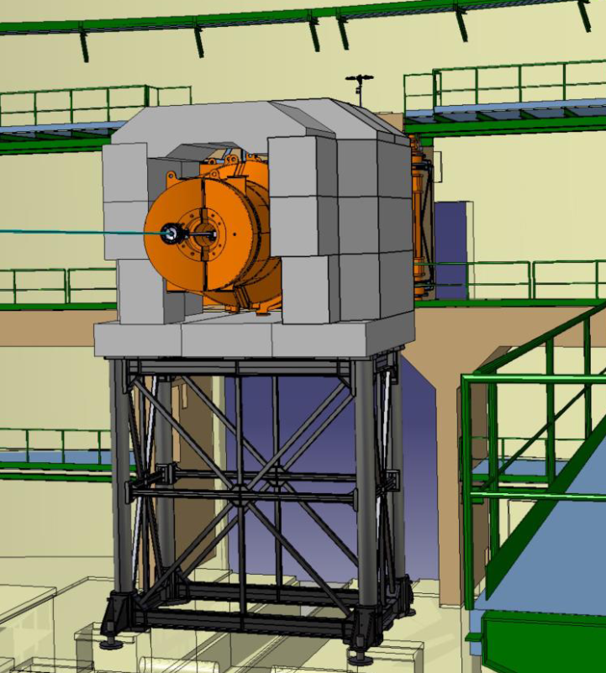
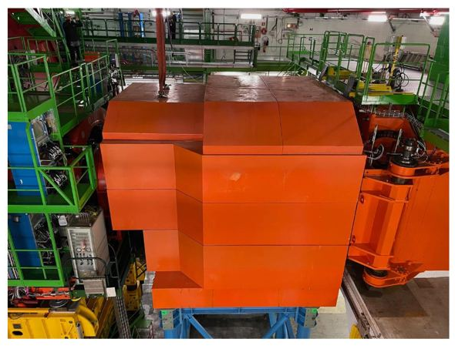
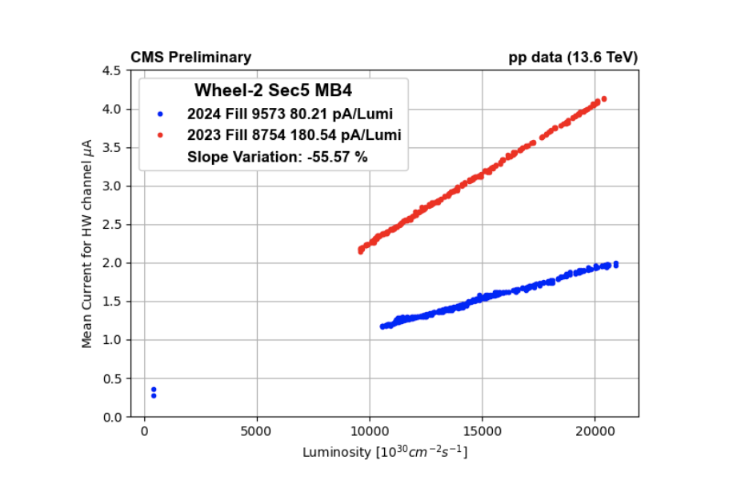
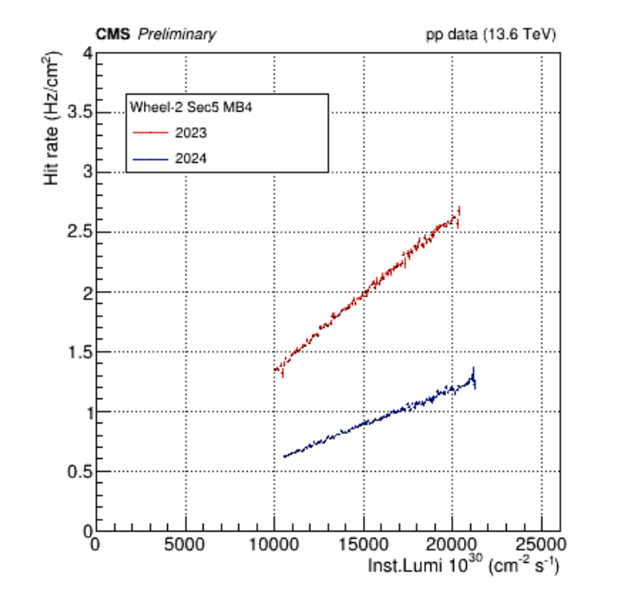
Background in 2024
A New Forward Shielding (NFS) was designed to reduce background in the cavern detected by the muon detectors. In the last shutdown, it was installed only on the negative side
Significant reduction of the currents and hit rates observed mostly in the outermost layer of the Muon System (MB4 and ME4)
52 % reduction
56 % reduction
DT Background currents and rates versus instantaneous luminosity in one MB4 sector of W-2 as measured in 2024 and 2023
Notes:
which will receive from now
on a much lower dose than before.
240 tons of additional shielding material:
90% Concrete
10% Steel

Slide 17
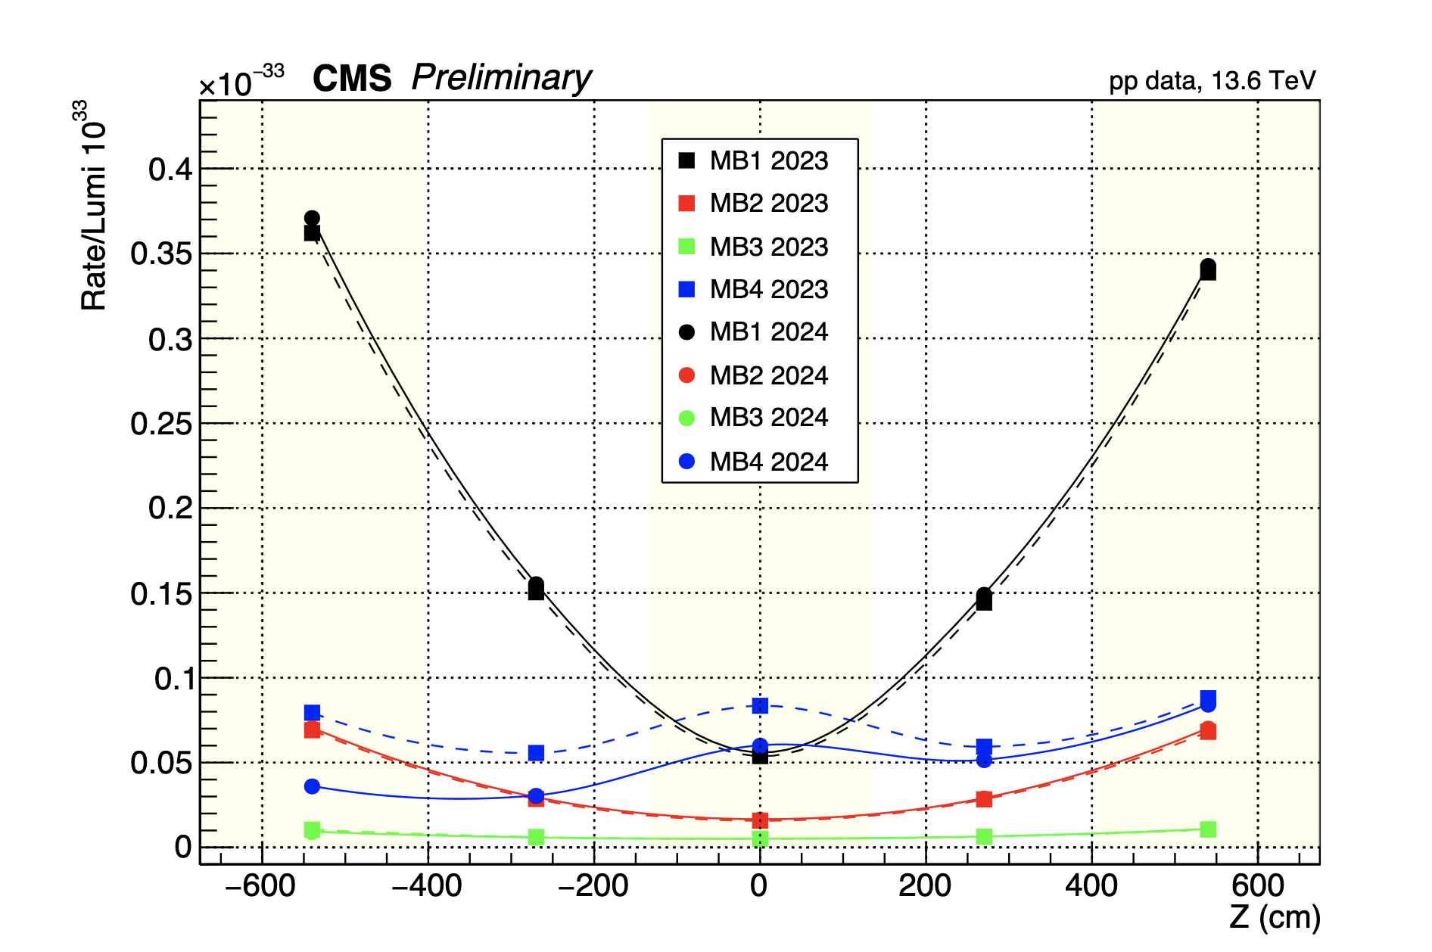
Background in 2024
The effect gradually decreases going negative side (where the shielding is installed) to the opposite side
No effect in the internal stations (MB1, MB2 and MB3)
The effect will be fully symmetric after the installation of the NFS on the positive side, thus dramatically reducing the detector aging process
NFS position
Notes:
which will receive from now
on a much lower dose than before.

Slide 18
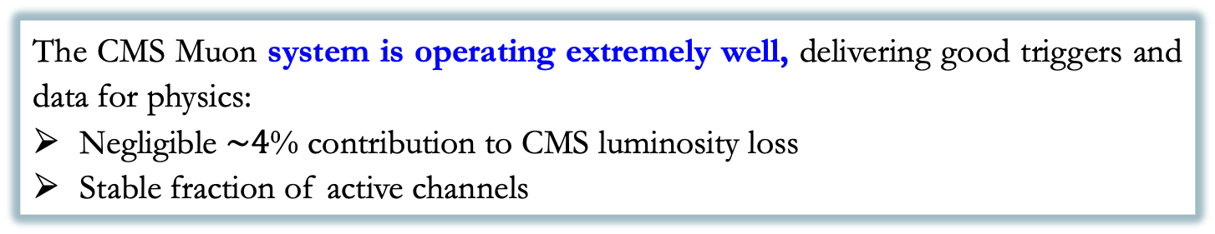
Conclusions
The CMS Muon system is operating extremely well, delivering good triggers and data for physics:
Negligible $\sim 4$% contribution to CMS luminosity loss
Stable fraction of active channels
After 14 years of LHC running with increasing instantaneous luminosity and 20 years since construction, the Muon detector performance remains within specifications both as a triggering and as a reconstruction system:
Muon chamber performance is stable with no degradation observed
Excellent and stable DT and CSC Segment and local trigger efficiency
Excellent efficiency for the new GE1.1 station: 94%
Significant reduction of the LHC background measured after the installation of the new shielding in early 2024
NEWS: published the paper Development of the CMS detector for the CERN LHC Run 3

Slide 19
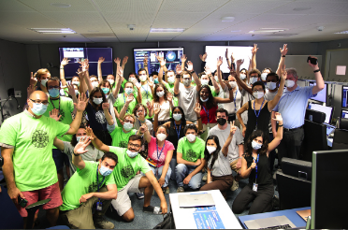

Thanks!
Credits
to CMS People

Slide 20

Backup slides

Slide 21


RUN3 DT Hits Efficiencies
DT hits efficiency exceeds 96.9 % (few exceptions are due to known hardware problems) and it is stable
In 2024, one chamber only in Wheel -2 Sector 8 MB1 is not working because of a gas connection problem: this problem is reported as a light blue bin in the plot and will be fixed over the coming YETS.

Slide 22

CMS Upgrade Project
The CMS detector has to be upgraded to cope with expected HL-LHC conditions (highest rate, fluence and pileup ever achieved) for new measurements and new physics searches

Slide 23


LHC and HL-LHC schedule
Phase 1
Today
Phase 2
10 years of running at higher rates and radiation doses
Notes:
So far LHC has delivered 5% of the total planned integrated luminosity. By the end of RUN3, it will be double
Major HL – LHC challenges wrt. LHC:
The instantaneous luminosity will increase of a factor 3-4
The Pile-Up (PU) (interaction proton – proton collisions in each Bunch Crossing) up to 5 times
The integrated luminosity up to 10 times
higher rates and radiation doses (radiation damage of detector and electronics components)

Slide 24

Muon Reconstruction
Tracker track reconstruction
Standalone Muon reconstruction
Performed using DT/CSC segments & RPC hits
Local reconstruction
Performed within single chamber
Global muon reconstruction (out side –in): a standalone muon is propagated to match a tracker track. If matching is positive a global fitting is performed.
Tracker Muon (inside – outside): a tracker track is propagated to muon system and qualified as muon if matching with standalone or one segment.

Slide 25



CSC Electronics Upgrade motivation
On-chamber and off-chamber electronics to be replaced in order to handle the CMS trigger requirements at HL-HC

Slide 26


LS2 CSC Upgrade activity
The on-detector Refurbishment of Electronics in LS2

Slide 27


Muon Upgrade
New GEM and RPC detectors needed to improve efficiency reconstruction and trigger performance at HL_LHC
NEW

