Slide 1
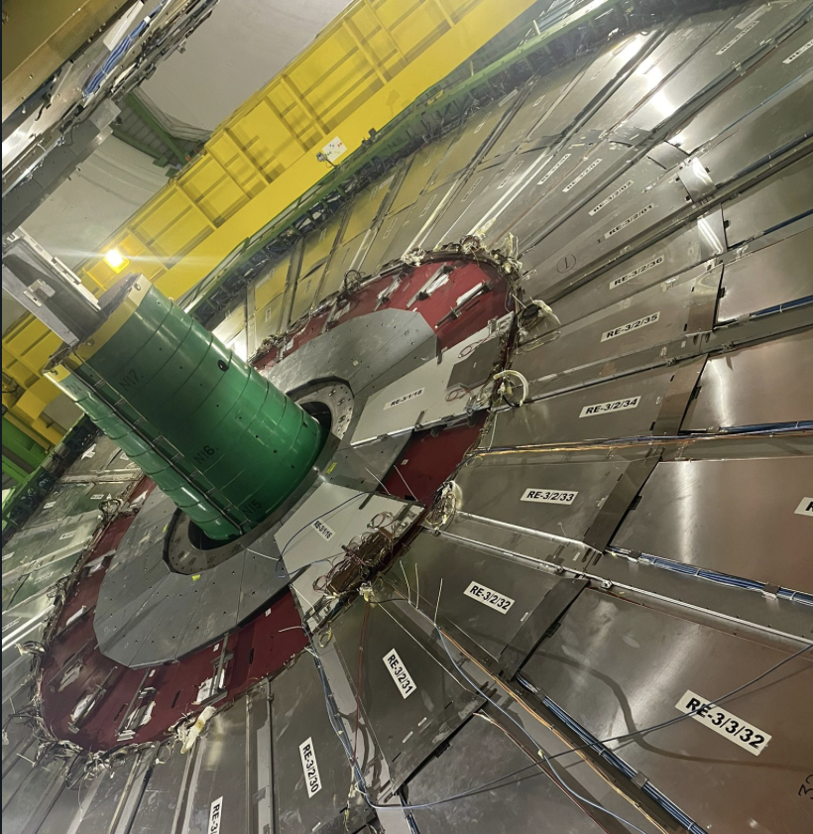


Improved RPC (iRPC) detector for CMS data taking in HL-LHC
Salvatore Buontempo
(INFN – Napoli)
on behalf of CMS Muon Group
ICHEP2024 – July 20th 2024 - Prague (Czech Republic)

Slide 2
Outline
The Compact Muon Solenoid (CMS) for the HL-LHC
The improved Resistive Plate Chambers (iRPCs) in CMS
iRPC production and quality control
Time and space resolution
Performance of iRPCs under gamma background
Installation in CMS
Conclusions and Perspectives

Slide 3
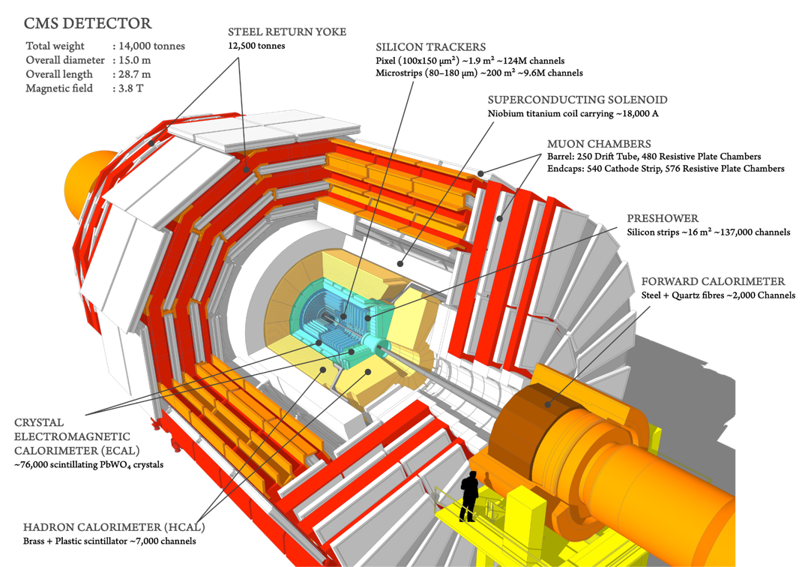
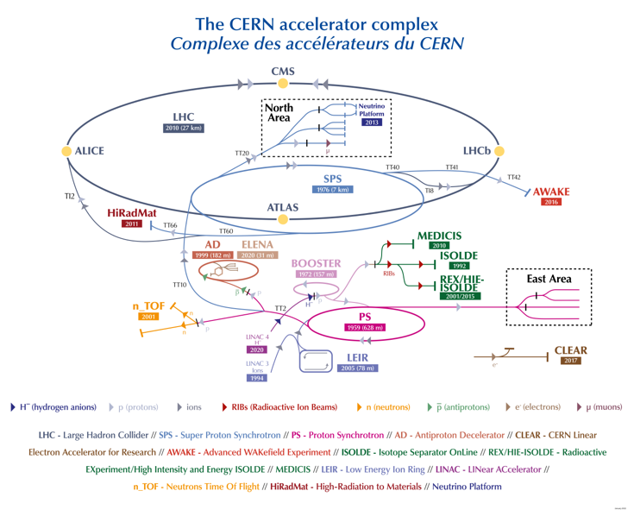
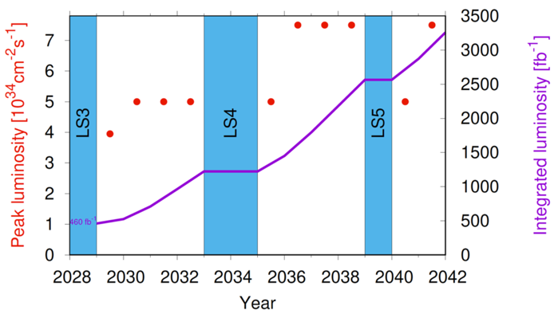
The Compact Muon Solenoid for HL-LHC
CMS is under Run III data taking and in the process of preparation to extend its sensitivity to new physics searches for the High-Luminosity LHC period starting in 2029, anticipated to feature a higher Instantaneous Luminosity to around 3000 fb⁻¹.

Slide 4
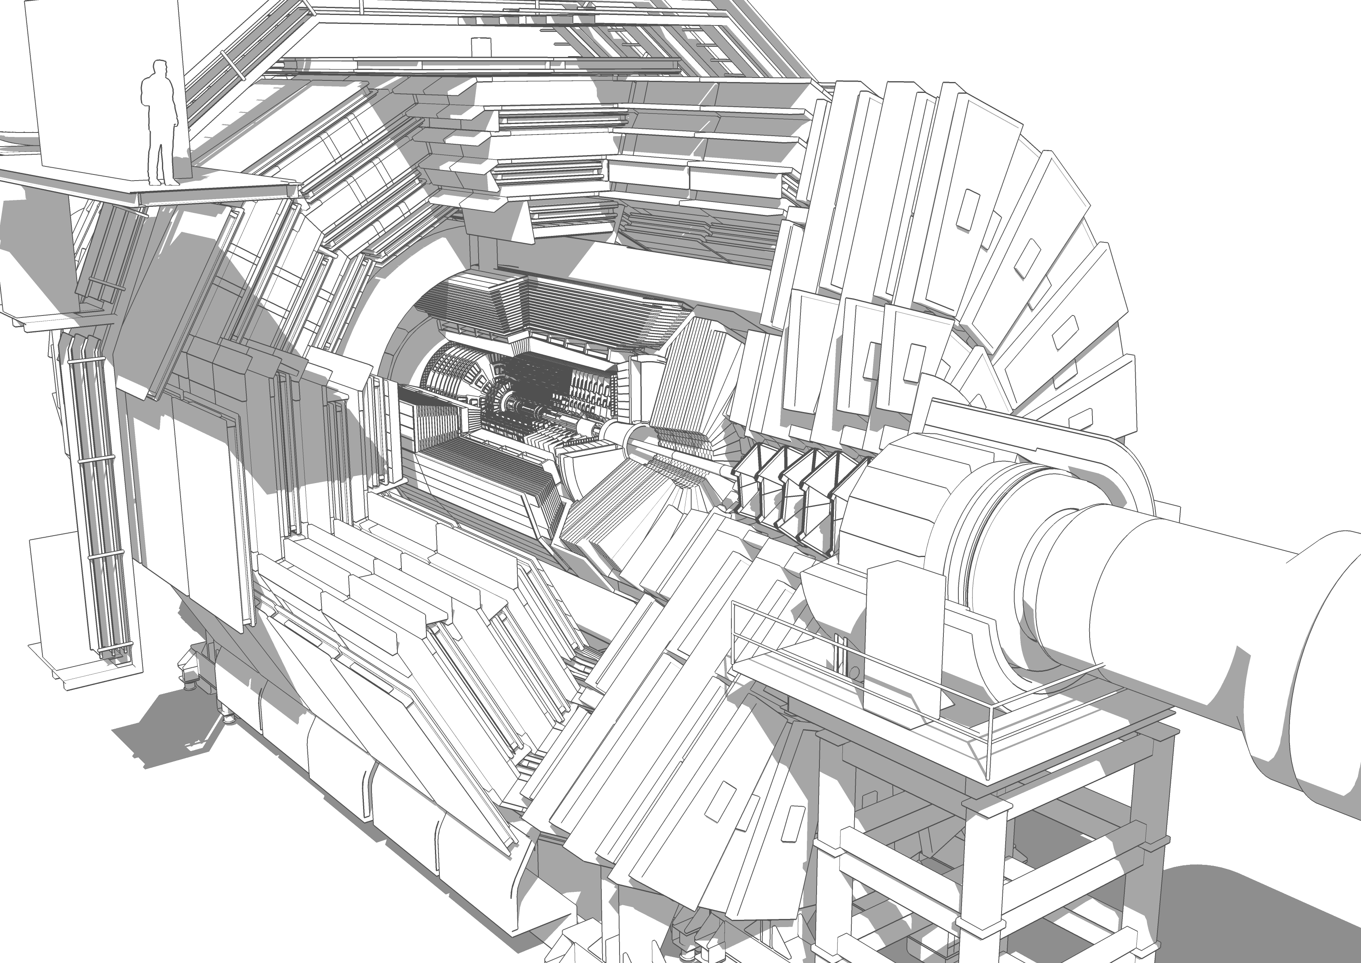





























RPC is the only Muon subsystem
that covers the entire CMS:
Barrel and Endcap

Slide 5

Cooling,
Construction
Assembly site, Operation
& Construction
TC, RC, DPGC
Operation
& Construction
/
TC
Assembly site, Operation
& Construction
GAP, DPGC
TrigC
UC, PCB, FEB
Back end
TrigC
Assembly site, PM,
UC, Operation
& Construction
HPL, PM,
RM, EC
RC, Operation
& Construction
EC, Link System
PM, RM, DPGC,
EC, TC, Operation
& Construction
Operation
& Construction
International CMS RPC

Slide 6
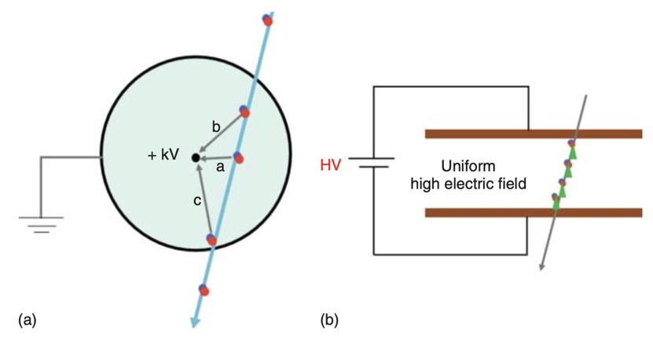
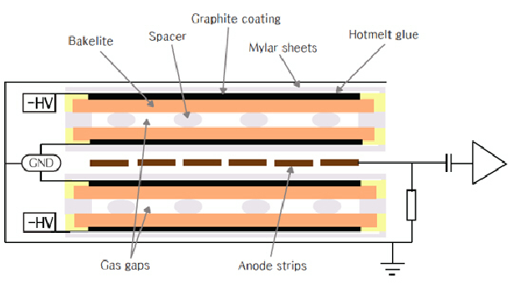
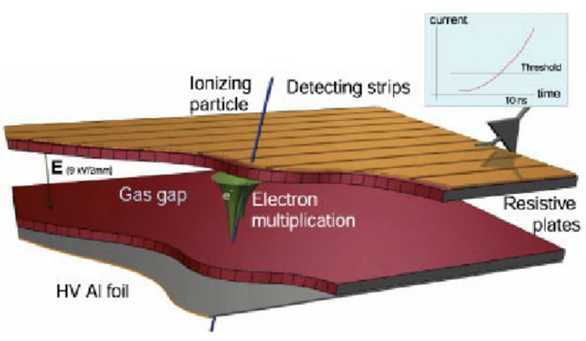
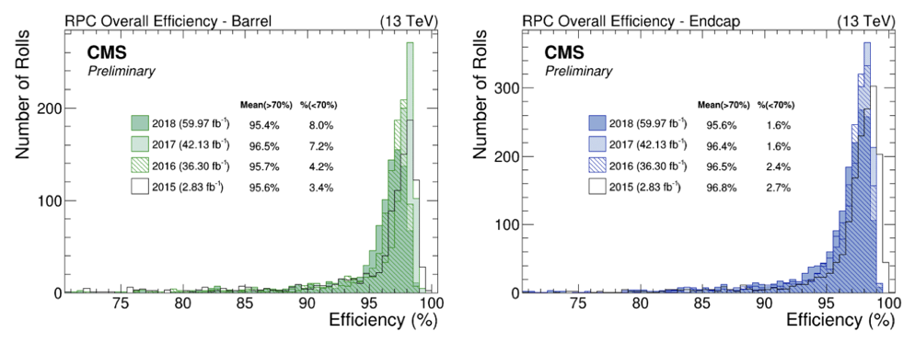
The Resistive-plate Chambers in CMS
Park, S et al (2012). CMS endcap RPC gas gap production for upgrade. Journal of Instrumentation. 7. P11013. 10.1088/1748-0221/7/11/P11013.
Abbrescia et al, 2018
Guiducci, Luigi & Montanari, Alessandro & Odorici, Fabrizio & Rossi, Antonio. (2006). Design and Test of the Off-Detector Electronics for the CMS Barrel Muon Trigger
RPC barrel and end cap efficiency during Run II (2015-2018)
Gas mixture used in CMS/RPC: 95.2 % C₂H₂F₄ + 4.5 % i-C₄H₁₀ + 0.3 % SF₆
6
Notes:
95.2 % C2H2F4 (R134a tetrafluoroethane), 4.5 % isobutane (C4H10) and 0.3 % SF6 (Sulphur hexafluoride)

Slide 7
The Resistive-plate Chambers in CMS
Park, S et al (2012). CMS endcap RPC gas gap production for upgrade. Journal of Instrumentation. 7. P11013. 10.1088/1748-0221/7/11/P11013.
Operations and Performance Summary of CMS Muon System for LHC Run 3
Talk by Gabriella Pugliese
Abbrescia et al, 2018
Latest results of longevity studies on the present
CMS Resistivity Plate Chamber (RPC) system for the HL-LHC phase
Poster by Mapse Barroso Ferreira Filho
Performance of eco-friendly alternative gas mixture in CMS iRPC detector in HL-LHC environment
Poster by Joao Pinheiro
Guiducci, Luigi & Montanari, Alessandro & Odorici, Fabrizio & Rossi, Antonio. (2006). Design and Test of the Off-Detector Electronics for the CMS Barrel Muon Trigger
RPC barrel and end cap efficiency during Run II (2015-2018)
Gas mixture used in CMS/RPC: 95.2 % C₂H₂F₄ + 4.5 % i-C₄H₁₀ + 0.3 % SF₆
7

Slide 8
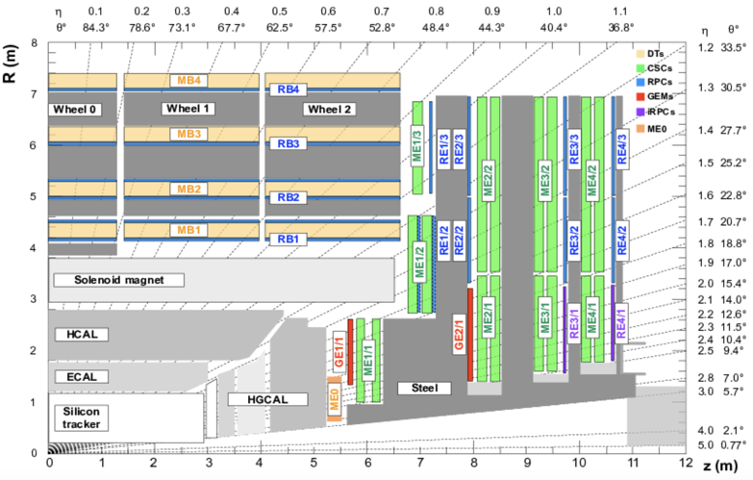
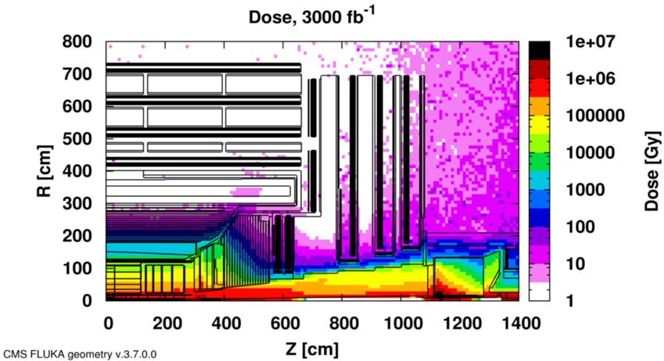
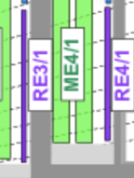
CMS Muon LHC Phase-II Upgrade
To cope with the high particle rate and high pileup environment due to increased luminosity in HL-LHC, the CMS forward region demands → improved trigger and reconstruction performance !
Interesting Physics in the forward region (CERN-LHCC-2017-012):
  long-lived particles decaying leptonically;
  final states with low pT muons;
  heavy slowly moving charged particles;
  highly boosted di-muons;
Muon System Upgrade for HL-LHC (|η| < 2.8):
  Existing DTs, CSCs and RPCs:
→ Upgrade the Electronics!
  Installation of new detectors in the forward region:
    Gas Electron Multipliers: ME0 and GE21
    Improved Resistive Plate-Chambers (iRPC) : RE31 and RE41
CERN Document Server courtesy
Hottest point
~ 700 Hz/cm²
CERN-LHCC-2015-010
8
Notes:
Replacement of ageing electronic parts
Increase event reconstruction capabilities particularly in forward region
Extend acceptance, Adding new detectors extending the eta coverage
Repair / replace your aged detectors as well as its electronic components - better timing
Update the trigger hardware and algorithms
Make your readout electronics with deeper buffering and faster processing

Slide 9
CMS Muon LHC Phase-II Upgrade
To cope with the high particle rate and high pileup environment due to increased luminosity in HL-LHC, the CMS forward region demands → improved trigger and reconstruction performance !
Interesting Physics in the forward region (CERN-LHCC-2017-012):
  long-lived particles decaying leptonically;
  final states with low pT muons;
  heavy slowly moving charged particles;
  highly boosted di-muons;
Muon System Upgrade for HL-LHC (|η| < 2.8):
  Existing DTs, CSCs and RPCs:
→ Upgrade the Electronics!
  Installation of new detectors in the forward region:
    Gas Electron Multipliers: ME0 and GE21
    Improved Resistive Plate-Chambers (iRPC) : RE31 and RE41
CERN Document Server courtesy
Hottest point
~ 700 Hz/cm²
The CMS Muon System Upgrade for High Luminosity LHC
Talk by Archie Sharma
CERN-LHCC-2015-010
9
Notes:
Replacement of ageing electronic parts
Increase event reconstruction capabilities particularly in forward region
Extend acceptance, Adding new detectors extending the eta coverage
Repair / replace your aged detectors as well as its electronic components - better timing
Update the trigger hardware and algorithms
Make your readout electronics with deeper buffering and faster processing

Slide 10
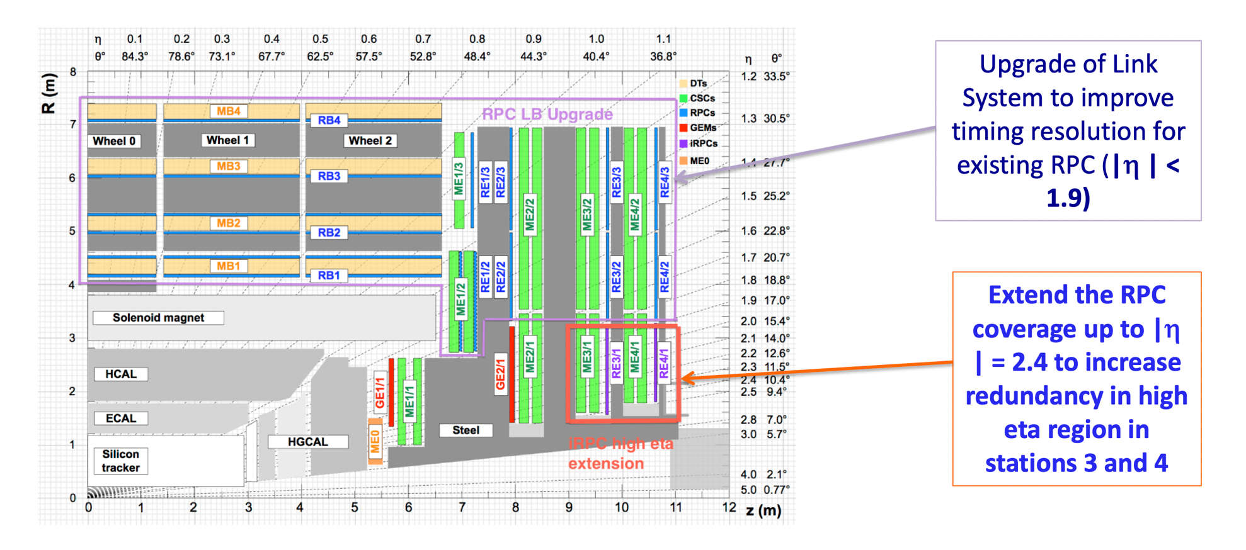


CMS RPC Upgrade Project
Upgrade of Link System to improve timing resolution for existing RPC system (|$η$|<1.9)
Replace all off-chamber electronics.
iRPC: Extend the RPC coverage up to |$η$|=2.4
in high eta region in stations 3 and 4

Slide 11
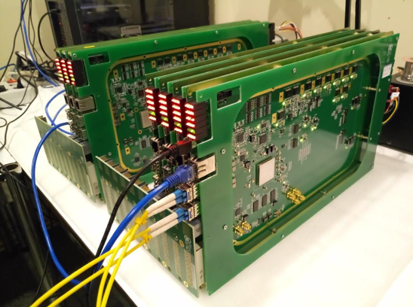
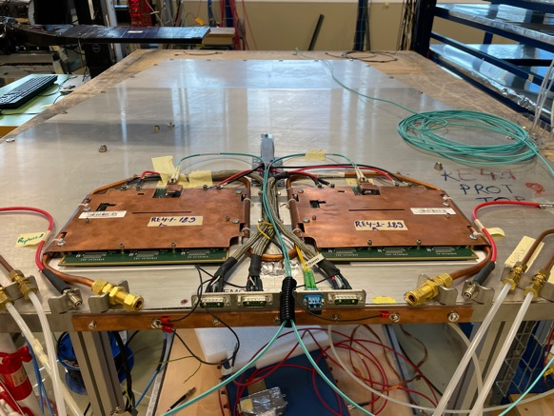

CMS RPC Upgrade Project
Upgrade of Link System to improve timing resolution for existing RPC system (|$η$|<1.9)
Replace all off-chamber electronics.
Extend the RPC coverage up to |$η$|=2.4
to restore redundancy in high eta region in stations 3 and 4

Slide 12

CMS RPC Upgrade Project
Upgrade of Link System to improve timing resolution for existing RPC system (|$η$|<1.9)
Replace all off-chamber electronics.
Extend the RPC coverage up to |$η$|=2.4
to restore redundancy in high eta region in stations 3 and 4
Focus of present talk

Slide 13
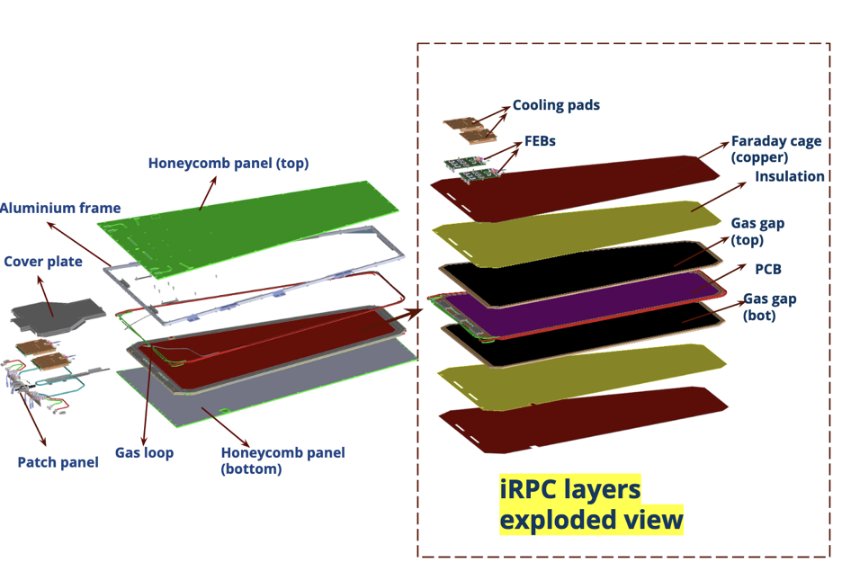
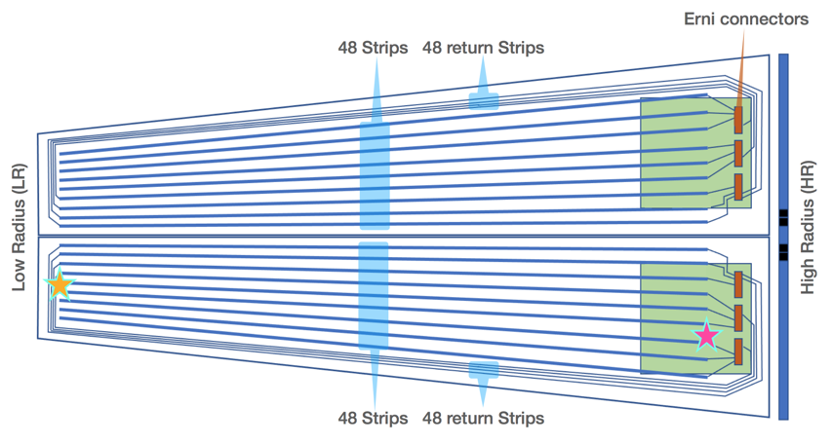
iRPC: improved Resistive Plate Chambers
 | RPC | iRPC
HPL thickness (mm) | 2 | 1.4
Number of gas gaps | 2 | 2
Gas gap thickness (mm) | 2 | 1.4
Resistivity (Ωcm) | 1 - 6 x 10¹⁰ | 0.9 - 3 x 10¹⁰
Charge threshold (fC) | 150 | 30 - 40
Space resolution in η (cm) | 20 - 28 | 1.5
Space resolution in φ (cm) | 0.8 - 1.9 | 0.3 - 0.6
Intrinsic timing resolution (ns) | 1.5 | 0.5
+ 72 chambers in RE3/1 and RE4/1 positions
  20 º coverage in 𝞍 per chamber
  Variable strip width from 0.6 cm to 1.23 cm
  trapezoidal geometry ~1.2 x 1.6(3) m² for RE 3(4)/1
Double readout in the strips high and low radius
Charge threshold between 30 and 40 fC
Strip PCB allow Return line concept
FEB positioned external and @ HR (lowest dose region)
13
Notes:
The new layout reduces the amount of the avalanche charge produced by the passage of a charged particle through the detector.
This improves the RPC rate capability by reducing the needed time to collect this charge.

Slide 14
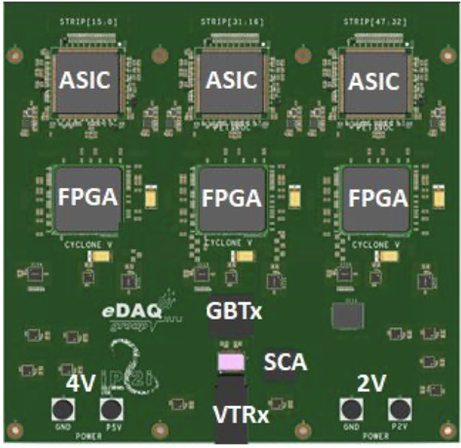
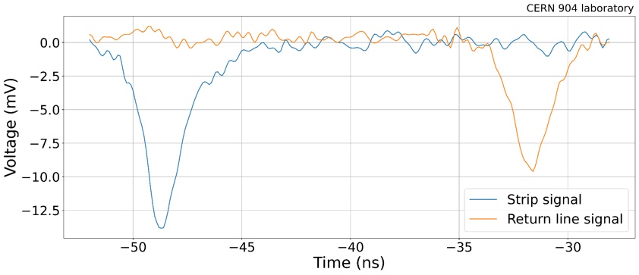
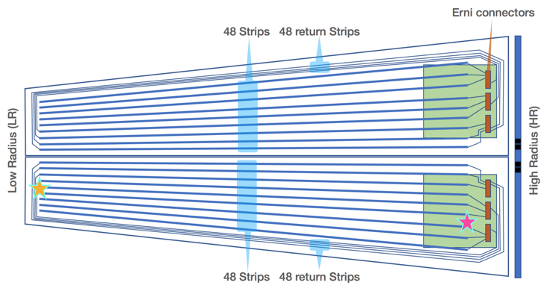
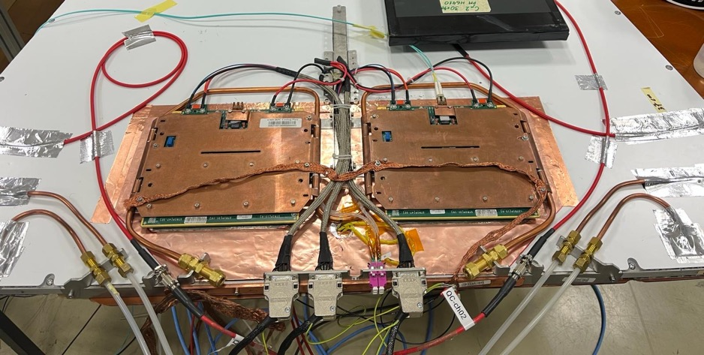
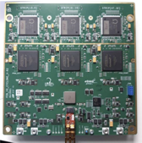
iRPC Front-end electronics (FEB)
Front-end Electronics for iRPC
LR Return signal
TOP/BOT
TOP/BOT
TOP/BOT
iRPCROC
iRPCROC
iRPCROC
CYCLONE V
CYCLONE V
CYCLONE V
Cooling pipe
Fiber readout
Gas supply
Gas return
HR Direct signal
FEB
HV connector
To Back-end board
Cooling plate with thermal pads
14
2V for left FEB
2V for right FEB
4V for both FEBs

Slide 15
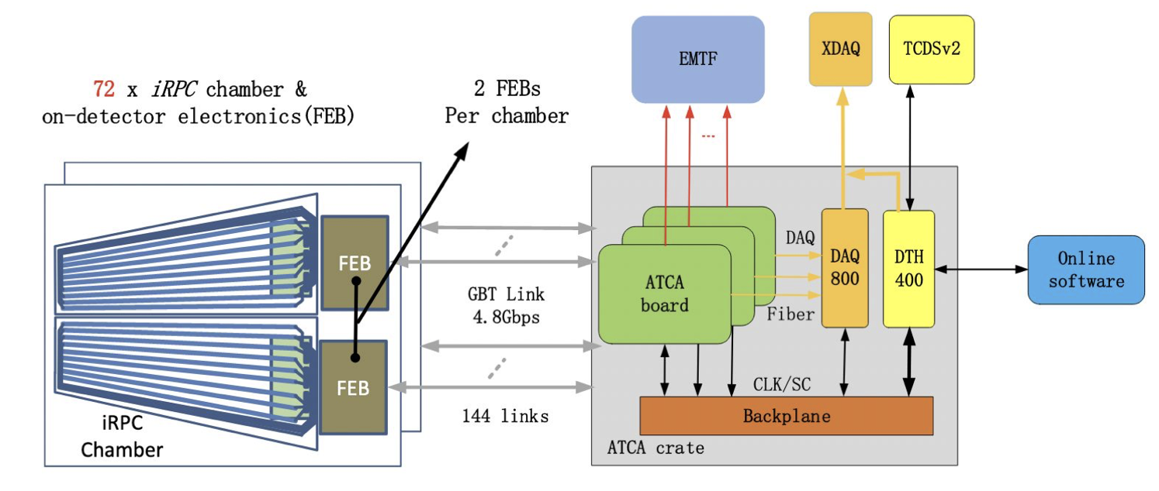
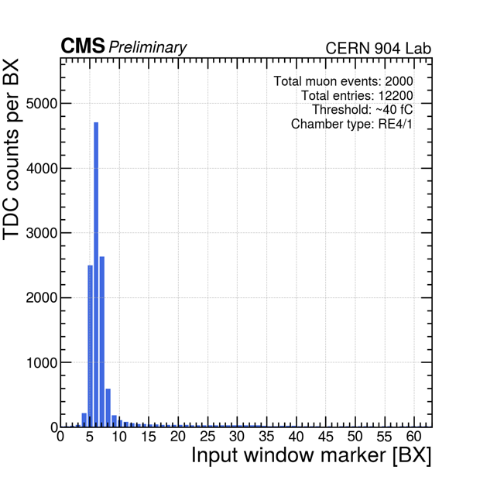
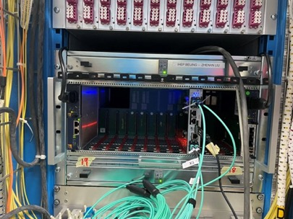
The iRPC back-end electronics
Back-end functions include:
Fast/slow control and monitor
Cluster finding and trigger primitive generation
Timing reference adjustment
Data acquisition
Serenity
At present, microTCA-based with
custom back-end board by IHEP is in use
FEB TDC data recorded in few BX,
well inside the 20 BX trigger latency
Set up in CMS Underground Service Cavern
Data transmission delay properly adjusted by Back-end
15
Notes:
The plot shows the number of Time-to-Digital Converter (TDC) data recorded for different readout window markers. X-axis marks the location of readout window position. For each bunch crossing (BX), every 25 ns, a maximum of 3 TDC data can be transmitted by the Front-End Board (FEB). The information from the FEB, and the signal from the trigger arrive at different timestamps. The Back-End Board (BEB) is in charge of making sure the data transmission delay is properly adjusted.

Slide 16


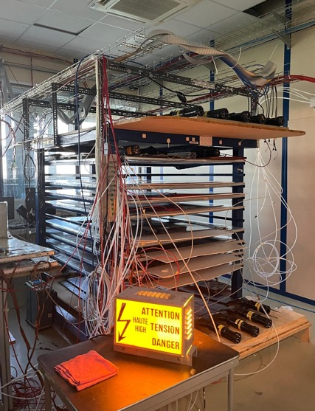
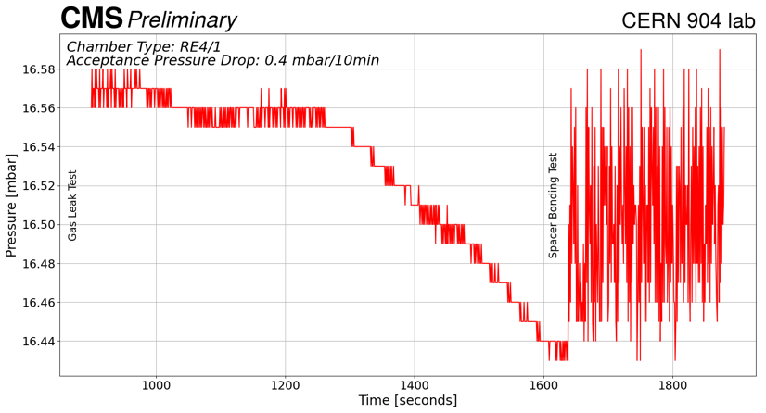
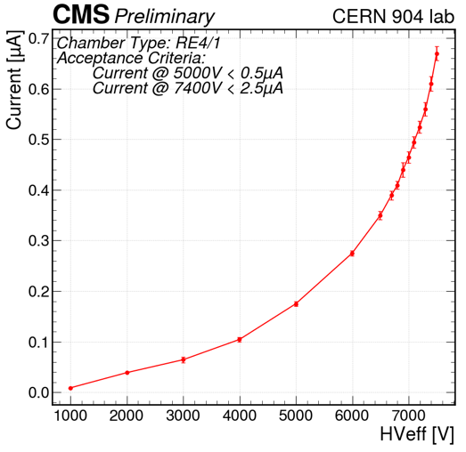
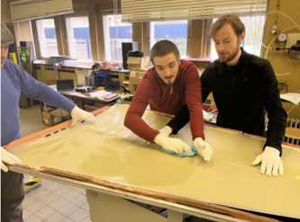
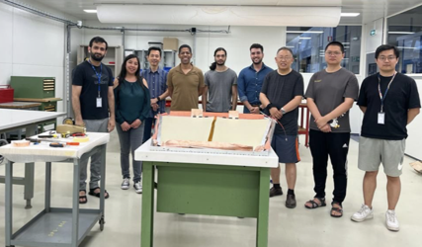
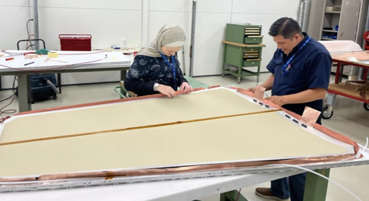
iRPC production and Quality Control @
First QC step performed in the original sites of components manufacturing
Second QC step is again on component level, but in the chamber assembly sites
(CERN and Ghent University) to check component quality & stability after transport
avalanche region
ohmic region
Leak test (drop < 0.4 mbar/10 min)
Spacer bonding test
Dark current test (< 2.5 uA)
Cosmic stand for gaps validation
Chamber assembly with validated components:
62/72 chambers manufactured so far, completion expected by end of August 2024
16

Slide 17
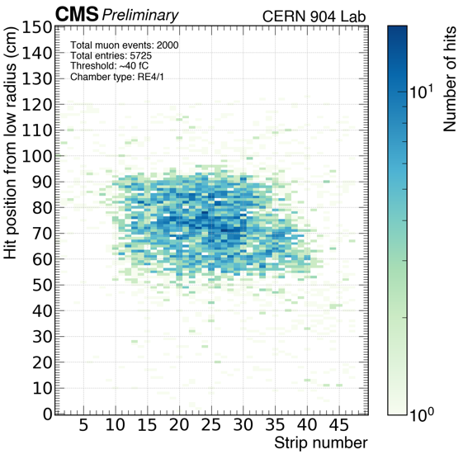
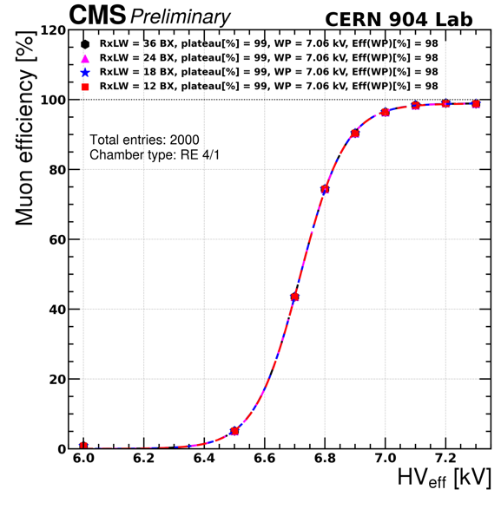
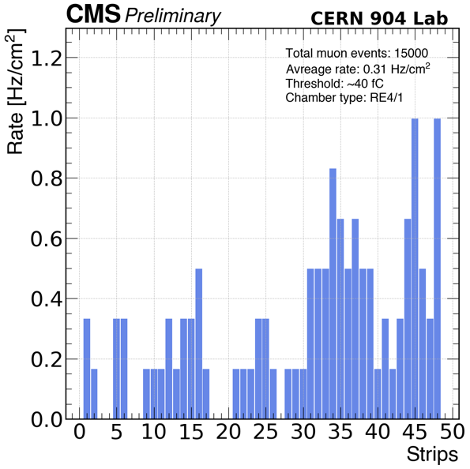
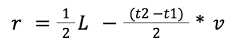
iRPC production and Quality Control @
3rd step: Cosmic efficiency with portable FEB v2.3
3 scintillators for coincidence + veto
30 x 40 cm² coincidence region
After TDC channel mapping, the hit position along the strips are obtained by the arrival time between LR and HR signals:
Efficiency of 98% and working point around 7050 V is stable up to 12 BX readout window!
Average noise < 1 Hz/cm²
measured in dedicate random scans
17
Notes:
Noise cut at 5 hz/cm2

Slide 18
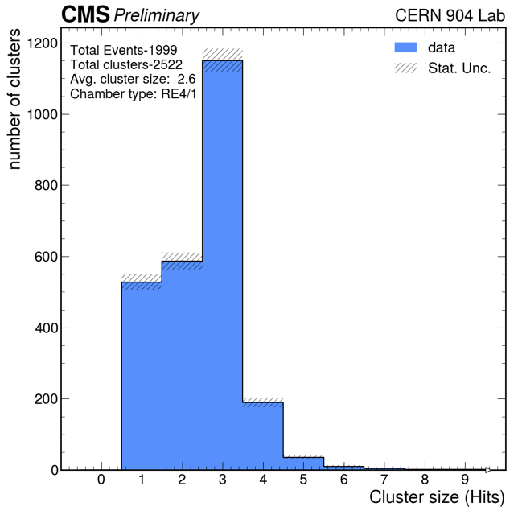
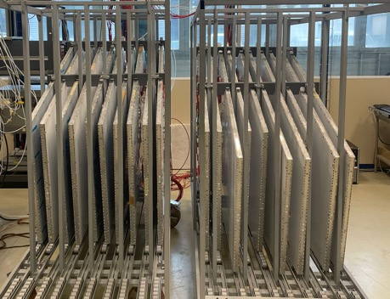
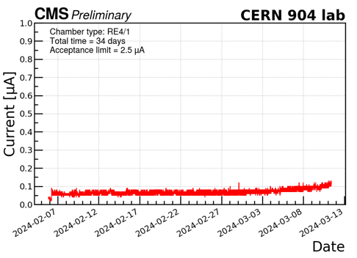
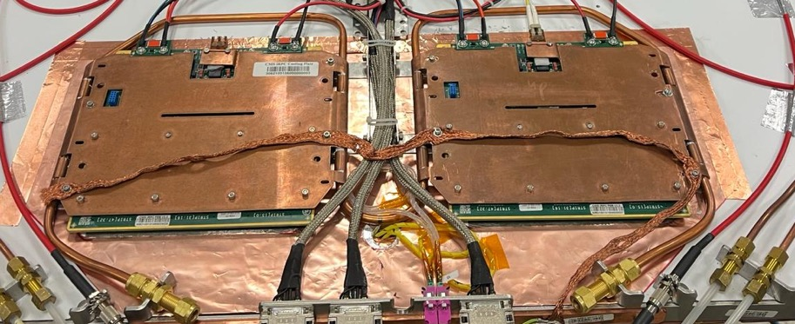
iRPC production and Quality Control @
Cluster size in cosmic test with FEB v2.3
Step 4: Final chambers with final FEBs (v2.3)
→ Long stability test: current monitoring @ WP for 1 month
Average cluster size = 2.6!
→ Final cosmic test with final FEB v2.3 + cooling system
Cluster size is defined as the number of adjacent strips fired when a muon crosses the detector
The strips pitch in the coincidence region is ~1 cm
18
cover (not shown in the picture)
Notes:
2.5 uA @ 7.1 kV

Slide 19
iRPC production and Quality Control @
Cluster size in cosmic test with FEB v2.3
Step 4: Final chambers with final FEBs (v2.3)
→ Long stability test: current monitoring @ WP for 1 month
Average cluster size = 2.6!
→ Final cosmic test with final FEB v2.3 + cooling system
CMS improved Resistive Plate Chamber (iRPC) upgrade:
Web-based automation for Quality Control
Poster by Ece Asilar
Cluster size is defined as the number of adjacent strips fired when a muon crosses the detector
The strips pitch in the coincidence region is ~1 cm
Production and quality control for CMS iRPC
Poster by Dilson De Jesus Damiao
19
cover (not shown in the picture)

Slide 20
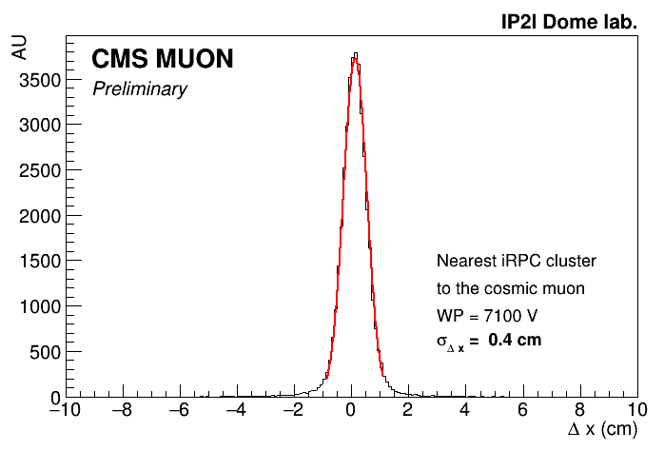
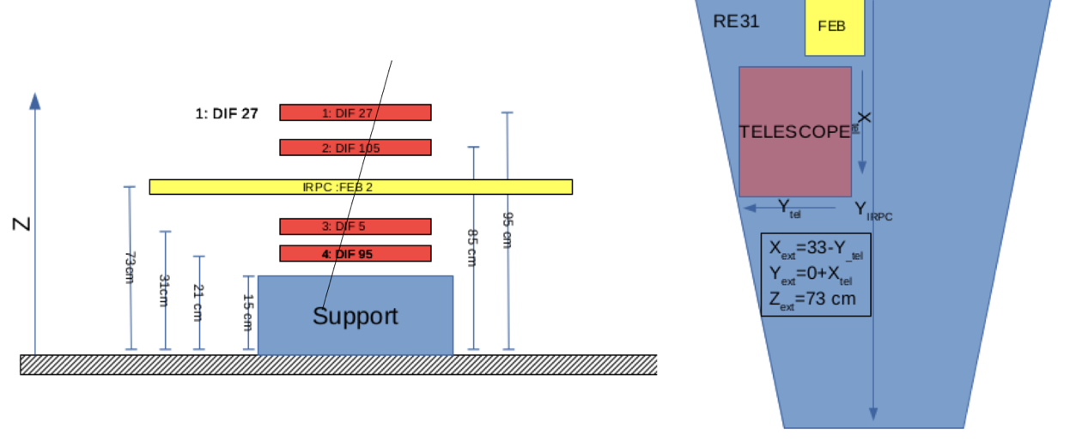
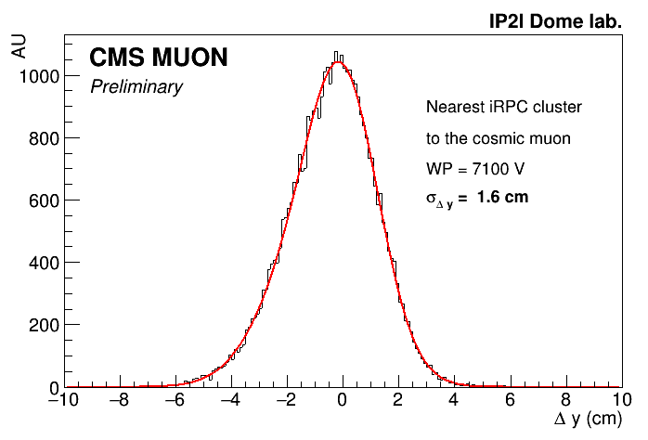

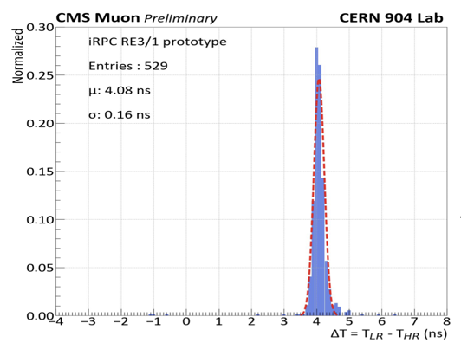





Space resolution
Telescope in Lyon University IP2I made up with 4 RPC chambers (2 mm double gap 30 x 50 cm²)
X-axis resolution depends on strip pitch in the telescope region:
  0.8 - 0.9 cm
20
In y-axis, resolution depends on
20

Slide 21
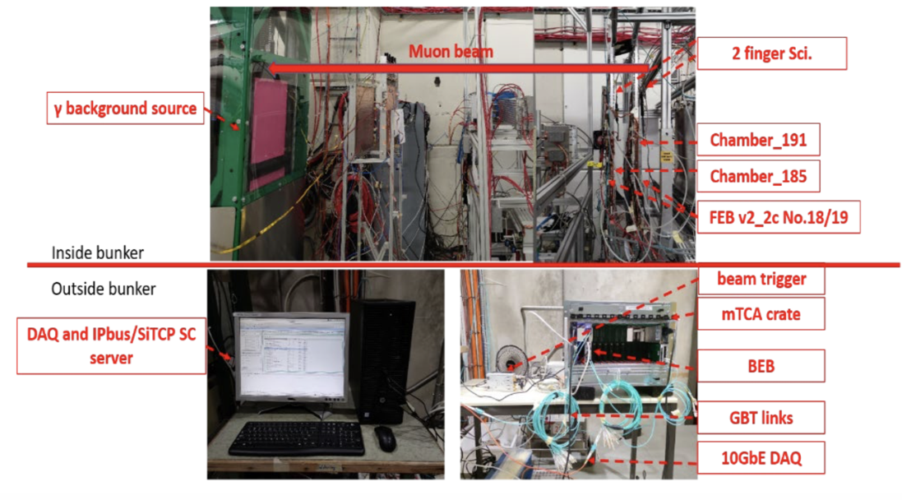
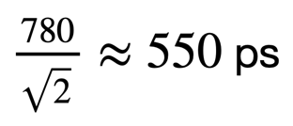
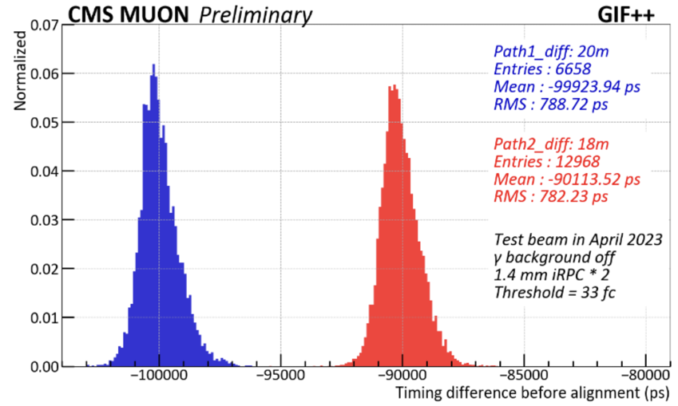
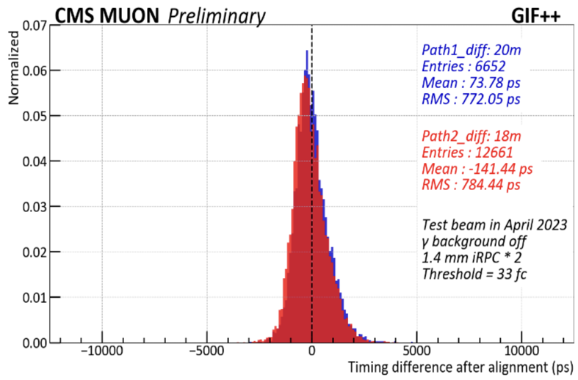
Time resolution
Timing resolution performed with 2 identical chambers and a muon beam
Absolute timing resolution of the system after alignment by back-end:
u
21
21

Slide 22



Performance of iRPC under gamma bkg
Performance of a iRPC chamber in Gamma Irradiation Facility (GIF++) at CERN
→ 12 TBq ¹³⁷Cs gamma source 662 KeV
→ Muon beam ~ 150 Gev/c
Efficiency curves
threshold @ ~ 40 fC
12 BX trigger window
Event display @ GIF++
Gamma Irradiation Facility ++
iRPC performance validated under background gamma rate within a safety factor of 3!
@ bkg-rate = 600-1000 Hz/cm²:
→ Efficiency = 96 - 96.7 %
→ Working Point = 7.07 - 7.11 kV
Data analysis ongoing with fine-tuned threshold and further optimised FEB configuration modes
22

Slide 23





Installation in CMS
Dec 21
Jan 22
4 demonstrator chambers (RE+4/1/15,16 and RE+3/1/15,16) were installed in CMS in the end of the Long Shutdown 2 (2021-22), 4 FEBs v2.1 and 4 FEBs v2.2:
  Noise < 1Hz/cm² with final end cap disk grounding
  FEB temperature stable in CMS endcap closed mode with water cooling
  HV currents showing smooth operation during LHC Run III
  Normal operation in 3.8 T magnetic field
2 mass production final chambers with final FEBs installed in CMS last YETS (2023):
  RE-3/1/16 and RE-3/1/18
All services are already installed since LS2 waiting for all 72 chambers
All 70 remaining chambers are expected to be installed next YETS 2024-2025 access time
Dec 23
23
Average noise ~ 0.2 Hz/cm²
23

Slide 24
Installation in CMS
Dec 21
Jan 22
4 demonstrator chambers (RE+4/1/15,16 and RE+3/1/15,16) were installed in CMS in the end of the Long Shutdown 2 (2021-22), 4 FEBs v2.1 and 4 FEBs v2.2:
  Noise < 1Hz/cm² with final end cap disk grounding
  FEB temperature stable in CMS endcap closed mode with water cooling
  HV currents showing smooth operation during LHC Run III
  Normal operation in 3.8 T magnetic field
2 mass production final chambers with final FEBs installed in CMS last YETS (2023):
  RE-3/1/16 and RE-3/1/18
All services are already installed since LS2 waiting for all 72 chambers
All 70 remaining chambers are expected to be installed next YETS 2024-2025 access time
Dec 23
CMS RPC Detector consolidation and preparation for new
chambers installation for Phase II upgrade programme
Poster by Joao Pinheiro
24
Average noise ~ 0.2 Hz/cm²
24

Slide 25
Conclusions and perspectives
iRPC chamber is an innovative design detector to operate in CMS at High Eta region with HL-LHC
iRPCs production and quality control for installation in CMS are ongoing in 2 assembly sites: 62/72 chambers manufactured and QC (with portable FEB) so far. Completion expected by end of August 2024
iRPC space resolution is ​∆x = 0.4 cm and ∆y = 1.6 cm, improved wrt to present ∆x = 1-2 cm and ∆y = 20-30 cm
iRPC timing resolution is ∆t ~ 0.5 ns, improved wrt to present ∆t ~ 1.5 ns
At 600 Hz/cm² and with a threshold of ~40 fC, the iRPC chambers have a performance of:
  96.7 % muon efficiency
  Working point ~ 7076 V
(further improvements recorded in last June/July test beam with FEB optimised threshold and configuration modes)
Demonstrators in P5 have already shown less than 1Hz/cm² of noise and stable operation with CMS yoke grounding, water cooling, 3.8T magnetic field and no interference with nearby subdetectors
First 2 final chambers successfully completed, installed and commissioned last December 2023 in CMS
Chamber construction (with FEB) expected to be completed by the November 2024, installation planned during next YETS access time expected in January 2025
25

Slide 26




















































Thank you
for your attention
ICHEP2024 – July 20th 2024 - Prague (Czech Republic)

