Slide 1

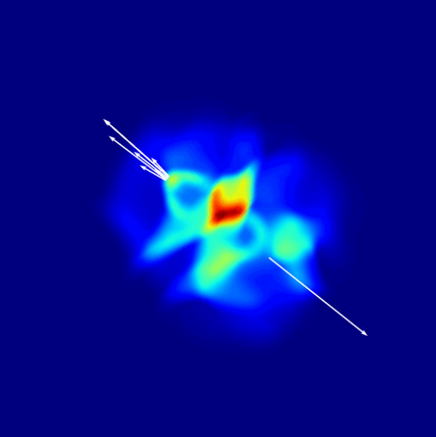

Jet tomography of QGP and medium response
ICHEP2024, July 17-24,2024, Prague
Xin-Nian Wang
Central China Normal University/Lawrence Berkeley National Laboratory

Slide 2
Jets in heavy-ion collisions
Multiple scattering
Transverse momentum broadening
Jet 1
q
q
Parton energy loss
Jet suppression
Jet 2
A-A collision

Slide 3

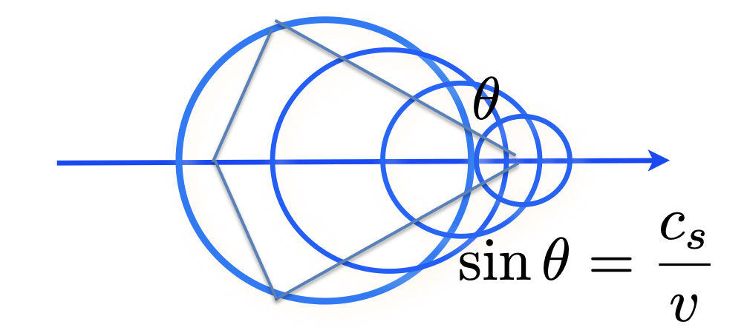
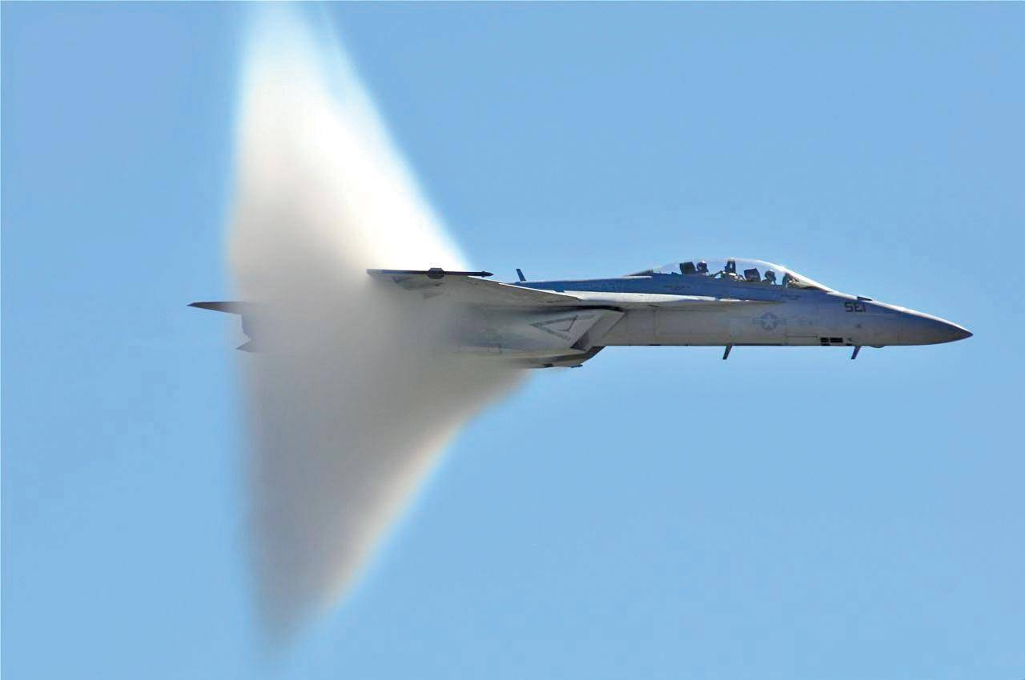
Bow waves, Mach waves

Slide 4




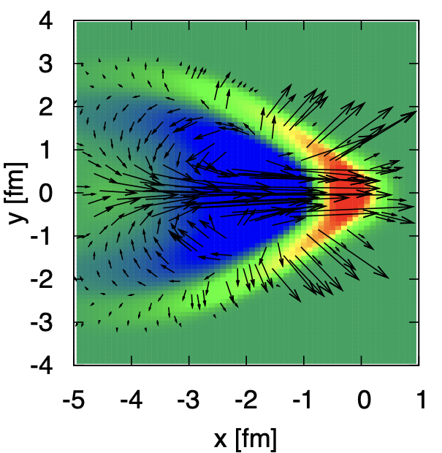
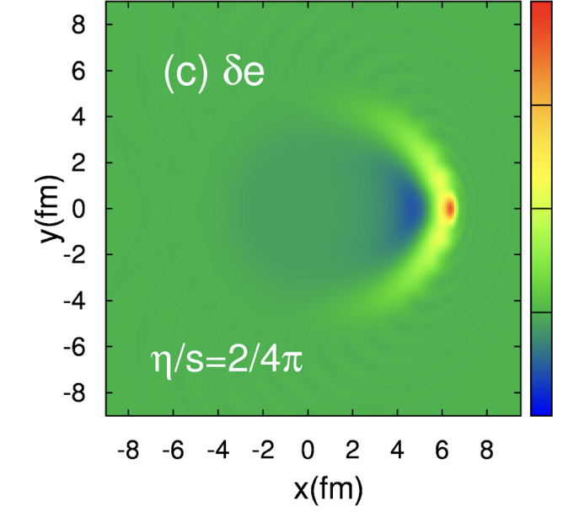
Jet-induced medium excitation
Casalderrey-Solana, Shuryak & Teaney (2005), Stoecker (2005)
Jet induced Mach-cone in QGP
Hydrodynamic approach
energy-momentum
deposited by jet
Betz, Noronha, Giorgio, Gyulassy,
Mishudtin, Rischke (2009)
Li Yan, S. Jeon, C. Gale (2018)
Diffusion wake

Slide 5
Microscopic picture of Mach wave
LBT: Linear Boltzmann Transport
Induced radiation
jet parton
pQCD elastic and radiative processes (high-twist)
Transport of medium recoil partons ( and back-reaction)
CLVisc 3+1D hydro bulk evolution
Back-reaction
(particle hole)
recoil parton
He, Luo, Zhu & XNW, PRC 91 (2015) 054908
Notes:
f_i(p_i)=\frac{1}{e^{p_i\cdot u/T}\pm 1} (i=2,4)
f_i(p)=(2\pi)^3\delta^3(\vec p_i-\vec p_0)\delta^3(\vec x-\vec x_0-t\vec v_i) [i=1,3]
\frac{dN_g}{dzd^2k_\perp dt}=\frac{2\alpha_s N_c}{\pi k_\perp^4} P(z)
(\hat p\cdot u) \hat q \sin^2(\frac{t-t_0}{2\tau_f})
p_1\cdot \partial f_1=-\int dp_2dp_3dp_4(f_1f_2-f_3f_4)|M_{12 \rightarrow 34}|^2(2\pi)^4\delta^4(\sum_i p_i) + {\rm inelastic}
\frac{dN_g}{dzd^2k_\perp dt} \approx \frac{2C_A\alpha_s}{\pi k_\perp^4}P(z) \hat q (\hat p\cdot u) \sin^2\frac{k_\perp^2 (t-t_0)}{4z(1-z)E}

Slide 6
CoLBT-hydro
(Coupled Linear Boltzmann Transport hydro)
Concurrent and coupled evolution of bulk medium and jet showers
LBT for energetic partons (jet shower and recoil)
Hydrodynamic model for bulk and soft partons: CLVisc
Parton coalescence (thermal-shower)+ jet fragmentation
Hadron cascade using UrQMD
Chen, Cao, Luo, Pang & XNW, PLB777(2018)86
Notes:
\partial_\mu T^{\mu\nu}(x) = j^\nu (x)
\delta f(p,x) \ll f(p,x)
j^\nu(x) = \sum_i p^\nu_i \delta^{(4)}(x-x_i) \theta(p^0_{cut}-p\cdot u)
j^\nu(x) = \sum_a\int \frac{d^3p}{(2\pi)^3}\frac{p^\nu}{p^0}f_a(p)\theta(p\cdot u - p^0_{cut})
p\cdot \partial f(p) =- C(p) \;\;\; p\cdot u > p_{cut}^0

Slide 7
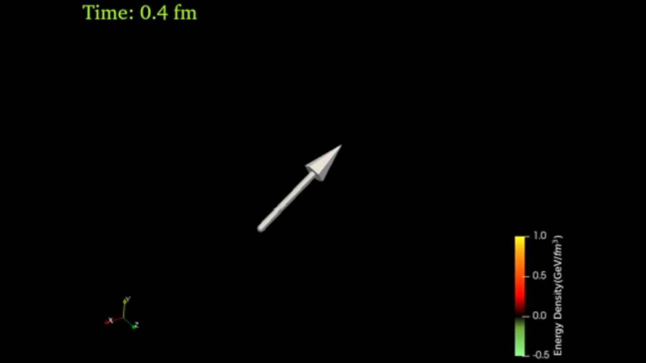
LBT & CoLBT: Jet-induced medium response
x
y
η_{s}
Energy transverse distribution of medium response in a static medium
3D energy density distribution of the medium response induced by a γ-jet in a 0-10% Pb+Pb event
Notes:
f_i(p_i)=\frac{1}{e^{p_i\cdot u/T}\pm 1} (i=2,4)
f_i(p)=(2\pi)^3\delta^3(\vec p_i-\vec p_0)\delta^3(\vec x-\vec x_0-t\vec v_i) [i=1,3]
\frac{dN_g}{dzd^2k_\perp dt}=\frac{2\alpha_s N_c}{\pi k_\perp^4} P(z)
(\hat p\cdot u) \hat q \sin^2(\frac{t-t_0}{2\tau_f})

Slide 8
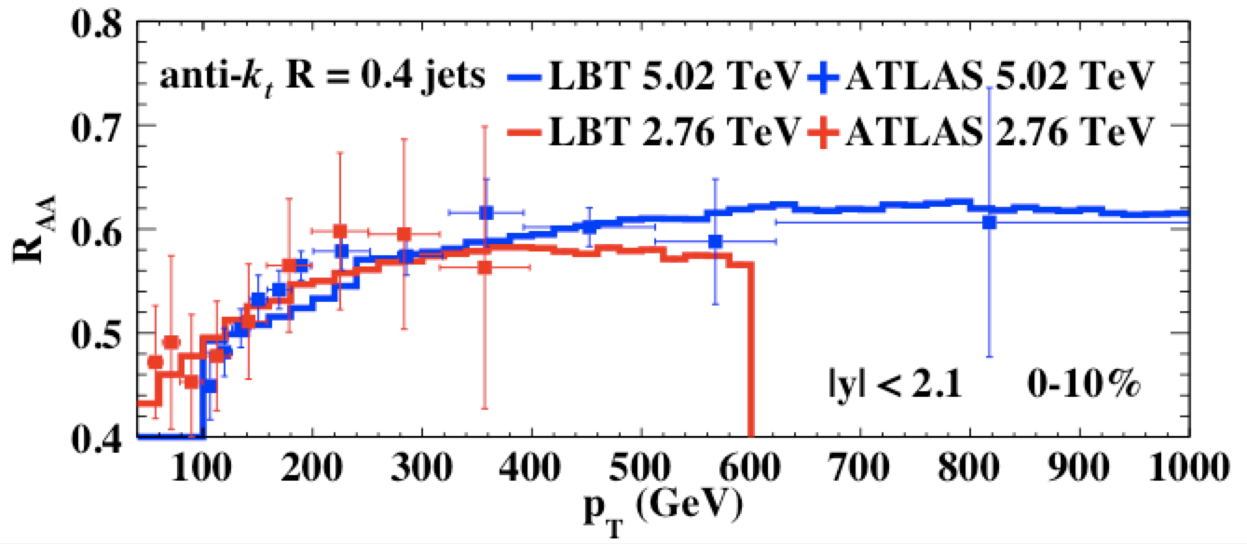
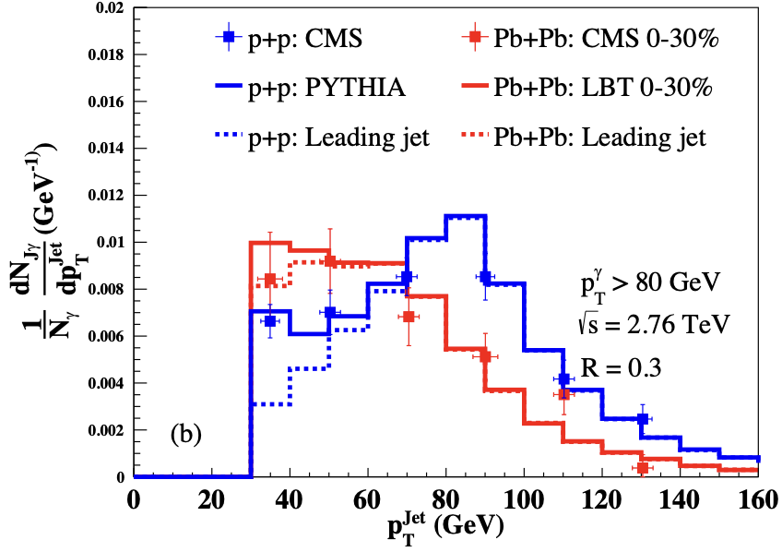
Jet suppression and energy loss
Single inclusive jets
γ - jets
Weak p_{T} dependence: initial jet spectra and p_{T} dependence of energy loss ΔE
Week energy dependence: increase of jet energy loss and the slope of initial spectra
Medium response reduce jet net energy loss
Luo, Cao, He & XNW, arXiv:1803.06785
He, Cao, Chen, Luo, Pang & XNW 1809.02525

Slide 9
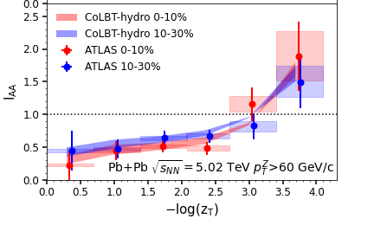
Modification of jets and medium response
r
CoLBT
e-Print: 2101.05422
Notes:
In order to Simultaneous description of hadron and jet RAA need to include jet-induced medium response

Slide 10
Search for jet-induced diffusion wake
Diffusion (DF) wake leads to depletion of soft hadron yield in the back of jet direction
γ-triggered-jet-hadron correlation
pT=0-2 GeV
Jet
Yang, Tan, Chen,Pang & XNW, PRL, 130 (2023) , 052301
pT=1-2 GeV
MPI
P_{T}^{Jet}/p_{T}^{γ}
DF-wake
x
y
η_{s}
Jet-distr
MPI
DF-wake
Notes:
Diffusion wake a universal phenomenon accompanying the projectile induced Mach wake

Slide 11
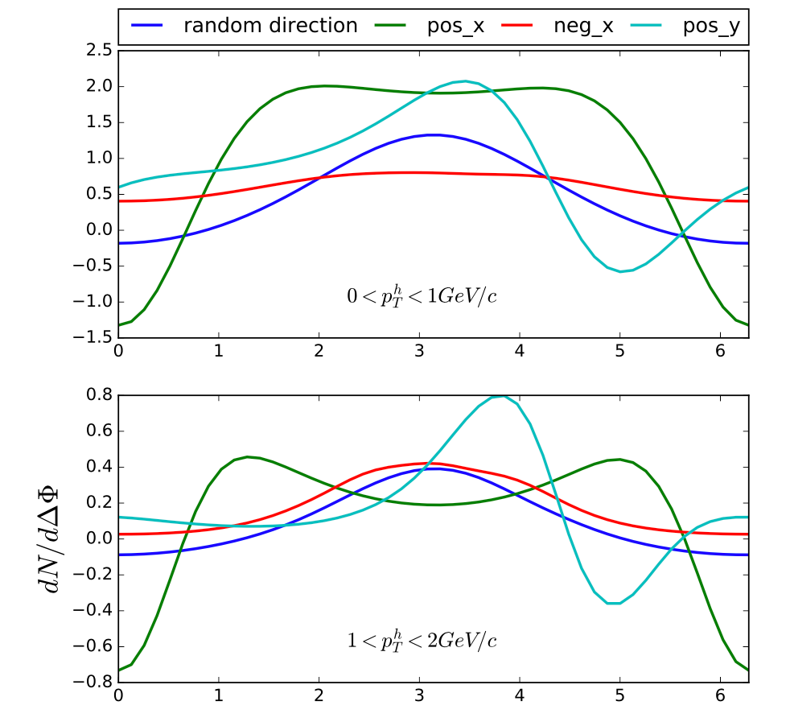
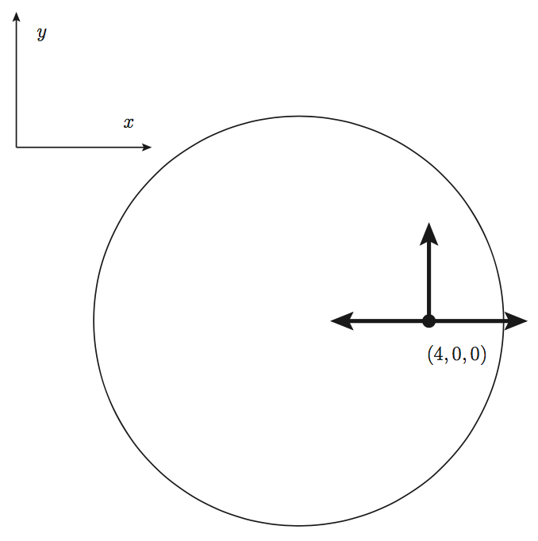
Initial position & azimuthal correlation
γ-hadron correlation
W Chen & XNW (2018)
Li, Liu, Ma, XNW and Zhu, Phys. Rev. Lett. 106, 012301 (2011)
ΔΦ
Tachibana, Shen & Majumder 2001.08321 (2020)

Slide 12
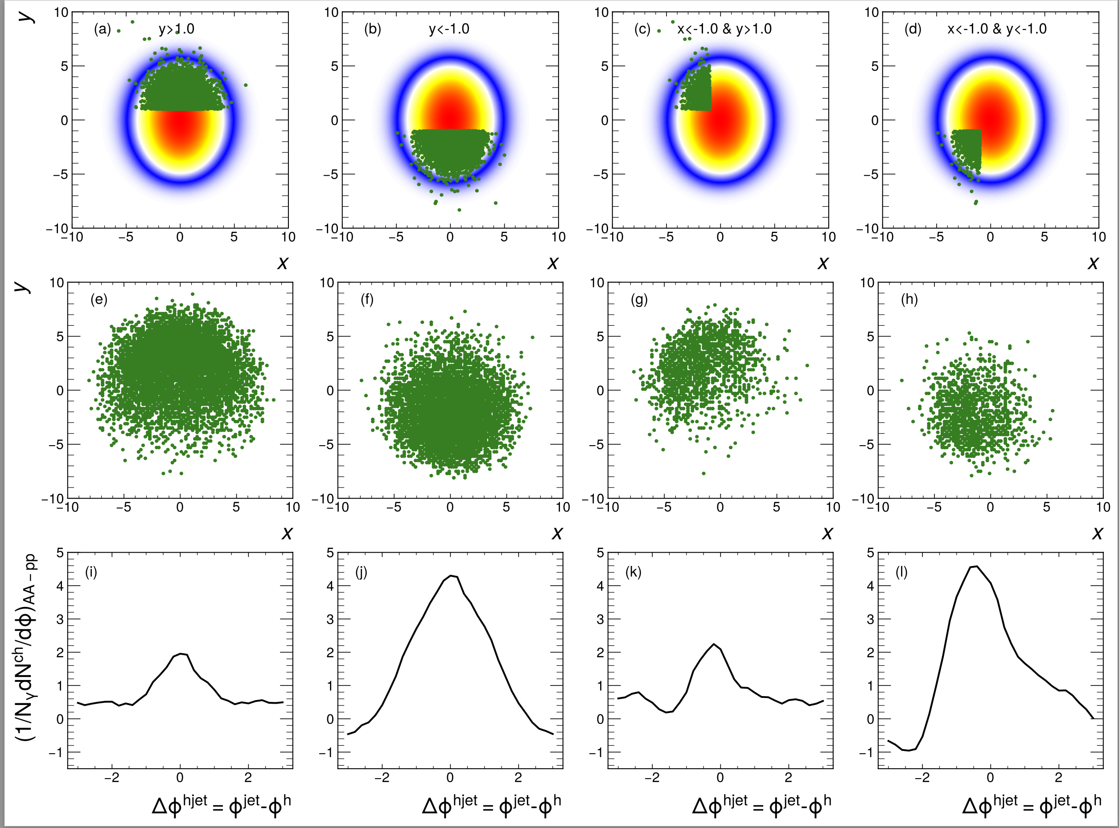
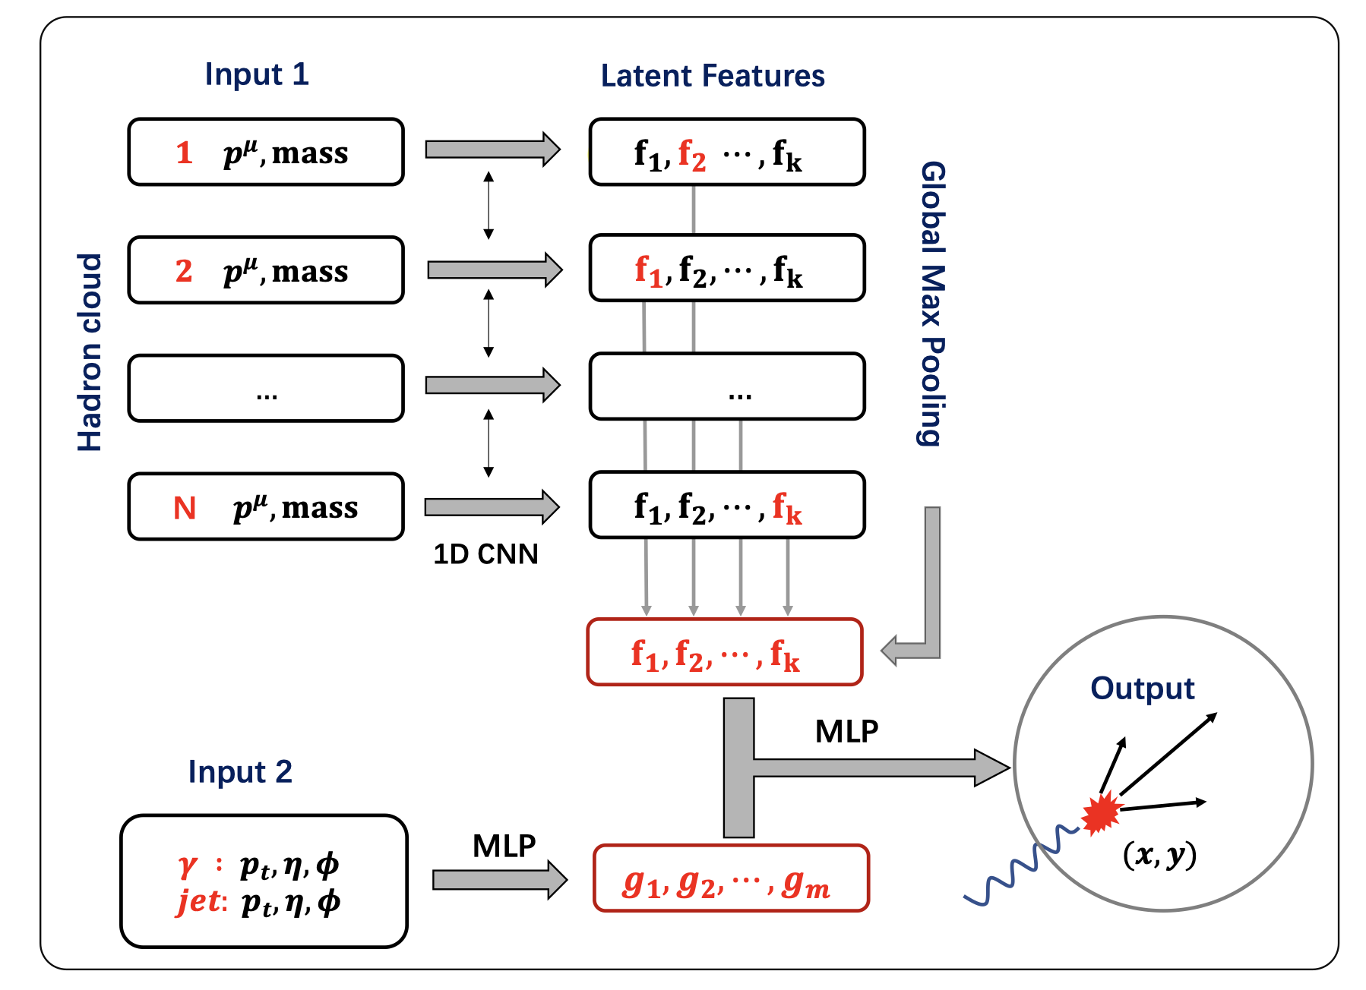
Deep learning assisted jet tomography
PCN (point cloud network)
DL network selection
Actual distribution
Eur.Phys.J.C 83 (2023) 7, 652
γ-soft hadron correlation
Yang, He，Chen，Ke，Pang & XNW
Notes:
Recently, the point could network as been applied to predict the transverse position of the initial jet production vertices

Slide 13
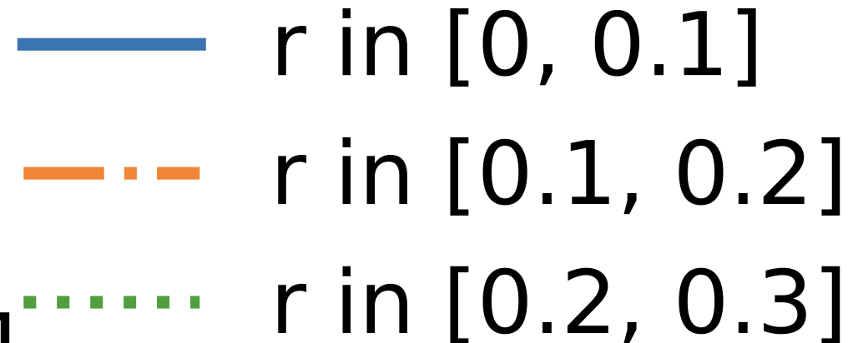
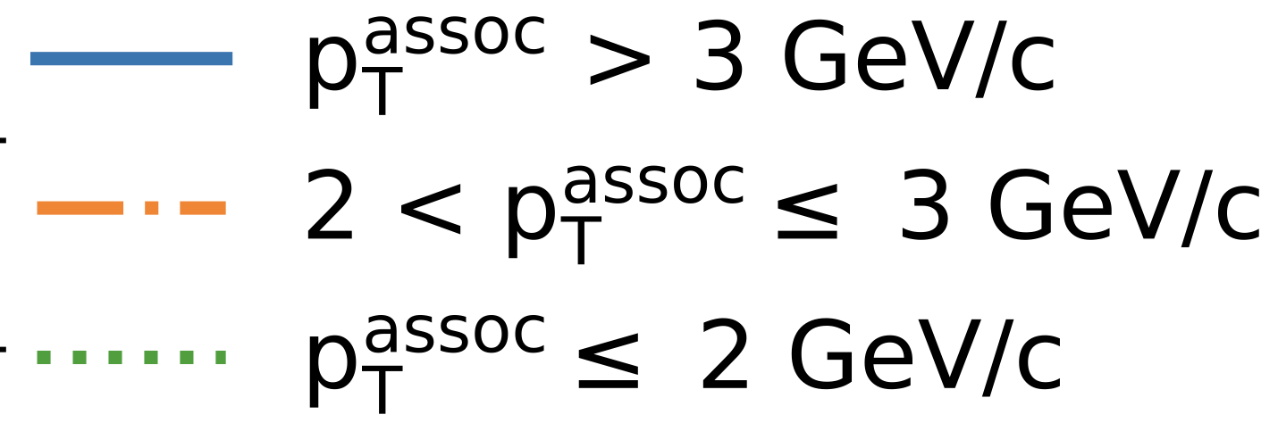
Asymmetric jet shape
Energetic hadrons at the core of jet deflected away from center
Soft hadrons from medium response at large angle flow into center
φ
r

Slide 14
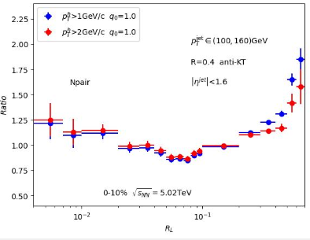
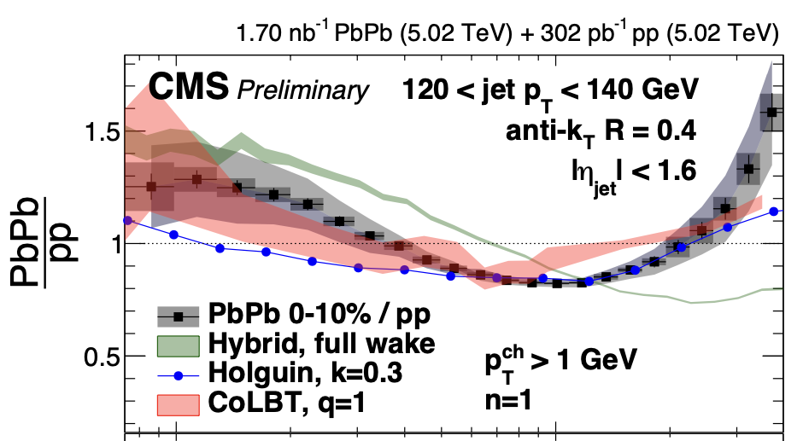
Single jet energy-energy correlator from CoLBT
Increased virtuality scale in medium leads to enhancement of EEC at small angle
Medium response leads to enhancement at large angle R_{L}>0.3

Slide 15
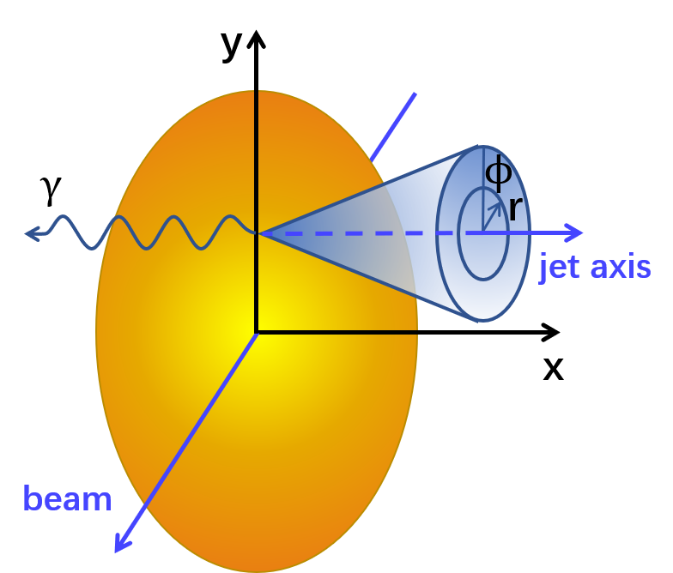
Asymmetric jet shape
Energetic hadrons at the core of jet deflected away from center
Soft hadrons from medium response at large angle flow into center
Xiao, He, Pang, Zhang & XNW, PRC 109 (2024) 5, 054906 (e-print: 2402.00264)

Slide 16
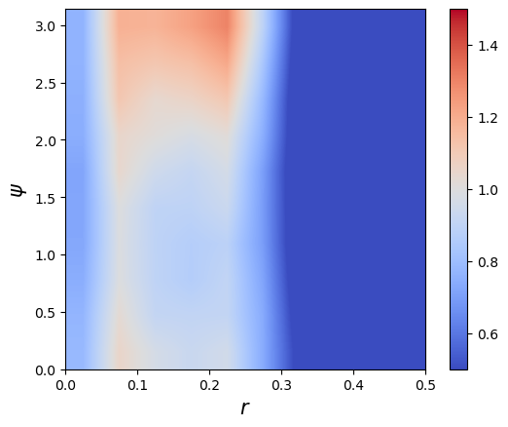
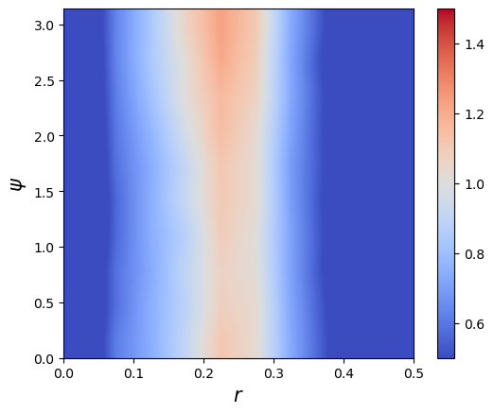
Seeing Mach-cone through 3p Azimuthal Correlation
p+p (γ+jet) p_{T}>40 GeV/c
0-10%Pb+Pb (γ+jet)
ψ
r
)
Back-to-back correlation due to momentum conservation of parton splitting
Azimuthal uniform correlation due to medium-response: Mach-cone – sound velocity?
r=(r1+r2)/2

Slide 17
Summary
Medium response reduces net jet energy loss
Medium response leads to
  enhancement of soft hadrons in jet direction
  depletion of soft hadron on the away side
Unique 3D structure of diffusion wake
Use 2D jet tomography to reveal the angular structure of Mach-cone excitation
Future studies: ML improved 2D tomography and constraint on EoS, transport coefficients

