Slide 1
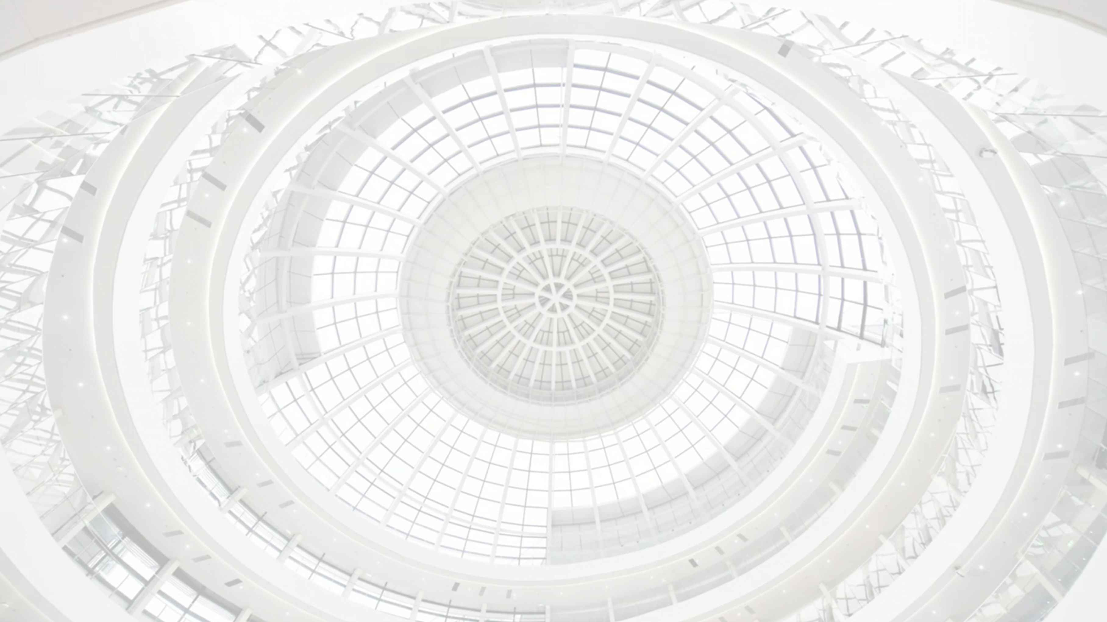
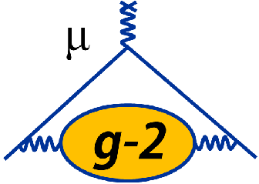


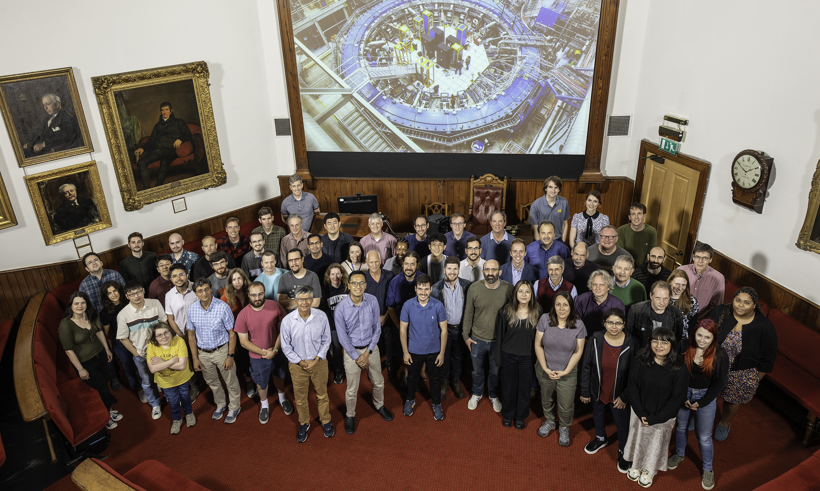

Run-2/3 measurement of the
muon anomalous magnetic moment by the
Muon g-2 experiment at Fermilab
Kim Siang Khaw
for Fermilab Muon g-2 collaboration
ICHEP 2024 @ Prague
2024.07.18
Muon g-2 collaboration @ Liverpool

Slide 2
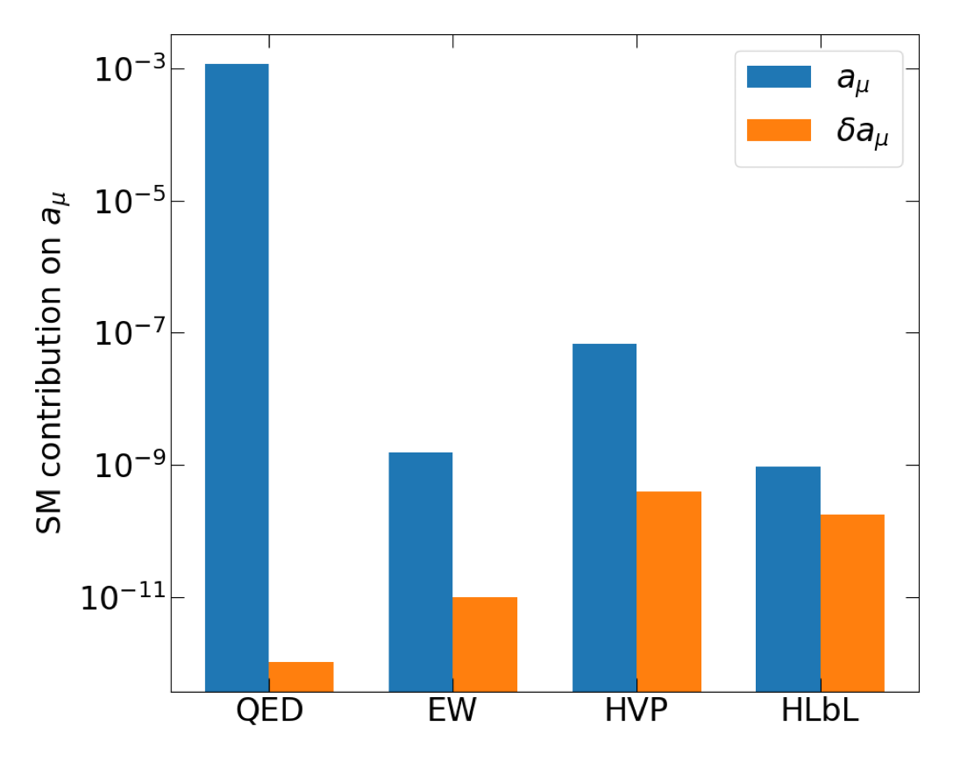
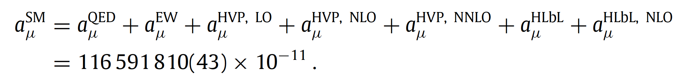
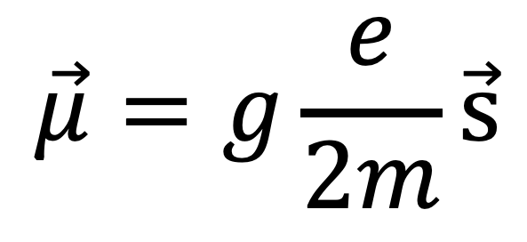

Why the Muon g-2?
$a_{μ}=\frac{g−2}{2}, g=2$ at the tree level
magnetic moment and spin
$$\vec{μ}=g\frac{e}{2m}\vec{s}$$
QED
Electroweak
Hadronic
Vacuum
Polarization
Hadronic
Light-by-light
Can be calculated and measured to high precision (sub-ppm)
Precision test of SM calculations (at 4-loop QED, EW, and QCD)
Powerful discriminant for BSM physics models
Theory Initiative White Paper
T. Aoyama et al. Phys. Rept. 887 (2020)

Slide 3
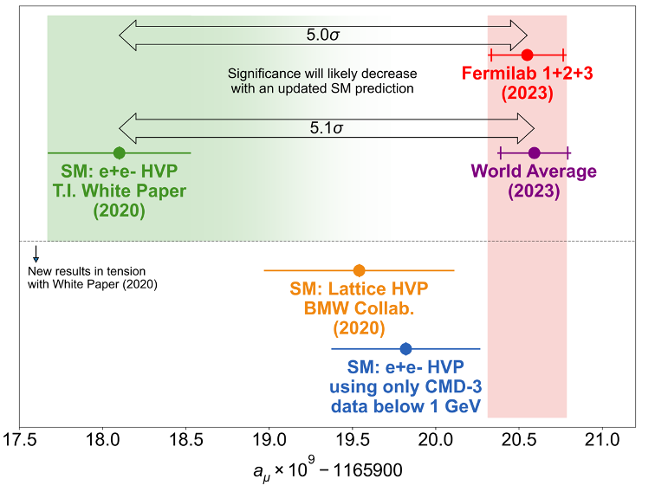
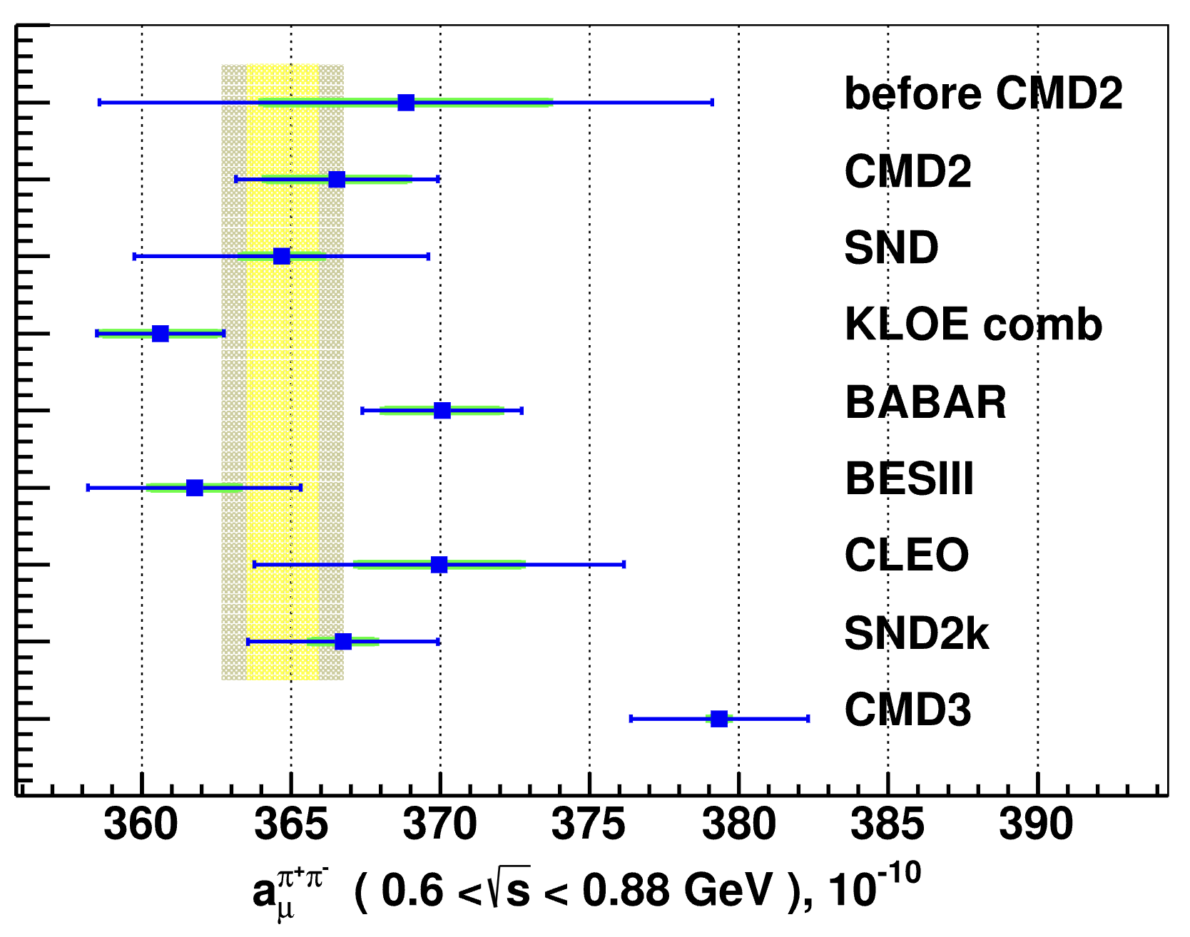
Theory vs Experiment for g-2
Large discrepancy between experiment and WP (2020)
New results since WP 2020
  BMW (swapping HVP from WP with their value) falls in between WP (2020) and experiment
  CMD-3 in tension with other e⁺e⁻ machine data (data-driven approach)
Many parallel efforts are underway to resolve the theoretical ambiguity
LQCD approach
New BMW result, see Z. Fodor's talk on Fri 6:15 pm (Sec 06)
Data-driven approach

Slide 4
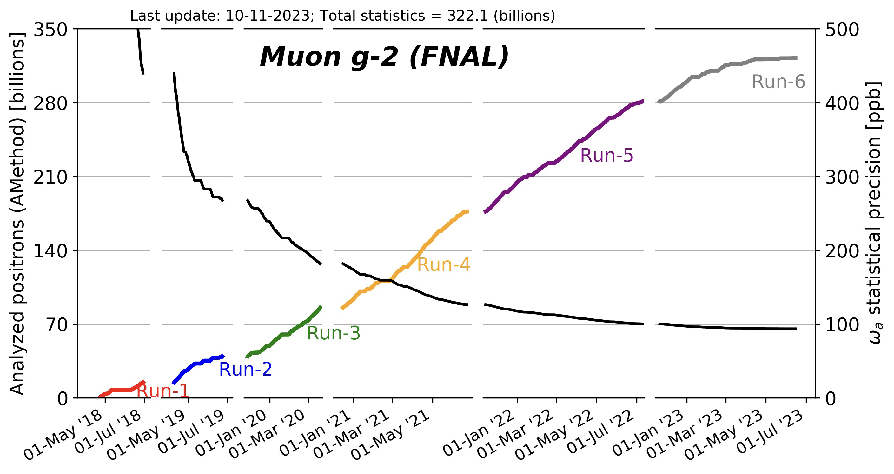
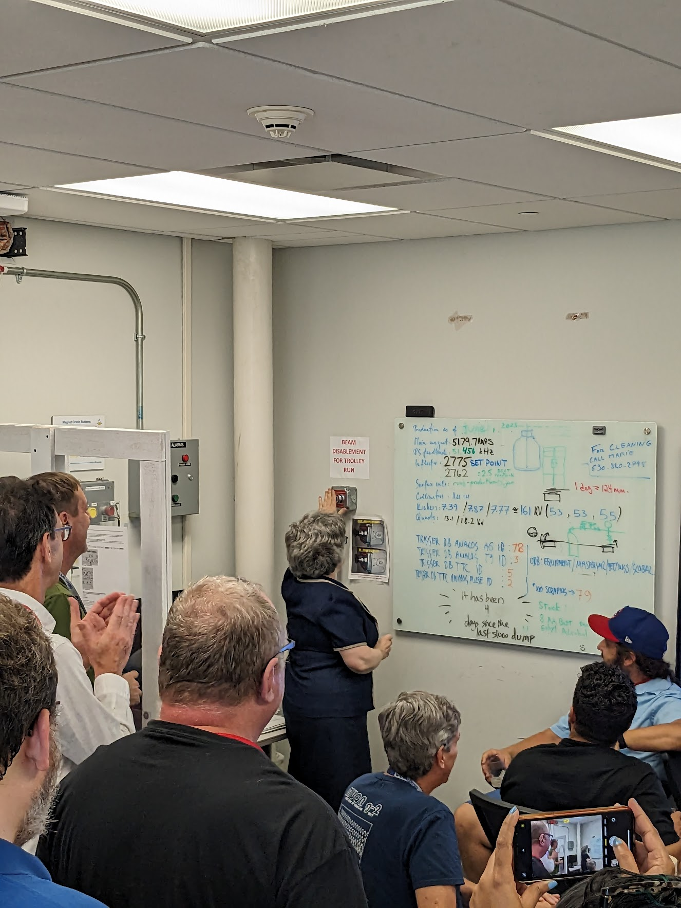
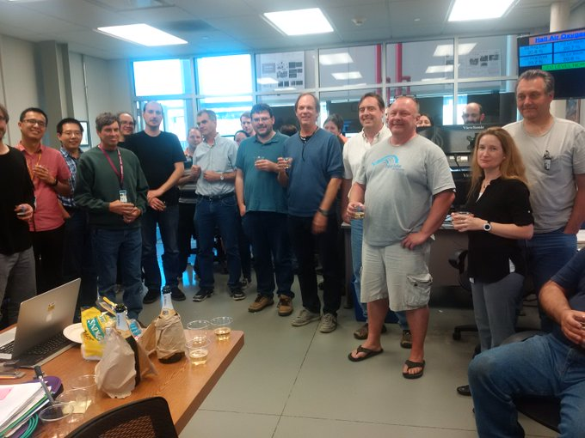
Status of the Muon g-2 experiment
Celebrating first beam at MC1
(Summer 2017)
Fermilab director Lia Merminga pushed the red button to shut the beam down (Jul 10, 2023)
Apr 2021: Run-1 Result (2018 data)
Aug 2023: Run-2/3 Result (2019-20 data)
~2025: Run-4/5/6 Result (2021-23 data)
Reached our proposal goal for statistics (~4x Run-1/2/3)

Slide 5
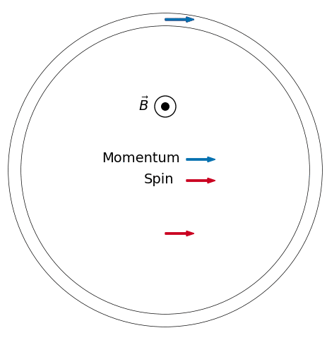
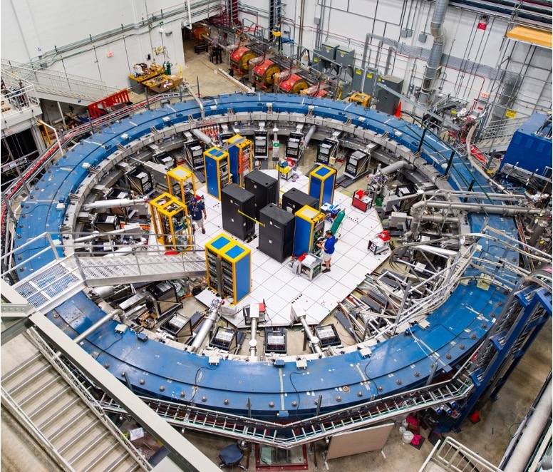
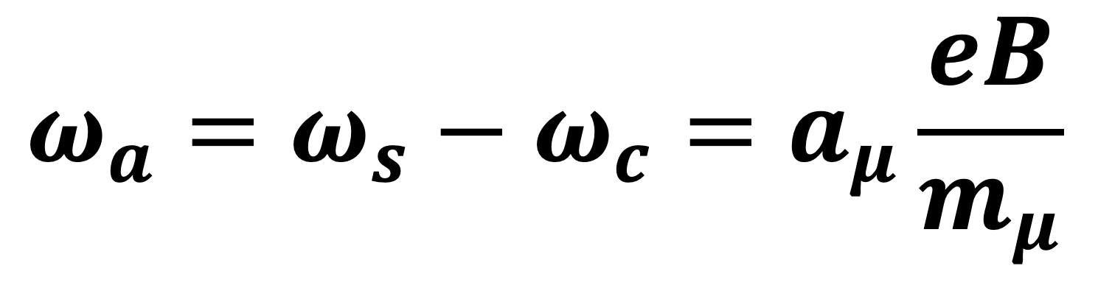
Principle of g-2 measurement
Inject a spin-polarized muon beam
into a magnetic storage ring
Measure the magnetic field
of the storage ring
Measure the difference in frequency
$$ω_{a}=ω_{s}−ω_{c}=a_{μ}\frac{eB}{m_{μ}}$$
Obtain g-2

Slide 6
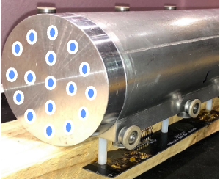
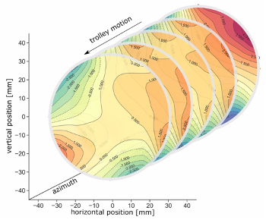
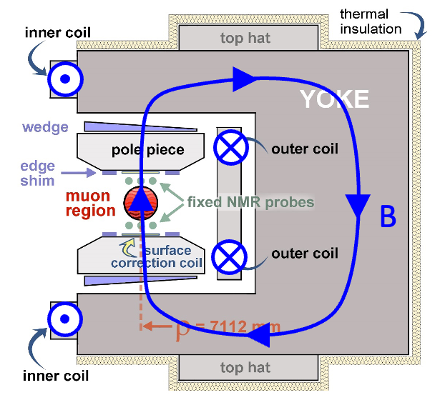
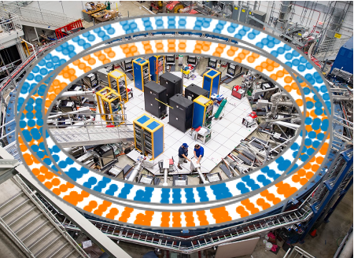
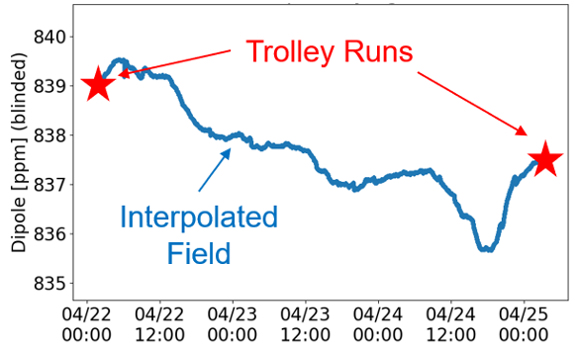
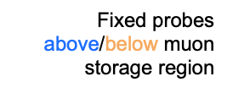
Muon g-2 superconducting storage ring
In-vacuum NMR trolley maps field every ~3 days
378 fixed NMR probes monitor field during muon storage at 72 locations
14 m diameter, 1.45 T
C-shaped SC magnet
17 petroleum jelly NMR probes
2D field maps (~8000 points)
Notes:
The storage ring is built as one continuous superferric magnet, an iron magnet excited by superconducting coils. A cross section of the magnet is shown in Fig 1. The magnet is C-shaped as dictated by the experiment requirement that decay electrons be observed inside the ring.

Slide 7
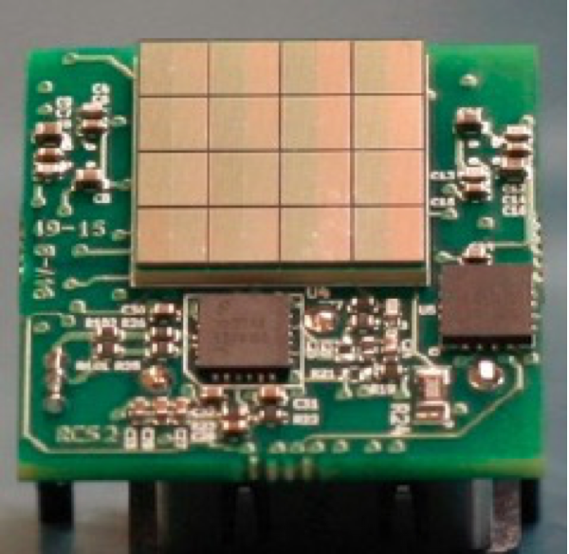
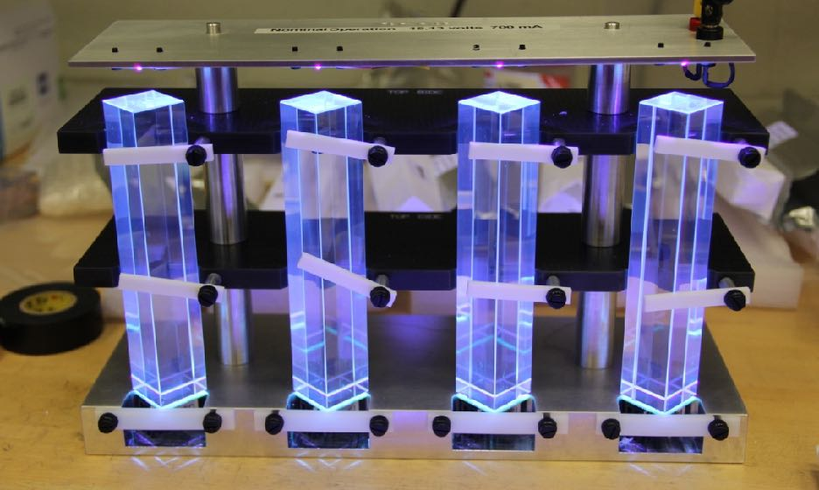
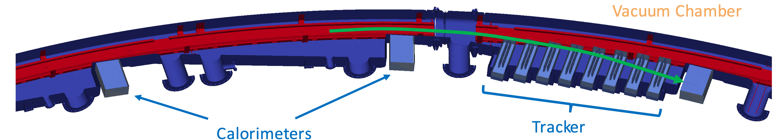
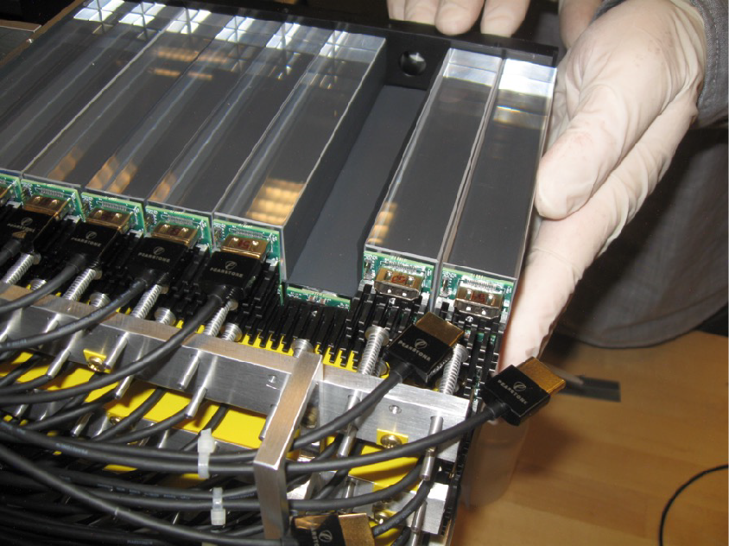
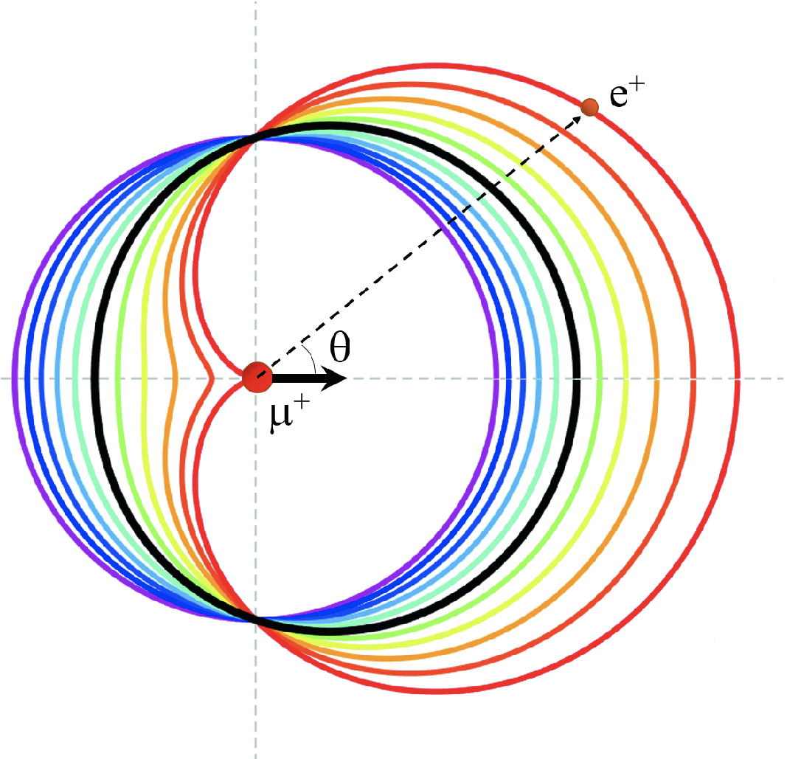
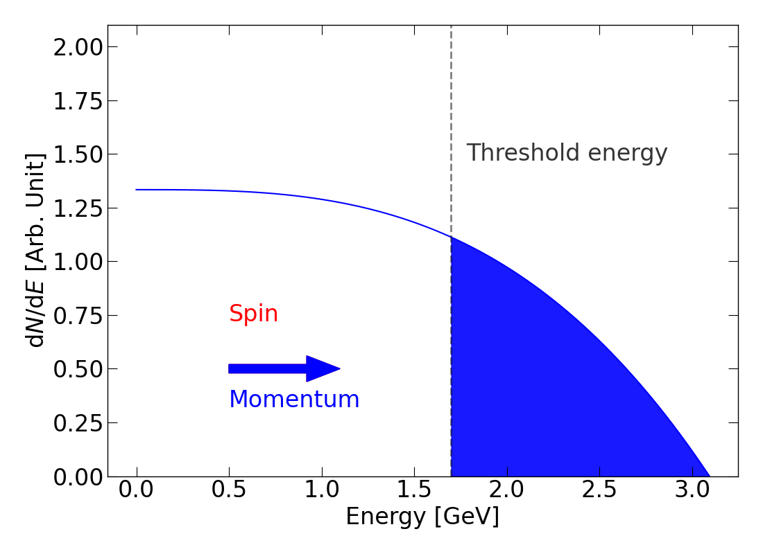
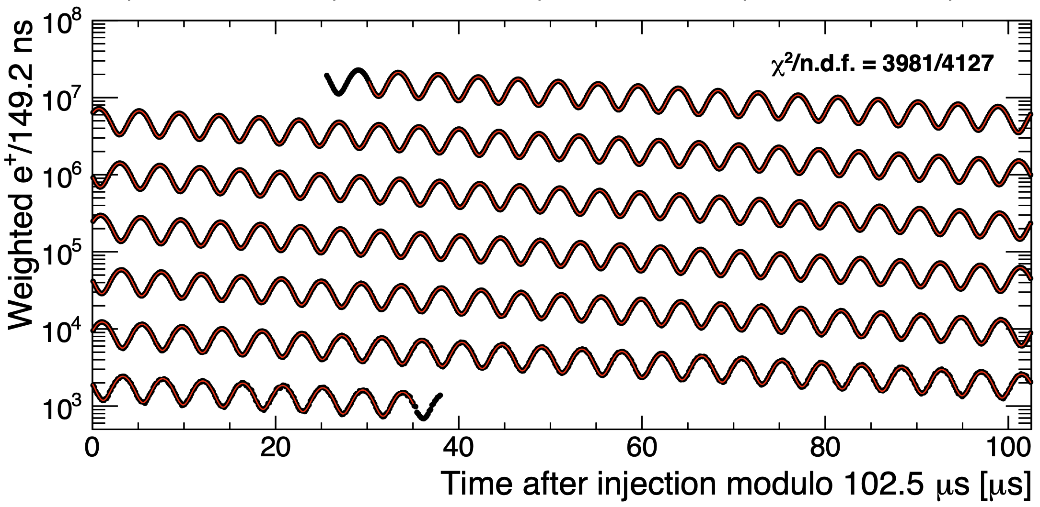
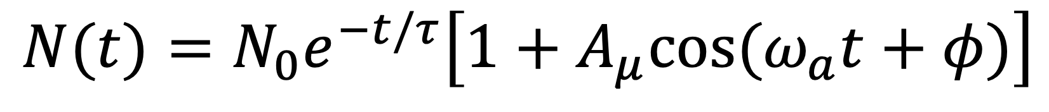
Precession frequency measurement
high energy 𝑒⁺ is emitted preferentially in the muon spin direction due to parity-violating weak decay
PbF₂ calorimeter
E = 26.4 MeV
a = 0
$$N(t)=N_{0}e^{−t/τ}\left[1+A_{μ}cos(ω_{a}t+φ)\right]$$
E = 52.8 MeV
a = 1

Slide 8
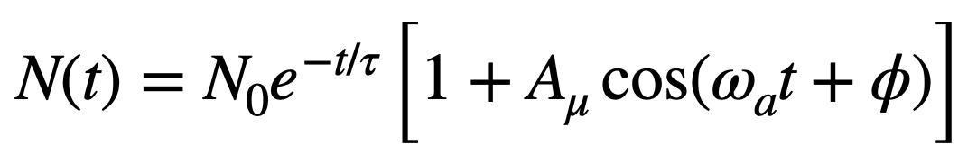
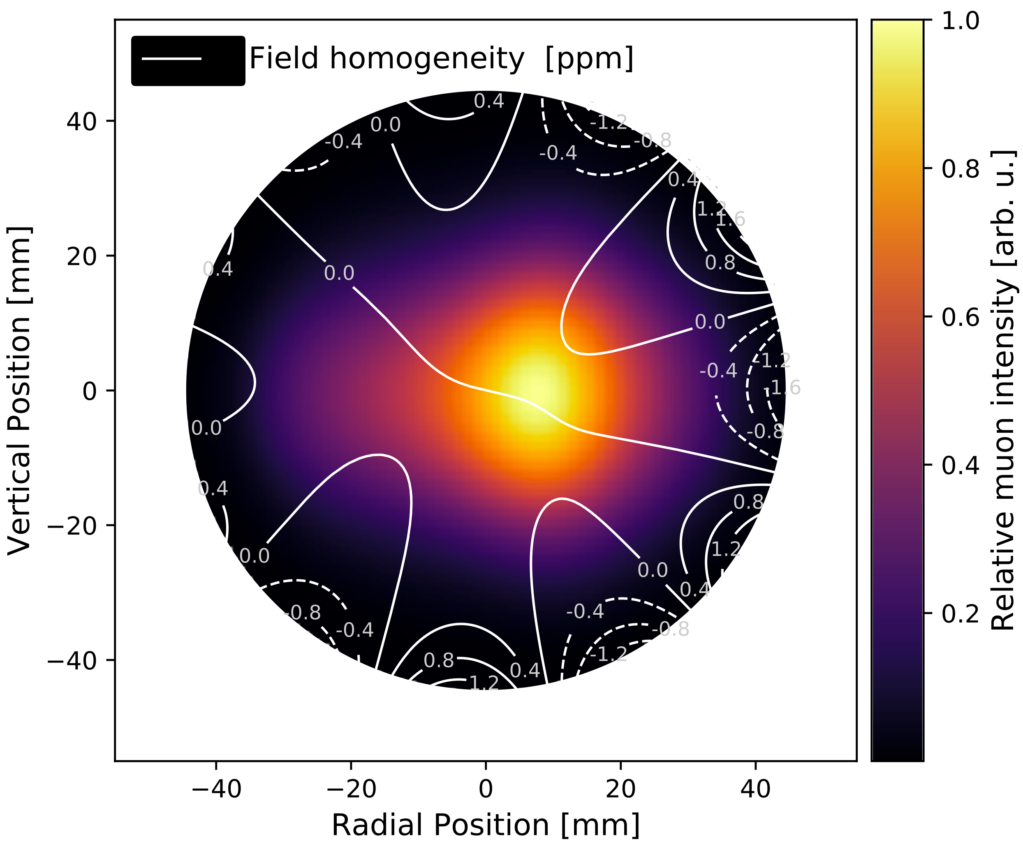
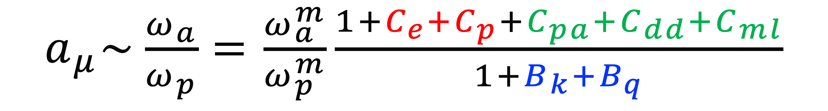
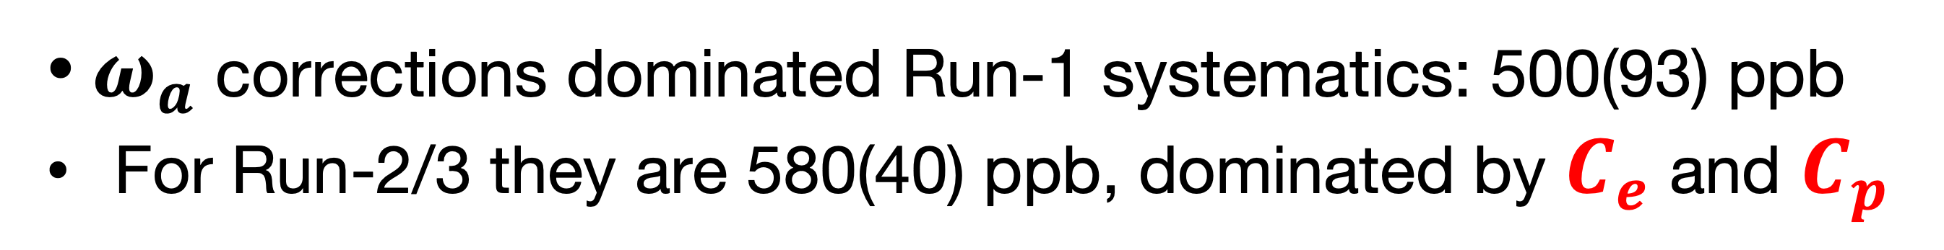
Additional corrections
see L. Cotrozzi's talk on Thu 11:00 am (Sec 05)
see KSK's poster 225 on Thu 7:00 pm (Sec 05)
Beam Dynamics Corrections
E-field & vertical motion: Spin precesses slower than in basic equation
Phase changes over each muon fill:
Phase acceptance, differential decay, and muon losses
$a_{μ}\sim \frac{ω_{a}}{ω_{p}}=\frac{ω_{a}^{m}}{ω_{p}^{m}}\frac{1+C_{e}+C_{p}+C_{pa}+C_{dd}+C_{ml}}{1+B_{k}+B_{q}}$
Transient magnetic fields:
Quad vibrations and kicker eddy current
$ω_{a}$ corrections dominated Run-1 systematics: 500(93) ppb
For Run-2/3 they are 580(40) ppb, dominated by $C_{e}$ and $C_{p}$

Slide 9
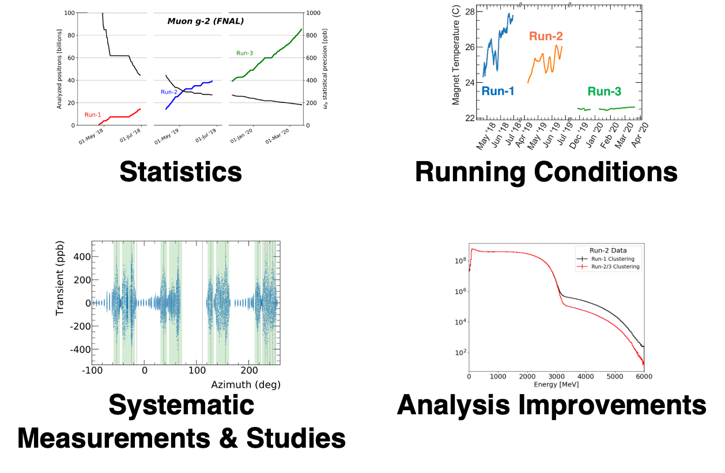
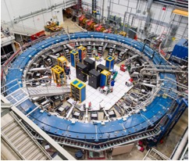
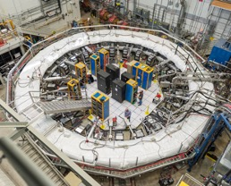
Run-2/3 uncertainty improvements
Damaged quad resistors fixed
Hall/Ring temperature stabilized
Kicker strength improved

Slide 10
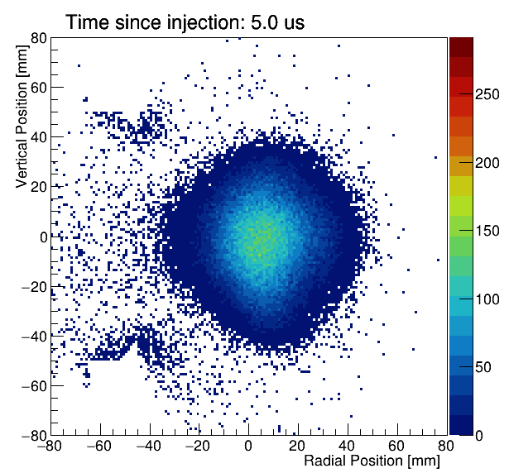
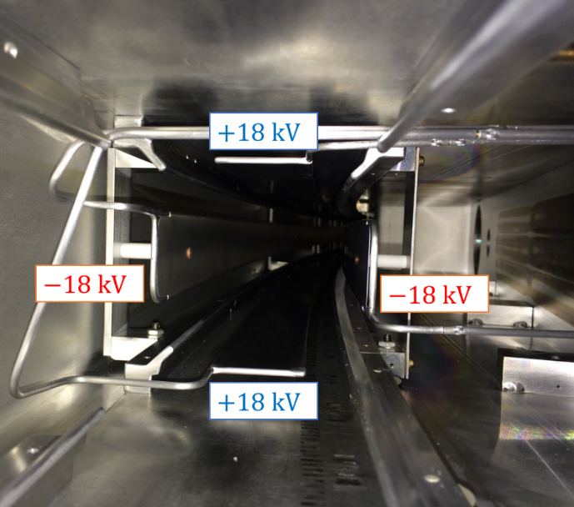
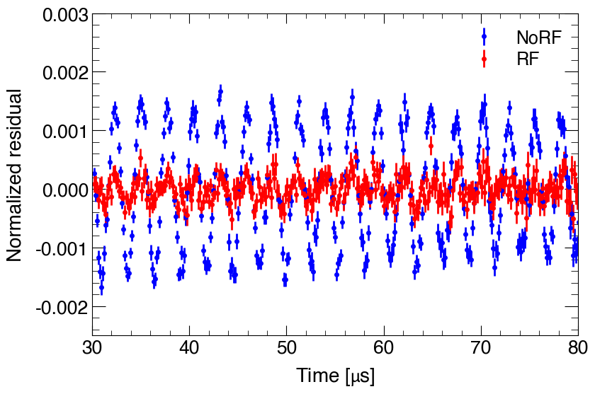
Suppressing CBO with a RF system
CBO is the coherent transverse betatron oscillation
Coupled with the calorimeter acceptance, it distorts the time spectrum
Implemented a RF system to reduce
the CBO significantly.
Run-5/6 data (almost half of the entire
data) was taken with the RF system.
higher acceptance
lower acceptance
Calorimeter
Electrostatic Quadrupole + RF
CBO
~1kV
RF E-field
~1kV

Slide 11
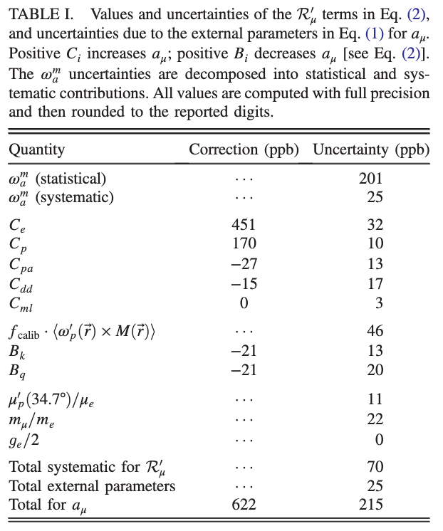
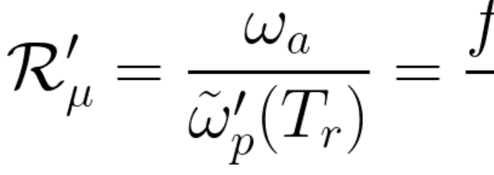
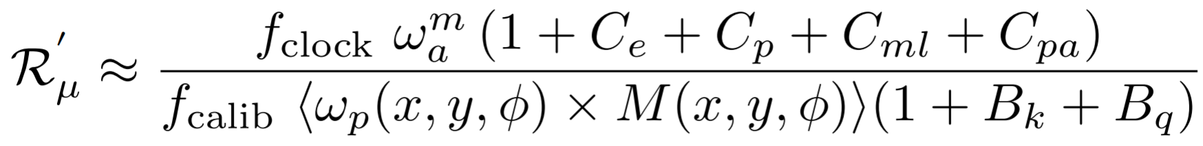
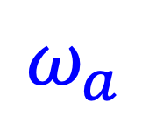

Run-4/5/6 expected improvements
Run-2/3 Result: PRL 131, 161802 (2023)
Expected Run-4/5/6 improvements
(Estimation for systematics on-going)
$$ω_{a}$$
~100 (in total Runs 1-6), ~x4 stats
~x10 reduction of CBO with the RF system (Run-5/6)
New signal processing algorithm
New beam-monitoring system (miniSciFi)
BD
New tracker-based analysis method
$$ω_{p}$$
More calibrations + cross-calibrations.
Better understanding and handling of magnet drift.
More and better measurements
Surpassed the TDR systematics goal of 100 ppb.
And possibly even smaller for Run-4/5/6!

Slide 12
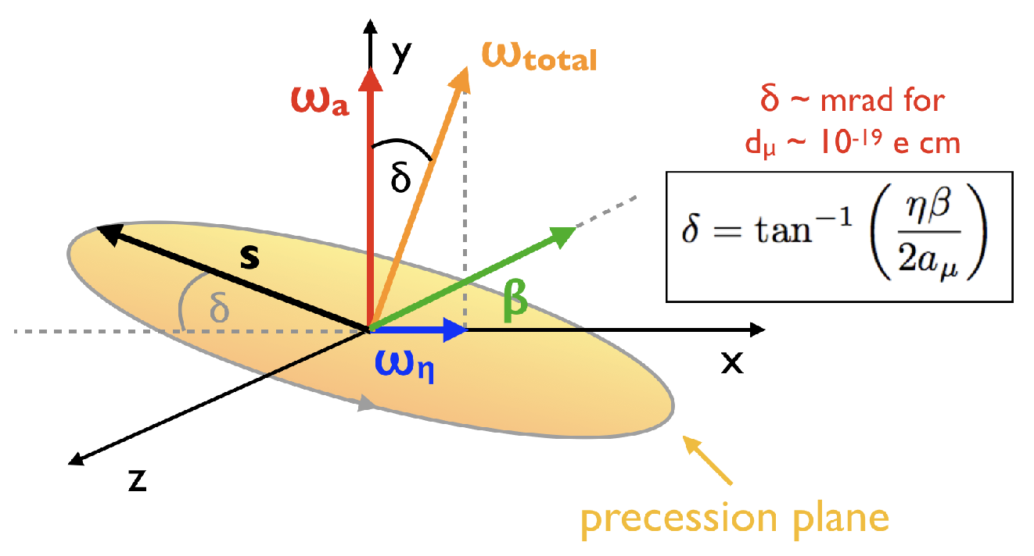
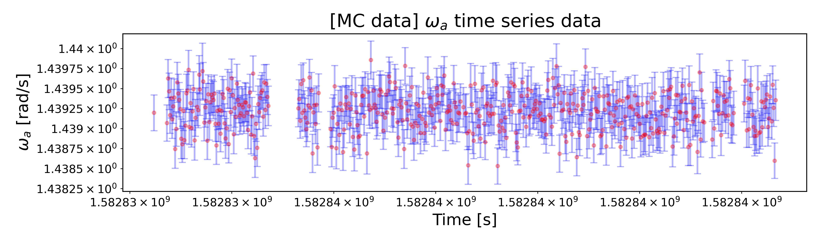
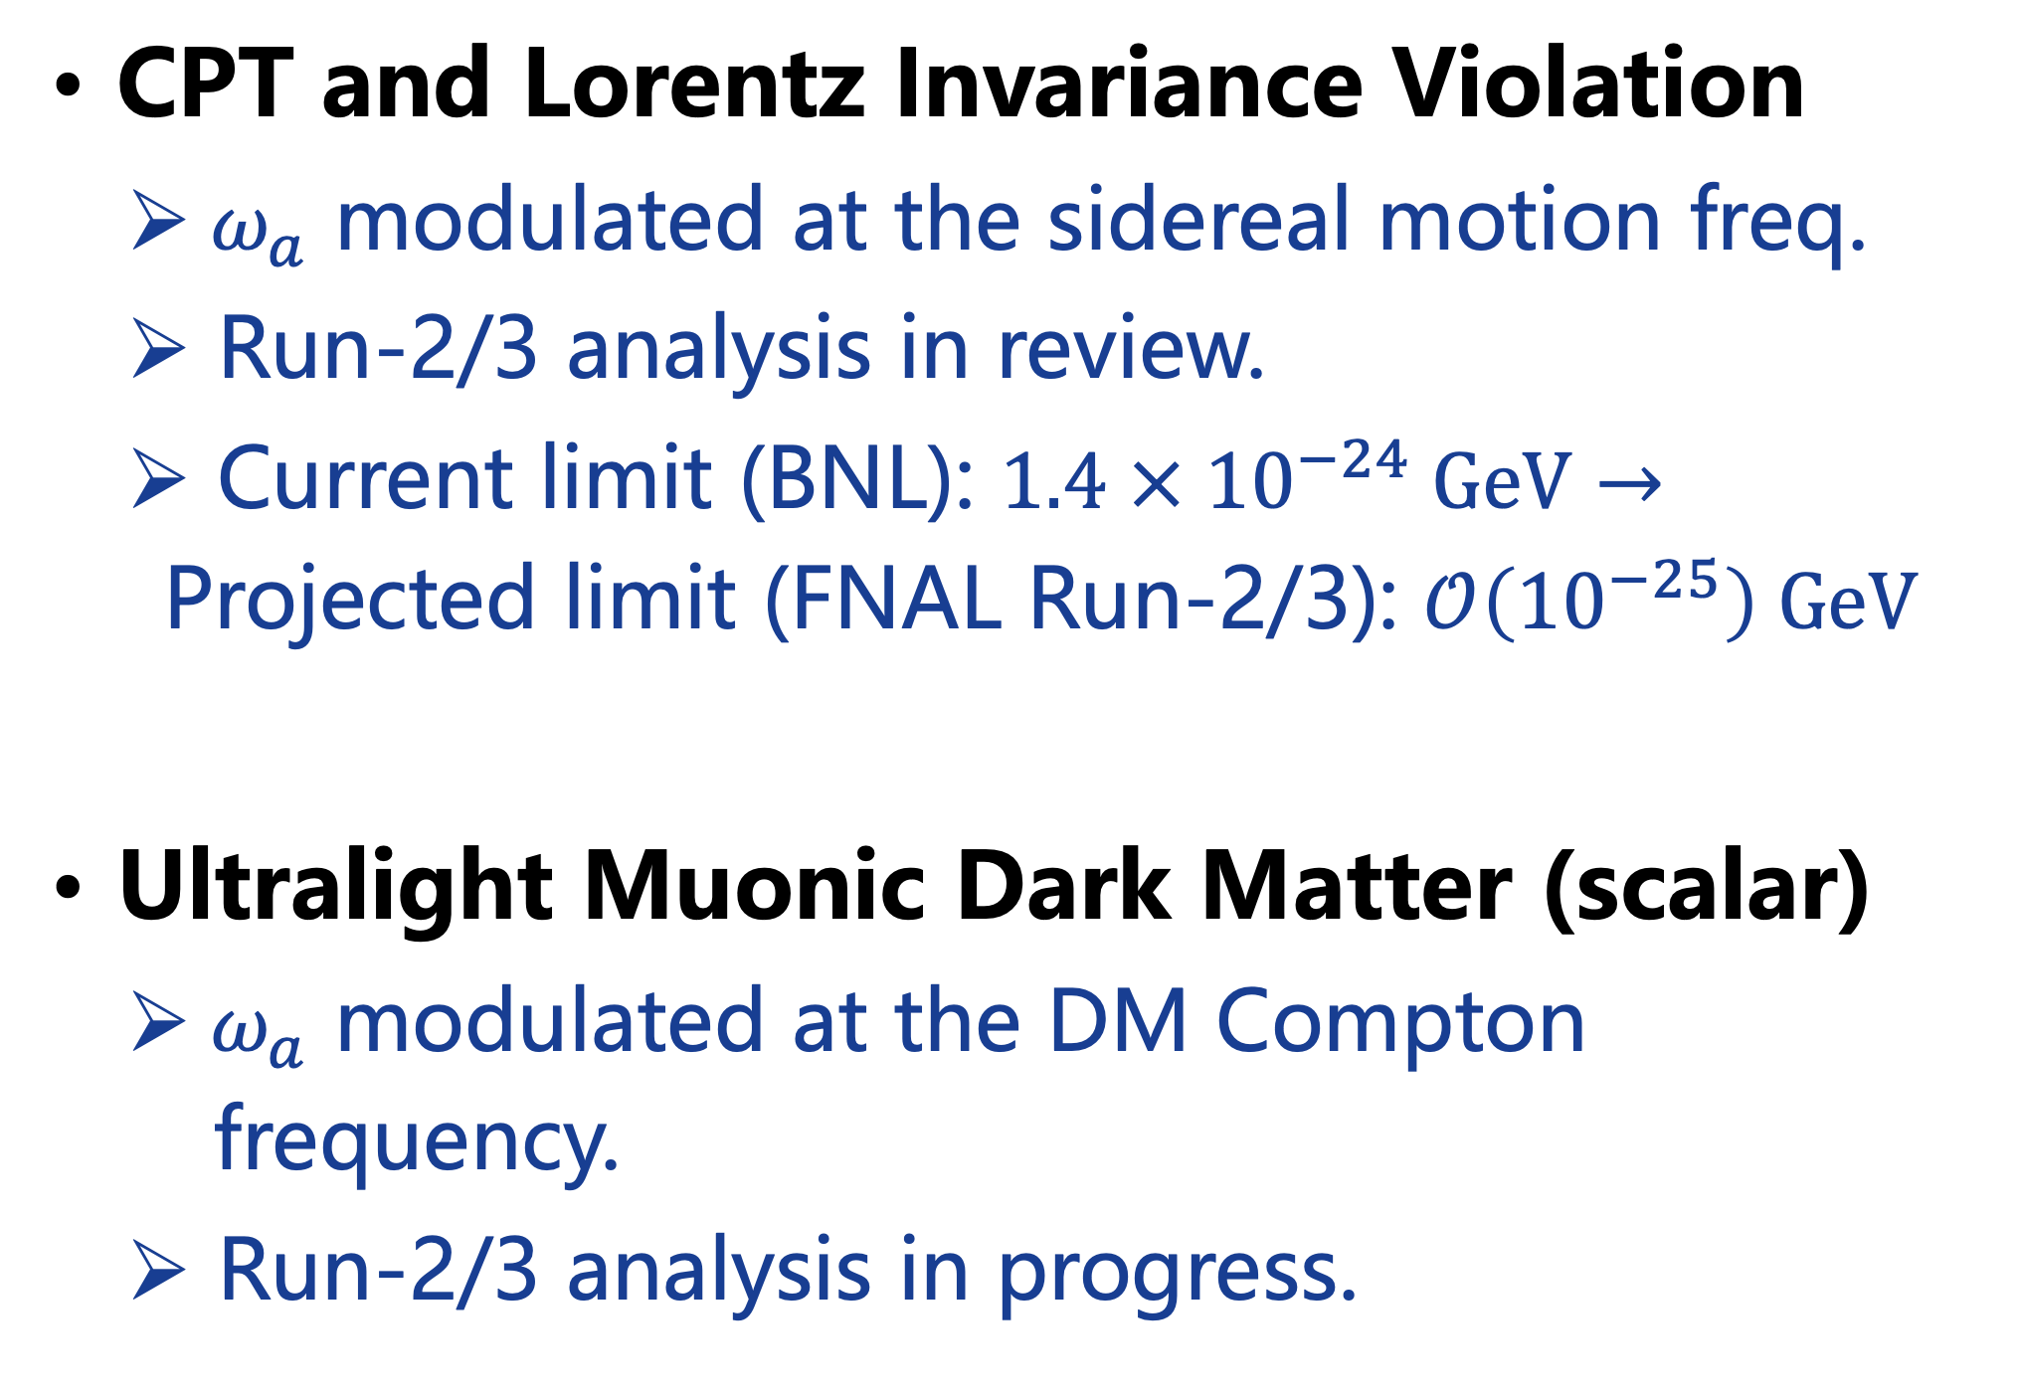
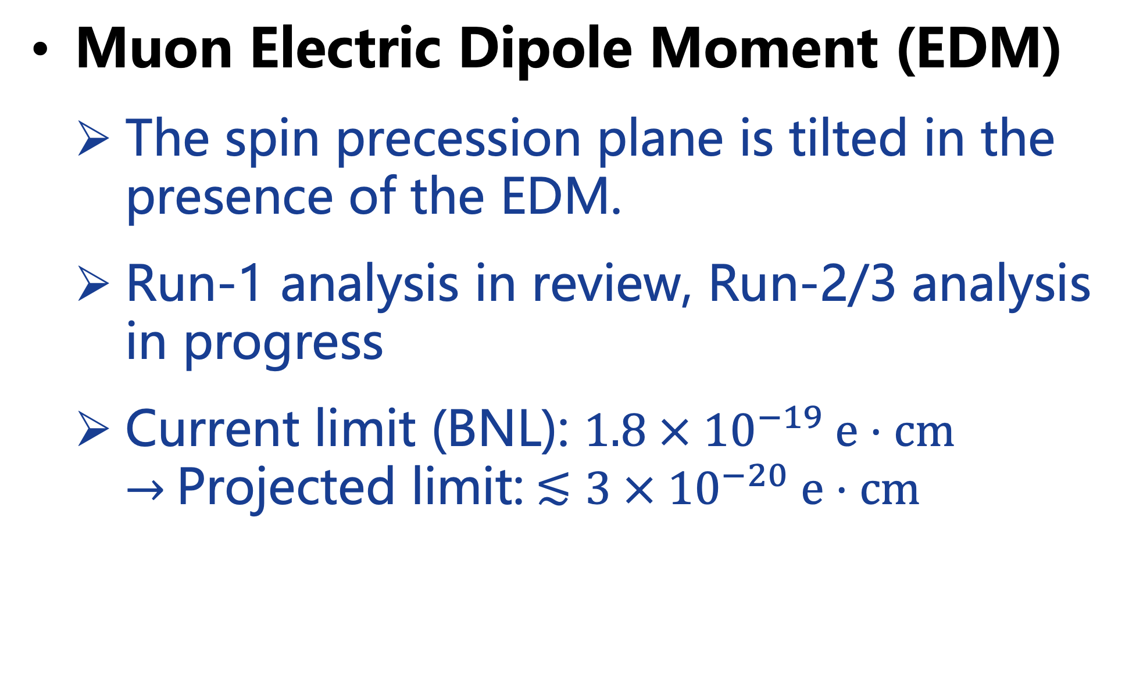
BSM searches (EDM, CPT/LI, DM)
see B. Mitra's talk on Fri 8:47 am (Sec 03)
Muon Electric Dipole Moment (EDM)
  The spin precession plane is tilted in the presence of the EDM.
  Run-1 analysis in review, Run-2/3 analysis in progress
  Current limit (BNL): $1.8 × {10}^{−19} e⋅cm→$Projected limit:$≲3 × {10}^{−20} e⋅cm$
CPT and Lorentz Invariance Violation
  $ω_{a}$ modulated at the sidereal motion freq.
  Run-2/3 analysis in review.
  Current limit (BNL): $1.4 × {10}^{−24} GeV→$
  Projected limit (FNAL Run-2/3): $𝒪\left({10}^{−25}\right) GeV$
Ultralight Muonic Dark Matter (scalar)
  ${ ω}_{a}$ modulated at the DM Compton
  frequency.
  Run-2/3 analysis in progress.

Slide 13
Summary
Our collaboration has completed the data-taking in Summer 2023
Run-2/3 results announced last year (PRL 131, 161802 (2023)), detailed analysis report in arXiv:2402.15410 (accepted by PRD).
Analysis of the remaining data (Run-4/5/6 taken from 2021-2023) is underway
A final result with ~140 ppb uncertainty is expected to be published in 2025
  We met the TDR statistical goal and will likely surpass the systematics goal
  Many improvements have been made in systematics. For instance, Run-5/6 data was taken with the RF system, and CBO was significantly reduced.
This result will set the stage for a final showdown between the current theory and experiment in 2025
BSM searches are also underway – EDM, CPT/LV and DM

Slide 14













Acknowledgement
Department of Energy (USA)
National Science Foundation (USA)
Istituto Nazionale di Fisica Nucleare (Italy)
Science and Technology Facilities Council (UK)
Royal Society (UK)
Leverhulme Trust (UK)
European Union's Horizon 2020
Strong 2020 (EU)
German Research Foundation (DFG)
National Natural Science Foundation of China (NSFC)
MSIP, NRF and IBS-R017-D1 (Republic of Korea)

