Slide 1
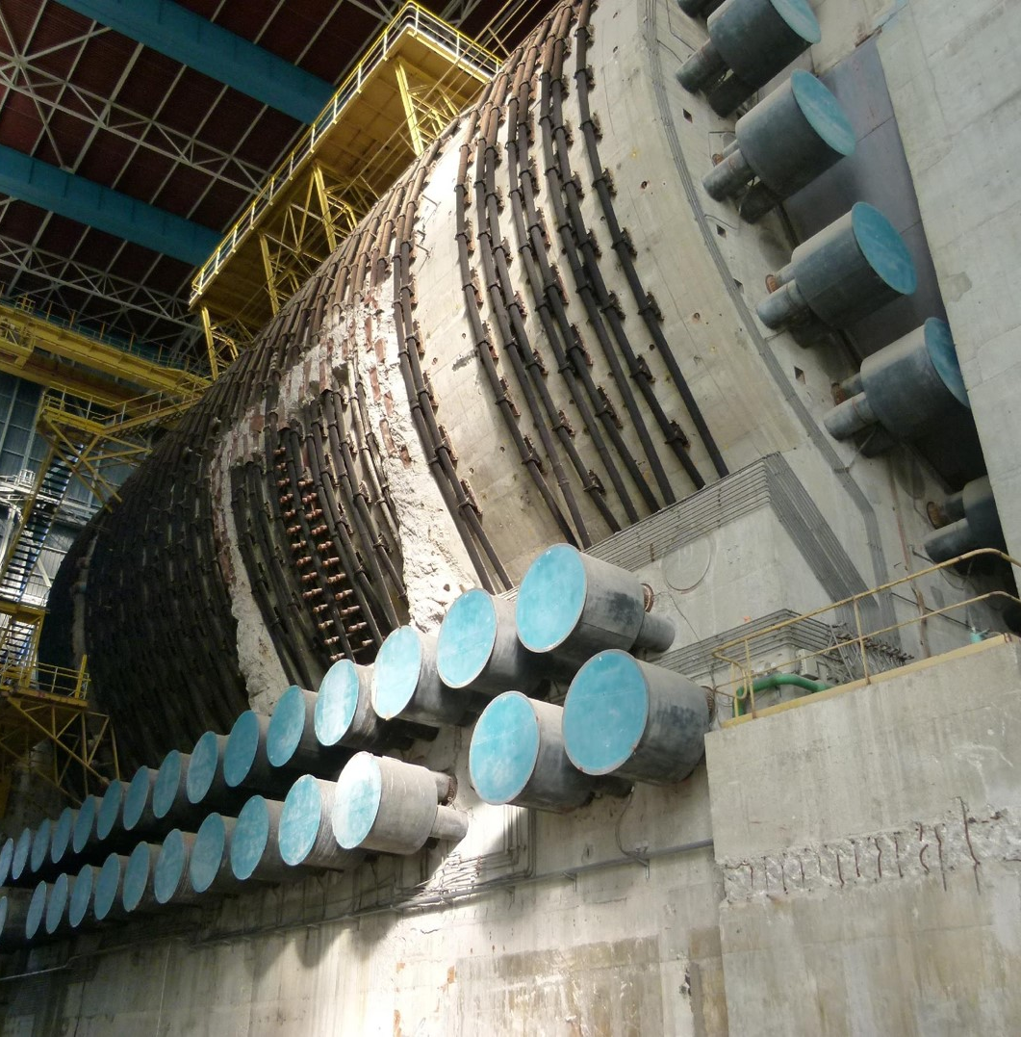

Muon tomography with multiplexed Micromegas detectors using compact telecopes for societal applications
David Attié
July 18, 2024

Slide 2
Overview
  Introduction
    Muon tomography - Principle
    Micromegas technology
    Multiplexed Micromegas detector (MultiGen)
    Muon telescopes using MultiGen
  Societal Applications
    WatTo demonstrator
    ScanPyramid mission
    First muon tomography a nuclear reactor
    Other nuclear applications
  Summary & Conclusions

Slide 3
Introduction
1

Slide 4
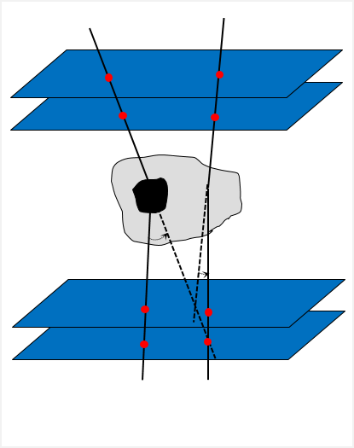
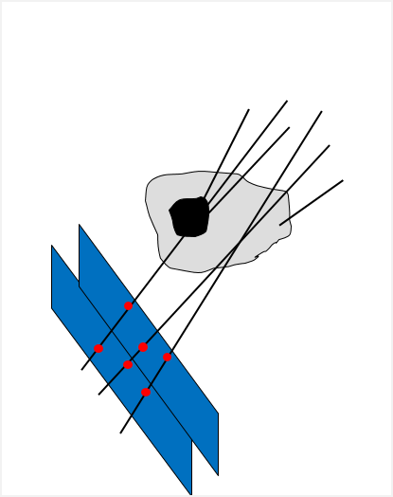
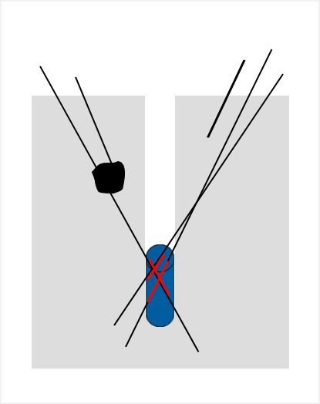
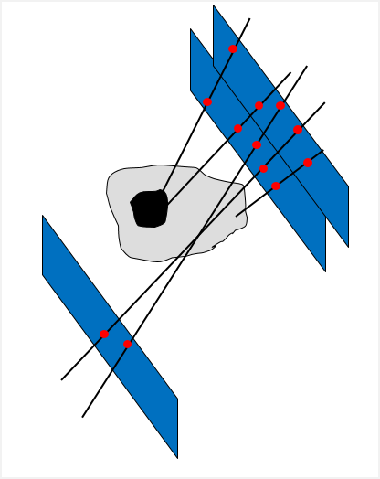
Muon tomography – Principle
  Use of atmospheric muons for non-invasive and non-destructive probe of internal structure of objects not accessible by usual methods (X-ray radiography, magnetometry, electrical resistivity, etc.)
  Muon tomography can be done using one of the three methods:
μ
  Safe and free
  Flux: ∼150 m⁻².s⁻¹ (in cos²θ)
  Highly penetrating (<E>∼4 GeV)
  Ultra-relativist with life time 2 μs
  Straight trajectories in mean
    Multiple Coulomb Scattering
    Transmission
    Absorption
Transmission
Transmission
Absorption
~10-100 m
~1 m
~10-100 m
~1 m
MCS

Slide 5
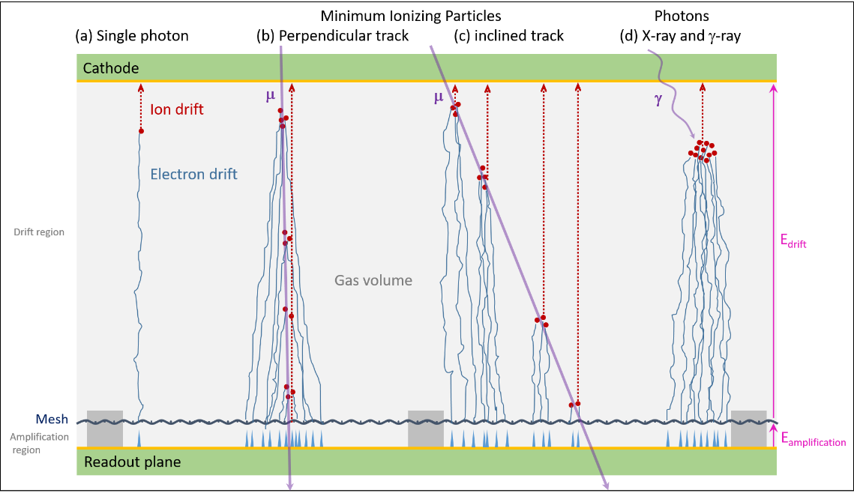
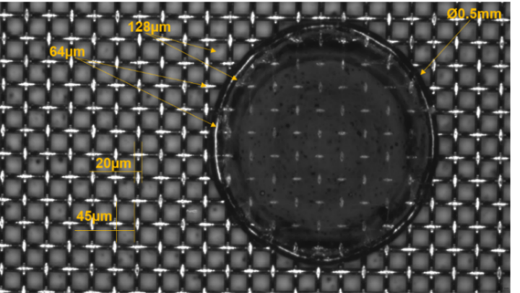
Micromegas technology
  Gaseous detector invented at CEA (1996)
    Defined by two regions:
      Conversion region (few mm to few m): E_{drift} ~100 V/cm
      Amplification region (~100 μm): E_{amplification} ~59 kV/cm
    Bulk Micromegas (2005)
      Robust, large area
      Industrialized manufacturing (printed circuit processes)
  Excellent performances for high-energy physics
    Spatial resolution < 100 µm
    Time resolution < 10 ns
    High flux operation
  Successful industrial transfer
    Started in 2012 with Elvia-PCB
    Production of 1250 m² for ATLAS/NSW
    ~ 150 resistive bulk Micromegas of 50×50 cm² for muon tomography
Pillar from bulk Micromegas

Slide 6
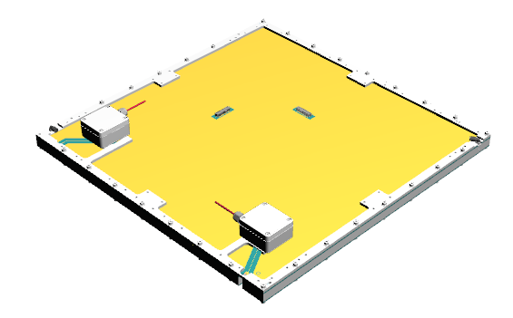
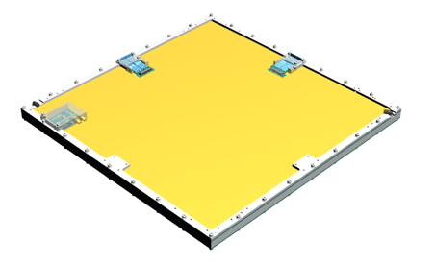
Multiplixed Micromegas detector
  « MultiGen » detector
    Resistive strip Bulk Micromegas
    2D readout (X & Y) with genetic multiplexing
    Each coordonate read out by 61 electronic channels
    PCB: 546×546 mm²
    Active area: 500×500 mm²
    Can be used in mosaic
[doi.org/10.1016/j.nima.2013.08.071]
MultiGen v2
MultiGen v3-v4
[doi.org/10.1016/j.nima.2016.08.006]
  Evolution since 2014: from prototype (CERN) to industrialization (ELVIA-PCB)
MultiGen Version | Number of Multiplexing Family | Number of strips (X/Y) | Strip pitch (μm) | Drift length (mm) | Year | Number of detector | Improvements
V1 | 17* | 1024 | 488 | 10 | 2014 | 7 | (*) one family incomplete: 13 strips missing
v2 | 17 | 1037 | 482 | 15 | 2015 | 42 | Complete families; grounding plane added
v3 | 17 | 1037 | 482 | 8-10 | 2017 | 50 | Connectors moved to sides; HV filters on PCB
v4 | 12 | 732 | 683 | 8 | 2019 | 52 | Number of family reduced to 12; resistivity increased
INB72 | 5 | 305 | 557 | 5 | 2022 | 8 | Number of family reduced to 5

Slide 7
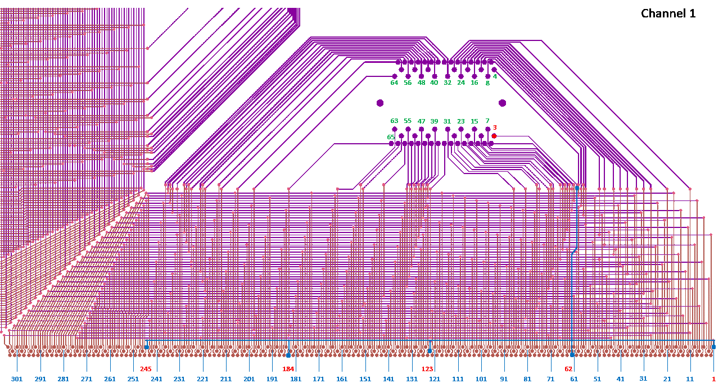
Genetic multiplexing - Example
    5 multiplexing families
    305 (5×61) strips

Slide 8
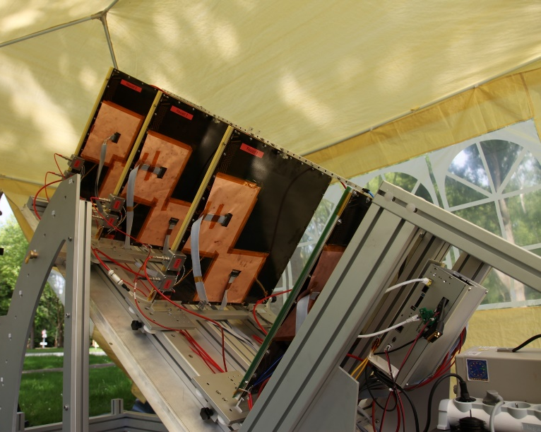
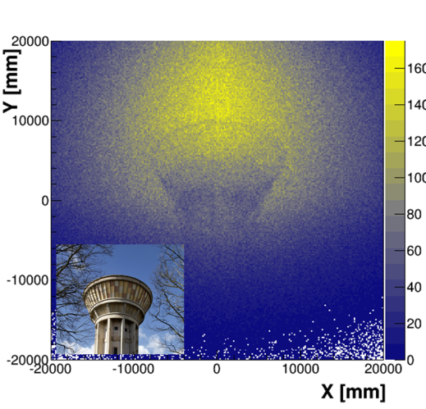
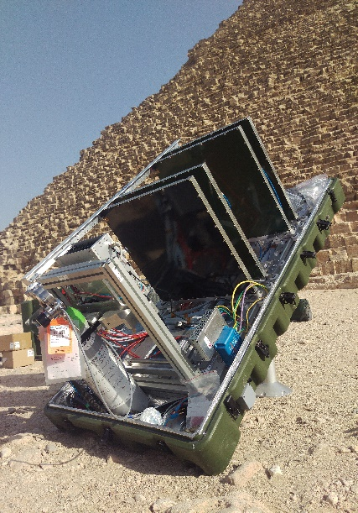
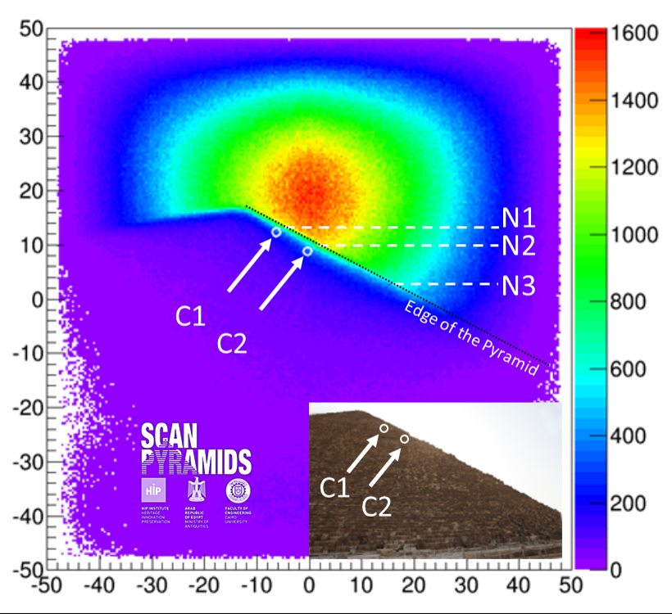
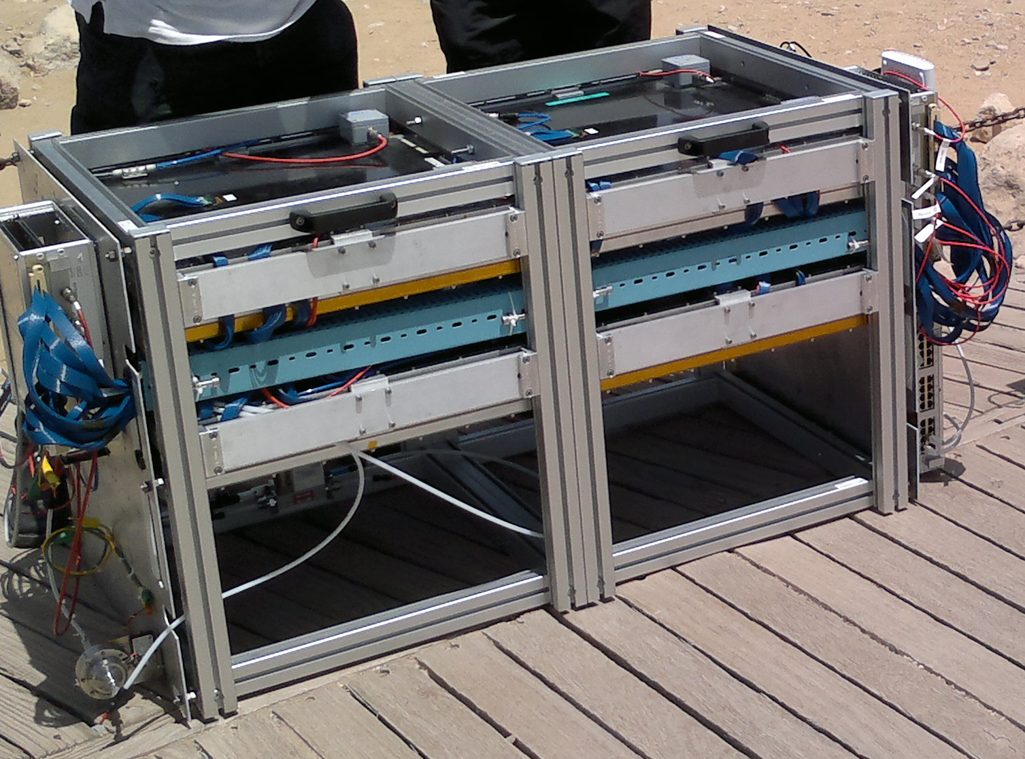
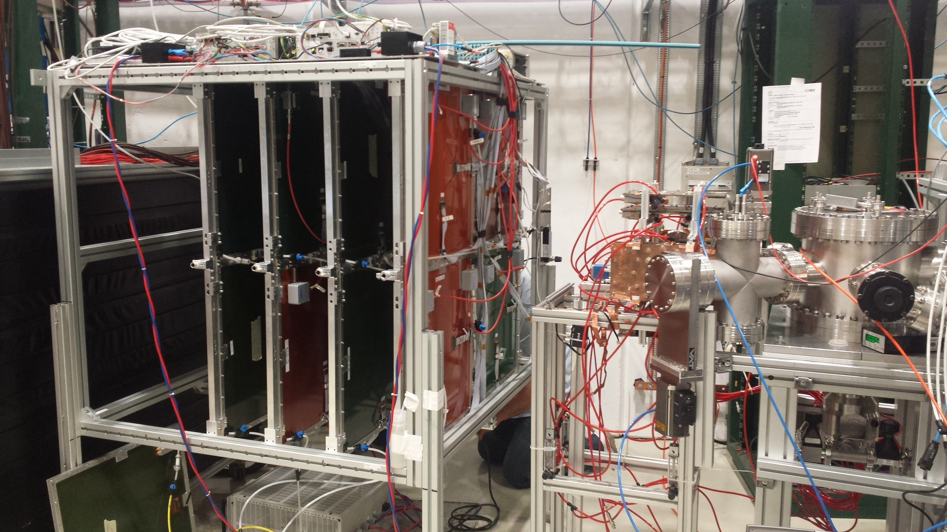
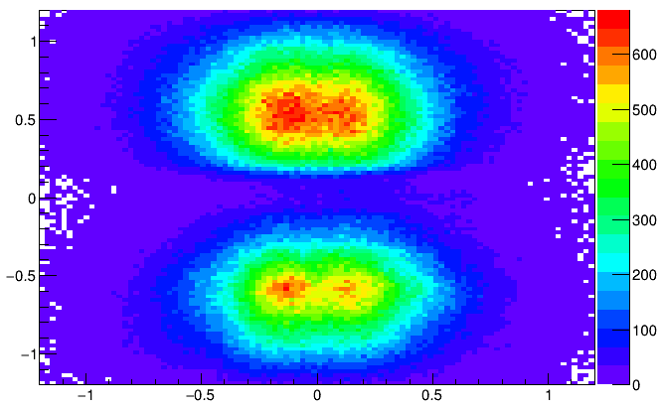
Muon Telescopes using MultiGen
1st Gen
(2015)
2nd Gen
(2016)
3rd Gen
(2017)
4th Gen
(2018)
  Improvements
    Compactness
    Autonomy
    Stability
  Perfomance today
    Spatial resolution ~250 µm
    Angular resolution ~ 2 mrad
    Time resolution ~10 ns
  Applications
    Fundamental Research
    Archaeology
    Nuclear Domain
    Civil Engineering
    ….
WatTo
MultiGen evolution
ScanPyramids
Gbar μ bkg
GBar

Slide 9
Societal Applications
2

Slide 10
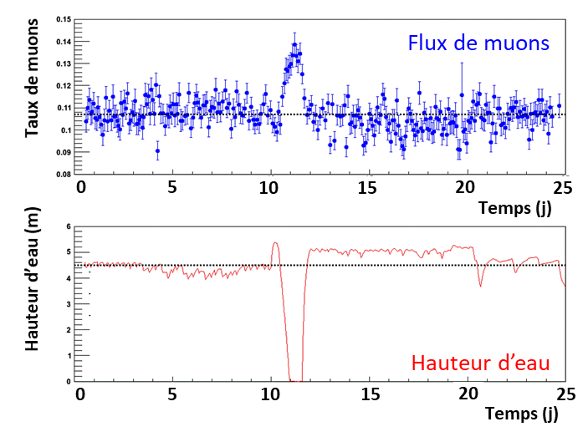
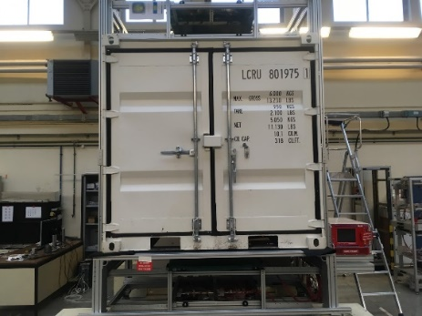
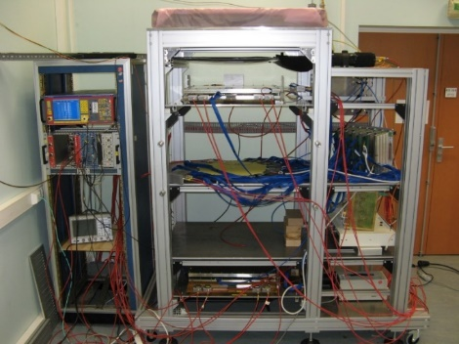
Muon tomography timeline at CEA/Irfu
  Started with the R&D of resistive multiplexed Micromegas
  Used for hodoscope in cosmic test bench
    Reduce channel number
    Large area with accurate tracking
  M-Cube :
  U detected in less than 4 minutes
2012
2013
2014
2015
2016
2017
X
X
X
X
X
  Cosmic bench for Clas12 detectors validation
  M-Cube:
  demonstrator for homeland security
  WatTo (Water Tower)
  ScanPyramids
1st muography HD online

Slide 11
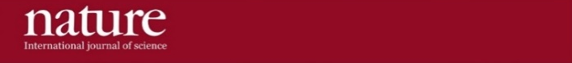
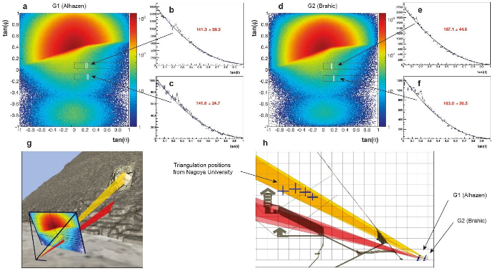

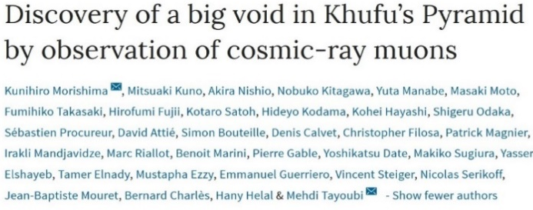
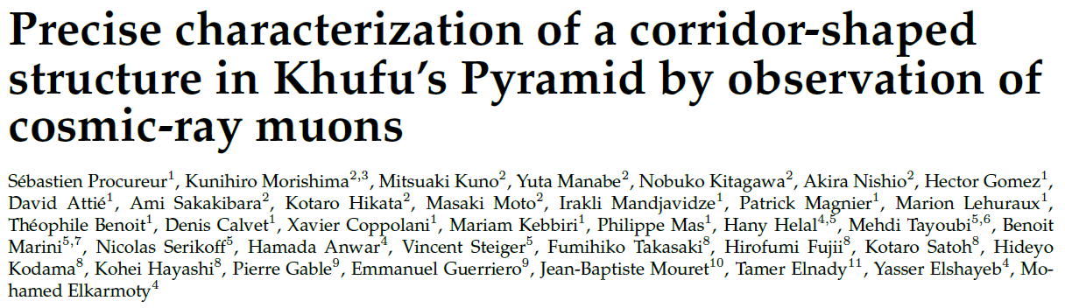

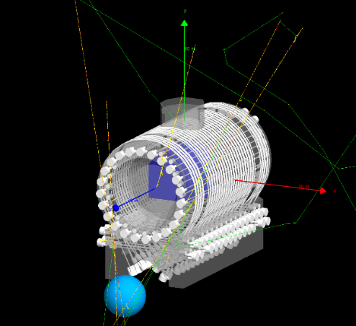
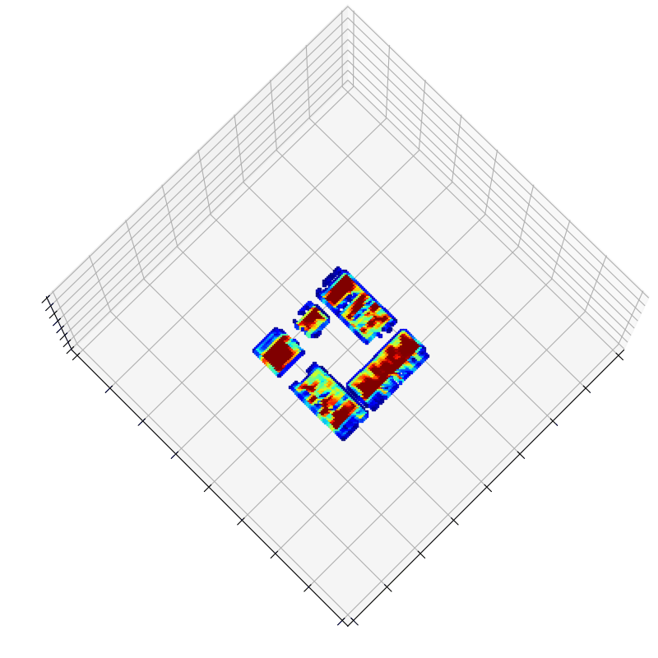
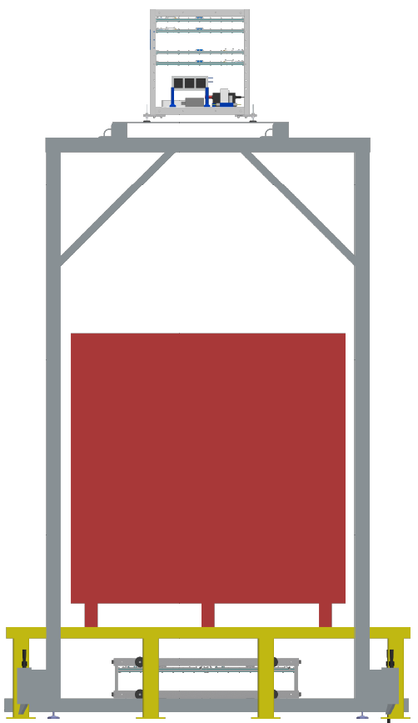
Muon tomography timeline at CEA/Irfu
Industrialization
  Common lab
2017
2018
2019
2020
2021
2022
X
X
X
X
X
X
X
Nuclear
Dismantling
projects
  Maison de l’Imagerie Muonique Ouverte aux applications Sociétales et Académiques
  G2 NR
  G2G3 nuclear Reactor (NR)
IZEN
1st muography of a military NR

Slide 12
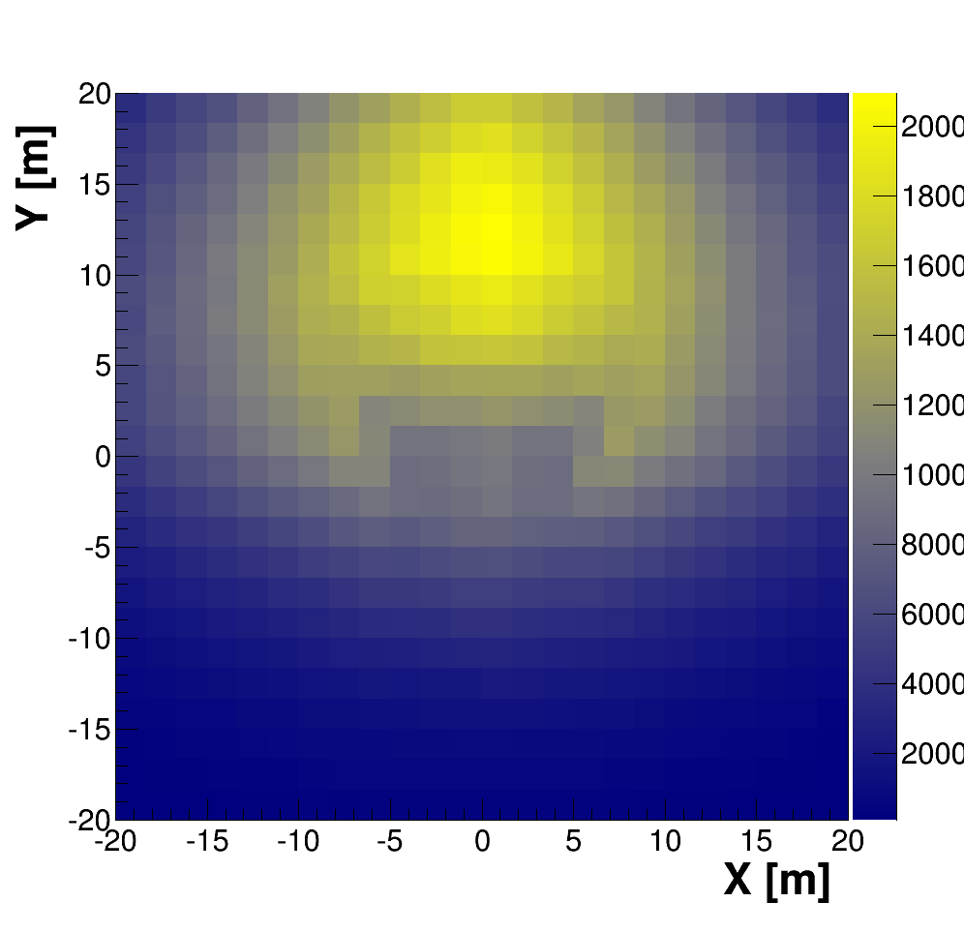
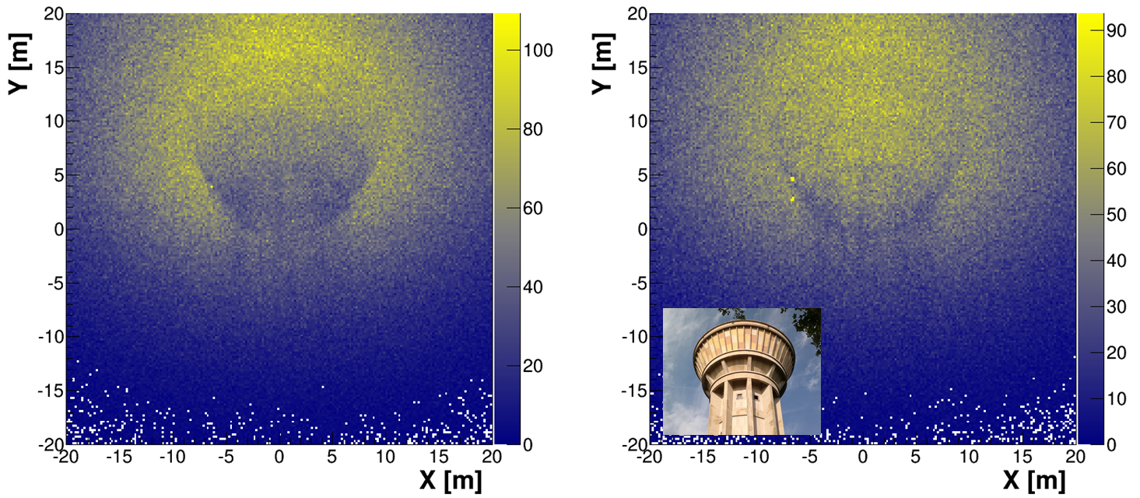
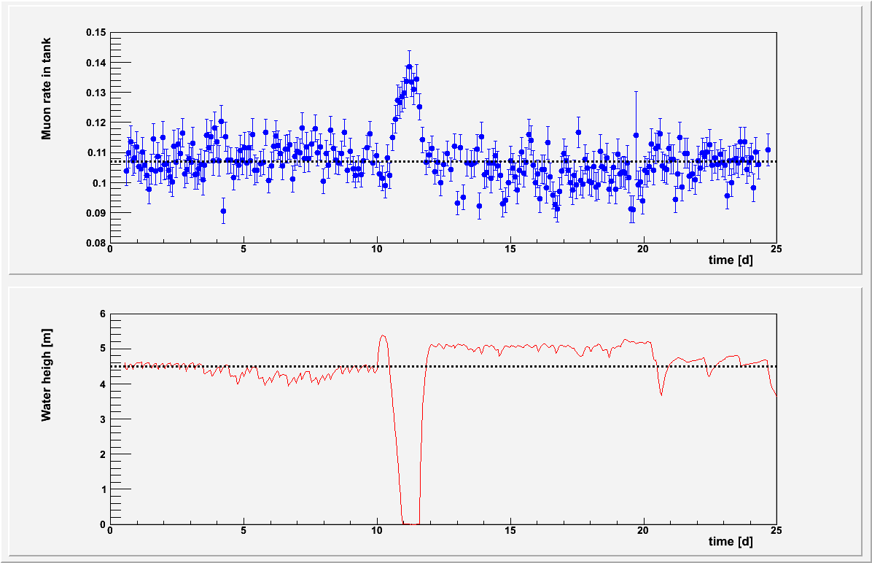
WatTo - Demonstrator
  Dynamic muography (position 2)
    4 days
  Static muography (position 1)
    4 weeks
    Scintillator telescope
→ First muography of a recognizable building
Muons flux in the tank
[ doi.org/10.1016/j.nima.2016.08.002]
Water heigh in the tank

Slide 13

ScanPyramids: Big Void
[doi.org/10.1038/s41467-023-36351-0]

Slide 14
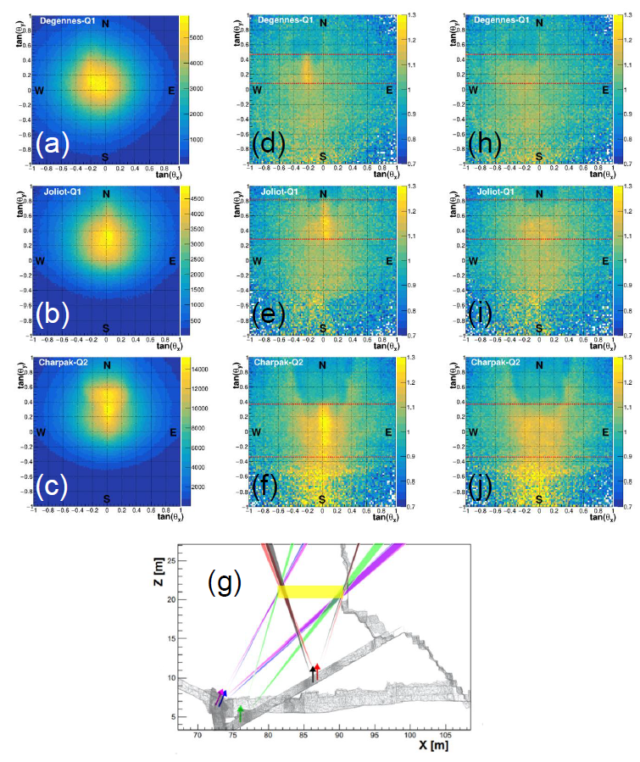
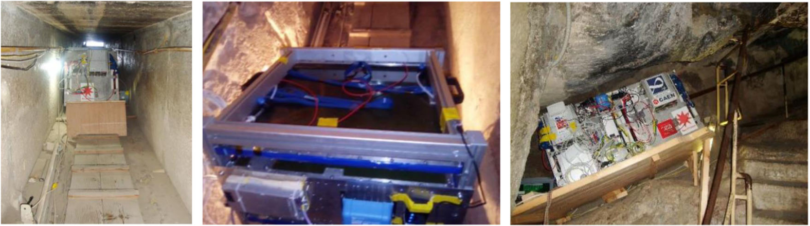
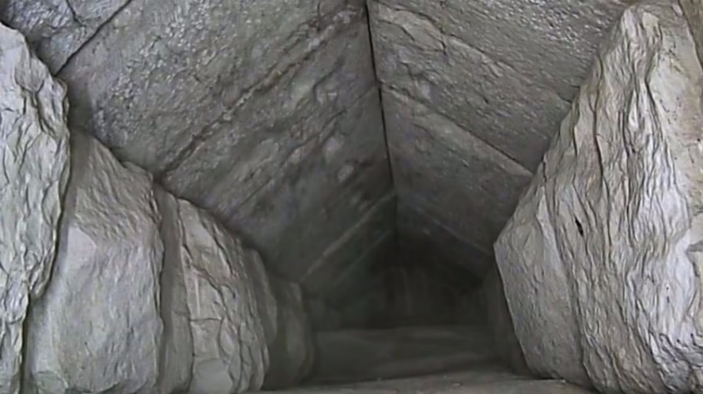
ScanPyramids: North Face Corridor
Raw data
Data/Sim wo NFC
Data/Sim with NFC
(c)
(b)
(a)
First "double“ outdoor telescope (100×50 cm²)
Improved gas system (filters & recirculation): total gas flow of 0,5 L/h 20 detectors
High precision simulation
(Geant4 + pyramid model) used for analysis
2x2x9 m³
Three telescopes
(c)
(a)
(b)
March 2nd, 2023
[doi.org/10.1038/s41467-023-36351-0]

Slide 15
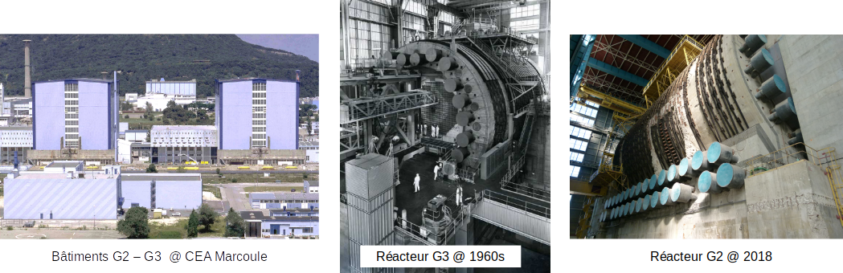
Nuclear Reactor G2G3 in dismantling
  Main objectives: survey military G2 and G3 reactors, located at CEA–Marcoule, using muon tomography
    Check the validity of existing drawings (1960s)
    Check the internal structure and aging of the reactors
    Identify defects (e.g. cracks) in the concrete body (if possible)
Buildings G2-G3 @ CEA Marcoule
G3 reactor @ 1960s
G2 reactor @ 2018

Slide 16
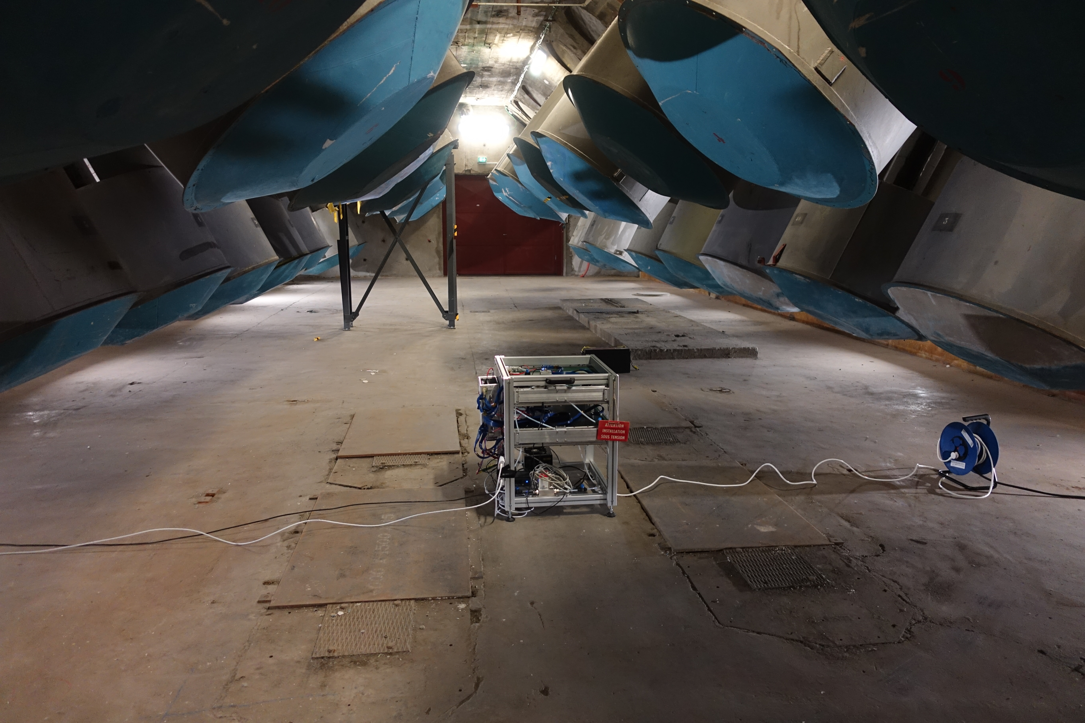
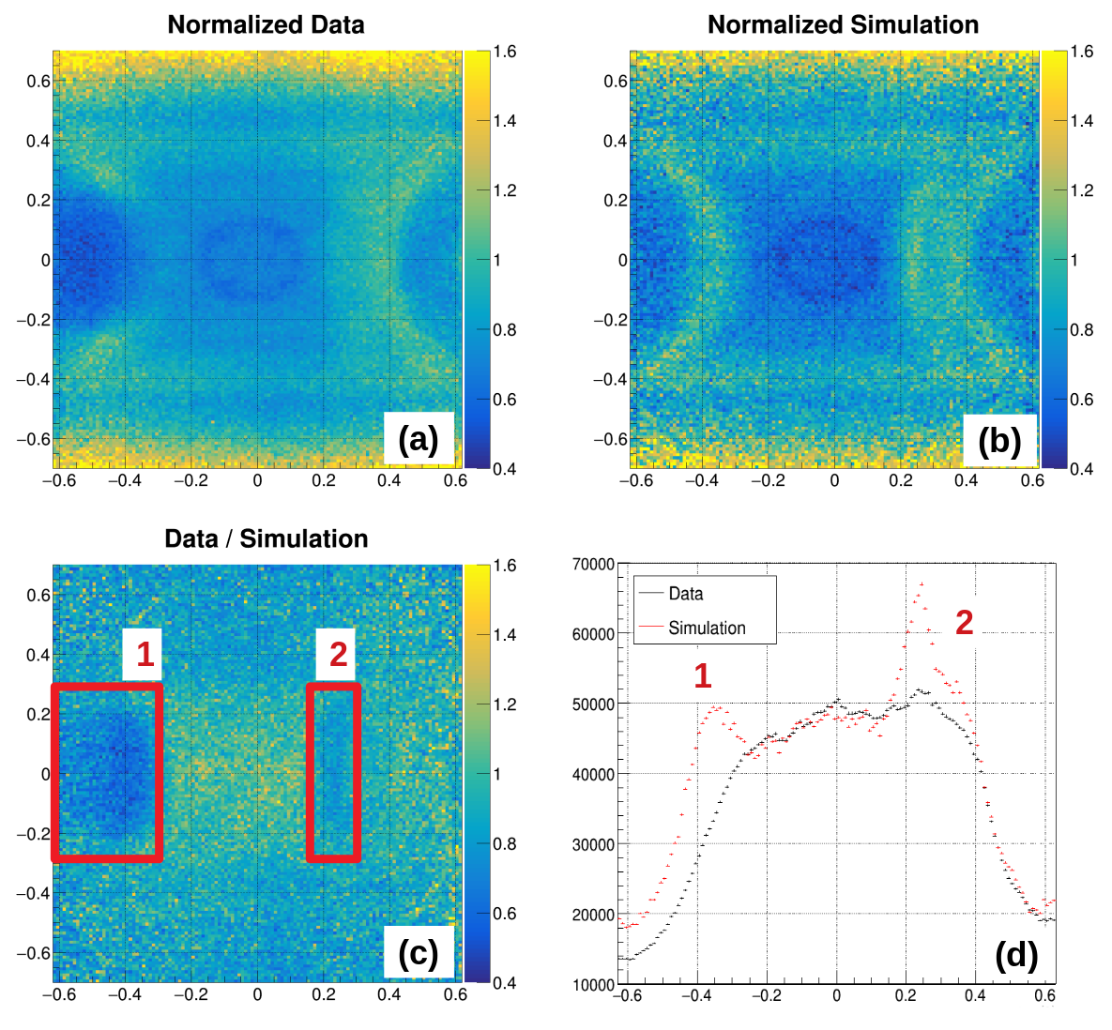
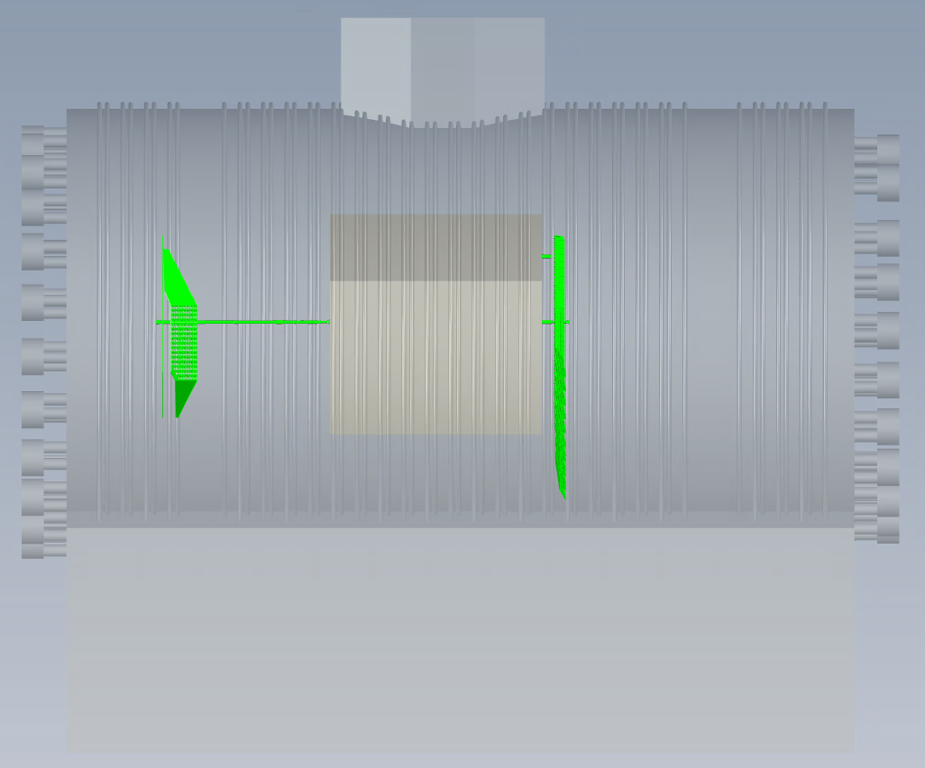
G2 – First Measurement
  First analysis: look for disagreements Reality–CAD Model
  Data/Monte Carlo comparison
    Monte Carlo generated with the geometry from the 3D - CAD model
    Any anomaly will imply differences between the model and the real structure
2 Data / MC disagreements
    Detector placed at the centre of the reactor (level – 0)
    Optimal position for a first overall image
2 : Unloading tubes
Assembling channels
1 : Loading tubes and block

Slide 17
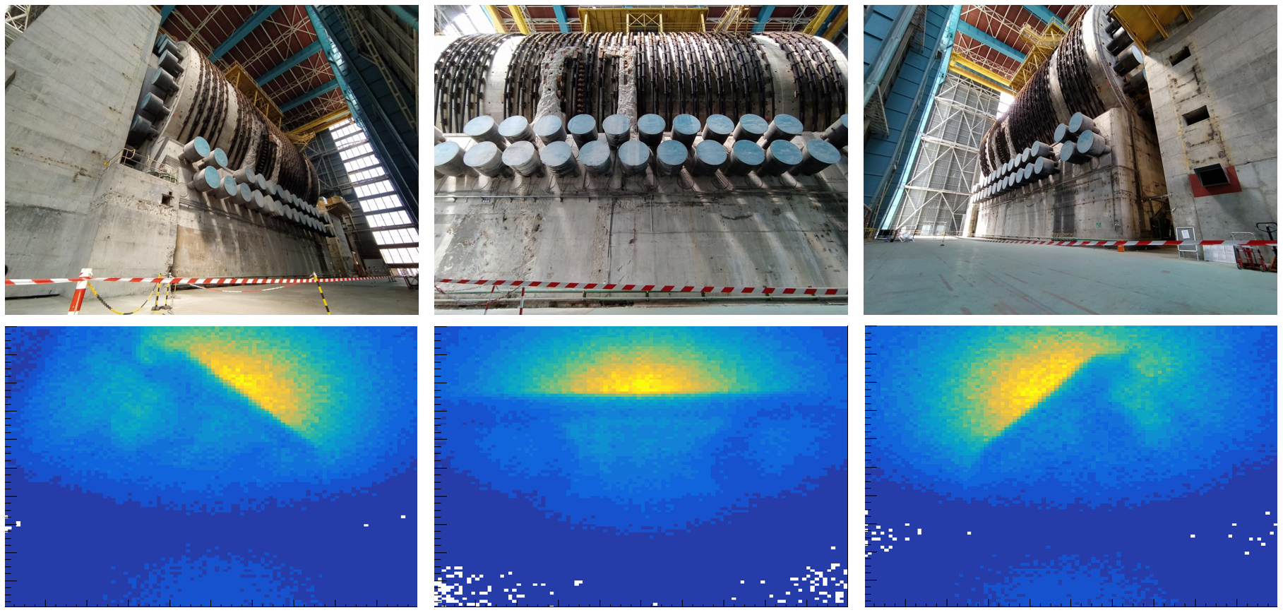
G2 – Multiposition with 4 telescopes
27 positions

Slide 18
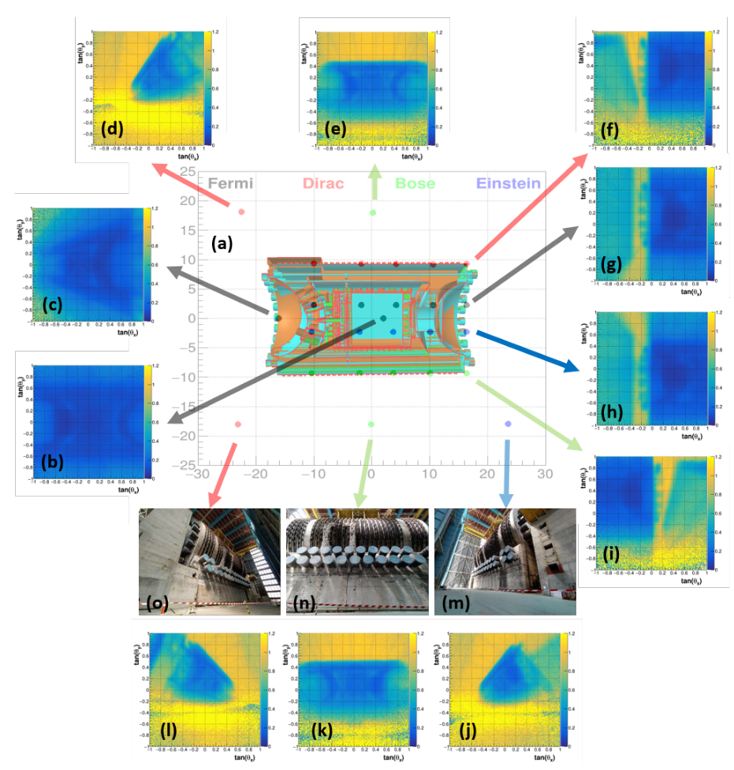
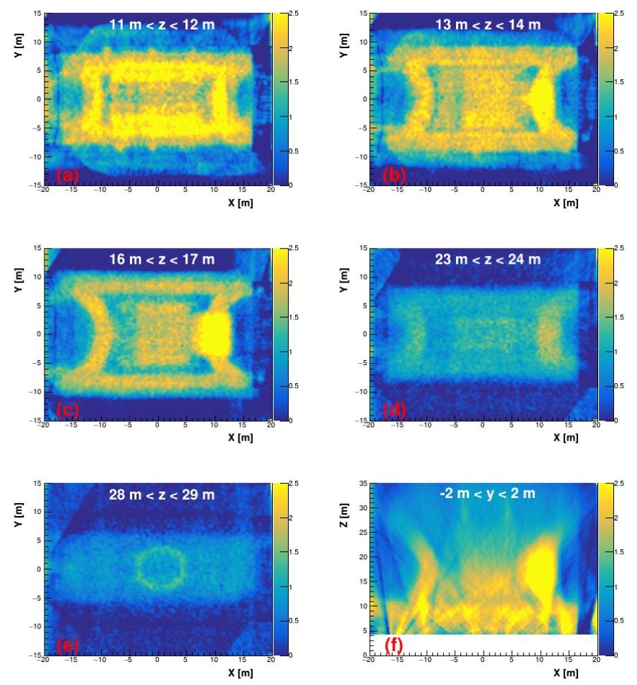
G2 – Multiposition → Tomography 3D
  Second analysis: Simultaneous Algebraic Reconstruction Technique (SART) first used for CT scan (1984)
SART Method
[D] (n_{v} x n_{m}) [𝞺] (n_{v}) = [o] (n_{m})
n_{v}: Voxels number = 2688000
of 25 cm side
n_{m}: 27 positions with 200 x 200 directions per 2D muography
(1 080 000 measurements)
→ [D] has ~ 2,9 10¹² elements
[𝞺] represents the (unknown) density in each voxel,
[o] is the opacity vector
[D] is a distance matrix
[doi.org/10.1126/sciadv.abq8431]
See video at vimeo.com/672377812/1ad9048fa0

Slide 19
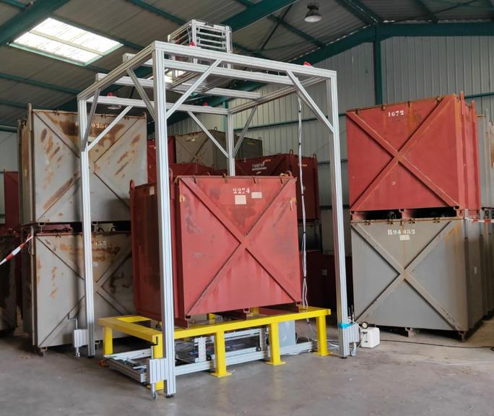
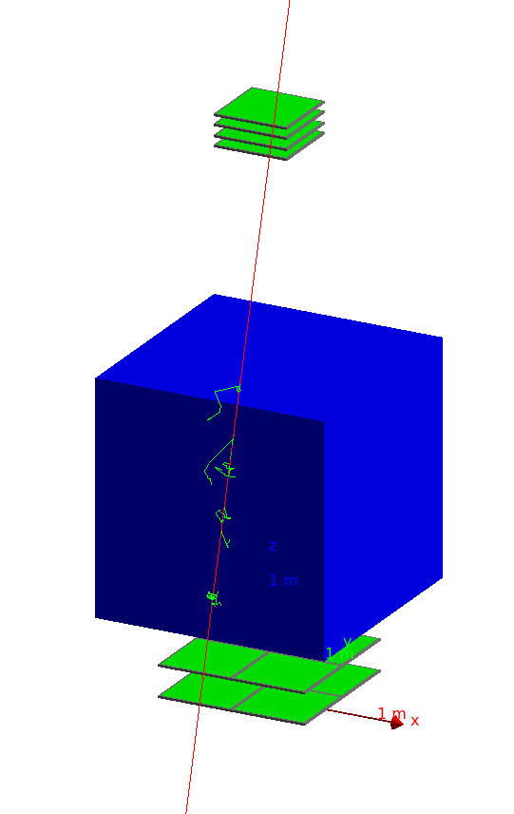
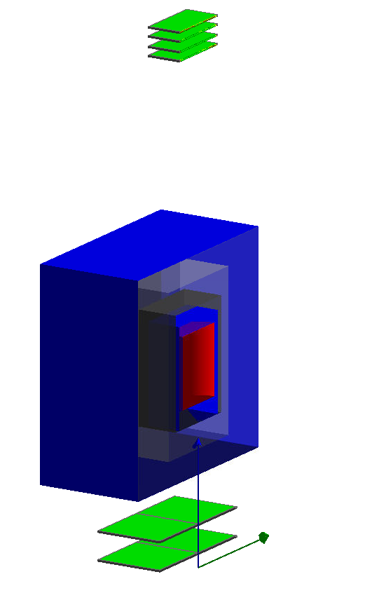
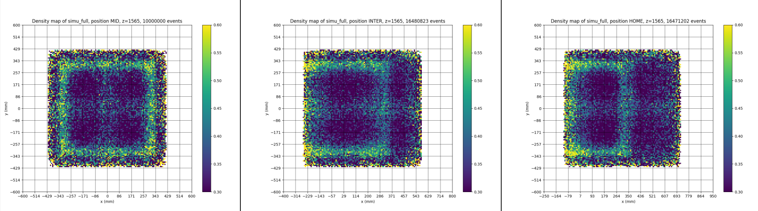
IZEN – Container scanning
  Main goal: container verification scope based on Micromegas detectors
    First order density of waste (~water, heavy metals, …)
    Integrity of the blocking concrete
  Muon tomography using absorption method (1 Top Tracker + 1m² bottom veto)
    More compact setup
    Less bluring
  Veto (1 m²) movable
    3 positions
    Reconstruction artefact to be solved

Slide 20
Summary & Conclusions
  CEA/Irfu group developed a muon telescope based on Micromegas detectors
    Robust technology
    Good performance (angular and spatial resolution)
  This telescope has been used in the last years in different muography applications
    Archaeology
    Engineering
    Nuclear domain
  Among the different projects related to nuclear domain
    Reactor model verification
    Nuclear waste containers inspection (still in progress)
  New ideas and projects on going

Slide 21
Thanks!
This talk has been possible thanks to the work of:
Raphaël Bajou, Théophile Benoit,
Héctor Gómez, Mariam Kebbiri,
Baptiste Lefèvre, Irakli Mandjavidze,
Philippe Mas, Daniel Pomarede and Sébastien Procureur
CEA SACLAY
91191 Gif-sur-Yvette Cedex
France
david.attie@cea.fr
Phone + 33 1 69 08 11 14

Slide 22

Cosmic test bench at CEA/Irfu
  Technological transfert from cosmic test bench hodoscope initially developed for Clas12 project
  Developed for detector characterization
    Based on bulk Micromegas detectors
    Reduced number of electronic channel
    → Genetic Multiplexing (patented)
    High performance (~250 μm space resolution)
  Advantages w.r.t. test beam in accelerators
    No booking needed
    Available anytime
    Free
Top Scintillator
HV module
doi.org/10.1016/j.nima.2013.08.071
Top μMs pair
Trigger Module
Characterized detector
DAQ
Bottom μMs pair
Bottom Scintillator
LV Module

Slide 23
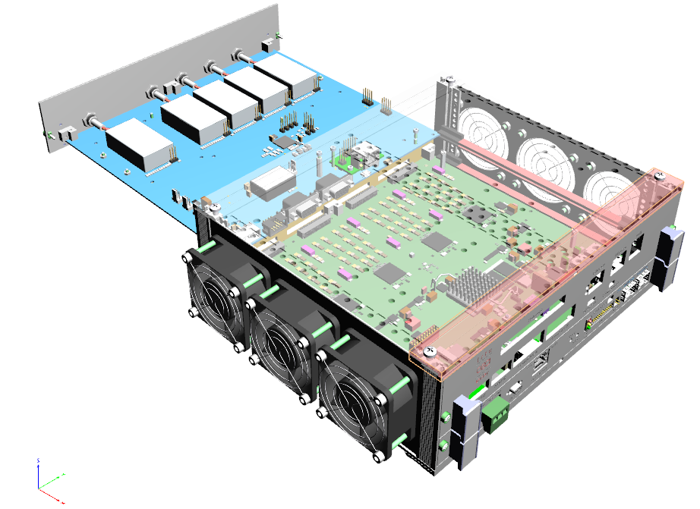
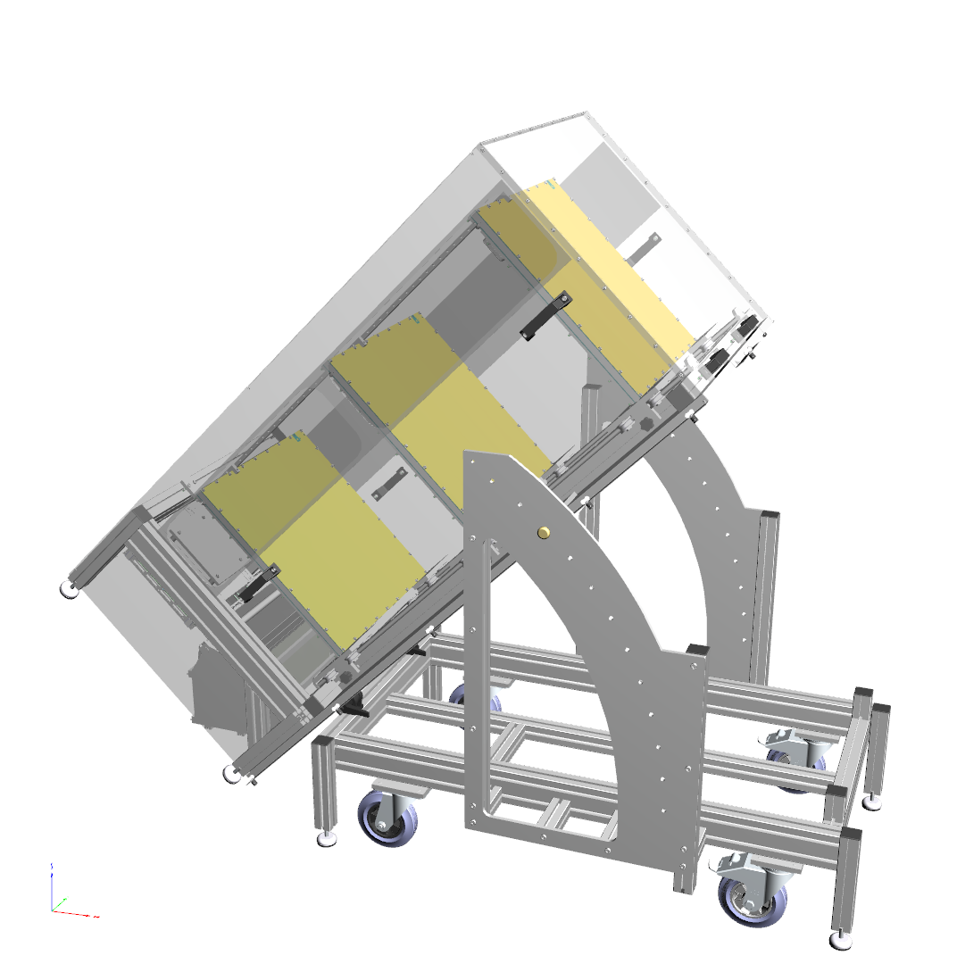
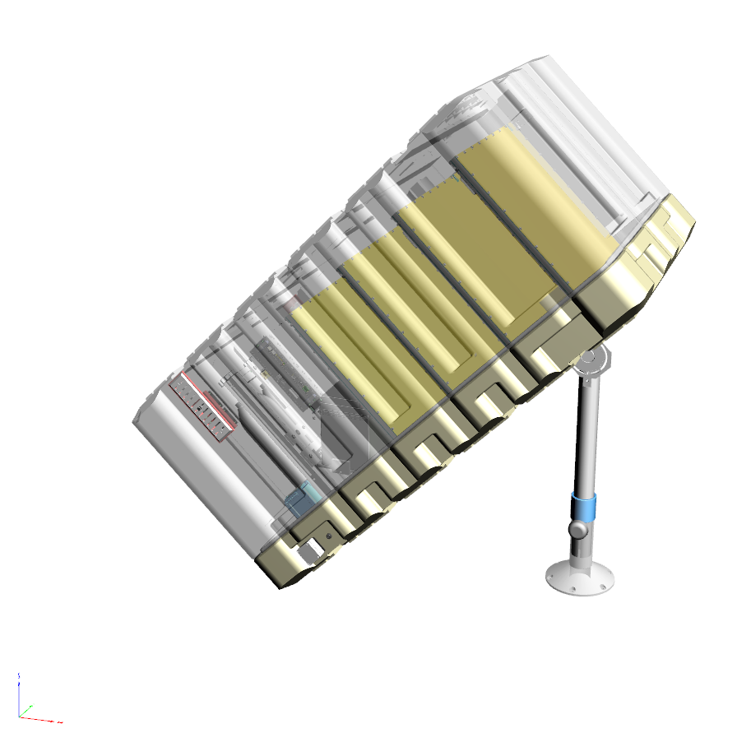
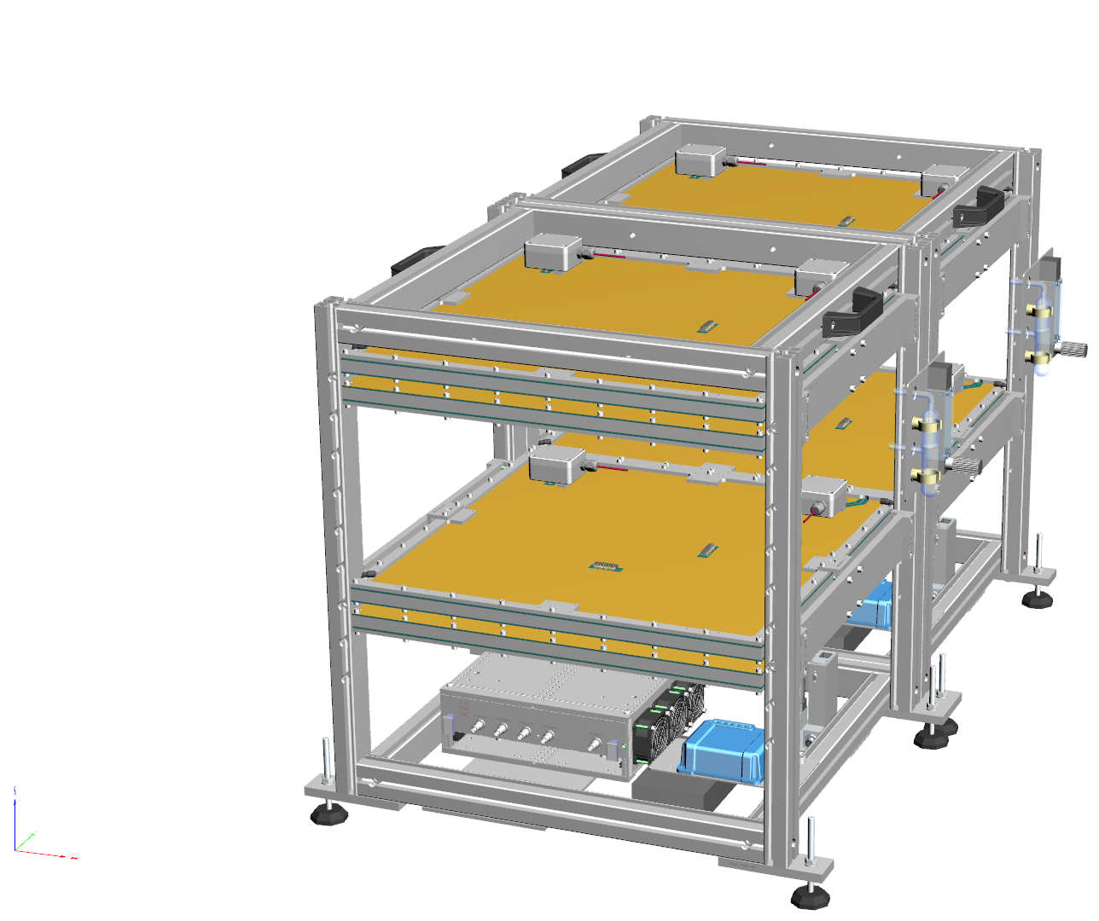
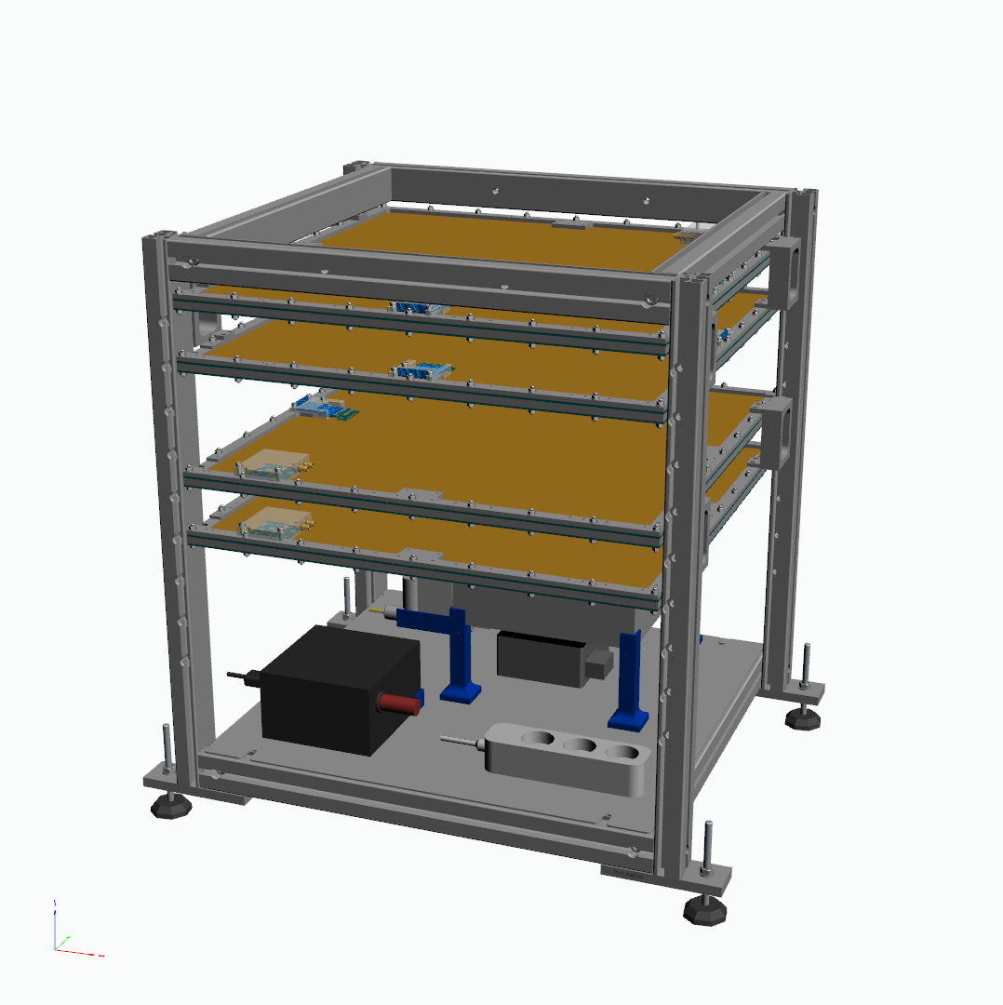
Muon Telescopes using MultiGen
  Evolution of the CEA/Irfu’s telescopes: towards compactness, transportability and industrialization
    2015: WatTo, ~200 kg
    2016: ScanPyramids (outside), ~130 kg
    2018: ScanPyramids (inside), cube, ~45 kg
    2019: G2G3, EDF, …, optimized cube, ~45 kg
  CEA/Irfu’s electronics cards: towards compactness, transportability and industrialization
    Front-End Unit (FEU) card developed for Clas12
    High-Voltage Power Supply (HVPS) card dedicated
DC-DC
6U Rack
HVPS
FEU
8 ASICs Dream
2015
2016
2018
2019-today

Slide 24
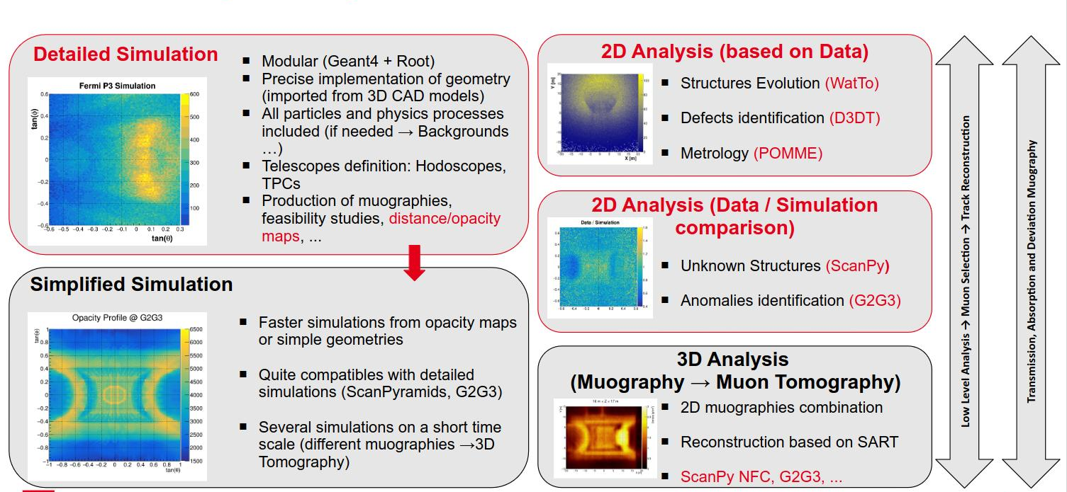
Simulations and data analysis

Slide 25


Iris-Instruments – Common laboratory
  Supplier of instrumentation for Geophysics reaching an academic clientele
  Lab-Com created in early 2020 with licensing agreement in geoscience, territorial security and industrial control (extension until mid-2025)
  Aim: R&D to develop a demonstrator for sale
  Success:
    Telescope now in catalog
  See website: http://www.iris-instruments.com
*Declaration versus Mass Measurement Comparison

