Slide 1
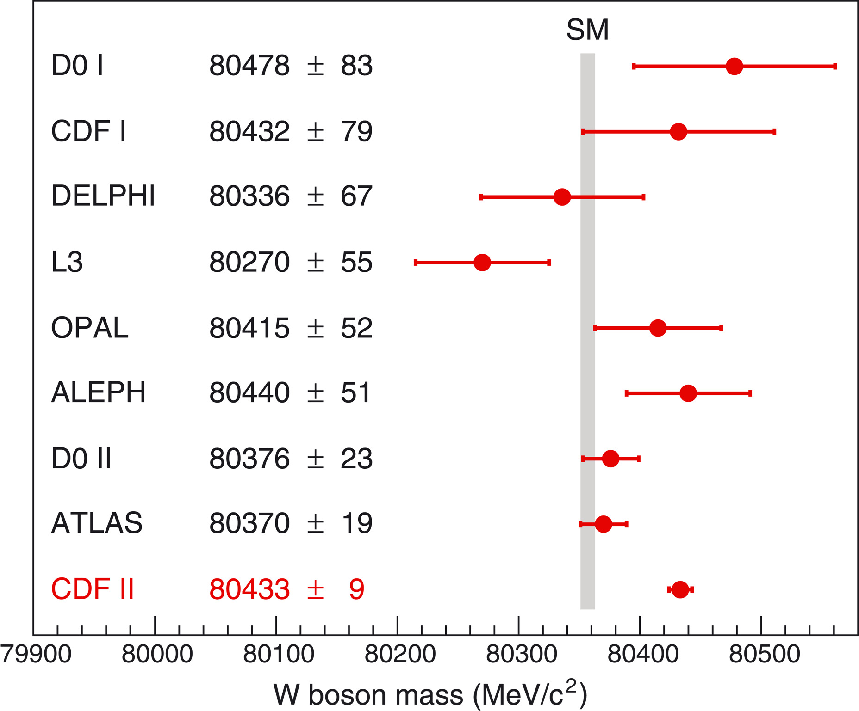
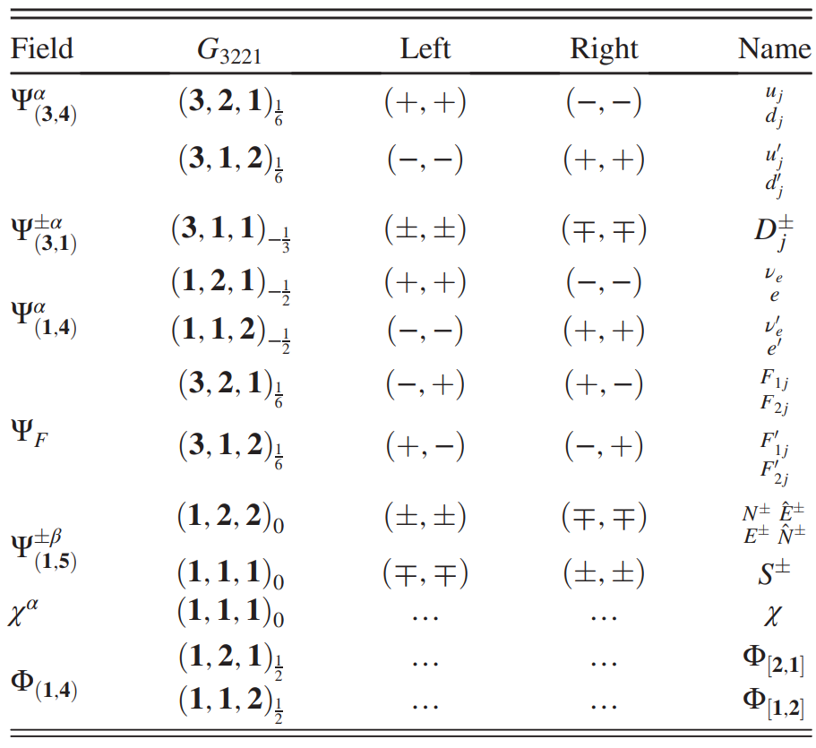
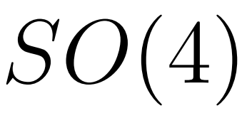
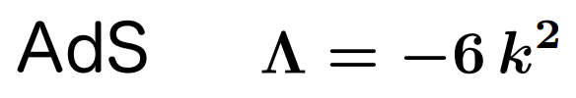
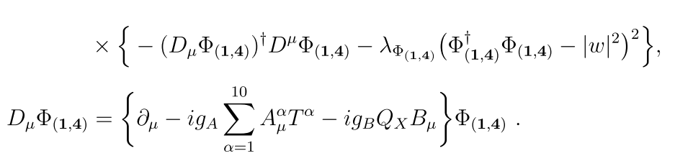

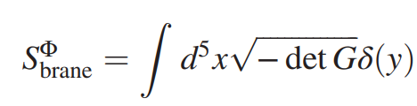
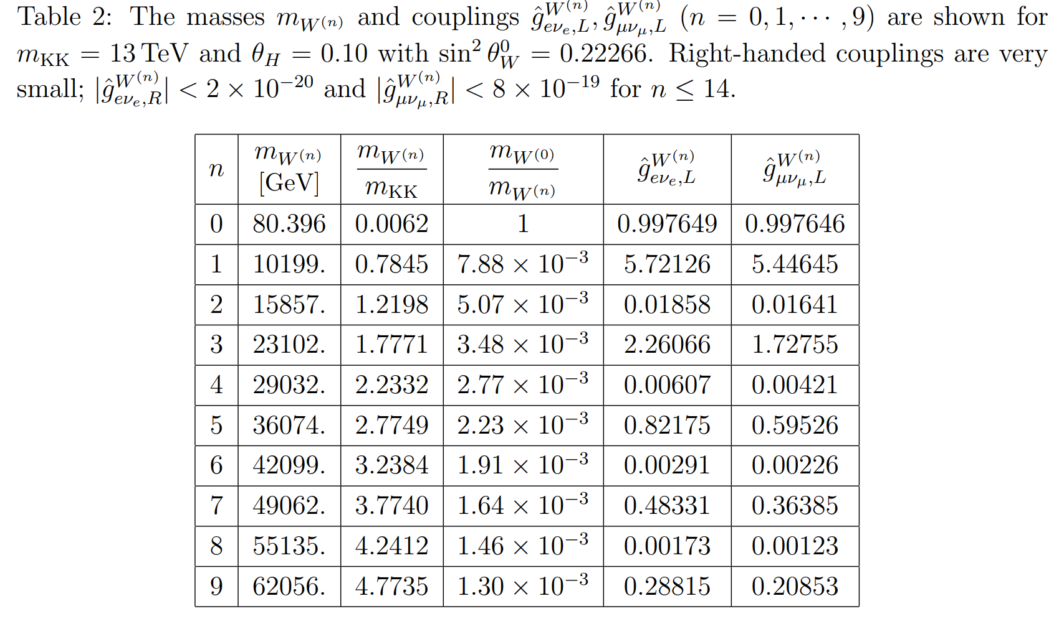
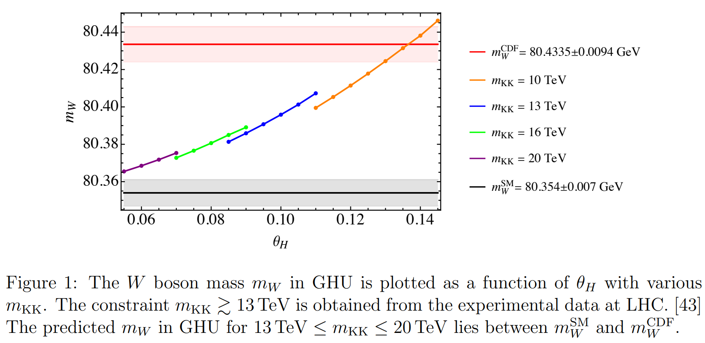
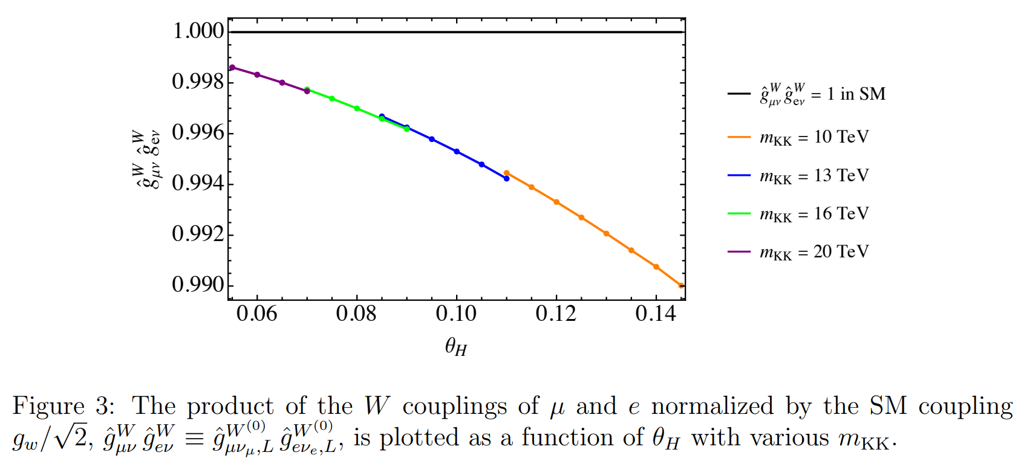
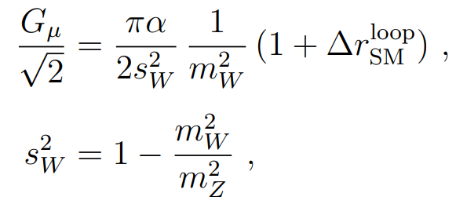
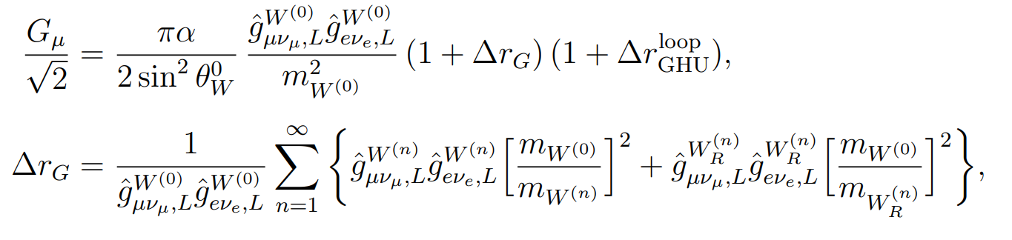
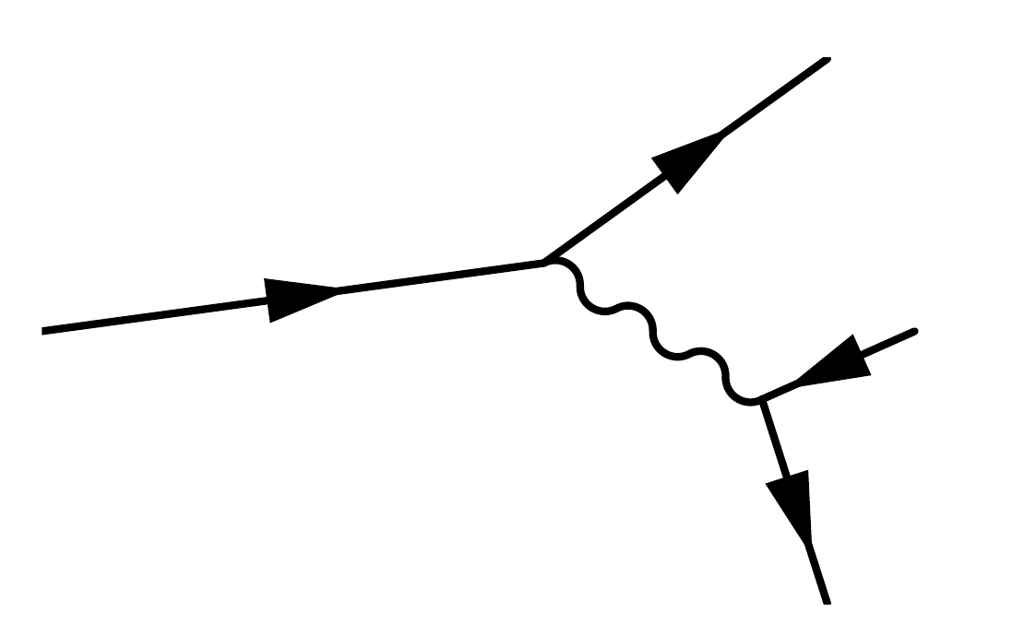
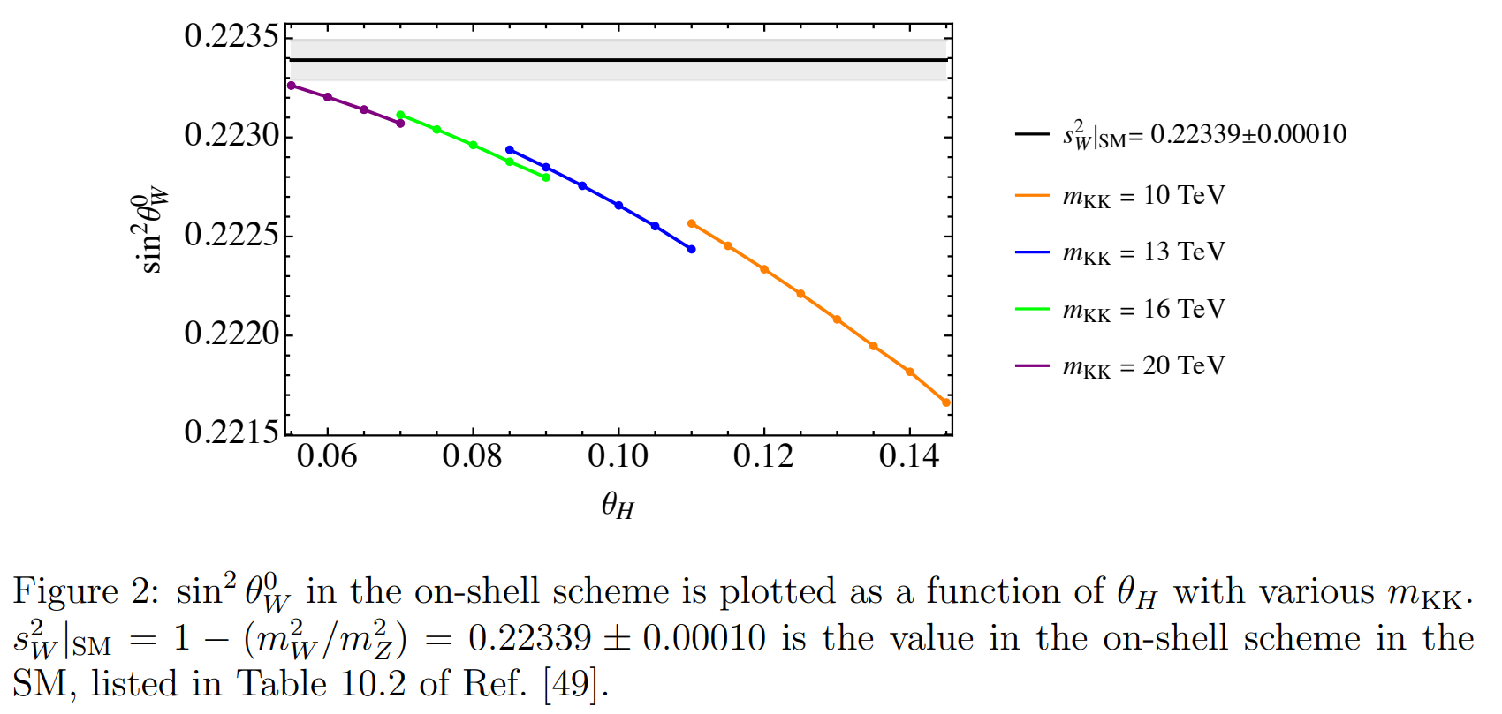
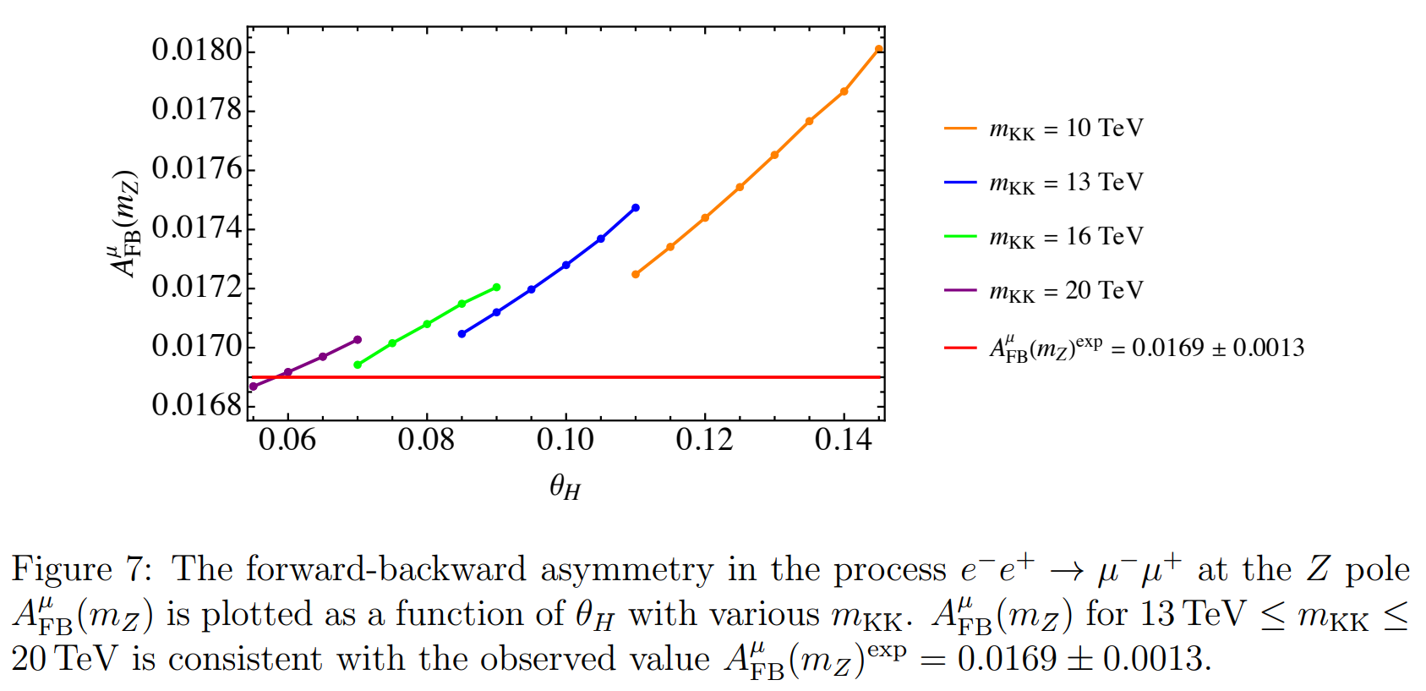
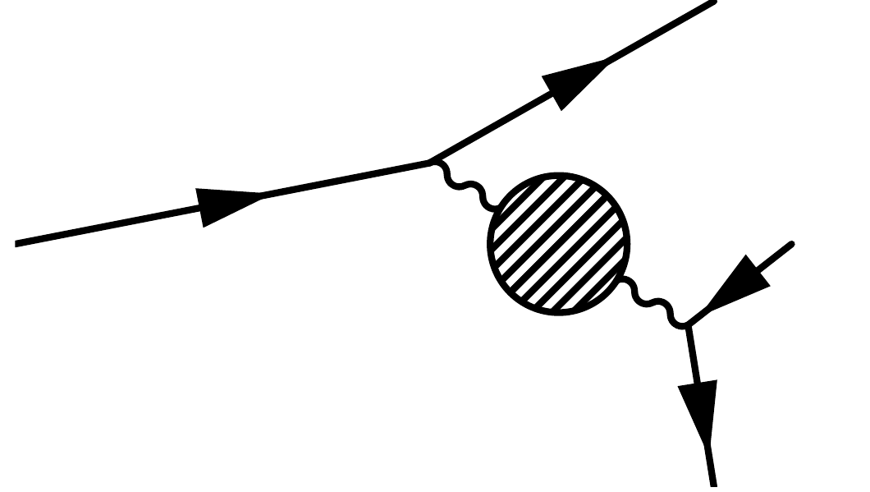
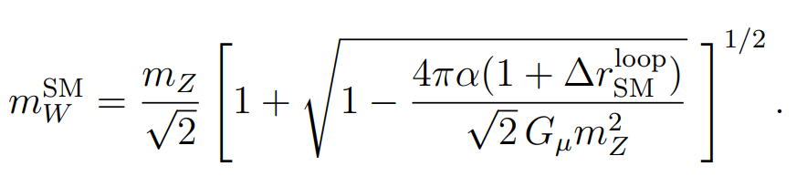

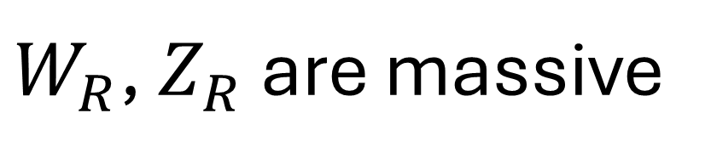
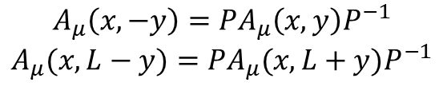
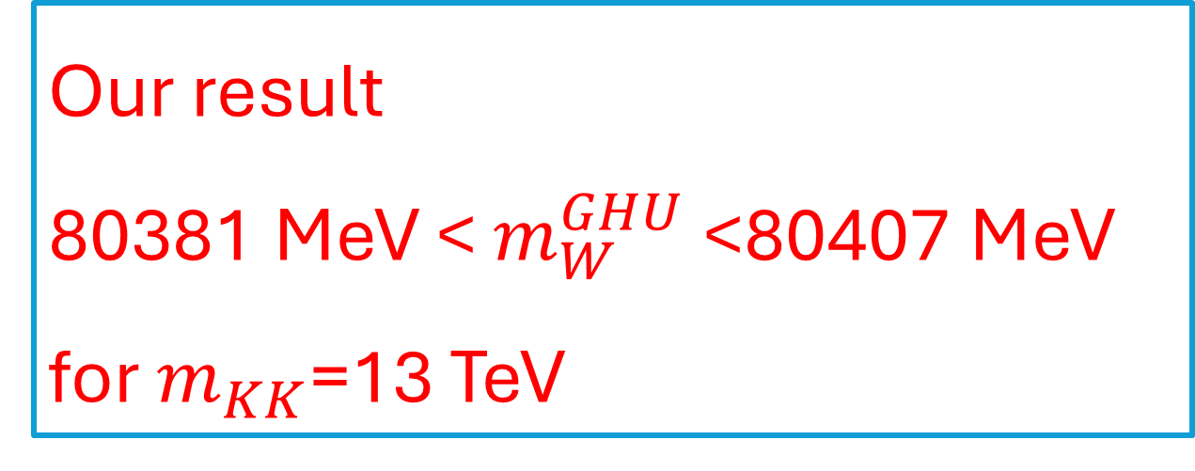


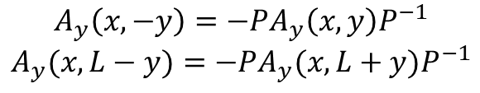
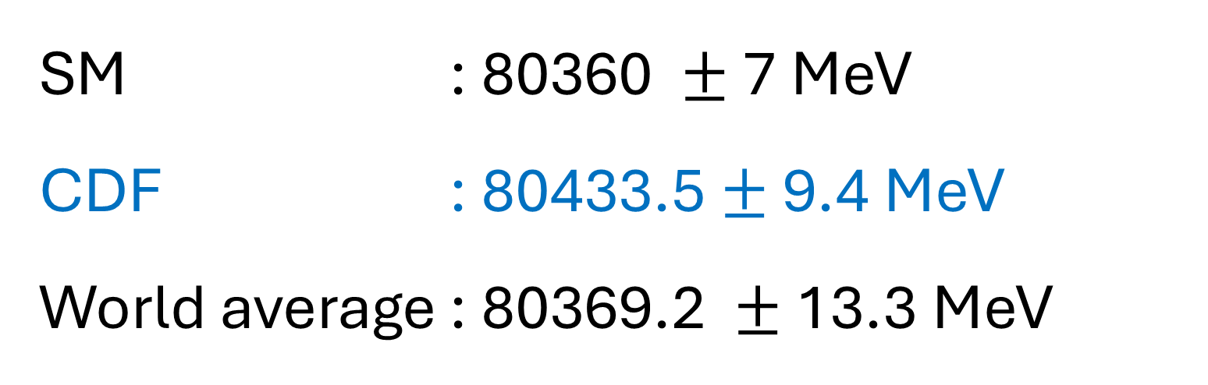


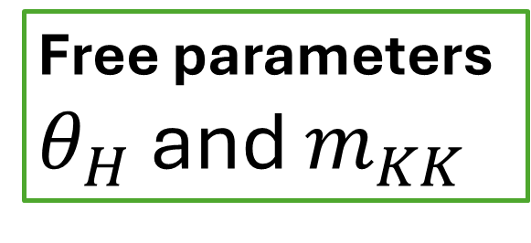
W boson mass in gauge-Higgs unification
Phys.Rev.D 108 (2023) 11, 115036
Yuta Orikasa(CTU, IEAP)
Collaborator: Shuichiro Funatsu, Hisaki Hatanaka, Yutaka Hosotani, Naoki Yamatsu
Science 376 (2022) 170
CDF anomaly
CDF has reported the anomaly of the W boson mass
Our result
80381 MeV < $m_{W}^{GHU}$ <80407 MeV
for $m_{KK}$=13 TeV
SM : 80360 $±$ 7 MeV
CDF : 80433.5 $±$ 9.4 MeV
World average : 80369.2 $±$ 13.3 MeV
W boson mass was significantly higher than SM prediction with a discrepancy of 7 standard deviations.
SO(5) ×U(1) gauge-Higgs Unification model in Randall-Sundrum space-time
Motivation
Particle contents
Higgs boson is a component of higher dimensional gauge boson
Quadratic divergence is protected
by gauge symmetry
Randall-Sundrum spacetime
Flat spacetime
low KK mass scale : $m_{kk}$=600GeV
Light Higgs boson : $m_{h}$=10 GeV
⇒Randall-Sundrum(RS) spacetime
Two branes and negative cosmological constant
Gauge symmetry
Boundary Condition
$$A_{μ}\left(x,−y\right)={PA}_{μ}\left(x,y\right)P^{−1}$$
$$A_{μ}(x,L−y)={PA}_{μ}(x,L+y)P^{−1}$$
$$A_{y}\left(x,−y\right)={−PA}_{y}\left(x,y\right)P^{−1}$$
$$A_{y}(x,L−y)={−PA}_{y}(x,L+y)P^{−1}$$
massless
Brane scalar
$W_{R}$, $Z_{R}$ are massive
Gauge and Yukawa couplings
Gauge and Yukawa couplings are determined by the integration of fifth dimension
Kaluza-Klein mode
In higher dimensional theory, SM fields are expanded by Kaluza-Klein(KK) modes.
The typical mass scale is called KK mass scale:$m_{kk}$
VEV of the brane scalar breaks SO(4) symmetry
Hosotani mechanism
W, Z are massive
Wilson line phase $θ_{H}$ is given by
Free parameters
$θ_{H}$ and $m_{KK}$
is a minimum of the effective potential
W boson mass
SM
Fermi constant determined from the µ-decay is given by
GHU
Fermi constant in GHU includes tree and loop contributions
ν
μ
ν
ν
μ
ν
W
$$W^{(n)}, W_{R}^{(n)}$$
μ
W
e
ν
e
e
Other loop contributions
Other loop contributions
We assume the loop contribution is the same as SM one and tree contribution is dominant.

