Slide 1


Mechanical tuning in Metamaterial-inspired resonators
Gagandeep Kaur
gagandeep.kaur@fysik.su.se
ICHEP 2024
19 July 2024
Funding provided by:

Slide 2

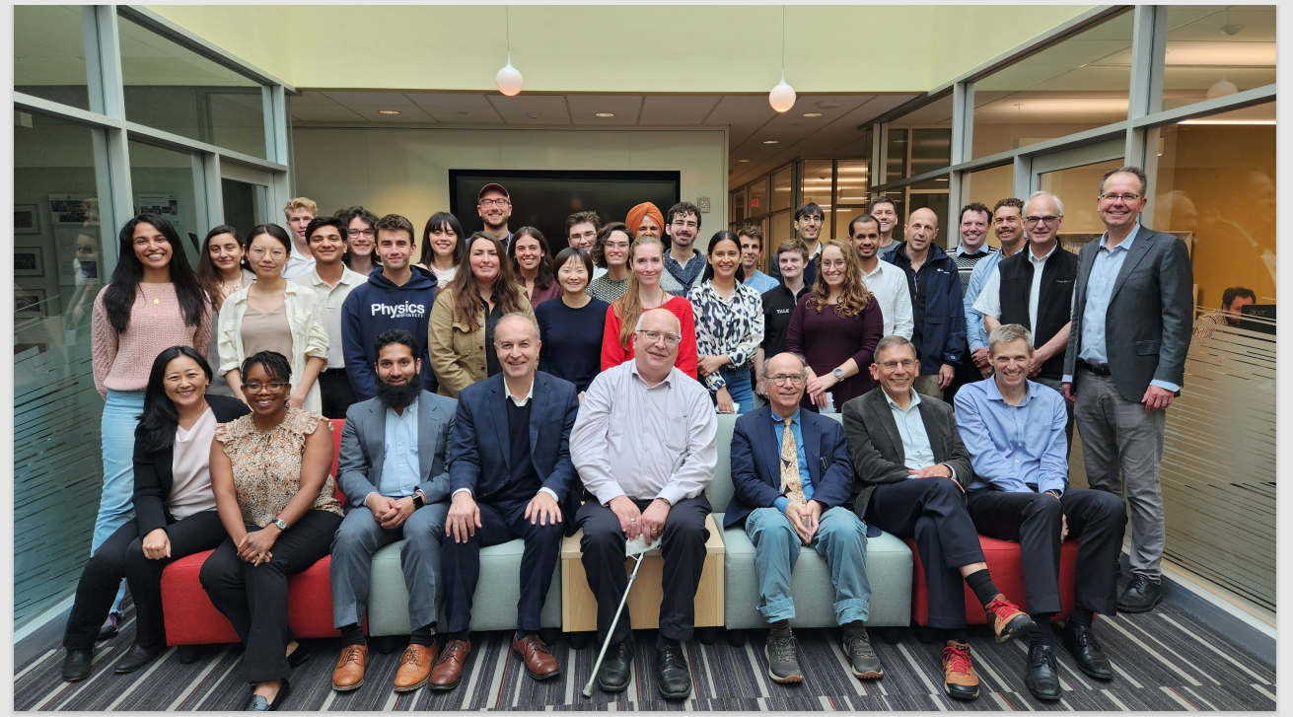
The ALPHA Collaboration
The ALPHA Collaboration meeting at Yale University, September 25-26, 2023
ALPHA White paper: Phys. Rev. D 107, 055013 (2023)

Slide 3
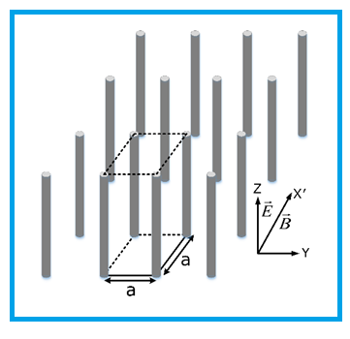
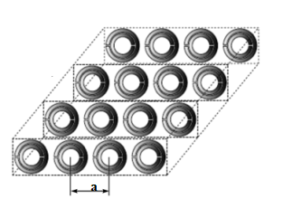
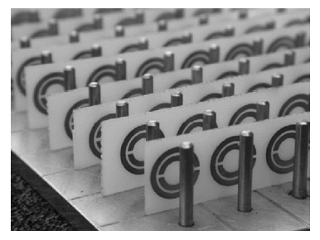
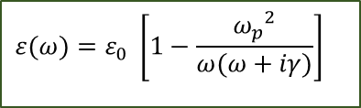
Metamaterial
Controlling ε and µ
Wire metamaterial
Negative ε
Negative µ
Negative ε and µ
$$ε(ω)=ε_{0} \left[1−\frac{{ω_{p}}^{2}}{ω(ω+iγ)}\right]$$
Tech. Phys. 58, 1-24 (2013)

Slide 4
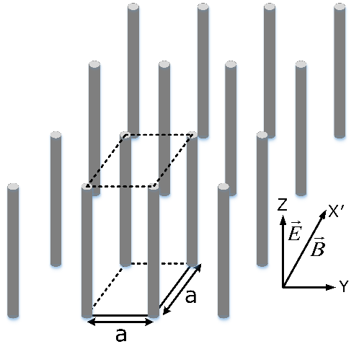
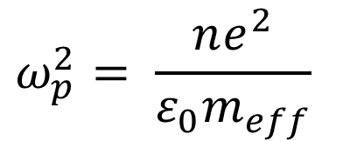
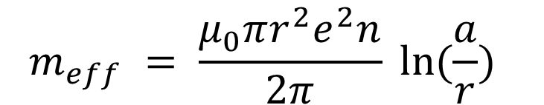
Wire Metamaterial: Controlling frequencies
  Plasma frequency depends entirely on lattice geometry
$$ω_{p}^{2}= \frac{ne^{2}}{ε_{0}m_{eff}}$$
$$m_{eff} = \frac{μ_{0}πr^{2}e^{2}n}{2π} ln⁡(\frac{a}{r})$$
Pendry et al.(1996) PhysRevLett.76.4773

Slide 5
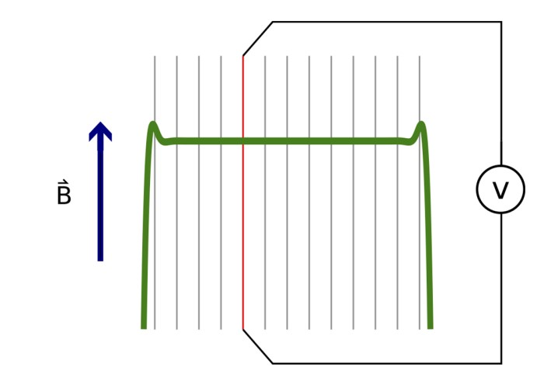
Motivation behind designs: Plasma Haloscope
Array of wires as effective medium
Axion detection with tunable cryogenic plasma
Axion mass matched to plasma frequency
Metamaterial based detector
Can in theory scan through a range of axion masses
Lawson et al. (2019), PRL

Slide 6
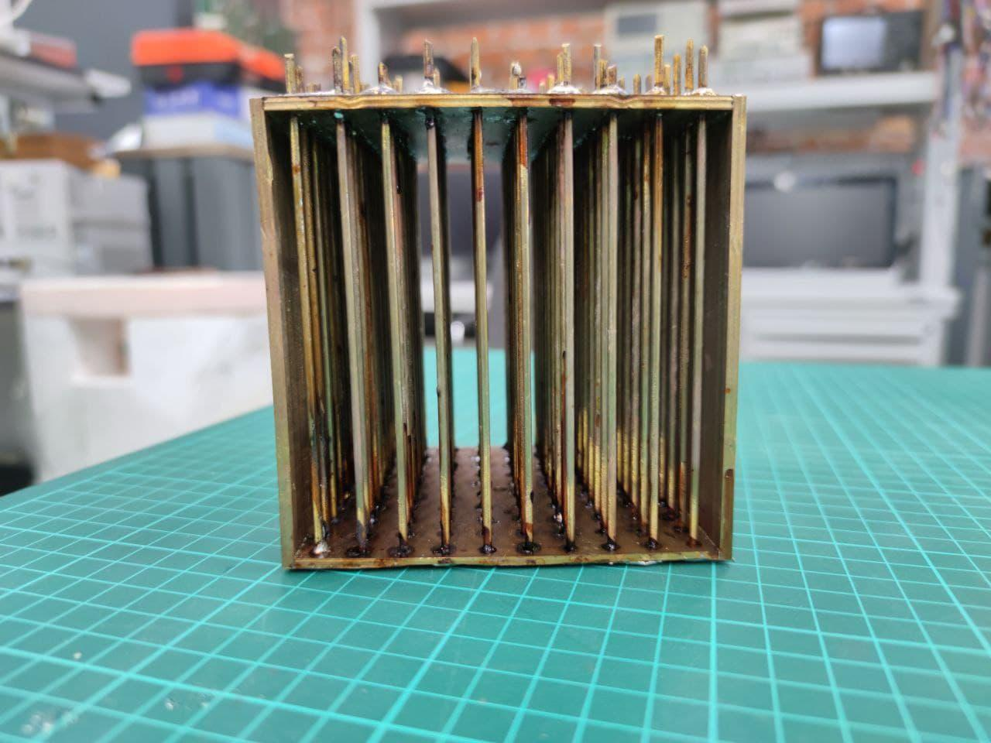
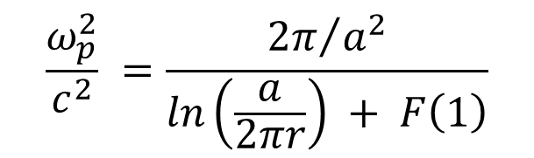
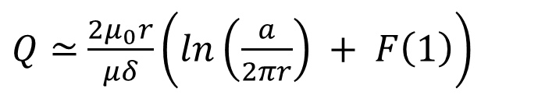
Motivation behind designs: WM filled resonator
$$\frac{ω_{p}^{2}}{c^{2}} =\frac{{2π}/{a^{2}}}{ln\left(\frac{a}{2πr}\right) + F\left(1\right)}$$
$Q≃$ $\frac{2μ_{0}r}{μδ}\left(ln\left(\frac{a}{2πr}\right) + F\left(1\right)\right)$
Wire radius = 1 mm, wire period = 10 mm, 10x10 array
Rustam et al. (2022), PRB

Slide 7
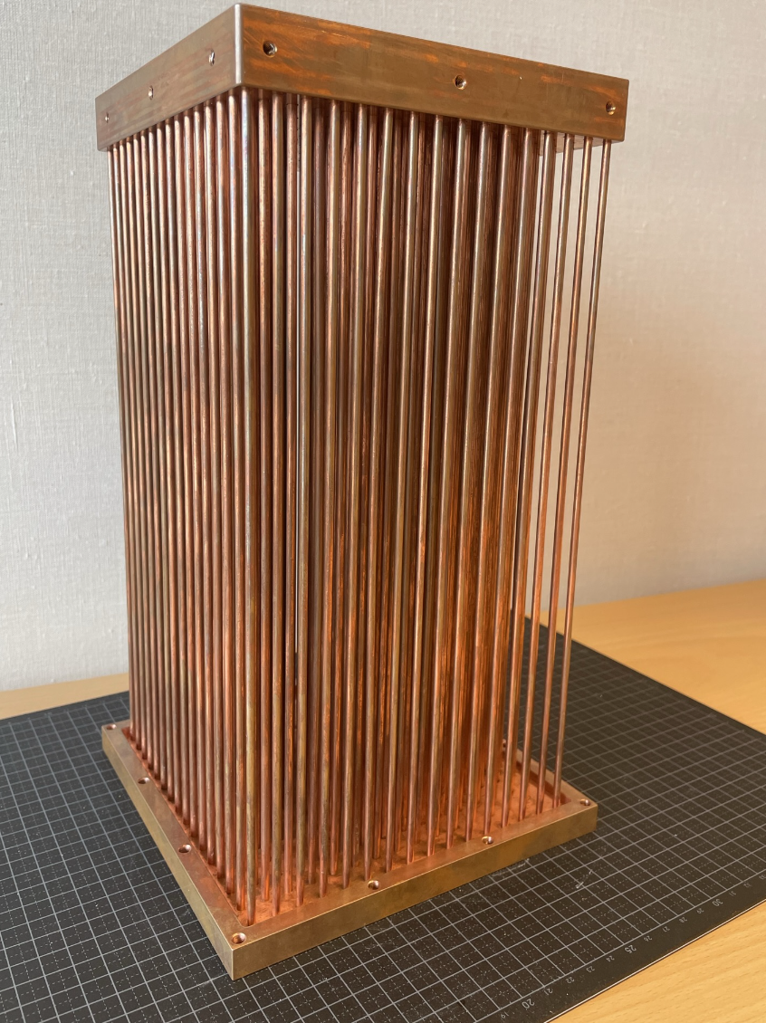
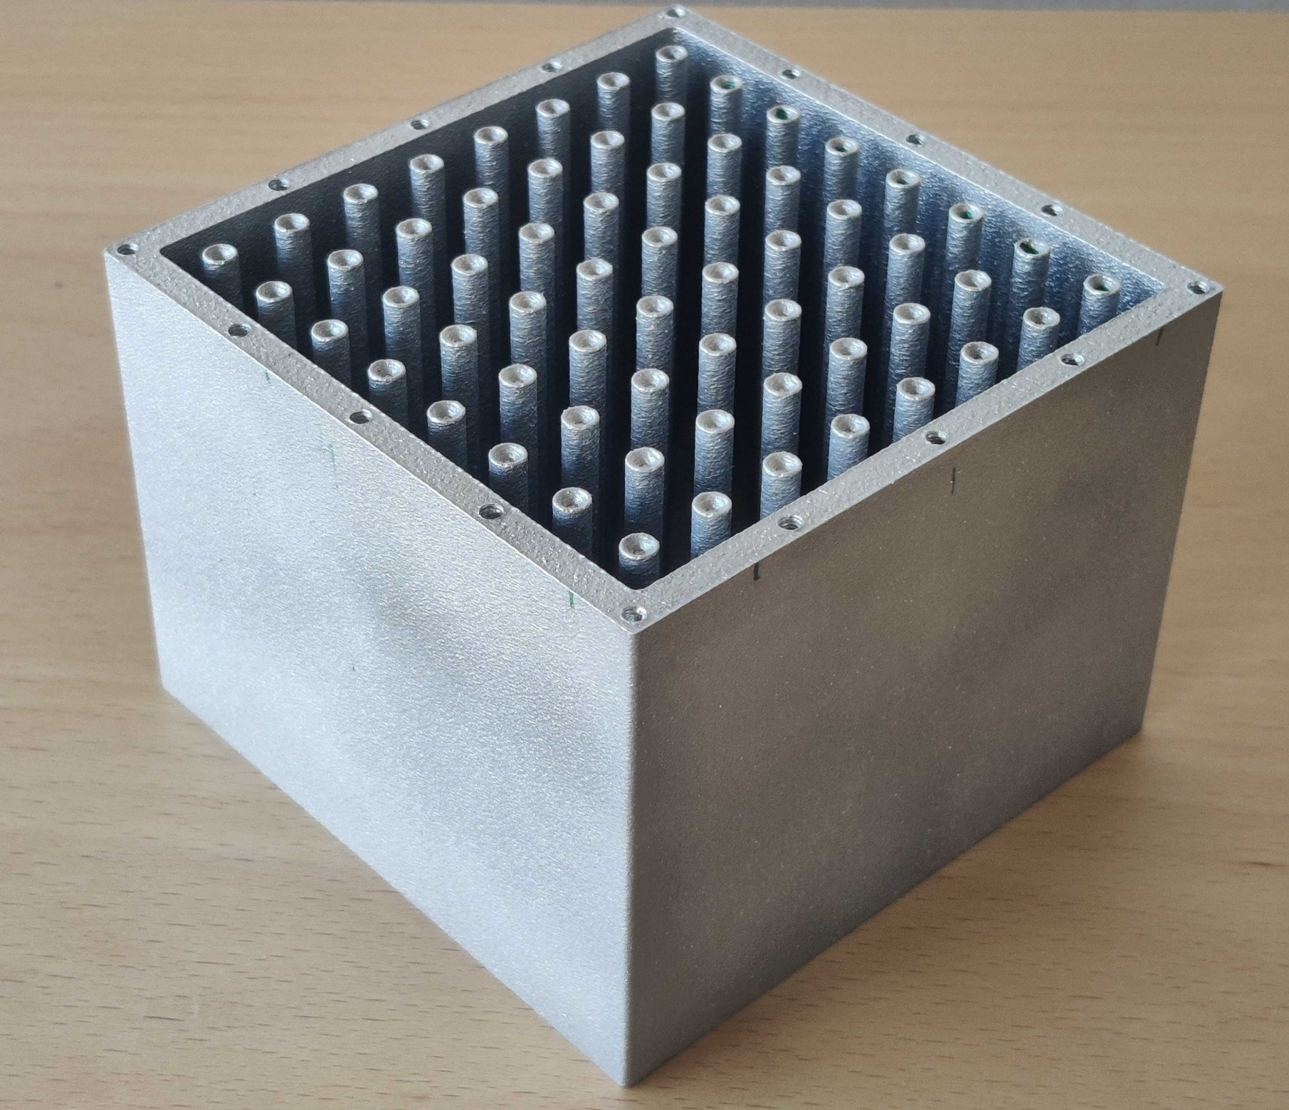
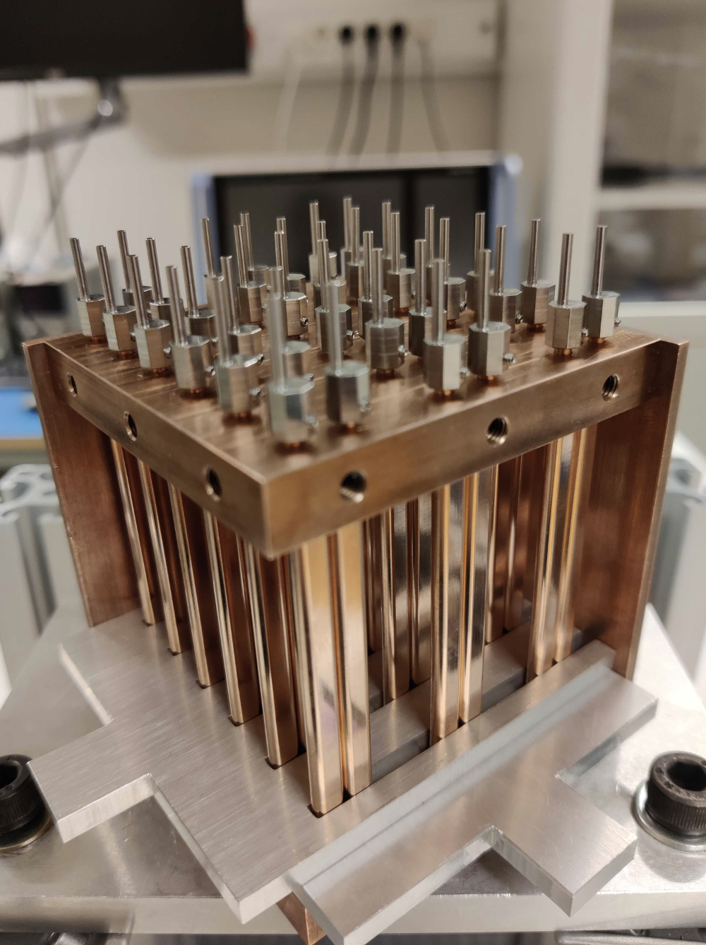
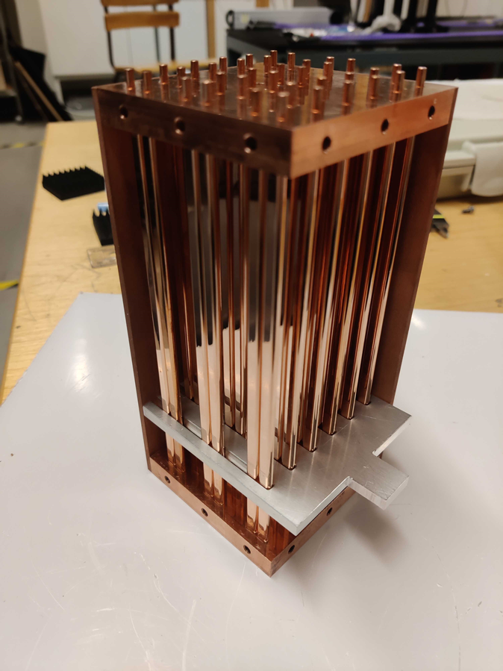
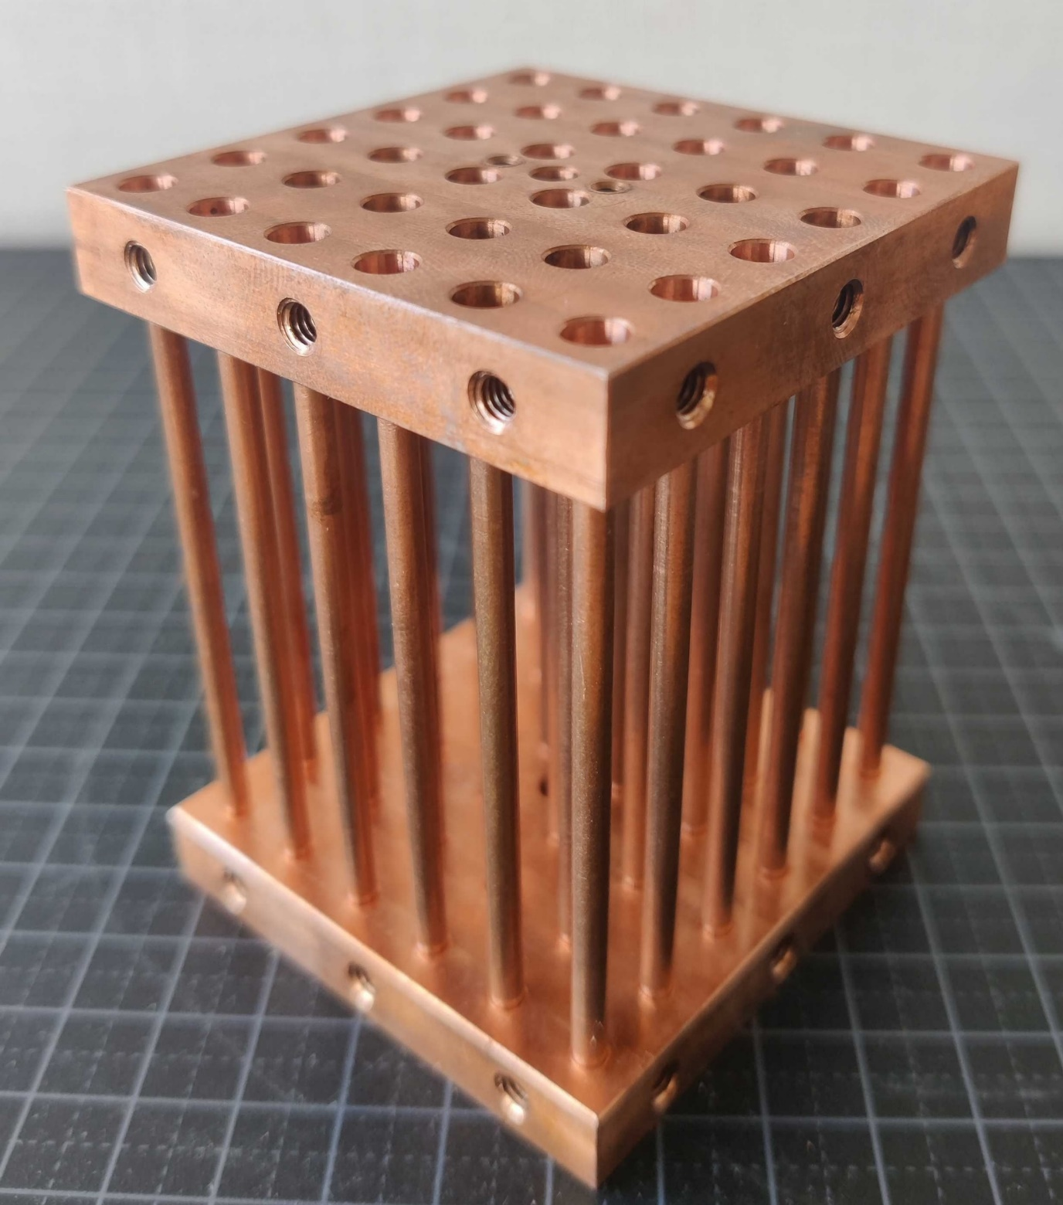
Metamaterial-inspired Resonator prototypes

Slide 8
Optimizing designs
Critical steps
Optimization parameters:
Losses
Coupling strength
Quality factor
Tuning range
1. 3D mechanical model
2. Run CST/COMSOL simulations
3. Get the design manufactured
4. Assemble resonator in lab
5. VNA measurements

Slide 9
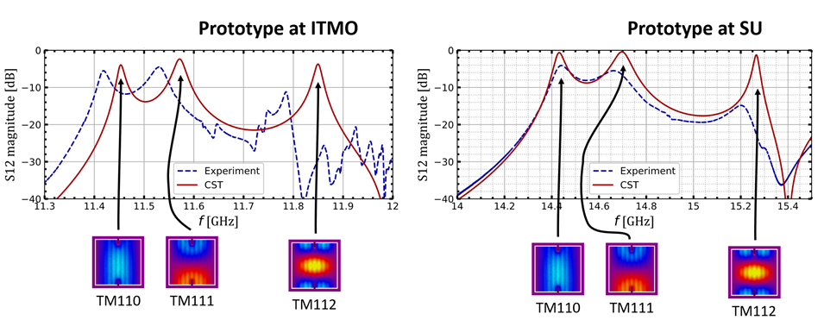
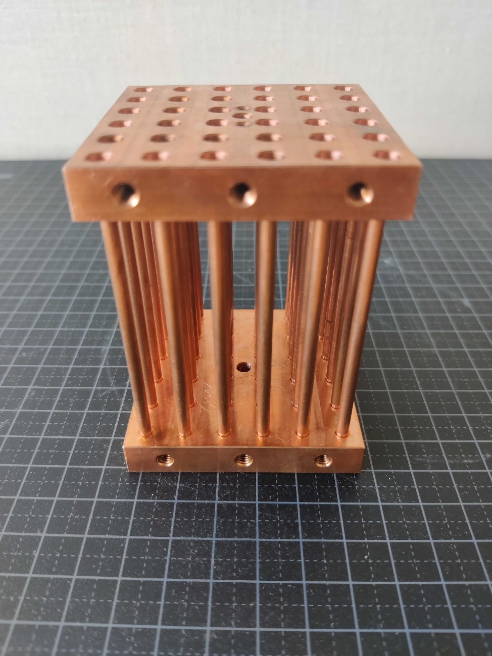
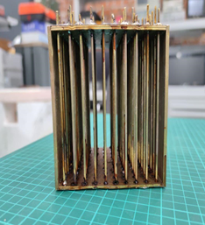
Static prototypes
Rod radius = 1 mm, Periodicity = 10 mm, 10x10 array
Rod radius = 1.5 mm, Periodicity = 10 mm, 6x6 array
Rustam et al. (2022), PRB

Slide 10
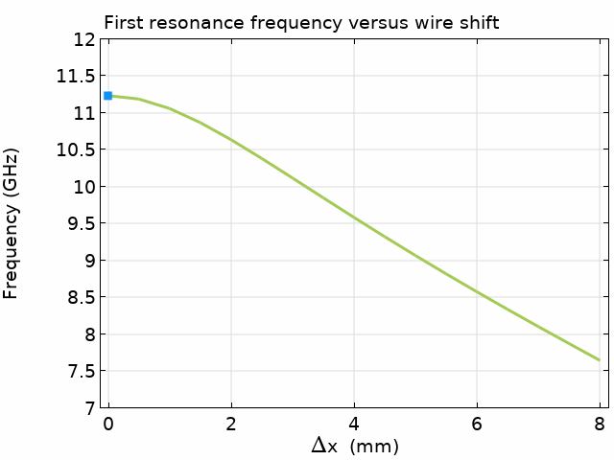
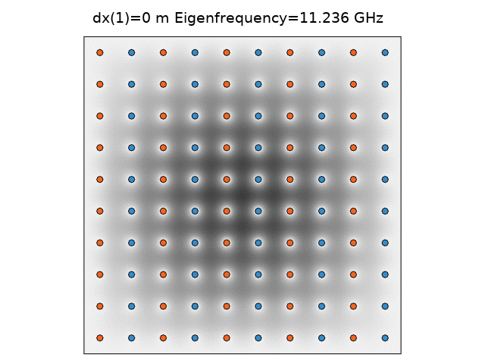

Tunable prototype: First tuning mechanism
Rustam Balafendiev
R&D at Stockholm University, guided by theory and simulations from the ITMO/St. Petersburg group (R. Balafendiev, P. Belov, M. Gorlach, et al.)

Slide 11
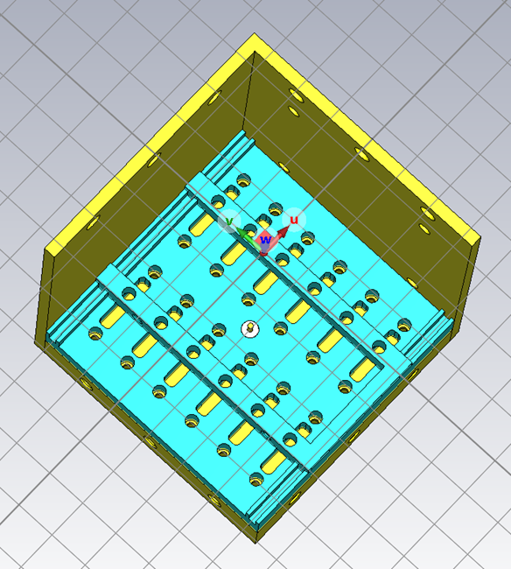
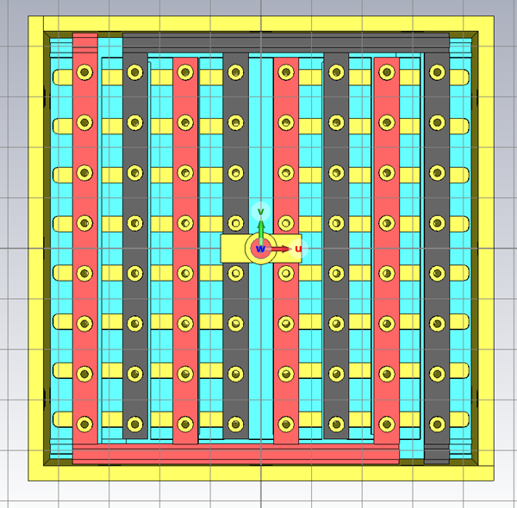
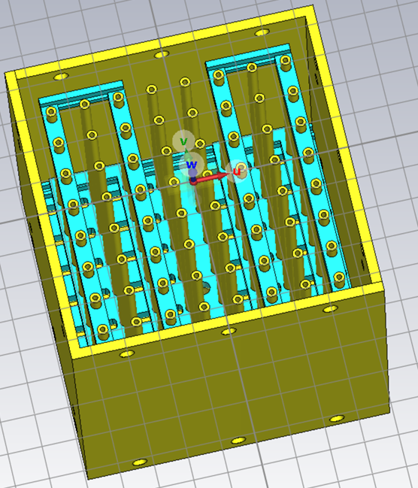
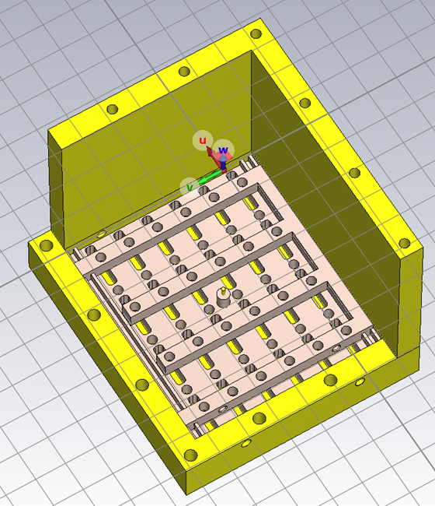
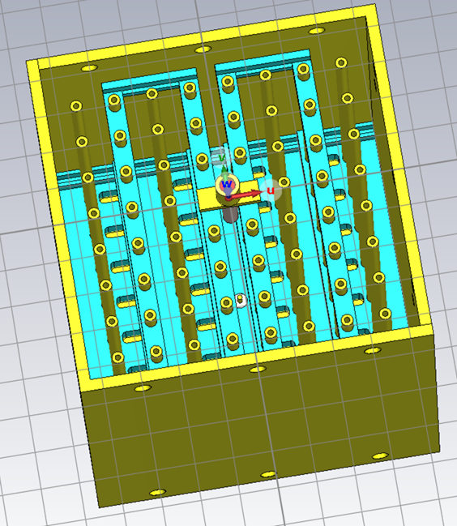
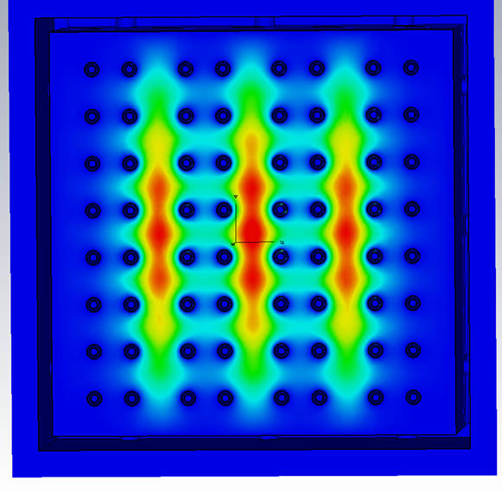
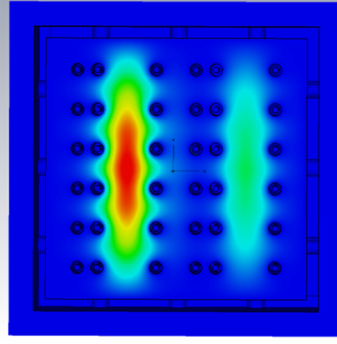
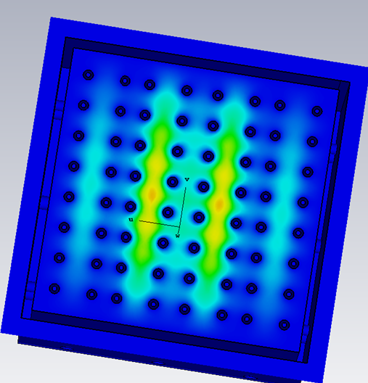
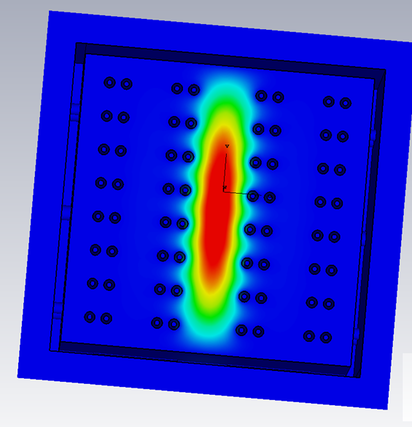
Translational design: Optimization
7X6 design
6X6 design
8X8 designs
Static design vs tunable:
Quality factor: ~4500 for
static
~1500 to 2500 for tunable
designs
Metal discontinuities causes mode mixing
Symmetry of design is critical for uniform field distribution

Slide 12
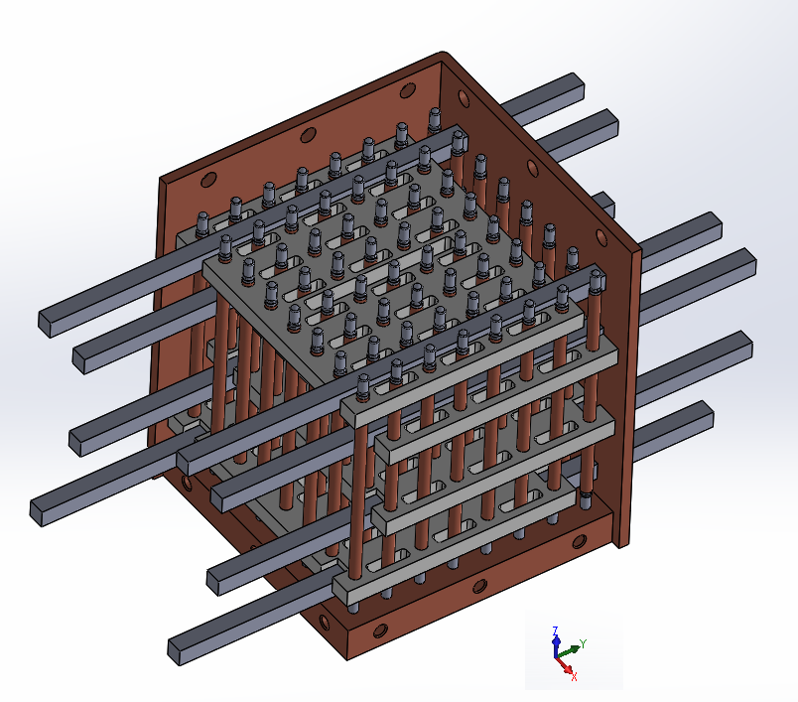
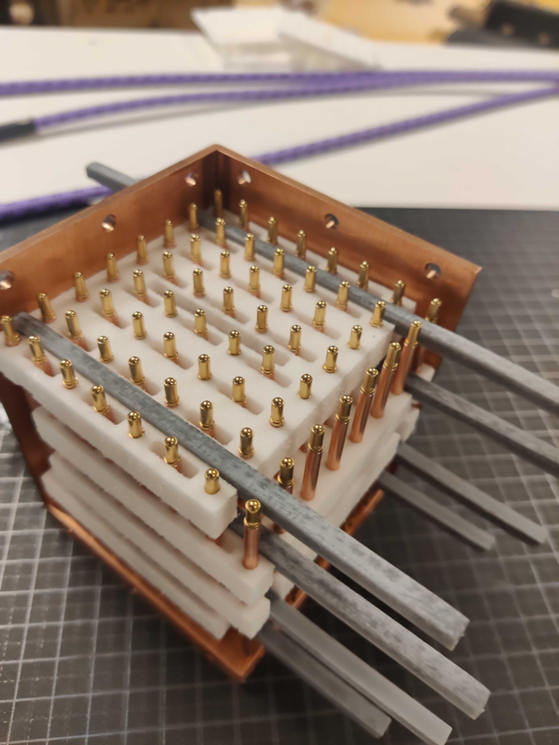
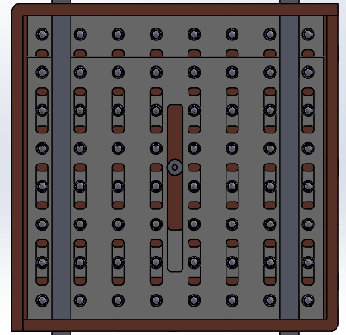
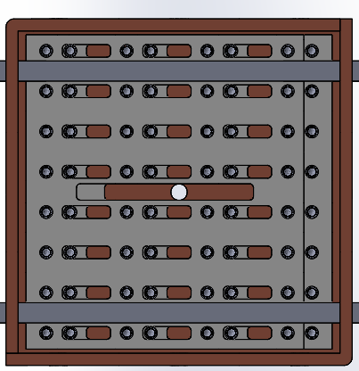
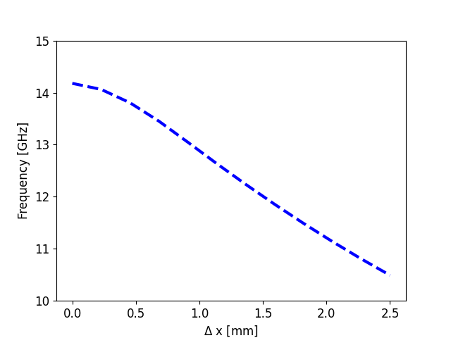
Translational prototype
Lateral translation of rods
Material of translational combs critical
Still modifying to improve connectivity and avoid mode mixing
Frequency of lowest resonant mode

Slide 13
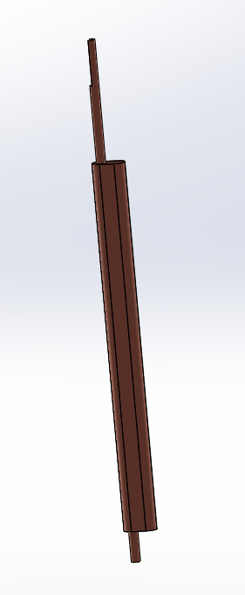
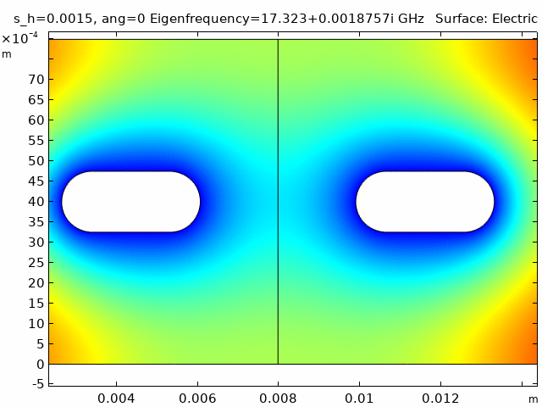
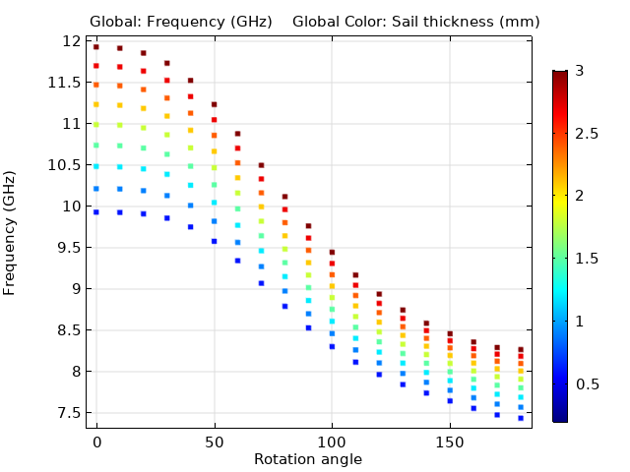
Rotational prototype: Design optimization
Tuning achieved by rotation of sail-type periodic element
Credit: Rustam Balafendiev

Slide 14
Rotational prototype
7.8cm X 7.8cm X 8cm
7.8cm X 7.8cm X 16cm
Sail-based, metamaterial-inspired resonator
Copper conductors on a rectangular lattice
Resonator dimensions:
Smaller: 7.8cm X 7.8cm X 8cm Larger: 7.8cm X 7.8cm X 16cm

Slide 15
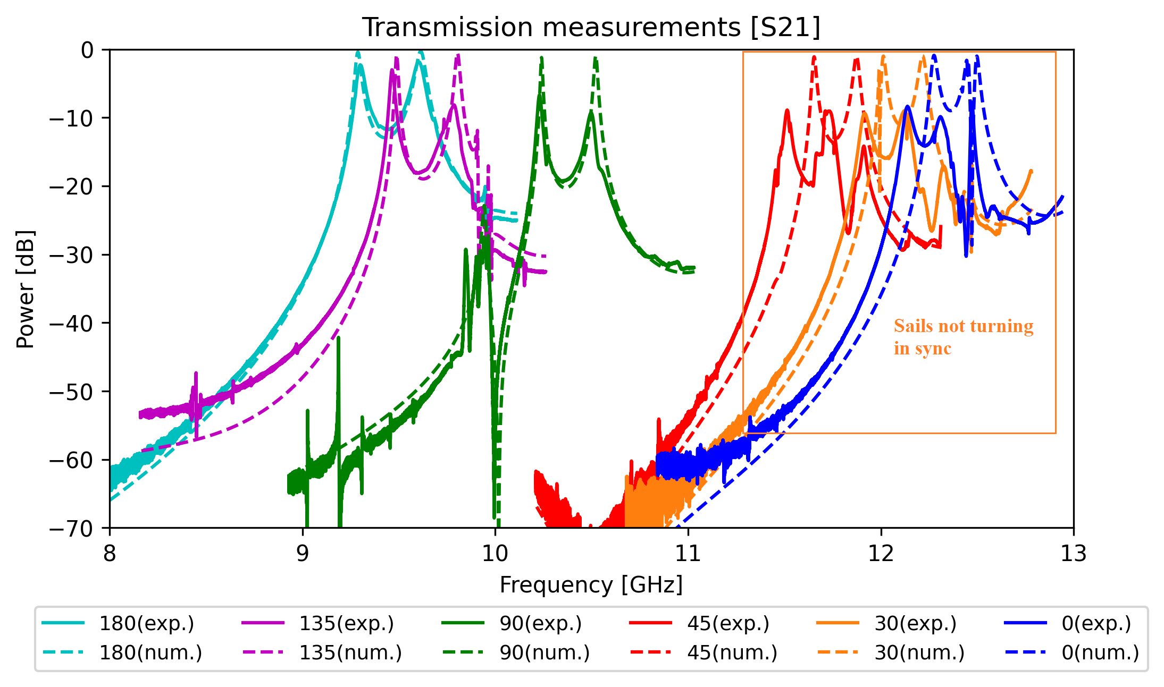
Transmission spectrum: Small prototype
7.8cm X 7.8cm X 8cm
Comparing experiment with simulations

Slide 16
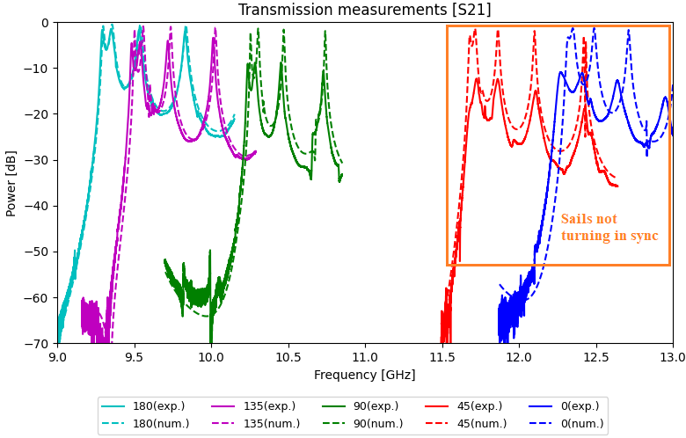
Transmission spectrum: Large prototype
7.8cm X 7.8cm X 16cm
Comparing experiment with simulations

Slide 17
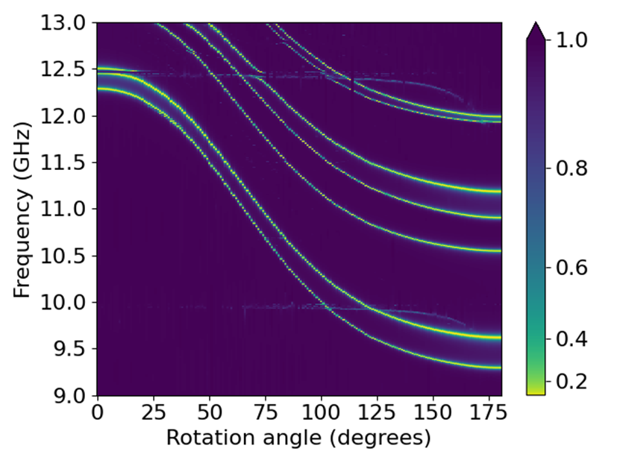
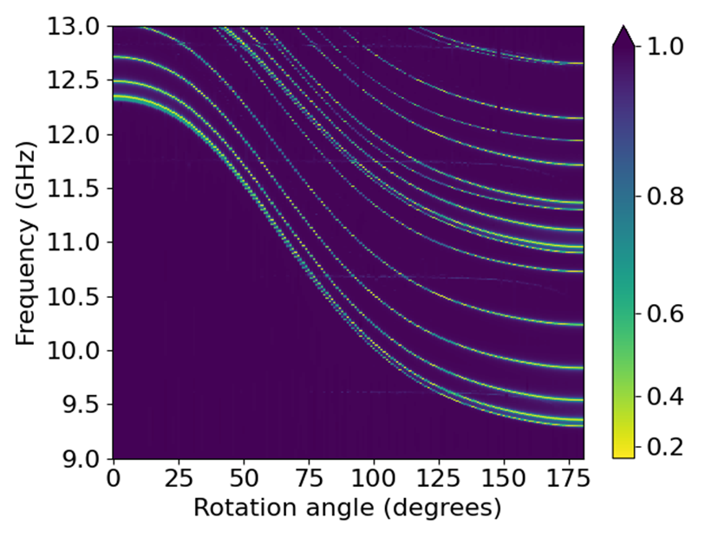
Mode map (3D CST sims)
7.8cm X 7.8cm X 8cm
7.8cm X 7.8cm X 16cm
TM 110 mode
TM 110 mode
TEM modes:
Small prototype: 10 GHz, 12.5 GHz
Large prototype: 9.64 GHz, 10.71 GHz, 11.78 GHz, 12.86 GHz

Slide 18
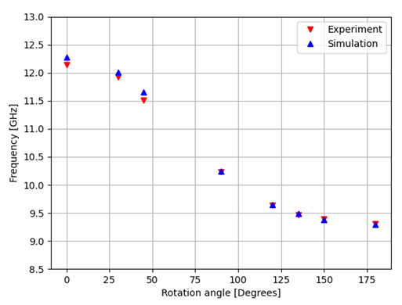
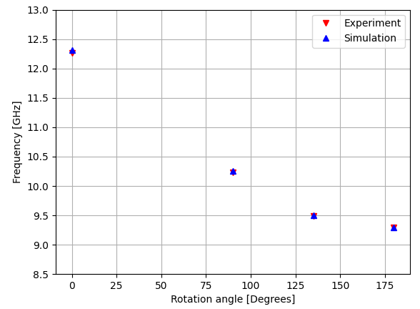
Tuning range
7.8cm X 7.8cm X 8cm
7.8cm X 7.8cm X 16cm
Good agreement between experiment and simulation for both
Demonstrate about 28% tuning range for both small and large systems

Slide 19
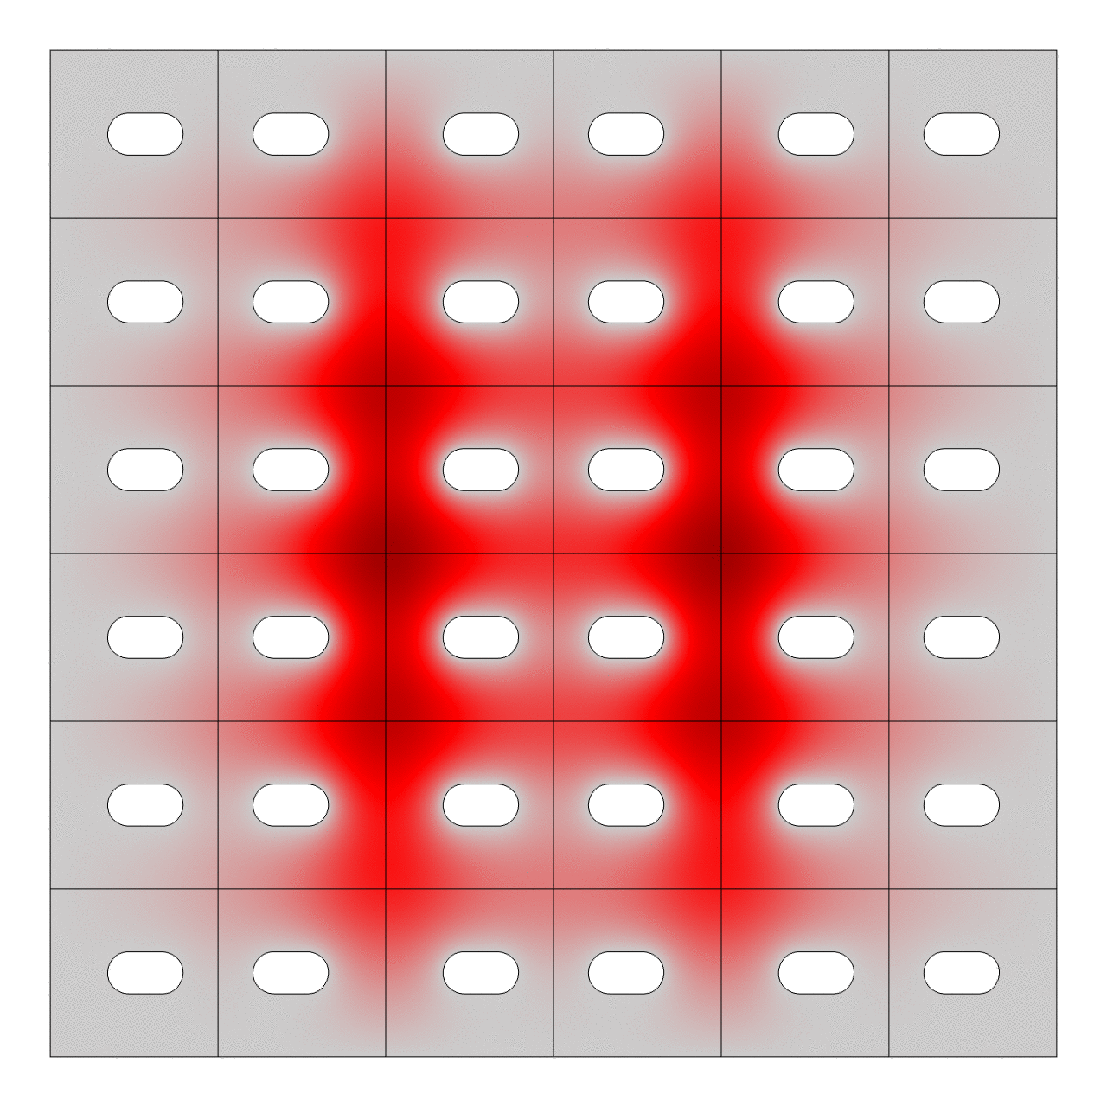
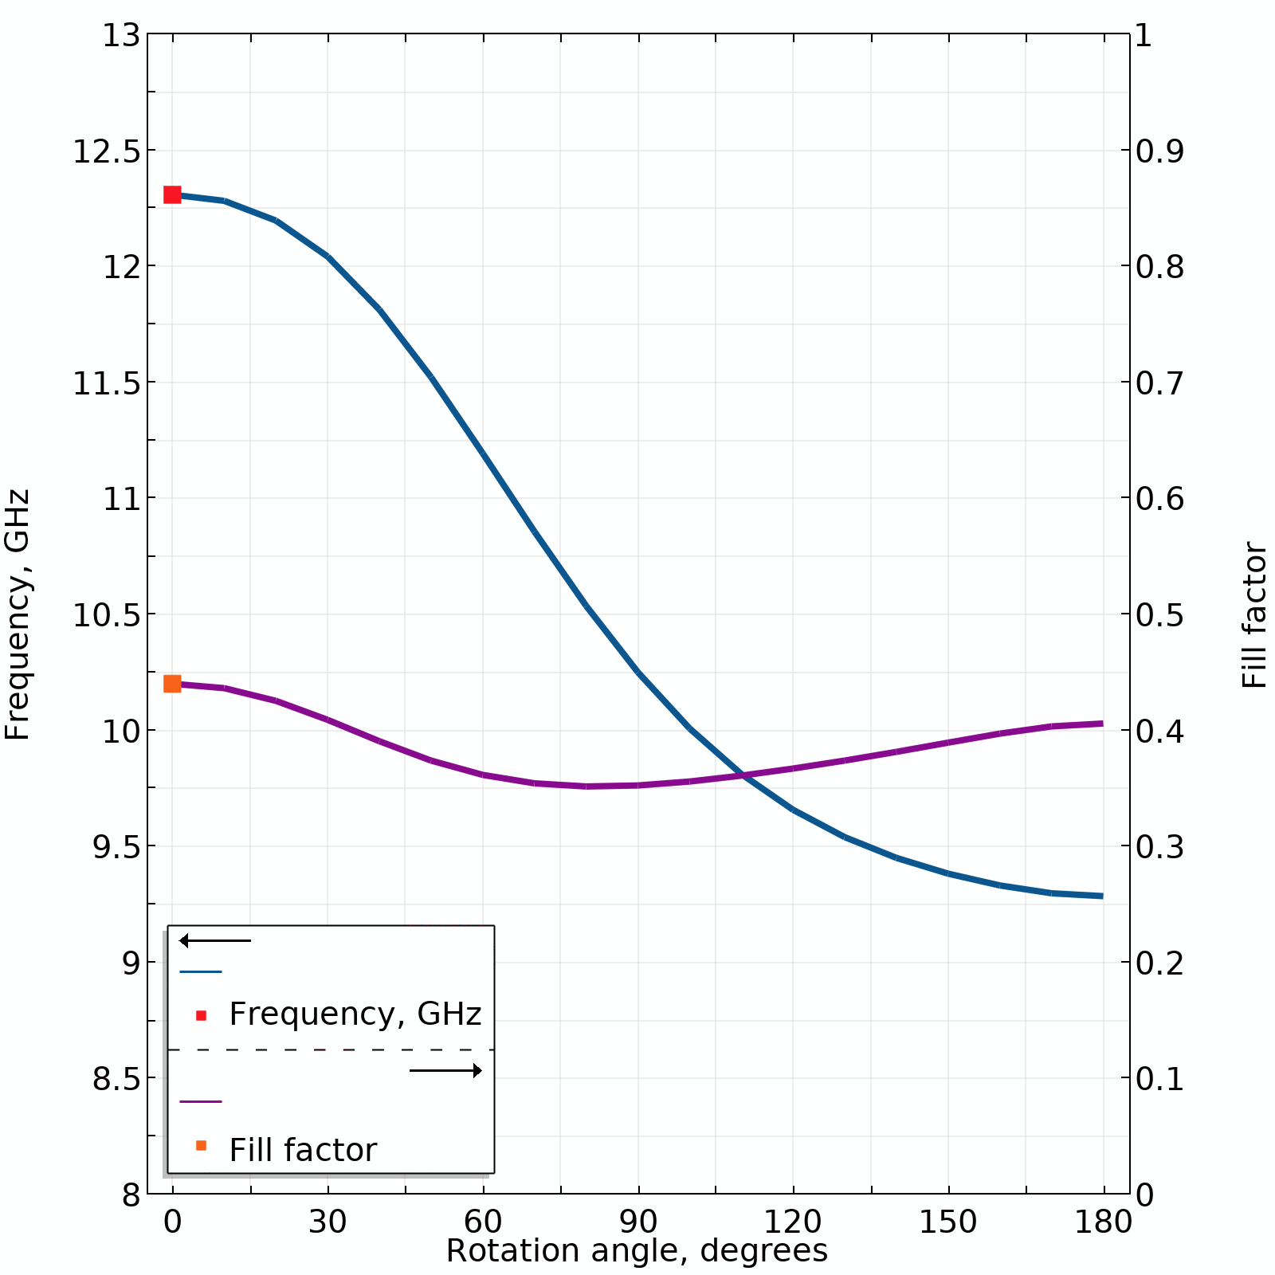
TM 110 mode
2D field profile of Ez calculated with COMSOL
Credit: Rustam Balafendiev

Slide 20
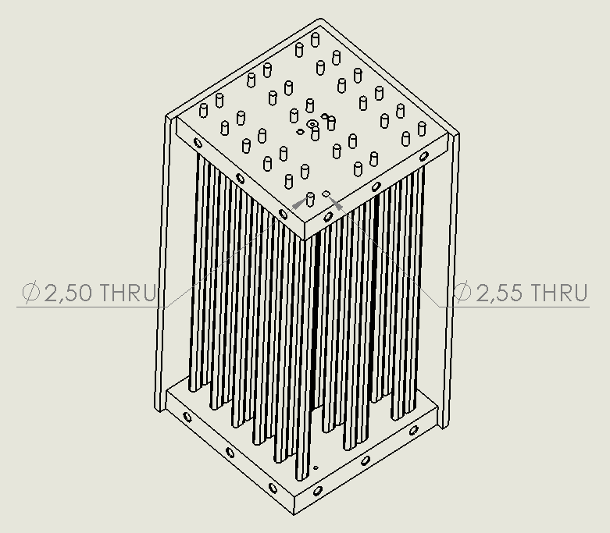
Optimization and Technical challenges
Critical interface: Oversizing of holes in outer plates
Rod diameter: 2.5mm
Size of holes in top plate: 2.55mm

Slide 21
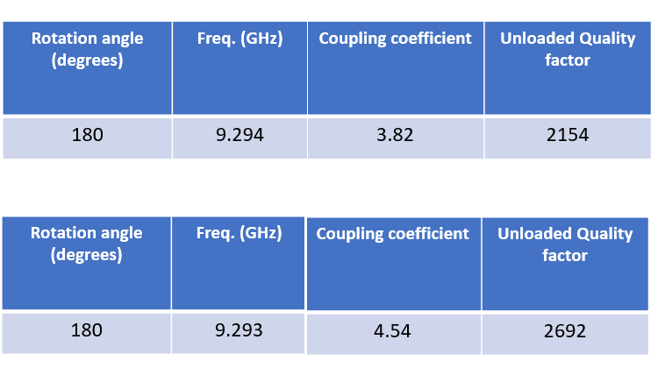
Optimization and Technical challenges
Oversizing between 50 um and 70 um
Critical interface: Oversizing of holes in outer plates
Striking a balance
Oversizing needed to facilitate rotational motion
Oversizing leads to radiation losses in copper plates
Oversizing between 30 um and 50 um

Slide 22
Conclusion
Current status
Testing 2 different approaches for mechanical tuning in resonator prototypes
Efficiently built and tested prototype based on rotational tuning (~9-13GHz)
Rotational prototype quite promising: tunability of about 28%
Future goals
Tuning at certain angles, working towards robust rotational tuning mechanism
Design modifications for covering wide frequency range 10-20 GHz
Cryogenic testing of the prototypes
Build static prototype with superconducting rods/sails

