Slide 1
Accelerator design and R&D efforts for Super Tau-Charm Facility
Jingyu Tang
On behalf of the STCF accelerator team
ICHEP 2024, July 17-24, 2024, Prague

Slide 2
Topics
Design goals of STCF
Current accelerator design scheme and key parameters
Key challenges in accelerator physics and technologies
Organization of the STCF accelerator study
Summary
Notes:
报告时间：12+3

Slide 3
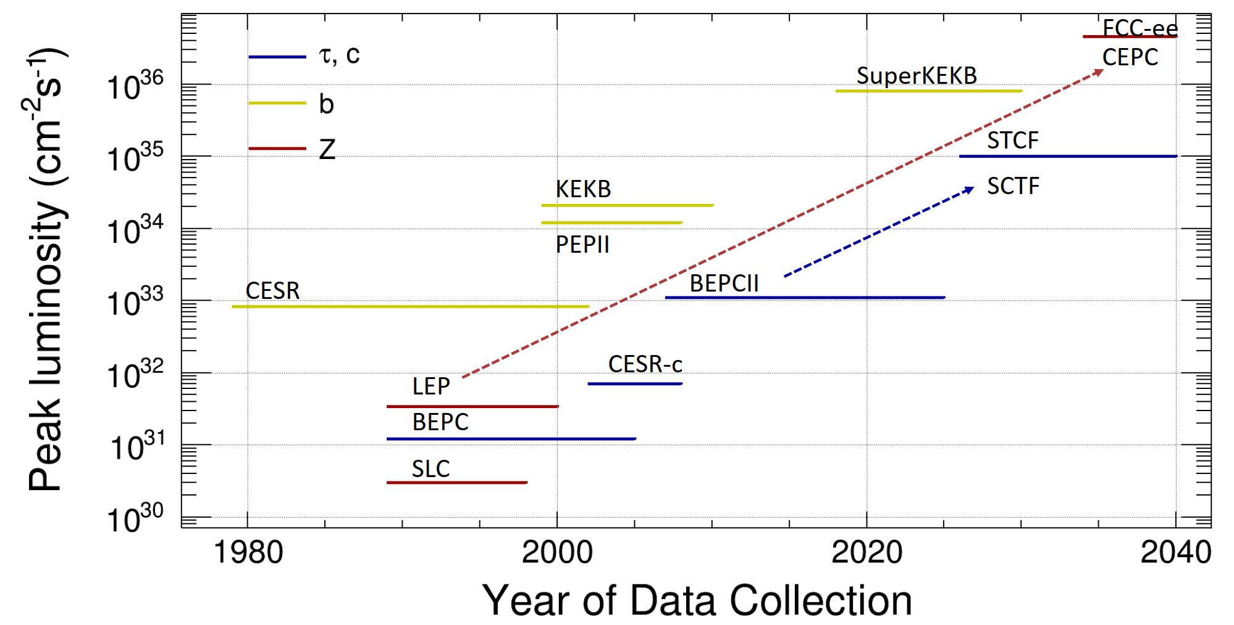
High-lumi e+/e- circular colliders
1st Generation
Single ring
2nd Generation
Double-ring
More bunches
Low β_{y}@IP
3rd Generation
Double-ring
Large Ib and crossing angle
Extremely low β_{y}@IP
Notes:
STCF is a national facility of global HEP strategy, an 𝑒+/𝑒− collider, dedicated to precision study of properties of charm-quark, tau-lepton, study of strong interactions, search of BSM physics

Slide 4
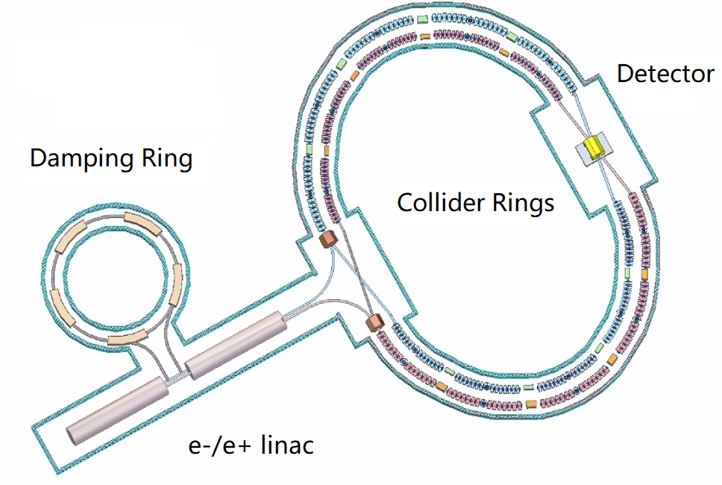
STCF Design Goals
Core design goal:
  CoM energy: 2-7 GeV
  Luminosity: >5×10³⁴ cm⁻²s⁻¹ @4GeV
  Upgrading potential: polarized beam, higher luminosity
Accelerator structure
  Double-ring collider:
  low emittance, high current, large Piwinski angle
  Injector: full-energy linac, e+ damping ring or accumulator, beam transport lines

Slide 5
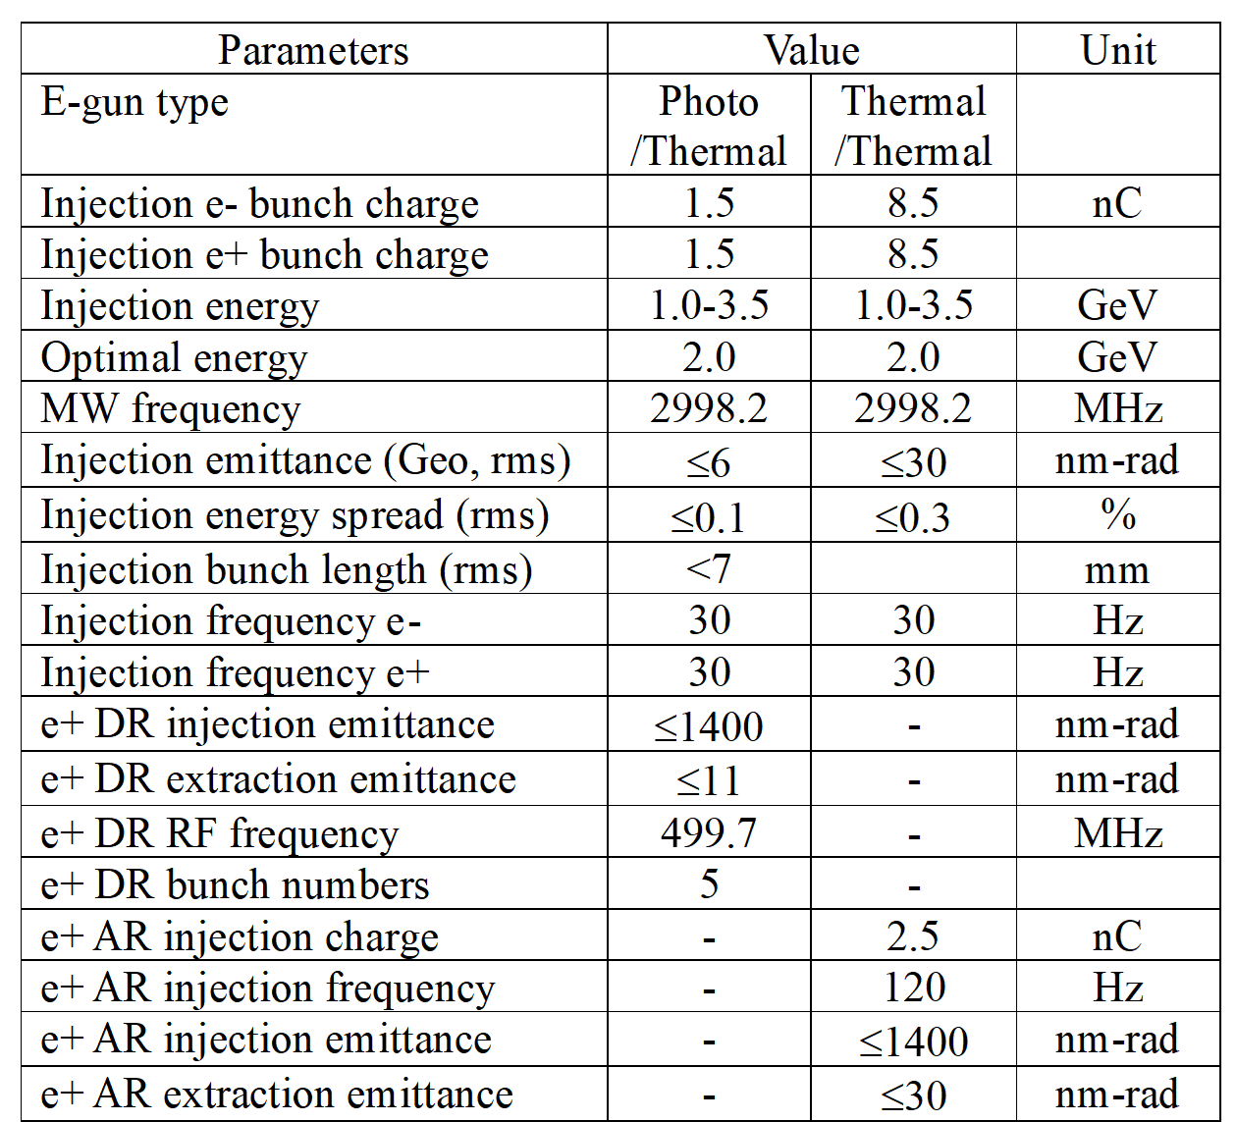
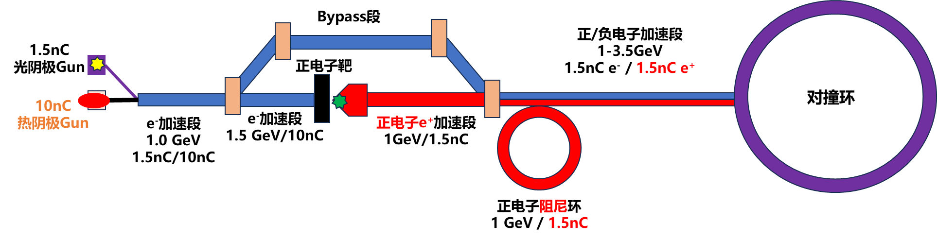
Current deign scheme and main parameters
Injector:
  Variable energy: 1-3.5 GeV
  High beam quality (emittance, energy spread)
  Two different CR injection: off-axis and swap-out
  Damping ring or accumulator ring for positrons @1 GeV
  Total length: ~400 m (+100 m beam transp.)

Slide 6
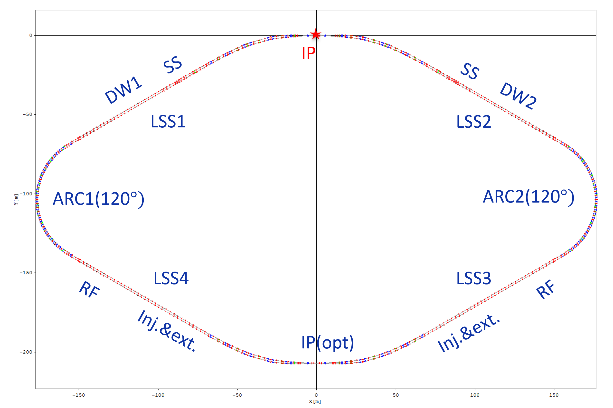
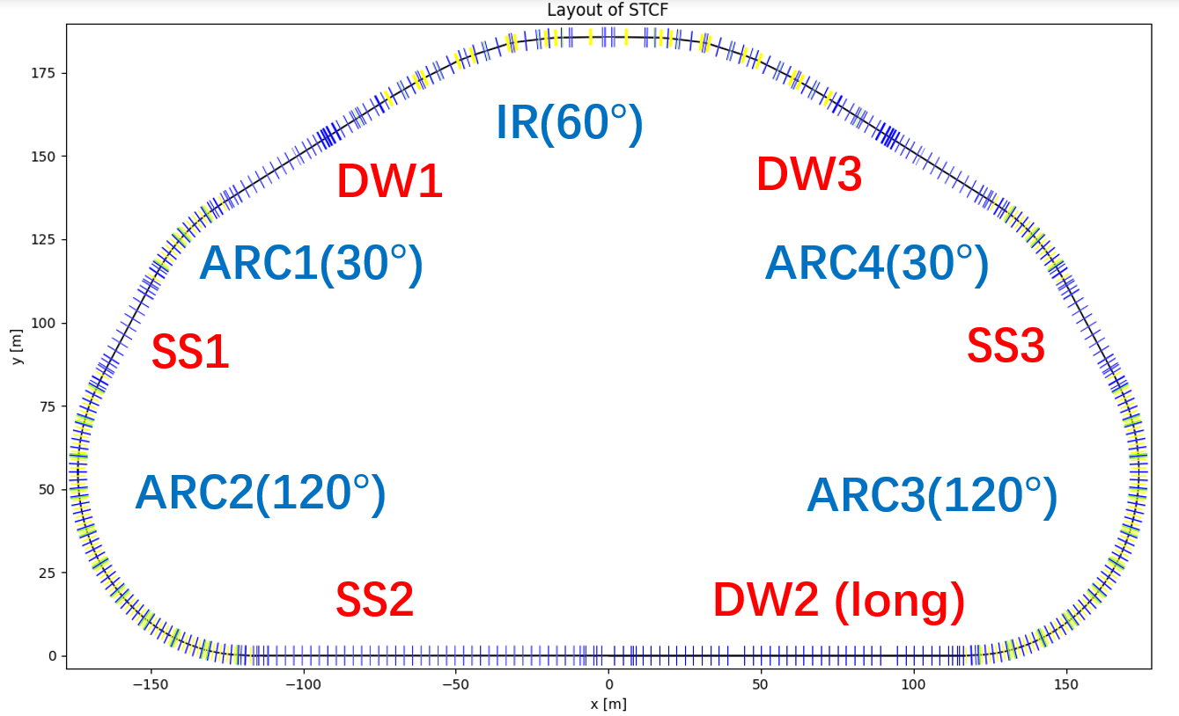
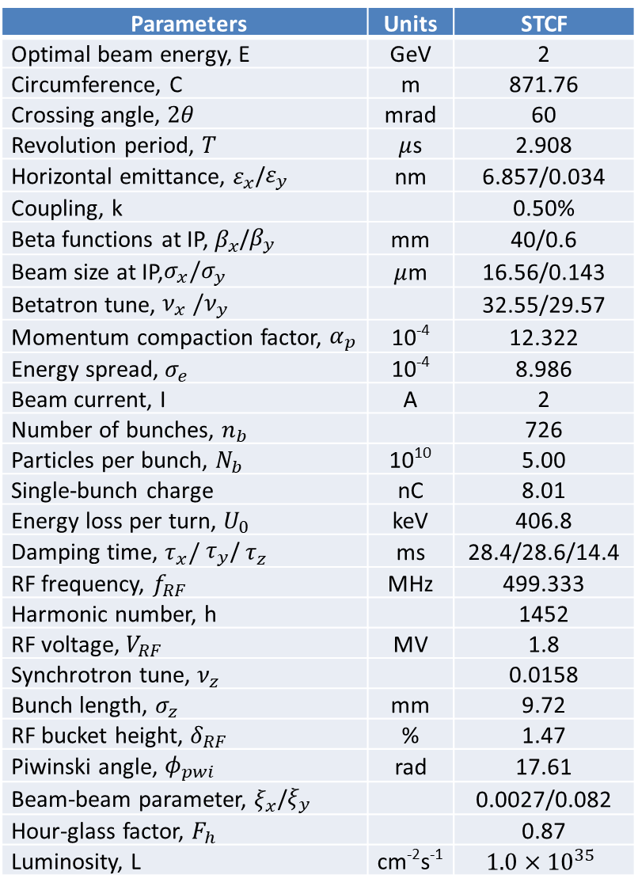
Collider rings:
  Injection energy: 1-3.5 GeV
  Optimal energy: 2 GeV
  Two injection schemes: off-axis, swap-out
Parameters | Units | STCF
Optimal beam energy, E | GeV | 2
Circumference, C | m | 871.76
Crossing angle, $2θ$ | mrad | 60
Revolution period, $T$ | $μ$s | 2.908
Horizontal emittance, $ε_{x}$/$ε_{y}$ | nm | 6.857/0.034
Coupling, k |  | 0.50%
Beta functions at IP, $β_{x}$/$β_{y}$ | mm | 40/0.6
Beam size at IP,$σ_{x}/σ_{y}$ | $μ$m | 16.56/0.143
Betatron tune, $ν_{x} /ν_{y}$ |  | 32.55/29.57
Momentum compaction factor, $α_{p}$ | 10⁻⁴ | 12.322
Energy spread, $σ_{e}$ | 10⁻⁴ | 8.986
Beam current, I | A | 2
Number of bunches, $n_{b}$ |  | 726
Particles per bunch, $N_{b}$ | 10¹⁰ | 5.00
Single-bunch charge | nC | 8.01
Energy loss per turn, $U_{0}$ | keV | 406.8
Damping time, $τ_{x}/$ $τ_{y}$/ $τ_{z}$ | ms | 28.4/28.6/14.4
RF frequency, $f_{RF}$ | MHz | 499.333
Harmonic number, h |  | 1452
RF voltage, $V_{RF}$ | MV | 1.8
Synchrotron tune, $ν_{z}$ |  | 0.0158
Bunch length, $σ_{z}$ | mm | 9.72
RF bucket height, $δ_{RF}$ | % | 1.47
Piwinski angle, $φ_{pwi}$ | rad | 17.61
Beam-beam parameter, $ξ_{x}$/$ξ_{y}$ |  | 0.0027/0.082
Hour-glass factor, $F_{h}$ |  | 0.87
Luminosity, L | cm⁻²s⁻¹ | $$1.0×{10}^{35}$$
2-fold lattice
1-IP lattice

Slide 7
Key challenges in accelerator physics and technologies

Slide 8
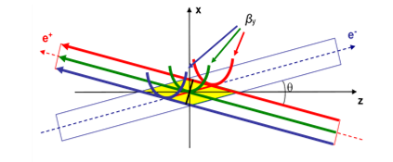
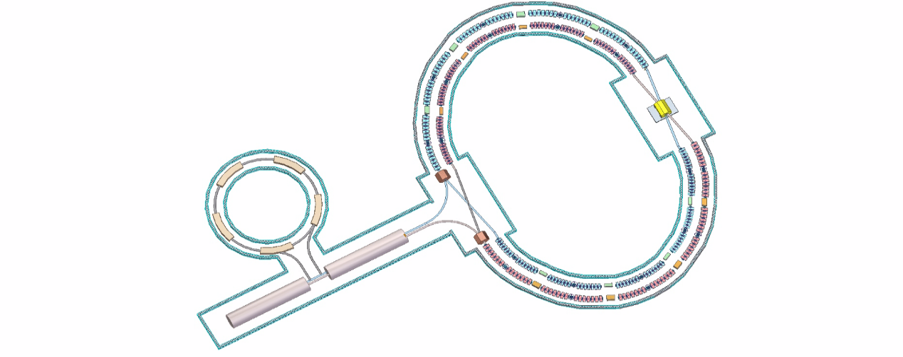
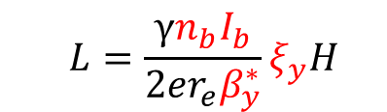
Key challenges on AP and technologies
Design goal: Super-high lumi., high-quality (high-current, low emittance) e+/e- beams collision (extremely low β*), stable operation
Great challenges: IR strong nonlinearity and collective effects; IR superconducting magnets
Collider Ring and IR AP design:
IP beam size (Y) nm scale, Crab-Waist, nonlinear compensation extremely difficult
IR Technologies:
SC magnets, MDI
  $$L=\frac{γn_{b}I_{b}}{2er_{e}β_{y}^{∗}}ξ_{y}H$$
Injection into CR (small DA): high I_{b} and low ε e+/e- sources
Other key technologies:
Ring RF, beam instrum. and control, beam injection…
Big Piwinski angle + Crab Waist

Slide 9
Key challenges on AP and technologies
No | Key design or tech | Prio. | Comments
1 | Collider ring AP design | A+ | Espec. IR, key to realize high-lumi
2 | IR SC magnets | A+ | Complex structure, high-field, tight space, less exp.
3 | Collider ring RF | A+ | High-power, deep-damped HOM, less exp.
4 | Injector AP design | A | Prov. high-qual. beams to CR, 2 injection schemes
5 | MDI | A | Very tight space and complex mech. (acc. and det.)
6 | Collider beam instrum. | A | High-prec. and fast bunch meas., fast feedbacks
7 | Collider ring injection | A | ns-scale kickers for bunch swap-out injection
8 | Positron source | A | Low e- energy to generate e+ beam
9 | Collider ring vacuum | A- | High-current circ. beams, ultra-high vacuum for IR
10 | Electron source | A- | High-bunch charge photocathode e-gun
11 | Linac microwave | A- | Large-aper. S-band acc. struct., less exp, LLRF
12 | Linac power source | A- | High-power solid-state modulator

Slide 10
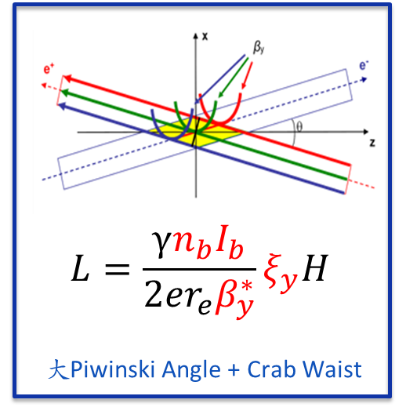
Key challenges (1) – CR AP design
A new-generation e+/e- collider
  How to attain two-order lumi. gain over the last-generation collider (BEPC-II)?
IR physics design
  The key and challenge for STCF accelerator
  New collision scheme: beam param (I_{b}, ε_{x} ; nm spot at IP), crossing angle, correlation with the B-B effect [Luminosity need]
  Special optics: Final Focus + Crab Waist (Telescope-Mini β, dispersion, phase advance) [Complexity]
  Strong nonlinearity: Local CC for extreme-low β, fringe-field, crab sextupoles ➔ very small DA and MA [very short beam lifetime]
  Complex MDI: SC magnets, vacuum, cryostat, beam monitors, interface with detector [Iterations]
➔Take advantage of a new machine, lessons from SuperKEKB ➔ better design

Slide 11
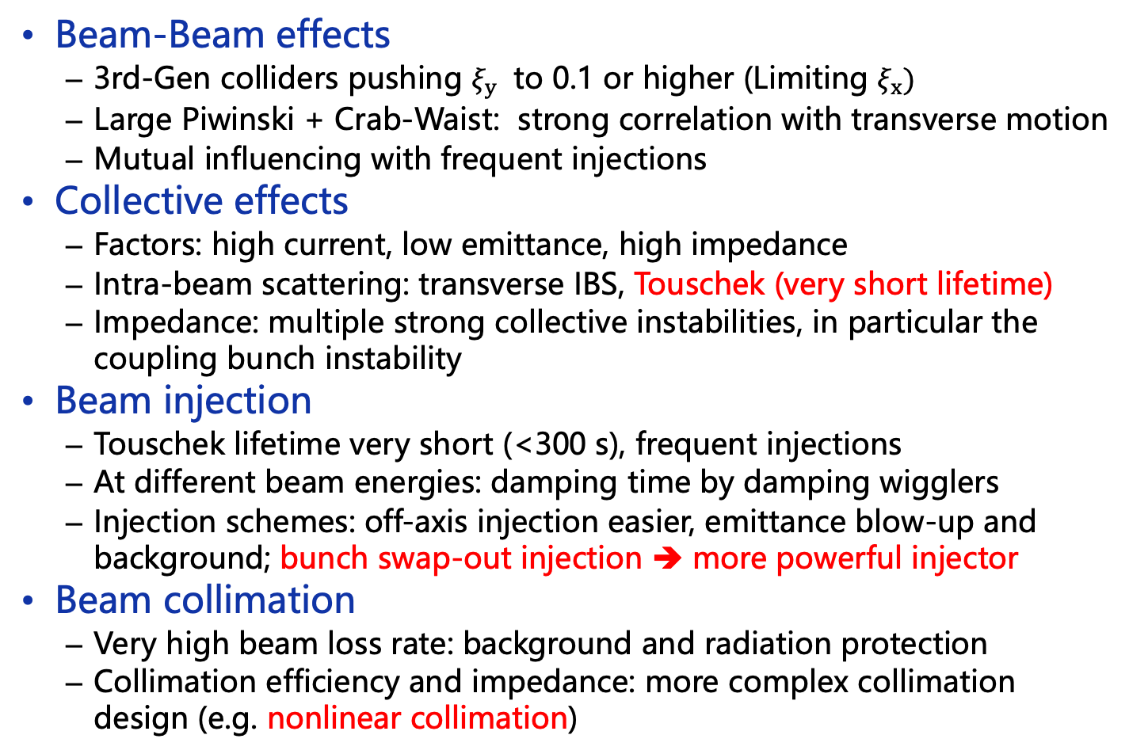
Other key problems in CR AP design
Beam-Beam effects
  3rd-Gen colliders pushing $ξ_{y}$ to 0.1 or higher (Limiting $ξ_{x})$
  Large Piwinski + Crab-Waist: strong correlation with transverse motion
  Mutual influencing with frequent injections
Collective effects
  Factors: high current, low emittance, high impedance
  Intra-beam scattering: transverse IBS, Touschek (very short lifetime)
  Impedance: multiple strong collective instabilities, in particular the coupling bunch instability
Beam injection
  Touschek lifetime very short (<300 s), frequent injections
  At different beam energies: damping time by damping wigglers
  Injection schemes: off-axis injection easier, emittance blow-up and background; bunch swap-out injection ➔ more powerful injector
Beam collimation
  Very high beam loss rate: background and radiation protection
  Collimation efficiency and impedance: more complex collimation design (e.g. nonlinear collimation)

Slide 12
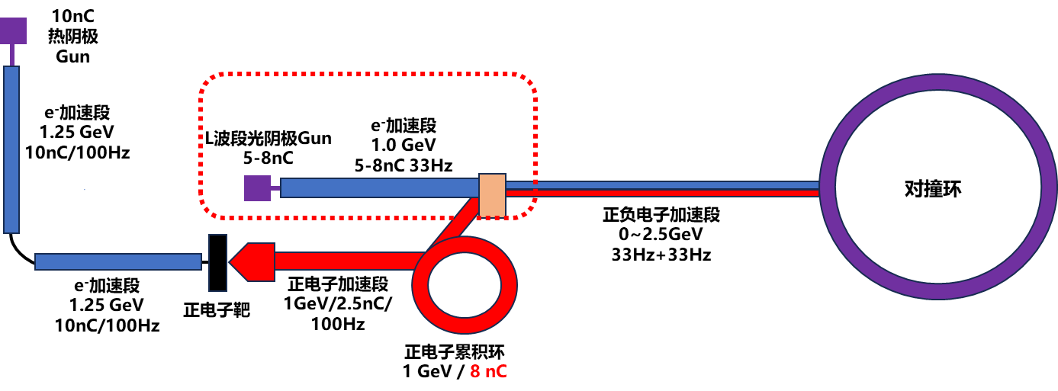
Key challenges (2) – Injector AP design
Injector providing e+/e- beams to CR
  Quality: energy spread, bunch charge, emittance, stability
  High frequency injections (~30 Hz)
  Large energy range: 1-3.5 GeV, ε <20 nm
  High current: 1.5 nC (off-axis); 8-10 nC (swap)
➔Better design:
A new machine, utilizing design and technology from FEL and 4G light source linacs.
Off-axis injection
Swap-out injection

Slide 13
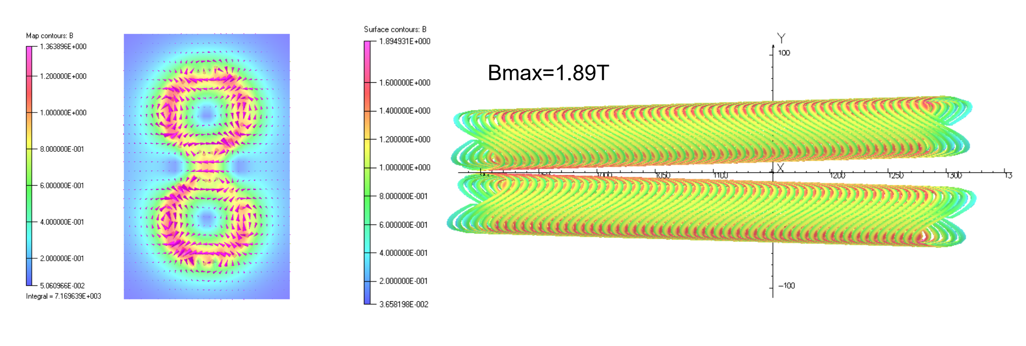
Key challenges (3) – IR SC magnets
IR SC magnets
  Technically very challenging, very few labs have experience
  Very tight space, complex and combined coils
  3rd-Gen e+/e- colliders even more difficult: twin-aperture, higher field gradient (~50 T/m)
  In China: IHEP built the first IR magnet for BEPC-II; some experience in other SC magnets
  STCF R&D: developing prototypes by steps, different technologies under consider. (BEPCII serpentine, CCT, cos2θ/DCT)
A CCT type prototype just started
(60 mrad, 54 mm separation, 50 T/m)
IHEP BEPCII-U (Serpentine)

Slide 14
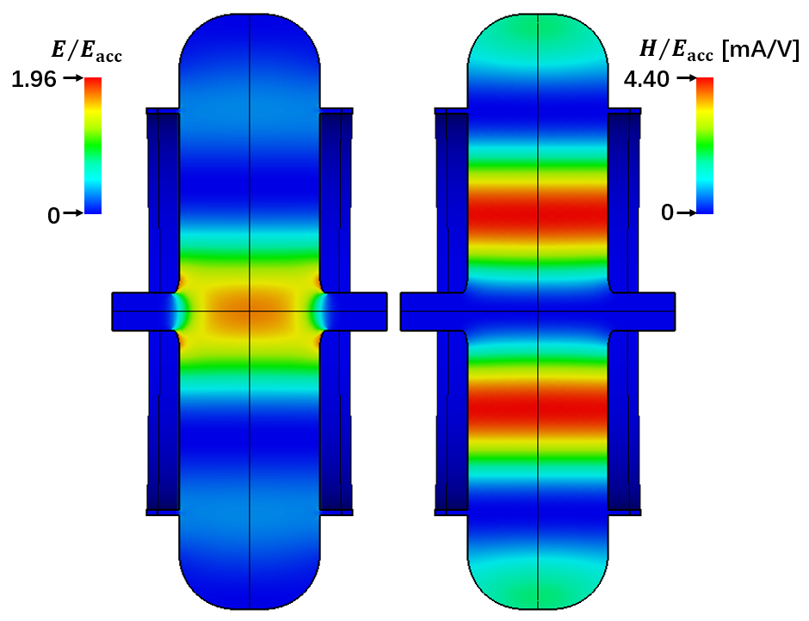
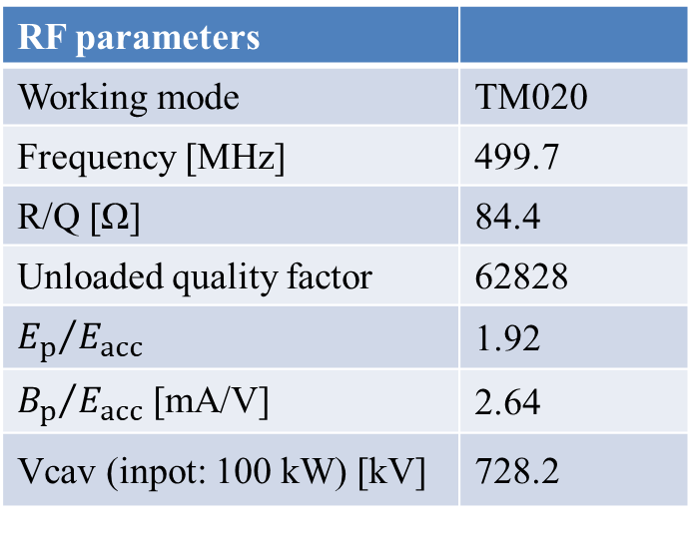
Key challenges (4) – Ring RF
RF for Collider rings
  High synchrotron radiation (2 Amperes): RF power and couplers
  HOM deep-damped: instabilities
  Large energy range (1-3.5 GeV): high V_{RF}
  Beam loading: at bunch swap-out injection
  Stability: more powerful LLRF
  Selected for R&D: TM020 RT cavity, 500 MHz; 200 kW coupler
RF parameters
Working mode | TM020
Frequency [MHz] | 499.7
R/Q [Ω] | 84.4
Unloaded quality factor | 62828
$${E_{p}}/{E_{acc}}$$ | 1.92
${B_{p}}/{E_{acc}}$ [mA/V] | 2.64
Vcav (inpot: 100 kW) [kV] | 728.2
TM020 cavity in prototyping

Slide 15
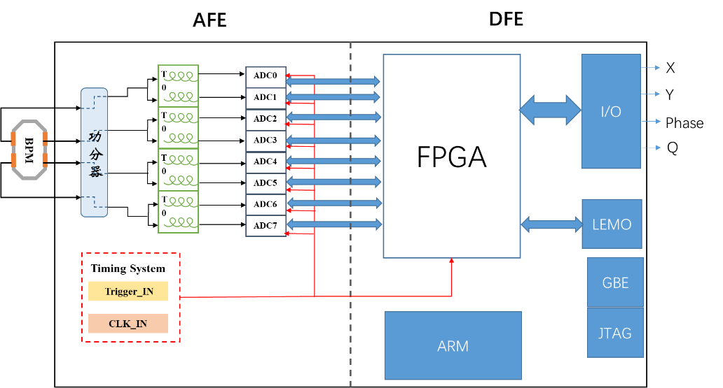
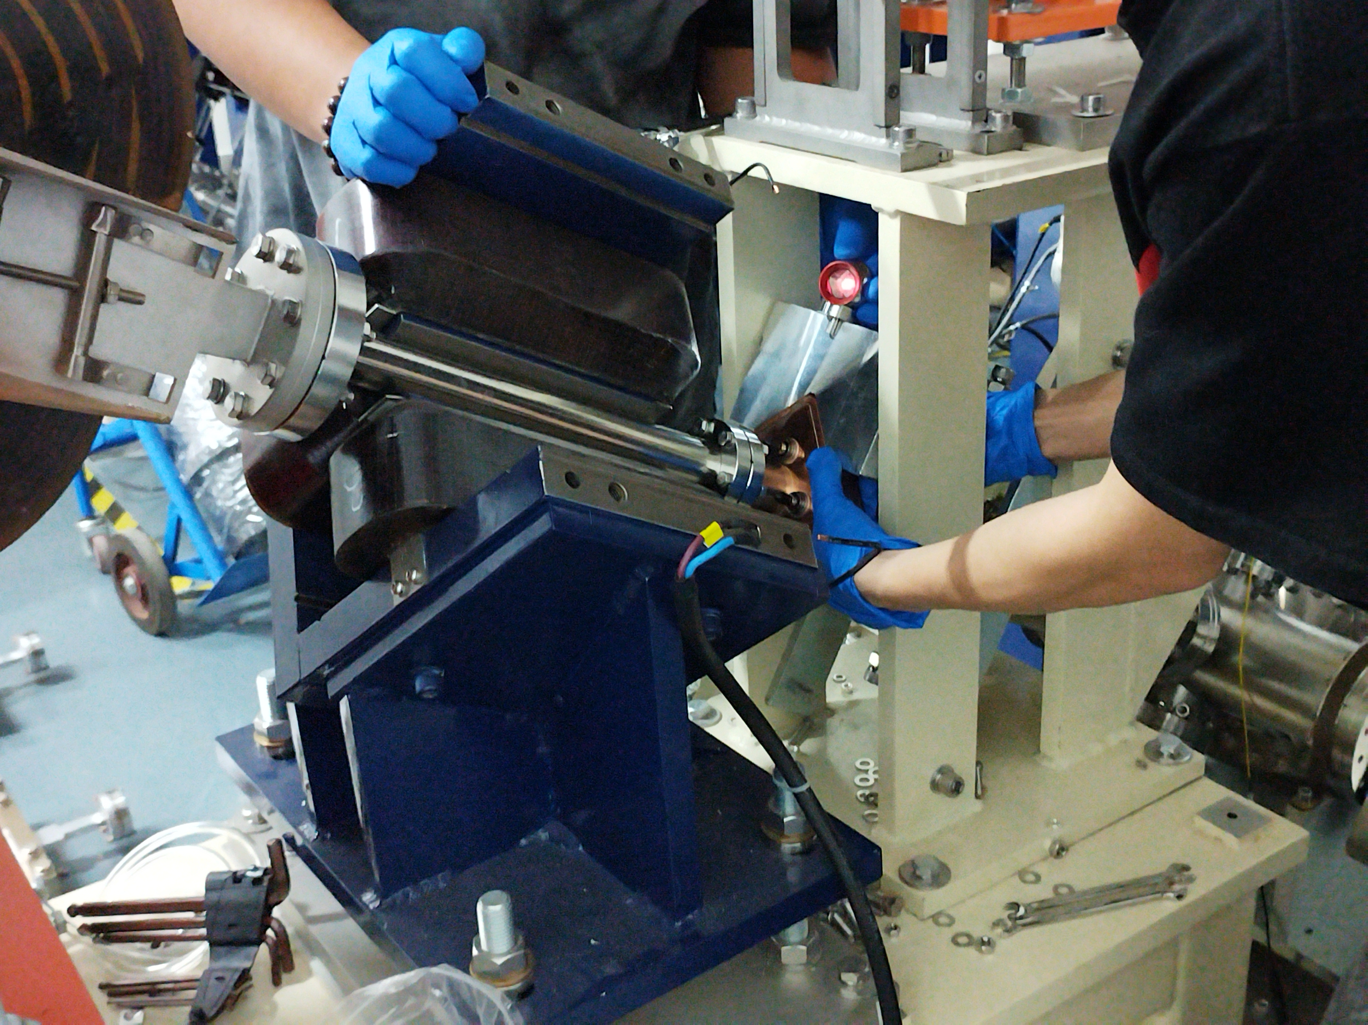
Key challenges (5) – Beam instrumentation
Requirements for beam instrum.
  CR precise bunch meas.: bunch-by-bunch 3D meas., trans. position res. <5 μm, long. phase res.<0.2 ps
  CR B-by-B fast feedback: coupled bunch inst.
  IP: orbit feedback
  Injector: bunch length and charge meas.
R&D efforts
  Bunch 3D meas.: probe, signal treat, electronics, S/N, integration
  B-by-B fast feedback: raising bandwidth, avoiding interference to single bunch
  Injector bunch length and charge meas.: cavity-based
  Prototypes: beam tests in different machines
Integrated board
for B-by-B 3D meas.
Cavity-based:
bunch length, charge and profile meas.

Slide 16
Electron-positron beams test platform
Test platform for supporting several injector R&Ds
  Electron source: mainly photocathode (also thermal e-gun)
  High-power solid-state modulator
  Positron target
  Magnetic horn
  Large-aperture S-band acceleration tube
  Beam diagnostic devices
Basic requirements
  Photocathode electron source
  100-MeV e- linac
  Positron target and magnetic horn
  100-MeV e+ linac
  Beam properties measurements, beam dumps

Slide 17
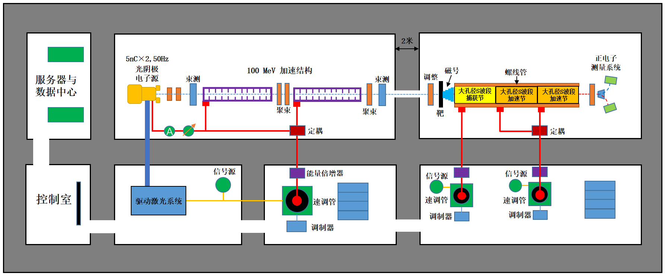
e- linac: 2* 6-m sections; e+ linac: 3 large-aper. accel. tubes
Located in the accelerator test hall of HALF (Hefei Advanced Light Facility under construction)

Slide 18
From prelim. study phase to R&D phase
Preliminary study phase (from 2018 to mid 2023)
  Very limited manpower (a dozen, mostly: small-portion part-time, students, retired consultants): preliminary conceptual design on the STCF accelerator
  Lacking experience in colliders
  Supporting the STCF study project
Key R&D phase (since August 2023)
  National Synchrotron Radiation Laboratory (NSRL) fully engaged in, as the co-supporter of the STCF project
  NSRL is focusing on the constr. of HALF (a 4G synchrotron light source, 2023.5 to 2028.9), still limited manpower
  Domestic collaborations: 8 institutions, contributing to half of current manpower
  About 90 persons, half are students, majority without experience in colliders

Slide 19
Summary
STCF accelerator goal is very challenging
Provincial and national financial resources to support the design and key technological R&Ds, aiming for construction in late 2020
STCF is a national project, attracts domestic institutions in the study
It is very important to collaborate with international labs, in particular, KEK and BINP
Thanks for attention!

