Slide 1
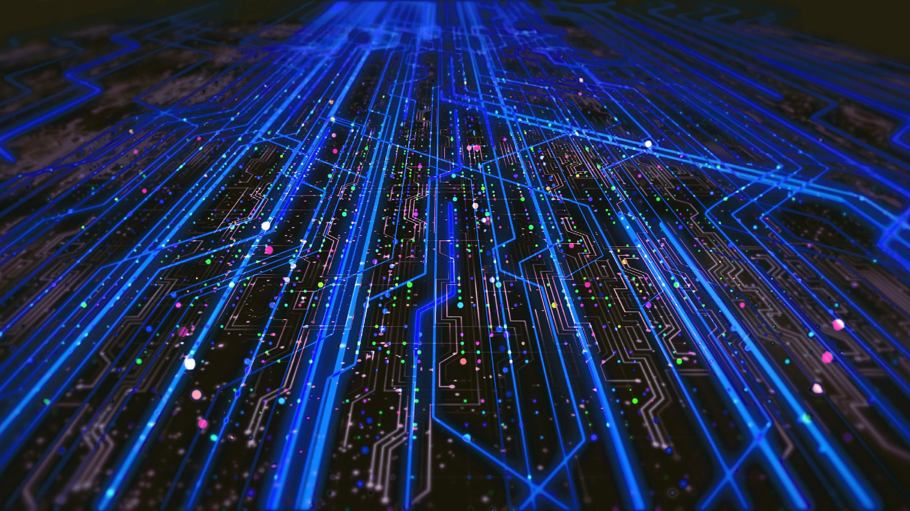
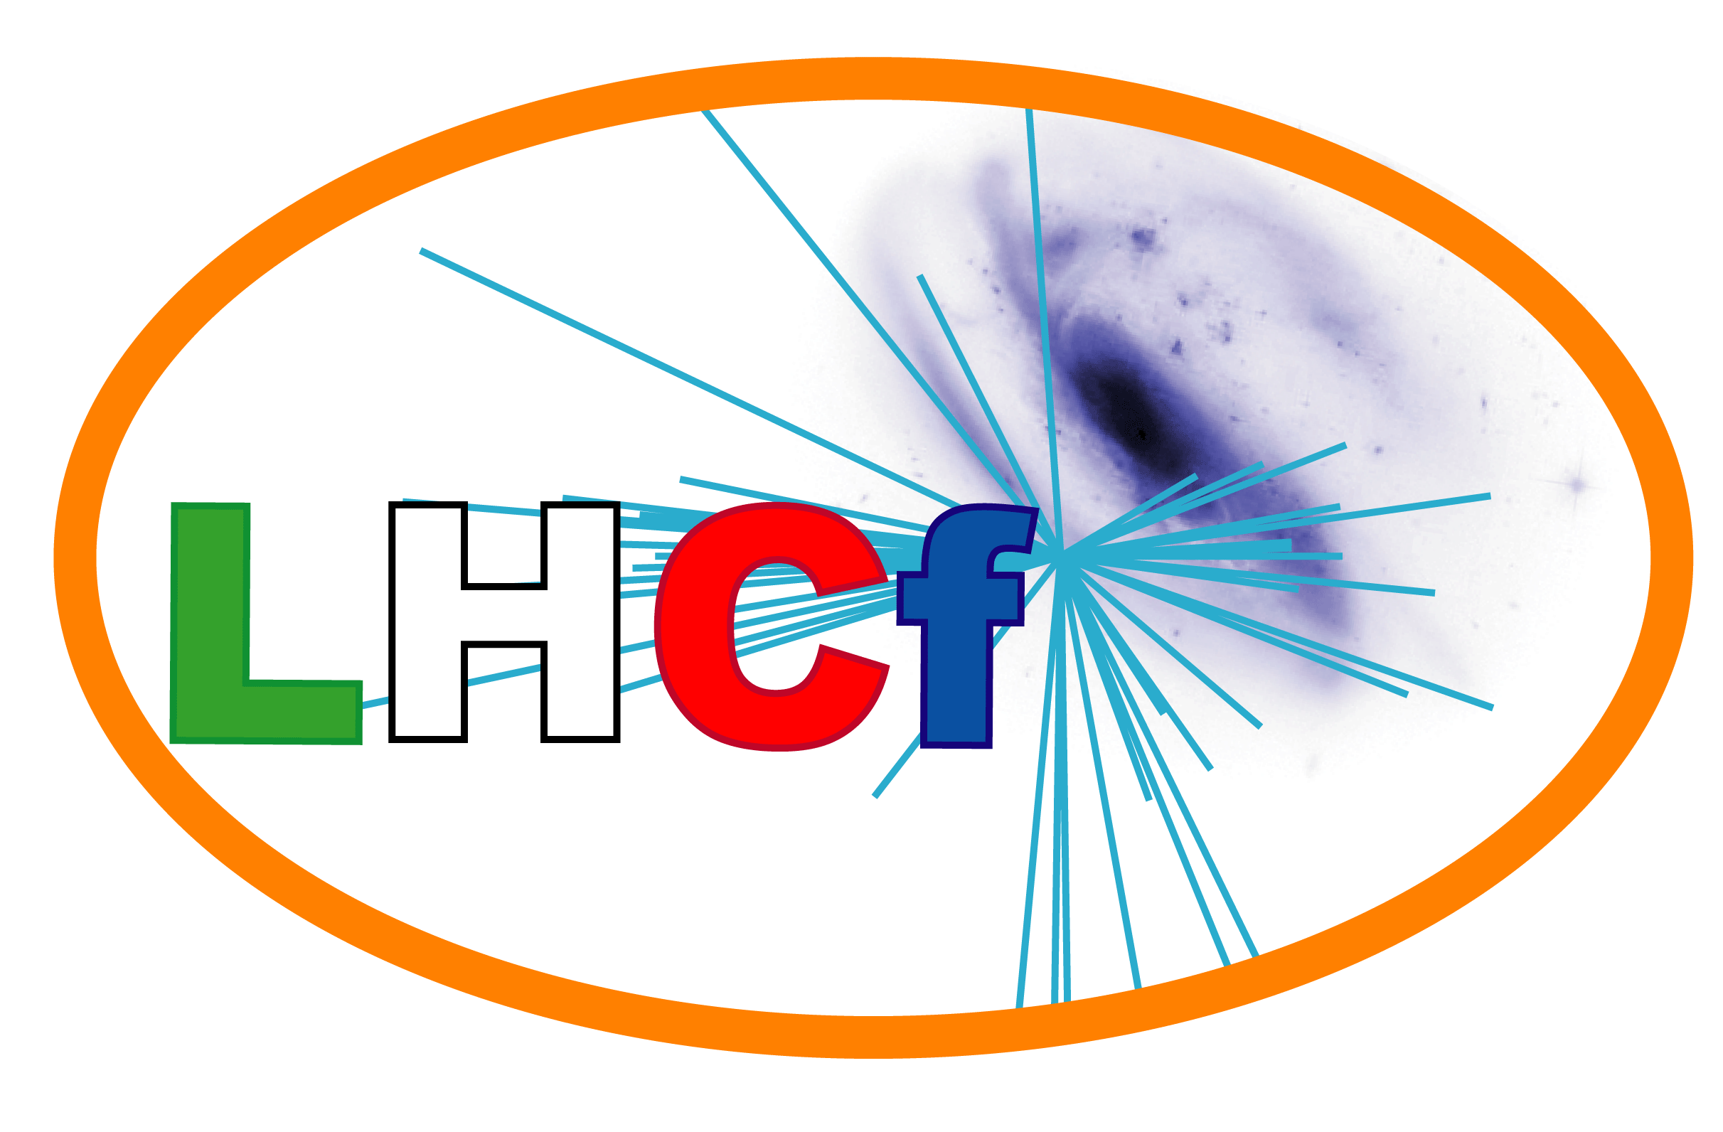


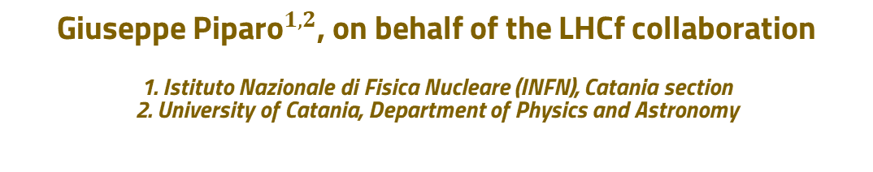
Reconstruction of multiple calorimetric clusters in the LHCf experiment with machine learning techniques​
Giuseppe ${\text{Piparo}}^{1,2}$, on behalf of the LHCf collaboration
1. Istituto Nazionale di Fisica Nucleare (INFN), Catania section
2. University of Catania, Department of Physics and Astronomy
${\text{42}}^{nd}$ International Conference on High Energy Physics (ICHEP 2024), Prague (CZE), Jul 17-24, 2024
ICSC Italian Research Center on High-Performance Computing, Big Data and Quantum Computing
Missione 4 • Istruzione e Ricerca

Slide 2
WHY TO IMPROVE LHCF RECONSTRUCTION WITH ML?

Slide 3
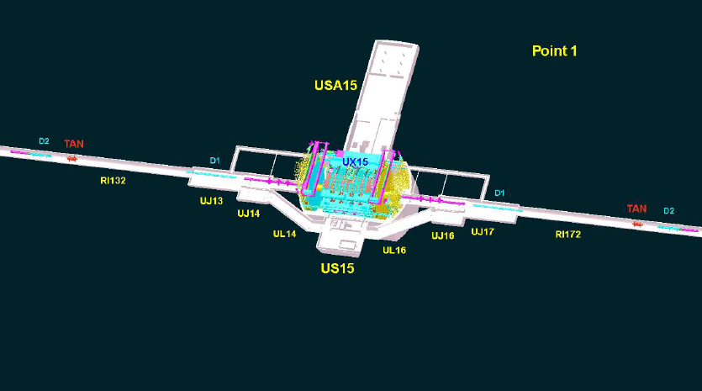
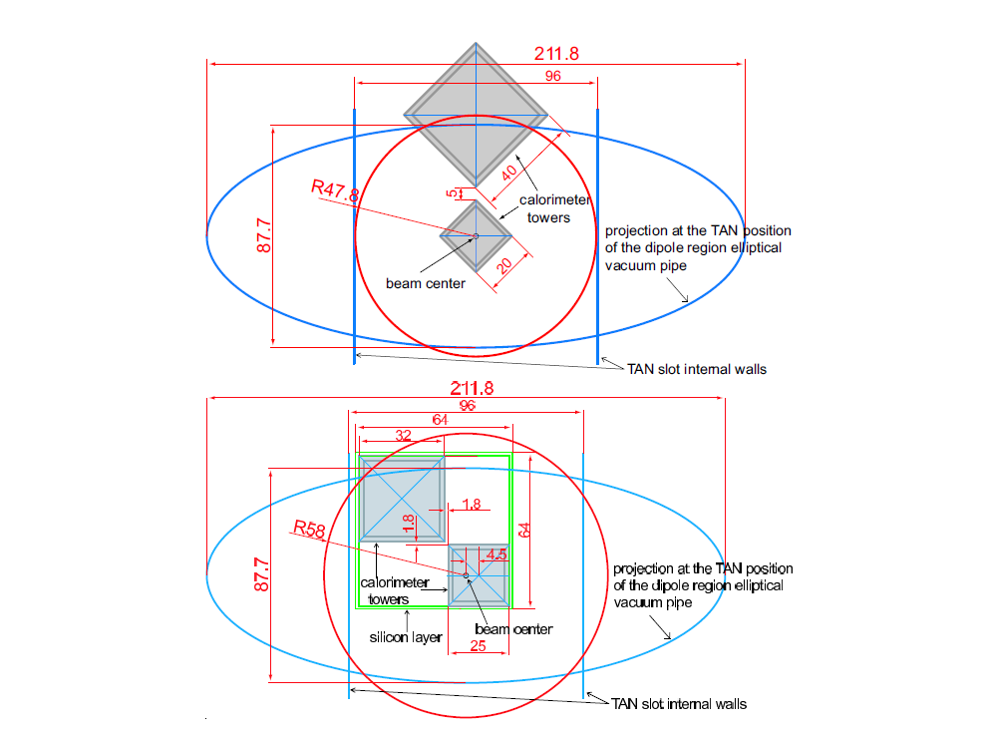
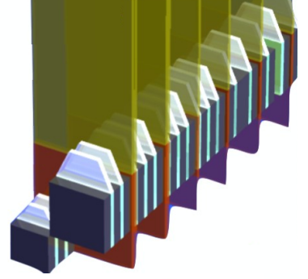
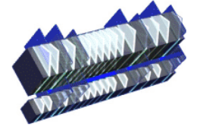
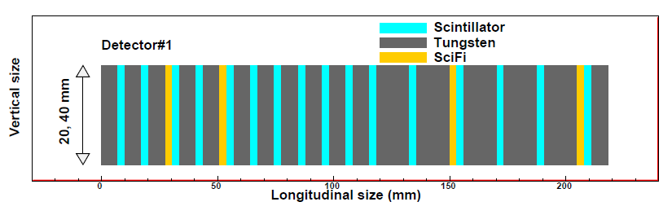
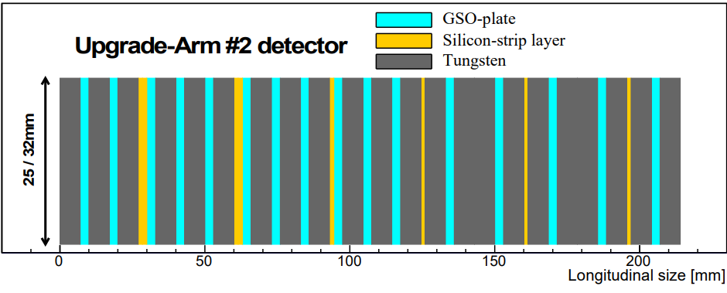
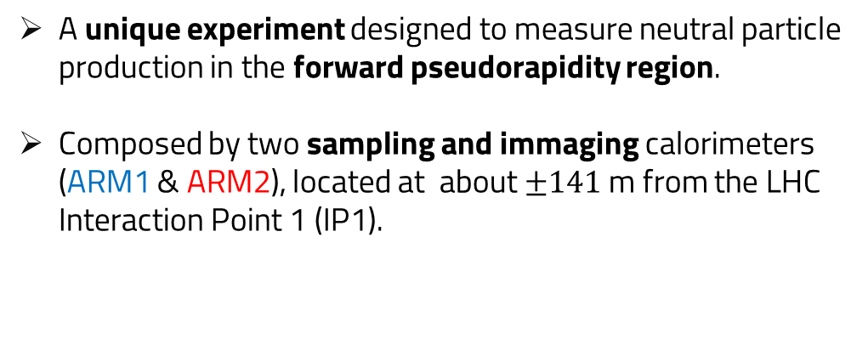



The LHCf Experiment at LHC
A unique experiment designed to measure neutral particle production in the forward pseudorapidity region.
Composed by two sampling and immaging calorimeters (ARM1 & ARM2), located at about $±141$ m from the LHC Interaction Point 1 (IP1).
Interaction
of LHC
ATLAS
Transversal view
Longitudinal view
ARM1
LHCF-ARM2
LHCF-ARM1
ARM2
$44$ $X_{0}$ and$1.6 λ_{I}$ deep
Energy resolution <5% for photons and 35-40% for neutrons
Tracking with 4 XY silicon microstrips layers.
Position resolution $≈40 μm$.
Same Energy resolution as ARM2.
Tracking with 4 GSO scintillator layers.
Position resolution $≈200 μm$.
G. Piparo for LHCf collaboration
ICHEP 2024, Prague, Jul 17-24, 2024
1

Slide 4
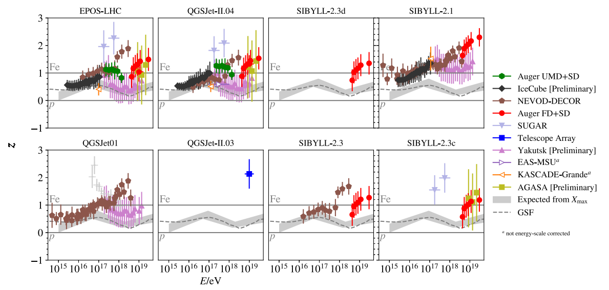
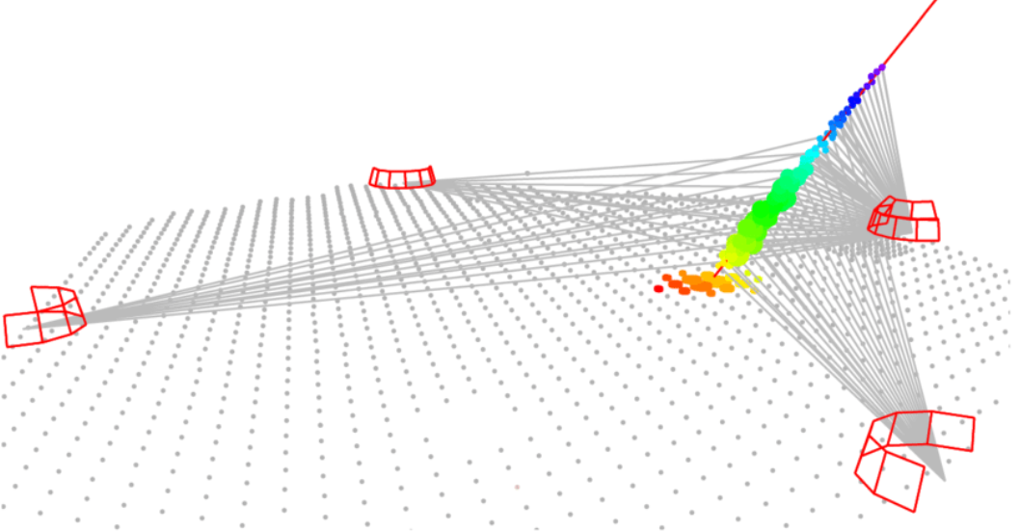
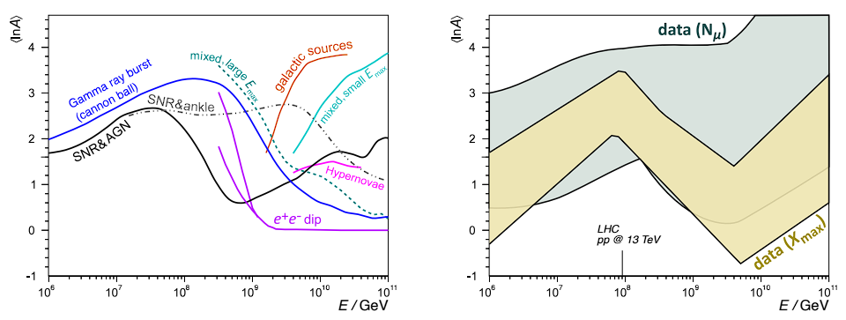
Experimental purpose of LHCf
The main hadronic interaction models (HIM) (like QGSJET, SIBYLL or EPOS) suffer of large discrepancy due to limited understanding of the soft QCD processes.
This is reflected on large uncertainties induced in the results of the ground-based cosmic rays experiments, due to the dependency of air shower modeling on HIM.
LHCf provides neutral particles' energy and momentum distributions in the forward region to test and calibrate the models.
ASS 367, 1 (2022)
G. Piparo for LHCf collaboration
ICHEP 2024, Prague, Jul 17-24, 2024
2

Slide 5
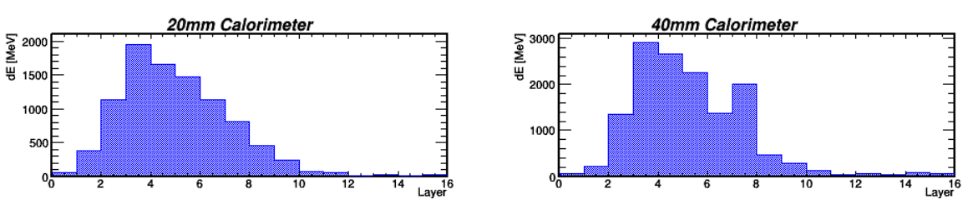
Reconstruction of multiple calorimetric clusters in LHCf
The total energy is reconstructed by summing the calibrated energy releases in the GSO layers. This sum is then converted to the total energy using a function derived from Monte Carlo simulations.
Energy releases
G. Piparo for LHCf collaboration
ICHEP 2024, Prague, Jul 17-24, 2024
3

Slide 6
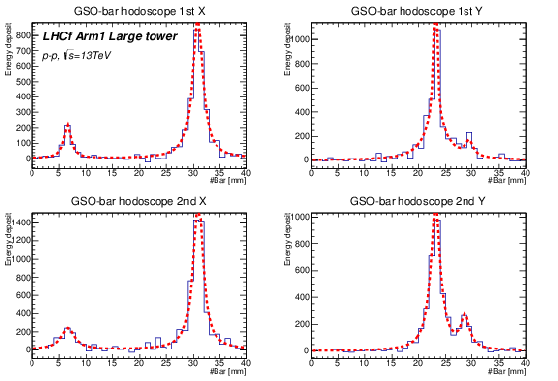
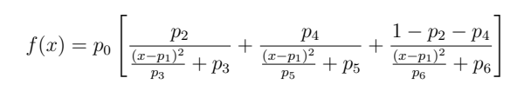
Reconstruction of multiple calorimetric clusters in LHCf
The total energy is reconstructed by summing the calibrated energy releases in the GSO layers. This sum is then converted to the total energy using a function derived from Monte Carlo simulations.
To reconstruct the position of hitting particles, we use the transversal profile of tracking detectors, by finding the peaks using TSpectrum and fitting them with a 3-component Lorentzian function for each peak.
The current energy-sharing method uses the ratio of peak heights for each particle to share the energy between the events.
Transversal profile with 2 clusters
Energy releases
3-components Lorentzian function
G. Piparo for LHCf collaboration
ICHEP 2024, Prague, Jul 17-24, 2024
4

Slide 7
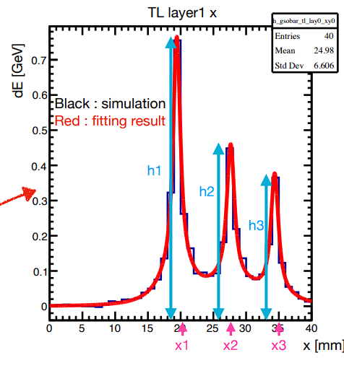
Reconstruction of multiple calorimetric clusters in LHCf
The total energy is reconstructed by summing the calibrated energy releases in the GSO layers. This sum is then converted to the total energy using a function derived from Monte Carlo simulations.
To reconstruct the position of hitting particles, we use the transversal profile of tracking detectors, by finding the peaks using TSpectrum and fitting them with a 3-component Lorentzian function for each peak.
The current energy-sharing method uses the ratio of peak heights for each particle to share the energy between the events.
This method was initially developed to determine the energy when two photons hit the same detector tower. We are now extending this approach to handle cases involving three or four photons and to account for the presence of neutrons.
Transversal profile with 2 clusters
Transversal profile with 3 clusters
Energy releases
3-components Lorentzian function
G. Piparo for LHCf collaboration
ICHEP 2024, Prague, Jul 17-24, 2024
5

Slide 8

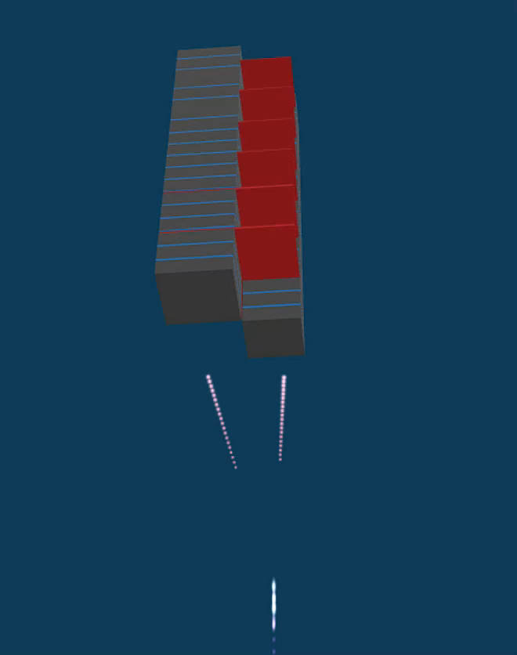
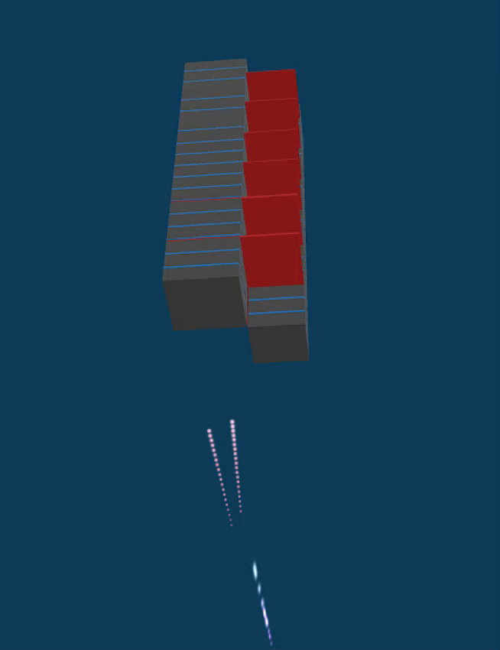
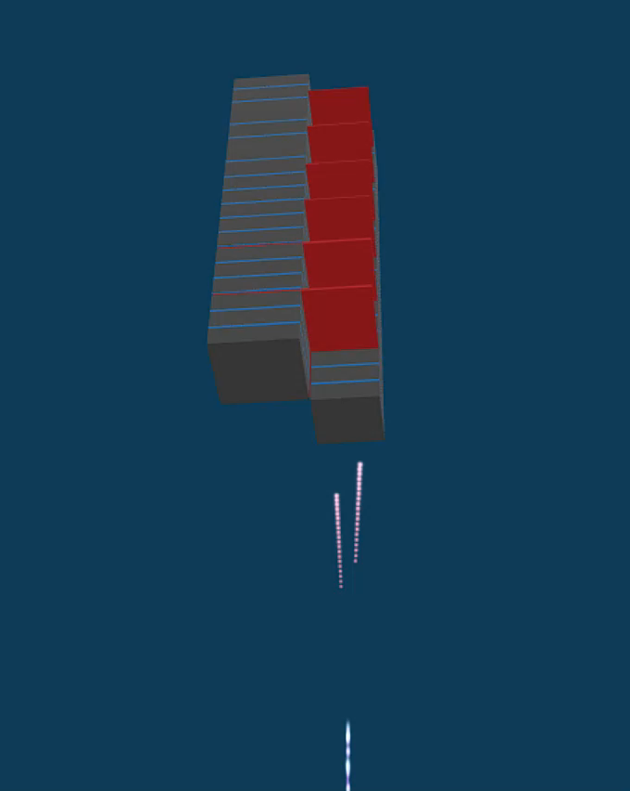
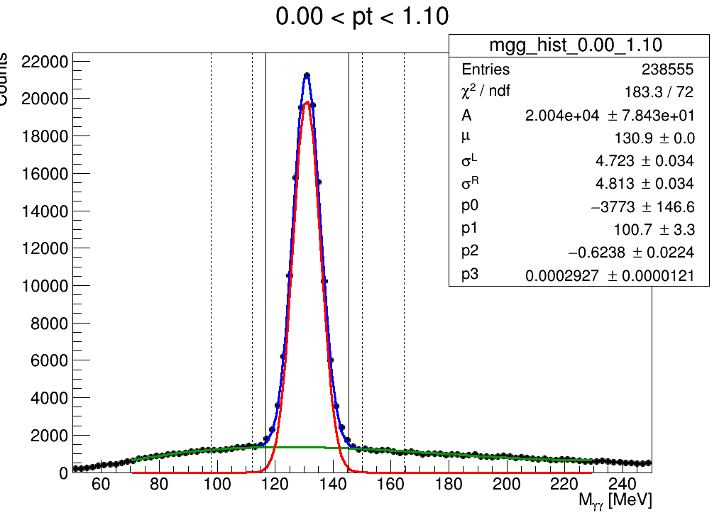
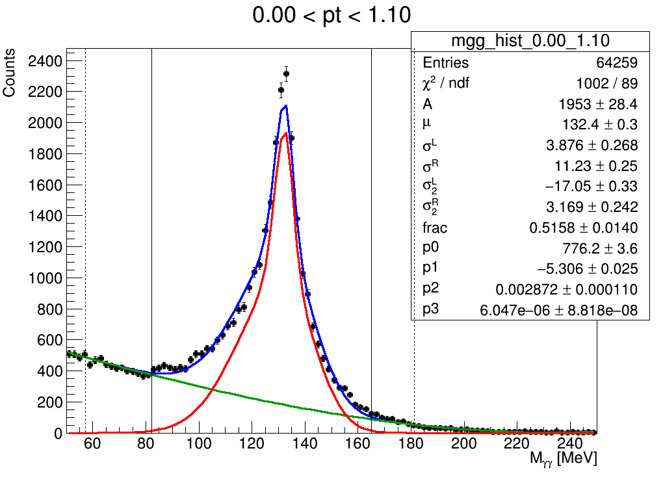
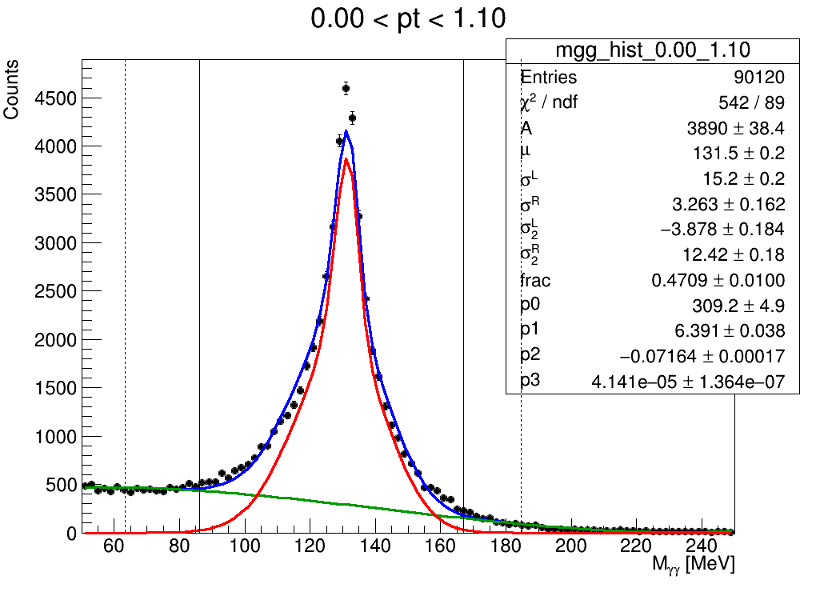
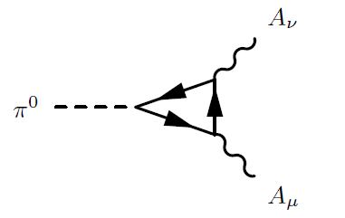
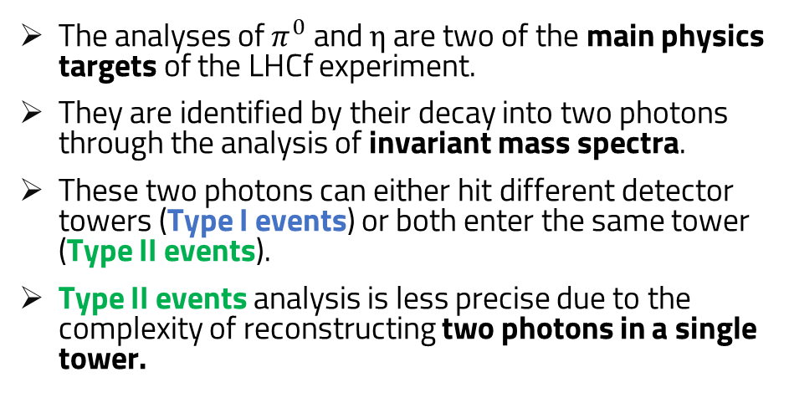
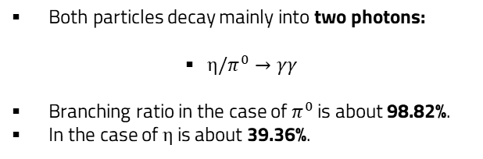
Motivation I: Type II $π^{0}$and 𝜂 analysis
TYPE I
TYPE II Large Tower
TYPE II Small Tower
The analyses of $π^{0}$ and $η$ are two of the main physics targets of the LHCf experiment.
They are identified by their decay into two photons through the analysis of invariant mass spectra.
These two photons can either hit different detector towers (Type I events) or both enter the same tower (Type II events).
Type II events analysis is less precise due to the complexity of reconstructing two photons in a single tower.
One photon for each tower
Two photons in the large tower
Two photons in the small tower
Both particles decay mainly into two photons:
$η/π^{0}→γγ$
Branching ratio in the case of $π^{0}$ is about 98.82%.
In the case of η is about 39.36%.
PRELIMINARY
PRELIMINARY
PRELIMINARY
η /
G. Piparo for LHCf collaboration
ICHEP 2024, Prague, Jul 17-24, 2024
6

Slide 9
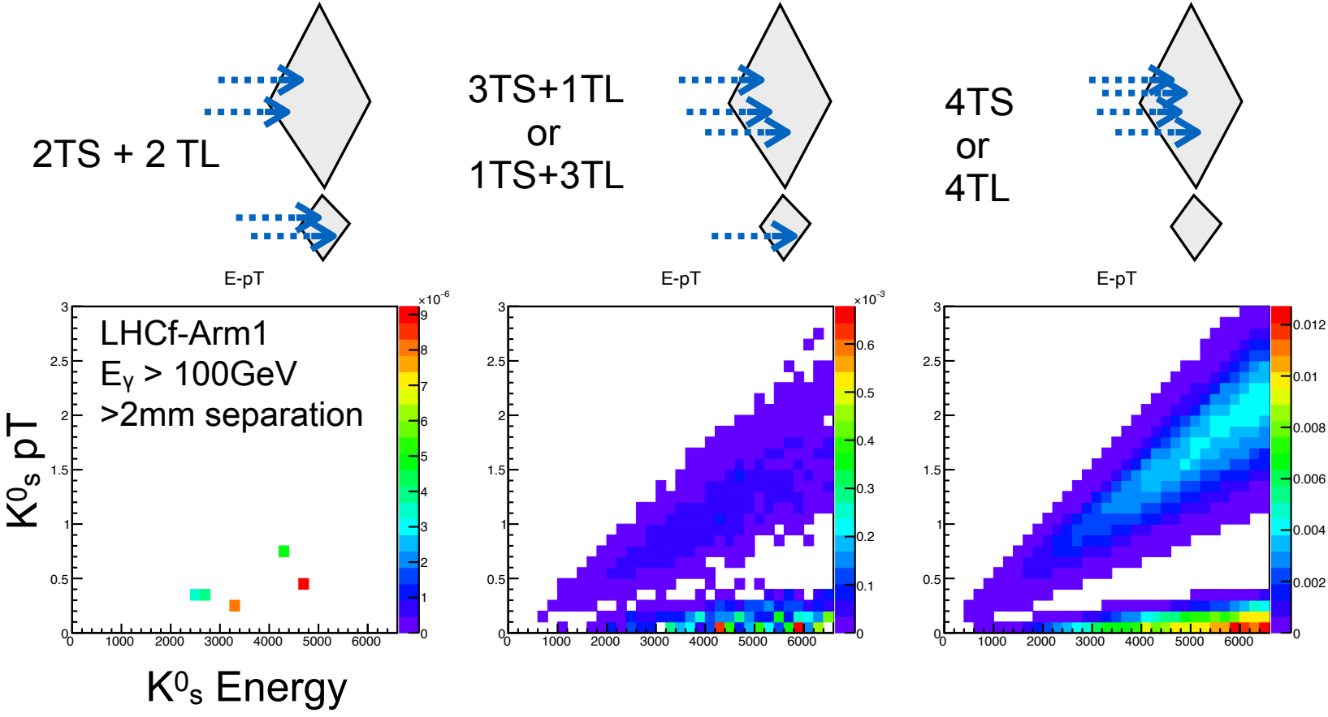
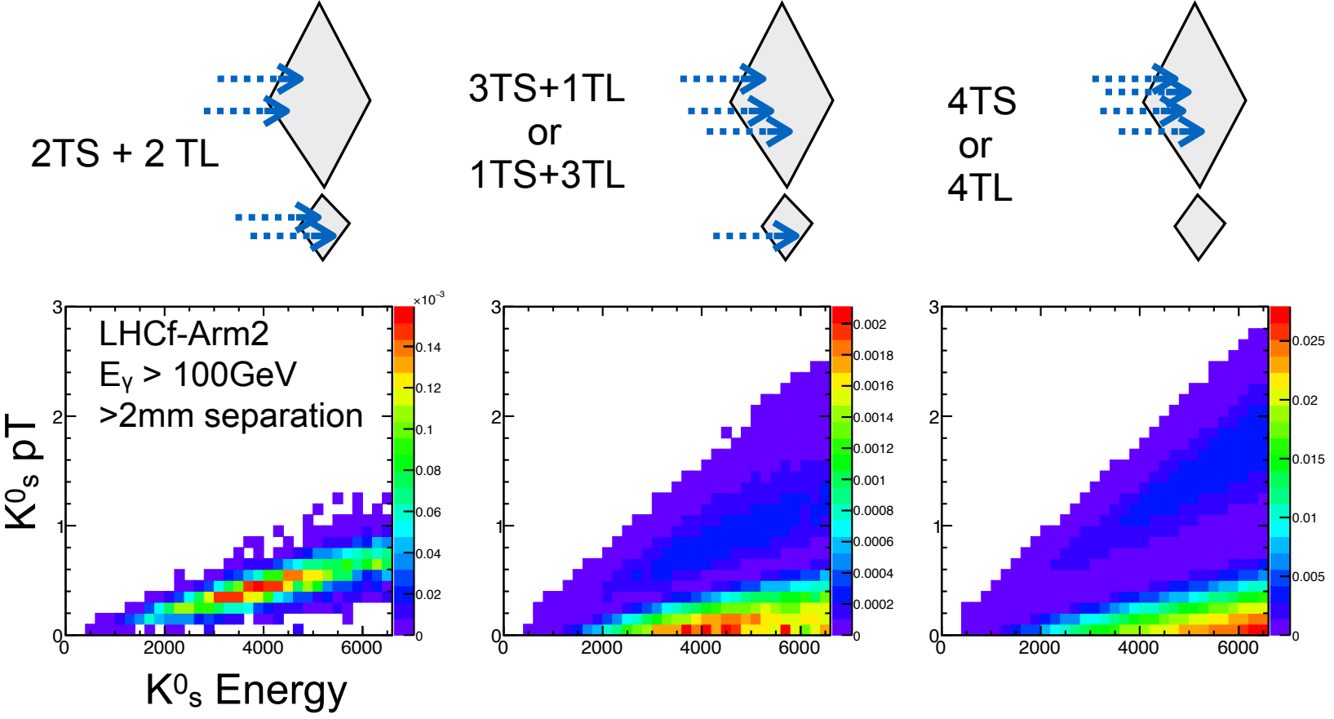
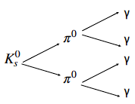
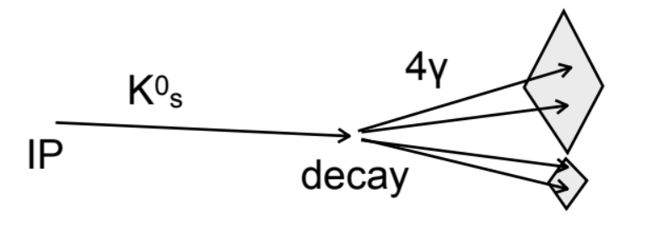

Motivation II: $K^{0}$analysis
$K_{s}^{0}$ measurements are critical for inferring the production of charged K mesons in EAS, which are significant sources of TeV-PeV atmospheric neutrinos, and to understanding strange quark forward production.
Understanding $K_{s}^{0}$production helps improve models of hadronic interactions in cosmic ray showers.
$K_{s}^{0}$events often involve multiple calorimetric hits, requiring the reconstruction of three or four particles.
G. Piparo for LHCf collaboration
ICHEP 2024, Prague, Jul 17-24, 2024
7

Slide 10
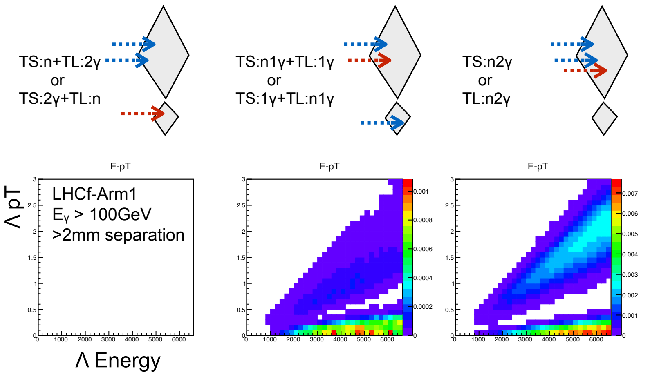
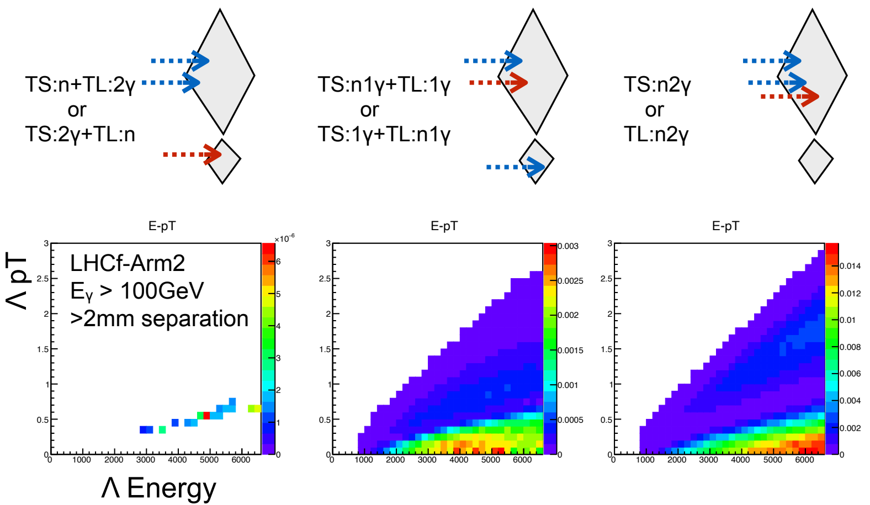
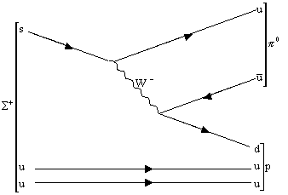
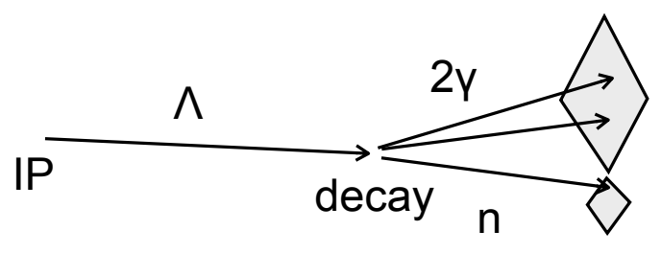

Motivation III: $Λ^{0}$analysis
$Λ^{0}$baryons are key to understanding forward strange particle production and hadronization in high-energy collisions.
Accurate $Λ^{0}$measurements refine models of strange quark behavior and improve QCD process predictions.
$Λ^{0}$ decays produce complex event topologies, involving mainly one or two photons and a neutron in a single tower.
Effective reconstruction requires distinguishing between different particle types and precisely determining their energies and positions, which is challenging due to overlapping signals and varied interaction characteristics.
$$Λ^{0}$$
d
d
n
G. Piparo for LHCf collaboration
ICHEP 2024, Prague, Jul 17-24, 2024
8

Slide 11
DEVELOPMENT STATUS

Slide 12
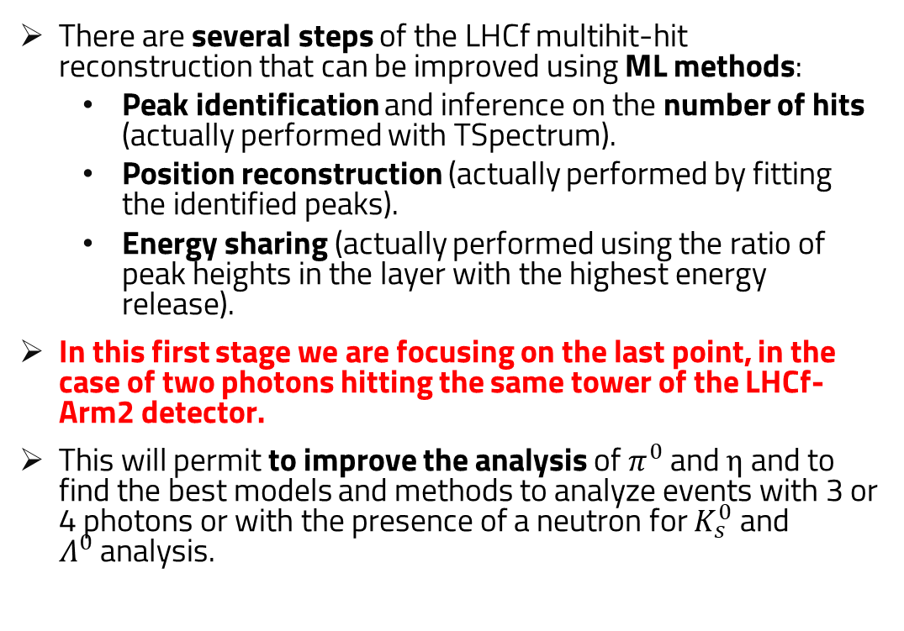
Machine Learning in the LHCf multi-hit reconstruction pipeline
There are several steps of the LHCf multihit-hit reconstruction that can be improved using ML methods:
  Peak identification and inference on the number of hits (actually performed with TSpectrum).
  Position reconstruction (actually performed by fitting the identified peaks).
  Energy sharing (actually performed using the ratio of peak heights in the layer with the highest energy release).
In this first stage we are focusing on the last point, in the case of two photons hitting the same tower of the LHCf-Arm2 detector.
This will permit to improve the analysis of $π^{0}$ and $η$ and to find the best models and methods to analyze events with 3 or 4 photons or with the presence of a neutron for $K_{s}^{0}$ and $Λ^{0}$analysis.
Transversal profile with 2 clusters
3-components Lorentzian function
G. Piparo for LHCf collaboration
ICHEP 2024, Prague, Jul 17-24, 2024
9

Slide 13
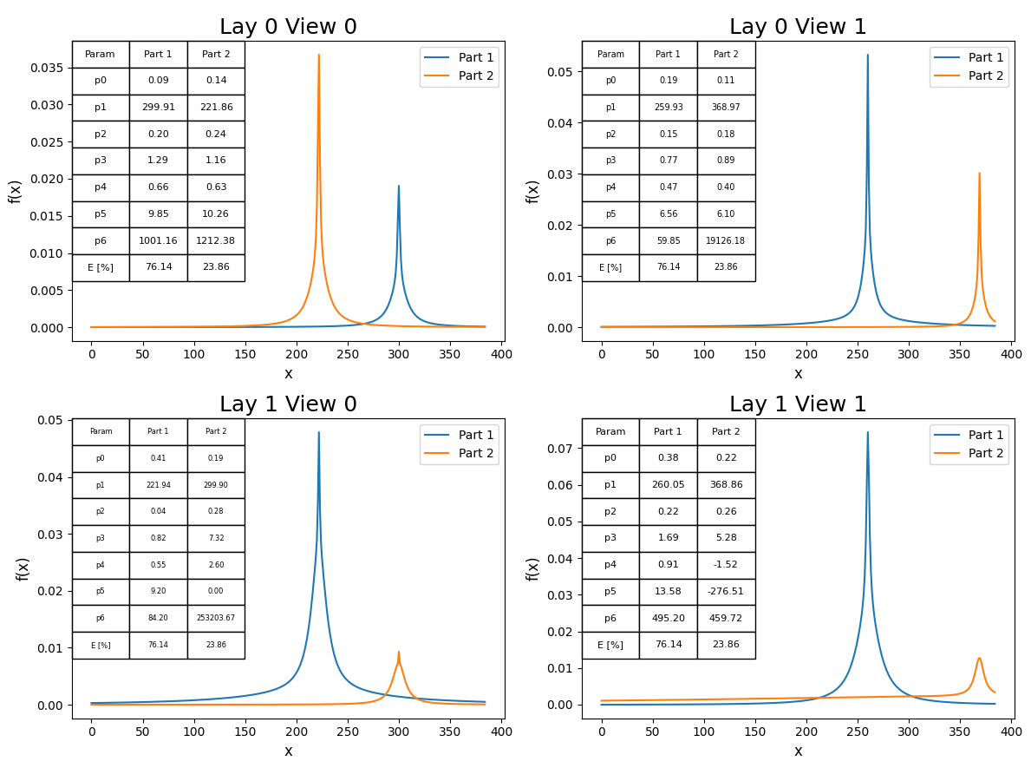
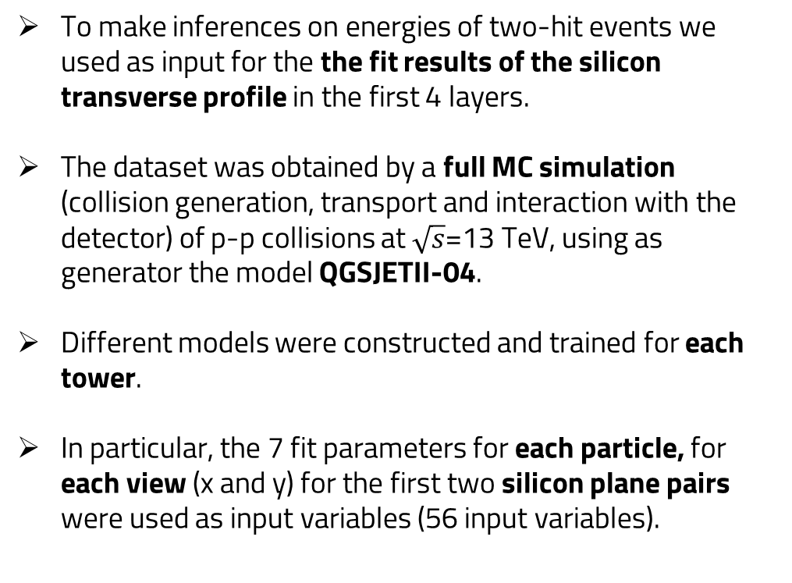
Dataset preparation
Layer 1 Small Tower view Y
Layer 1 Small Tower view X
To make inferences on energies of two-hit events we used as input for the the fit results of the silicon transverse profile in the first 4 layers.
The dataset was obtained by a full MC simulation (collision generation, transport and interaction with the detector) of p-p collisions at $\sqrt{s}$=13 TeV, using as generator the model QGSJETII-04.
Different models were constructed and trained for each tower.
In particular, the 7 fit parameters for each particle, for each view (x and y) for the first two silicon plane pairs were used as input variables (56 input variables).
Layer 2 Small Tower view X
Layer 2 Small Tower view Y
channel
channel
3-components Lorentzian function
G. Piparo for LHCf collaboration
ICHEP 2024, Prague, Jul 17-24, 2024
10

Slide 14
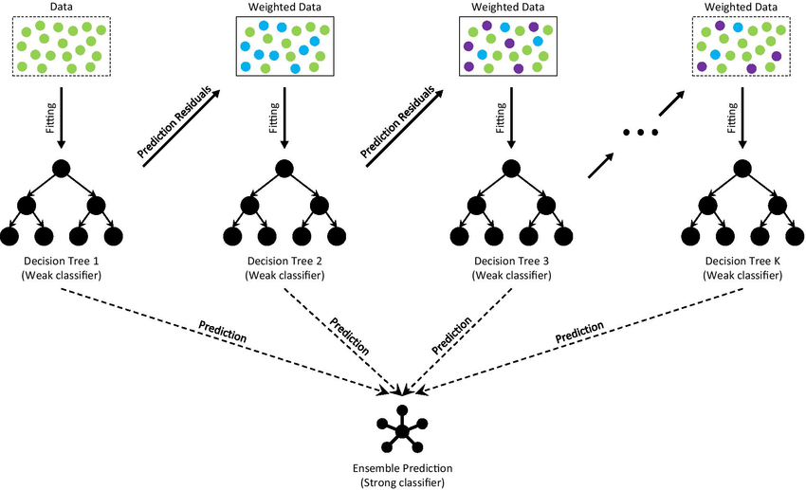
Tested models
Input dataset (56 fit parameters)
We tested two similar approaches, both based on gradient-boosting decision trees (BDTs).
Two ensemble models were constructed, consisting of two BDTs on a first level to make inferences on the single energy of each of the two photons, and an on-top BDT which, based on the predictions of the previous two combined with the input dataset, would make inference on the energy of both particles.
BDT for first particle
BDT for second particle
Energy first particle
Energy second particle
On-top BDT
Energy first and second particle
G. Piparo for LHCf collaboration
ICHEP 2024, Prague, Jul 17-24, 2024
11

Slide 15

Tested models
Input dataset (56 fit parameters)
We tested two similar approaches, both based on gradient-boosting decision trees (BDTs).
Two ensemble models were constructed, consisting of two BDTs on a first level to make inferences on the single energy of each of the two photons, and an on-top BDT which, based on the predictions of the previous two combined with the input dataset, would make inference on the energy of both particles.
In particular, the two libraries used for the test are XGBoost and CatBoost, which were initialized with similar values of the hyperparameters (e.g. 300k weak learners and depth of each tree equal to three).
The RMSE was used as a metric for the evaluation.
BDT for first particle
BDT for second particle
Energy first particle
Energy second particle
On-top BDT
Energy first and second particle
G. Piparo for LHCf collaboration
ICHEP 2024, Prague, Jul 17-24, 2024
12

Slide 16

Tested models
Input dataset (56 fit parameters)
We tested two similar approaches, both based on gradient-boosting decision trees (BDTs).
Two ensemble models were constructed, consisting of two BDTs on a first level to make inferences on the single energy of each of the two photons, and an on-top BDT which, based on the predictions of the previous two combined with the input dataset, would make inference on the energy of both particles.
In particular, the two libraries used for the test are XGBoost and CatBoost, which were initialized with similar values of the hyperparameters (e.g. 300k weak learners and depth of each tree equal to three).
The RMSE was used as a metric for the evaluation.
BDT for first particle
BDT for second particle
Energy first particle
Energy second particle
On-top BDT
Energy first and second particle
G. Piparo for LHCf collaboration
ICHEP 2024, Prague, Jul 17-24, 2024
13

Slide 17
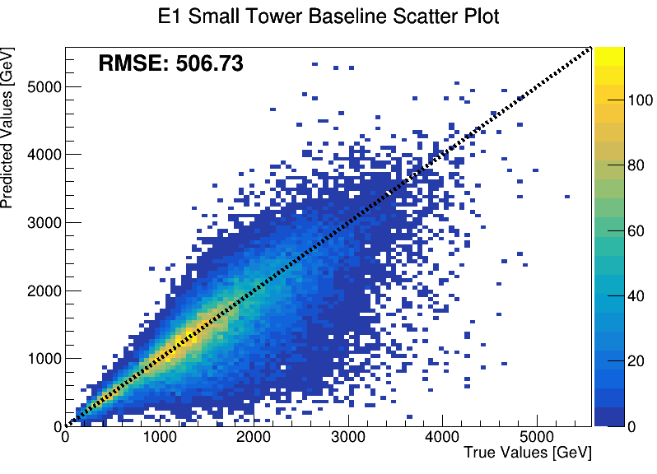
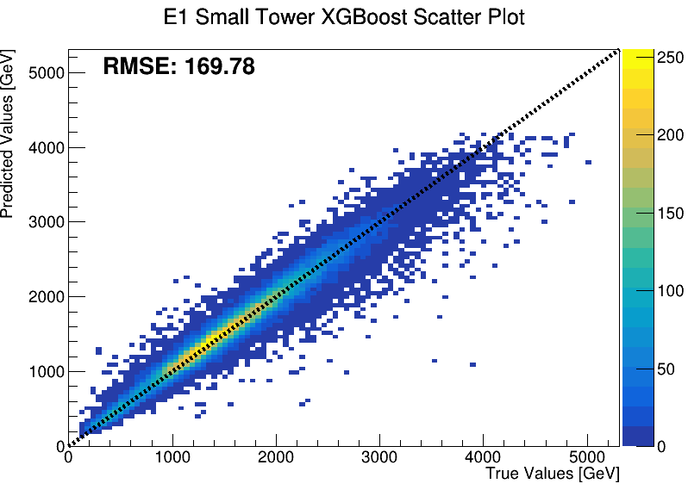
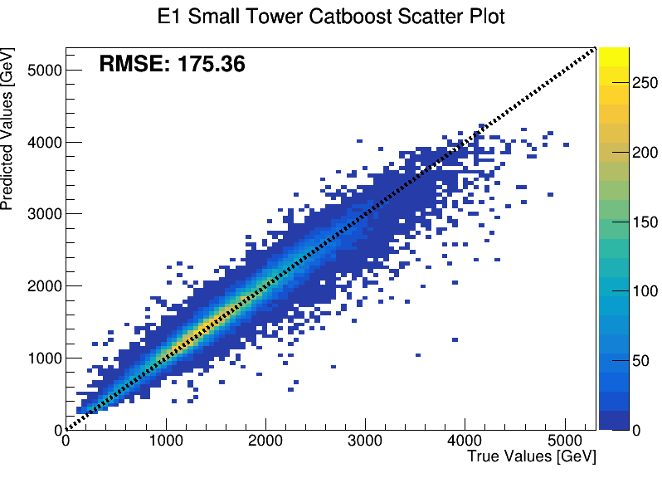
Results of first particle energy in Small Tower
Train events = 93k
Test events = 40k
G. Piparo for LHCf collaboration
ICHEP 2024, Prague, Jul 17-24, 2024
14

Slide 18
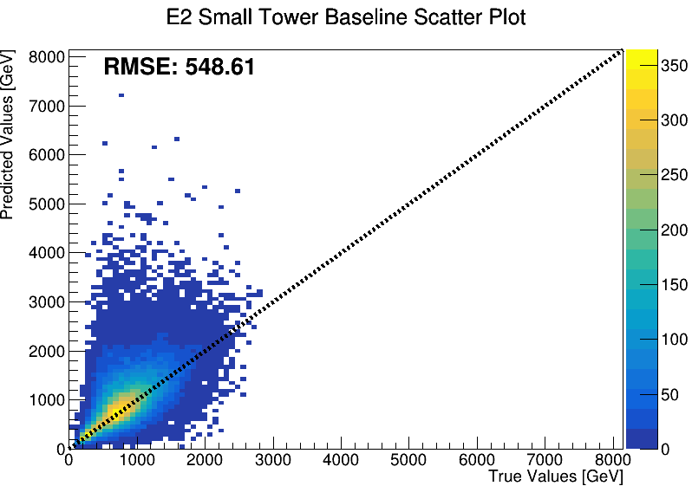
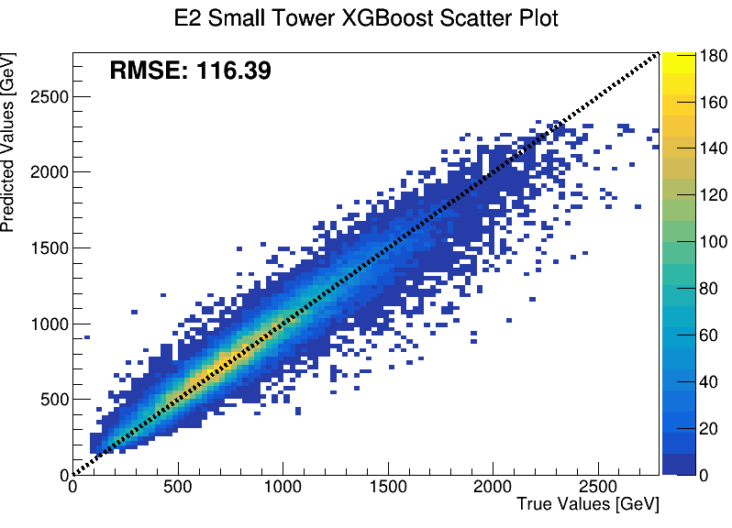
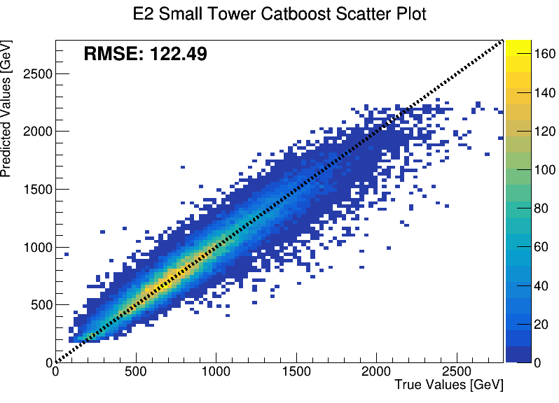
Results of second particle energy in Small Tower
Train events = 93k
Test events = 40k
G. Piparo for LHCf collaboration
ICHEP 2024, Prague, Jul 17-24, 2024
15

Slide 19
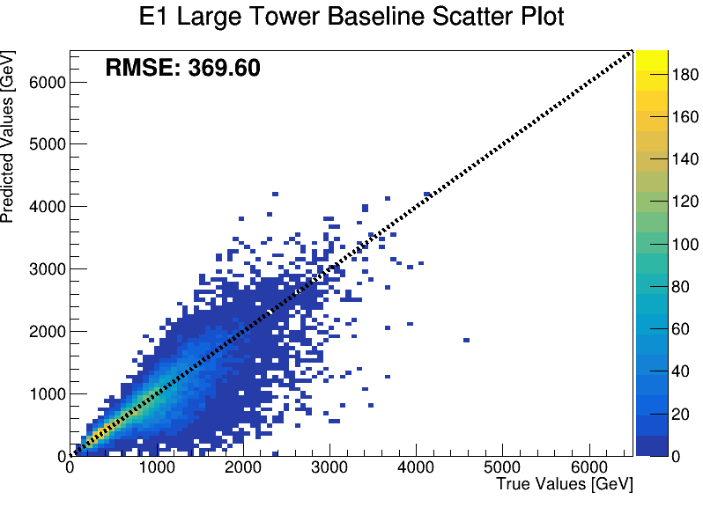
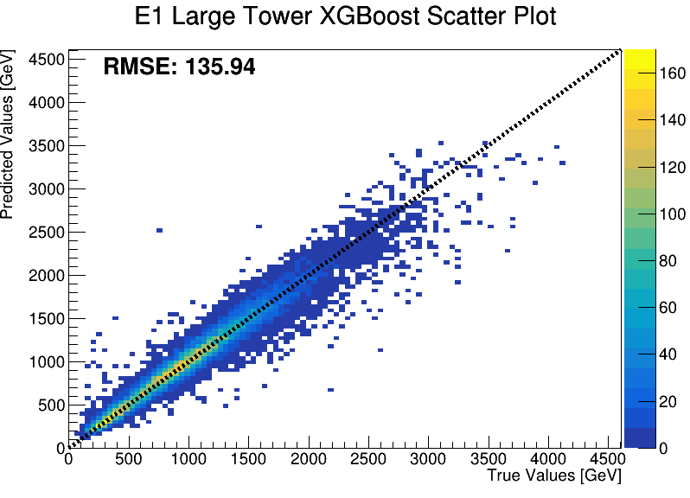

Results of first particle energy in Large Tower
Train events = 42k
Test events = 18k
G. Piparo for LHCf collaboration
ICHEP 2024, Prague, Jul 17-24, 2024
16

Slide 20



Results of second particle energy in Large Tower
Train events = 42k
Test events = 18k
G. Piparo for LHCf collaboration
ICHEP 2024, Prague, Jul 17-24, 2024
17

Slide 21
FUTURE PROSPECTS

Slide 22

Prospects: extend to more than two hits
Layer 1 Small Tower view Y
Layer 1 Small Tower view X
Current methods are primarily designed for events with up to two particles hitting the same detector tower.
Extending these techniques to handle more complex scenarios with three or four hits is crucial for comprehensive multi-hit event reconstruction.
Increased number of hits leads to significant signal overlap, making accurate deconvolution more challenging.
We performed preliminary tests using a 3-hits dataset, but with low statistics (O(1k) events).
Layer 2 Small Tower view X
Layer 2 Small Tower view Y
channel
channel
3-components Lorentzian function
G. Piparo for LHCf collaboration
ICHEP 2024, Prague, Jul 17-24, 2024
18

Slide 23






Prospects: extend to more than two hits
Current methods are primarily designed for events with up to two particles hitting the same detector tower.
Extending these techniques to handle more complex scenarios with three or four hits is crucial for comprehensive multi-hit event reconstruction.
Increased number of hits leads to significant signal overlap, making accurate deconvolution more challenging.
We performed preliminary tests using a 3-hits dataset, but with low statistics (O(1k) events).
First results are encouraging, but more statistics is needed.
G. Piparo for LHCf collaboration
ICHEP 2024, Prague, Jul 17-24, 2024
19

Slide 24


Prospects: use of the raw transverse distribution of position detectors
We are exploring the use of raw transverse distribution data from position detectors, moving away from relying solely on fit parameters.
This approach leverages the raw signals directly from the detectors to potentially enhance the accuracy of particle reconstruction.
Test perfomed on a different dataset, created using the same methodology but with a new simulation of p-p collisions at $\sqrt{s}$=13 TeV (QGSJET II-04 as generator).
Layer 1 Large Tower view X
Layer 1 Large Tower view Y
Layer 2 Large Tower view X
Layer 2 Large Tower view Y
channel
channel
G. Piparo for LHCf collaboration
ICHEP 2024, Prague, Jul 17-24, 2024
20

Slide 25





Prospects: use of the raw transverse distribution of position detectors
We are exploring the use of raw transverse distribution data from position detectors, moving away from relying solely on fit parameters.
This approach leverages the raw signals directly from the detectors to potentially enhance the accuracy of particle reconstruction.
Test perfomed on a different dataset, created using the same methodology but with a new simulation of p-p collisions at $\sqrt{s}$=13 TeV (QGSJET II-04 as generator).
Encouraging Outcomes: Initial results from are positive, showing improved accuracy in particle reconstruction.
Only O(20k) events, improvements are expected by increasing the statistics.
G. Piparo for LHCf collaboration
ICHEP 2024, Prague, Jul 17-24, 2024
21

Slide 26




Prospects: use of the raw transverse distribution of position detectors
We are exploring the use of raw transverse distribution data from position detectors, moving away from relying solely on fit parameters.
This approach leverages the raw signals directly from the detectors to potentially enhance the accuracy of particle reconstruction.
Test perfomed on a different dataset, created using the same methodology but with a new simulation of p-p collisions at $\sqrt{s}$=13 TeV (QGSJET II-04 as generator).
Encouraging Outcomes: Initial results from are positive, showing improved accuracy in particle reconstruction.
Only O(20k) events, improvements are expected by increasing the statistics.
G. Piparo for LHCf collaboration
ICHEP 2024, Prague, Jul 17-24, 2024
22

Slide 27

Summary
The LHCf experiment measures neutral particle production in the forward pseudorapidity region to improve hadronic interaction models used in the cosmic rays field.
Machine learning can enhance the reconstruction of calorimetric clusters, particularly for complex events involving multiple particles.
Focus areas include energy sharing and position reconstruction, improving $π^{0}$ and $η$ event analyses and opening new physics channels such as $K_{s}^{0}$ and $Λ^{0}.$
Two-Hit Events: Improved accuracy in energy reconstruction using ensemble methods based on CatBoost and XGBoost.
Three-Hit Events: Very preliminary results indicate potential for handling more complex scenarios, though additional data and refinement are needed.
Four hit studies, the possible presence of a neutron and improved position reconstruction using ML are foreseen, probably using raw transverse distribution data.
G. Piparo for LHCf collaboration
ICHEP 2024, Prague, Jul 17-24, 2024
23

Slide 28
Thanks for the attention!
This work is partially supported by ICSC – Centro Nazionale di Ricerca in High Performance Computing, Big Data and Quantum Computing, funded by European Union – NextGenerationEU
Giuseppe ${\text{Piparo}}^{1,2}$, on behalf of the LHCf collaboration
1. Istituto Nazionale di Fisica Nucleare (INFN), Catania section
2. University of Catania, Department of Physics and Astronomy
${\text{42}}^{nd}$ International Conference on High Energy Physics (ICHEP 2024), Prague (CZE), Jul 17-24, 2024
ICSC Italian Research Center on High-Performance Computing, Big Data and Quantum Computing
Missione 4 • Istruzione e Ricerca

