Slide 1

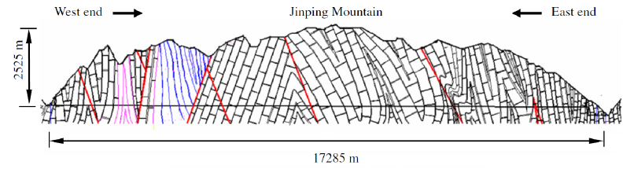

Development of LiCl aqueous solution for neutrino detection for Jinping Neutrino Experiment
Zhe Wang
Tsinghua University
（for the research group）
July 18, 2024

Slide 2
Contents
Jinping Neutrino Experiment(JNE) in plan
Target volume, 500 m³, at Jinping laboratory
---- Solar, Geo, Supernova neutrinos, etc.
Properties and development of LiCl aqueous solution as a neutrino target
(organic luminescent material added)
Sensitivity for solar neutrino upturn effect
Prospects for geo and supernova neutrinos

Slide 3
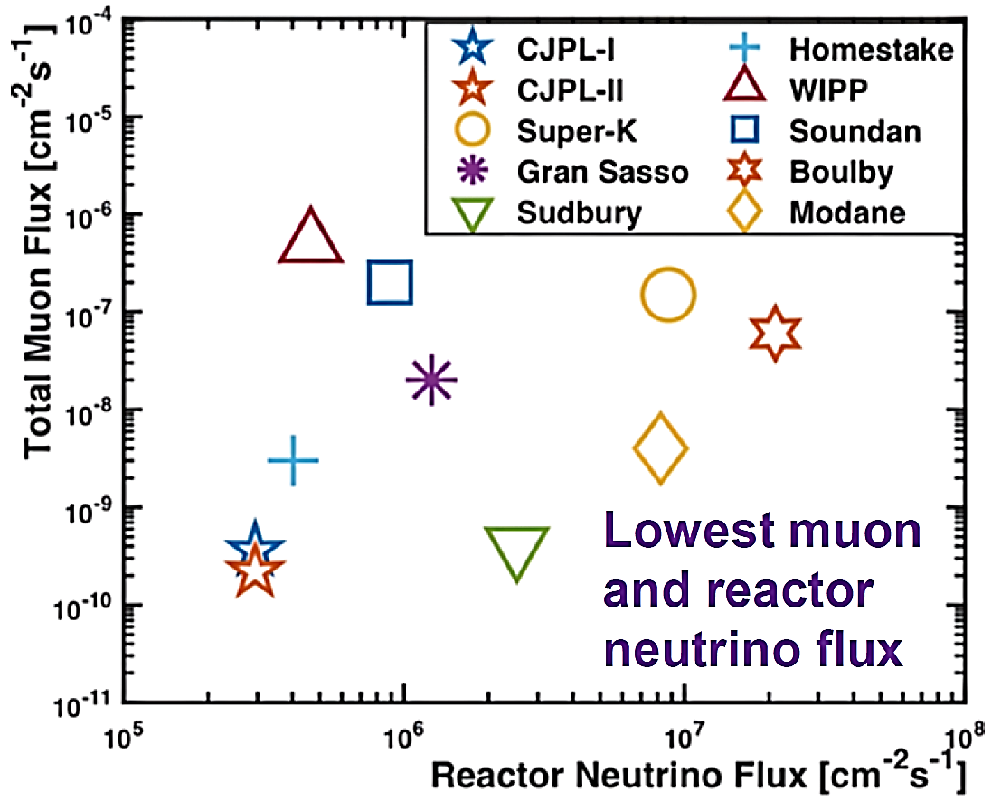
China Jinping Underground Laboratory (CJPL) ----
An ideal low background experiment site
2400 m overburden
1000 km to reactors

Slide 4
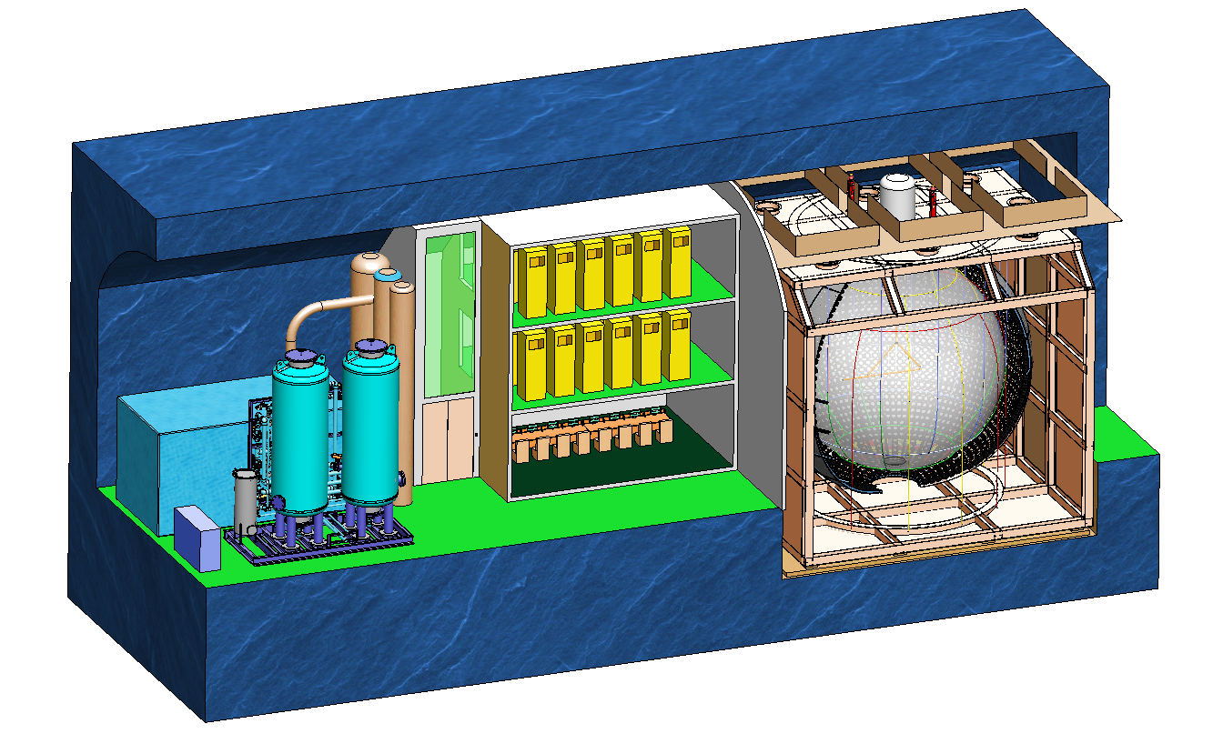
A 500 m³ detector is planned at CJPLII
Calibration Unit
SST Tank
PMT Truss
PMT
Acrylic Sphere
HV, FEE, Trigger, Clock
Online Data-taking
Pure Water
Shift Station
Target volume: 500 cubic meter

Slide 5
Goal of the Jinping Neutrino Experiment (JNE)
Solar neutrino
B-8 neutrino spectrum, upturn effect (matter-induced survival probability increase)
Geo neutrino
crust geo neutrino model study (Qinghai-Tibetan Plateau geoneutrino)
Diffuse supernova neutrino background (DSNB, aka supernova relic neutrinos)
Other new physics

Slide 6
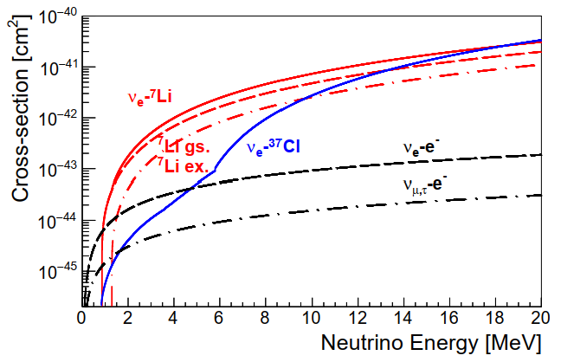

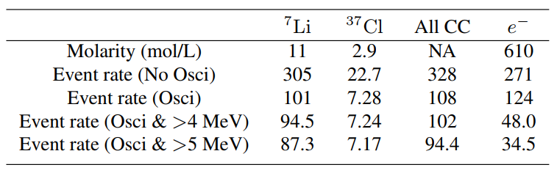
(Saturated) LiCl aqueous solution for neutrino det.
CC process for ν_{e}:
  Measure neutrino energy
High cross-section:
  ν_{e}-Li7: 60 times of ν_{e}-e elastic
  for solar B8 neutrinos
High natural abundance of Li7: 92%
High solubility: 80 g LiCl in 100 g water
B8 Event rate/100 ton-year solution

Slide 7
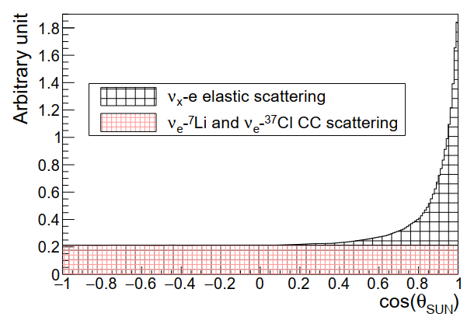



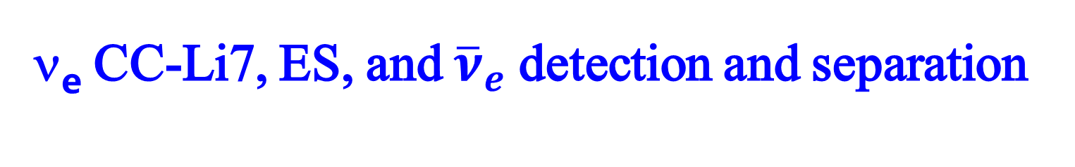
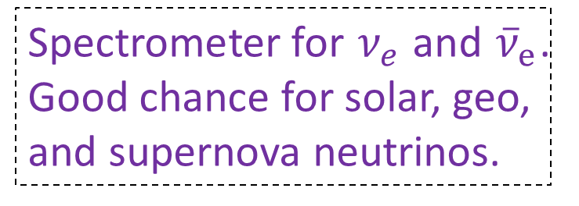
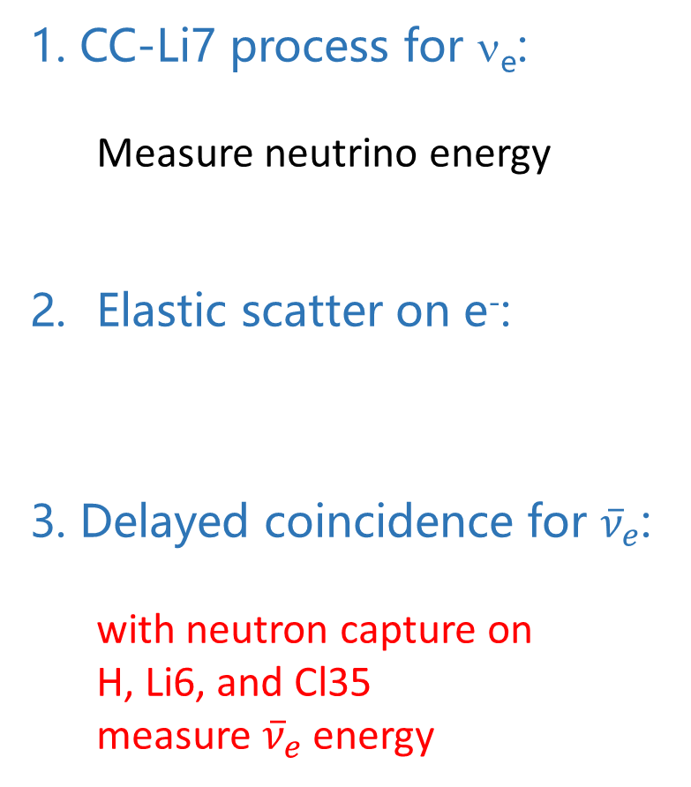
ν_{e} CC-Li7, ES, and ${\overline{ν}}_{e}$detection and separation
CC-Li7 process for ν_{e}:
  Measure neutrino energy
Elastic scatter on e⁻:
Delayed coincidence for ${\overline{ν}}_{e}$:
with neutron capture on
H, Li6, and Cl35
measure ${\overline{ν}}_{e}$ energy
CC-Li7, ES separated by solar angle
Spectrometer for $ν_{e}$ and ${\overline{ν}}_{e}$. Good chance for solar, geo, and supernova neutrinos.

Slide 8
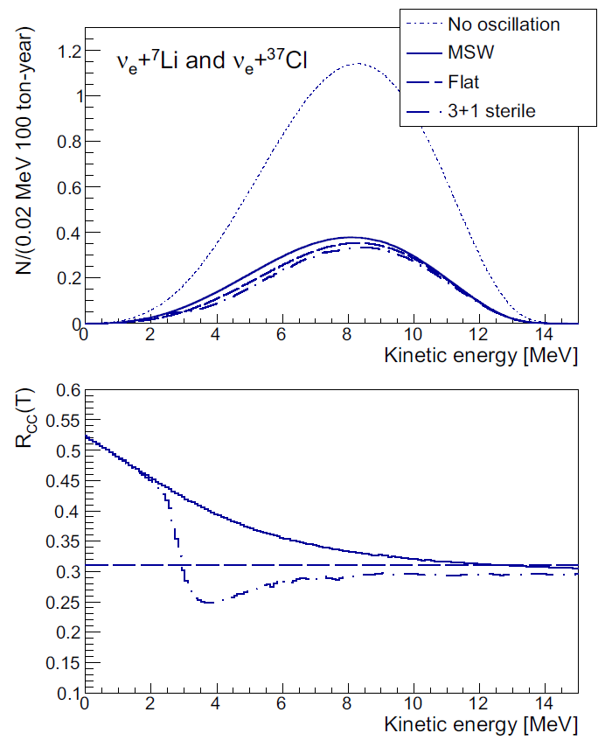
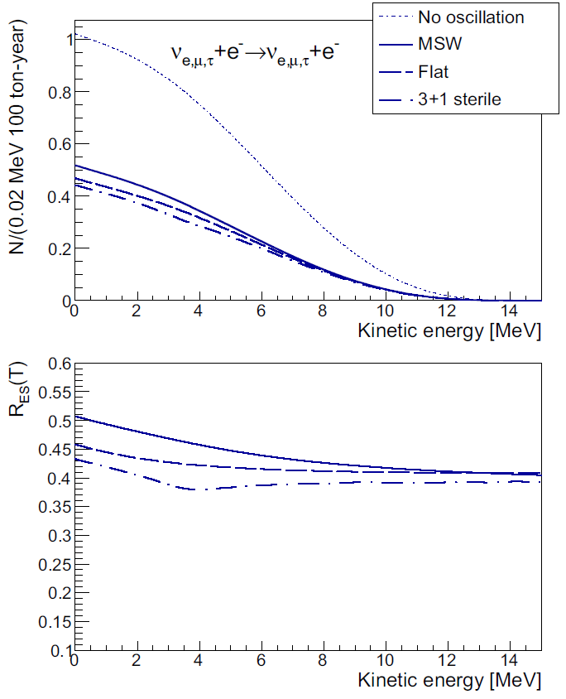
CC-Li7 vs ES for solar neutrino oscillation study
ES process at 4 MeV
Relative difference=6.7%
CC process at 4 MeV
Relative difference=23%
CC-Li7 process on nuclei is good to measure B-8 neutrino spectrum and any energy-dependent physics

Slide 9
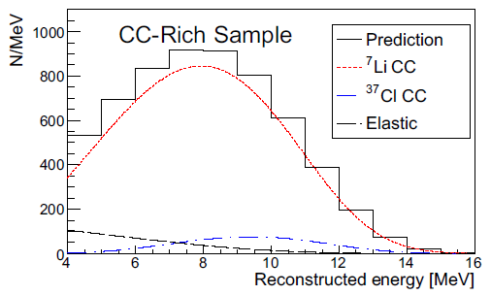
Solar B8 neutrino extraction simulation
With a solar angle cut, CC-Li7 process signals can be clearly extracted.
JNE can serve as a solar neutrino spectrometer.

Slide 10
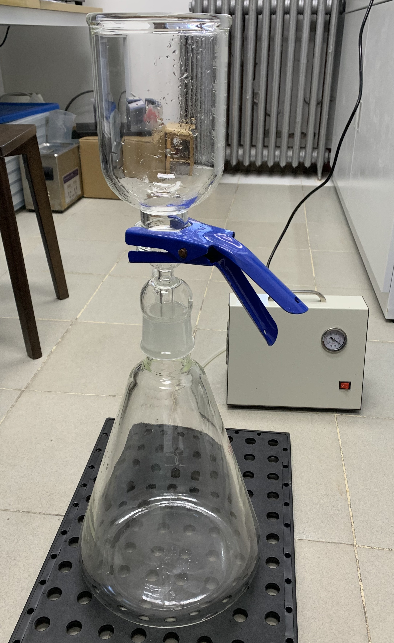
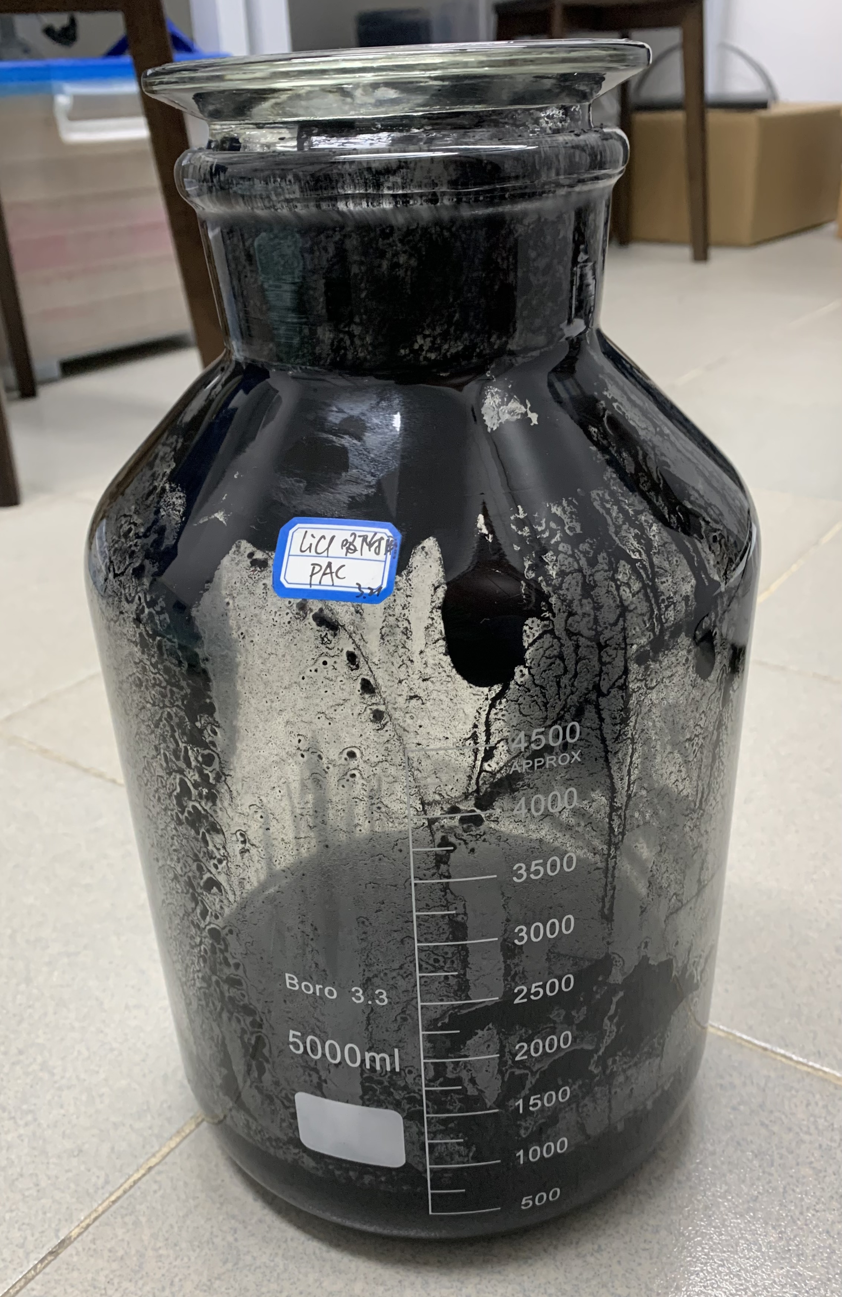
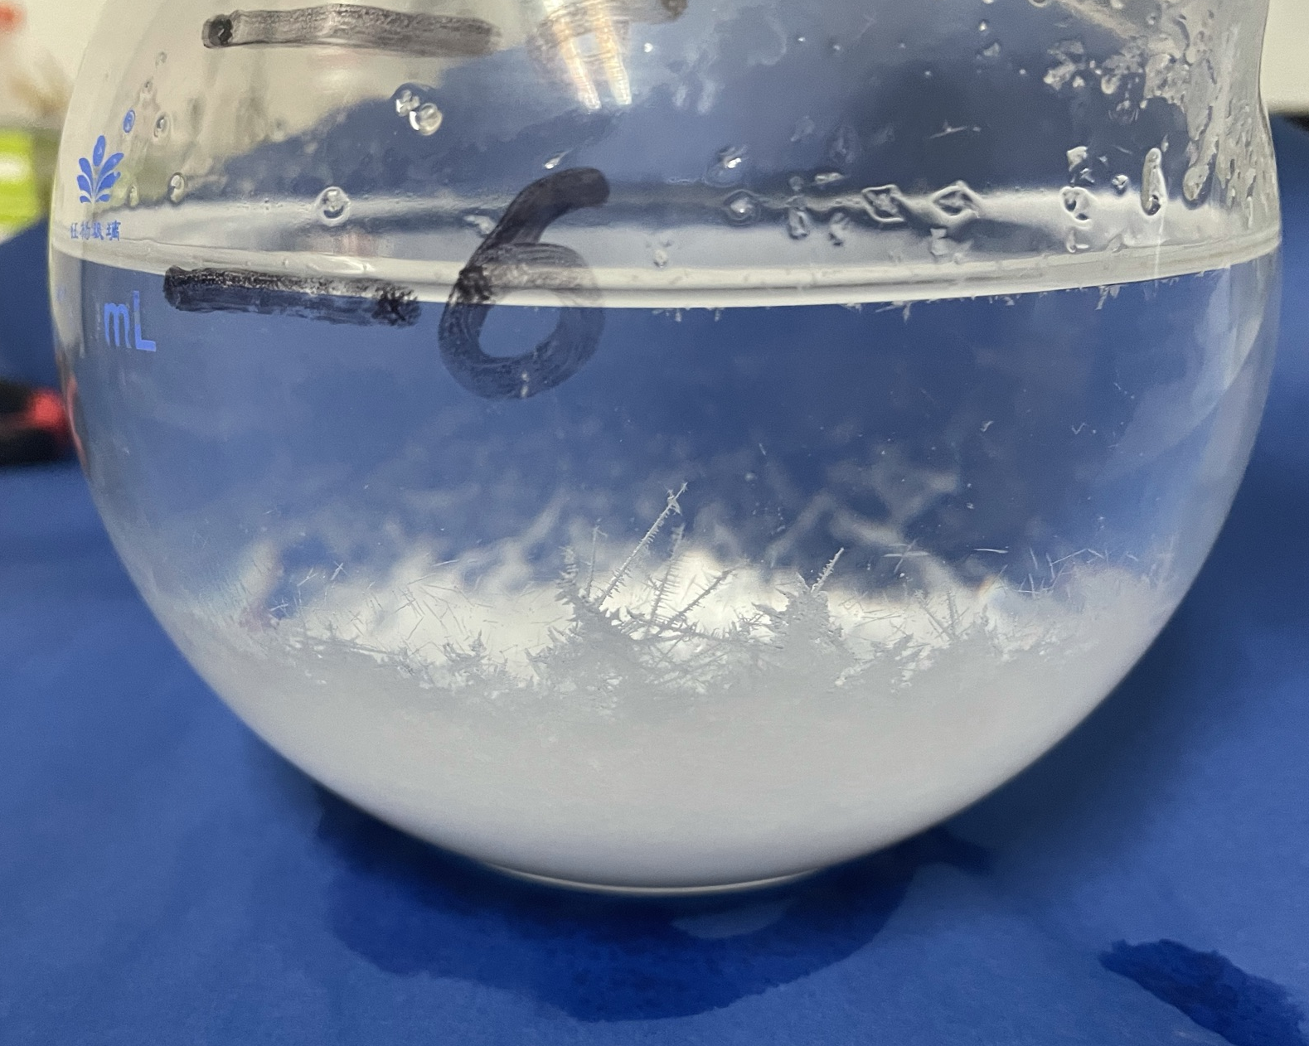
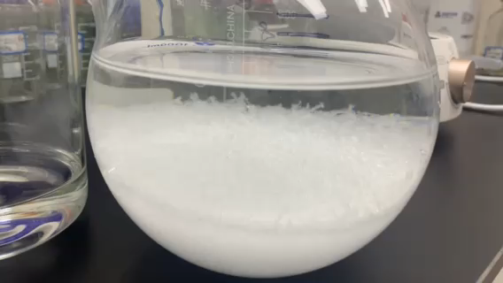
LiCl Water Solution Attenuation Length
LiCl water solution attenuation length improvement
Absorption with powered activated charcoal
Thermal recrystallization

Slide 11
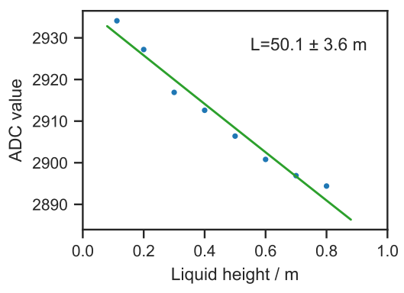
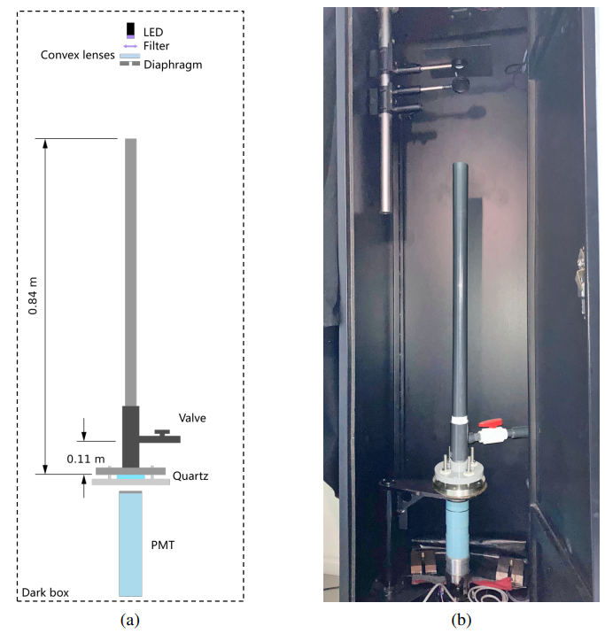
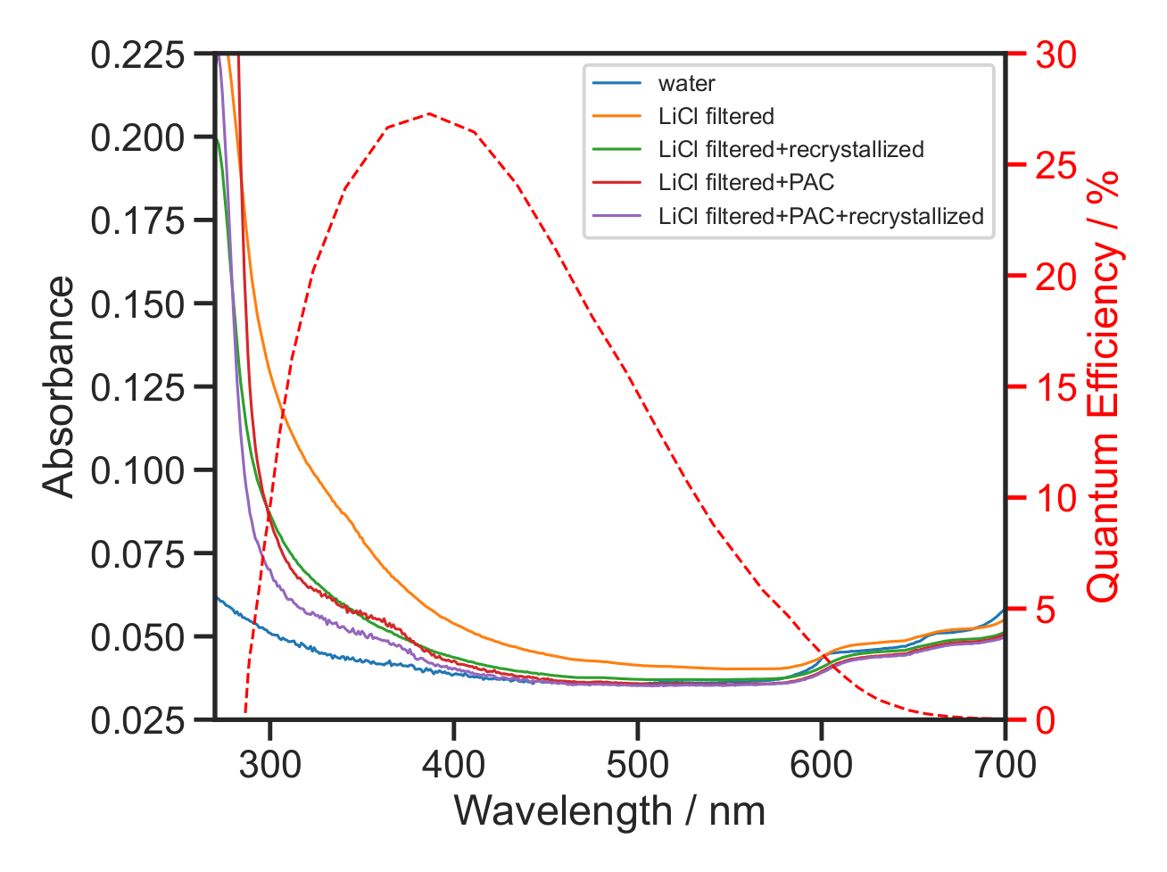
LiCl Water Solution Attenuation Length
50 m attenuation length
achieved.

Slide 12
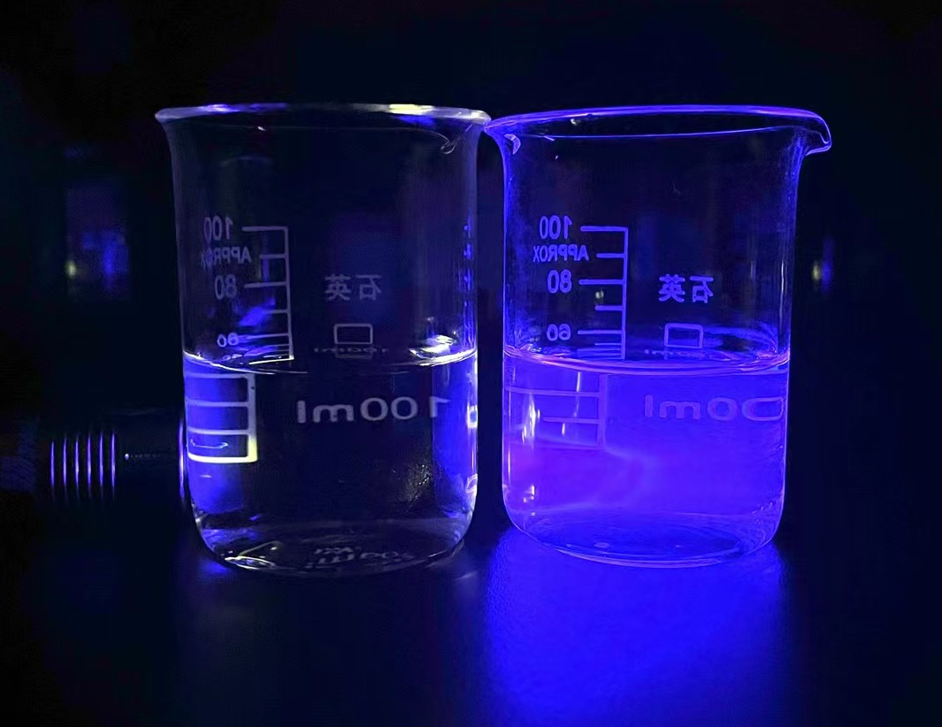
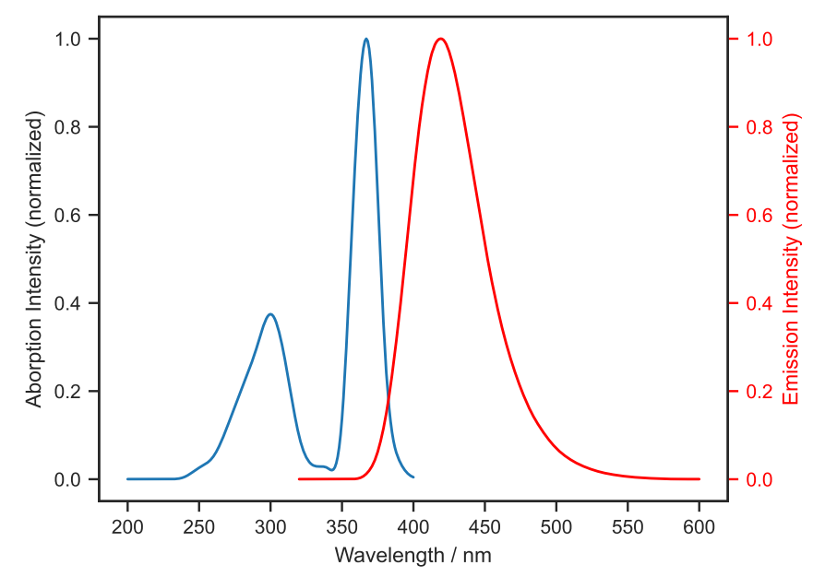
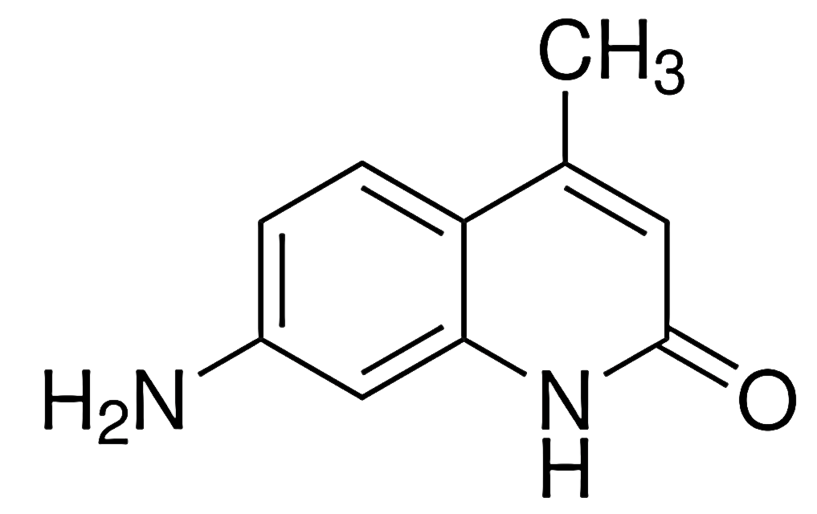
LiCl aqueous solution with carbostyril 124
Adding 1 ppm CS124 to LiCl aqueous solution
Convert short wavelength UV to longer wavelength
Convert short attenuation length UV to long attenuation length visible light
Minor scintillation light yield
LiCl solution
LiCl solution + 1 ppm CS124
CS124 absorption and emission spectra

Slide 13
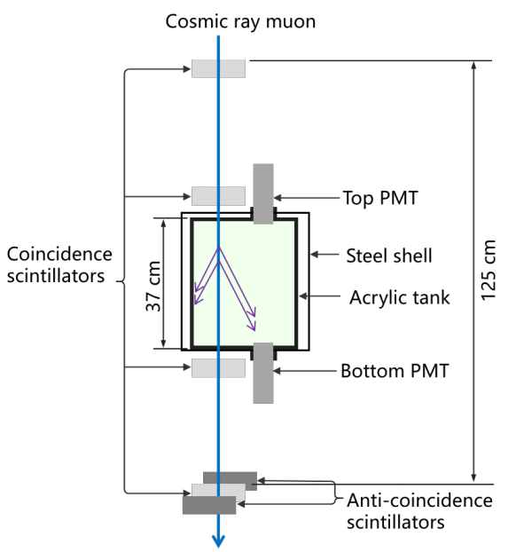
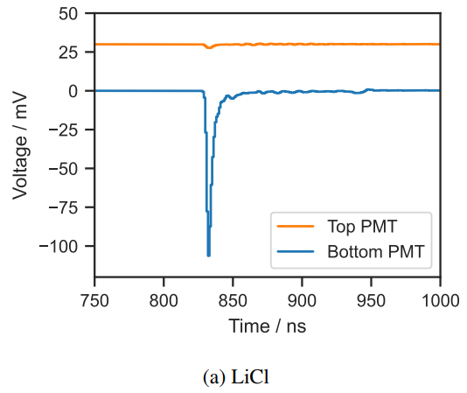
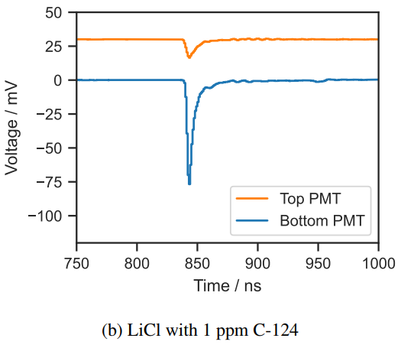
Uniform light output from LiCl solution+CS124
Light yield verification with a muon telescope
Reflection
Scintillation
Cherenkov
Cherenkov
3.7 PE detected from isotropic scintillation (uniform)
12.3 PE for Cherenkov (forward)

Slide 14
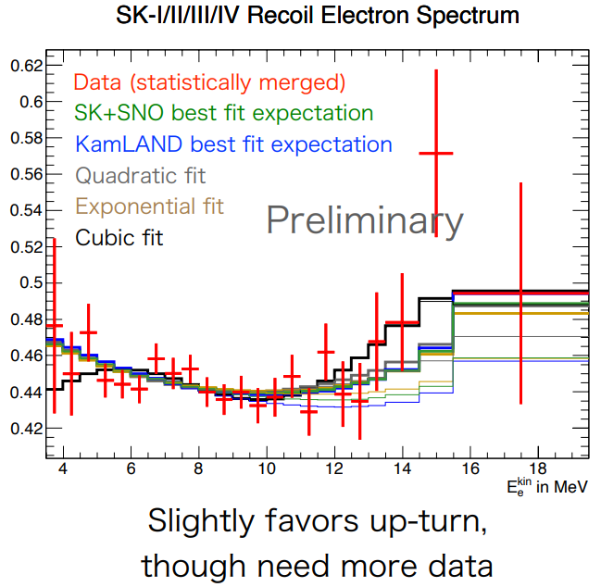
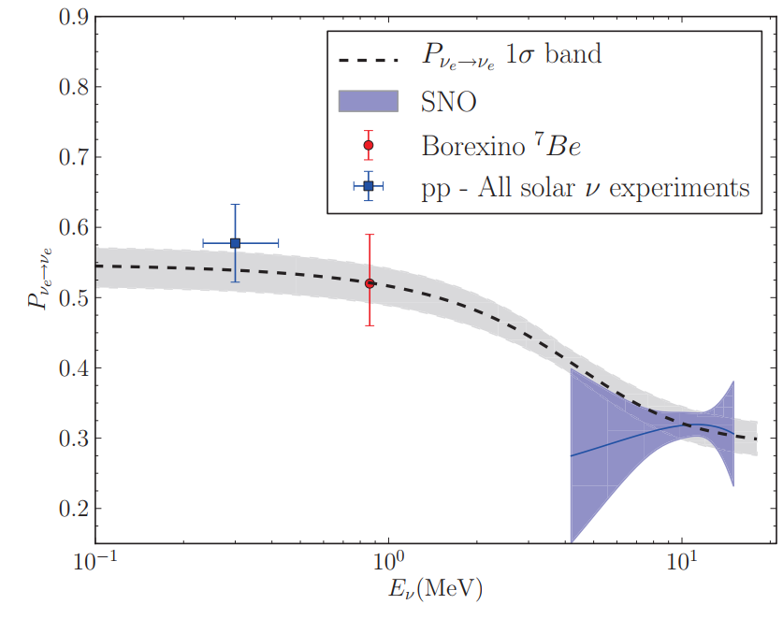
Solar Neutrino Upturn effect
Solar neutrino survival probability vs energy
SNO
SK

Slide 15
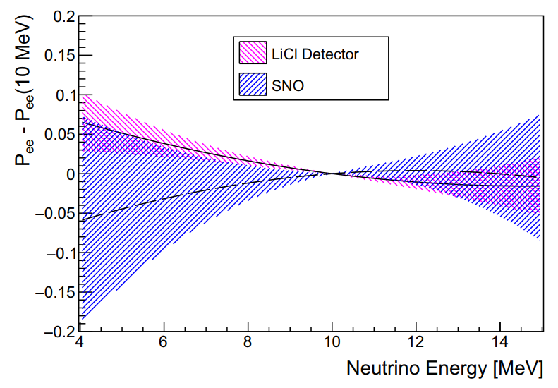
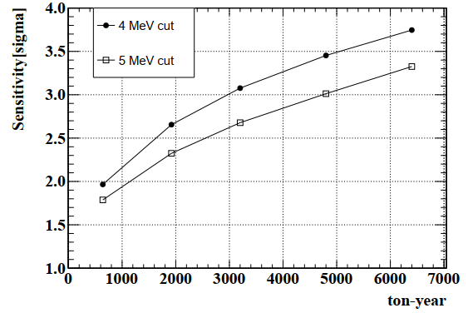
Upturn effect sensitivity with LiCl Solution
Solar neutrino survival probability-average vs energy
Upturn discovery sensitivity versus exposure
6400 ton-year, 4 MeV cut
5-10 years for 3 sigma
CC on Li7 has an advantage than ν-e ES in measuring solar neutrino upturn effect.
JNE - A compact detector!
SK
SNO

Slide 16
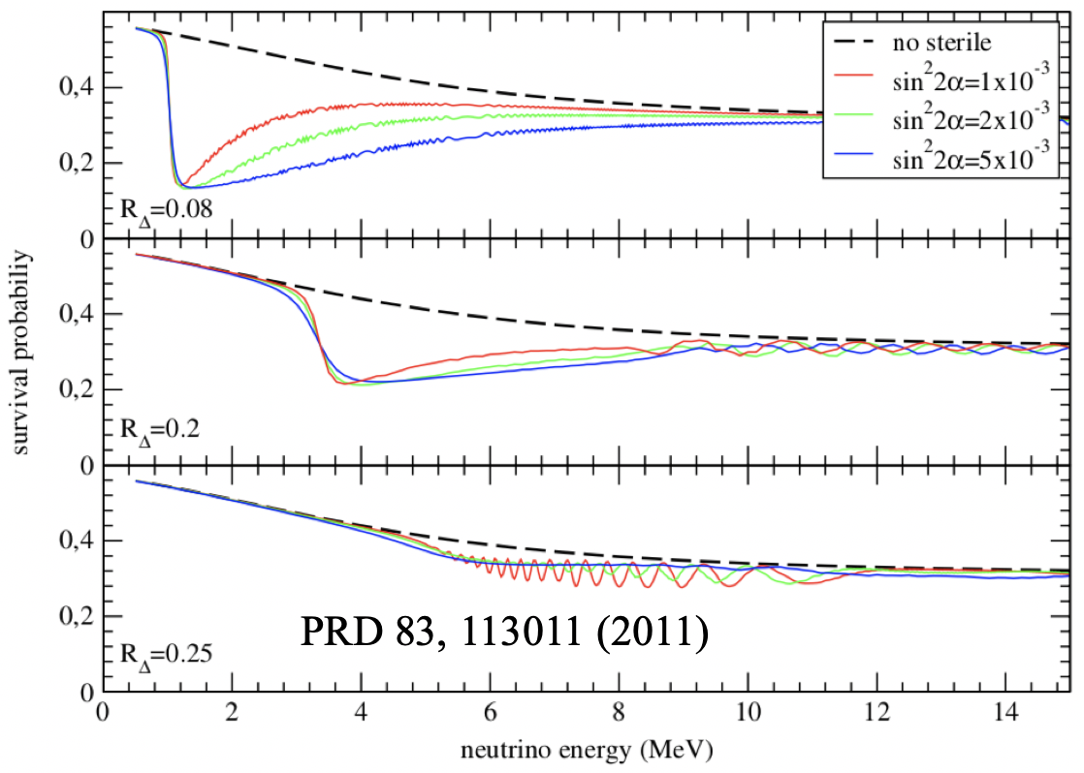
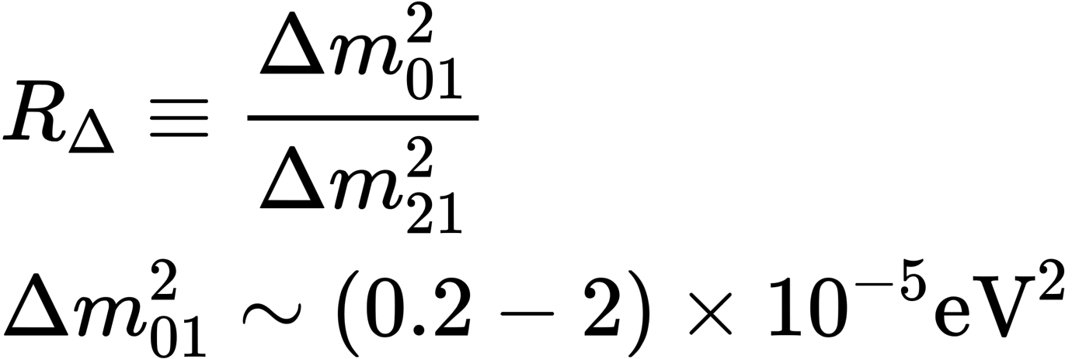
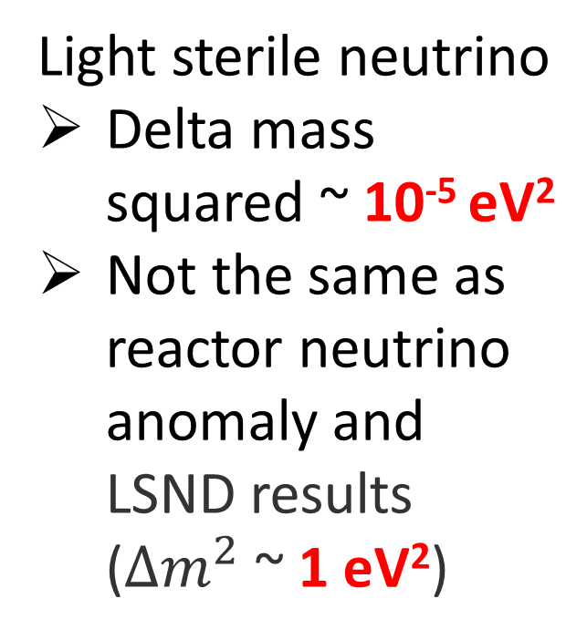
Light Sterile Neutrino in Solar Neutrino Physics
Light sterile neutrino
Delta mass squared ~ 10⁻⁵ eV²
Not the same as reactor neutrino anomaly and LSND results ($∆m^{2}$ ~ 1 eV²)
Dip and wiggle
Structures: need a CC-Li7 detector

Slide 17
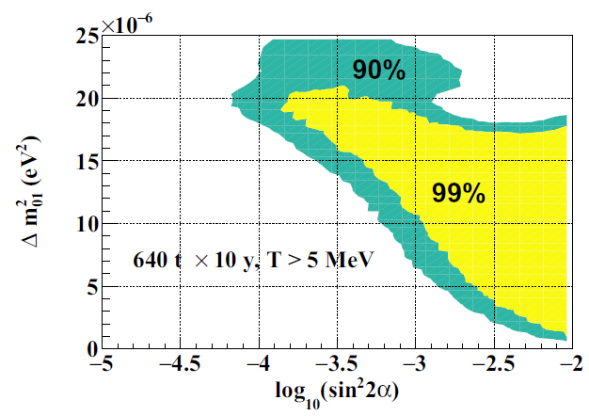
CC-Li7 for Light Sterile Neutrino Rejection
Sensitivity calculation for JNE.
Sensitive to small delta mass squared region of sterile neutrinos, 1e-5 eV²

Slide 18
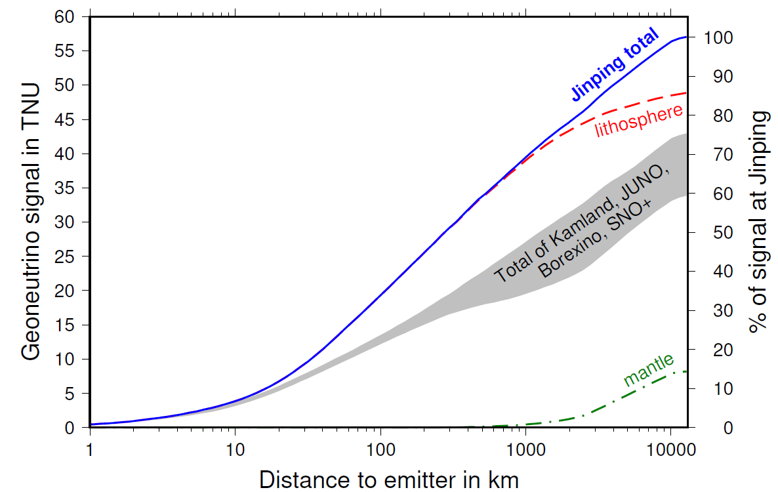
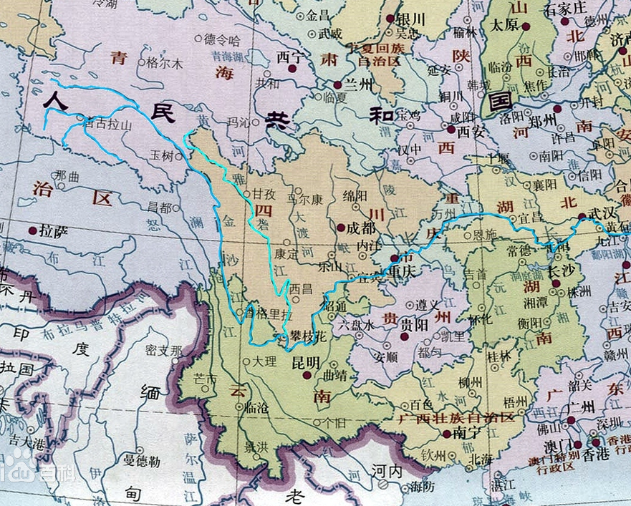
Geo Neutrinos at JNE
Ondrej Sramek et al, 2016
1000 km radius
JNE is very sensitive to Qinghai-Tibet plateau crust neutrinos

Slide 19
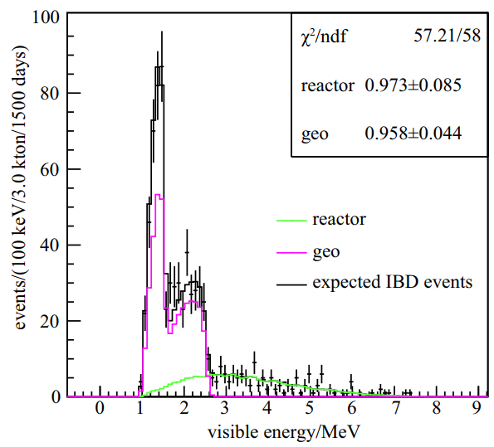
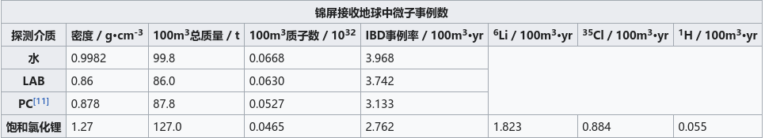
Geo Neutrino at JNE
With the prompt-delayed signal detection method in LiCl solution:
Minor reactor BKG at CJPL
Expect tens of geoneutrinos in 5-10 years with the 500-ton detector
(constrain crust model to
10-20%)
Initial result on U/Th ratio
Event rate summary for hundred-ton detector

Slide 20
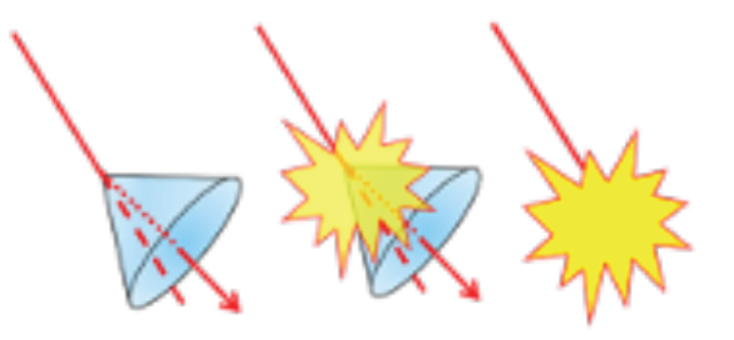
Adding CS124 indicates that: a high salt (LiCl) Cherenkov liquid scintillator is possible
Pure
LiCl aqueous solution
fluor
LiCl
aqueous + fluor solution
Direction
Energy
Position
Particle identification
Better than pure water or liquid scintillator

Slide 21
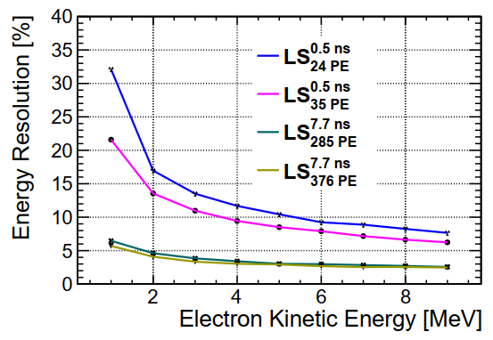
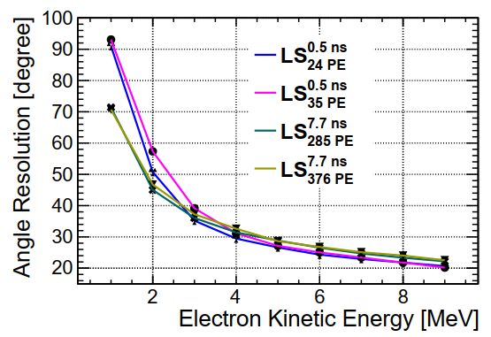
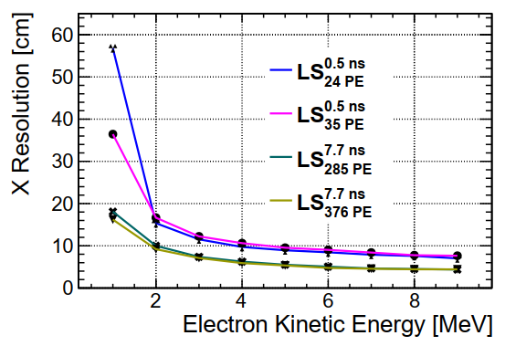
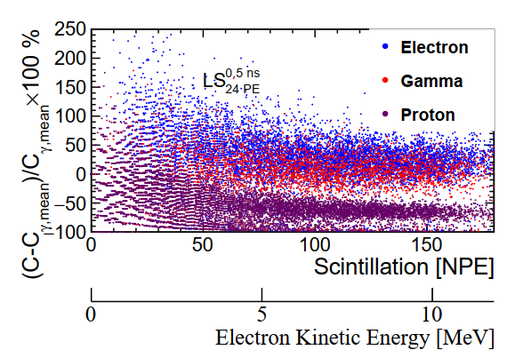
Cherenkov Liquid Scintillator Reconstruction
Reconstruct both Cherenkov light and scintillation light
Energy; 2. Direction; 3. Position; 4. Particle identification
Guide liquid scintillator development
Scintillation decay time
Scintillation light yield

Slide 22
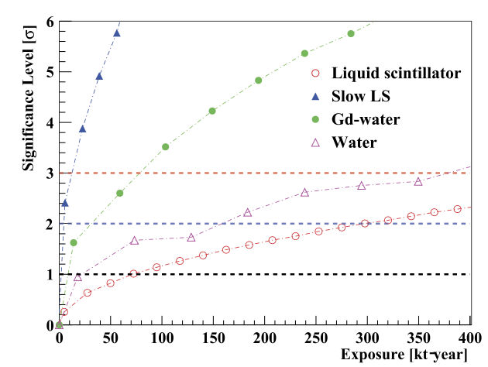
Diffuse supernova neutrino background
With Cherenkov-scintillation liquid scintillator:
Have the capability for particle identification to suppress atmospheric neutrino neutral current background
Expect a few golden candidate supernova relic neutrinos in 5-10 years with the 500-ton detector
Cherenkov LS
Expect an improvement better than this figure. Work in progress.

Slide 23
Summary
LiCl aqueous solution
  Long attenuation length, 50 m at 430 nm
  Fluor can be added, ex. CS-124 ➔ Cherenkov liquid scintillator
Compact detector for solar neutrino upturn study
Sizable geo-neutrino signal strength from Qinghai-Tibet plateau
Great signal-to-background ratio in DSNB detection
LiCl aqueous solution -- A new neutrino detection medium candidate

Slide 24
Thank you.
All related publications can be found at http://jinping.hep.tsinghua.edu.cn/Publications.php

