Slide 1
An update to
Estimation of CP violating EDMs from known mechanisms in the SM
An experimentalist’s take on…
Prajwal T. Mohan Murthy
MIT Laboratory for Nuclear Science
Apurva Chauhan Jeff A. Winger
Wellesley College Mississippi State University

Slide 2
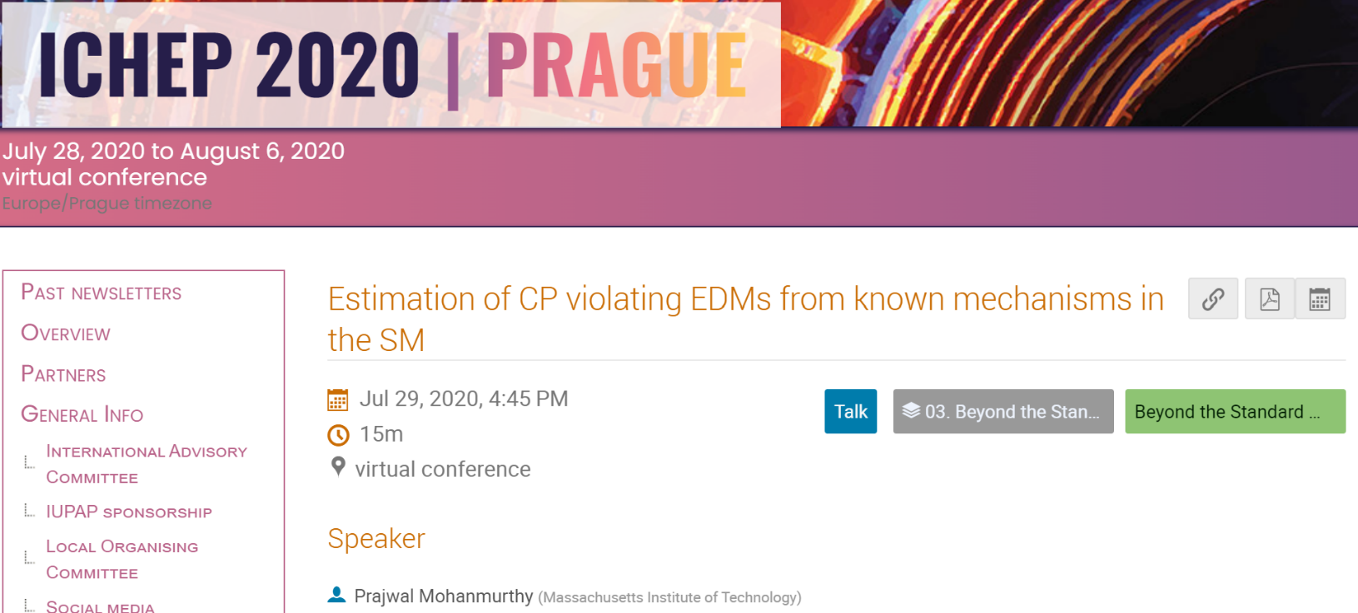
Overview: Very much an update!
CPV in SM
Atoms
Summary
1
2
3
4
5
Sub-atomic particles
Molecules

Slide 3
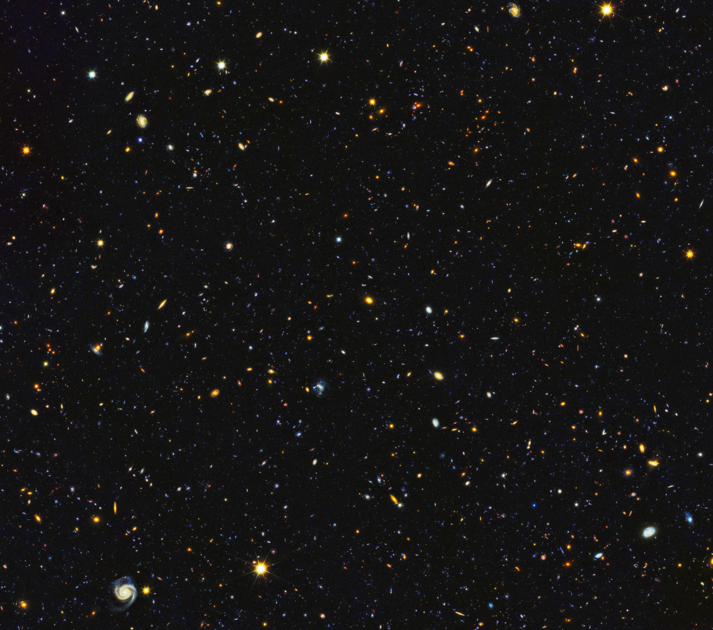
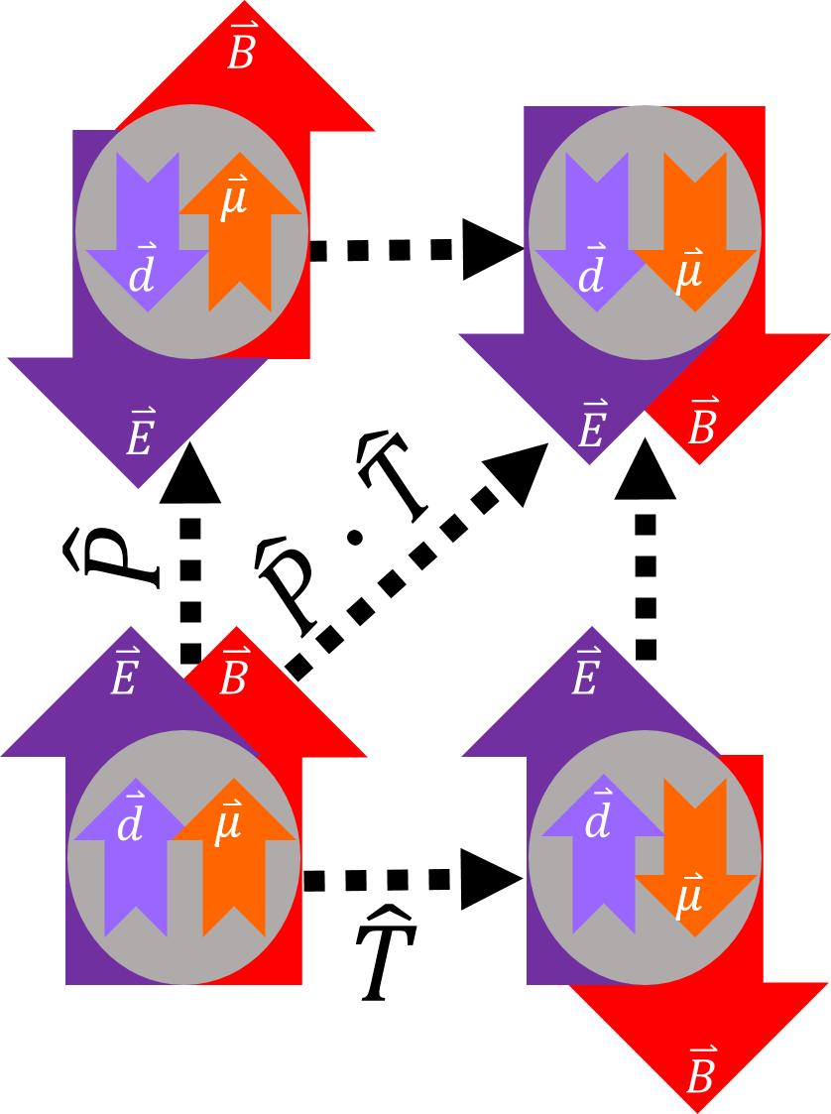
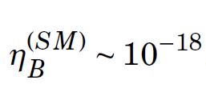

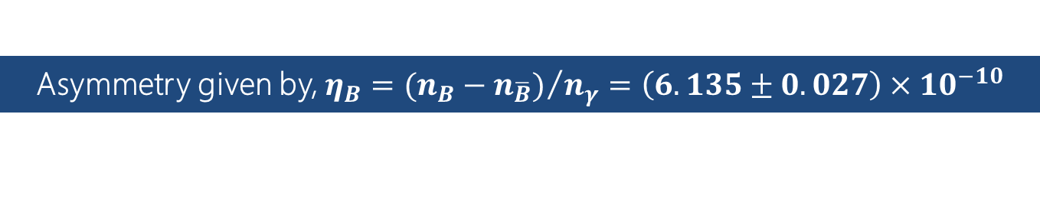

T/CP Violation?
1
Naively, equal amounts of matter and antimatter; but, most of this is matter…
CPT: CP Violation ↔ T Violation
Asymmetry given by, $η_{B}={(n_{B}−n_{\overline{B}})}/{n_{γ}=\left(6.135±0.027\right)×{10}^{−10}}$
Sakharov Conditions
Baryon # violation
C & CP violation
Out of thermodynamic equilibrium
CKM (QCD-$\overline{θ}$)
Non zero EDM of sub-atomic particles:
Leptons
Baryons
violate P, CP, and T symmetries.
Even atomic EDM violate P/CP/T.
Example: in e, n →
An EDM is a signature of P, T, CP, CT violation
Plank Collaboration, arXiv: 1807.06209

Slide 4
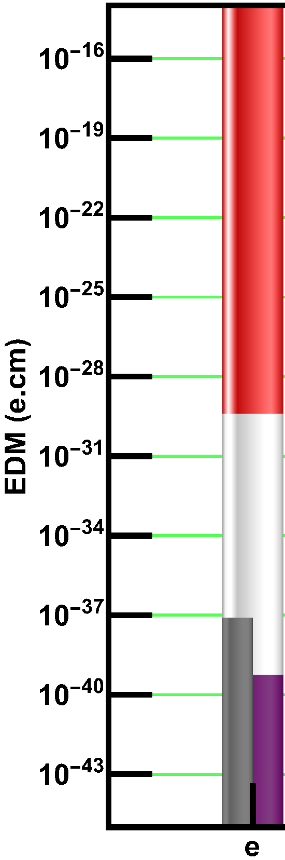
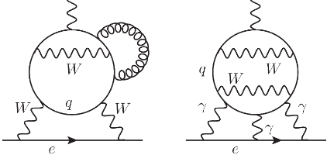
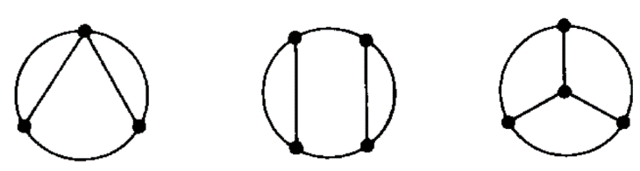
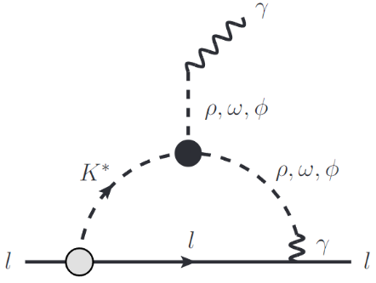
Charged Leptons: e
2
(i) EDM from SM-CKM (4-loop); (ii) EDM from SM-θ_{QCD}
90 % C.L. upper limit from YbF⁺ e-EDM experiment
T. S. Roussy et al., Science 381, 46 (2023)
M. Pospelov and A. Ritz, Phys. Rev. D 89, 056006 (2014)
4-loop
F. Hoogeveen, Nucl. Phys. B 341, 322 (1990)
3-loop
4-loop
Dressed with mesons
D. Ghosh & R. Sato, Phys. Lett. B 777, 335 (2018)
Electron SM-θ-EDM
Electron SM-CKM-EDM
Y. Yamaguchi and N. Yamanaka, Phys. Rev. Lett. 125, 241802 (2020)

Slide 5
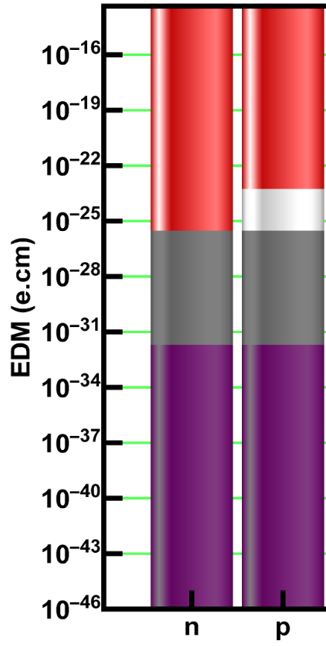
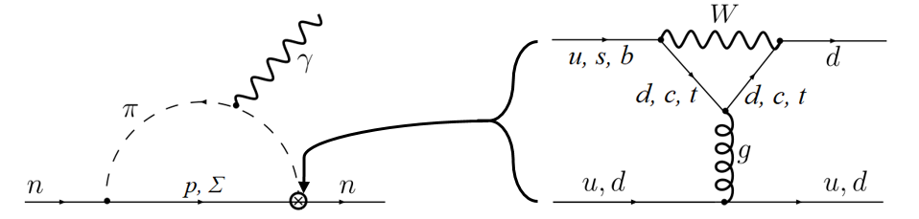






Reminder: Light Baryons
2
(i) SM-CKM-EDM (1-loop); (ii) SM-$\overline{θ}$ directily from nEDM
$d_{n}<(1.8×{10}^{−26})$ e.cm (UCN)
C. Abel, et al., Phys. Rev. Lett. 124, 081803 (2020).
Neutrons ~ Proton
($n→pπ^{−}$)
($p→nπ^{+}$)
($n→pπ^{−}$)
($p→nπ^{+}$)
$d_{n}\sim \overline{θ}(6×{10}^{−17})$ e.cm → $\overline{θ}<3×{10}^{−10}$
n,p SM-θ-EDM, nEDM directly from QCD-$\overline{θ}$
M Pospelov and A Ritz. Ann. Phys. 318.1 (July 2005), pp. 119–169
n,p SM-CKM-EDM from diagrams above
IB Khriplovich and AR Zhitnitsky, Phys. Lett. B 109.6 (Mar. 1982), pp. 490–492.

Slide 6
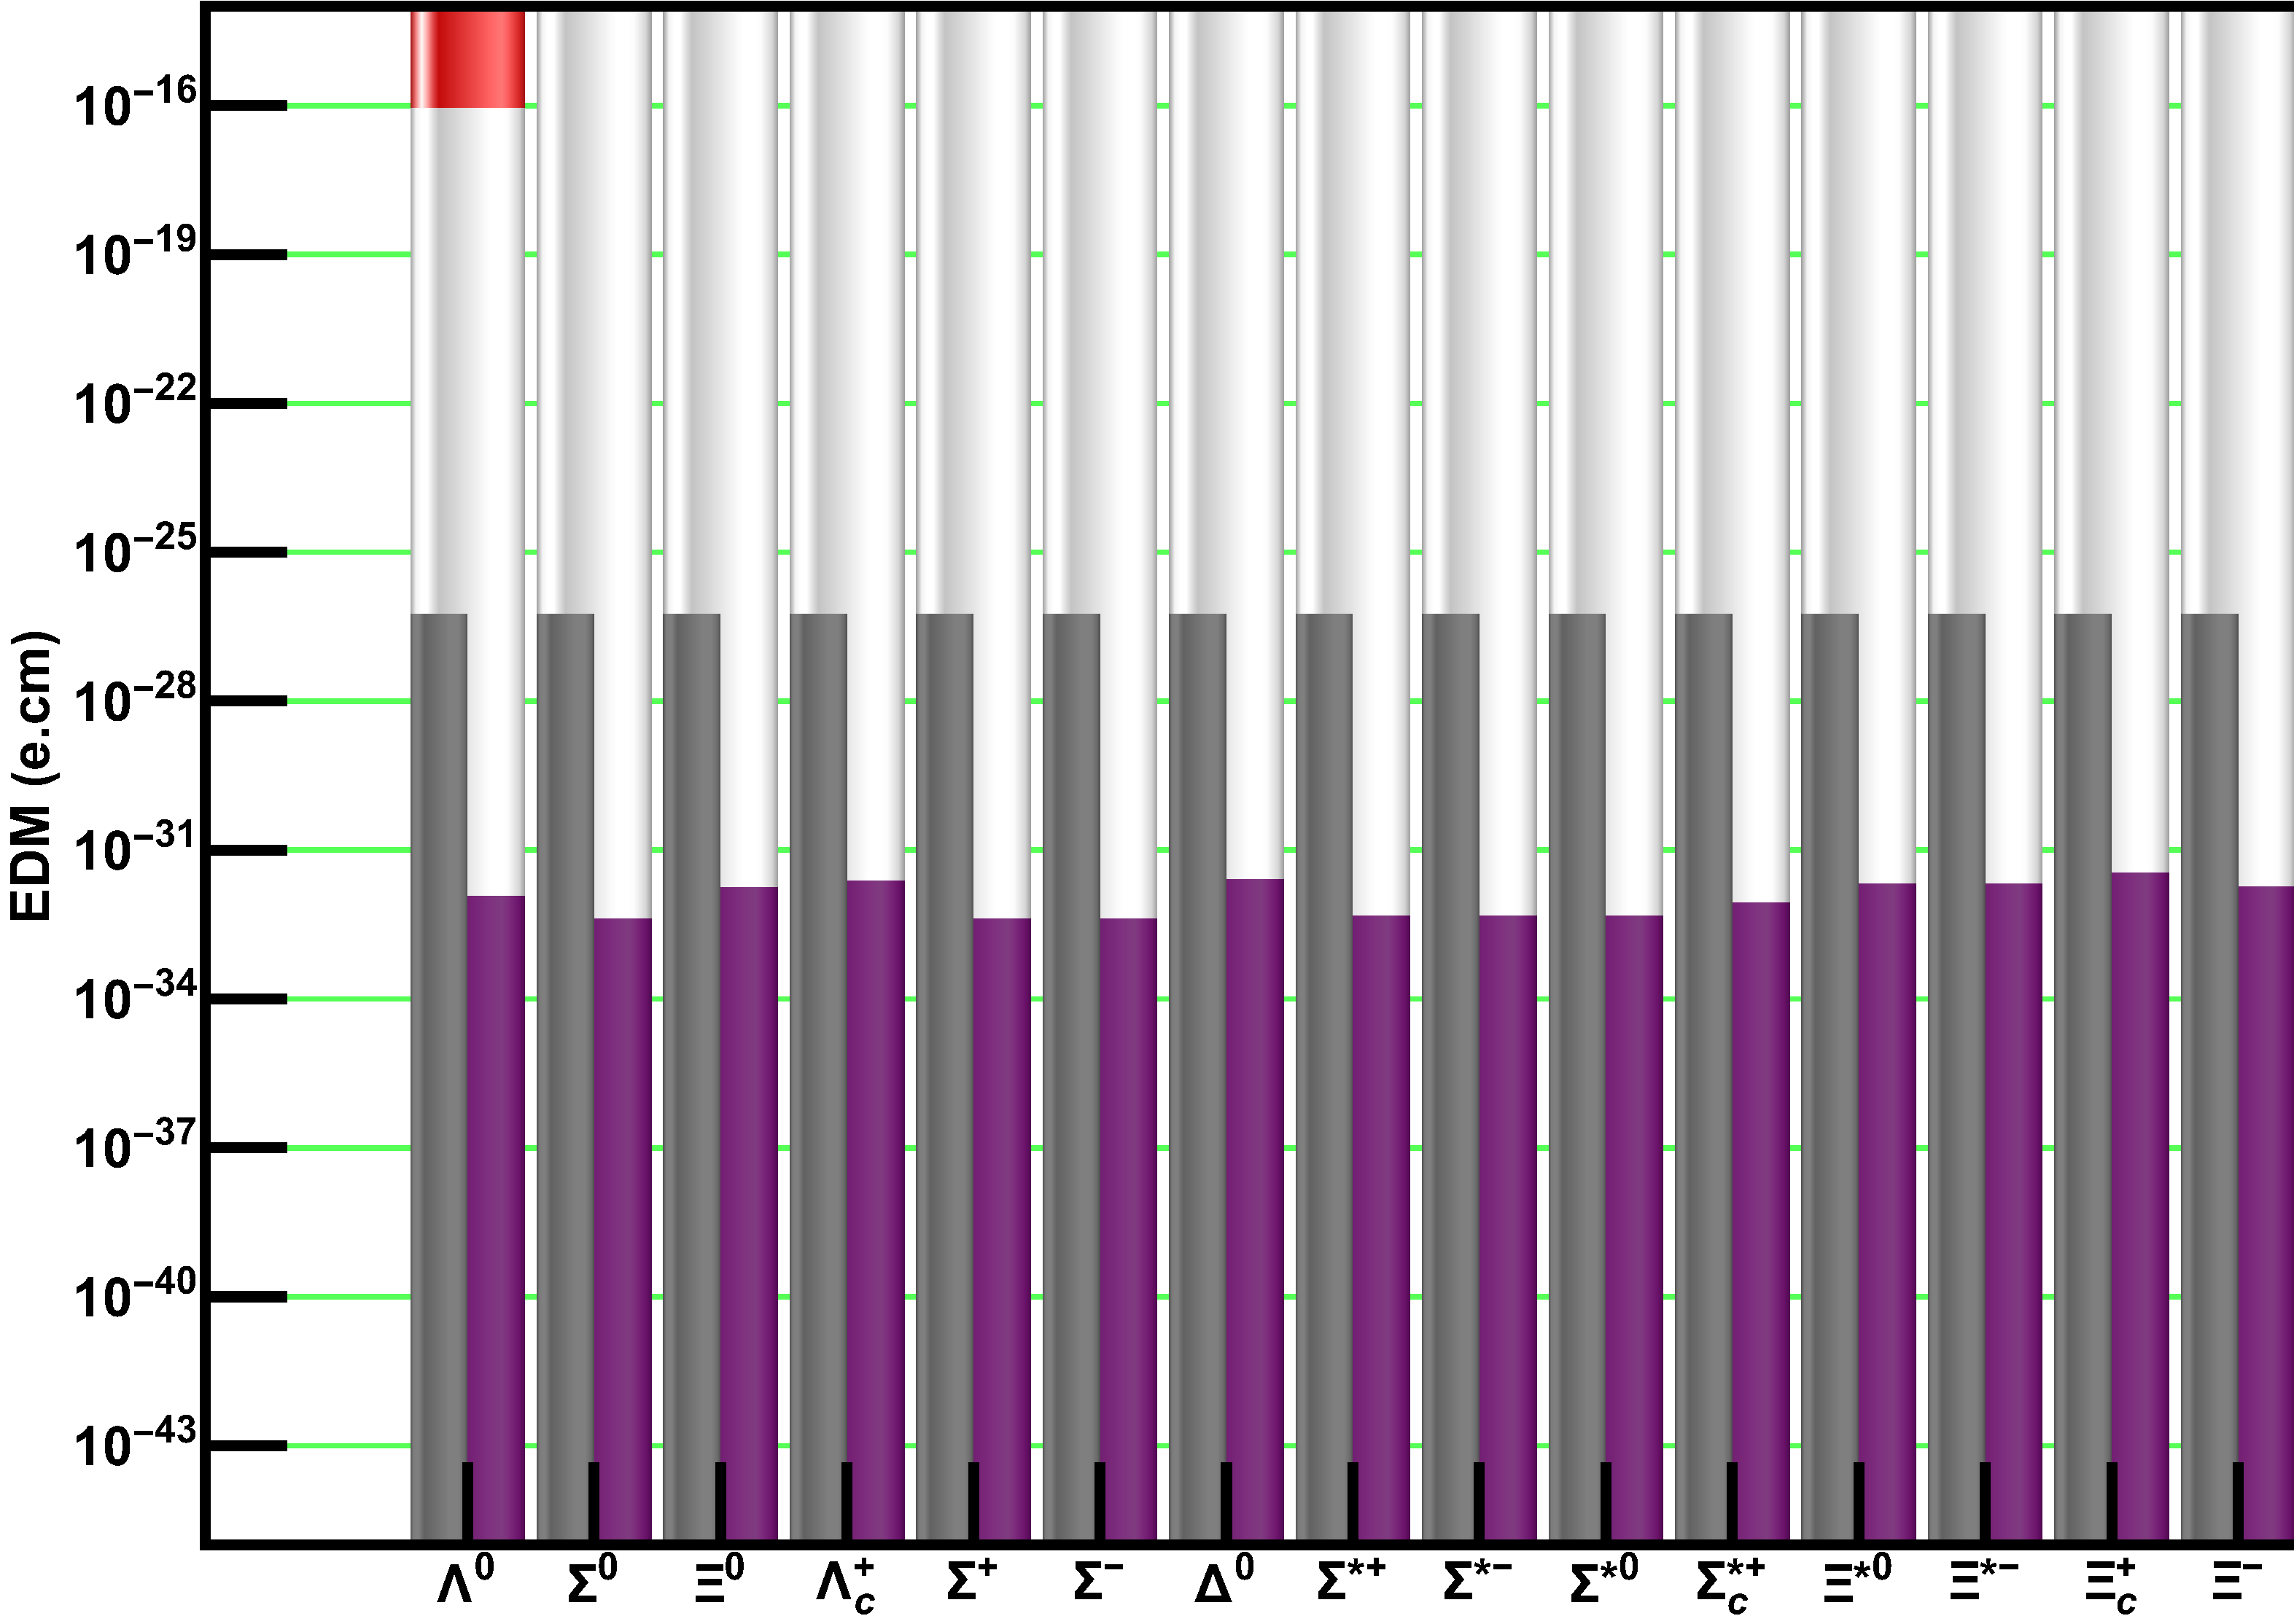
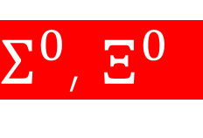
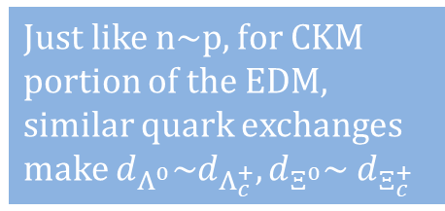



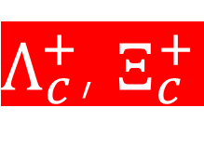



HEP Community: Do this!
2
(i) SM-CKM-EDM (1-loop); (ii) SM-$\overline{θ}$ similar to n,p EDM
$d_{n}\sim \overline{θ}(6×{10}^{−17})$ e.cm → $\overline{θ}<3×{10}^{−10}$
Limit SM-$\overline{θ}$-EDM to n,p-SM-$\overline{θ}$-EDM
$$d_{B}∝m_{B}$$
$$Λ^{0}$$
$$d_{Λ^{0}} \sim d_{n}/2$$
A. Pich & E. de Rafael, Nucl. Phys. B 367.2 (Dec. 1991), pp. 313–33
$Σ^{0}$, $Ξ^{0}$
$d_{Λ^{0}}:d_{Σ^{0}}:d_{Ξ^{0}}=$ 3 : -1 : 4
D Atwood & A Soni., Phys. Lett. B 291.3 (Sept. 1992), pp. 293–296.
$Λ_{c}^{+}$, $Ξ_{c}^{+}$
Just like n~p, for CKM portion of the EDM, similar quark exchanges make $d_{Λ^{0}}\sim d_{Λ_{c}^{+}},d_{Ξ^{0}}\sim d_{Ξ_{c}^{+}}$
Only 1 of these has an indirect measurement, which comes from pX fixed target experiments.

Slide 7
Atoms
3
Net~ 0
In an atom…
EDM
Nucleus
e-cloud
EDM’
Exceptions:
Relativistic electrons in high-z atoms (Eg.: ²¹⁰Fr)
Deformed nuclei (Eg.: ²²⁵Ra)
CPV interaction between nucleus & electrons

Slide 8

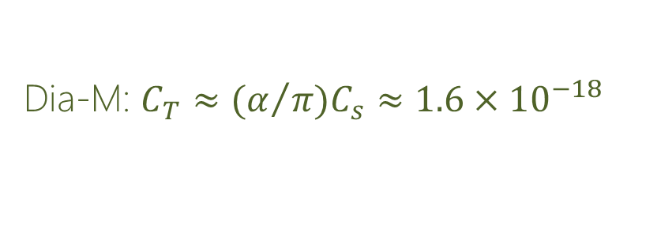


Atoms: LE parameters
3
$$d_{Atom}= ρ_{A}^{e}d_{e}$$
$+\sum_{N=\{p,n\}}{ρ_{Z}^{N}d_{N}}$
$+{ α}_{C_{s}}C_{s}$
$$+{ α}_{C_{T}}C_{T}$$
$$+{ α}_{{\overline{g}}_{π}^{0}}{\overline{g}}_{π}^{0}+α_{{\overline{g}}_{π}^{1}}{\overline{g}}_{π}^{1}$$
Electron
Neutrons & Protons
Scalar eN coupling
Tensor eN couping
πNN interactions
$$κ_{s}S$$
Schiff moment
Para-M: $C_{s}≈7×{10}^{−16}$
Dia-M: $C_{T}≈{{(α}/π)C}_{s}≈1.6×{10}^{−18}$
T. Chupp and M. Ramsey-Musolf, Phys. Rev. C 91, 035502 (2015)
Y. Ema, T. Gao, and M. Pospelov, Phys. Rev. Lett. 129, 231801 (2022)

Slide 9
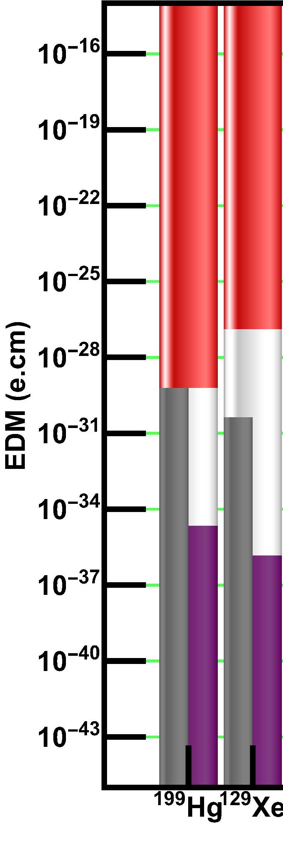

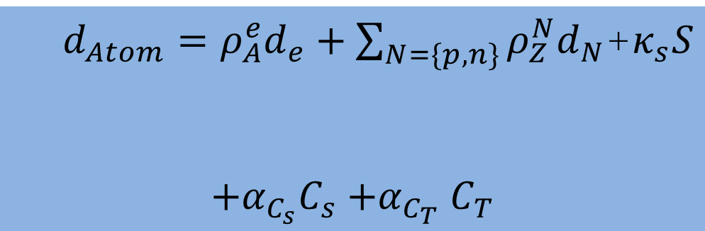
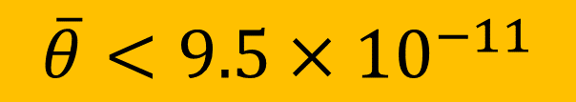

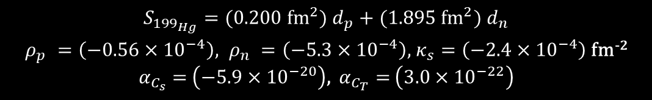
Atoms
3
>>Single Source: Electron, eN contributions are small<<
Dominated by CPV Schiff moment
Nuclear CPV EDMs are suppressed due to Schiff screening.
$d_{Atom}=ρ_{A}^{e}d_{e}+\sum_{N=\{p,n\}}{ρ_{Z}^{N}d_{N}}$+$κ_{s}S$
$$+α_{C_{s}}C_{s}{+α}_{C_{T}}C_{T}$$
e-EDM
n,p-EDM
Schiff mo.
$S_{{199}_{Hg}}=(0.200 {fm}^{2})$ $d_{p}+(1.895 {fm}^{2}) d_{n}$
$ρ_{p}^{}=\left(−0.56×{10}^{−4}\right), ρ_{n}^{}=\left(−5.3×{10}^{−4}\right)$, $κ_{s}=\left(−2.4×{10}^{−4}\right)$ fm⁻²
$α_{C_{s}}=$ $\left(−5.9×{10}^{−20}\right)$, $α_{C_{T}}=$ $\left(3.0×{10}^{−22}\right)$
$$C_{s}=0.03θ$$
$$C_{T}≈(α/π)C_{s}$$
$$\overline{θ}<9.5×{10}^{−11}$$
B Graner et al, Phys. Rev. Lett. 116.16 (Apr. 2016), p. 161601.
J Engel et al., Prog. Part. Nucl. Phys. 71 (July 2013), pp. 21–74.

Slide 10
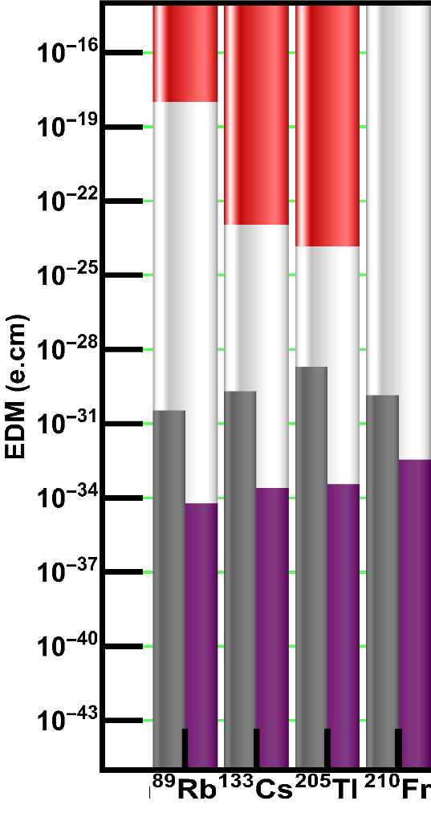
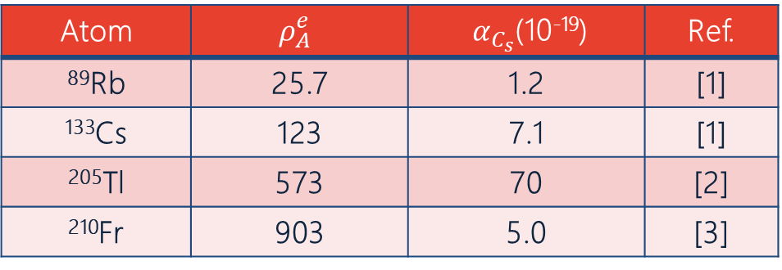
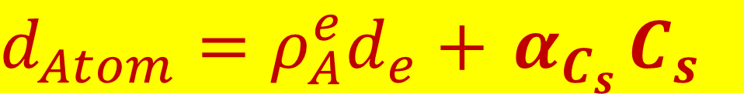
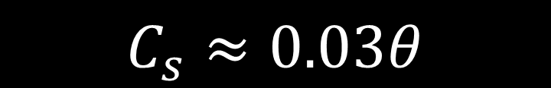
Atoms: Paramagnetic
3
>>Single Source: Electron contribution is small, dominated by CPV eN interactions<<
Underestimates: Lack of nuclear contributions, but comparable to ¹⁹⁹Hg
Atom | $$ρ_{A}^{e}$$ | ${ α}_{C_{s}}$(10⁻¹⁹) | Ref.
⁸⁹Rb | 25.7 | 1.2 | [1]
¹³³Cs | 123 | 7.1 | [1]
²⁰⁵Tl | 573 | 70 | [2]
²¹⁰Fr | 903 | 5.0 | [3]
$$d_{Atom}=ρ_{A}^{e}d_{e}+{ α}_{C_{s}}C_{s}$$
$$C_{s}≈0.03θ$$
[1] HS Nataraj et al., Phys. Rev. Lett. 101.3 (July 2008), p. 033002.
[2] ZW Liu and HP Kelly, Phys. Rev. A 45.7 (Apr. 1992), pp. 4210–4213.
[3] TMR Byrnes et al., Phys. Rev. A 59.4 (Apr. 1999), pp. 3082–3083.

Slide 11
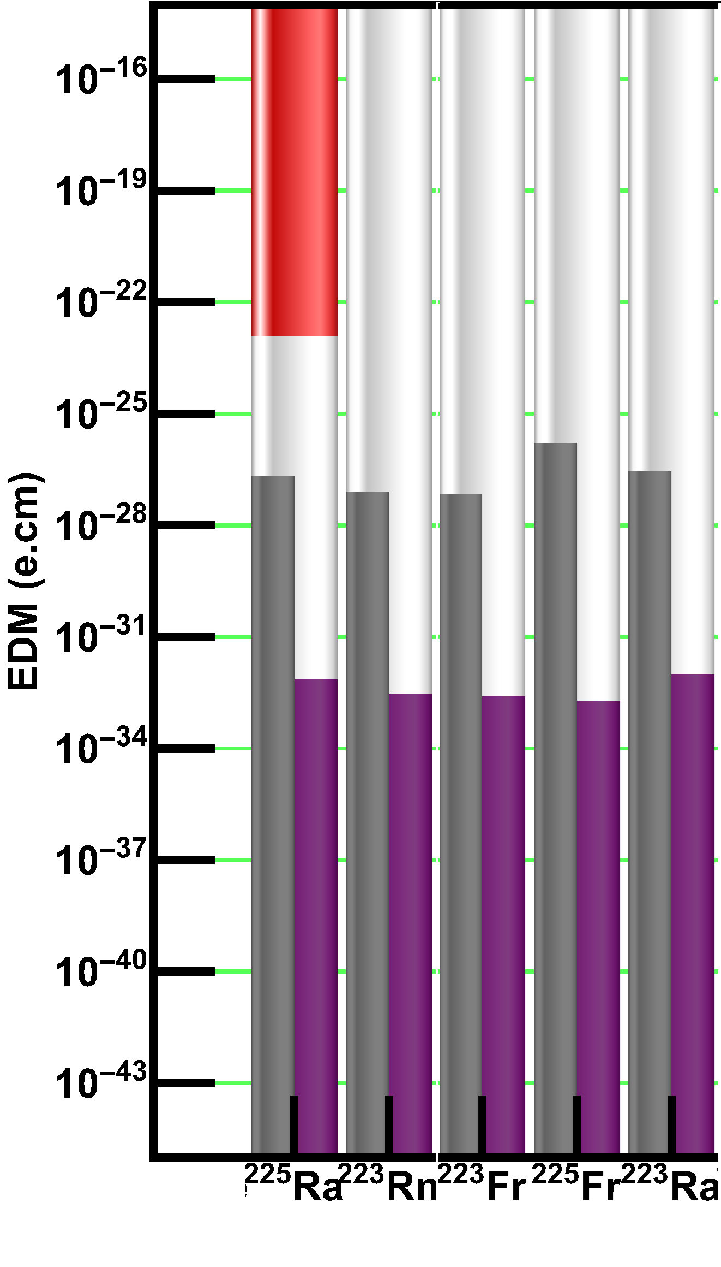
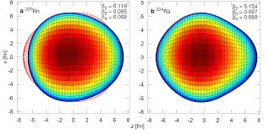
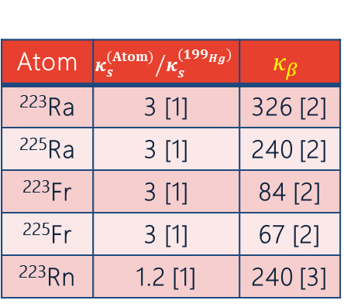
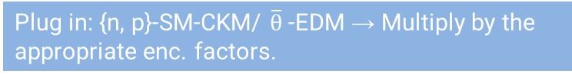
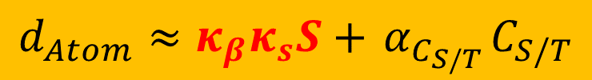
Deformed Atoms
3
Nuclear Octupole+Quadrupole deformation enhances atomic EDM
Rest of the diamagnetic systems are represented as a ratio w.r.t. ¹⁹⁹Hg
$$d_{Atom}≈κ_{β}κ_{s}S+{ α}_{C_{S/T}}C_{S/T}$$
Plug in: {n, p}-SM-CKM/ $\overline{θ}$-EDM → Multiply by the appropriate enc. factors.
Atom | $${κ_{s}^{(Atom)}}/{κ_{s}^{({199}_{Hg})}}$$ | $$κ_{β}$$
²²³Ra | 3 [1] | 326 [2]
²²⁵Ra | 3 [1] | 240 [2]
²²³Fr | 3 [1] | 84 [2]
²²⁵Fr | 3 [1] | 67 [2]
²²³Rn | 1.2 [1] | 240 [3]
[1] VA Dzuba et al., Phys. Rev. A 66.1 (July 2002), p. 012111
[2] JHd Jesus and J Engel, Phys. Rev. C Nucl. Phys. 72.4 (Oct. 2005), p. 045503
[3] V Spevak, et al., Phys. Rev. C Nucl. Phys. 56.3 (Sept. 1997), pp. 1357–1369

Slide 12
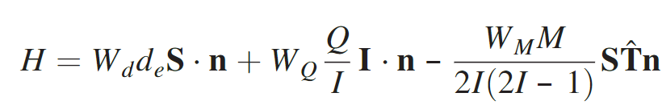
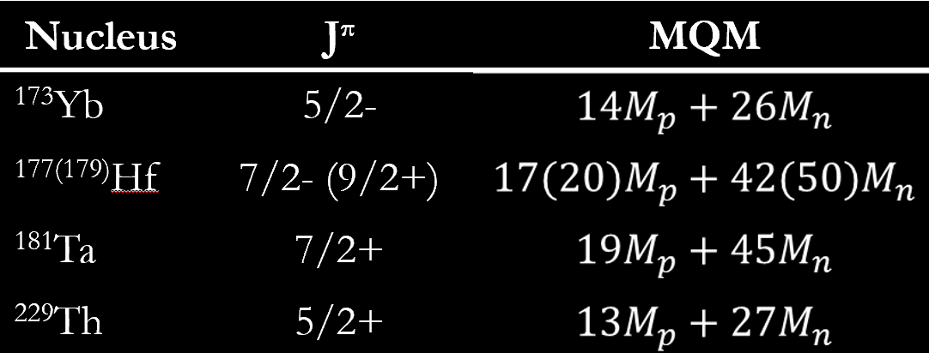
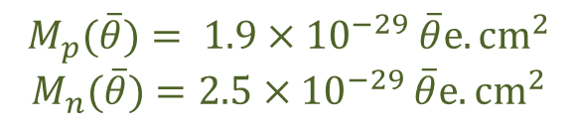

Mols: LE parameters
4
When nuclei with MQM, NSM is put in an mol. → Large (x10⁵) CPV EDM
e-EDM
e-spin
Nuclear Schiff Moment
Nuclear-spin
Mol.’s symmetry axis
Nuclear MQM
$$M_{p}(\overline{θ})= 1.9{×10}^{−29}\overline{θ}e.{cm}^{2}$$
$$M_{n}(\overline{θ})=2.5{×10}^{−29}\overline{θ}e.{cm}^{2}$$
$$M_{N}≈4.5×{10}^{−44}e.{cm}^{2}$$
B. G. C. Lackenby and V. V. Flambaum, Phys. Rev. D 98, 115019 (2018)

Slide 13
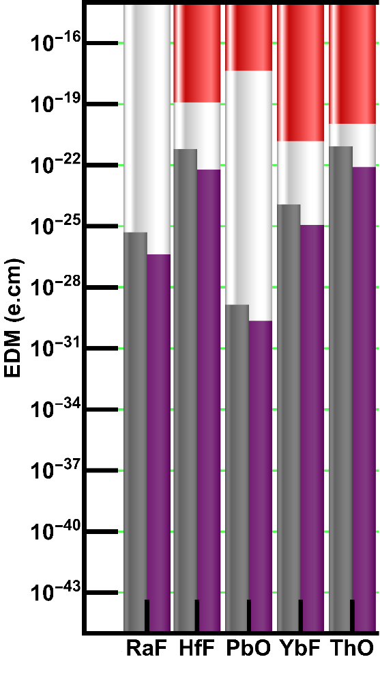
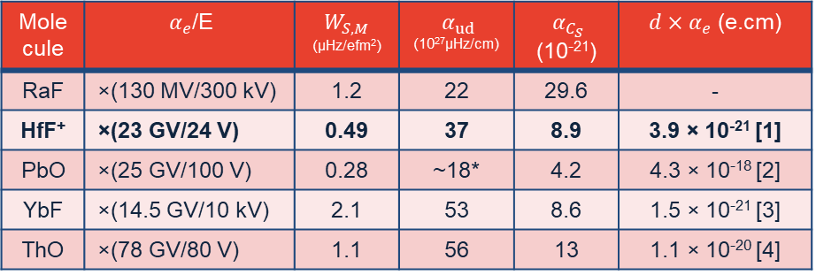

Apparatus
Polar Molecules
4
1
Polar molecules have LARGE intra-molecular E-field ~ GV/cm.
Comparing EDMs requires normalizing with this field.
$$σ_{d}∝1/E$$
$$d_{}\sim { α}_{e}d_{e}+{ α}_{p}d_{p}+{ α}_{C_{S}}C_{S}+W_{M}M_{N}+{ α}_{ud}(\tilde{d_{u}}−\tilde{d_{d})}$$
Molecule | ${ α}_{e}$/E | $$W_{S,M}$$ (µHz/efm²) | ${ α}_{ud}$ (10²⁷µHz/cm) | ${ α}_{C_{S}}$ (10⁻²¹) | $d×{ α}_{e}$ (e.cm)
RaF | ×(130 MV/300 kV) | 1.2 | 22 | 29.6 | -
HfF⁺ | ×(23 GV/24 V) | 0.49 | 37 | 8.9 | 3.9 × 10⁻²¹ [1]
PbO | ×(25 GV/100 V) | 0.28 | ~18* | 4.2 | 4.3 × 10⁻¹⁸ [2]
YbF | ×(14.5 GV/10 kV) | 2.1 | 53 | 8.6 | 1.5 × 10⁻²¹ [3]
ThO | ×(78 GV/80 V) | 1.1 | 56 | 13 | 1.1 × 10⁻²⁰ [4]
Best e-EDM: $d_{e}^{(HfF^{+})}<4.1×{10}^{−30}$ e.cm (90% CL)
Missing: FrAg, RaAg
$$\text{SM}\text{−}\text{CKM}\text{,}\overline{θ}\text{−}\text{EDM}∝(∗) \text{e}\text{−}\text{SM}\text{−}\text{CKM}\text{,}\overline{θ}\text{−}\text{EDM}$$
[1] T. S. Roussy et al., Science 381, 46 (2023). [2] S Eckel et al, Phys. Rev. A 87.5 (May 2013), p. 052130. [3] JJ Hudson et al., Nature 473.7348 (May 2011), pp. 493-496. [4] ACME Collaboration, Nature 562.7727 (Oct. 2018), pp. 355-360.

Slide 14
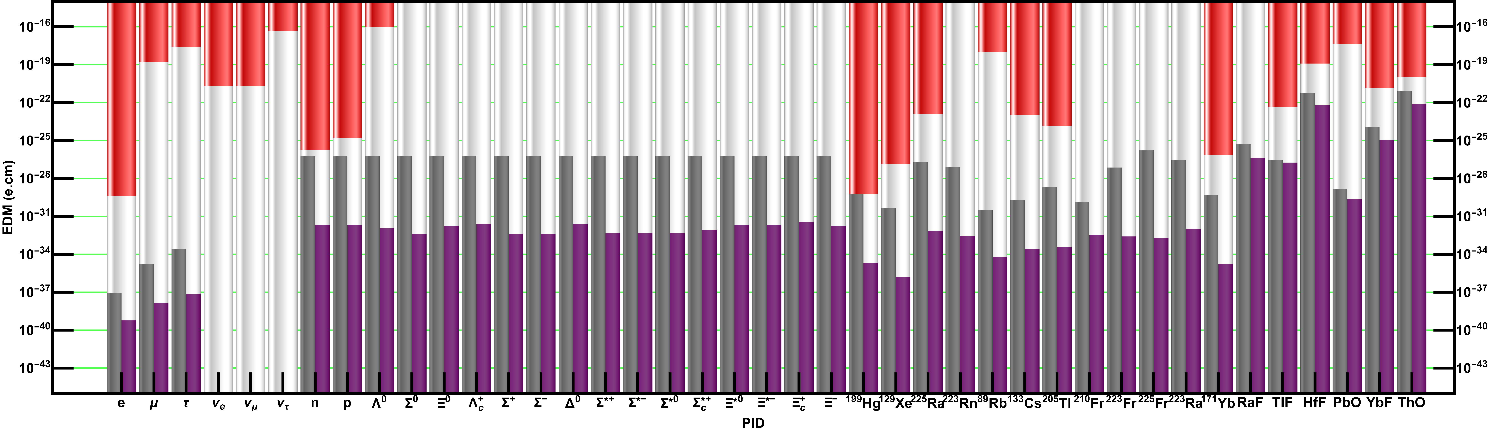

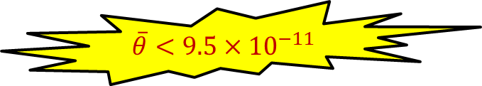
Summary
5
C_{s}, C_{T}
$\overline{θ}<9.5×{10}^{−11}$
S, M_{N}
!
HEP Community, impose limits (10⁻¹⁷ e.cm) on: $Σ^{+,∗+,0,−,∗−},Ξ^{−,∗−,0},Δ^{0},Λ_{c}^{+},Σ_{c}^{∗+},Ξ_{c}^{+}$
✔
Systems where SM “background free”: eg.-{e,µ,τ}. Systems where SM can explain any EDM discovered (without improvement in sensitivity): eg.-{n, ¹⁹⁹Hg}.
ASK ME ABOUT: ³He, p, n, Ra
Thanks: K. Kirch
DOE # DE-SC0014448/19768

Slide 15
Backup
Notes:
If there is relevant video content, such as a case study video, demo of a product, or other training materials, include it in the presentation as well.

Slide 16
Motivation
1
Strong CP Problem
Absence of CPV in Strong Sector

Slide 17
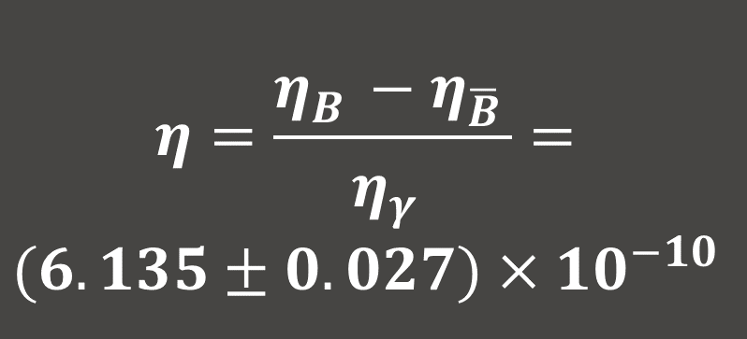
Motivation
1
Baryon Asymmetry of the Universe
$$η=\frac{η_{B}^{}−η_{\overline{B}}^{}}{η_{γ}^{}}=$$
$$(6.135±0.027)×{10}^{−10}$$
Planck Collaboration et al. arXiv: 1807.06209 [astro-ph.CO]

Slide 18


Sakharov Conditions
1
Lopsided baryon generation requires:
Baryon number violation (like ${p→\overline{e}π}^{0})$
C & CP Violation: CPV (n,e) EDM
Interactions out of thermal equilibrium
AD Sakharov, JETP Lett. 5.1 (1967), pp. 24–27.

Slide 19

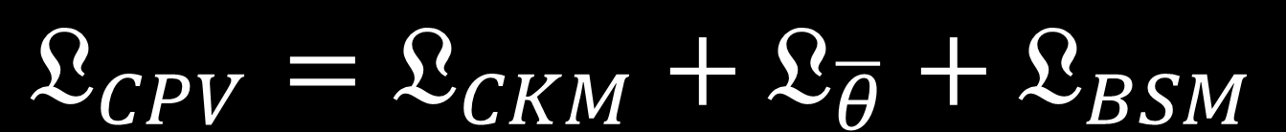

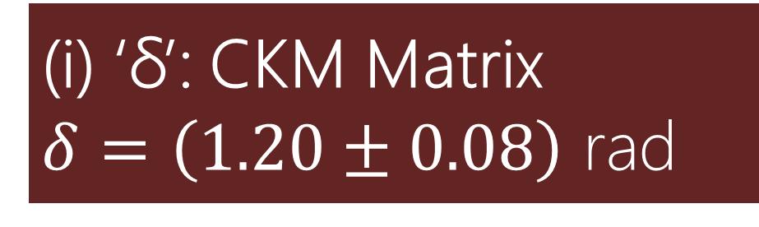
Sources of CPV in SM
1
$$𝔏_{CPV}=𝔏_{CKM}+𝔏_{\overline{θ}}+𝔏_{BSM}$$
(i) ‘δ’: CKM Matrix
$δ=\left(1.20±0.08\right)$ rad
$$\left[\begin{matrix}V_{ud} & V_{us} & V_{ub} \\ V_{cd} & V_{cs} & V_{cb} \\ V_{td} & V_{ts} & V_{tb}\end{matrix}\right]$$
(ii) ‘$\overline{θ}$’: QCD, $\overline{θ}≲{10}^{−10}$
G ’t Hooft, Phys. Rev. Lett. 37.1 (July 1976)

Slide 20


Sources of CPV in SM
1
$$𝔏_{CPV}=𝔏_{CKM}+𝔏_{\overline{θ}}+𝔏_{BSM}$$
(i) ‘δ’: CKM Matrix
$δ=\left(1.20±0.08\right)$ rad
$$\left[\begin{matrix}V_{ud} & V_{us} & V_{ub} \\ V_{cd} & V_{cs} & V_{cb} \\ V_{td} & V_{ts} & V_{tb}\end{matrix}\right]$$
$$η_{CKM} \sim {10}^{−18}$$
$$η_{BAU} \sim {10}^{−10}$$
A. Riotto and M. Trodden, Annu. Rev. Nucl. Part. Sci. 49, 35 (1999).

Slide 21

Sources of CPV in SM
1
$$𝔏_{CPV}=𝔏_{CKM}+𝔏_{\overline{θ}}+𝔏_{BSM}$$
(i) ‘δ’: CKM Matrix
$δ=\left(1.20±0.08\right)$ rad
$$\left[\begin{matrix}V_{ud} & V_{us} & V_{ub} \\ V_{cd} & V_{cs} & V_{cb} \\ V_{td} & V_{ts} & V_{tb}\end{matrix}\right]$$
Too Little…
Need other sources.
What can we expect from $𝔏_{\overline{θ}}$
$$η_{CKM} \sim {10}^{−18}$$
$$η_{BAU} \sim {10}^{−10}$$
A. Riotto and M. Trodden, Annu. Rev. Nucl. Part. Sci. 49, 35 (1999).

Slide 22

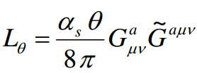
Strong CP Problem
1
Traditional Answer:
CP Violating Term – θ
Parity violation in weak sector?
Strong CP Problem
d_{n}< 2.9 ×10⁻²⁶ e.cm (90%C.L.)
θ < 10⁻¹⁰
Solution in strong sector:
Promote the “Theta” term to a QCD field. This field undergoes symmetry breaking to give rise to QCD Axions.

Slide 23
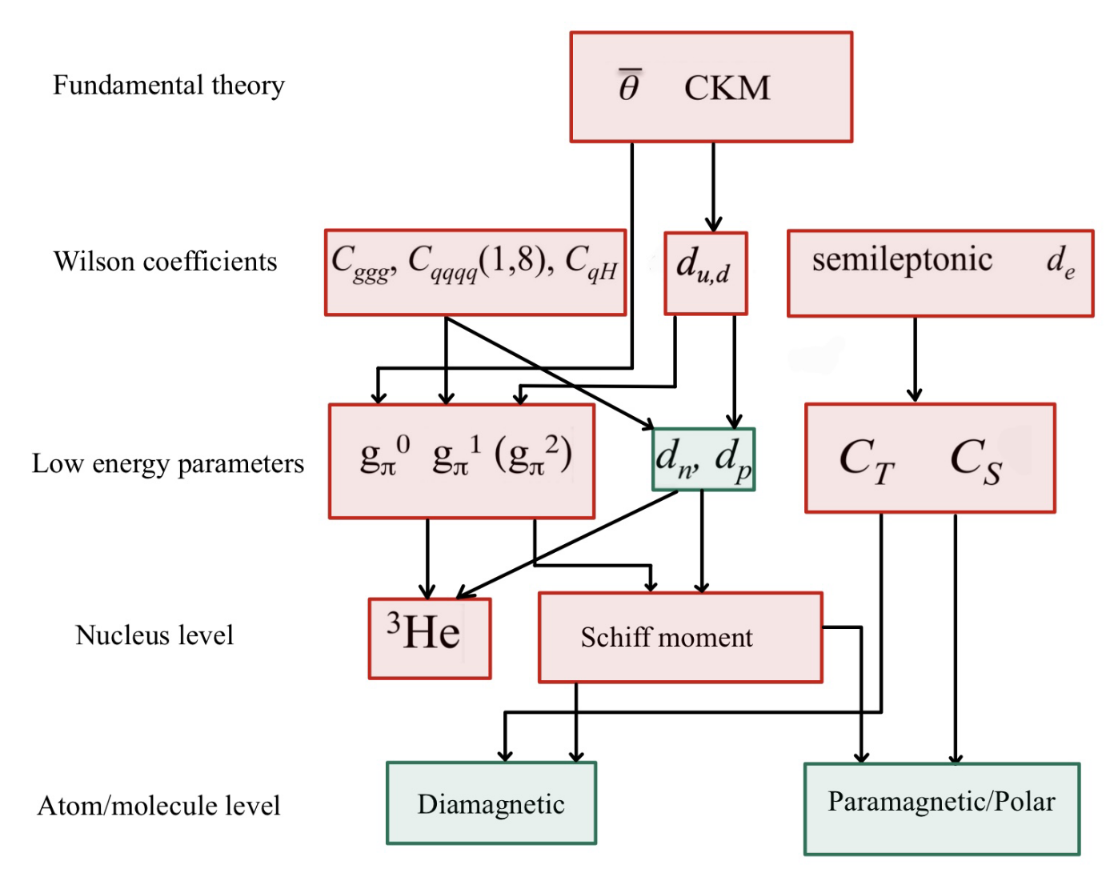


Low energy parameters
1
$$C_{s}≈7×{10}^{−16}$$
$$C_{T}≈{{(α}/π)C}_{s}≈1.6×{10}^{−18}$$
T. Chupp and M. Ramsey-Musolf, Phys. Rev. C 91, 035502 (2015)
Y. Ema, T. Gao, and M. Pospelov, Phys. Rev. Lett. 129, 231801 (2022)
A. Chauhan, BS Thesis, Wellesley College (2024)

Slide 24

Charged Leptons: e
2
(i) EDM from SM-CKM (4-loop); (ii) EDM from SM-θ_{QCD}
90 % C.L. upper limit from YbF⁺ e-EDM experiment
T. S. Roussy et al., Science 381, 46 (2023)
$ℒ_{CPV}=ℒ_{CKM}$+ $ℒ_{\overline{θ}}$+ $\boxed{ℒ_{?}}$
EDM if measured in this portion has a chance of having BSM origins.
Electron SM-θ-EDM
Electron SM-CKM-EDM
Y. Yamaguchi and N. Yamanaka, Phys. Rev. Lett. 125, 241802 (2020)

Slide 25
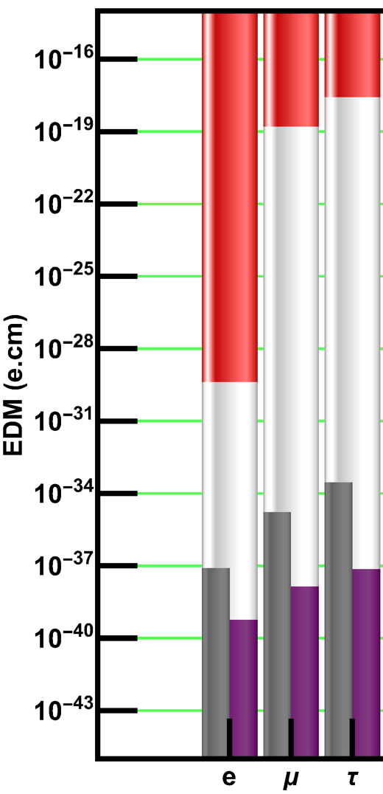

Charged Leptons: µ,τ
2
(i) EDM from SM-CKM (4-loop); (ii) EDM from SM-θ_{QCD}
$$d_{l}∝m_{l}$$
Muon
90 % C.L. upper limit from Muon g-2 experiment
Muon (g-2) Collaboration, Phys. Rev. D 80.5 (Sept. 2009), p. 052008.
Tau-Lepton
90 % C.L. upper limit from $e\overline{e}$: Belle Collaboration
K Inami et al. Phys. Lett. B 551.1 (Jan. 2003), pp. 16–26.
Updated by: K. Kirch and P. Schmidt-Wellenburg, arXiv: 2003.00717 (2020).
τ, µ SM-θ-EDM, scaled by mass from electron
D Ghosh and R Sato, Phys. Lett. B 777 (Feb. 2018), pp. 335–339.
τ, µ SM-CKM-EDM, scaled by mass from electron
M Pospelov and A Ritz, Phys. Rev. D 89.5 (Mar. 2014), p. 056006.

Slide 26
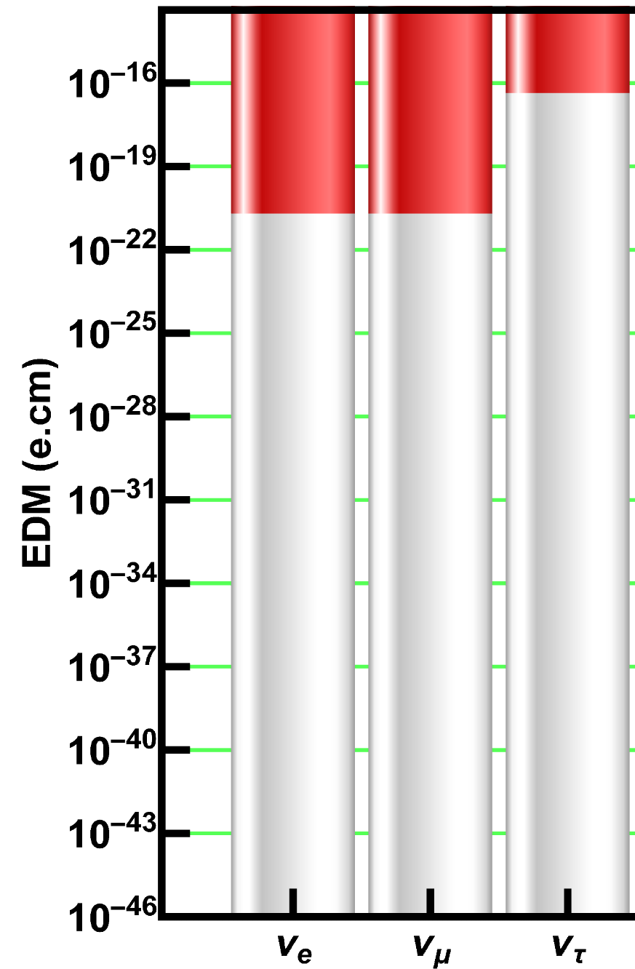
Neutrinos
2
(i) Not known! ; (ii) Not known! (iii) Only experimental constraints
Electron & Muon-Neutrino
90 % C.L. upper limit from indiect $e\overline{e}$: collisions
F del Aguila and M Sher, Phys. Lett. B 252.1 (Dec. 1990), pp. 116–118.
LB Okun, Sov. J. Nucl. Phys. ITEP–14 (1986).
Tau-Neutrino
90 % C.L. upper limit from indiect $e\overline{e}$: collisions
A Gutiérrez-Rodríguez et. al., Phys. Rev. D 69.7 (Apr. 2004), p. 073008.
R Escribano and E Massó, Phys. Lett. B 395.3 (Mar. 1997), pp. 369–372.

Slide 27





Reminder: Light Baryons
2
(i) SM-CKM-EDM (1-loop); (ii) SM-$\overline{θ}$ directily from nEDM
Neutrons ~ Proton
($n→pπ^{−}$)
($p→nπ^{+}$)
$d_{n}<(1.8×{10}^{−26})$ e.cm (UCN)
C. Abel, et al., Phys. Rev. Lett. 124, 081803 (2020).
Direct nEDM upper limit (<1.8×10⁻²⁶ e.cm) from UCN experiments
Better limit (<1.3×10⁻²⁶ e.cm) from ¹⁹⁹Hg, but a dirtier extraction
$d_{n}<(1.3×{10}^{−26})$ e.cm [¹⁹⁹Hg]
$d_{p}<(1.7×{10}^{−25})$ e.cm
B. Graner et al, Phys. Rev. Lett. 116.16 (Apr. 2016), p. 161601.
M Pospelov and A Ritz. Ann. Phys. 318.1 (July 2005), pp. 119–169
IB Khriplovich and AR Zhitnitsky, Phys. Lett. B 109.6 (Mar. 1982), pp. 490–492

Slide 28



Strange and Charmed Baryons
2
(i) SM-CKM-EDM (1-loop); (ii) SM-$\overline{θ}$ similar to n,p EDM
$d_{n}\sim \overline{θ}(6×{10}^{−17})$ e.cm → $\overline{θ}<3×{10}^{−10}$
Only 1 of these has an indirect measurement, which comes from pX fixed target experiments.
L Pondrom et al., Phys. Rev. D 23.3 (Feb. 1981), pp. 814–816.
Limit SM-$\overline{θ}$-EDM to n,p-SM-$\overline{θ}$-EDM
$$Λ^{0}$$
$$d_{Λ^{0}} \sim d_{n}/2$$
A. Pich & E. de Rafael, Nucl. Phys. B 367.2 (Dec. 1991), pp. 313-33

Slide 29

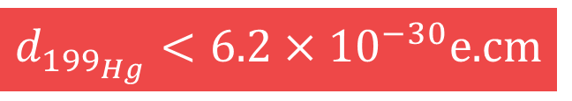


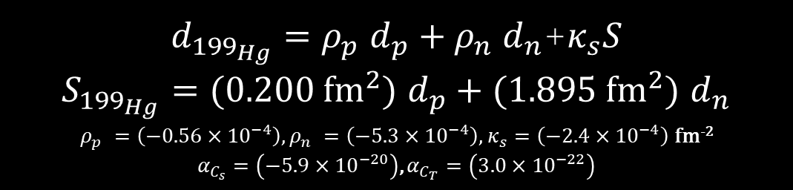
Atoms: Diamagnetic
3
!!Single Source: Electron, eN contributions are small!!
>>dominated by CPV Schiff moment<<
Nuclear CPV EDMs are suppressed due to Schiff screening.
$d_{Atom}=ρ_{A}^{e}d_{e}+\sum_{N=\{p,n\}}{ρ_{Z}^{N}d_{N}}$+$κ_{s}S$
$$+α_{C_{s}}C_{s}{+α}_{C_{T}}C_{T}$$
e-EDM
n,p-EDM
Schiff mo.
$d_{{199}_{Hg}}=ρ_{p}^{}d_{p}+ρ_{n}^{}d_{n}$+$κ_{s}S$
$S_{{199}_{Hg}}=(0.200 {fm}^{2})$ $d_{p}+(1.895 {fm}^{2}) d_{n}$
$ρ_{p}^{}=\left(−0.56×{10}^{−4}\right),ρ_{n}^{}=\left(−5.3×{10}^{−4}\right)$, $κ_{s}=\left(−2.4×{10}^{−4}\right)$ fm⁻²
$α_{C_{s}}=$ $\left(−5.9×{10}^{−20}\right)$, $α_{C_{T}}=$ $\left(3.0×{10}^{−22}\right)$
Plug in: {n, p}-SM-$\overline{θ}$-EDM
$d_{{199}_{Hg}}<6.2×{10}^{−30}$e.cm
$$\text{Plug} \text{in}\text{: \{}\text{n}\text{, }\text{p}\text{\}−}\text{SM}\text{−}\text{CKM}\text{−}\text{EDM}$$
B Graner et al, Phys. Rev. Lett. 116.16 (Apr. 2016), p. 161601.
J Engel et al., Prog. Part. Nucl. Phys. 71 (July 2013), pp. 21–74.

Slide 30
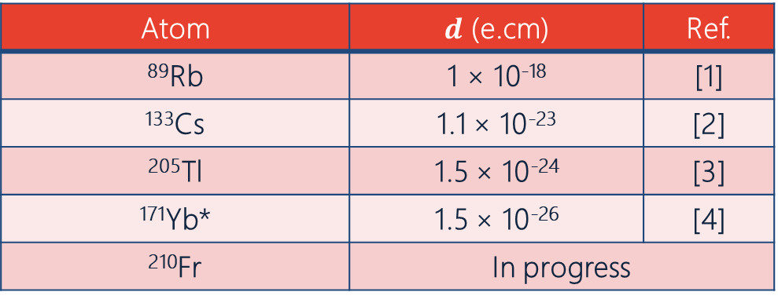
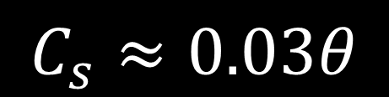

Atoms: Paramagnetic
3
>>Single Source: Electron contribution is small, dominated by CPV eN interactions<<
Underestimates: Lack of nuclear contributions, but comparable to ¹⁹⁹Hg
Atom | $d$ (e.cm) | Ref.
⁸⁹Rb | 1 × 10⁻¹⁸ | [1]
¹³³Cs | 1.1 × 10⁻²³ | [2]
²⁰⁵Tl | 1.5 × 10⁻²⁴ | [3]
¹⁷¹Yb* | 1.5 × 10⁻²⁶ | [4]
²¹⁰Fr | In progress
$$d_{Atom}=ρ_{A}^{e}d_{e}+{ α}_{C_{s}}C_{s}$$
$$C_{s}≈0.03θ$$
[1] ES Ensberg, Phys. Rev. 153.1 (1967), 36–43. [2] SA Murthy et al., Phys. Rev. Lett. 63.9 (1989), 965–968. [3] ED Commins et al, Phys. Rev. A 50.4 (1994), 2960–2977. [4] T. A. Zheng et. al, Phys. Rev. Lett. 129, 083001 (2022).

Slide 31

Deformed Diamagnetic Atom
3
Nuclear Octupole+Quadrupole deformation enhances atomic EDM
Rest of the diamagnetic systems are represented as a ratio w.r.t. ¹⁹⁹Hg
There are experimental limits for both symmetric and deformed nuclear atoms.
Atom | $$d\text{ (}\text{e}\text{.}\text{cm}\text{)}$$ | $$Ref.$$
¹²⁹Xe | 1.3 × 10⁻²⁷ | [1]
²²⁵Ra | 1.2 × 10⁻²³ | [2]
²²³Rn | -
[1] Allmendinger et al., arXiv: 1904.12295
[2] M Bishof et al., Phys. Rev. C Nucl. Phys. 94.2 (Aug. 2016), p. 025501.

Slide 32




Apparatus
Diamagnetic Molecules
4
1
There is one diamagnetic molecule of interest: TlF. Behaves like diamagnetic atom.
$d_{TlF}<4.3×{10}^{−23}$e.cm
$$d_{TlF}\sim 573d_{e}+{d_{p}}/2$$
Plug in: {n, p}-SM-$\overline{θ}$-EDM → Multiply by the appropriate enc factors.
Plug in: {n, p}-SM-CKM-EDM → Multiply by the appropriate enc factors.
Cho, K Sangster, and EA Hinds, Phys. Rev. A 44.5 (Sept. 1991), pp. 2783–2799.

Slide 33



Apparatus
Diamagnetic Molecules
4
1
There is one diamagnetic molecule of interest: TlF. Behaves like diamagnetic atom.
$d_{TlF}<4.3×{10}^{−23}$e.cm
$$d_{TlF}\sim 573d_{e}+{ α}_{C_{T}}C_{T}+{ α}_{C_{S}}C_{S}+{{d_{p}}/2+W}_{S}S$$
Constituent electron contribution
CPV eN Interaction
Nuclear contribution
$S_{TlF}=$ ${[d_{p}}/4+e(\tilde{d_{u}}−\tilde{d_{d}})] {fm}^{2}, { W}_{S}^{}=28,571 Hz/e {fm}^{3}$
$α_{C_{s}}=$ $\left(2.9×{10}^{−18}\right)$, $α_{C_{T}}=$ $\left(2.7×{10}^{−16}\right)$
Plug in: {n, p}-SM-CKM,$\overline{θ}$-EDM → Multiply by the appropriate enc. factors.
EA Hinds et al., Phys. Rev. A 44.5 (Sept. 1991), pp. 2783–2799.
P. Mohanmurthy and J. A. Winger, PoS 390, 265 (ICHEP2020) (2020)

Slide 34



Apparatus
Polar Molecules
4
1
Polar molecules have LARGE intra-molecular E-field ~ GV/cm.
Comparing EDMs requires normalizing with this field.
Molecule | $E_{Mol.}$ (GV/cm) | $$E$$
RaF | 0.130 [1] | 300 kV [A]
HfF⁺ | 23 [2] | 24 V [B]
PbO | 25 [3] | 100 V [C]
YbF | 14.5 [4] | 10 kV [D]
ThO | 78 [5] | 80 V [E]
$$σ_{d}∝1/E$$
[1] AD Kudashov et al., Phys. Rev. A 90.5 (Nov. 2014), p. 052513. [A] M Bastani Nejad et al., Phys. Rev. ST Accel. Beams 15.8 (Aug. 2012), p. 97. [2] T Fleig and MK Nayak, Phys. Rev. A 88.3 (Sept. 2013), p. 032514. [B] WBCairncross et al., Phys. Rev. Lett. 119.15 (Oct. 2017), p. 153001. [3] MG Kozlov and D DeMille, Phys. Rev. Lett. 89.13 (Sept. 2002), p. 133001. [C] S Eckel et al., Phys. Rev. A 87.5 (May 2013), p. 052130. [4] DM Kara et al., New J. Phys. 14.10 (Oct. 2012), p. 103051. [D] JJ Hudson et al., Nature 473.7348 (May 2011), pp. 493–496.
[5] M Denis and T Fleig, J. Chem. Phys. 145.21 (Dec. 2016), p. 214307. [E] ACME Collaboration, Nature 562.7727 (Oct. 2018), pp. 355–360.
$$\text{SM}\text{−}\text{CKM}\text{−}\text{EDM}∝(∗) \text{e}\text{−}\text{SM}\text{−}\text{CKM}\text{−}\text{EDM}$$
SM-$\overline{θ}$-EDM $∝$ $(∗)$ e-SM-$\overline{θ}$-EDM

