Slide 1
CERN’s strategy for an environmentally responsible research
Benoît Delille & Sonja Kleiner – On behalf of CERN
International Conference on High Energy Physics – July 2024 – Prague, CZ

Slide 2
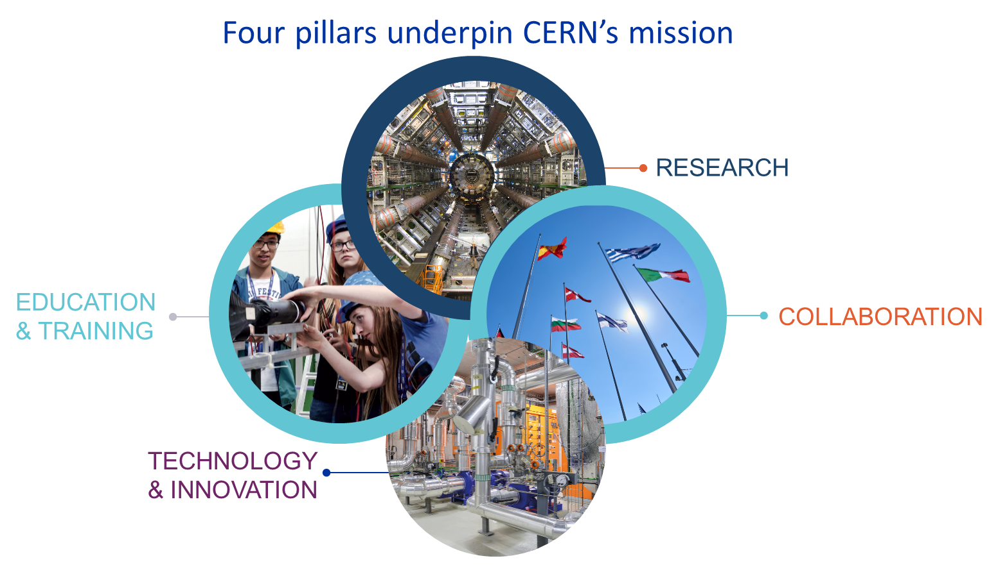
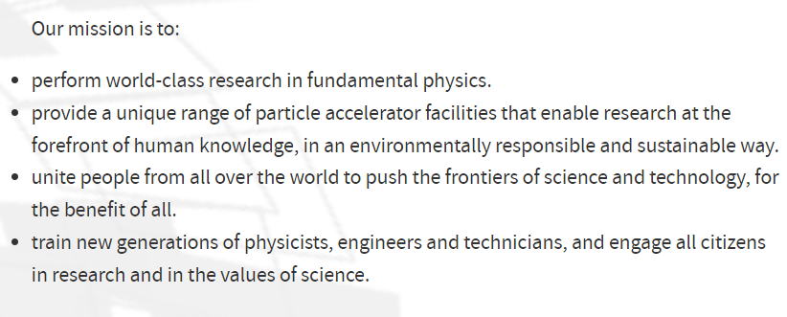
About CERN

Slide 3


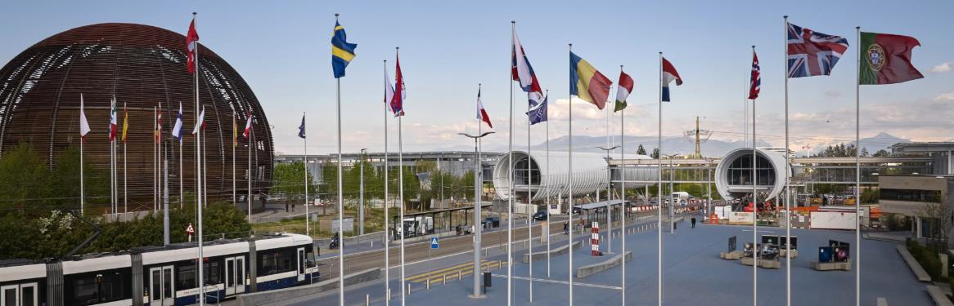
Current strategy for environment and sustainability
Three main lines of actions (2021-2025):
Minimise the Laboratory‘s impact on the environment
Pursue actions and technologies aiming at energy savings and reuse
Identify and develop CERN‘s technologies that may contribute to mitigating the impact of society on the environment
Environment and sustainability are crucial aspects of projects and activities in the High Energy Physics field.
Any future project should have minimal environmental footprint.

Slide 4

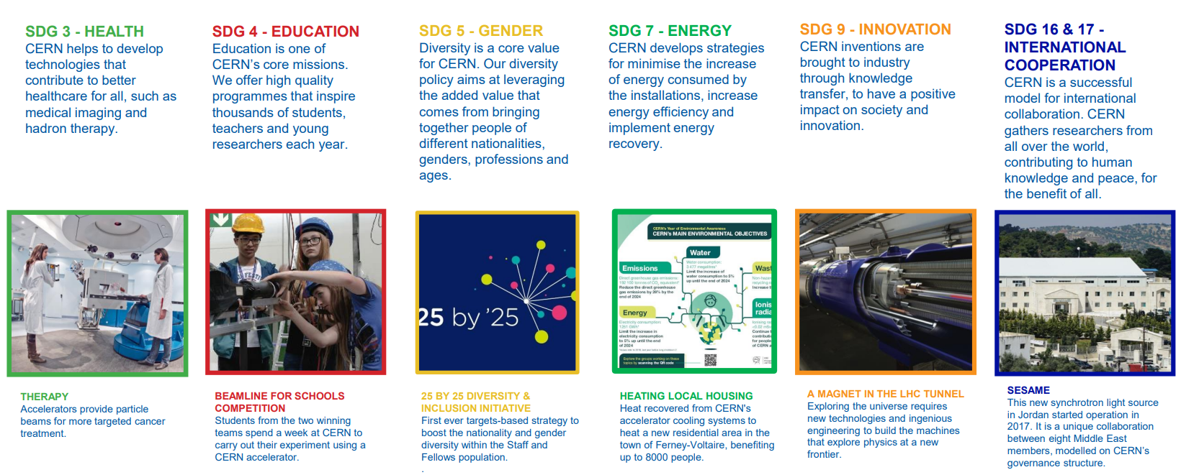
CERN & United Nations SDGs

Slide 5



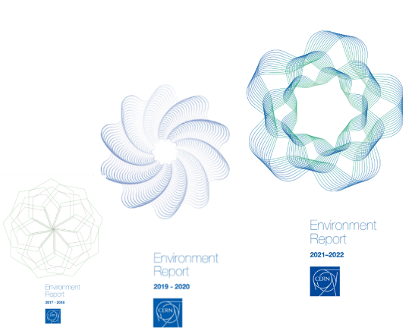
CERN High priority environmental objectives – Horizon 2025
The laboratory is committed to limiting rises in electricity consumption to 5% up to the end of Run 3 (baseline 2018) – Target max 1314 GWh/y
CERN’s objective is to reduce direct CO₂e emissions by 28% by the end of Run 3 (baseline 2018) – Target max 138 300 tCO₂e
The laboratory is committed to keeping the increase in its water consumption to 5% up to the end of Run 3 (baseline 2018) – Target max 3651 ML
No showstopper to achieving these objectives by the first year of the next long shutdown (LS3) 2026 - 2028
Three public facing Environment Reports published, following the Global Reporting Initiative (GRI) Standards – available here

Slide 6
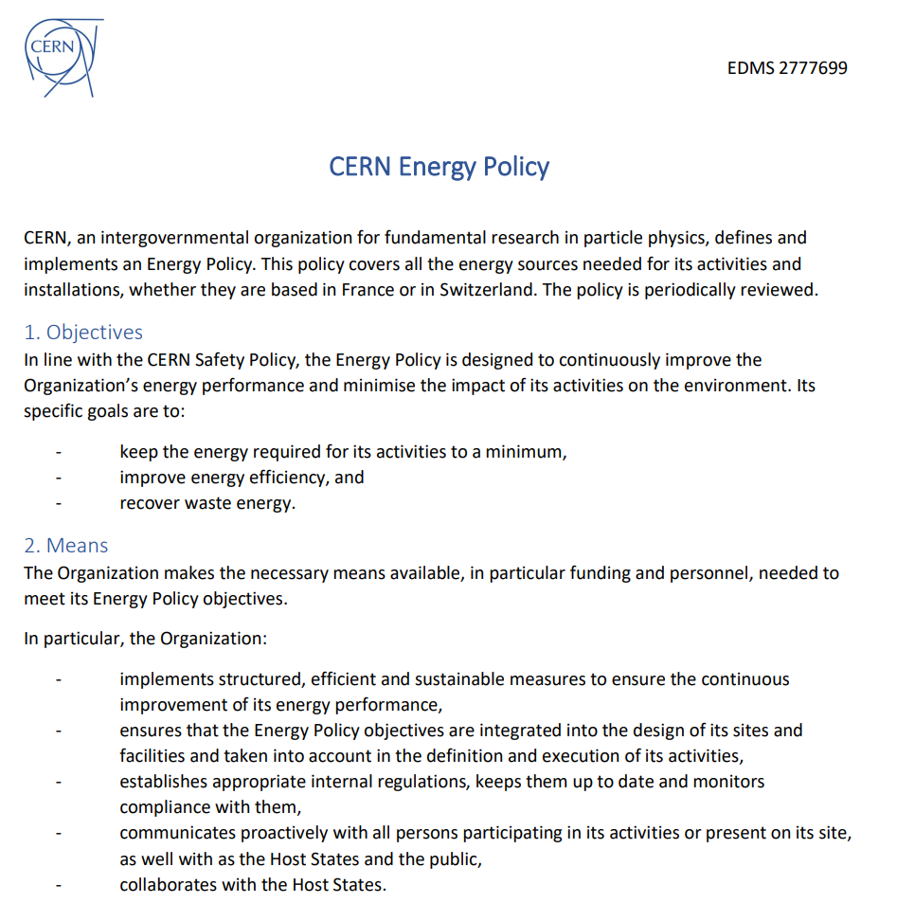
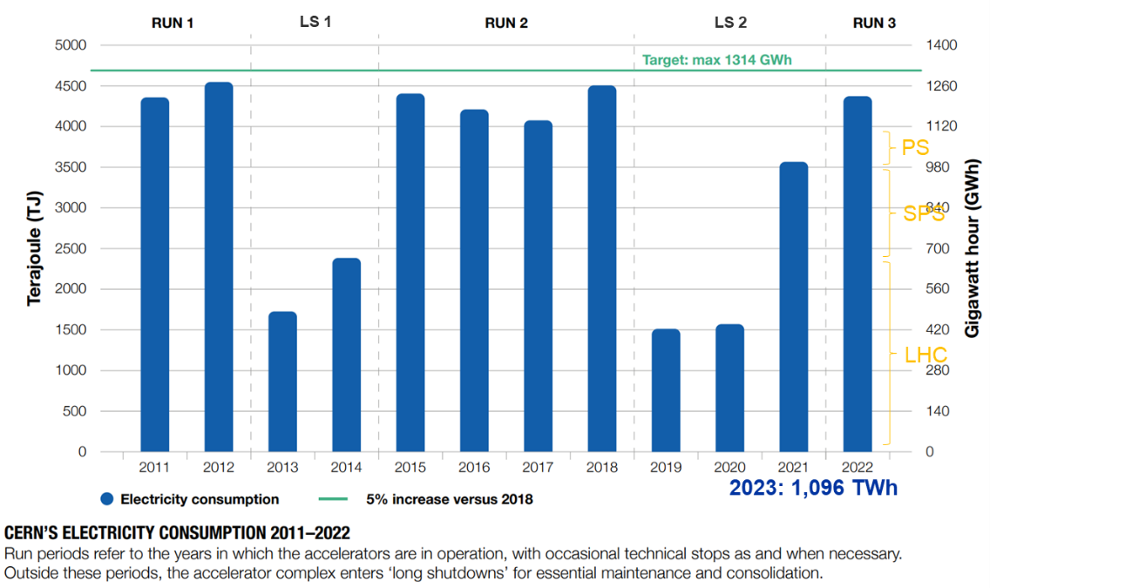
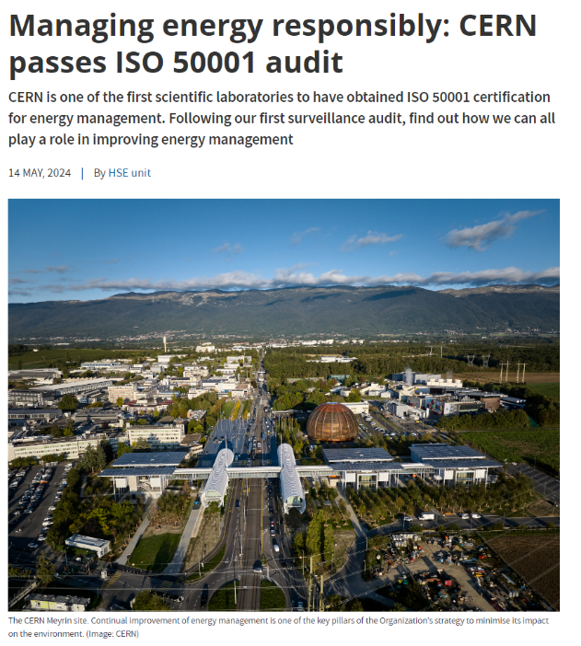
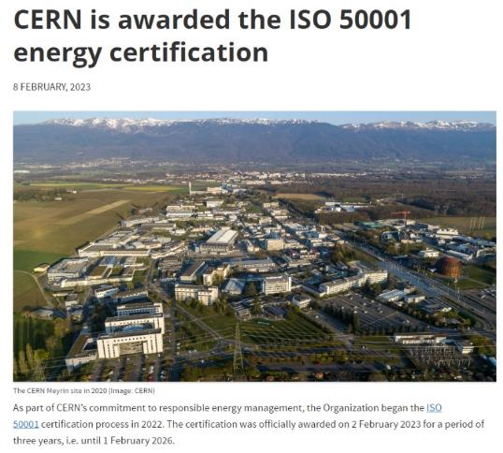
Energy
Notes:
From 320 measuring devices used, likely moving to 520 in 2024.
Electricity consumption of the tertiary infrastructure (CERN Campus) about 5 to 7 % of the total electricity consumption.

Slide 7
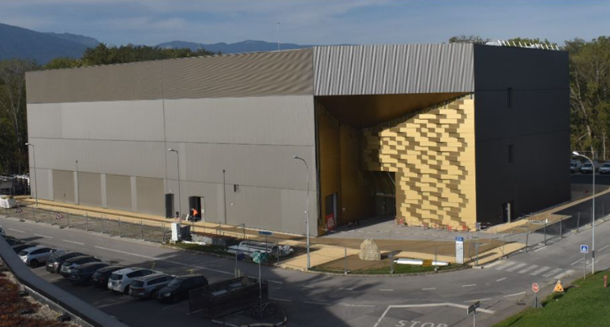
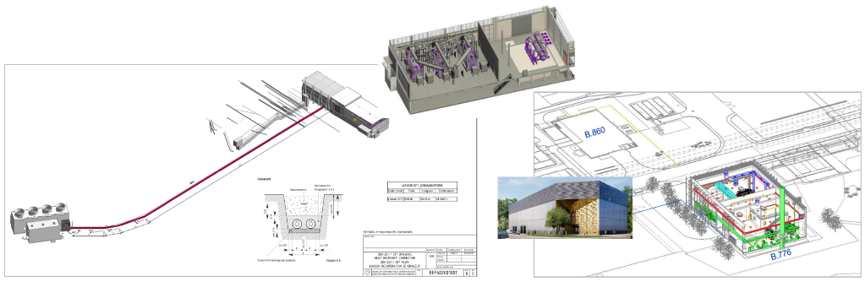
Energy
Improve energy efficiency – example of CERN Data Centres
CERN new Data Centre on the Prévessin site (F) PUE target of 1.1 – recently inaugurated (ramp-up to 12 MW over the next 10 years)
Existing Data Centre on the Meyrin site (CH) 2023 Annual PUE of 1.42 (4 MW – 35 GWh/y)
Recover waste energy – ongoing projects
One project for heating new housing in a surrounding municipality (~ 8000 people) – 20 GWh/y recovered waste heat from LHC PA8 cooling tower units
Two projects for heating CERN main sites – recovered waste heat from cooling tower units (LHC PA1) and from the new Prévessin Data Centre
  An outstanding step for CERN to depart from fossil fuel
Prévessin Data Centre
Heating plant – Meyrin site (CH)
Heating plant – Prévessin site (F)
Notes:
The Data Centre on the Meyrin site was constructed in 1972. The last major upgrade took place in 2010/2011.
The new Data Centre on the Prévessin site is also equipped with an efficient water-cooling system, integrating a special water recirculation unit.
CERN Total gas consumption: reduction of at least 60% vs 2022 (171 TJ) as of 2026/2027

Slide 8
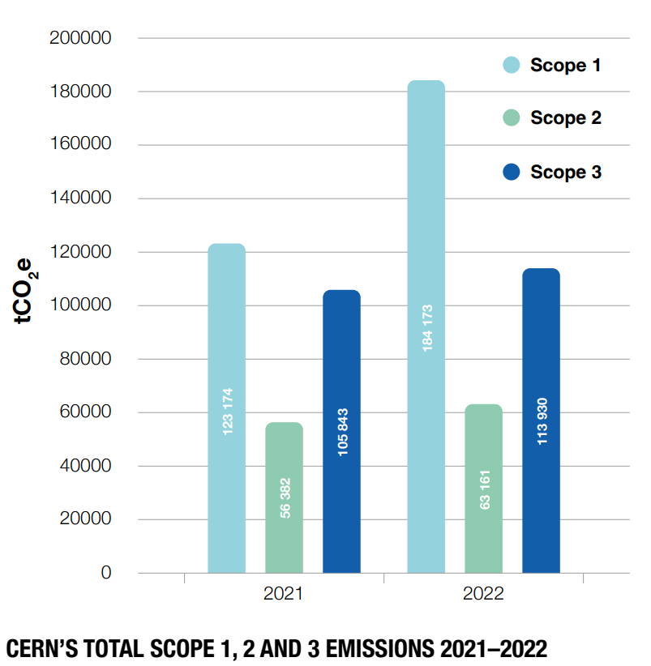
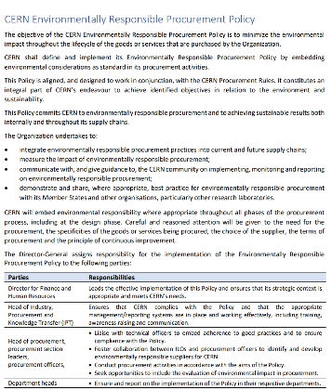

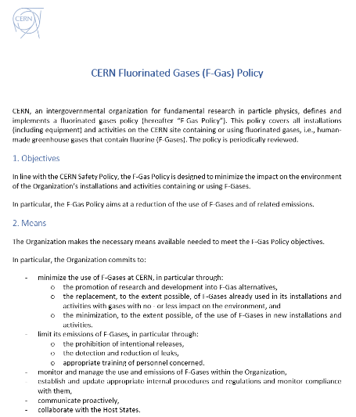
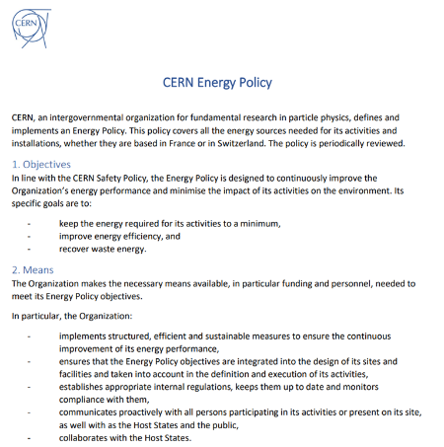
Emissions
CERN’s greenhouse gas emissions reported according to the Greenhouse Gas Protocol
Direct emissions/scope 1 mainly linked to LHC experiments and the use of fluorinated gases – CERN F-Gas Policy recently approved
Indirect emissions/scope 2 linked to the supply of electricity – CERN Energy Policy published in 2022
Indirect emissions/scope 3 mainly resulting from procurement (92%) – CERN Environmentally Responsible Procurement Policy effective since 2024 + Guidelines for duty travel published early 2024
LS 2
RUN3
Target Scope 1: max 138 300 tCO₂e

Slide 9
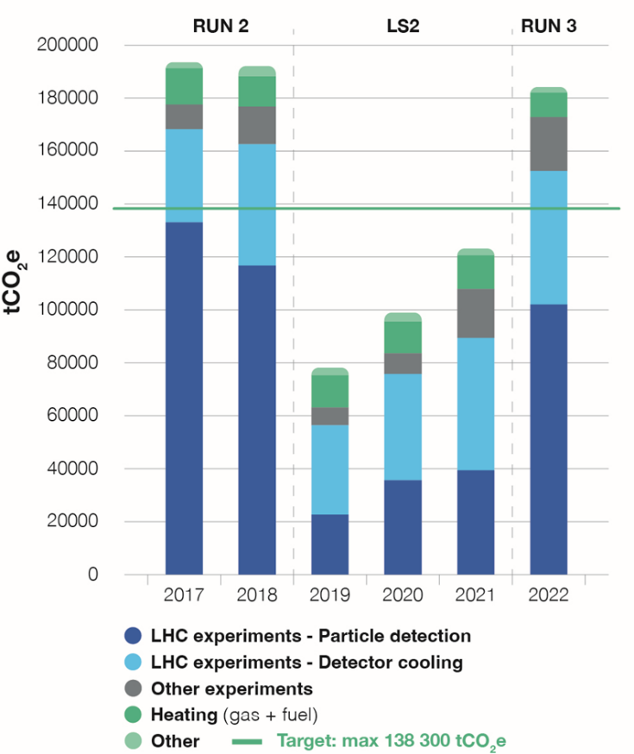
Emissions
Scope 1 – direct emissions
Detector cooling
Reduction potential for RUN4 vs 2018 of ~ 40’000 tCO₂e
Particle detection
Reduction potential for RUN4 vs 2018 of more than 13’000 tCO₂e
Main source of scope 1 emissions linked to F-gases used for detector cooling (mostly PFCs such as C₆F₁₄ and C₃F₈) and for particle detection (mostly HFCs such as HFC-134a)
2023: 170’000 tCO₂e

Slide 10
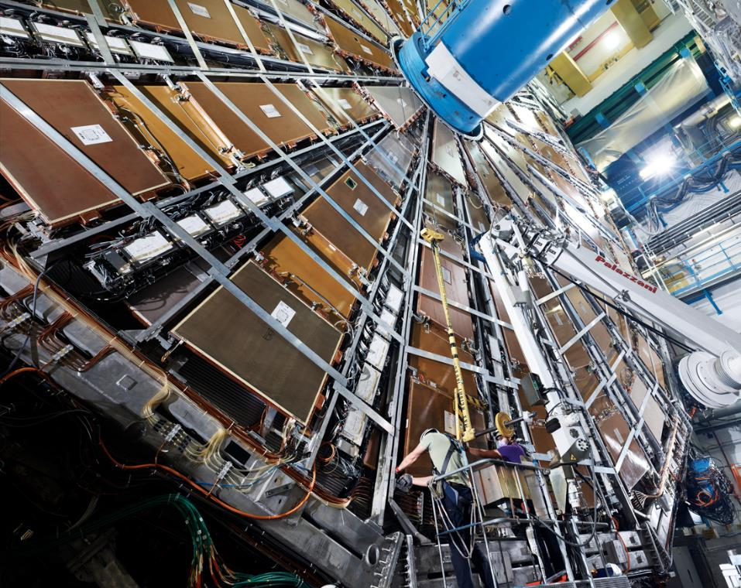
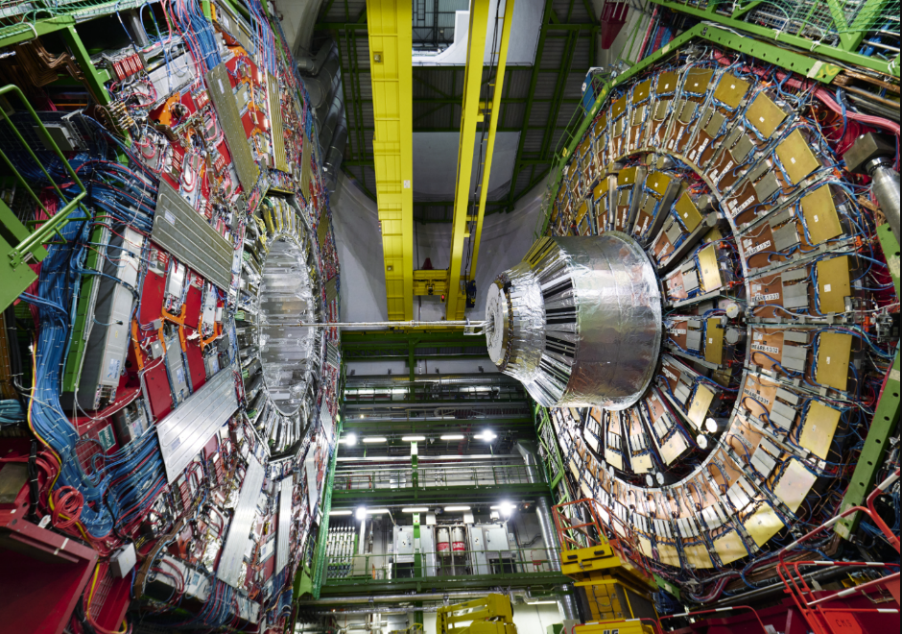
Emissions
Scope 1 – direct emissions
Within LHC experiments - 3 pillar R&D strategy to minimize emissions of fluorinated gases: recirculation and optimisation, gas recovery and the search for more environmentally friendly alternatives
ATLAS and CMS: continued investment in R&D to reduce detector leaks and prepare for a transition from Perfluorocarbons (PFCs) to CO₂ cooling
Since beginning of August 2023, ATLAS operates the RPC detectors with a new gas mixture – lowering CO₂e emissions from the RPC detectors
Final LS2 upgrade work to the ATLAS detector before cavern closure
CMS during the final stages of LS2

Slide 11
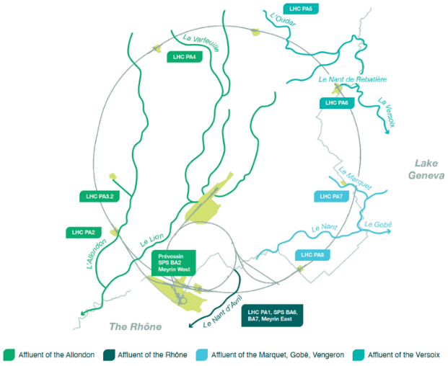
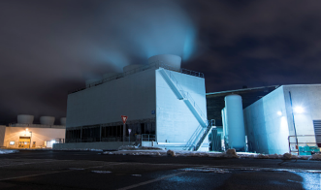
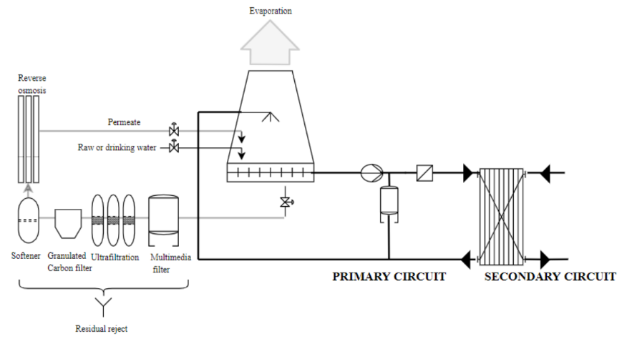
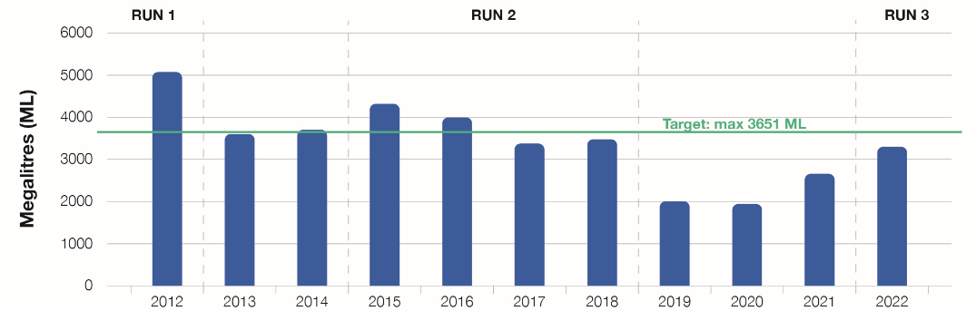
Water and effluents
CERN strives to minimise its water consumption through continuous consolidation and improvement of its cooling and sanitation infrastructures - Since 2000, water consumption has decreased by some 80%, from 15’000 megalitres to 3’234 megalitres in 2022
Ambitious project for reducing the current impact linked to the blowdown of the LHC & SPS cooling tower circuits (released into a local stream: about - 90% of effluent water volume and pollutants load from 2027/2028)
2023: 3000 ML
Future cooling water recycling plant under study

Slide 12
Horizon 2030
While the number of collisions will be multiplied by a factor of 5 to 7.5 during RUN4 (2029-2032) with respect to the nominal LHC design, CERN commits to limiting its electricity consumption to 1.5 TWh/y, which equates to an increase of 11%
Direct CO₂e emissions are linked to CERN’s core operations. CERN’s objective is to reduce them by 50% vs baseline 2018
Despite a growing demand for cooling water, CERN will strive to keep the water consumption below 3600 ML
3 high priority objectives out of 9

Slide 13
Challenges ahead
Environment and sustainability constitute a focus area for CERN now and in the future
The next long shutdown (LS3 – 3 years from 2026 on) is a key milestone to conclude essential projects (e.g. GHG emissions) in CERN’s efforts to minimise its impact on the environment
Horizon 2030 environmental objectives were recently approved. A set of projects and the corresponding budget has been integrated in CERN’s Medium-Term Plan and was approved by the CERN Council in June this year
A revised strategy beyond 2030 will be driven also by expectations of CERN Member States, Host States and by the needs of the HEP community

Slide 15
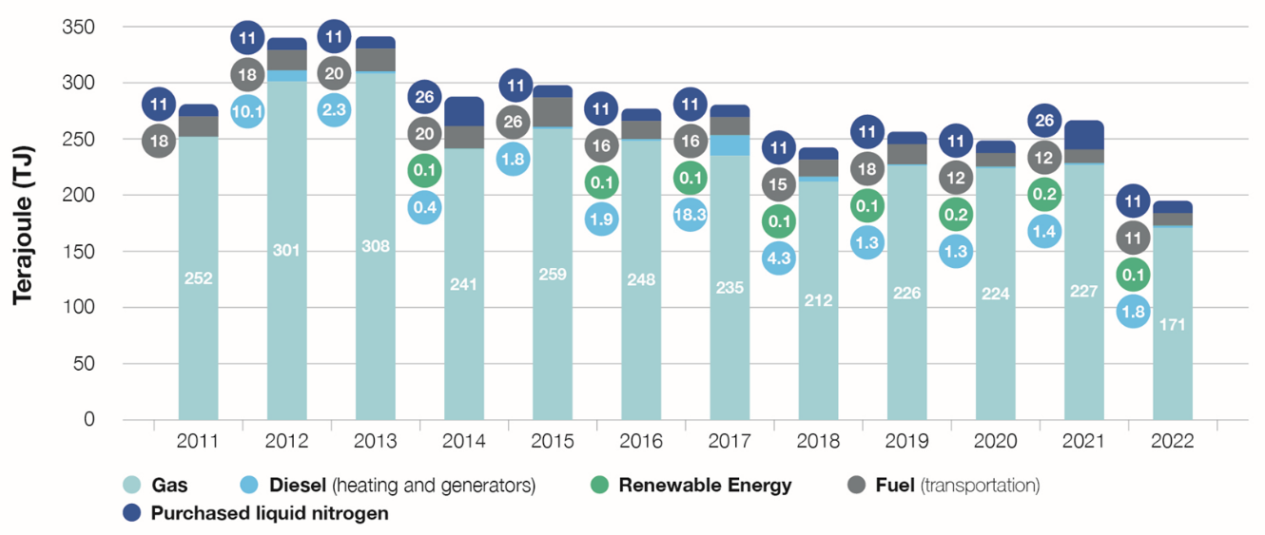
Energy – Other categories
Campus energy saving actions in 2022: Delayed start-up of heating in buildings & reduced temperature of the heating boilers
Meyrin and Prévessin sites heating mostly provided by heat recuperation from CERN infrastructures as from 2026/2027: Two heat recovery projects approved (from LHC Point1 cooling towers and the new data centre in Prévessin)
CERN investigated solutions to incorporate more renewable energy sources in the future
Notes:
Campus energy savings: - delayed start-up of heating in buildings - reduced temperature of the heating boilers - replaced halogen lamps with LEDs…

Slide 16
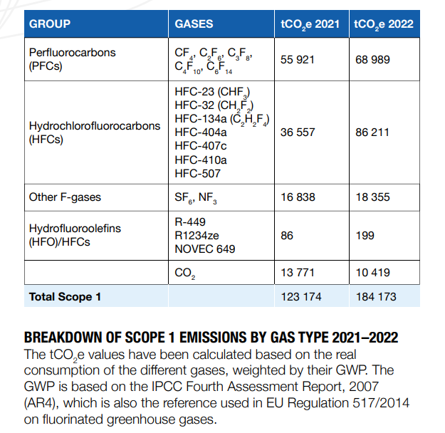
Emissions - Scope 1 (direct) – breakdown by gas type
Main source of scope 1 emissions linked to F-gases used for detector cooling (mostly PFCs such as C₆F₁₄ and C₃F₈) and for particle detection (mostly HFCs such as HFC-134a)
CO₂ emissions highlighted in the table are resulting from on-site combustion processes (heating plants, emergency generators, CERN vehicle fleet)

Slide 17
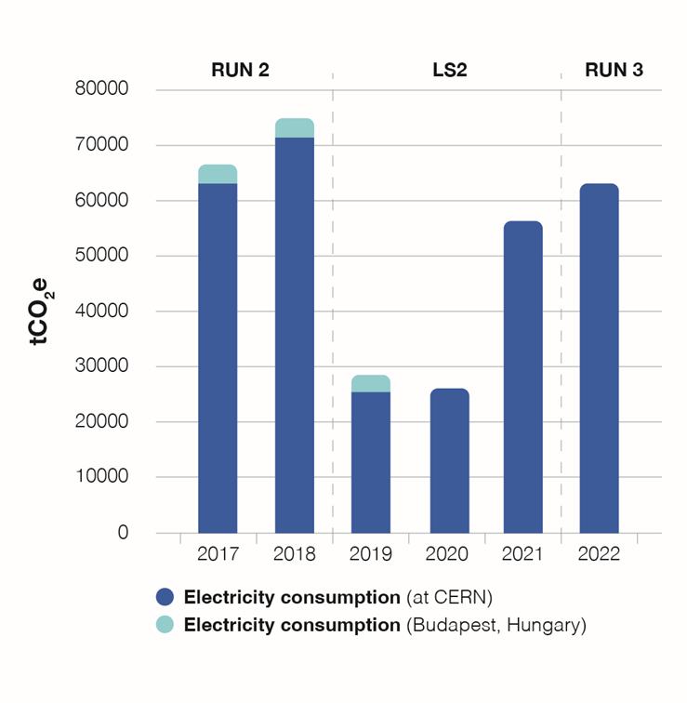
Emissions – Scope 2 (indirect)
CERN’s principal electricity supplier (EDF – France) generates low-carbon electricity mainly of nuclear origin. French energy mix contributes to keeping energy-related CO₂ emissions low
Review of CO₂ emission factors linked to electricity supply, to ensure that the figures quoted remain as accurate as possible

Slide 18
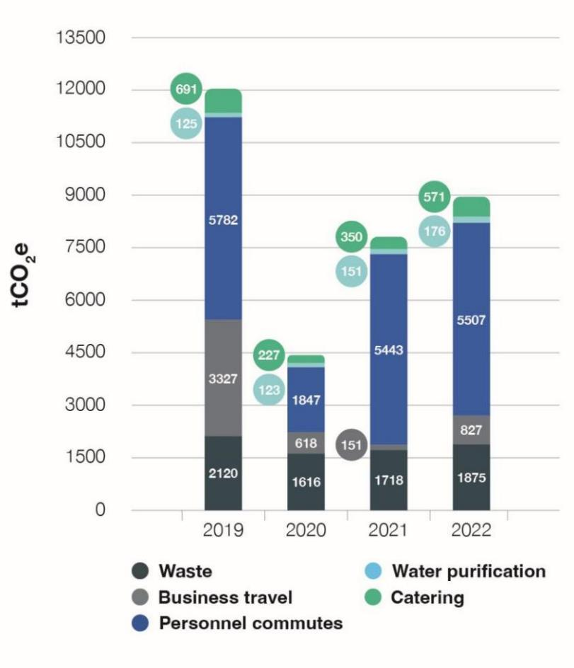
Emissions - Scope 3 (indirect)
Duty travel: Working Group set up in April 2022 to develop CERN-wide duty travel guidelines with the goal of reducing the emissions from CERN-related duty travel
Mobility: Goal for 2025 is to keep individual motorised vehicle commuting constant. Encourage alternative modes of transportation, such as cycling, public transport and carpooling
  Survey of the mobility habits of CERN personnel (2022):
    61% of CERN personnel use individual motorised
    vehicles for commuting (68% in 2018)
    Walking and cycling increased: 24% of all
    commutes (17% in 2018)

Slide 19
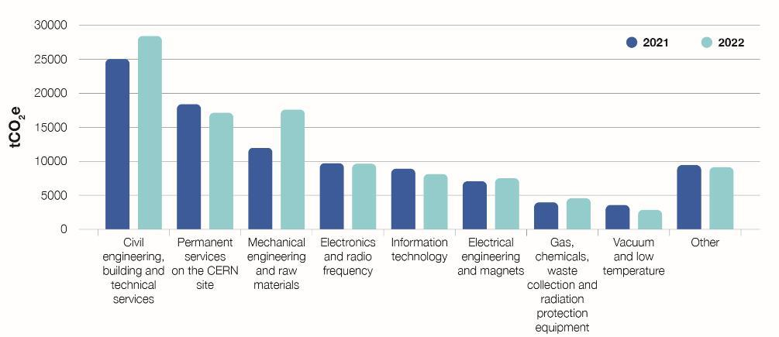
Emissions: scope 3 (indirect) - procurement
CERN Environmentally Responsible Procurement Policy Project (CERP3) launched in September 2021
  Environmentally Responsible Procurement Policy drafted
    Better understand the most CO₂e emitting procurement families
    Develop and prioritise action plans
  Development of a supplier engagement programme (for suppliers representing top 80% of CERN emissions)
2021: 98 030 tCO₂e
2022: 104 974 tCO₂e

Slide 20
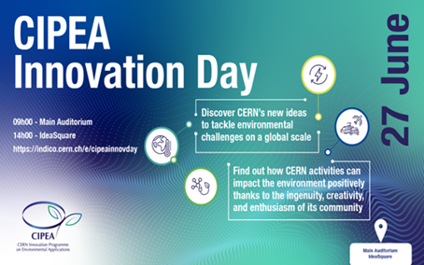
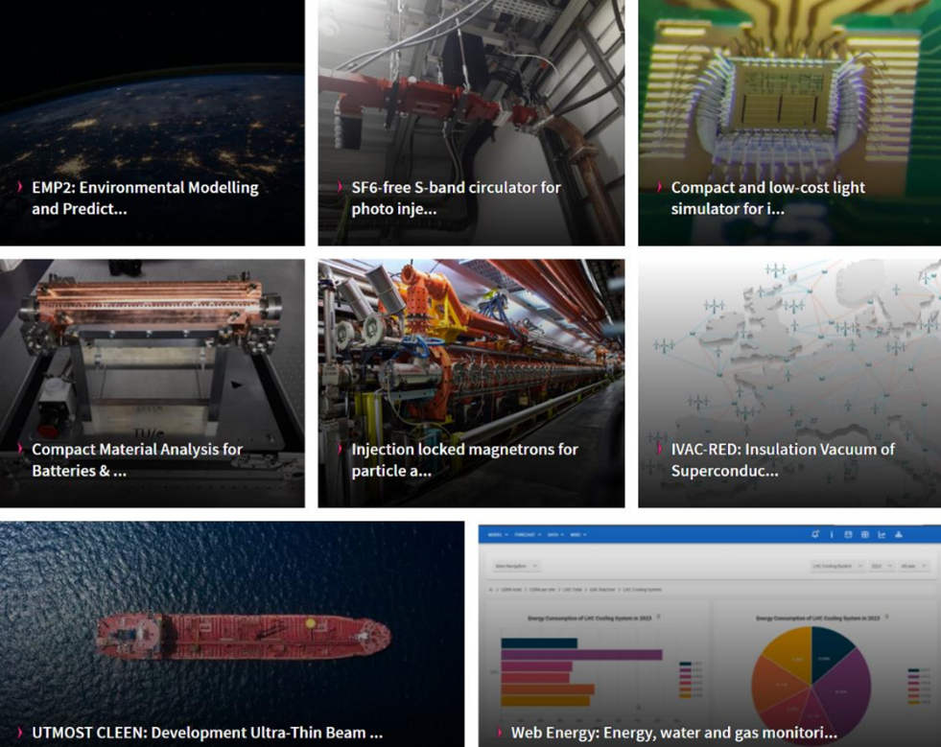
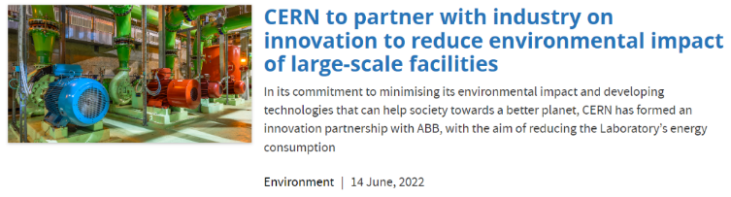

Knowledge and technology for the environment - Highlights
2022: CERN Innovation Programme on Environmental Applications (CIPEA) endorsed by the CERN Management
+ Others

