Slide 1

Quantum simulation of thermal field theories
Iván Cuntín, Wenyang Qian, Bin Wu
Instituto Galego de Física de Altas Enerxías – Universidade de Santiago de Compostela

Slide 2
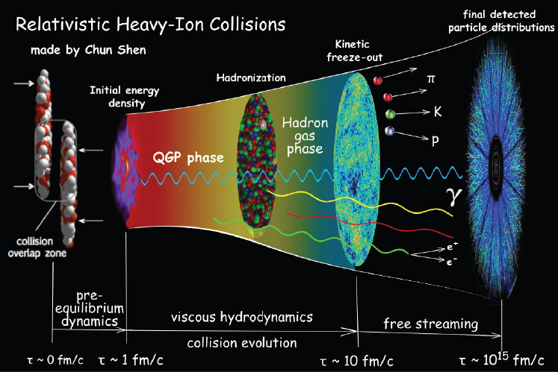
1.1 Introduction
QGP constitutes one of the main research areas in QCD physics.
Time evolution of QCD matter before thermalization has been studied using classical approaches such as classical field simulations or kinetic theory
It has not yet been resolved from fundamental principles of QCD
Lattice QCD is only applicable at low baryon densities where the numerical sign problem does not interfere with calculations
Quantum computing is a potential tool for solving real-time dynamics from QCD first principles ​

Slide 3
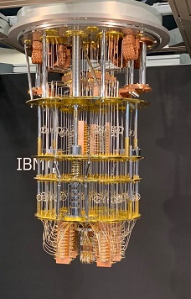
1.2 State of the art in quantum computer technology
Quantum computing (QC) is a rapidly-emerging technology that harnesses the laws of quantum mechanics to solve problems too complex for classical computers.
Currently, we are in the Noisy Intermediate-Scale quantum (NISQ) era:
  Quantum processors containing up to ~ 1000 qubits
  Sensitive to their environment
  Prone to quantum decoherence
Quantum information science has proved useful in a broad range of physics applications
Quantum simulation is potentially more advantageous in reducing the problem complexity from exponential to polynomial
IBM Condor employs over 1000 qubits ⇨

Slide 4

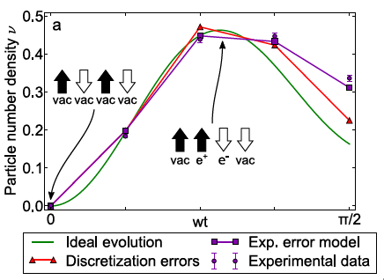



1.3 Quantum computing in quantum field theory
$φ^{4}$ theory
Jordan, Lee & Preskill, 2011 [arXiv:1112.4833]
Klco & Savage, 2018 [arXiv:1808.10378]
Fermion fields
Jordan, Lee & Preskill, 2014 [arXiv:1404.7115]
Schwinger model
de Jong et al., 2022 [arXiv:2106.08394]
Martínez et al., 2016 [arXiv:1605.04570v1]
We study QFT in thermal equilibrium preparing for a broader study of real-time dynamics

Slide 5



1.4 Thermal field theory
Thermal states are typically difficult to prepare on a circuit and involve non-unitary operations.
Quantum imaginary time evolution (QITE) requires exponentially less space and time per iteration compared with their classical counterparts
Motta, 2019 [arXiv:1901.07653]
Expectation value
Partition function
The trace can be calculated by summing the expectation values over the complete set of states
$$f_{p}^{i}={\left\langle {â_{p}^{i}}^{†}â_{p}^{i}\right\rangle }_{β}$$
We focus on phase space distribution:

Slide 6






2.1 Fermion fields in 1+1 dimensions
Lagrangian density
Majorana fermions
$$ψ^{†}=ψ^{T}$$
$$ℒ=\frac{1}{2}\overline{ψ}\left(i∂−m\right)ψ−ℋ_{I}\left(ψ\right)$$
$$\left\{ψ^{α}\left(t,x\right),ψ^{β}\left(t,y\right)\right\}=δ\left(x−y\right)δ^{αβ}$$
Step 1: put the theory on a spatial lattice:
$$\hat{H}=\frac{1}{2}\sum_{n}{{\overline{ψ}}_{n}\left[−\frac{i}{2a}γ^{1}\left(ψ_{n+1}−ψ_{n−1}\right)+mψ_{n}\right]−\frac{r}{4a}\sum_{n}{{\overline{ψ}}_{n}\left(ψ_{n+1}−2ψ_{n}+ψ_{n−1}\right)+{\hat{H}}_{I}}}$$
with $ψ_{n}\left(t\right)≡\sqrt{a}ψ\left(t,na\right)$
Qian & Wu, 2024 [arXiv:2404.07912]
Step 2: Map it onto qubits: N qubits needed to represent N Majorana fermions​
One can use both coordinate and momentum space to represents on qubits

Slide 7

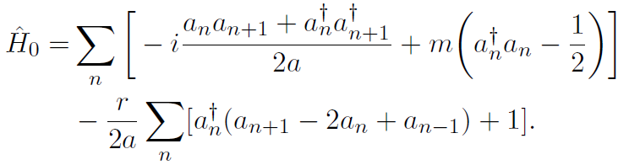

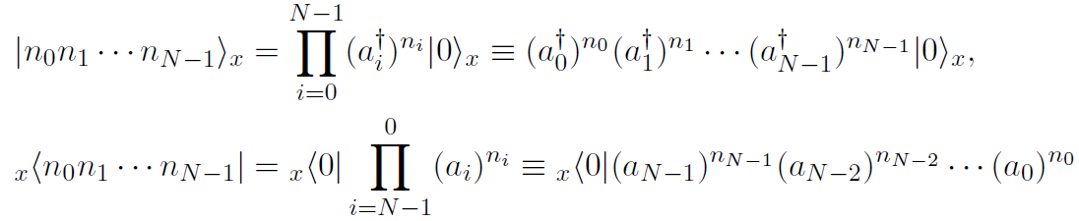
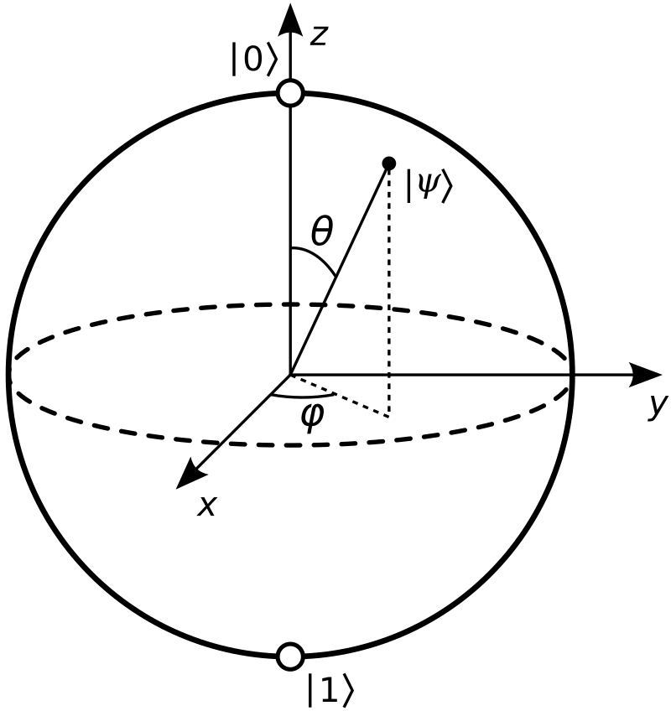
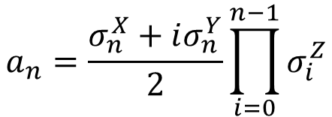
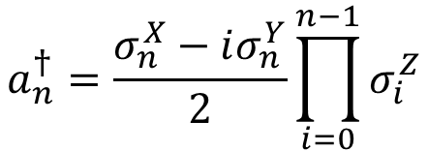


2.2 Representation in coordinate space
Step 1: In terms of the creation/annihilation operators, the Hamiltonian may be written as
Step 2: Map it onto qubits using eigenstates of $a_{n}^{†}a_{n}$ as the computation basis
$$bit→\{0,1\}$$
$$qubit→\left|ψ\right\rangle =α\left|0\right\rangle +β\left|1\right\rangle$$
The fermions can be map to qubits using the Jordan-Wigner transformation
$$a_{n}^{†}=\frac{σ_{n}^{X}−iσ_{n}^{Y}}{2}\prod_{i=0}^{n−1}{σ_{i}^{Z}}$$
$$a_{n}=\frac{σ_{n}^{X}+iσ_{n}^{Y}}{2}\prod_{i=0}^{n−1}{σ_{i}^{Z}}$$

Slide 8


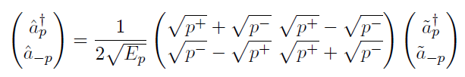
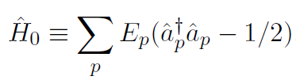
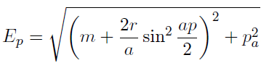
2.3 Representation in momentum space
Step 1: Hamiltonian in terms of creation and annihilation operators in momentum space
1
2
3
Step 2: Map it onto qubits using eigenstates of $a_{p}^{†}a_{p}$ as the computation basis
We use coordinate space (field operator space) for simulations and momentum space for analytical calculations

Slide 9
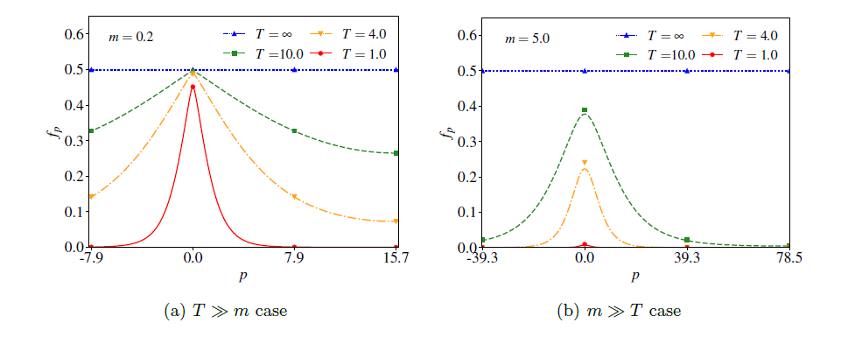


2.4 Simulation results for free fermion fields
Using the QITE algorithm
Qian & Wu, 2024 [arXiv:2404.07912]
Analytical result: Fermi-Dirac distribution

Slide 10






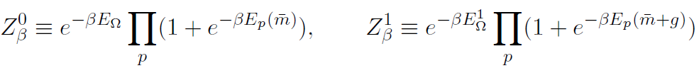
2.5 Thermal states of interacting fermion fields on lattice
Four-fermion interaction vanishes → we introduce one more Majorana field
There exist two types of quasiparticles with two phase-space distributions:
where

Slide 11
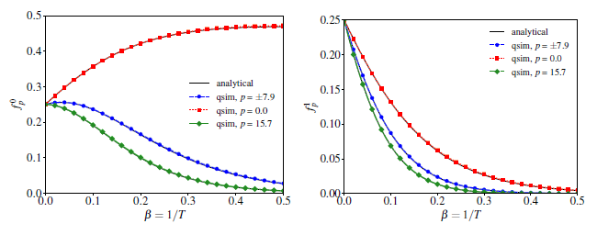
2.6 Simulation results for interacting fermion fields
Qian & Wu, 2024 [arXiv:2404.07912]

Slide 12

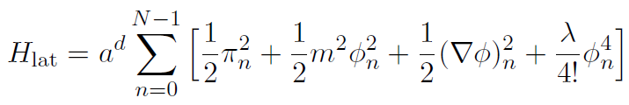
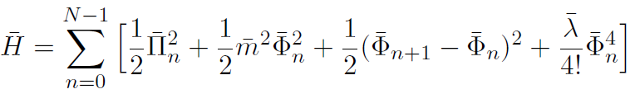



3.1 SCALAR FIELD THEORY
IC, Qian & Wu [work in progress]
Lagrangian density for the $φ^{4}$ theory in d + 1
Field and conjugate-field operators
Step 1: Discretised hamiltonian
We use dimensionless hamiltonian in (1+1) spacetime
$$\left[{\overline{Φ}}_{n},{\overline{Π}}_{n^{′}}\right]=iδ_{nn^{′}}$$
Step 2: Map it onto qubits​
One can use both coordinate and momentum space to represents on qubits
12

Slide 13
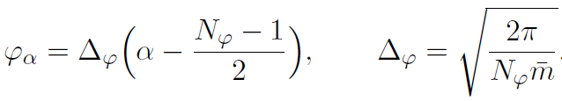


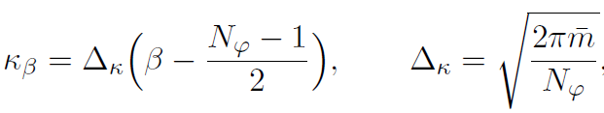



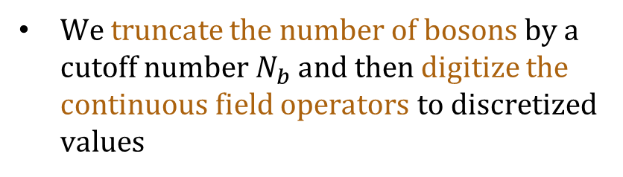

3.2 Field operator discretisation
Macridin et al., 2021 [arXiv:2108.10793]
The lattice Hilbert space is a tensor product of local Hilbert space at each lattice site
Discrete field operators $Φ_{n}$ acting on $H_{n}$
The local Hilbert space at a single lattice site is infinite dimensional because there are infinitely many bosons contributing to the local wave function
Discrete conjugate field operators $Π_{n}$ acting on $H_{n}$
$φ_{n}=\left(−∞,∞\right)$
We truncate the number of bosons by a cutoff number $N_{b}$ and then digitize the continuous field operators to discretized values
$$φ_{n}=\left[−φ_{max},φ_{max}\right]$$

Slide 14
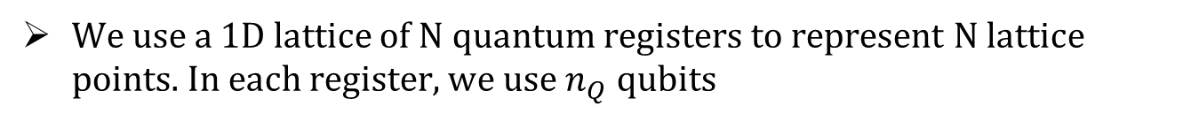


3.3 Scalar field theory on the qubit
We use a 1D lattice of N quantum registers to represent N lattice points. In each register, we use $n_{Q}$ qubits
$$N_{φ}=2^{n_{Q}}$$
$$n_{T}=Nn_{Q}$$
We represent the ${\{|φ_{α}⟩\}}_{n}$ on the n^{th} quantum register using binary representation of the label α. The generic state |k⟩ in coordinate space is
Again, we can do the mapping onto qubits using eigenstates of $a_{p}^{†}a_{p}$ as the computation basis, but now $a_{p}^{†}a_{p}$ must be truncated

Slide 15
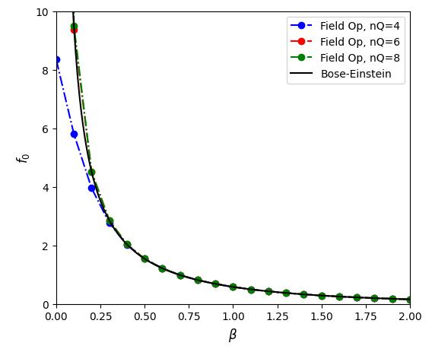
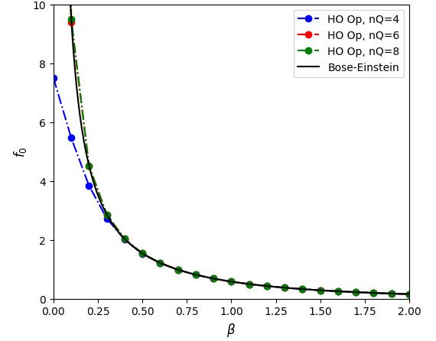
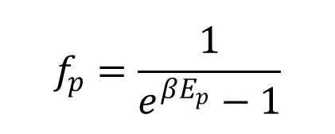
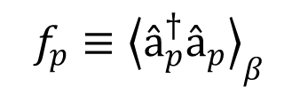
3.5 Simulation results for scalar fields
IC, Qian & Wu [work in progress]
$$f_{p}=\frac{1}{e^{βE_{p}}−1}$$
Analytical results: Bose-Einstein distribution
$$f_{p}≡{\left\langle â_{p}^{†}â_{p}\right\rangle }_{β}$$

Slide 16
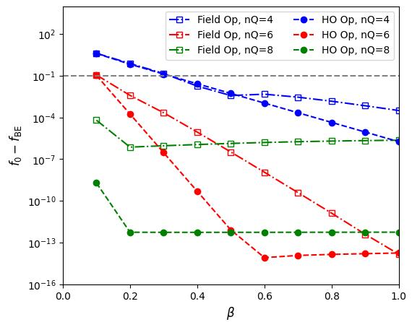

Slide 17
Summary
We formulated the quantum field theory for Majorana fermions and scalar fields in 1+1 dimensions on the qubits and studied its various thermal properties at finite temperature using quantum simulation algorithms
We showed that the QITE algorithm can be used to study thermal observables such as the distribution function at finite temperature.
Our numerical results using quantum simulation are compared to analytical calculations and exact diagonalization methods, showing good agreement

Slide 18
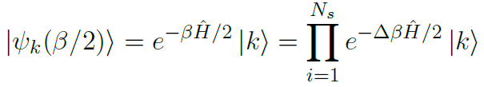

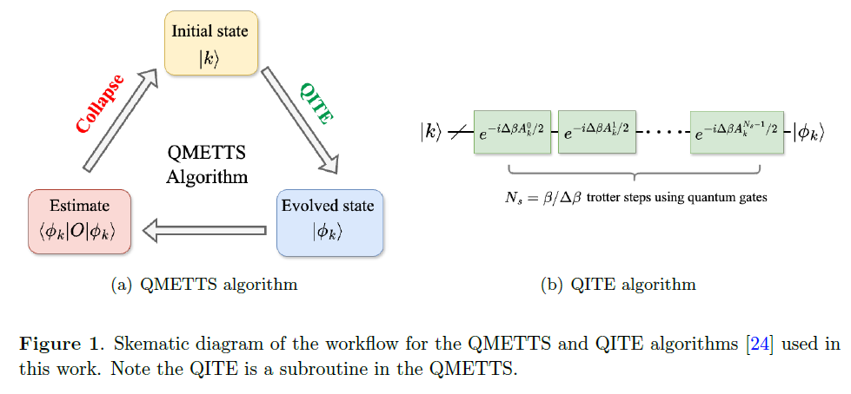




Quantum imaginary time evolution
Motta, 2019 [arXiv:1901.07653]
Trotter formula:
Real-time Hamiltonian operator
determined by solving the linear matrix equation
whose matrix elements are evaluated as expectation values on the quantum circuit

Slide 19



Thermal expectation on the circuit
White, 2009 [arXiv:0902.4475]
Minimally entangled typical thermal state method (METTS)
Redefined quantum state
in QITE:
Thermal observables
Equivalent to sampling $\left|φ_{k}\right\rangle$ with probability $P_{k}/Z$ and summing its expectations ${\left\langle O_{k}\right\rangle }_{β}$

Slide 20


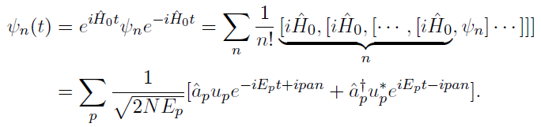

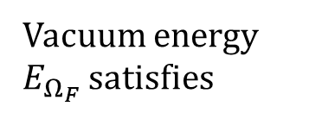
Thermal states of free fermion fields on lattice
Vacuum energy $E_{Ω_{F}}$ satisfies
Phase-space distribution function

Slide 21




Diagonalization of the discrete Hamiltonian
Discretizing ψ and expressing $ψ_{B}$in terms of $b^{†}$ and b:
H is a hermitian $2^{N+1}×2^{N+1}$ matrix
All its off-diagonal matrix elements vanish between the eigenstates of $b^{†}$ b

Slide 22


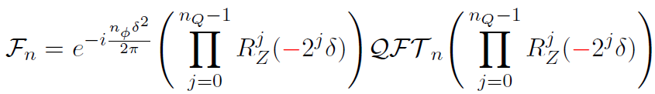
Field operator representation

