Slide 1
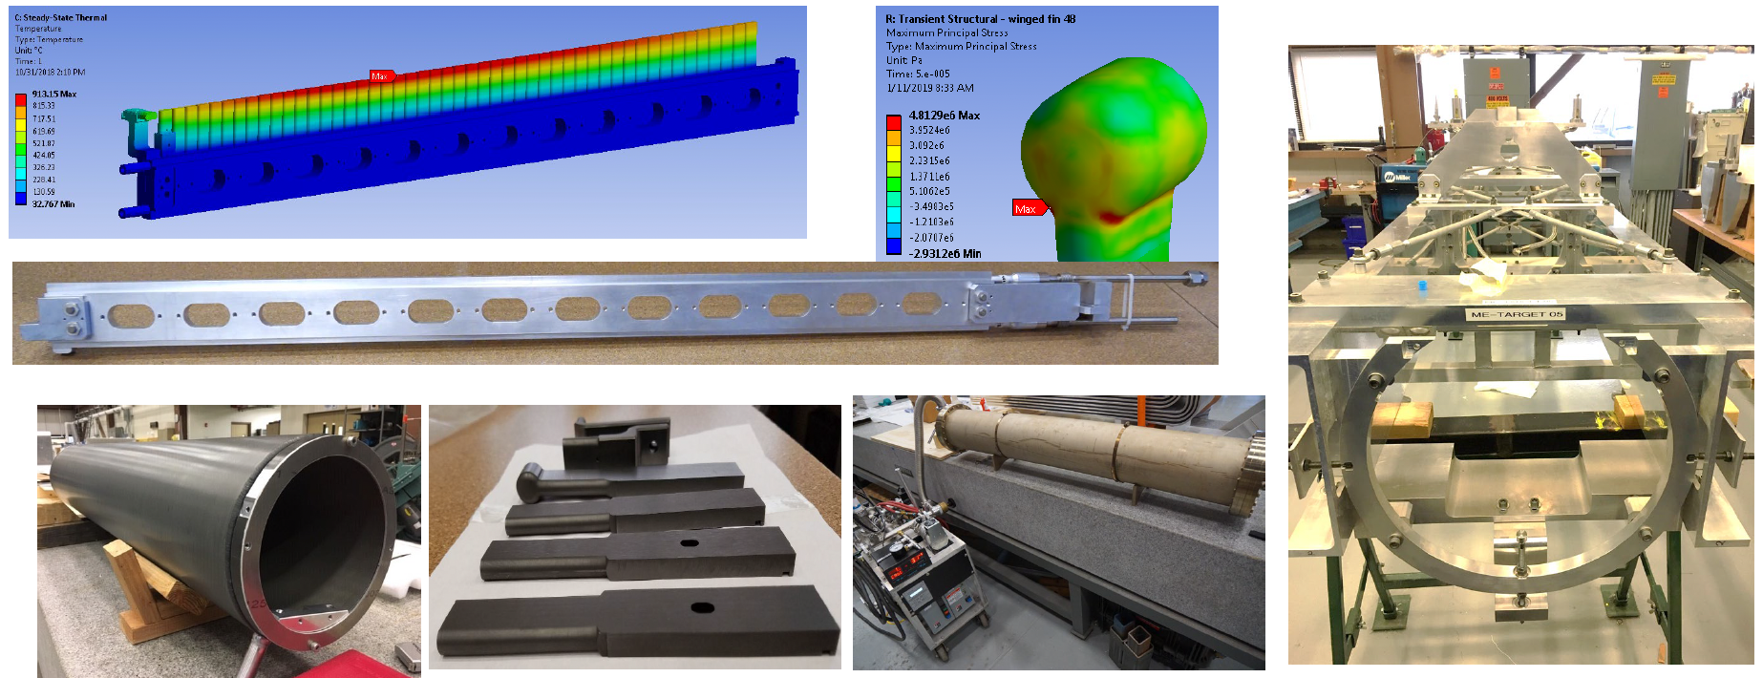
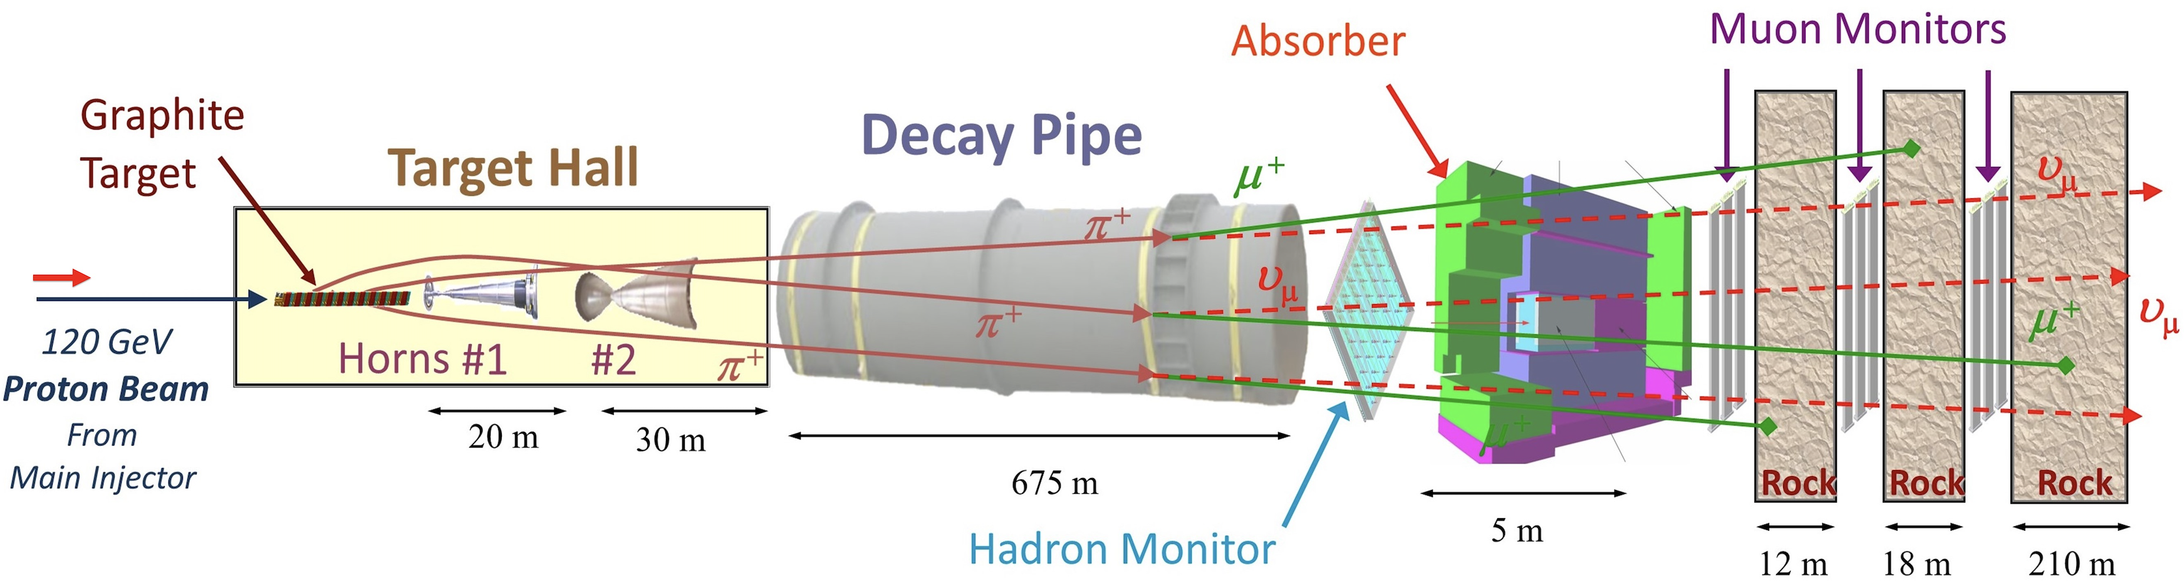
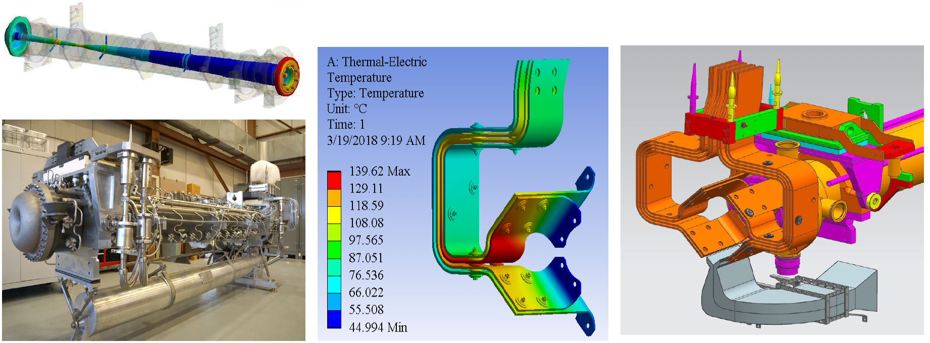
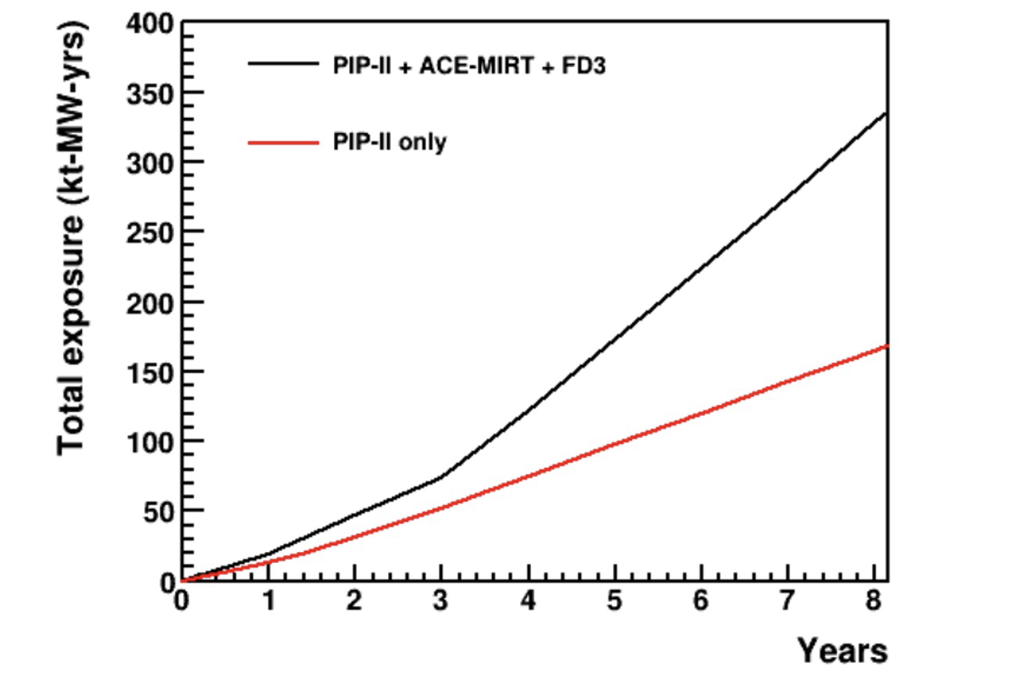
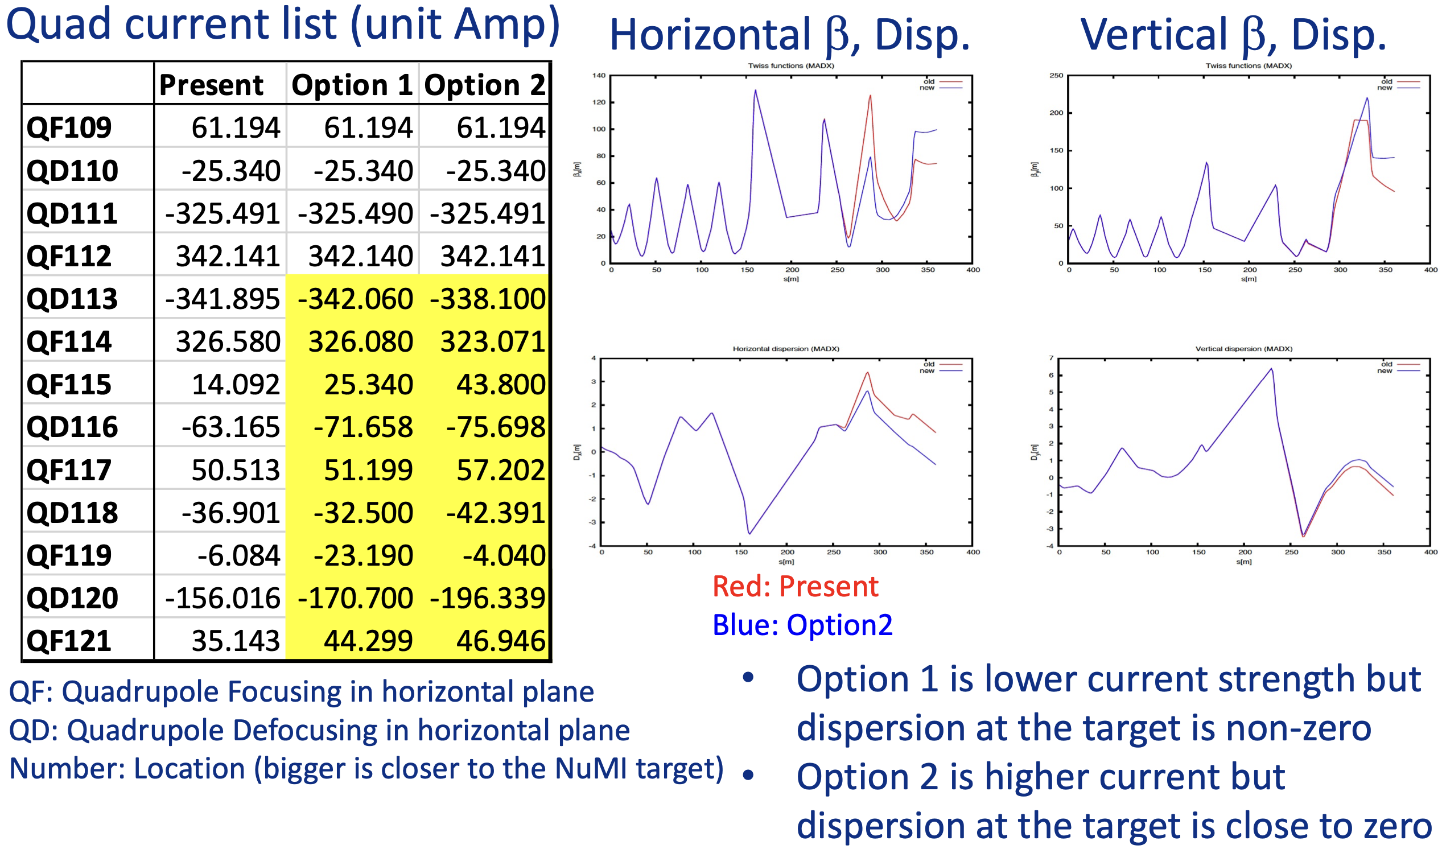
Achievement in Beam Power Records for the NOvA Target System
Katsuya Yonehara and Athula Wickremasinghe for the NuMI target system, Fermilab
ICHEP 2024, Prague
Introduction
Major upgraded Items
We began upgrading the NOvA target system for 1-Mega Watt (1-MW) beam operation in 2017. Major challenges included maintaining the quality of neutrino beams with reliable instrumentation, reducing instantaneous beam heating on the target, increasing cooling power to handle the high-power beam, and controlling tritium water production rate. We finally achieved a one-hour beam power record of 1.018 MW in Summer 2024. This milestone demonstrates our capability to operate at 2+ MW beam power for the future Long Baseline Neutrino Facility (LBNF) and Deep Underground Neutrino Experiment (DUNE).
1-MW target and cooling water system
The new 1-MW target and cooling water system have been in operation since 2019. It is designed to accept a Protons On Target intensity of 6.5e13 POT, which is the design value of the ACE-MIRT project.
From Top Left: FEA temperature simulation, simulated temperature of winged fin at accidental condition, target chase frame, Helium gas leak test, target fins, and target canister
Layout of the NOvA target system
1-MW horn system and Air diverter
Present and future beam power upgrade:
Accelerator Complex Evolution-Main Injector Ramp and Targetry R&D (ACE-MIRT)
The new 1-MW horn features powerful cooling capabilities. Especially, the stripline temperature is maintained by an air diverter.
The Fermilab Accelerator Complex will operate with fast Main Injector ramp rate to increase the Protons On Target. This project is called ACE-MIRT. The table shows the current time structure of the beam and the future plan.
From Left: Horn 1 and FEA temperature simulation of inner conductor, simulated stripline temperature, structure of air diverter
Optimize proton beam spot size at the target
The NuMI beam transport optics is optimized to minimize instantaneous beam heating on the target.
FD3
ACKNOWLEDGEMENT
Operated by Fermi Research Alliance, LLC under Contract No. DE-AC02-07CH11359 with the United States Department of Energy.

