Slide 1
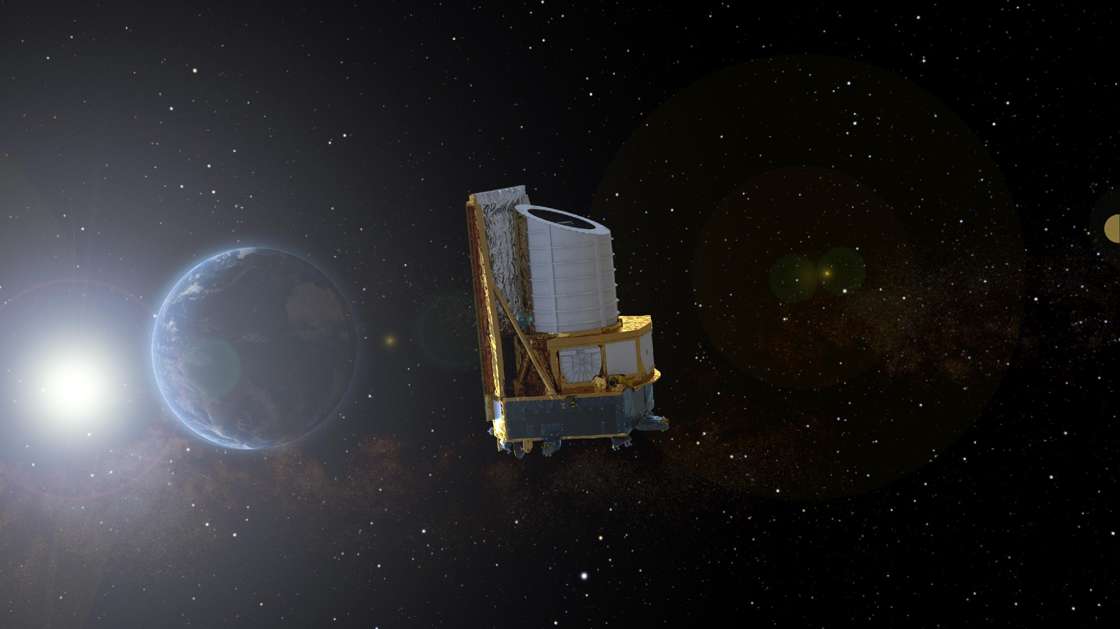



The Euclid mission: scientific forecast, overview and status
Cristobal Padilla
ICHEP 2024, Prague
July 18th, 2024
On behalf of the Euclid Consortium

Slide 2

Present model of our Universe
H₀
Ω_{m}
Ω_{b}
Ω_{Λ}
σ₈
n_{s}
Current
expansion rate
Dark Energy
density
Scale index of
initial density
fluctuations
Matter density
Baryon density
„Clumpiness“

Slide 3
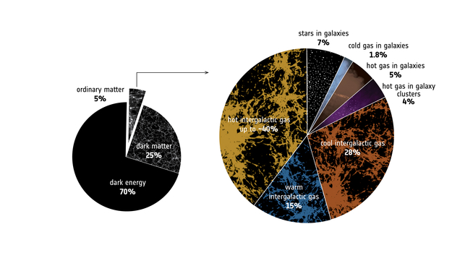
Present model of our Universe
We only observe 5% of our universe
We know that there is a lot of matter we do not see
  Galaxies rotate too fast
  Galaxies move too fast inside its cumulus
LHC has “only” discovered the Higgs up to now
Neutrinos mass, hierarchy?
We know that the Universe is not stopping its expansion
  In fact, the expansion is accelerating

Slide 4
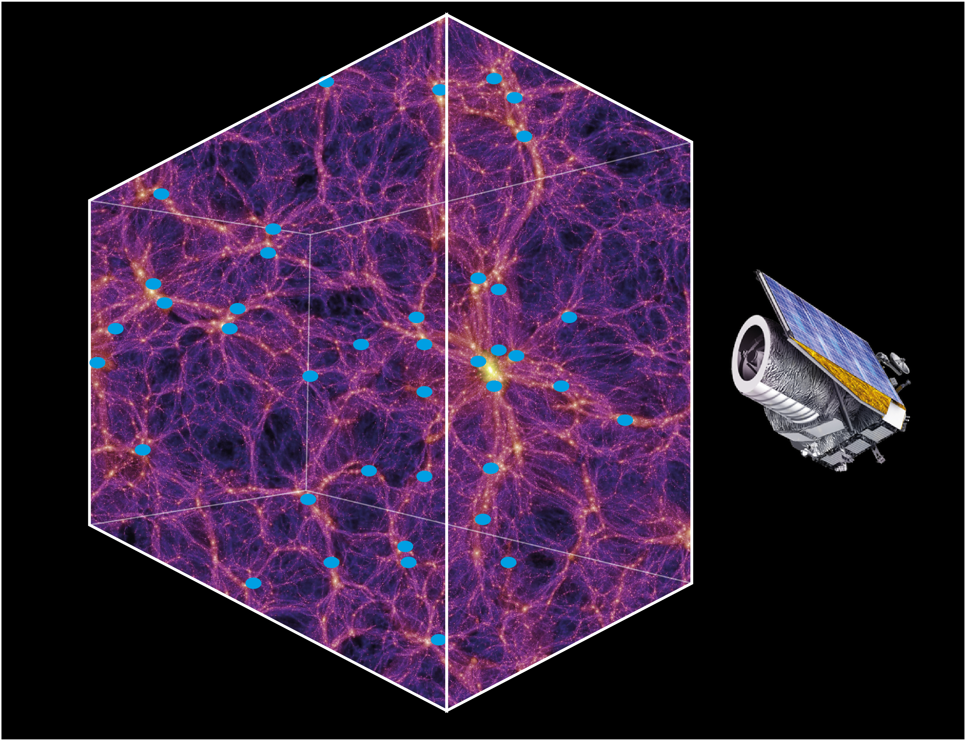
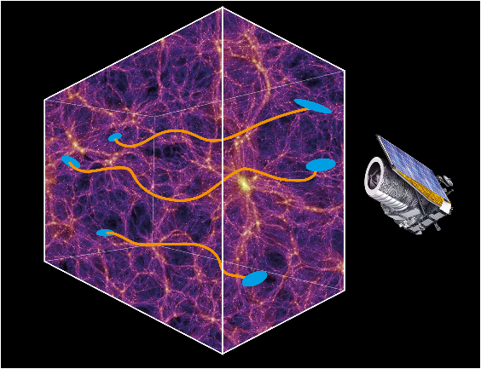
Two primary probes
Galaxy clustering
Cosmic Shear
Credit: Springel+ (2005) (Background) ESA/ATG medialab (spacecraft)

Slide 5
Cosmology from Large Scale Structures
Simulated dark matter distribution
Dependance of size and distribution of structures
Amount of matter and clustering
Ω_{m ,} σ₈
Expansion of Universe at different distances
w, Ω_{Λ}
We cannot directly observe dark matter
Credit: Springel+ (2005)

Slide 6
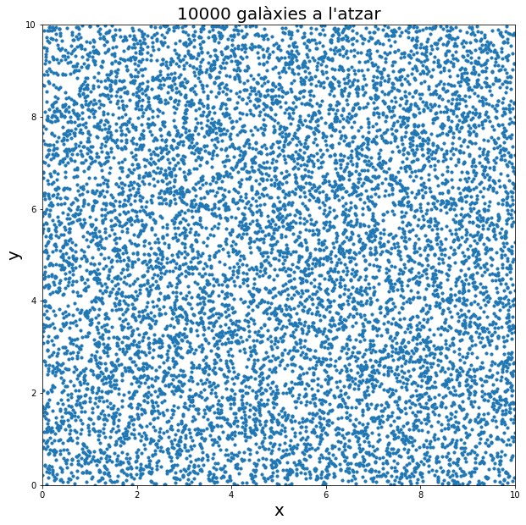
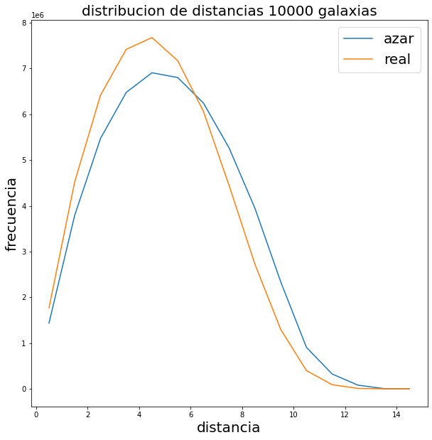
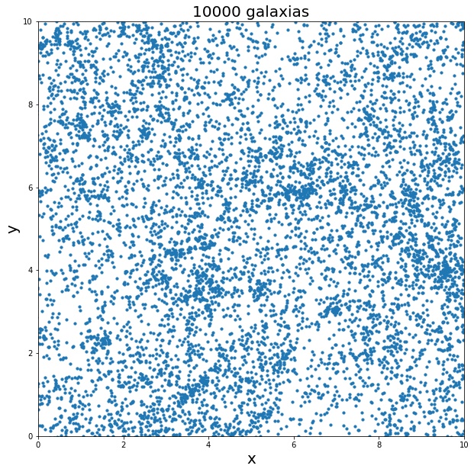
Measurement Galaxy Clustering
Make the histogram of the distances of galaxies
Difference between random positioning of galaxies and with the gravitational effects
  Clustering
  Depends on distribution of Dark Matter
Credit: F. Castander
Frequency
Distance

Slide 7
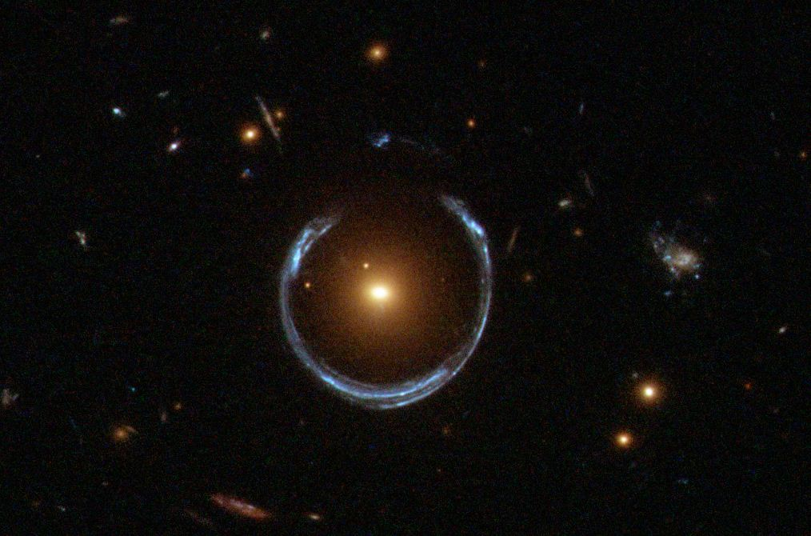
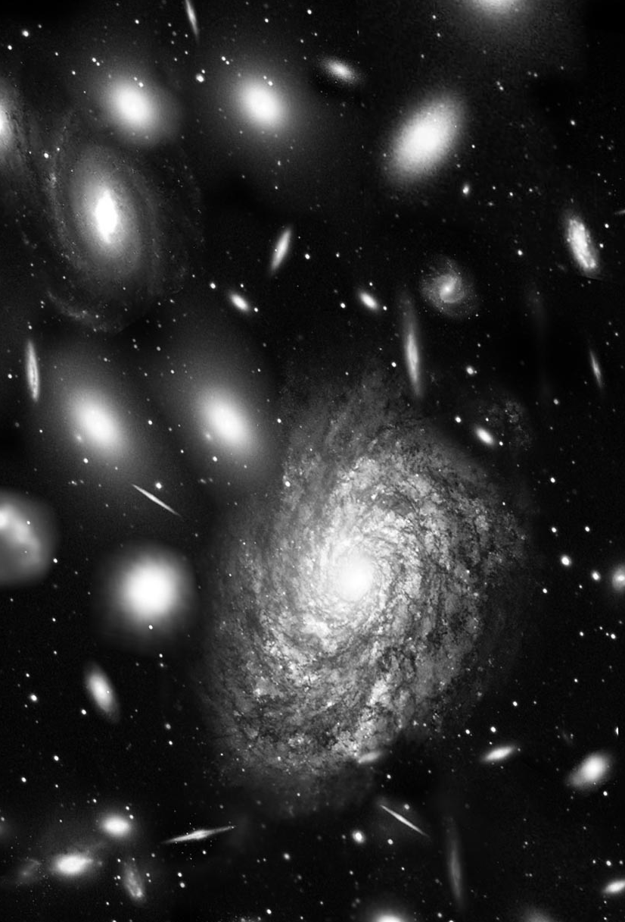
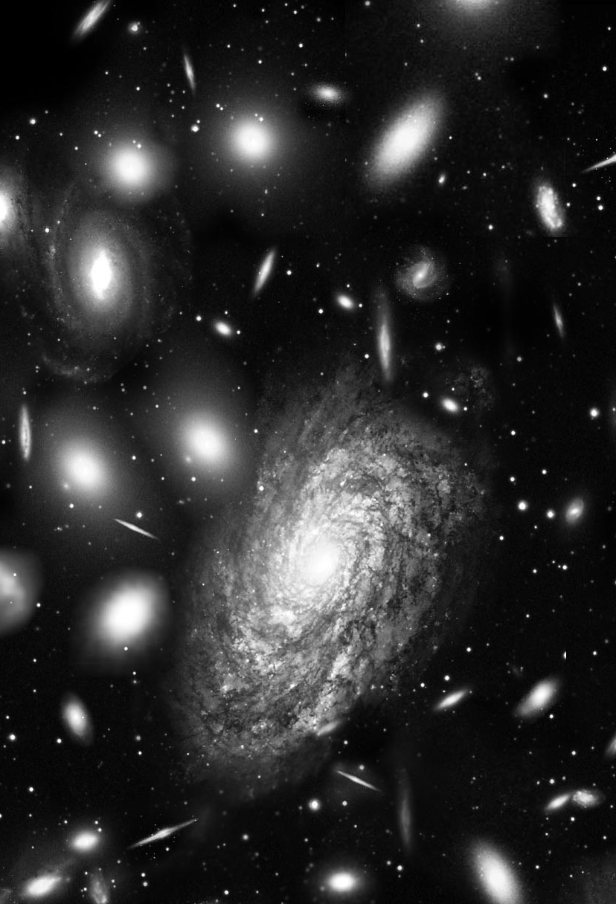
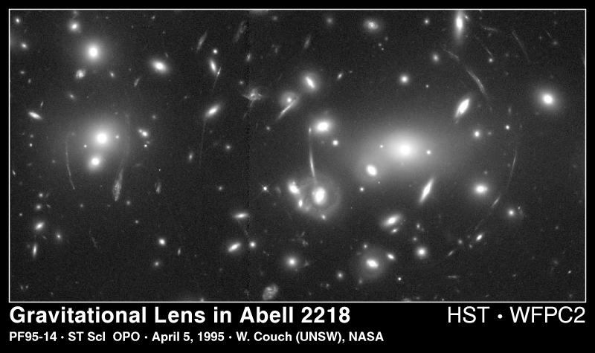
Gravitational Lensing
Strong Lensing
Weak Lensing
Original
Lensed

Slide 8
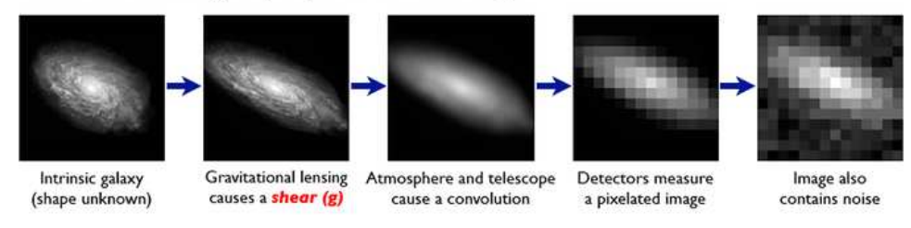
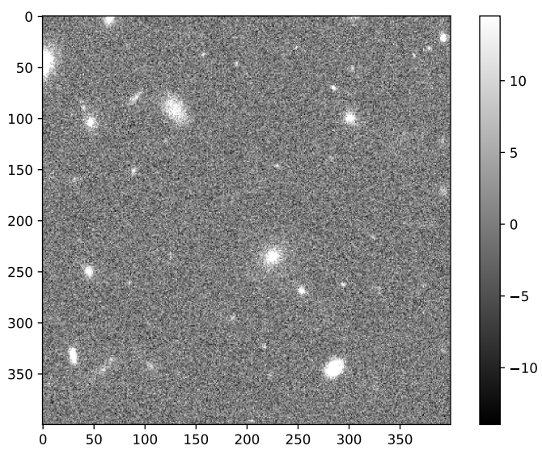
Shape Measurements challenge
VIS-like simulated image
Credit: Bridle+ (2006)
Shape measurements are very difficult:
PSF Convolution
Pixelization
Image Noise
Detection Probabilities and blending
Credit: Jansen+ (2024)
Realistic image simulations are used to test, validate and calibrate measurement methods

Slide 9
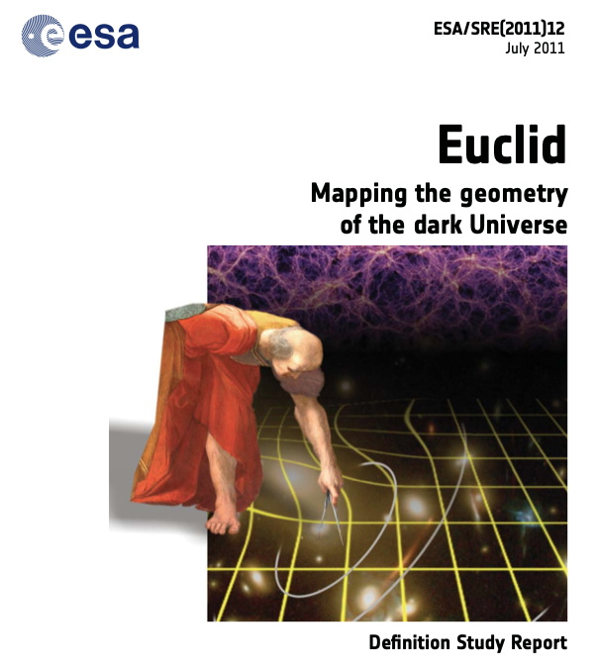
Main objectives
Euclid is designed to understand the nature of
Dark Energy and Dark Matter
Reach a dark energy FoM > 400 using only Euclid primary probes
Needs telescope in space with exquisite control of instrumental and optical effects
Measure the exponent of the growth factor with a 1 sigma precision < 0.02
Measure the sum of the neutrino masses with a 1 sigma precision better than 0.03 eV.
Constrain the spectral index and measure non-Gaussianity of initial conditions
Credit: ESA Euclid Definition Study report
Notes:
List the main goals of the Euclid mission as defined in the Euclid Red Book: test dark energy (w0wa and gamma within certain values using only Euclid primary probes: Weak Lensing and Galaxy Clustering), test dark matter (hierarchy and neutrino masses) and primordial initial conditions (spectral index combined with Planck and non Gaussianities)

Slide 10

The Euclid Consortium
More than 2700 registered scientists
14 European countries + USA + Canada + Japan
Responsible for the two Euclid instruments and the reduction and analysis of the data (Science Ground Segment)
Notes:
Euclid aims to map 2 billion years of cosmic history to understand the nature of Dark Energy and Dark Matter, creating the largest 3D catalogue ever built of the Universe’s Large Scale Structure

Slide 11
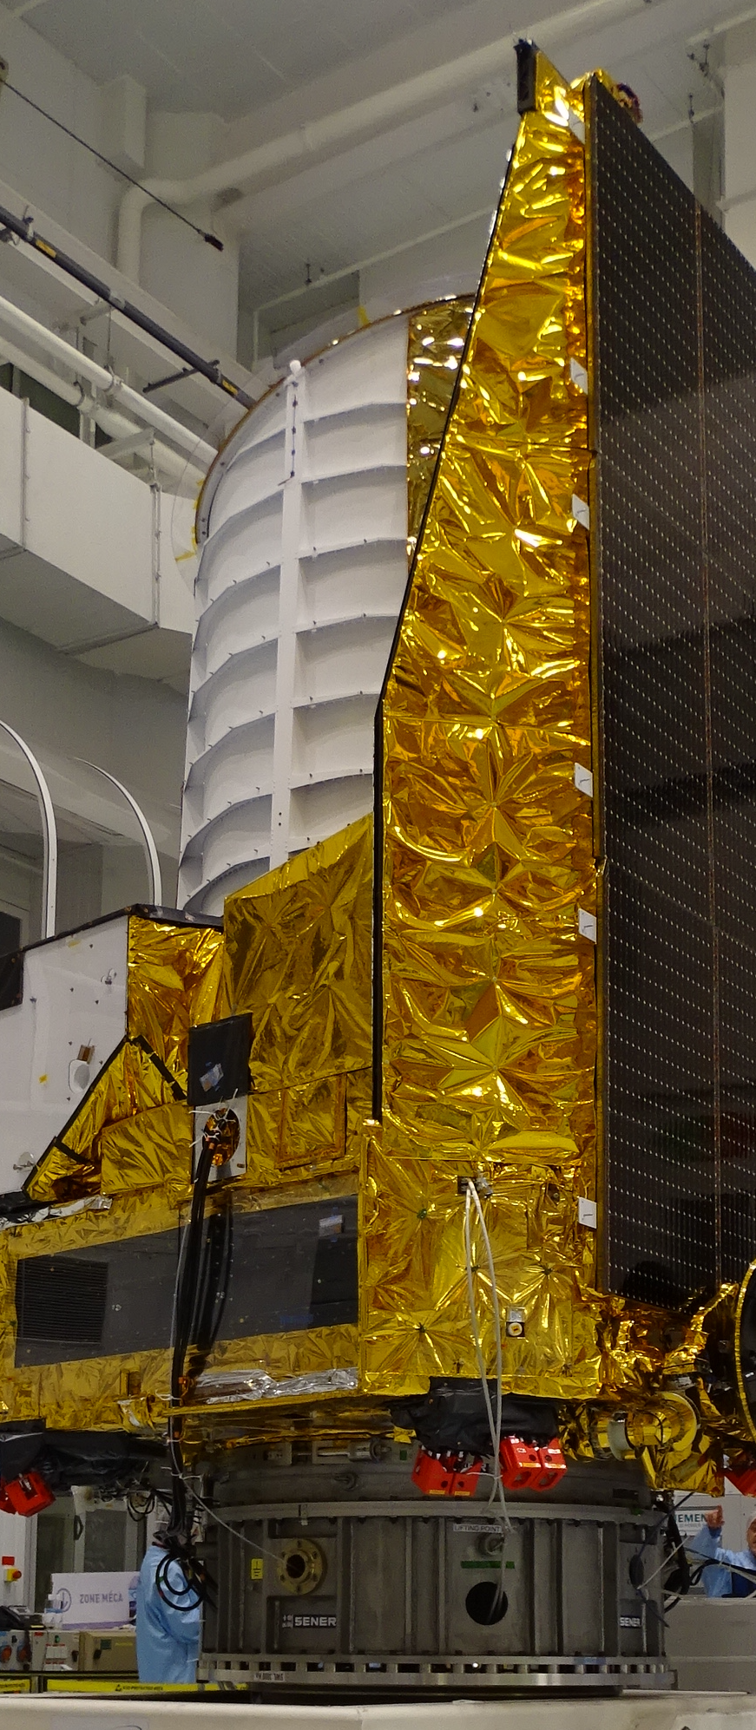
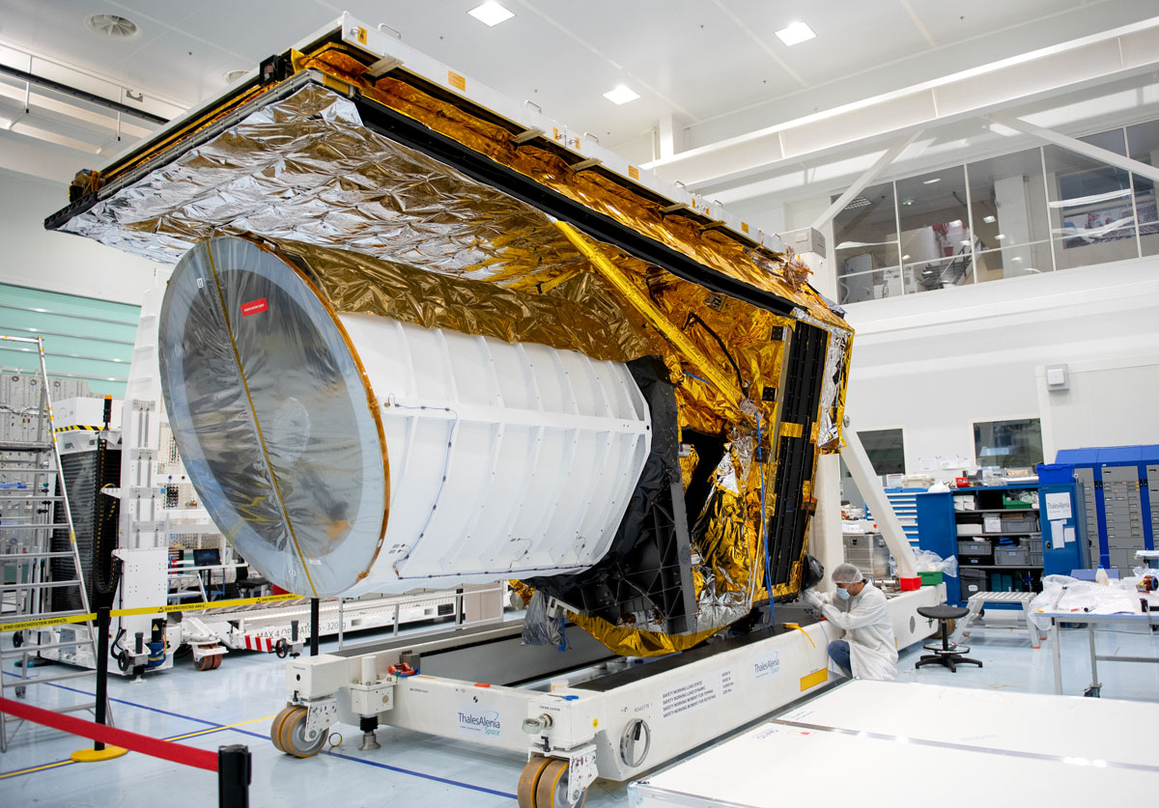
Euclid Satelite

Slide 12
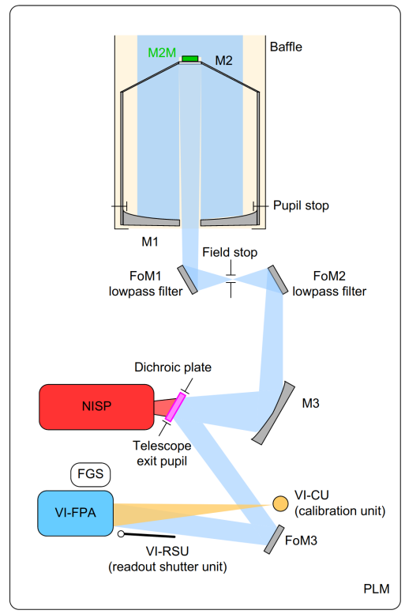
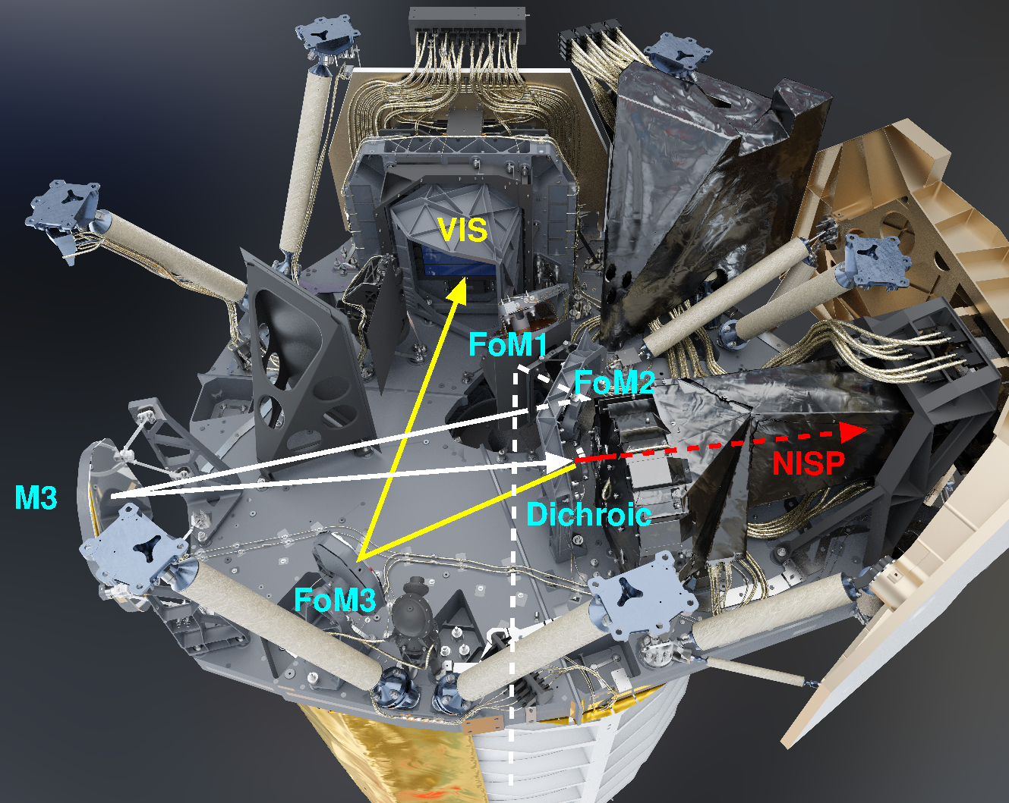
Euclid Telescope and instruments

Slide 13
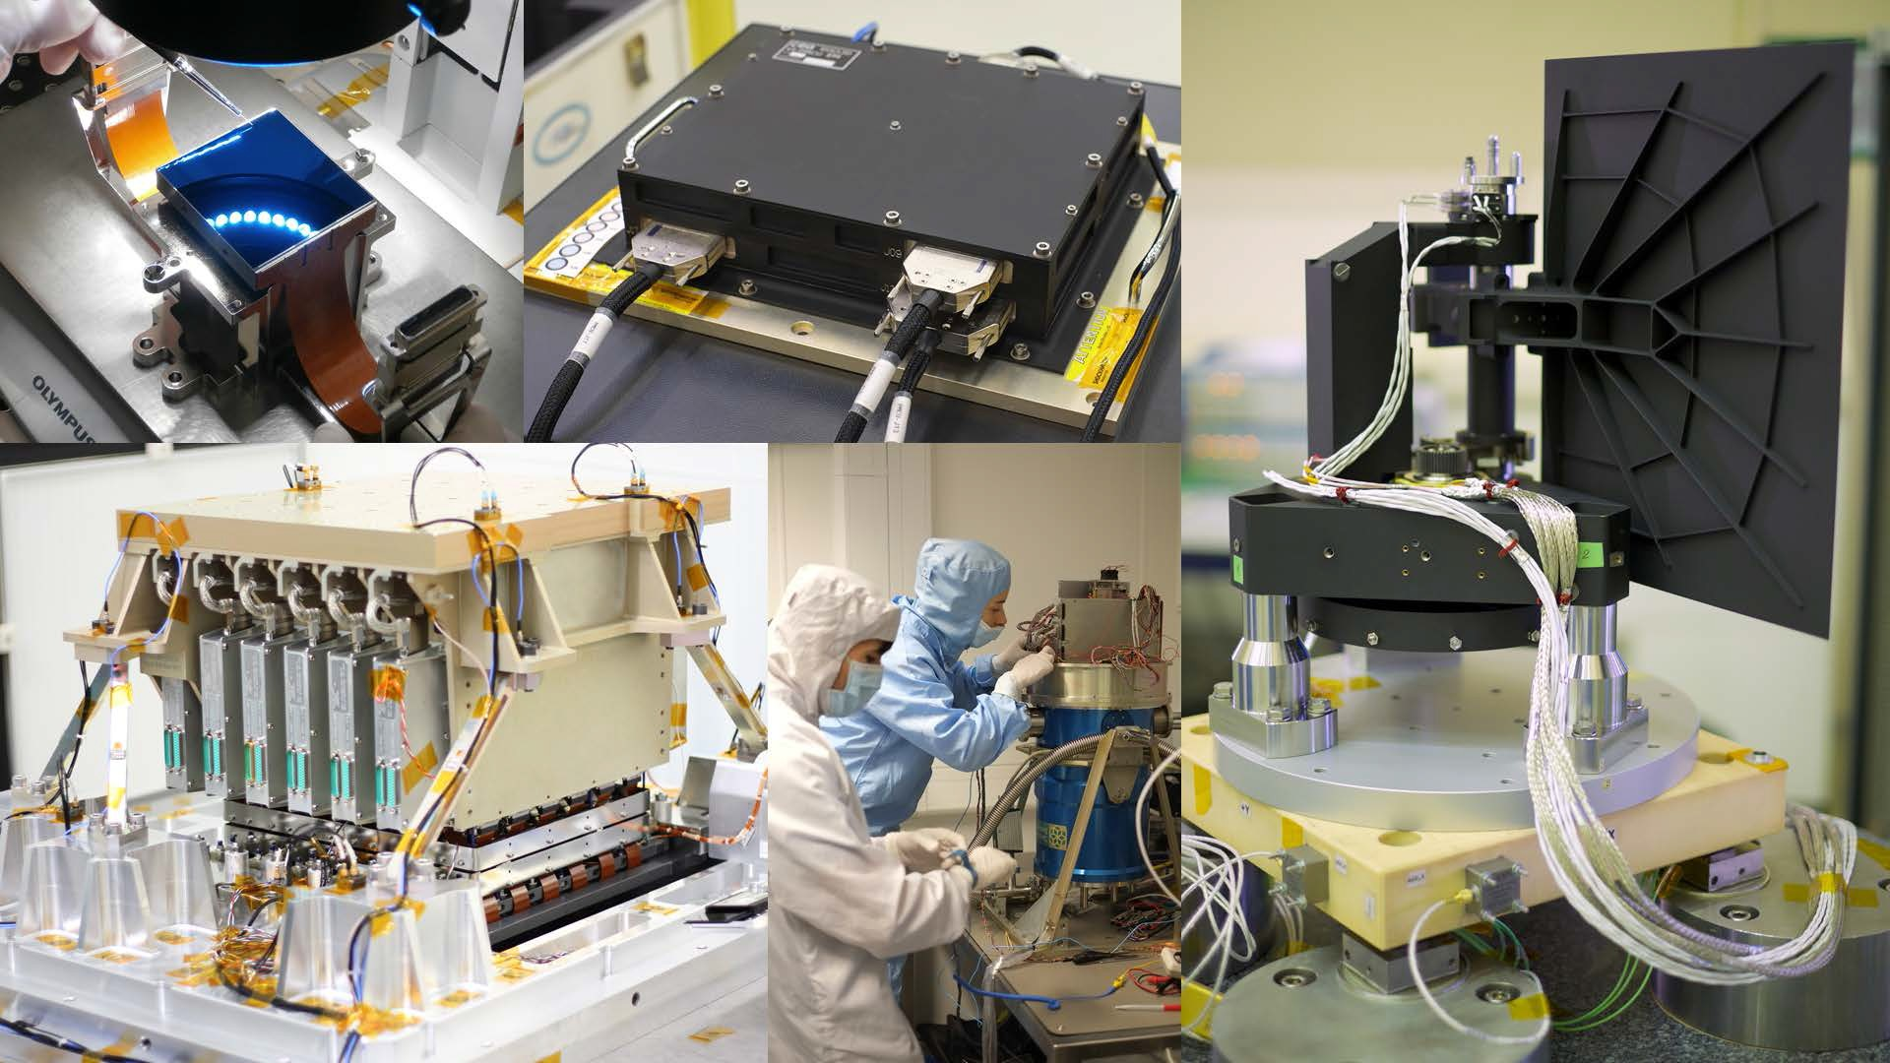
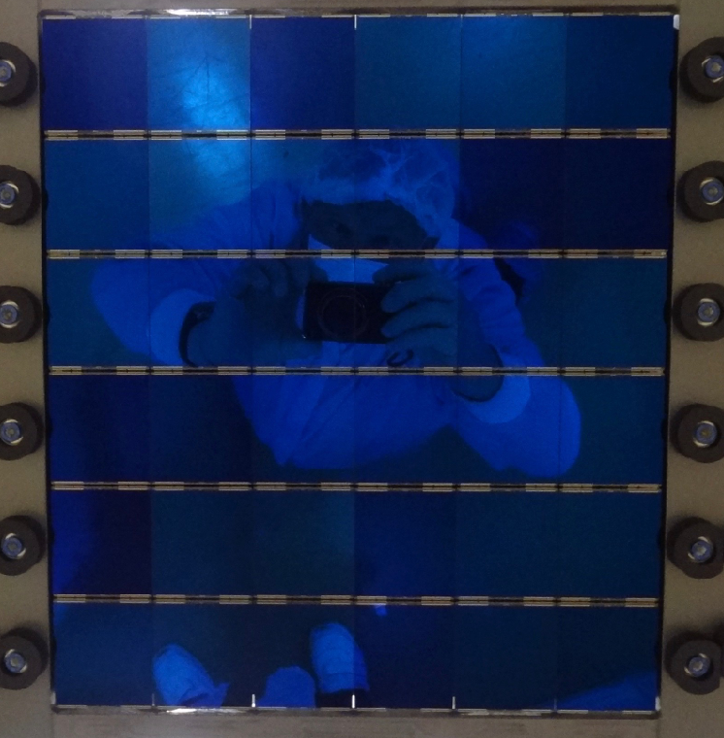
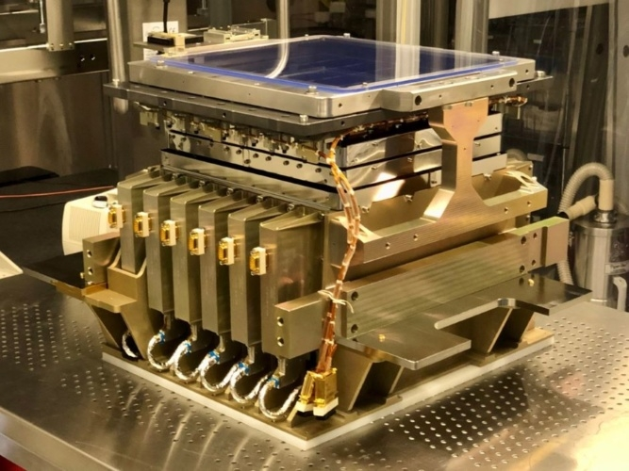
VIS Instrument
Readout Shutter Unit
Focal-plane instrument, no fore-optics
36 4k x 4k CCDs, 0.1” / pixel
Readout time 72 seconds
530-920 nm wavelength range defined by coated
mirrors, detectors, and dichroic beamsplitter
Blade shutter
Calibration lamp (6 wavelengths)
Depth: 26.2 AB mag (5σ point source)
VIS CCDs
Power, Mechanism and Control Unit
VIS CCD testing
Focal Plane Assembly

Slide 14
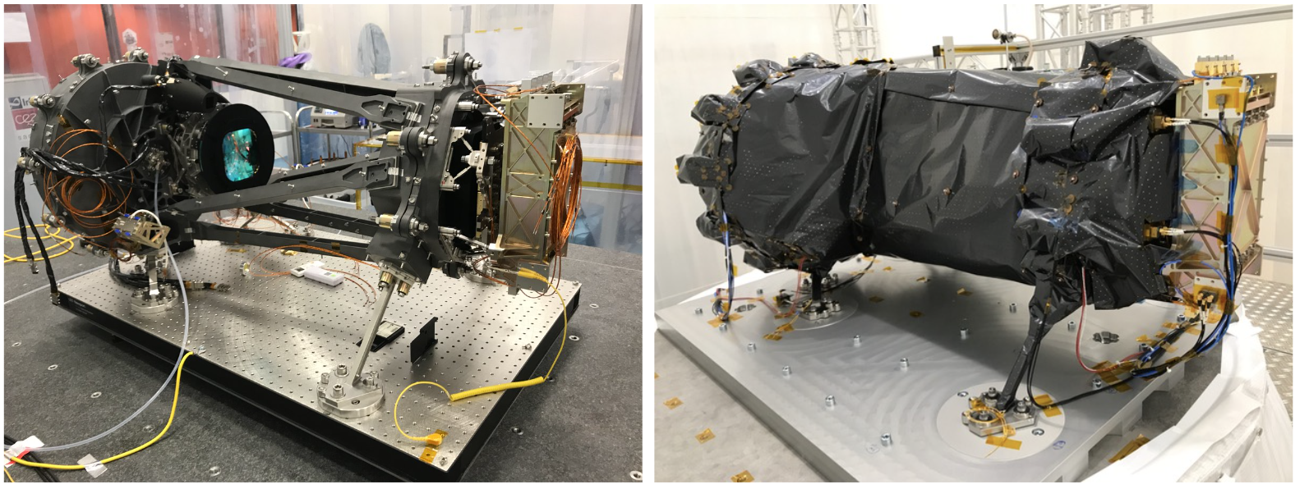
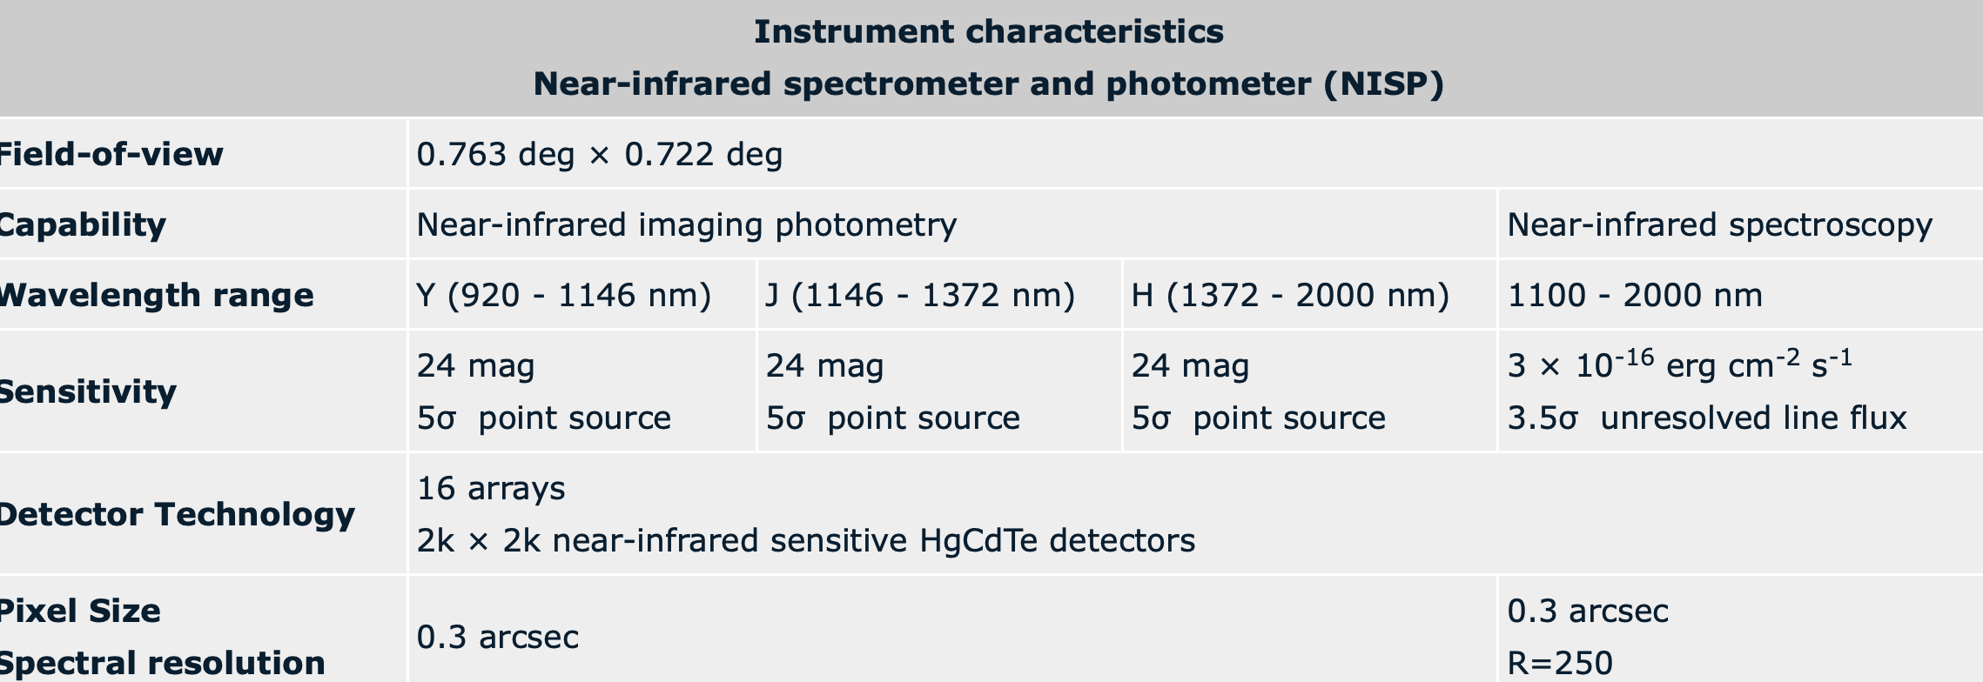
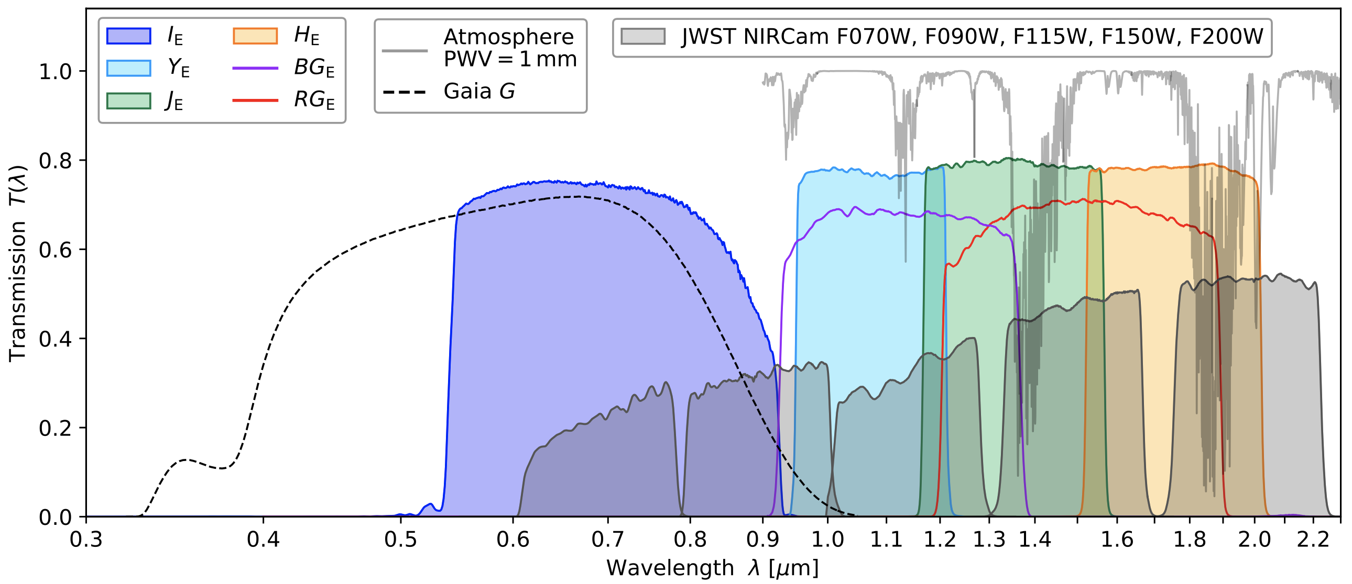
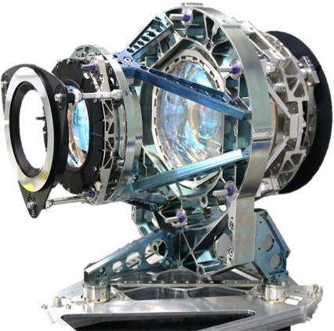
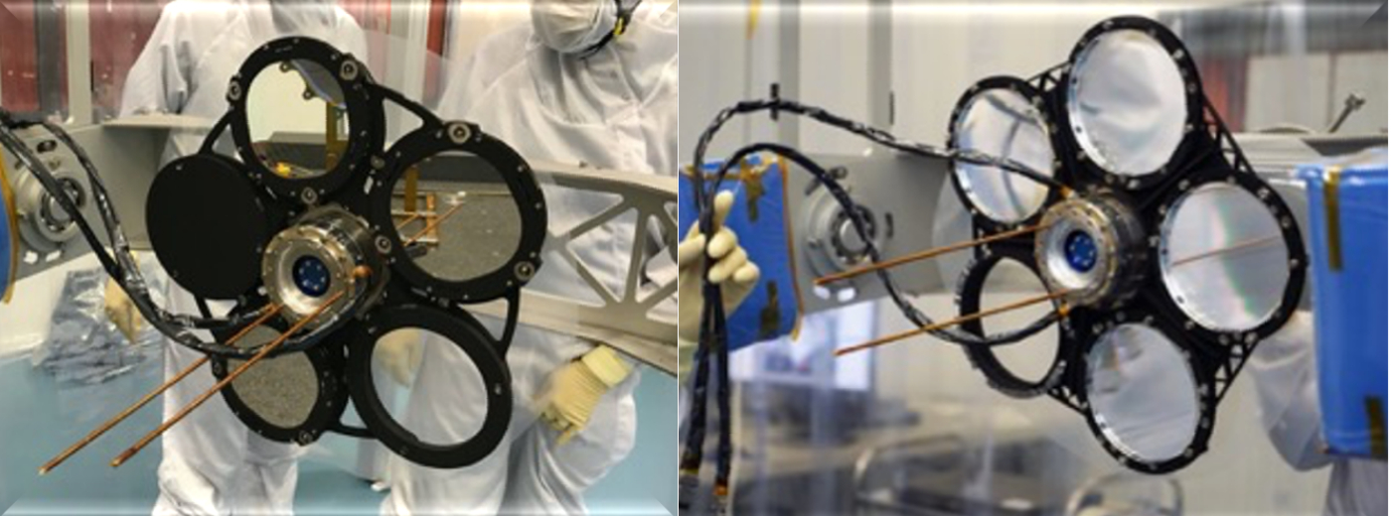
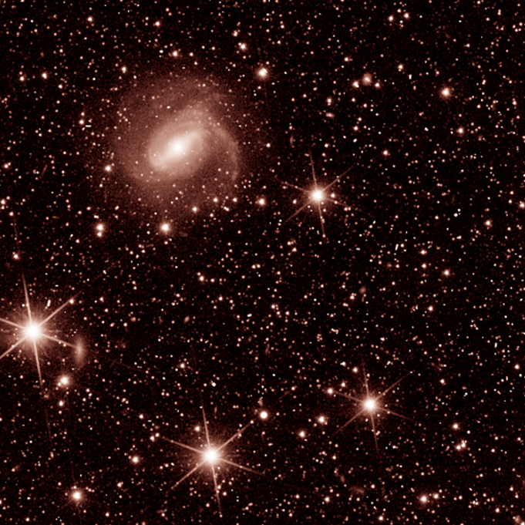
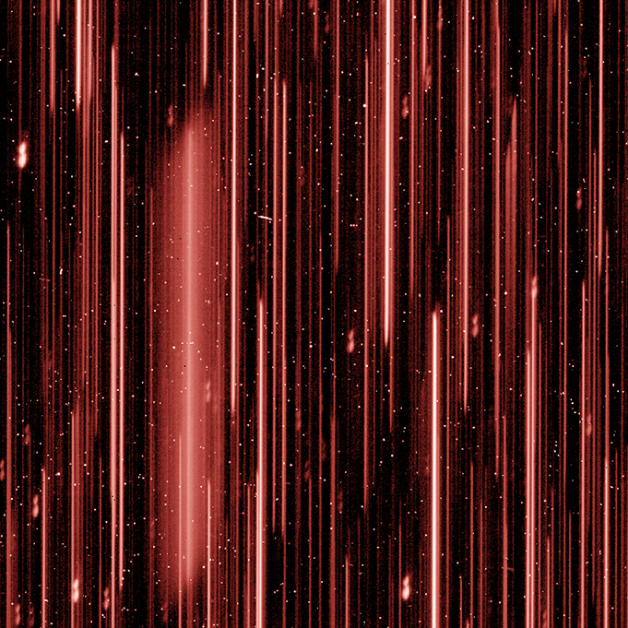
NISP Instrument

Slide 15
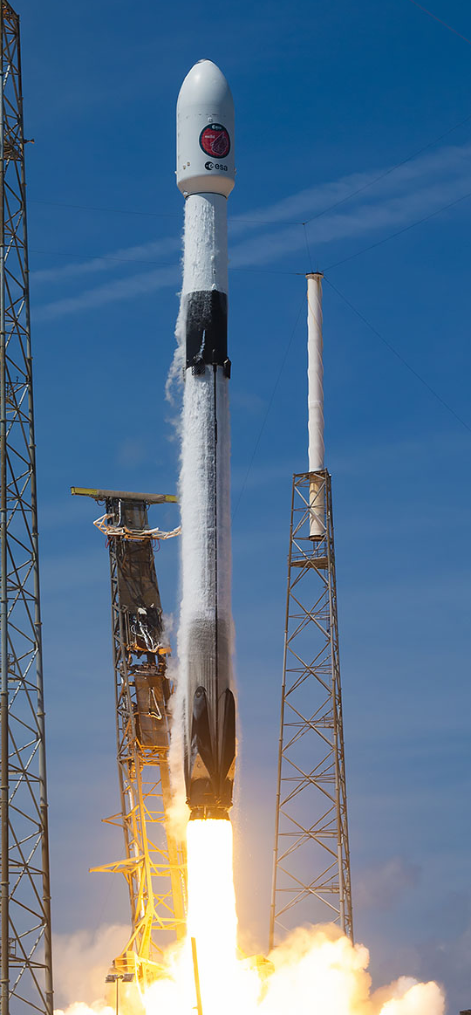

Successful Launch on July 1st,2023
Euclid launched on a Falcon 9 on 1st July 2023, from Cape Canaveral. (Credits: ESA, NASA & Space-X)

Slide 16
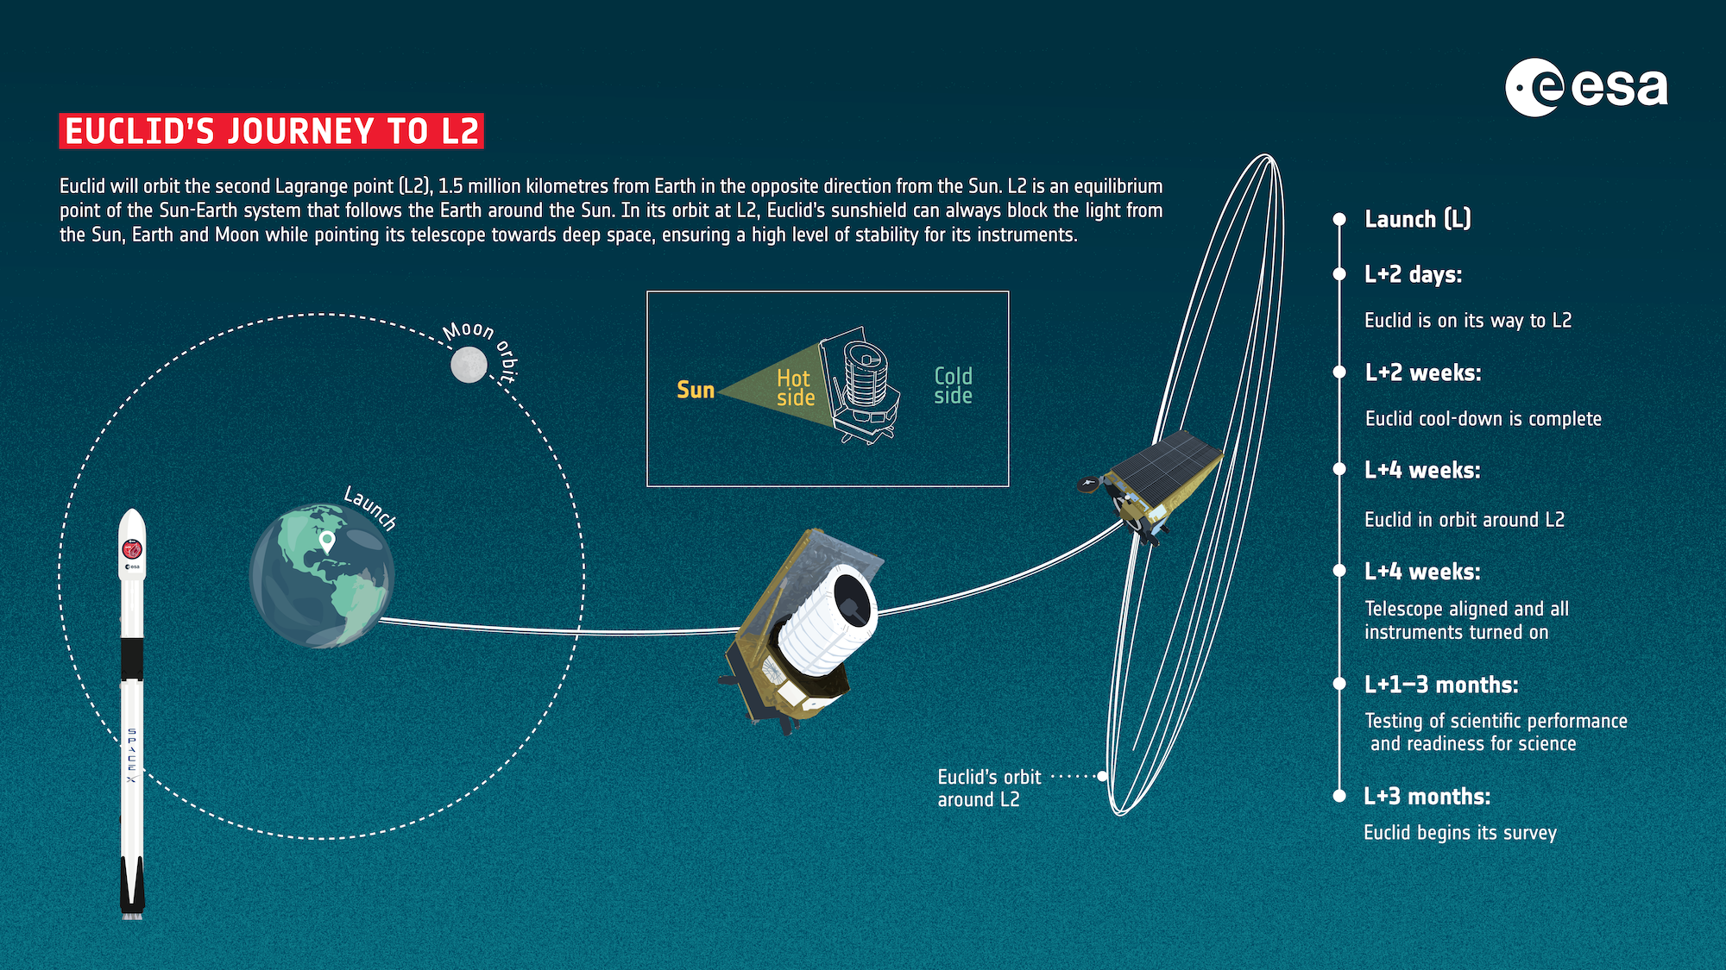
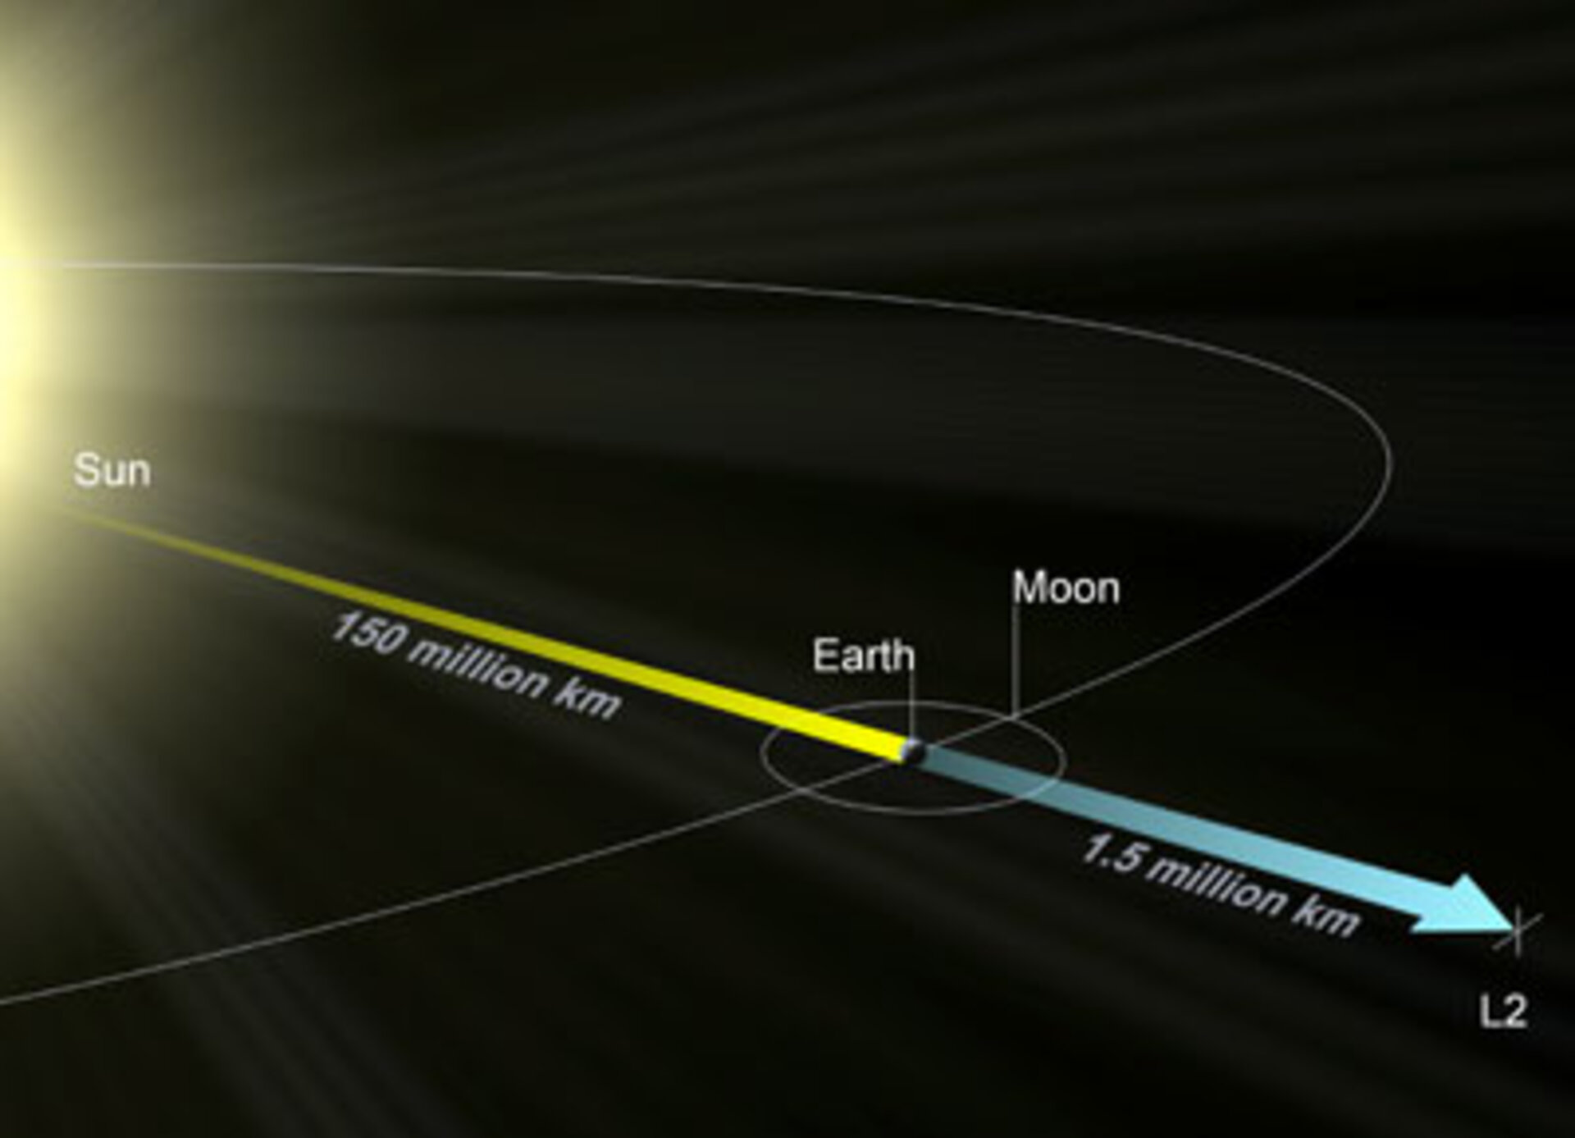

Slide 17
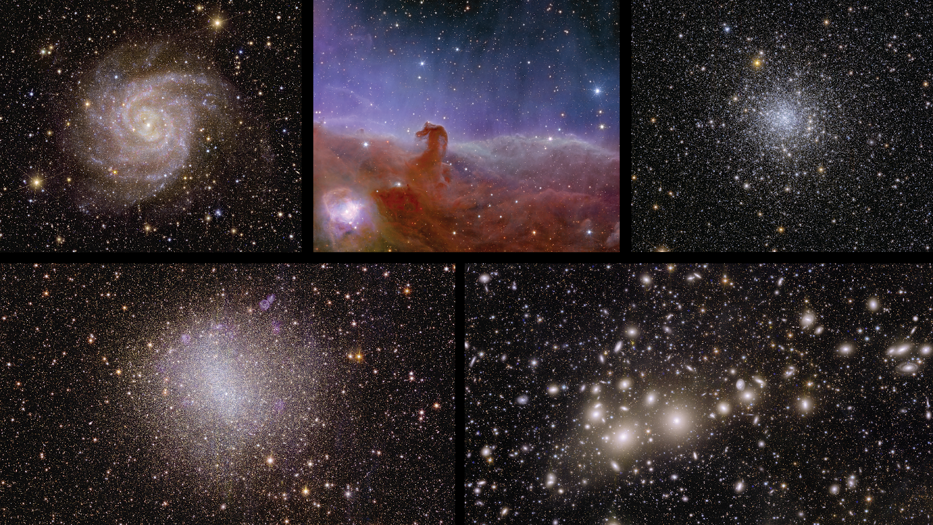
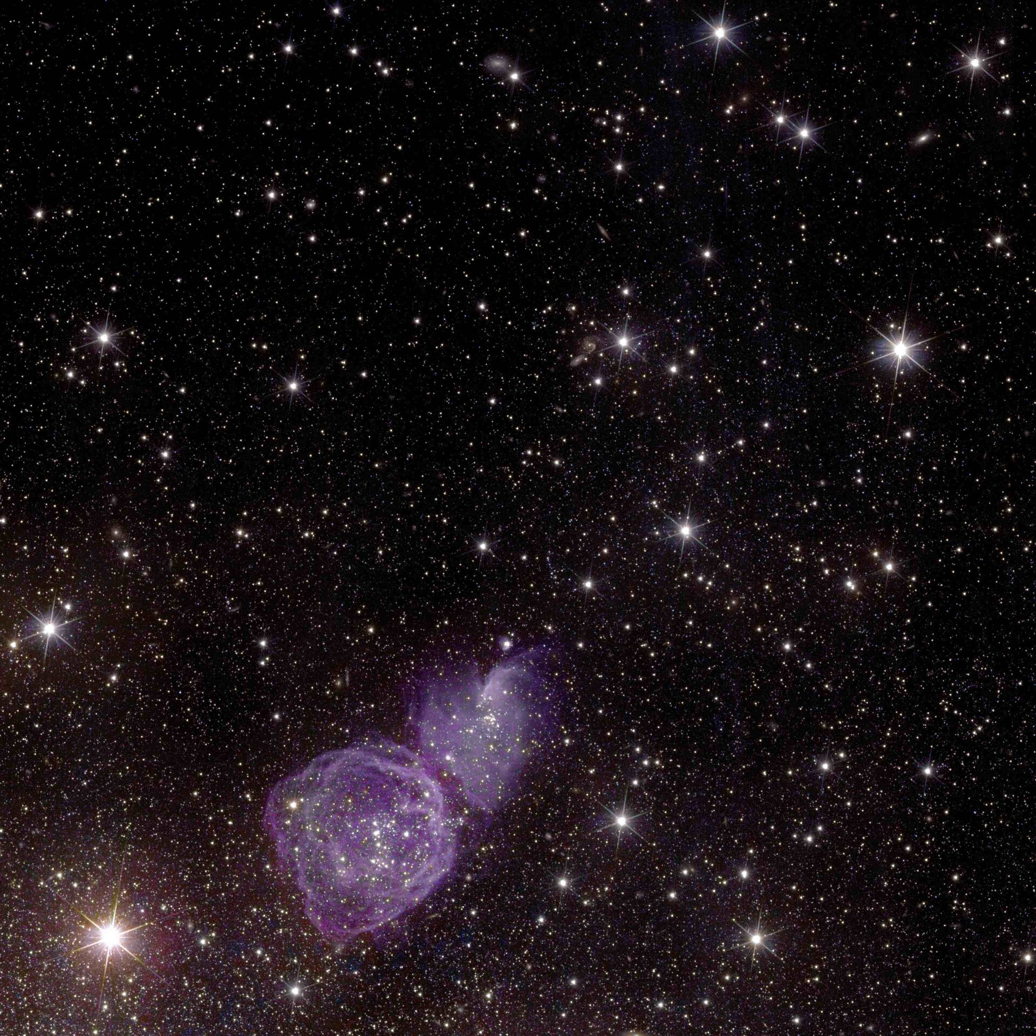
Horsehead Nebula (1375 ly)
Globular Cumulus NGC 6397 (7.8 kly)
Spiral Galaxy IC342 (11 mly)
Euclid
Euclid First Images
Supernova Explosions
Irregular Galaxy NGC 6822 (1.6 mly)
Perseus Galaxy Cumulus (240 mly)

Slide 18
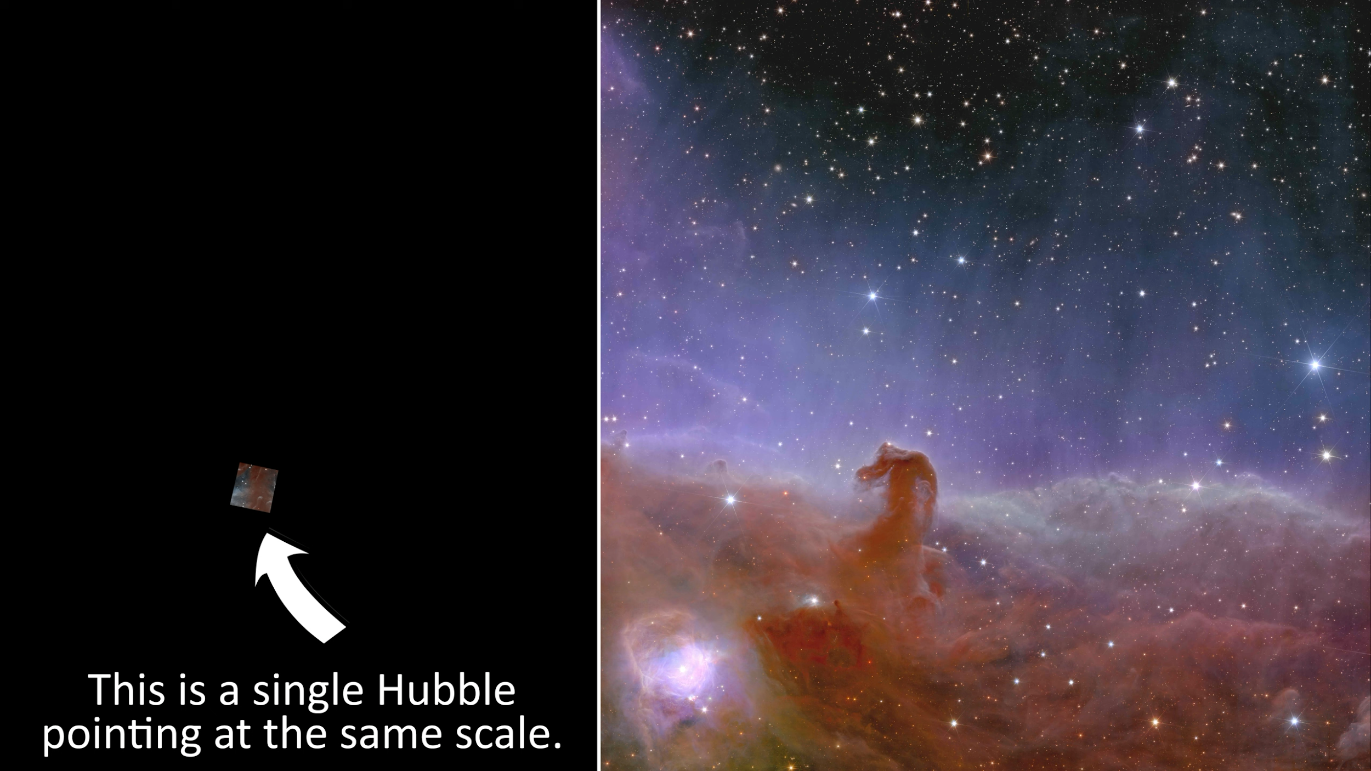
Basic Slide
Chris Pattison

Slide 19
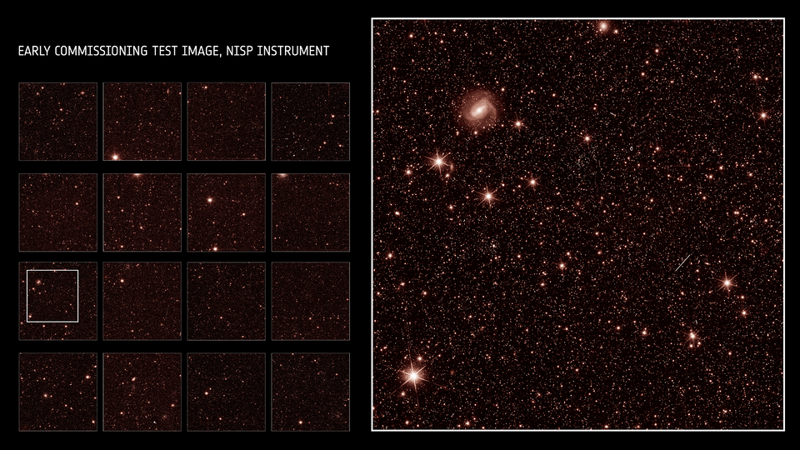
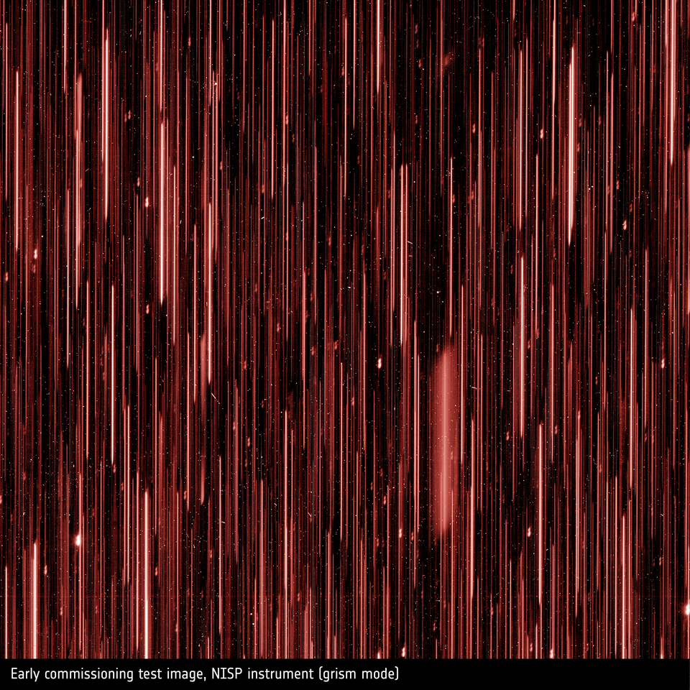
NISP
Grism channel
Jahnke et al. 2024
Notes:
Grism exposure

Slide 20
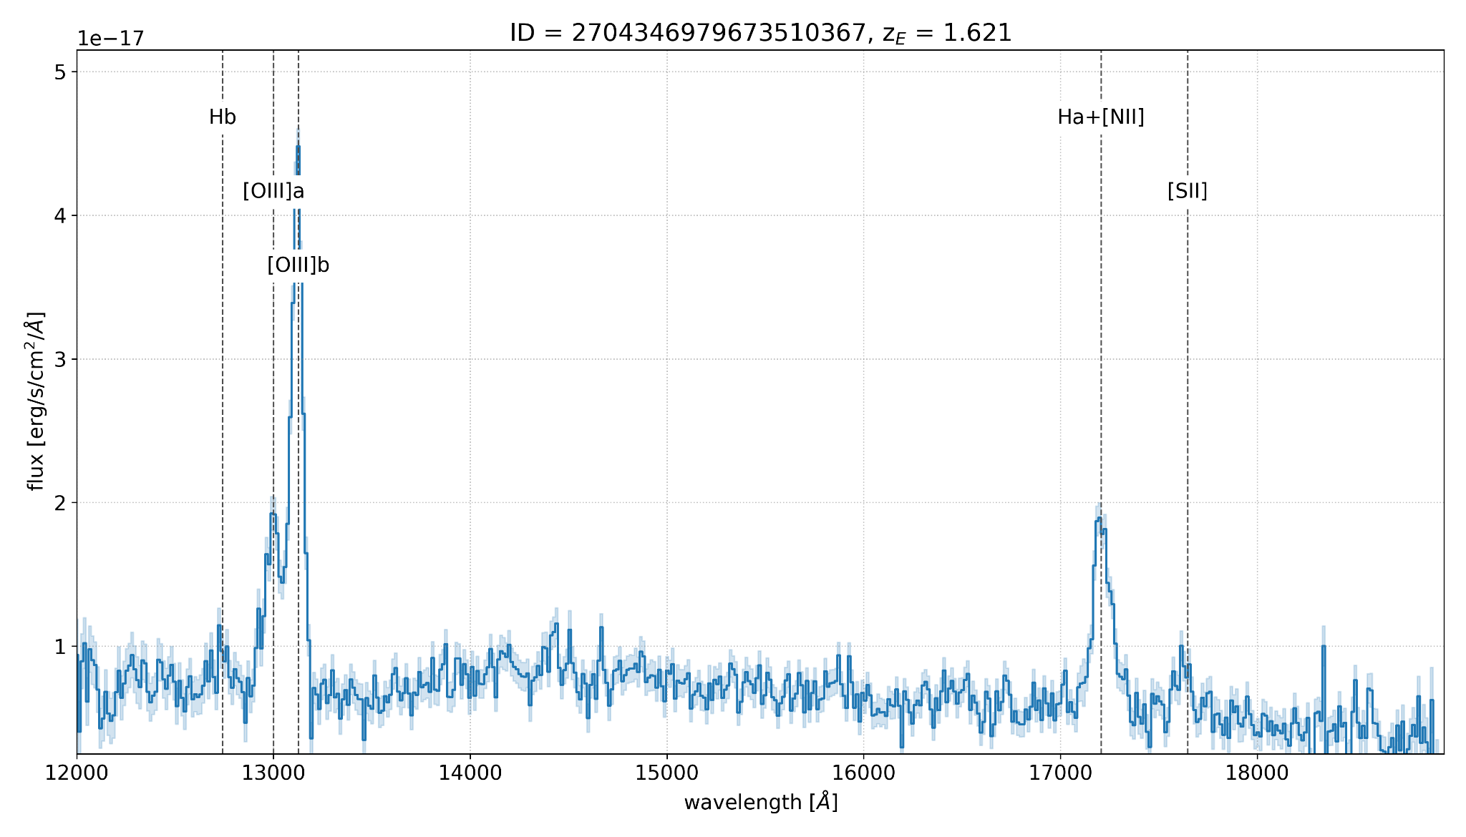
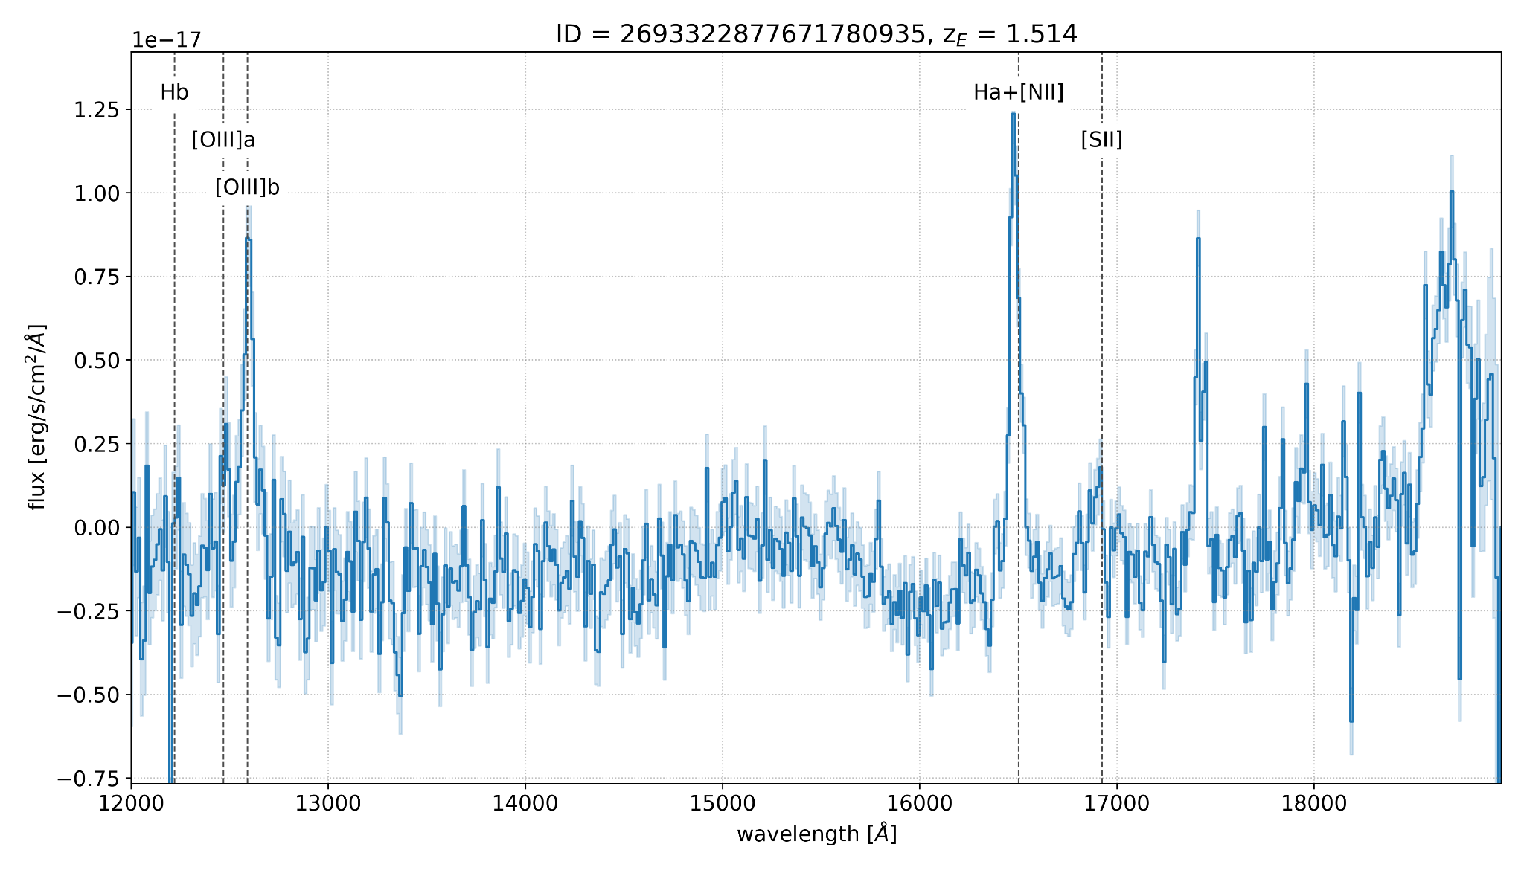
Examples of high SNR spectra
Euclid Preliminary
z=1.621
strong emission line galaxy, with multiple lines
Euclid Preliminary
z=1.514
F(Hα) = 1e-15 erg/s/cm²
SNR = 20.5
H_{E} = 20

Slide 21
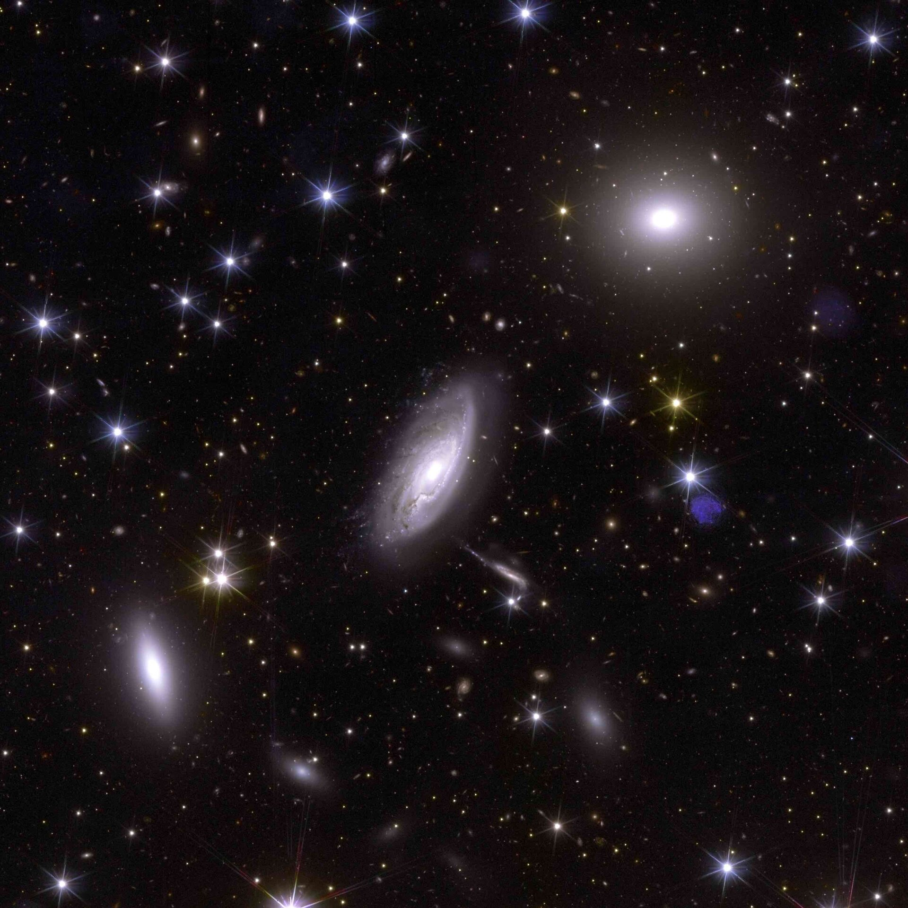
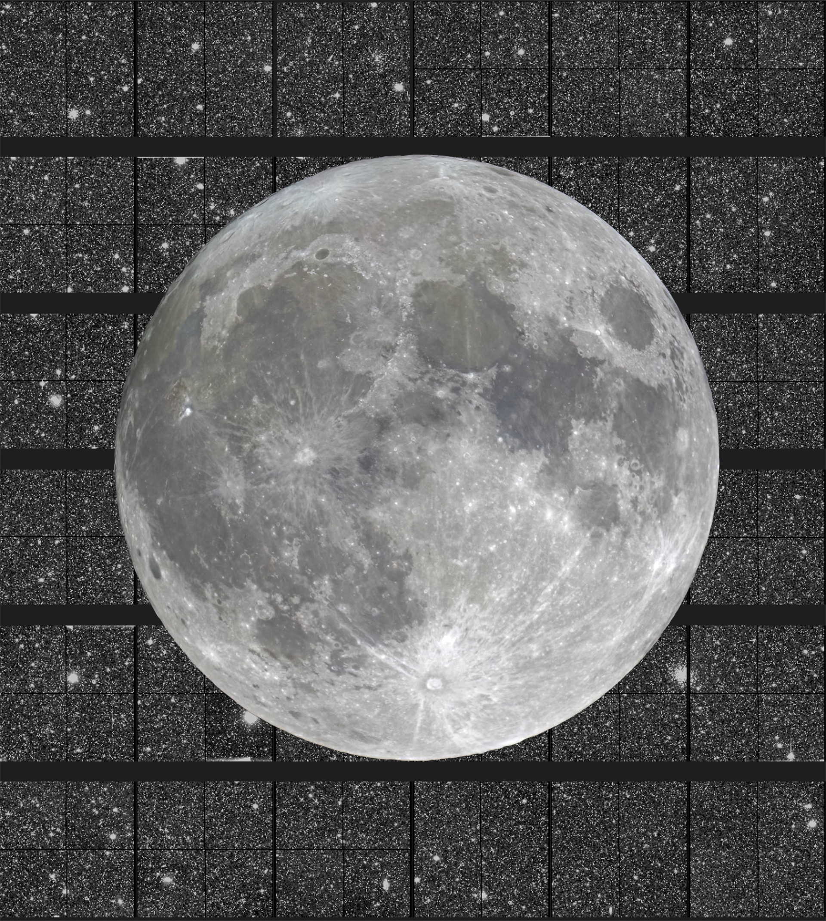
Euclid Survey
Euclid observes ~10 deg²/day in the wide survey

Slide 22
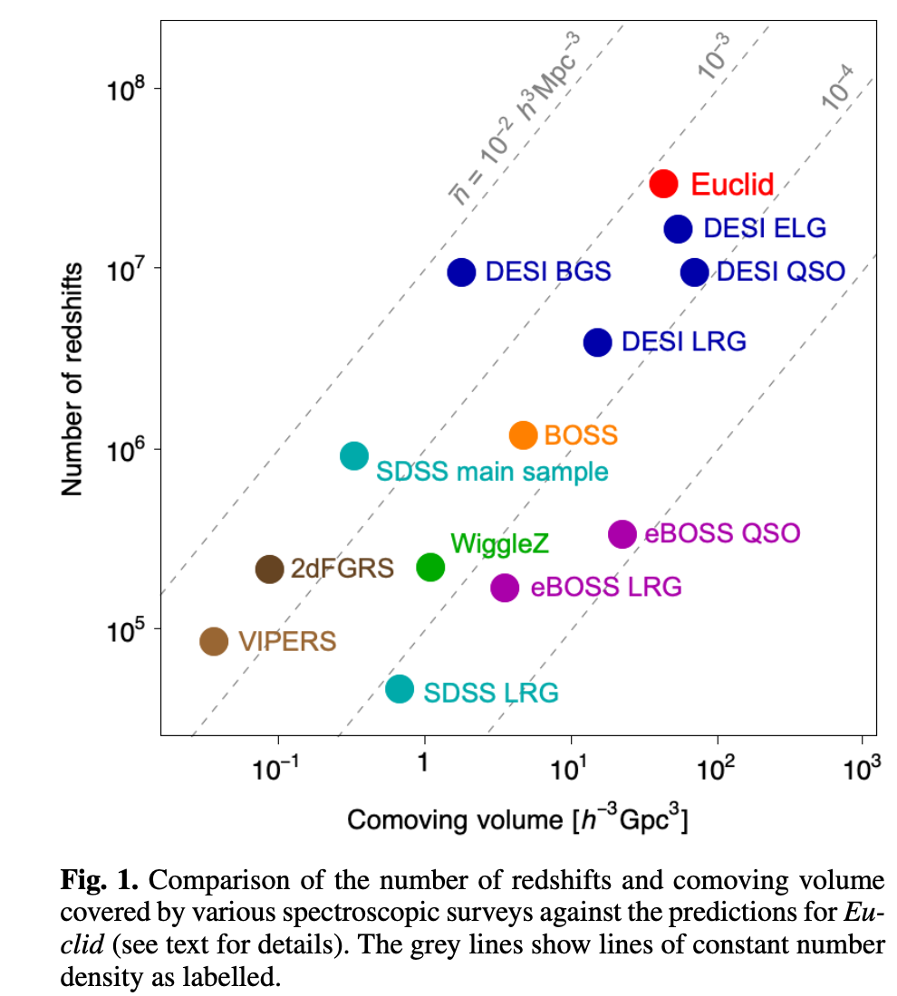
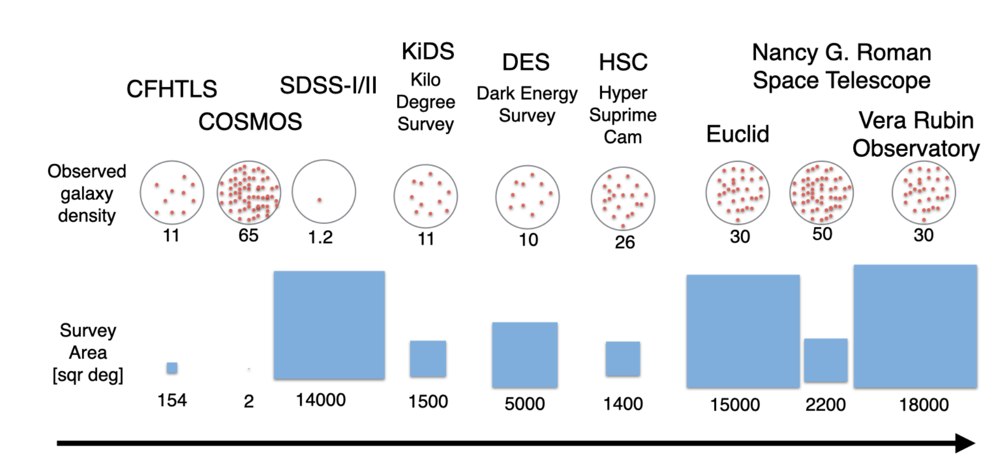
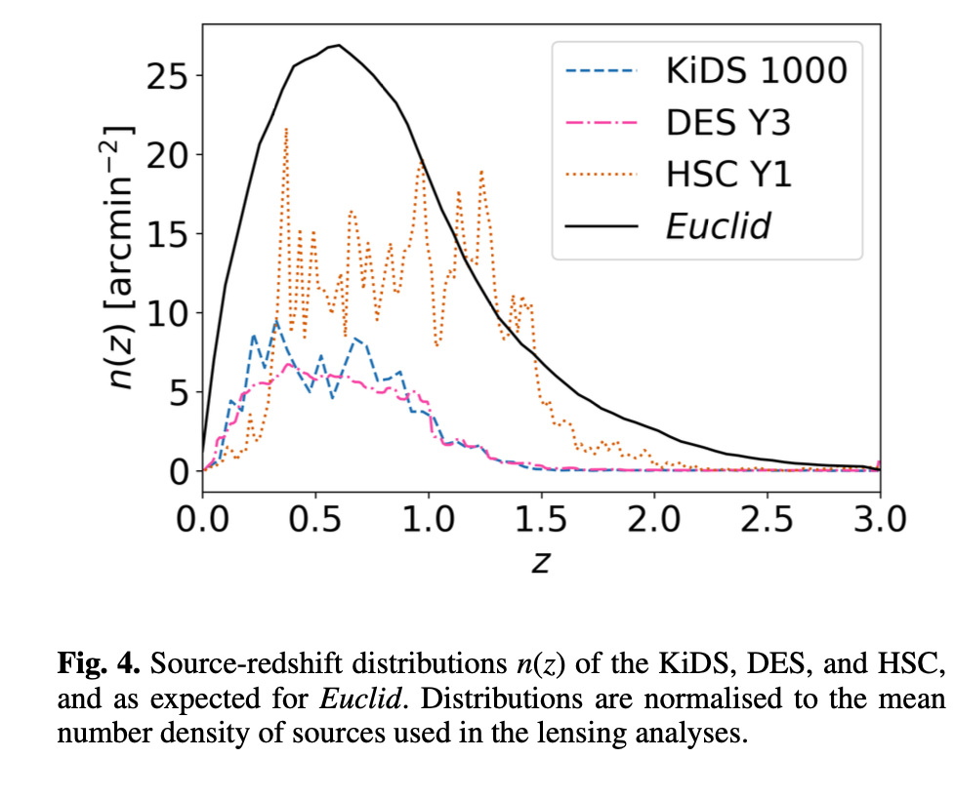
The Euclid Survey in Context
Euclid WL vs. Stage III & IV experiments
(credit: Elisabeth Krause)
now
Unprecedented volume coverage with objects up to redshift 2

Slide 23
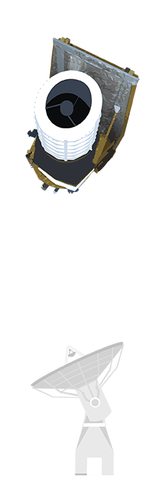
Data transfer
Collecting 30 Petabytes of unprocessed data
Communications from L2, to ESOC (Germany), to ESAC (Madrid), once per day
Distribution along 9 dedicated data centres
Credit: ESA/ATG
Notes:
Explain gravitational Lensing

Slide 24
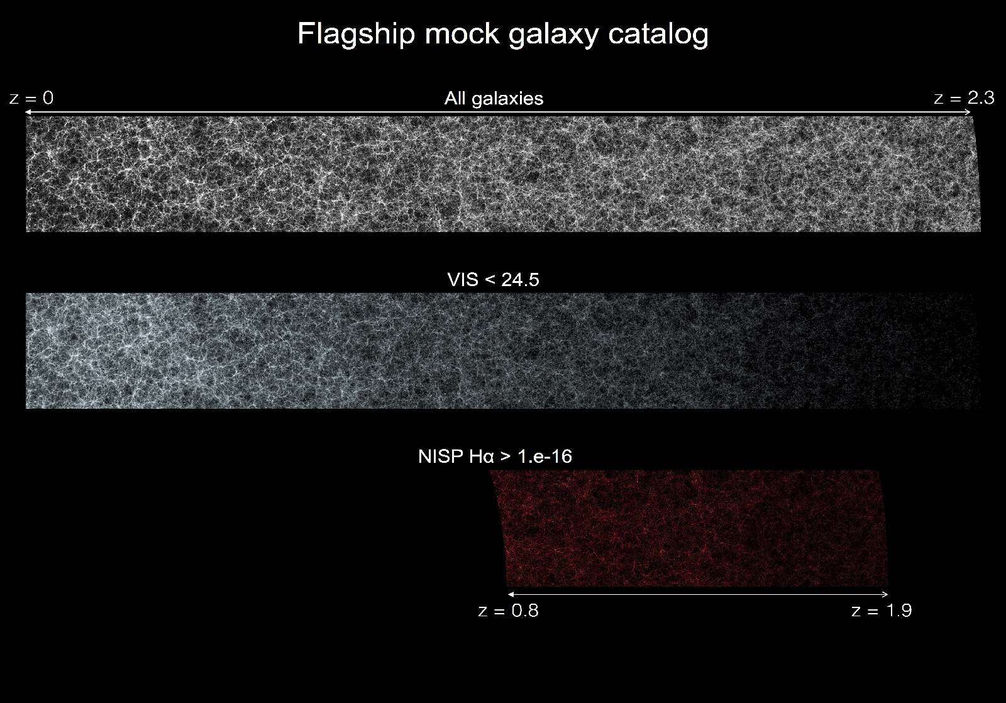
Euclid Flagship Simulations
Simulations are crucial to achieve Euclid’s scientific goals:
Instrumental effects
Analysis biases
….
Just cannot simulate multiple universes….
Euclid spectroscopic galaxy sample

Slide 25
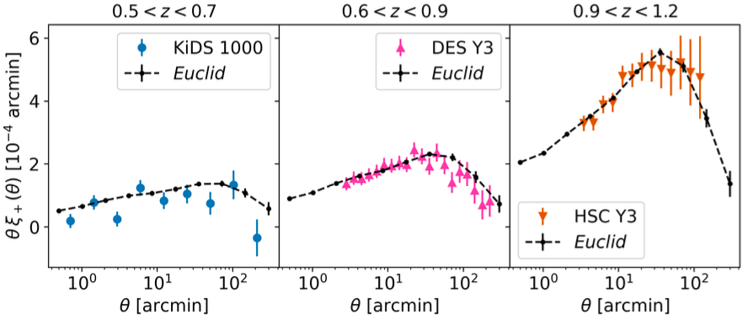
Cosmology with Euclid: combined probes (weak lensing & galaxy clustering)
The so-called “3x2pt” analysis combines:
Angular auto-correlation functions
(galaxy positions);
Shear auto-correlation functions
(galaxy ellipticities);
Cross-correlations between
positions and ellipticities.
Sensitive to the matter distribution
along the line-of-sight, and
the history of structure formation.
Forecast shear auto-correlation functions (with the highest S/N for every survey)
(Mellier et al 2024)
Euclid S/N an order of magnitude higher than other surveys

Slide 26
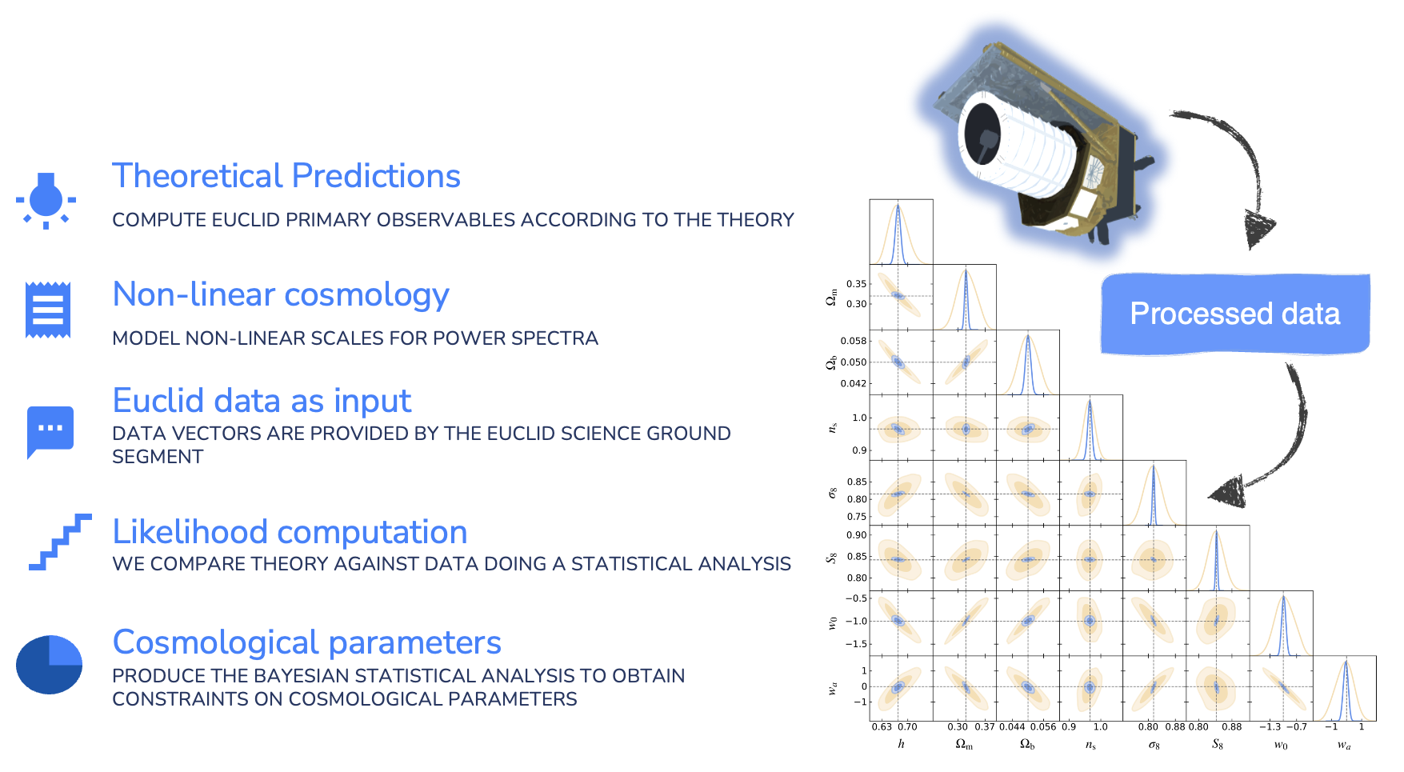
Cosmological inference: overview

Slide 27
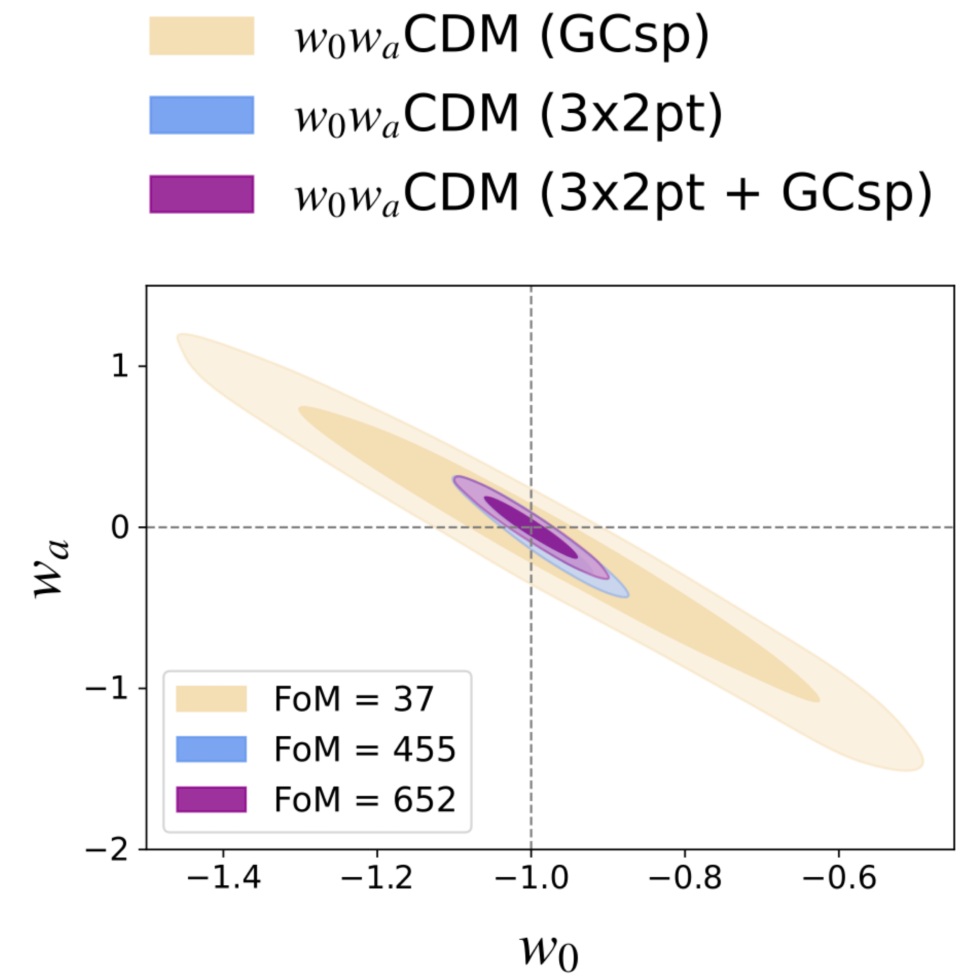
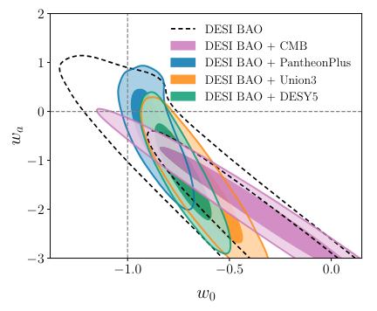
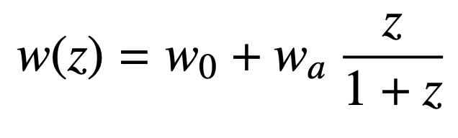
Euclid: the physics of cosmic acceleration
The dark energy equation of state w ≠ -1 indicates a departure from the cosmological constant, requiring a dynamical dark energy scenario.
Parameterized evolution of w(z):
27
Euclid Forecast
(Mellier et al 2024)
DESI Collaboration 2024

Slide 28

Euclid Additional Science
Recombination
Dark ages
Big Bang
Evolution of Galaxies
First stars
10⁵ galaxy clusters
Cosmic Voids
Cross-correlations with CMB temperature and lensing
10⁵ strong gravitational lenses
Transients in Deep fields
  ~50 Super-luminous SNe / year (Inserra+17)
Galaxy formation and evolution
  Census of AGN at 1 < z < 3
  Galaxy morphologies at z > 1
  Lyman break galaxies at z > 7
  High-z quasars
Milky Way
  Census of brown dwarf stars
  Satellites & environs
First galaxies
Galaxy growth
Galaxy clusters
x10 in number of sources compared to previous surveys in most cases

Slide 29

The Euclid Data Releases
2500 deg²
7500 deg²
14000 deg²
First Cosmology results in 2026 and several public releases afterwards that will continue to produce interesting physics results

Slide 30
Summary
Euclid will observe 1/3 of sky at redshifts up to 2
  Currently observing ~10 deg²/day
The results will provide high precision results in the Dark Energy Equation of state and other cosmological parameters
Spacecraft, system and instruments work as expected
  Early issues (guiding system, stray light) solved brilliantly
  X-ray flares and ice deposition are handled successfully on a regular basis
Legacy data will also help understanding key fundamental issues in non-cosmological science
  We just released the Early Release Observation papers
Euclid aims to map 2 billion years of cosmic history to understand the nature of Dark Energy and Dark Matter, creating the largest 3D catalogue ever built of the Universe’s Large Scale Structure

Slide 31
List of Early Release Observation papers
Euclid: Early Release Observations – Programme overview and pipeline for compact- and diffuse-emission photometry, Cuillandre et al.
Euclid: Early Release Observations – A glance at free-floating new-born planets in the σ Orionis cluster, Martin et al.
Euclid: Early Release Observations – Unveiling the morphology of two Milky Way globular clusters out to their periphery, Massari et al.
Euclid: Early Release Observations – Deep anatomy of nearby galaxies, Hunt et al.
Euclid: Early Release Observations – Globular clusters in the Fornax galaxy cluster, from dwarf galaxies to the intracluster field, Saifollahi et al.
Euclid: Early Release Observations – Overview of the Perseus cluster and analysis of its luminosity & stellar mass functions, Cuillandre et al.
Euclid: Early Release Observations – Dwarf galaxies in the Perseus galaxy cluster, Marleau et al.
Euclid: Early Release Observations – The intracluster light and intracluster globular clusters of the Perseus cluster, Kluge et al.
Euclid: Early Release Observations – A preview of the Euclid era through a magnifying lens, Atek et al.
Euclid: Early Release Observations – NISP-only sources and the search for luminous z = 6 – 8 galaxies, Weaver et al.

Slide 32
Credits
All Euclid material shown here on behalf of (and approved by) the Euclid Consortium and ESA
For more information and proper credit to national space agencies and funding organisations: https://www.euclid-ec.org/
Pictures and movies: https://www.esa.int/Science_Exploration/Space_Science/Euclid
Notes:
Euclid aims to map 2 billion years of cosmic history to understand the nature of Dark Energy and Dark Matter, creating the largest 3D catalogue ever built of the Universe’s Large Scale Structure

Slide 34
EXTRA SLIDES

Slide 35


Internal straylight
Left: Sunlight hitting a thruster nozzle reaches VIS detectors. NISP is unaffected.
Middle: Straylight is largely avoided by orienting Euclid so that nozzle is in shadow
Right: The survey was fine-tuned to select low-straylight conditions, only.

Slide 36


X-ray contamination
X-rays from Solar flares penetrate sunshield and reach VIS. Average area loss during Solar maximum: 3-4%
VIS image taken during an X-class flare. Weak flares cause isolated cosmics. Strong flares result in contiguous area loss.
X-rays enter through the major gaps between solar cells.
Credit: J.-C. Cuillandre

