Slide 1

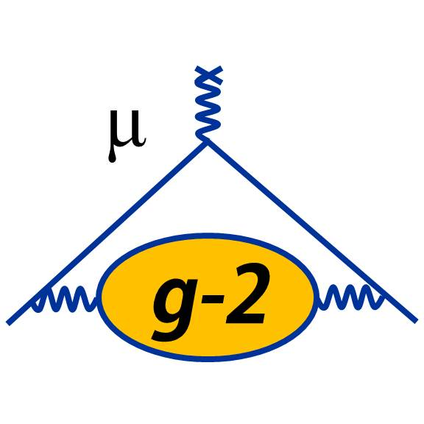



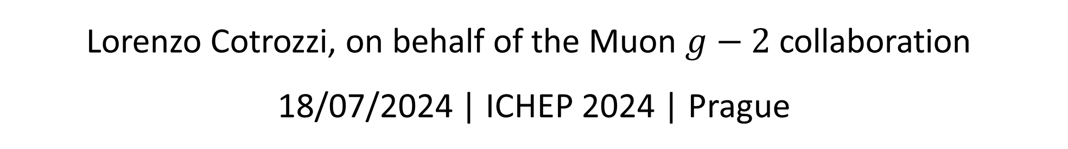
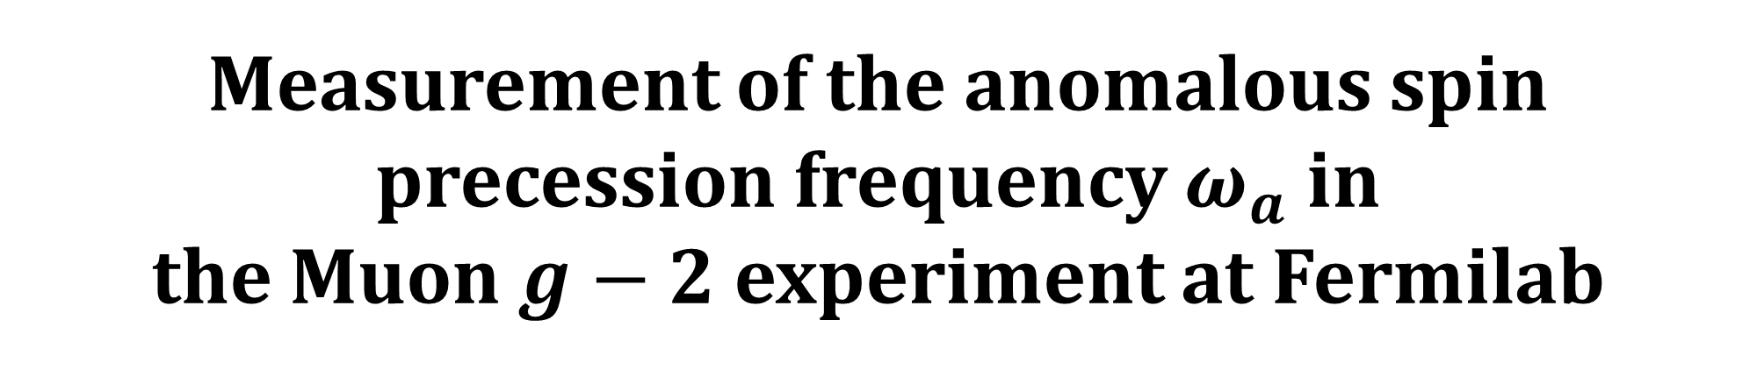
Measurement of the anomalous spin precession frequency $ω_{a}$ in the Muon $g−2$ experiment at Fermilab
Lorenzo Cotrozzi, on behalf of the Muon $g−2$ collaboration
18/07/2024 | ICHEP 2024 | Prague
FERMILAB-SLIDES-24-0182-V

Slide 2
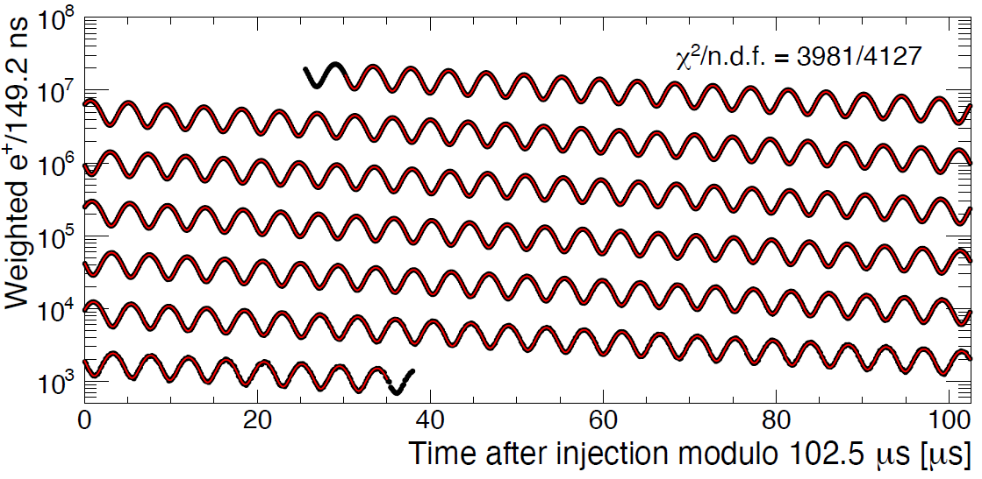
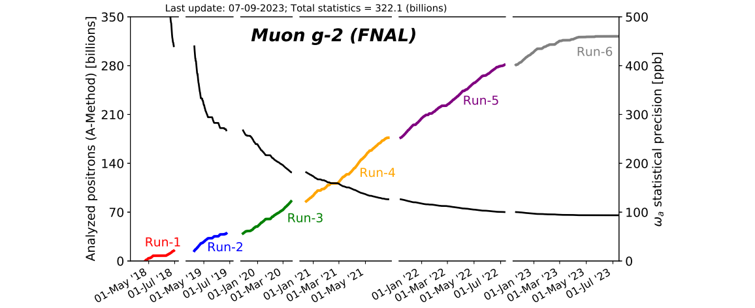
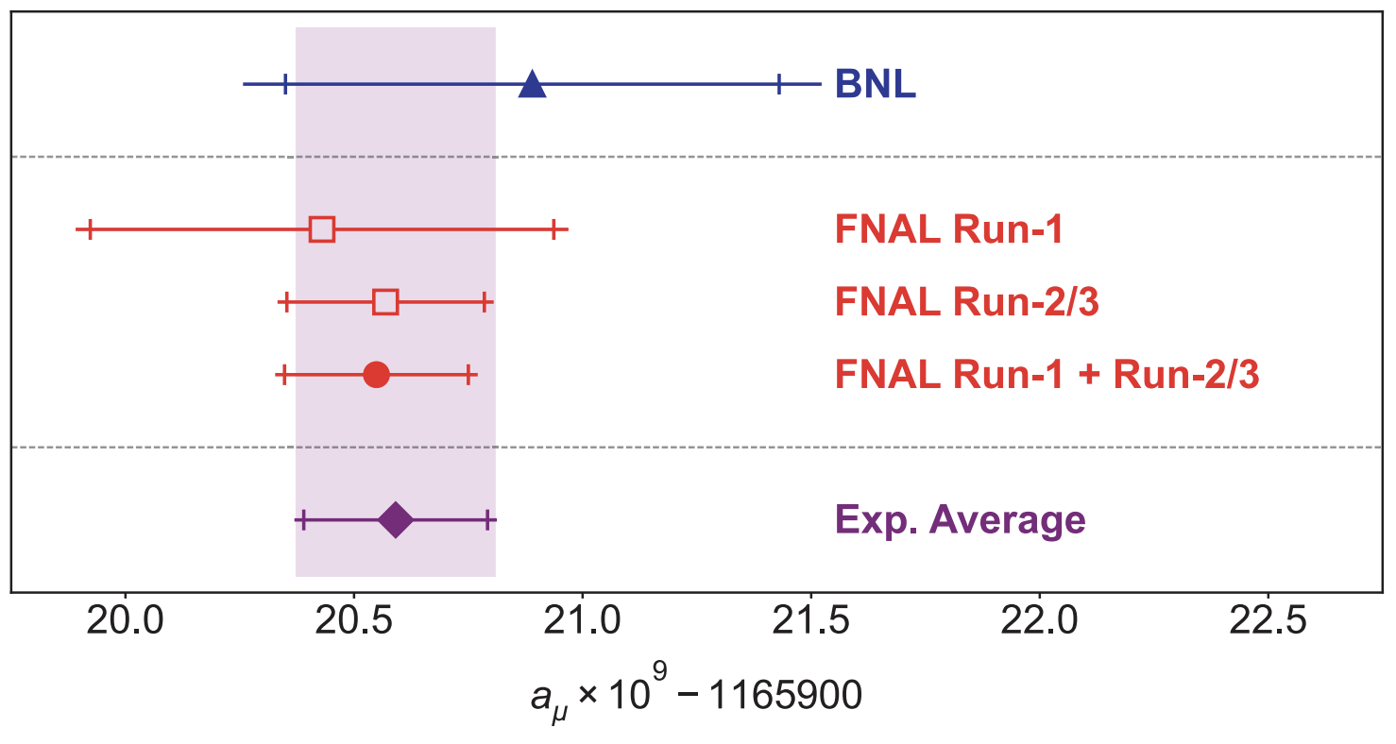

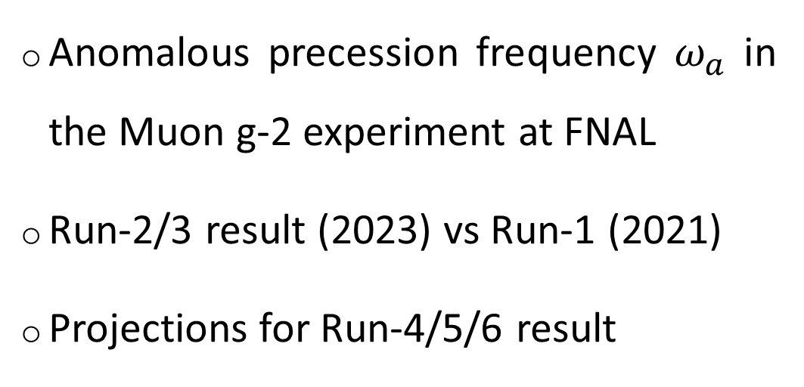
Outline
Anomalous precession frequency $ω_{a}$ in the Muon g-2 experiment at FNAL
Run-2/3 result (2023) vs Run-1 (2021)
Projections for Run-4/5/6 result

Slide 3
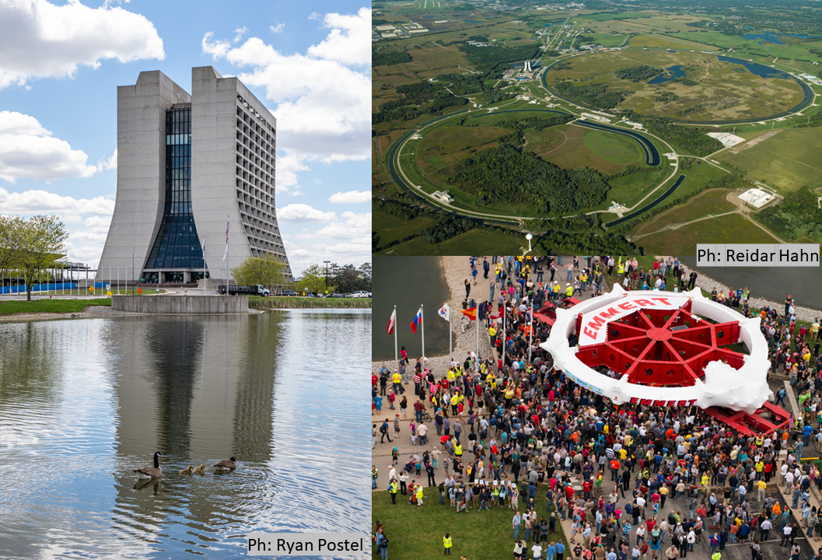
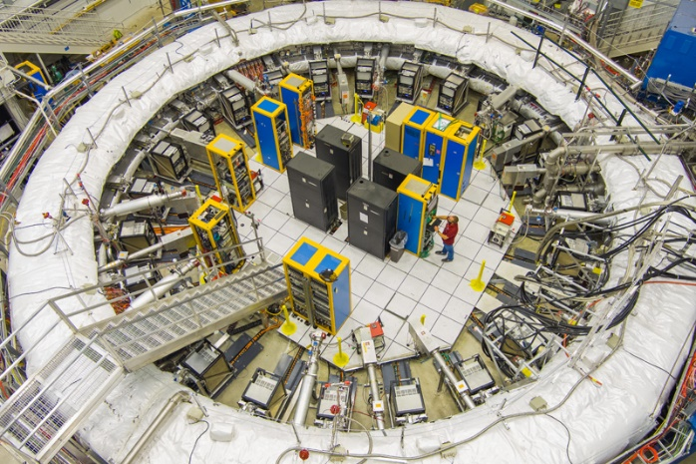
Experiment at Fermilab Muon Campus
Presented in the previous talk by Kim Siang

Slide 4
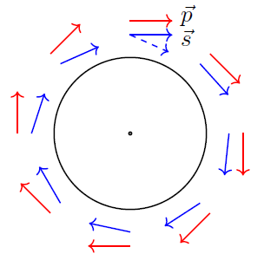
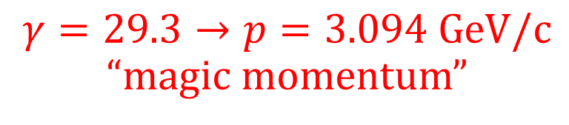
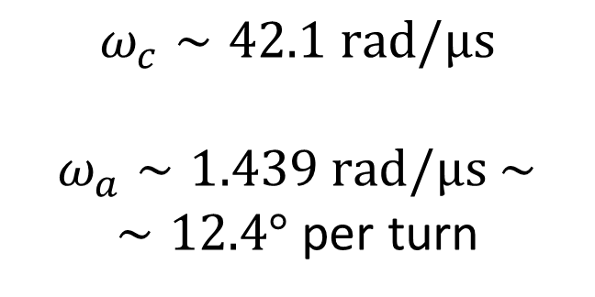
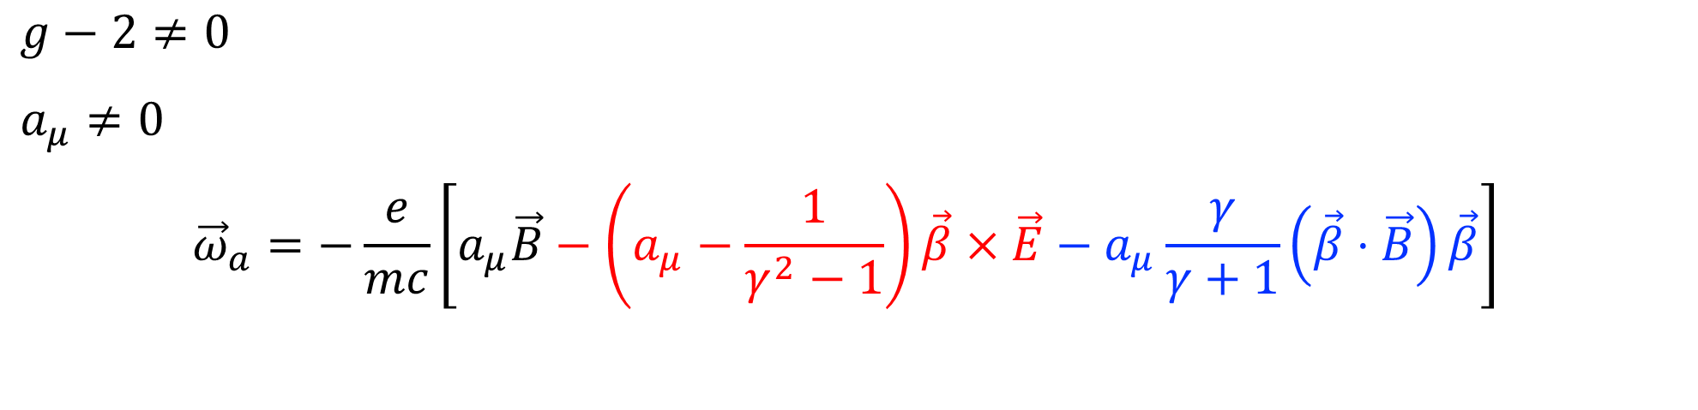

Anomalous spin precession in B-field
$$g−2≠0$$
$a_{μ}≠0$
$${\vec{ω}}_{a}=−\frac{e}{mc}\left[a_{μ}\vec{B}−\left(a_{μ}−\frac{1}{γ^{2}−1}\right)\vec{β}×\vec{E}−a_{μ}\frac{γ}{γ+1}\left(\vec{β}⋅\vec{B}\right)\vec{β}\right]$$
$→$ spin precesses with anomalous frequency ${\vec{ω}}_{a}={\vec{ω}}_{spin}−{\vec{ω}}_{c}$
$γ=29.3→p=3.094 GeV/c$ “magic momentum”
$$ω_{c}∼42.1 rad/μs$$
$ω_{a}∼1.439 rad/μs$ $∼$
$∼12.4°$ per turn
$$\vec{β}⋅\vec{B}=0$$

Slide 5
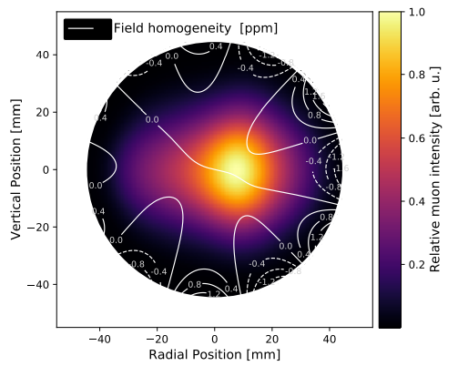





Master formula for $a_{μ}$
  $$a_{μ}=\frac{ω_{a}}{ω_{p}}×\frac{μ_{p}^{′}\left(T_{r}\right)}{μ_{e}\left(H\right)}\frac{μ_{e}\left(H\right)}{μ_{e}}\frac{m_{μ}}{m_{e}}\frac{g_{e}}{2}$$
External factors, known to 25 ppb
Make spin precess slower (E-field, vertical motion)
See poster tonight by Kim Siang
Make phase change within $700 μs$
  $$\frac{ω_{a}}{ω_{p}}=\frac{ω_{a}^{m}}{ω_{p}^{m}}×$$
corrections for effects that…
Induce transient magnetic fields
$m$=Measured values

Slide 6
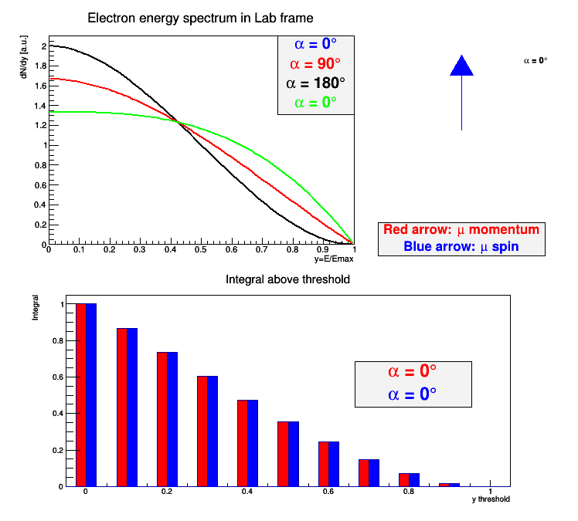
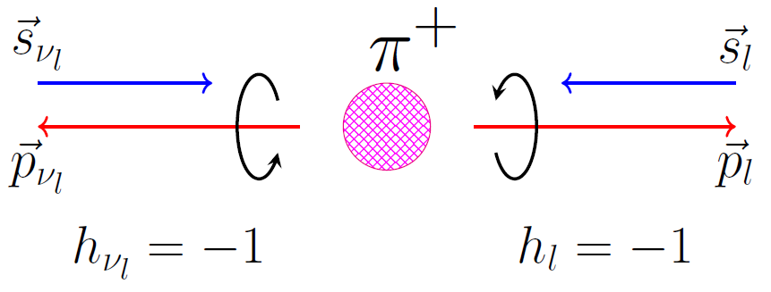
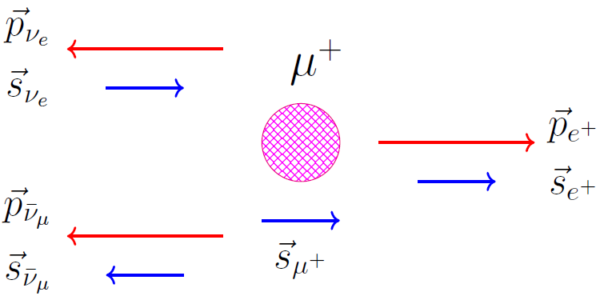
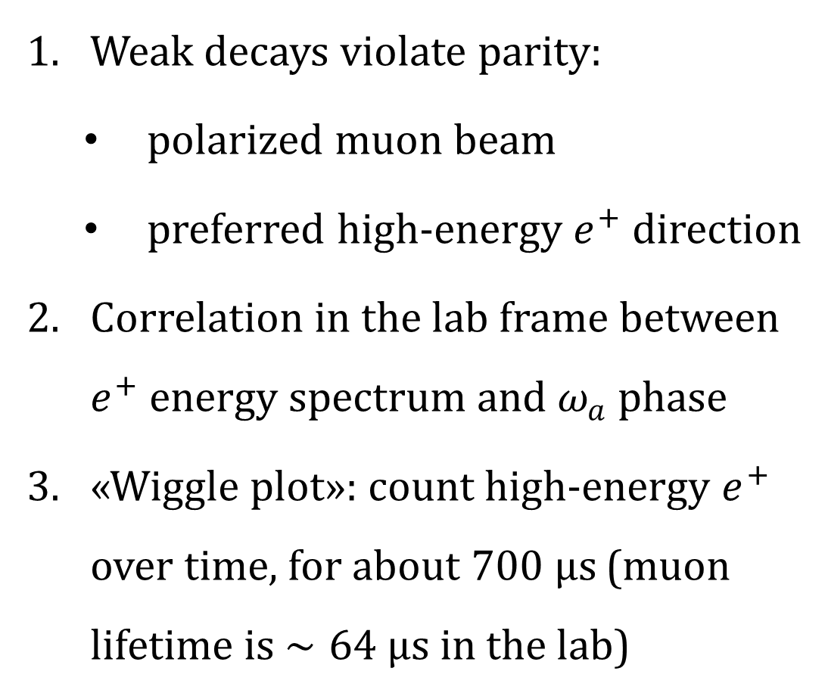
Principle of $ω_{a}$ measurement
Weak decays violate parity:
  polarized muon beam
  preferred high-energy $e^{+}$ direction
Correlation in the lab frame between $e^{+}$ energy spectrum and $ω_{a}$ phase
«Wiggle plot»: count high-energy $e^{+}$ over time, for about $700 μs$ (muon lifetime is $∼64 μs$ in the lab)

Slide 7
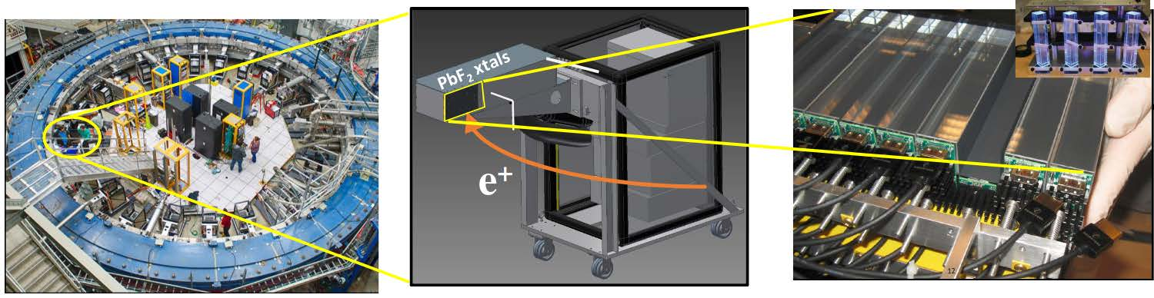
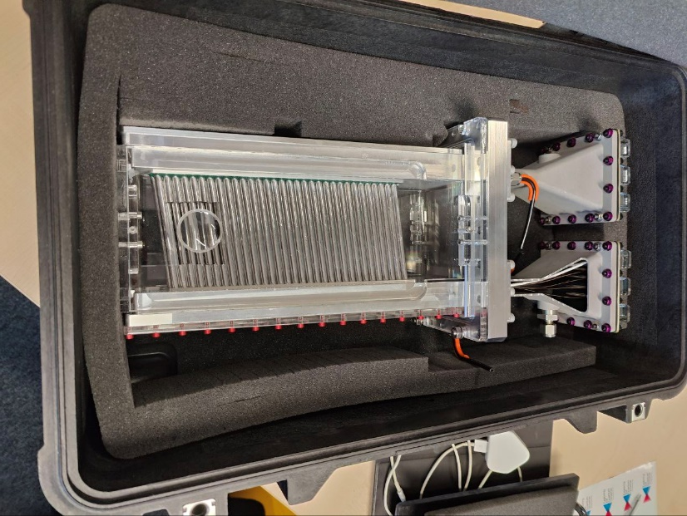
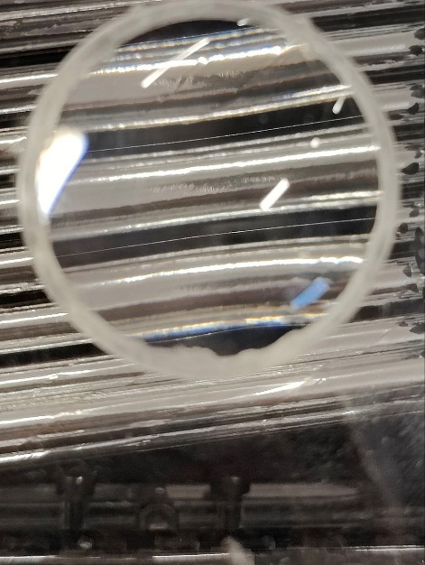

Detectors
24 e.m. calorimeters
Measure (E,t) of $e^{+}$
Each made of $6×9$ PbF₂ crystals, $15X_{0}$, read out by large-area SiPMs
$e^{+}$ generate electromagnetic shower, SiPMs detect Cherenkov light ($n=1.8$)
2 straw tube trackers
Each has 8 modules and 32 planes
50:50 Argon:Ethane at 1 atm pressure
Extrapolate decay vertex location to
measure beam distribution

Slide 8
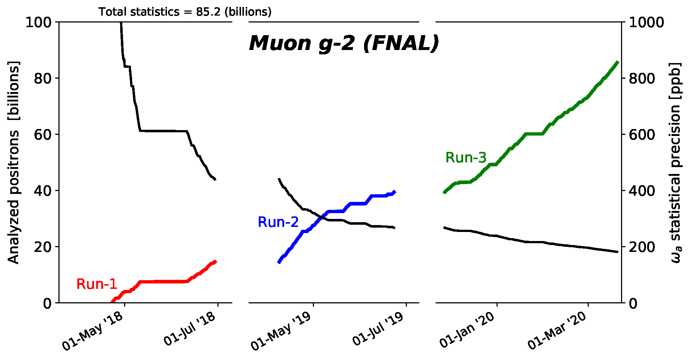
Run-2/3 (2019-2020 campaign)
Dataset | Stat. unc. [ppb]
Run-1 | 434
Run-2/3 | 201
Combined Run-1+Run-2/3 | 185
FNAL design goal | 100
Statistics: $∼5$ more muon decays than Run-1. Systematic limitations in Run-1 were fixed: reached 25 ppb on $ω_{a}$, 70 ppb on $a_{μ}$, surpassed design goal of 100 ppb

Slide 9
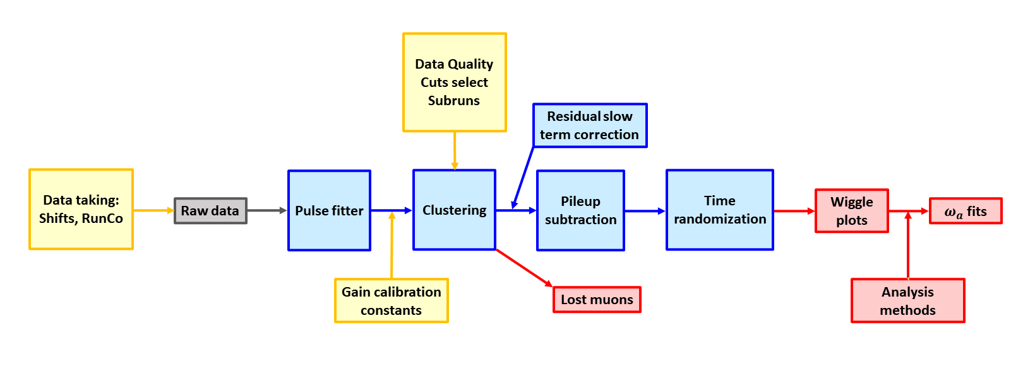
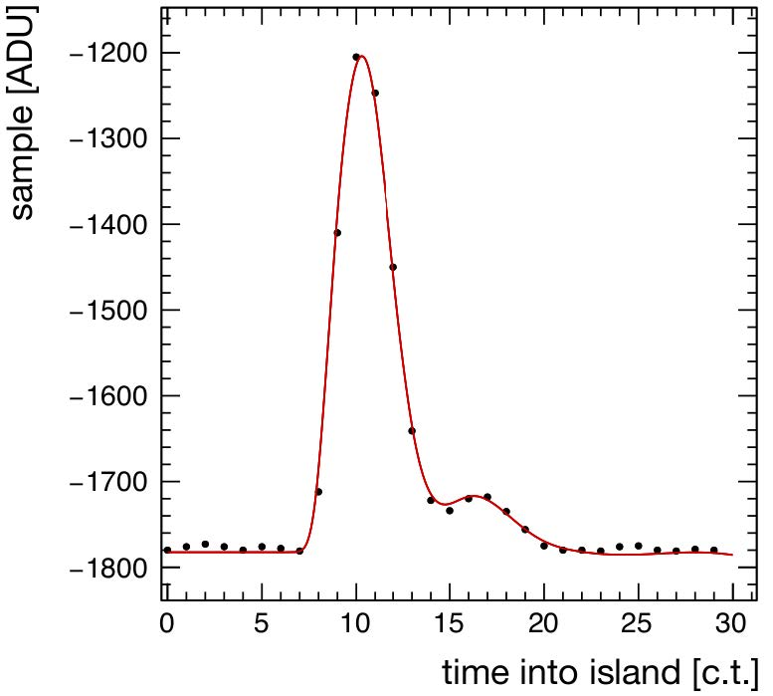

$ω_{a}$ analysis flowchart

Slide 10
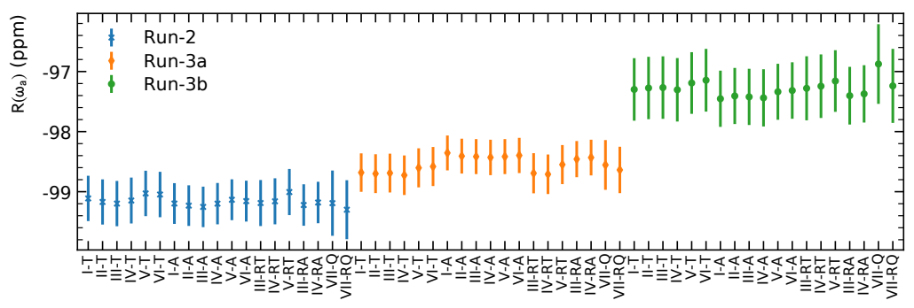

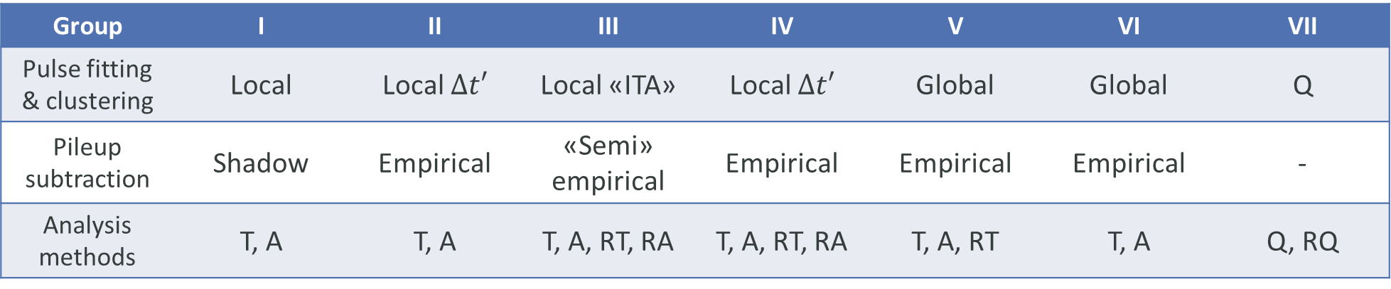
Run-2/3 $ω_{a}$ analysis teams
Group | I | II | III | IV | V | VI | VII
Pulse fitting & clustering | Local | Local $Δt′$ | Local «ITA» | Local $Δt′$ | Global | Global | Q
Pileup subtraction | Shadow | Empirical | «Semi» empirical | Empirical | Empirical | Empirical | -
Analysis methods | T, A | T, A | T, A, RT, RA | T, A, RT, RA | T, A, RT | T, A | Q, RQ
For details on combination: see next talk by Alberto Lusiani
Notes:
Each applies secret offset; many different methods tested; consistency checks before publishing

Slide 11
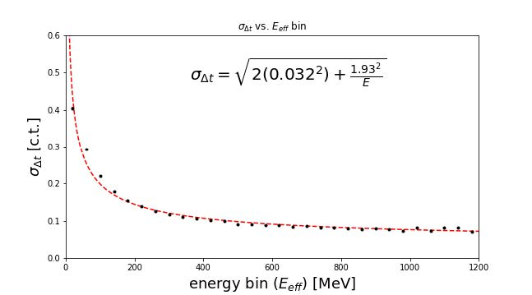
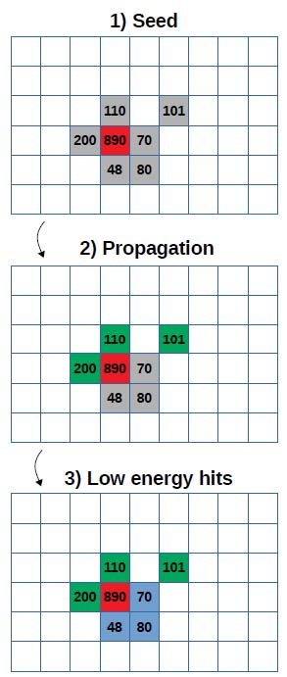
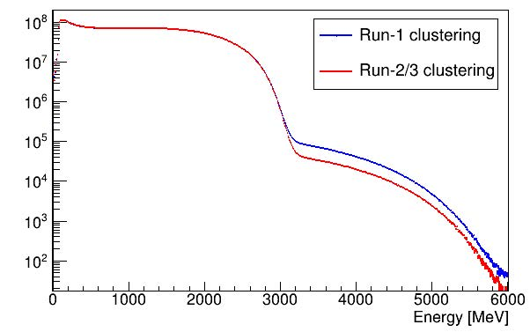
Reconstruct $e^{+}$ events
Pulse fitter identifies traces on crystals
New algorithms took into account detector’s
time and energy resolutions
Reduced pileup in un-physical region
Pulse fitter
Pileup dominated Run-1 systematics (35 ppb).
Now reduced to 7 ppb!
Un-physical

Slide 12
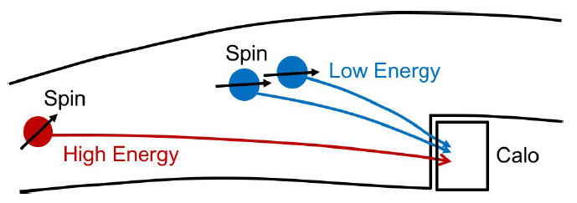
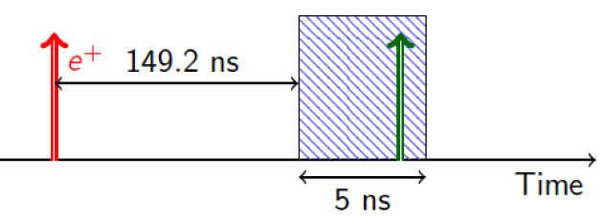
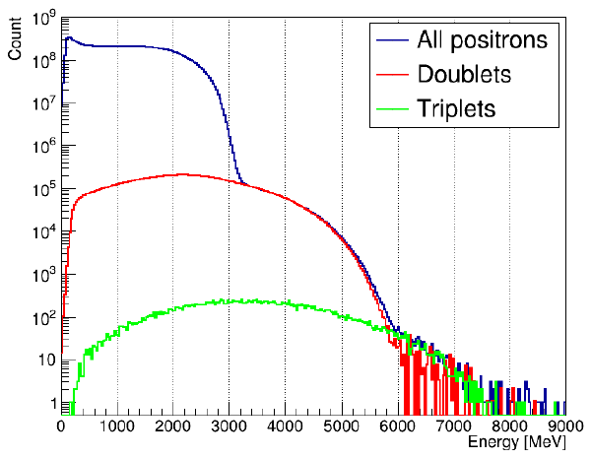
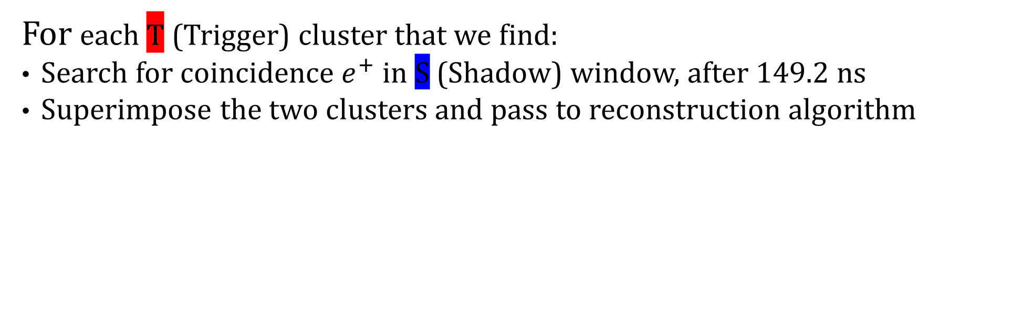
Improved pileup correction since Run-1
(example for «local» method)
T
S
For each T (Trigger) cluster that we find:
Search for coincidence $e^{+}$ in S (Shadow) window, after 149.2 ns
Superimpose the two clusters and pass to reconstruction algorithm
If not resolved: merge them and build pileup
In Run-2/3: also searched for triplets (2 shadows)

Slide 13
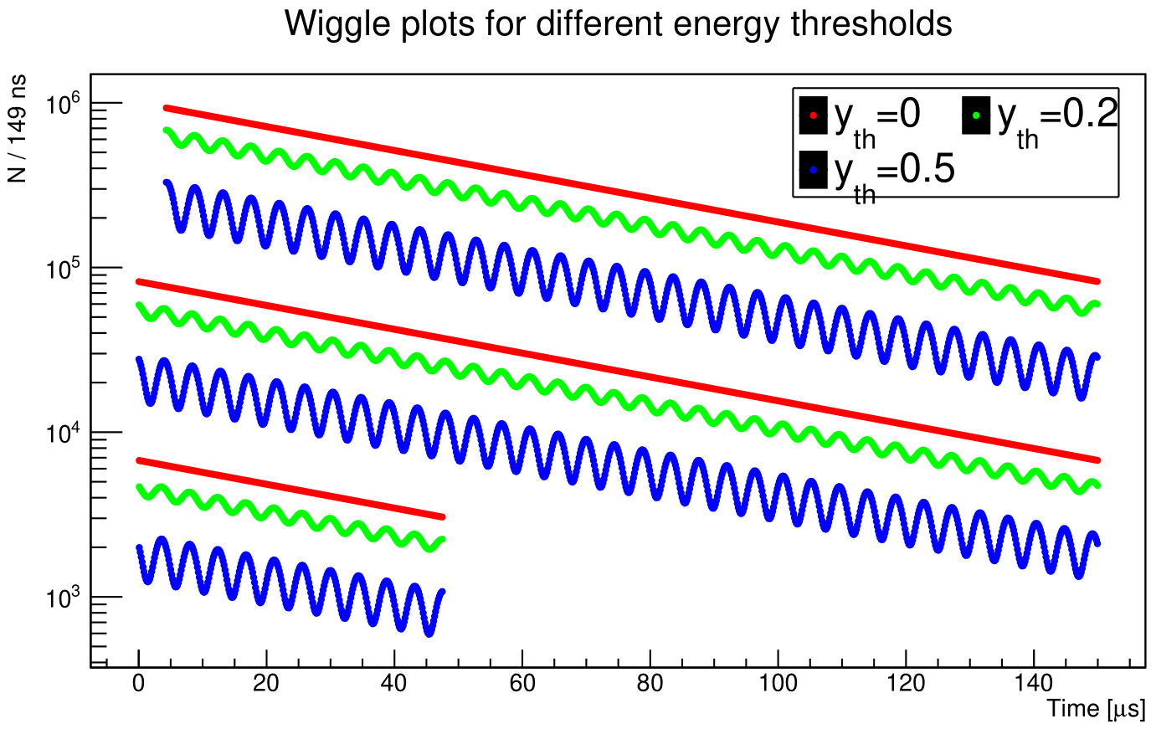
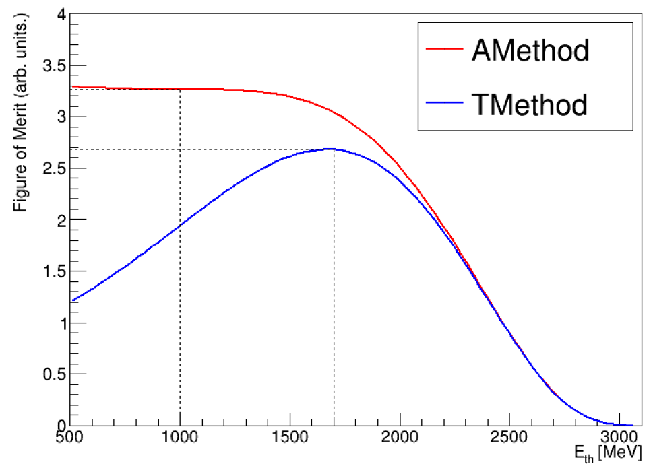

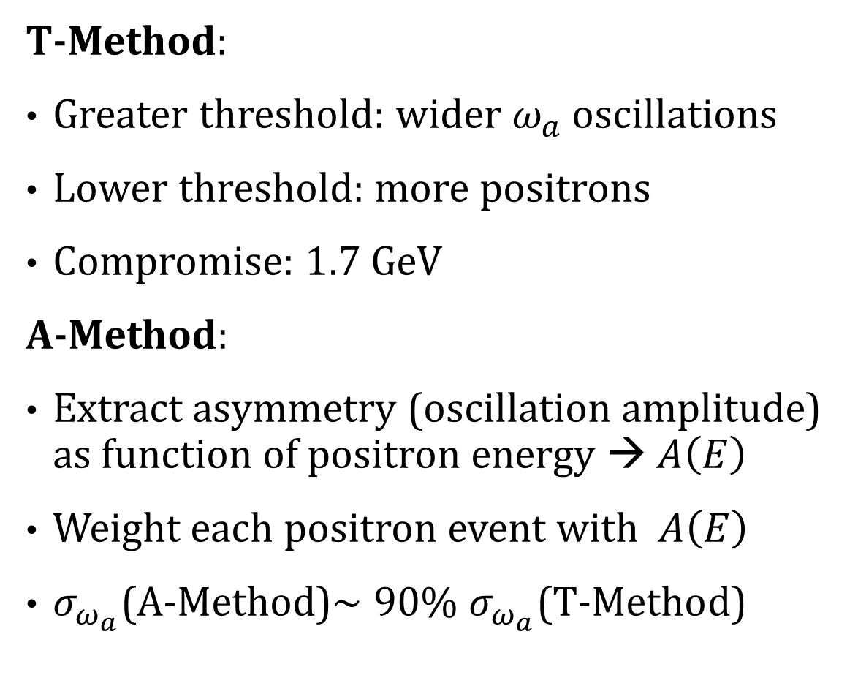


Methods for $ω_{a}$ analysis
T-Method:
Greater threshold: wider $ω_{a}$ oscillations
Lower threshold: more positrons
Compromise: $1.7$ GeV
A-Method:
Extract asymmetry (oscillation amplitude) as function of positron energy → $A\left(E\right)$
Weight each positron event with $A\left(E\right)$
$σ_{ω_{a}}$(A-Method)$∼90\%{ σ}_{ω_{a}}$(T-Method)
$y_{th}=E/3.1$GeV
$$\frac{1}{σ_{ω_{a}}^{2}}$$

Slide 14
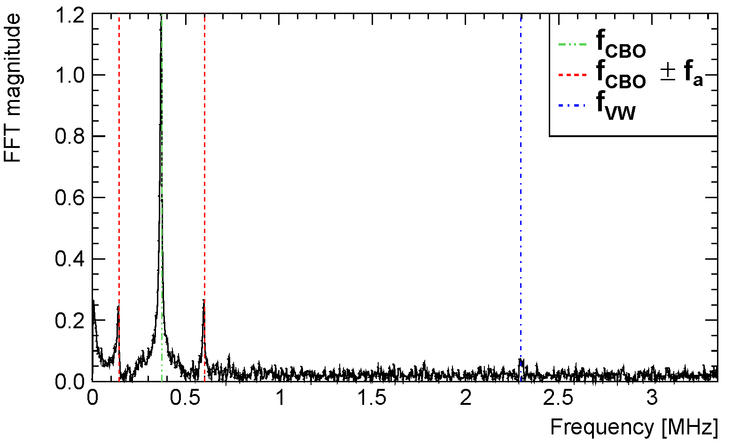
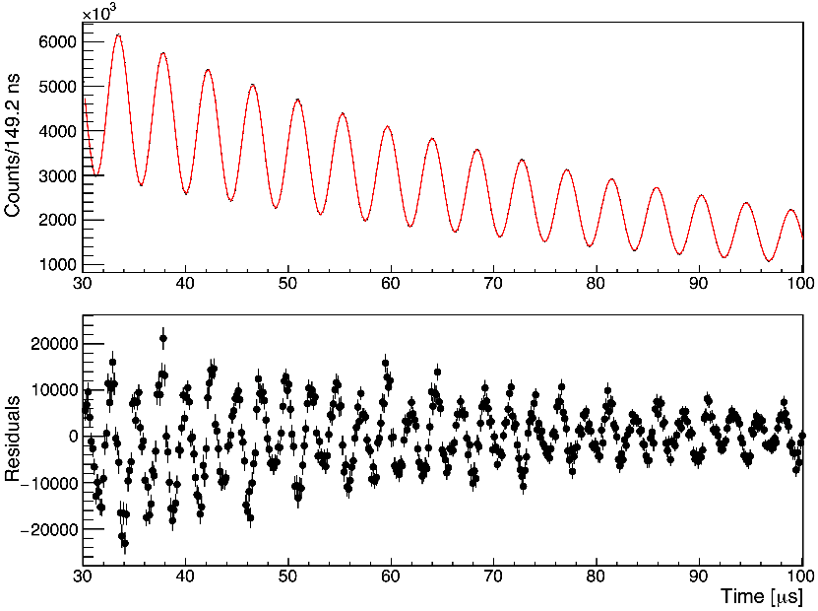

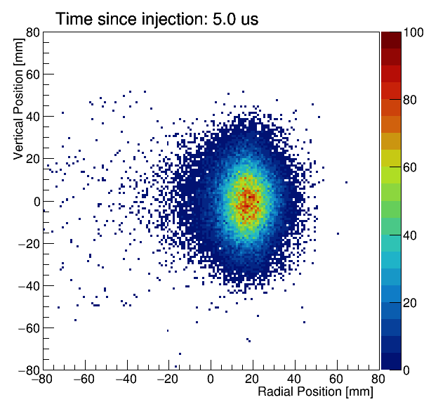
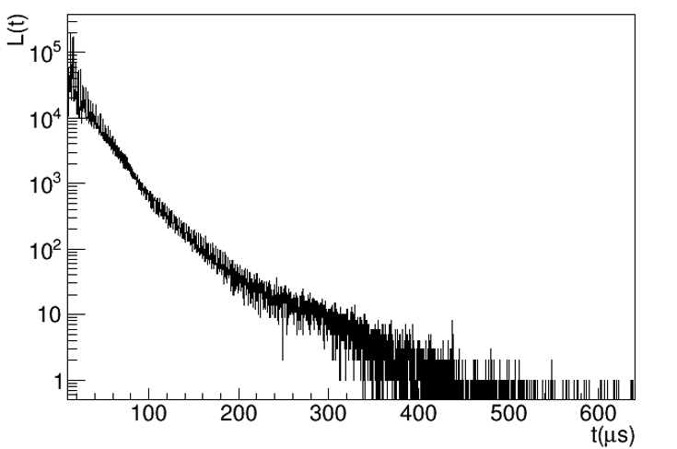

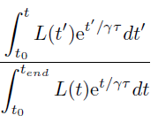


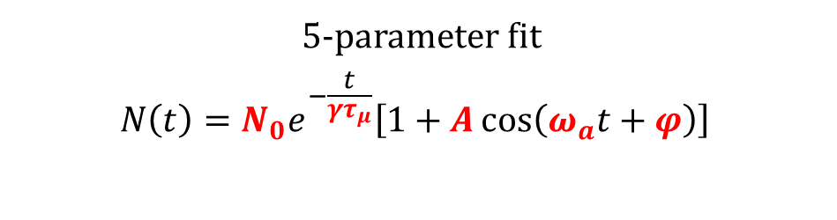
$ω_{a}$ fit
5-parameter fit
$$N\left(t\right)=N_{0}e^{−\frac{t}{γτ_{μ}}}\left[1+A\cos\left(ω_{a}t+φ\right)\right]$$
FFT of residuals
Muon losses over time
Coherent betatron oscillations (CBO)

Slide 15
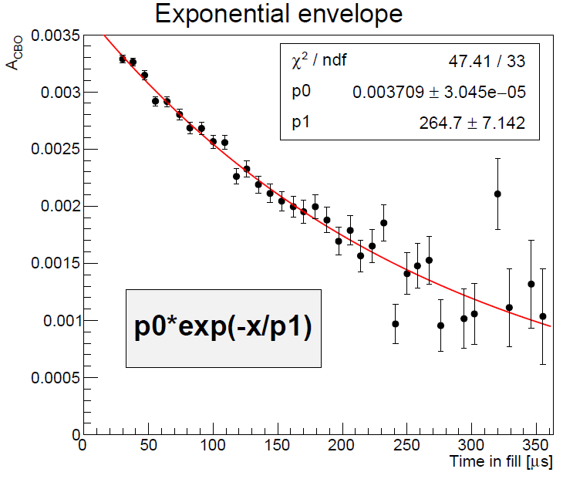
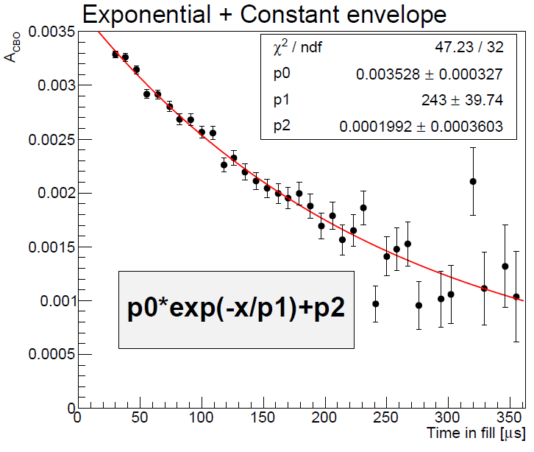
CBO model: amplitude vs time
CBO dominated Run-1 systematics (38 ppb).
Now reduced to 21 ppb!
$CBO\left(t\right)=1+A_{CBO}\cos\left(ω_{CBO}t+φ_{CBO}\right)×e^{−t/τ}$ Decoherence
Muons are an ensemble: betatron oscillations decohere over time
Sliding window fits to determine good or bad envelopes: more statistics→more studies than Run-1; also input from tracker data
… and many other models tested

Slide 16
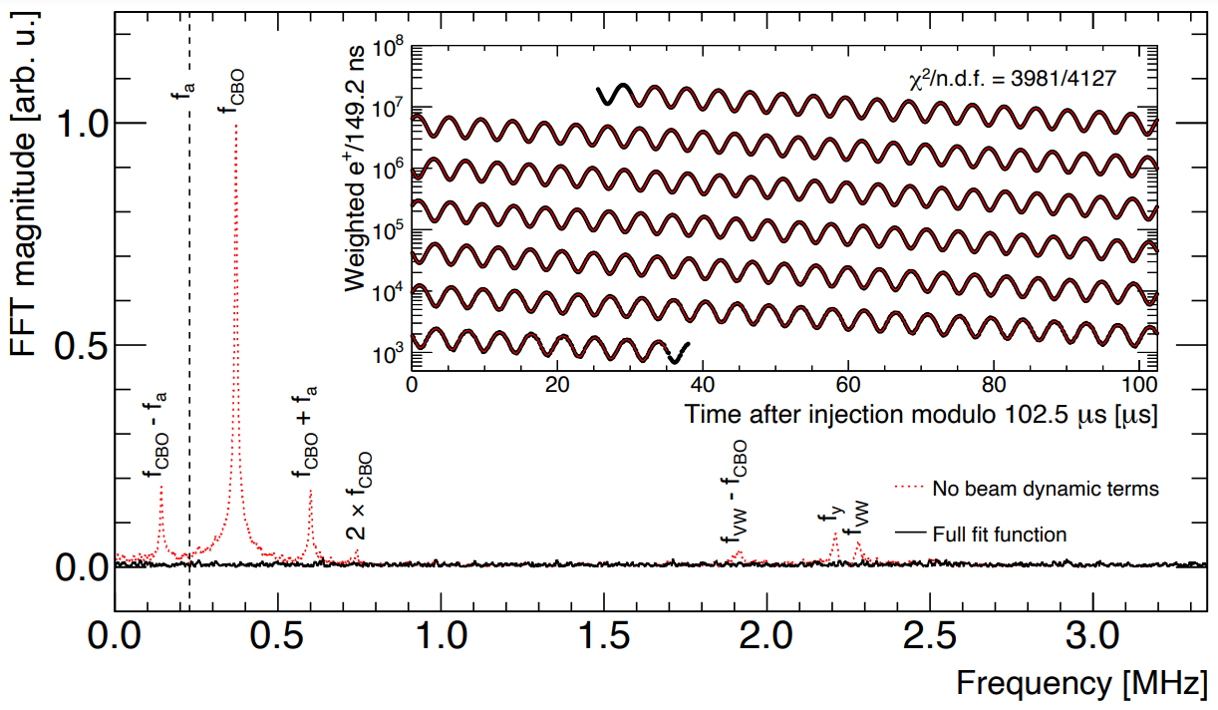



Run-2/3: $ω_{a}$ fit and FFT of residuals
CBO peaks
Final fit includes all oscillations
$$N\left(t\right)=N_{0}e^{−\frac{t}{γτ_{μ}}}\left[1+A\cos\left(ω_{a}t+φ\right)\right]$$
$×$
$×CBO\left(t\right)×VW\left(t\right)×…$
Vertical motion

Slide 17








Ratio method wiggle plots
$$e^{+}$$
Randomly split positrons in 4 groups
Shift two groups in time by $±$ half precession period $T_{a}/2$. Recombine:
$$V(t)$$
$$U(t)$$
$$R\left(t\right)=\left[V\left(t\right)−U\left(t\right)\right]/[V\left(t\right)+U(t)]$$
It gets rid of muon lifetime and normalization $N_{0}$ in fit function. Any «slow» effect is highly reduced!

Slide 18


New “Ratio” A-Method
Weight each positron with asymmetry function (like A-Method)
R: $\left\{V\left(t\right);U\left(t\right)\right\}$ → RA: $\left\{\overline{V}\left(t\right)=\sum_{E}{A\left(E\right)}V\left(E,t\right);\overline{U}\left(t\right)=\sum_{E}{A\left(E\right)U\left(E,t\right)}\right\}$
R: $\frac{V\left(t\right)−U\left(t\right)}{V\left(t\right)+U\left(t\right)}$ → RA: $\frac{\overline{V}\left(t\right)−\overline{U}\left(t\right)}{\overline{V}\left(t\right)+\overline{U}\left(t\right)}$
Statistical uncertainty on $ω_{a}$ is minimized
Exponential due to muon lifetime is cancelled
Reduces the sensitivity of $ω_{a}$ to most «slow
effects», such as SiPM gain fluctuations!
A-Method
RA-Method

Slide 19

Prospects for $ω_{a}$ analysis in Run-4/5/6
Statistical uncertainty:
With Runs1-->6, we expect to surpass design uncertainty of 100 ppb
21.9 times the previous BNL experiment
Running conditions in Run-4/5/6:
Quadrupole Radio-Frequency switched on during Run-5 → reduced radial and vertical motion of muons, more stable beam and less muon losses
Systematic sources of uncertainty:
CBO expected to be reduced, thanks to Quad RF and to dedicated studies in task forces

Slide 20

Summary and conclusions
  New muon $a_{μ}$ experimental average has unprecedented precision of 190 ppb:
    Factor $∼2$ improvement in statistical and systematic uncertainties on $ω_{a}$
    Improved running conditions; upgraded reconstruction and pileup subtraction algorithms; more studies on beam dynamics effects
  Future analysis is expected to meet desing goals:
    Surpassed goal statistics: 21+ times w.r.t. previous BNL experiment
    RF system ON: improved beam stability, ongoing evaluation of systematics

Slide 21


… and more details in recent 2024 paper
  «Detailed Report on the Measurement of the Positive Muon Anomalous Magnetic Moment to 0.20 ppm» on arXiv:2402.15410 [hep-ex]
  Soon to be published on Phys. Rev. D
  A few more physics papers will come out in the future, e.g. Beyond Standard Model searches: see tomorrow’s talk on CPT/LIV by Baisakhi Mitra

Slide 22




THANK YOU FOR
YOUR ATTENTION!
lorenzo.cotrozzi@liverpool.ac.uk
July 2023 collaboration meeting @ Liverpool, UK

Slide 23

Extra: Bad resistors backup

Slide 24



Injection and muon storage
Inflector cancels main dipole field and injects at $∼$8 cm radially away from nominal orbit
3 fast magnetic kickers provide 10 mrad kick and place muons in orbit
8 Electrostatic Quadrupoles (ESQ) focus in the vertical direction
1.
2.
3.

Slide 25



Run-2/3 improved running conditions
Before Run-2: fixed faulty resistors in 2/32 quadrupole plates → better storage, more stable beam oscillations and reduced systematics
After Run-2: added thermal insulation to ring → less variable magnetic field
Mid Run-3: upgraded kicker cables for optimal kick → more centered beam
Run-1
Run-2
Run-3
Vertical beam width change

Slide 26

Extra: $ω_{a}$ backup

Slide 27


Run-1 vs Run-2/3 systematics
d

Slide 28



Run-2/3 Result: FNAL + BNL Combination
D. P. Aguillard et al, Phys. Rev. Lett. 131.161802 (2023)
D. P. Aguillard et al, arxiv:2402.15410 (2024)
2006: 540 ppb
April 7th, 2021
August 10th, 2023
(203 ppb)
Running improvements
$∼5$x statistics
Analysis improvements (CBO, pileup, reconstruction, …)
70 ppb syst. → exceeded goal!
2023: 190 ppb

Slide 29


Blinded analysis
Hardware: main clock is tuned at $(40−ε)$ MHz
Offset only known to two scientists external to the
collaboration
Software: each $ω_{a}$ analyzer applies their own, secret offset to their results

Slide 30




Run-2/3 unblinding
Software unblinding
Hardware unblinding

Slide 31





Example of new method to subtract pileup
T
S
For each T (Trigger) cluster that we find:
Search for coincidence $e^{+}$ in S (Shadow) window, after 149.2 ns
Superimpose the two clusters and pass to reconstruction algorithm
→If not resolved: merge them and build pileup
Finally: subtract merged event and add single events

Slide 32


Radial and vertical motion of the beam
Field index: $n$ (quad voltages)
Radial motion of the beam: $ω_{x}=ω_{c}\sqrt{1−n}$
CBO is the aliased frequency $ω_{CBO}=ω_{c}−ω_{x}$
CBO period of about 2.7 $μs$

Slide 33


Randomization
d

Slide 34



Laser-based gain monitoring system
Built by INFN/CNR-INO: time synchronization and calibration of 1296 SiPMs on timescales from ns to days/weeks. Gain changes dominated $ω_{a}$ systematics at BNL: exceeded goal of 20 ppb at FNAL.
Standard operating mode:
Sync pulse: time synchronization at $∼50$ ps
In-Fill pulses: monitor rate-dependent gain changes at ${10}^{−4}$ during $700 μs$ of $μ^{+}$ beam
Out-of-Fill pulses: monitor stability over days
Notes:
OOF would be 10^-3

Slide 35






SiPM gain calibration
In-Fill: sag in power supply due to initial injection splash.
Recovery timescale of front-end electronics: $𝒪$(10 $μs$).
Short-term: consecutive positron hits within $𝒪$(100 ns).
After the first hit, the recovery time of pixels reduce the gain experienced by the second hit.

Slide 36



CBO model: frequency vs time
CBO dominated Run-1 systematics (38 ppb).
Now reduced to 21 ppb!
Exponential relaxation of CBO frequency
Run-1: faulty ESQ resistors enhanced this effect 10 times!
Sliding window fits to determine lifetime and constrain it in $ω_{a}$ fits
→
Run-1
Run-2/3

Slide 37
Run-4/5/6: current status and puzzles
With much more statistics, we can investigate the residual slow term
→ energy leakage in calorimeters?
→ reconstruction effect?
Further improved reconstruction with new pulse fitting technique
Task forces in place to address dominating Run-2/3 systematics
Quadrupole Radio-Frequency switched on during Run-5, to highly reduce radial and vertical motion of muons → more stable beam dynamics and much fewer lost muons!

Slide 38



«Slow» effects: ratio vs non-ratio
Gain calibration
Pileup

