Slide 1















Diversity and equitable opportunities
Highlights!
Tracey Berry
ATLAS D&I Contact (2022-24), Vice-Dean EDI for EPMS (5 Depts) @
42nd ICHEP, July 2024, Prague
1

Slide 2
Motivations for Talk
Why do we need talks on “Diversity and equitable opportunities” ?
Everything is fine
It’s nothing to do with me!
There are so many barriers
We need things to improve!
Everything is fine for me …. but I see barriers for others

Slide 3
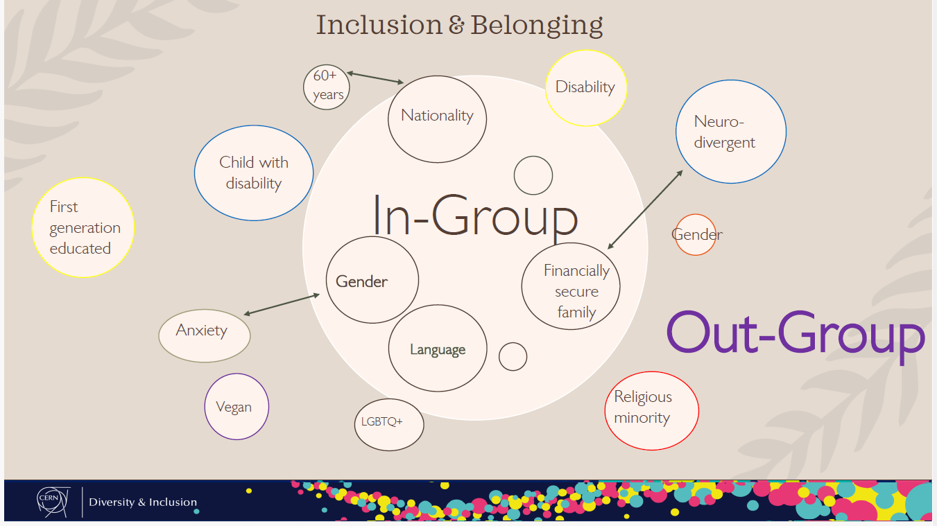
Diversity & Inclusion

Slide 4



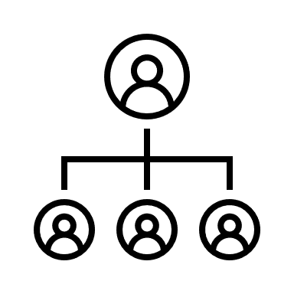



Your journey to the conference!
Being at this conference indicates that you have been given opportunities
invitation for talk or poster – selection process
register – approval by group lead
travel – visa/passport
transport – funds
home arrangements – caring repsonsibilities
Different for everyone – Diversity!

Slide 5
Your journey to the Conference!
Diversity!...
But equitable opportunities?
Each step can be easier/harder
Being at this conference indicates that you have been given opportunities
invitation for talk or poster – selection
register – approval by group lead
travel – visa/passport
transport – funds
home arrangements – caring responsibilities
Career Stage/ Nationality/ Gender
Biases: gender/ethnicity/age/caring
Nationality/Mobility/Health/Age/Religion/LGBTQ+
funding biases? gender/ethnicity
Gender/Age/Ethnicity

Slide 6





Your journey to the Conference!
Before the conference indicates that you have been given opportunities
How achieve your position? -job applications/CV/reference letter/interviews
How did you get your PhD placement – given advice/CV/interview
How did you choose your UG University – guess/advice/visit Unis/school
Did your family help support your career choices? – mental/financial/physics
How/when/where did you even hear of particle physics/LHC/neutrinos? – opportunities/outreach
Different for everyone – Diversity!

Slide 7


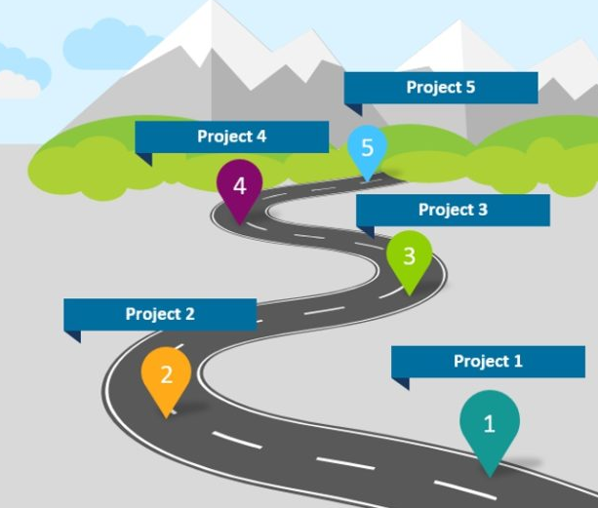





Career Progress/Success
Progress/Success in your career….
Professor.
Where is the top - clouds!
Self-determined, lonely path
Clear path & support
Tenure .
Postdoc 2
Postdoc 1
PhD
Are step heights equal
For everyone?
Start climbing the stairs
Advice...
Best way...
Was it the right stairs?:
- moving backwards!
Was there another way to get to the top?

Slide 8
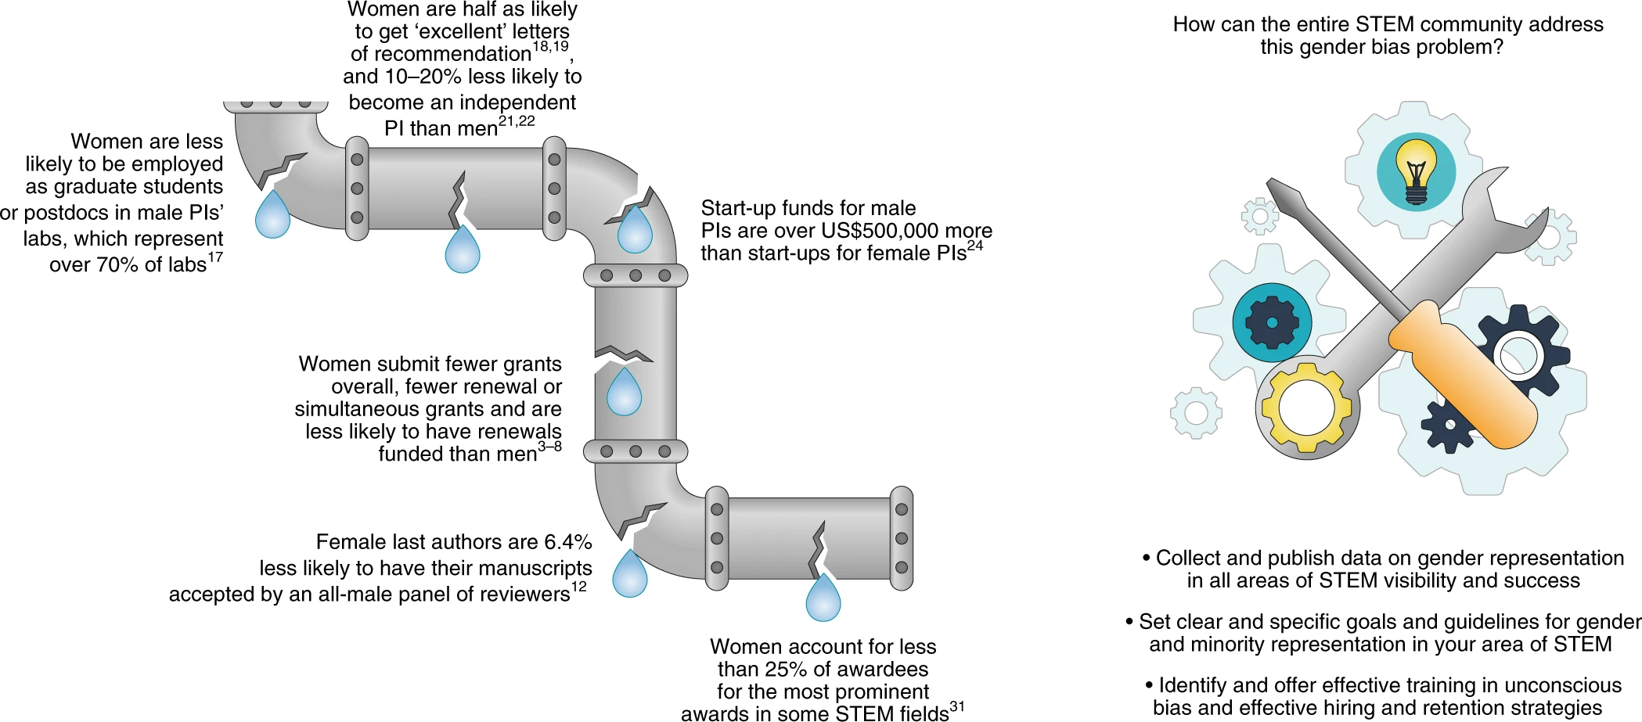
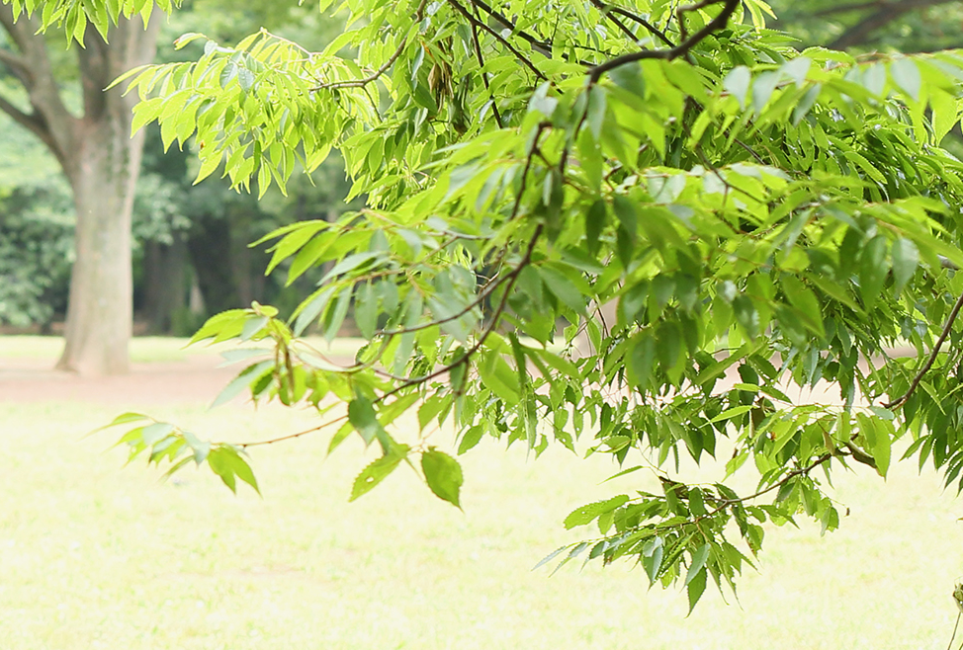
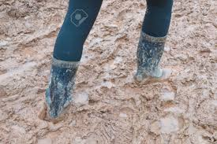
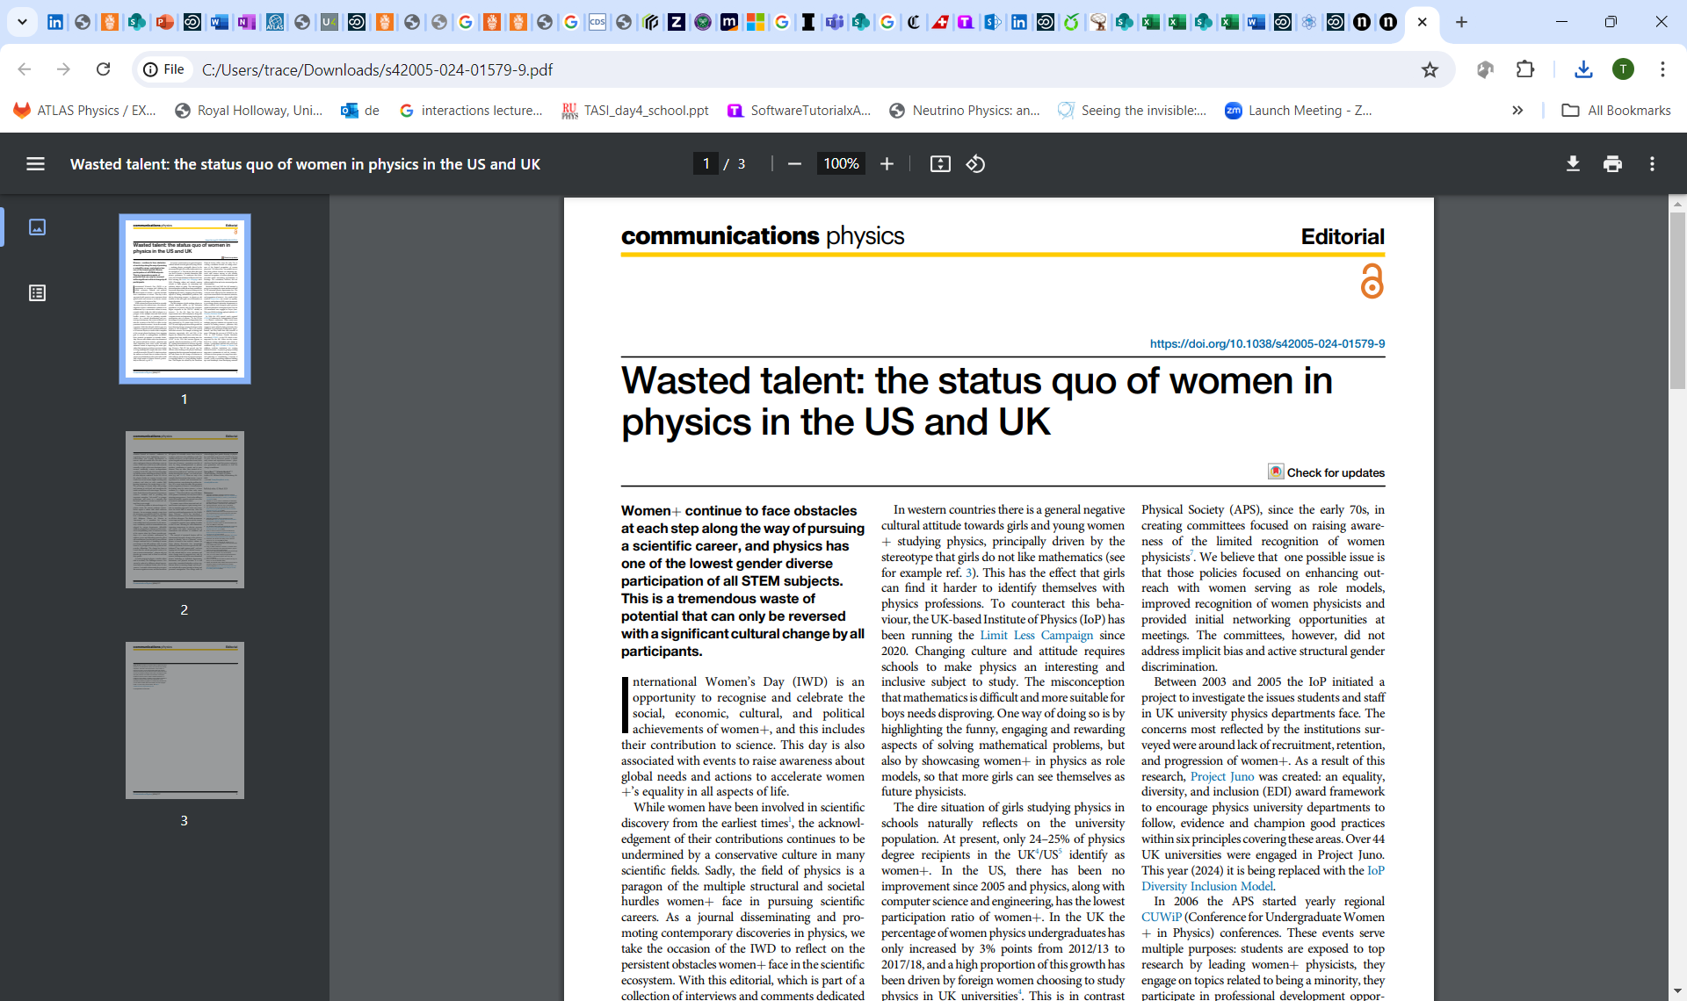
Every step is harder: Nature
minorities
Fig. 1: The leaky pipeline of women in STEM.
From: How the entire scientific community can confront gender bias in the workplace
Wasted talent: the status quo of women in physics in the US and UK
https://www.nature.com/articles/s42005-024-01579-9
https://www.nature.com/articles/s42005-024-01572-2
https://www.nature.com/articles/s42005-024-01565-1
https://www.nature.com/articles/s42005-024-01562-4
https://www.nature.com/articles/s42005-024-01561-5
https://www.nature.com/articles/s42005-024-01560-6
https://www.nature.com/articles/s42005-024-01557-1
https://www.nature.com/articles/s41559-018-0747-4/figures/1
https://www.nature.com/articles/s42005-024-01579-9

Slide 9
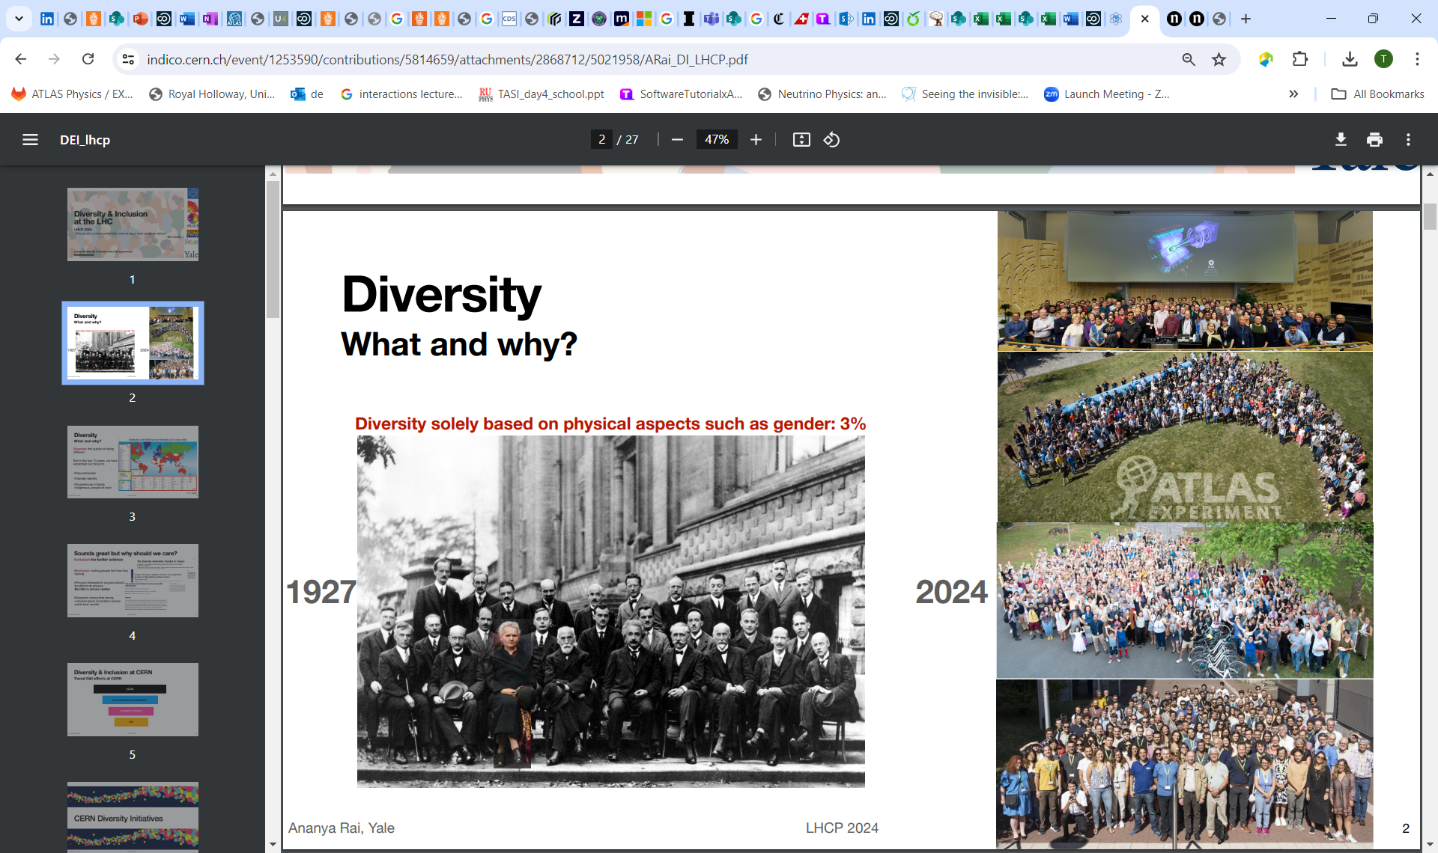
Evolving Diversity in Physics
Original studies focused on gender
5th Solvay Conference on physics
“Electrons and Photons”
4 %
Attendees included: Neils Bohr, Born, de Broglie, Marie Curie, Dirac, Albert Einstein, Heisenberg, Pauli, and Schrödinger.
17/29 attendees were or became Nobel Prize winners, including Marie Curie who, alone among them, had won Nobel Prizes in two separate scientific disciplines.

Slide 10
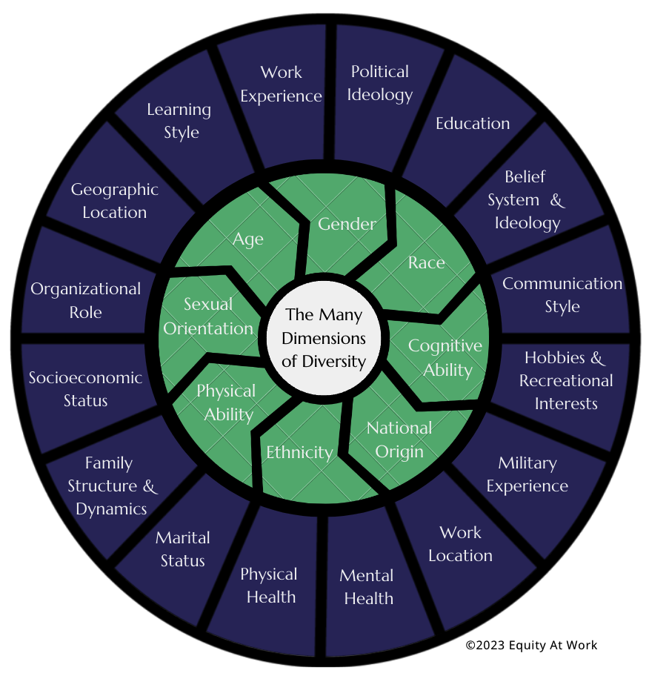
Dimensions of Diversity
last 10 years focus also on:
Race
Ethnicity
Sexual Orientation
Gender identity
Disability
Neurodiversity
Age
Diversity: the quality of being different
Diversity
The presence of differences within a given setting. In the workplace, that can mean differences in race, ethnicity, gender, gender identity, sexual orientation, age and socioeconomic class. It can also refer to differences in physical ability, veteran status, whether or not you have kids, etc.
Equity
The process of ensuring that practices and programs are impartial, fair and provide equal possible outcomes for every individual.
Inclusion
The practice of ensuring that people feel a sense of belonging in the workplace. This means that every employee feels comfortable and supported by the organization when it comes to being their authentic selves.

Slide 11
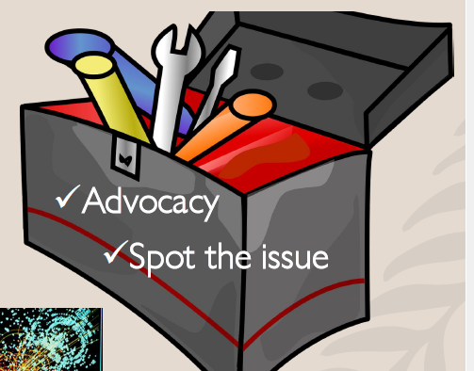
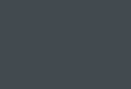
What are PP collaborations/research councils/Universities doing ?
Diversity and equitable opportunities

Slide 12
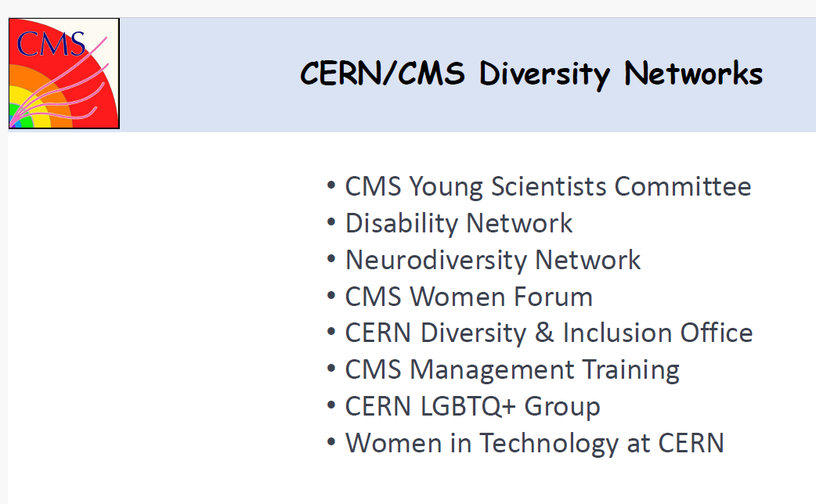
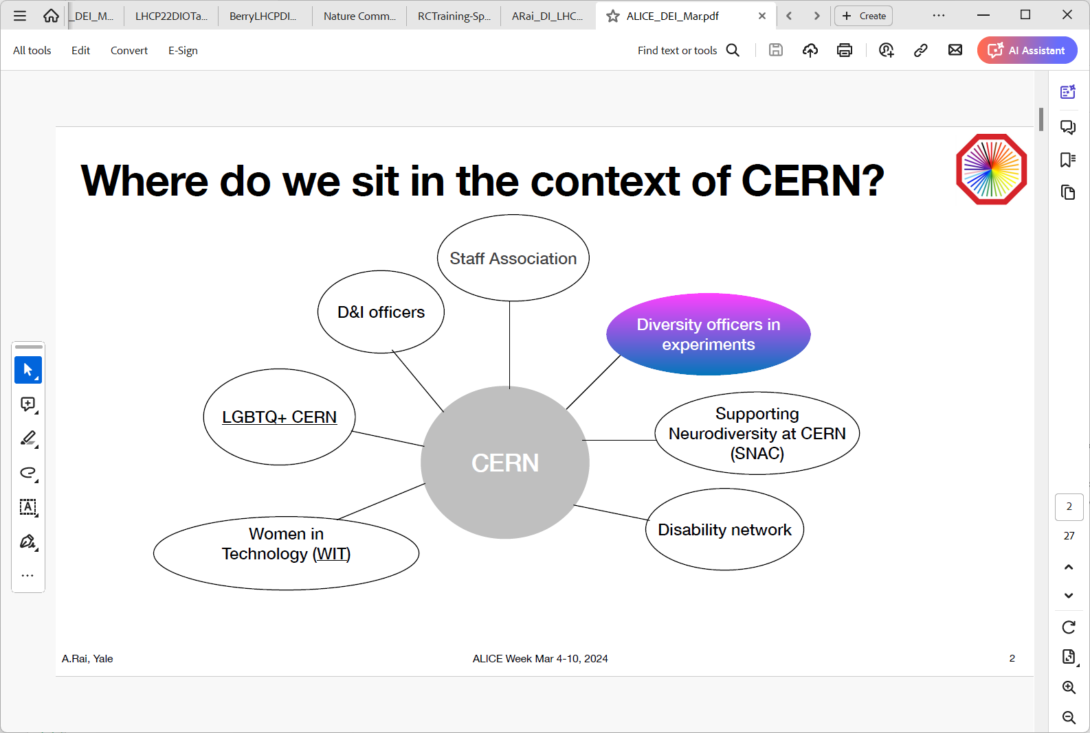
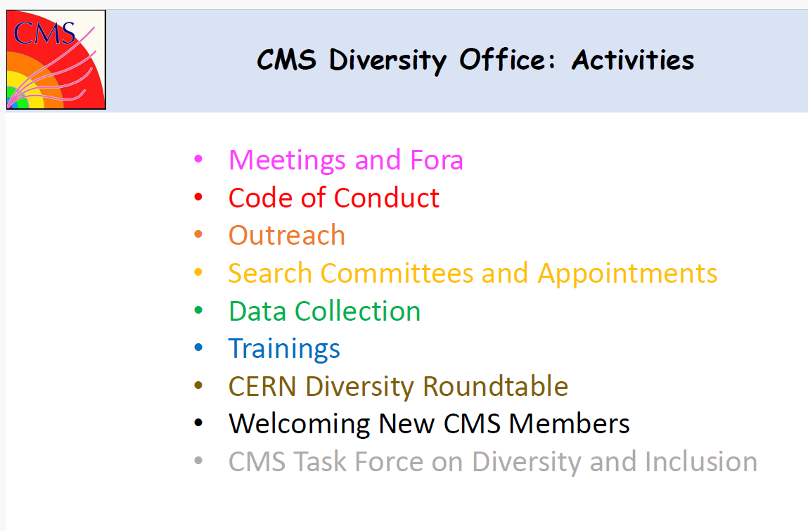
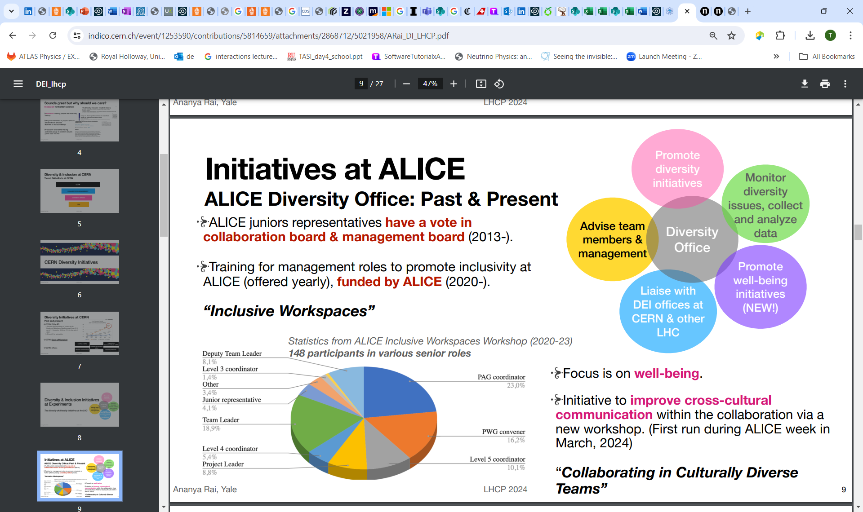
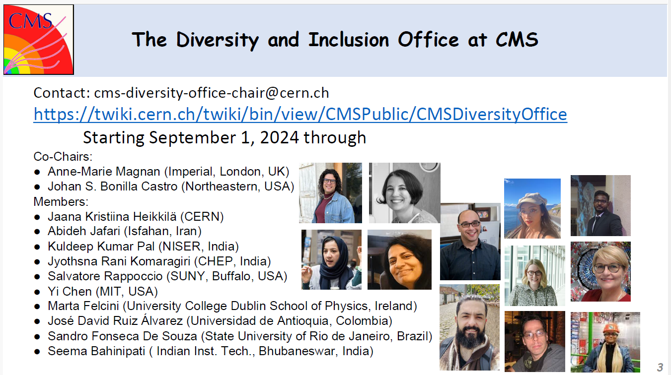
Tiered Diversity and Inclusion
Research Labs
Research Lab/Institute
Collaboration Management
Diversity Offices
Early Career
Groups
You

Slide 13
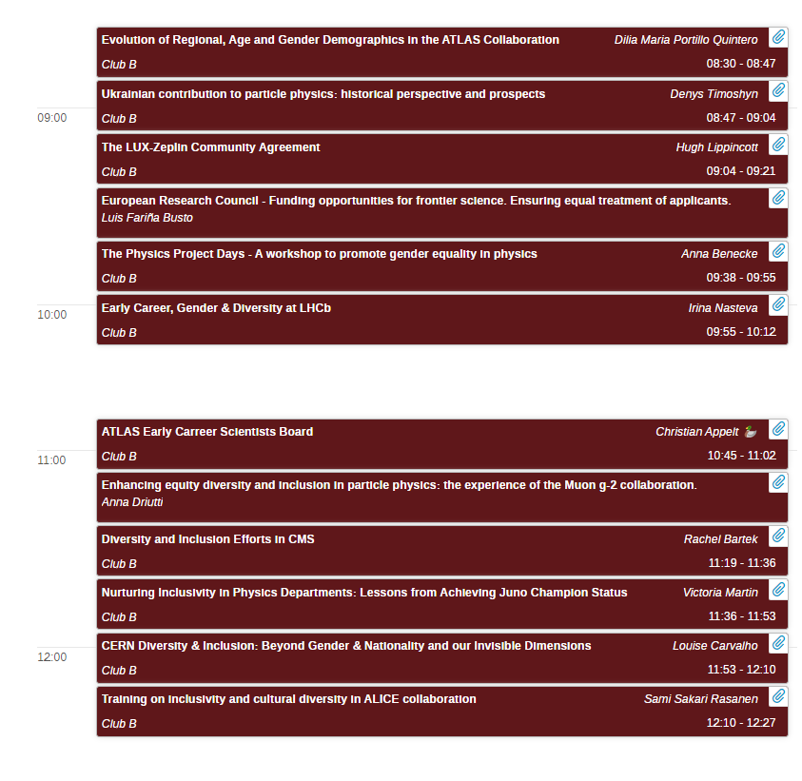
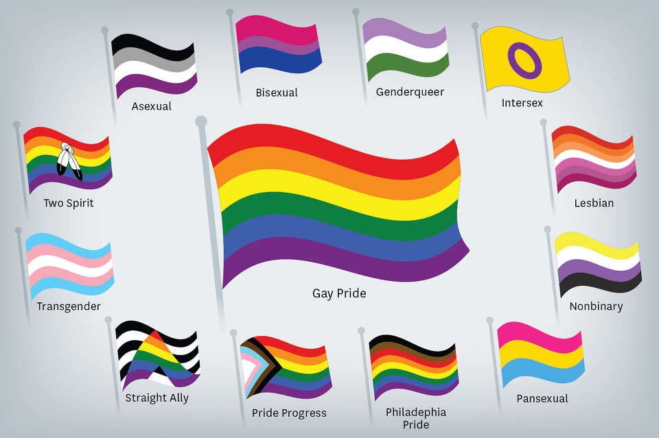







EDI Parallel Sessions
Collaboration Topic Talks
Ukraine
Funding £/$
Girls into
Physics
First EDI and Sustainability Discussion Session @ICHEP
ECR
Community Agreement
Inclusivity in
UK Physics Dept
Invisible Dimensions
https://indico.cern.ch/event/1291157/sessions/543526/#20240720.detailed

Slide 14
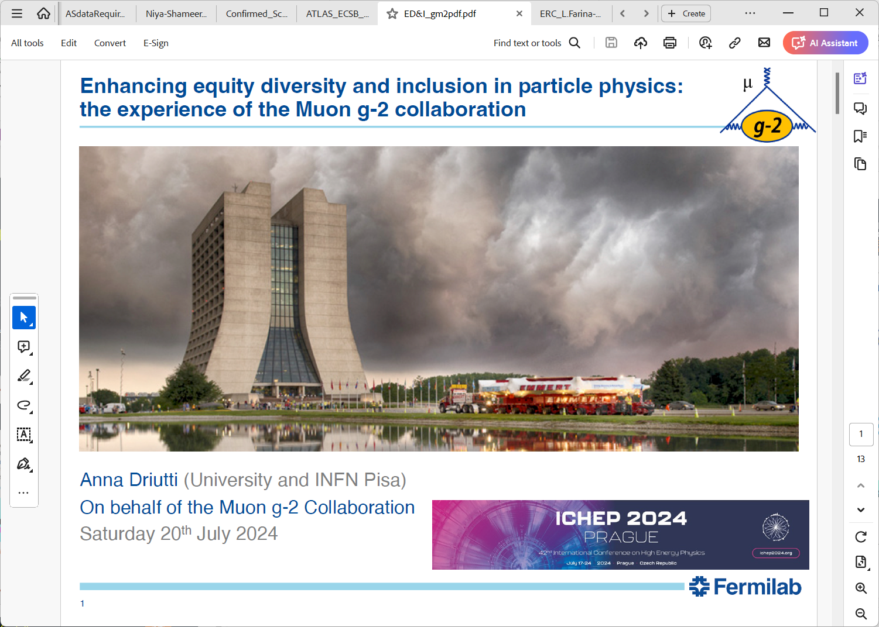
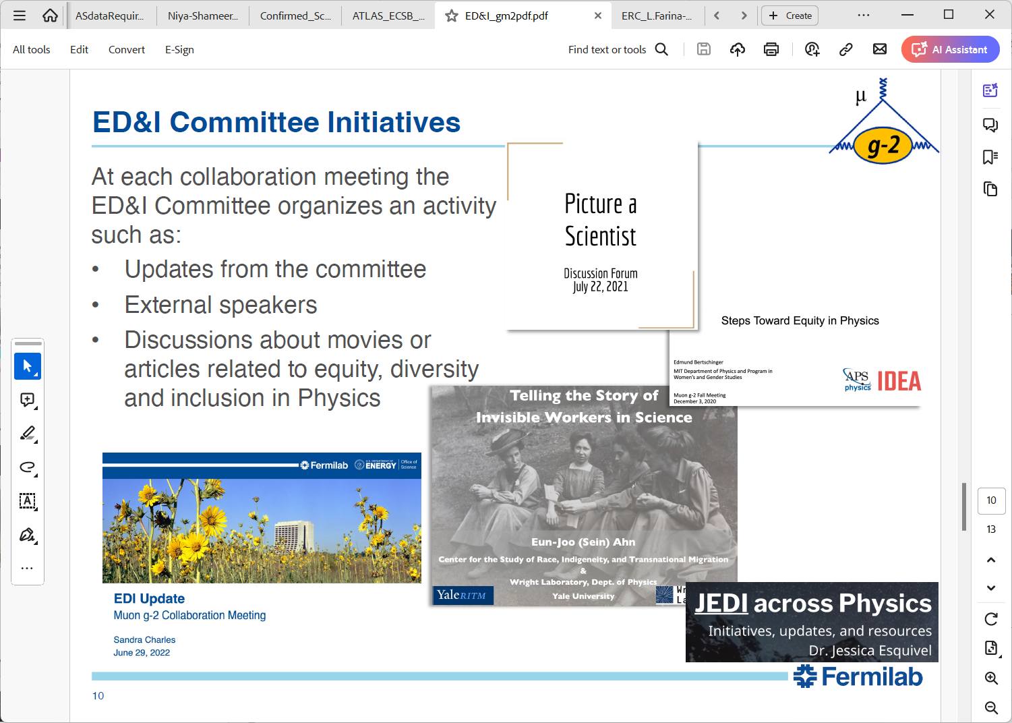
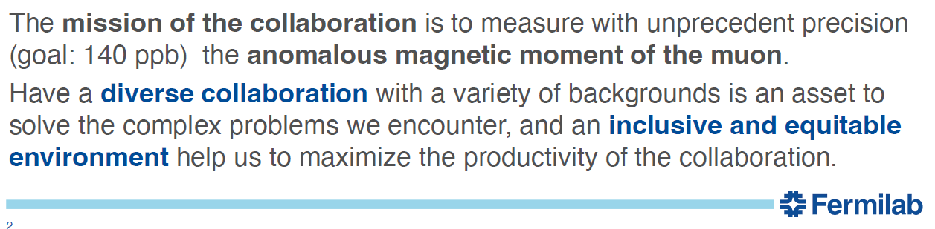


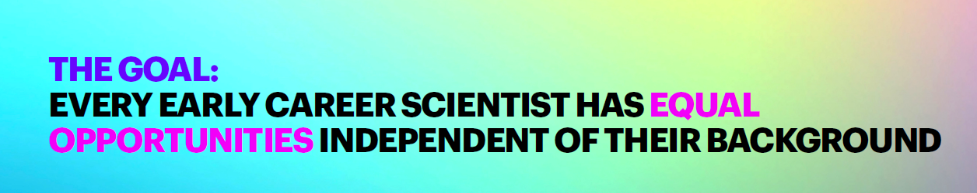
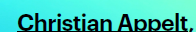
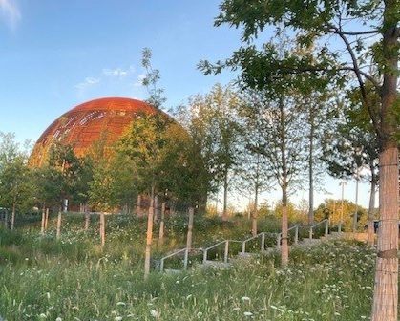
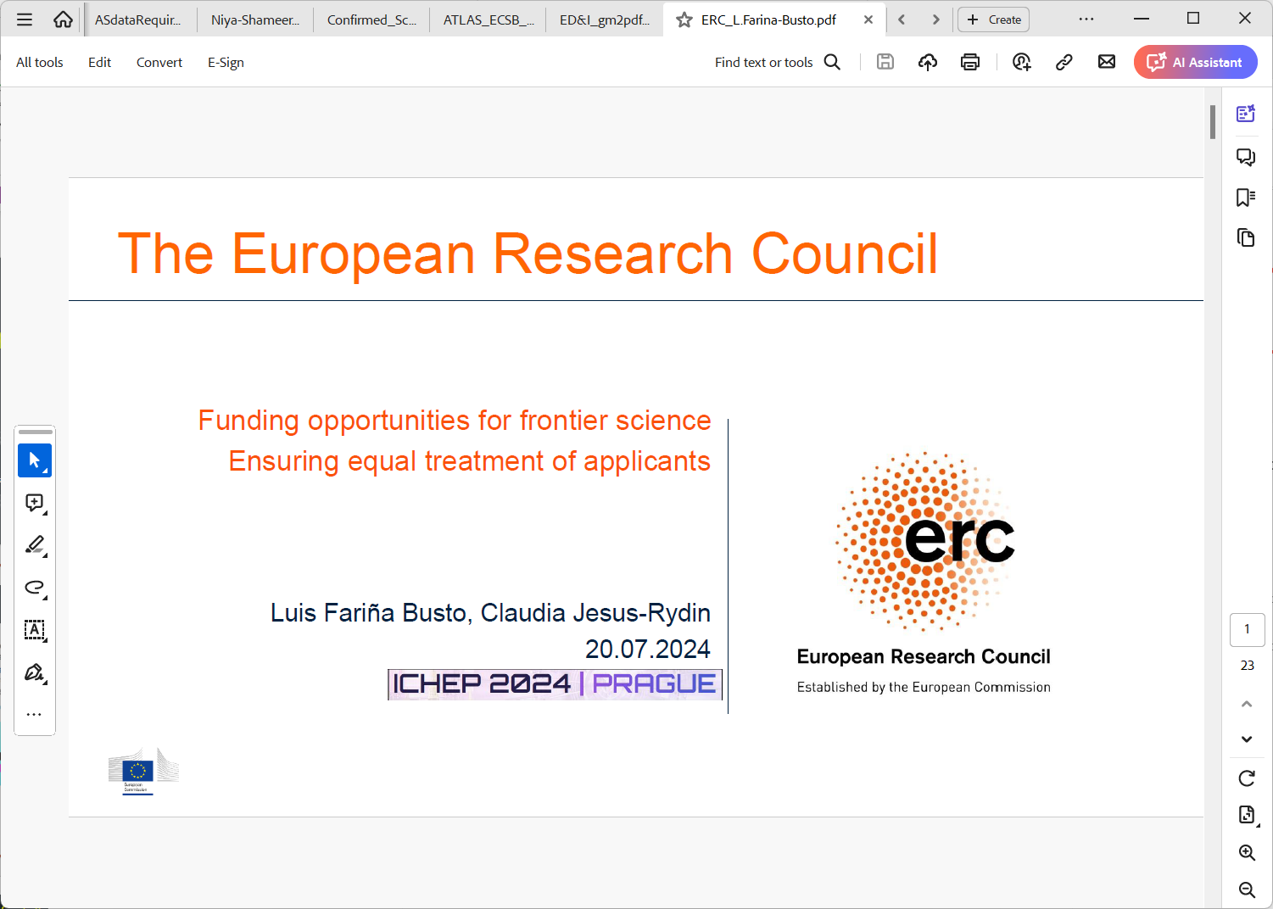
Collaboration and Funders Aims

Slide 15
What are PP collaborations doing ?
Diversity

Slide 16

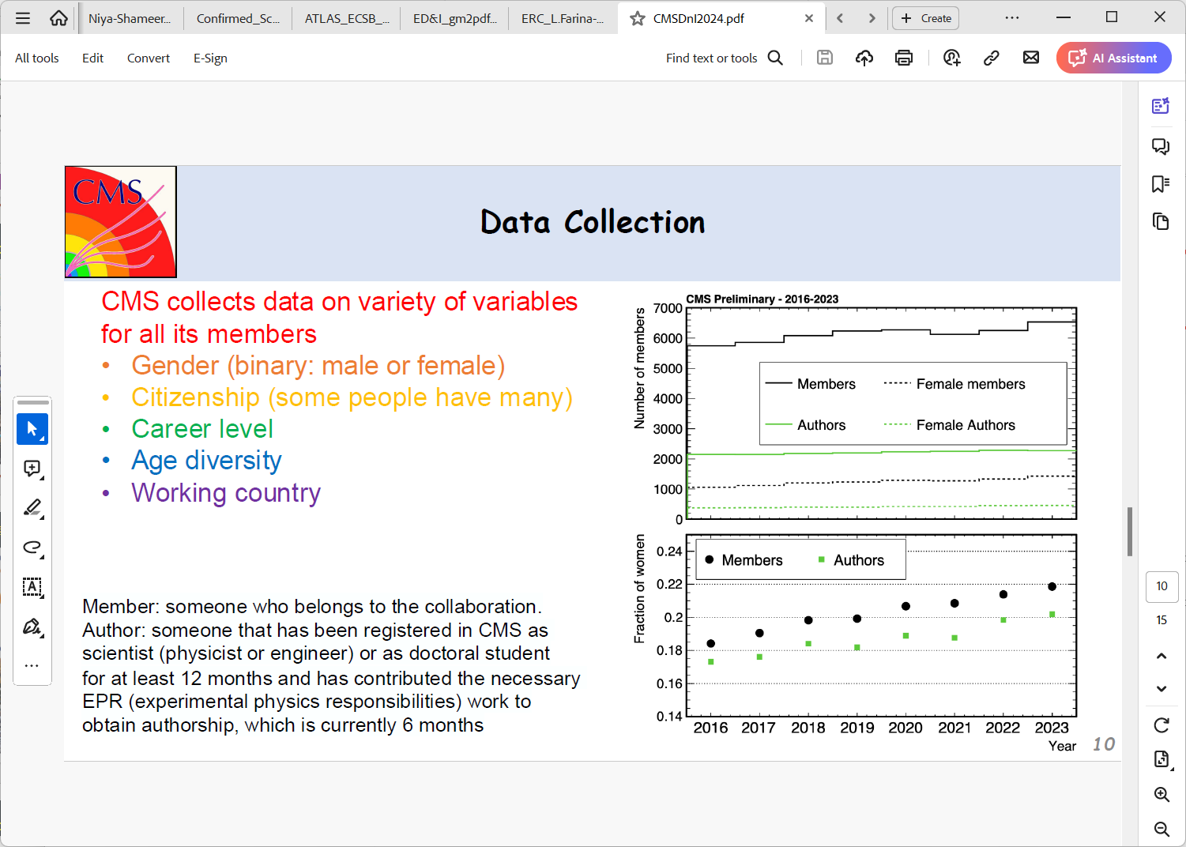
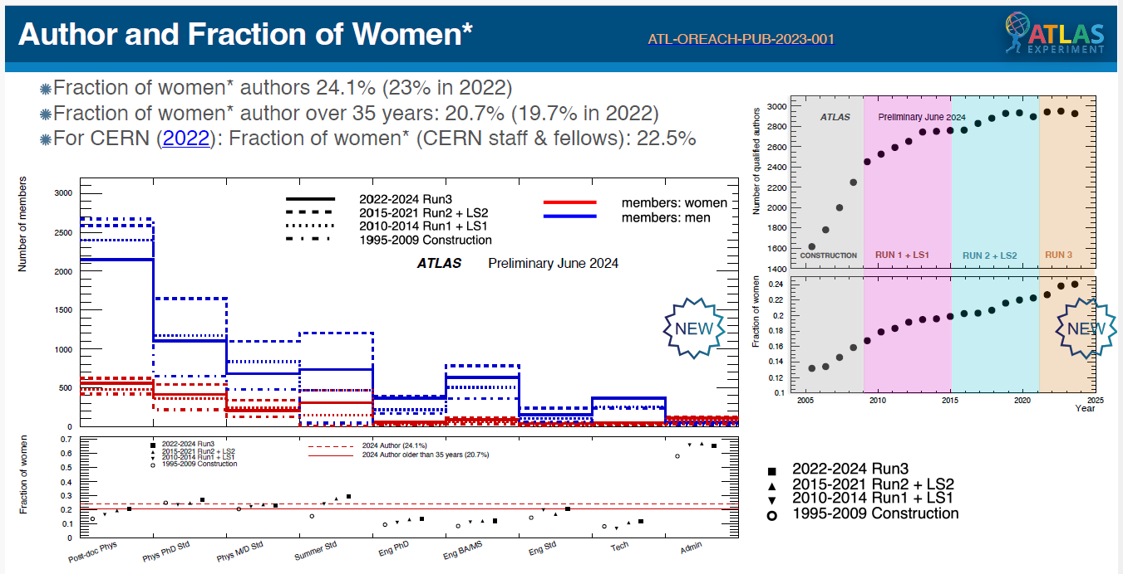
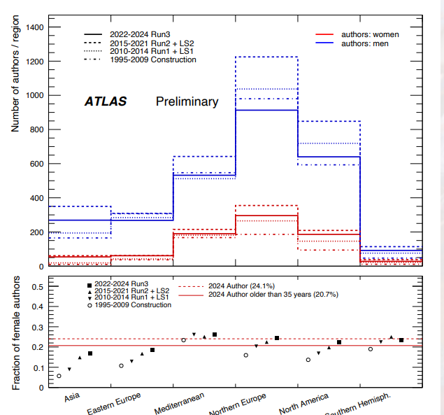
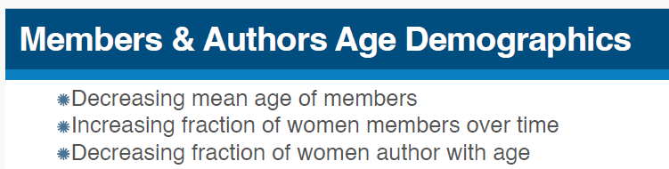
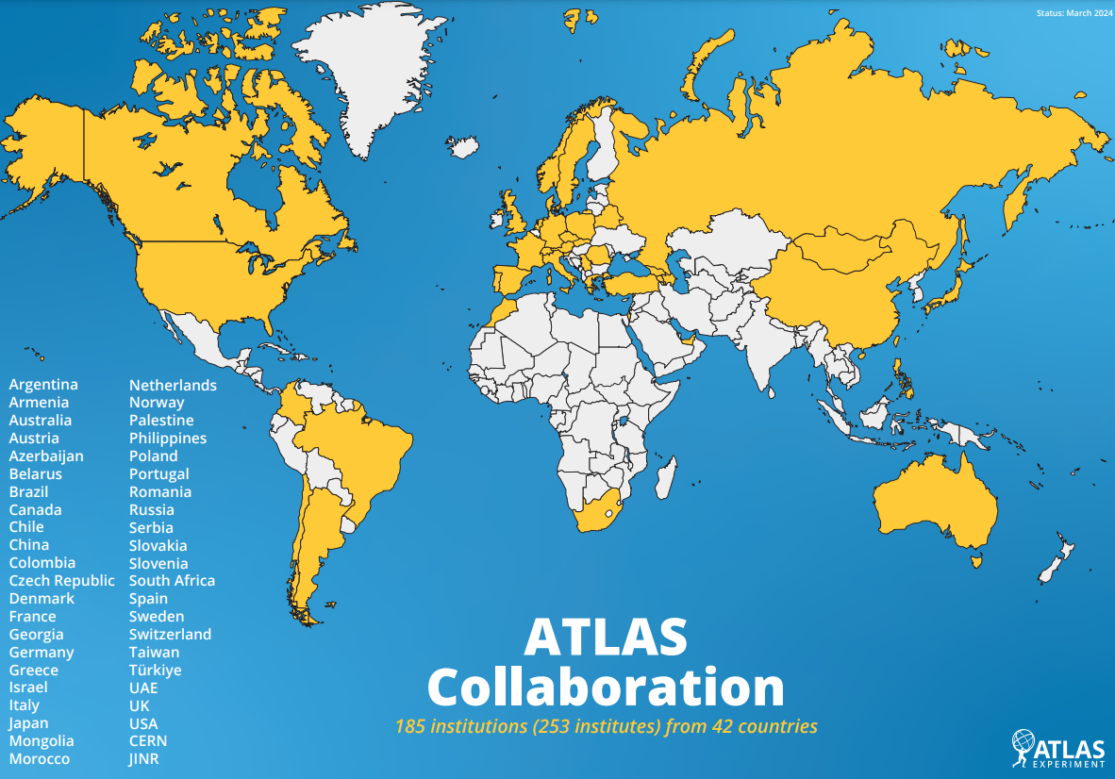
What are PP collaborations doing ?
Diversity
Dilia Quartero Rachel Bartek
Assessing/monitoring
Acknowledging Diversity
Monitoring → Showing diversity → Celebrating it
Broadening minds
- each person has (only) their own lived experience
- inclusivity/cultural events
Training – unconscious bias
Where we are, What we know, How we can learn .

Slide 17
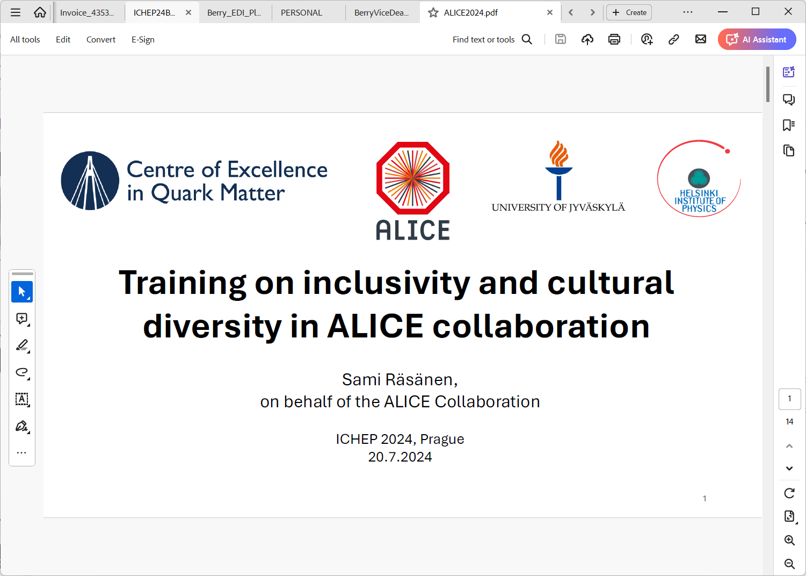
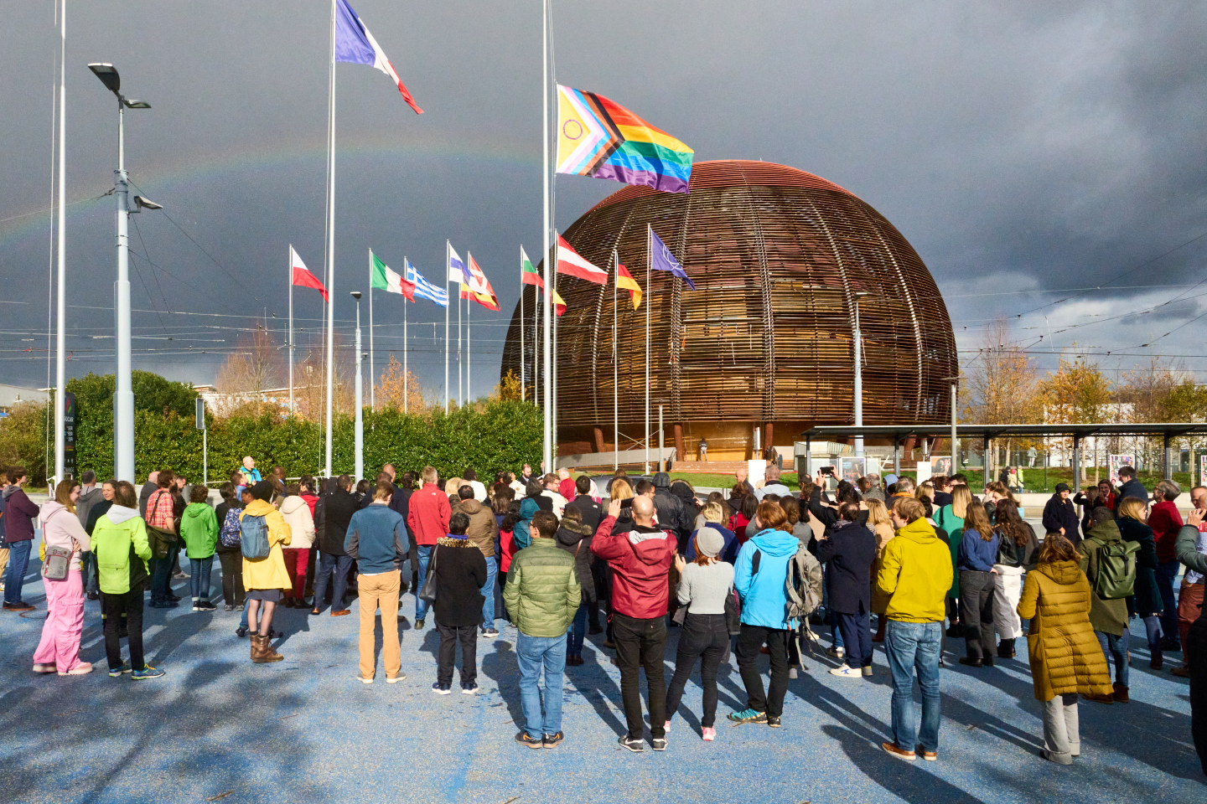
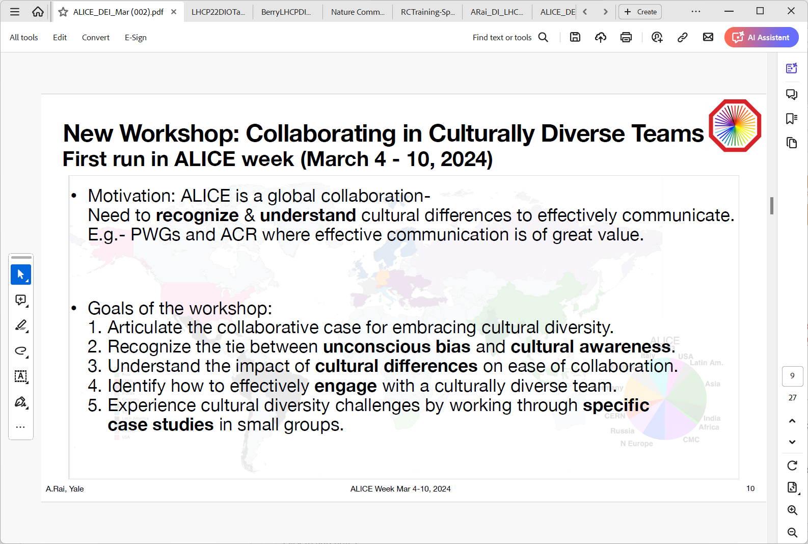
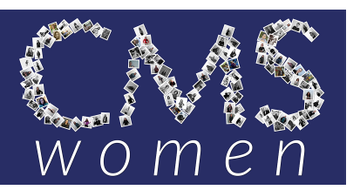
What are PP collaborations doing ?
Diversity
Sami Rasanen
Acknowledging Diversity
Monitoring
Broadening minds
- each person has (only) their own lived experience
- inclusivity/cultural events
Training – unconscious bias
Diversity Day Events
LGBTQ+STEM Day CERN Raised Flag - 17 November
Goals of the workshop:
2. Recognize tie between unconscious bias and cultural awareness.
3. Understand the impact of cultural differences on ease of collaboration

Slide 18
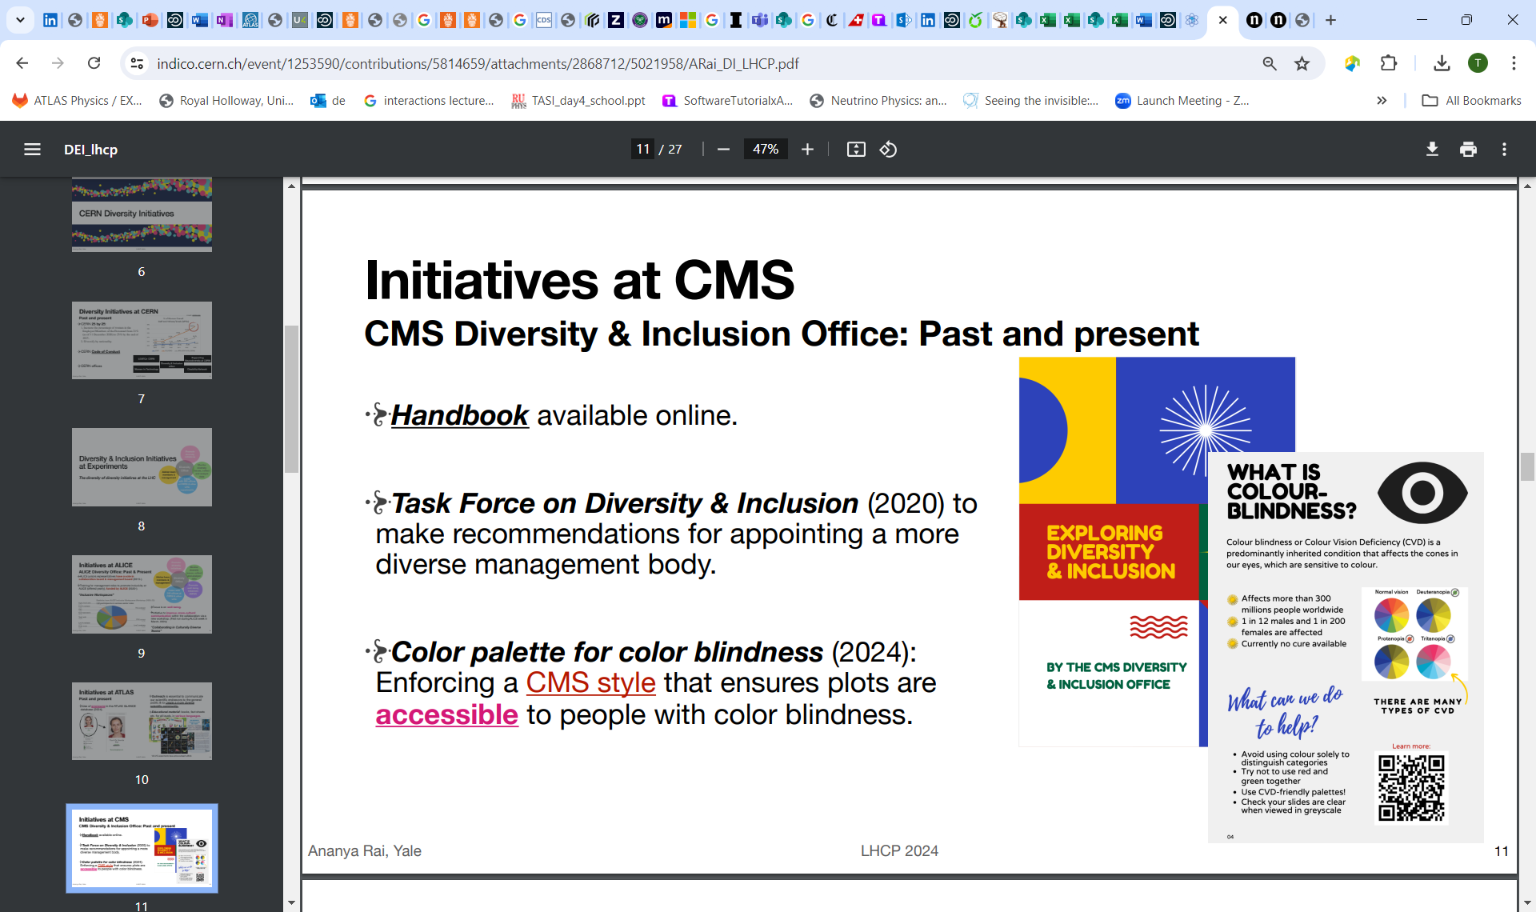
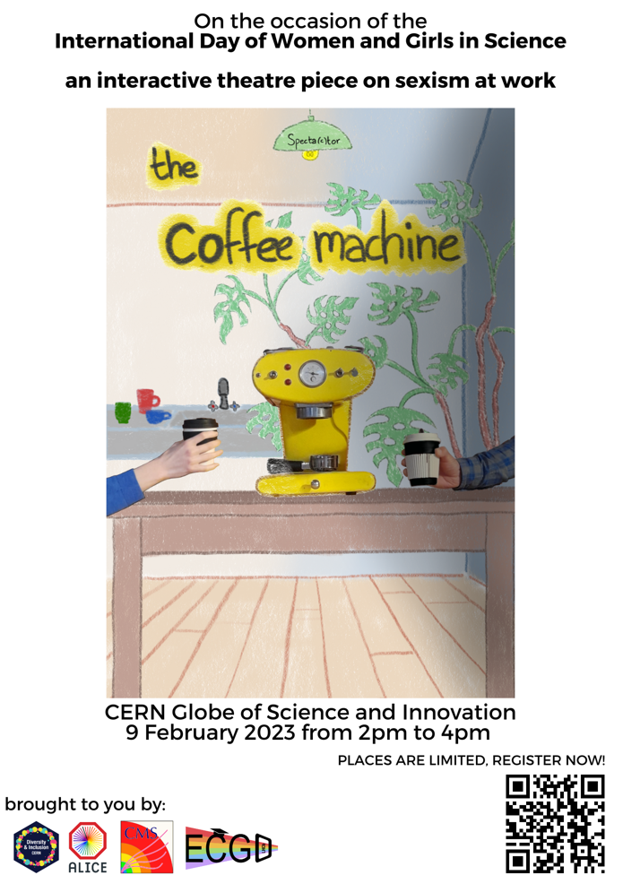
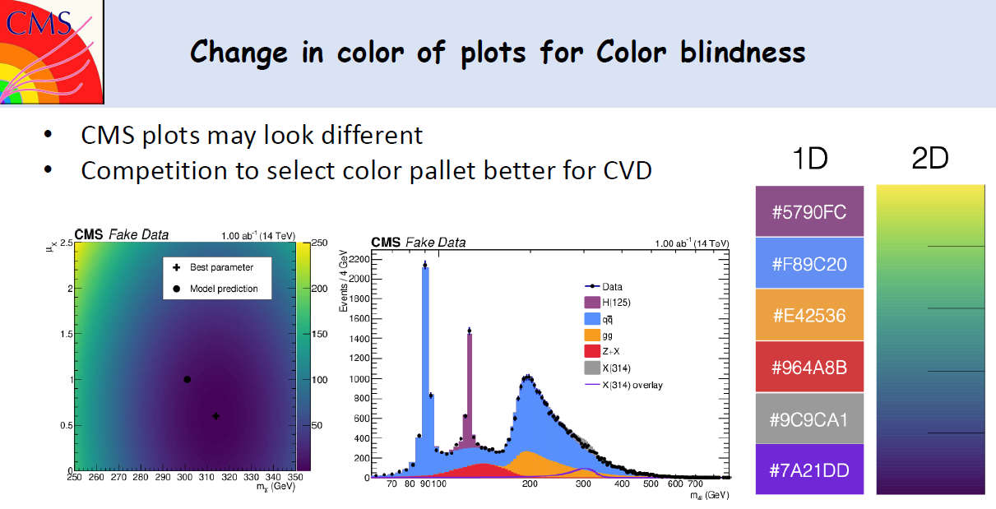
What are PP collaborations doing ?
Diversity
Rachel Bartek
Sami Rasanen
Acknowledging Diversity
Monitoring → Proud of diversity
Broadening minds
- each person has (only) their own lived experience
- inclusivity/cultural events
Training/Awareness – unconscious bias, theatre, interactive booklet
Workshops
Training for management roles to promote inclusivity at ALICE (offered yearly), funded by ALICE (2020-)
improve cross-cultural communication within collaboration (224March) “Collaborating in Culturally Diverse Teams”

Slide 19
What are PP collaborations doing ?
Equitable opportunities

Slide 20
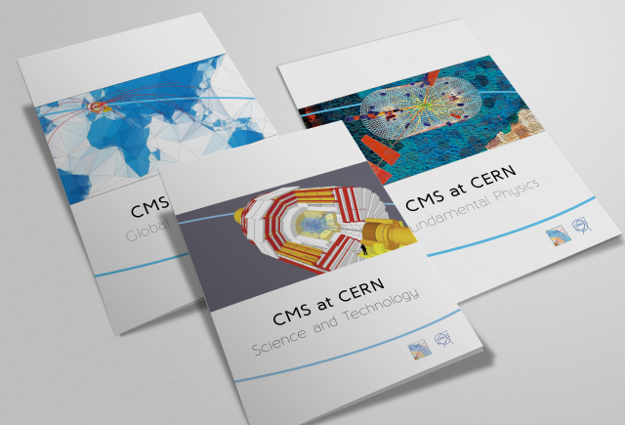
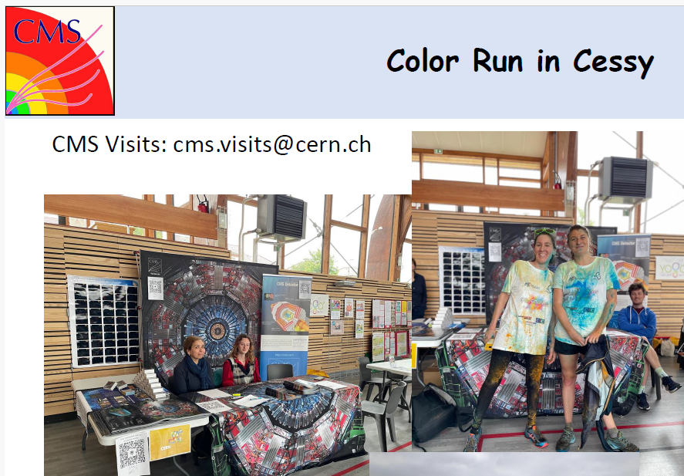
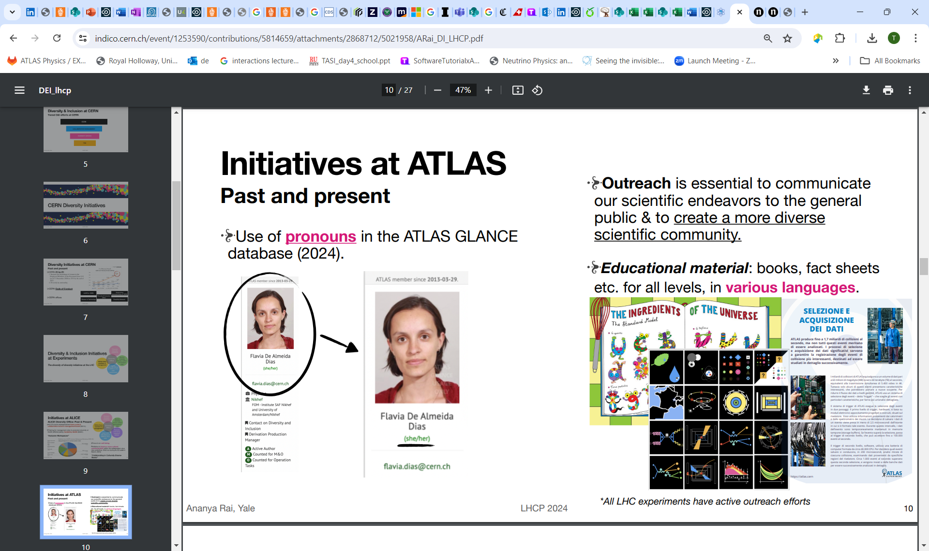
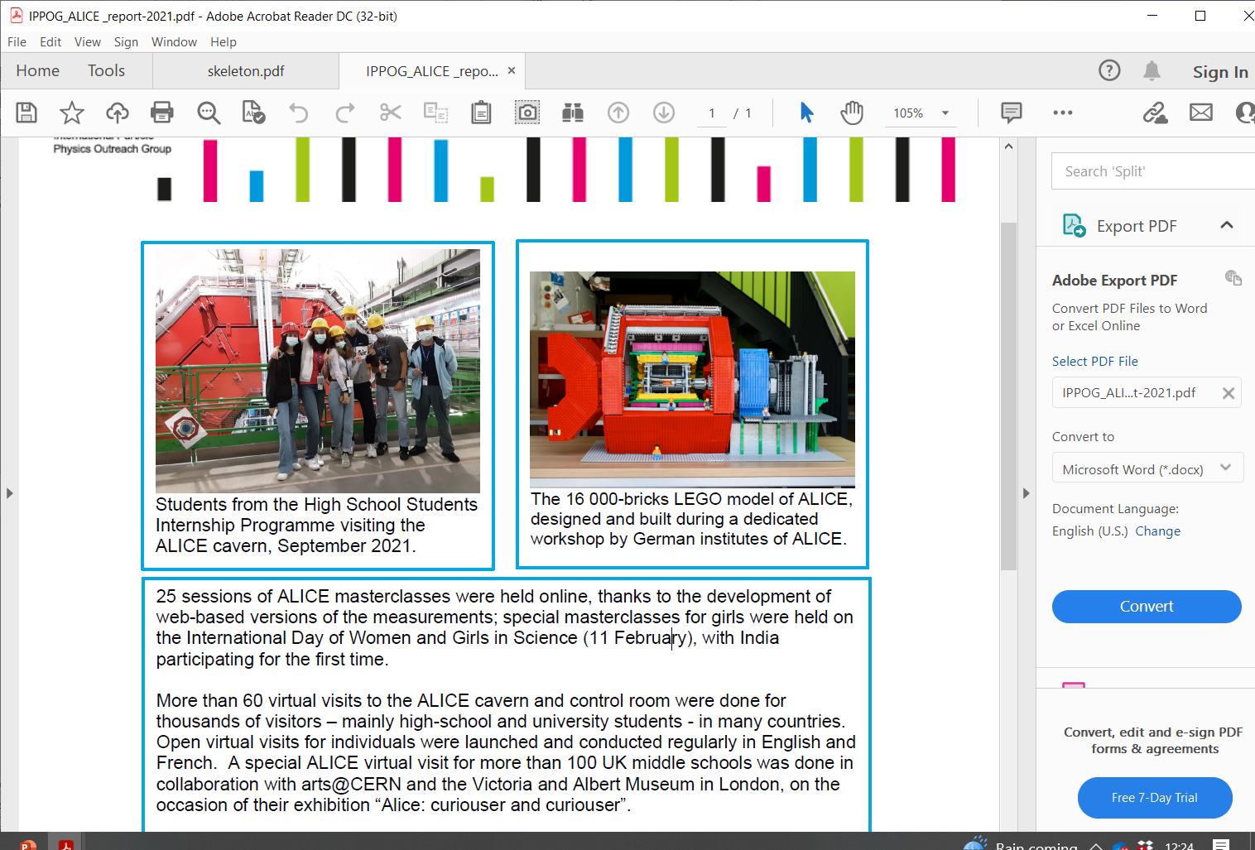
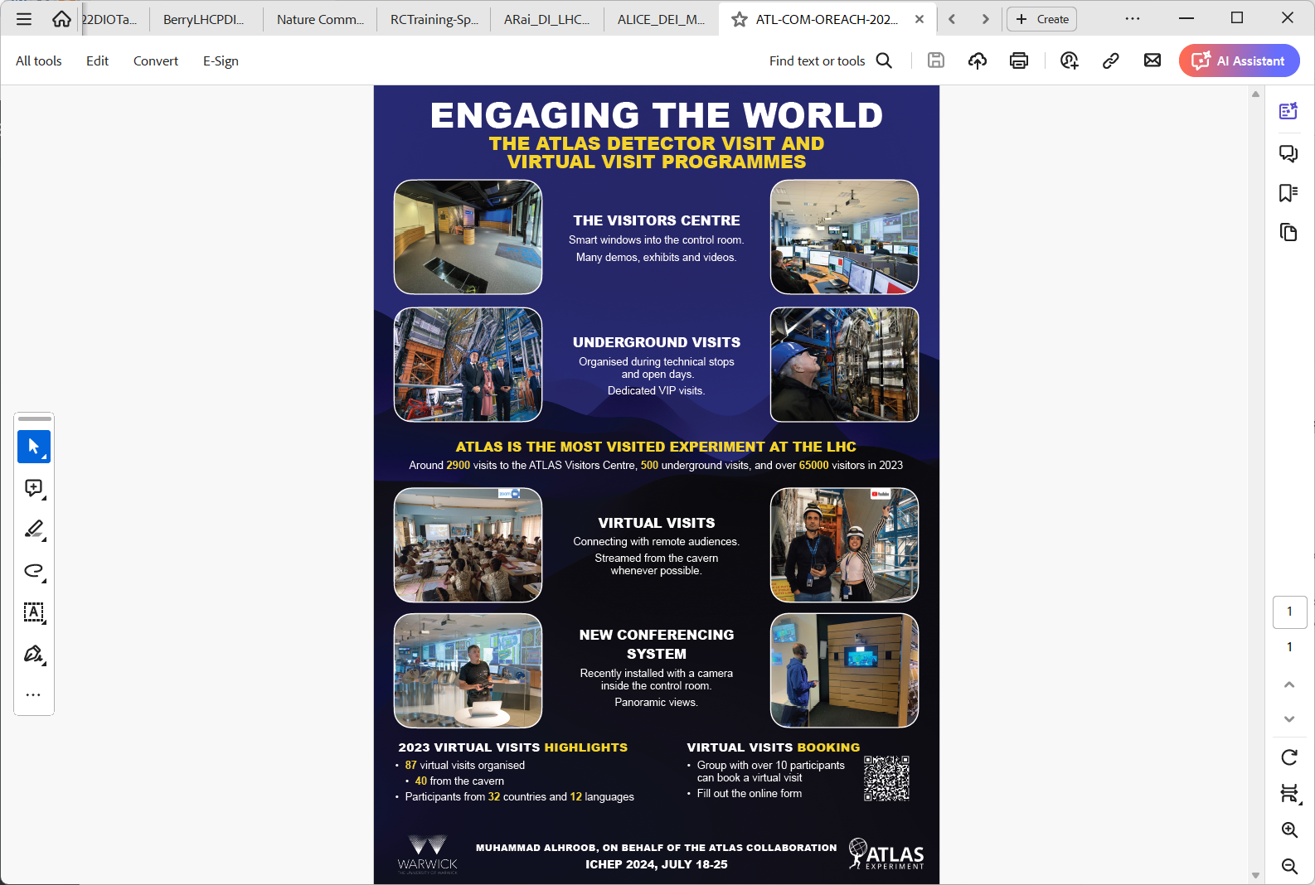
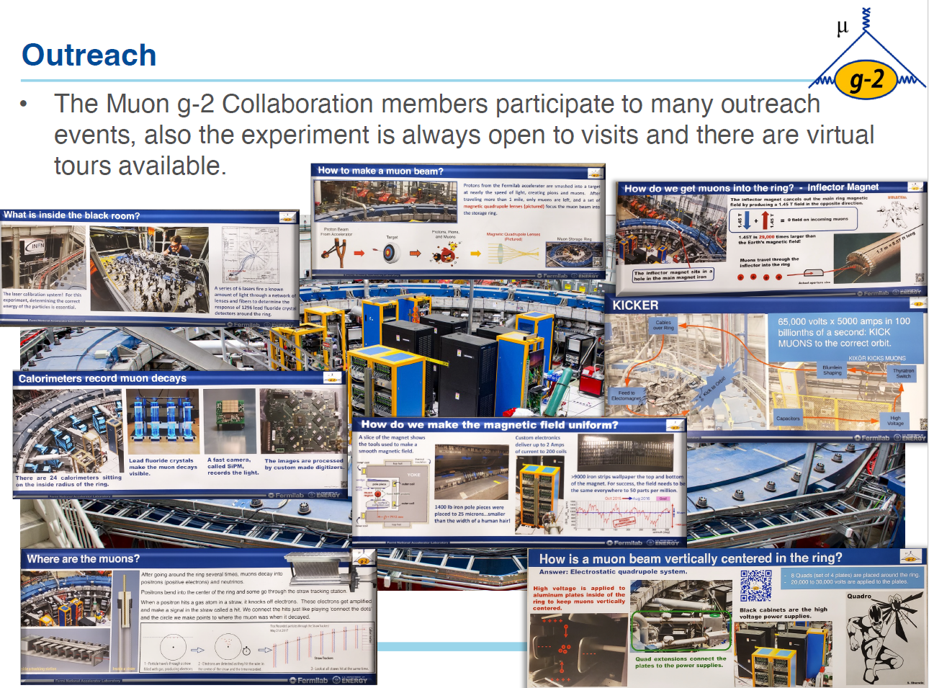
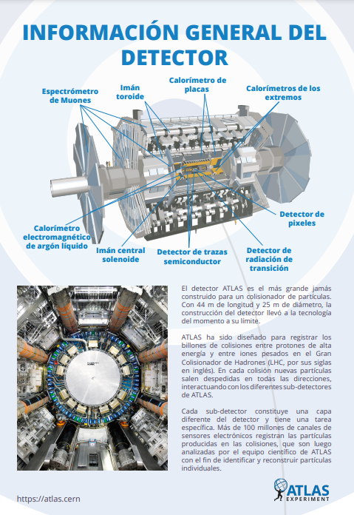
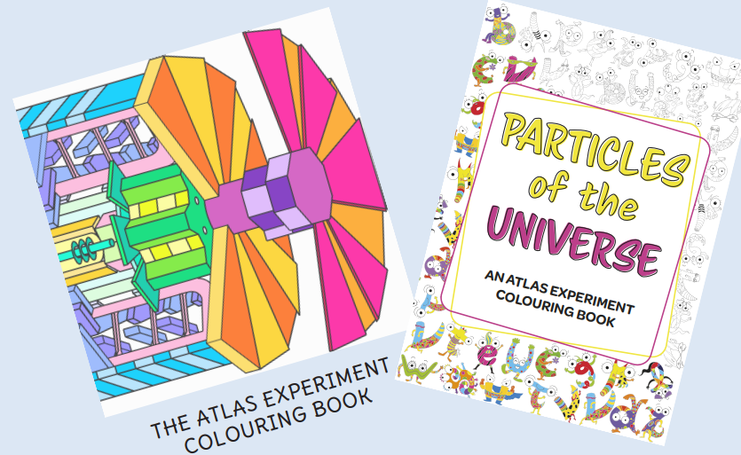
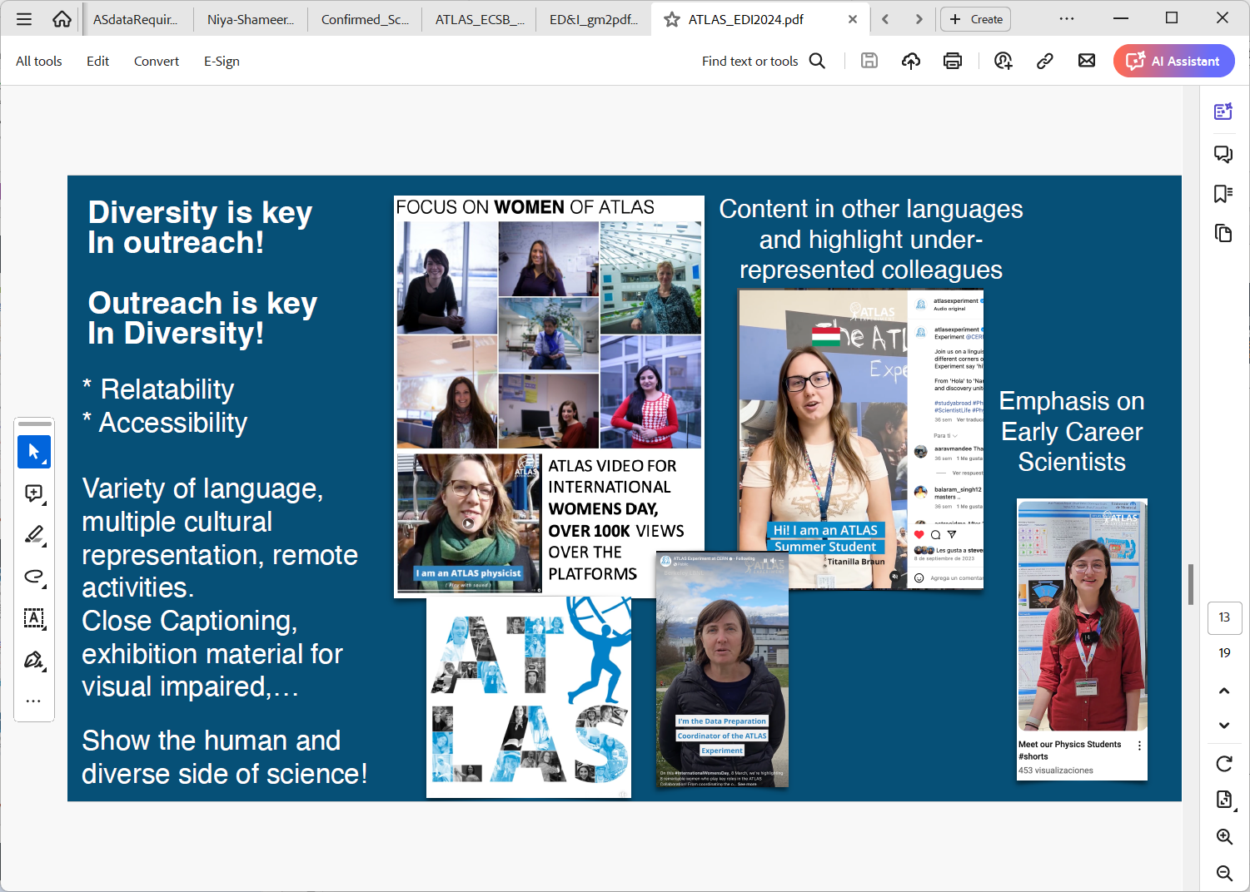
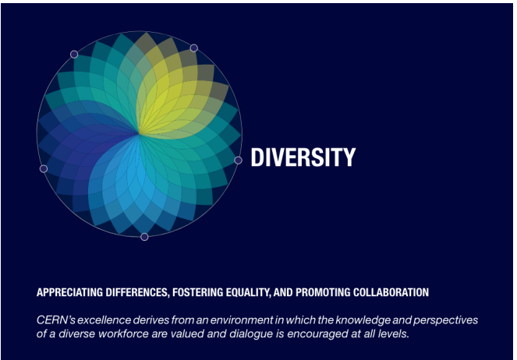
What are PP collaborations doing ?
Equitable opportunities
Creating equitable opportunities
Outreach/increasing accessibility/awareness
ECR Groups and Mentoring
Grants
Code of Conduct/ Community Agreement
Frameworks: Speakers committees, collaboration boards
Girls into Physics Days

Slide 21
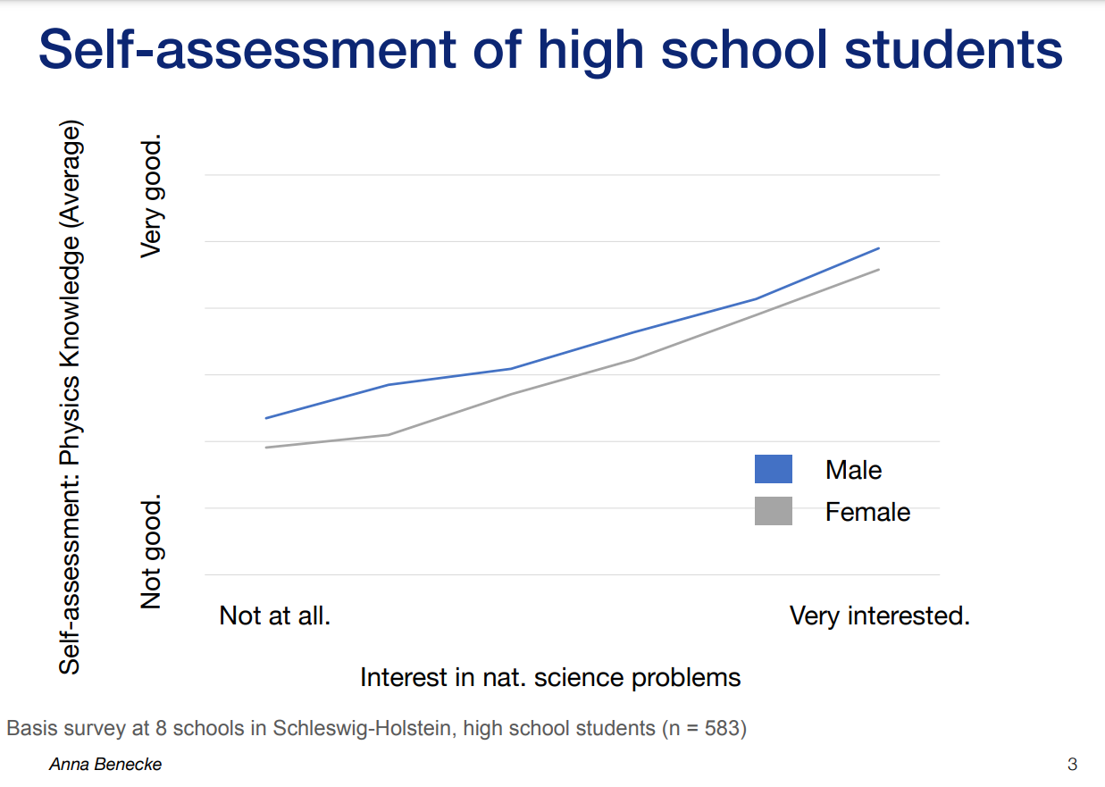
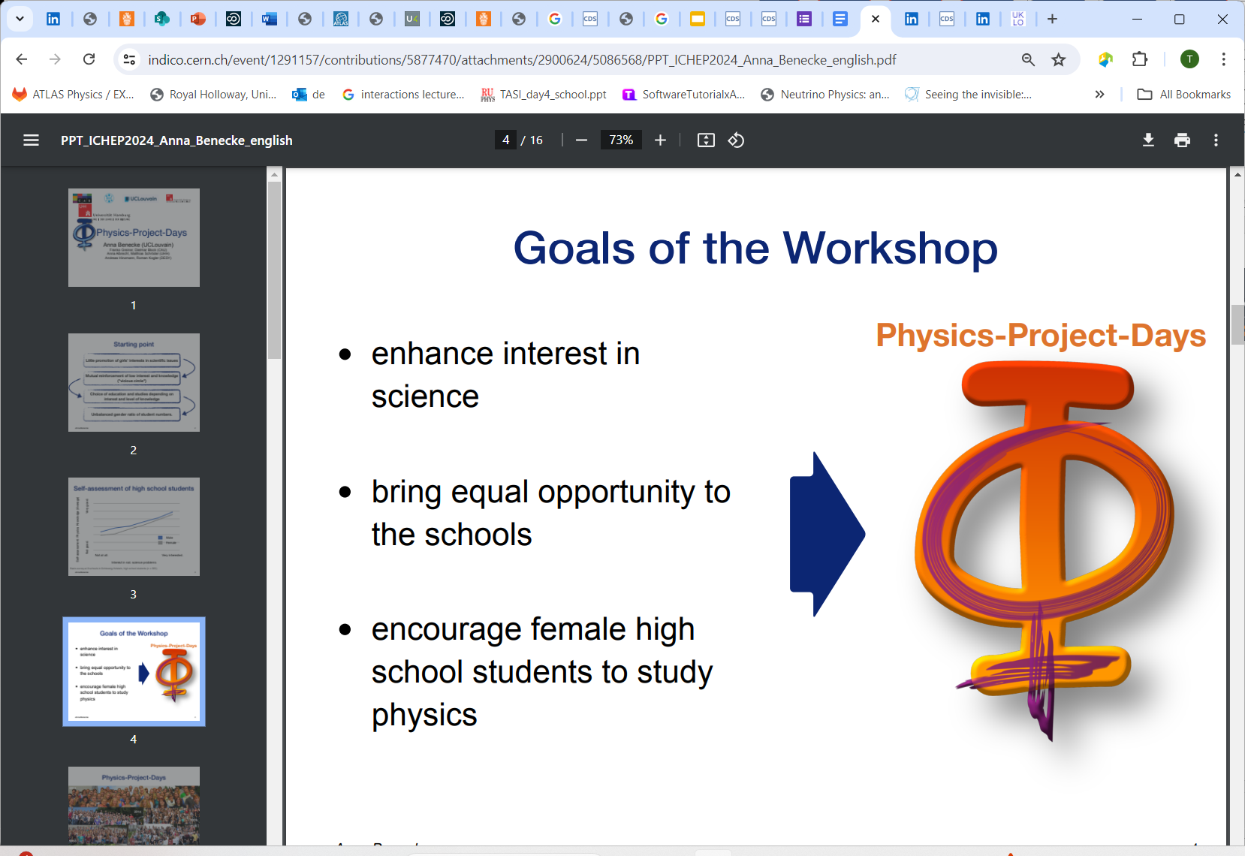
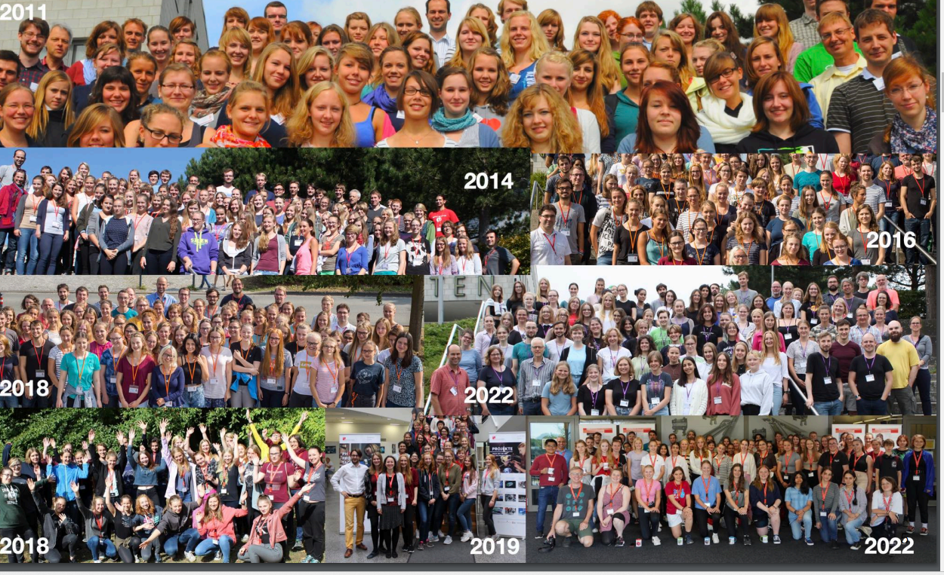




Physics Project Days
Addressing the start of the pipeline
Anna Bennecke

Slide 22








What are PP collaborations doing ?
Equitable opportunities
Ease transition
Creating equitable opportunities
Outreach
ECR Groups and Mentoring
Code of Conduct/ Community Agreement
Frameworks: Speakers committees, collaboration boards
Irina Nasteva’s Talk & Christian Appelt
Irina Nasteva’s
Christian Appelt
22

Slide 23


ECR & EDI Groups
Support career paths

Slide 24


What are PP collaborations doing ?
Equitable opportunities
Irina Nasteva’s Talk
Christian Appelt
Staying well
Creating equitable opportunities
Outreach
ECR Groups and Mentoring
Sami Rasanen
LHC Early Career Scientists Fora arranges the Healthy Minds for Masterminds -workshops during 2021-2023
404 responses from LHC experiments
24

Slide 25



What are PP collaborations doing ?
Equitable opportunities
Funding Tips
Creating equitable opportunities
Outreach
ECR Groups and Mentoring
Grants
Luis Fariña Busto
Gave us tips on how to get money – all levels!
Explain what you are doing! Basics – details for specialists, but don’t lose non-specialists, avoid hype, as PI you are self-propelled and competent, don’t give up, try again!

Slide 26

ERC Success Rates
Funders working to create equitable opportunities
Showed more plots by country

Slide 27



What are PP collaborations doing ?
Equitable opportunities
Working Environments
Creating equitable opportunities
Outreach
ECR Groups and Mentoring
Grants
Code of Conduct/ Community Agreement
Frameworks: Speakers committees, collaboration boards
Hugh Lippincott
ALICE junior representatives have a vote in collaboration board and management board (2013-)
Community Agreement
Pronouns in Database

Slide 28





Ukraine Talk
Denys Timoshyn
ICHEP was held in Kyiv in years 1959 and 1970!

Slide 29

Is everything covered?

Slide 30




Invisible Dimensions - Survey
Louise Carvalho
Intersectionality of dimensions
More than one nationality
First in family to go to University
Financially supporting others
Caring for others
Neurodivergent: self – or child/spouse/sibling
Two body issue

Slide 31


What can YOU do?
Support everyone in your career / be considerate – mentor others
Be an ally to those treated unfair, call out bad behaviour
Don’t assume that your lived experience are the same as anyone else’s – learn about others
Attend training courses to become more equipped
a) If you are in-charge of others
– create a positive, inclusive, fair, open and transparent culture
- where people can be heard and contributions valued
- giving people same opportunities may be not treating people equally
b) Allocate resources fairly: money, time, PhD students, talks,
workload: shifts etc
c) Have summer students to help with EDI work, make a team, EDI seminars!
5) Don’t be scared of EDI – do your best! – everyone creates the culture (+/-)
Victoria Martin

Slide 32




danke
Děkuji
感謝
bedankt
多謝
obrigado
grazie
gracias
Thank you
dyakuyu
xie xie 謝謝
takk
Arigatou gozaimasu
merci
Teşekkürler
tracey.berry@cern.ch

Slide 33
Collaboration and Funders Aims

Slide 34


Slide 35


Slide 36

LHC-wide Survey
Staying well

Slide 37


Slide 39

LZ Community Agreement Hugh Lippincott
LZ ~200 people, ~36 institutions, 7 countries
majority in US and UK
Original code of conduct adopted in 2018
Mostly aspirational
“”Unacceptable conduct may warrant further action. “
Not explicitly spelled out how would actually work
Developed in 2022 –
June 2023 - Ratification of new Community Agreement
Two ombudspeople
Creation of Case Review Committee (CRC)
○ 5 members, all from IB, elected by collaboration
○ Two year terms
○ Chair chosen by elected CRC - convenor-level
Reflecting & Reviewing after 1 year – more training

Slide 40
Sample D&I-related Policies, Actions, Learnings
Gender Equality Plan; International Gender Champion; Contract extension post-maternity leave; Increased co-parent leave; Genera Network; Women-in-Tech network
SRR gender inclusive language; Official D&I lanyard; DIO Network; D&I Roundtable; Nationality and Gender dashboards; Gender diverse selection boards; 577 email policy
Career Break Fellowship; Non-binary inclusion study group; Dual Career Network; DG Statement on LGBTQ STEM; Neurodiversity network
STEM internship for students with disability; Central budget for office adaptations; Disability & Inclusion at work handbook
“Spouse & Partner equal rights”; Infant feeding room; Crèche on-site; Swiss work permit for spouse
D&I Awareness Workshops; Active Bystander training; D&I embedded in mandatory learnings;
Invisible dimensions poll; Harassment prevention seminars

Slide 41




Setting Diversity Targets– Data!
Monitor diversity issues and report periodically to the collaboration
Data collection and reporting vital – to see trends
Quantitative and Qualitative (surveys)
Analysis/ Identify Actions/Review
But some characteristics easier to monitor than others
Louise Carvalho’s Talk
→ 1.3% from our 25% target!
Do you answer surveys? Fill in your details?
Takes up your time
Question why this is needed? What happens with data?
Will this result in change?

Slide 42


Slide 43


