Slide 1


Dark Matter
Theoretical Framework and Candidates
Kathryn M. Zurek, ICHEP 2024, Prague

Slide 2
Why Dark Matter?
Dark Matter Paradigm Remains the Only Viable Framework for the Full Range of Observations
BBN
(baryons)
CMB
(curvature)
LSS
(matter)
Supernovae
(DE)
Galaxy curves
(matter)

Slide 3





Dark Matter Requires Physics Beyond the Standard Model
The Range of Possibilities is Stunning.
In this talk, we will parse probing this entire mass range as a series of theoretically-well-motivated experimental challenges
The question for the progress of the field is: how many of these challenges can we meet in the next 10-20 years?
de Broglie wavelength = galaxy size
Warm DM
WIMP paradigm
Shot-noise fluctuations in Lyman-alpha forest

Slide 4
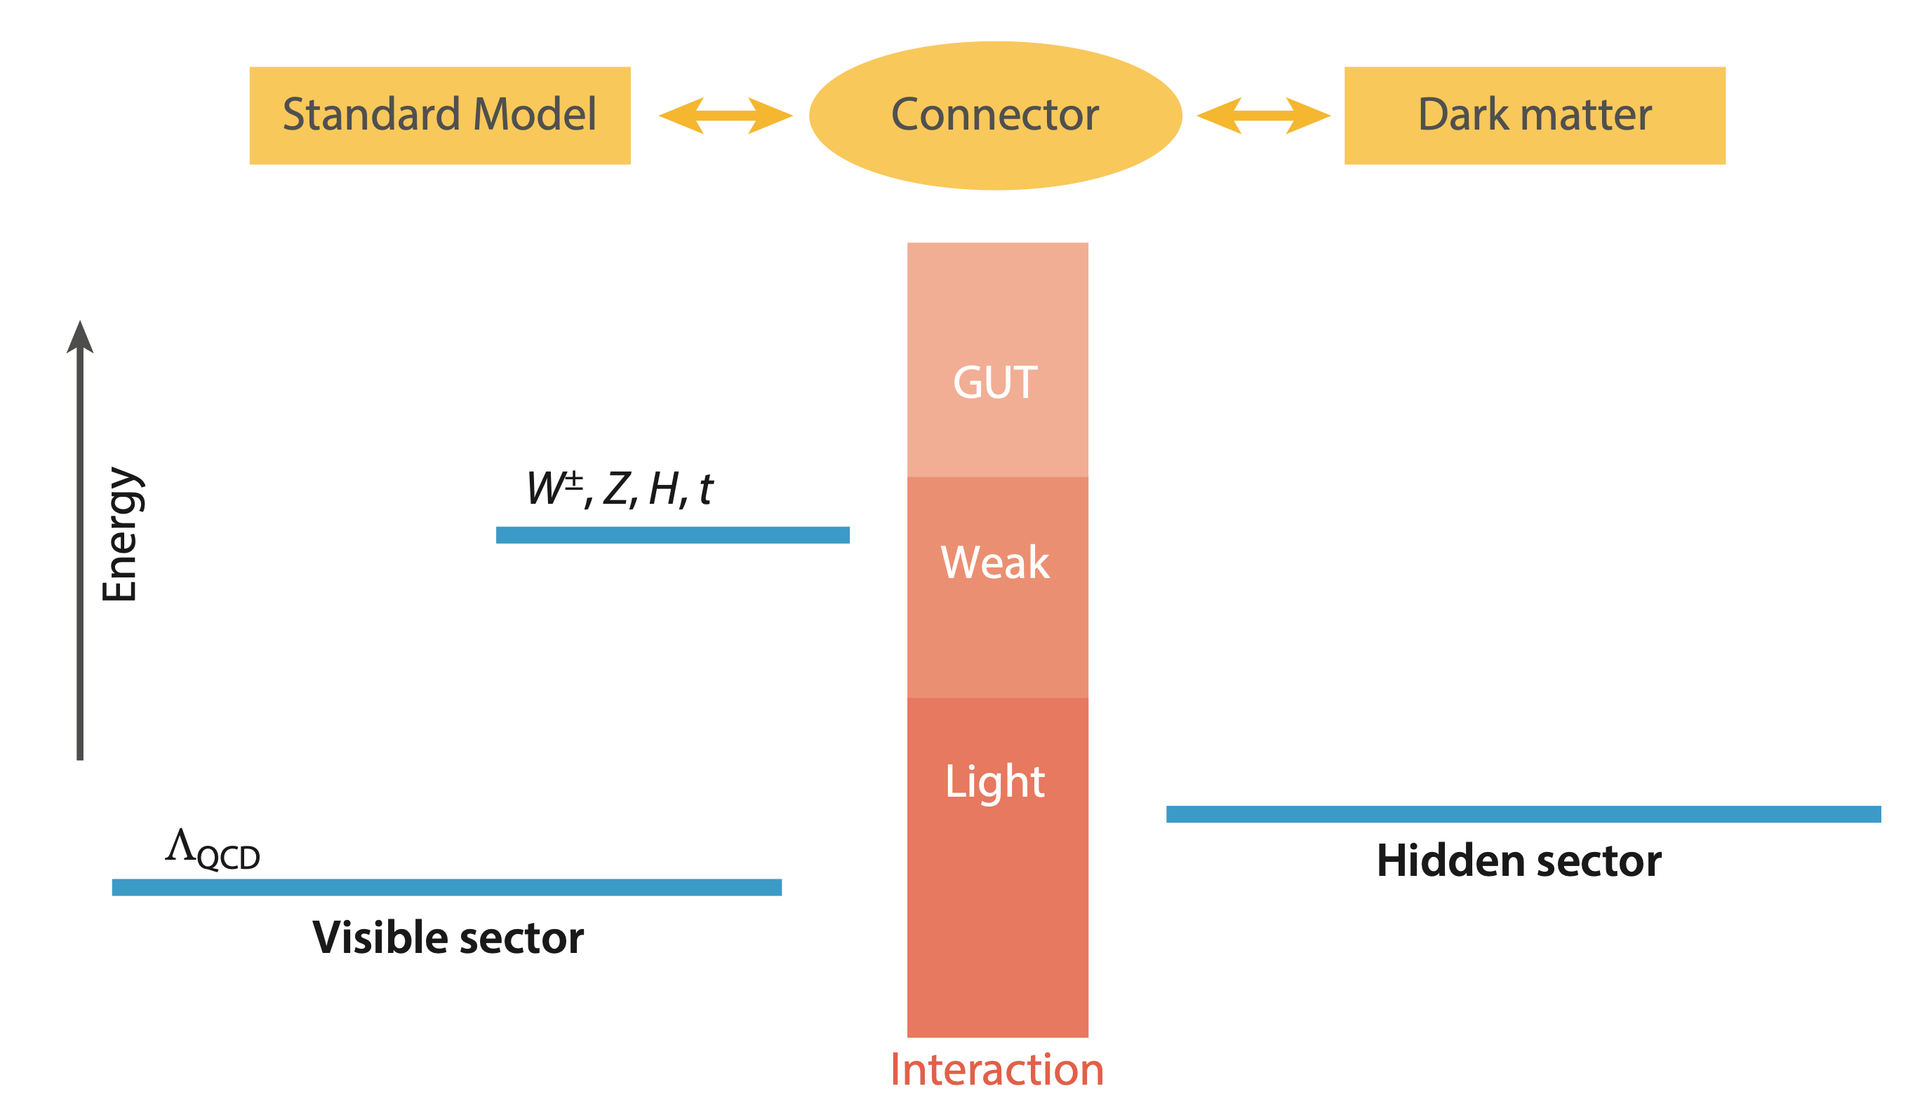
The Challenge.
All known properties of dark matter are via the gravitational interaction.
Gravity is weak.
Gravity gives the gross properties of dark matter — density and large-scale clustering.
Learning about particle properties will require stronger-than-gravitational interactions.
Gravity

Slide 5



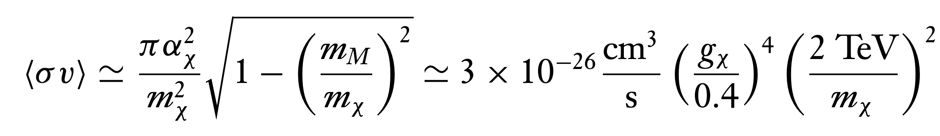
Weakly Interacting Massive Particles
Theoretically Well-Motivated and Experimentally Still Viable
WIMPs have not been found but are not theoretically eliminated.
They remain well-motivated by their observed abundance.
The relic abundance estimate for WIMPs gives:
Relic abundance, indirect detection
DM
SM
DM
SM
Production at colliders

Slide 6
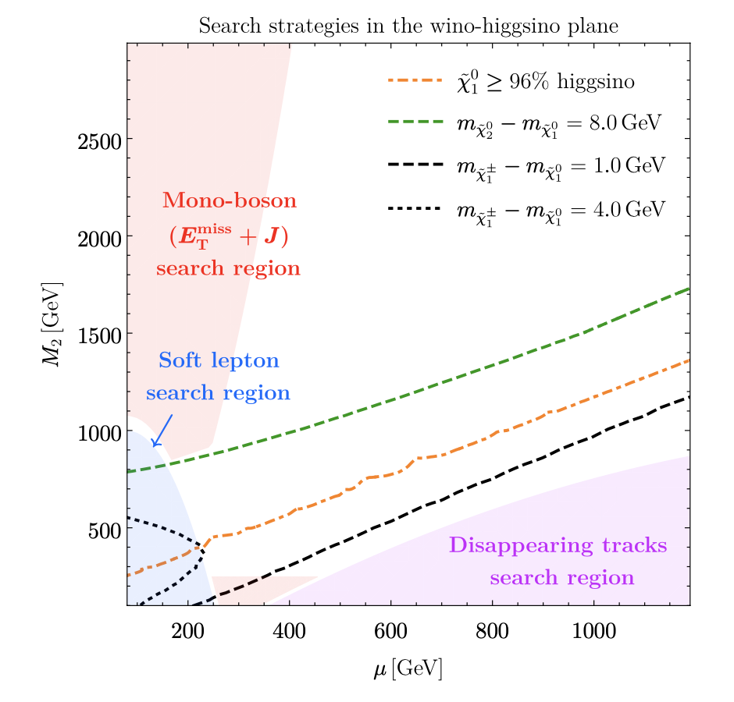
Weakly Interacting Massive Particles
Theoretically Well-Motivated and Experimentally Still Viable
WIMPs have not been found but are not theoretically eliminated.
Cosmologically-favored pure electroweakino masses have not been eliminated by LHC, which more strongly constrains colored particles.
Carpenter et al 2309.07213

Slide 7
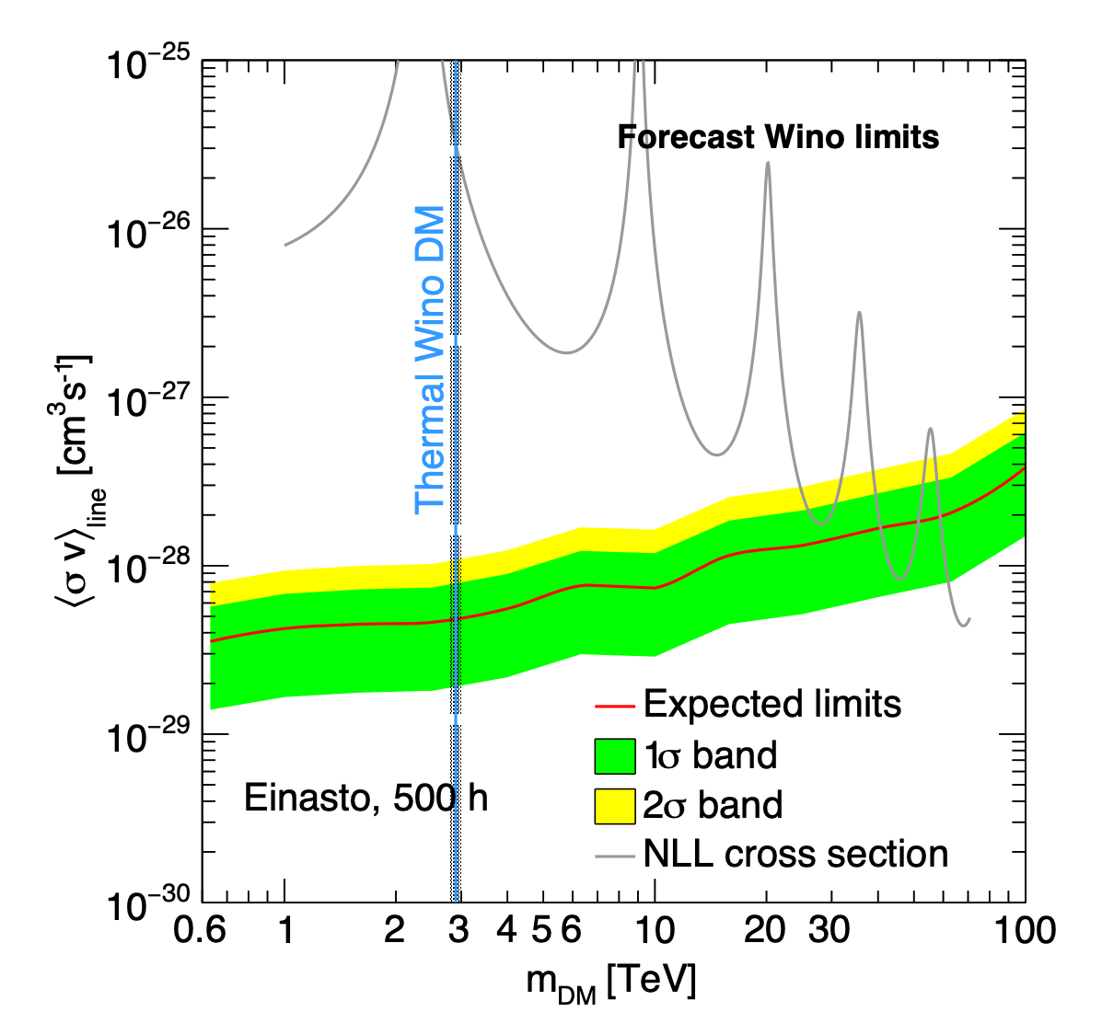
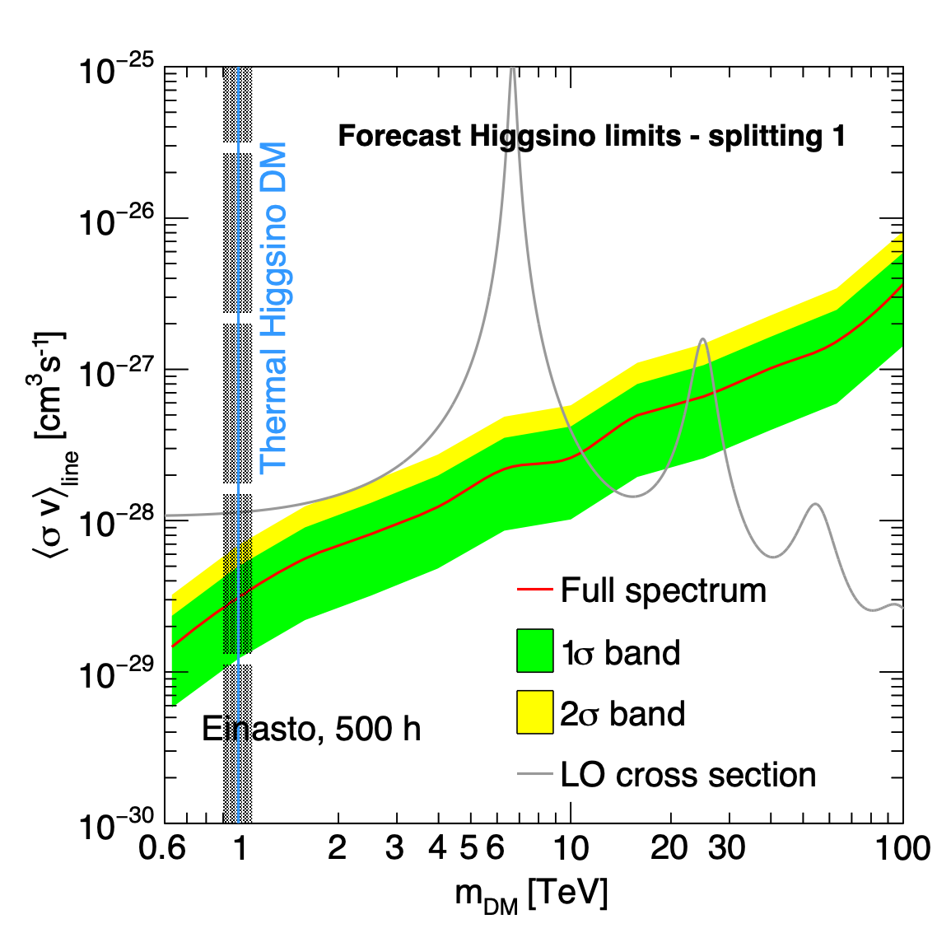
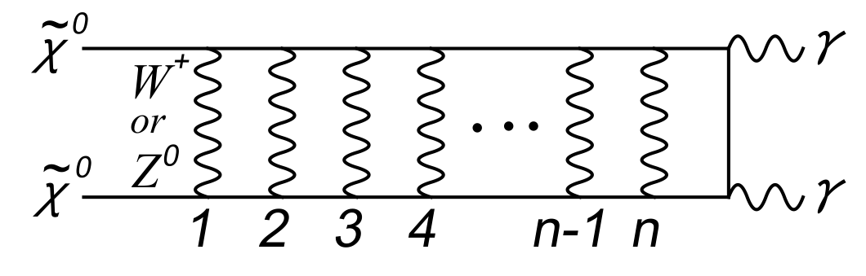
Weakly Interacting Massive Particles
Theoretically Well-Motivated and Experimentally Still Viable
WIMPs have not been found but are not theoretically eliminated.
Pure electroweakinos produce detectable annihilation by-products in Cherenkov Telescopes
Rinchiuso et al 2008.00692
Hisano, Matsumoto, Nojiri, Saito, 0412403
Challenge #1: Fully Cover Electroweakino DM, e.g. with Cherenkov Telescopes

Slide 8
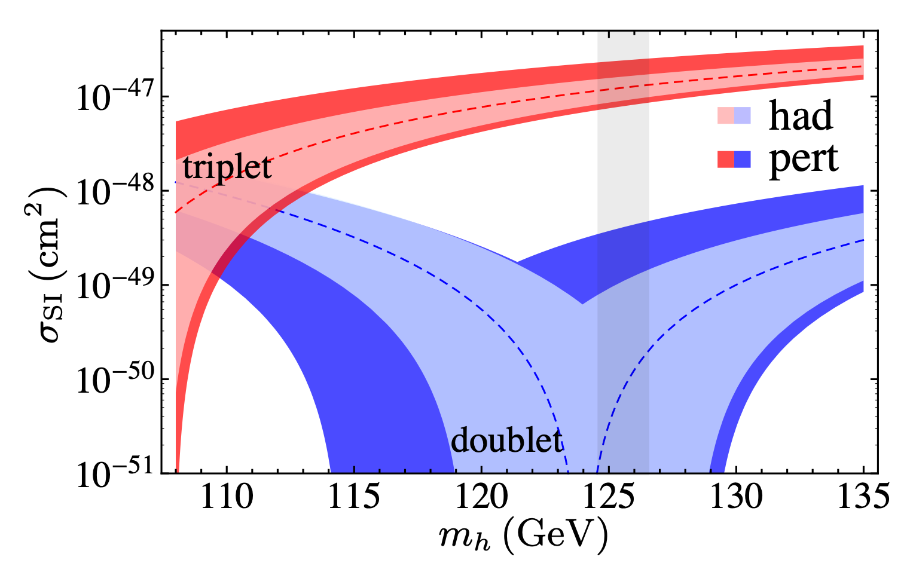
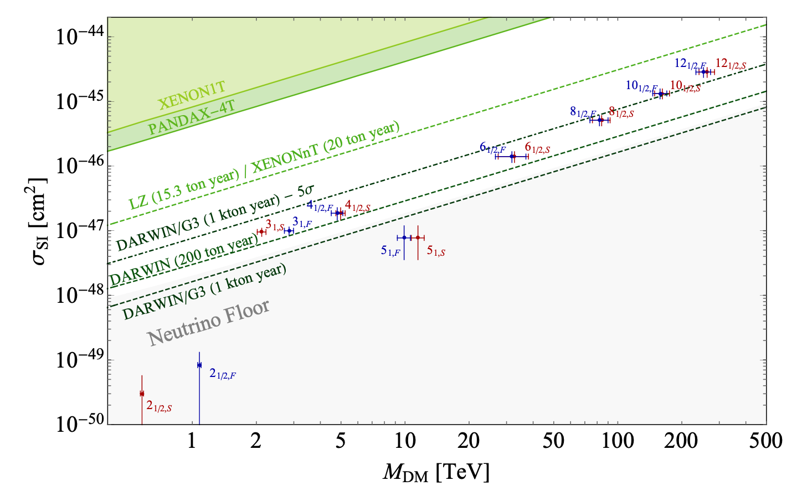
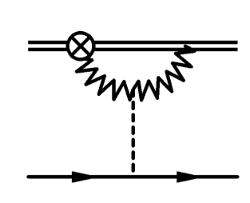
Weakly Interacting Massive Particles
Theoretically Well-Motivated and Experimentally Still Viable
WIMPs have not been found but are not theoretically eliminated.
Pure electroweakinos have small scattering cross-sections in Direct Detection, because the tree-level Higgs-mediated process vanishes.
Hill, Solon 1309.4092
Bottaro et al 2205.-4486
Challenge #2: Search for WIMPs to the Neutrino Background in Direct Detection

Slide 9
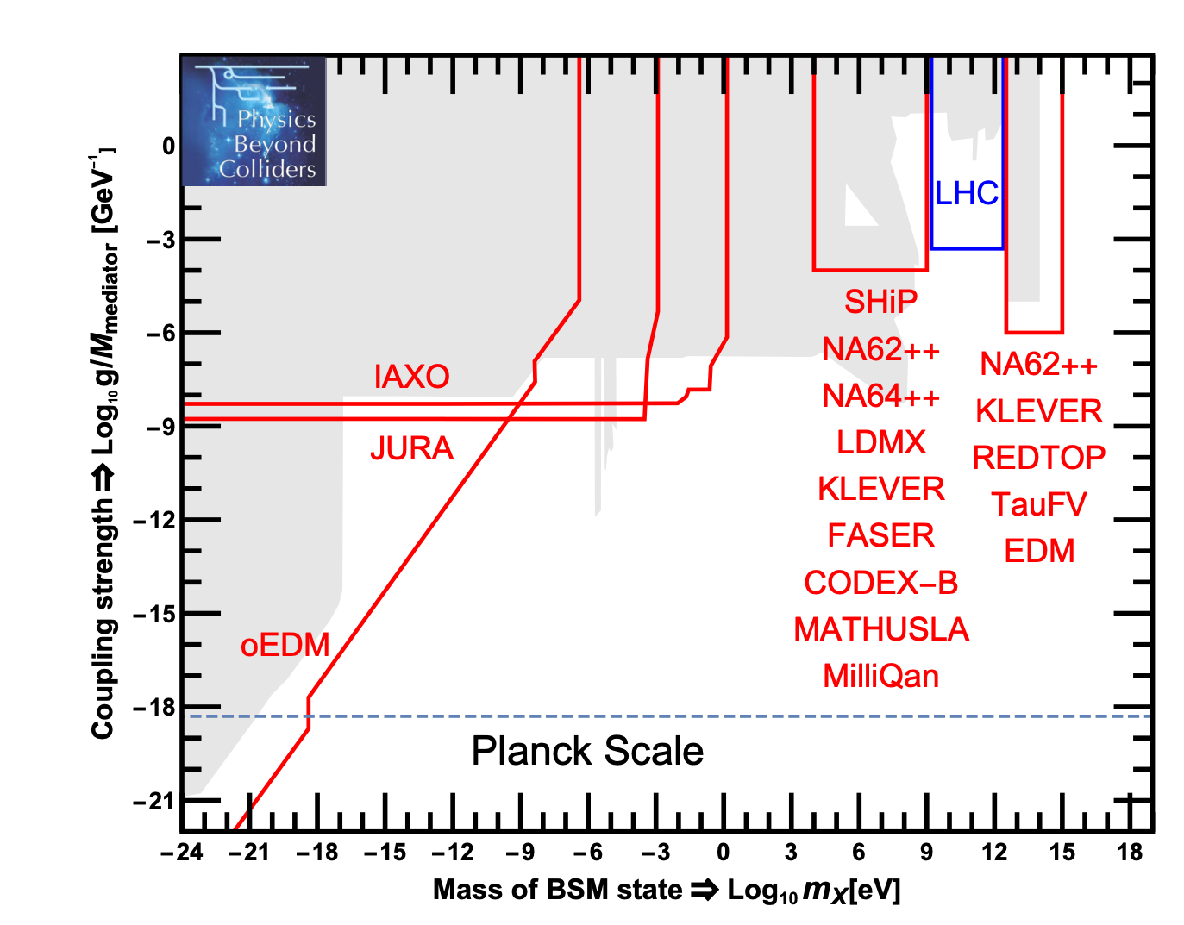
Dark Matter of a Very Low Mass
Dark Matter with Mass Below the Weak Scale
Such low-mass states have evaded detection by having small couplings to the SM.
de Broglie wavelength = galaxy size
Warm DM
WIMP paradigm
Shot-noise fluctuations in Lyman-alpha forest
1901.09966

Slide 10

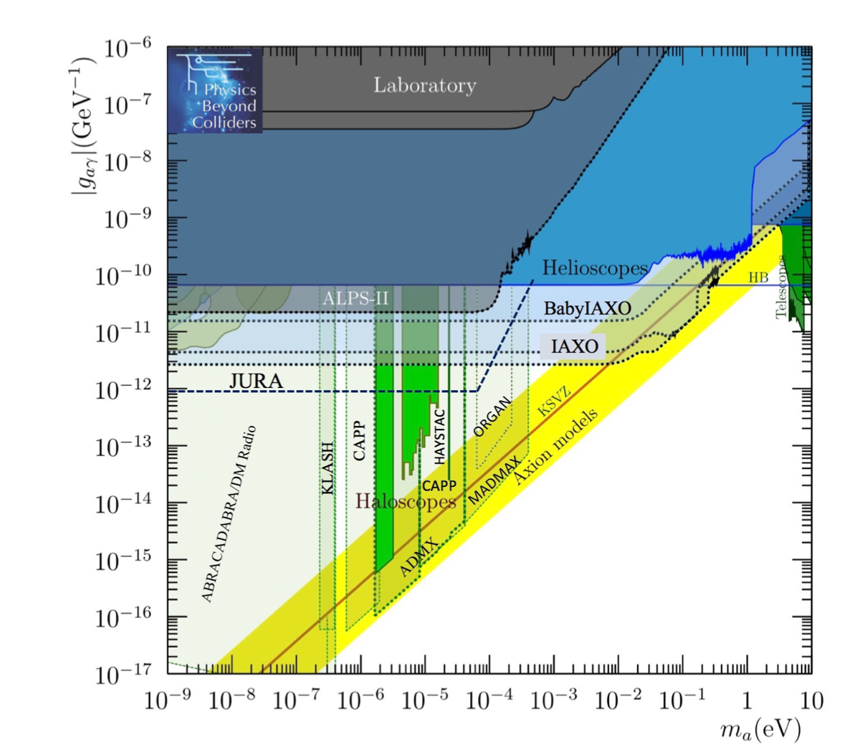
Dark Matter of a Very Low Mass
Dark Matter with Mass Below the Weak Scale
Such low-mass states have evaded detection by having small couplings to the SM.
One powerful motivation for searches is dark matter density, while satisfying cosmological constraints, such as the axion.
1901.09966
de Broglie wavelength = galaxy size
Wavelike
Shot-noise fluctuations in Lyman-alpha forest
Warm DM
WIMP paradigm
Challenge #3: Build out the suite of axion searches

Slide 11
Dark Matter of a Very Low Mass
Dark Matter with Mass Below the Weak Scale
Next, we discuss an intermediate range where observation via particle interactions with SM is still highly motivated though not detectable with traditional experiments
These are hidden sector/valley DM models, which arise generically in top-down constructions, and give rise to qualitatively different observational signatures
de Broglie wavelength = galaxy size
Wavelike
Shot-noise fluctuations in Lyman-alpha forest
Warm DM
WIMP paradigm
Review KZ 2401.03025

Slide 12
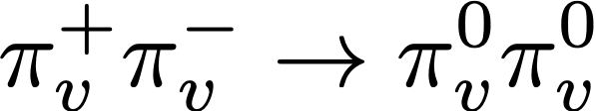
What’s in the hidden valley?
Slide 2007
Higgs sector
KK modes
MSSM particles
Tevatron
Z
SU(N) gauge group
+ quarks
Mass
LEP
Mass gap
The visible Universe
Many theories with this structure:
QCD-like theory with F flavors and N colors
QCD-like theory with only heavy quarks
QCD-like theory with adjoint quarks
Pure glue theory
UV-fixed point = confining
N=4 SUSY Conformal
RS throat
Seiberg duality cascade
KS throat
Remnant from SUSY breaking
Partially higgsed SU(N) theory
Banks-Zaks sector
Unparticles

Slide 13
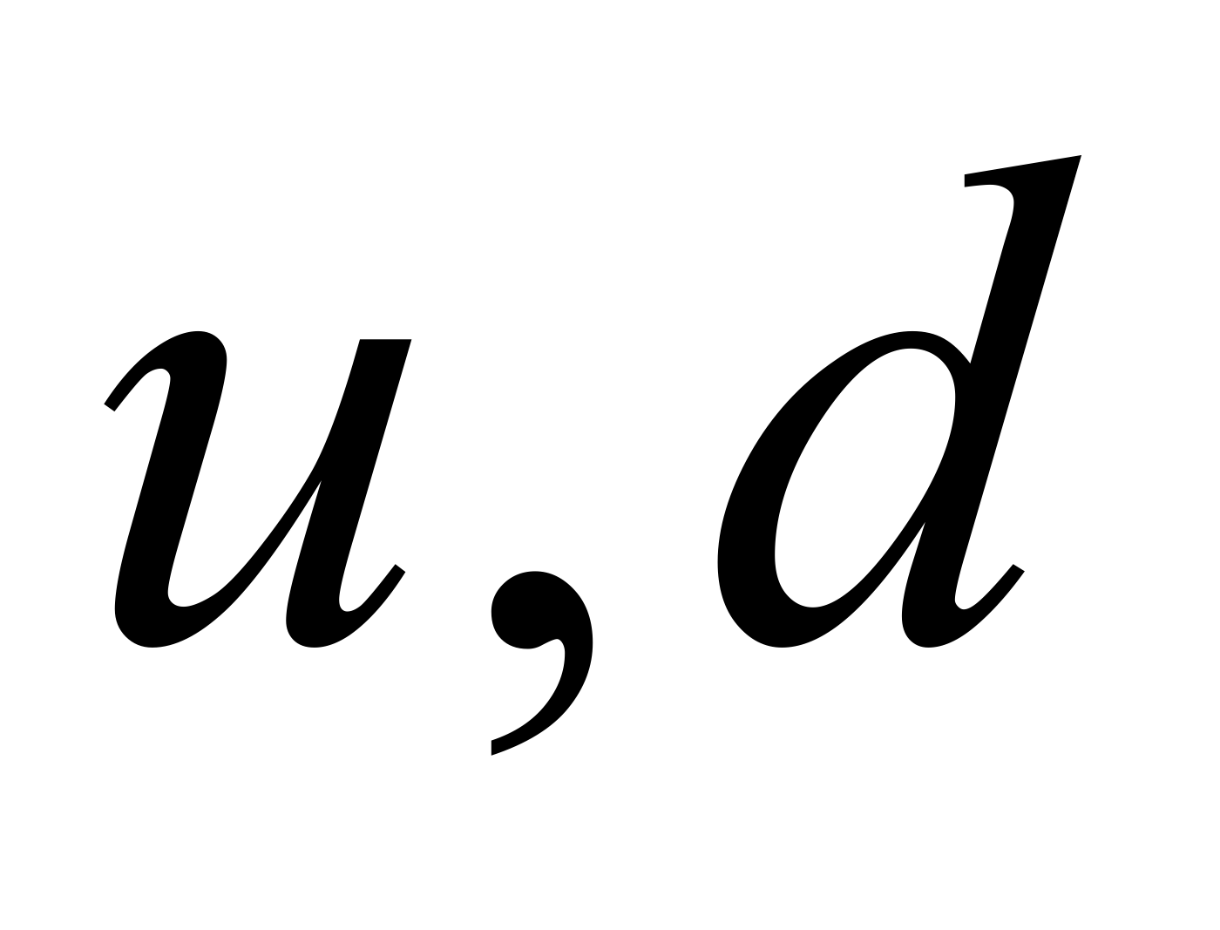
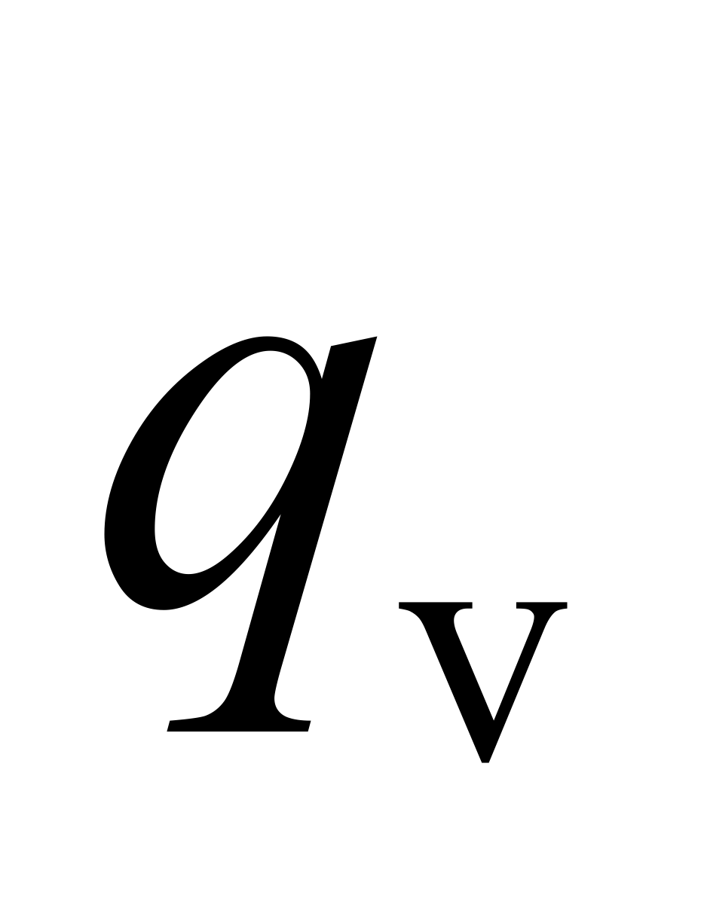
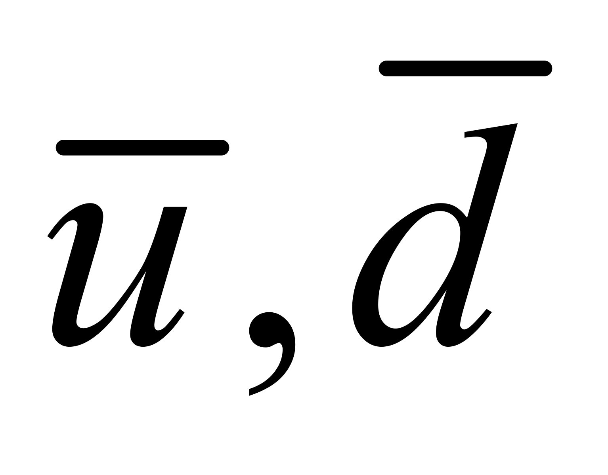
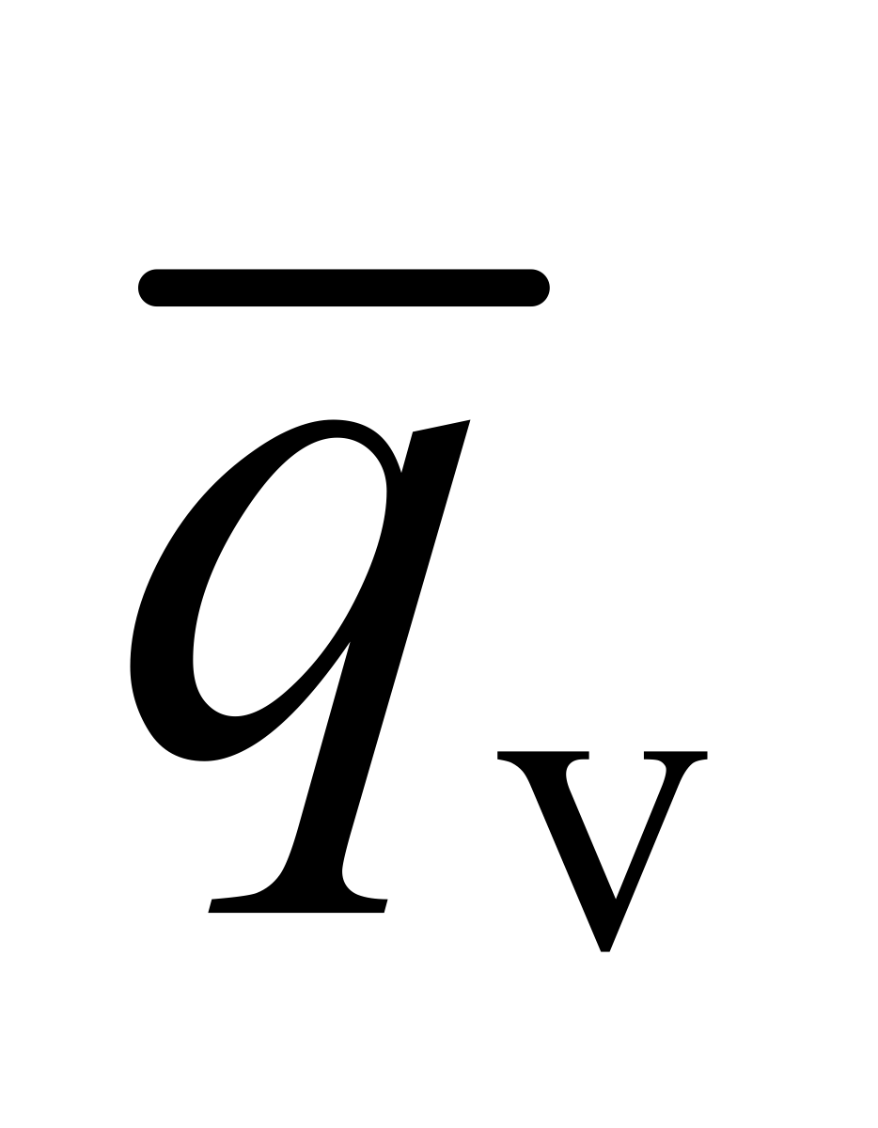

A concrete example
Slide 2007
Z’ mediator
SU(N) gauge theory with 1 light quark
Shower of v-hadrons
Z’
Each pair reconstructs to low mass v-hadron
Reconstruct entire event to Z’ resonance

Slide 14
Hidden Sector Dark Matter
Theories have broadened the scope of experimental searches.
Hidden sectors have their own forces and dynamics that are not parasitic on the SM forces.
New experiments look at new mass scales with new forces at weaker couplings
pure glue, light flavors, heavy flavors, quirky asymmetric dark matter, Strongly Interacting Massive Particle (SIMP), Wess-Zumino-Witten SIMP
Darkogenesis, Xogenesis, Hylogenesis, Cladogenesis, ADM from Leptogenesis, Dark Affleck-Dine
Dark photons, Freeze-in, WIMPless miracle
Mirror Matter, Atomic Matter, Self-Interacting Dark Matter, Magentic, Dark Anapole and EDMs
Challenge #4: Build out the suite of accelerator searches—high energy and intensity—for hidden sectors

Slide 15
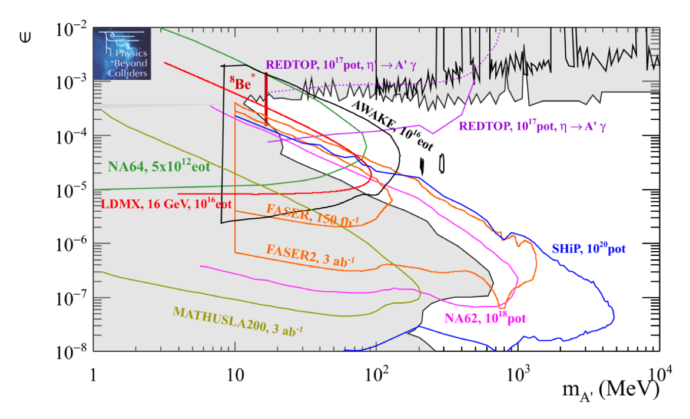
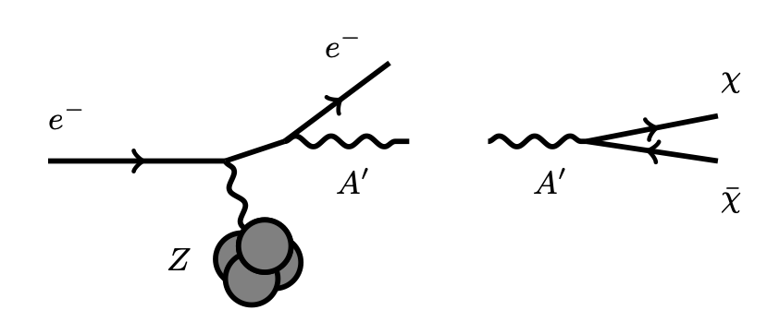
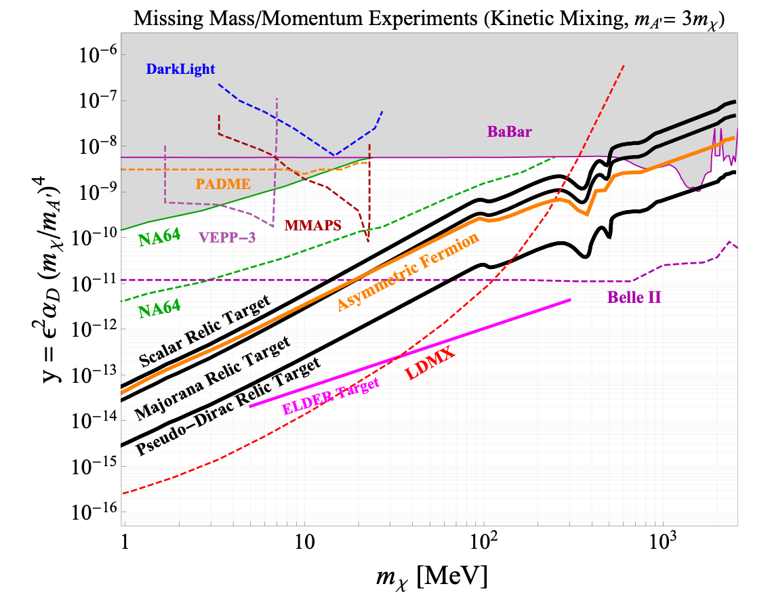
Hidden Sector Dark Matter
Theories have broadened the scope of experimental searches.
1901.09966
Challenge #4: Build out the suite of accelerator searches—high energy and intensity—for hidden sectors
Izaguirre, Krnjaic, Schuster, Toro

Slide 16
Hidden Sector DM in Experiments
Focusing the Lamplight
HSDM has dramatically broadened the scope of DM theory.
In 2008, they said the direct detection of light DM was not possible. We have come a long way.
Since HSDM does not solve a SM problem, unlike WIMP and axion, its couplings to SM are less determined. Can we hope to have an experimentally predictive theory?

Slide 17
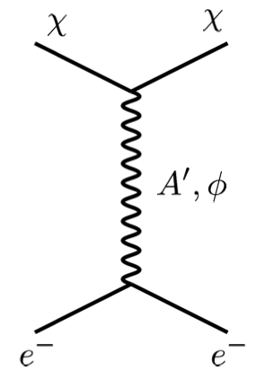
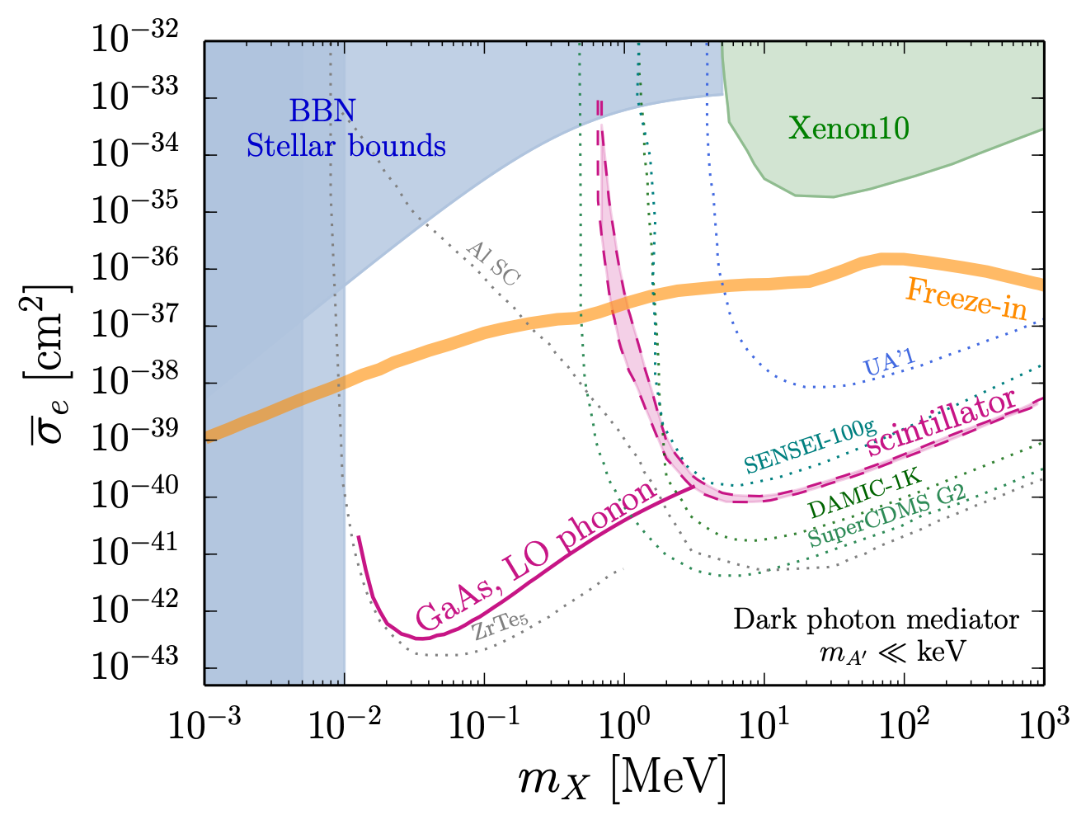
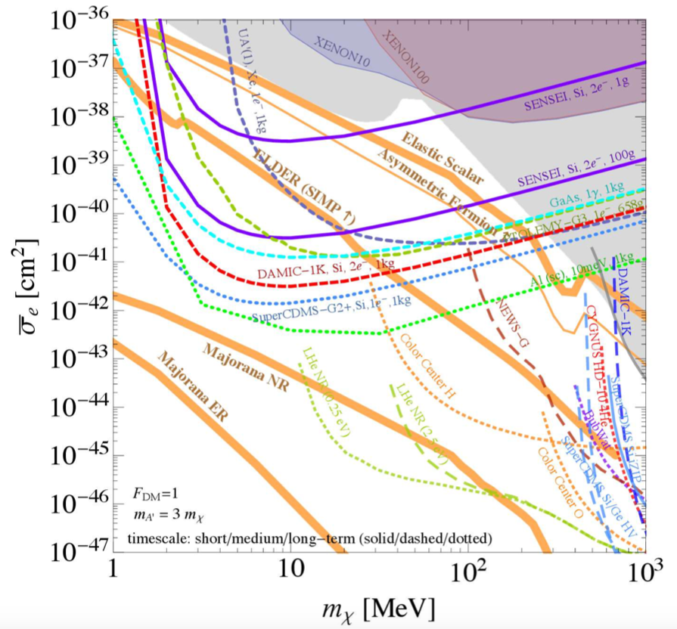
Hidden Sector DM in Experiments
Models Best-Motivated by Relic Abundance Can be Reach with 1 kg-yr exposure
Yes, if we utilize DM abundance as a guide.
Thermal Freeze-out
Asymmetric Dark Matter
SIMP
Freeze-in
US Cosmic Visions 1707.04591
Knapen, Lin, Pyle KZ 1712.06598
US Cosmic Visions 1707.04591
Challenge #5: Cover the abundance-driven light DM models in direct detection

Slide 18
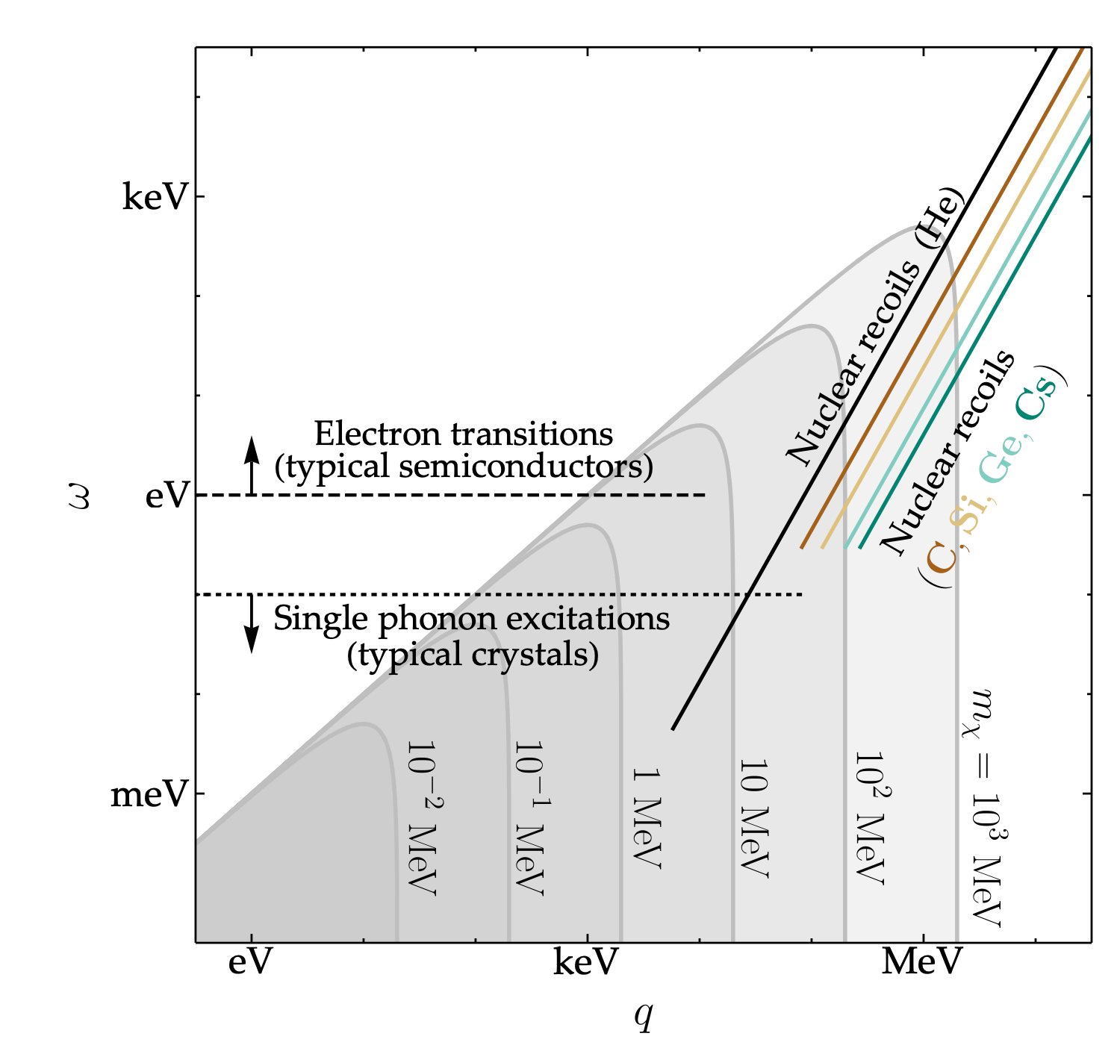
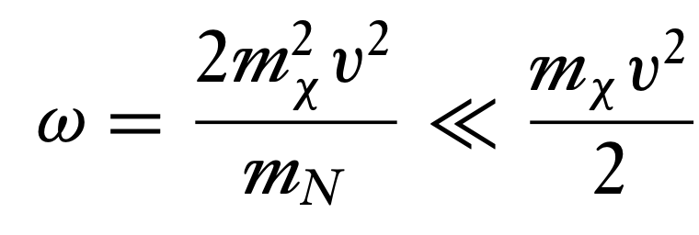
The Landscape of sub-GeV Dark Matter Direct Detection
Beyond Nuclear Recoil in Direct Detection
Nuclear Recoil utilized in WIMP searches is poorly matched to light DM detection.
At low momentum transfer and energy deposition, free nuclei are not correct d.o.f.
Trickle, Zhang, KZ, 1910.08092

Slide 19

The Landscape of sub-GeV Dark Matter Direct Detection
An understanding of condensed matter systems, and its collective behavior, is crucial
1 meV
1 eV
1 keV
1 MeV
1 GeV
100 GeV
mass
Super-conductors
Electron excitation
Semiconductor
SuperCDMS
Nuclear recoil
XENON1T
LZ
Absorption
Dirac Materials
Superfluid helium
Polar Crystals
QCD axion, “ultralight frontier”
Collective Excitations — Phonons/ Magnons
~meV energy resolution
~eV energy resolution
~keV energy resolution
Models Best-Motivated by Relic Abundance Can be Reached with 1 kg-yr exposure

Slide 20
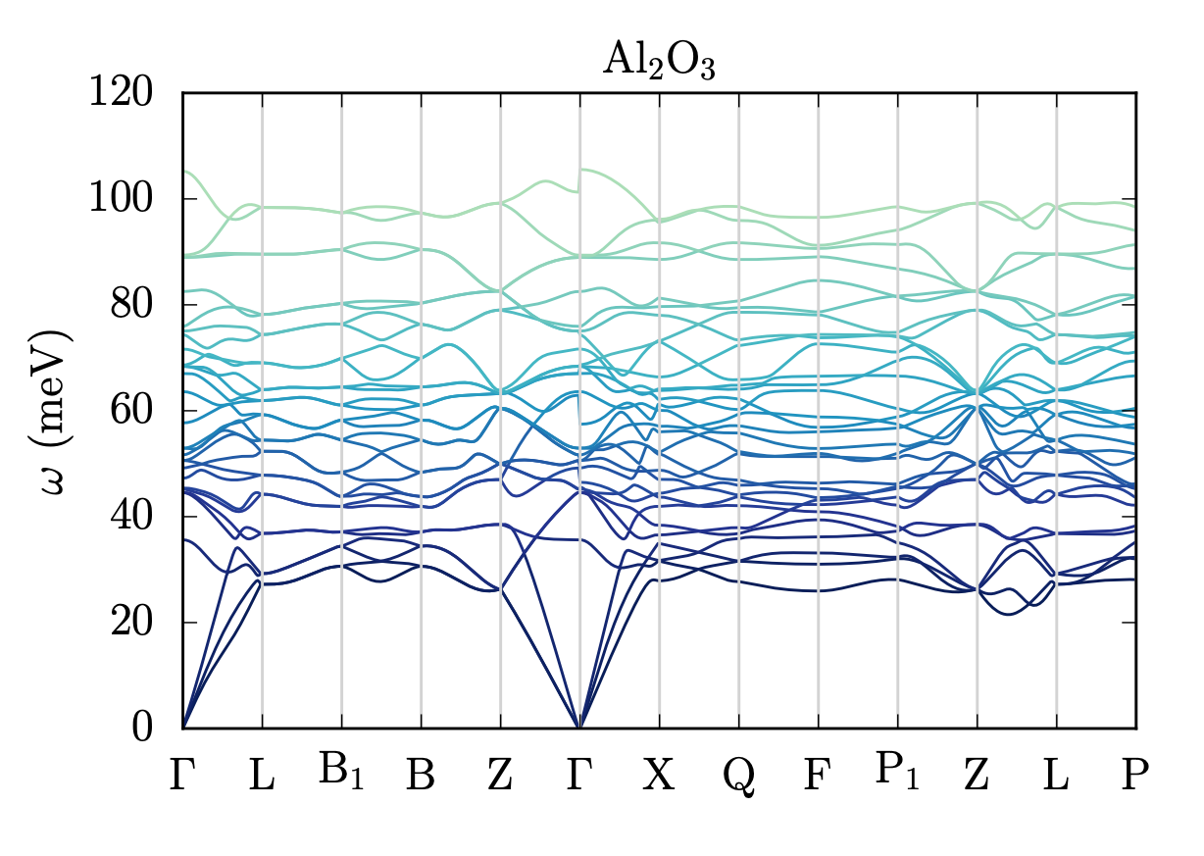
New Ideas for Dark Matter Detection
Collective Excitations
At low momentum transfer and energy deposition, the relevant degrees-of-freedom are not free nuclei but collective modes
DM
Phonons
Hochberg, Lin, KZ 1604.06800, Schutz, KZ PRL 1604.08206, Knapen, Lin, Pyle, KZ 1712.06598

Slide 21
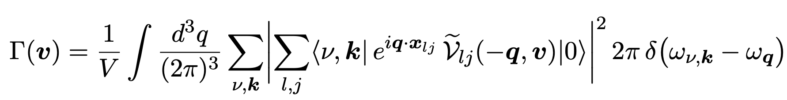

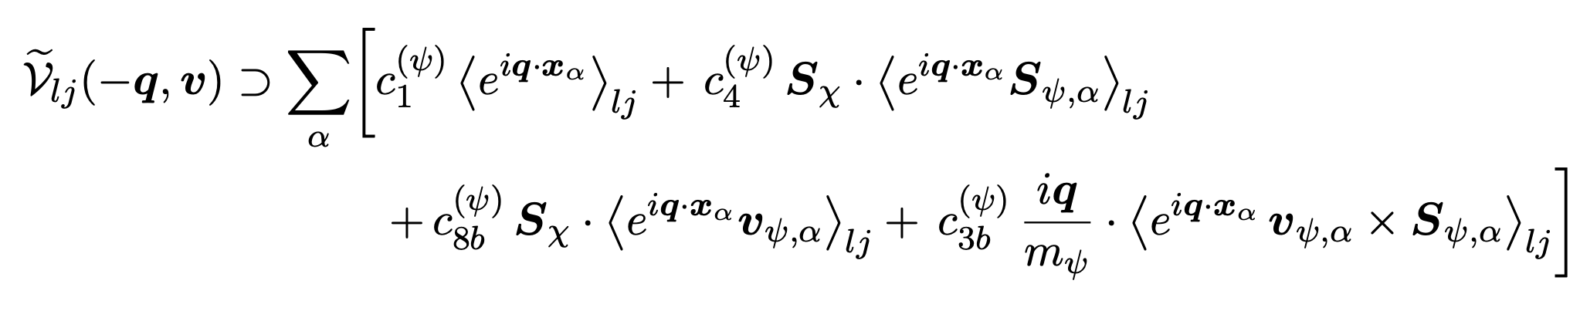
EFT of Dark Matter Interactions
Collective Excitations
DM interaction probability is determined by the interaction of the DM with the lattice effective degrees-of-freedom
p’
𝜒
DM
Dark Matter rate calculators are available, PhonoDark, PhonoDark-abs, for EFT of DM interactions, and a variety of materials
p
| i 〉 → | f 〉
crystal lattice
Knapen, Lin, KZ, 1712.06598
Trickle, Zhang, KZ, 2009.13534

Slide 22
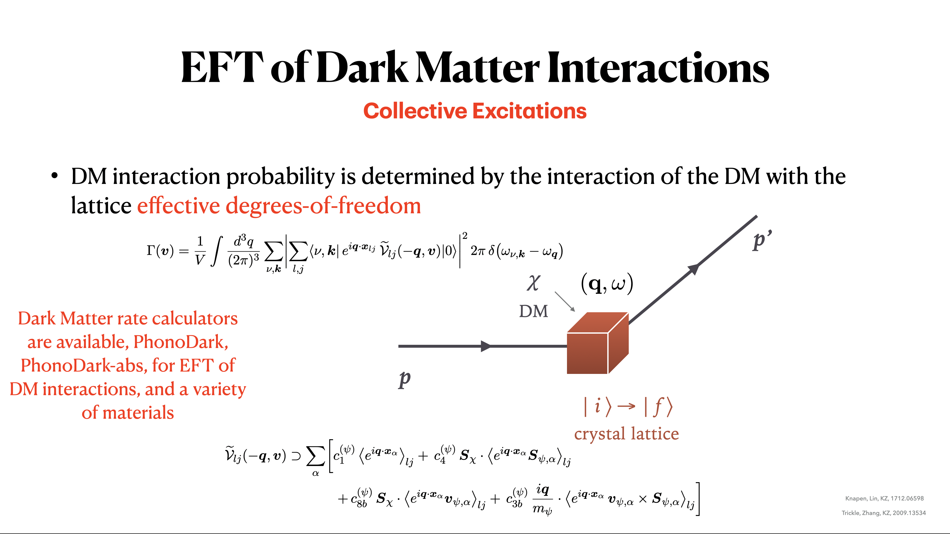

Slide 23
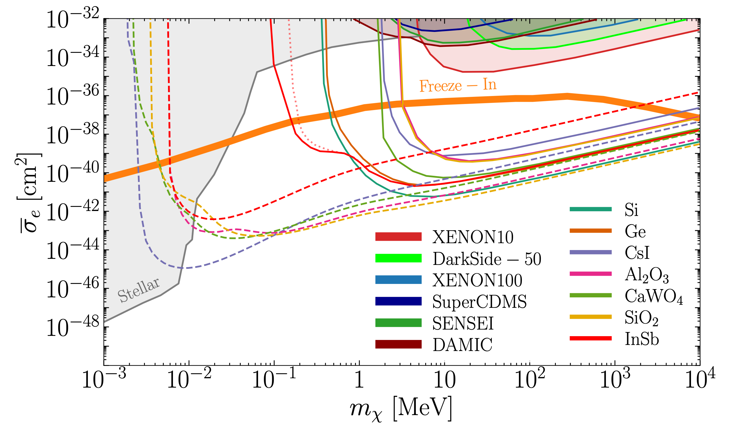
Low-Mass DM Sensitivity
Models Best-Motivated by Relic Abundance Can be Reached with 1 kg-yr exposure
Trickle, Zhang, KZ et al 1910.10716

Slide 24
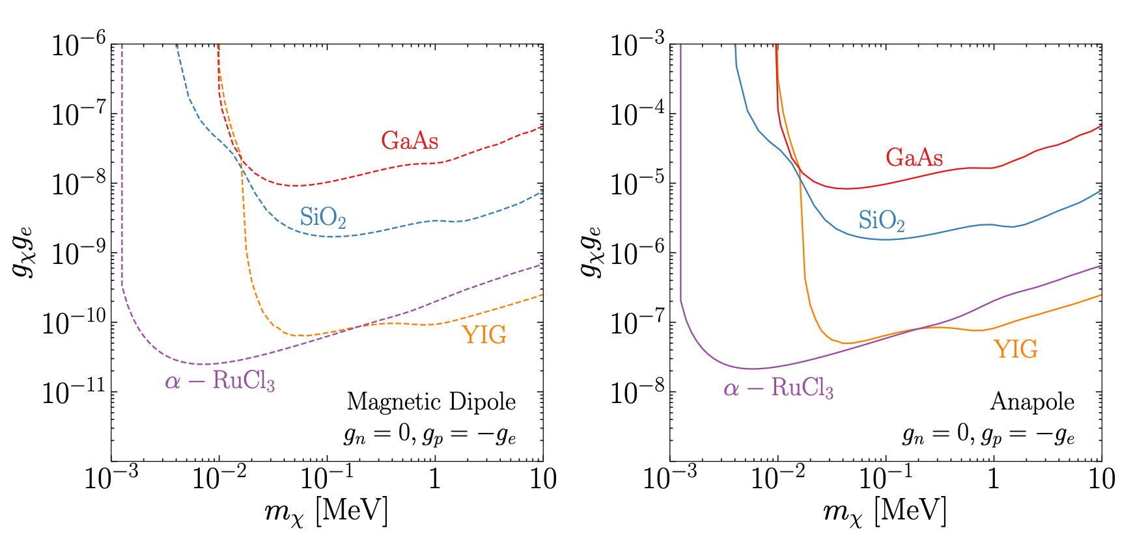
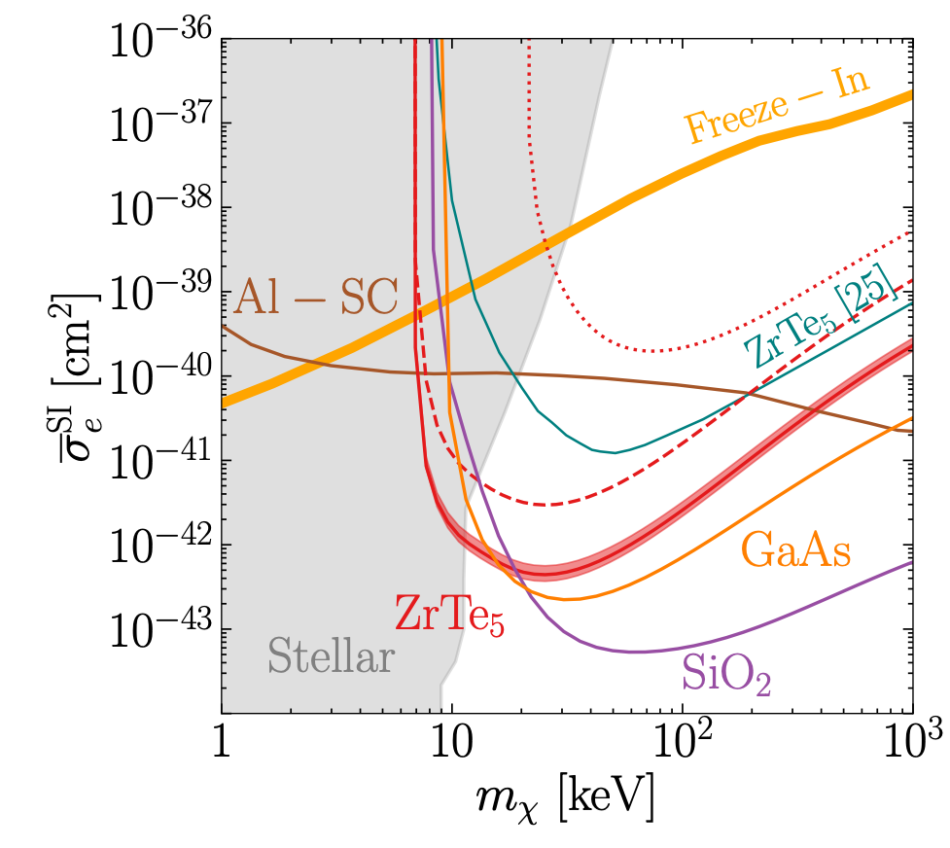
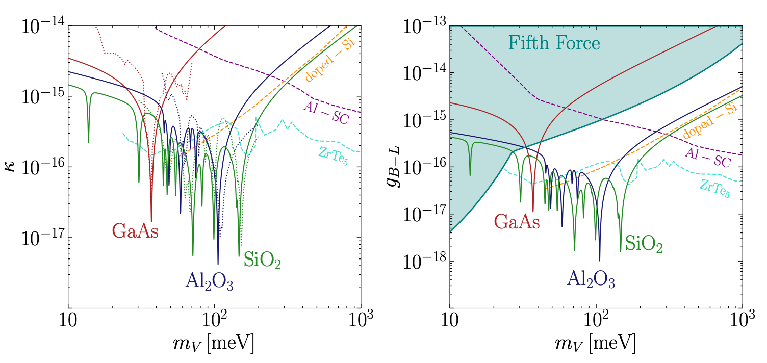
Low-Mass DM Sensitivity
Broad Range of Models are Reachable with Standard Materials
Trickle, Zhang, KZ, 2009.13534
Mitridate, Trickle, Zhang, KZ, 2202.11716
Mitridate, Trickle, KZ, 2308.06314

Slide 25
Dark Matter of a Very High Mass
Learning about Microscopic Properties of DM Through Gravitational Force
It is challenging to set the relic abundance of DM through SM interactions when it is heavier than ~10 TeV, because cross-sections are not sufficiently large.
de Broglie wavelength = galaxy size
Warm DM
WIMP paradigm
Shot-noise fluctuations in Lyman-alpha forest

Slide 26
Gravitational Detection of DM
Microscopic Nature of DM Can Leave Imprints on Sub-Halos
It might be possible to detect sub halos as light as
Many theories (e.g. PBH, axions, WDM, SIDM, early MD) predict different behavior than LambdaCDM at different sub-halo mass scales, requiring a wide range of new measurements of small scale power.
???
Challenge #6: Observe the Dark Matter Power on Small Scales

Slide 27
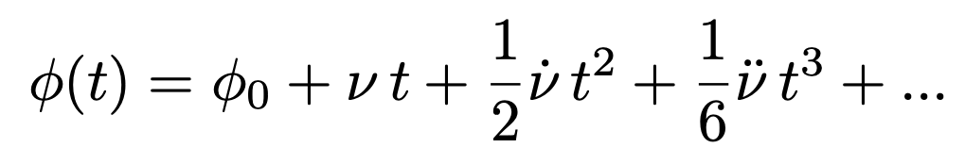
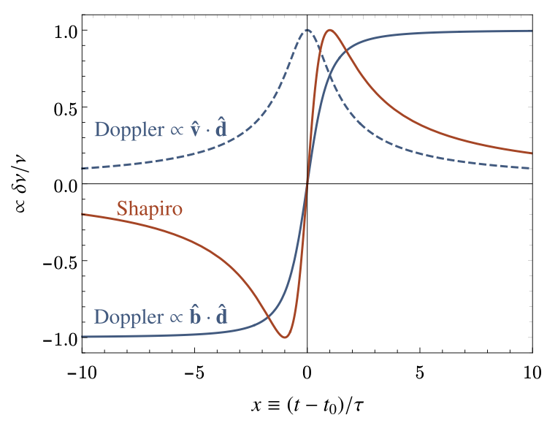
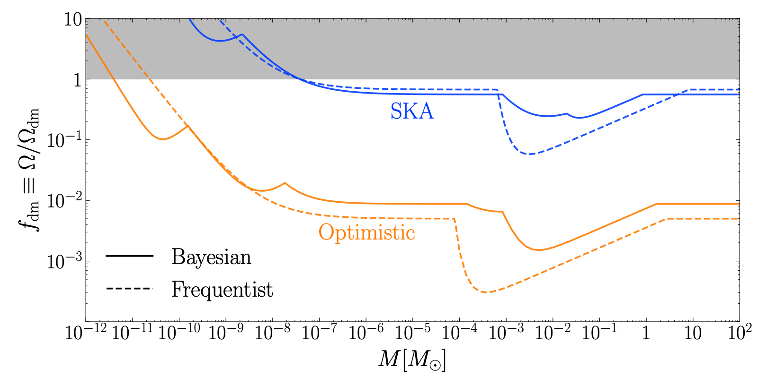
Dark Matter Substructure
Observing DM substructure is a long-term, challenging but extremely important problem.
All involve utilizing changes in the metric due to transiting DM substructure.
e.g. Changes in pulse time-of-arrival due to metric fluctuations.
Earth
Pulsar
Lee, Taylor, Trickle, KZ 2104.05717

Slide 28
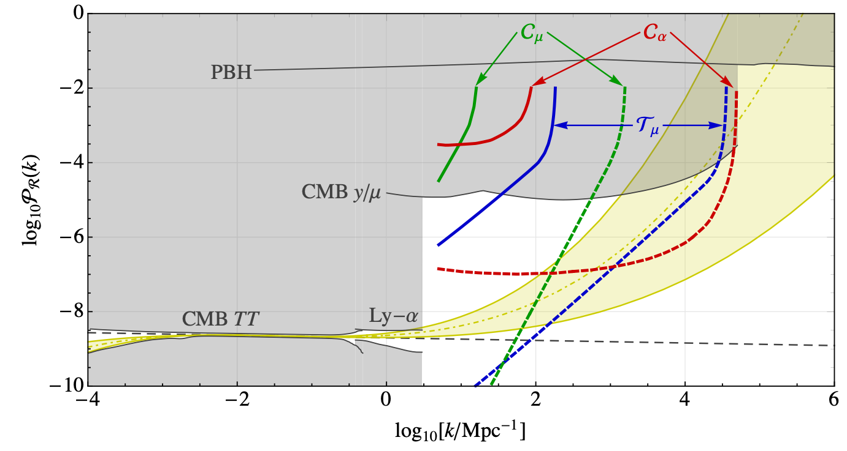
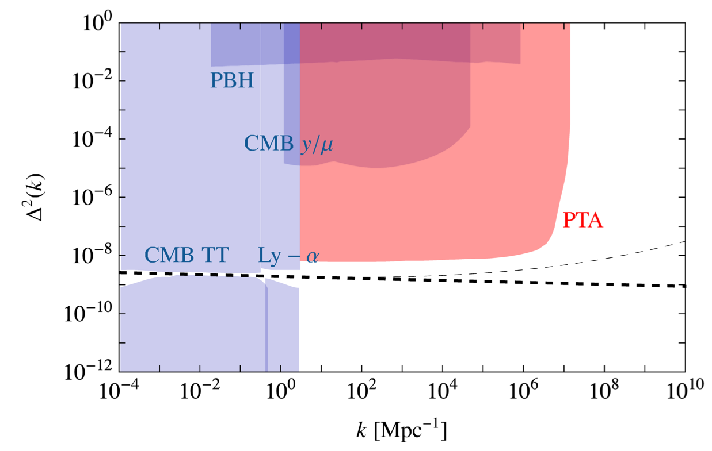
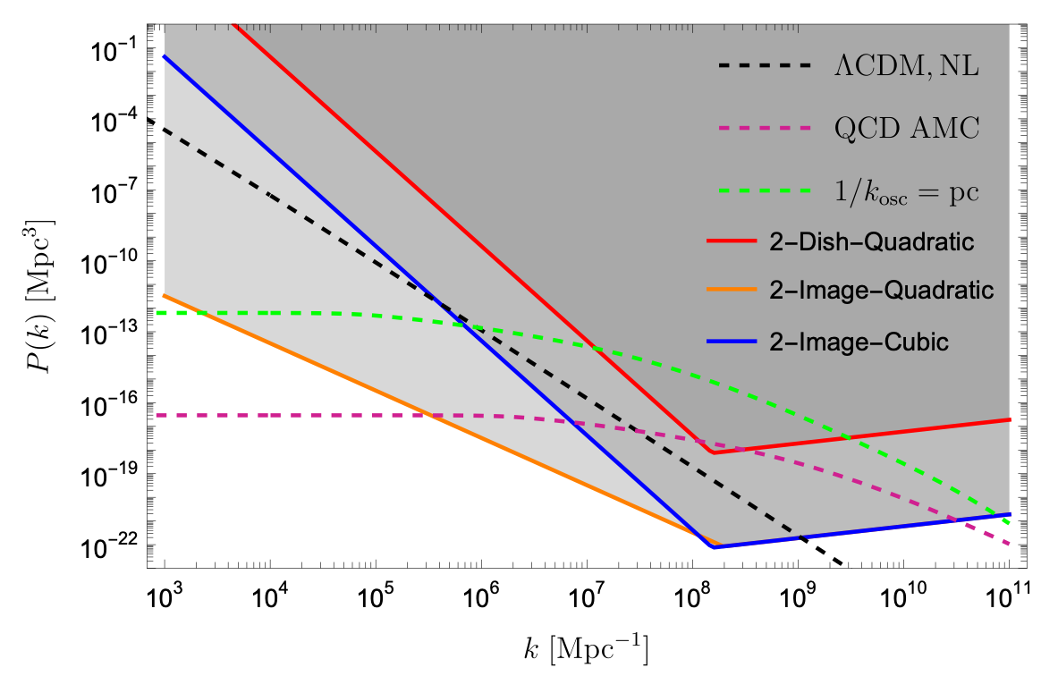
Dark Matter Substructure
Observing DM substructure is a long-term, challenging but extremely important problem.
All involve utilizing changes in the metric due to transiting DM substructure.
Existing ideas involve astrometric lensing, PTAs, FRBs and make optimistic assumptions. How can we bring this closer to an achievable goal?
Tilburg, Taki, Weiner 1804.01991
Lee, Mitridate, Trickle, KZ 2012.09857
Xiao, Dai, McQuinn 2401.08862

Slide 29
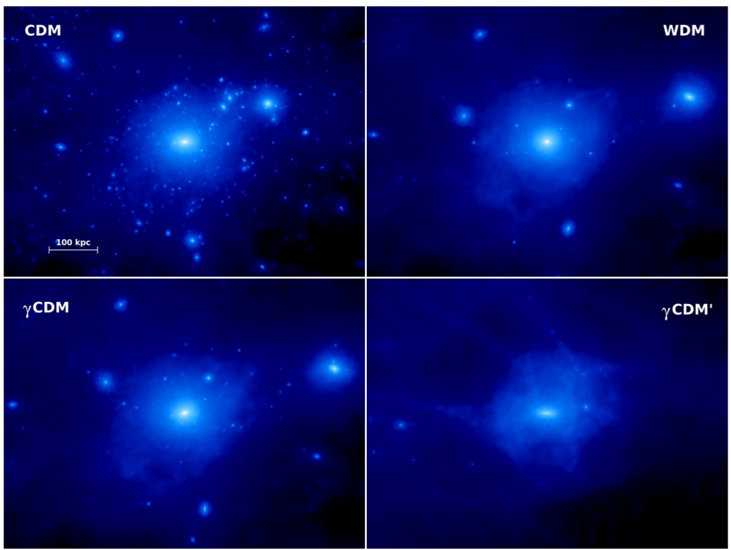
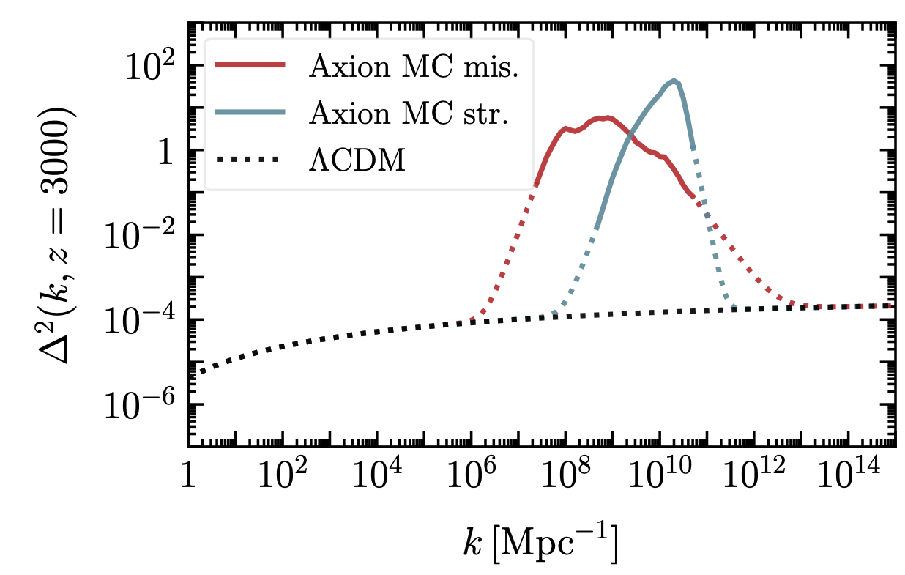
Dark Matter Substructure
Tests Microscopic Nature of Dark Matter
LambdaCDM model predicts scale invariant power spectrum, and only gravitational dynamics in dark matter sub-halos.
A measurement of the power spectrum on small scales is a gravitational imprint of the microphysical nature of dark matter
Lee, Mitridate, Trickle, KZ 2012.09857
Boehm et al 1404.7012
Challenge #7: Robustly Constrain Non-gravitational DM Self-interactions

Slide 30
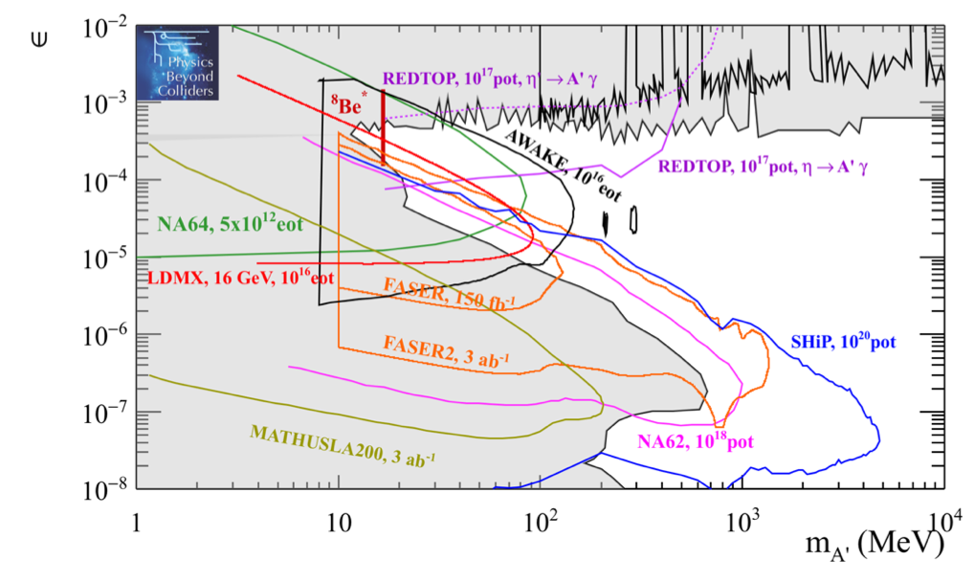
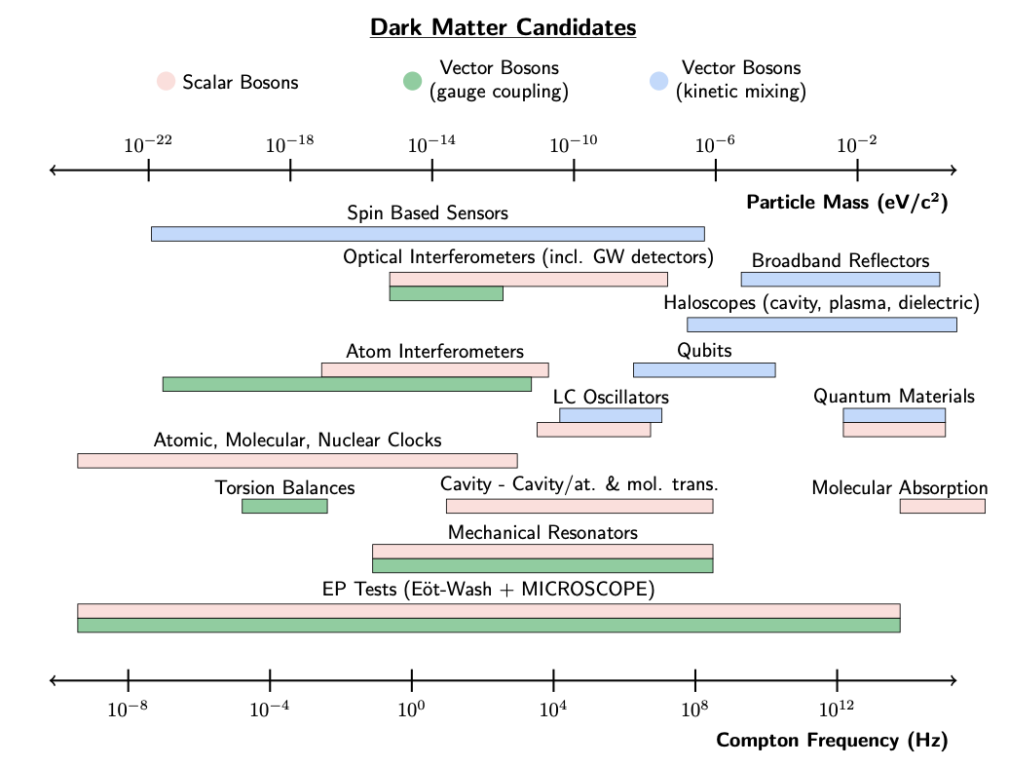
Discussion
The Dark Matter Road Ahead
A broad theoretical net has been cast.
Many theory frameworks and ideas have been proposed to tile the astrophysically and cosmologically viable model space.
The theoretical ideas for experiments to search for these theories are available, such as collective excitations.
There is a well-defined and exciting experimental search program underway.
This will remain an experimentally-driven field, with crucial theoretical support.

Slide 31
Discussion
The Dark Matter Road Ahead
Important astrophysical observations remain.
  What is the nature of the GCE?
  Can we separate baryonic effects from DM to make definitive statements about non-gravitational DM interactions?
  Can we observe DM substructure below Dwarf scales?
  Can we map the cosmic history of the Universe?
This will remain an experimentally-driven field, with crucial theoretical support.
Challenge #8

Slide 32
New Ideas for Direct Detection
Beyond Nuclear Recoil in Direct Detection
1 meV
1 eV
1 keV
1 MeV
1 GeV
100 GeV
mass
Absorption
Super-conductors
Semiconductors
SuperCDMS
Traditional WIMP
XENON1T
LZ
Magnons
Dirac Materials
Polar Crystals
DAMIC, SENSEI
Superfluid Helium
Graphene
QCD axion, “ultralight frontier”
~meV energy resolution
~eV energy resolution
~keV energy resolution
Collective excitation
Electron excitation
Nuclear recoil

