Slide 1
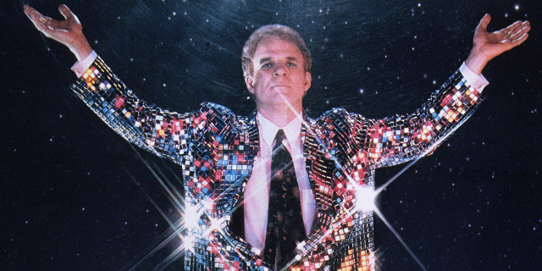
Making the most of your 10 minutes of fame
Dave.Barney@cern.ch
Notes:
5 mins introduction
10 mins 1st exercise
15 mins presentations
= 30 mins
10 mins theory
5 mins exercise 2
5 mins discussing results
= 25 mins
25 mins theory
5 mins Fabiola
= 30 mins
Including a break
25 mins to modify existing presentations
25 mins to show them
Total 110 mins (have 105 mins!)

Slide 2
Making engaging presentations
≠ soft skill!

Slide 3
the presentation is for the audience make sure you know your audience and try to get in their heads to understand what they want!
i.e. students, teachers, general public, media, influencers: all want/need different things

Slide 4
What is the purpose of a presentation?

Slide 5
What is the purpose of a presentation?
For the audience to understand
one or more messages
And possibly act upon those messages

Slide 6
message ≠ information

Slide 7
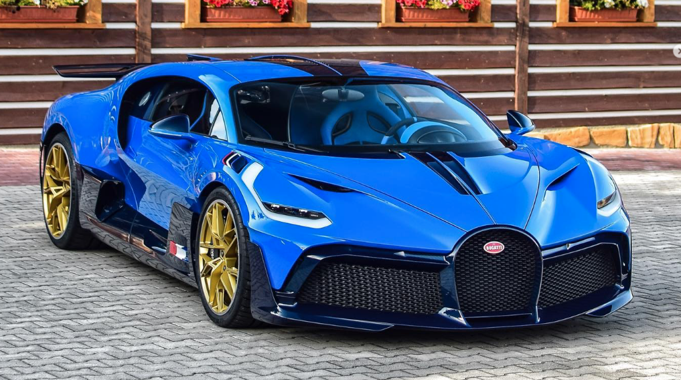
Supercars of Prague (1/3)
This is “information”

Slide 8
Bugatti Divo in Prague
This is also “information”

Slide 9
The only Bugatti Divo in Prague is the official ICHEP taxi!
This is a “message” that you can act upon!

Slide 10
What is a message?
It is not the “what”
It is the “so what?”
Including the “so what?” explicitly on your slides is a basic redundancy
Even if the “so what?” is the only text on your slide, an offline reader will be able to understand the important points of the presentation – e.g. in the “title” part of your slides!

Slide 11
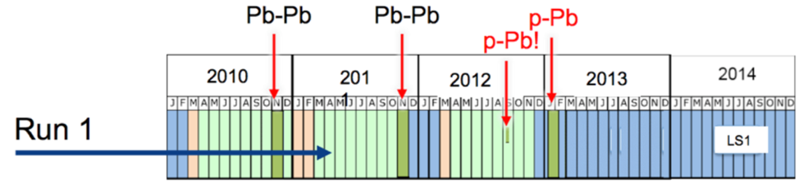
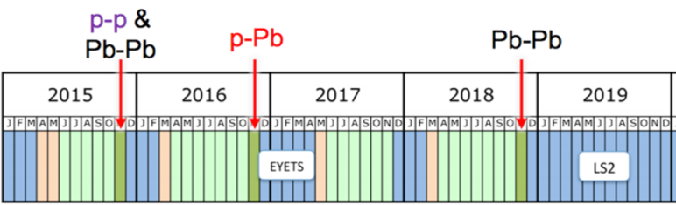
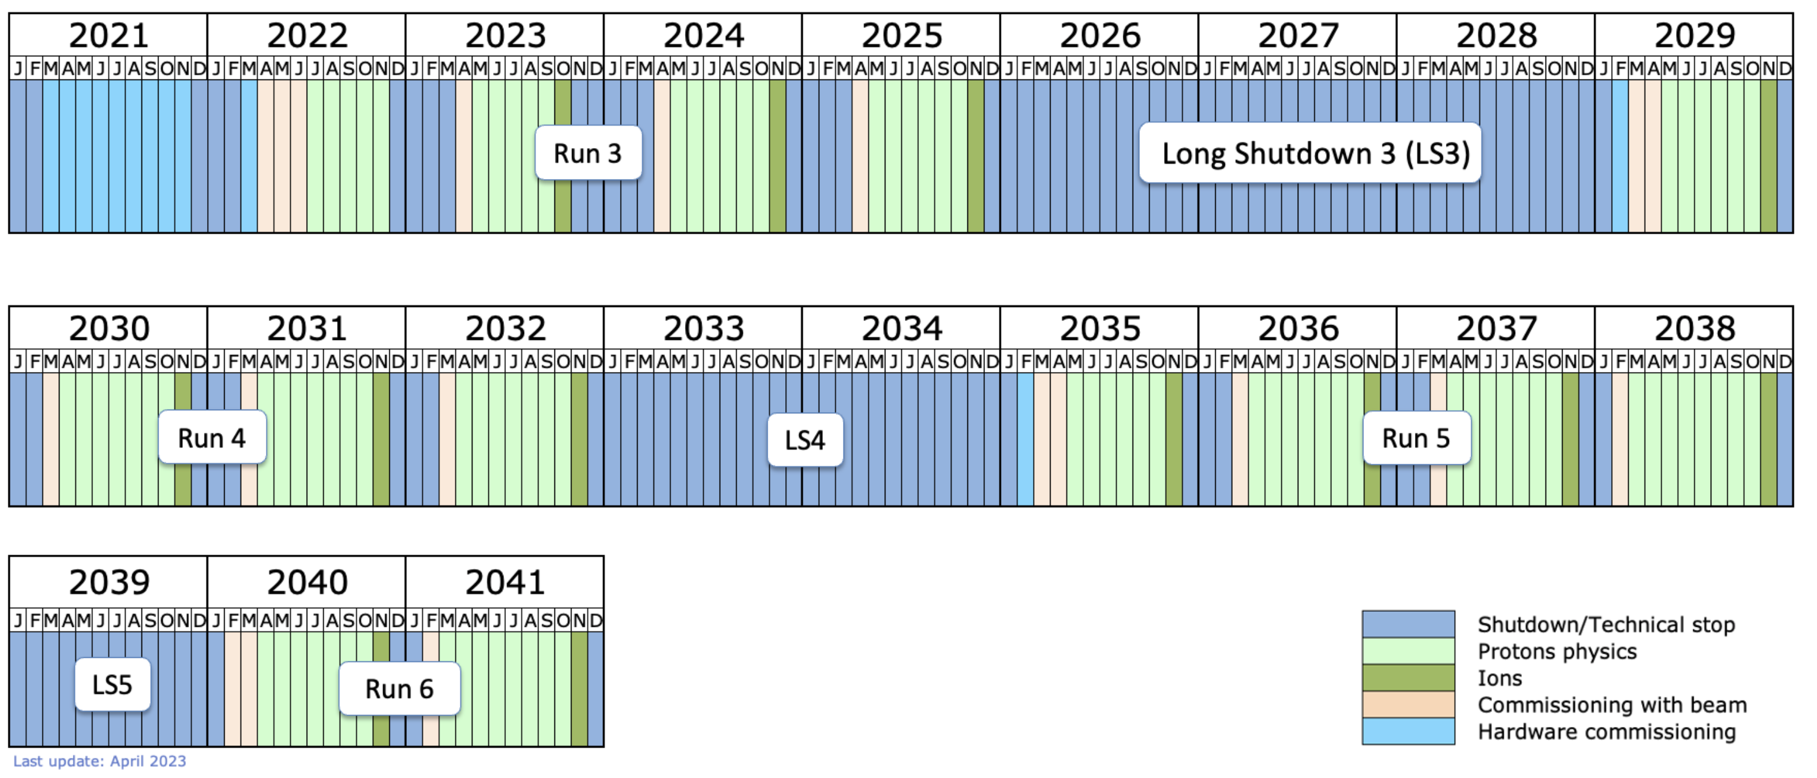
Long-term LHC schedule
Run 2
*
High-Luminosity LHC (HL-LHC)
X10 more collisions than LHC

Slide 12
CMS has taken ~4% of the planned amount of data!
Run 2
*
High-Luminosity LHC (HL-LHC)
X10 more collisions than LHC

Slide 13
When preparing a presentation, think of one or two main messages that you want to pass – depending on the target audience of course. For example:
HEP is worth funding, now and in the future
The LHC experiments are doing precision physics
You too can take part in HEP, whether you are a physicist, an engineer, a technician, work in administration etc.
Understanding more about our place in the Universe is fundamental to the survival of the human race
And make sure all of your presentation focuses on these main messages

Slide 14
Anecdotes can be even more memorable than messages, especially if the story includes something that went wrong, and how it was solved

Slide 15
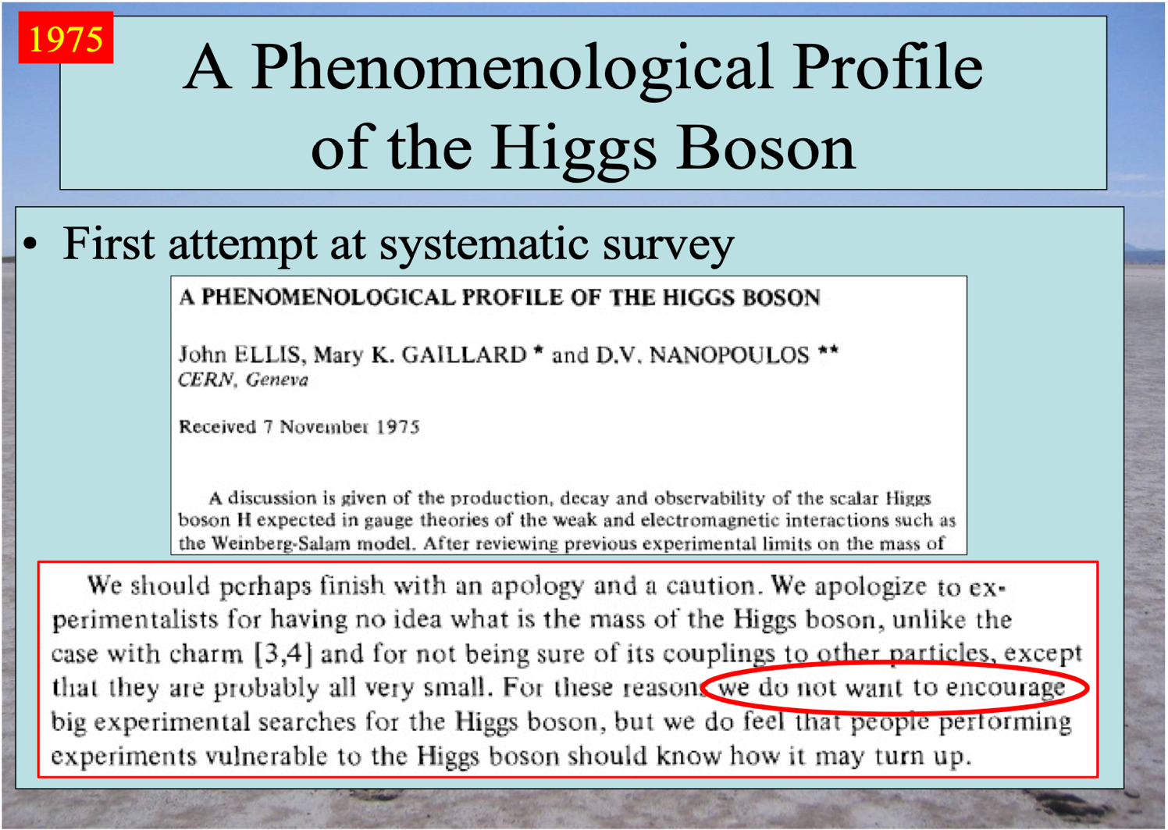
https://indico.cern.ch/event/1139771/ 8th June 2022

Slide 16
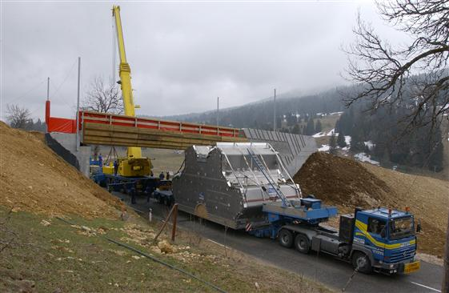
The ATLAS endcap toroids faced some unexpected difficulties when being transported to CERN
A bridge at a ski resort appeared unexpectedly
https://cds.cern.ch/record/1344500/files/image_0010.jpg?subformat=icon-1440

Slide 17
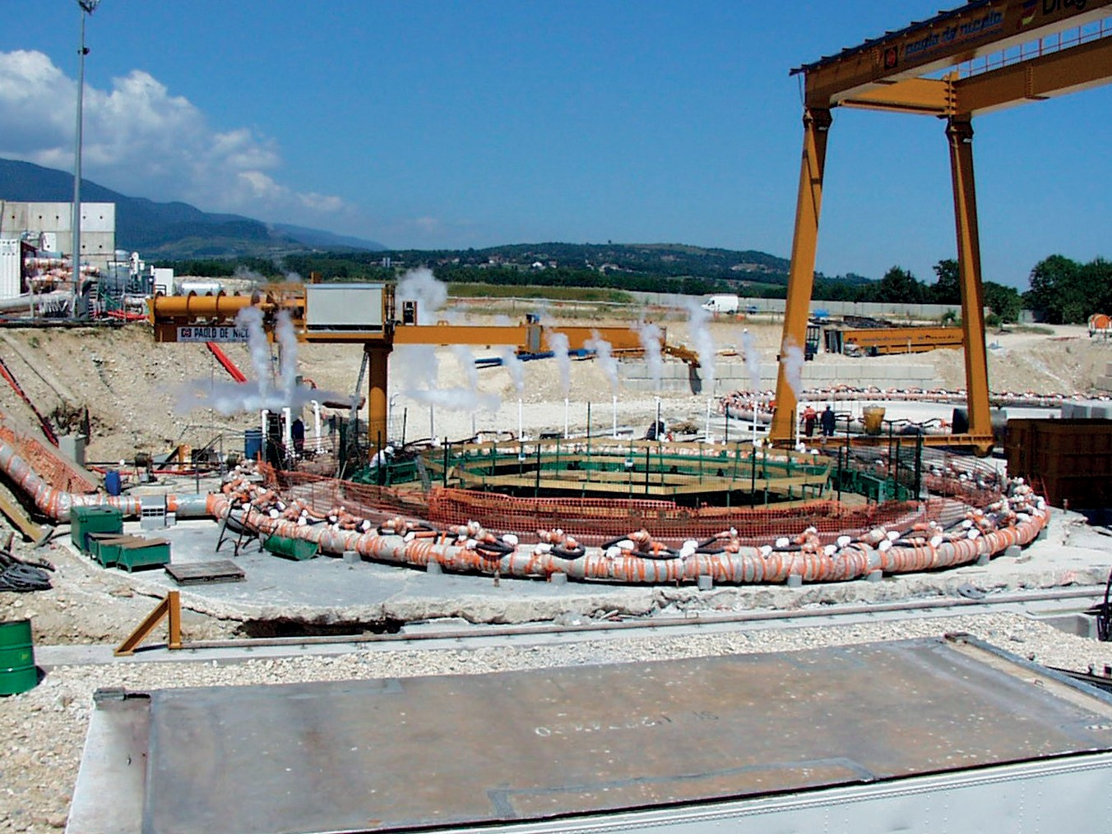
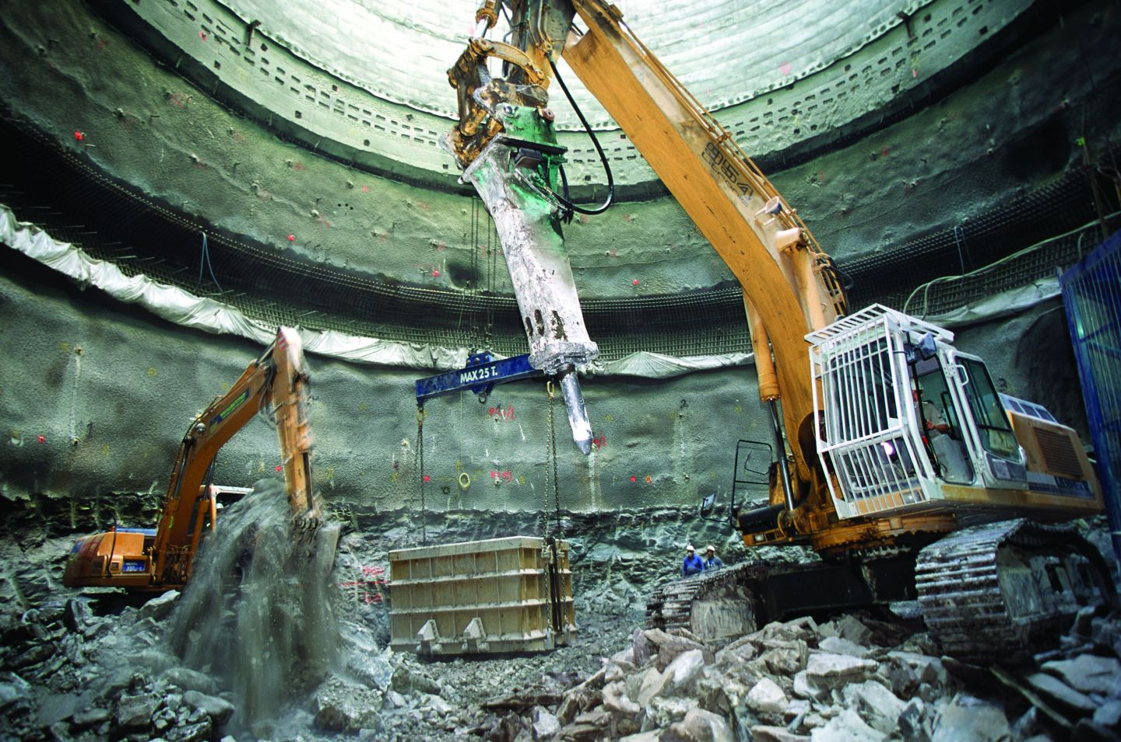
When excavating the CMS shaft in Cessy, we hit the water table. We froze the ground with liquid N₂ so we could dig through it!
https://cmsexperiment.web.cern.ch/detector/massive-underground-excavation

Slide 18
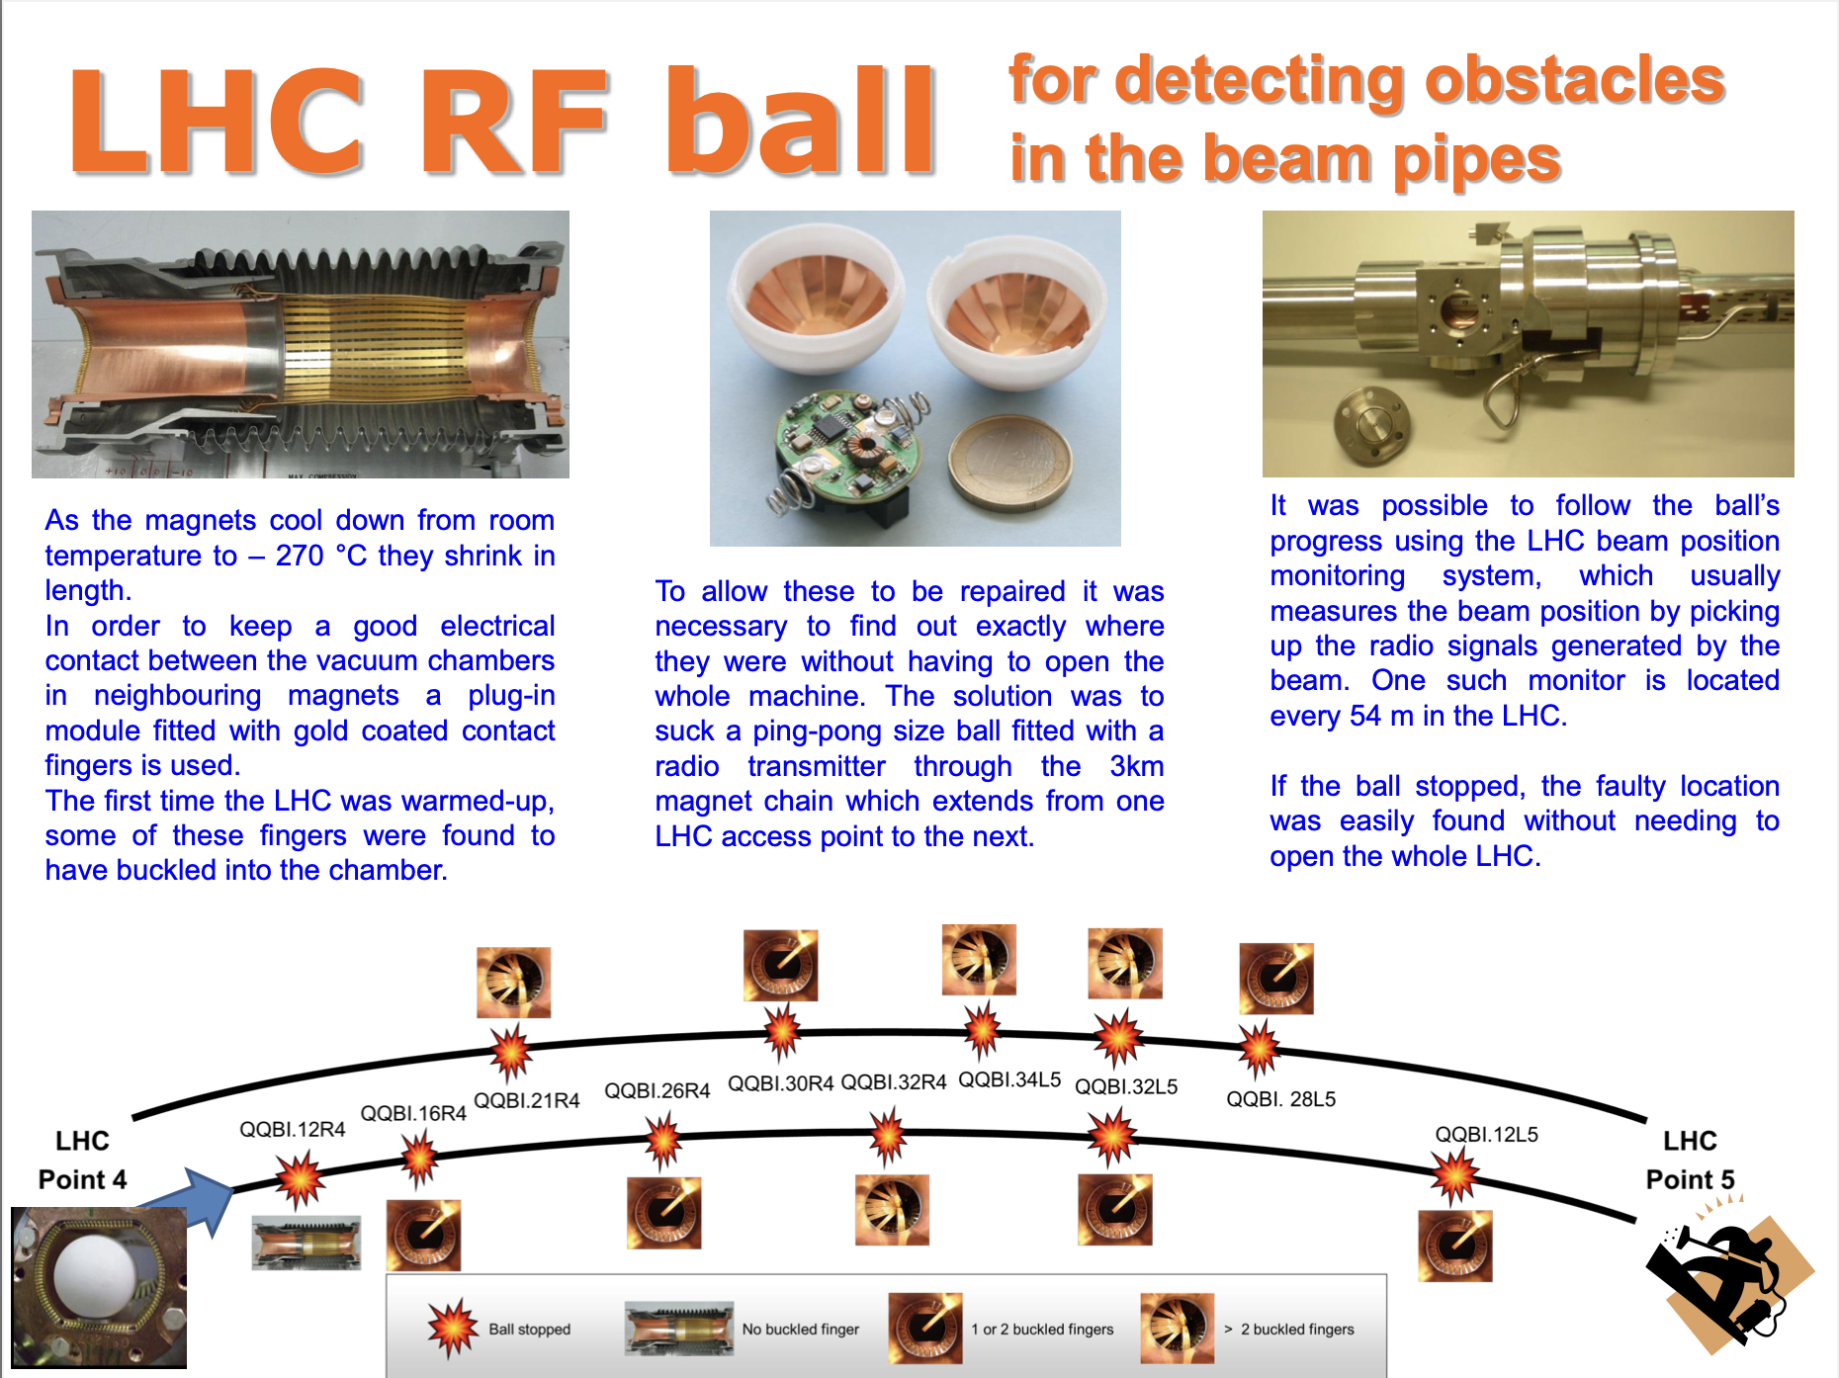
https://indico.cern.ch/event/802599/contributions/3336829/attachments/1805119/2945614/RF_ball_open_days_1_ORJ.pdf

Slide 19
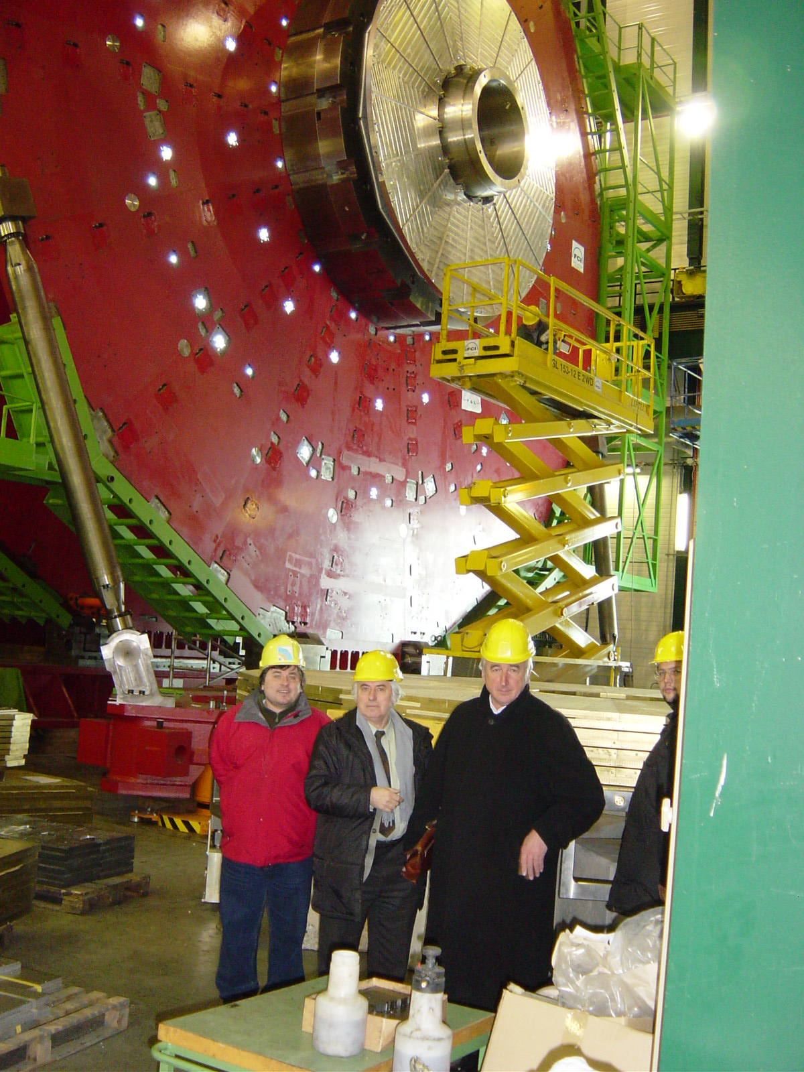
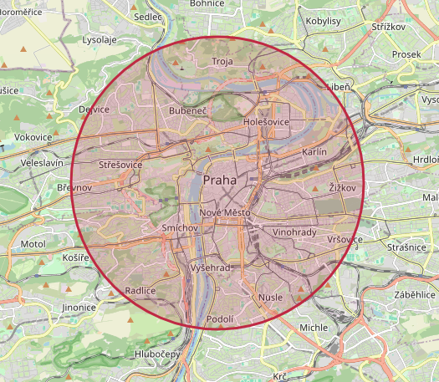
Add some “local interest” to your talk
Size of the LHC,
if it were around Prague
Czechia in CMS:
Charles University, Prague
2 physicists
2 software engineers
2 students
Mainly working on
Hadron Calorimeter
https://natronics.github.io/science-hack-day-2014/lhc-map/

Slide 20
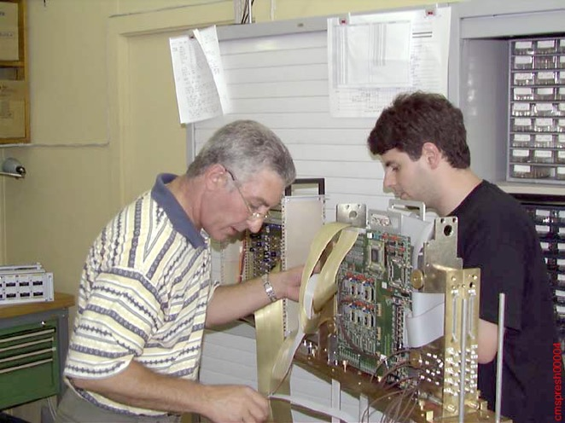
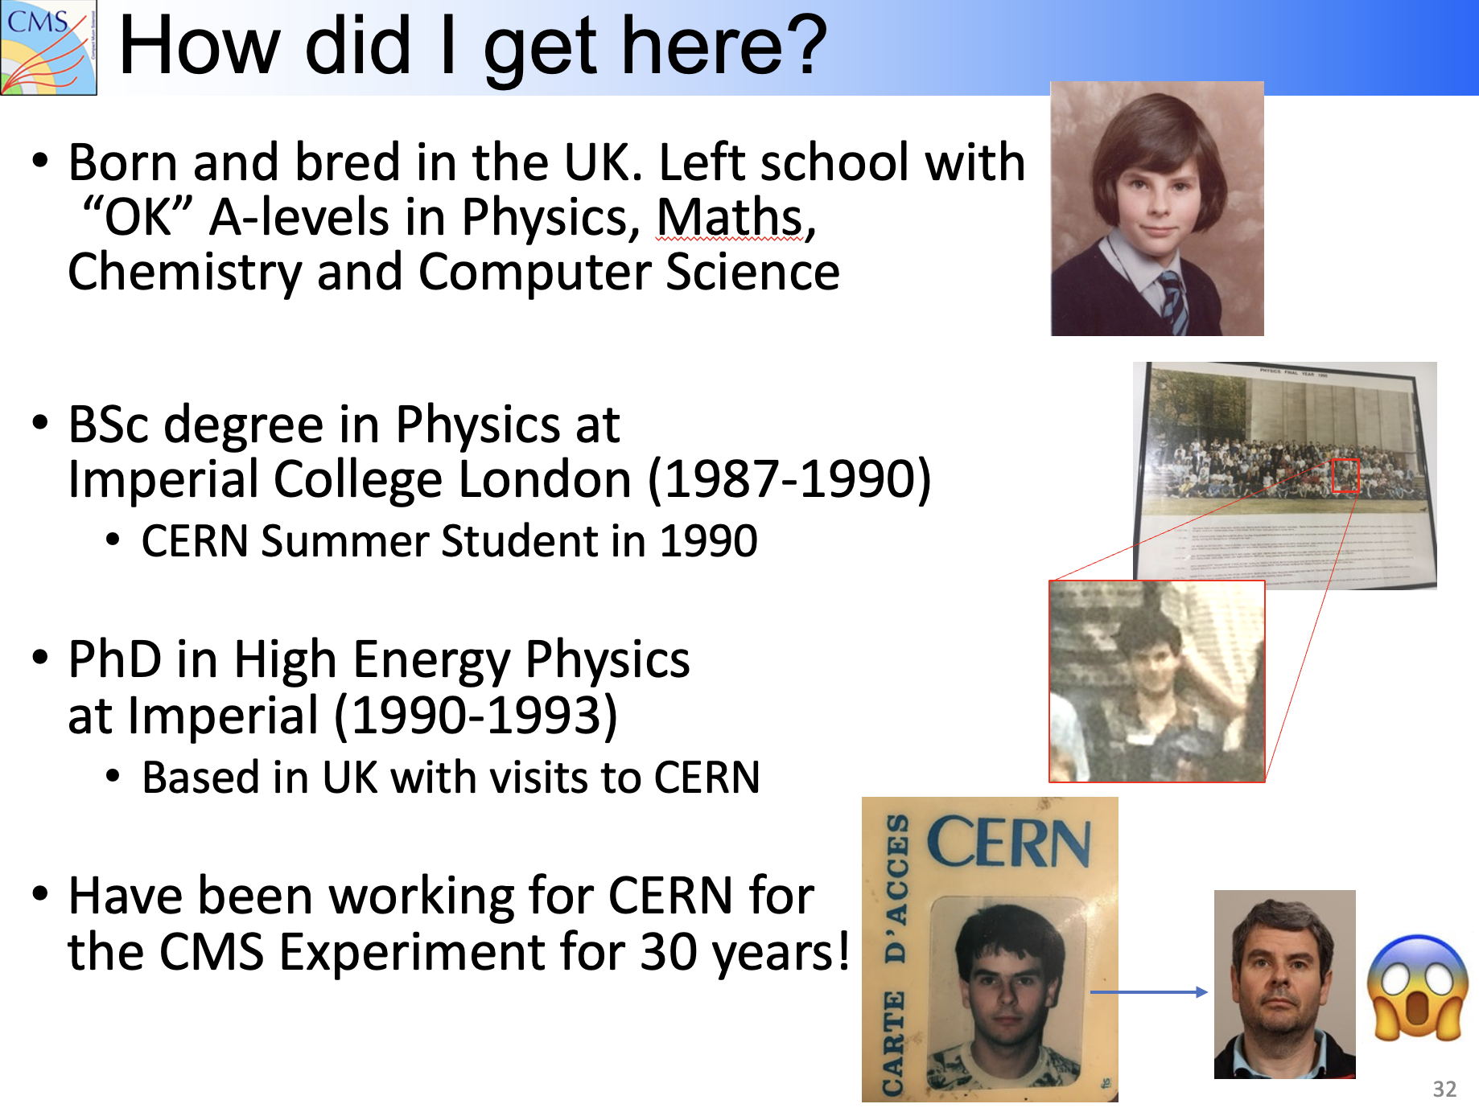
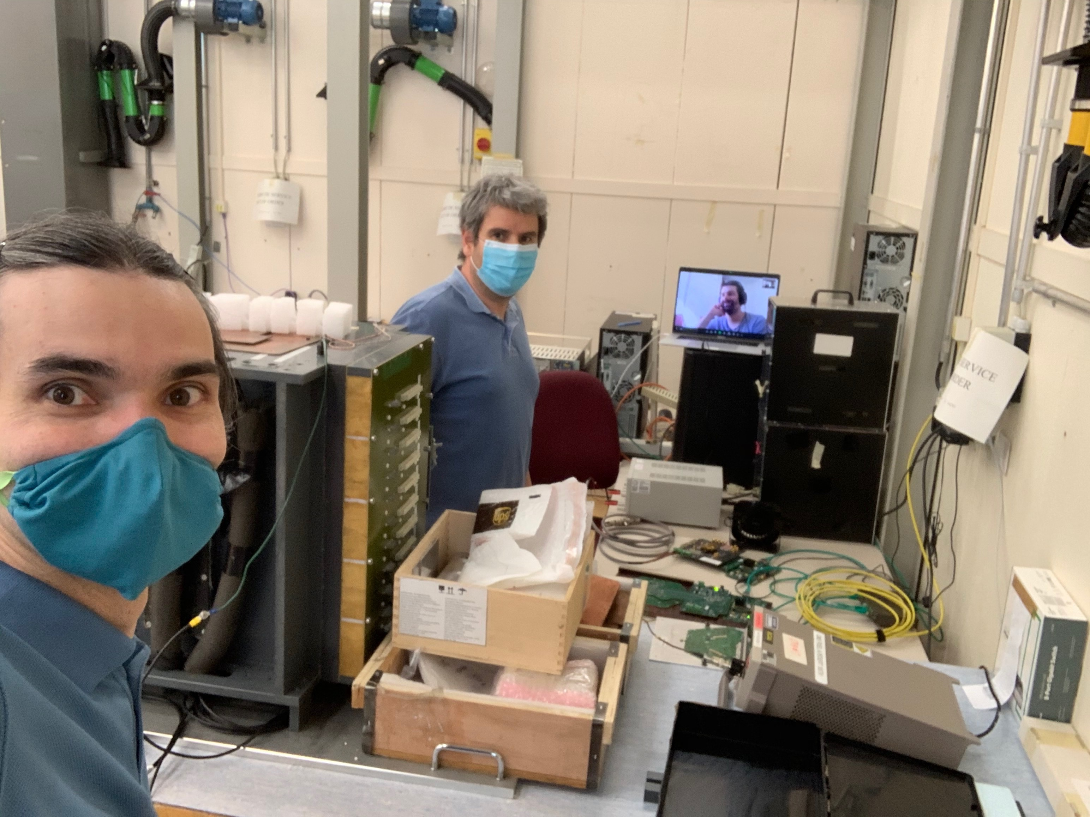
Add some personal history if you can (and if appropriate): i.e. what have YOU done in HEP?

Slide 21
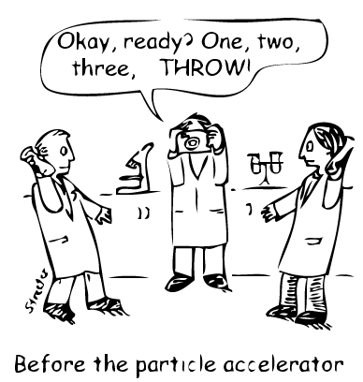
Be interactive, if appropriate and if you can e.g. don’t give all the answers; ask the audience!
What do we do at CERN?
We smash things together
and see what happens!

Slide 22
Be interactive, if appropriate and if you can e.g. don’t give all the answers; ask the audience!
What do we do at CERN?

Slide 23
Be interactive, if appropriate and if you can e.g. don’t give all the answers; ask the audience!
What do we do at CERN?
We smash things together
and see what happens!

Slide 24
Be interactive, if appropriate and if you can e.g. don’t give all the answers; ask the audience!
And regularly come back to the audience for more interaction
→ Helps keep them attentive and interested

Slide 25
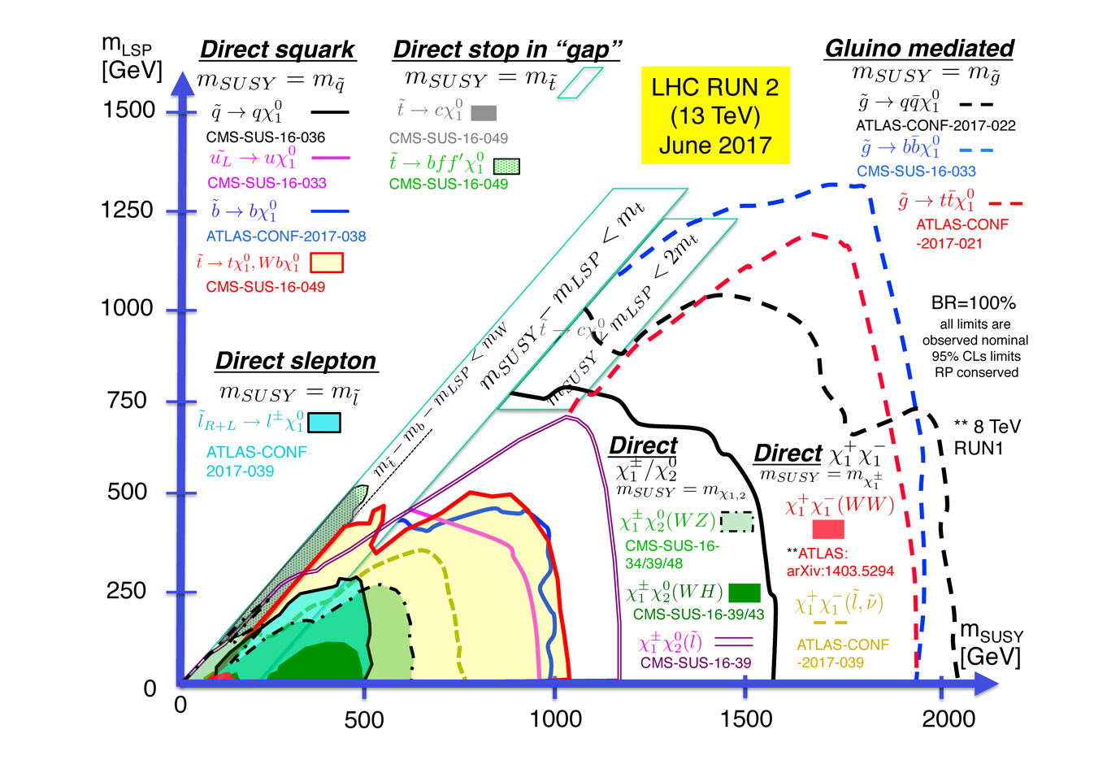
Adapt your plots to focus on the main message

Slide 26
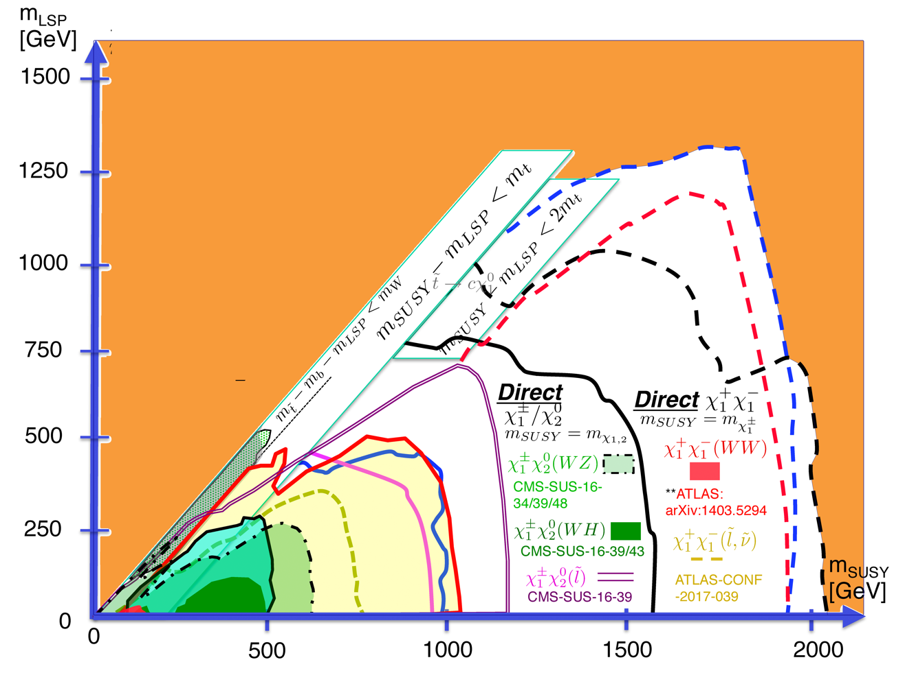
Adapt your plots to focus on the main message
Exploration “landscape” for SUSY
Phase space still possible

Slide 27
Content ordering for most of our talks follows a “standard” format. Does it have to?
- title
- overview of talk
- what we did
- what we found
- what this means
- what we do next
Notes:
Is a summary needed?
Three most important messages from the talk

Slide 28
Content ordering for most of our talks follows a “standard” format. Does it have to?
- title
- overview of talk
- what we did
- what we found
- what this means
- what we do next
This is the exciting stuff!
Notes:
Is a summary needed?
Three most important messages from the talk

Slide 29
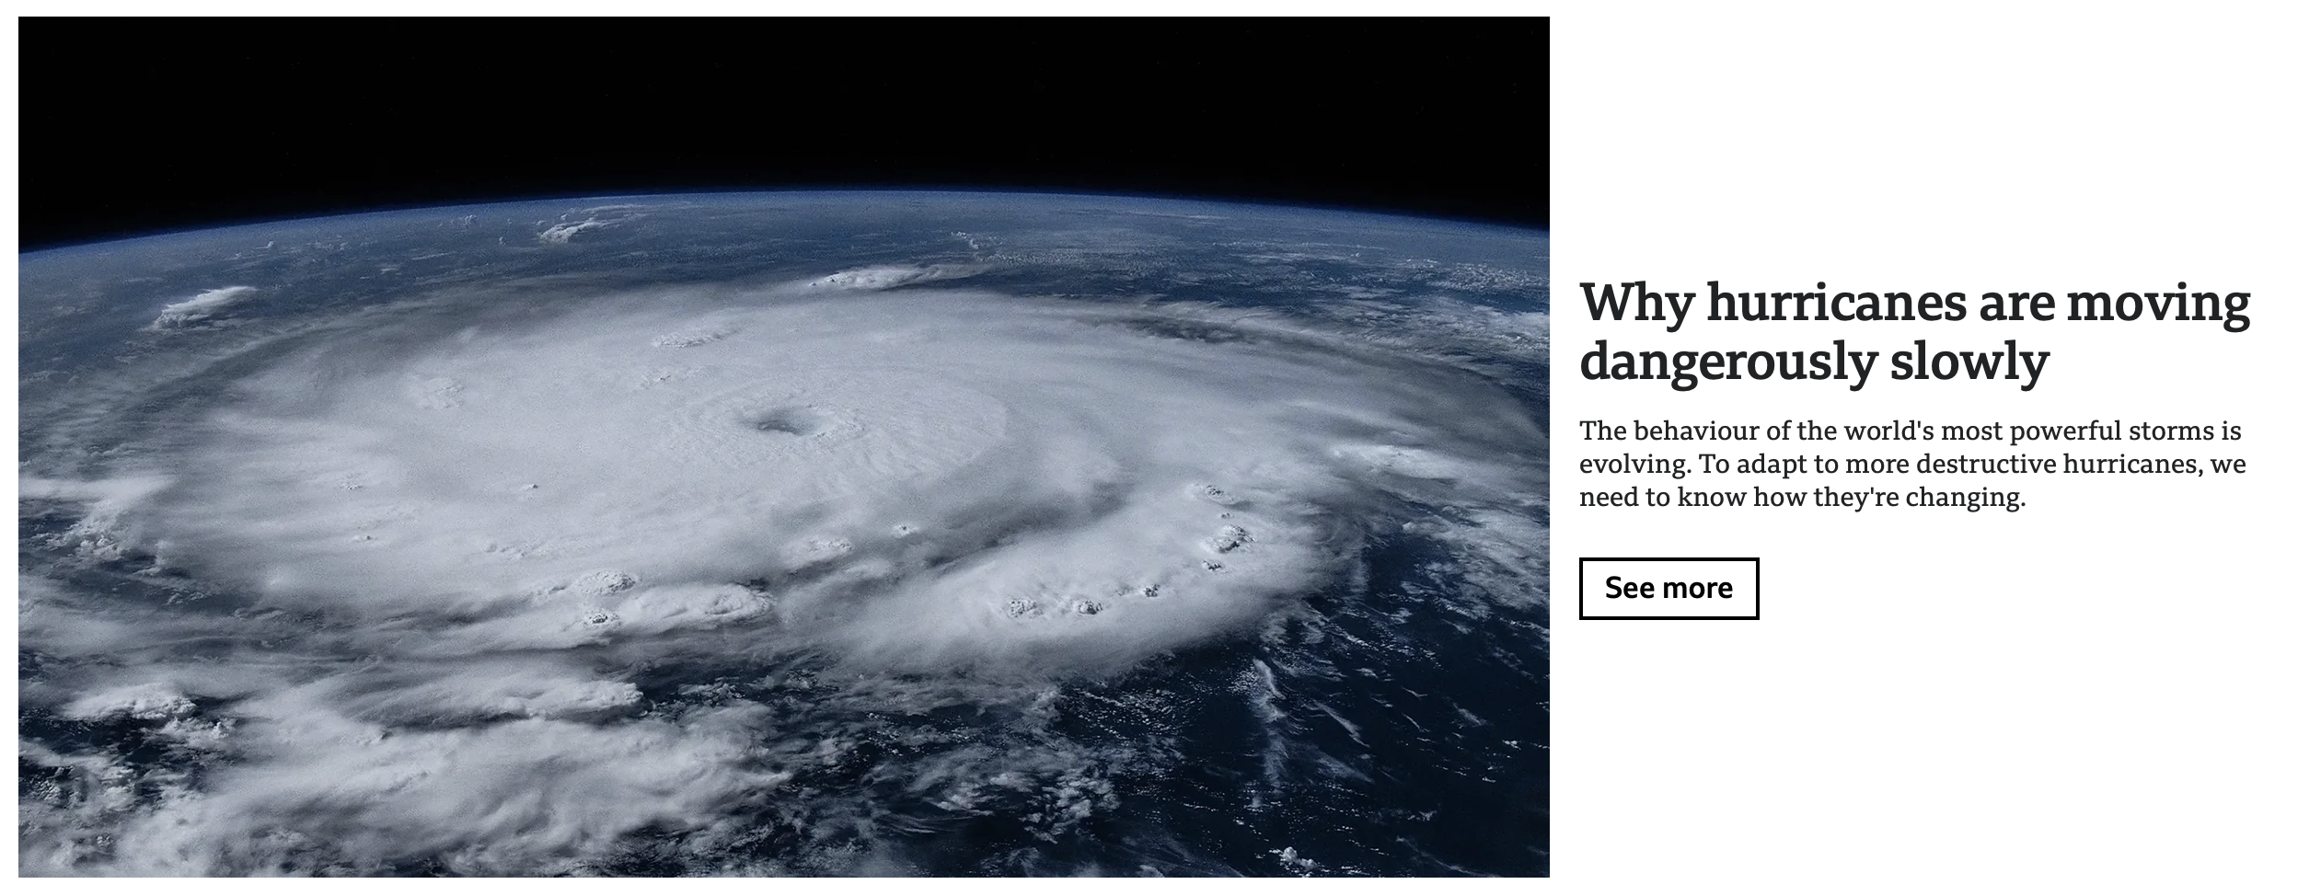
But compare to a newspaper…
- Headline & image to
get attention!
- Give the main message(s)
- links to more information
https://www.bbc.com/future/article/20240712-modern-hurricanes-are-rewriting-the-rules-of-extreme-storms

Slide 30
But compare to a newspaper…
- Headline & image to
get attention!
- Give the main message(s)
- links to more information
https://www.bbc.com/future/article/20240712-modern-hurricanes-are-rewriting-the-rules-of-extreme-storms
Can a similar structure be used in your talks?

Slide 31
And finally…some thoughts about presenting the presentation!
Be passionate about your topic!
Engage with the audience - talk to them and not the screen; do not read the slides!
→ limiting the text on slides helps
Use the space you have and use body language (but not excessively)
→ and don’t play with coins, keys etc.!
Pay attention to timing!

Slide 32
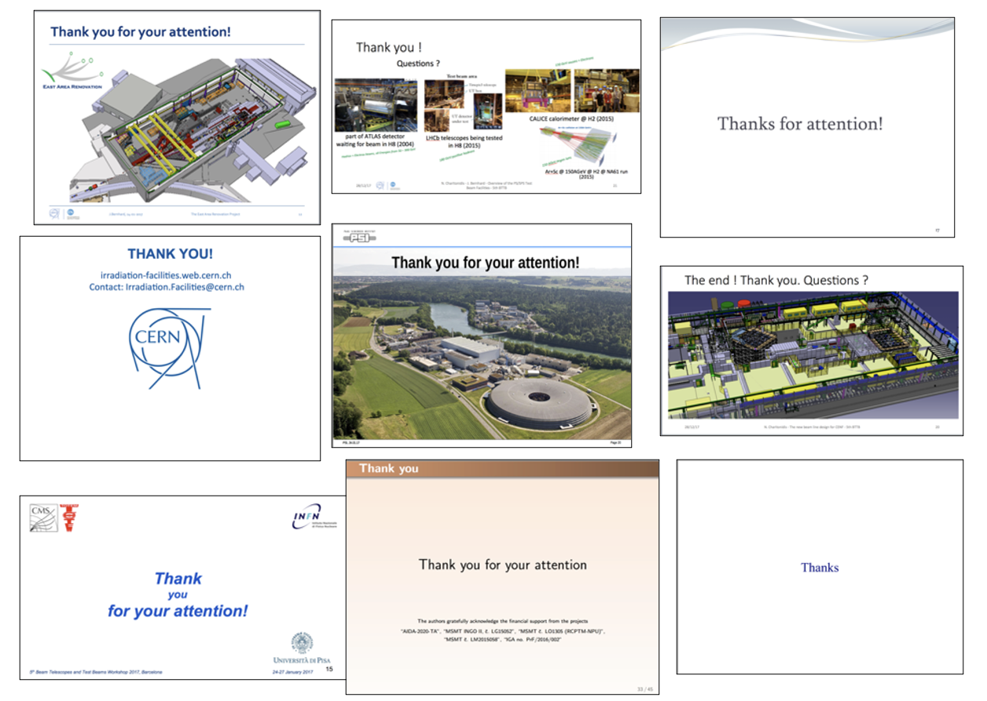
For ending a talk, a transition to Q&A is normally the most effective

Slide 33
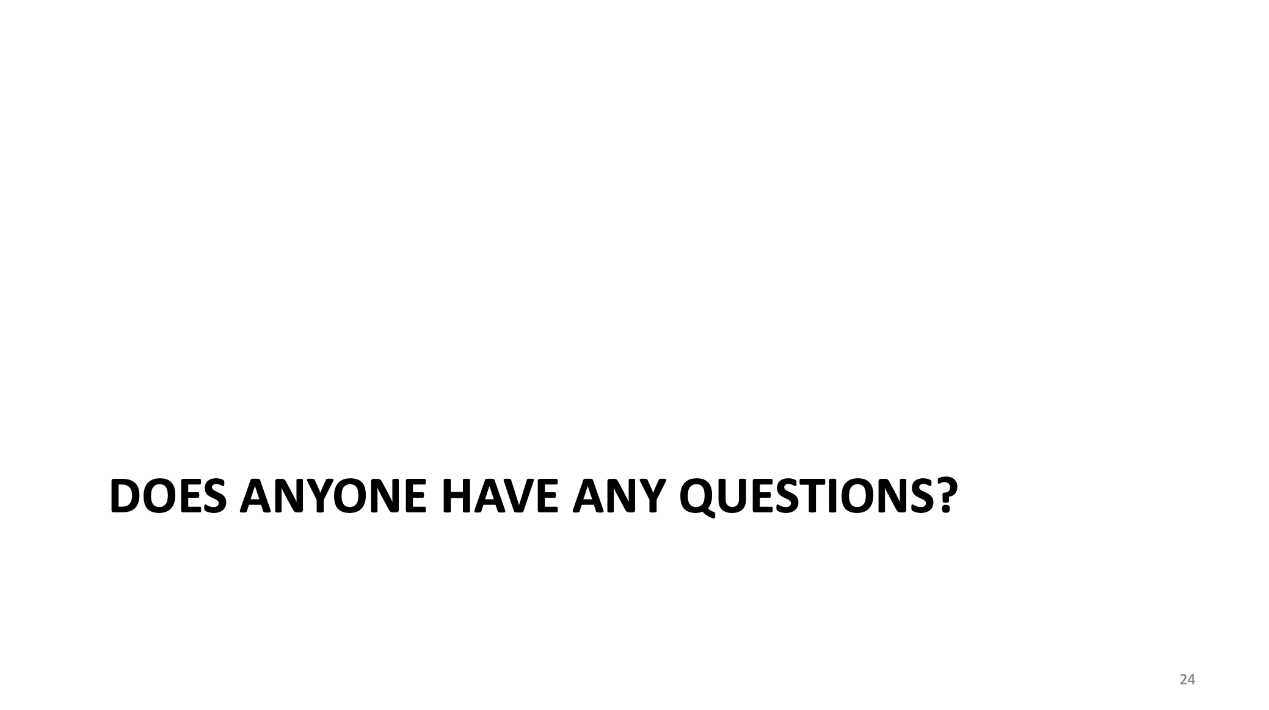
For ending a talk, a transition to Q&A is normally the most effective
X

Slide 34
Another good way to end a talk is with a summary of the main messages!
Know your audience and target them!
Select a few main messages that you want to get across and focus the talk around these messages
Anecdotes – especially ”triumph over adversity” – are really powerful
Add local interest if you can
Add some personal history if you can
Be interactive (if appropriate)
Simplify plots to focus on the main message
Don’t be afraid to think differently for the content ordering

Slide 35
Another good way to end a talk is with a summary of the main messages!
Know your audience and target them!
Select a few main messages that you want to get across and focus the talk around these messages
Anecdotes – especially ”triumph over adversity” – are really powerful
Add local interest if you can
Add some personal history if you can
Be interactive (if appropriate)
Simplify plots to focus on the main message
Don’t be afraid to think differently for the content ordering
All of these guidelines are perfectly applicable to any talk you give – including to the HEP community!

