Slide 1
RADiCAL Update 1.June.2023
A very successful run.
  Running over the holiday weekend went very smoothly after initial startup challenges through Friday, 26 May.
  The collaborative team was very strong, and the run was a great opportunity for student participation.
  In the wee hours of the holiday weekend, we requested, and Nikos provided, at 150 GeV electron beam file. Many thanks to Nikos for this, allowing us to extend our measurements to higher beam energy.
Downstream wire chamber was made functional, with very good precision to see incoming particle beam positions at the RADiCAL module.
  Spatial resolution ~1mm.
  Chamber signals needed 12dB attenuation to avoid saturating and possibly overdriving the inputs of the CAEN DRS modules. We were able to get these from the electronics pool.
  We only had sufficient DAQ channels to read in one chamber , so the second, upstream and dysfunctional chamber was not needed, and no further work was done with it by us.
Data runs taken:
  Electrons at 150, 125, 100, 75, 50 and 25 GeV.
  Electrons at 25 GeV were more problematic. After struggling with LRS trigger logic and CAEN connectivity issues, suspected possible SEUs in CAEN modules.
  Runs were taken with both DSB1 and LuAG:Ce WLS shifters, and in varying combinations. Signals from the Radical and Pb Glass backing calorimeter were excellent, so we are optimistic about high quality measurements at Shower Max in RADiCAL - including timing and energy resolution, and spatial precision.
  For each beam and operative setting we have at least recorded 10⁶ triggers.
  Positive beam at 100 and 50 GeV. To provide mip and hadron behavior reference.

Slide 2
RADiCAL Update 1.June.23
Image of the RADiCAL Module 1.4 x 1.4 cm² using Wire Chamber Coordinates - through the CAEN DAQ, triggered the by 2 x 2 cm² Scintillation Counter
Corner of 2 x 2 cm² beam counter
Aperture for DSB1 Timing Capillary
Dia ~ 1.5mm
During alignment studies of instrumentation, during which detectors were not quite aligned…
Corner of 1.4 x 1.4 cm² RADiCAL Module

Slide 3
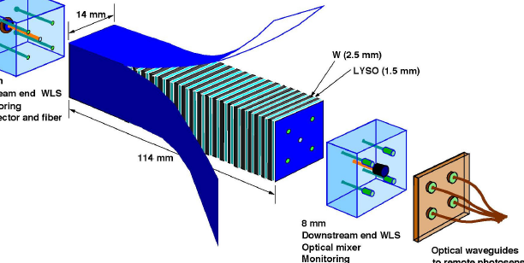
RADiCAL Module Structures

Slide 4
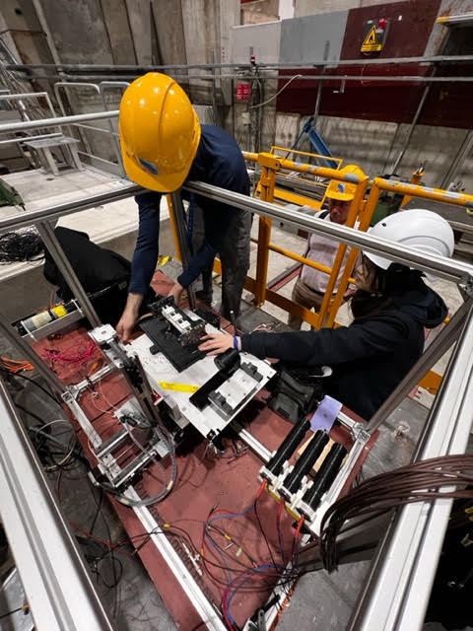
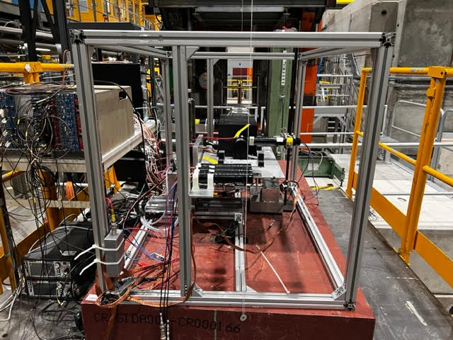
RADiCAL Beam Setup

Slide 5
RADiCAL Update 1.June.2023
Disassembly and de-installation
  All went smoothly
  Two elements - the RADiCAL module and Pb glass backing calorimetry - exhibited a low count rate based on mobile detection equipment. Outcome:
    Gamma spectroscopy for the RADiCAL module to assess release for shipment to the US.
    Transfer of the Pb glass to the Supervised Radiation area of 186/1-C21.
Thank you to the CERN team for all the support for a successful run.

