Slide 1
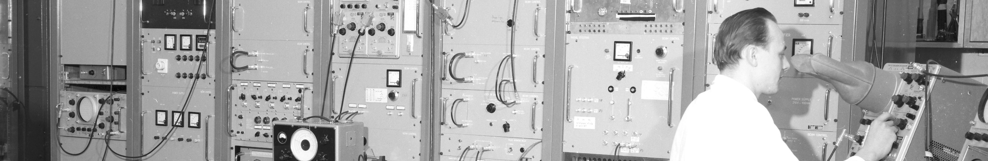
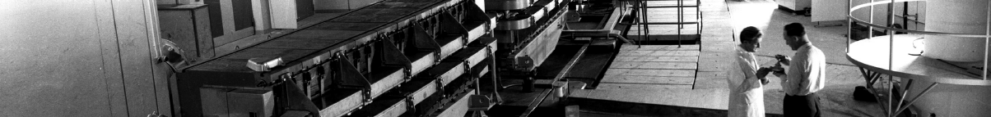
PS Report week 22
Many thanks
to the PS OP and coordination teams as well as all equipment experts and support teams!

Slide 2
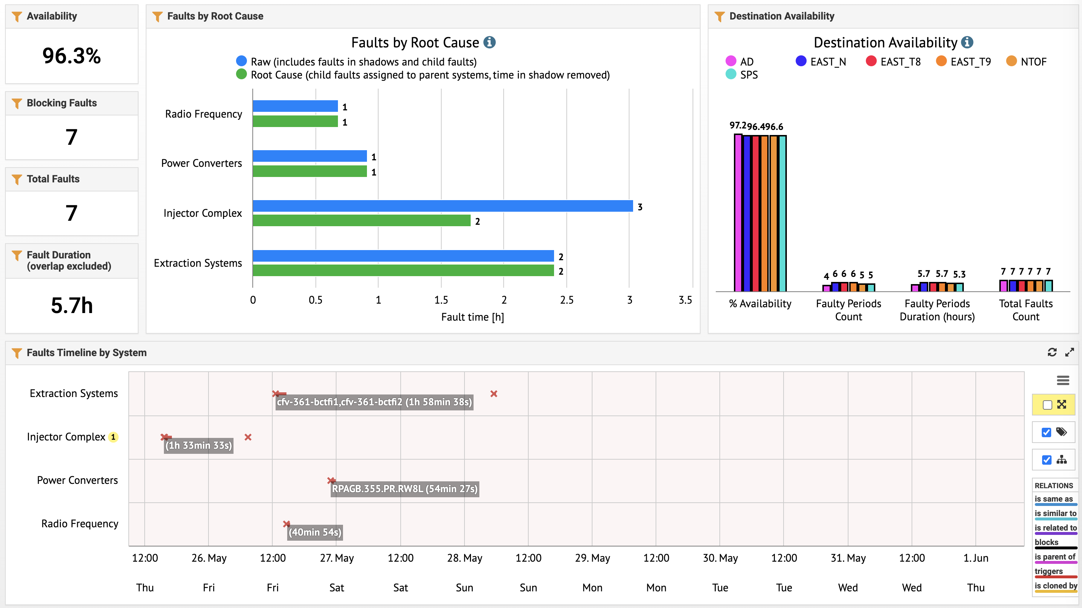
Availability
SMH57 WIC on Temp
Issues during update for KFA71
W8L cooling issue
C10 MHz controls issue:
“Coarse Tuning fault:?

Slide 3
Main issues
                General issues with KFA71 modules continue → agreed to make JIRA issues to keep ABT informed and up-to-date
                KFA71 synchronised by ABT → OASIS global on 8b4e made to diagnose any rise-time variations of KFA71 (sum signal)
                KFA71 intervention to replaced Timing Gateway card in trigger chain (causing 25 ns jitter): old Timing Gateway card was (for some unknown reason) programmed with respect to the falling edge of the trigger pulse. It was assumed that it would be programmed with respect to the rising edge: new card was calibrated to the rising edge. The trigger pulse length is 10 us, which explains what we saw from the CCC when the new TG card was installed. Reverted. The new TG card will be reprogrammed with respect to the falling edge and a future intervention scheduled. Confusion caused by reboot of front-end for new n_TOF timings.
                W8L tripped with a cooling fault on EAST → EPC piquet called about 1h downtime
                WIC temperature faults on SMH57 stopped East → ABT expert needed (kicker piquet called by accident) about 1h downtime for EAST

Slide 4
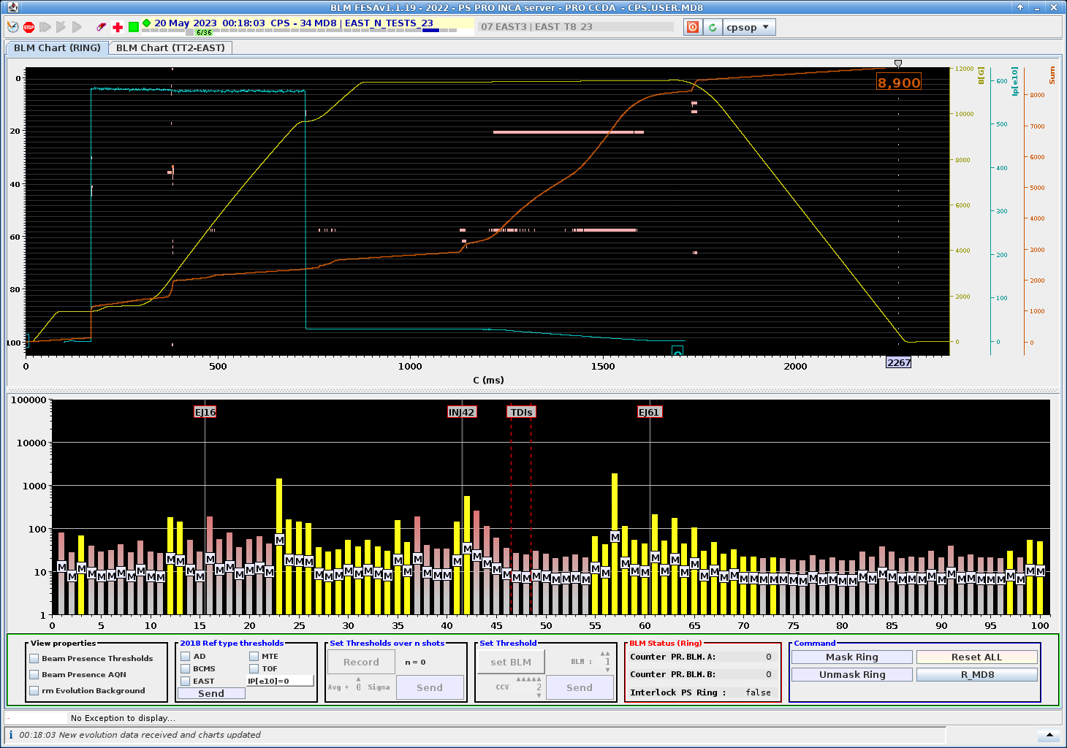
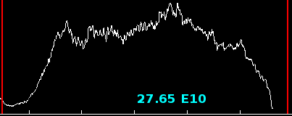
Main Activities
                New EAST cycle with ramp of dedicated TOF created to increase parasitic intensity to ~550E10 p
                This will allow us to increase the flux to 2.2E12 p/s once we get the green light
                In general constantly working to improve EAST spill quality

Slide 5
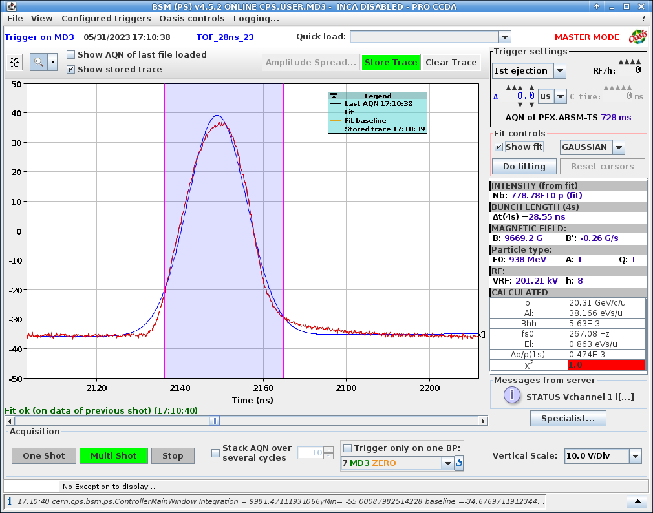
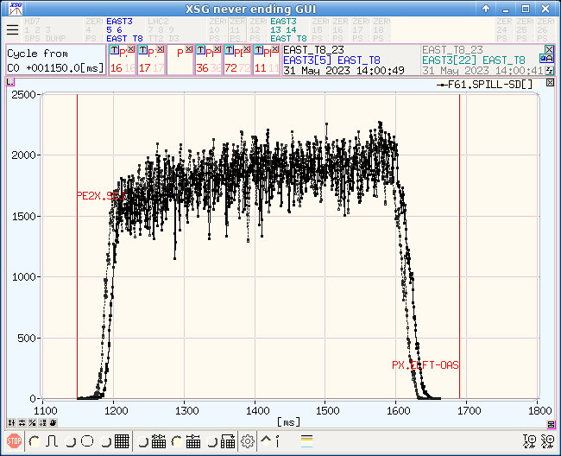
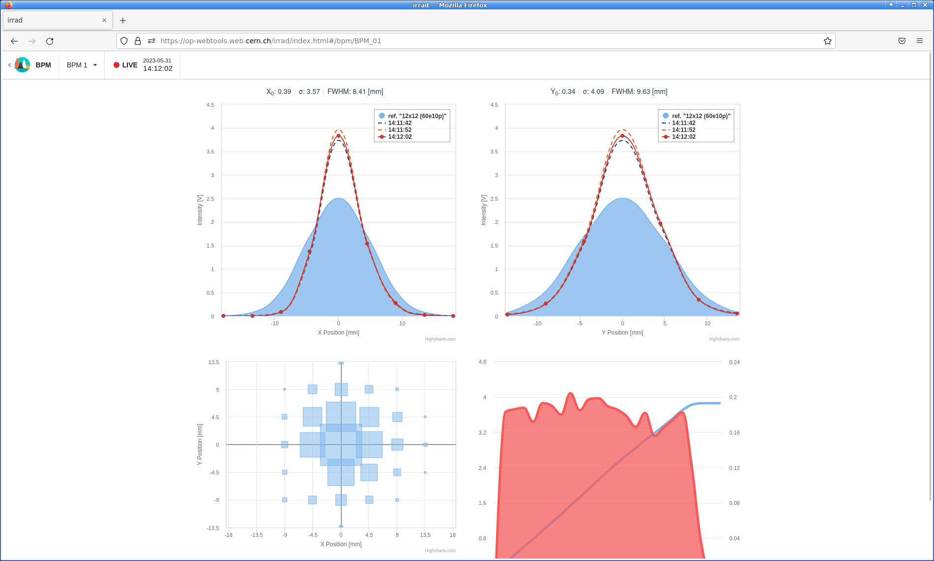
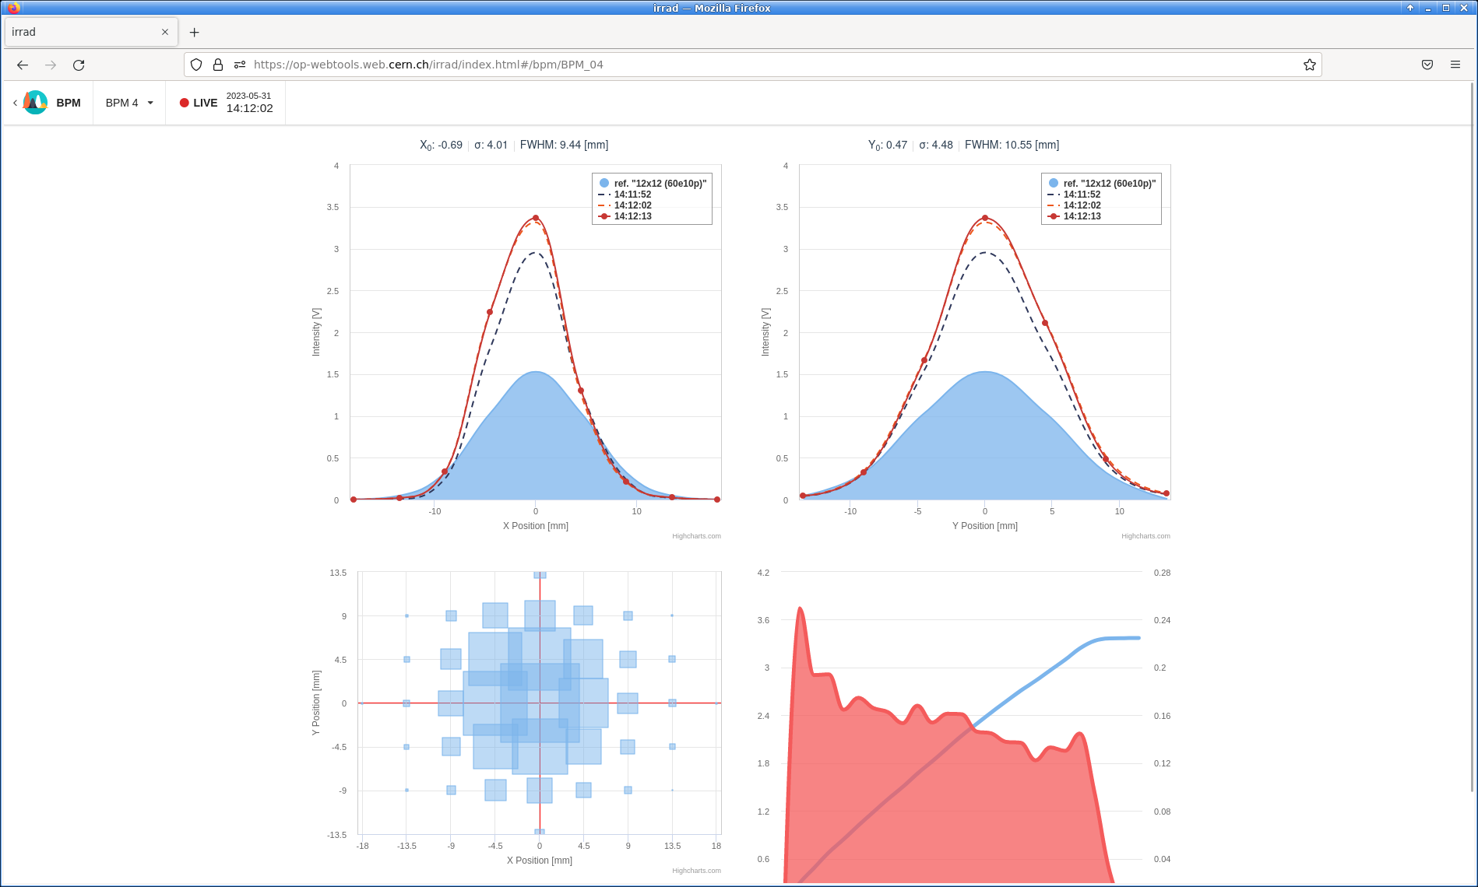
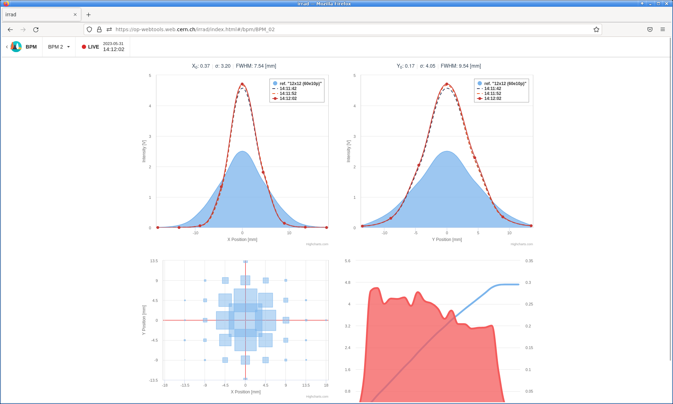
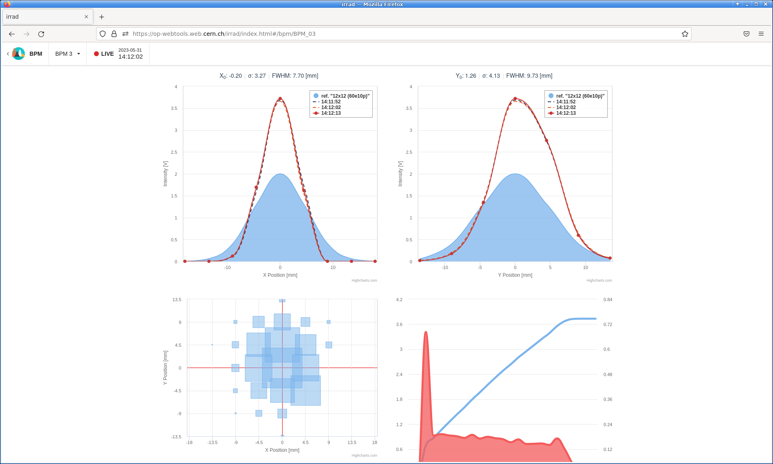
Main Activities
                TOF 28 ns
                Request received for 7 June
                Beam tested this morning and available
                T8
                High intensity beam tested yesterday afternoon up to 80e10
                Good transmission, raisonnable BLM reading, good spill shape, nice beam on BPMs without resteering needed.
                Could be used as operational beam when needed. (could help to reach 2.2e16 p+/week)

Slide 6
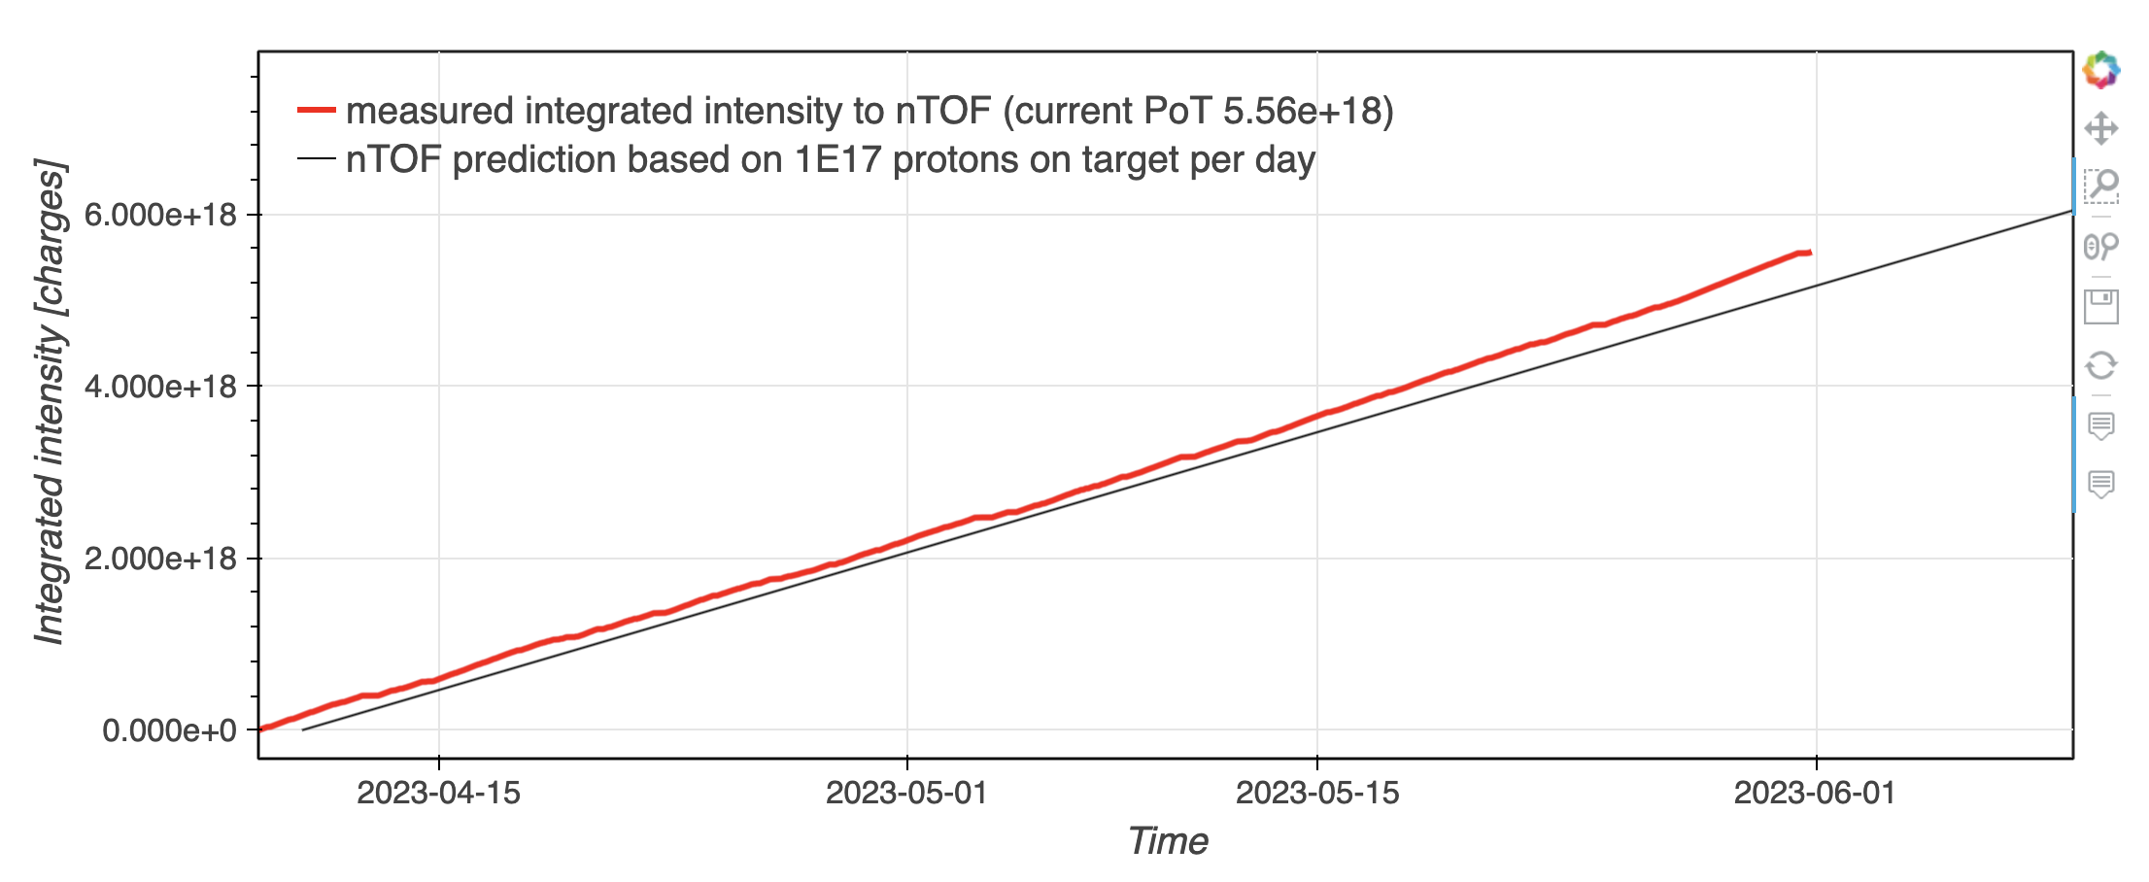
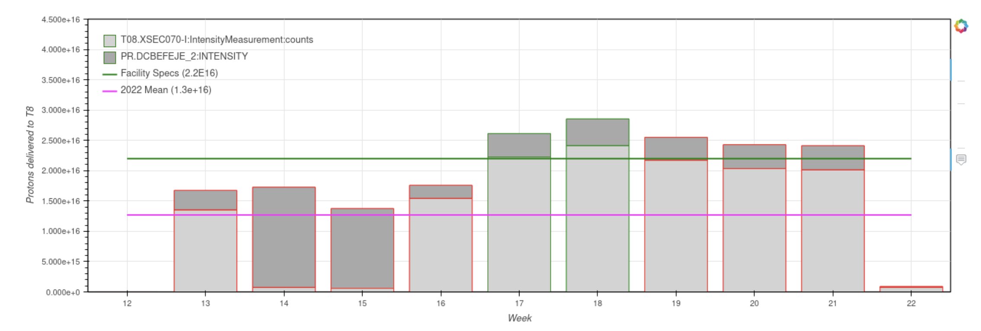
BPT (Beam Performance Tracking)
                nTOF
                Proton On Target 2023
                T8
                Intensity per week

Slide 7

PS Coordinator for week 21 – Matthew Fraser
PS Coordinator for week 22 – Denis Cotte
PS Coordinator for week 23 – Alexandre Lasheen
Questions and Comments
9:00 live meeting in the CCC on Wednesday and Friday
Zoom link to follow the meeting on remote: https://cern.zoom.us/j/9372114100?pwd=L29BcmlHUENCdFBRSytXYVcrM1B4Zz09
Meeting ID : 937 211 4100
Passcode: 525463

