Slide 1
PSB Magnet TF
Subtask 4
G.P. Di Giovanni on behalf of the PSB team

Slide 2

PSB
The PSB is the first synchrotron in the proton injector chain.
It is composed by 4 superposed rings, each with a circumference of ~157 m.
26 May 1972: first protons to reach the nominal extraction energy:
  Energy upgraded from the design 800 MeV to 2.0 GeV (LIU project)
Currently, the Linac4-PSB is the source of all protons produced at CERN for physics.
  First synchrotron to start, last to stop.
  Operational year spans from 8-10 months/year.

Slide 3
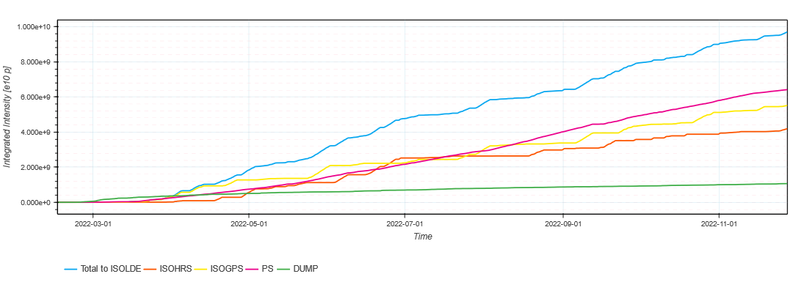
How Many Protons?
Example of PSB extracted intensity in 2022 (source https://bpt.web.cern.ch/):
  Only a few % of all protons produced by the PSB in a year are for the LHC.
~9.7E19 protons to ISOLDE
~6.4E19 protons to PS
~1.0E19 protons to DUMP

Slide 4
PS Booster Layout and Powering

Slide 5
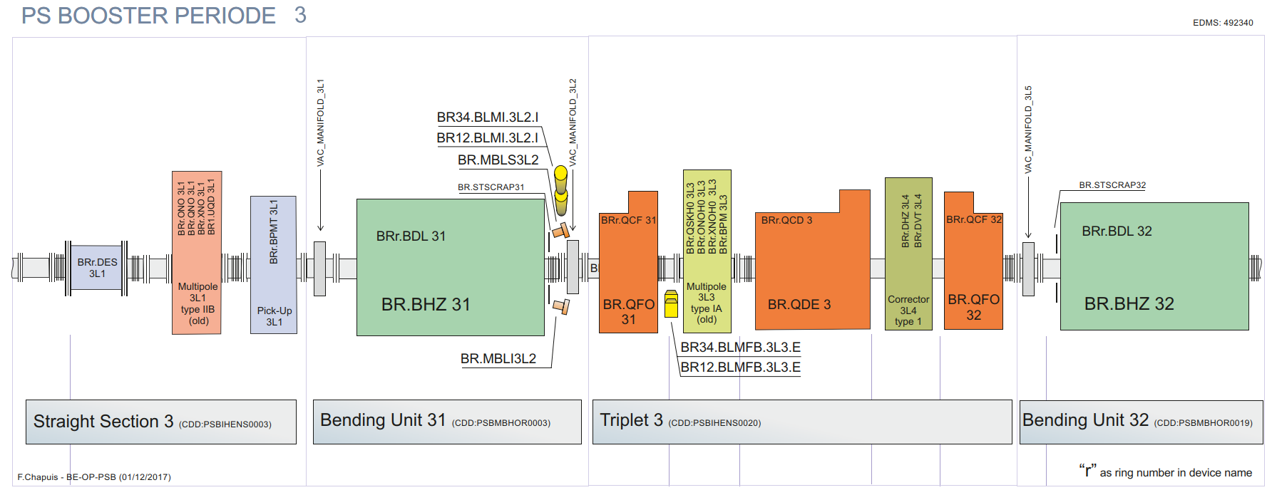
PSB Ring Magnets
The PS Booster is 157.08 m long and divided into 16 periods, each period contains:
  Two main horizontal bending magnets, 2 focusing and 1 defocusing quadrupole magnet.
  Dipole and multipole corrector magnets in the straight sections.
beam
9.8175 m

Slide 6
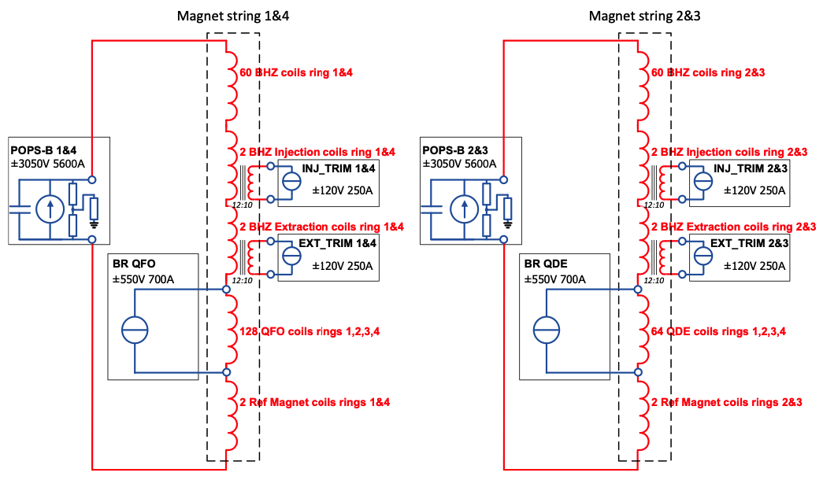
PSB Main Magnets Circuits
Focusing quads:
MPS14 + QFO (base tune control)
+ QCF (ring-by-ring adjustments)
Special defocusing quads (QDE3/14):
MPS23 + QDE (base tune control)
+ QCD (ring-by-ring adjustments)
+QCD3/14 (fast beta-beat correction)

Slide 7
Cycling in the CPS Complex

Slide 8
Cycling of the CPS complex (I)
Presently the lengths of the different cycles of all the PS-Complex proton accelerators are
integer multiples of a so called “basic period” of 1.2 s duration.
The basic period is the smallest unit in terms of repetition time for all proton injectors.
Linac4 and PSB always run with a cycle of 1.2 s, independent on the type of
operation (e.g. high or low intensity), whereas the PS employs cycles of different lengths,
corresponding to one, two or three basic periods (1.2 s, 2.4 s or 3.6 s, respectively), depending
on the beam production.

Slide 9
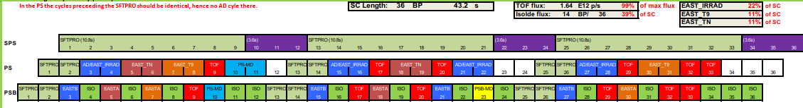
Cycling of the CPS complex (II)
The PS Complex “super-cycle” is made up of a number of individual cycles, each of which has to
be a multiple of 1.2 seconds in length. These cycles are executed sequentially in a pre-set order.
There is no restriction on the length of the Supercycle (determined by the SPS).
Pre-LS2 all beams were delivered with an extraction kinetic energy of 1.4 GeV.
Since 2020, the PSB delivers beam:
  At 1.4 GeV for the ISOLDE facility (up to 40% of SC).
  At 2.0 GeV for all other Fixed-Target and LHC beams (decision taken during the LIU project).

Slide 10
Why increasing the energy at 2 GeV?

Slide 11
Goal of CERN Upgrades for Protons
The High Luminosity LHC (HL-LHC) upgrade:
Aims at 3000 (4000) fb⁻¹ total integrated luminosity over HL-LHC run
Based on operation at levelled luminosity of 5 (7.5) x10³⁴ cm⁻²s⁻¹ by lowering β*
 | N_{b} (x 10¹¹ p/b) | ε_{x,y,} (μm) | Bunch/batch spacing | Bunches
HL-LHC | 2.3 | 2.1 | 25 ns / 200 ns | 4x72 per injection
Achieved | 1.3 | 2.7 | 25 ns / 200 ns | 4x72 per injection
→ Double intensity and double brightness (ratio between intensity and transverse emittance)
→ The LHC brightness is defined in the PSB

Slide 12
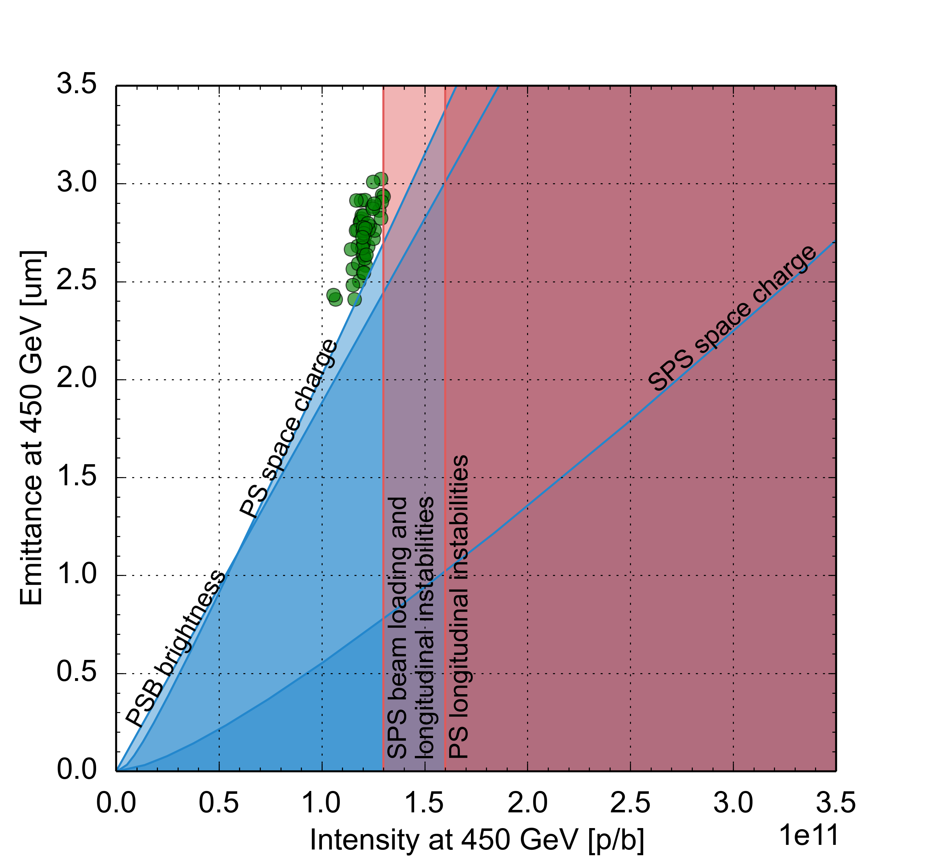
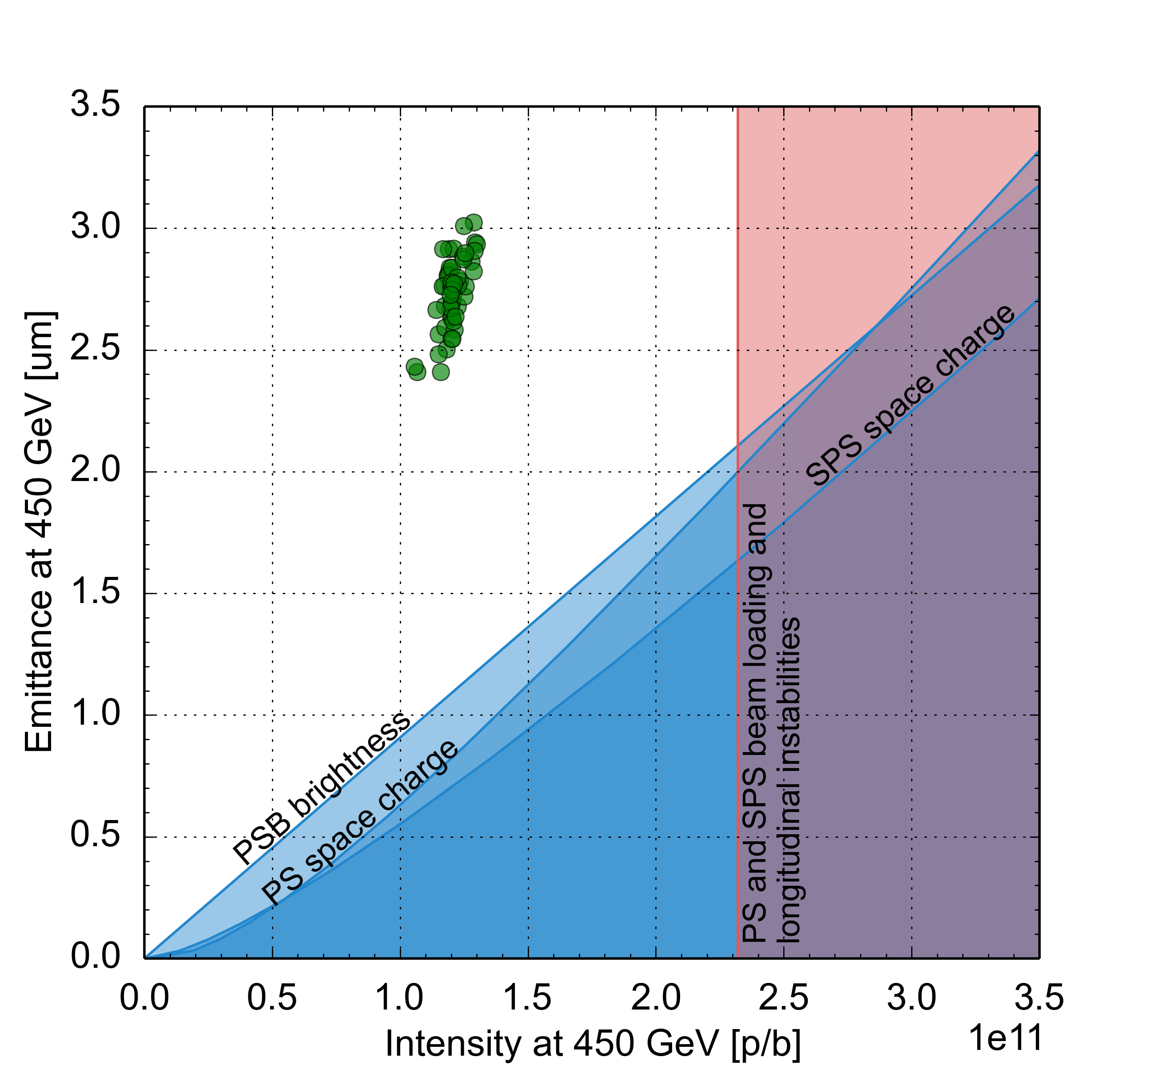
Beam performance with LIU upgrades
Effect of the LIU baseline upgrade items on beam parameter reach, based on existing machine models and anticipated equipment performance
Pre-LS2
Post-LS2
Connection of PSB to Linac4
PSB acceleration to 2 GeV
PS RF upgrades
SPS upgrade
  Power and LLRF upgrade of 200 MHz RF system
  Longitudinal impedance reduction
  a-C coating of focusing quadrupole chambers
  Deployment of low γ_{t} optics
  Upgrade of beam dump and protection devices

Slide 13
How can we contribute to the TF effort?

Slide 14

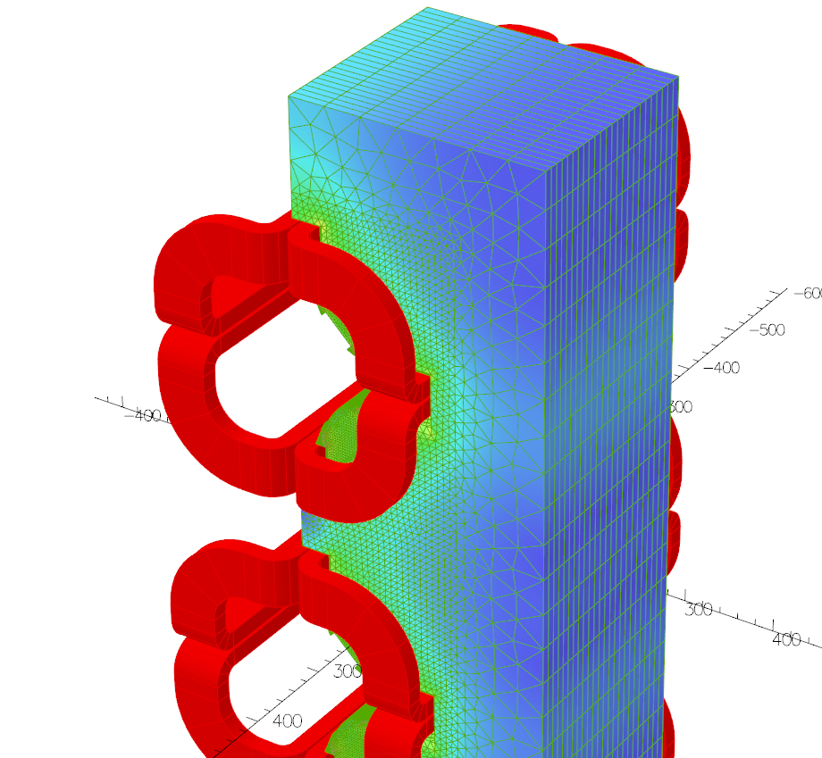
Reducing the Energy of some/all beams?
Lower field = lower force, so it could be beneficial for the magnets mechanical stress moving some/all of the beams from 1.4 GeV to 2.0 GeV.
The PSB can produce all the beams at 1.4 GeV:
  It was possible pre-LS2 and there is no fundamental bottleneck in decreasing the kinetic energy at extraction.
  Proof of concept done in 2022 and confirmed in 2023, with initial variants of EAST and TOF at 1.4 GeV available for the PS.
  Issues is with the performance deterioration (physics) for the downstream machines and the impact on the resources:
    Space-charge plays a significant role and lowering the PS injection energy requires a sustained MD program across the complex.
    Resources limitations: The same ABP, ABT, RF, OP experts are already battling with operational issues.
Simulations show a modest force (~250 N) on the coil and brazed joint, measurements on the repaired QFO91
magnet in 2022 showed no movement during the magnetic cycle (source A. Newborough JAPW).
All experts converging on the main culprit being the Galvanic corrosion on the copper. Will this work help at all?
One of the outcomes of this review should be deciding it makes sense to pursue the lowering of the kinetic energy and
prioritizing the resources required to attain the maximum performance under these conditions.

Slide 15
PSB in degraded mode
PSB is composed of 4 rings, so at times (b/c of issues) it happens to operate the machine with <4 rings.
  We usually refer to it as “degraded” operation.
  With 3 rings we can still fulfil the majority of the downstream machine requests.
    Several mitigations schema are in place for LHC, AD, ISOLDE, TOF, EAST
    More work needed for MTE (NA physics) if it is a long-term issue.
  Can we run with 1 aperture less?
    Unfortunately, it does not seem possible to simply shunt and/or block the water for one aperture.
      POPS-B nested circuit.
      Water flowing in all apertures.

Slide 16
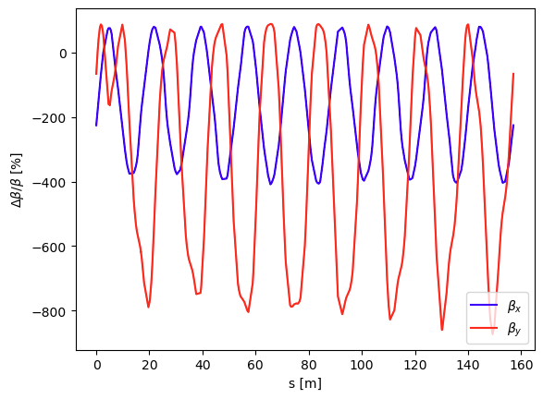
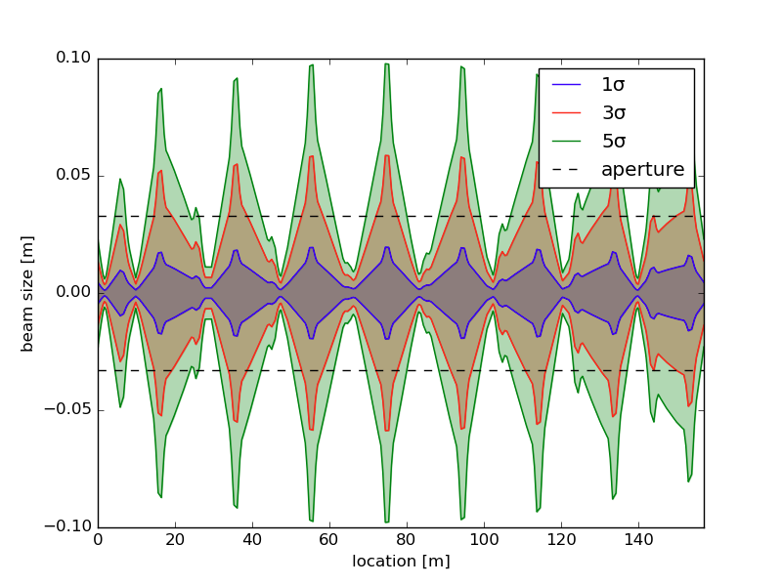
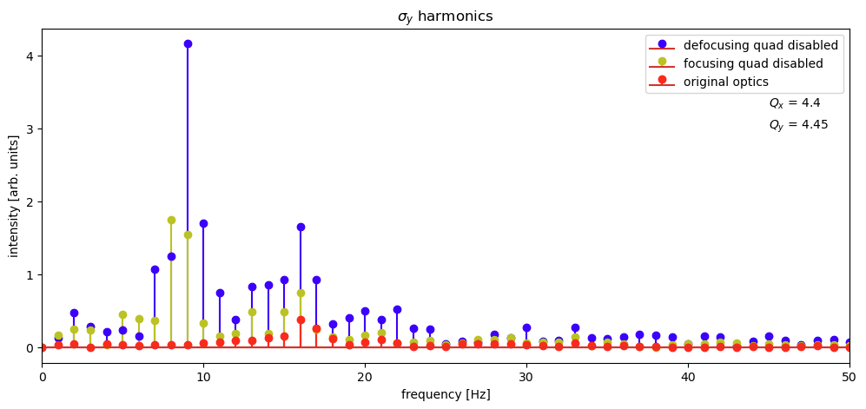
Running without 1 magnet…
Impact of removing one magnet studied in simulation by F. Asvesta (BE-ABP) and H. Huttunen (BE-ABP).
  The absence of a magnet will break the symmetry of the machine:
      Large beta-beating oscillation, limiting severely intensity and brightness.
        Beam will not fit in the machine aperture.
        Removing 1 quadrupole will lead to the rise of several strong hamonics, for almost all systematic resonance lines
          Not enough correctors to compensate them.
      Also, a loss of a QDE is twice as problematic as 1 QFO.
      Simply not an option.
Periodicity of the PSB is 16, i.e. 16 identical cells or sector
Expected beta-beating when removing QFO11
(generally measured to be ~20%)
Expected beam size evolution of LHC beams
(ε_{x}/ε_{y} = 1.6/1.8 um in simulation)
Systematic Resonance lines

Slide 17
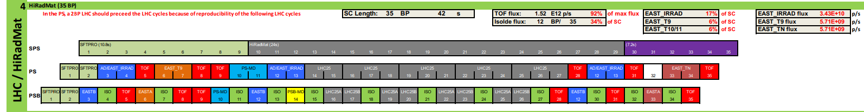
Running without Cooling
Example of SC for a standard LHC filling in 2022 (~23% of SC)
In 2023 with the current Hybrid injection schema (8b4e + 36b) the LHC filling requires ~21% of the SC.
Tests performed to determine the RMS current limits in case we need to run without water:
  ~1/3 of Supercycle may be possible over a limited period of time.
  ~1/5 in continuous operation.
If a similar decision is taken (and before an electrical failure occurs!) it could be possible to fill the LHC and provide beams to a few other facilities, e.g. NA, AD-ELENA, in any case to be arbitrated at the IEFC.

Slide 18
Summary
Context:
  Proton sharing, Cycles, Supercycles, PSB layout, PSB powering schema, LHC Injector Upgrade, …
Reducing the energy of the beams to 1.4 GeV?
    Possible, however the latest chemical analyses indicate that the issue lies with Galvanic corrosion on the copper.
    Easy to convert beams in the PSB, significant effort required in the other machines.
    It must come as a request from the management out of this review:.
        If implemented, the physics facilities must accept significant degraded physics performance.
Degraded mode operation:
    Operation with <4 rings always possible, if we can find ways to shunt only one aperture.
    Operating with 1 quadrupole less is not possible.
    Impact on operating without cooling on the quads:
      We could run with ~20% of the Supercycle.
      Filling the LHC remains possible.
      Beams for other facilities, like NA, could be delivered and would need high level arbitration.

Slide 20
Proof of Concept
Test done in the PSB-PS in 2022
Goal was to identify possible limitations (PS aperture restrictions?) in injecting in the PS.
Rescaled the energy to 1.4 GeV of the operational TOF beam (the highest single ring intensity beam at 2 GeV)
  PSB could extract 850e10 protons-per-ring (nominal intensity).
  The transverse dimension growth was ~30%, compatible with the rescale for the rigidity from 2.0 GeV to 1.4 GeV.
  At the time of the test PS was limited at ~600e10 ppr b/c of losses.
    No optimization done on either machine, so margin to improve.
  The test confirmed no major limitation in the PS.
  PSB is moving from a commissioning phase to an operational one:
    After the Easter break, the plan is to prepare 1.4 GeV variants for EAST and TOF and test them in the PS.
    Based on the feedback and limitations, this will define the following steps.

Slide 21
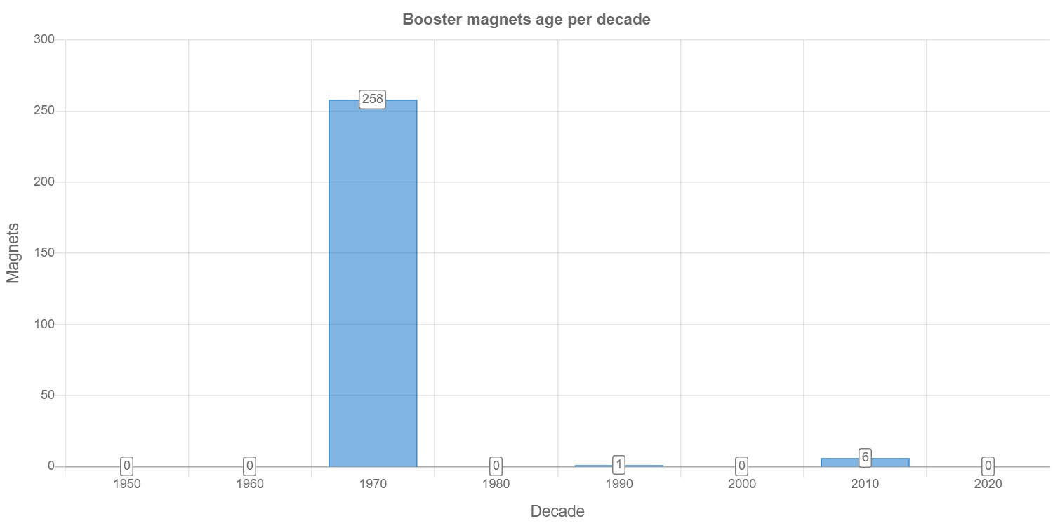
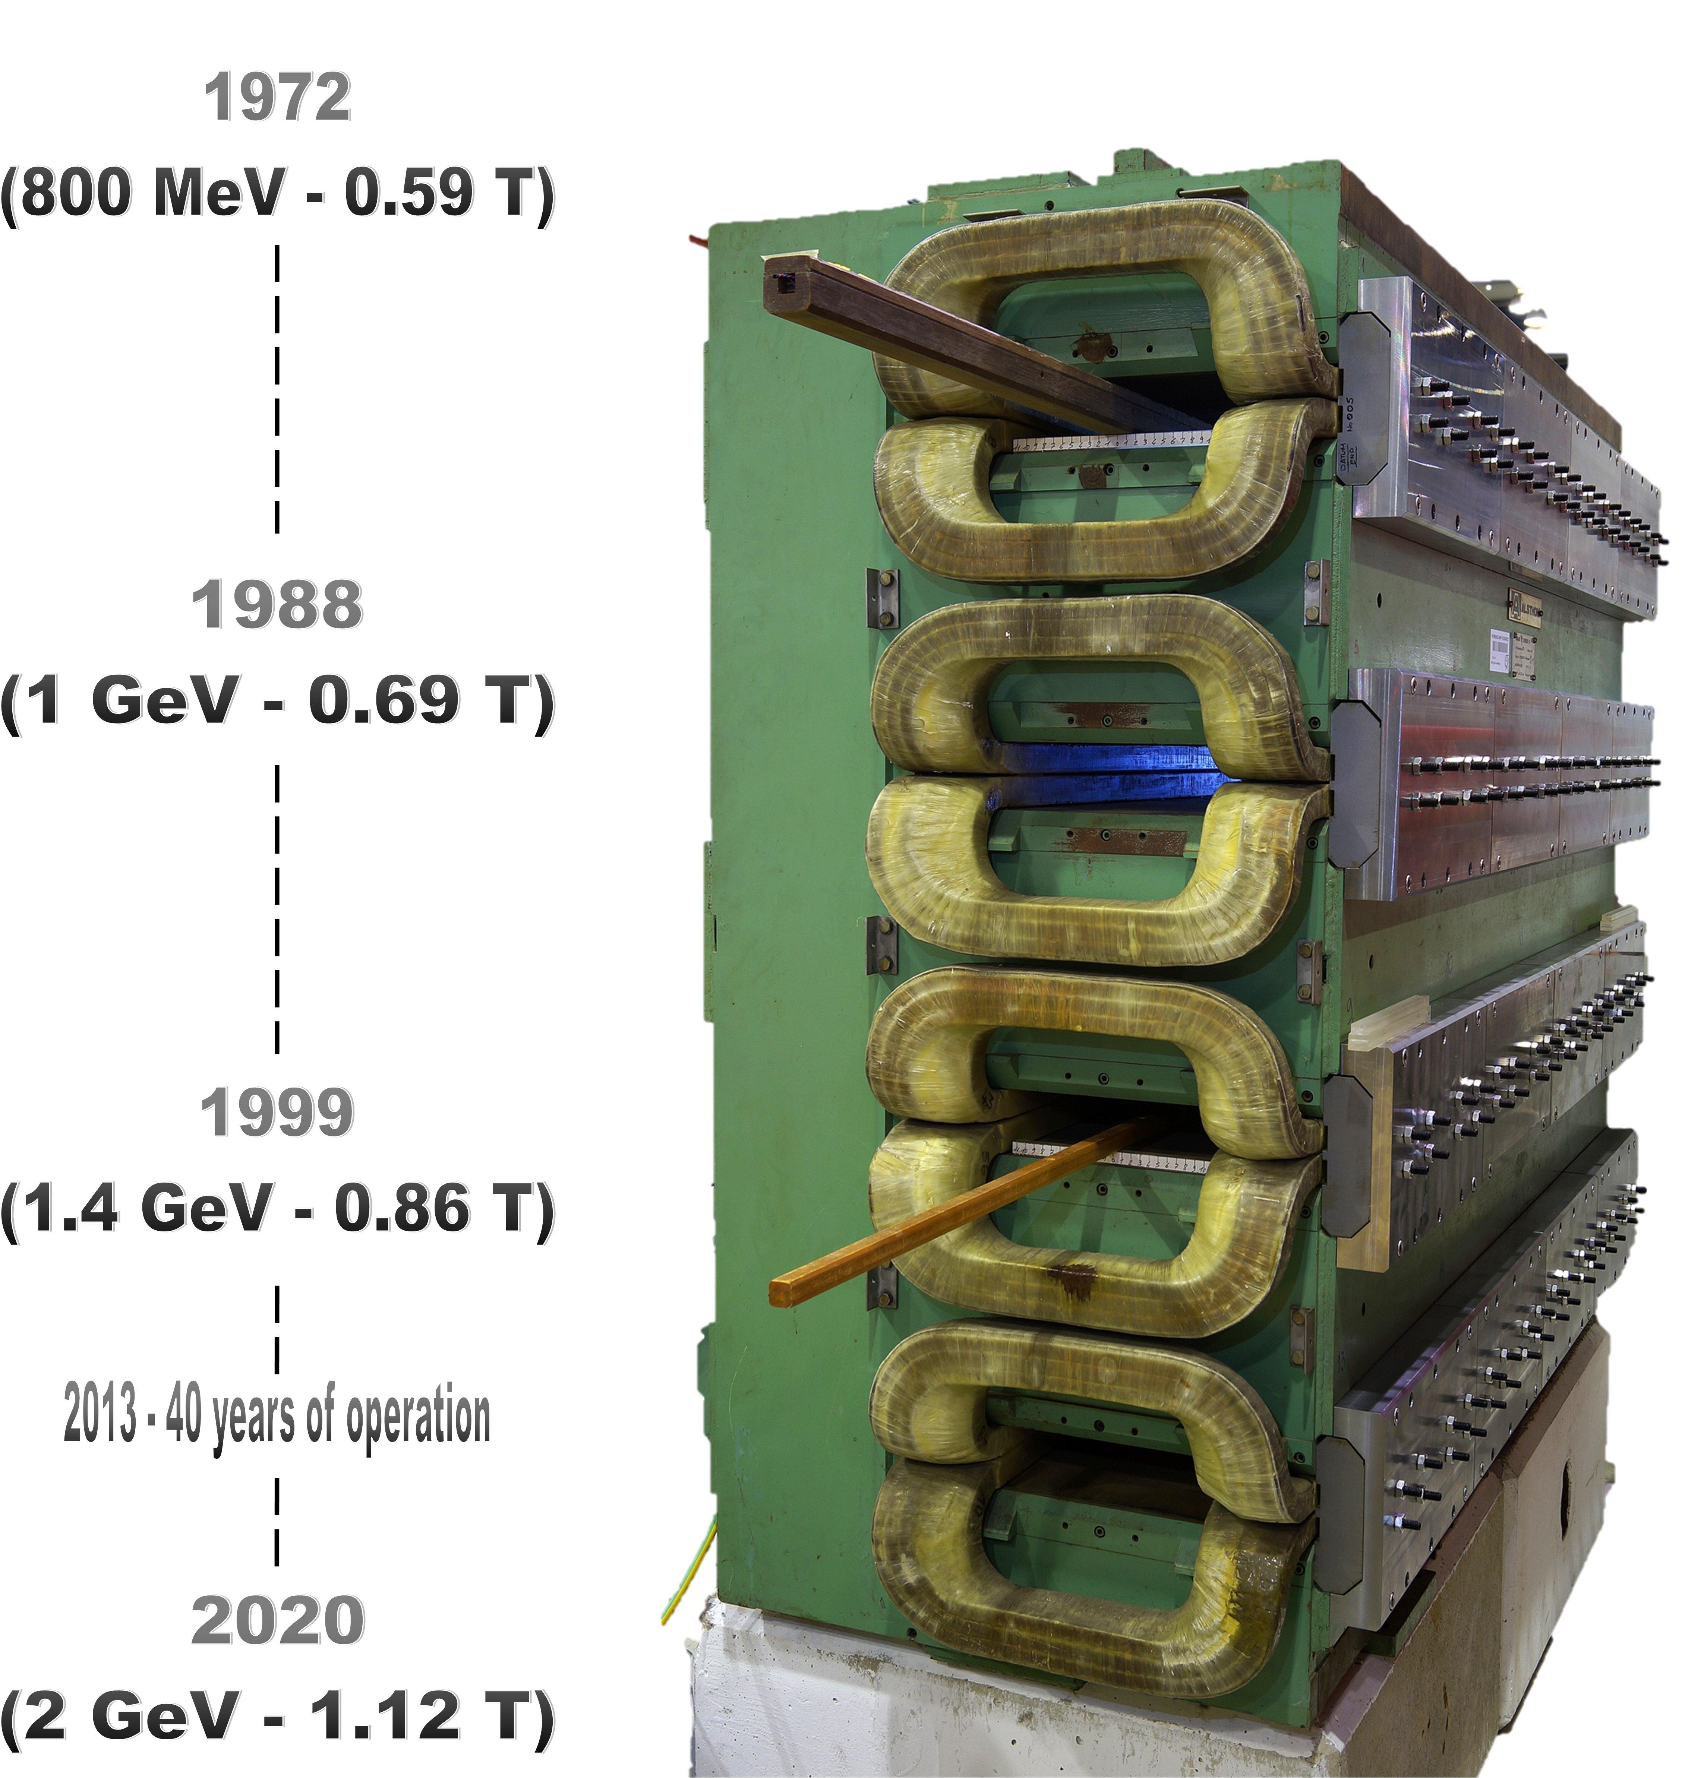
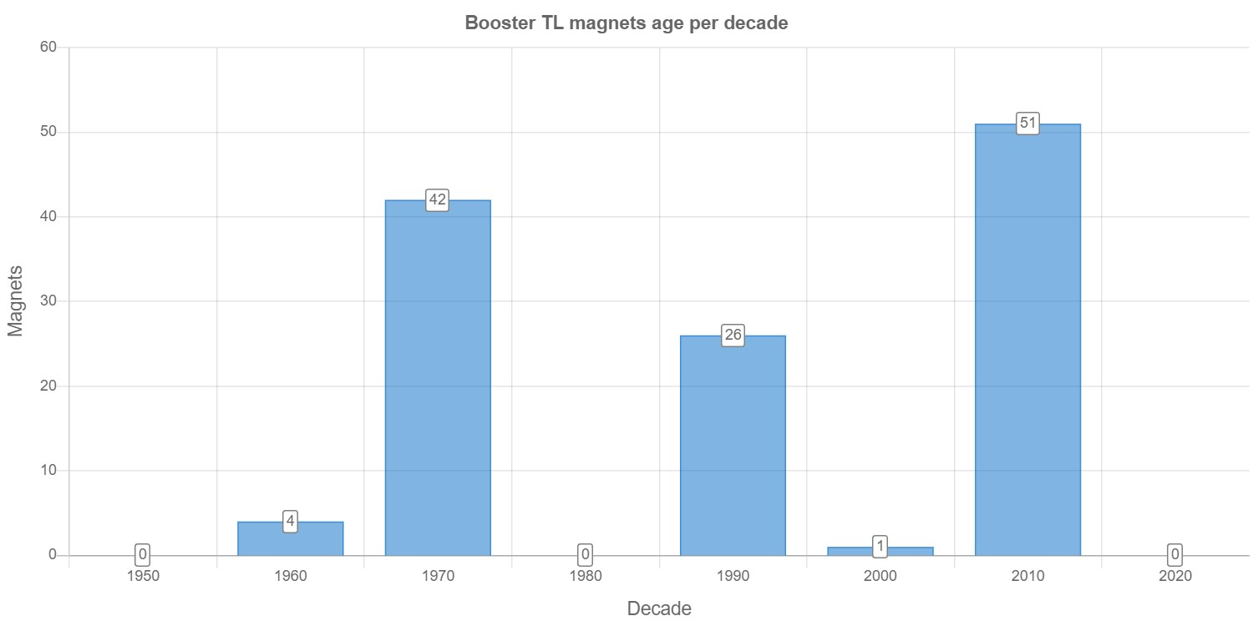
PSB magnet ageing
Newborough
JAPW 2022
PSB Ring Magnet Production by Decade
450 – 550 million cycles
26.4 millions with POPS-B and
~ 20 million @ 2 GeV
+200 million up to 2040?
(Estimations from EPC & OP)
The PSB Upgrades
1950
1960
1970
1980
1990
2000
2010
2020
PSB TL Magnet Production by Decade
1950
1960
1970
1980
1990
2000
2010
2020
07/12/22
JAPW - TE/MSC-NCM

Slide 22
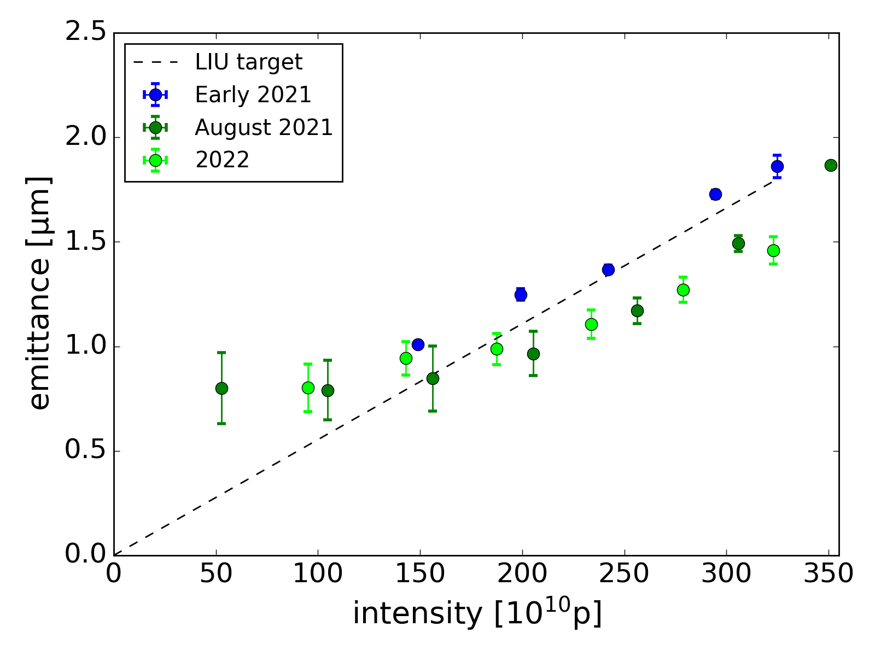
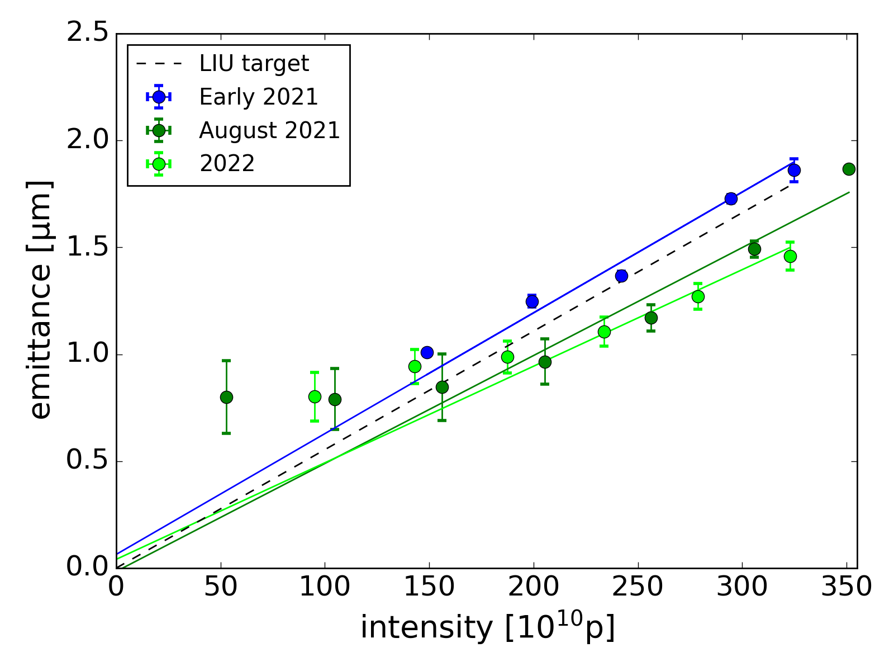
LHC Beams Production Scheme
PSB Brightness curve
I > 180e10p
constant brightness
→ same space charge tune spread
I < 180e10p (BCMS regime)
emittance plateau
(injected emittance & foil scattering)
→ smaller space charge tune spread
BCMS regime:
Production scheme could be modified
with minimal impact on brightness!

Slide 23
Brightness limitations: space charge
Particles within a bunch moving at speed lower than speed of light generate a repulsive force
This is an additional defocusing force on single particles → transverse tune shift (negative)
Particles feel different space charge defocusing forces according to their positions in the bunch
→ tune spread
y
z
x
Notes:
But

Slide 24
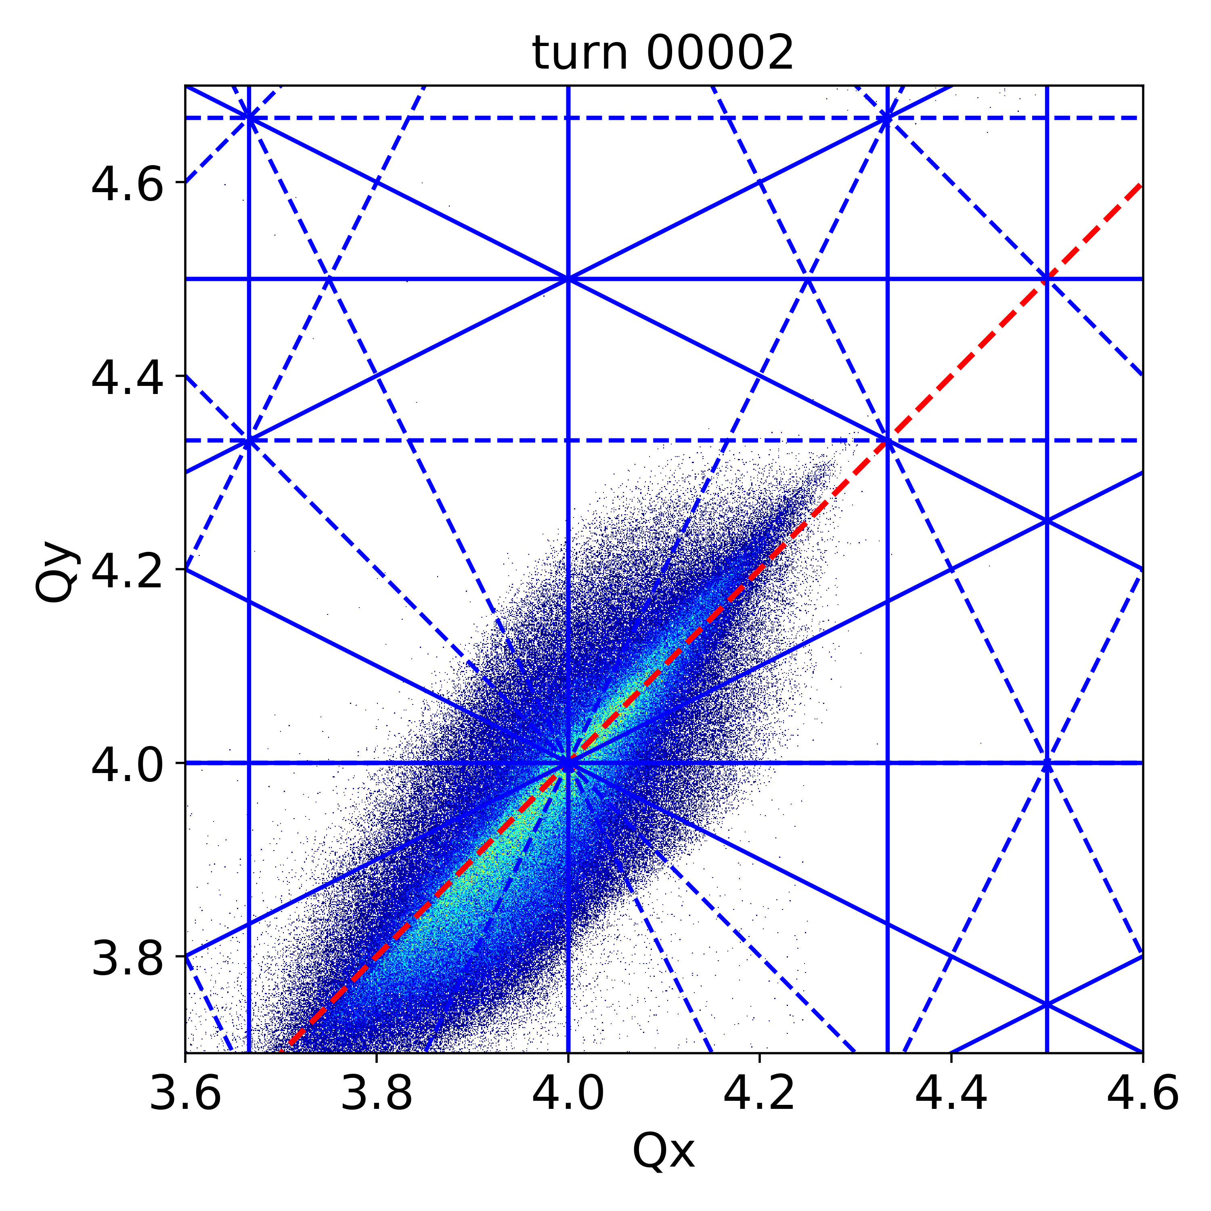
Brightness limitations: space charge
In the tune diagram (Q_{x}, Q_{y}), the nominal tunes are placed in areas free from resonance lines
Space charge shifts the tunes of
the single particles shift, which may
hit the resonance lines!
PSB simulation
for 50 MeV inj.
y
z
x
Particles oscillating close to the bunch peak density
Notes:
But

Slide 25
Brightness limitations: space charge
In the tune diagram (Q_{x}, Q_{y}), the nominal tunes are placed in areas free from resonance lines
Space charge shifts the tunes of
the single particles shift, which may
hit the resonance lines!
PSB simulation
for 50 MeV inj.
y
z
x
Particles at the tails of the longitudinal distribution
Notes:
But

Slide 26
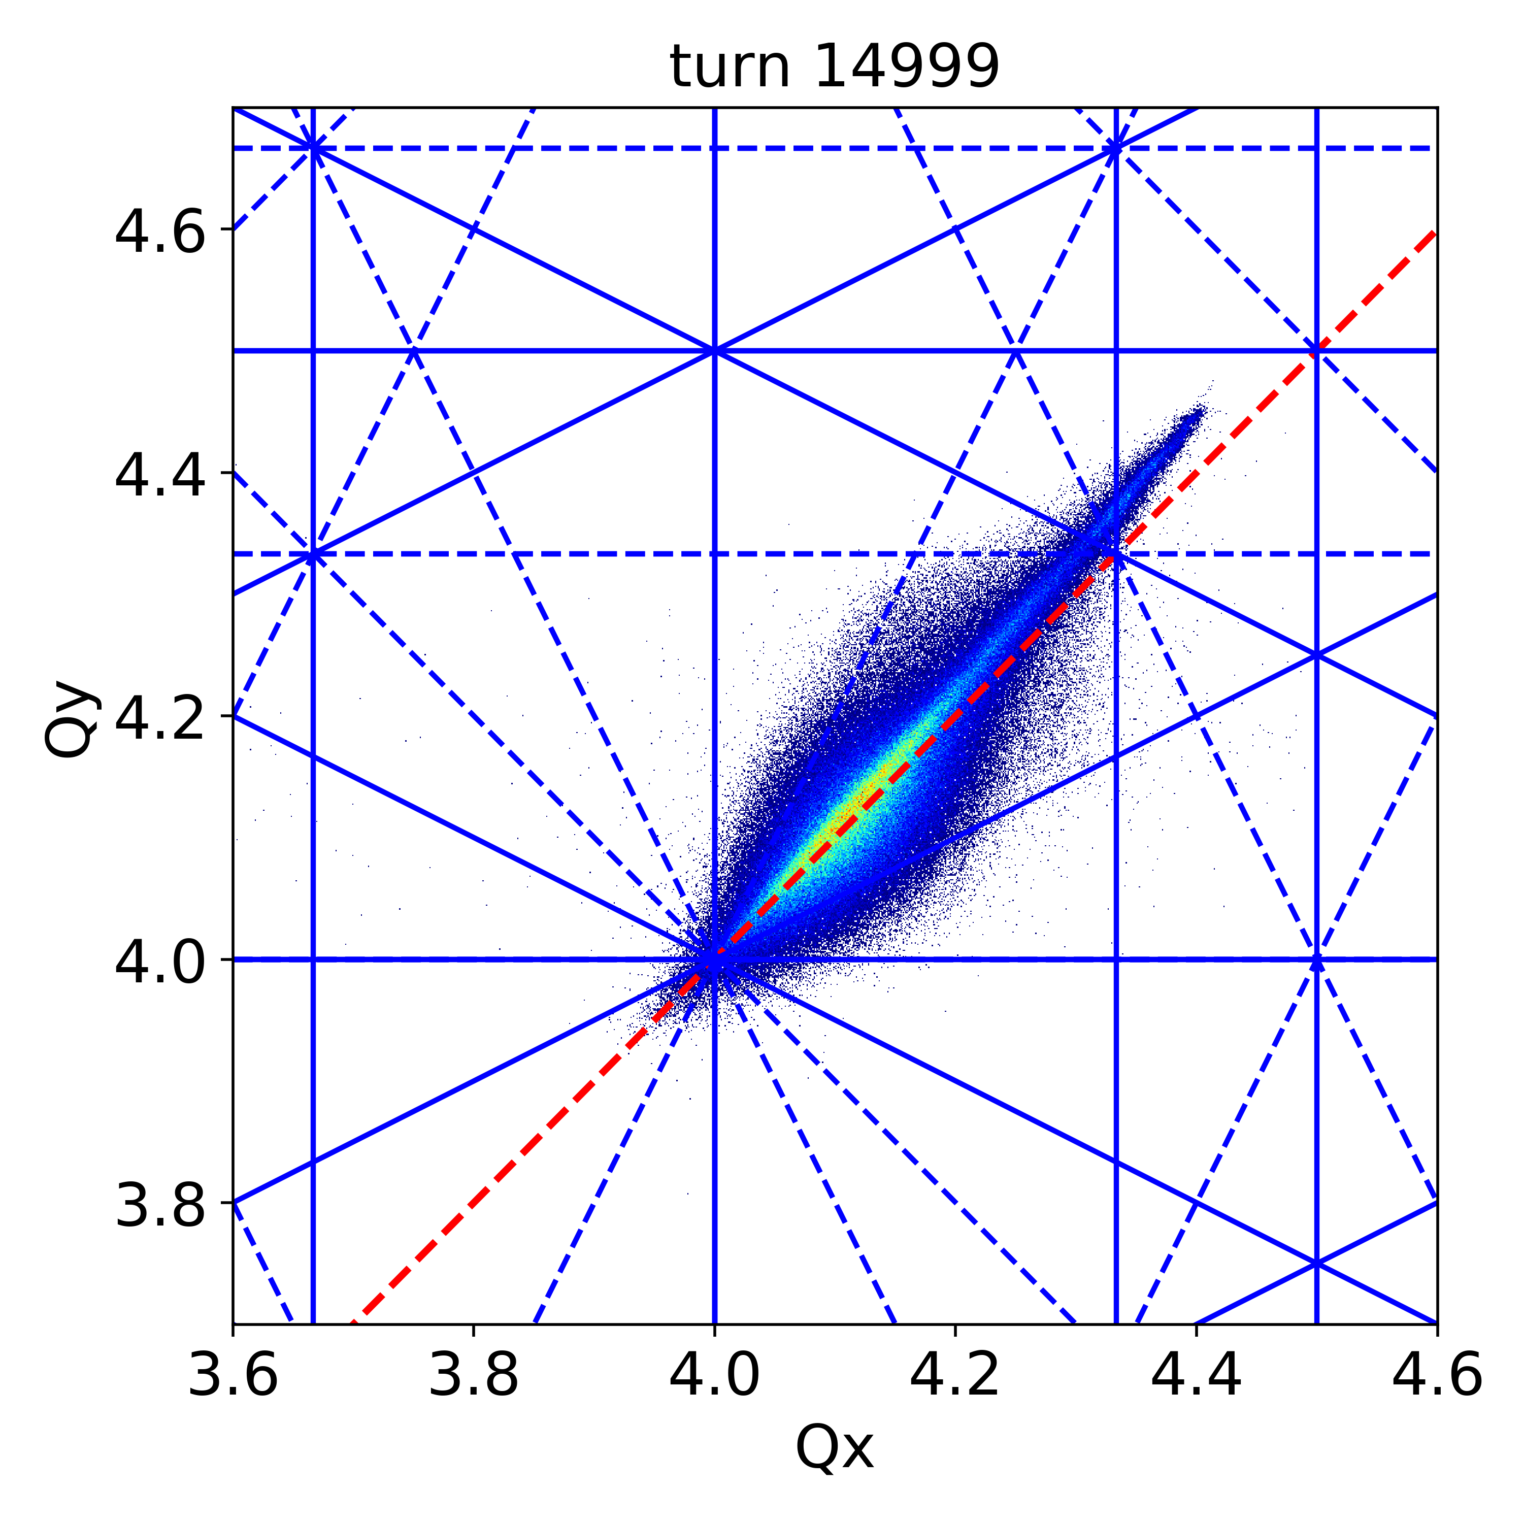
Brightness limitations: space charge
Due to their shifted tunes, some of the particles can hit resonances so that the trajectories of those particles can
  Grow to large amplitudes and get stabilised
  → emittance growth
  Become unstable and hit the machine
  aperture → beam loss
ΔQx
PSB simulation
for 50 MeV inj.
ΔQy
strong resonances
Brightness limitation!
Notes:
But

Slide 27
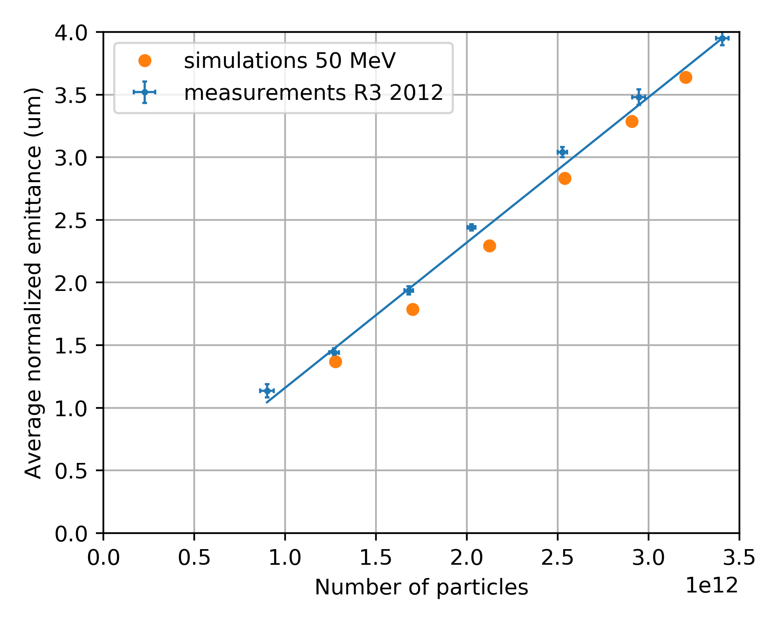
Brightness limitations: space charge
Example of the PSB:
Due to the brightness limitation imposed by space charge effects, the transverse emittance increases linearly with intensity!
Need to increase beam energy to overcome brightness limitation!

Slide 28
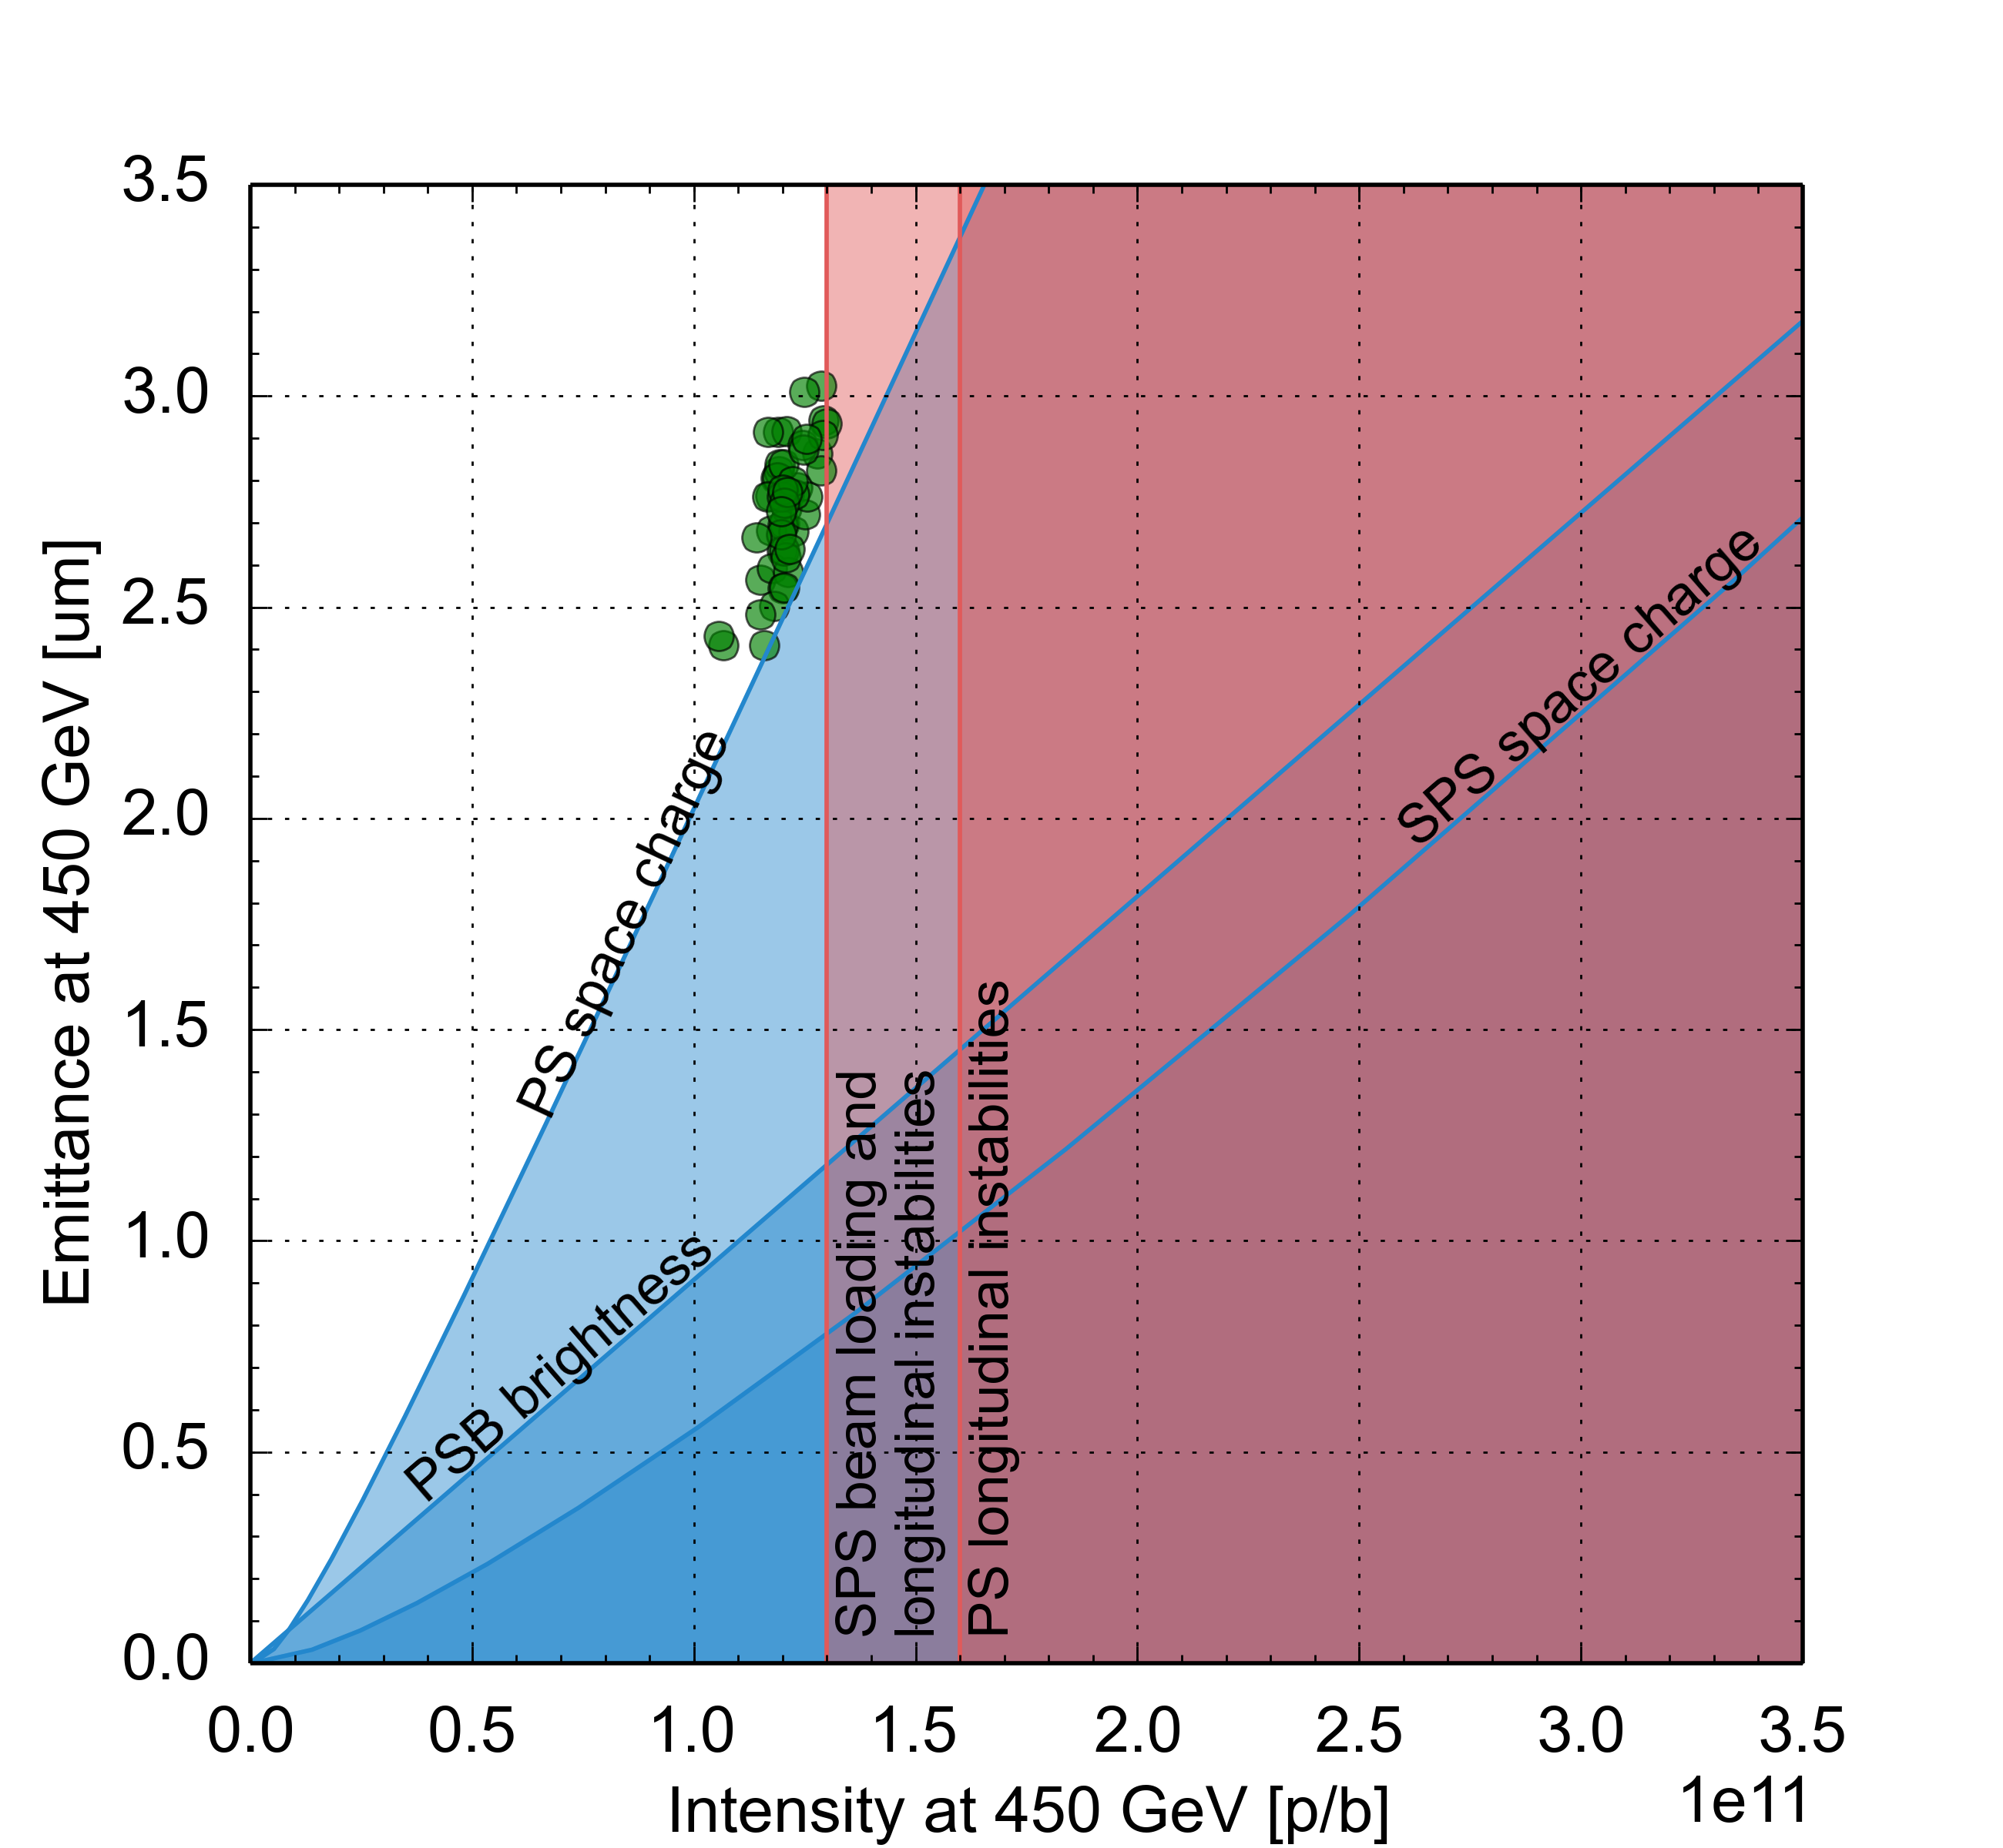
Beam performance with LIU upgrades
Effect of the LIU baseline upgrade items on beam parameter reach, based on existing machine models and anticipated equipment performance
Connection of PSB to Linac4
  Linac4 providing 25 mA within 0.4 um
  Charge exchange H⁻ injection at 160 MeV into PSB

Slide 29
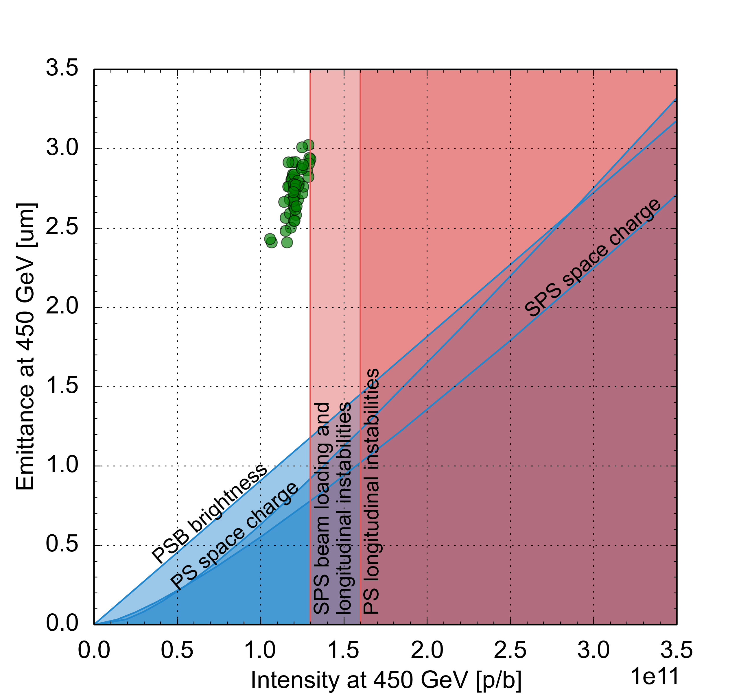
Beam performance with LIU upgrades
Effect of the LIU baseline upgrade items on beam parameter reach, based on existing machine models and anticipated equipment performance
Connection of PSB to Linac4
PSB acceleration to 2 GeV
  Reduced tune spread by 40% at PS injection due to energy scaling
  Longer bunches at PSB-PS transfer further reduce PS space charge tune spread

Slide 30
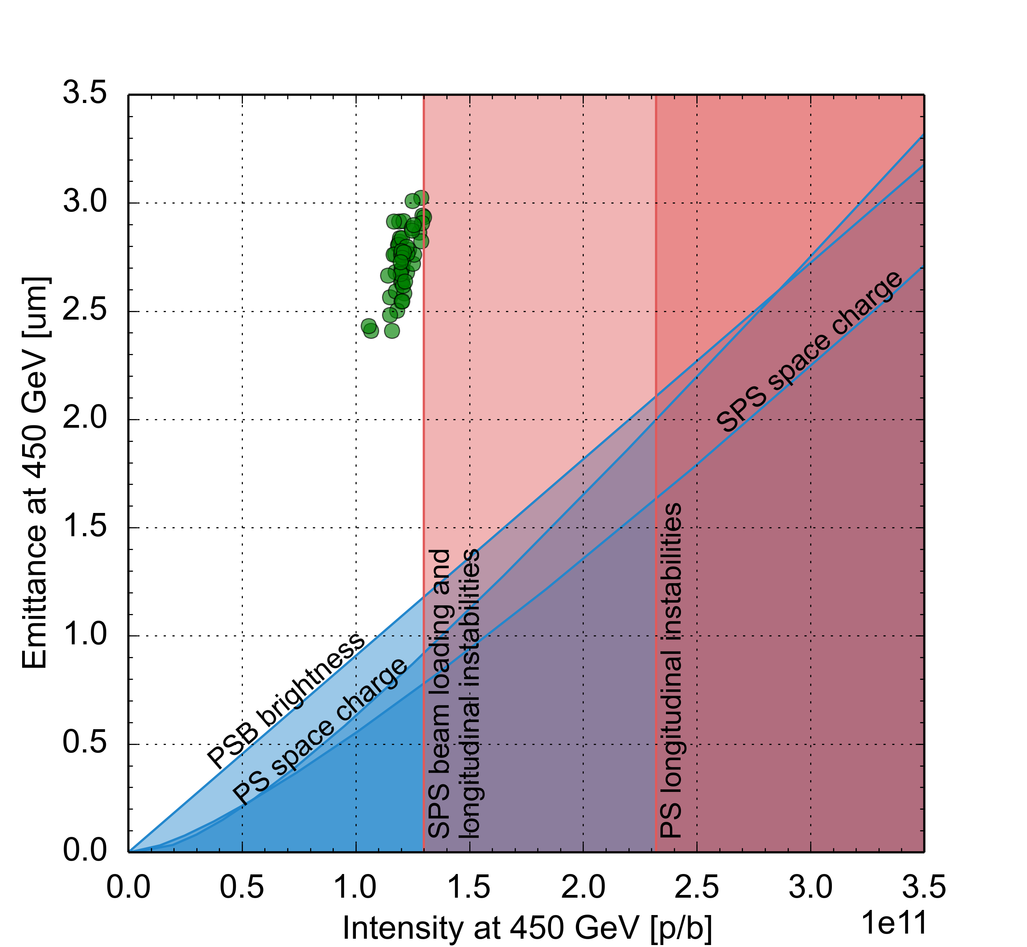
Beam performance with LIU upgrades
Effect of the LIU baseline upgrade items on beam parameter reach, based on existing machine models and anticipated equipment performance
Connection of PSB to Linac4
PSB acceleration to 2 GeV
PS RF upgrades
  New broadband cavity for longitudinal feedback system against instabilities
  Impedance reduction of RF systems
  …

Slide 31
Beam performance with LIU upgrades
Effect of the LIU baseline upgrade items on beam parameter reach, based on existing machine models and anticipated equipment performance
Connection of PSB to Linac4
PSB acceleration to 2 GeV
PS RF upgrades
SPS upgrade
  Power and LLRF upgrade of 200 MHz RF system
  Longitudinal impedance reduction
  a-C coating of focusing quadrupole chambers
  Deployment of low γ_{t} optics
  Upgrade of beam dump and protection devices

