Slide 1

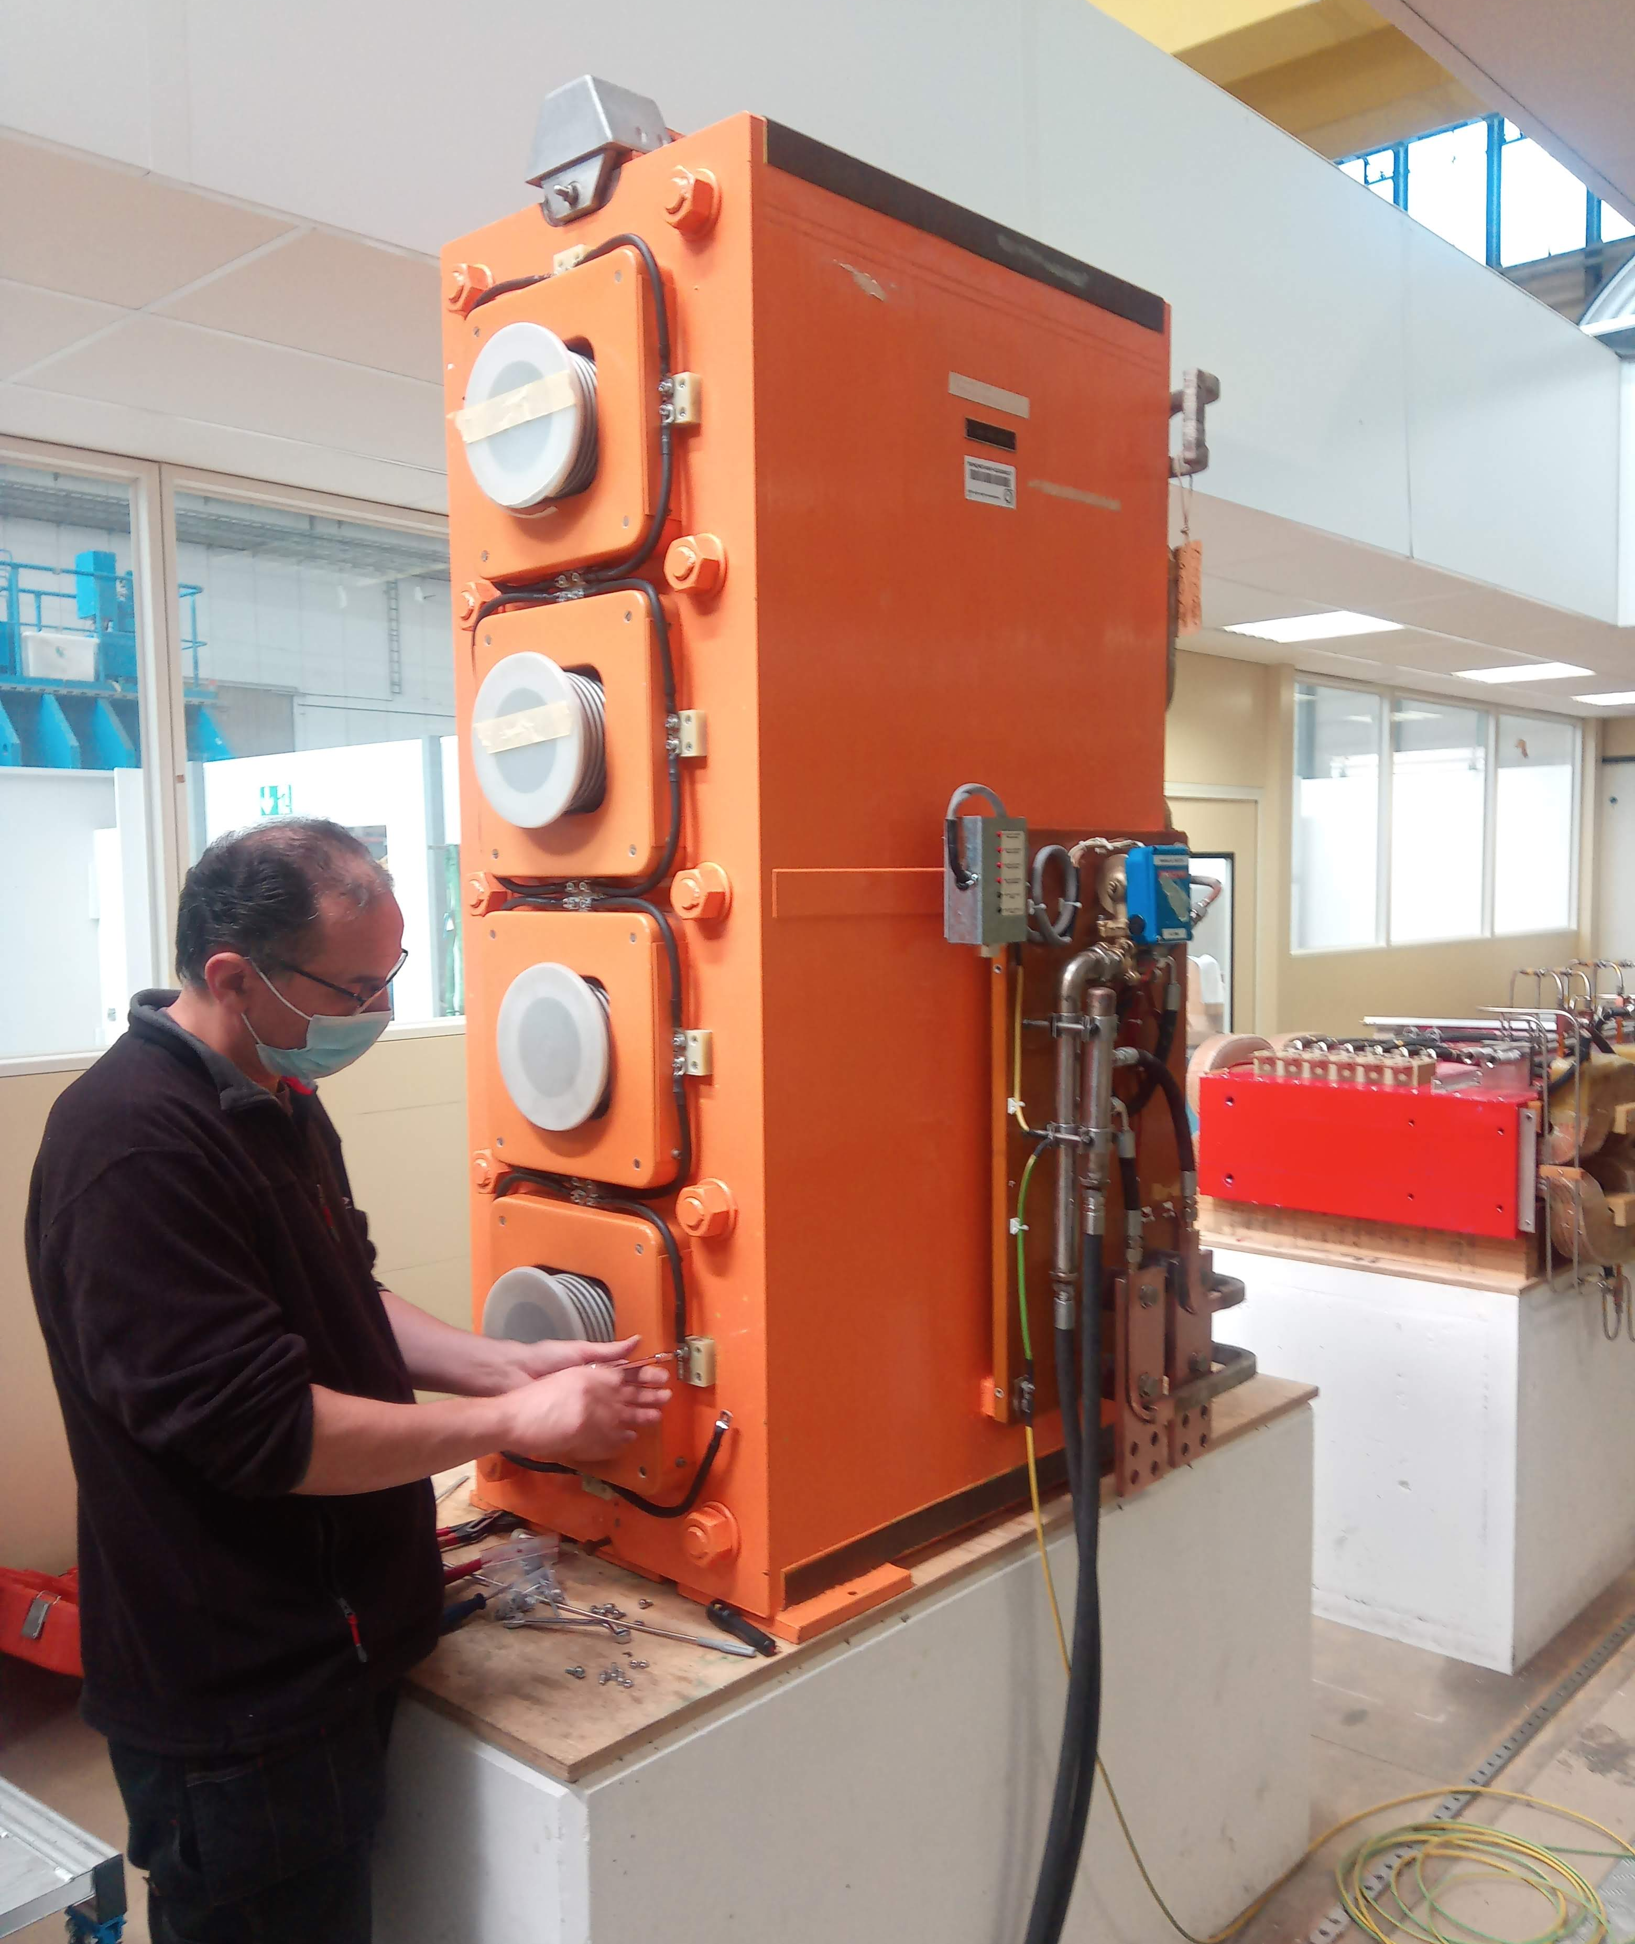

PSB Quadrupole
Renovation & Production
M. Karppinen & A. Newborough

Slide 2
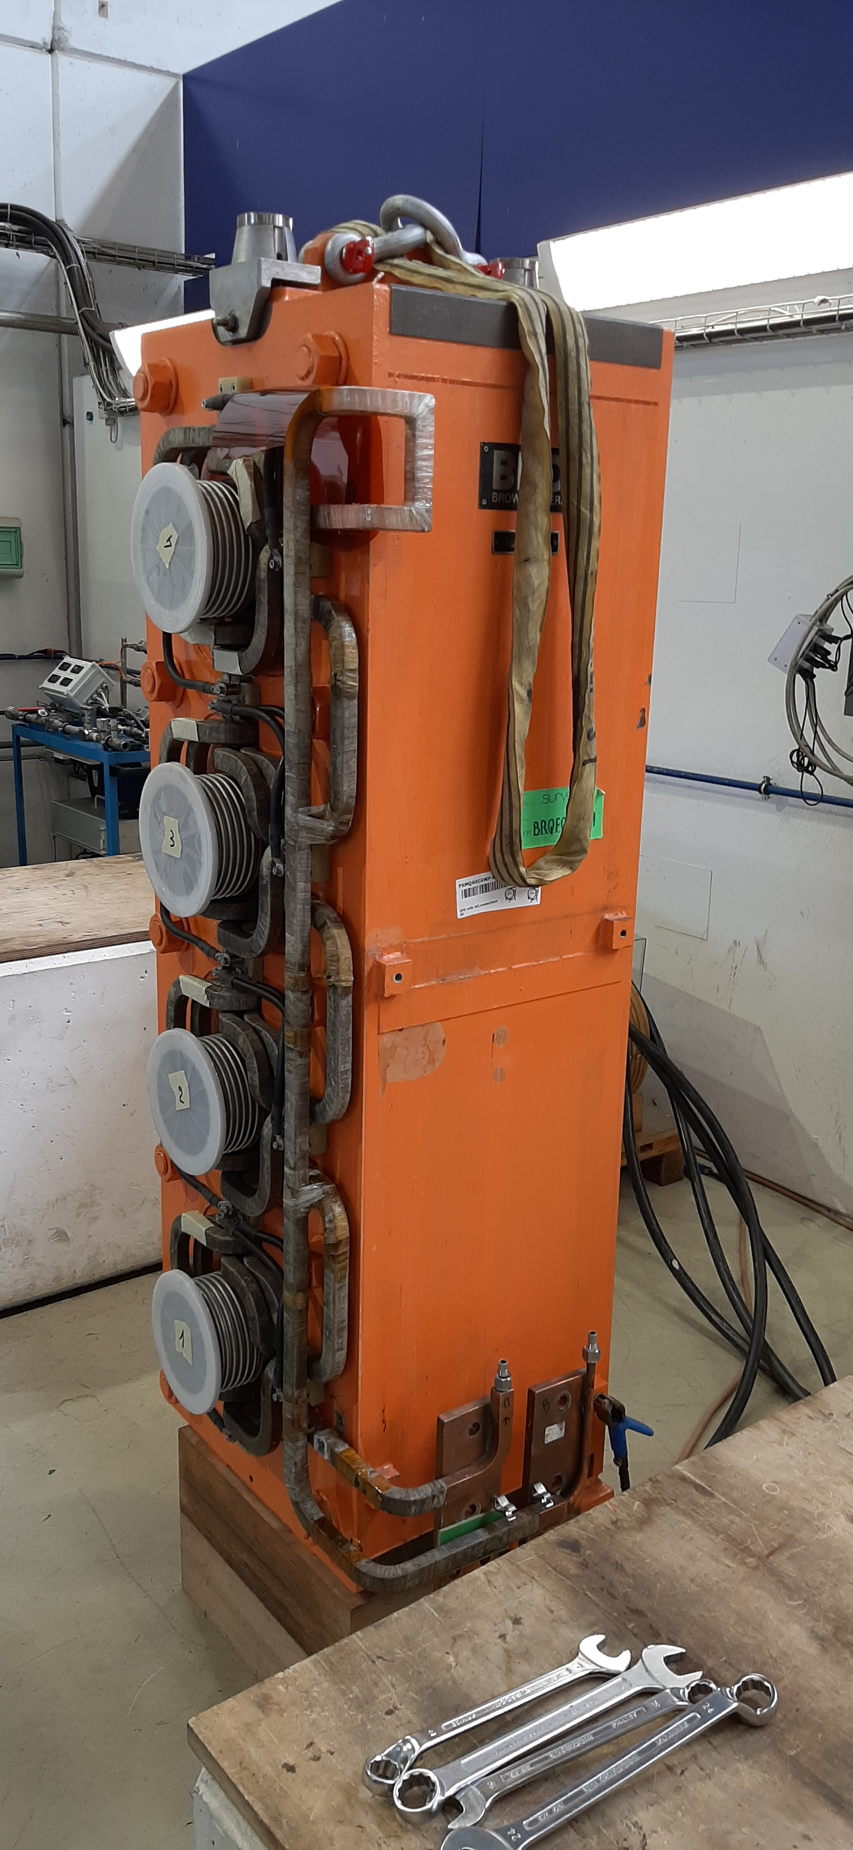
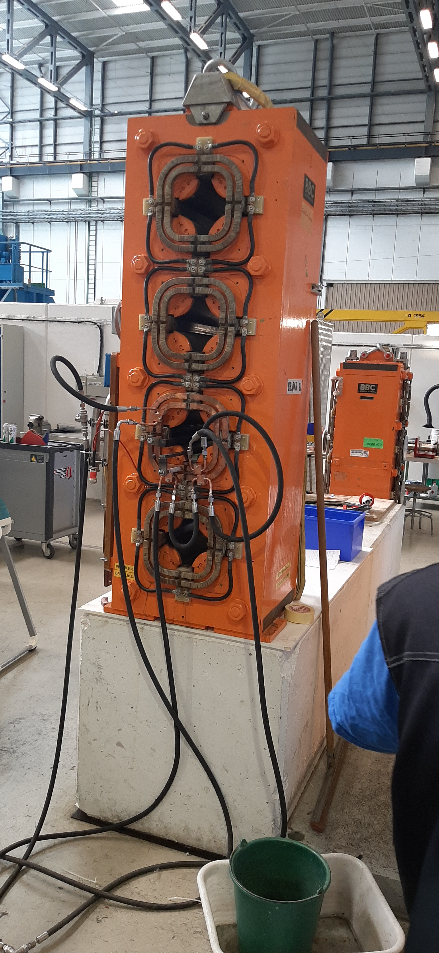
PSB Main Quadrupole
48 installed magnets of 4 types (from 1970’s)
5 Spare units
Laminated iron yoke, no split planes
Coil with 2 turns built up within the yoke
76 brazed connections
Insulation based on Mica/glass fiber wrap
VPI of the whole magnet after coil assembly
After 50 years of reliable operation, water leaks caused by selective corrosion of Cu at and adjacent to the Ag-Cu-P brazing.
Process enhanced by the presence of Sulphur in the cooling water.
Magnets are approaching the end of life and we shall consider replacing them all.

Slide 3
General Strategy
Renovation of 5 spare units at CERN
Production of up to 50 new units in industry
  Single Contractor
  Split supply: Yoke – Magnets
In the meantime corrective maintenance of leaking units
CERN supply:
  Conductor
  Iron - Yoke laminations - Yoke assemblies

Slide 4
Design File
EN-MME allocated additional external resources and progressing well
Mock-up:
  Coil design
  Bending tool, brazing jig, CNC jig
Quadrupole magnet:
  3D CATIA design of yoke, coils, assembly (Input for EM FEA vs MM)
  Yoke lamination drawing (press tool)
  First design iteration based on archived drawings
  Verification against spare magnets and reverse engineering as required
  As-built design file by Jul-23

Slide 5
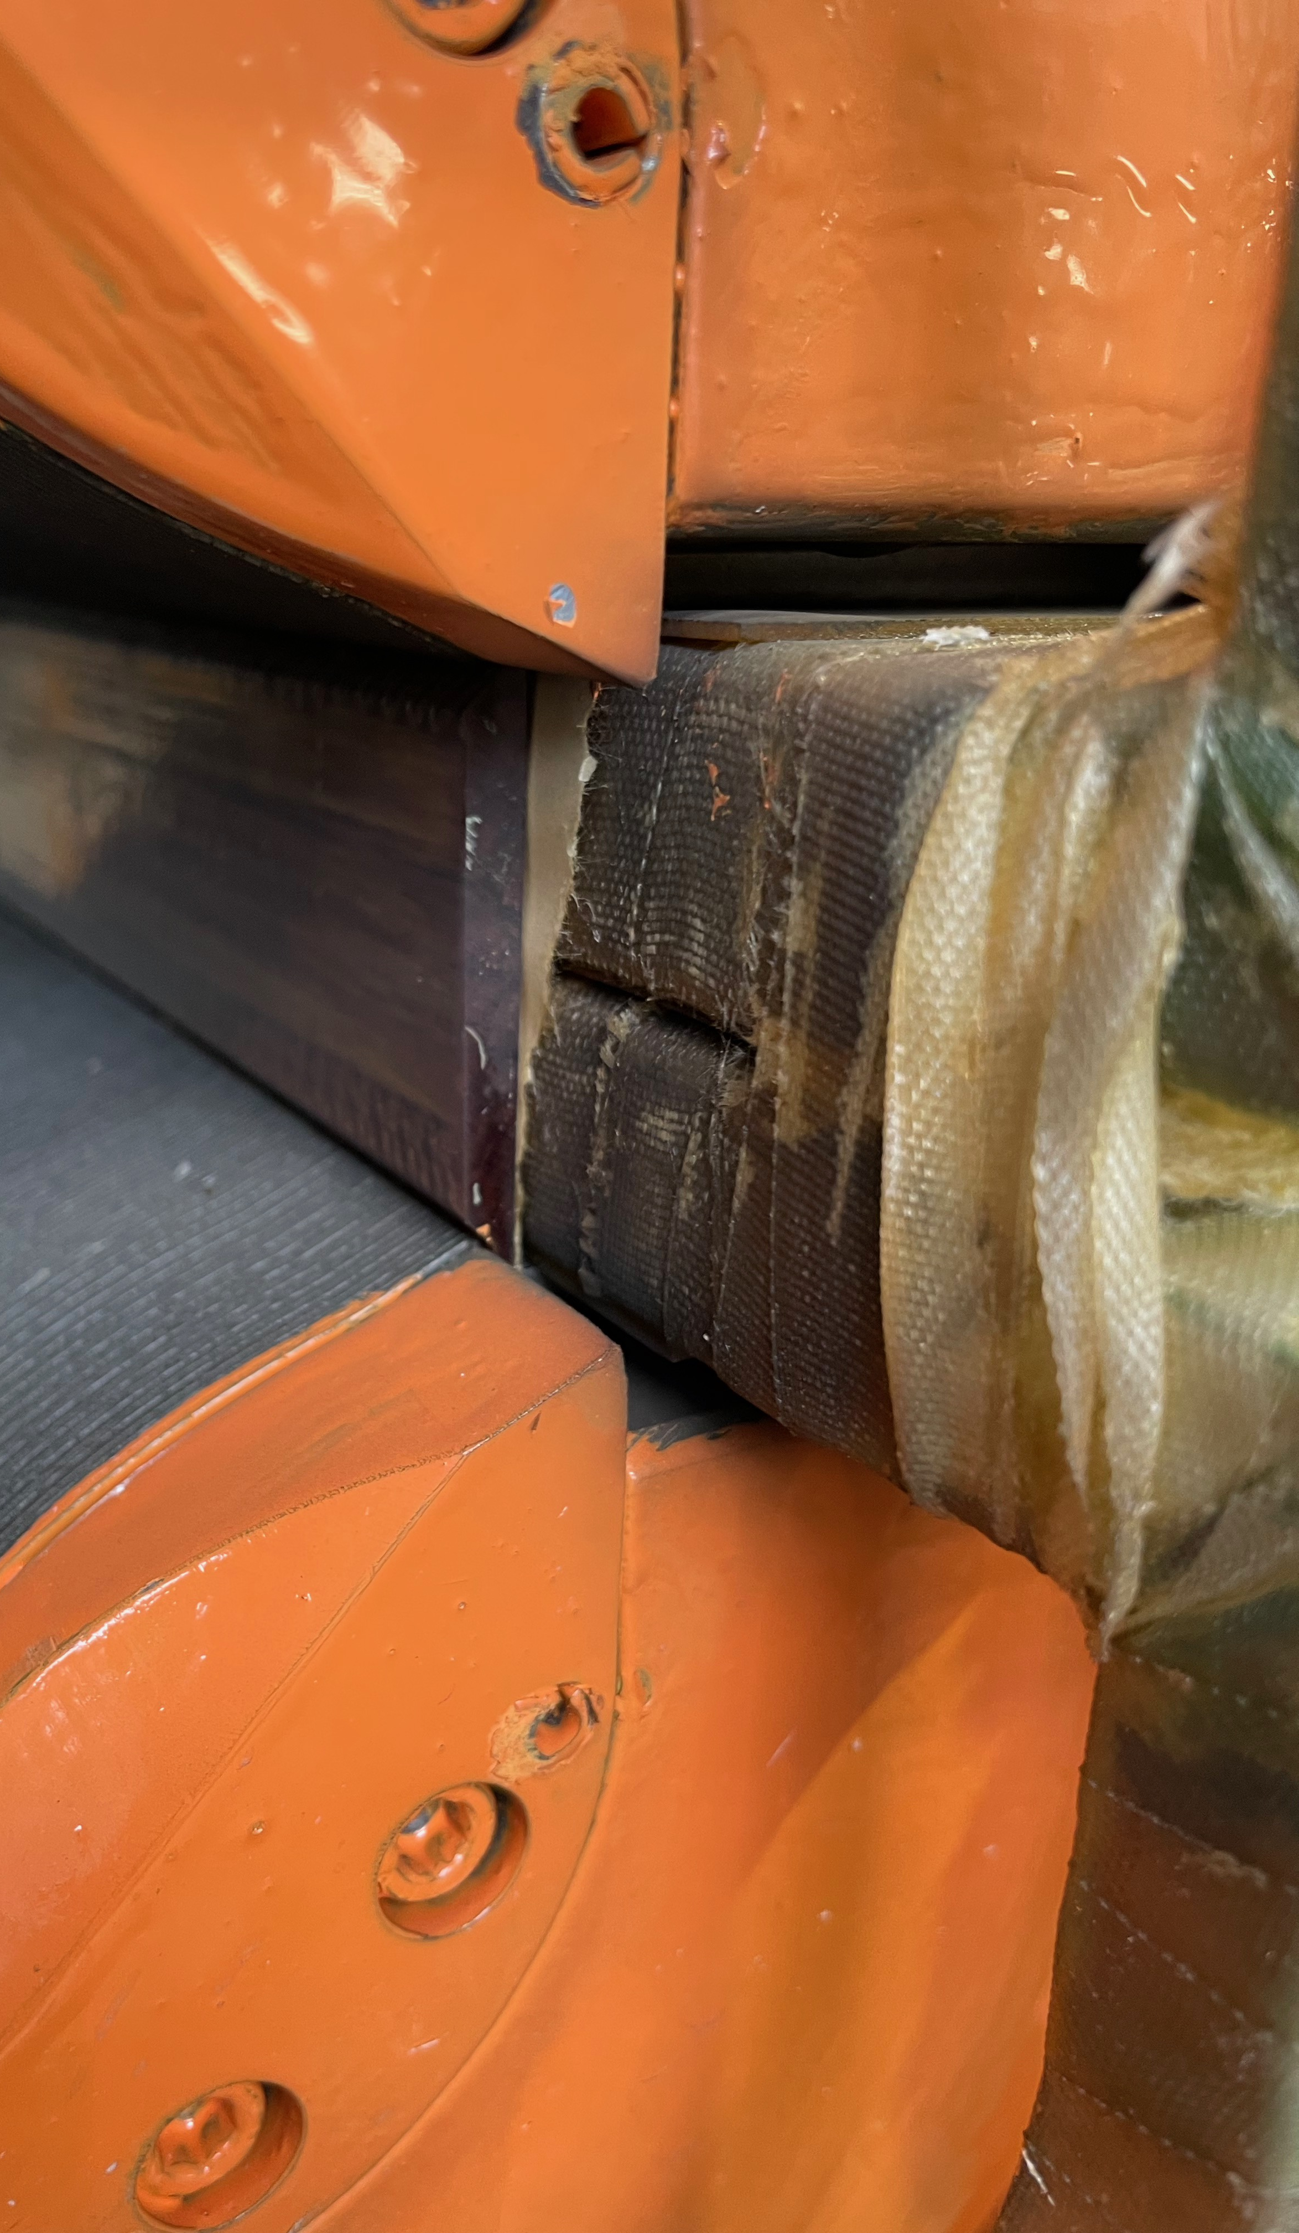
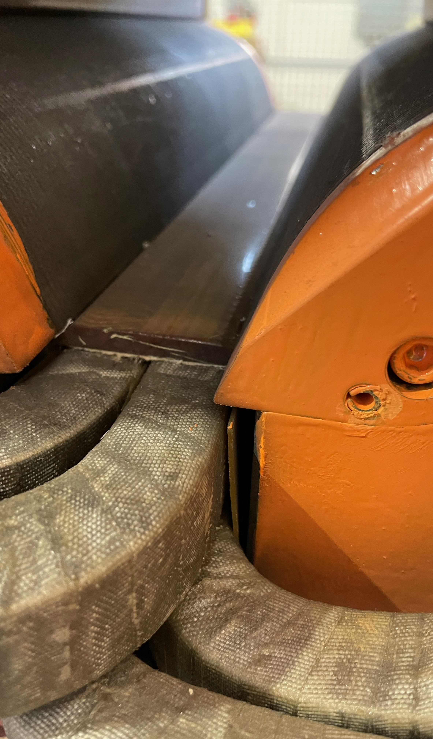
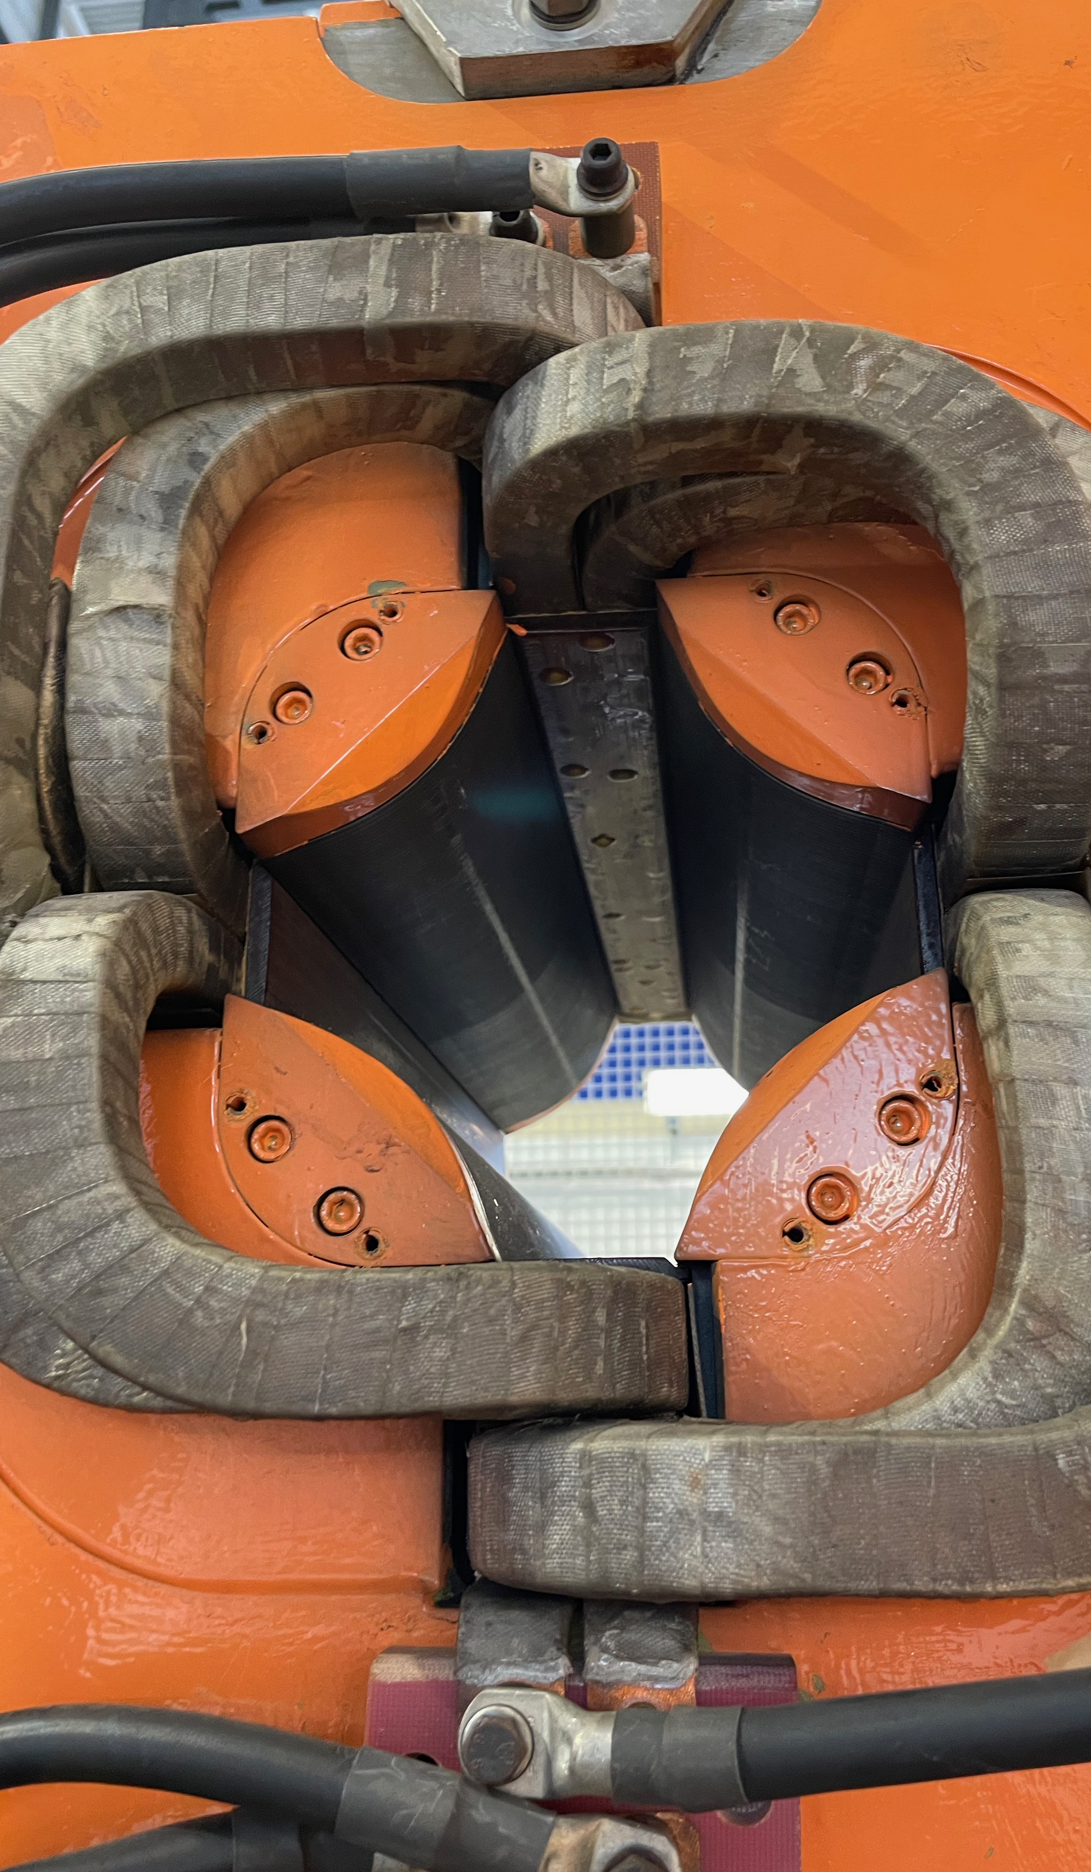

Slide 6
VPI or VARTM^{(*}
Full assembly dipped in resin followed by gelling locally around the conductor to maximise resin retention
After cleaning the excess of resin, curing in separate oven
Not clear which process was used for series magnets
VPI would ensure better impregnation within the wrapped conductor insulation, but requires investment in an autoclave
VARTM may provide adequate impregnation. Probably requires a new vacuum tank.
VPI currently not available at CERN and could provide an added value also for other projects (HFM, HTS,..)
^{*)} VPI – Vacuum Pressure Impregnation
VARTM – Vacuum Assisted Resin Tranfer Moulding

Slide 7
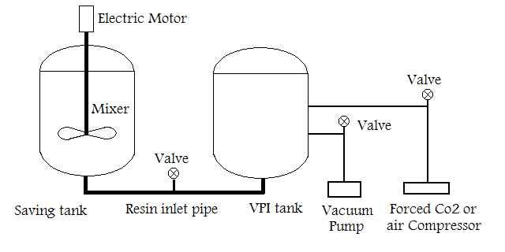
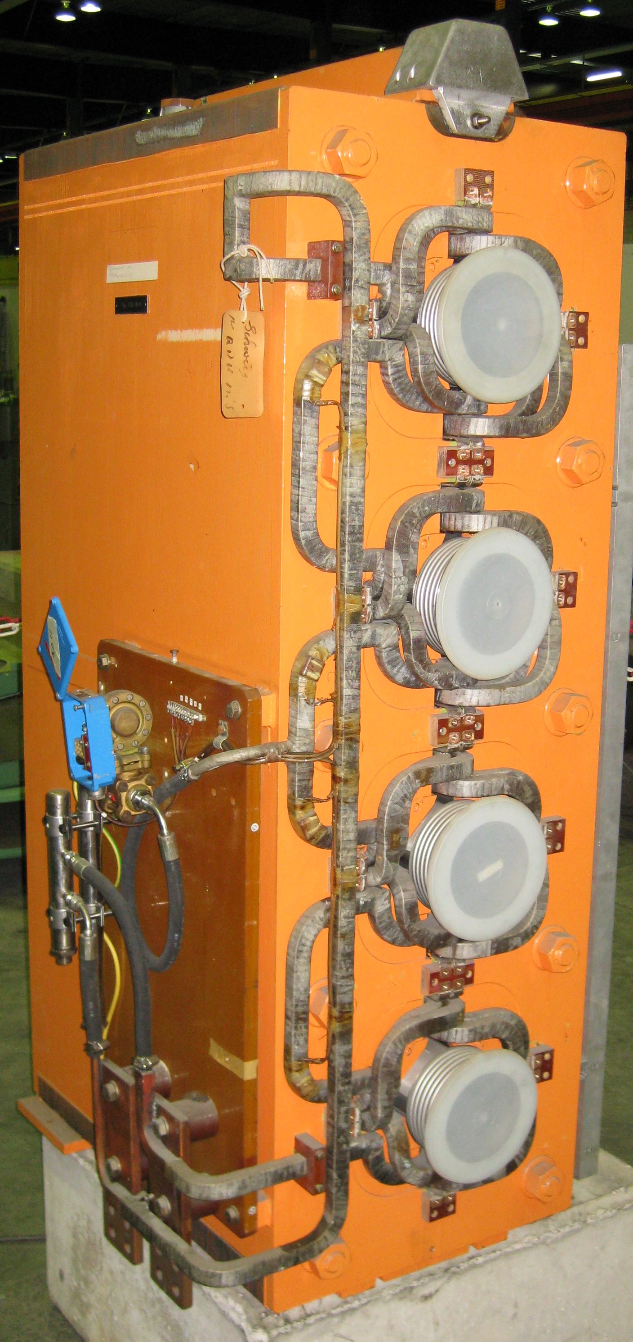
Autoclave (VPI)
Top-loaded vs. horizontal loading
Resin reservoir
Flooding reservoir
Vacuum system
Resin injection system
Pressurisation system (5-12 bars)
Heating (outgassing, injection, gelling)
Dripping of excess resin
Curing in separate oven

Slide 8
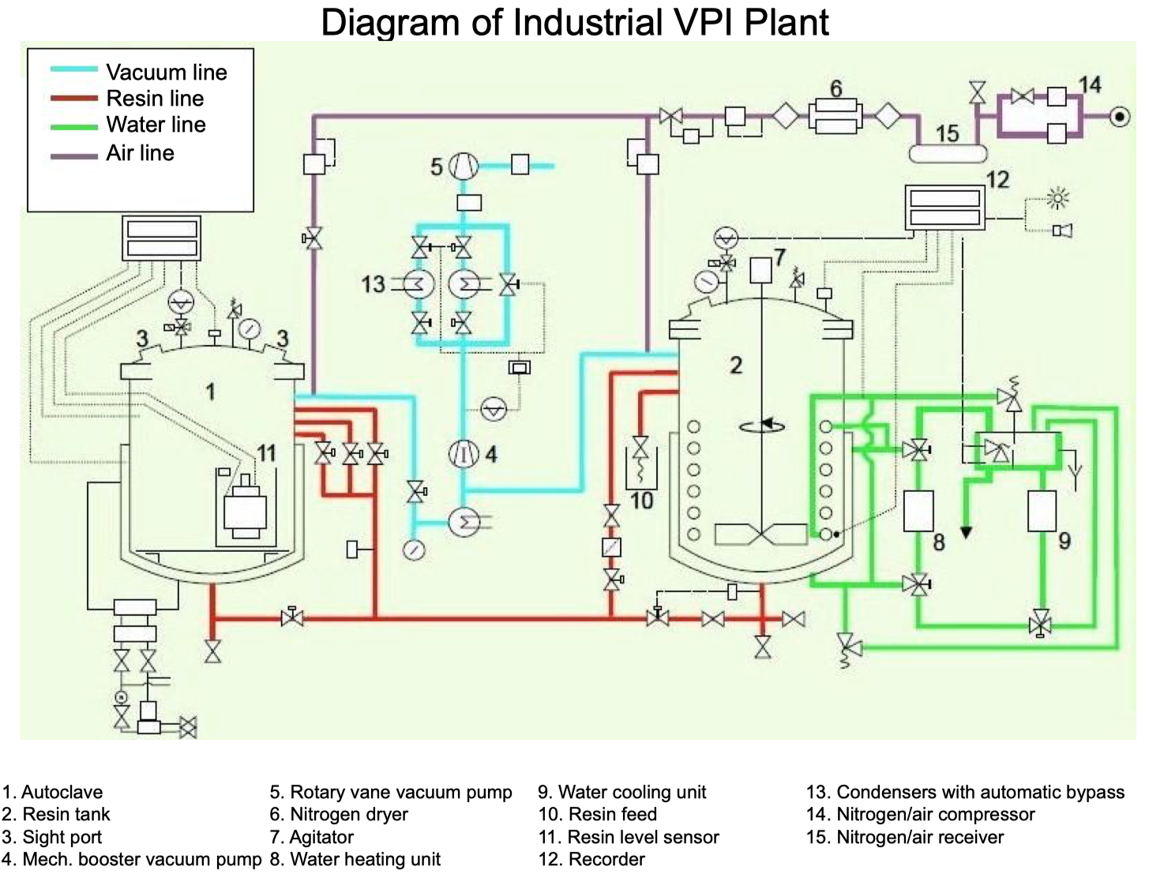
Tendering 3 months
Lead-time 5-12 months
Budget 500-700 kCHF^{(*}
^{*)}Provisional indication from 2 suppliers

Slide 9
Type D: L x W x H = (960 x 700 x 1750) mm, m = 5640 kg

Slide 10
(Possible) VPI Process overview
Coils are wrapped with dry/absorbent Mica-based insulation tape that is not cured prior to assembly in the yoke. All brazings are made before the impregnation.
The magnet assembly is dried over several hours in the autoclave under elevated temperature (~80°C) and purged with dry N₂ (or CO₂) flow at p = 1..10 mbar.
Vacuum drying at p = 0.1..0.5 mbar.
The impregnation resin is pre-heated (~60°C) and de-gassed p = ~0.5 mbar.
Magnet flooded with the epoxy resin under vacuum (~60°C).
High pressure (5-12 bars) is applied in the autoclave to push the impregnation resin into the insulation.
Raise temperature (~80°C) by hot water circulation / electric current to partially gel the resin around the conductor and/or use insulation tape with accelerator for better resin retention.
Temperature of the autoclave is decreased and the impregnation resin is pushed back to a storage tank.
The magnet is removed from the autoclave and excess of resin is cleaned off.
Curing at 80°C and 120-130 °C in an oven

Slide 11
Resin choice
Araldite F, HY 905, DY 040, DY 061 (100 pbw , 100 pbw, 0 - 20 pbw, 0.2 - 1 pbw), often used for NC magnet coils (VARTM).
Other resins to be investigated for the VPI process along with tapes with and without accelerator.
Tapes with accelerator in conjunction with bisphenol A epoxy resin and anhydride hardener are used for largest turbine generator windings because of the best impregnability of all known systems.
Sample testing & mock-up assembly to finalise the resin choice and associated process.

Slide 12
Impregnation & Insulation Samples
Impregnation samples
  As-built insulation (VPI)
  As-built insulation (VARTM)
  Tape with accelerator (VPI)
  Tape with accelerator (VARTM)
Vonroll offer (30-50 kCHF) for VPI samples
CERN polymer lab will do VARTM samples
Hot water flow
Hollow Cu- conductor
Clamp & grnd ins.

Slide 13
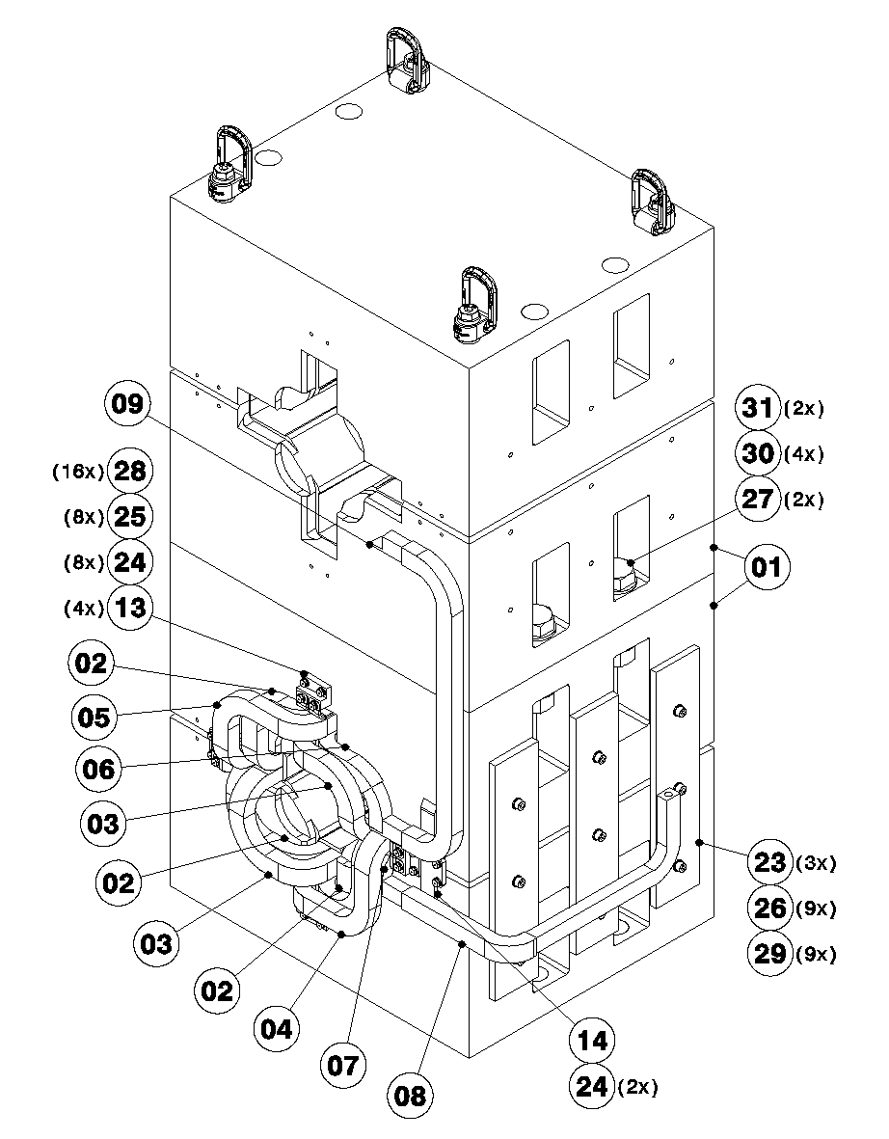
Mock-up: Coil assembly
Coil forming and preparation of parts & sub-assemblies
Representative brazing qualification samples (CT, SEM)
Connection end assembly of the coil
  SIL-FOS (as-built)
  Vacuum brazing
  Brazing JIG design
Insulation wrapping
Return end assembly of the coil in the yoke incl. trim circuit and ground insulation
  Brazing using SIL-FOS (as-built)
Insulation wrapping

Slide 14
Mock-up Impregnation
VPI at industrial partner
  Process to define and validate through samples
  Heating concept (electric, water circulation, ..)
  Resin system (viscosity, pot-life, cure-cycle)
  Insulation (with or without accelerator)
VARTM at CERN?
Stripping and cleaning of the apertures
1st assembly-disassembly completed by End-23

Slide 15

Renovation of 5 Spare Units
Activated magnets
  Shipping outside of CERN complicated (possible?)
  Safety aspects related to dismounting of the coils
Infrastructure
  Autoclave
  Curing oven
Stripping and re-assembly process to validate with mock-up
Cost estimate 1.35 MCHF (5 magnets incl. 540 kCHF for Autoclave & oven)
1st certified unit by (earliest) Mid-2024
Unit #2 completed End-24
Unit #5 completed Mid-26

Slide 16
Production of New Magnets
Tendering process (MS & IT) targeting FC in March-24
Strategy:
  Scenario 1: Single Contractor for the entire supply
  Scenario 2: Split supply: Yoke – Magnet assembly
CERN supplied items:
  Conductor
  Iron sheets
  Option 1: Yoke laminations (press-tool)
  Option 2: Yoke assemblies (stacking fixture)

Slide 17
Production Scenario 1:
Scenario 1: Single Contractor for the entire supply
2 parallel production lines
CERN supplied items:
  Conductor (~380 kCHF)
  Iron sheets (~433 kCHF)
  Option 1: Yoke laminations (press-tool) (~270 kCHF+150kCHF = 420 kCHF)
50 off magnets (~5.46 MCHF contract, excl. CERN supplied items)^{(*}
Pre-series unit validated by (earliest) Mid-25
10 series magnets Q3-26
20 series magnets Q3-27…
^{*)} +Set of vacuum chamber & bellows ~7 kCHF

Slide 18
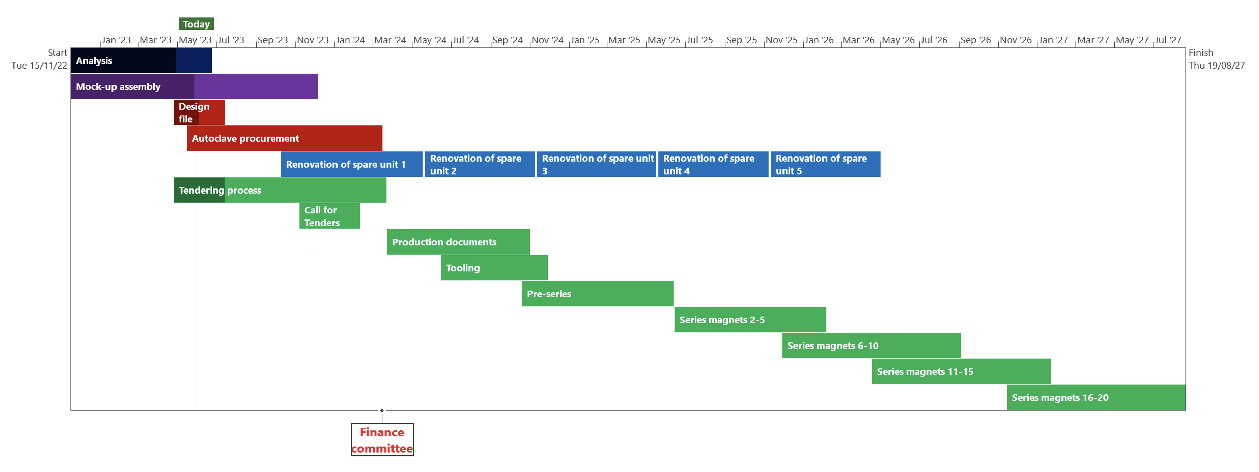
Project Time-line: Scenario 1
Link to
MS Project GANTT (Full pdf)

Slide 19
Production Scenario 2:
Scenario 2: Split supply: Yoke – Magnet assembly
1 production line for yoke assembly (sequential production)
2 parallel production lines for magnet assembly
CERN supplied items (50 off magnets):
  Conductor (~380 kCHF)
  Iron sheets (~435 kCHF)
  Option 1: Yoke laminations (press-tool) (~270 kCHF+150kCHF = 420 kCHF)
  Option 2: Yoke assemblies (stacking fixture) (42 kCHF x 50 = 2.1 MCHF all included)
    Pre-series yoke by Mid-24
    5 Yoke assemblies by End-24
50 off magnets (~4.96 MCHF contract, excl. CERN supplied yoke assemblies) ^{(*}
Pre-series unit validated by (earliest) Mid-25
10 series magnets Beg-26
20 series magnets Q3-26…
Rebuilding 4 or 5 Spare magnets at CERN
^{*)} +Set of vacuum chamber & bellows ~7 kCHF

Slide 20
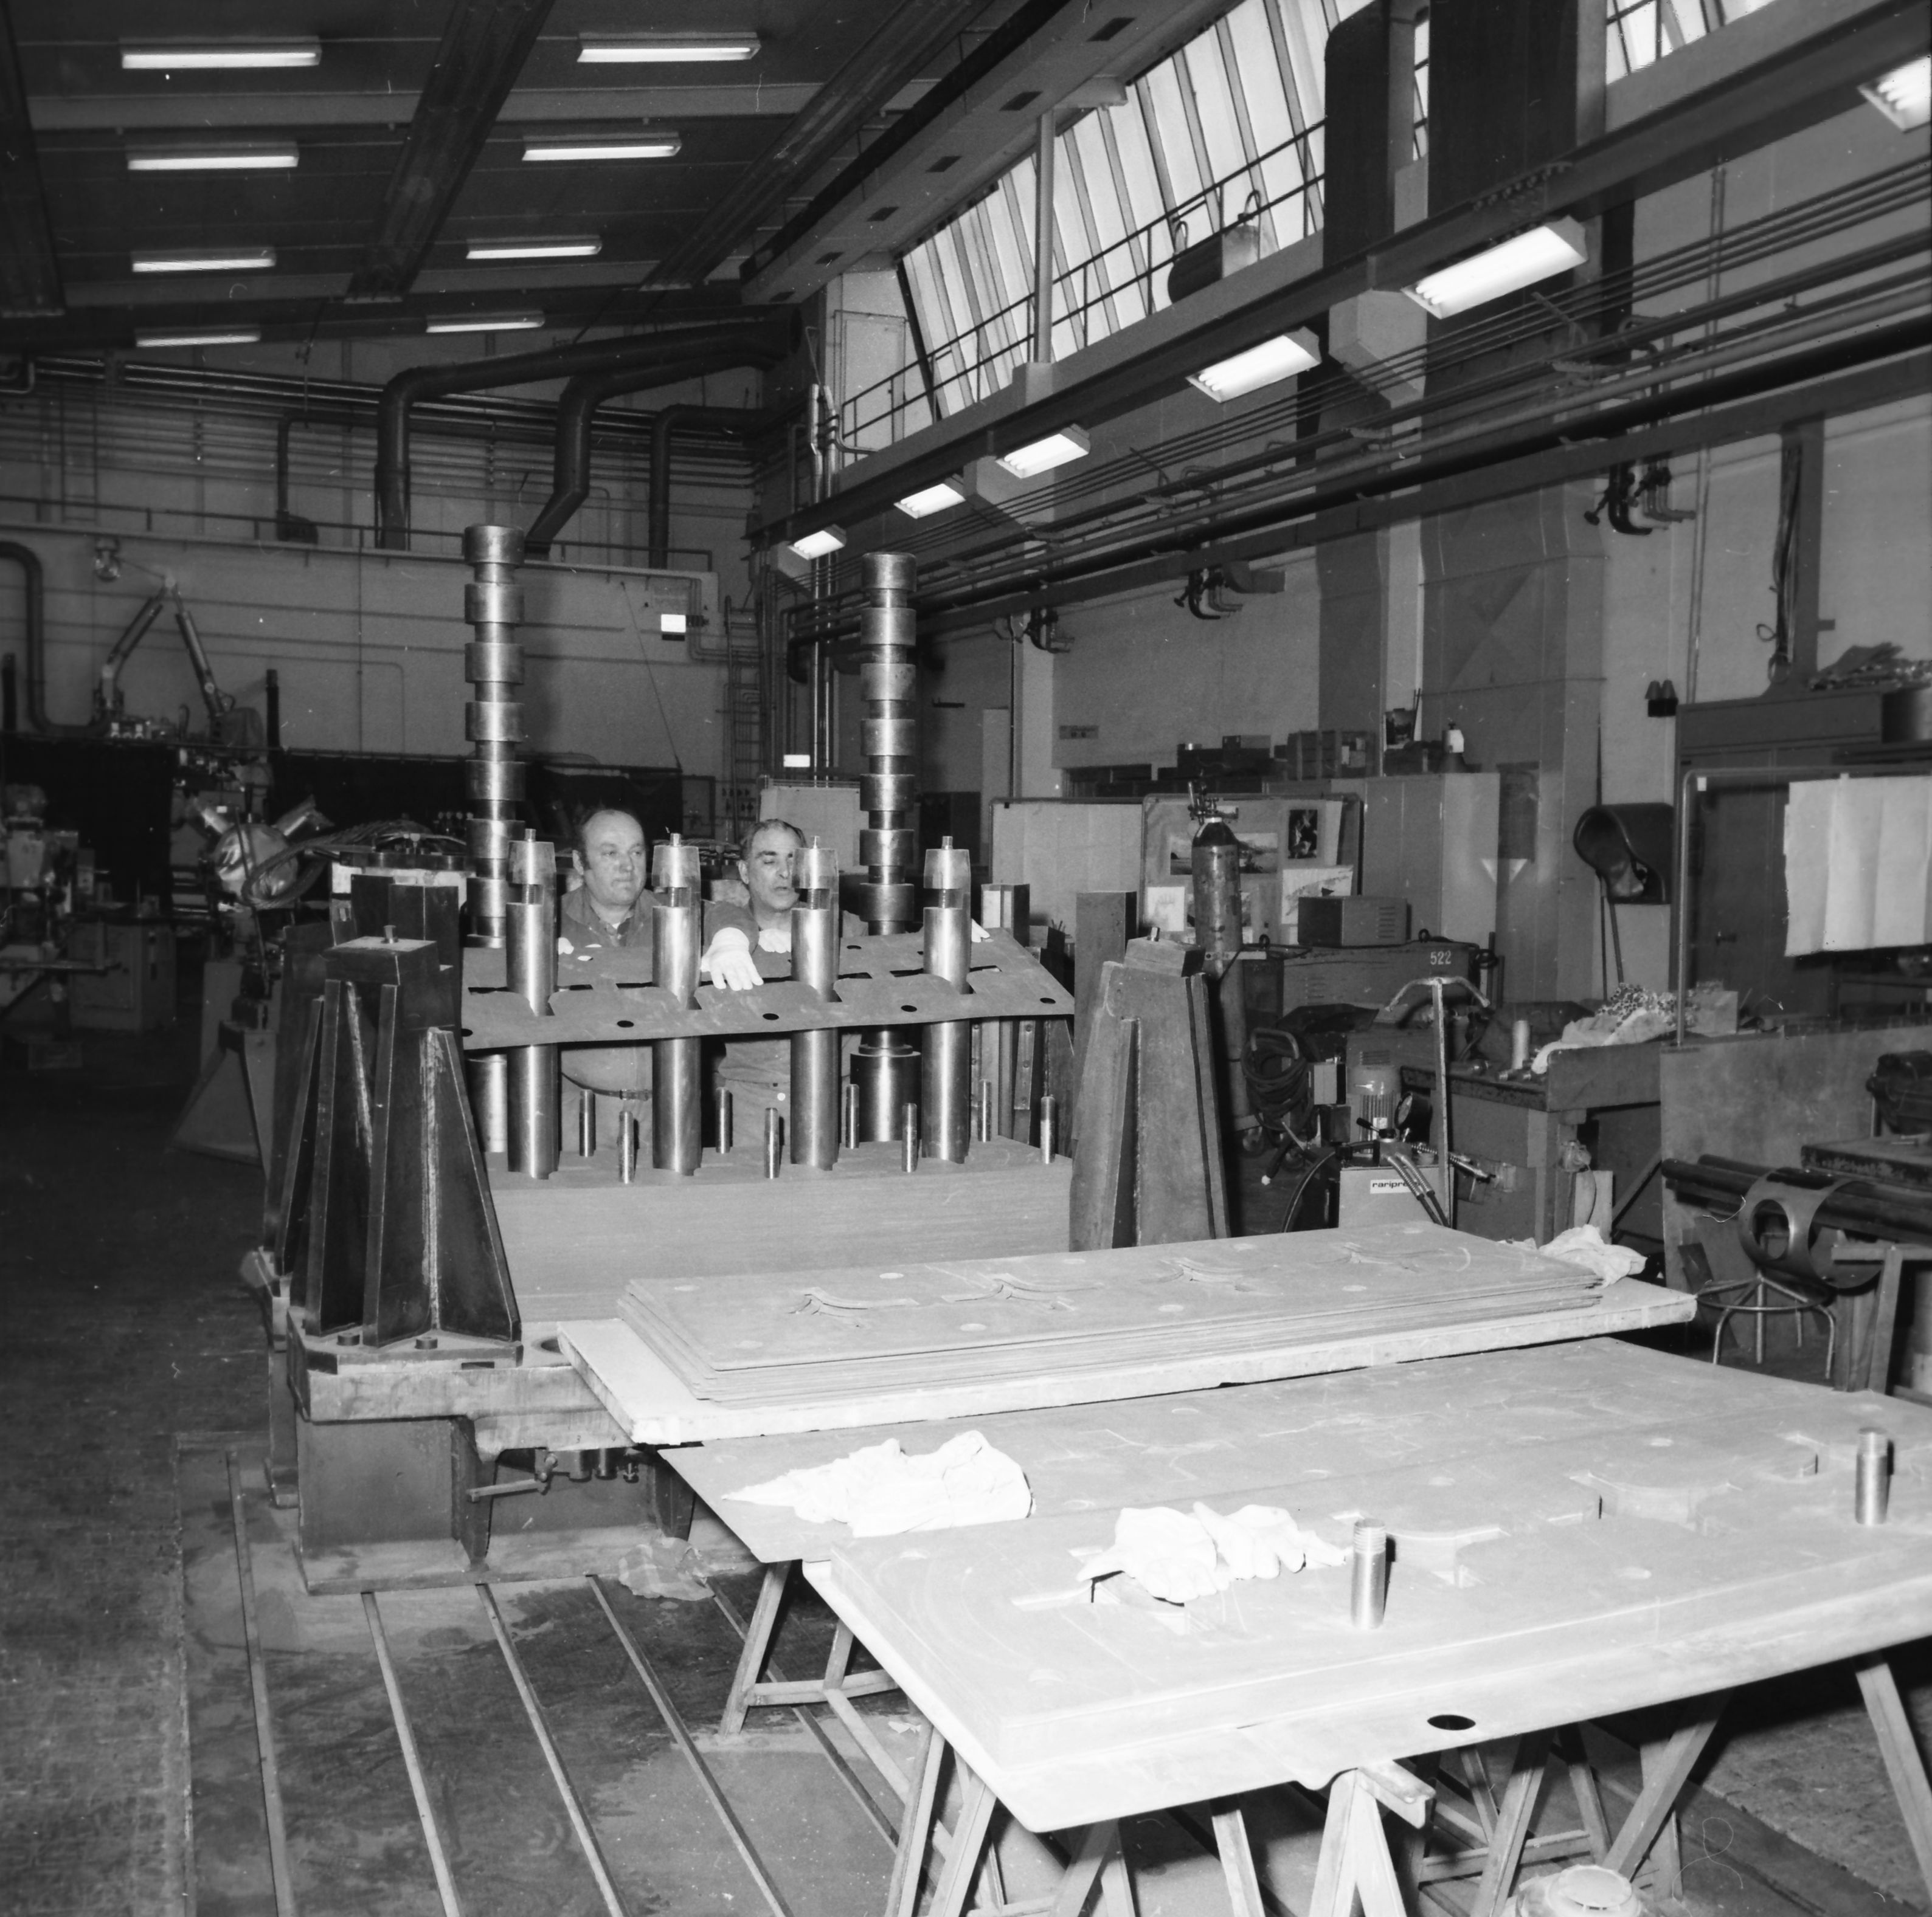
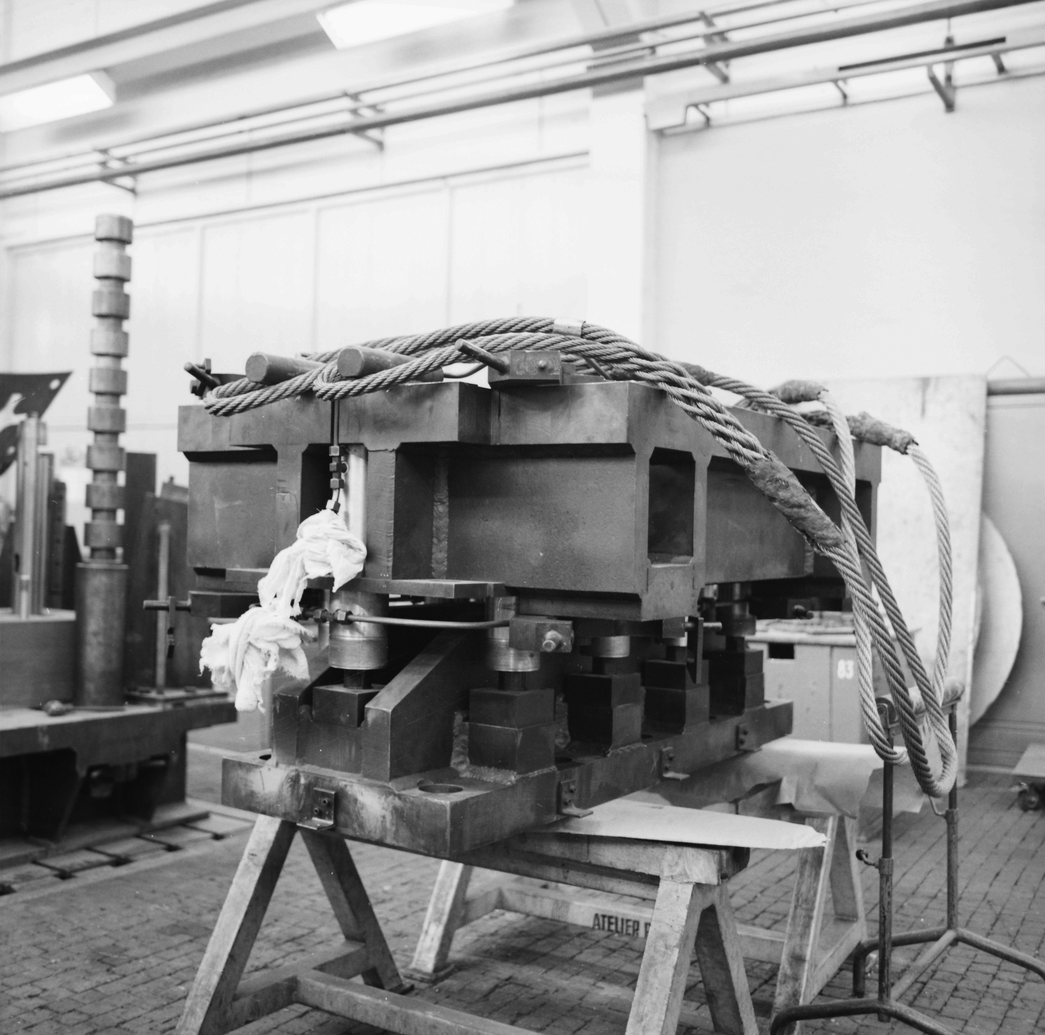
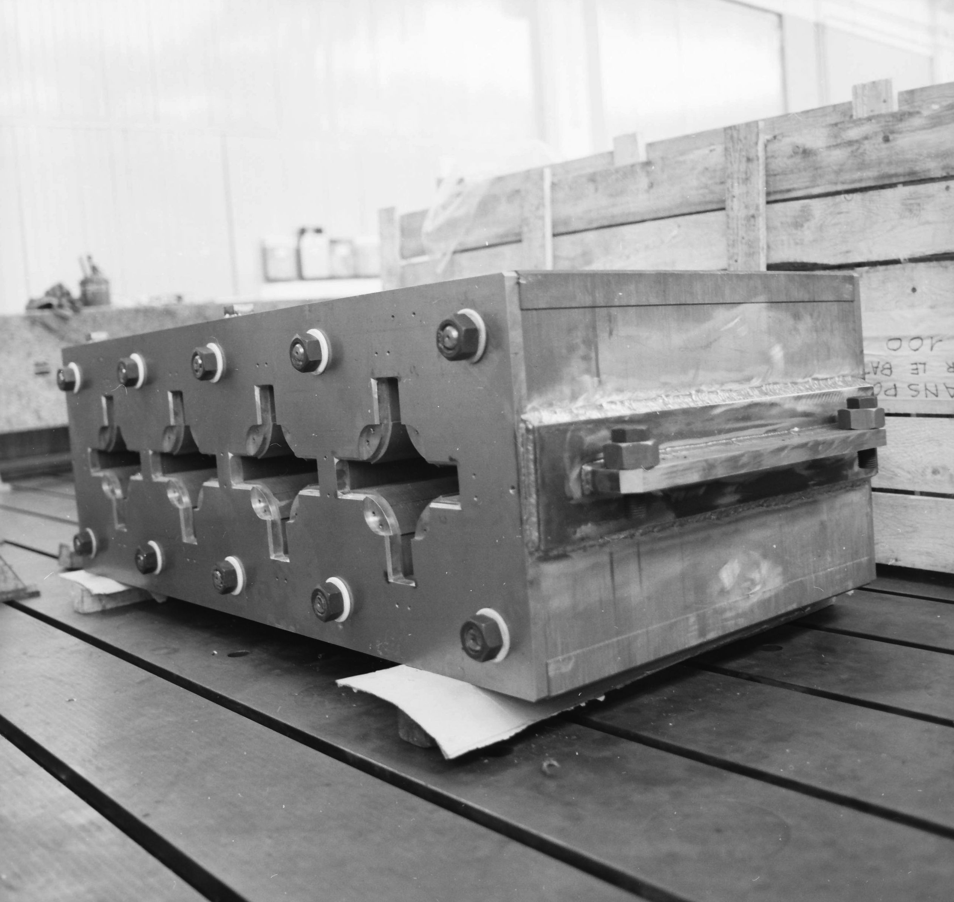
Yoke Assembly

Slide 21
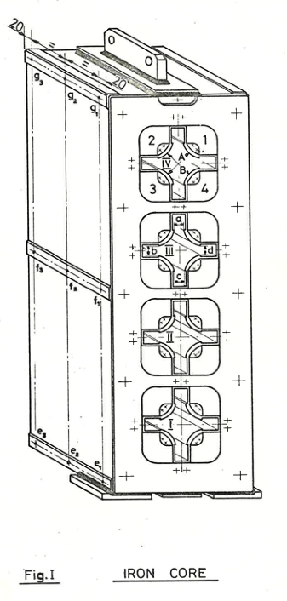
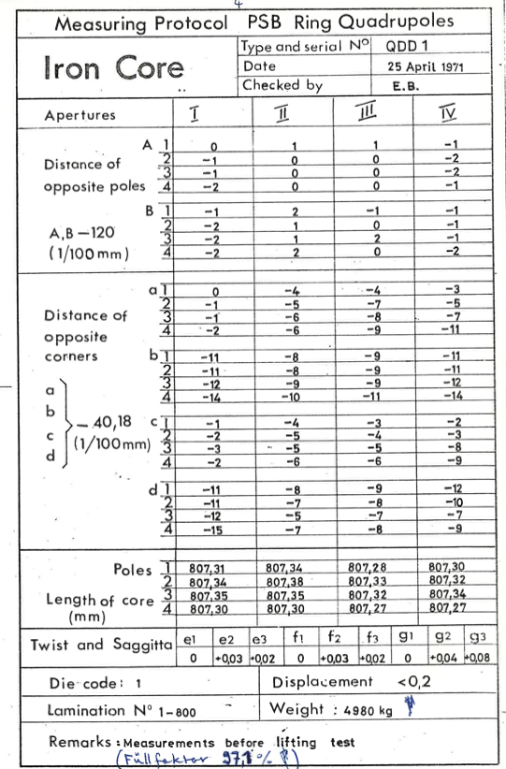
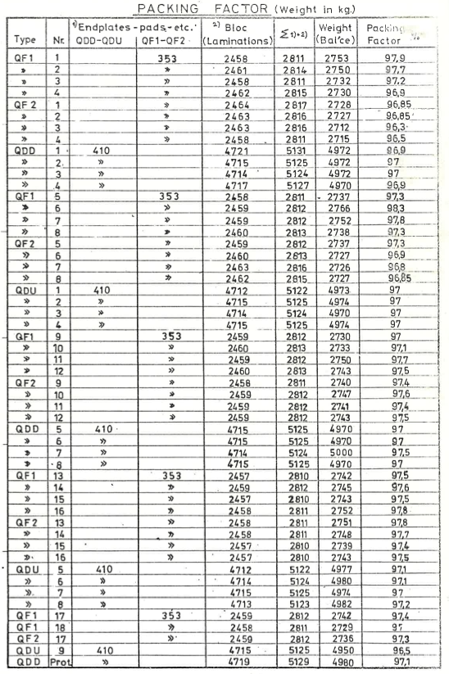
Example of Series Yoke Metrology

Slide 22
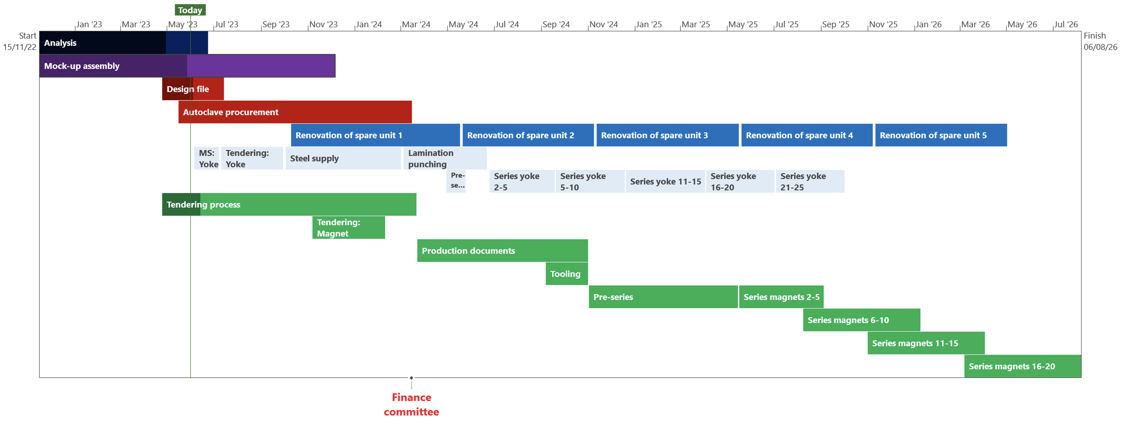
Project Time-line, Scenario 2
Link to
MS Project GANTT (Full pdf)

Slide 23
Cost Estimate: Scenario 2
CERN:
Renovation of 1 unit
Rebuilding 4 units
Cu-conductor
Iron sheets
Yoke laminations
54 Yoke assemblies
Certification
Contract:
Assembly of 50 magnets

Slide 24
Proposed Strategy
Complete design file
Procurement of an autoclave
Mock-up to define the process, VPI in industry
CERN to launch production of the yoke assemblies (50-56 off)
Launch industrial procurement of up to some 50 units
Renovation of 1 spare unit at CERN, depending on yoke supply
Assembly of up to 5 magnets at CERN with new yoke assemblies
It is not possible to replace all magnets at once, strategy required extending over multiple shutdowns

Slide 25
Complementary slides

Slide 26
Cost-estimate
Tooling
Material
Components

Slide 27
DO & FSU

Slide 28
Renovation of 1 Spare & Re-building 4

Slide 29
Production 50 Magnets
Yoke Assemblies by CERN
Does not include:
Engineering
Profit margin
Risk
…

