Slide 1
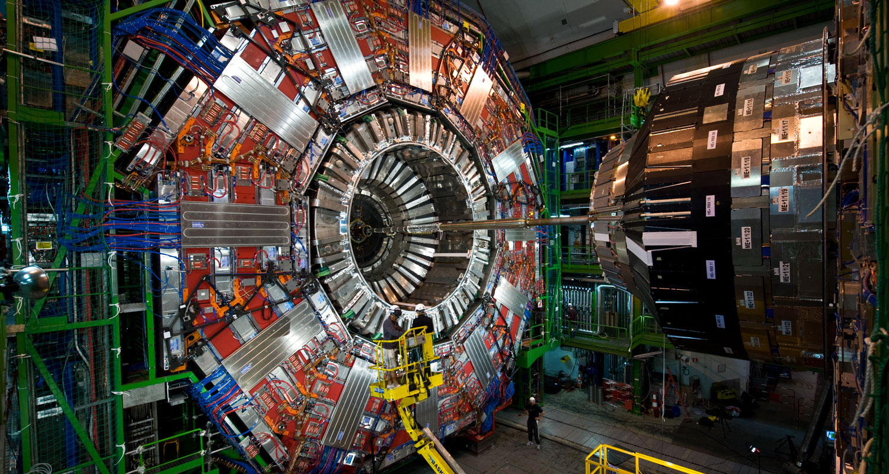
Overview of High Energy Physics research on CMS
Jay R. Dittmann
Baylor HEP Mini-Symposium
Day 1 – June 5, 2023

Slide 2
The Large Hadron Collider
“the machine”

Slide 3
The Large Hadron Collider
“the machine”

Slide 4
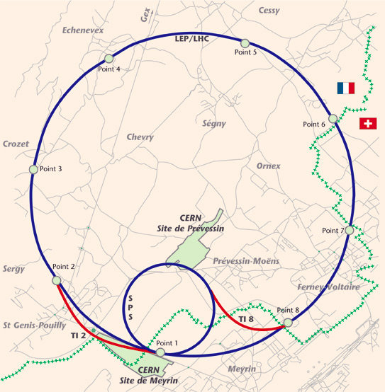
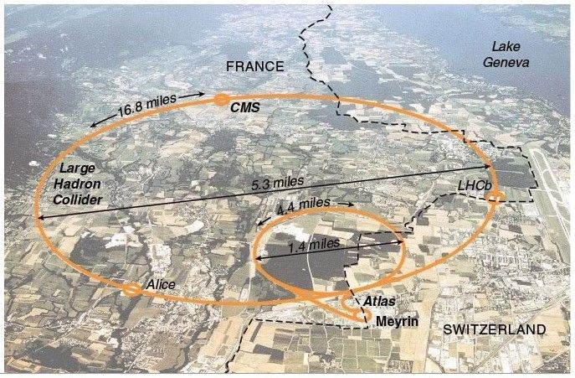
The Accelerator Complex at CERN

Slide 5
The Accelerator Complex at CERN
PS Booster: 1.4 GeV
PS: 25 GeV
SPS: 450 GeV
LHC: 6.8 TeV

Slide 6
CMS at the Large Hadron Collider
, France

Slide 7
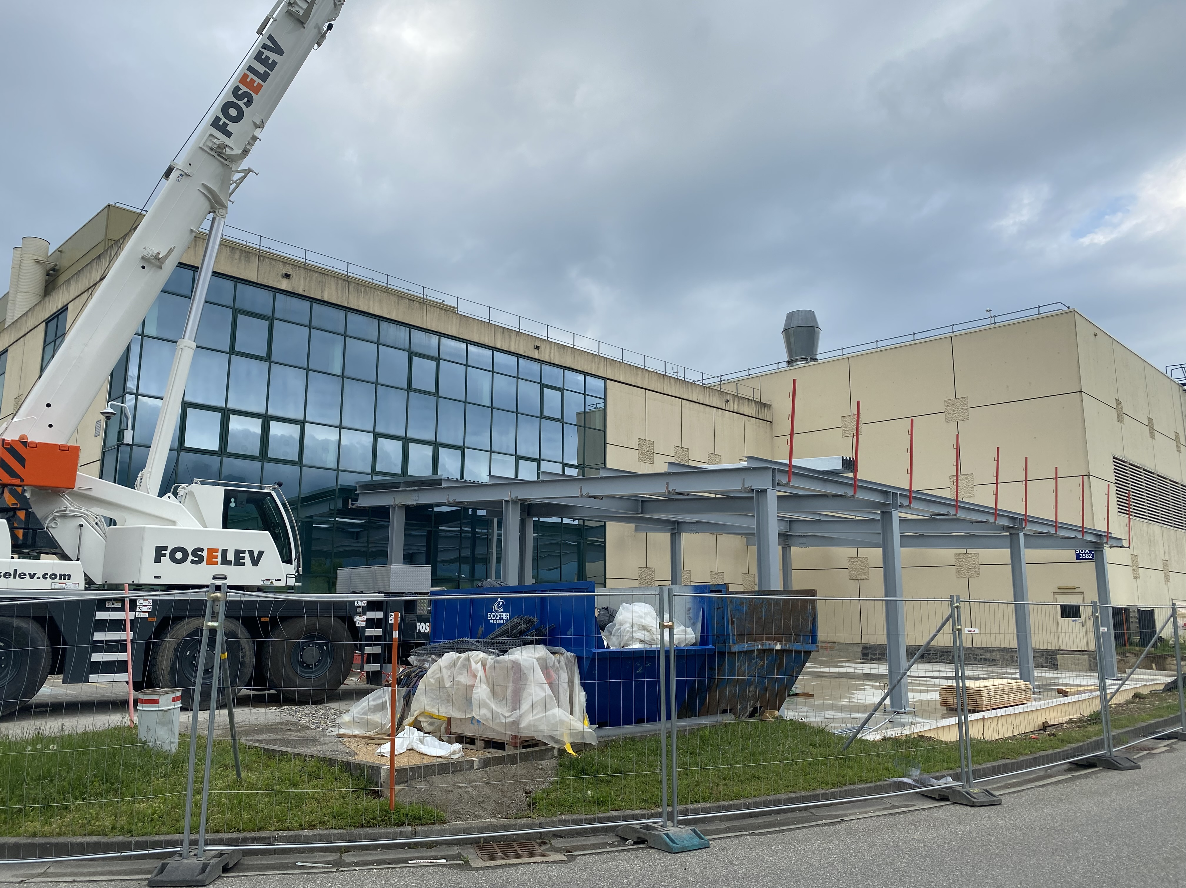
CMS at Point 5
new control room under construction

Slide 8
The Compact Muon Solenoid Detector

Slide 9
The Compact Muon Solenoid Detector

Slide 10
The Compact Muon Solenoid

Slide 11
CMS: The First 25 Years

Slide 12
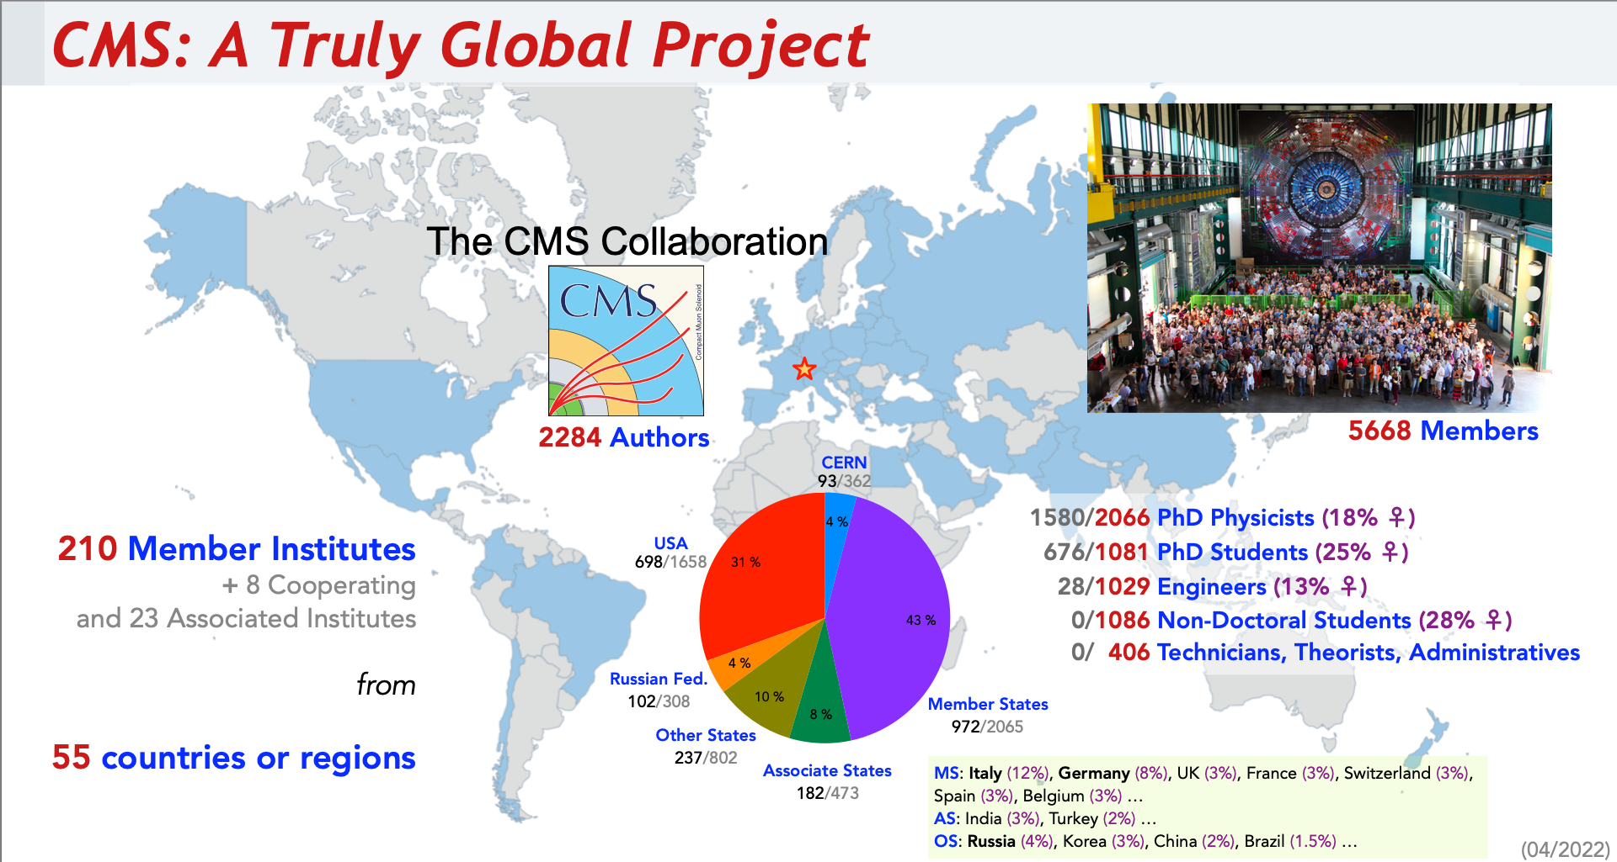
CMS: A Truly Global Project

Slide 13
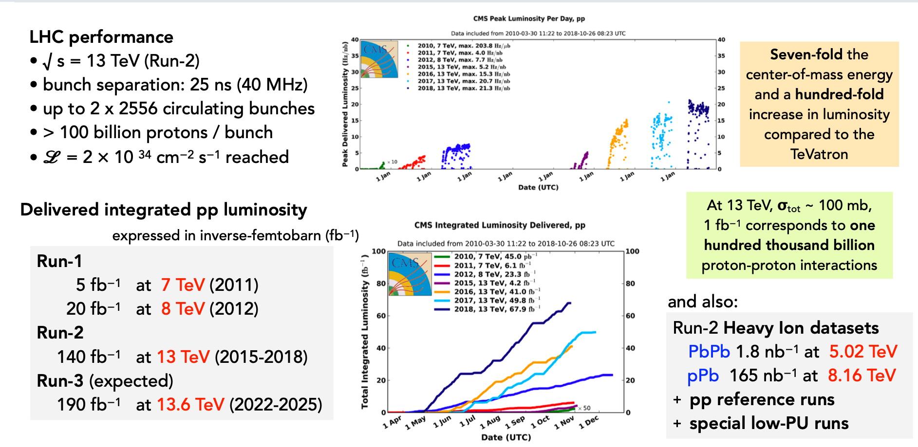
LHC Luminosity

Slide 14
Proton-Proton Interactions at the LHC

Slide 15
Stairways to .... new discoveries?

Slide 16
Stairways to .... new discoveries?

Slide 17
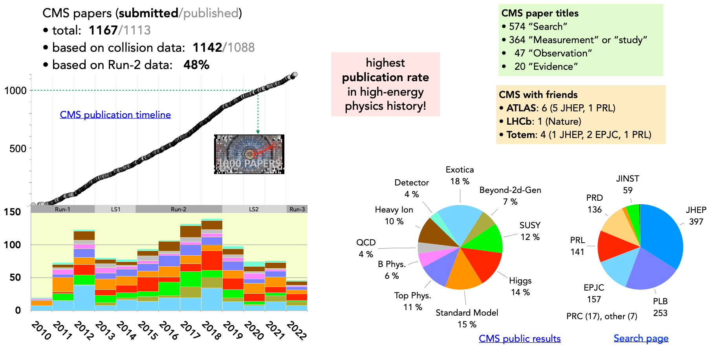
CMS Publications
(as of June 2022)

Slide 18
En Route to Higher Luminosity

Slide 19
It’s Only the Beginning!

Slide 20
CMS Phase 2 Upgrades

Slide 21
CMS Organization
...based on the CMS Constitution

Slide 22
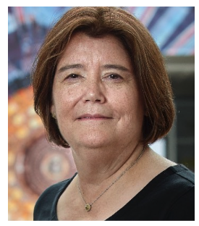
CMS Organization
Patricia McBride
CMS Spokesperson
2022-2024

Slide 23
CMS Organization

