Slide 1
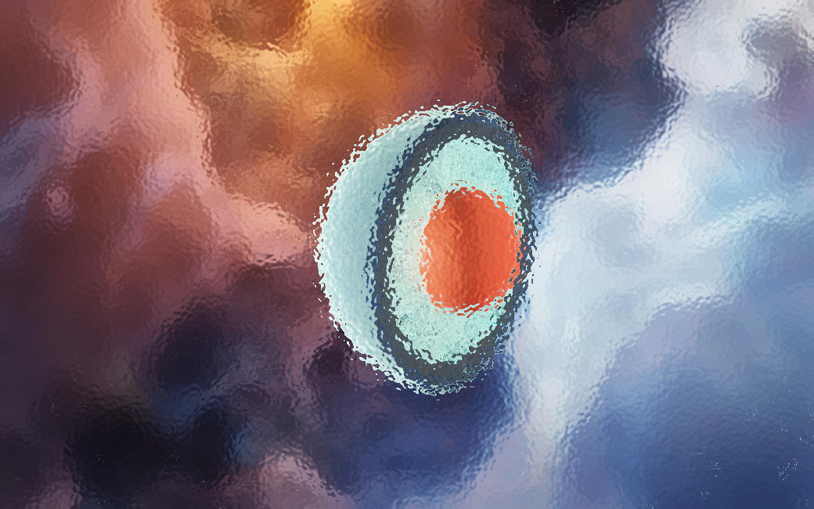




Neutron stars as a laboratory for particle and nuclear physics
Aleksi Vuorinen
University of Helsinki & Helsinki Institute of Physics
pQCD and EFTs at high density:
Gorda, Kurkela, Paatelainen, Säppi, AV, PRL 127, 2103.05658
Gorda, Paatelainen, Seppänen, Säppi, PRL 131, 2307.08734
Applications to neutron-star physics:
Annala et al., Nature Phys. (2020), 1903.09121
Annala et al., PRX 12 (2022), 2105.05132
Annala et al., Nature Comm. (2023), 2303.11356
(Very) recent lecture notes: AV, 2405.01141 (today)
CATCH22+2
DIAS, Dublin, 3 May 2024

Slide 2
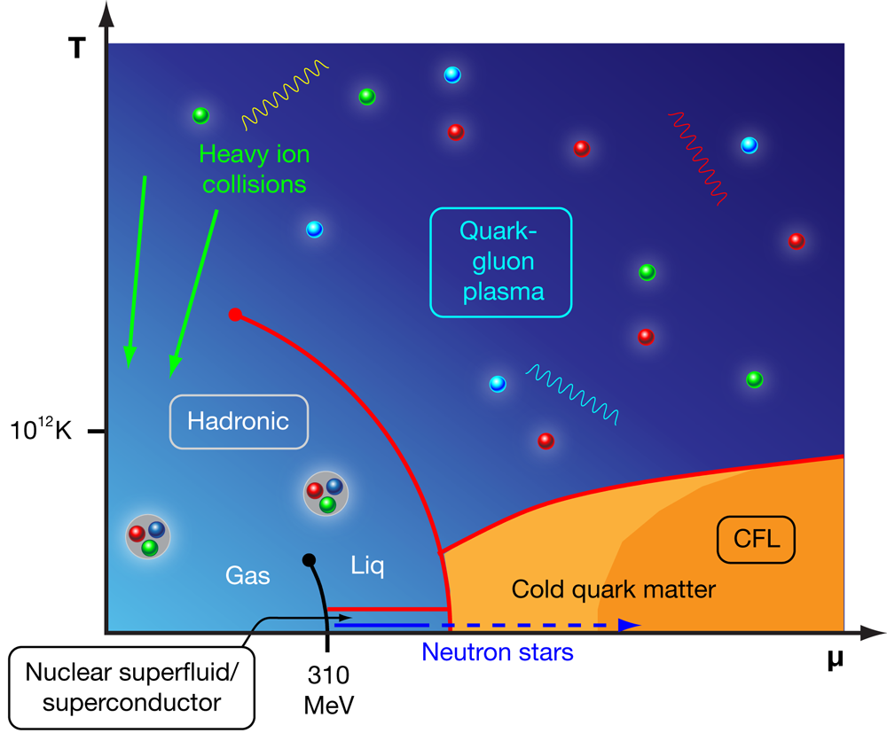
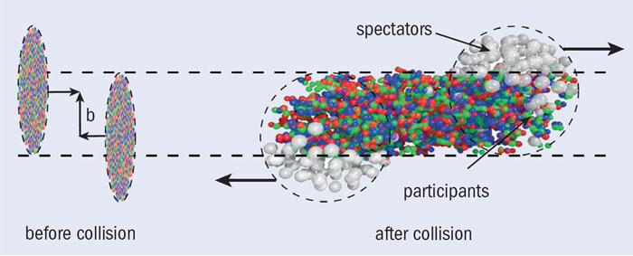
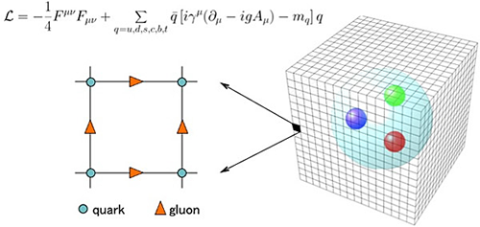
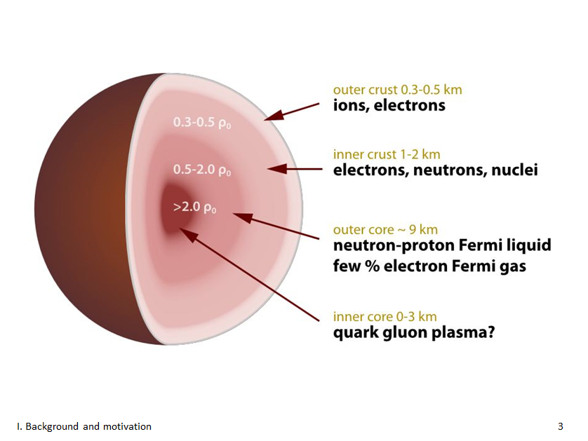
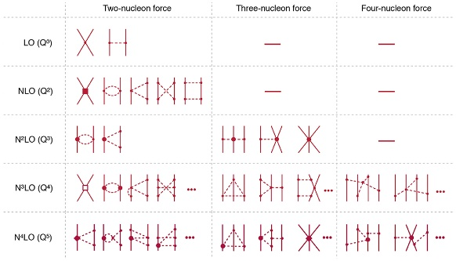
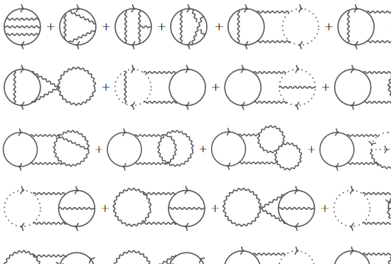
Fundamental prediction from the structure of QCD: Due to asymptotic freedom, at high enough energy densities one enters the deconfined phase, with quarks and gluons as the degrees of freedom
?

Slide 3
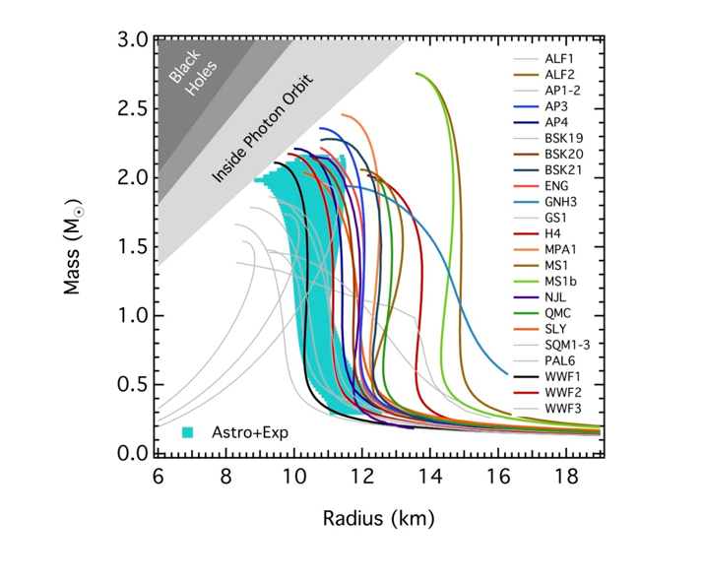

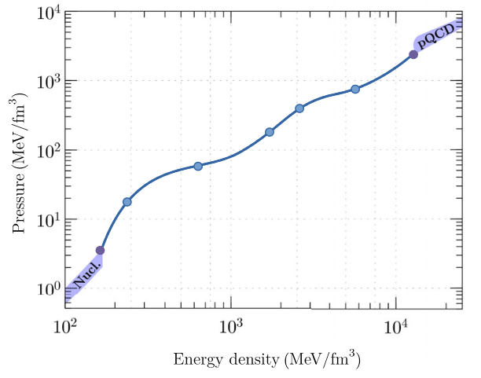
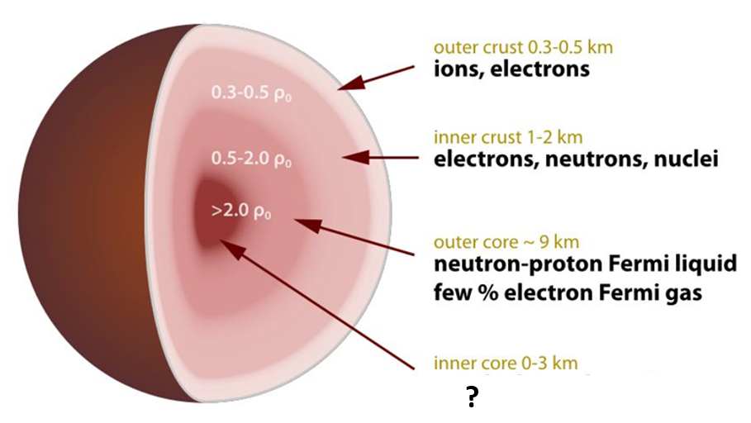
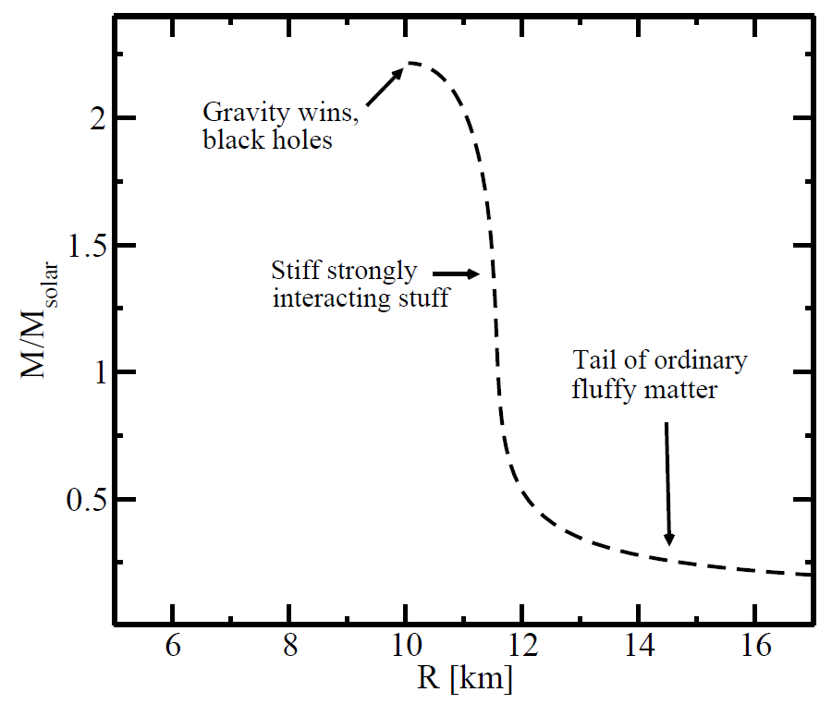
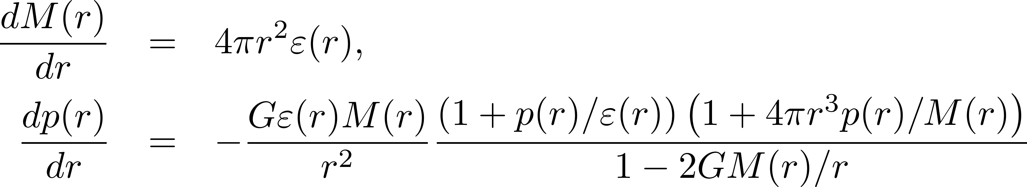
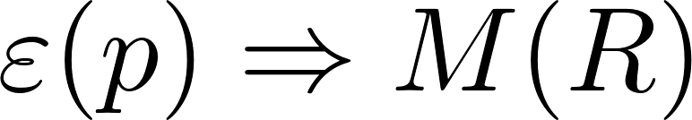
Dense QCD challenge: can we solve NS properties and composition using only first-principles theory tools and robust observational data? Do some NS cores contain deconfined matter?
Link between micro and macro from GR and Equation of State (EoS):
[Ozel et al., ApJ 820 (2016)]

Slide 4
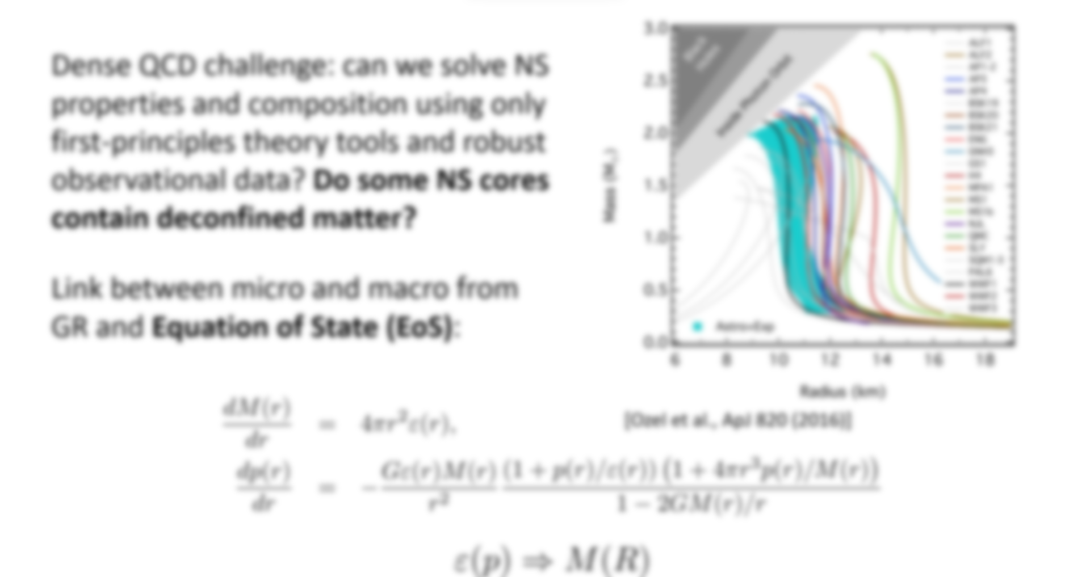
Clear need for systematic and model-independent approach to the microphysics of neutron stars, with the EoS playing a special role

Slide 5
NS matter: from dilute crust to ultradense core

Slide 6
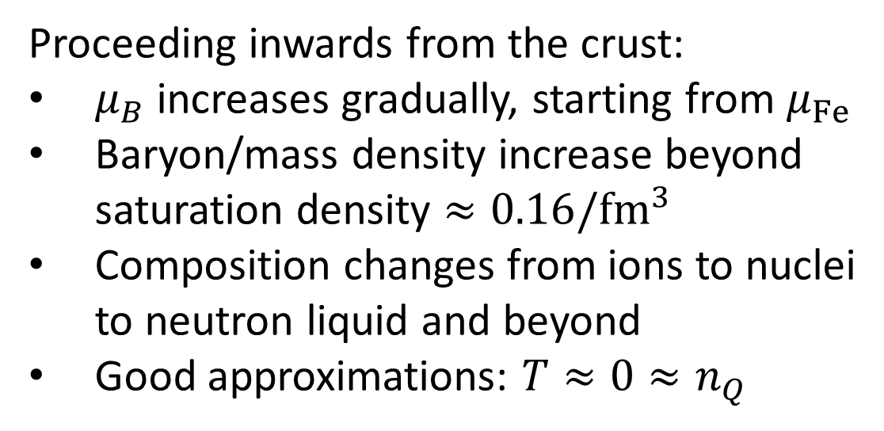
Proceeding inwards from the crust:
$μ_{B}$ increases gradually, starting from $μ_{Fe}$
Baryon/mass density increase beyond saturation density $≈0.16/{fm}^{3}$
Composition changes from ions to nuclei to neutron liquid and beyond
Good approximations: $T≈0≈n_{Q}$

Slide 7
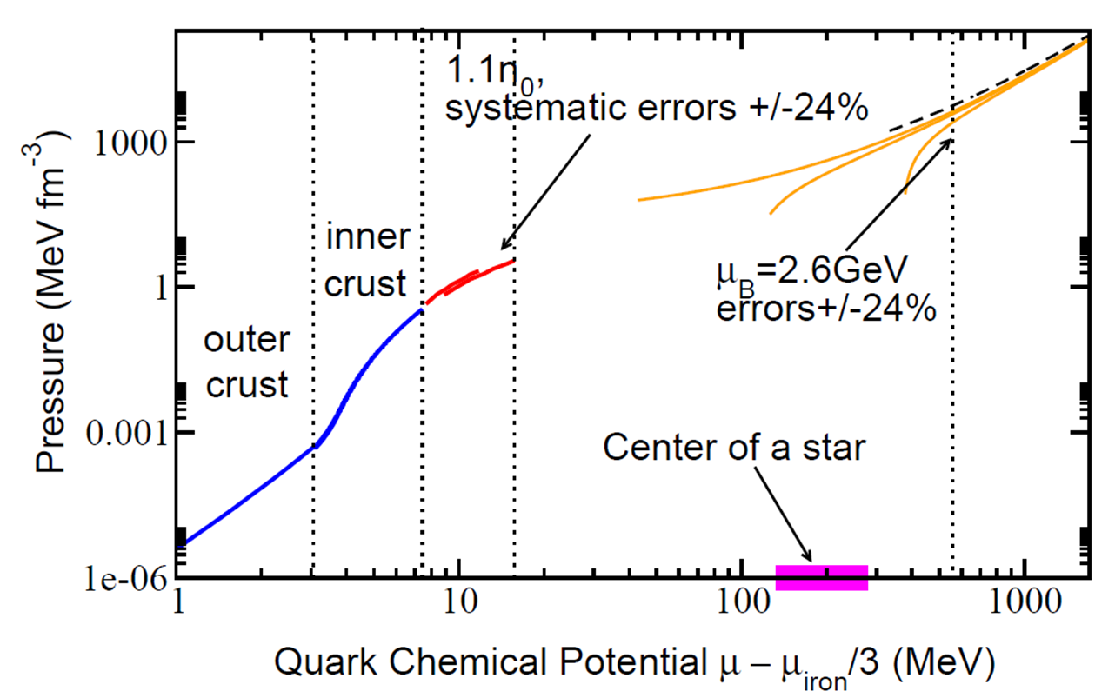
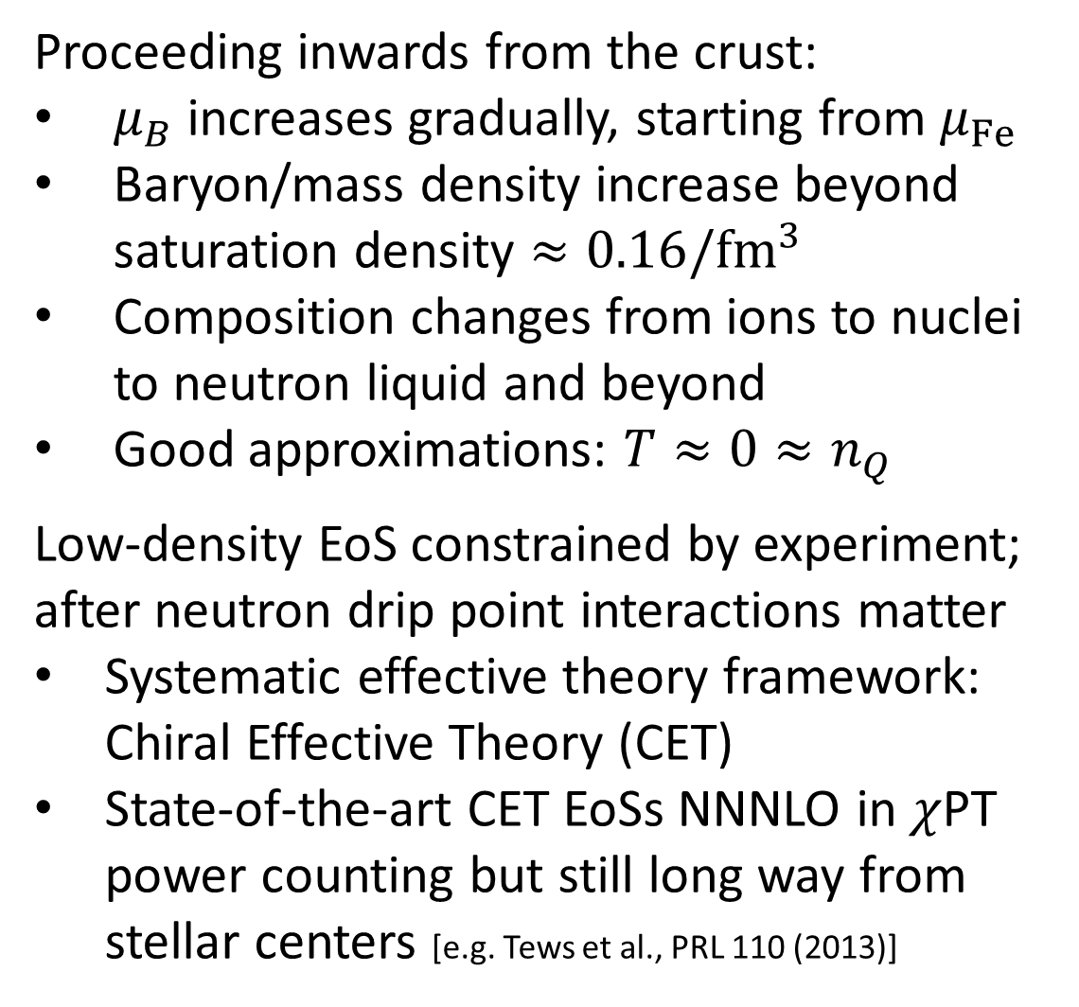
Proceeding inwards from the crust:
$μ_{B}$ increases gradually, starting from $μ_{Fe}$
Baryon/mass density increase beyond saturation density $≈0.16/{fm}^{3}$
Composition changes from ions to nuclei to neutron liquid and beyond
Good approximations: $T≈0≈n_{Q}$
Low-density EoS constrained by experiment; after neutron drip point interactions matter
Systematic effective theory framework: Chiral Effective Theory (CET)
State-of-the-art CET EoSs NNNLO in $χ$PT power counting but still long way from stellar centers [e.g. Tews et al., PRL 110 (2013)]

Slide 8
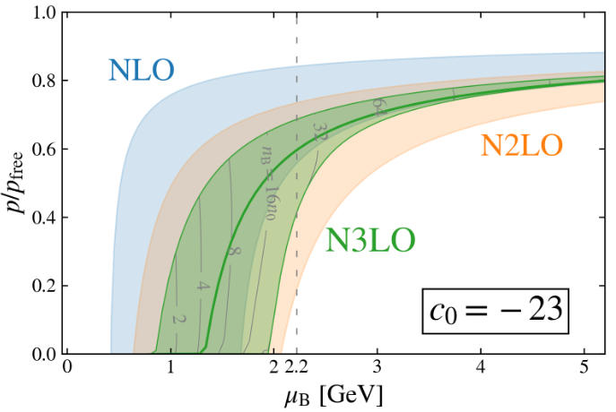
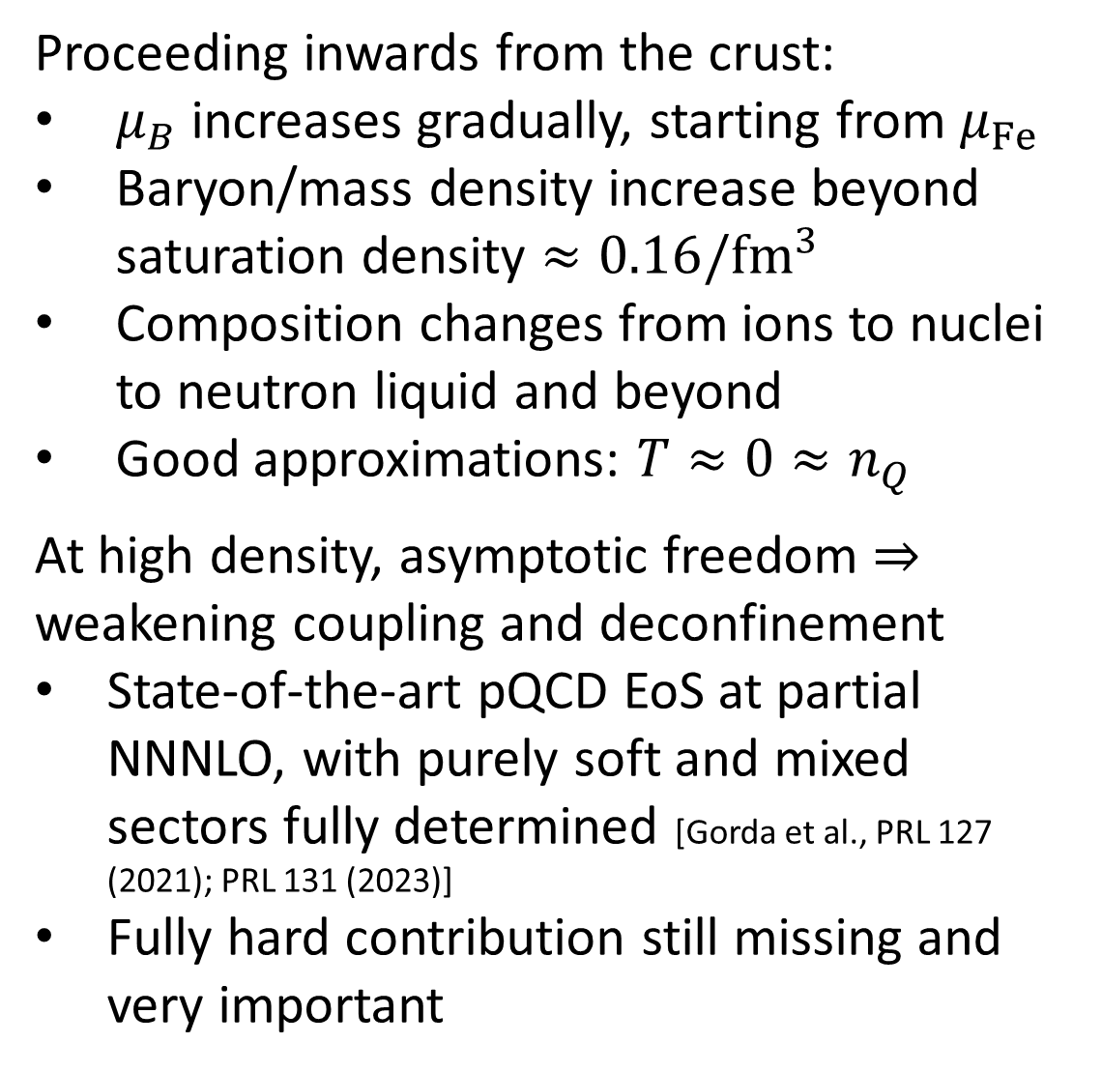
Proceeding inwards from the crust:
$μ_{B}$ increases gradually, starting from $μ_{Fe}$
Baryon/mass density increase beyond saturation density $≈0.16/{fm}^{3}$
Composition changes from ions to nuclei to neutron liquid and beyond
Good approximations: $T≈0≈n_{Q}$
At high density, asymptotic freedom $⇒$ weakening coupling and deconfinement
State-of-the-art pQCD EoS at partial NNNLO, with purely soft and mixed sectors fully determined [Gorda et al., PRL 127 (2021); PRL 131 (2023)]
Fully hard contribution still missing and very important

Slide 9
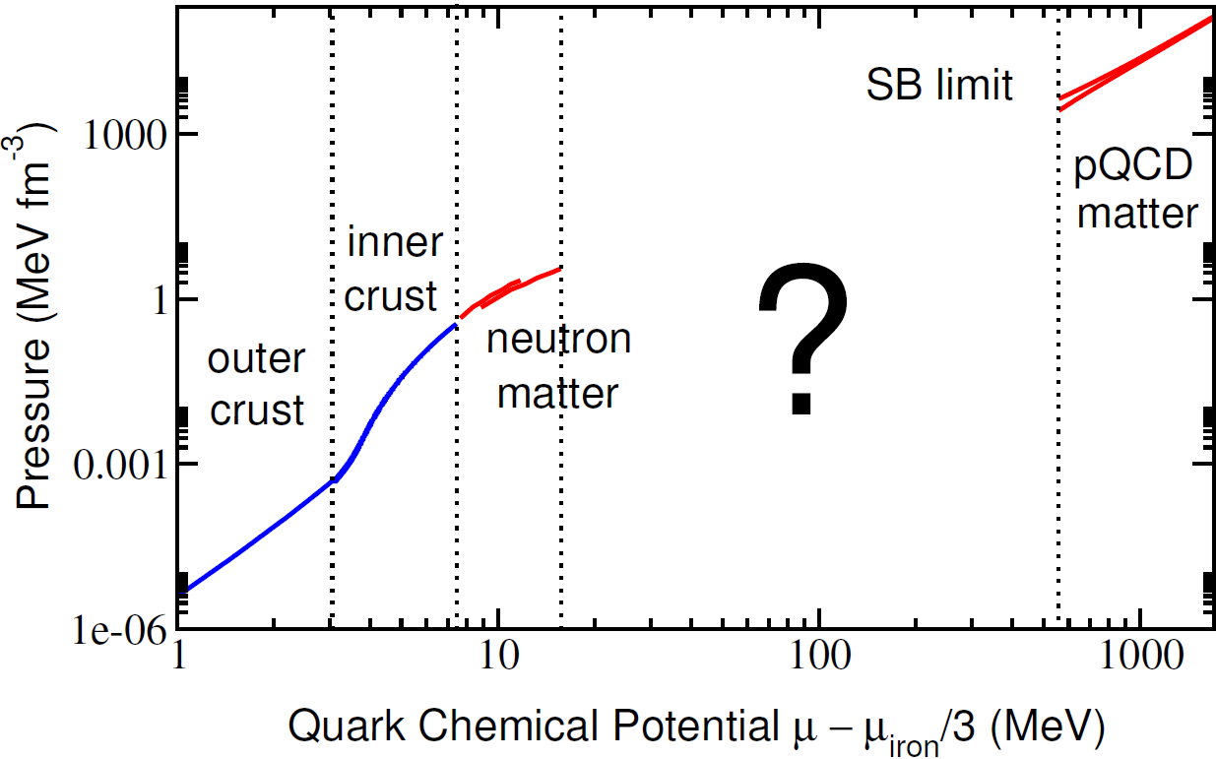
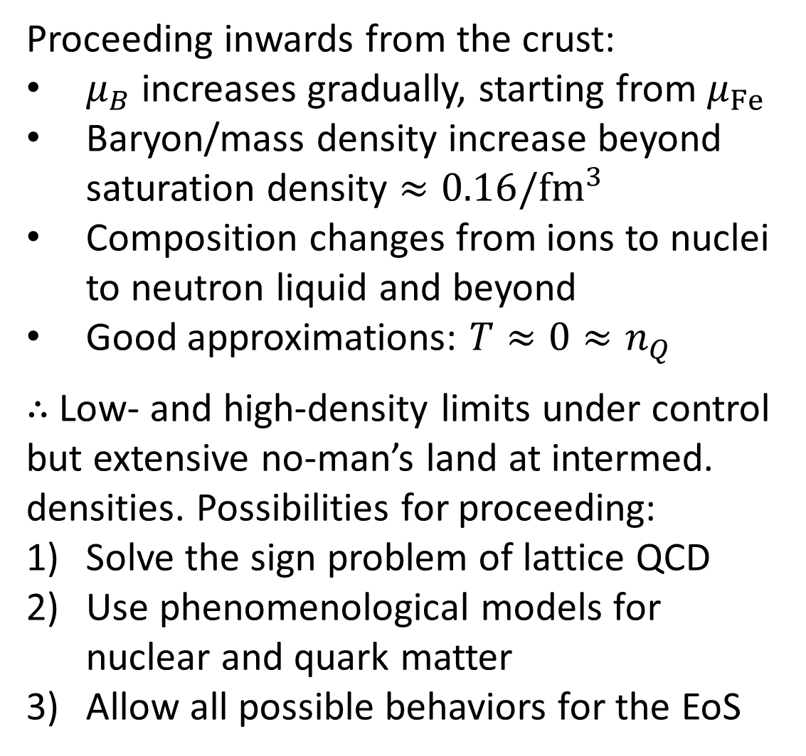
Proceeding inwards from the crust:
$μ_{B}$ increases gradually, starting from $μ_{Fe}$
Baryon/mass density increase beyond saturation density $≈0.16/{fm}^{3}$
Composition changes from ions to nuclei to neutron liquid and beyond
Good approximations: $T≈0≈n_{Q}$
$∴$ Low- and high-density limits under control but extensive no-man’s land at intermed. densities. Possibilities for proceeding:
Solve the sign problem of lattice QCD
Use phenomenological models for nuclear and quark matter
Allow all possible behaviors for the EoS

Slide 10
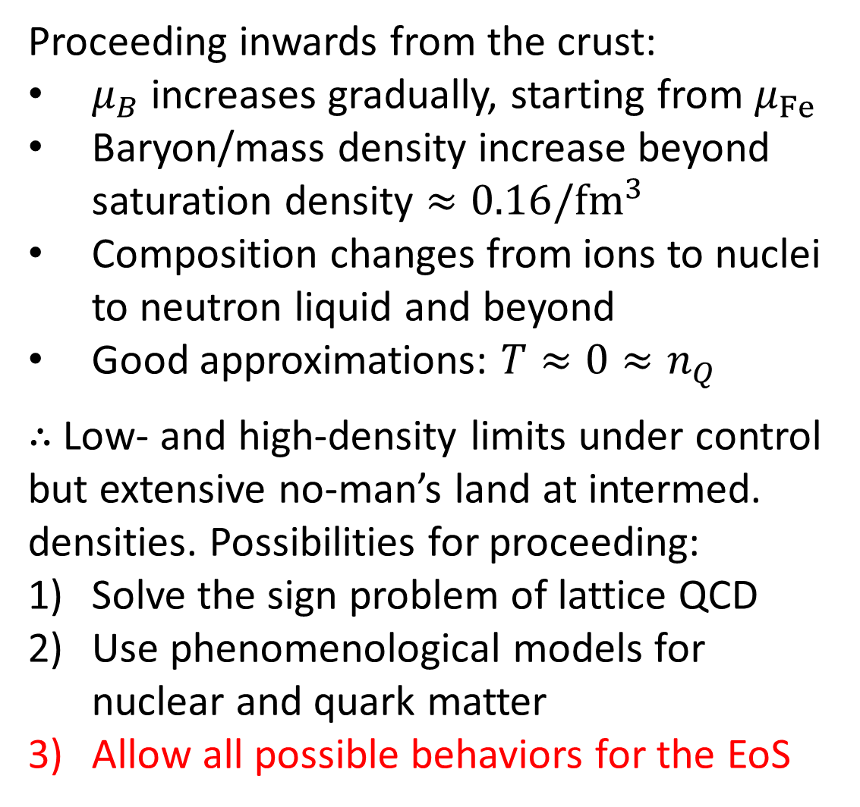
Proceeding inwards from the crust:
$μ_{B}$ increases gradually, starting from $μ_{Fe}$
Baryon/mass density increase beyond saturation density $≈0.16/{fm}^{3}$
Composition changes from ions to nuclei to neutron liquid and beyond
Good approximations: $T≈0≈n_{Q}$
$∴$ Low- and high-density limits under control but extensive no-man’s land at intermed. densities. Possibilities for proceeding:
Solve the sign problem of lattice QCD
Use phenomenological models for nuclear and quark matter
Allow all possible behaviors for the EoS

Slide 11
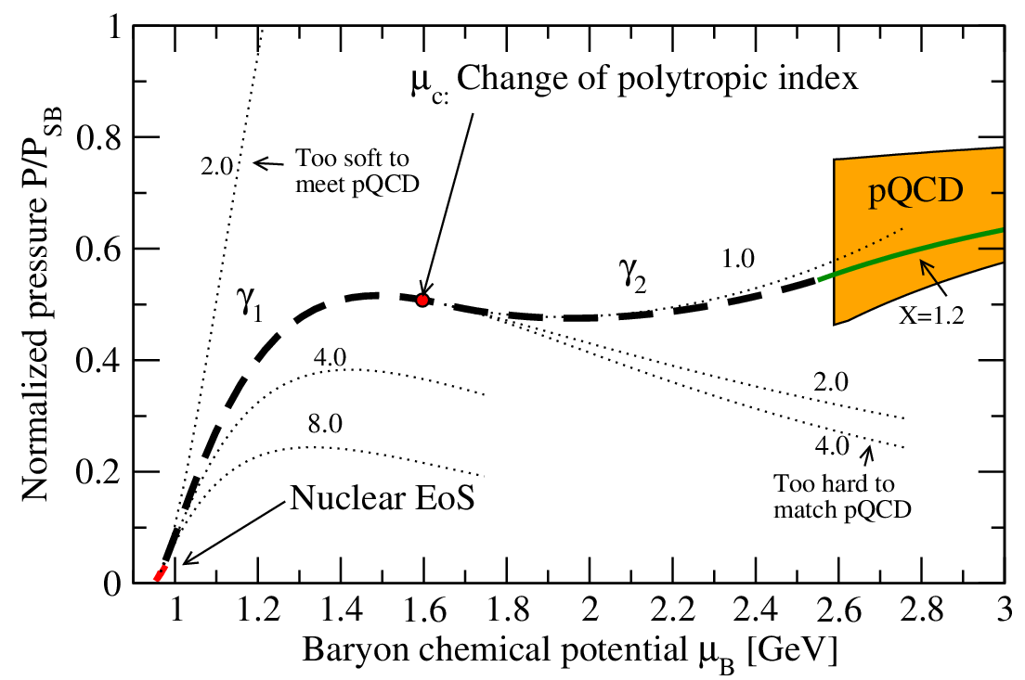
Possible way to proceed: build huge ensembles of randomly generated interpolators with piecewise basis functions – or use nonparametric Gaussian Process regression

Slide 12
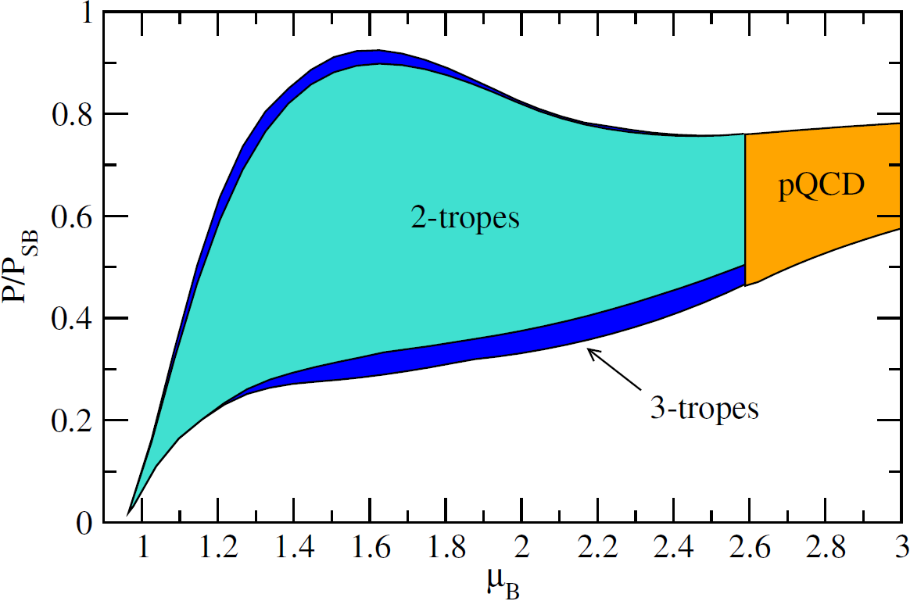
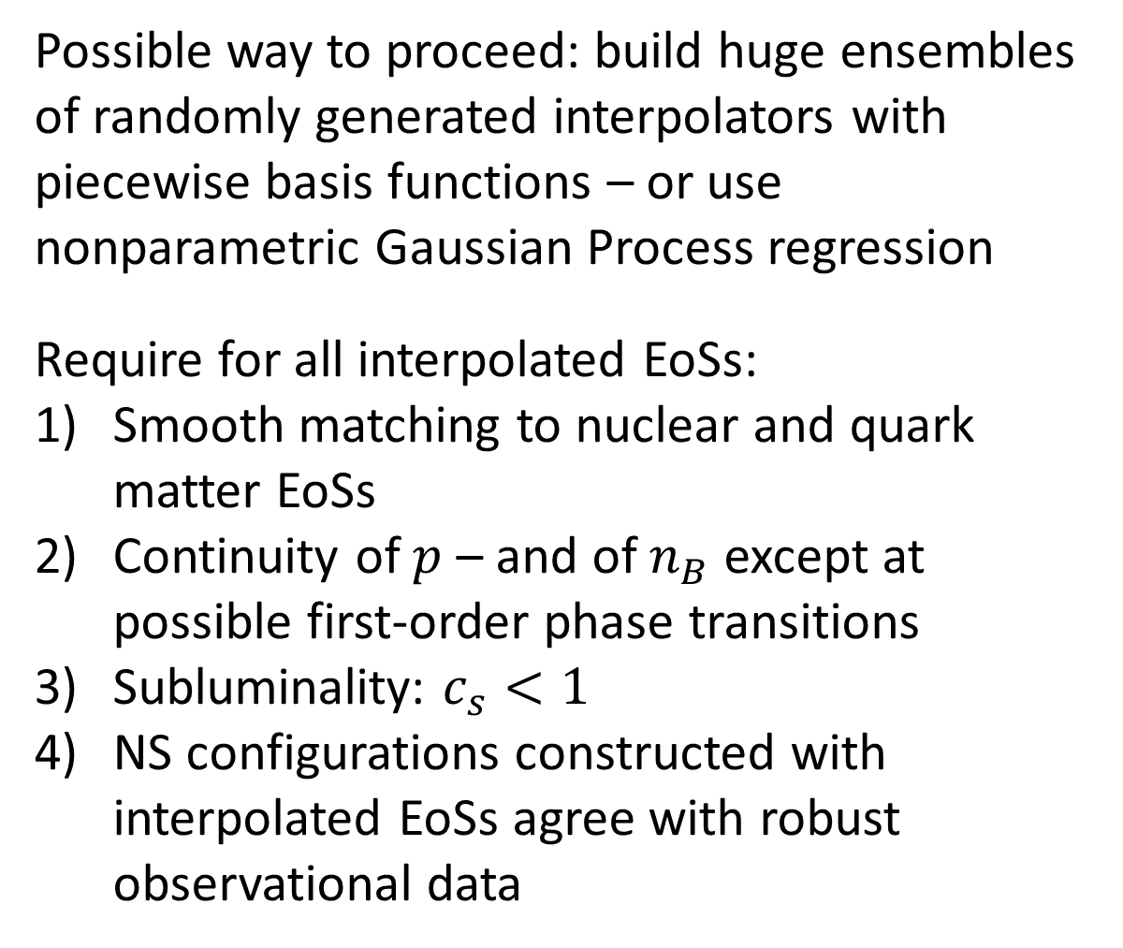
Possible way to proceed: build huge ensembles of randomly generated interpolators with piecewise basis functions – or use nonparametric Gaussian Process regression
Require for all interpolated EoSs:
Smooth matching to nuclear and quark matter EoSs
Continuity of $p$ – and of $n_{B}$ except at possible first-order phase transitions
Subluminality: $c_{s}<1$
NS configurations constructed with interpolated EoSs agree with robust observational data
[Kurkela et al., ApJ 789 (2014), Gorda et al., PRL 120 (2018); Gorda et al., ApJ 950 (2023)]

Slide 13
What do we know from NS observations?

Slide 14
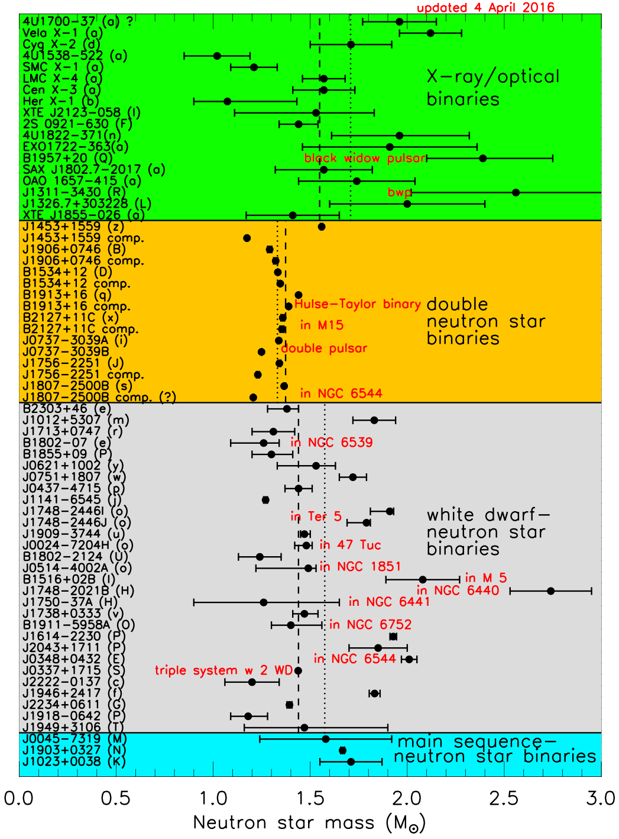
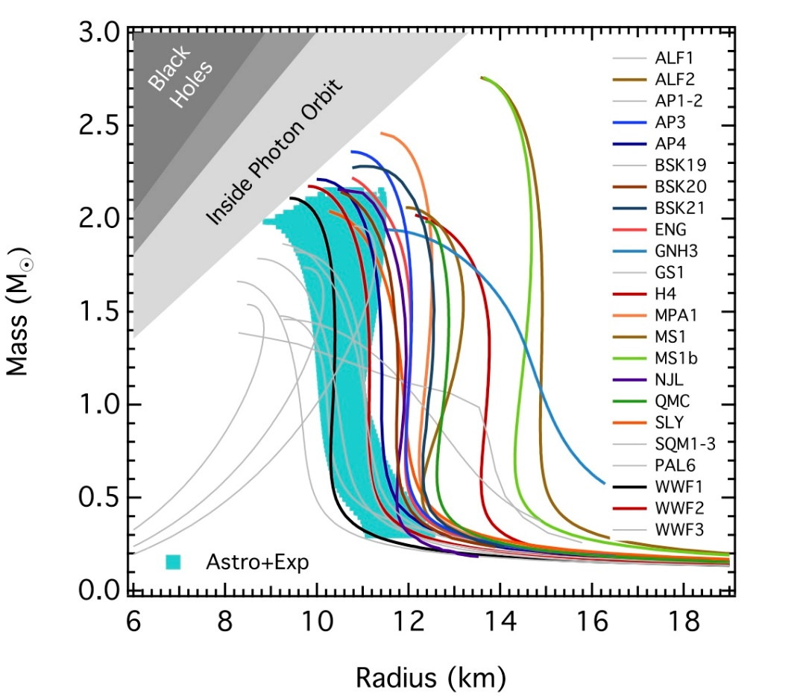
By now, three accurate Shapiro delay measurements of two-solar-mass neutron stars:
Demorest et al., Nature 467 (2010)
Antoniadis et al., Science 340 (2013)
Cromartie et al., Nature Astronomy 4 (2019)
$$∴ M_{max}>2M_{⊙}$$
Fig: J. Lattimer

Slide 15
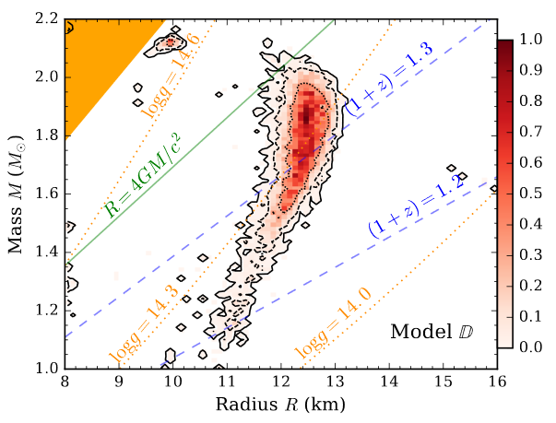
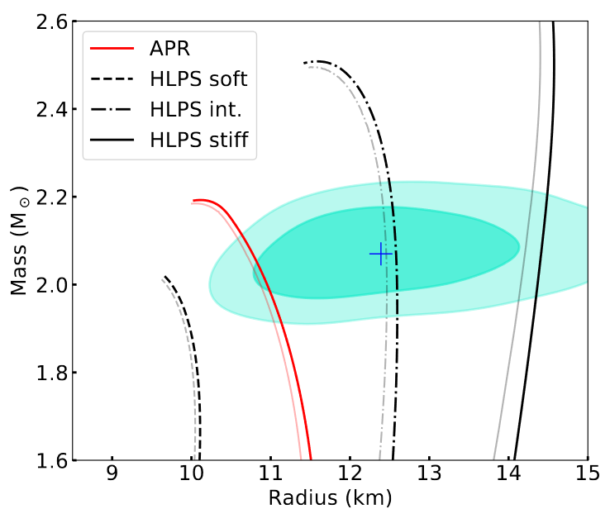
Radius (and combined $MR$) measurements more problematic, but recently important progress through X-ray observations:
Cooling of thermonuclear X-ray bursts provide radii to $\sim ±400$m [Nättilä et al., Astronomy & Astrophysics 608 (2017), …]
Pulse profiling (NICER) $⇒$ nontrivial lower bounds for two stellar radii, including PSR J0740+6620 with $M≳2M_{⊙}$ [Miller et al., Astrophysical Journal Letters 918 (2021),...]

Slide 16
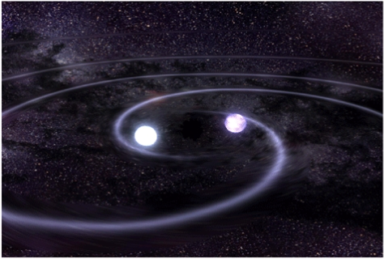
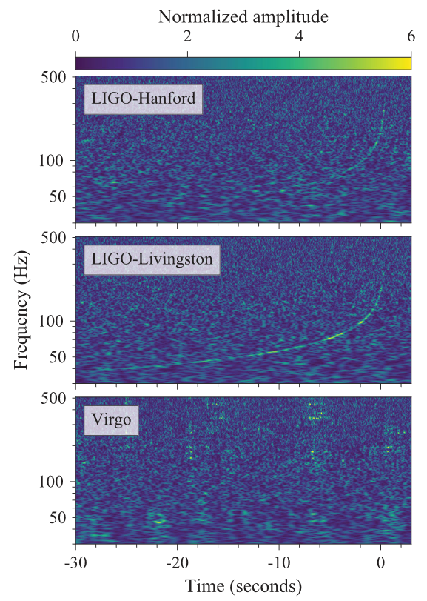
Gravitational wave breakthrough: First observed binary NS merger GW170817 by LIGO & Virgo in 2017 (and many since then)
Three types of potential inputs:
Tidal deformabilities of the NSs during inspiral – good measure of stellar compactness
Ringdown pattern – sensitive to EoS (also at $T≠0$), but frequency too high for LIGO/Virgo
EM counterpart: indirect information on merger product
Gravitational wave breakthrough: First observed binary NS merger GW170817 by LIGO & Virgo in 2017 (and many since then)
Three types of potential inputs:
Tidal deformabilities of the NSs during inspiral – good measure of stellar compactness
Ringdown pattern – sensitive to EoS (also at $T≠0$), but frequency too high for LIGO/Virgo
EM counterpart: indirect information on merger product
[LIGO and Virgo collaborations, PRL 119 (2017), PRL 121 (2018)]

Slide 17
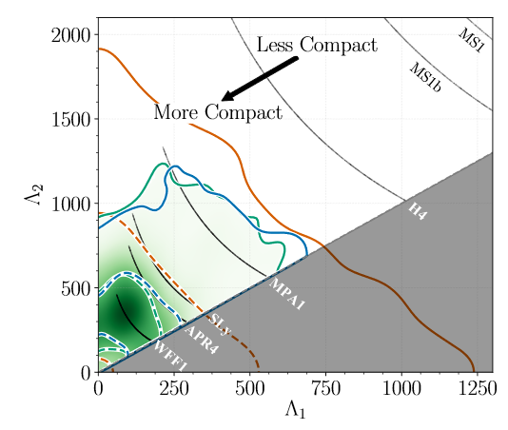
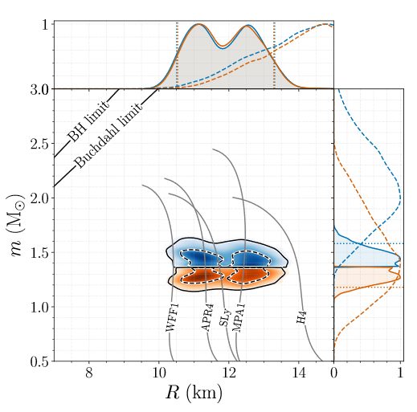
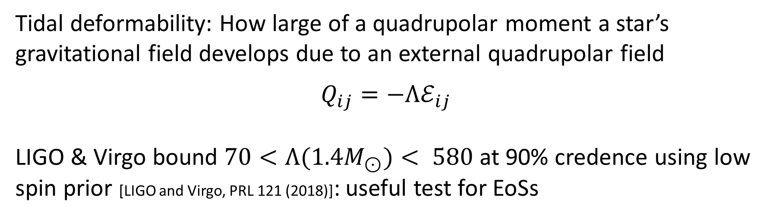
Tidal deformability: How large of a quadrupolar moment a star’s gravitational field develops due to an external quadrupolar field
$$Q_{ij}=−Λℰ_{ij}$$
LIGO & Virgo bound $70<Λ(1.4M_{⊙})< 580$ at 90% credence using low spin prior [LIGO and Virgo, PRL 121 (2018)]: useful test for EoSs

Slide 18
Gravitational wave breakthrough: First observed binary NS merger GW170817 by LIGO & Virgo in 2017 (and many since then)
Three types of potential inputs:
Tidal deformabilities of the NSs during inspiral – good measure of stellar compactness
Ringdown pattern – sensitive to EoS (also at $T≠0$), but frequency too high for LIGO/Virgo
EM counterpart: indirect information on merger product
[LIGO and Virgo collaborations, PRL 119 (2017), PRL 121 (2018)]

Slide 19
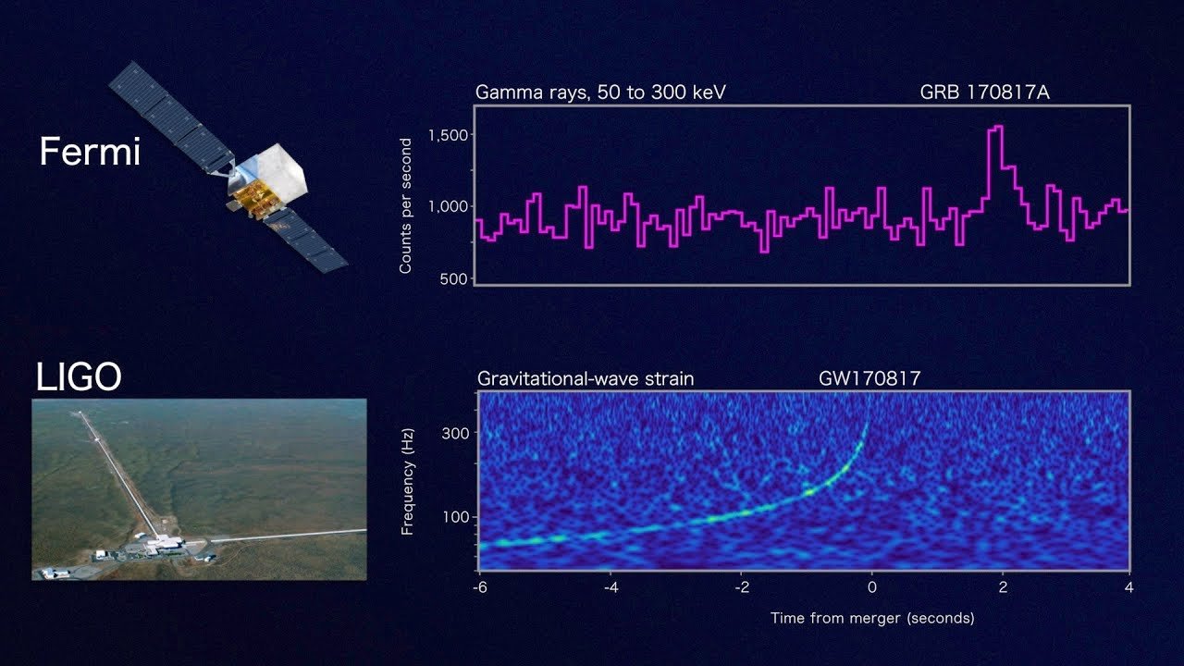
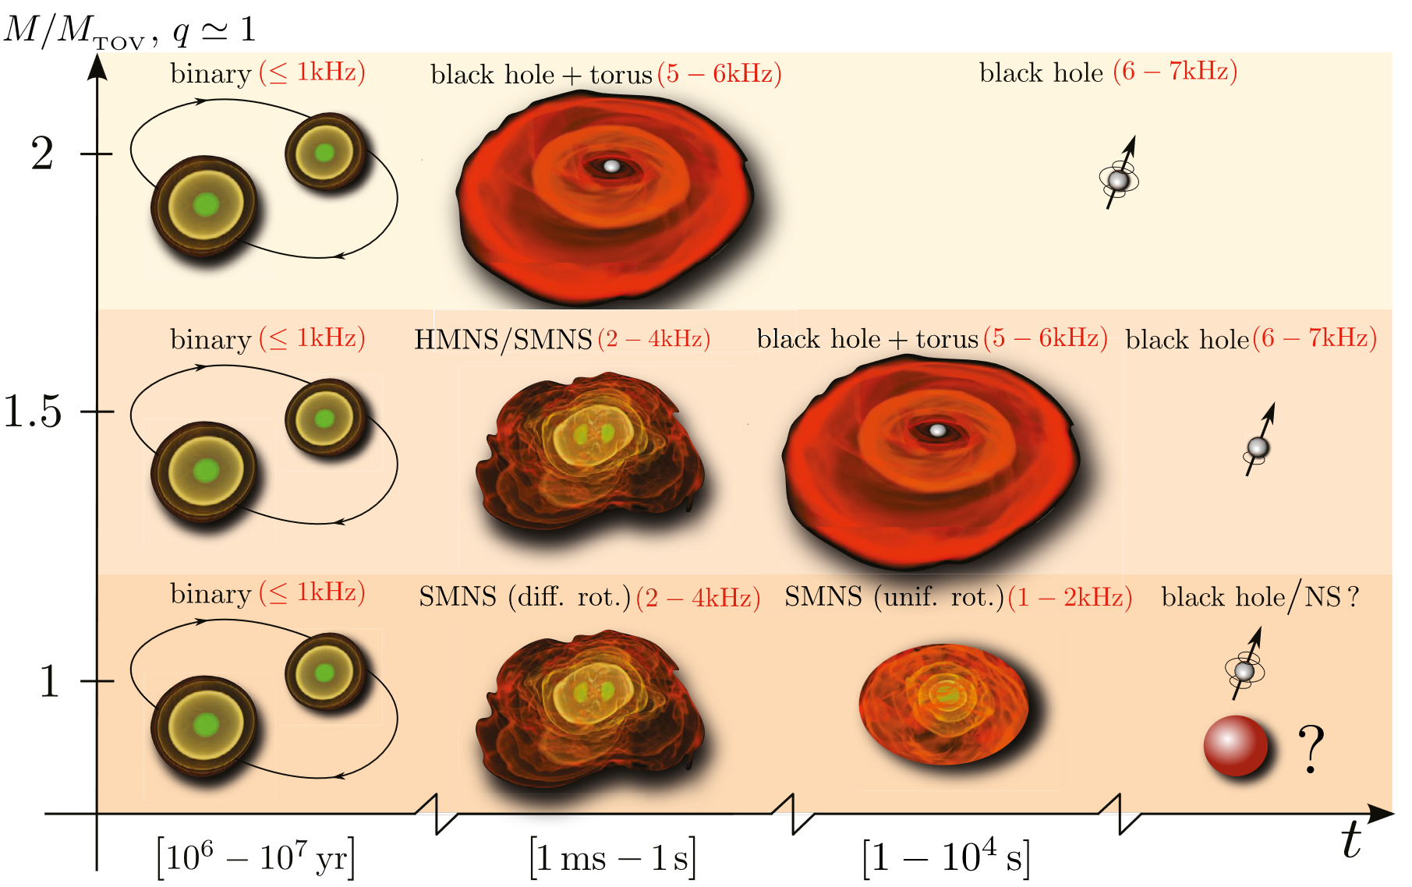
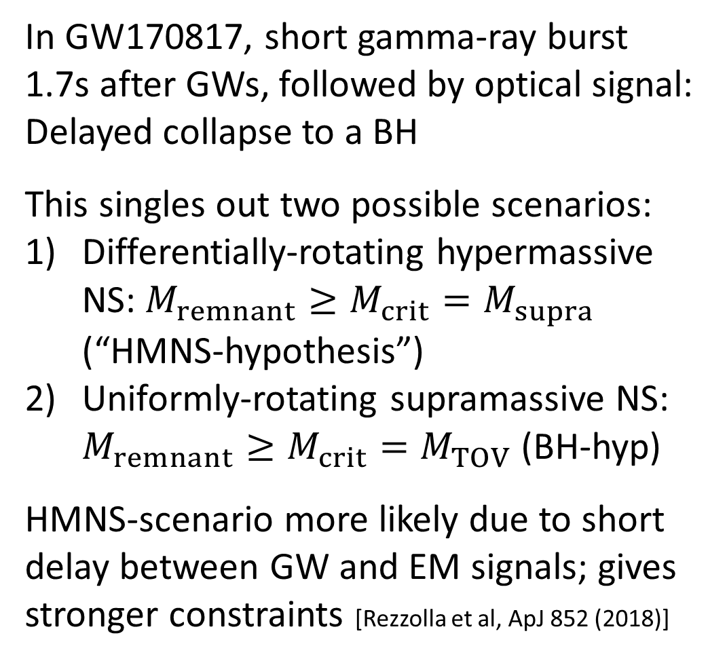
In GW170817, short gamma-ray burst 1.7s after GWs, followed by optical signal: Delayed collapse to a BH
This singles out two possible scenarios:
Differentially-rotating hypermassive NS: $M_{remnant}≥M_{crit}=M_{supra}$ (“HMNS-hypothesis”)
Uniformly-rotating supramassive NS: $M_{remnant}≥M_{crit}=M_{TOV}$ (BH-hyp)
HMNS-scenario more likely due to short delay between GW and EM signals; gives stronger constraints [Rezzolla et al, ApJ 852 (2018)]

Slide 20
NS-matter EoS: model-independent interpolation

Slide 21
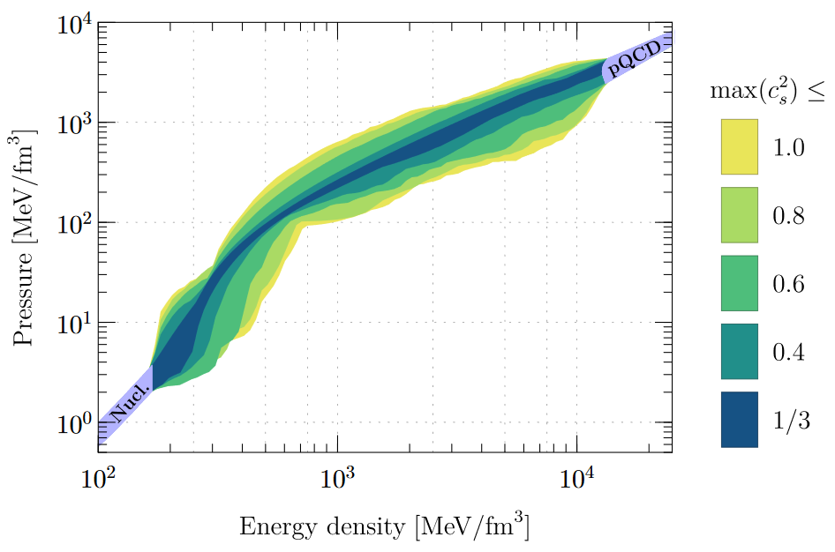
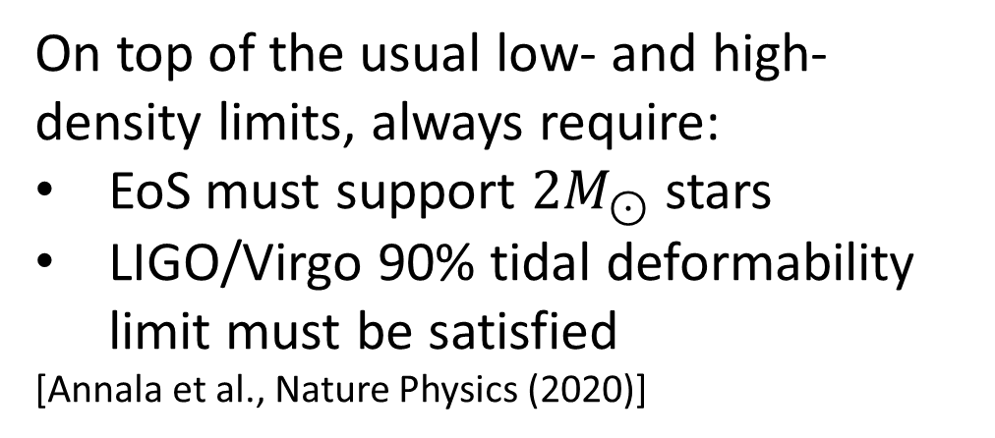
On top of the usual low- and high-density limits, always require:
EoS must support $2M_{⊙}$ stars
LIGO/Virgo 90% tidal deformability limit must be satisfied
[Annala et al., Nature Physics (2020)]

Slide 22
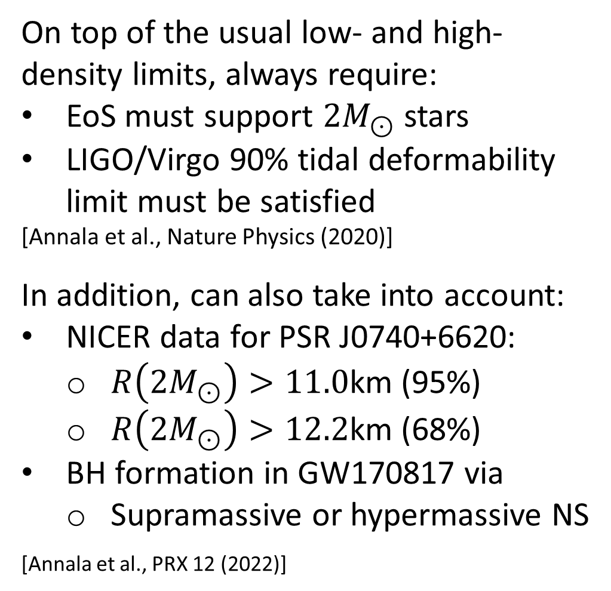
On top of the usual low- and high-density limits, always require:
EoS must support $2M_{⊙}$ stars
LIGO/Virgo 90% tidal deformability limit must be satisfied
[Annala et al., Nature Physics (2020)]
In addition, can also take into account:
NICER data for PSR J0740+6620:
  $R\left(2M_{⊙}\right)>11.0$km (95%)
  $R\left(2M_{⊙}\right)>12.2$km (68%)
BH formation in GW170817 via
  Supramassive or hypermassive NS
[Annala et al., PRX 12 (2022)]

Slide 23
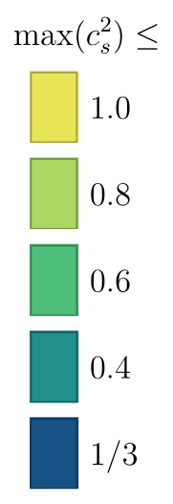


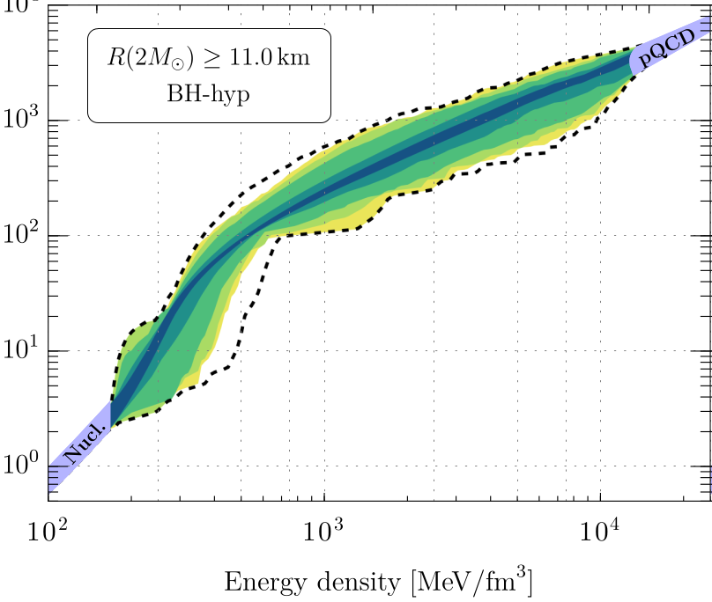
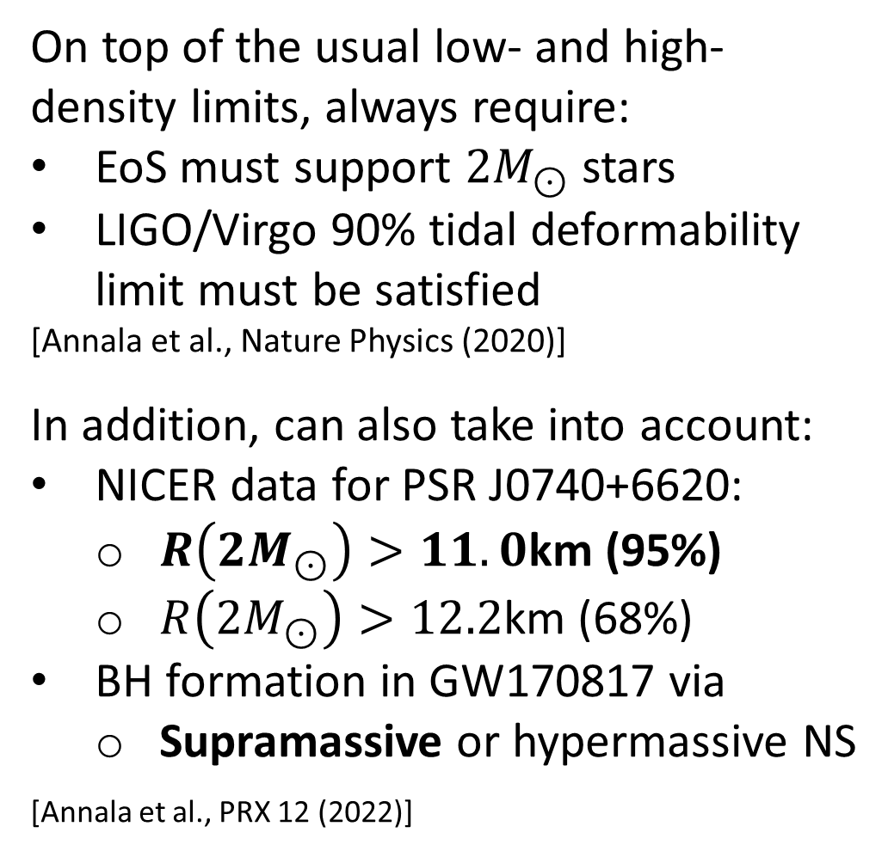
On top of the usual low- and high-density limits, always require:
EoS must support $2M_{⊙}$ stars
LIGO/Virgo 90% tidal deformability limit must be satisfied
[Annala et al., Nature Physics (2020)]
In addition, can also take into account:
NICER data for PSR J0740+6620:
  $R\left(2M_{⊙}\right)>11.0$km (95%)
  $R\left(2M_{⊙}\right)>12.2$km (68%)
BH formation in GW170817 via
  Supramassive or hypermassive NS
[Annala et al., PRX 12 (2022)]

Slide 24
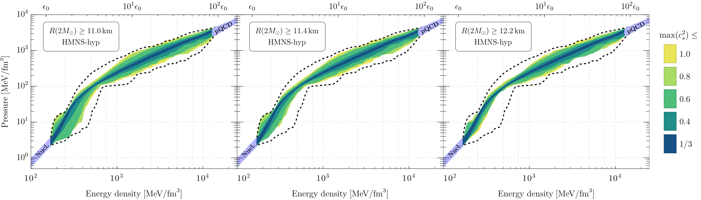
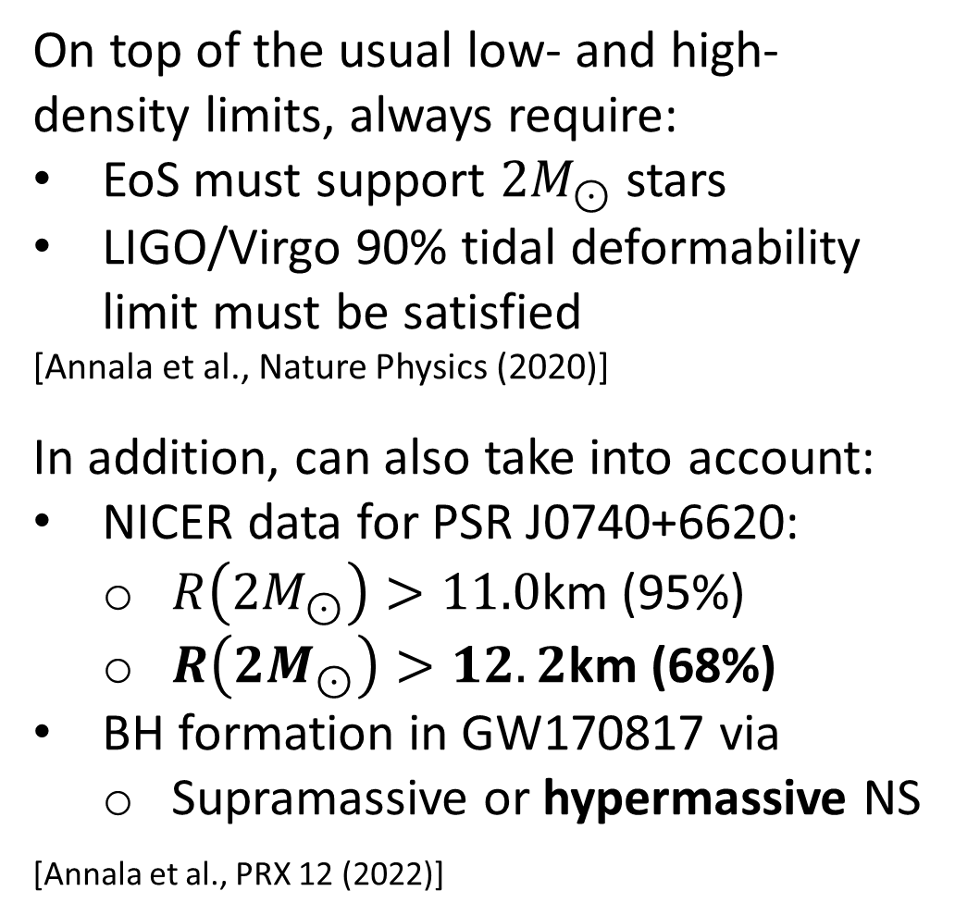
On top of the usual low- and high-density limits, always require:
EoS must support $2M_{⊙}$ stars
LIGO/Virgo 90% tidal deformability limit must be satisfied
[Annala et al., Nature Physics (2020)]
In addition, can also take into account:
NICER data for PSR J0740+6620:
  $R\left(2M_{⊙}\right)>11.0$km (95%)
  $R\left(2M_{⊙}\right)>12.2$km (68%)
BH formation in GW170817 via
  Supramassive or hypermassive NS
[Annala et al., PRX 12 (2022)]

Slide 25
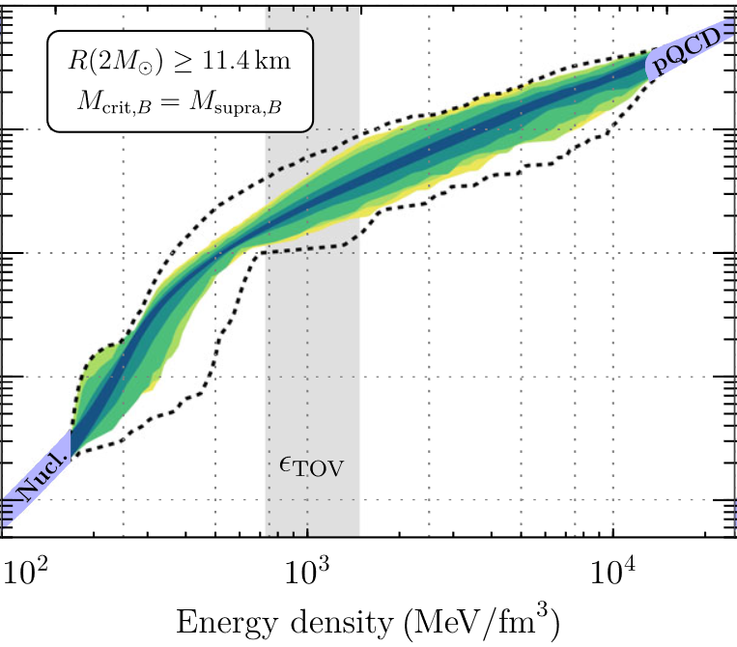
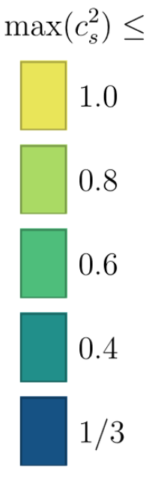
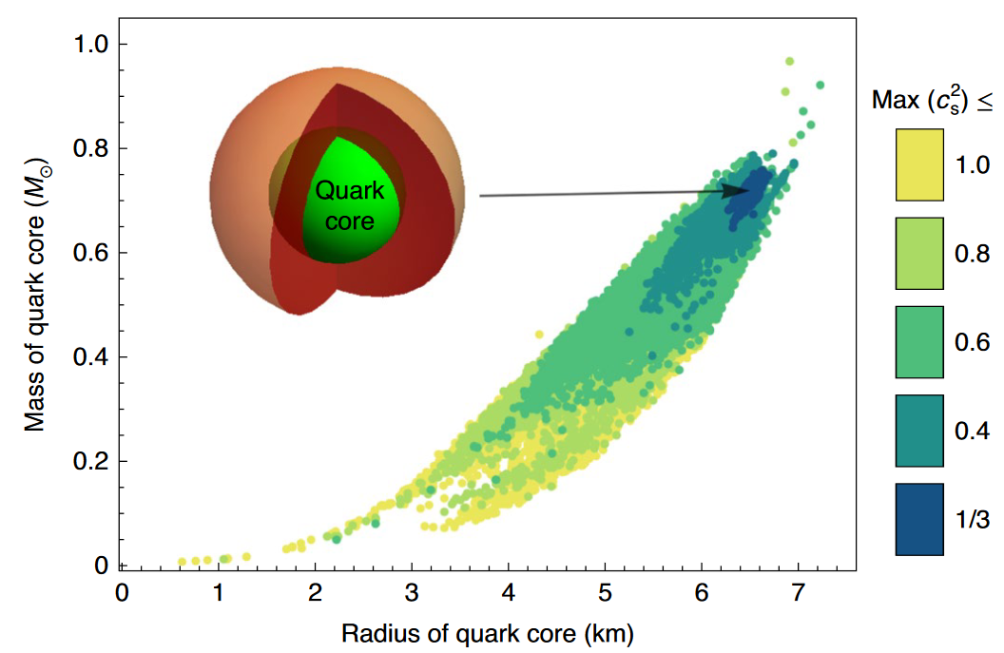
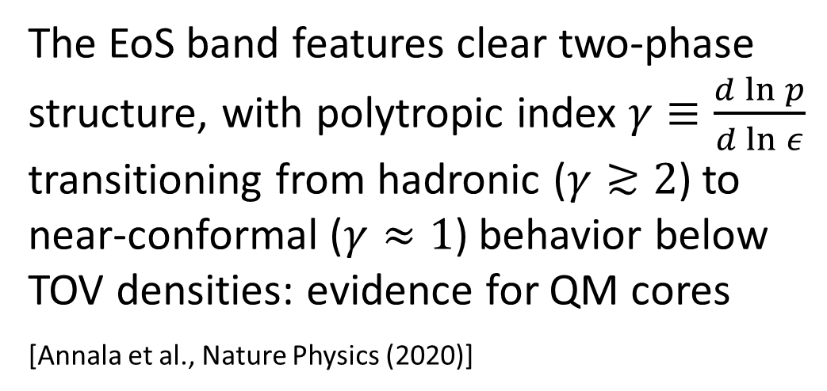
The EoS band features clear two-phase structure, with polytropic index $γ≡\frac{d\ln{p}}{d\ln{ε}}$ transitioning from hadronic ($γ≳2$) to near-conformal ($γ≈1$) behavior below TOV densities: evidence for QM cores
[Annala et al., Nature Physics (2020)]

Slide 26
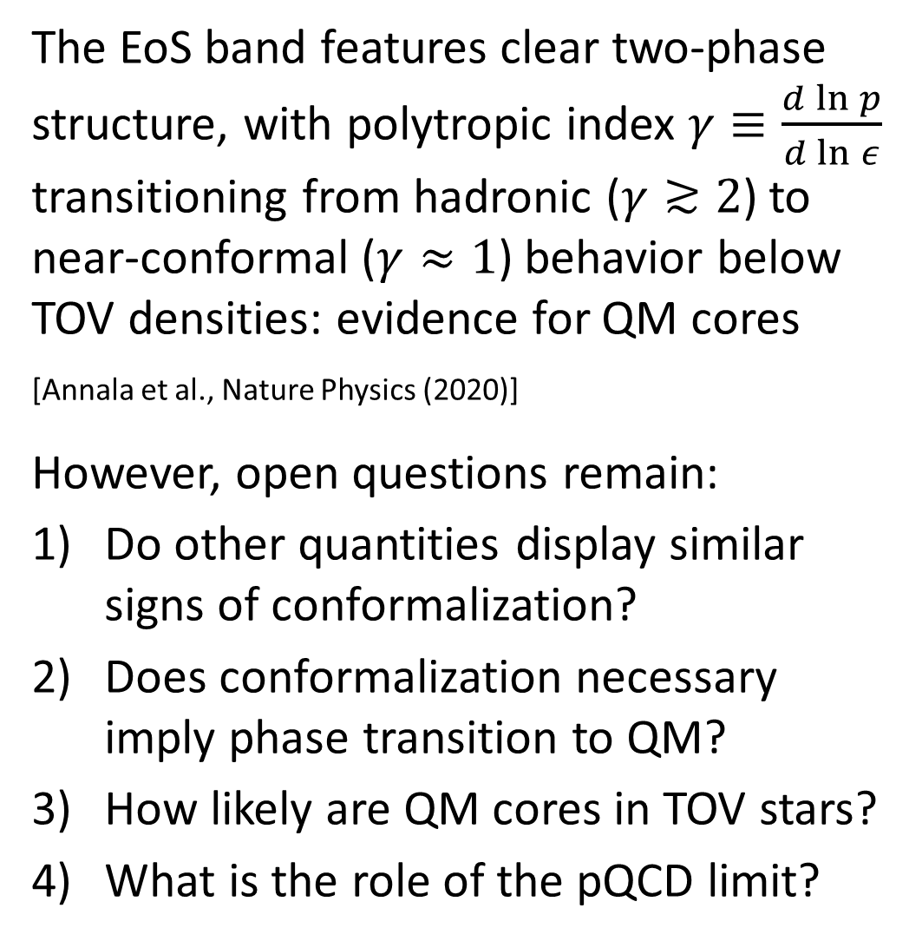
The EoS band features clear two-phase structure, with polytropic index $γ≡\frac{d\ln{p}}{d\ln{ε}}$ transitioning from hadronic ($γ≳2$) to near-conformal ($γ≈1$) behavior below TOV densities: evidence for QM cores
[Annala et al., Nature Physics (2020)]
However, open questions remain:
Do other quantities display similar signs of conformalization?
Does conformalization necessary imply phase transition to QM?
How likely are QM cores in TOV stars?
What is the role of the pQCD limit?

Slide 27
NS-matter EoS: recent Bayesian results

Slide 28

Improvements in recent work:
Factor in measurement uncertainties $⇒$ ability to utilize many more observations in the analysis
Track also conformal anomaly and its rate of change $∆ ≡\frac{ε−3p}{3ε}$, $∆′≡\frac{d∆}{d\ln{ε}}$
For comparison, construct EoSs also with nonparam. Gaussian Process regression
[Annala, Gorda, Hirvonen, Komoltsev, Kurkela, Nättilä, AV, Nature Comm. 14 (2023)]
28

Slide 29



Improvements in recent work:
Factor in measurement uncertainties $⇒$ ability to utilize many more observations in the analysis
Track also conformal anomaly and its rate of change $∆ ≡\frac{ε−3p}{3ε}$, $∆′≡\frac{d∆}{d\ln{ε}}$
For comparison, construct EoSs also with nonparam. Gaussian Process regression
Ultimate goal: Approx. likelihoods of various scenarios (QM core, destabilizing FOPT,…)
Tool: Bayes’ thm. $P\left(EoS | data\right)=\frac{P(data|EoS)P(EoS)}{P(data)},$ MCMC simulations, and ab-initio limits
[Annala, Gorda, Hirvonen, Komoltsev, Kurkela, Nättilä, AV, Nature Comm. 14 (2023)]
29

Slide 30


Main results:
All quantities studied – $γ, c_{s}^{2}, ∆, ∆′$ – consistently approach their conformal limits close to (but below) the central densities of $M_{TOV}$ stars
[Annala, Gorda, Hirvonen, Komoltsev, Kurkela, Nättilä, AV, Nature Comm. 14 (2023)]
30

Slide 31

Main results:
Optimal quantity to track: “conformal distance” $d_{c}≡\sqrt{∆^{2}+{\left(∆^{′}\right)}^{2}}$
  Its conformalization ensures that of all other quantities considered
  Values in dense NM ($≳0.4$) and perturbative QM ($≲0.2$) far apart
  In FOPTs $d_{c}≥1/(3\sqrt{2})≈0.24$
$∴$ Our (intentionally conservative) criterion for near-conformality: $d_{c}<0.2$
[Annala, Gorda, Hirvonen, Komoltsev, Kurkela, Nättilä, AV, Nature Comm. 14 (2023)]
31

Slide 32


Main results:
Probability of conformalized matter in centers of
$1.4M_{⊙}$ NSs: 0%
$2.0M_{⊙}$ NSs: 11%
$M_{TOV}$ NSs: 88%
New criterion very conservative: with old criterion ($γ<1.75$) from our 2020 Nat. Phys., the above 88% would be 99.8%.
For remaining 12% of TOV-star centers, nearly all EoSs feature FOPT-like behavior.
[Annala, Gorda, Hirvonen, Komoltsev, Kurkela, Nättilä, AV, Nature Comm. 14 (2023)]
32

Slide 33



Main results:
For weak coupling and CFTs, normalized pressure $∝$ number of active degrees of freedom.
In centers of TOV stars, $p/p_{FD}$ at approx.
2/3 of its value in pQCD, while at high T crossover transition from hadron gas to QGP at much smaller values of $p/p_{SB}$.
$∴$ “Near-conformal“ very likely implies “deconfined”.
[Annala, Gorda, Hirvonen, Komoltsev, Kurkela, Nättilä, AV, Nature Comm. 14 (2023)]
33

Slide 34


Main results:
All results independent of the details of interpolation, with results from non-parametric Gaussian Process regression well in line.
With GP method, also possible to show that it is precisely the pQCD constraint that softens the EoS in the cores of TOV stars.
[Gorda, Komoltsev, Kurkela, Astrophys. J. 950 (2023)]
[Annala, Gorda, Hirvonen, Komoltsev, Kurkela, Nättilä, AV, Nature Comm. 14 (2023)]
34

Slide 35
Conclusions

Slide 36
Main takeaways:
Active interplay between particle & nuclear theory and observational astrophysics leading to rapid unraveling of the mysteries of NS cores
Strong evidence for rapid conformalization of matter near TOV star centers, identifiable as onset of deconfinement
Strong destabilizing first-order phase transition remains as only alternative for QM cores, perhaps visible in postmerger GW signal
In near future, qualitative improvements expected from CET & pQCD calculations as well as observations, bringing the discovery of QM cores within sight

