Slide 1
Keeping young talents attached
The Fellow Program of Netzwerk Teilchenwelt
Andrea Mayer-Houdelet, TU Dresden
Christian Klein-Bösing, Uni Münster

Slide 2
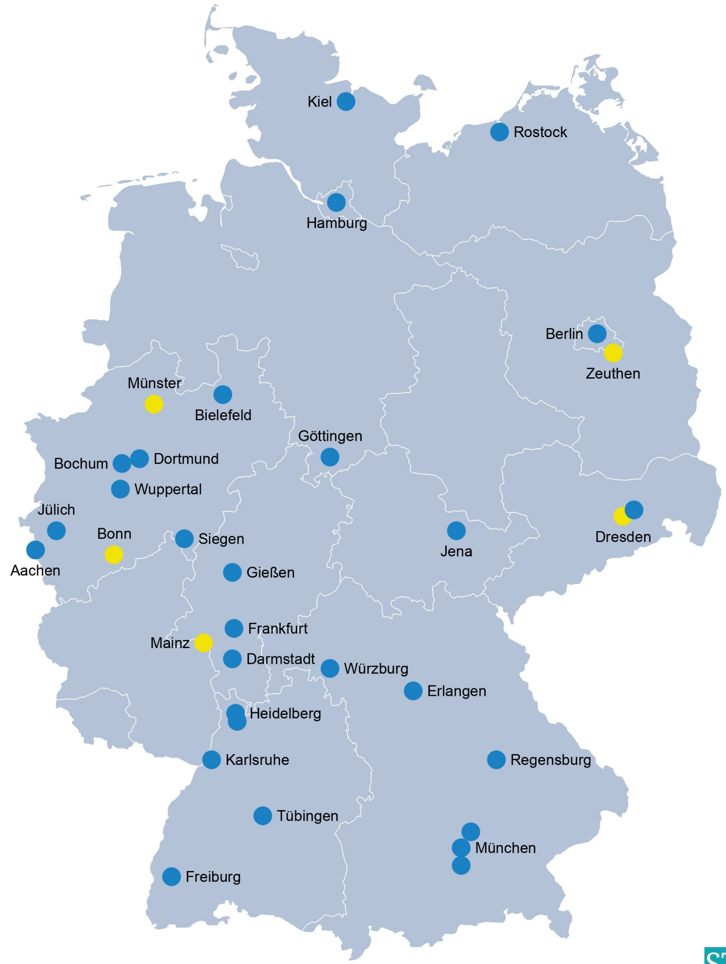
Netzwerk Teilchenwelt
Visible and established brand since 2010
Target groups:
  High school students
  Teachers
  Broad public
34 universities/research labs + CERN
NEW: Uni Bielefeld, FZ Jülich,
Helmholtz Institute Jena, Helmholtz
Center Dresden Rossendorf
  Entire subject area of the smallest particles:
    Particle and astroparticle physics
    Hadrons and nuclei

Slide 3
Netzwerk Teilchenwelt
Common objective:
  Joint outreach: Make research tangible!
  Bundle existing activities
  Share structures and programs
  (Synergy effects)
  Promotion / recruitment of young talents (research, outreach)
  High visibility and impact of outreach
Project team:
  TU Dresden, DESY Zeuthen / CERN
  Hubs in Bonn, Mainz and Münster

Slide 4
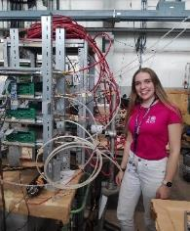
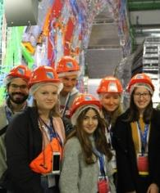
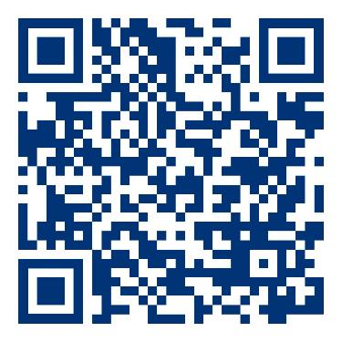
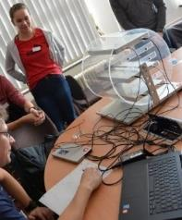
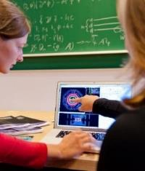
Multi Step Program
List of
140 papers
incl. 39 prizes
CERN project weeks (2 weeks)
Research projects in the institutes
(→ STEM Competitions (Jugend Forscht etc.))
15
50% female
CERN workshop (4 days)
Particle Physics Acadamy Mainz (10 Days)
75
Own Commitment
Detector projects (own measurements)
Working with Cosmic@Web (Portal with experimental data)
Tutor for masterclasses
Passing on the fascination with physics
250
(Int‘l) Masterclasses in schools, at learning venues or online
(Astro-)Particle Physics | Nuclear and Hadron Physics
1-day event/project day
Conducted by young scientists (PhD students)
3500
2439
390
Number of students
per year
Starting Physic BSc 2021
Notes:
In the basic program, young people take part in a master class (particle physics or astroparticle physics), for example. In the qualification program, the focus is on communicating the knowledge they have already acquired. This can take the form of a presentation at school on the subject of astro/particle physics, a project or support as a tutor in a master class.
Active members of the Particle World network can apply for workshops at CERN to visit the international research center, deepen their knowledge, look over the shoulders of researchers and meet like-minded people. Travel and accommodation are funded by the network. It is also possible to prepare research papers for school or a competition such as Jugend forscht, supervised by facilitators of Netzwerk Teilchenwelt. Part of the research work may even be carried out during the project weeks at CERN.
In addition, you can register for our Fellow Program during your studies and thus gain direct access to the research groups.

Slide 5


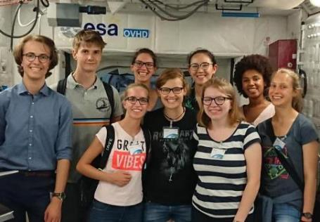
Fellow program – Targeted promotion of young talents
Established 2017
Fellows
  Experienced talents
  participated in several program levels
  Now studying physics or shortly before
  Lateral entry also possible for physics students
Today: 160 Fellows, 50% female
SCHOOL
RESEARCH GROUPS
© Saskia Plura

Slide 6
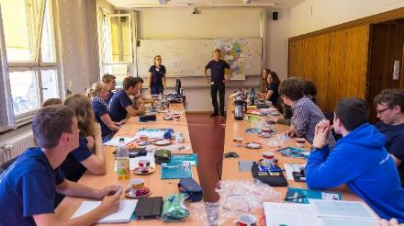
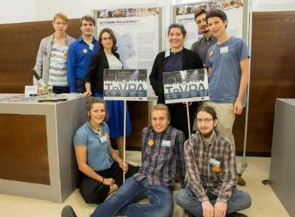
Fellow program – Targeted promotion of young talents (2)
© Netzwerk Teilchenwelt
Major goals:
  Foster connection between highly motivated students and research groups
  Group leaders can involve Fellows via local Teilchenwelt contact person
Win for research groups / group leaders:
  Young talents for research tasks and outreach
Win for Fellows:
  Early connection to research
  Professional training/supervision
  Personal contacts
  Networking: local and nationwide
Annual Fellow Meeting
© DESY by Ashley Jones
Fellows helping @ TeVPA Conference
© DESY / Ashley Jones

Slide 7
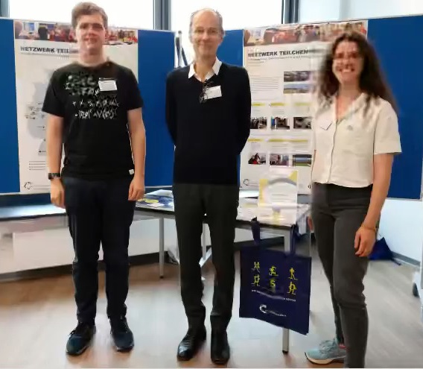
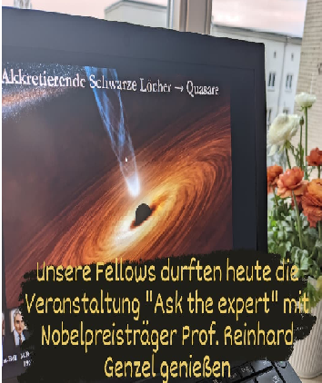
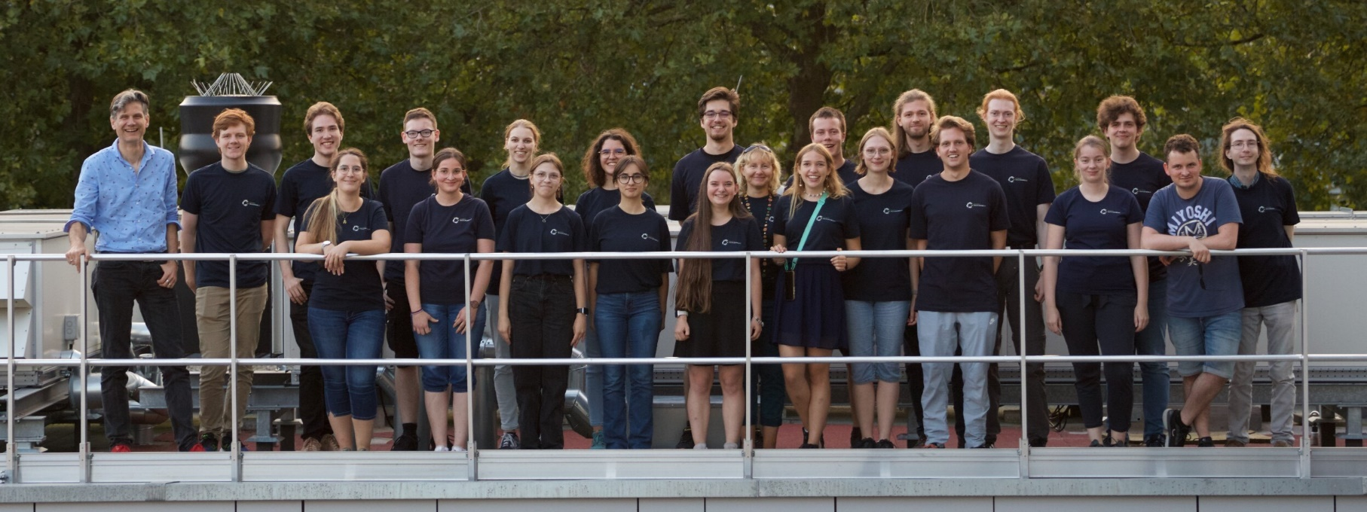
Offers within the Fellow program
Tailored trainings:
Central offers
  Ask the Expert: Online lecture on current research highlights, wide choice of topics and speakers
  Annual Fellow meetings: expert lectures, poster session, group work, cultural program etc.
  Fellow school: lectures and tutorials (yearly)
  Conference participation: national physics conferences (DPG, German LHC Groups)
Local offers / activities
  Internships, jobs
  Invitation to group or institute events
  Involvement in outreach activities
  Regulars' tables/Fellow afternoons
© Netzwerk Teilchenwelt
Fellows with Spokesperson
@ ATLAS-D-Meeting
Ask the Expert
© Netzwerk Teilchenwelt
Fellow Meeting Münster 2023
© Philipp Kompa
Notes:
Ask the Expert
Concept: online lecture on current research at Fellow level, wide selection of topics and speakers, 30 min lecture + discussion each
Topics e.g. Black holes (R. Genzel), Higgs (R. Harlander), Belle II (C. Sfienti), Controlled nuclear fusion (A. Junghans), Neutrino astronomy (M. Kowalski), Black hole image (A. Zensus)
Fellow meeting
Lectures: ATLAS detector, scattering board, inspiring secondary school students with particle physics, new OPAL Masterclass - Machine Learning
Exchange between Fellows
City tour

Slide 8
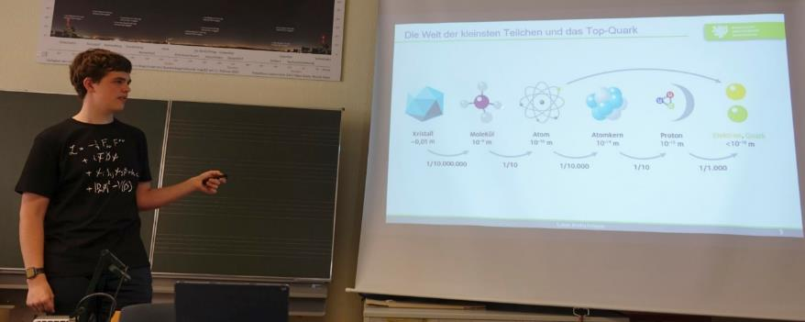
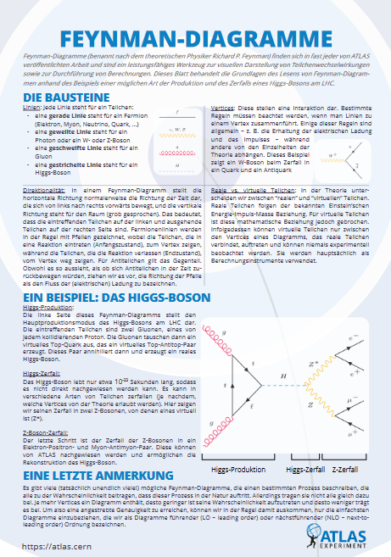
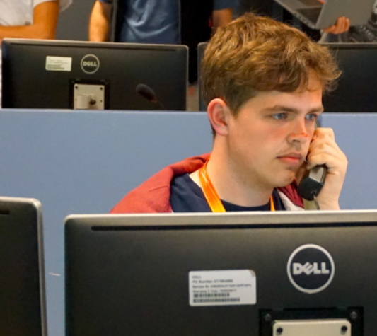
Young role models
© Netzwerk Teilchenwelt
Fellow Lukas Kretschmann (19)
2020 CERN workshop, 2021 CERN project weeks, Jugend forscht; several internships at University of Wuppertal
High School Research:
Cross-section measurement of t-channel
single top quark production at √s = 13 TeV
with the ATLAS detector at the LHC
3rd semester physics, University of Wuppertal
Fellow spokesperson, co-organizer of "Ask the expert“
active in ATLAS Outreach, German Cheat/Fact Sheets
Youngest ATLAS shift leader at CERN
© CERN, Joni Pham

Slide 9
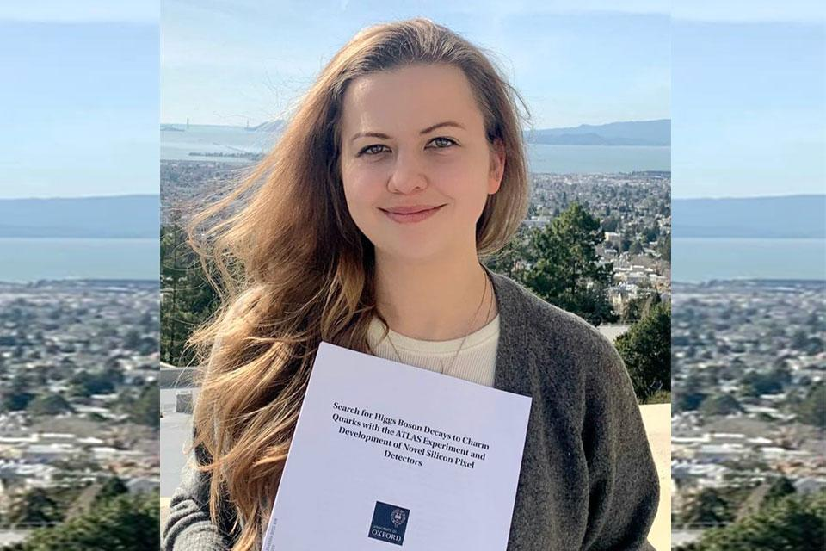
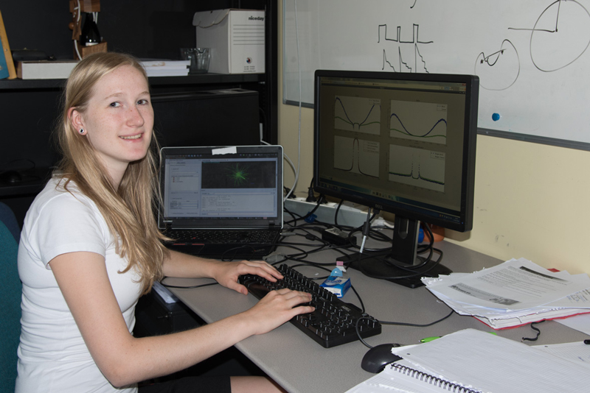
Long Term Impact
(survey among graduates of CERN workshops 2010-2014)
ATLAS thesis award winner 22
Maria M.: “Netzwerk Teilchenwelt has changed my study plans in particular and given me the opportunity to get to know modern day-to-day research." Physics Bachelor University of Göttingen, Master Imperial College London, PhD University of Oxford, now PostDoc at Berkeley Lab
Lara B.: "[...] really encouraged my interest in physics. As I didn't have any teachers in secondary school who encouraged my interest (rather the opposite), there were people in Netzwerk Teilchenwelt who motivated me and gave me great experiences. These experiences are certainly one of the reasons why I will be starting my physics degree in the fall." Physics Bachelor University of Göttingen, Master University of British Columbia in Vancouver, now PhD student at University of British Columbia

Slide 10
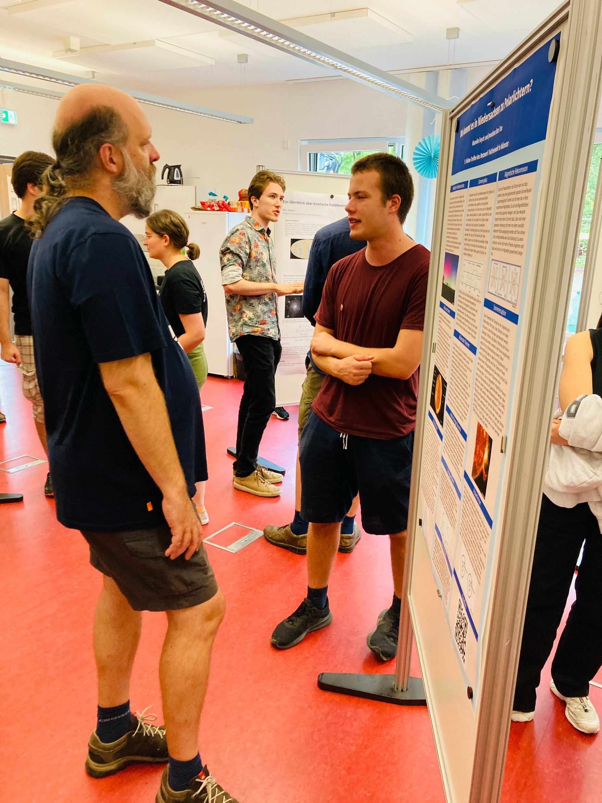
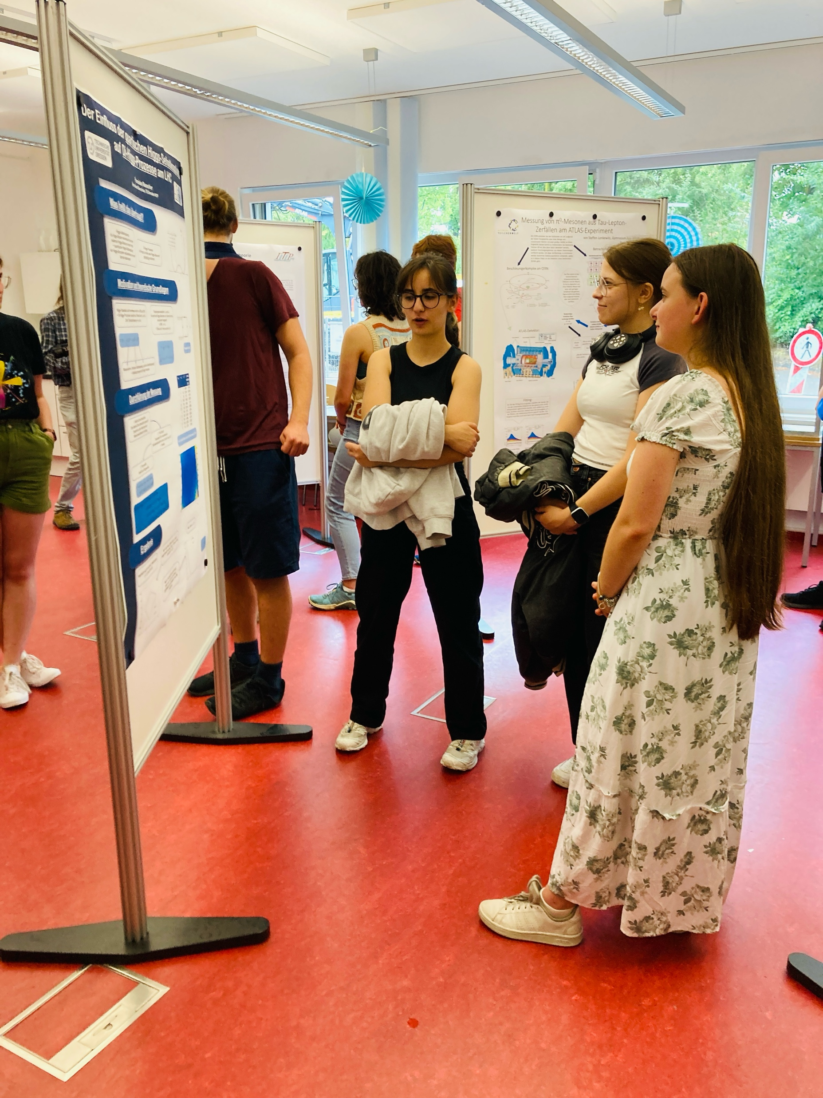
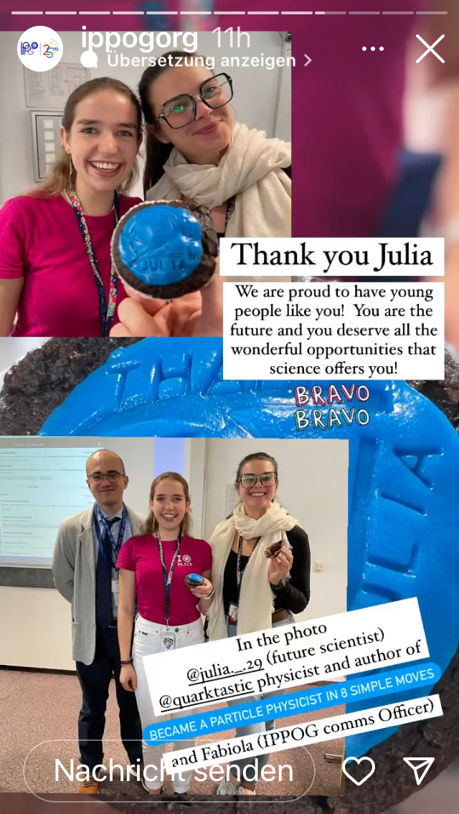

Summary
Newly established Fellow program
Build on young talents from the Multi step program
Masterclasses: Gateway to particle physics
Win-win situation for fellows and group leaders
  Training offers and networks for fellows
  well trained students, potential PhDs, skilled communicators
Partially self-sustaining and self-organized
  Organize own trainings and even Masterclasses to attract new talents
  Role models young age
50% females maintained throughout all steps!
Fellow poster session Uni Münster
Fellow Julia at IPPOG Meeting

