Slide 1

Stories from the Science of CERN
An anthology of short stories of fiction
Co-edited by
Connie Potter & Rob Appleby
IPPOG Thursday 30 November 2023
CONNIE POTTER

Slide 2
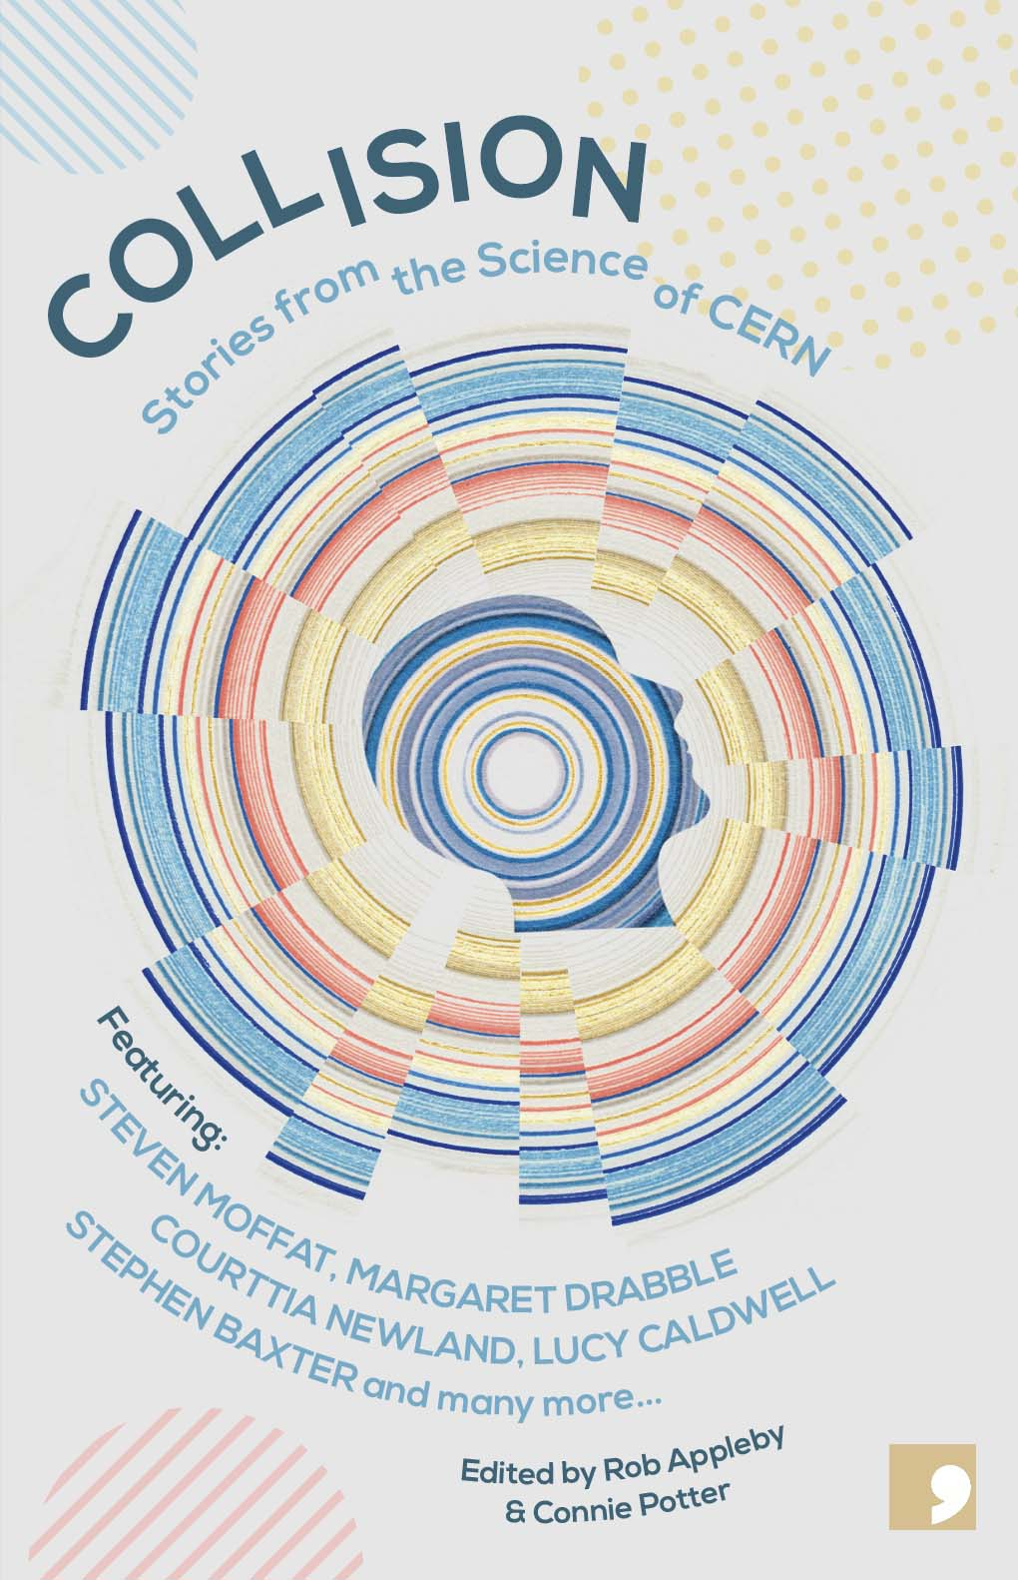
What is it?
A first-ever collection of short stories bringing established, professional authors together with members of the CERN community
Non-profit publisher Comma Press (https://commapress.co.uk/), managed by Ra Page, had already worked with Prof. Rob Appleby, Manchester University and head of UK-LHC, on a previous anthology on another topic
Rob secured a tiny grant, seduced Ra with the idea and then convinced Connie Potter/CERN to become part of the project
Started work in Spring of 2021 : team of Ra, Rob and Connie

Slide 3
The process.
Step One:
Email every single mailing list in the worldwide CERN technical and scientific community
‘Come up with a very short pitch for a fictional short story, based on something you have worked on at CERN in the past, are working on now, or an original, interesting idea for the future’
Over 300 proposals received
Ra contacted select writers to propose the book idea to them. Connie also reached out to a couple of Special Guests she had shown around CERN to see if they were interested
All said yes. Immediately.

Slide 4
The process… continued
Step Two:
Spend weeks working on the proposals, shortening, editing, condensing into a central database
Step Three:
Share list with authors. Talk through with them some of the ones on their shortlist
Step Four:
Inform submitters their idea had been chosen and connect author and submitter

Slide 5
The pairings
Adam Marek
Andrea Giammanco
Bidisha
Kristin Lohwasser
Courttia Newland
Daniel Cervenkov
Ian Watson
Andrea Bersani
Lisa Luxx
Carole Weydert
Luan Goldie
Carole Weydert
Joe Haley
Lucy Caldwell
Margaret Drabble
Tessa Charles
Adam Marek
Andrea Giammanco
Pete Kalu
Michael Davis
Stephen Baxter
John Ellis
Steven Moffat
Pete Dong
Desiree Reynolds
Jens Vigen
Lilian Weezer
Gino Isidori

Slide 6
The process… continued
By end 2021 almost all authors had met the scientists at least once for a long zoom meeting
Mid March 2022 : Visit of a large fraction of the final authors to CERN over two days
Some writers adapted or even re-wrote their story after the visit
By end 2022 a first draft of the final book was ready with afterwords written by the scientific partners
‘blurb’ quotes for the book jacket were obtained from musicians Peter Gabriel and Wayne Coyne and Oscar-winning screenwriter Kenneth Lonergan
Book came out in March 2023

Slide 7
What happened next?
Since the book came out, there have been interviews, articles, reviews and live, in-person events and book readings in the UK and the US.
Here’s a sample

Slide 8
Watch Adam Marek and Prof Rob Appleby talk about the project on BBC's The Click
Listen to Steven Moffat and Lucy Caldwell talk about the project with Samira Ahmed on BBC Radio 4's Front Row
Listen to Steven Moffat and Prof Peter Dong talk to Ian McMillan about ‘Going Dark’, reverse causality, the measurement problem and consciousness on Radio 3's The Verb.
'Collision review: How CERN's stellar secrets became sci-fi gold' - The New Scientist
Featured in The Guardian's best science fiction round-up
Featured in The New Scientist's best science fiction round-up of 2023
Reviewed in E&T magazine
Reviewed in The CERN Courier

Slide 9
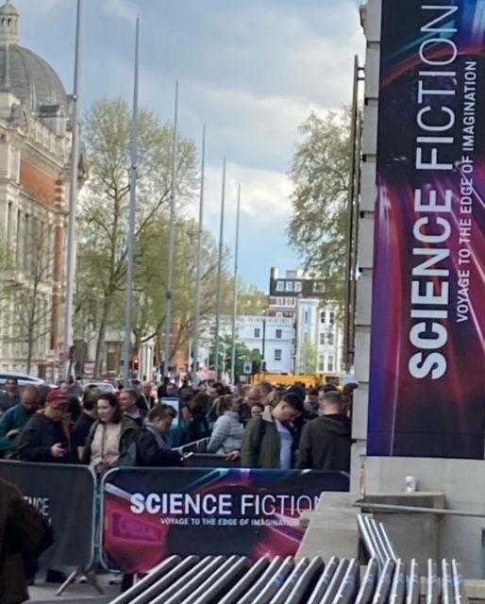
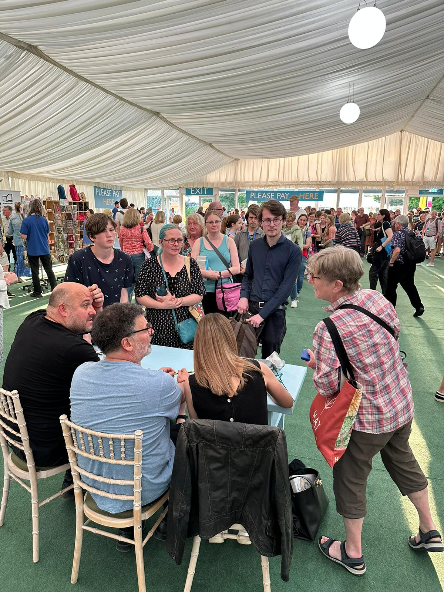
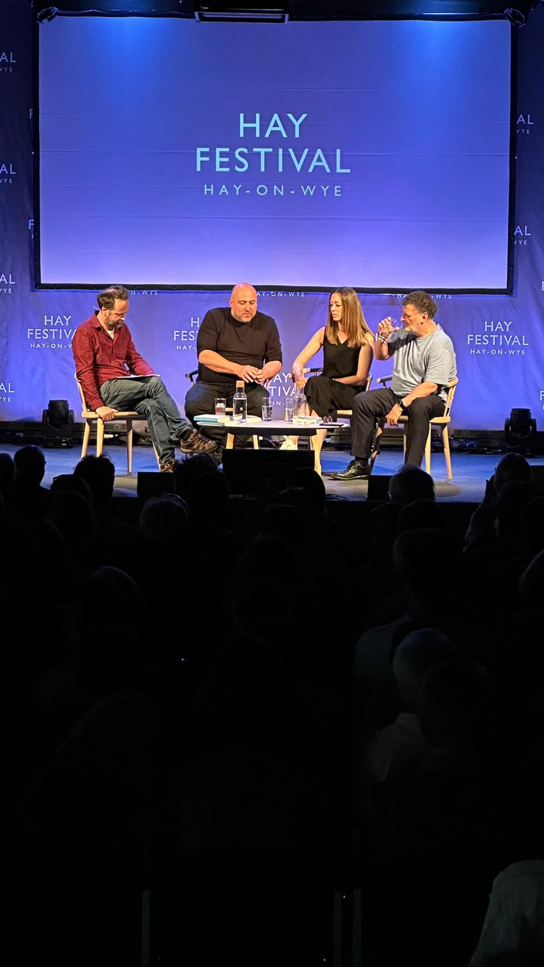
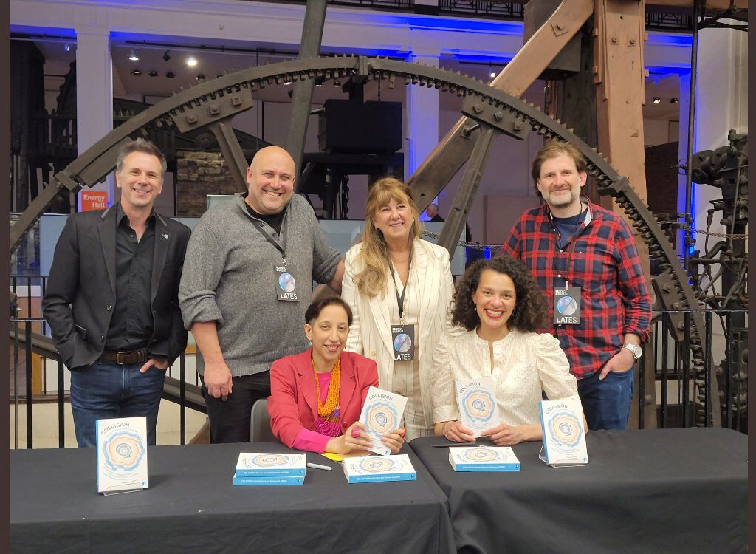

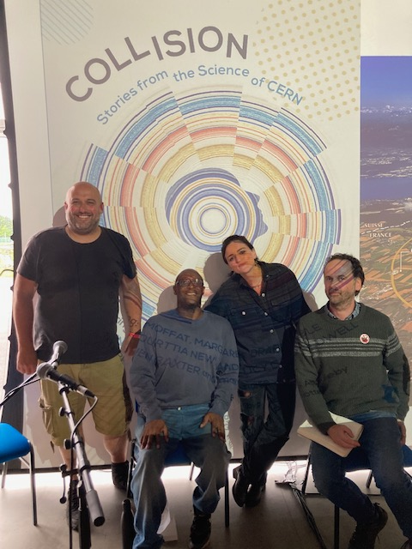
British Science Museum, London ’Late’ event with writers Steven Moffat, Bidisha, Luan Goldie, Adam Marek
Hosted by Rob Appleby and Connie Potter
Hay Festival in Wales panel with Lucy Caldwell, Steven Moffat, Ra Page and Rob Appleby
Panel at the Bluedot Festival in Cheshire with Courttia Newland, Lisa Luxx, Rob Appleby and Ra Page
Southern Festival of Books, Nashville, Tennessee Panel and Reading
With Lucy Caldwell, Rob Appleby and Connie Potter

Slide 10
Upcoming
1 December 2023 at the Royal Institution in London: Panel, reading and signing with Lady Margaret Drabble, Steven Moffat, Kristin Lohwasser and Connie Potter, hosted by the BBC’s Spencer Kelly
18 February 2024 at the Northern Ireland Science Festival:
Dark Matters: A Night of Short Fiction Inspired by John Stewart Bell and CERN with Lucy Caldwell and Michael Davis
Interview of Connie Potter and Rob Appleby in Nature magazine

Slide 11
Result?
Hard work.
Incredibly successful.
Over 3500 books sold so far.
Interest in turning one or two stories into TV or film
Interest in an ‘American’ version of Collision
Get a feel for it was received here with this very short film
Video play https://cernbox.cern.ch/s/HAzfMLm9nq7gN9z

Slide 12
Conclusion
Very successful way of combining physics and literature to reach a new audience.
Each story is quite different. Each writer’s voice varies considerably.
Stories are the writers interpretation of what they have seen and heard.
The afterword from the scientific partner is quite unique and has proven popular.
Do not be afraid to try something new. We didn’t know how this would be received. Could have flopped. It’s a chance one takes.
Instead it flies high.
Get your copy at the CERN shop in the Science Gateway
Thank you

