Slide 1
From Service to Science: Veteran Transition Initiatives @ Fermilab
Office of Equity, Diversity Inclusion and Accessibility
International Particle Physics Outreach Group Conference
30 Nov 2023

Slide 2
VALOR (Veteran Applied Laboratory Occupational Retraining) Program
VALOR is a right-sizing of Fermilab’s award-winning VetTech program. The new program expands opportunities for military veterans by providing multiple entry points for STEM- based technical learning and training that lead to consideration for full-time employment.
VALOR JROTC
Paid, six-week summer internship for Illinois JROTC high school juniors, seniors, and recent graduates. Interns provide technical support for an experiment or research group.
Supervision and direction by a Fermilab employee. Interactions with project teams, scientists, engineers, and support personnel.
VetTech Program
Paid, six-week summer internship for military veterans to intern as a technician to fabricate, assemble, calibrate, operate, test, repair or modify a variety of electronic or mechanical equipment, systems, devices or databases. Information technology, procurement, and ES&H opportunities are also available.
VALOR Apprenticeship
Paid, six-month training and career exploration for military veterans at the beginning of their civilian careers.
Primary focus - developing and demonstrating technical proficiencies. The apprentice may fabricate, assemble, calibrate, operate, test, repair/modify electronic/mechanical equipment, systems, devices, or databases.

Slide 3
DoD SkillBridge : Office of Military Affiliated Communities-University of Chicago
Purpose
Opportunity for service members to gain valuable work experience through specific industry training, apprenticeships, or internships during the last 180 days of military service.
Goal
Build a rich workforce pipeline of trained technical, and computing and procurement professionals, to fill critical roles as incumbents retire.
Benefit
No cost for workforce training
Job training and work experience for active military
Strengthens our commitment to military communities
Pathway to long-term employment security
Division/Directorate Support
Accelerator Directorate
Environment Safety and Health
Finance and Procurement
Infrastructure Services
Security and Emergency Management

Slide 4
Recruitment Strategy: Outreach and Partnerships
VetTech
College of DuPage GMC
IL Dept of Employment Security
US Dept of Veteran Affairs (Hines/Jesse Brown)
VALOR
University of Chicago OMAC
City Colleges of Chicago
Naval Great Lakes Station
VALOR JROTC
Airforce Academy High School
CPS Department of JROTC
East Aurora High School
Lindblom Math and Science Academy
Marmion Academy
West Aurora High School
Career Networking/Events
Chicago Brigade
Hire Vets
NIU Spring Career Fair
Students Veterans of America
Women’s Veteran Alliance
Wounded Warriors Project

Slide 5
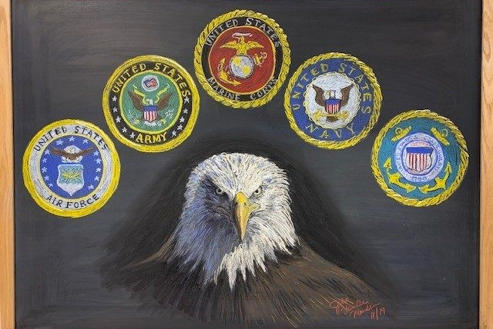
Resources and Engagement: Veterans Lab Resource Group
Veterans Laboratory Resource Group
A resource for military veterans, families and friends of military service men and women at Fermilab.
Leadership: Brian Niesman • Brandon White • Chandler Lawrence
Executive Sponsor: Susan Simpkins
Current Veterans employed: ~125

Slide 6
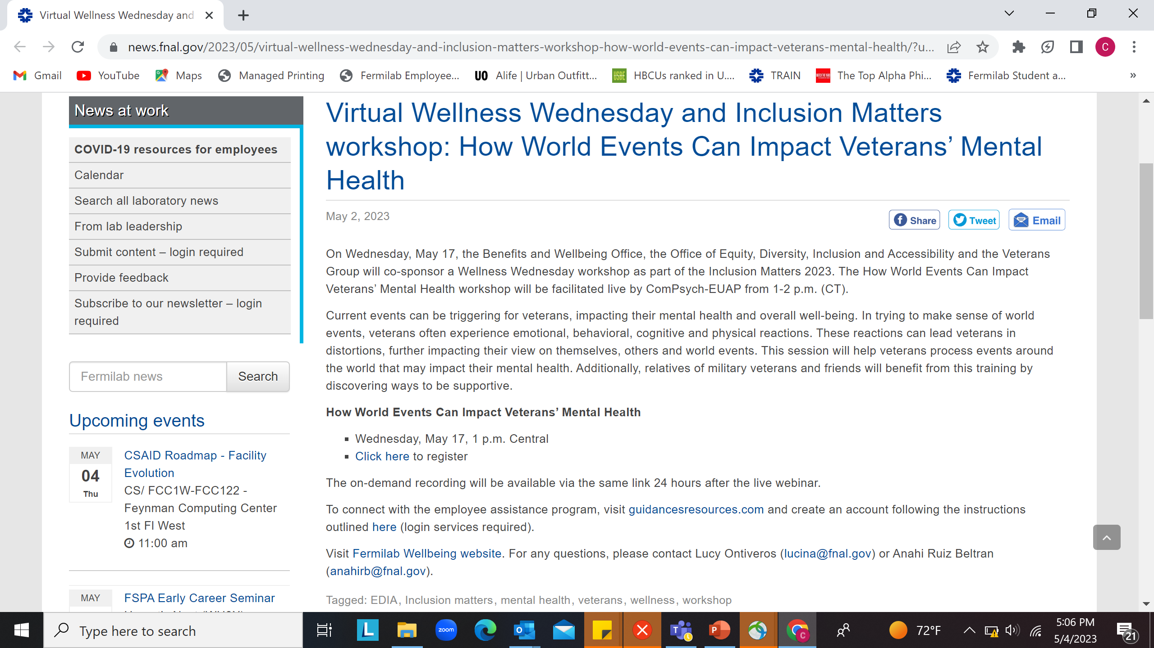
Resources and Engagement: Courageous Conversations

Slide 7
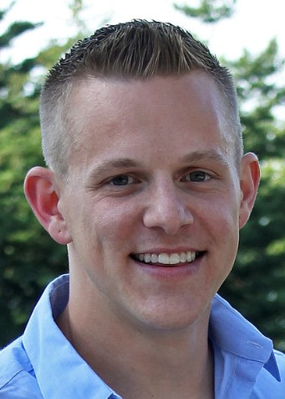
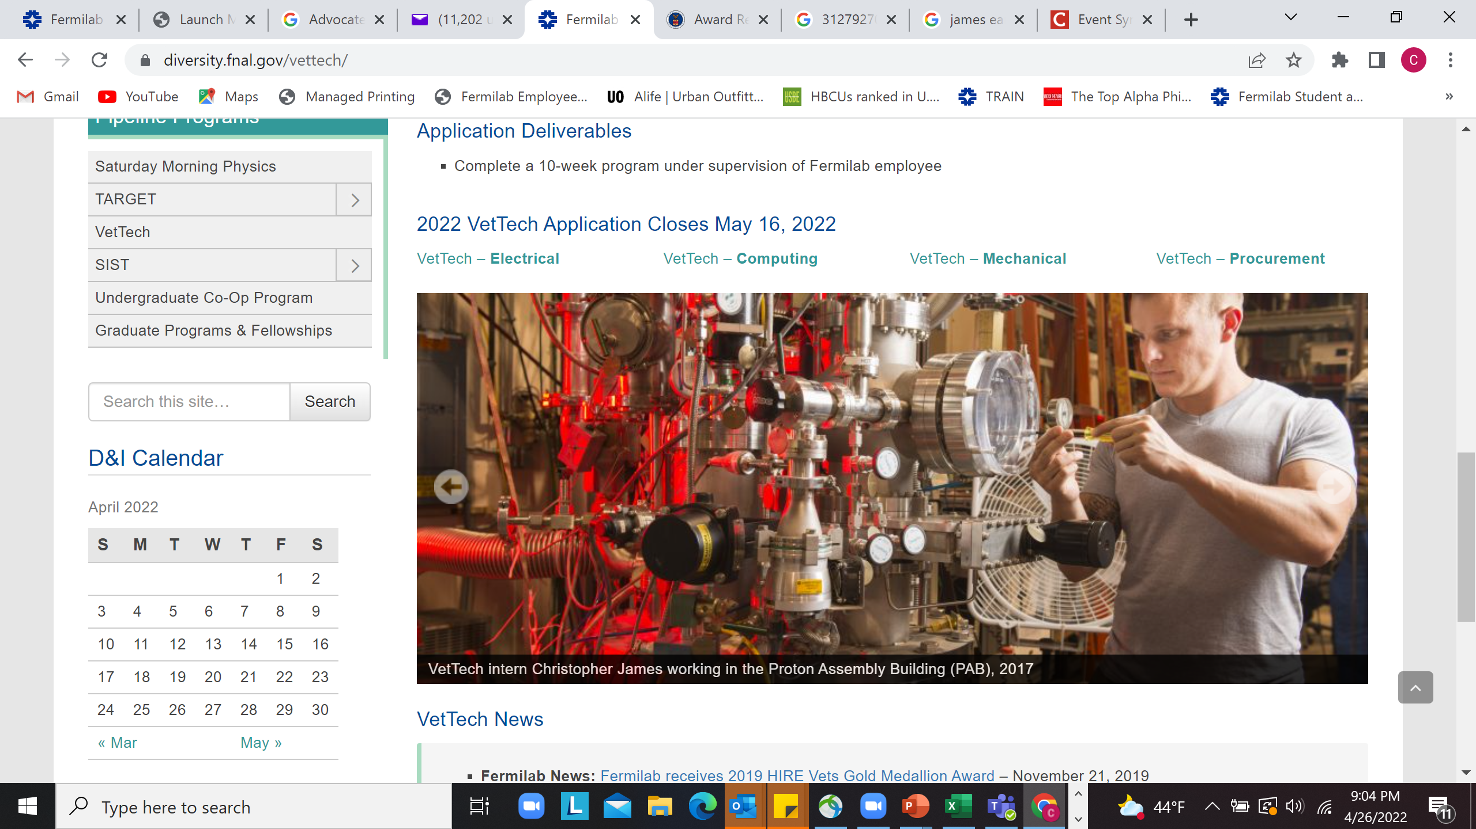
Success At-Glance: Conversions
Christopher James
VetTech Intern 2017
Neutrino Division Mechanical Technician
SQMS Staff Engineer I Hired 2019
VetTech/VALOR Supervisor

Slide 8

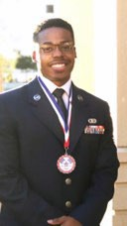
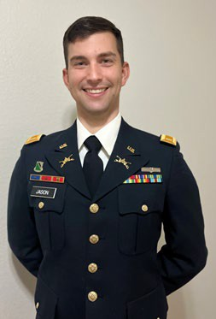
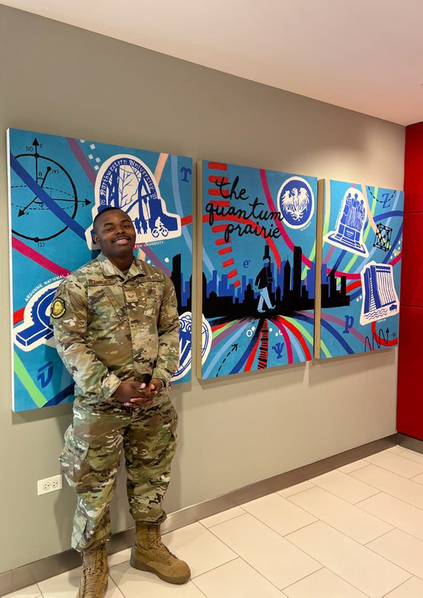
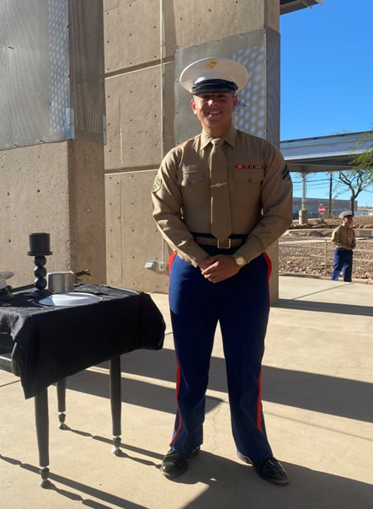
Converting Veteran Interns to Employees
Small Business Liaison Officer Finance and Procurement Hired 2023
Financial Analyst
Finance and Procurement Hired 2023
Area Facilities Manager Infrastructure Services Division Hired 2023
Cybersecurity Specialist Accelerator Directorate Hired 2023

Slide 9
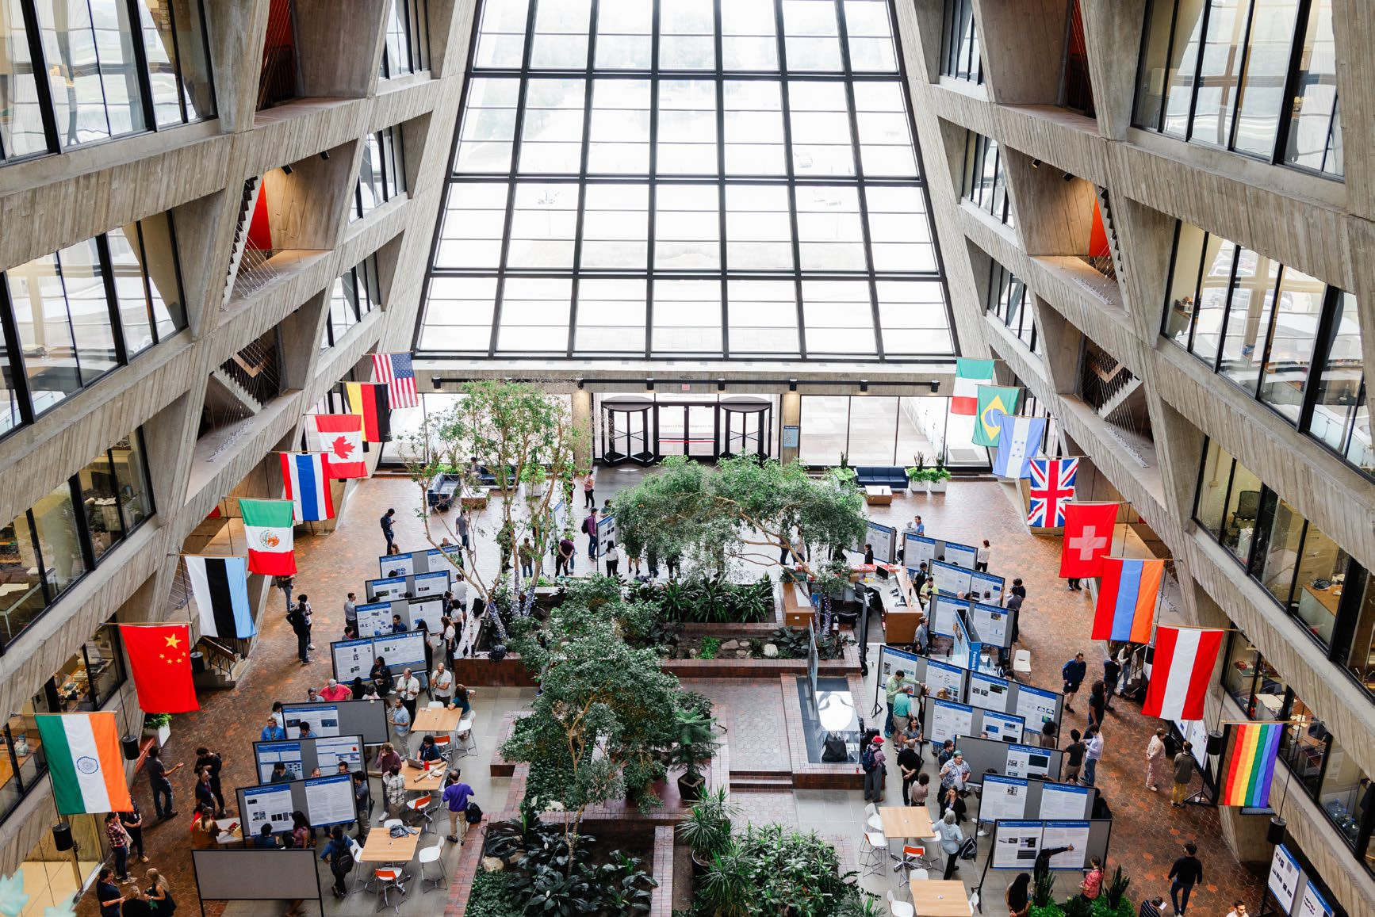
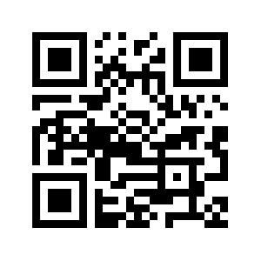
Connect with us!
More information:
Internships.fnal.gov
Contact:
Internships@fnal.gov

