Slide 1
Public Engagement
Universal Science & Music of Physics
S. Goldfarb, University of Melbourne, ATLAS IPPOG Representative
CERN, Geneva, 30 November 2023

Slide 2
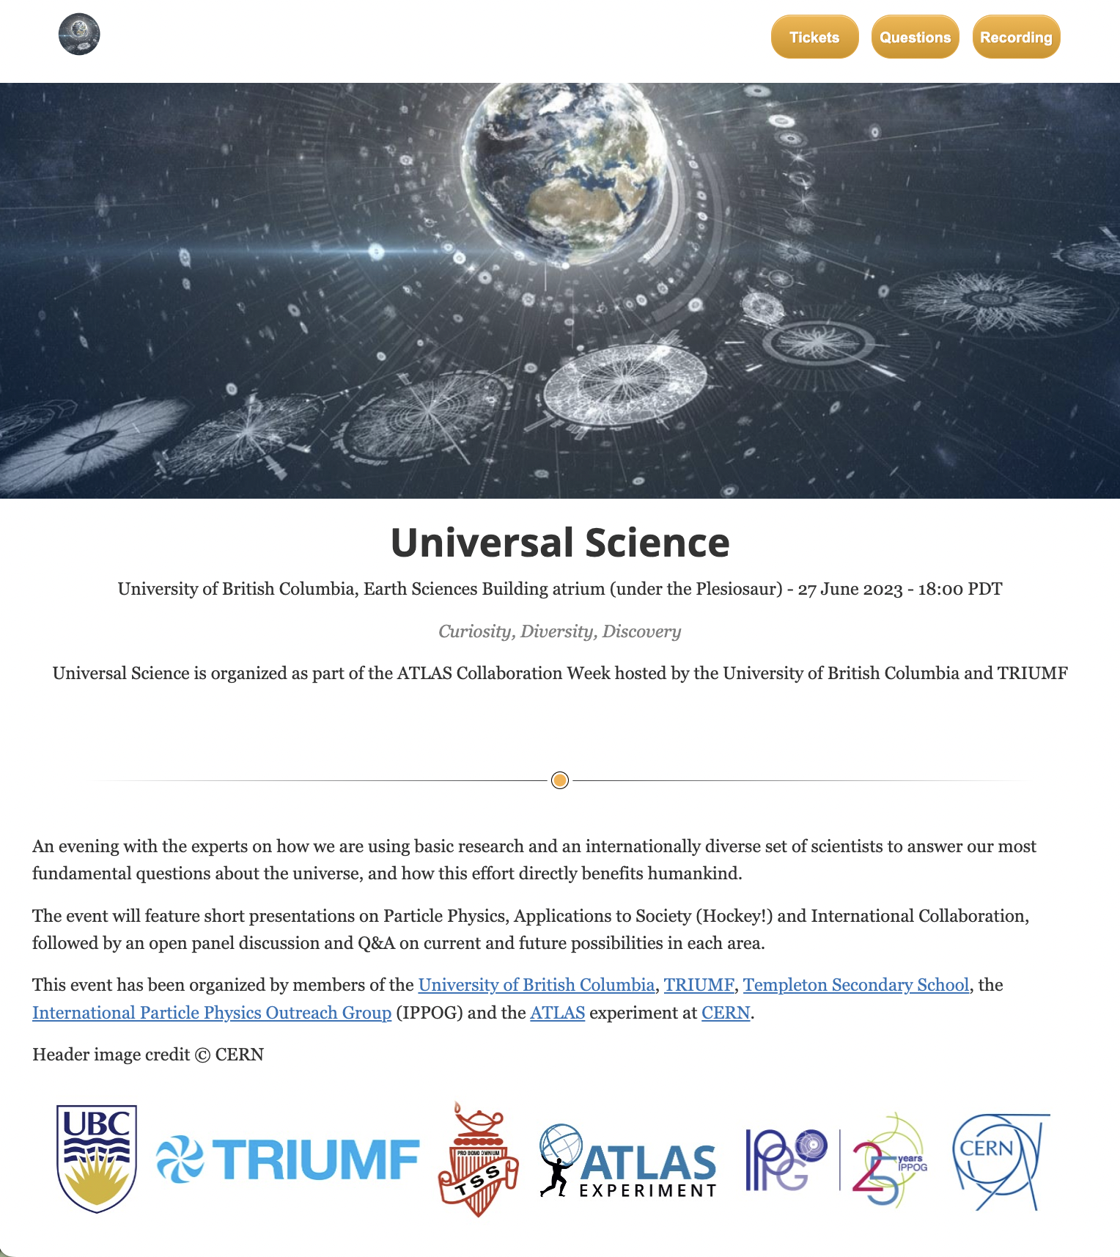
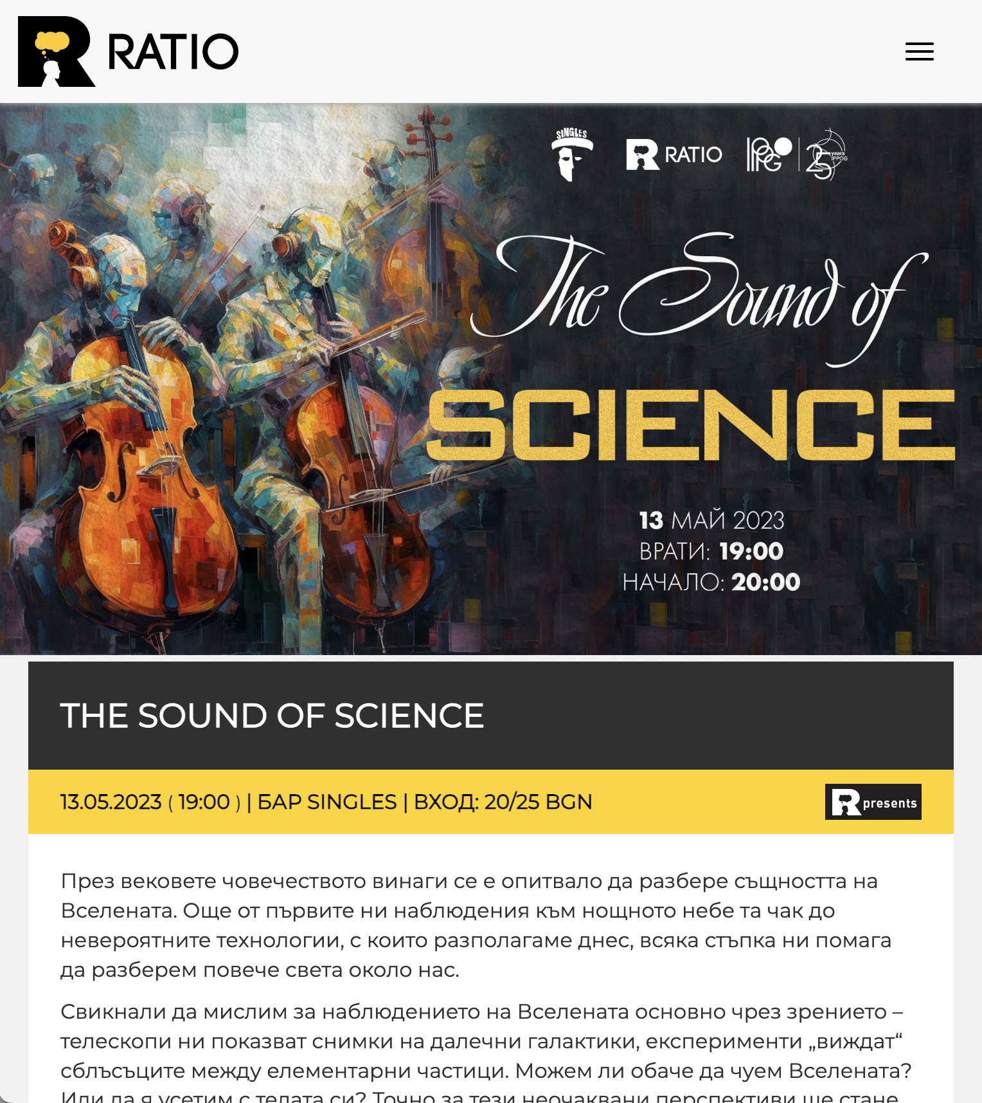
Two Public Event Recipes
Universal Science
Music of Physics

Slide 3
Commonalities
Common methods of both activities
  Optimise interaction between scientists & public
  Grab attention of public
  Bring scientists into public engagament
  Create environment that encourages conversation
Common goals
  Audience should learn more about the goals of particle physics
  Scientists should learn more about public hopes and concerns
  Connections should be made
  Fun should be had

Slide 4
Universal Science
Description
  Public event attached to conference or collaboration meeting
  Underlying theme of Diversity in Science (never explicitly emphasised)
Ingredients
  Small public auditorium with nearby exhibition space
  3 Local scientists adept at making engaging public presentations
  3 Additional students / young scientists willing to engage an audience
  Local partners with access to media, existing audience
Recipe
  Event starts with scientists at exhibits meeting with public
    Food & Drink an important catalyst
  Three short (15-minute) talks on physics, something, and diversity
    Something has been computing, gaming, education, etc.
  Talks followed by a panel discussion including more local scientists
  Extra time for one-on-one discussion

Slide 5
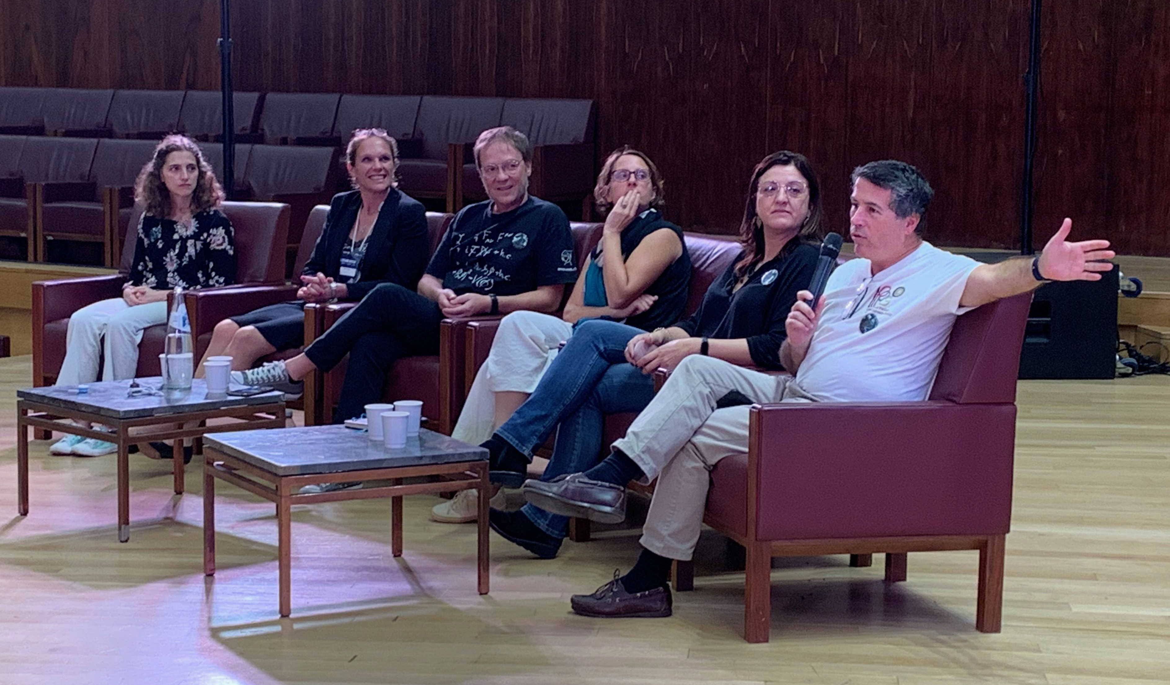
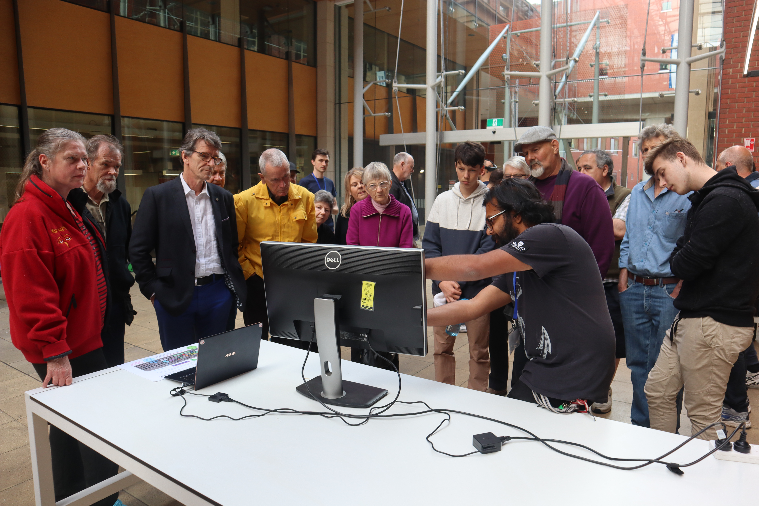
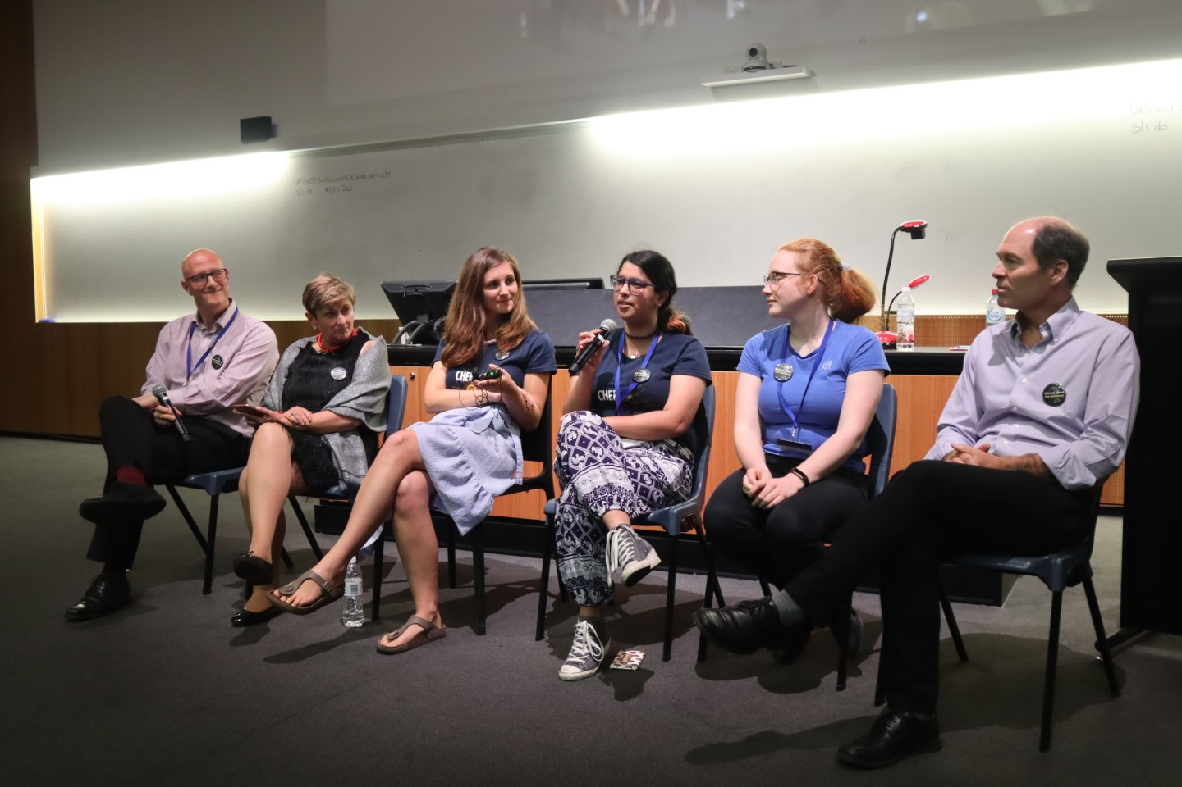
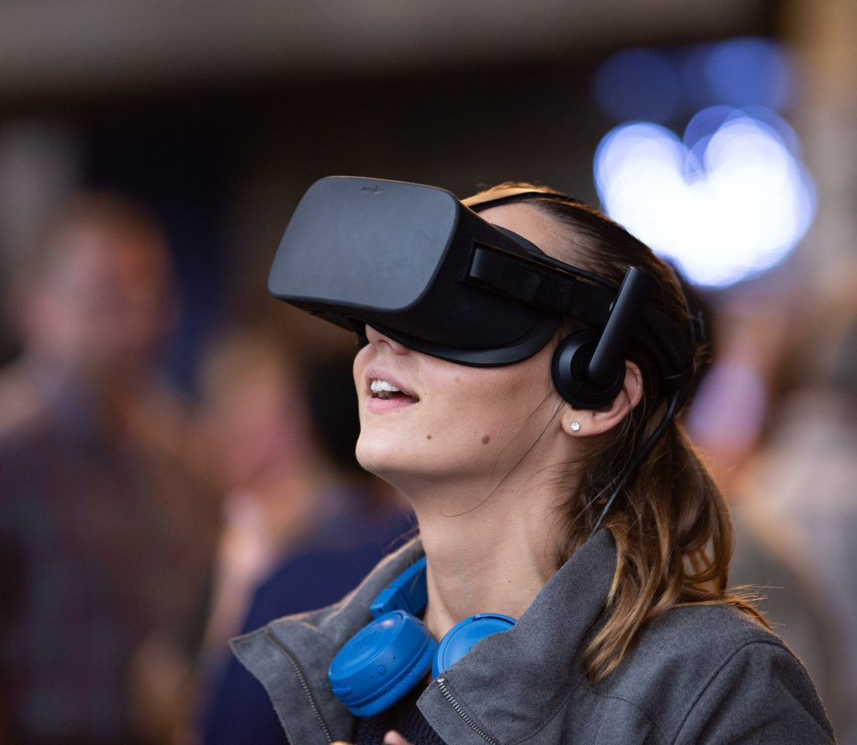
Universal Science
Steve’s Tips
Need dedicated local partner
  Publicize, publicize, publicize
Get meeting participants involved
  Posters, exhibits, brochures
  Answering questions one-on-one
Keep talks short and sharp
Use Q&A app like http://sli.do
Need effective moderator for Q&A
Listen to the audience
Concerning diversity:
  Show off international diversity
  Admit weaknesses
Remote participation possible
Photograph & record everything!

Slide 6
Music of Physics
Description
  Public event engaging audience with music triggered by science
    Cosmic piano, Sonification, Science-themed compositions, Cool instruments (theremin),…
  Can also include component on Physics of Music
Ingredients
  Small public stage / pub
  Local musicians, composers, scientists
  Local partners with access to media, existing audience
Recipe
  Narrator tells a story (e.g. cosmic rays, LHC, Higgs, Voyager, etc.)
  Musical acts are threaded into the story
  Final act should be climactic and perhaps a bit chaotic (a crescendo)
    E.g. Duet with cosmic piano, followed by full ensemble

Slide 7
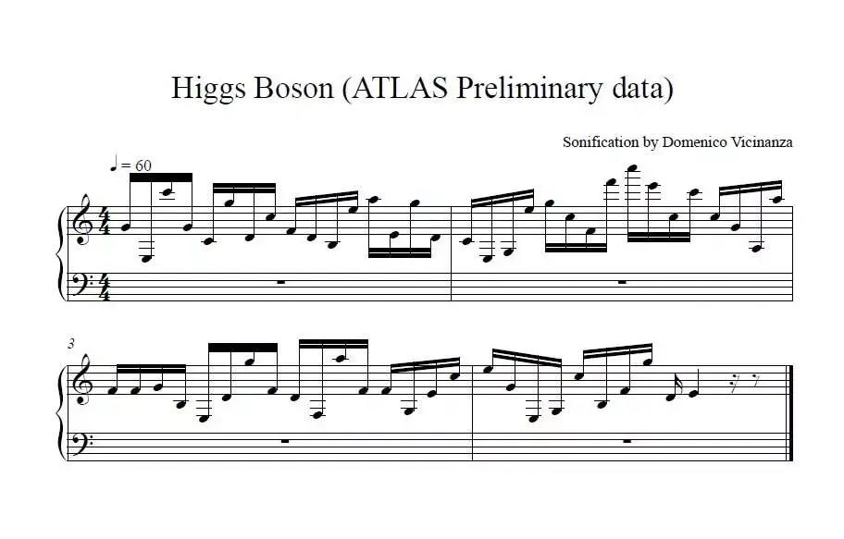
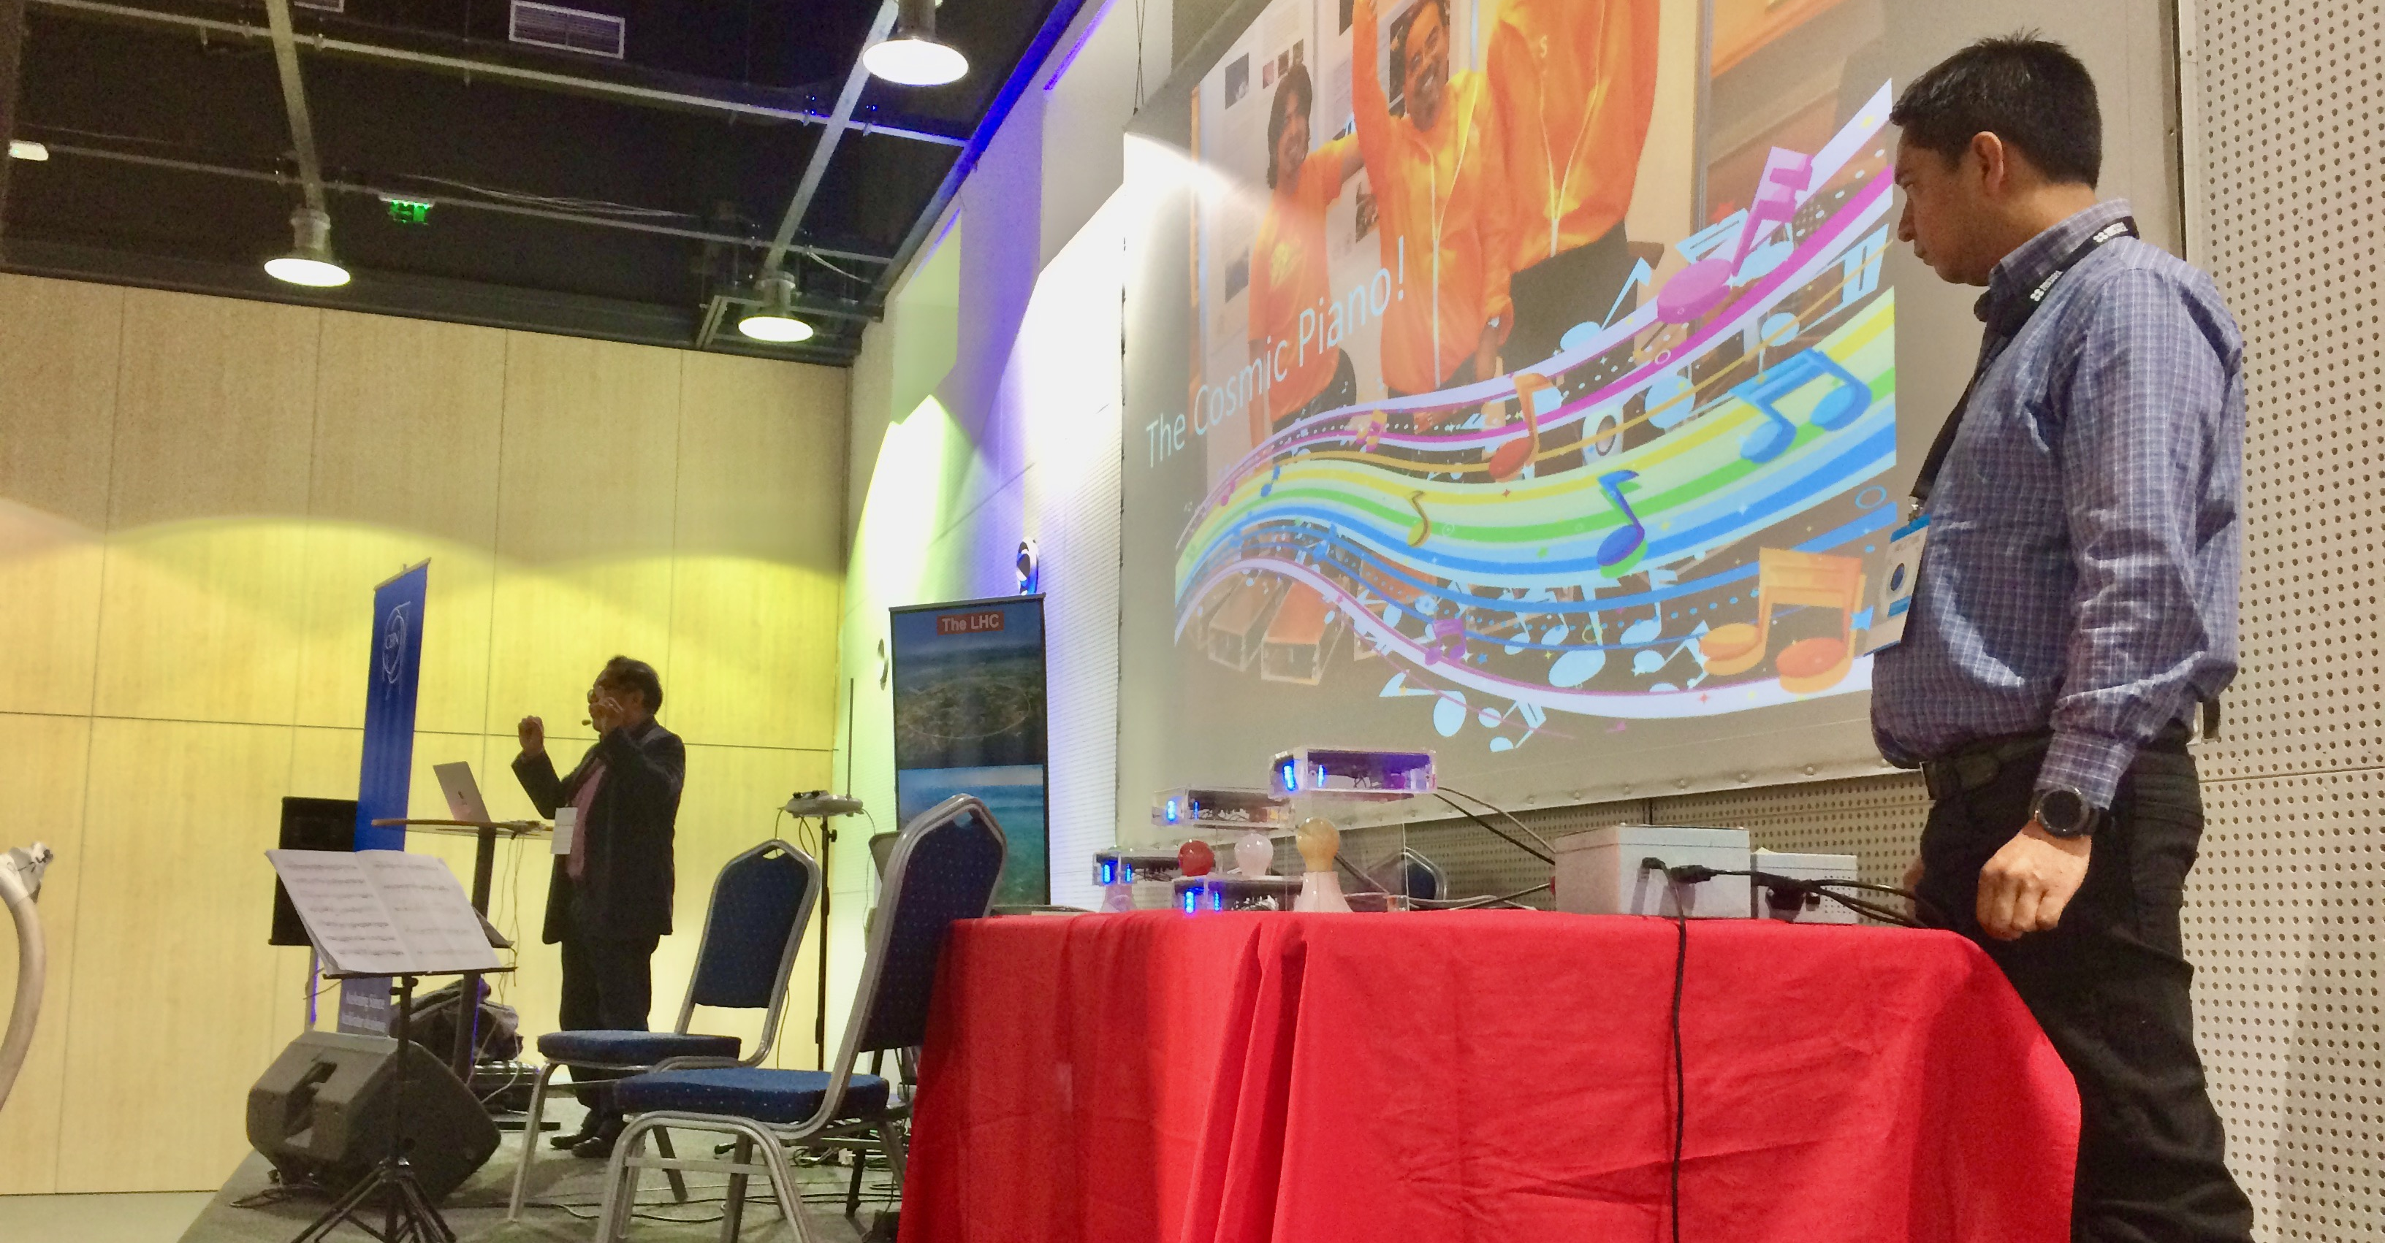
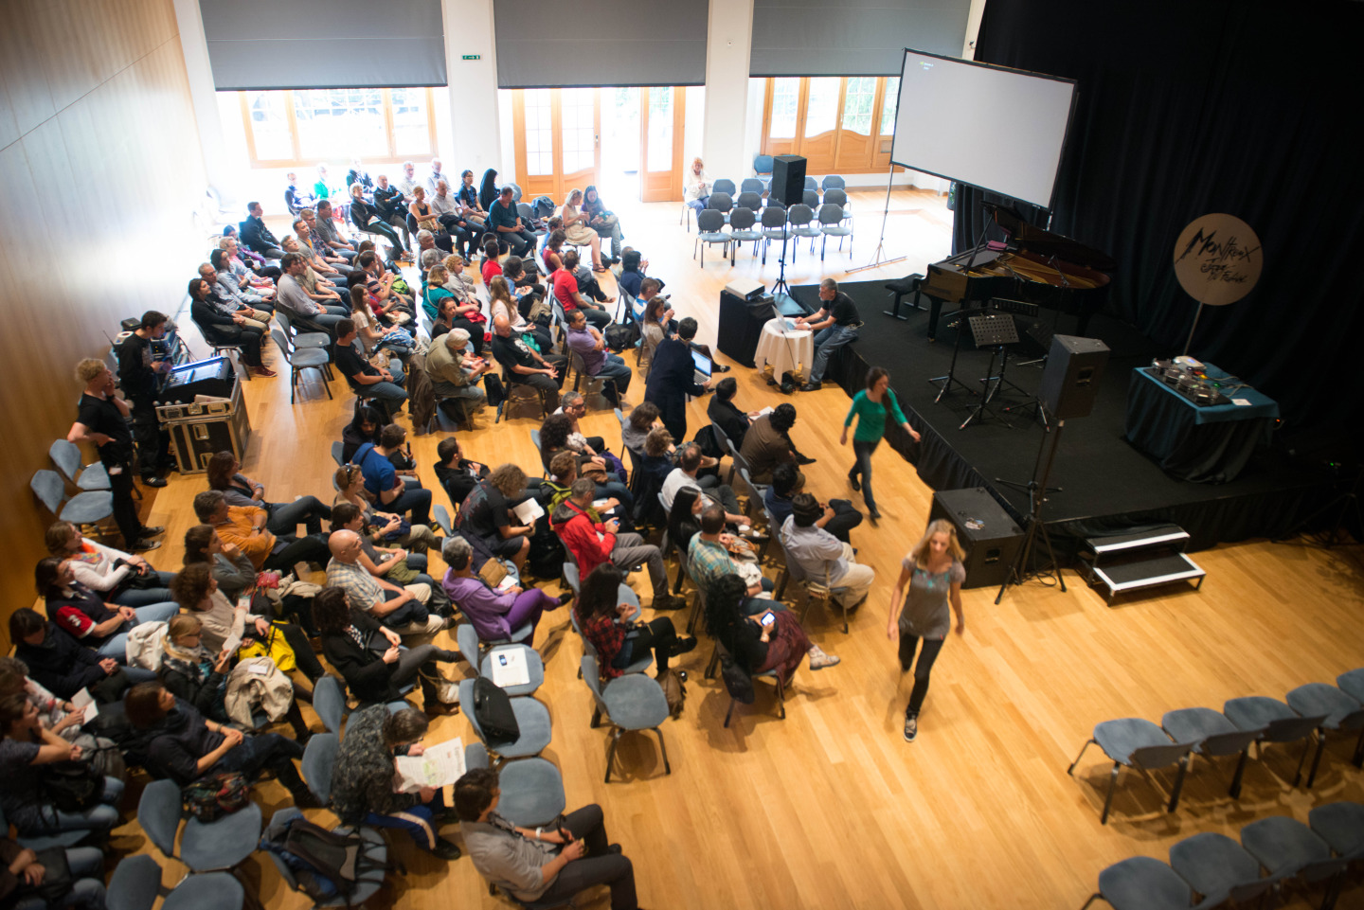
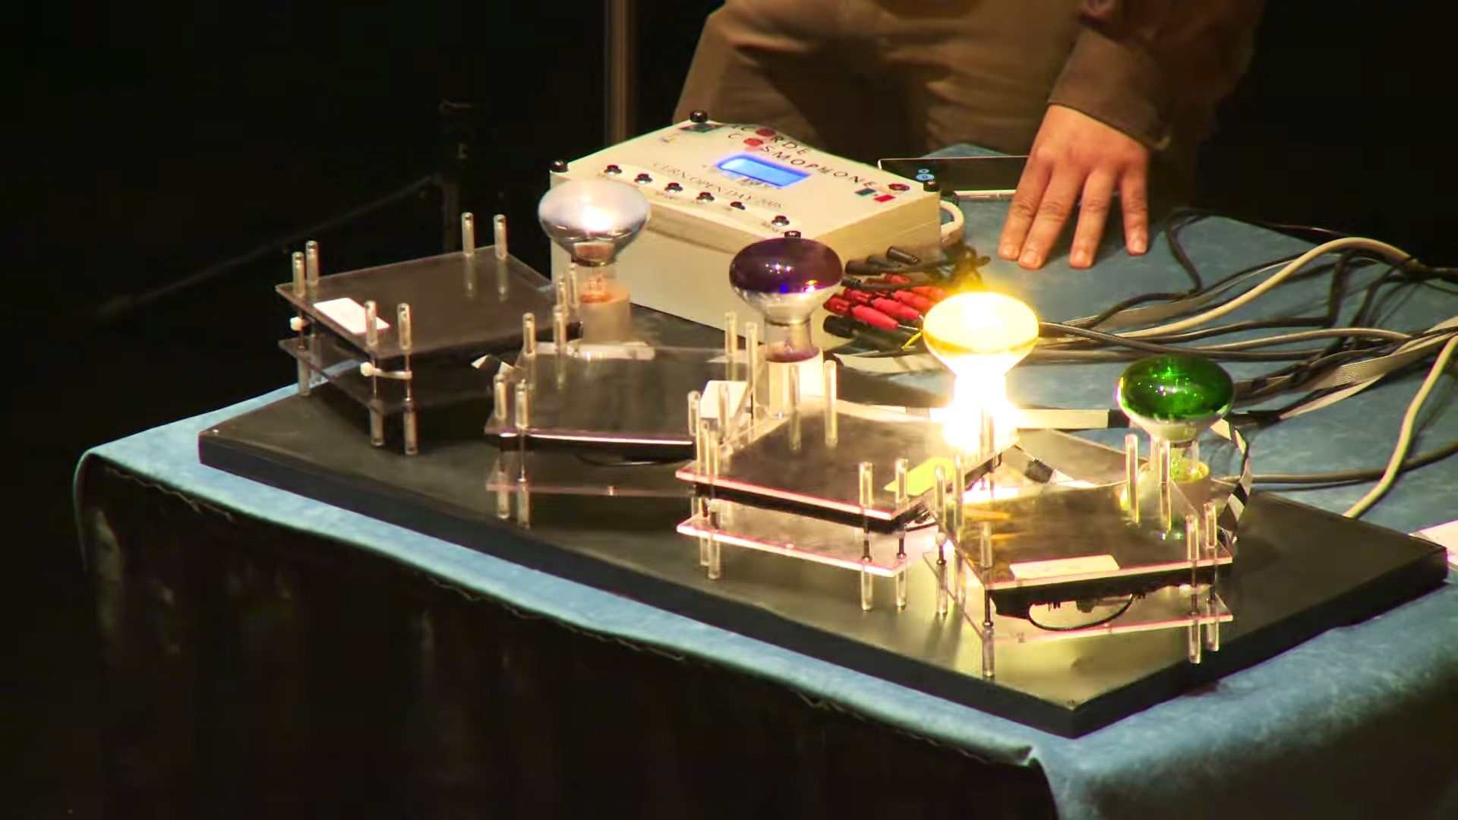
Music of Physics
Steve’s Tips
Need dedicated local partner
  Publicize, publicize, publicize
Works best in a cosy location
Needs sound expertise
Use local talent whenever possible
Popular acts:
  Cosmic piano
  Ensemble playing science-themed music
  Cyborgs
  Interactive physics of music demos
  The Theremin
Minimise lecturing
Maximise music
Photograph & record everything!

Slide 8
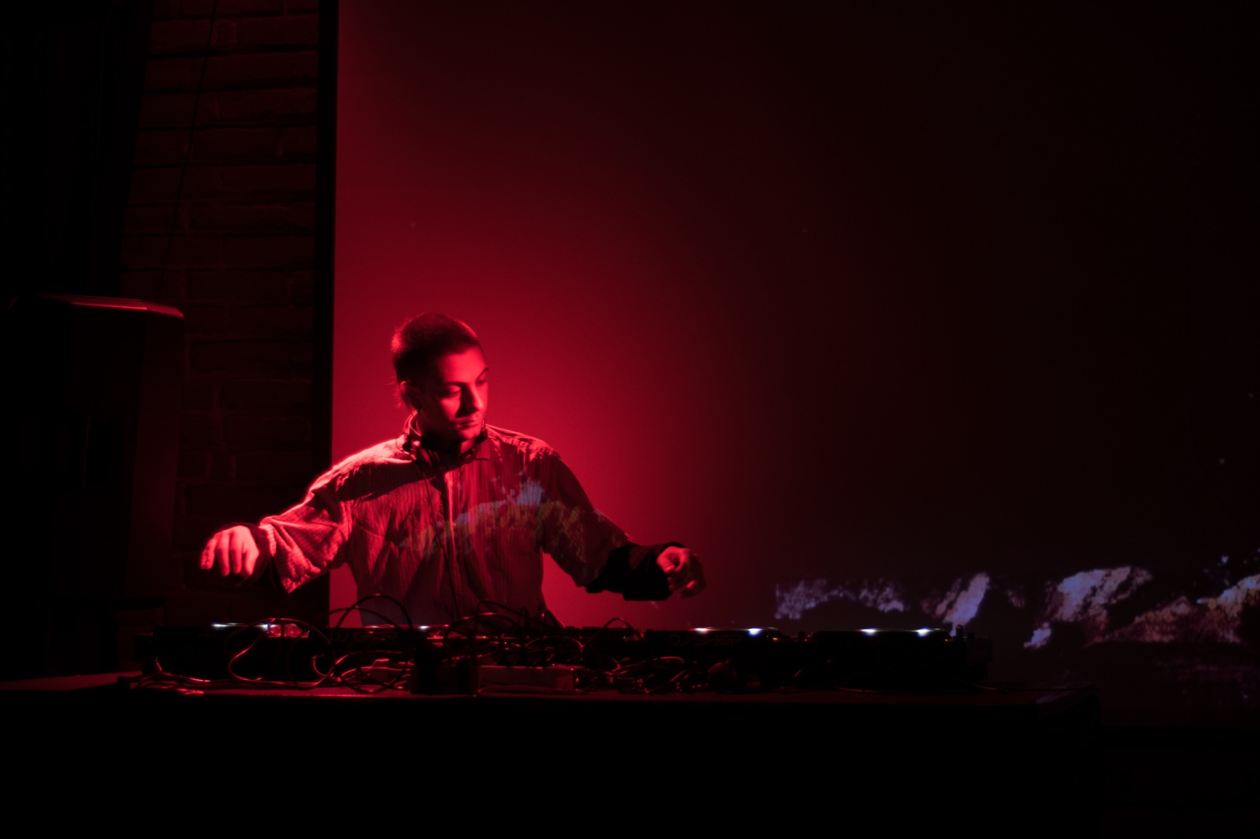
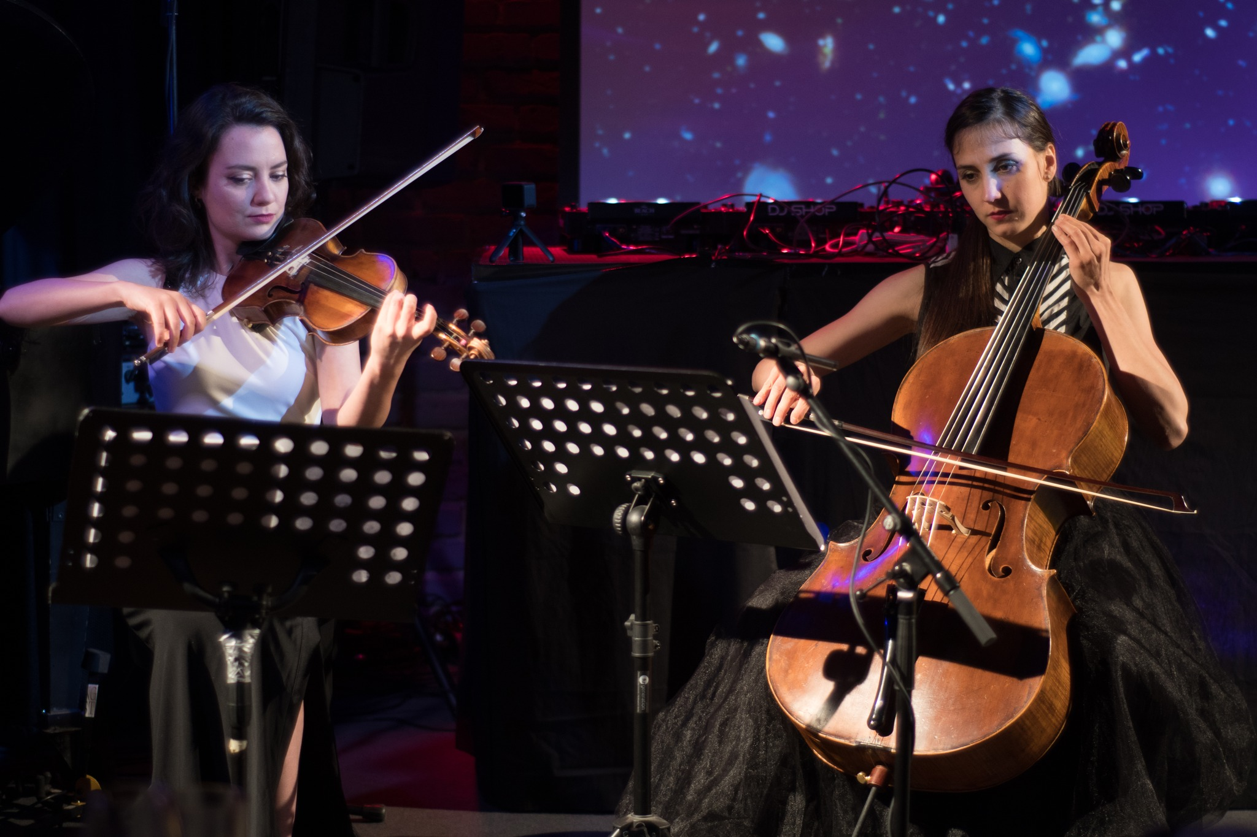
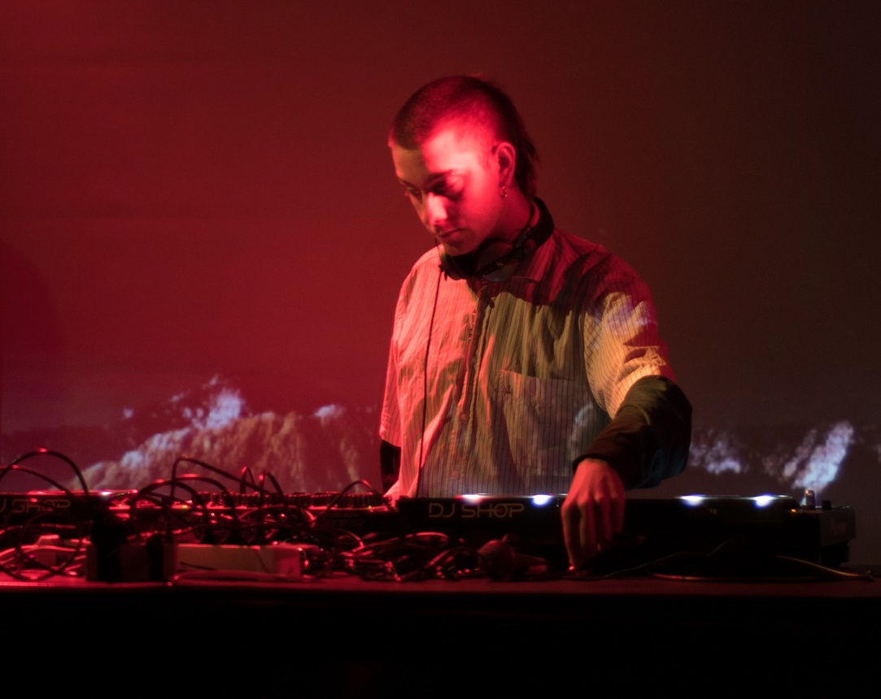
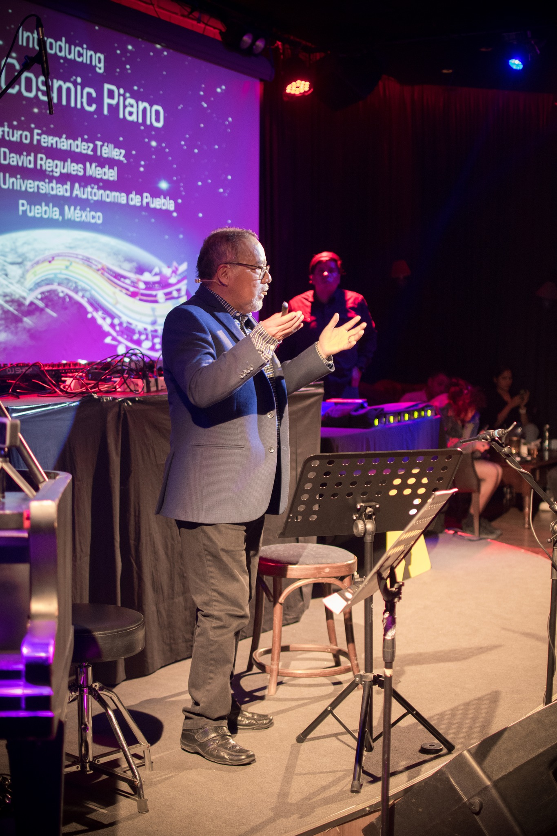
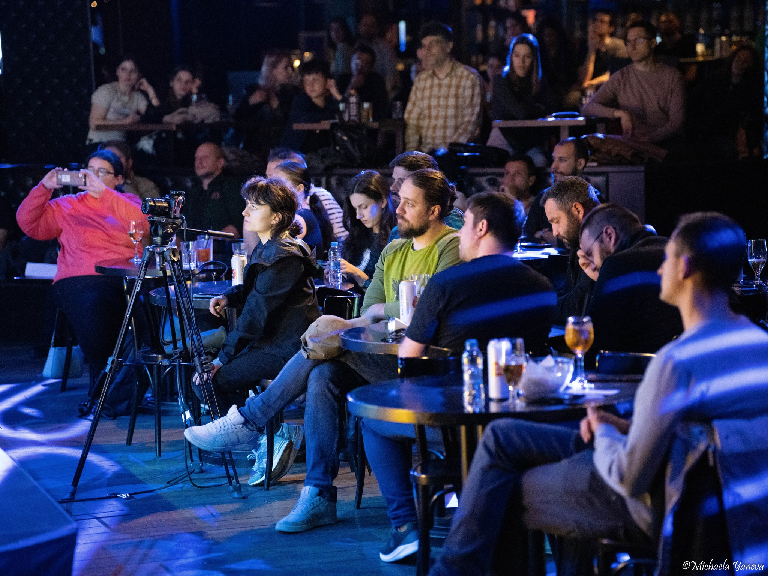
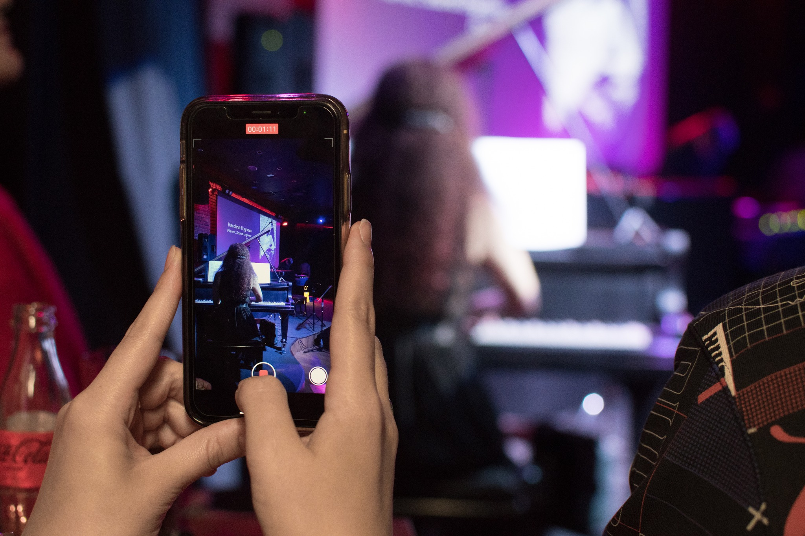
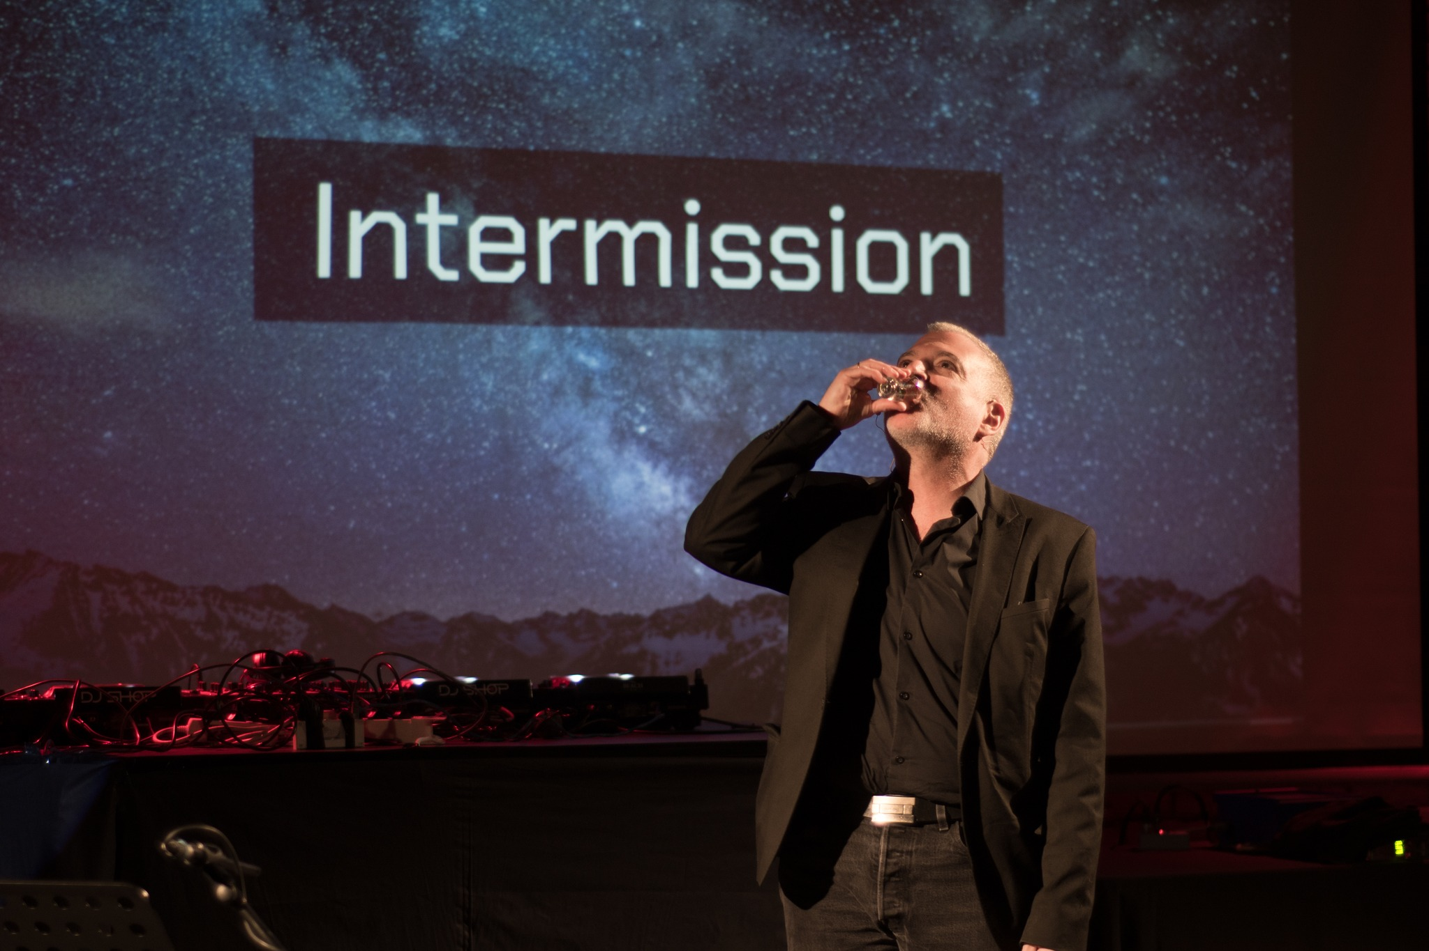
Music of Physics

Slide 9
Past Events
Universal Science
  CHEP 2018 – Sofia, Bulgaria
  CHEP 2019 – Adelaide, Australia
  ICHEP 2020 – Online
  ATLAS Week 2022 – Lisbon, Portugal
  ATLAS Week 2023 – Vancouver, Canada
Music of Physics
  Montreux Jazz Festival 2013, 2014, 2015 – Montreux, Switzerland
  Bluedot Festival 2016 – Jodrell Bank, UK
  Science Festival 2018 – Sofia, Bulgaria
  Science Festival / IPPOG / RATIO 2023 – Sofia, Bulgaria

Slide 10
In Summary
Lessons Learnt
  Public engagement benefits from attention-grabbing catalysts
  Conversations need to go both ways:
    Convey the fundamental messages of science and society
    Listen to your audience and try to address concerns
  Effective local partners are essential for organising events
    Local publicity
    Local talent
  Make it fun!

