Slide 1

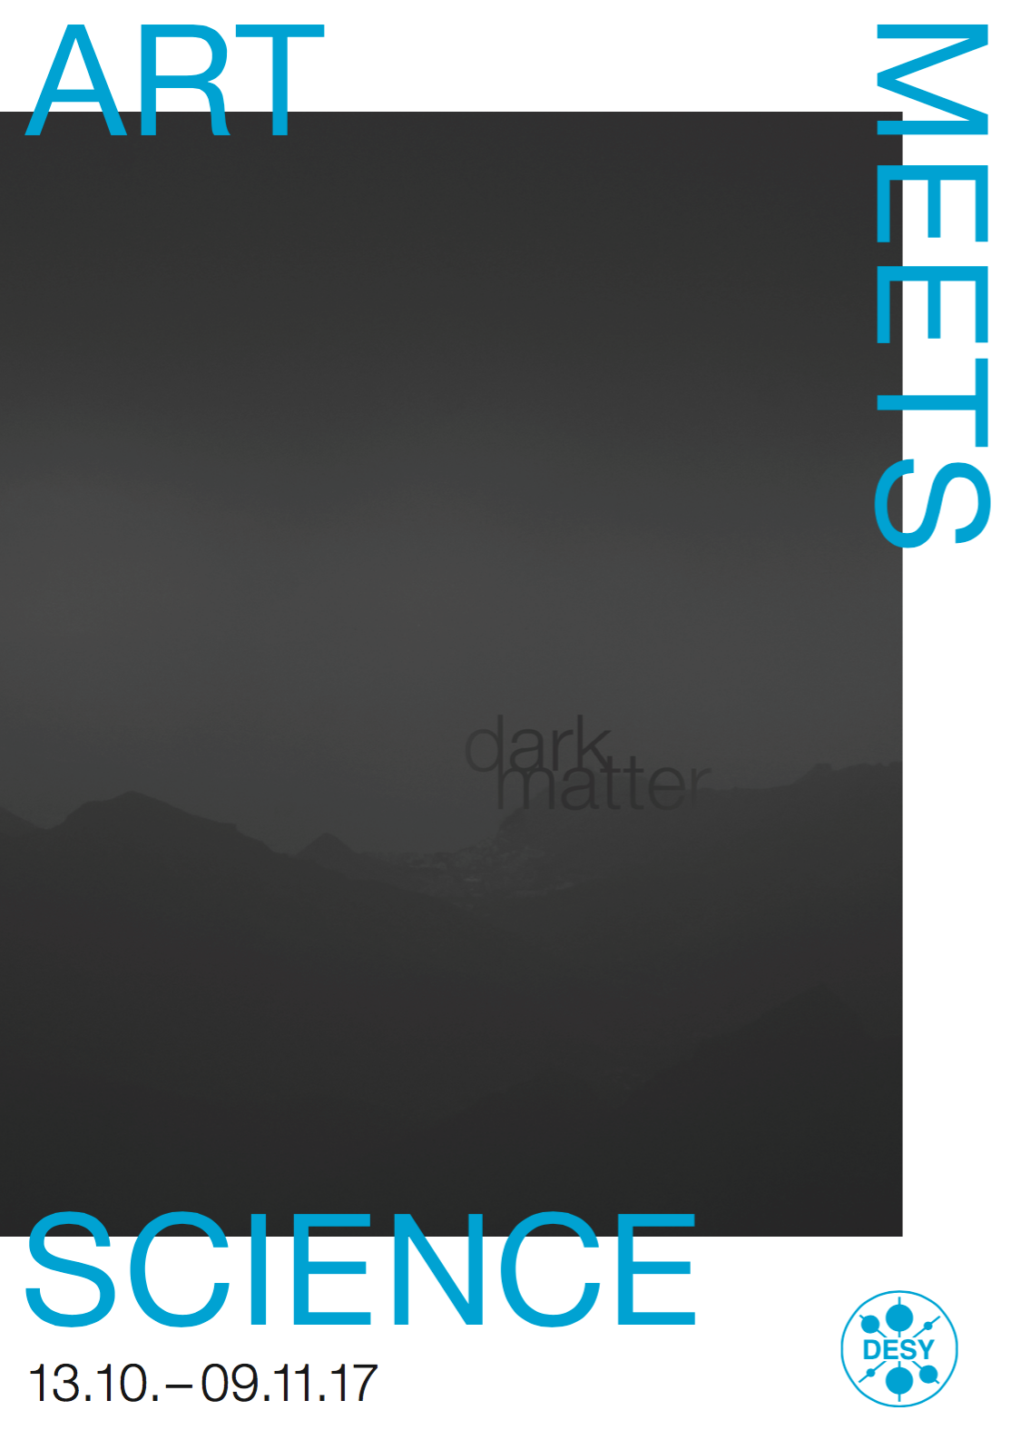
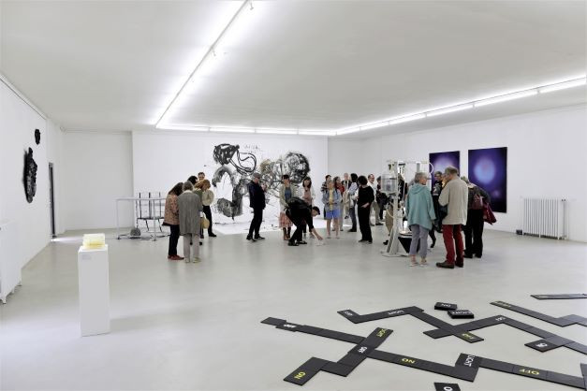
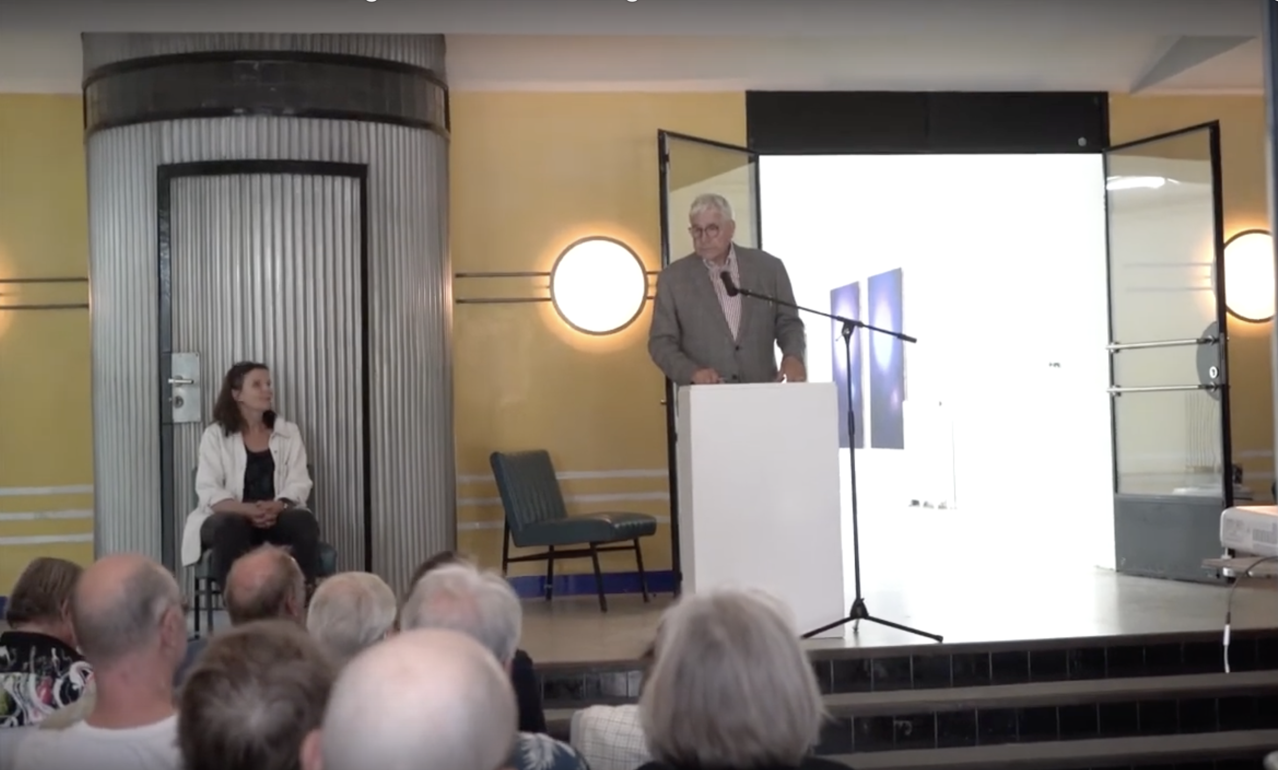
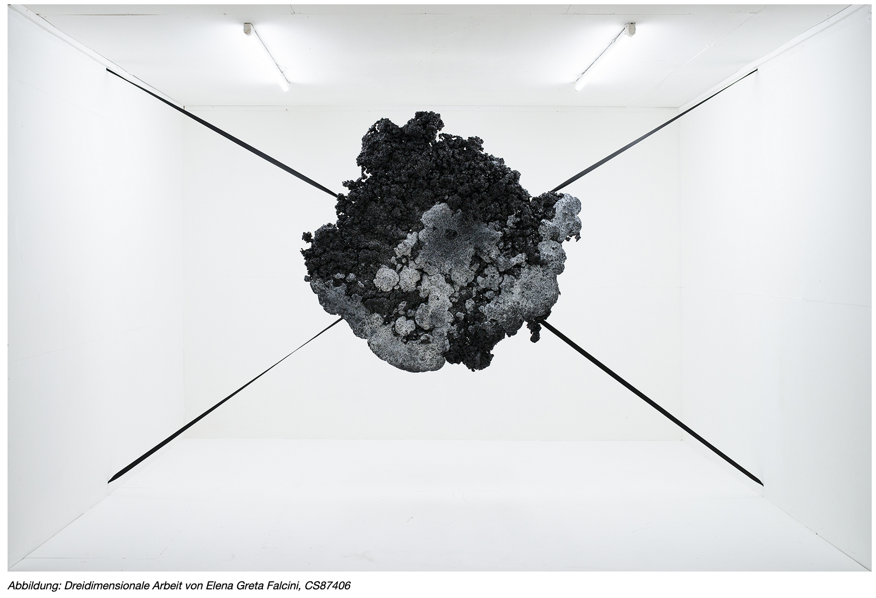
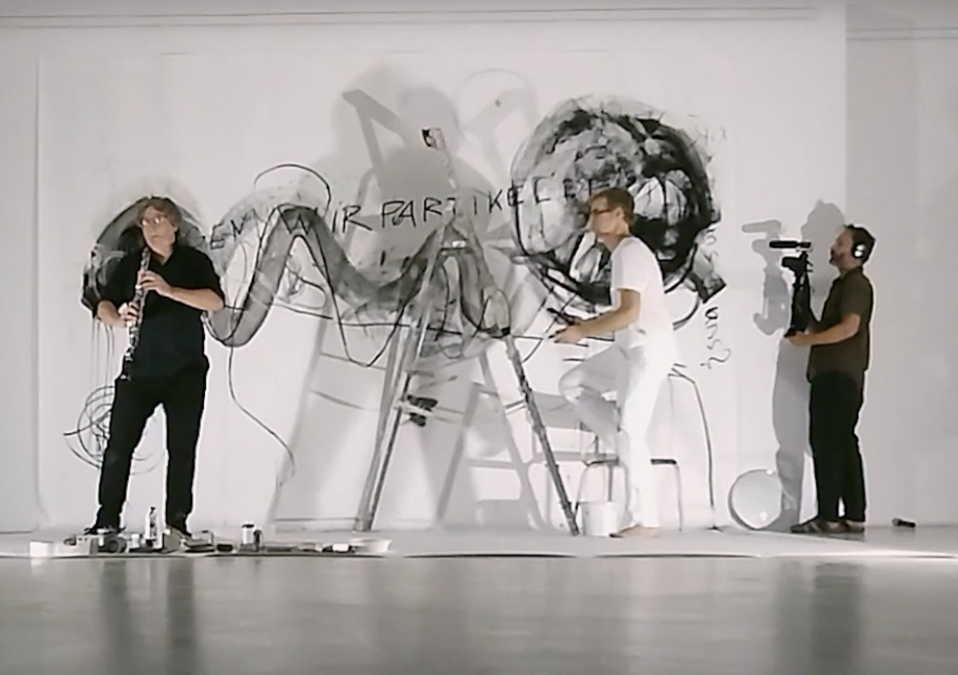
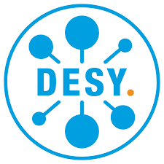

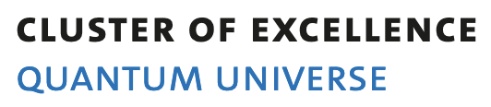
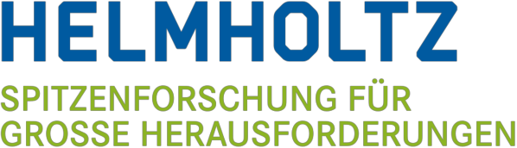
Art Meets Science in Hamburg - Christian Schwanenberger
Deutsches Elektronensynchrotron (DESY) Universität Hamburg
Programme Kick off: 10 scientists 15 artists
8 Projects in total
topical artwork presented in a working lab
➞ part of research for one month: ~ 2500 visitors, almost all new to campus (70-80%), plus 20’000 visitors during DESY day, TV, radio and press coverage, …

Slide 2
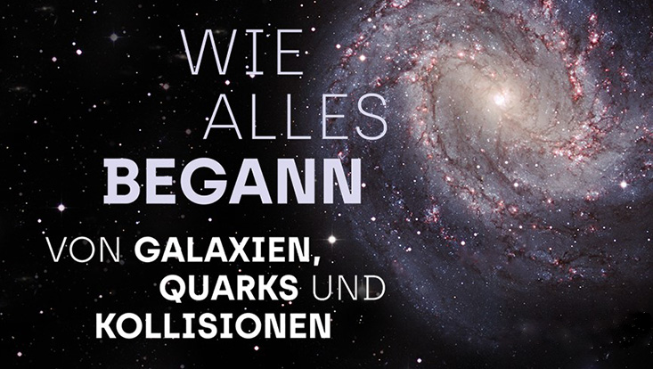
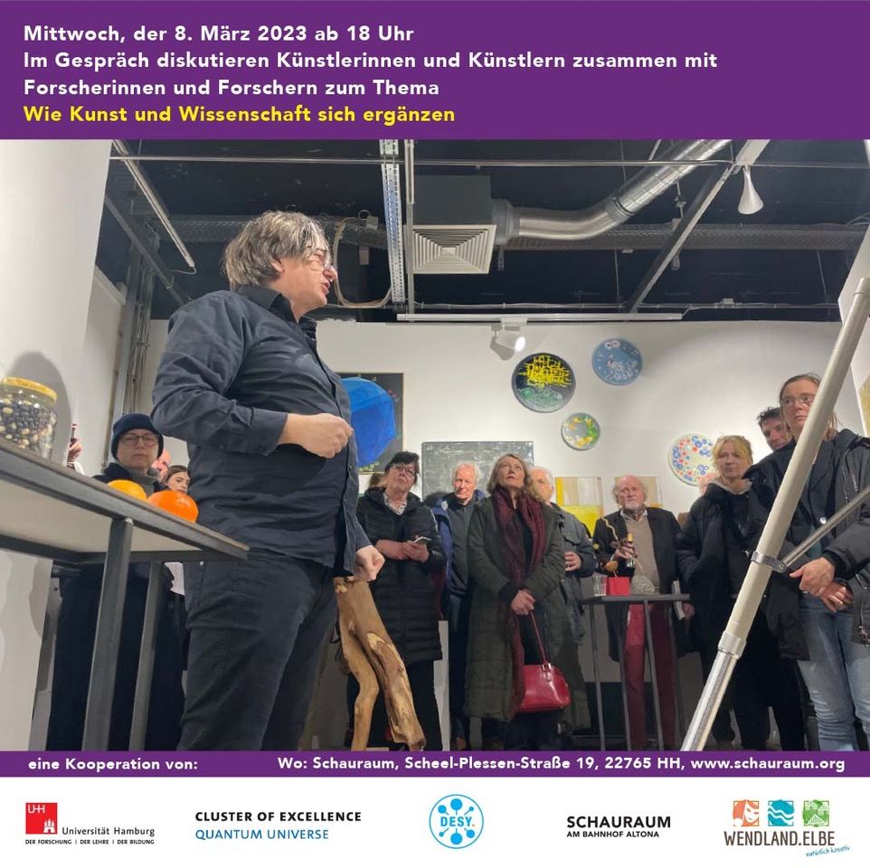
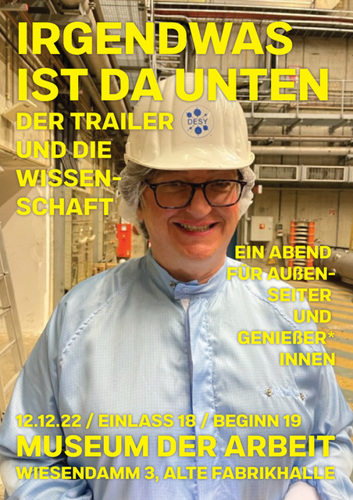
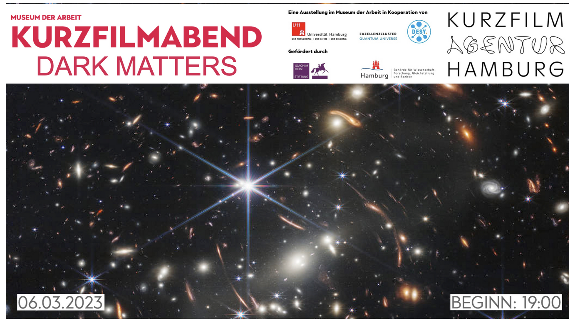
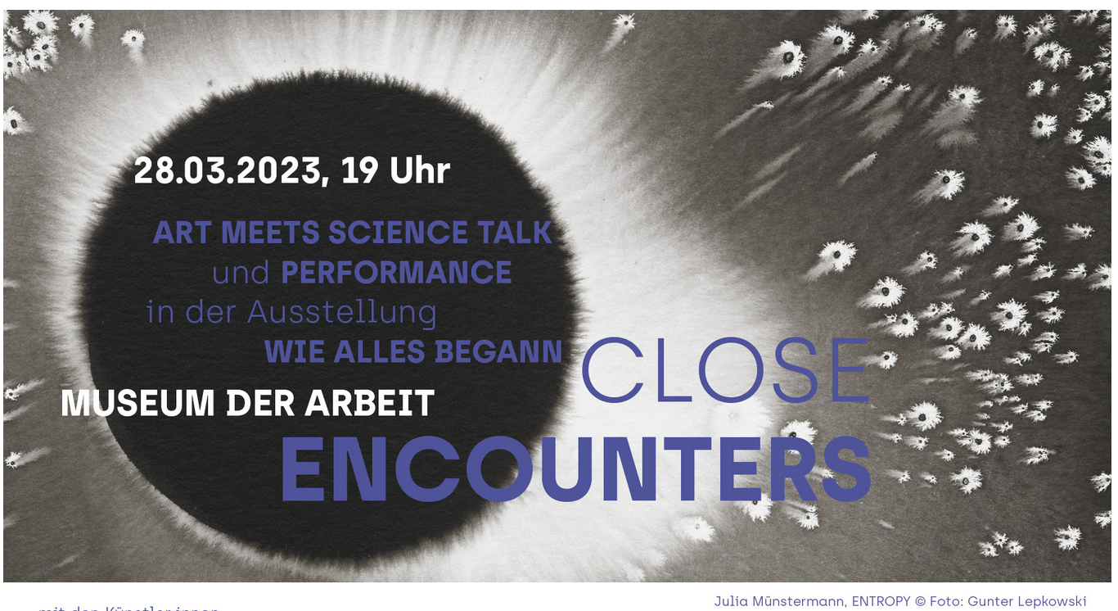
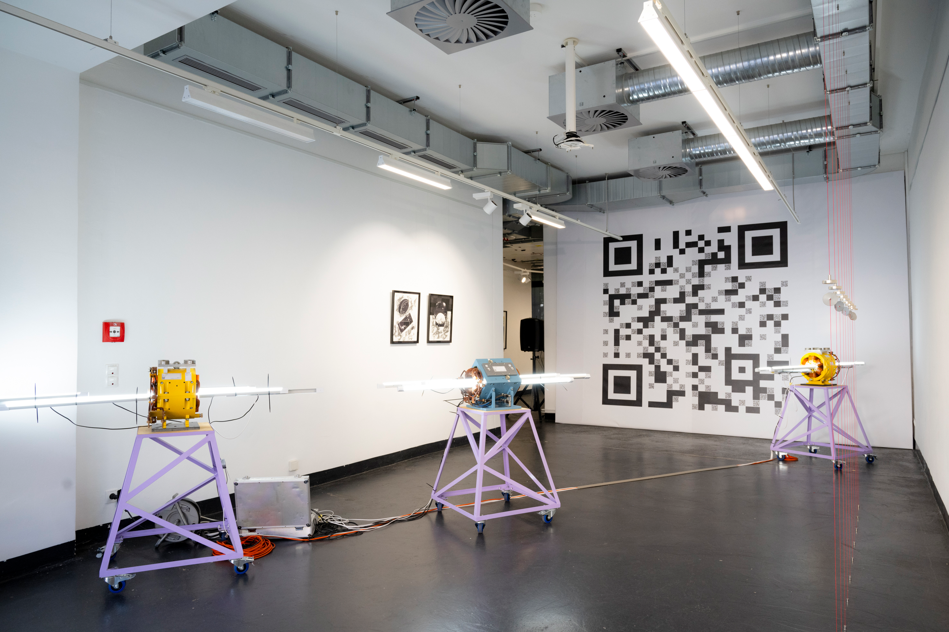

Science Exhibition: Museum der Arbeit, 10/22-05/23
Symbiose: Schauraum Altona, Hamburg, 02-03/23
Science Exhibition: Museum der Arbeit, 10/22-05/23
Art exhibition during EPS-HEP conference 08/23
?

Slide 3
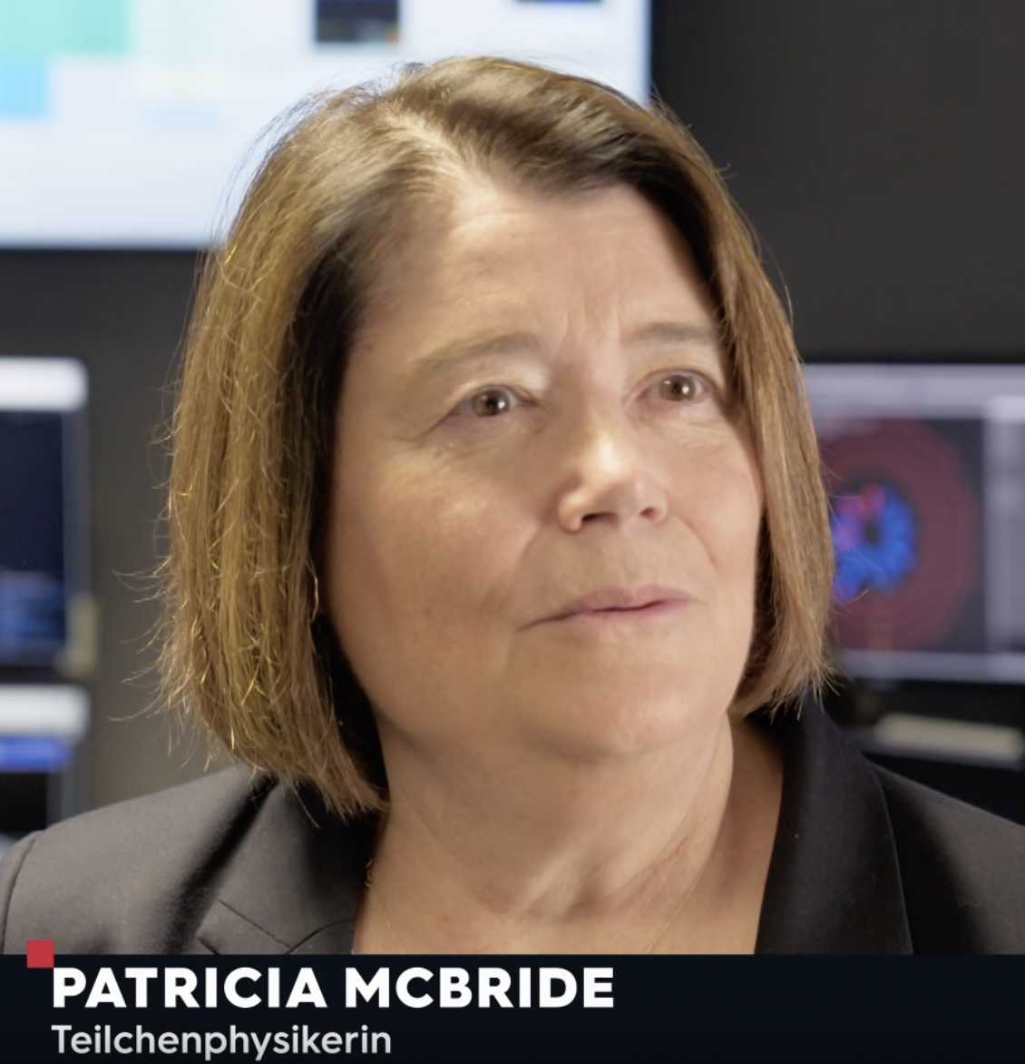
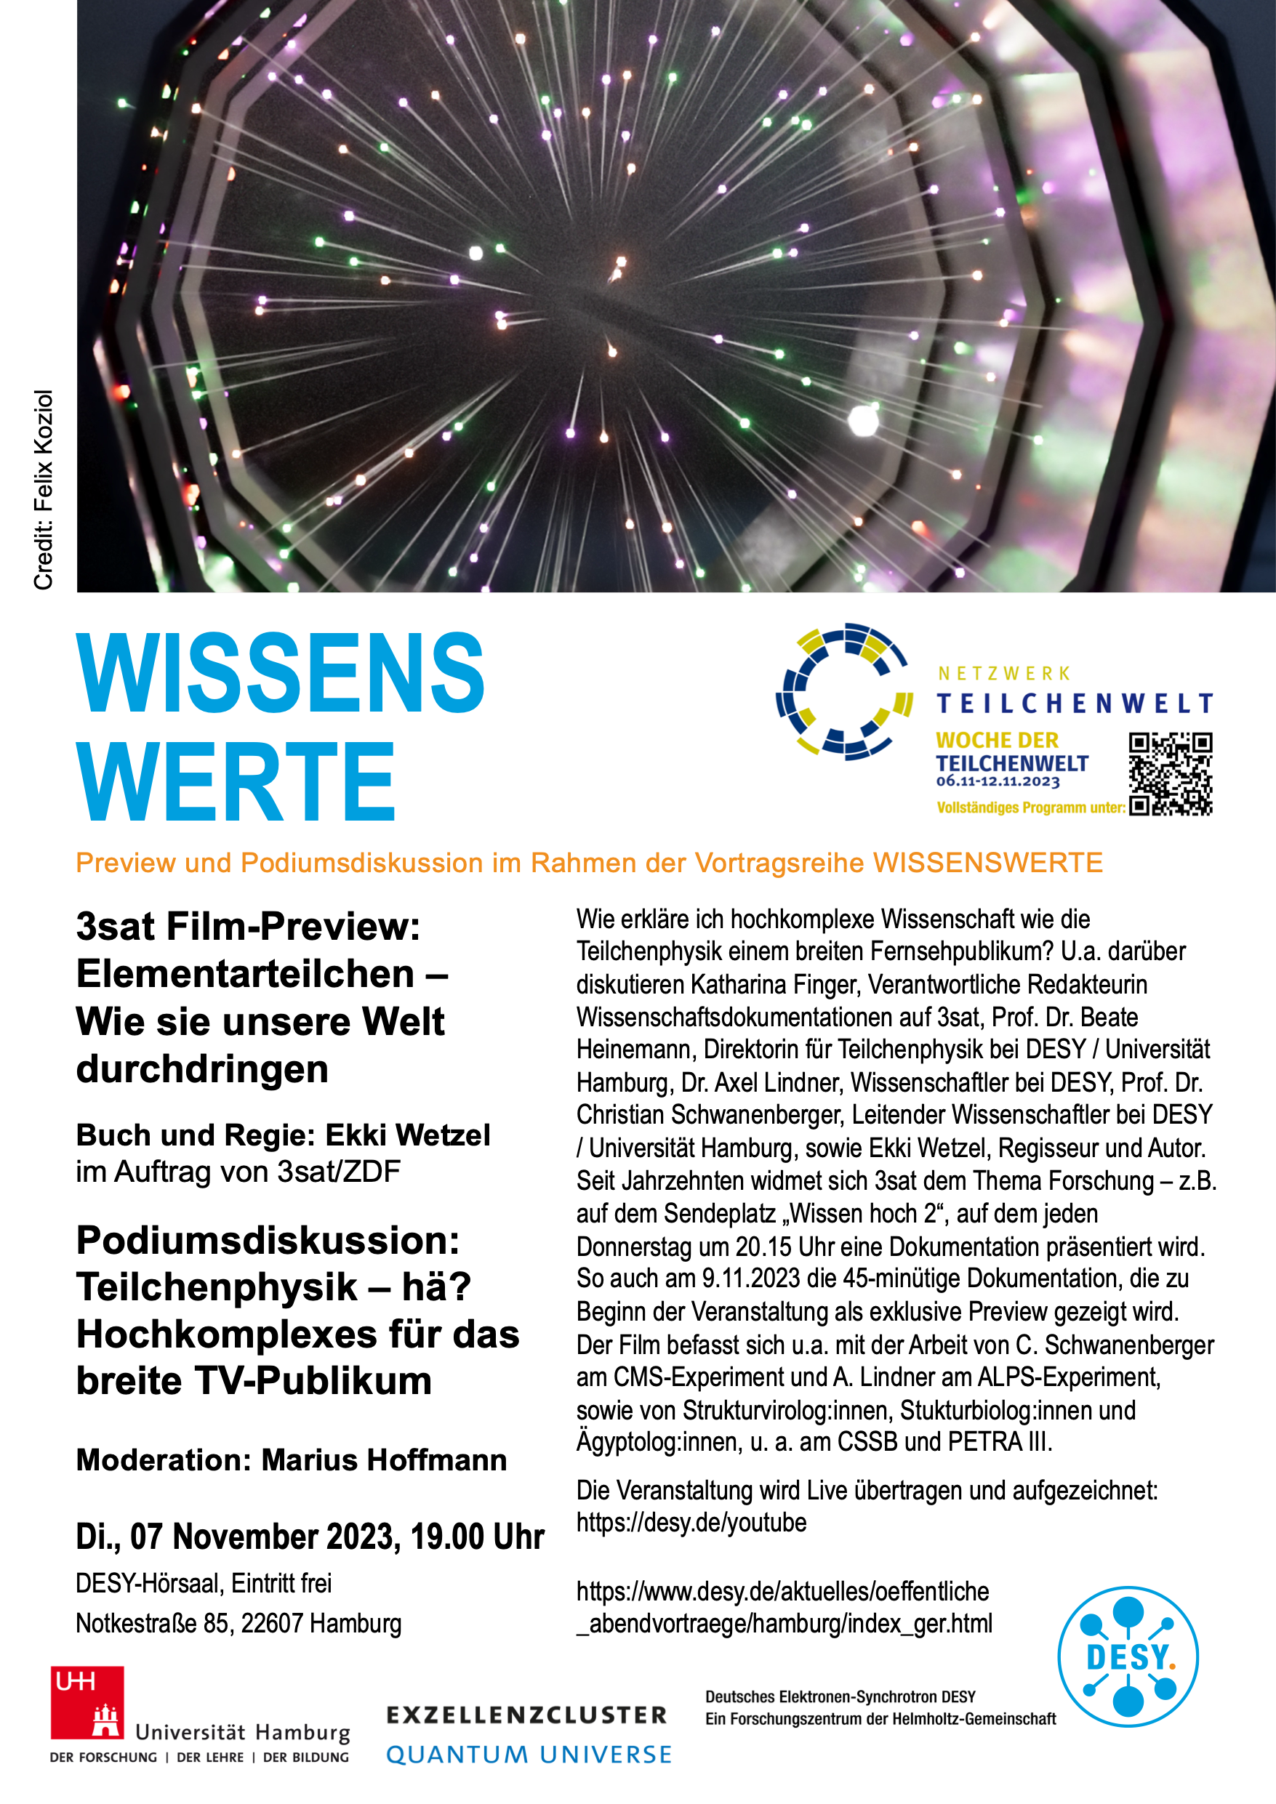
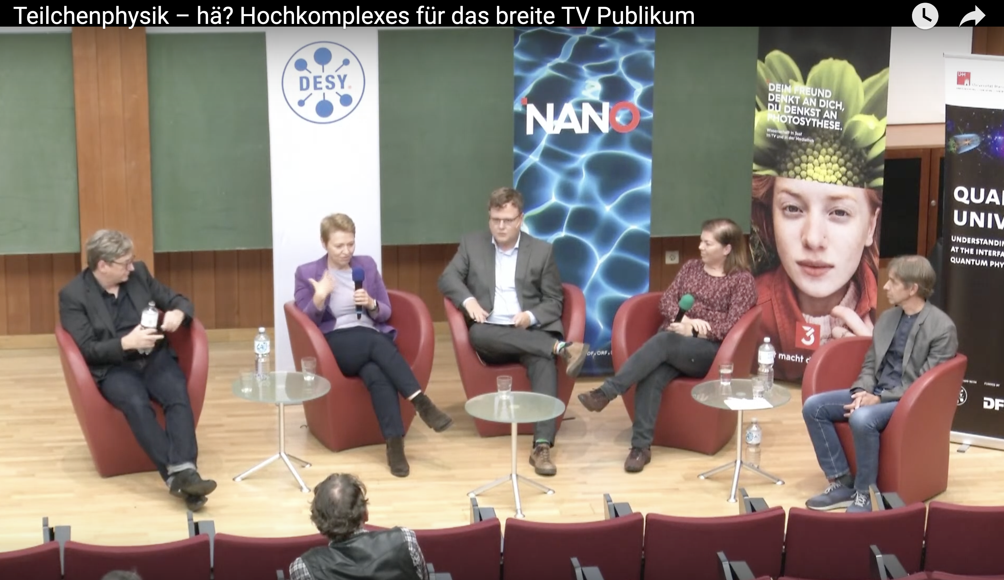
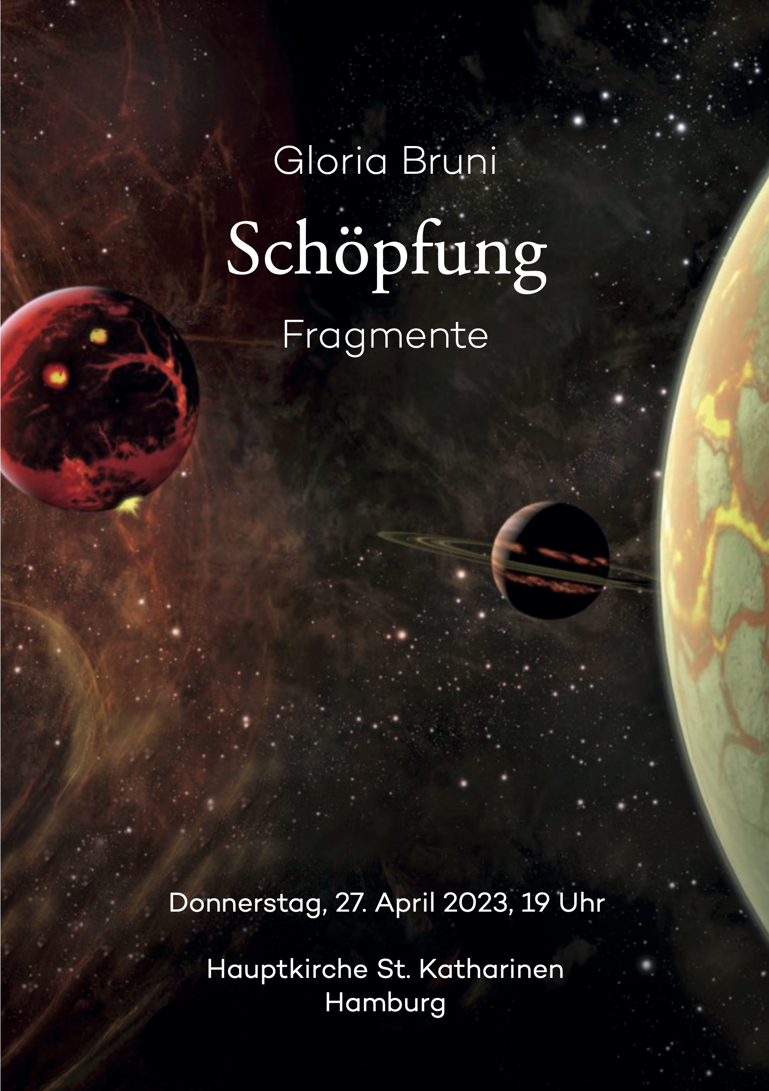
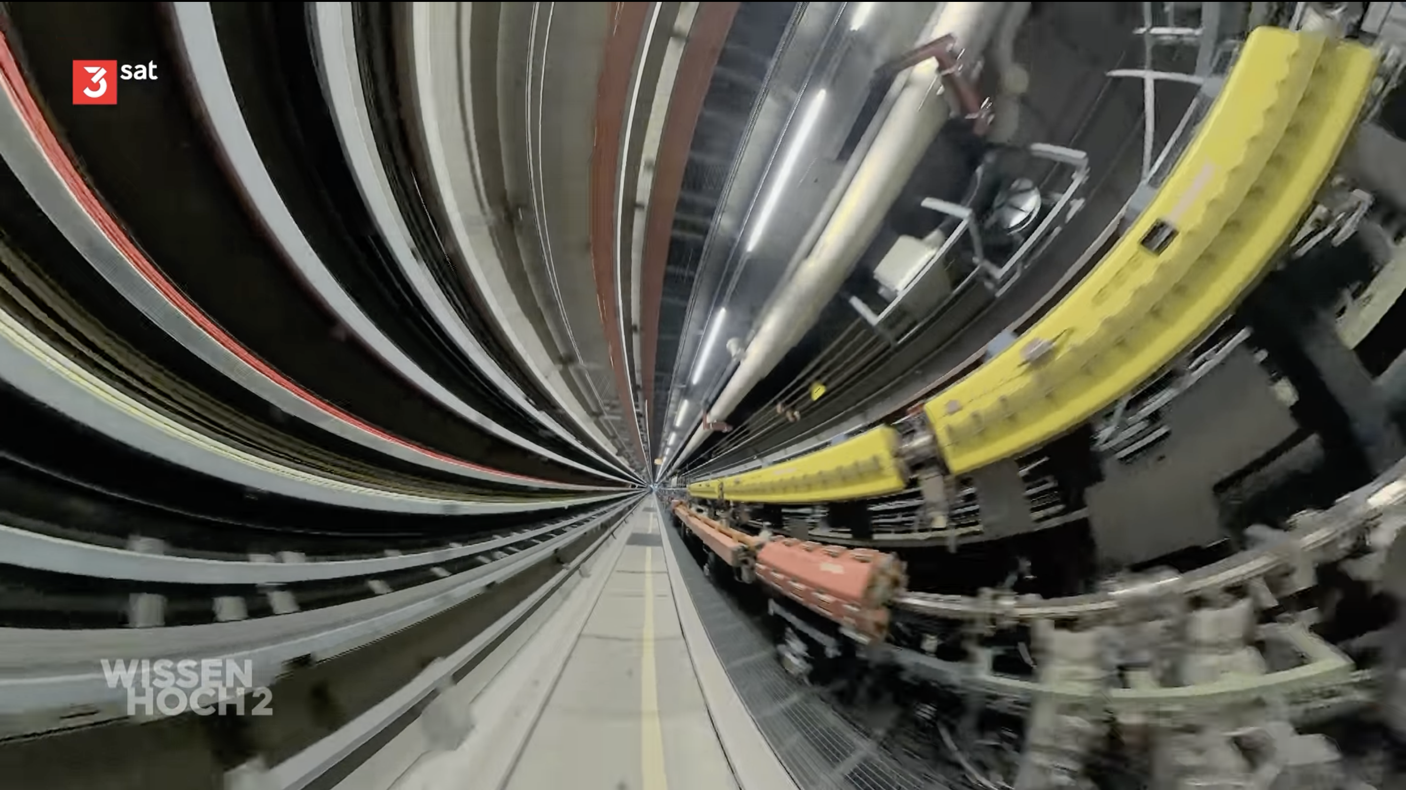
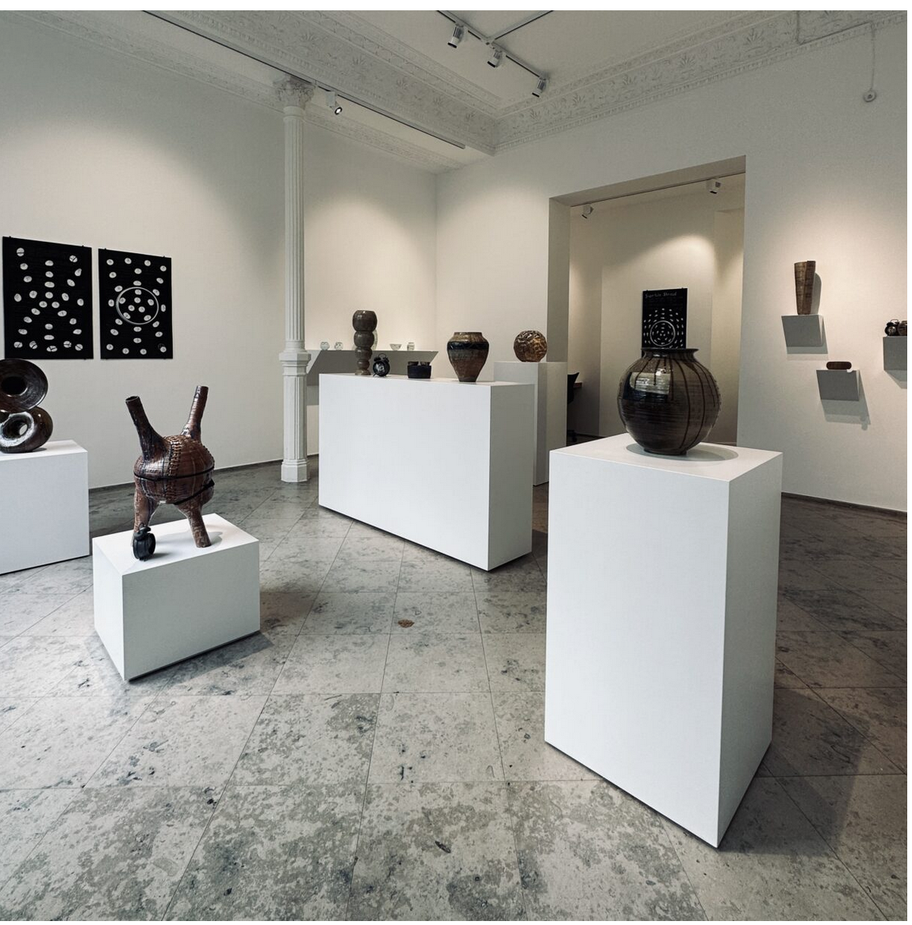
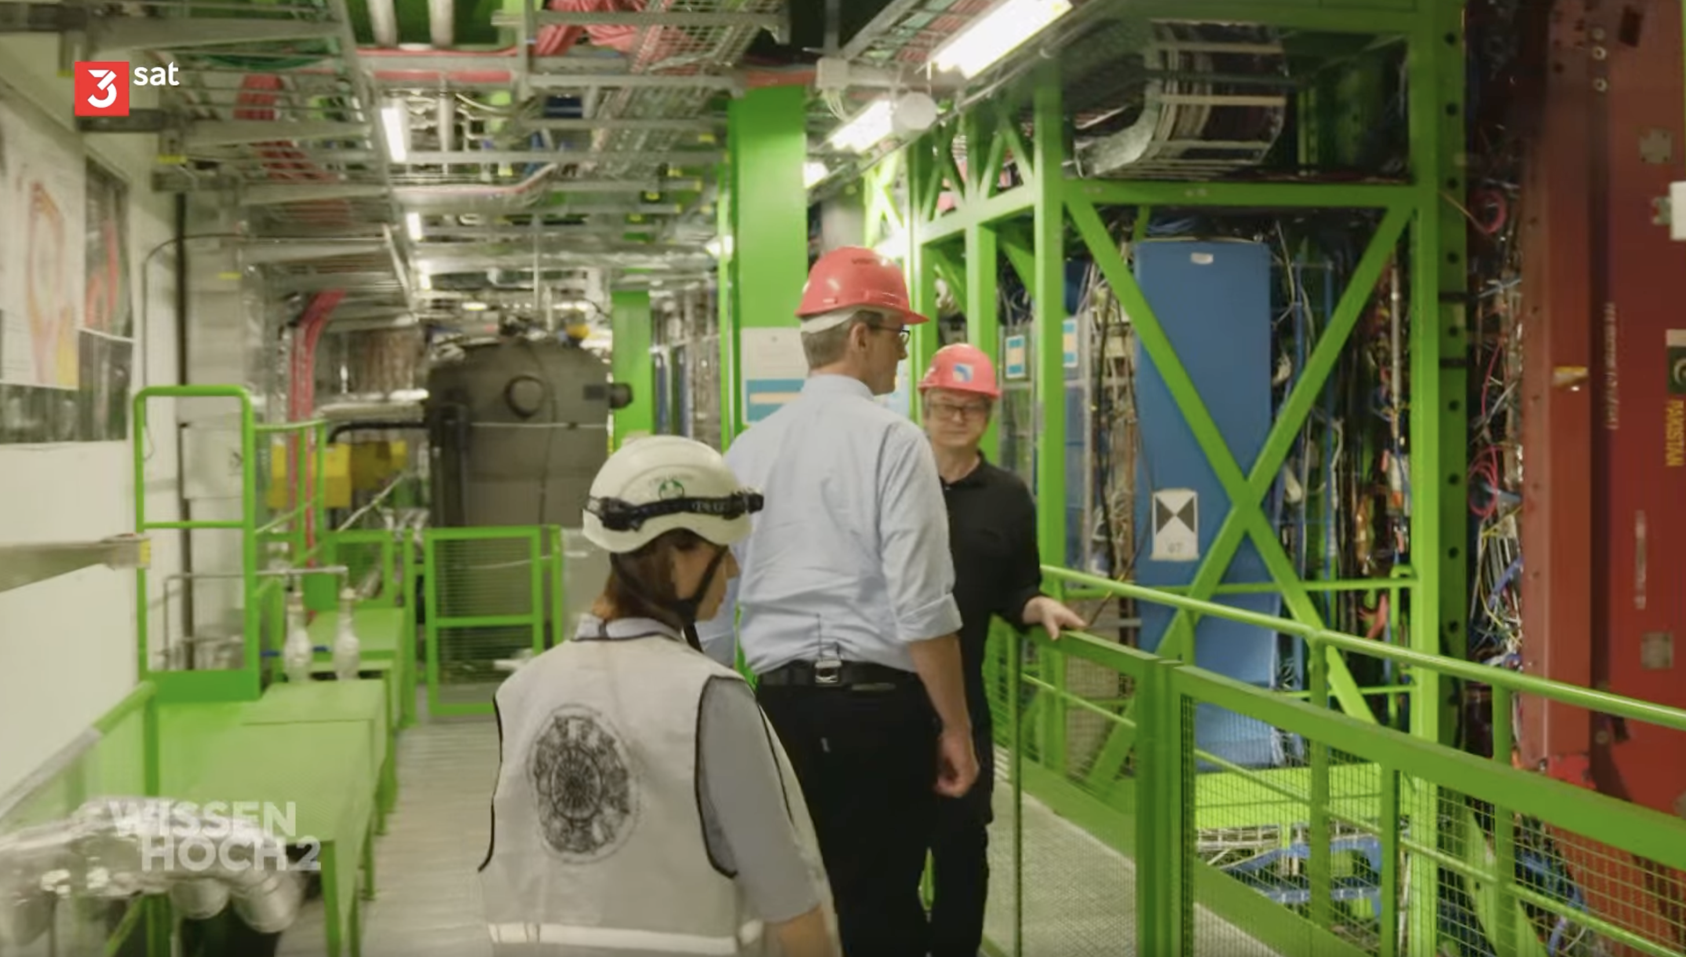
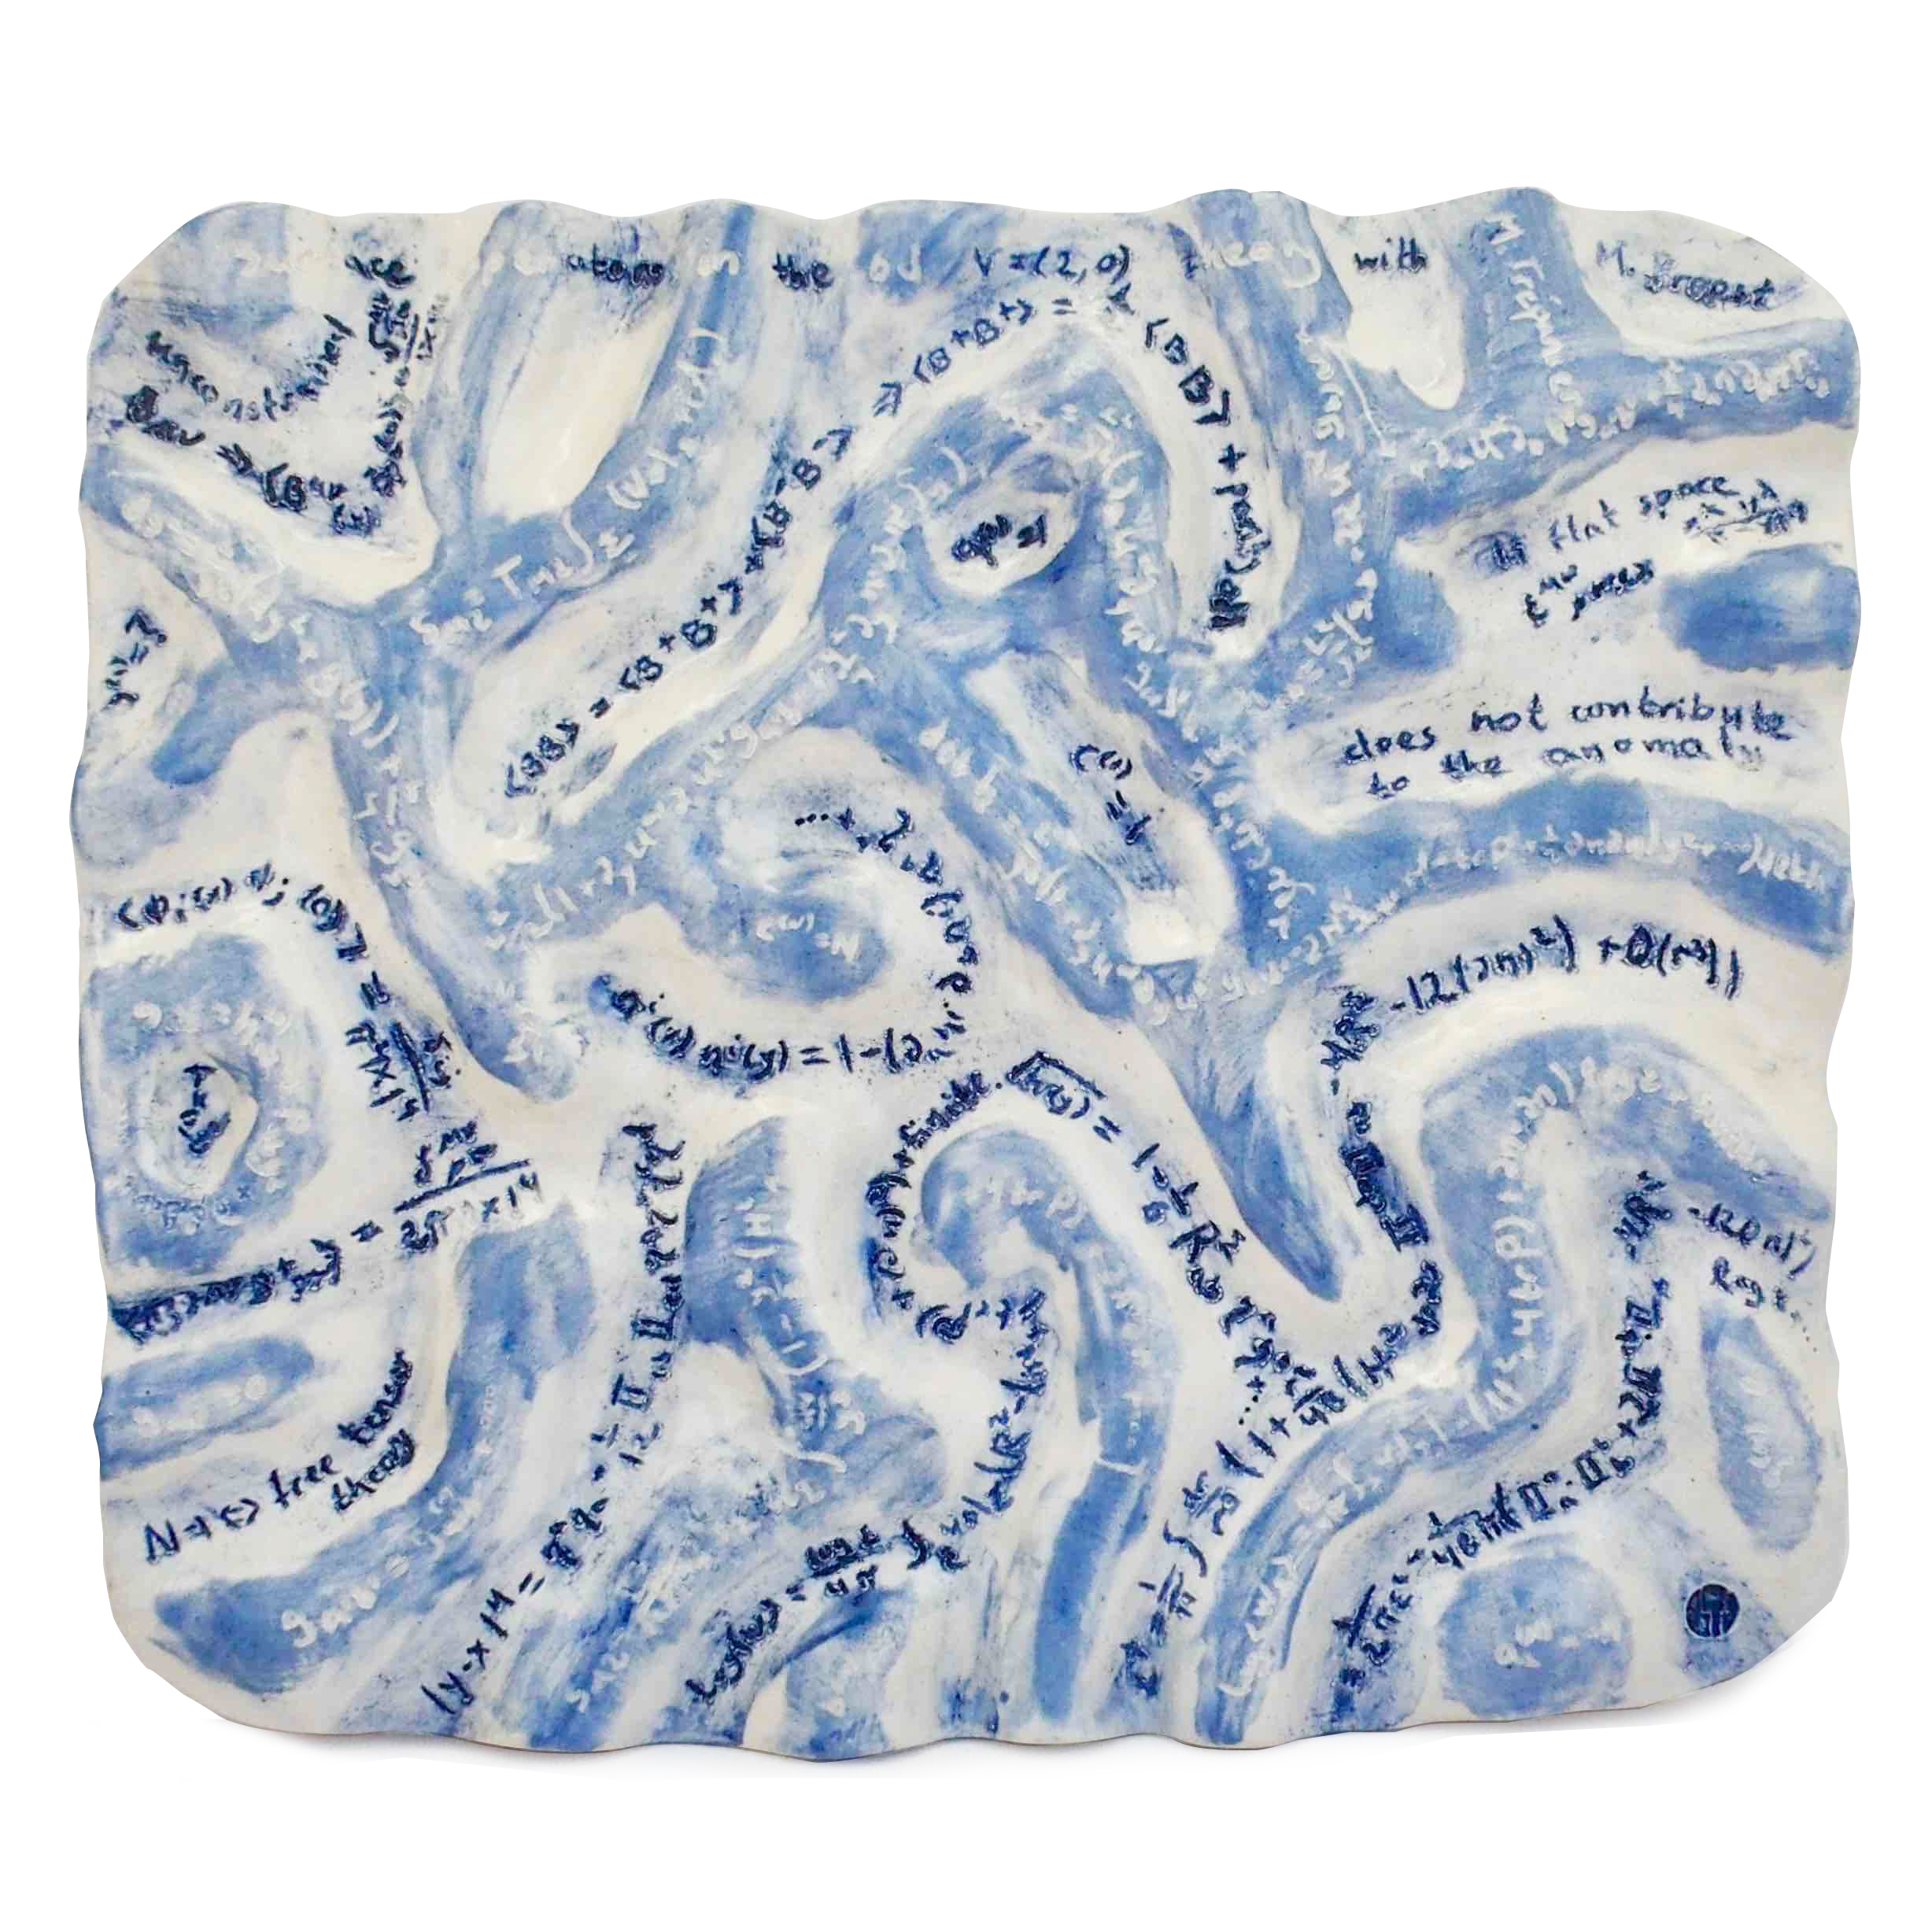
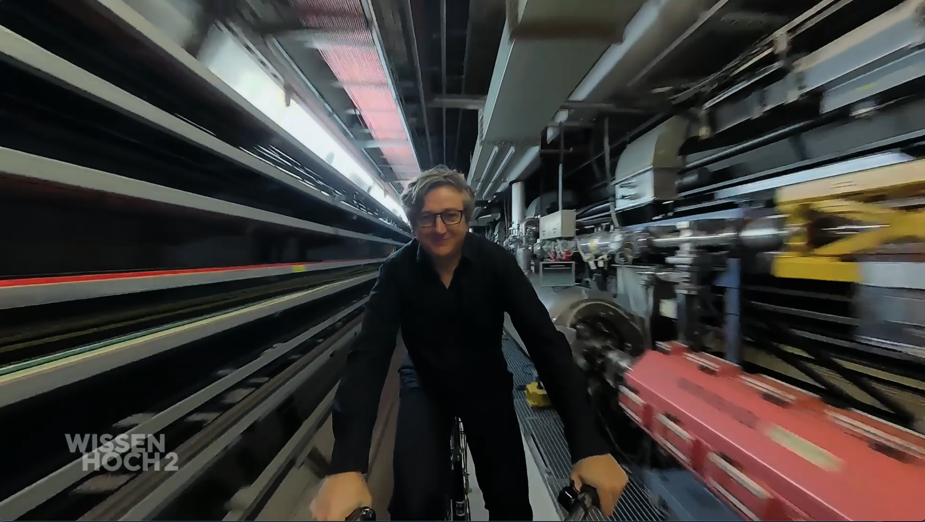
Ekki Wetzel: 3sat Film on Elementary Particles
Art exhibition: Nadav Drukker, Galerie HIDDE VAN SEGGELEN, 11-12/23
Opera: Gloria Bruni, Creation, Fragments, 04/23
?
3sat Mediathek:
Elementarteilchen – Wie sie unsere Welt durchdringen:
https://www.3sat.de/wissen/wissenschaftsdoku/231109-sendung-elementarteilchen-wie-sie-unsere-welt-durchdringen-wido-100.html

Slide 4
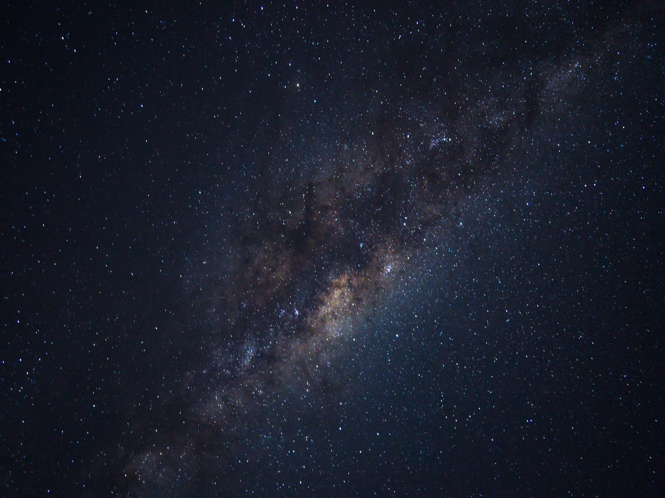
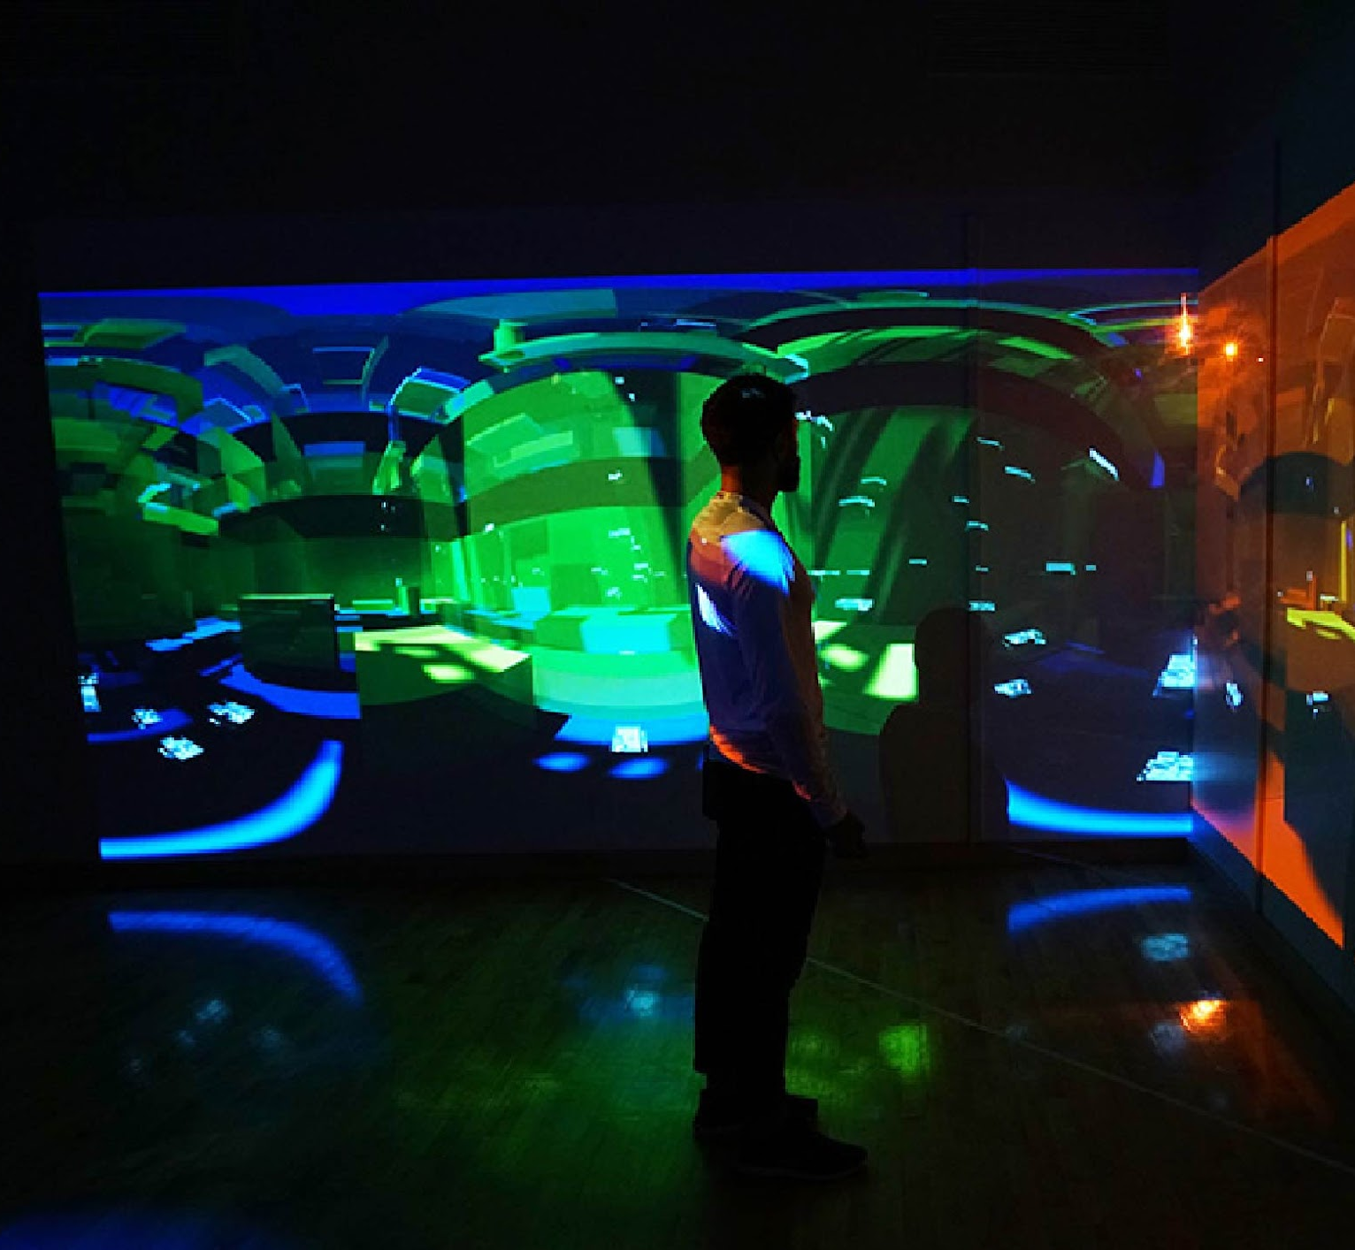
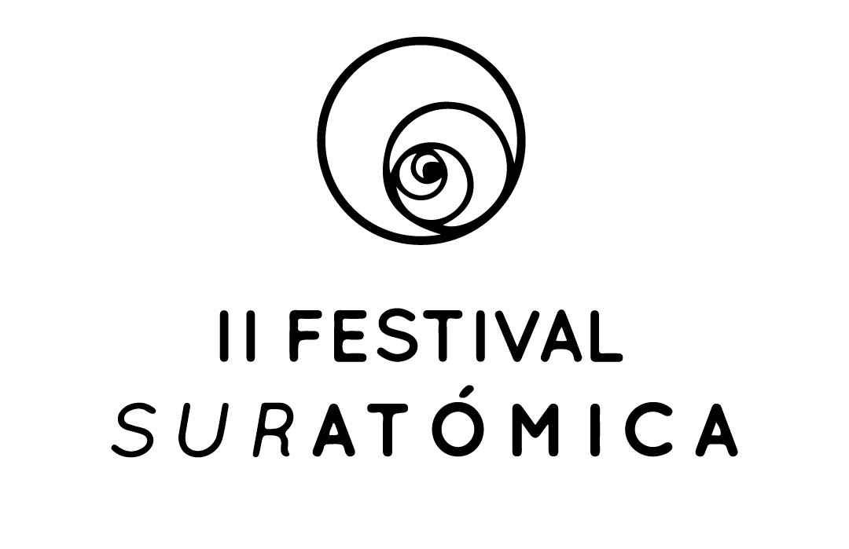
suratomica.com / @suratomica
SURATÓMICA
Suratómica is a network of organizations, groups, collectives and creatives at a global level that, under the ideas of collaboration and openness, generates diverse spaces for the creation of new knowledge. With a focus on Latin America, the Suratómica Network promotes new dialogues between diverse ways of knowing, opening spaces for creation and experimentation to strengthen reflection on the arts, sciences, society and alternative forms of organization.
https://www.suratomica.com
Reverberations of a Topological Daydream_Santiago Tavera_2018_Foto Abraham Mercado
[-]
Notes:
Nata

Slide 5
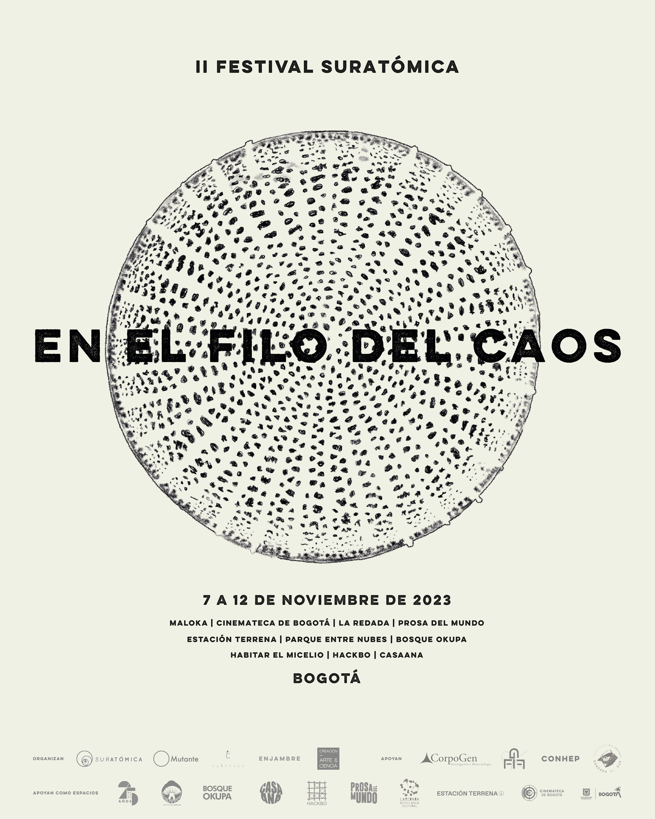
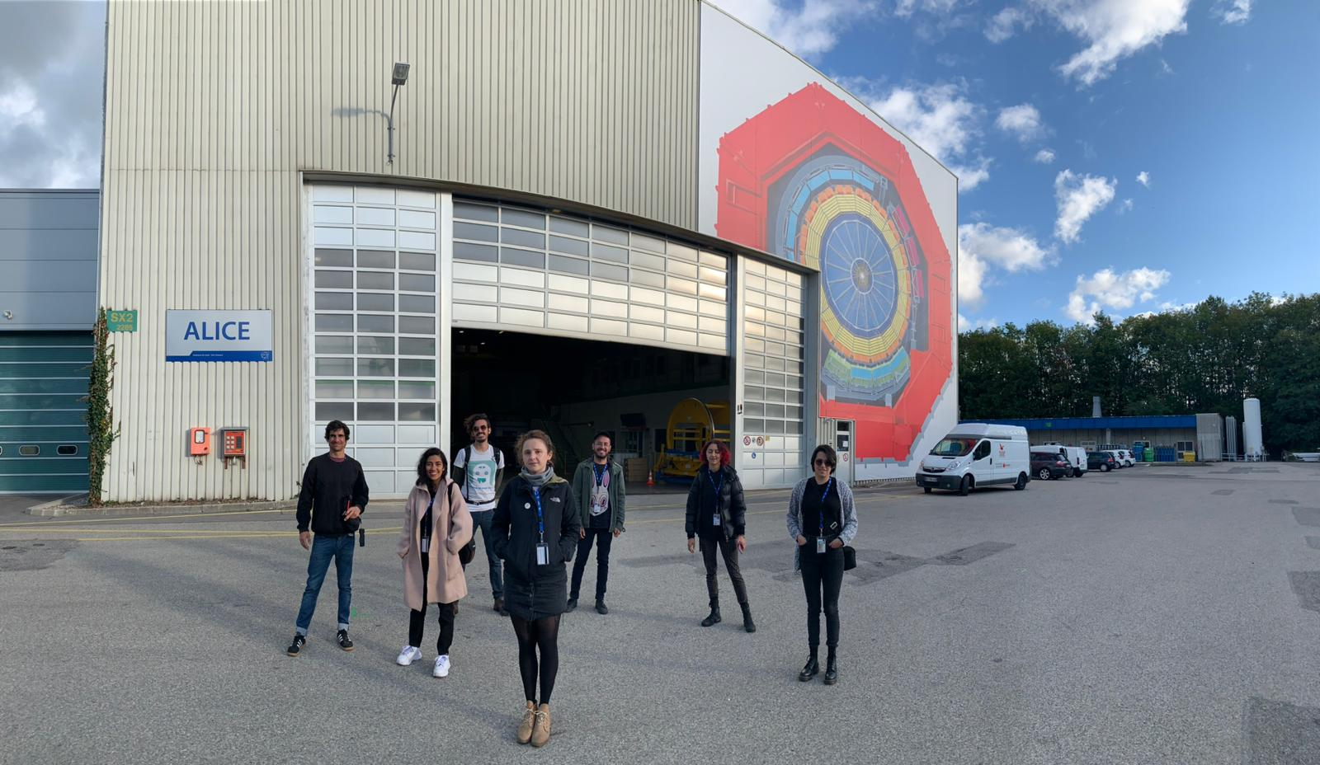
The Suratómica Festival of Creation - Art & Science is a space for meeting, creation and dissemination for local and international creatives, artists and scientists. With scientific talks, art masterclasses, workshops and spaces for dialogue, the festival seeks to spread scientific and artistic thought in our region.
The union of arts and science is currently one of the bases for the creation of new knowledge around alternative, more open and equitable social structures. The Suratómica Festival is above all a meeting point for dialogue from different areas of knowledge, which under the ideas of collaboration, openness of knowledge and diversity, come together to think about new forms of organization, creation and alternatives to the idea of development.
FESTIVAL
suratomica.com / @suratomica
Projects preview 2024
Working visits at CERN, collaboration with scientists at CERN, Colombia, Austria, Germany and others.
Exhibitions and Festivals
Residencia Suratómica en los Laboratorios del CERN 2019
Foto por Michael Hoch
[-]
Notes:
Nata

Slide 6
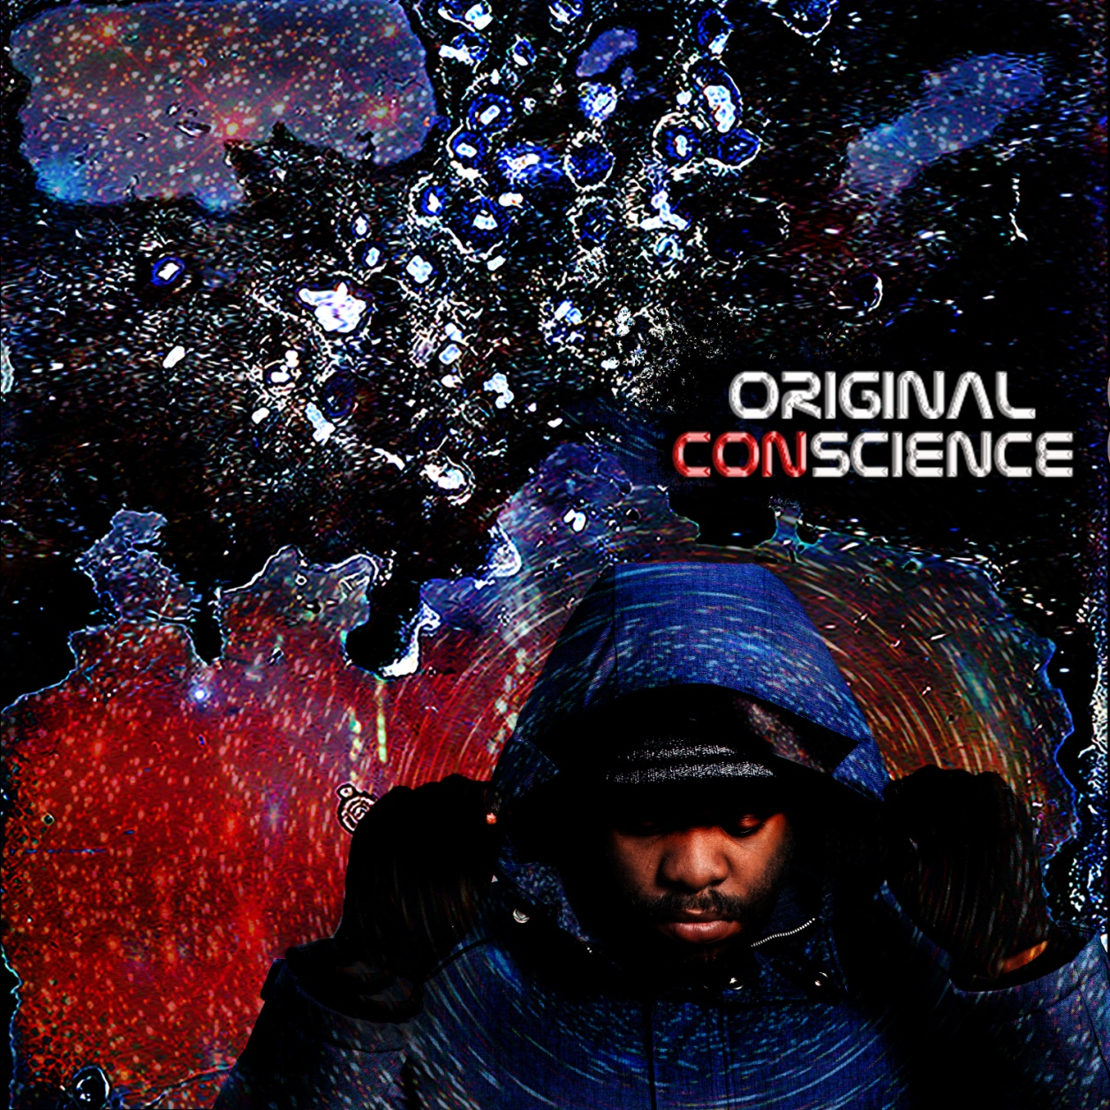
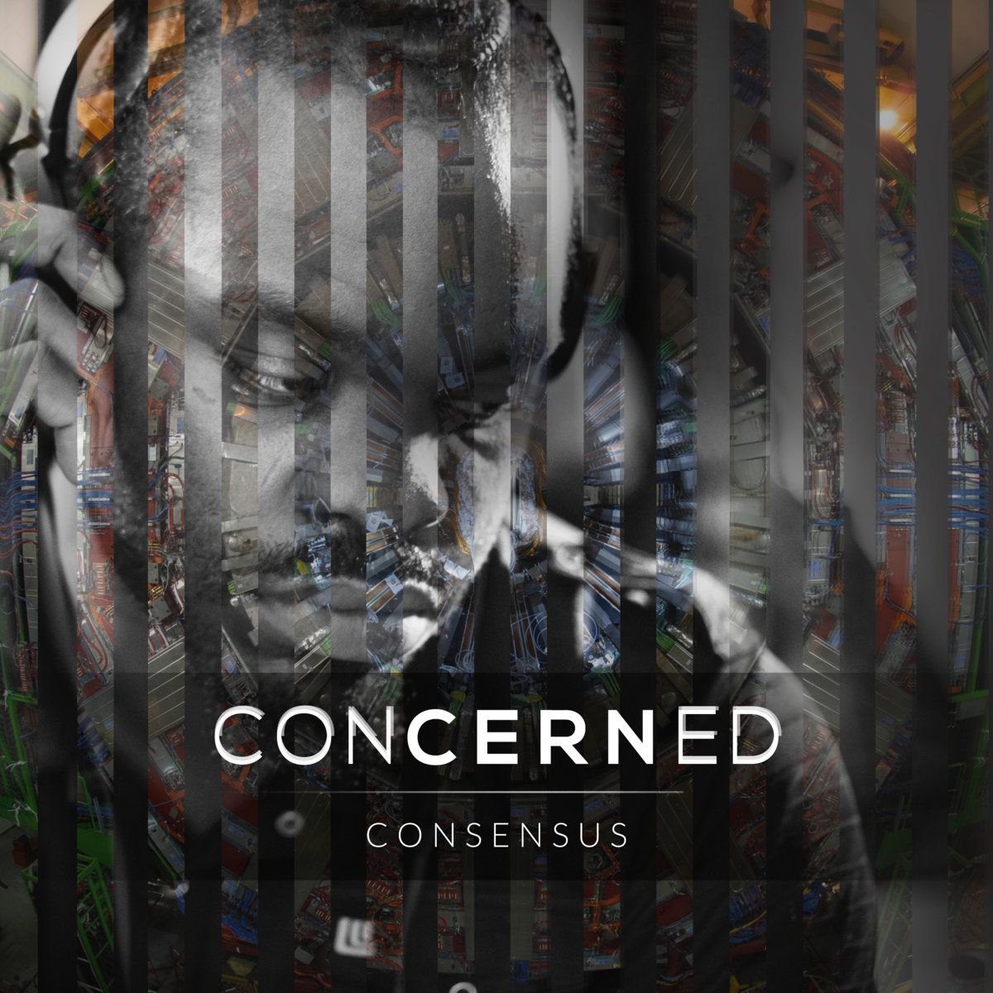
engagement via music & lyrics
Original ConScience:
ConCERNed
14 SONGS & LYRICS
9 SONGS & LYRICS
Web Link: Original ConScience Album Explained
Web Link : Engagements
Web Link : DUNE MUSIC VIDEO

Slide 7

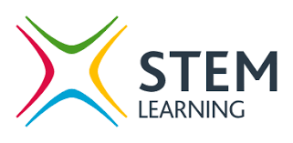

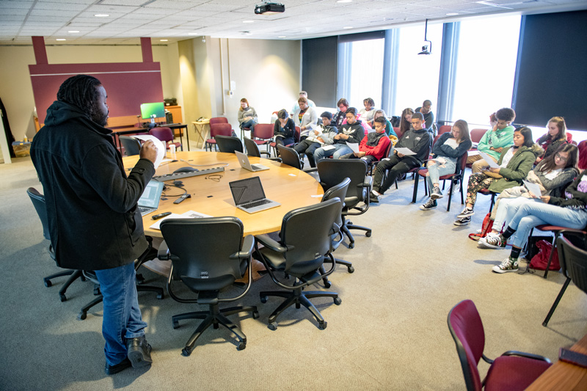
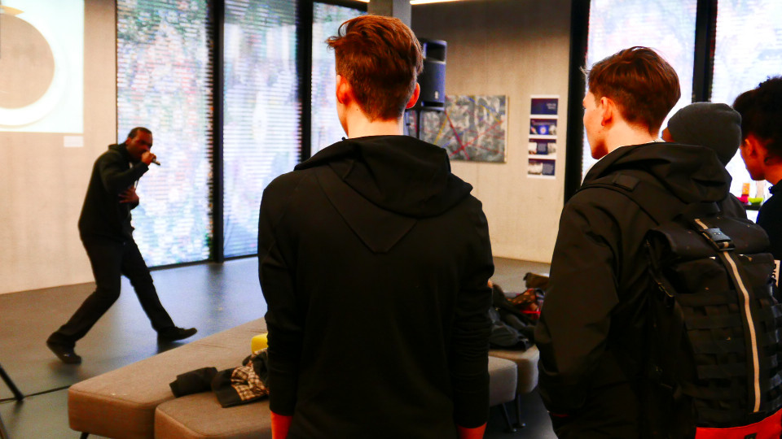
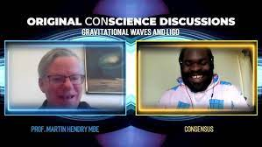
Preliminary Research
CASE STRUDIES: ORIGIN Project,
Imperial, Bristol University, Fermilab, CERN, STEM Learning UK
GCSE
Age:14-16
Online In the Classroom Universities Research institutions

Slide 8
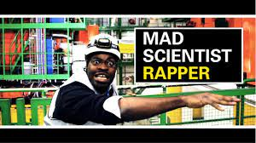
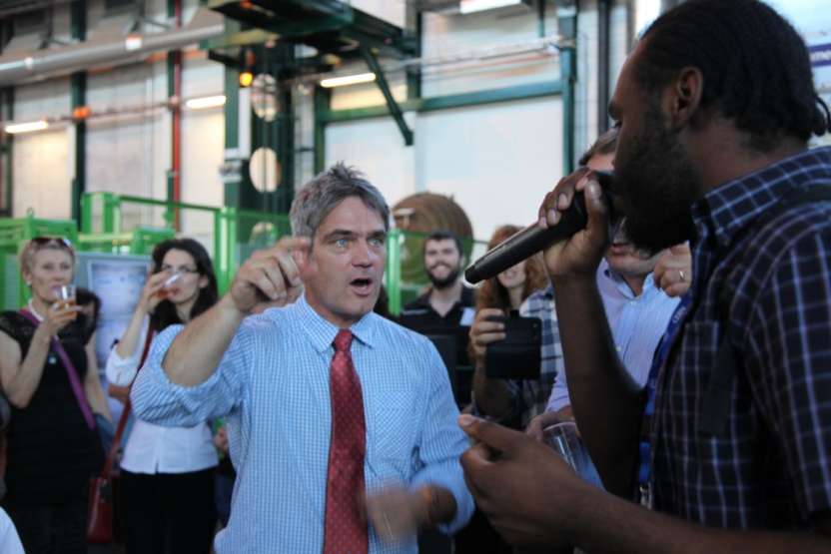
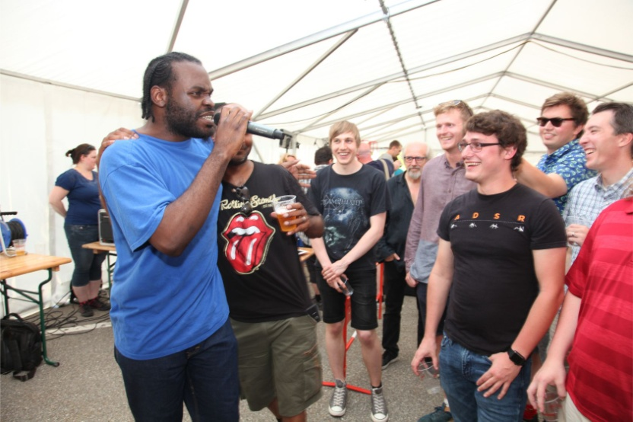
ConCERNed
Engagements

