Slide 1
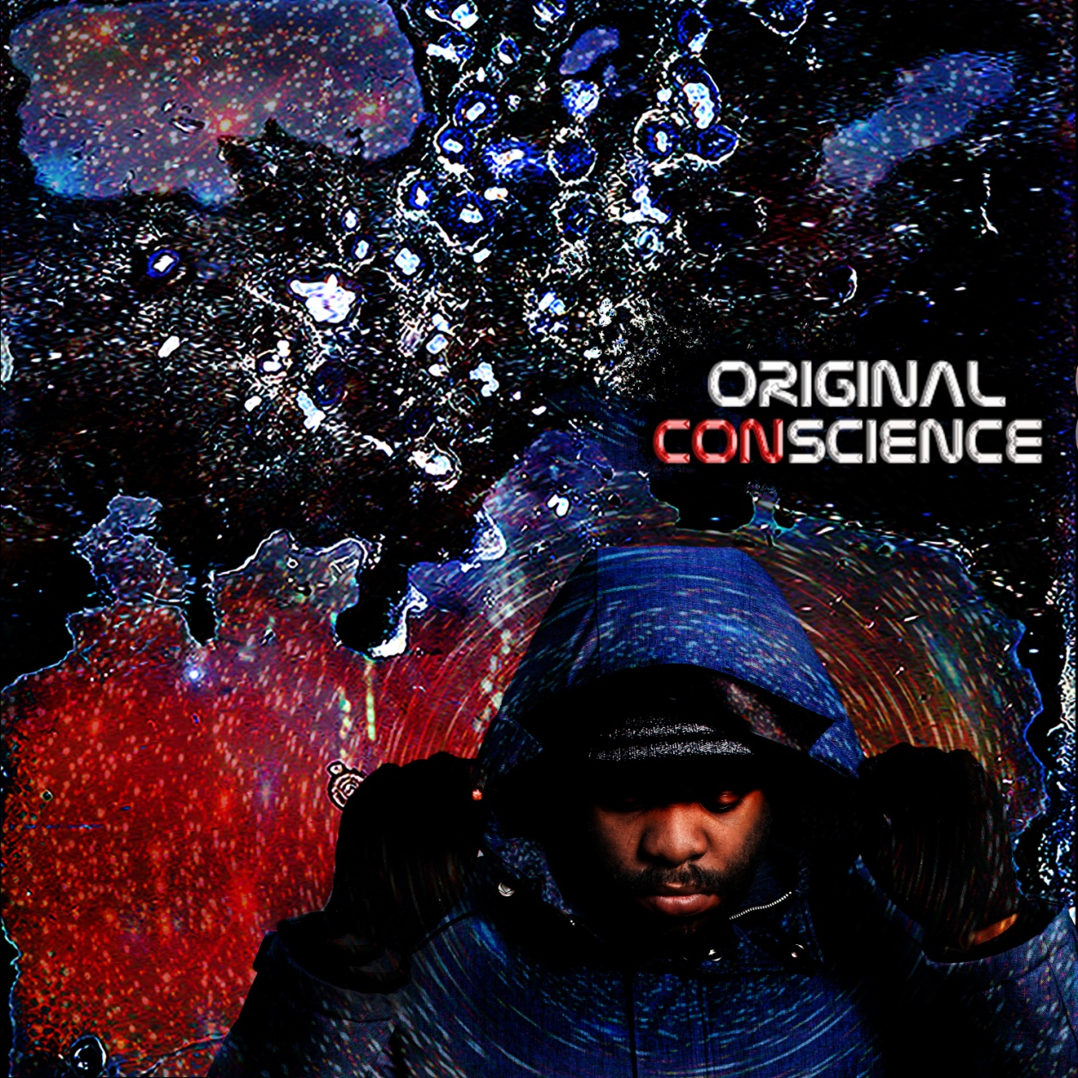
Original ConScience
DUNE MUSIC VIDEO

Slide 2
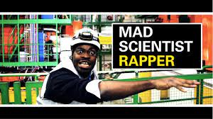
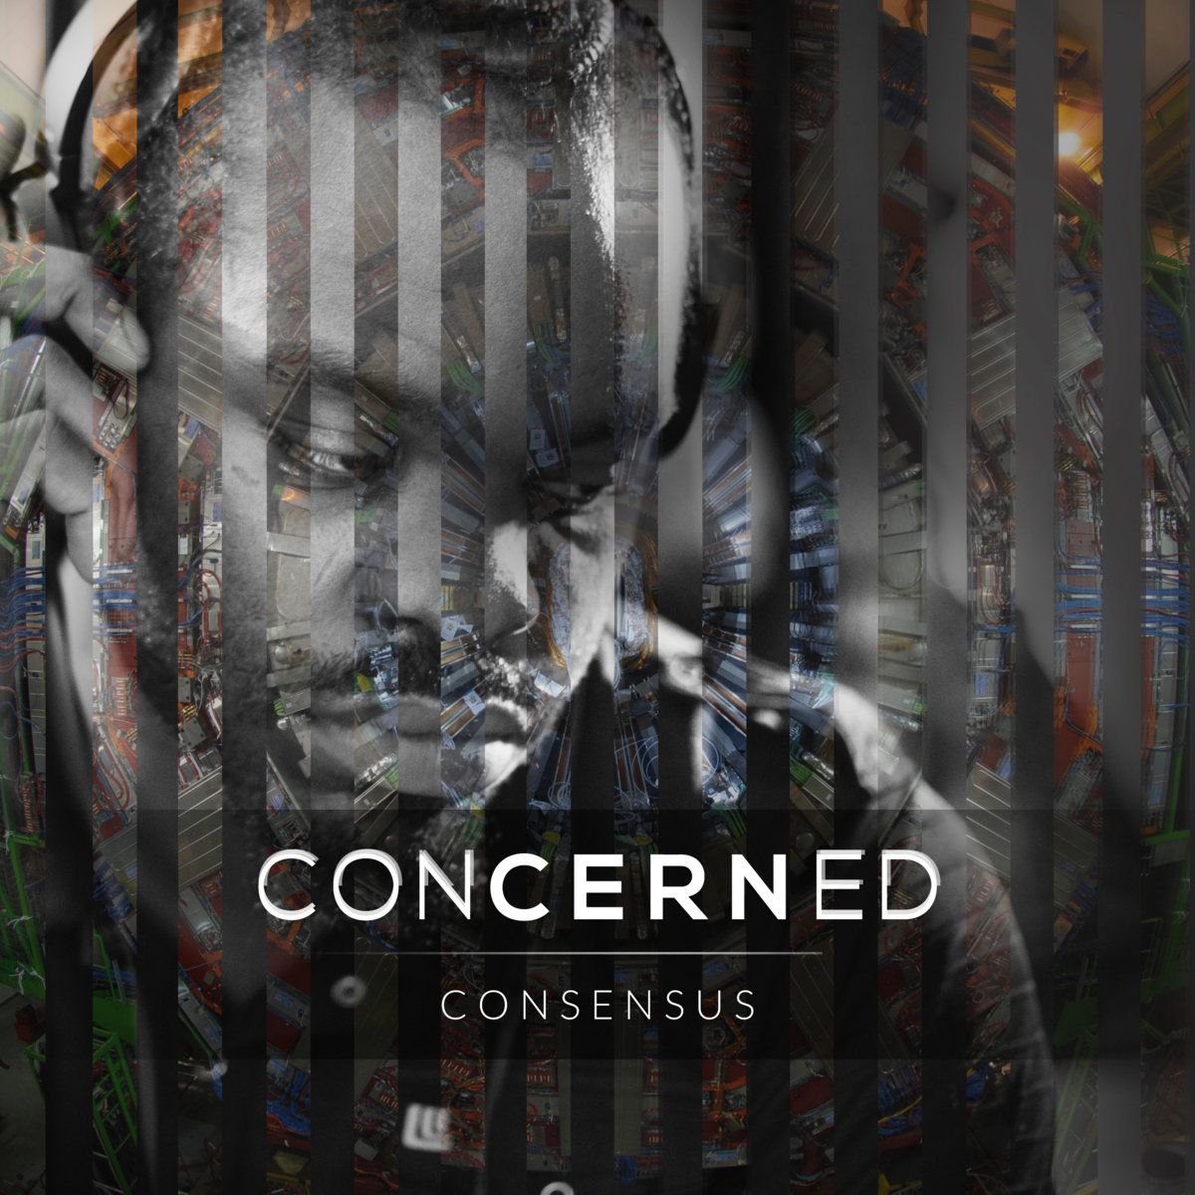
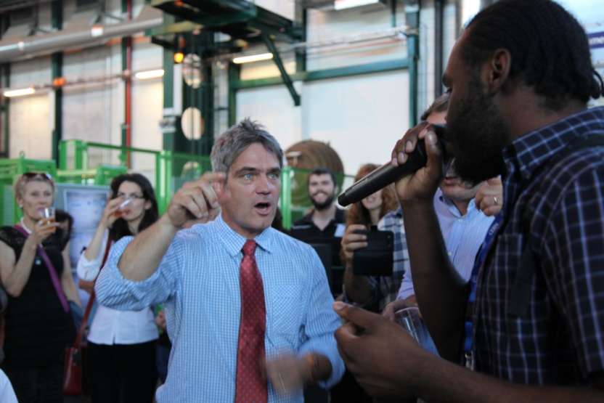
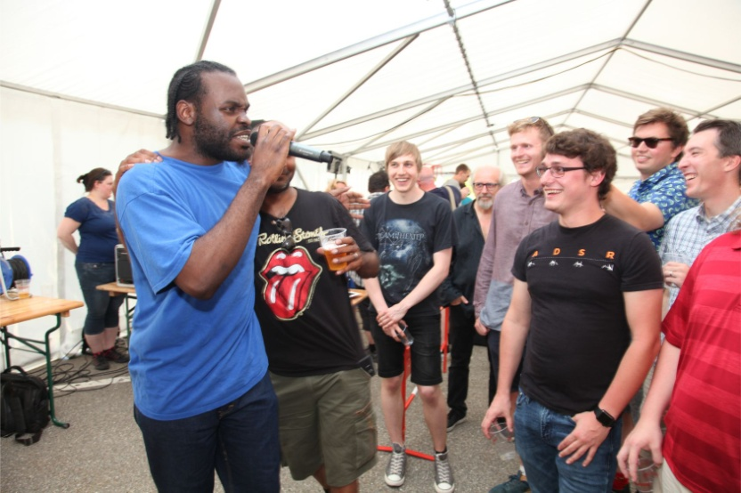
ConCERNed
Engagements

Slide 3



Preliminary Research
CASE STRUDIES: ORIGIN Project,
Imperial, Bristol University, Fermilab, CERN, STEM Learning UK
GCSE
Age:14-16
General
Public

Slide 4
Original ConScience Album Explained

Slide 5
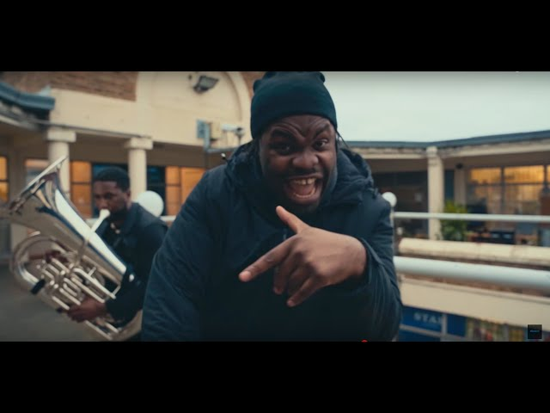
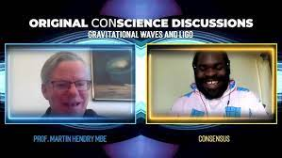
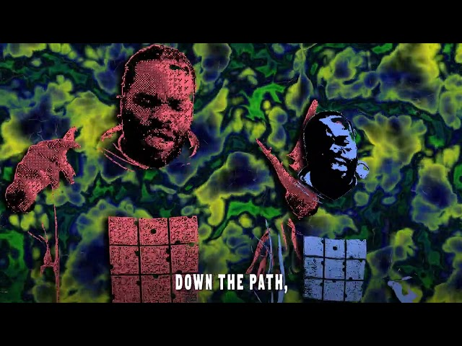
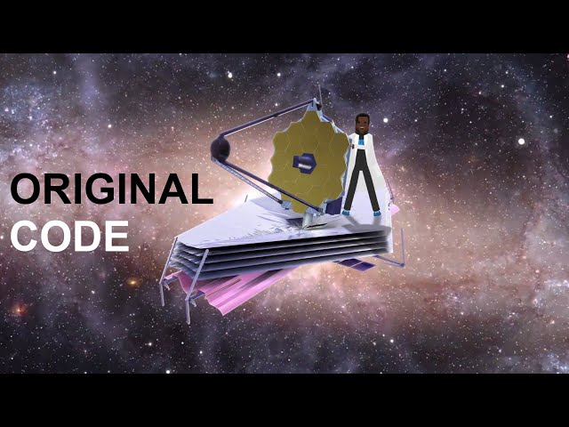
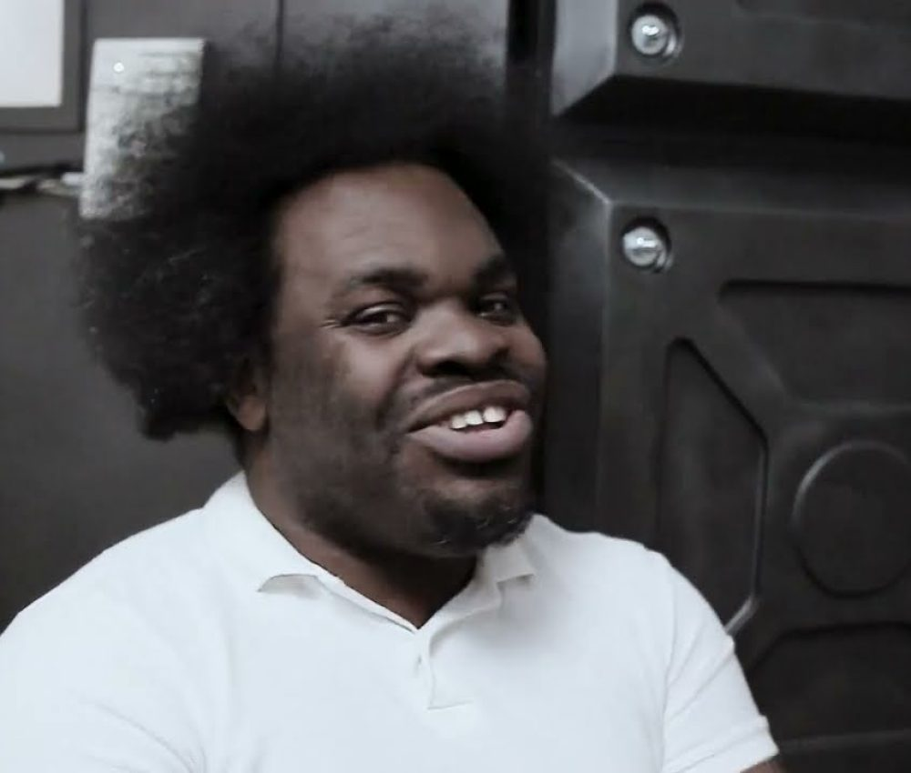
Album Videos

Slide 6
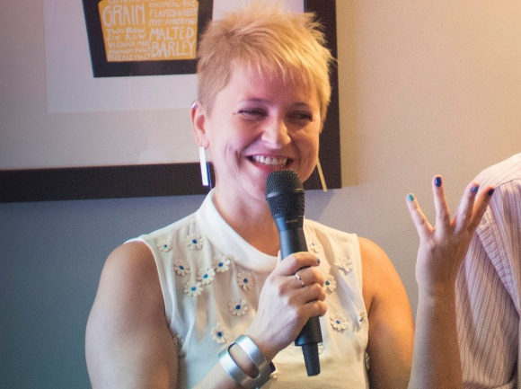
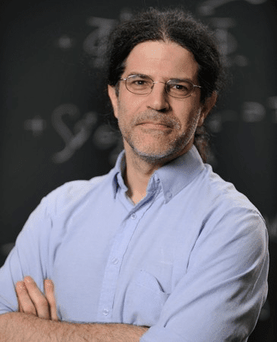
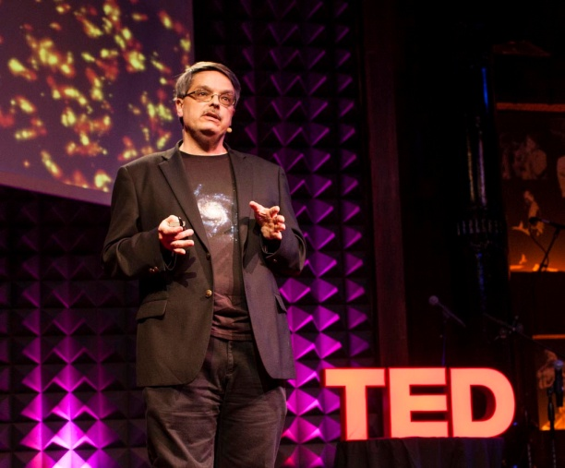
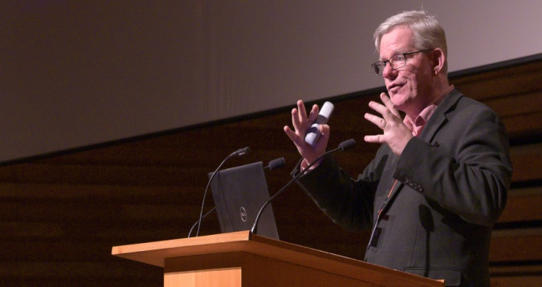
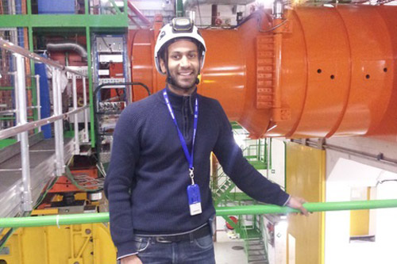
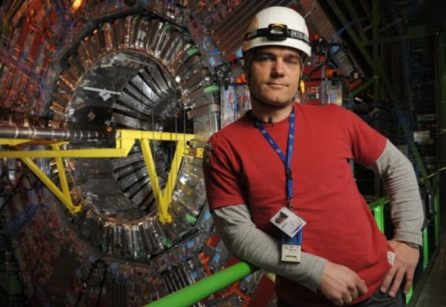
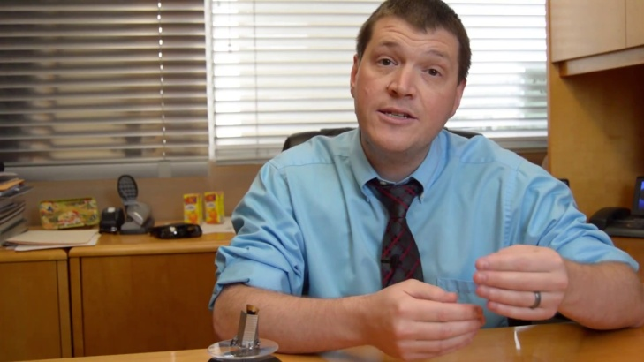
Collaboration
Agnes Mocsy,
Pratt Institute / YALE
David E. Kaplan,
Johns Hopkins
Don Lincoln
Fermilab
Martin Hendry, LIGO
Sudan Paramesvaran
CERN, DUNE
Michael Hoch, CERN
Dan Batcheldor, NASA

Slide 7
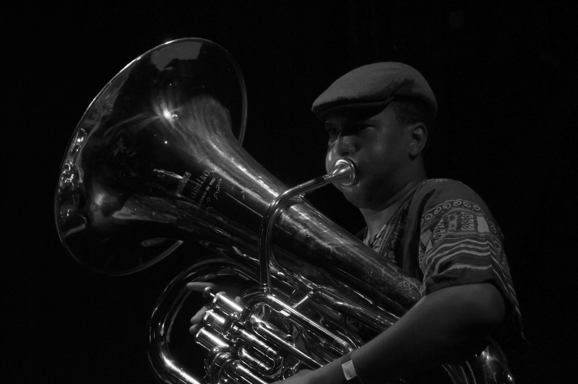
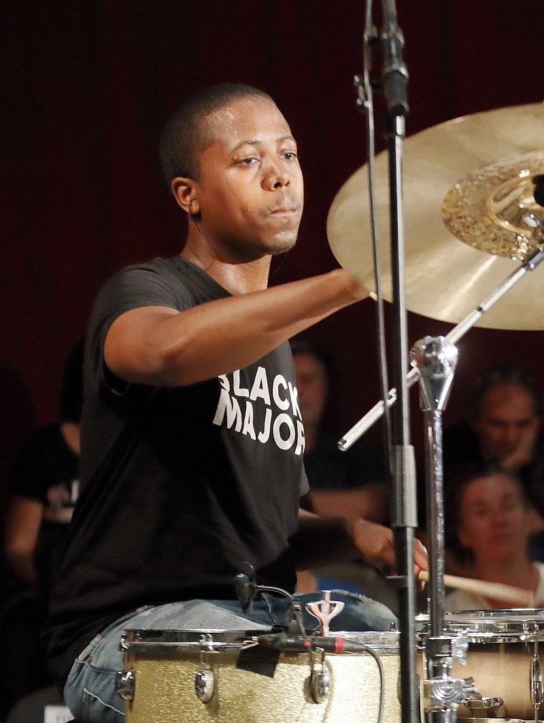



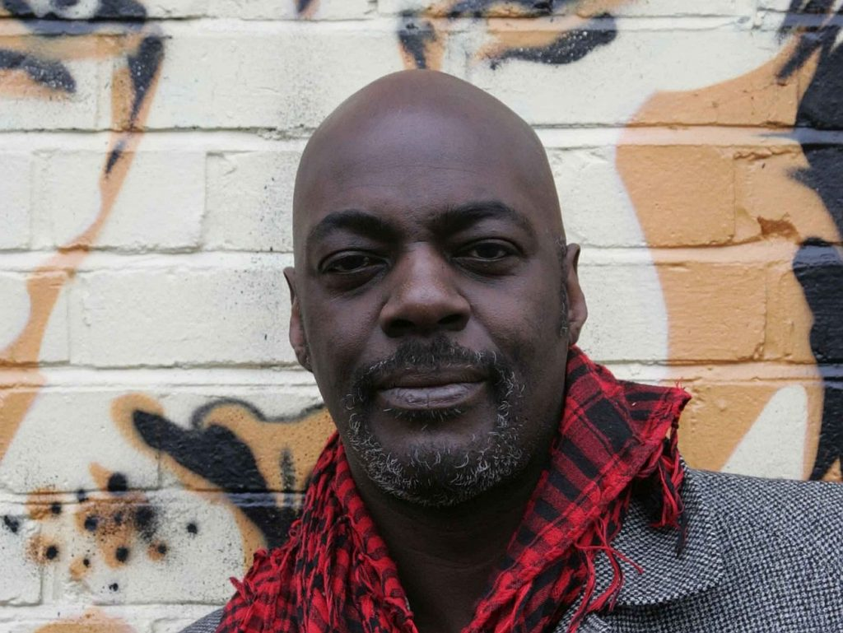
Collaboration
Theon Cross
Jazz / Multi-Genre
Teshay Makeda,
Reggae/ Rnb / Soul
Moses Boyd
Jazz / Hip-hop / Multi-genre
Dana Mckeon
Pop, Commercial
Clapper Priest,
Reggae / Sound System Culture
Matt Green
Rapping Science Teacher

Slide 8
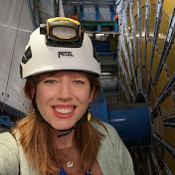




Dissemination
Educational Promotion
MUSIC PROMOTION
Secondary Schools
Universities
Science Centers
Science festivals
Physics Experiments
Science Communicators
Social Media
Radio & TV
Social Media influencers
Blogs and Magazines
Podcasts
Music Festivals
Live Music Events

Slide 9

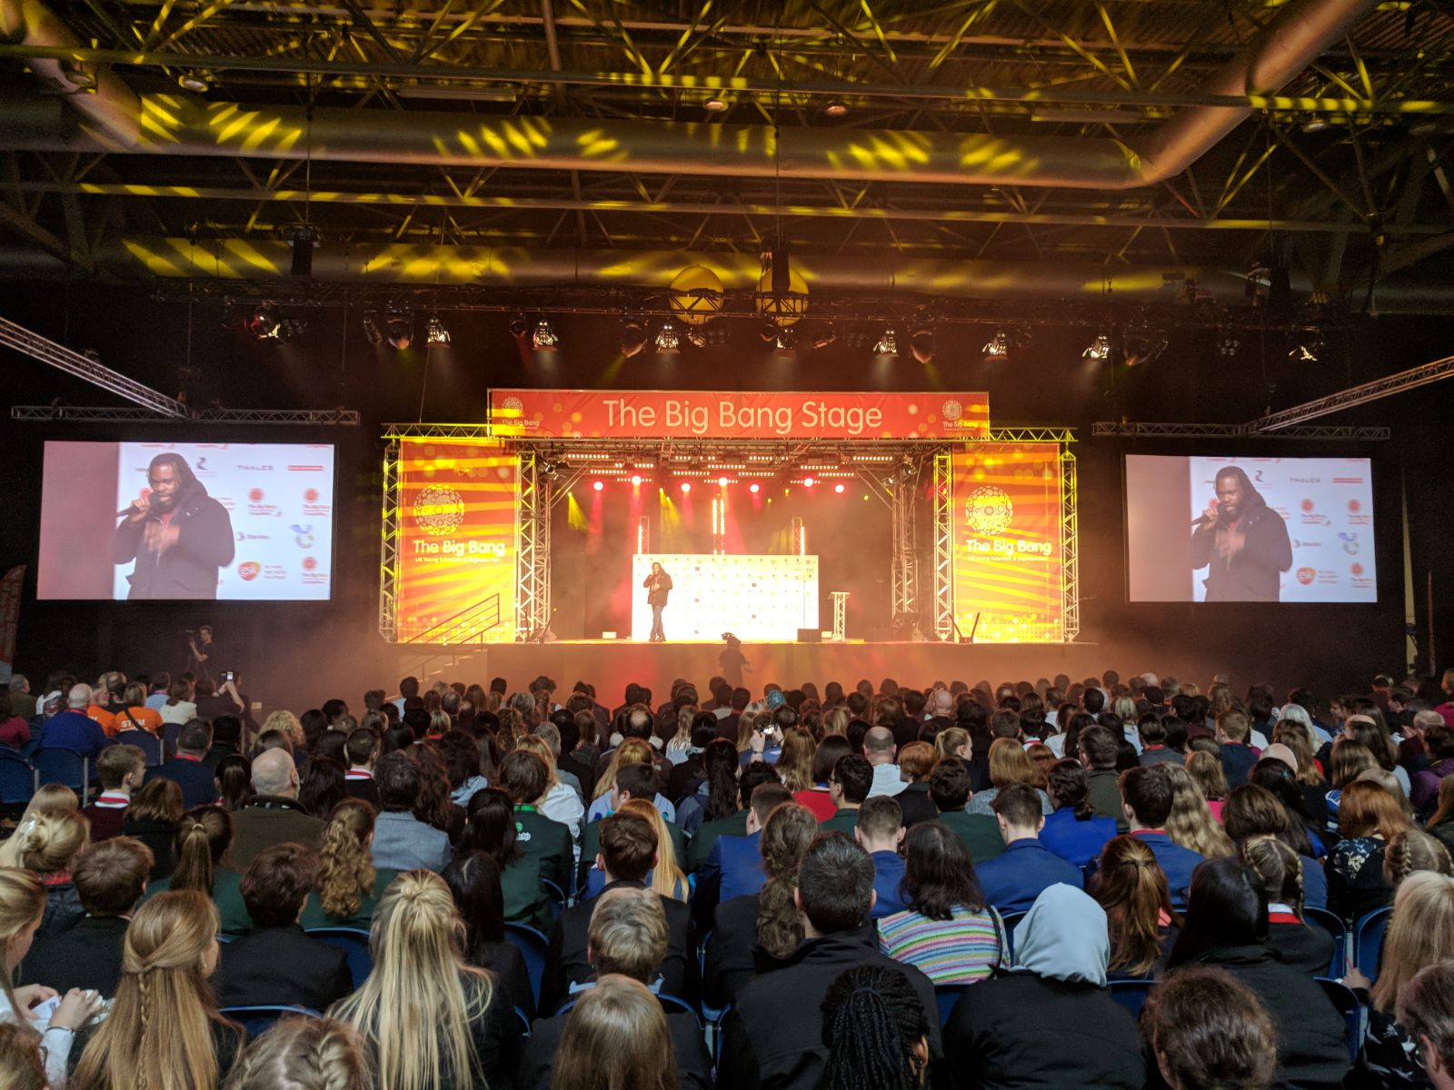
Live Performance
Clubs, live band, bars, lecture theatres, festivals

Slide 10
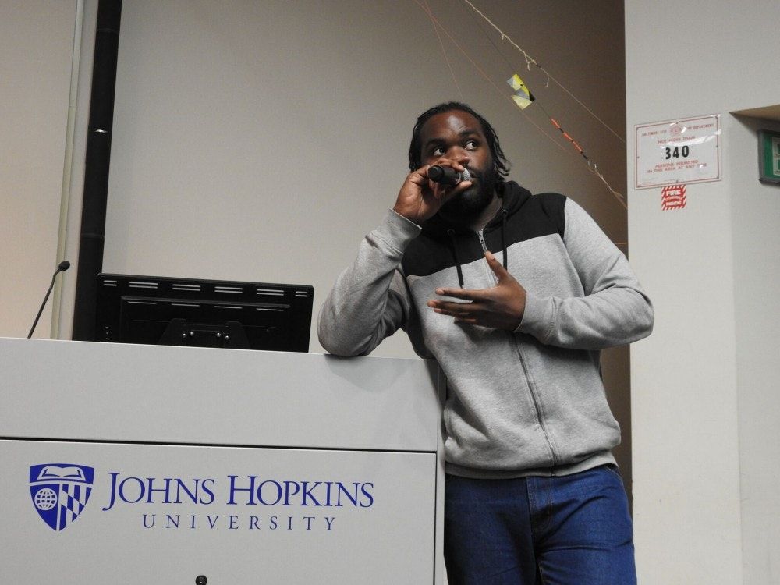
Live Performance
Clubs, live band, bars, lecture theatres, festivals

Slide 11
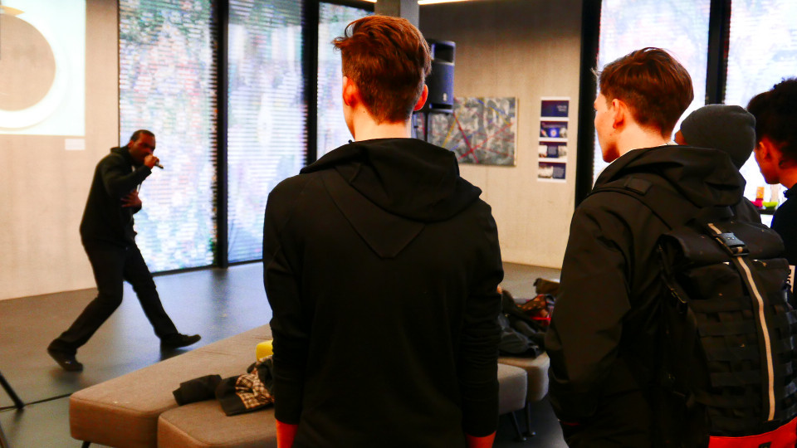
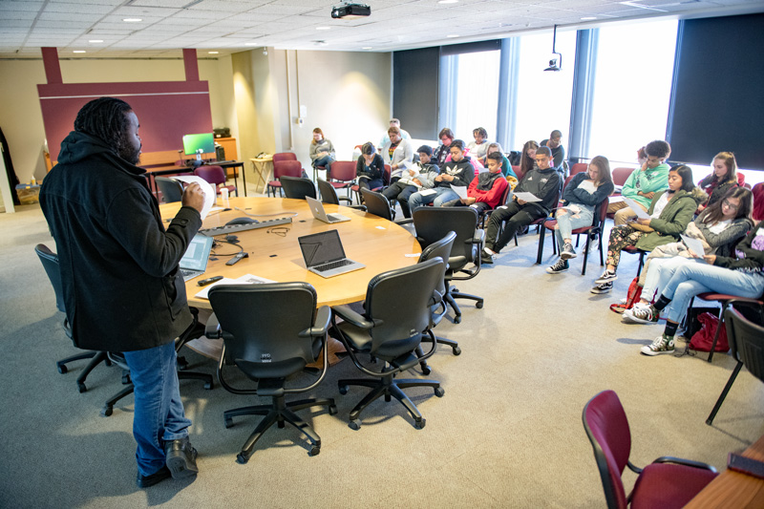
In the Classroom
Online
In the Classroom
Universities
Research institutions
Multiple Choice
Find the Relevant Phrases
Fill in the Missing Words
Group Quizzes / Raise of Hands
Comprehension Style Questions

Slide 12
Thanks for Listening!
What Next
Release Party
UK Album Tour
Workshops
Colloquiums
Materials Dissemination
Evaluation
Book??
Future Songs?
Website: consensus.avr-music.com
ConCERNed Engagements
Original ConScience Explained
BBC Interview
Discussions
Contact:
avr.truth@gmail.com
management@avr-music.com

