Slide 1
26th IPPOG Meeting – 29-30 November 2023 (*)
News from the Coordination
Pedro Abreu, LIP and IST, (Co-)Chair
Claire Adam, LAPP and IN2P3, Annecy, (Co-)Chair
Fabiola Cacciatore, University of Notre Dame, Coordination Team
Jana Fiserova, CERN, Coordination Team
Zoe Nikolaidu, CERN, Coordination Team
Hanife Olgunsoy, CERN, Coordination Team
(*) at CERN and online via Zoom

Slide 2
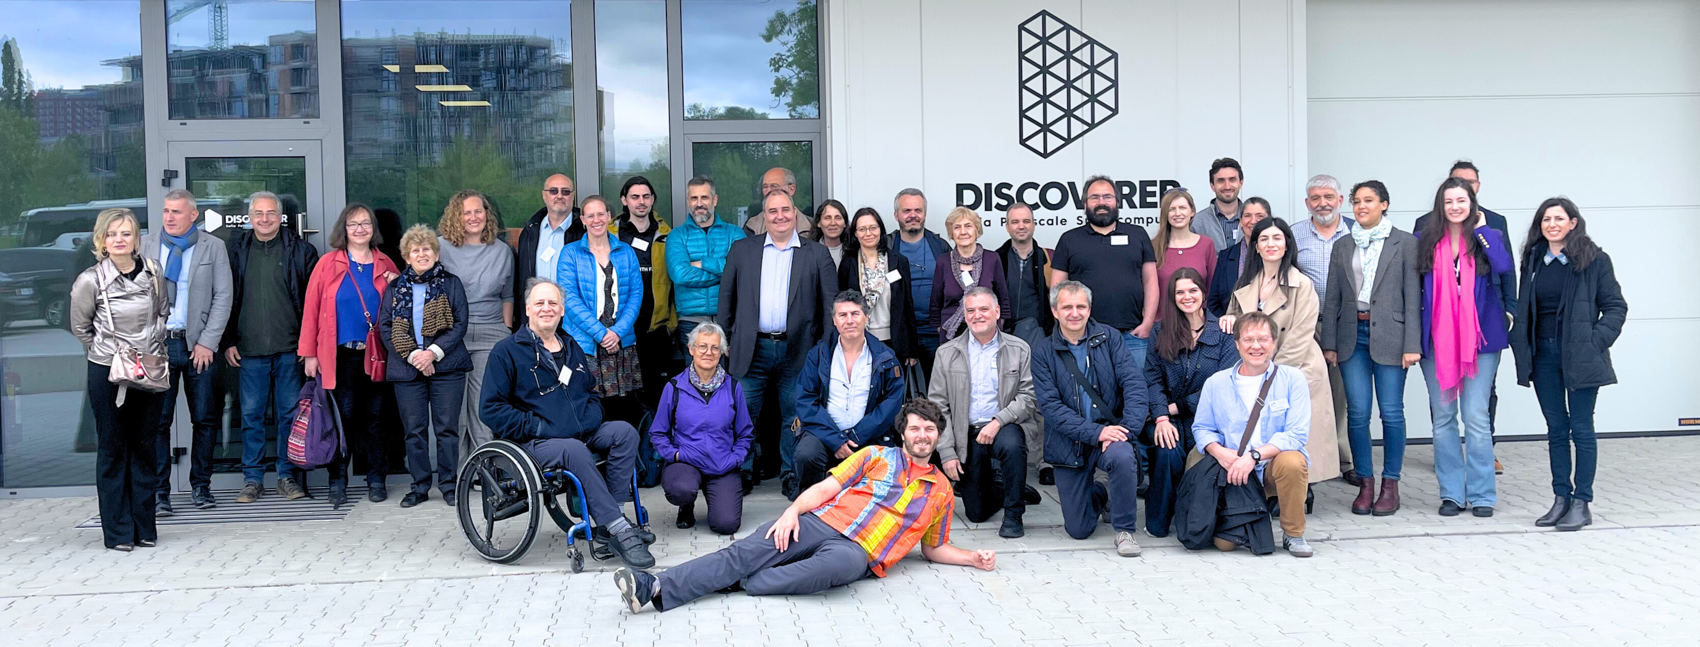
25th IPPOG Meeting at Sofia, Bulgaria(*)
9–11 May 2023
https://indico.cern.ch/e/ippog-2023-spring
https://indico.cern.ch/e/ippog-cb-2023-spring
(*)& online via Zoom
(36 participants in presence,
20 participants in Zoom)

Slide 3
9-11 May 2023
25th IPPOG Meeting at Sofia, Bulgaria(*)
Working Groups
  Bringing Masterclasses to New Countries (Uta Bilow, Ken Cecire)
  Outreach of Applications for Society (Barbora Gulejova, Sarah Zoechling, Yiota Foka)
  Explaining Particle Physics to a Lay Audience (Barbora Gulejova, Thomas Naumann)
Meeting Theme & Panel Discussion
  Quantum computing
    HPCs (Kiril Kirilov)
    Quantum Computing Panelists: Iliya Lingorski (moderator), Sasha Mehlhase (Munich Quantum Valley), Federico Meloni (DESY), Elias Fernandes-Combaro (CERN & U.Oviedo), Petar Nikolov (Technical University Sofia).
(*)& online via Zoom
Full Agenda and report in
https://indico.cern.ch/e/ippog-2022-spring

Slide 4
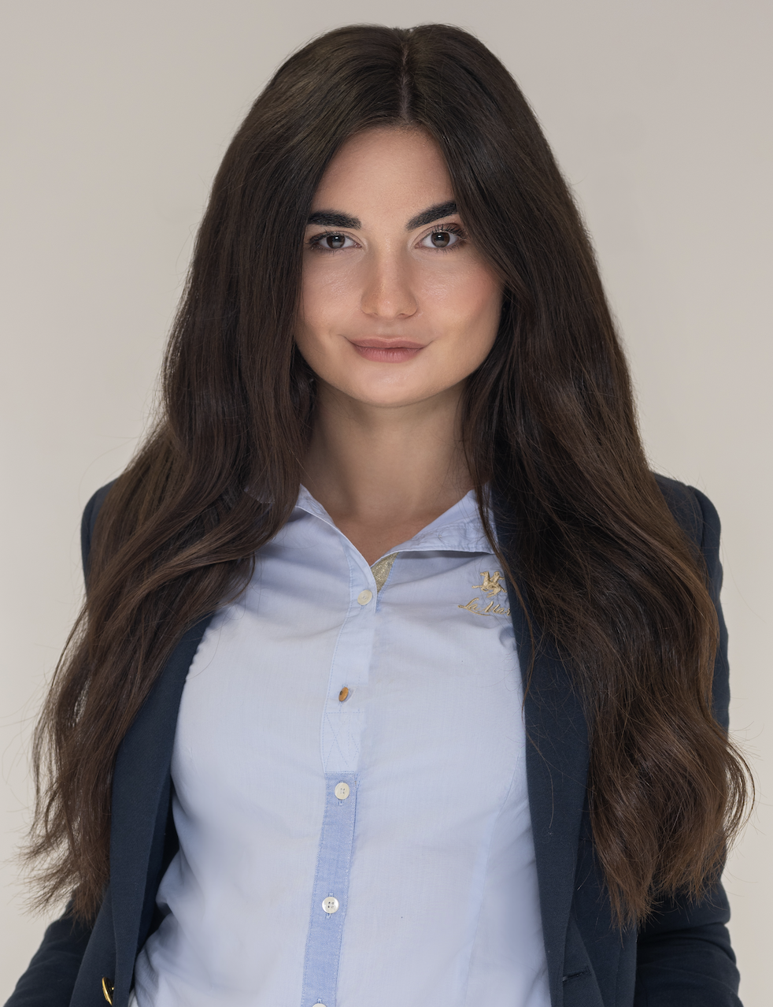
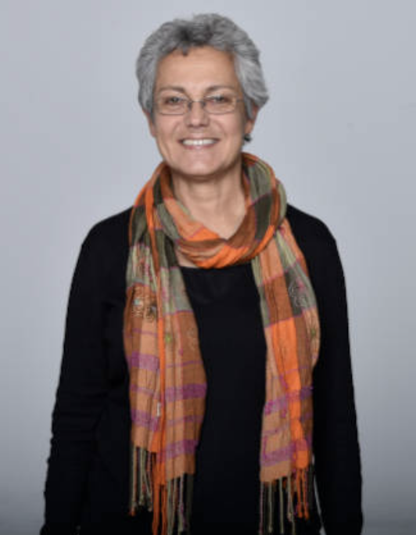
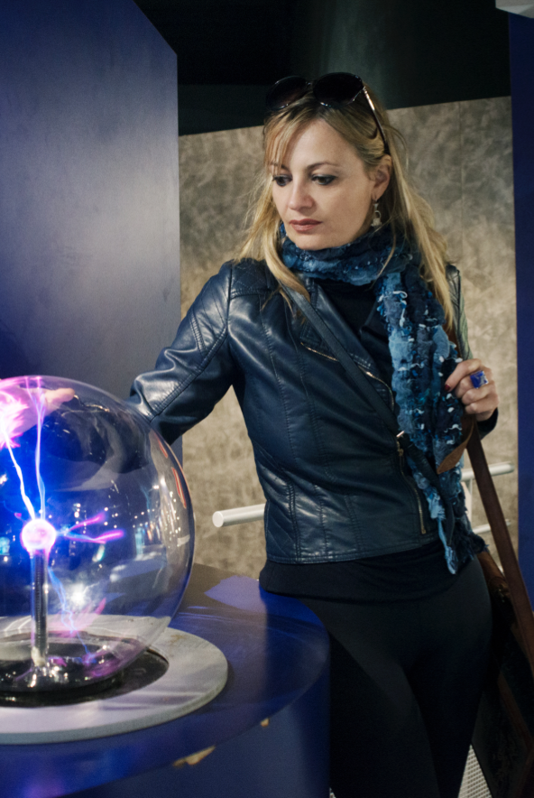
Welcome new CT members
Jana Fiserova
Coordination
Assistant
Despina
Hatzifotiadou
Beatrice
Bressan
WELCOME!
Head of SPC
Resources Advisor

Slide 5
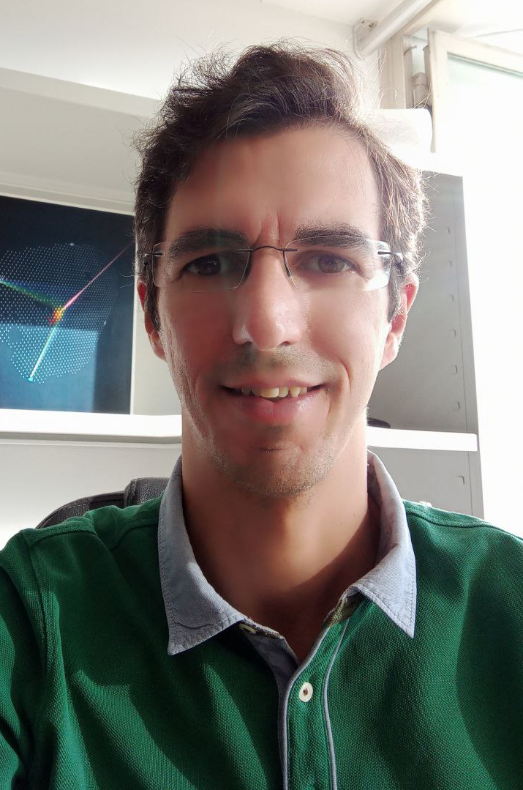
Welcome new members
Raul Sarmento
Representative of the
Pierre Auger Observatory

Slide 6
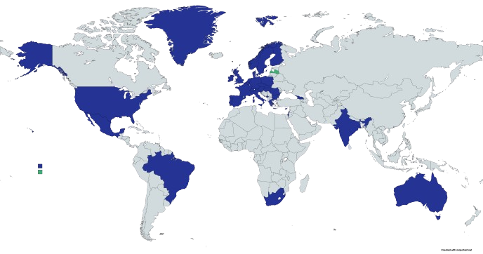
IPPOG World Map
IPPOG Membership
33 Countries, 7 Collaborations,
1 International Lab, 2 National Labs
Member countries
Pending signature
Experiments:
ALICE, ATLAS, BELLE-II,
CMS, HAWC, LHCb, Pierre Auger Observatory
International Lab: CERN
Associate Members:
DESY. GSI

Slide 7
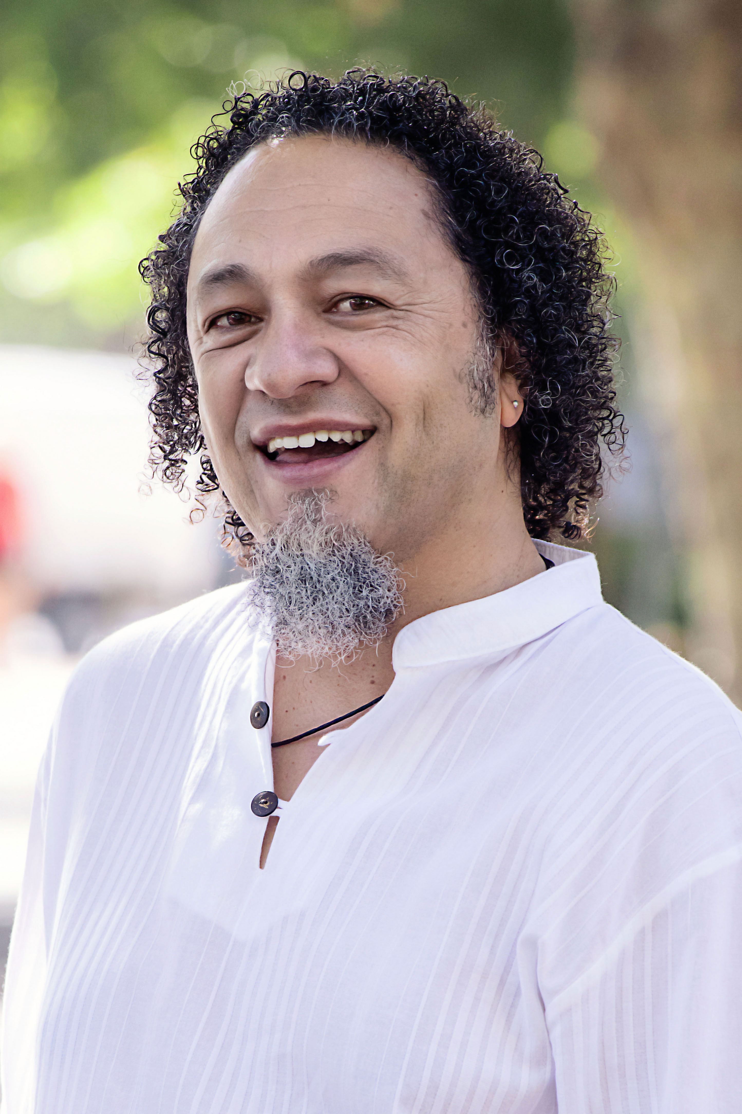
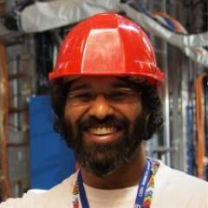
Thank you and Welcome
South Africa
Thank you,
Sahal Yacoob
Welcome
Gilian Arendse

Slide 8
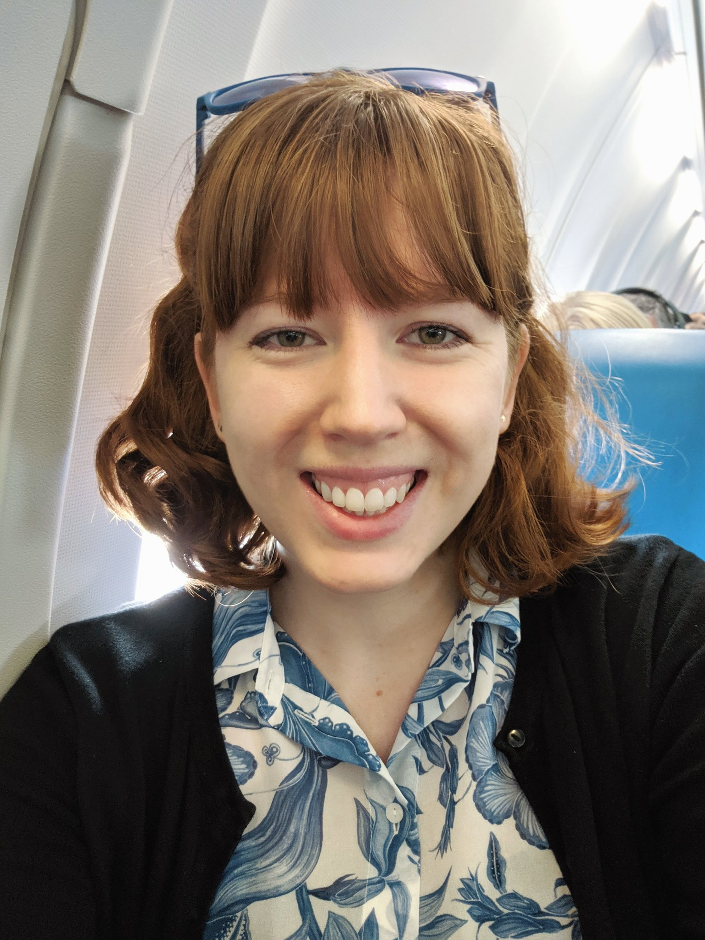
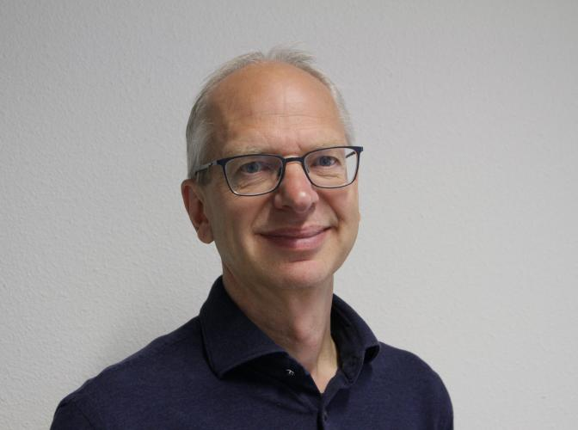
Thank you and Welcome
The Netherlands
Thank you,
Charles Timmermans
Welcome
Clara Nellist

Slide 9
IPPOG Members (+Associated Members)
41 Members: 33 Countries, 7 Experiments, 1 International Lab.
2 Associate Member(s): 2 National Labs.
 | Member | Representative | Signed
1 | Netherlands | Charles Timmermans | 22 Sep 2016
2 | Germany | Christian Klein-Bösing | 23 Sep 2016
3 | Norway | Farid Ould-Saada | 21 Oct 2016
4 | Portugal | Ricardo Gonçalo | 1 Nov 2016
5 | Sweden | Jonas Strandberg | 1 Nov 2016
6 | Switzerland | Katharina Mueller | 4 Nov 2016
7 | Slovak Republic | Ivan Melo | 15 Nov 2016
8 | Romania | Gabriel Stoicea | 17 Nov 2016
9 | Finland | Sami Lehti | 29 Nov 2016
10 | Belgium | Gwenhaël de Wasseige | 30 Nov 2016
11 | CERN | Ana Godinho | 19 Dec 2016
12 | Italy | Catia Peduto | 21 Dec 2016
 | Member | Representative | Signed
13 | France | Nicolas Arnaud | 23 Dec 2016
14 | Poland | Kszysztof Wozniak | 29 Dec 2016
15 | Australia | Paul Jackson | 14 Feb 2017
16 | USA | Spencer Pasero | 14 Mar 2017
17 | ATLAS | Rebeca Gonzalez | 1 Nov 2017
18 | BELLE II | Rok Pestotnik | 19 Feb 2018
19 | Slovenia | Anja Kranjc Horvat | 19 Apr 2018
20 | Czech Republic | Vojtech Pleskot | 21 Apr 2018
21 | Brazil | Marcelo Munhoz | 26 Apr 2018
22 | Greece | Nick Tracas | 19 Jun 2018
23 | Austria | Natascha Krammer | 6 Oct 2018
24 | Denmark | Ian Gardner Bearden | 6 Oct 2018

Slide 10
IPPOG Members (+Associated Members)
41 Members: 33 Countries, 7 Experiments, 1 International Lab.
2 Associate Member(s): 2 National Labs.
 | Member | Representative | Signed
25 | LHCb | Bolek Pietrzyk | 6 Oct 2018
26 | ALICE | Despina Hatzifotiadou | 6 Oct 2018
27 | Ireland | Jon-Ivar Skullerud | 11 Dec 2018
28 | CMS | Freya Blekman | 13 Mar 2019
29 | United Kingdom | Darren Price | 14 Mar 2019
30 | Hungary | Dezso Horvath | 11 Apr 2019
31 | Spain | Alberto Ruiz | 26 Jun 2019
32 | Montenegro | Ivana Pićurić | 23 Oct 2019
33 | HAWC | Ruben Alfaro Molina | 19 Dec 2019
34 | Georgia | Lasha Sharmanashvili | 05 Oct 2020
 | Member | Representative | Signed
35 | South Africa | Sahal Yacoob | 12 Oct 2020
36 | Israel | Ehud Duchovni | 8 Jan 2021
37 | Bulgaria | Roumyana Mileva Hadjiiska | 26 Jan 2021
38 | India | Bedangadas Mohanty | 19 Nov 2021
39 | Cyprus | Fotios Ptohos | 10 Mar 2022
40 | Mexico | Arturo Fernandez Tellez | 25 Nov 2022
41 | Pierre Auger Obs | Raul Sarmento | 11 May 2023
 | Associate Members | Representative | Signed
1 | DESY (NLab Germany) | Thomas Naumann | 09 May 2020
2 | GSI (NLab Germany) | Ralf Averbeck | 04 Dec 2020
[NLab: Associate Member as National Lab]

Slide 11
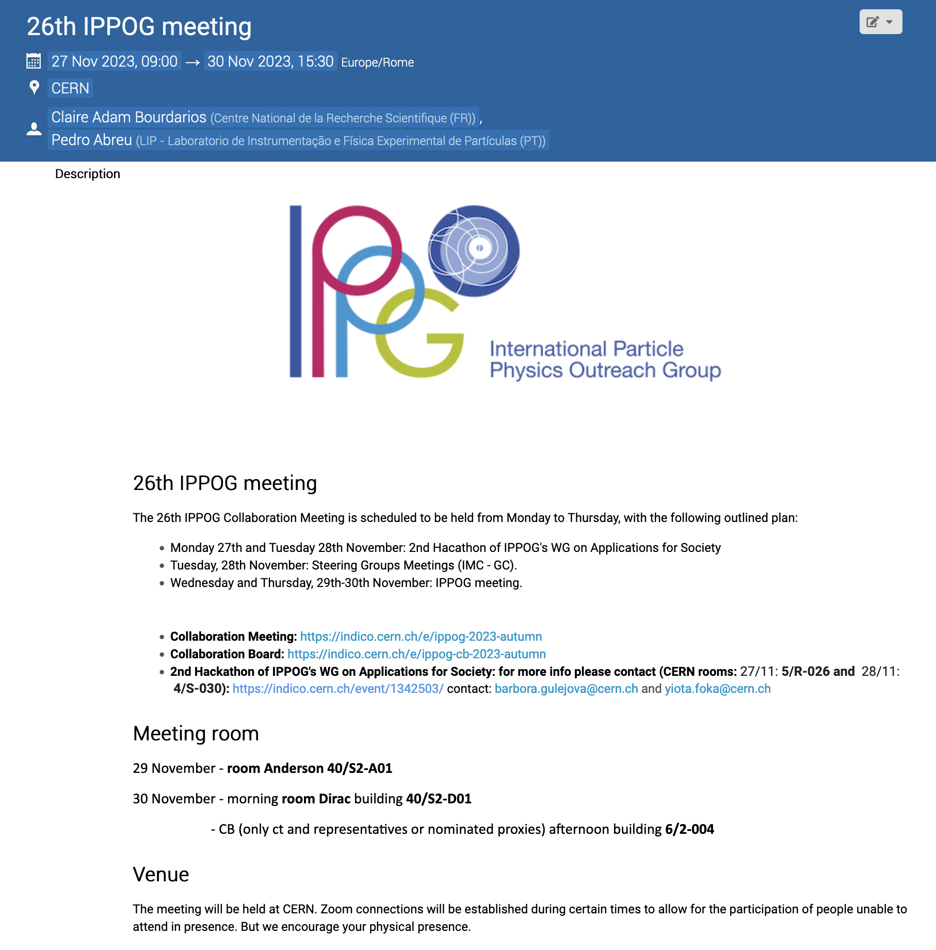
IPPOG Autumn Meeting 2023
Full Agenda
https://indico.cern.ch/event/ippog-2023-autumn
Back to full days
Pre-meeting Monday
  Special IPPOG Masterclasses for CERN Staff – non-physicists
  Hackathon on Applications for Society WG
Pre-meeting Tuesday
  Hackathon on Applications for Society WG
  Masterclasses to new countries WG
  Exhibits and Public Events WG
  International Masterclasses Steering Group
  [Optional] “Ghost Particle” screening + minipix demo
Wednesday
  Collaboration Matters
  Working and Steering Groups/Speakers Committee Reports
  Visit to Science Gateway
Thursday
  Success stories
+CB – …/event/ippog-cb-2023-autumn

Slide 12
Welcome Guest Speakers
@ Inspiring Success Stories
Hassnae El Jarrari (CERN)
  ACHEP conference in Morocco
Anna Onnerstad (U. Jyväskylä, FI )
  ALICE HEPscape in Finland
Sam Gregson
  Bad boy of science
Cortez Watkins
  Veteran Transition Initiatives at Fermilab
Maria Belen Lovino
  Looking for new interactions with dark matter
Andrea Mayer-Houdelet
  The Fellow Program of Netzwerk Teilchenwelt
  Robert Valentin Harlander
  Acquiring Feynman diagrams in a playful way
Hannes Nitsche
  Gamification Elements in Physics Masterclasses
@ Future(?) Members
Toms Torims (with Gundega Selga Horste)
Latvia Outreach Activities

Slide 13
CB Discussions & Votes
Points for Discussion during Thursday Collaboration Board
  Latvia accession to IPPOG (vote)
  Author list (discussion and possible vote)
  Budget discussion and approval 2024 (vote)
  Venue and Date for Spring Meeting 2024 (vote)
  Venue and Date for Autumn Meeting 2024 (vote)

Slide 14
Housekeeping
Reminders from Pedro&Claire …and not only (please):
  @Zoom: Stay muted! Unmute only to speak – also show your face if privacy allows…
  Use cable ethernet connection if possible (or move to the room of the wi-fi router)
  For questions/comments raise your hands! (in Reactions, bottom bar)
  The chatbox will also be monitored in case you want to comment.
  PRESENTATIONS:
    Keep track of time
    Speak slowly and clearly! …and remember to breathe while presenting.
    Leave a summary with key points in the last slide
Stay awake!…and enjoy the meeting in the comfort of this room!

