Slide 1
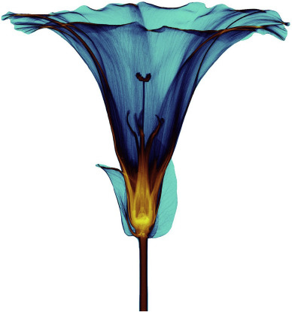
MEDIPIX COLLABORATION
MINIPIX-EDU
PINELOPI CHRISTODOULOU
IPPOG
28/11/23
Notes:
The miniature particle tracking and imaging detectors such as MiniPIX can record very small levels of radioactivity which is present everywhere: In the air you breathe, in the water you drink, in the food you eat and, yes, even in your own body.

Slide 2
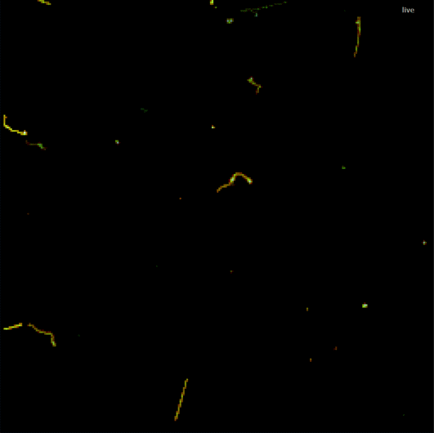

Minipix-Edu: Wow a particle in my screen!
https://www.linkedin.com/pulse/fascinating-patterns-drawn-radiation-particle-physics-jan-jakubek/
Notes:
An affordable device designed for physics classes where students can literarily “see” the radiation surrounding us. It is a miniaturized and low-power solution of radiation camera with single particle counting or particle tracking detector Timepix. The standard MiniPIX EDU system incorporates a single Timepix detector (256 x 256 pixels with a pitch of 55 μm) with 300 or 500 μm thick silicon. Minipix- EDU belongs to the family of hybrid pixelated detectors. This means that the sensor is segmented to pixels and each pixel is connected through bump bonding to the electronics. More specifically, Minipix - EDU consists of 256x256 pixels each with 55um pitch. The chip is able to measure the time of arrival of the particles and their deposited charge for each individual pixel of the matrix. This means that it is possible to reconstruct the track and energy of individual particles that interacted with the sensor. This is why it is called a photon counting detector. Furthermore, by setting proper threshold values it is possible to measure without the influence of noise. In Figure 3, a cross section view of the Minipix -Edu can be seen. With orange is the sensor material, with green the bump-bond and with blue is the electronic chip.

Slide 3
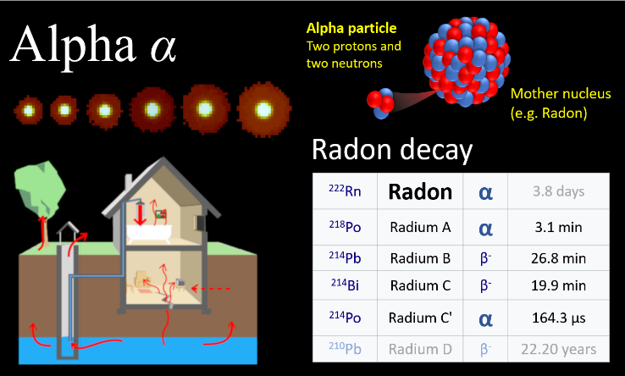
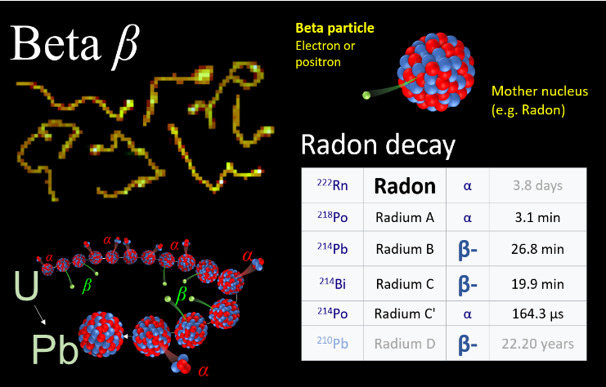
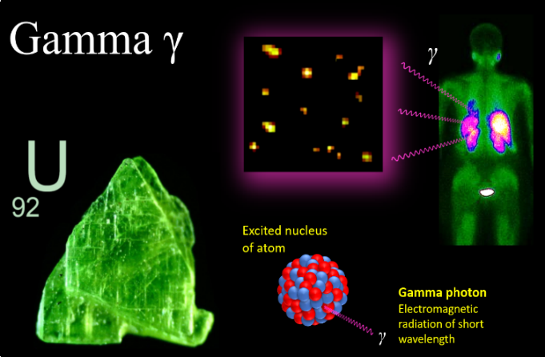
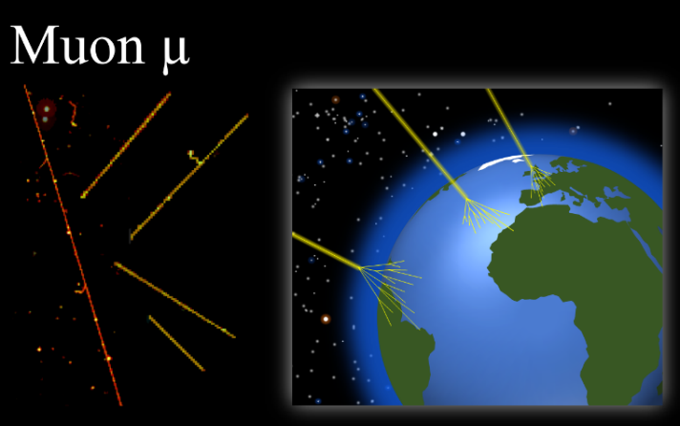
Particle identification
https://www.linkedin.com/pulse/fascinating-patterns-drawn-radiation-particle-physics-jan-jakubek/
Notes:
Alpha particles are observed as large roundish blobs in our pictures. They originate from decay of certain unstable atomic nuclei such as Radon. The alpha particle is composed of two protons and two neutrons (which is in fact nucleus of Helium). They are electrically charged (carrying two positive charges of protons). Alpha particles are large and heavy -that is why they don't penetrate deep into objects. In the air they would fly less than 5 cm till they would stop and change into normal helium atom (stealing two electrons from atoms around). Since they cannot penetrate though the dead layer of human skin, they present substantial risk for people only if generated inside of the body, typically in lungs, causing internal irradiation and potentially cancer. Radon as main source of alpha particles in our environment is generated from radium in the solid grains of the rock in the soil, they emanate the radon atom toward pore gases or fluids in the intergranular space. Then radon migrates at significant distances from the site of generation reaching houses of people where it can accumulate if not ventilated properly. formed by electron or positron (anti-electrons) flying at high speed (close to speed of light). Such fast flying electrons can be generated during decay of unstable atoms or they can start as normal electron accelerated by other particle flying around (e.g. hit by gama ray, cosmic muon ...). They are relatively lightweight and charged so they often change direction during collisions with other electrons when flying through the material. That is why we see them in our detector as crooked lines like "worms". During these interactions they decelerate gradually loosing all their energy, stop and become normal electron. Depending on original speed (energy) they can fly tens of centimeters or even meters in the air. Since they interact so often they present high risk for human body. Gama rays
are photons of electromagnetic radiation. They have zero rest mass and no electric charge. They are of the same nature as photons of visible light just with much shorter wavelength and, therefore, much more energy and, therefore, much more penetrating. They originate in nucleus of atom during transitions from excited state to state with less energy - this happens usually just after radioactive decay. They don't interact very often with material. They can fly tens of meters in the air or more. They penetrate human body easily interacting just rarely. They are stopped by large and heavy materials. That is why radiation shielding is usually made of thick lead.
When flying through the mater they would interact mostly with electrons. During such interactions they spent either all energy (photo effect) or part of it (Compton scattering) recoiling an electron which continues similarly as beta ray. Therefore in our images we cannot distinguish original beta rays caused by radioactive decay from electrons recoiled by energetic gamma photons - they cannot be distinguished, they are identical.
We can identify gamma rays reliably only if their energy is low and electrons they recoil don't fly far from interaction point. Because beta rays of the same energy would be absorbed in the air and they would not reach the detector. Therefore we see those gamma rays as small dots. Mouns are generated during interactions of cosmic rays in the upper layers of atmosphere. They are charged and 207 times heavier than electrons. They are fast and heavy that is why they don't change direction of flight often. We see them as narrow straight strikes. They are unstable with mean lifetime of 2 microseconds. The fact that we can detect then on the ground level is nice demonstration of validity of the Einsteins's relativity theory. If the relativity principles would not be valid, muons would fly only about 600 meters till they would decay.

Slide 4
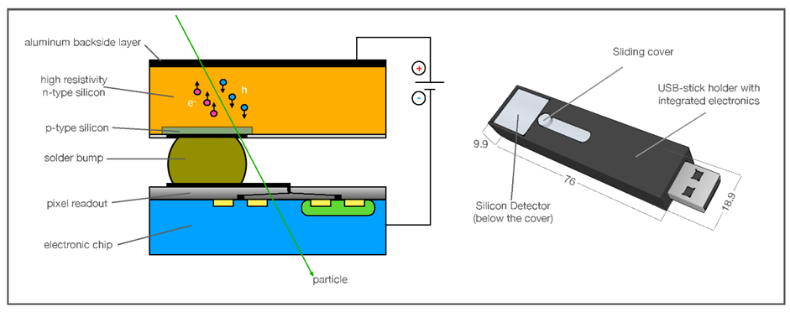
How it works: Photon counting hybrid pixelated detector
Photon counting detector:
Information of individual photons
Pixelated detector: 256 x 256 pixels
Pixel size: 55 x 55 μm
Hybrid detector: sensor is bump bonded
to electronics
Sensor material: Silicon or CdTe
Dark current: none
Maximum frame rate: 45 fps
Operating temperature range: 0-55 °C
Notes:
To measure ionizing radiation a sensor made from suitable semiconductor material is necessary. When ionizing radiation interacts with the semiconductor material, it produces charged carriers (electrons, holes). Usually, the sensor material is Silicon. Then a proper bias has to be applied on the sensor material in order to navigate the produced charged carriers to the electrodes and avoid recombination effects. The charge produced by the movement of the charge carriers is transformed into a pulse voltage that can be afterwards analyzed by the electronic chain of the detector chip.

Slide 5
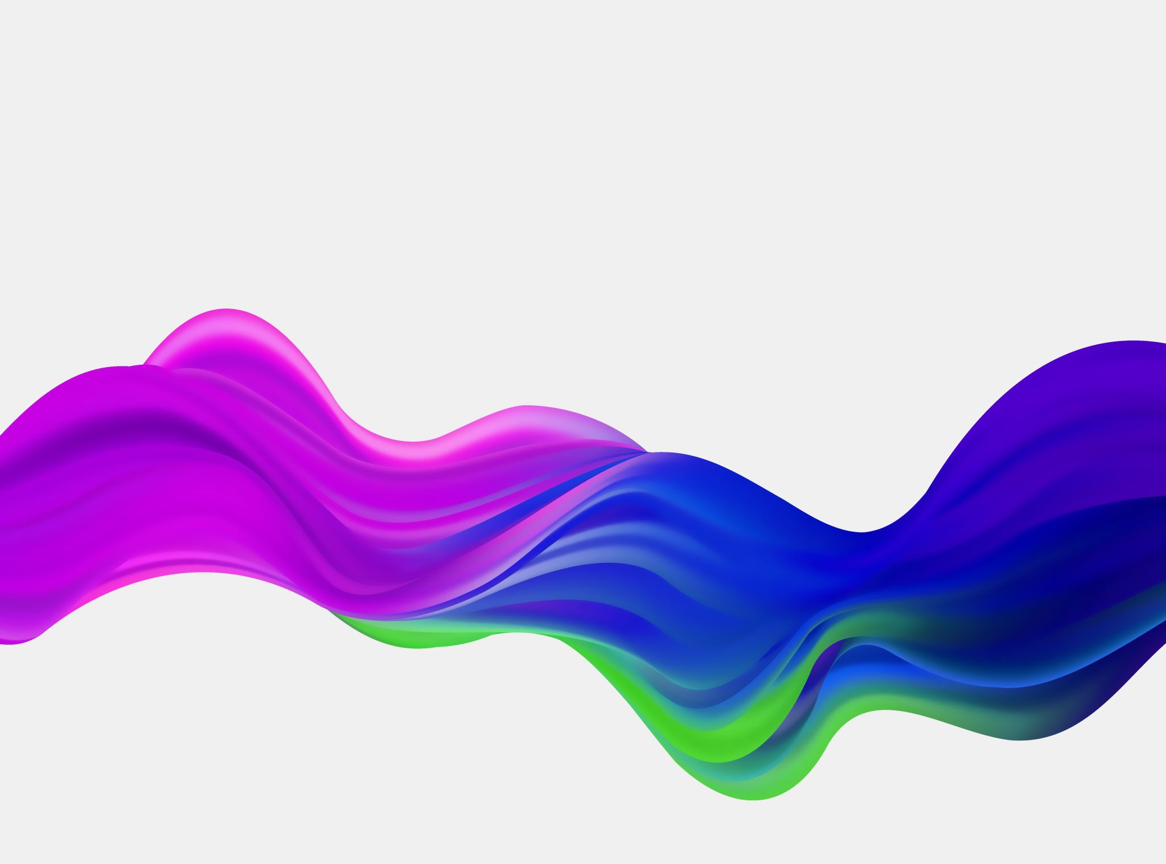
Applications of the MEDIPIX detectors
Notes:
It is really an exciting idea that students can take measurements with a detector developed at CERN, one of the world's largest and most respected centres for scientific research. Even more exciting is the idea that the detectors technology has been used in many fascinating fields, such as space exploration, Spectroscopic X-ray imaging for medicine and even art (material reconstruction). Some of the applications are briefly described below.

Slide 6
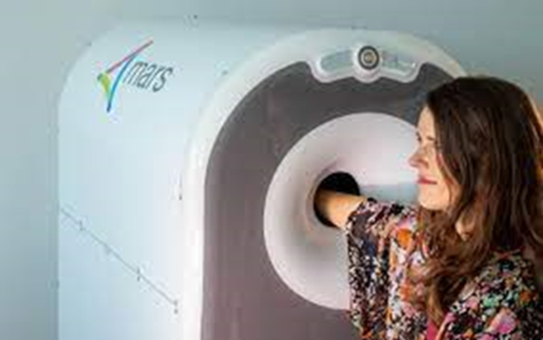
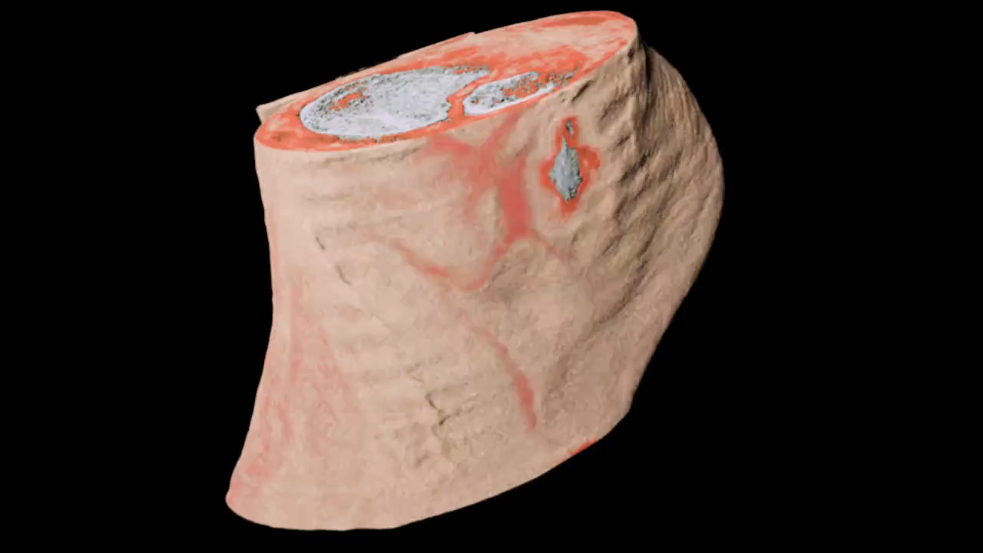
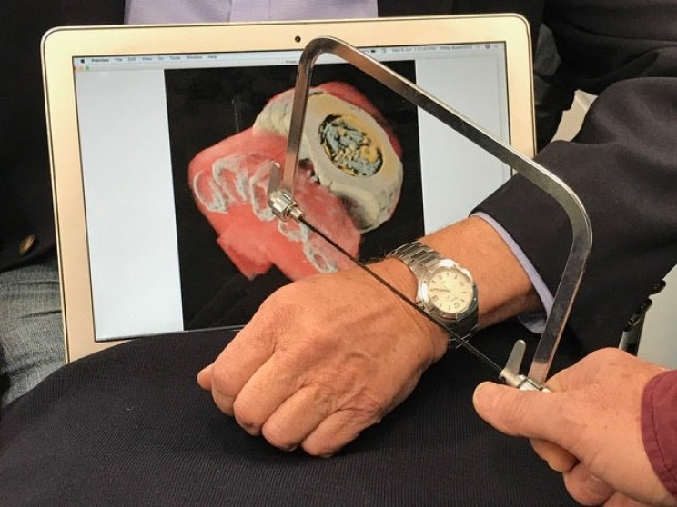
Spectroscopic X-ray imaging

Slide 7
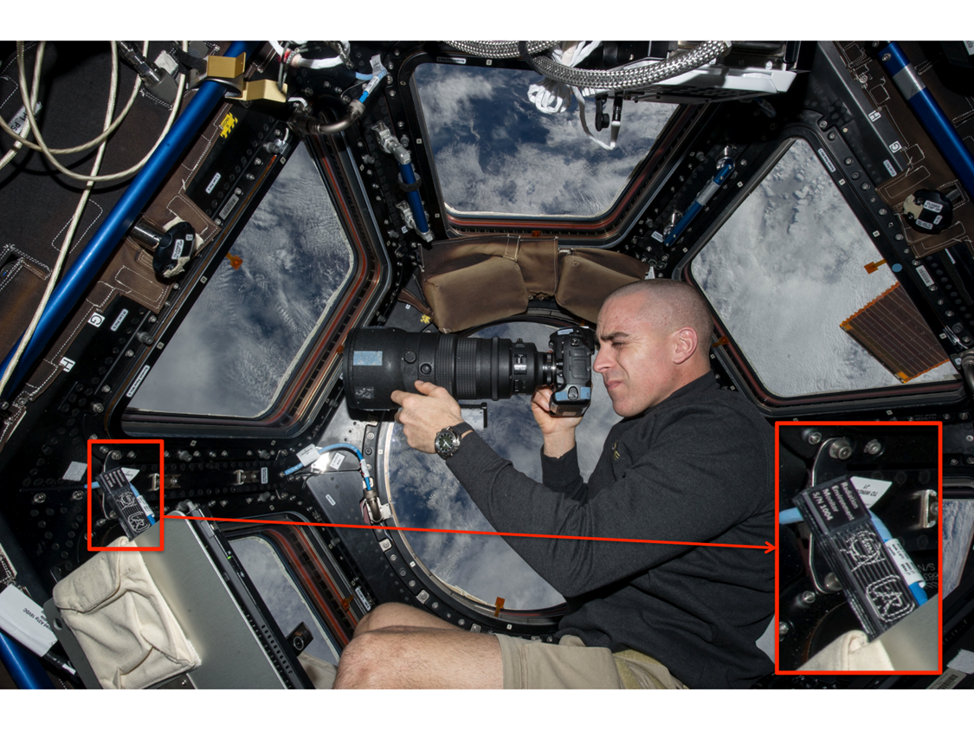
Application in Space Dosimetry
Timepix is being exploited for radiation monitoring in NASA’s Orion rocket and at the International Space Station
Image of the astronaut Chris Cassidy working near the Timepix USB on the International Space Station (Courtesy of NASA, photo ref. no. iss036e006175)

Slide 8
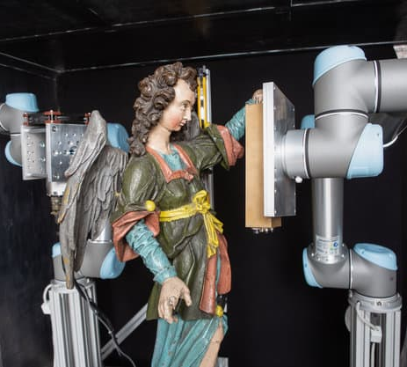

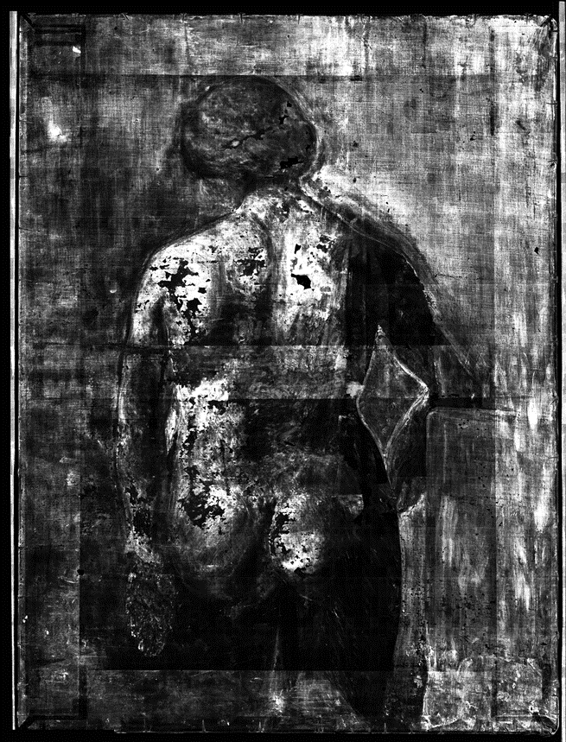
Application: Art restoration
Single particle counting X-ray imaging detectors + Robotic arms! https://insightart.eu/

Slide 9
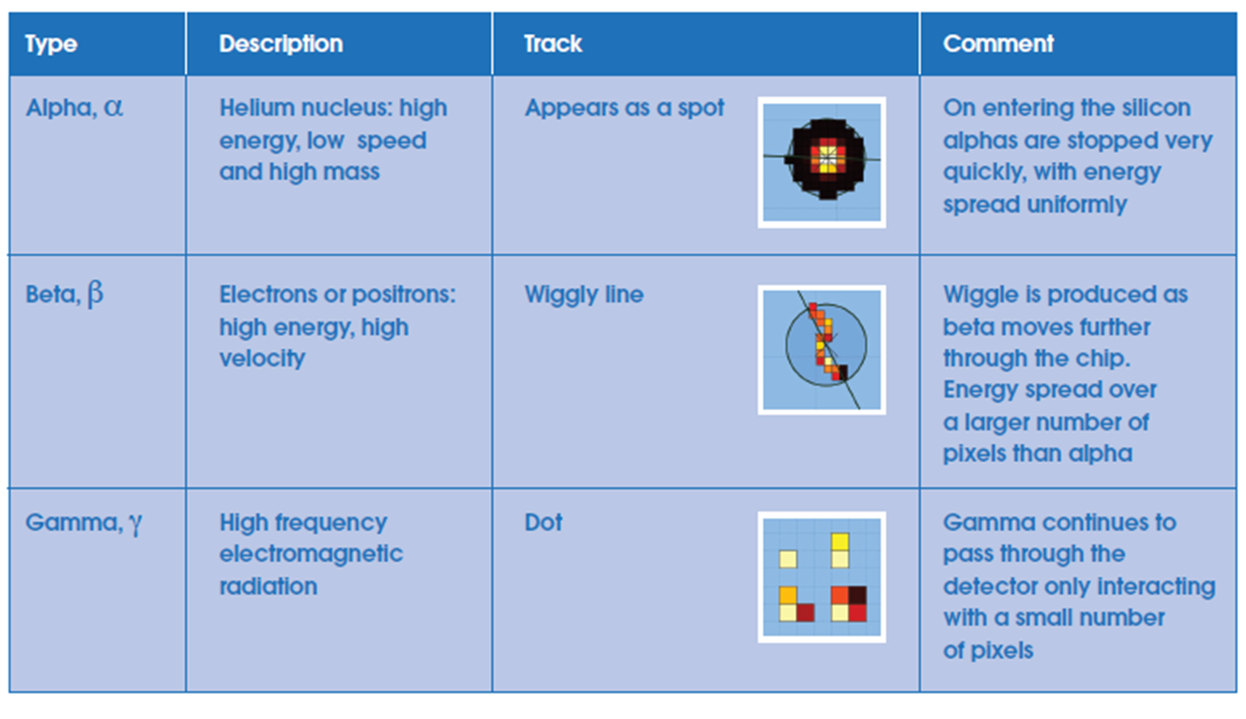
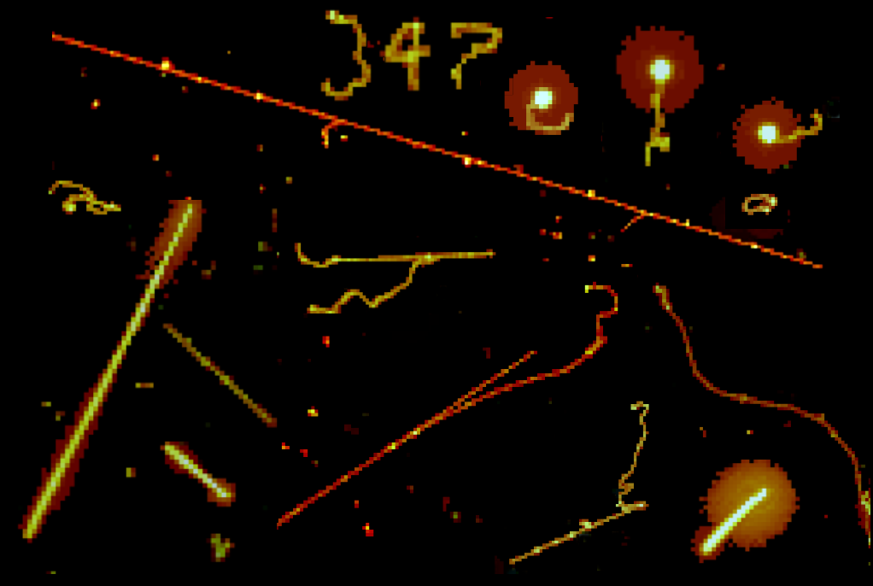
Application in Education
Is there a difference between day and night radiation?
Does the radiation change when somebody enters the room?
What happens if I would place a piece of granit close to the detector? And what about ash? Or air filter?
Is there some preference in directions of muons? And beta rays?
Does the neodymium magnet affect the particles?
Can I find some new particles in mountains? Or in mines? Or on board of plane? What about lightning during the storm? Can I use natural radiation to make an image of something?

Slide 10
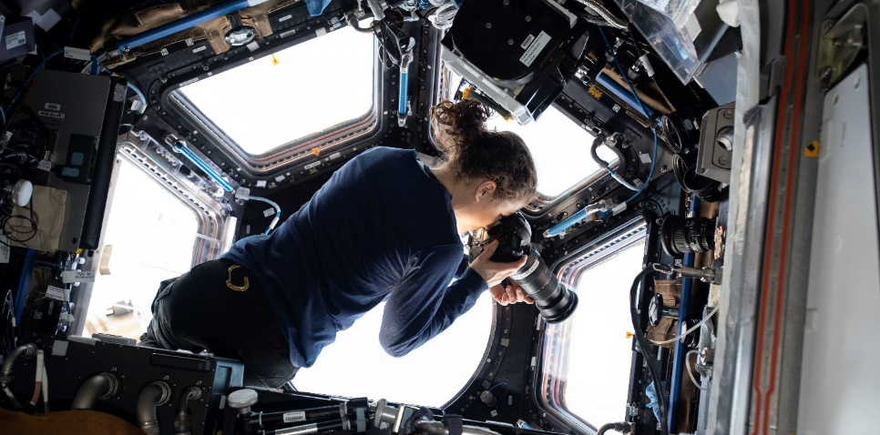
Thank you

Slide 11

EXTRA SLIDES

Slide 12
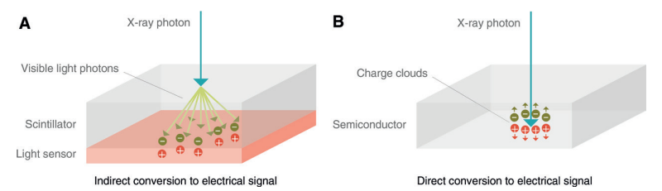
Photon counting detectors
1. Direct conversion
Conventional energy-integrating detector
Photon-counting detector
https://doi.org/10.1148/radiol.2018172656

Slide 13
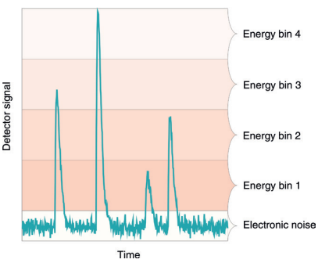
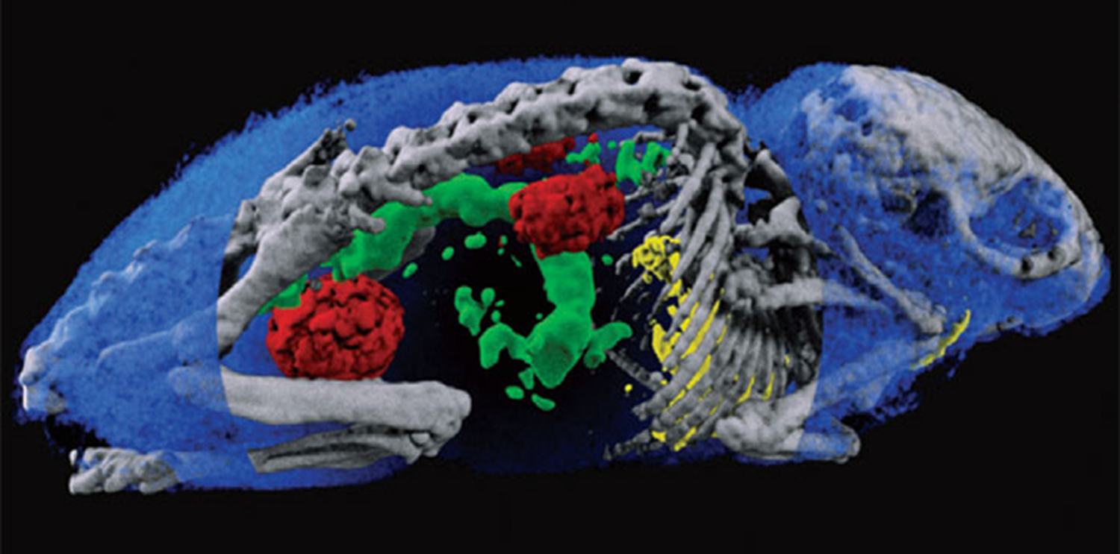
2. Elimination of electronic noise
able to discriminate the energy of each incident x-ray photon.

Slide 14
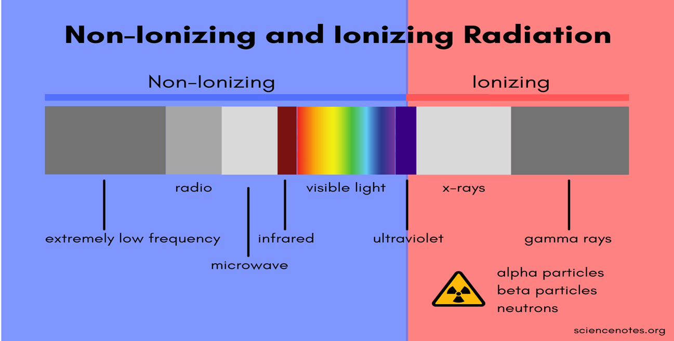
Introduction about Radiation
What is radiation?
Radiation is the emission or transmission of energy in the form of waves or particles through space or through a material medium.
Radiation is often categorized as either ionizing or non-ionizing

Slide 15
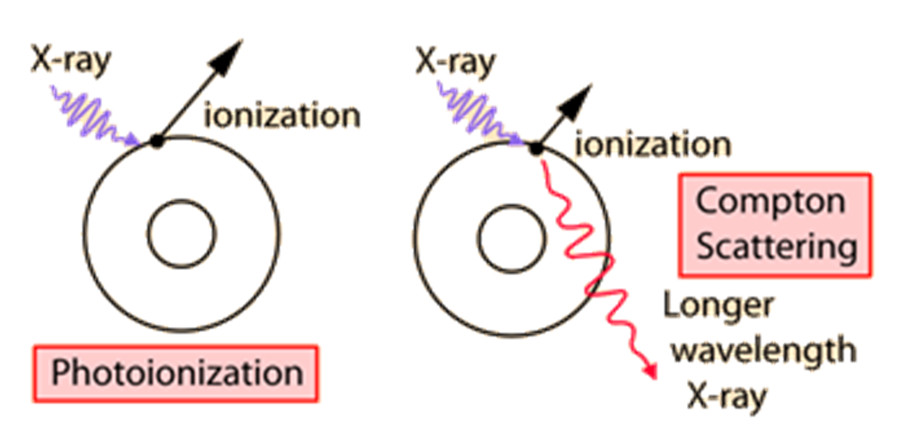
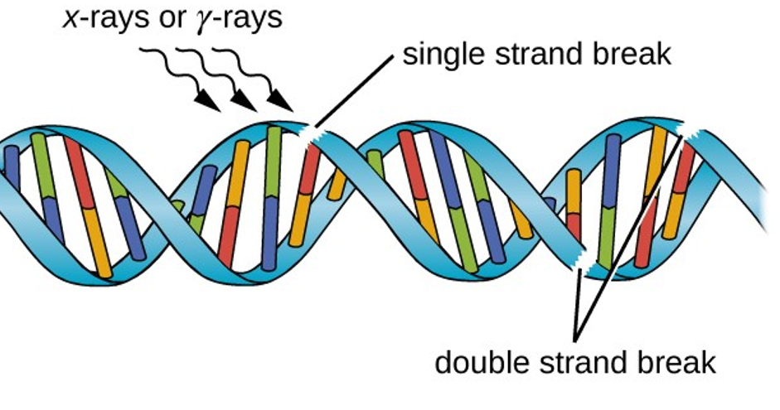
Ionization
Ionization is the ejection of one or more electrons from an atom or molecule to produce a fragment with a net positive charge (positive ion)

Slide 16
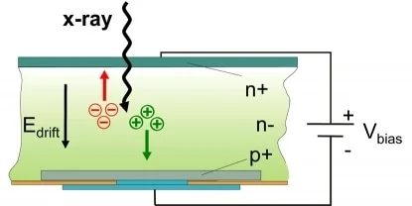
Sensor in hybrid detectors
When ionising radiation strikes the
detector its energy is deposited in the silicon layer.
This is then converted into an electrical signal and amplified.

Slide 17
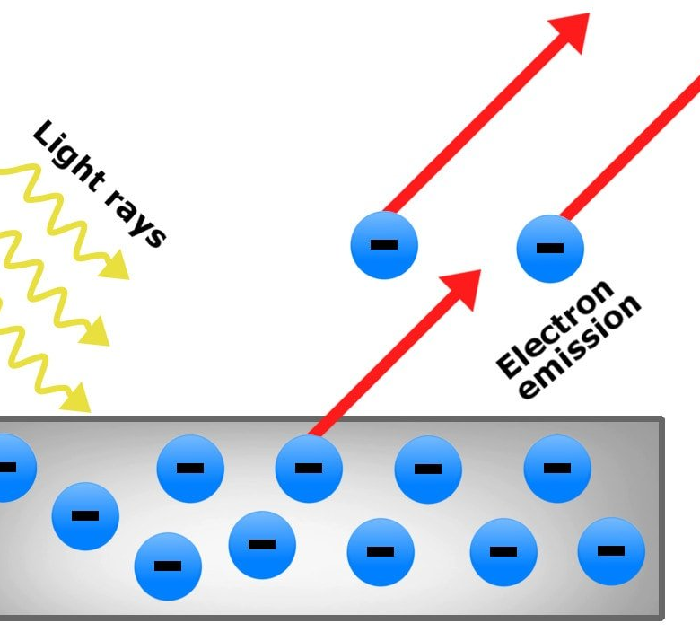
X-rays
The mechanisms of interaction for ionizing radiation in the form of x-rays and gamma-rays include the
Photoelectric effect,
Compton scattering and at high enough energies,
Electron positron pair production.

Slide 18
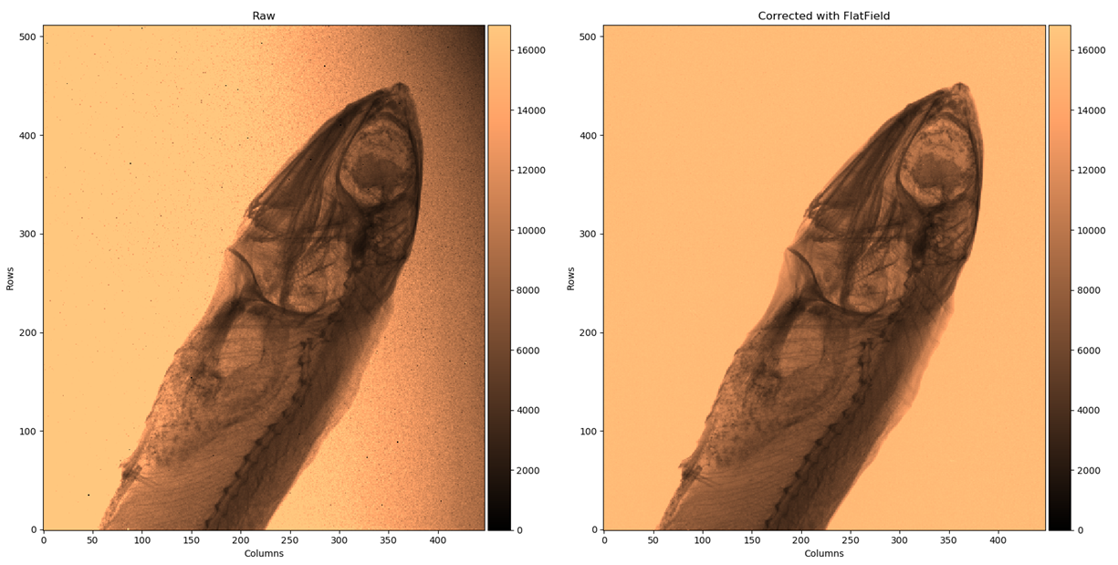
Photon counting image Timepix4
Timepix4 paper:
X. Llopart et al 2022 JINST 17 C01044

