Slide 1

PS Booster magnets Task Force - Subtask-2
Analysis and understanding of the failure modes
PS Booster magnets Task Force day – 14th June, 2023
Ana Teresa Perez and Stefano Sgobba
EDMS_2866091

Slide 2
Open questions for the Subtask-2
Are all the failure modes properly understood?
Are the processes to evaluate the nature and severity of the causes for these failures strong enough?
Outline
Methodology
A wide spectrum of analysed samples
Commonalty of phenomena
Current understanding
Analysis and effect of the environment
Potential risk for other circuits
Summary and plan for future work

Slide 3
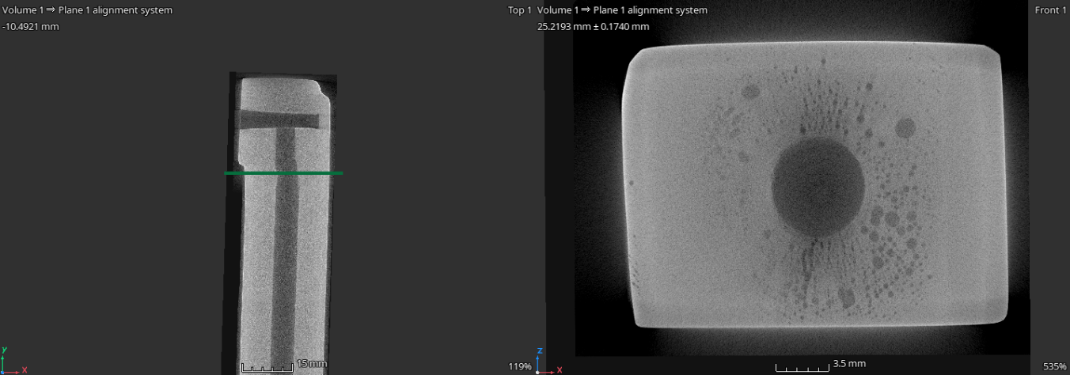
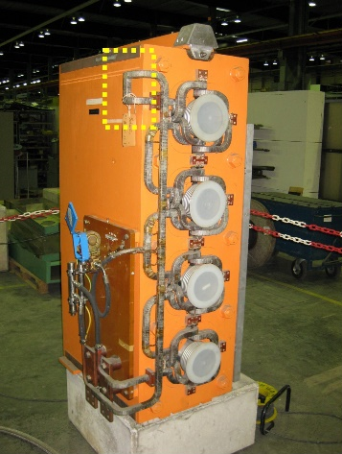
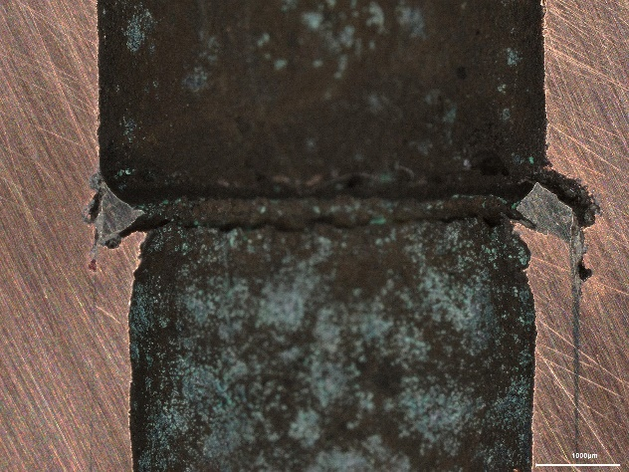
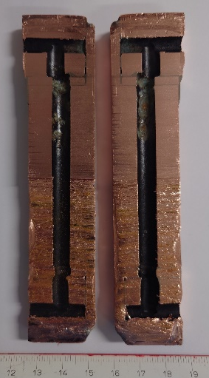
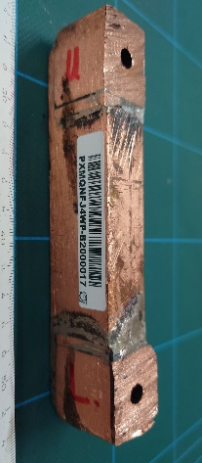
Analysed samples & method
All the conducts under study correspond to Cu based sections mostly brazed with Sil-Fos (self-fluxing Cu based filler with Ag and P)
Brazing
Cu bulk
Analysed samples
No-leaking samples extracted from different PSB locations
Quadrupoles/ Dipoles/ Bending Magnets
After different service time
From 2 weeks to 50 years
Common cooling circuit of demineralized water
Equivalent for all accelerators circuits
Samples examination procedure
Non-destructive test by computed microtomography (CT)
Selection of the cutting planes based on qualitative results
Dry cutting to access the inner surface of the conduct
Inspection and chemical analysis of the inner surface
Metallurgical preparation (polishing) of the longitudinal cuts
Examination of the brazed joints by OM and SEM
Common effort from TE-MSC, HSE-RP, EN-CV, EN-MME and TE-VSC to ensure the appropriate procedure and analysis

Slide 4
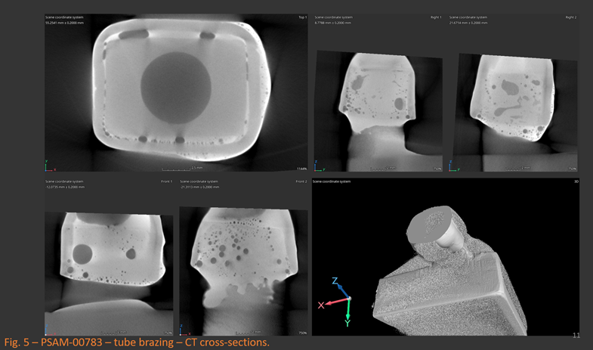
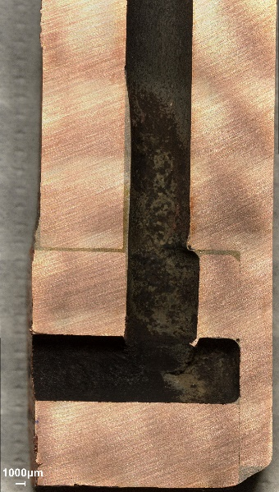
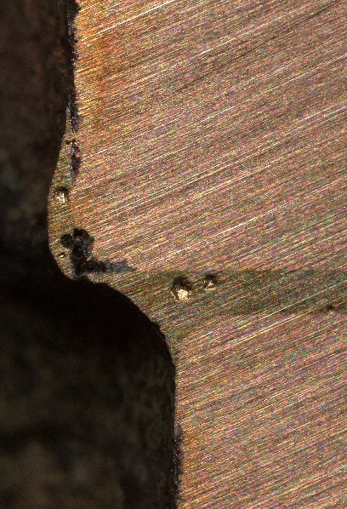
Commonalty of phenomena
PSB bending dipole (installed until LS2) by M. Celuch
What was observed?
Poor brazing interfaces presenting numerous discontinuities
Corrosion selectively attacks Cu at the interface with the Sil-fos braze (Cu-Ag-P) and the Cu phase within the braze metal
As corrosion progresses, the Cu grain structure is revealed and, in some sites, a large gap is formed
“S” detected in the conduct surface (up to 5.5 wt. %)
Cu bulk
Oxidized Cu
Sil-fos
PSB main quadrupole (installed until YETS 22/23)

Slide 5
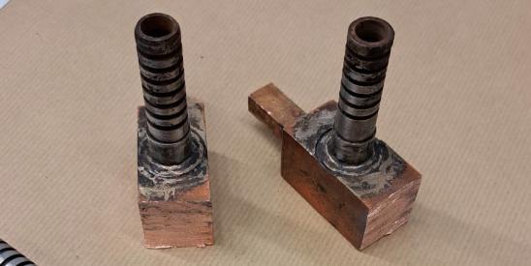
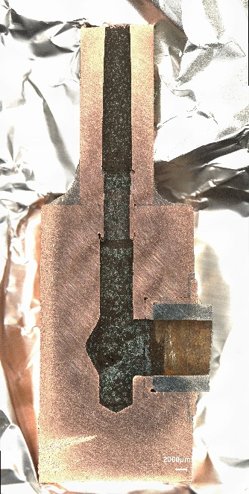
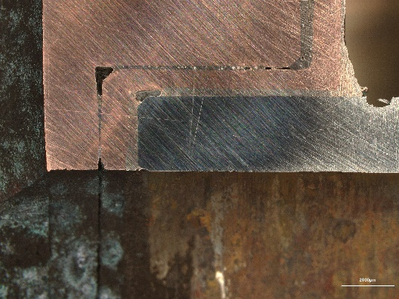
Commonalty of phenomena
What was observed?
Poor brazing interfaces presenting numerous discontinuities
Corrosion selectively attacks Cu at the interface with the Sil-fos braze (Cu-Ag-P) and the Cu phase within the braze metal
As corrosion progresses, the Cu grain structure is revealed and, in some sites, a large gap is formed
“S” detected in the conduct surface (up to 5.5 wt. %)
The phenomena is practically not visible associated to Cu-Ag
PSB bending dipole (installed until LS2) by M. Celuch
The corrosion affects mainly the Cu phase in the Sil-fos vicinity
Cu
Cu
Steel
Cu bulk
Oxidized Cu
Sil-fos
Cu-Ag filler
Sil-fos
PSB bending dipole (installed until LS2)
PSB main quadrupole (installed until YETS 22/23)

Slide 6
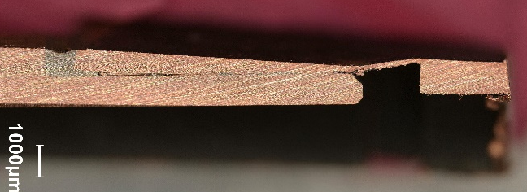
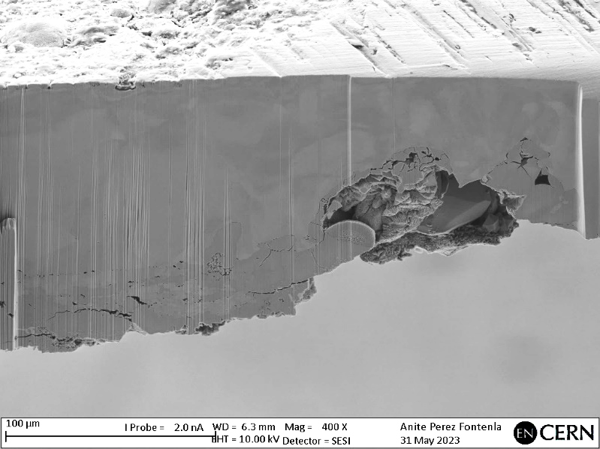
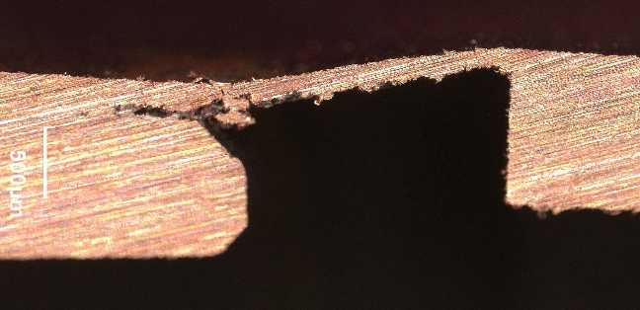
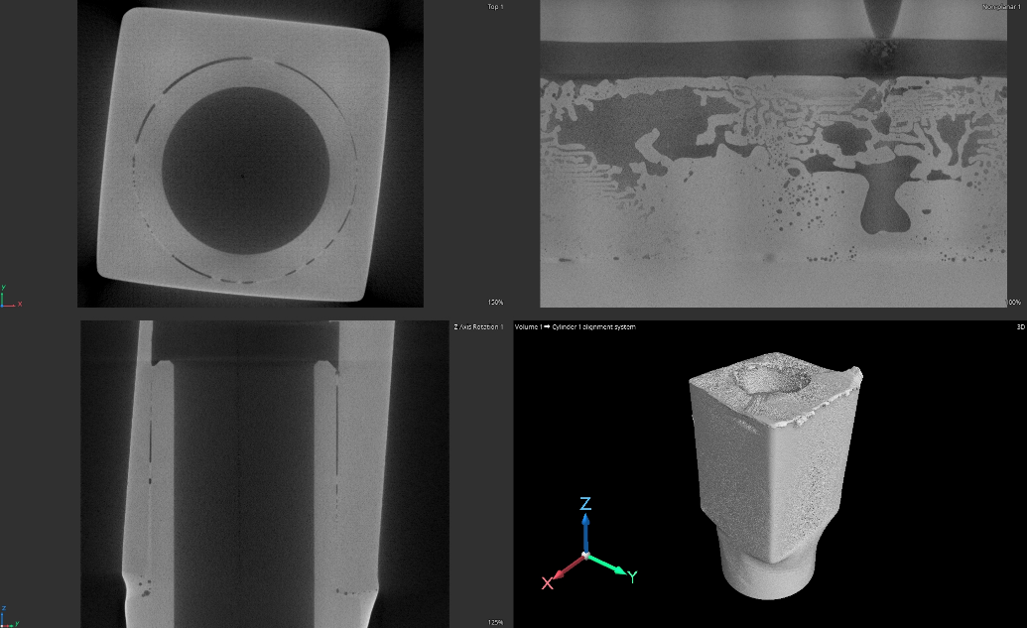
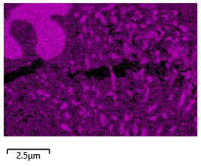
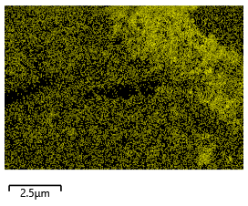
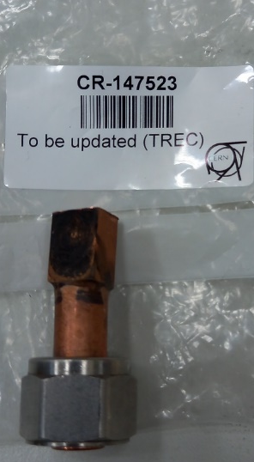
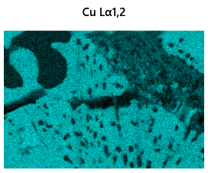
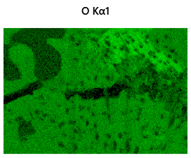
Commonalty of phenomena
Sil-fos
FIB-SEM
What was observed?
Leaking component installed during LS2 in HIE-ISOLDE
Wall thinning due to mechanical issue during manufacturing
Poor brazing interface presenting numerous discontinuities
“S” non-detected in the conduct surface (below 1 wt. %)
Same phenomena: Corrosion selectively attacks Cu at the interface with the Sil-fos braze (Cu-Ag-P) and the Cu phase within the braze metal
Cu-Cr-Zr
Cu
Ag
P
CT by M. Celuch
Cu-Cr-Zr to Cu (Sil-fos) brazing in HIE-ISOLDE (installed during LS2??)
High-sensitivity EDS elementary maps in corroded region shows severe oxidation of the Cu phase in while P and Ag are not affected
Cu
O

Slide 7
Current understanding
What do we know?
Examples of Cu-Ag-P brazed joints presenting similar corrosion were found in papers about transformers and tap water ducts. In those cases, sulphide-containing species in the water was reported as the main cause of the attack
Brazed joints fabricated from a high-Ag filler, that contained no “P”, exhibited no corrosion when exposed to the same sulphide environment
In our samples the “S” presence increases (up to 5.5 wt. %) with operation time but same corrosion phenomena (incipient) in samples with only “S” traces
 |  | Extracted from | Time in service | Material | Sulphur content | Failure
PSB | Sample #1 | PSB main quadrupole | 50 years | Cu/Cu | Up to 5.5 wt. % | At the Sil-fos interface
 | Sample #2 | PSB main quadrupole | 2 weeks | Cu/Cu | Traces
 | Sample #3 | PSB bending dipole | removed LS2 | Cu/Cu & Cu/StSt | Up to 5.5 wt. %
 | Sample #4 | PSB main quadrupole | removed YETS 21/22 | Cu/Cu | Up to 5.5 wt. %
 | Sample #5 | PSB main quadrupole | removed YETS 22/23
 | Sample #6 | PSB main quadrupole | removed YETS 22/23
HIE-ISOLDE | Sample #7 | Conduct | Installed LS2 | Cu-alloy/Cu | Traces
Is sulfur the root-cause in our cooling circuits failure?
“S” is not detected in the PSB water when analysed by ICP-OES (detection limit 1.6 ppm ) or under the form of SO₄⁻² by IC-CD (detection limit 0.1 ppm) → Test Dec. 2022
Nonetheless, evidence of “S” contamination at the inner surface of some conducts is confirmed by different techniques (EDS and XPS)
PSB main quadrupole (installed ~2 weeks)
HIE-ISOLDE (installed ~ 2 years)

Slide 8
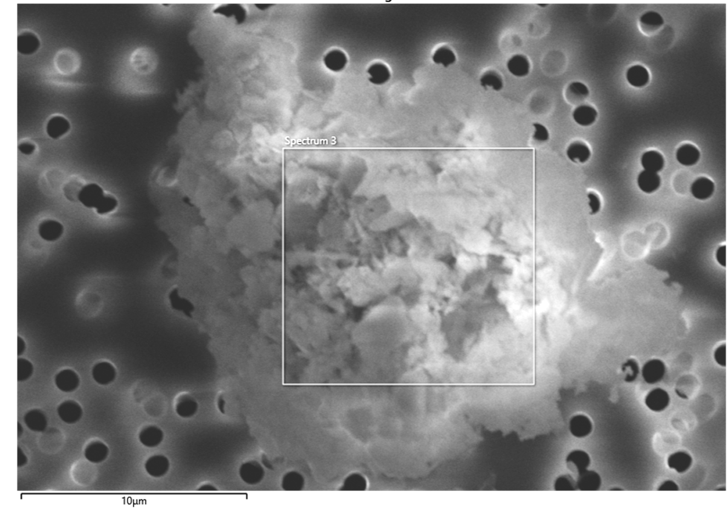
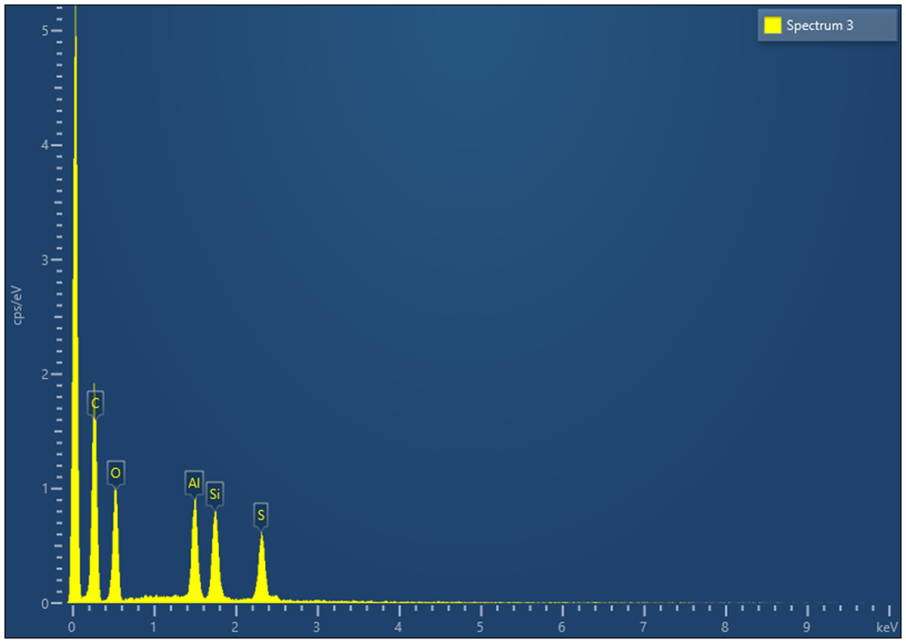
Current understanding
Particles containing “S” are present in the water
Representative number of particles present in suspension within the PSB water were collected in a membrane and analysed by Automatic Particle Analysis (APA)
Apart from “S”, particles rich in other elements were also present: Fe rich ~ 54 %, Ca ~ 12 %, Al ~ 11 % or Cu ~ 6 %
The presence of micrometric “S” rich particles is confirmed (~ 0.82 % of the 15.000 analysed)
Element | Wt%
O | 34.17
Al | 19.74
Si | 21.65
S | 24.45
Total: | 100

Slide 9
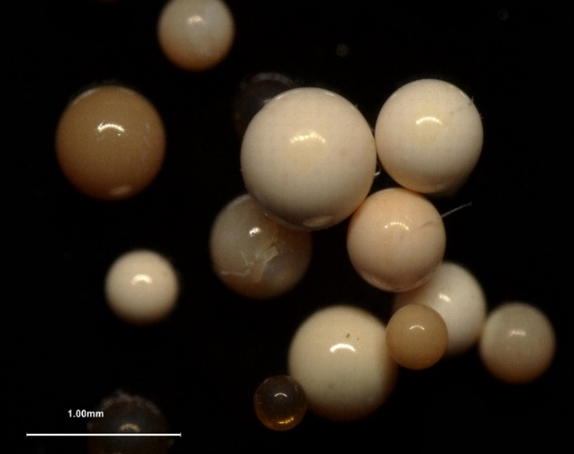
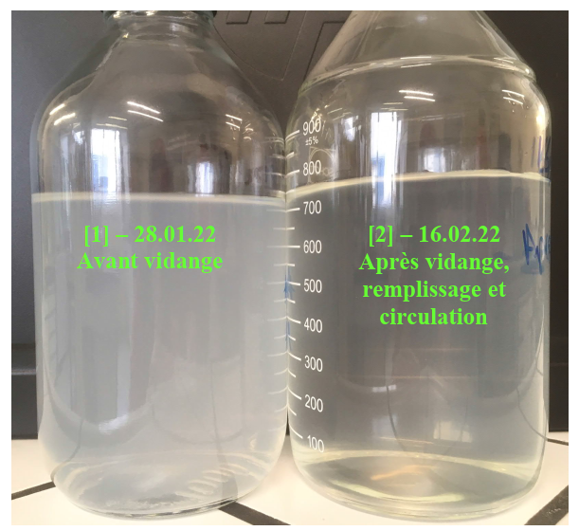
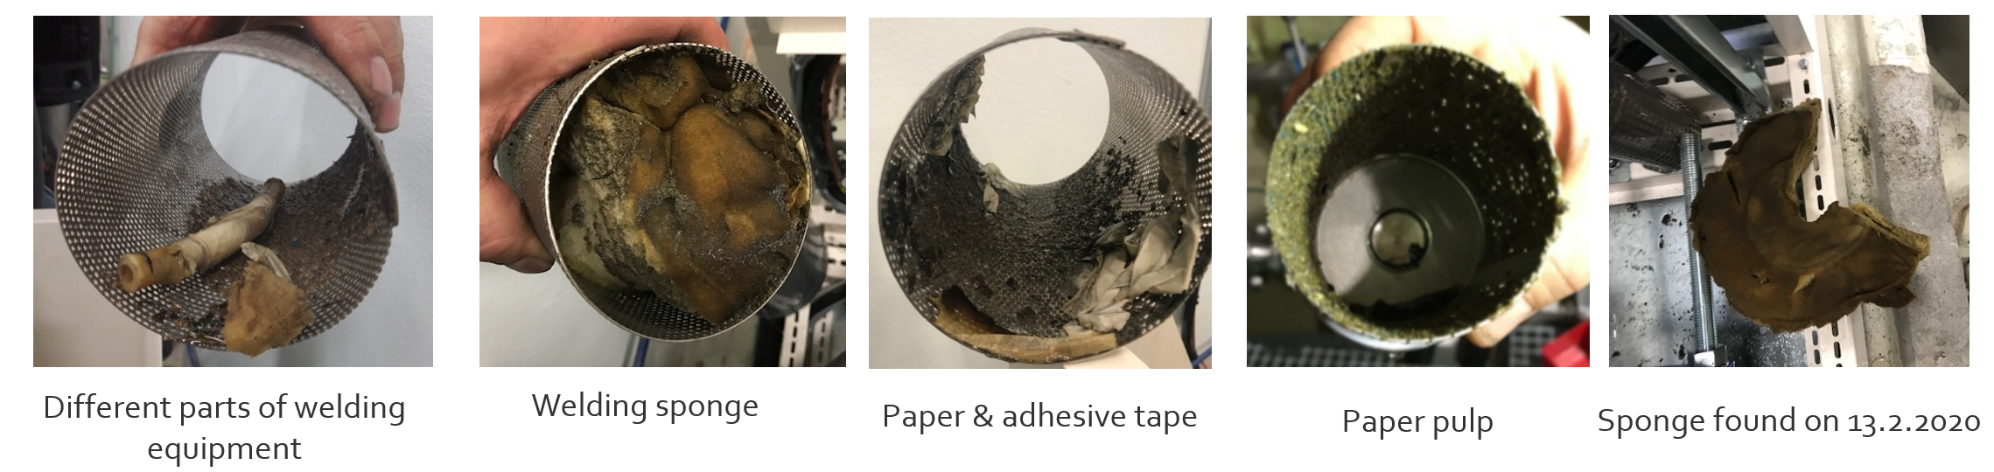
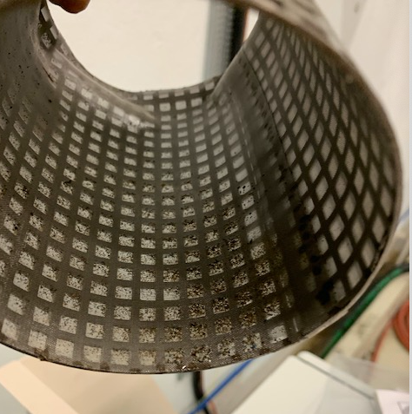
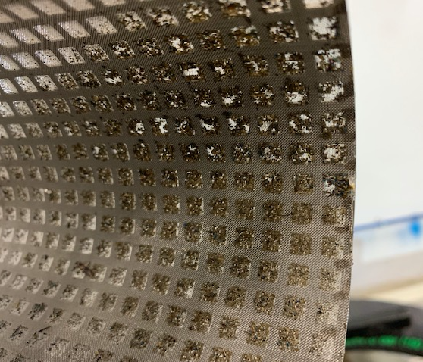
Analysis and effect of the environment
The origin of the “S” contamination is unclear:
Feb. 2022: resin particles reported in LHC point 4 water cooling with cloudy aspect [xx]
Dec. 2019: pollution was detected causing damage on PSB RF equipment [XX].
Followed by a careful cleaning process The circuit was drained and rinsed many times during commissioning and the water quality was then conform before providing water to the magnets
Before LS2: ion-exchange resin was accidentally injected into the cooling system. The resin contents sulphur [XX]
Ambralite resins
Courtesy of B. Teissandier EDMS 2718759
Network cleaned
Courtesy of G. Petrika and S. Deleval

Slide 10
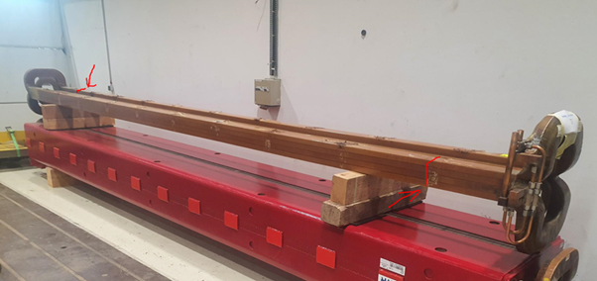
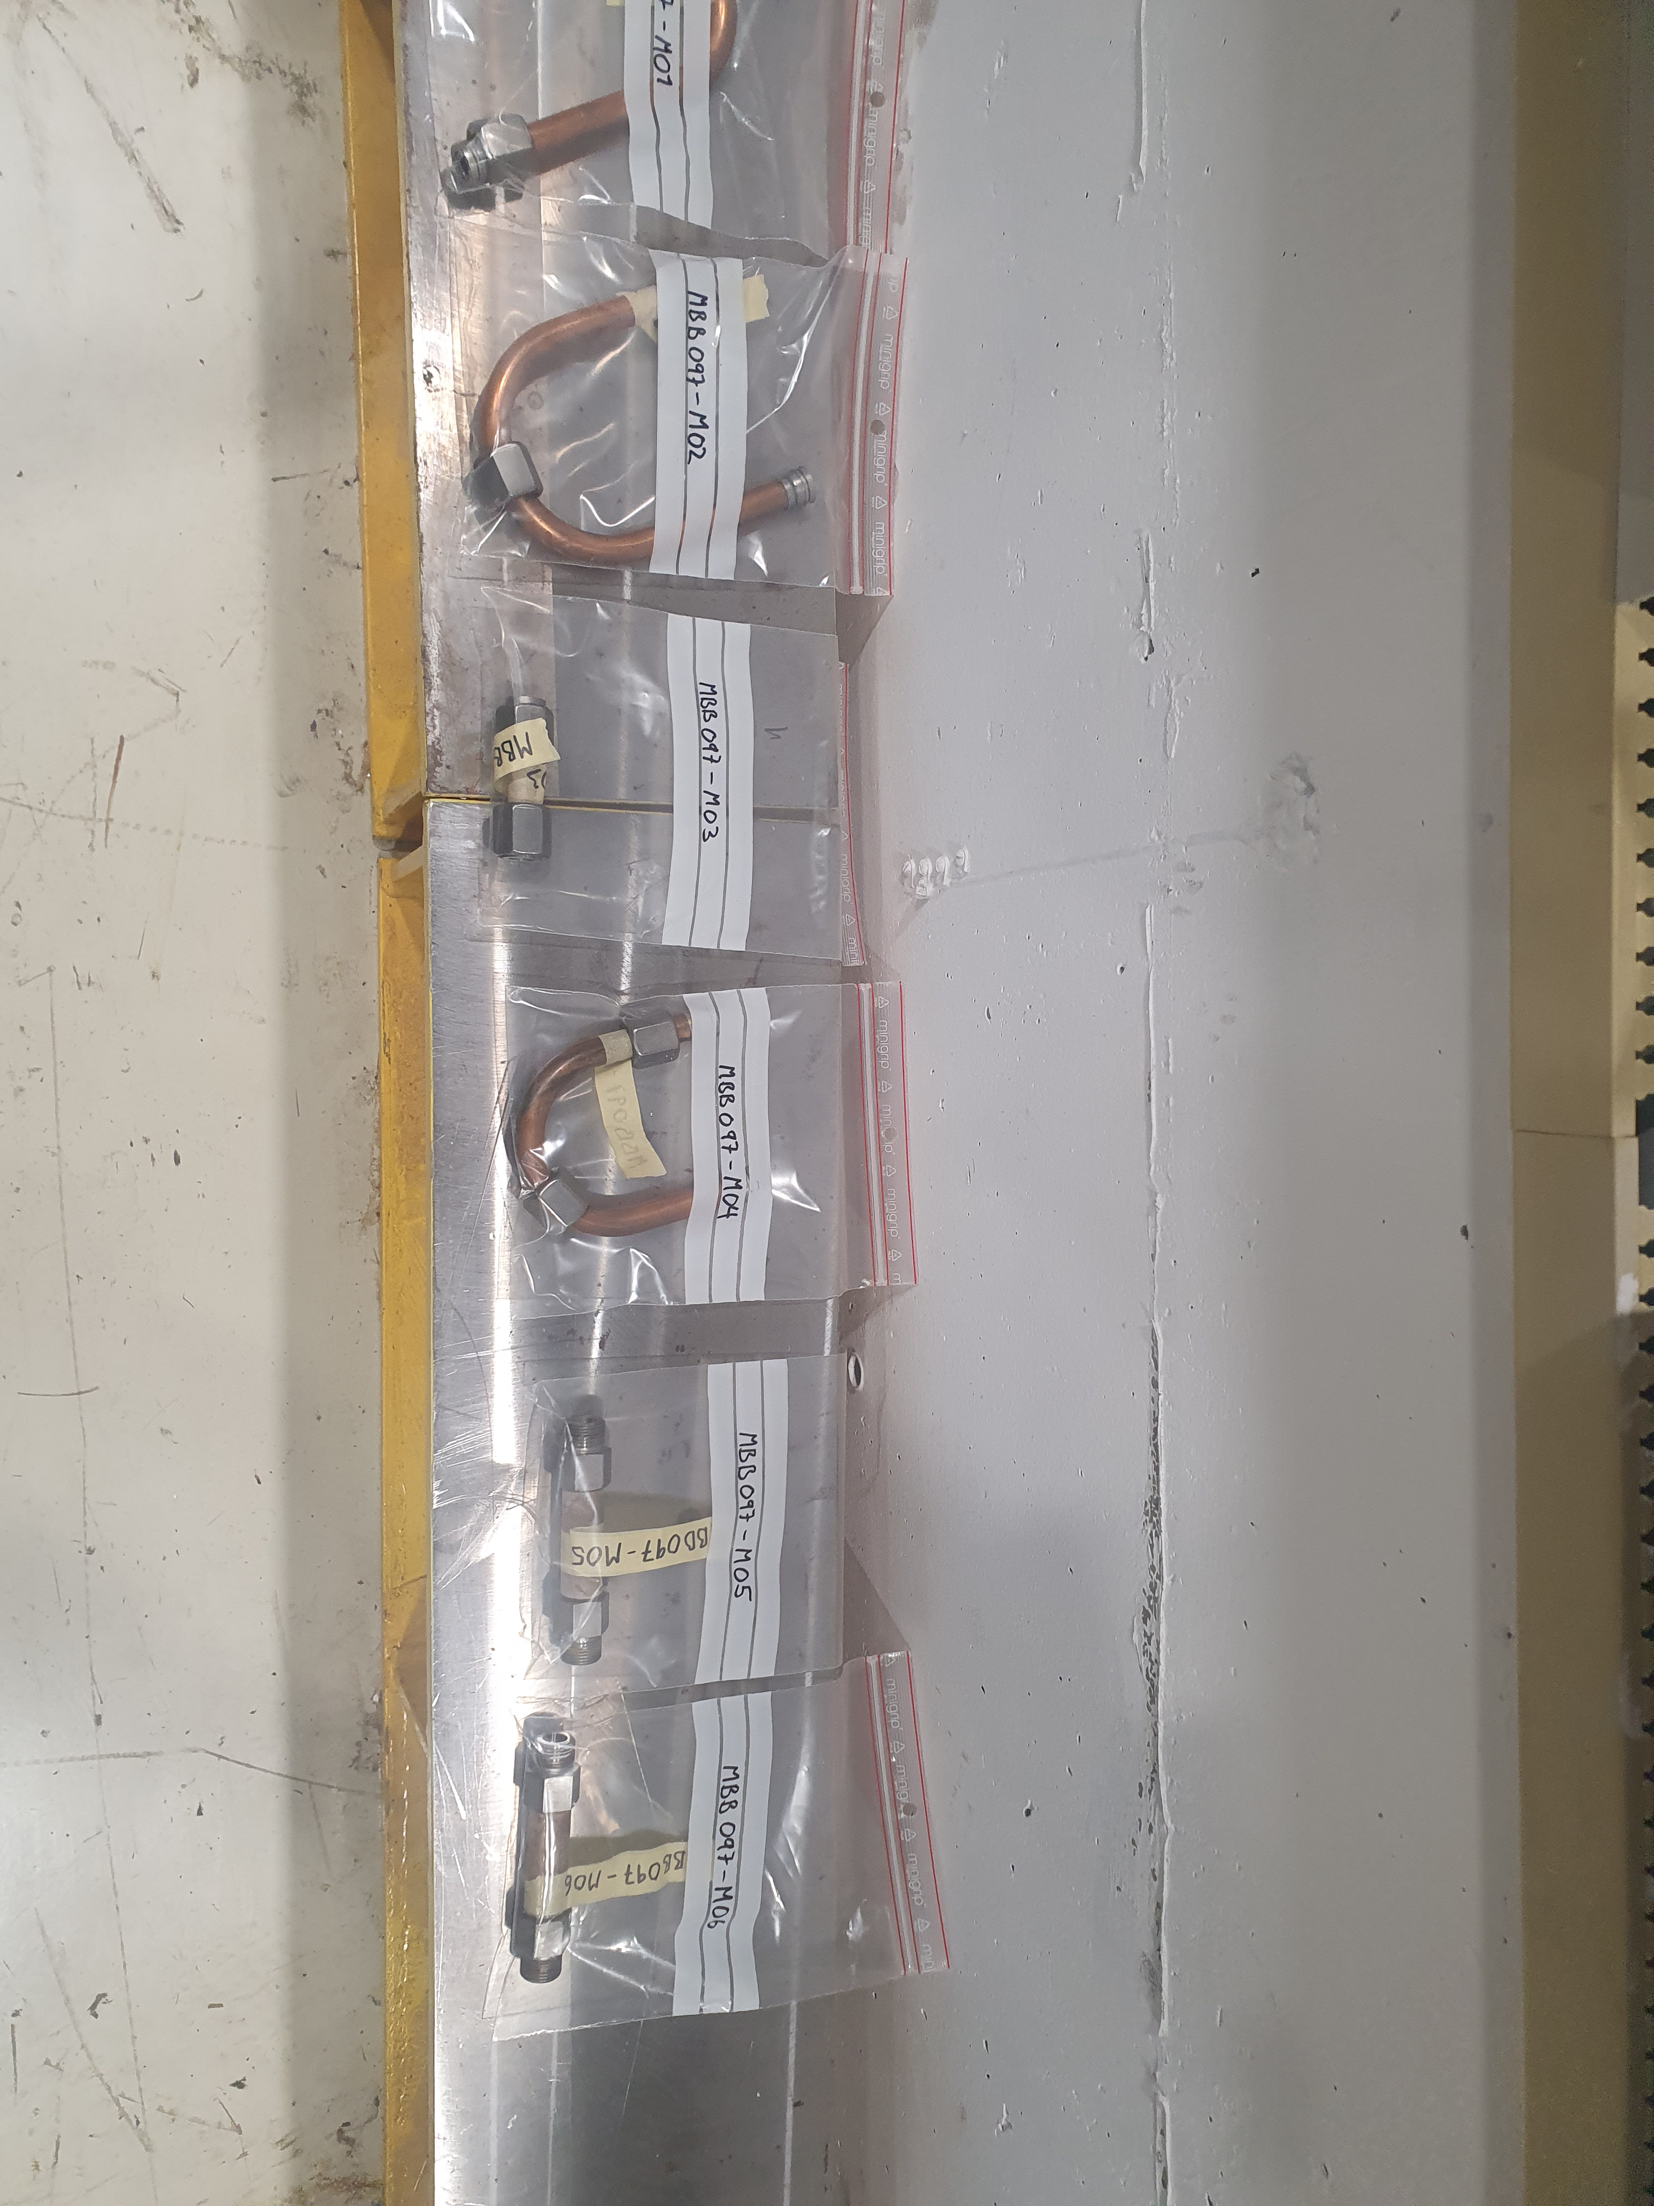
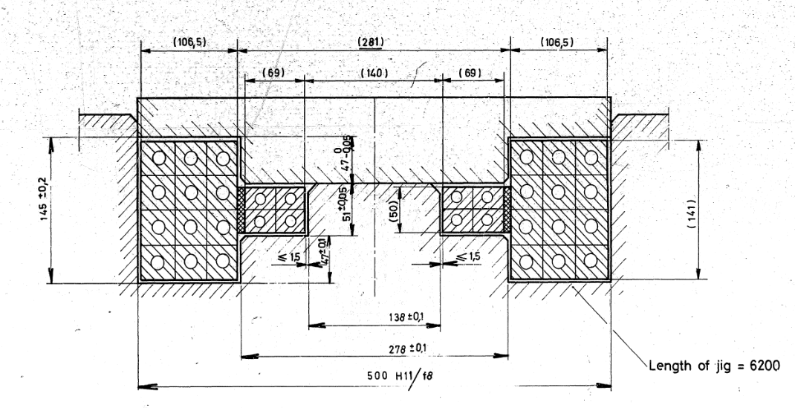
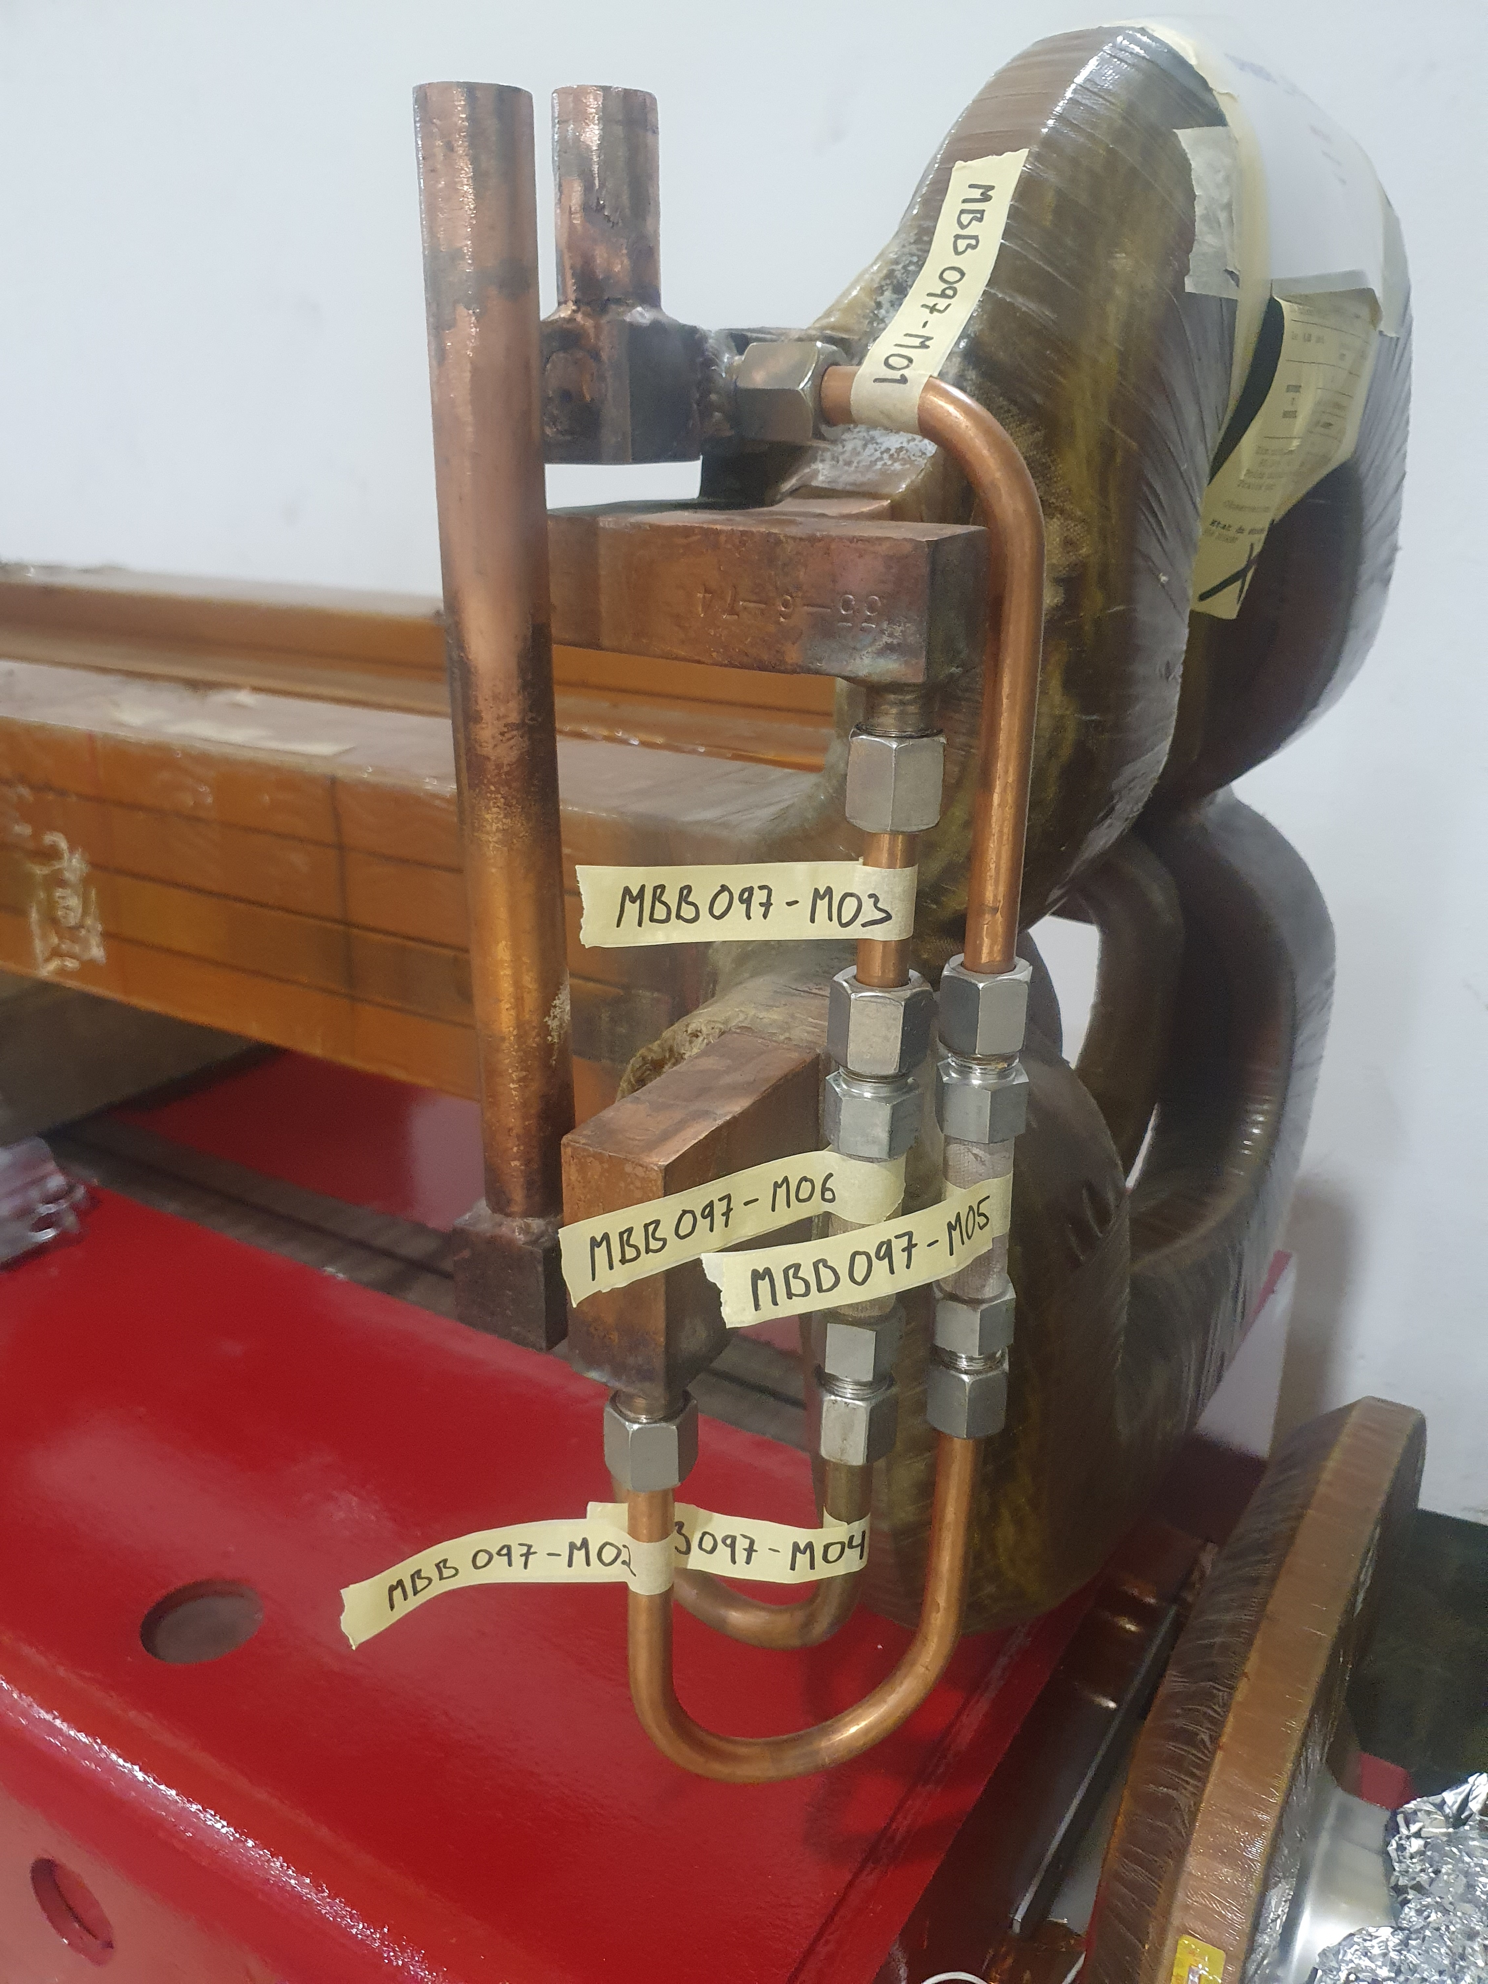
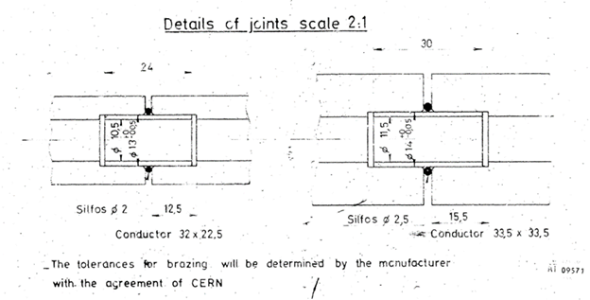
Potential risk for other circuits
SPS MBB coil
Cu-Cu joint with Sil-fos but different cooling circuit
Same analysis procedure as described above
Leak test on-going
SPS cooling water analysis and APA
MBB coil cross section, 32 brazing joints
SPS MBB coil
Internal brazing sleeve

Slide 11
Summary and plan for future work
Poor brazing interfaces presenting numerous discontinuities
Corrosion selectively attacks Cu at the interface with the Sil-fos braze (Cu-Ag-P) and the Cu phase within the braze metal
The damage is more severe on samples with longer service time
Also, the S presence in the conduct inner surface increases with the service time
Nevertheless, the same phenomena was observed in sample installed for short period (2 weeks) and HIE-ISOLDE circuit
The S origin could be related with ion-exchange resin debris present in the cooling water
The Cu-Ag braze present on PSB samples was not affected at the same level as the Sil-fos

Slide 13
Draft work plan – medium term
1) Identify all magnet cooling circuits (⇒ TE/MSC)
    Copper based
    Including soldered, brazed and/or braze welded joints
  2) For the above circuits
    Provide history of operation (demineralized water, maintenance – dry periods)
    Information about parent and filler metal grades, if available
    Availability of unoperated or shortly operated spares, for comparison (⇒TE/MSC)
    Sampling and analysis of the water (S residues)
    Historical analyses of the water if available (⇒EN/CV)
    3) On selected cooling circuit joints (based on relevance, accessibility, availability for removals…)
    Perform similar analyses as for PSB (⇒EN/MME)

