Slide 2
PS Booster magnets Task Force
Subtask-1: Readiness and history of spares, including those in radioactive storage.
Antony Newborough on behalf of TE/MSC

Slide 3
  Introduction
    Magnet ageing
    Booster layout
    QF & QD design and construction
  Inventory of spare magnets and non-Conformities
  List of samples analysed to date and future plans

Slide 4
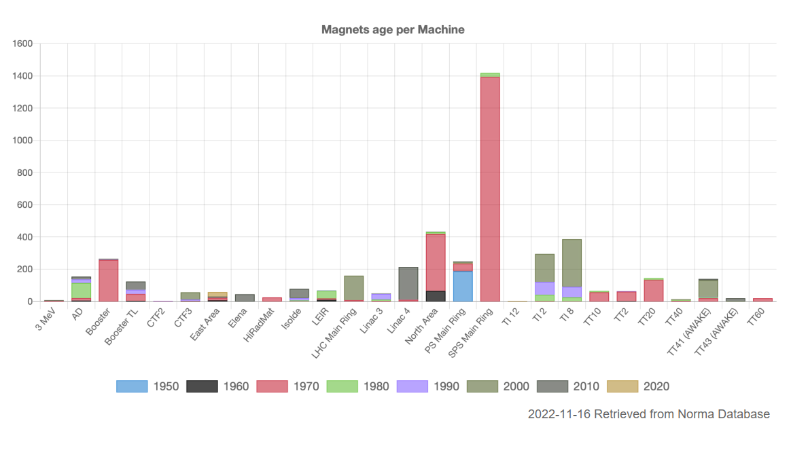
Magnet ageing by machine…
Magnet Production Decade by Machine
Continuous refurbishment of MU
Extremely reliable to date
NA Cons underway
Refurbishment of all MU completed in LS2

Slide 5
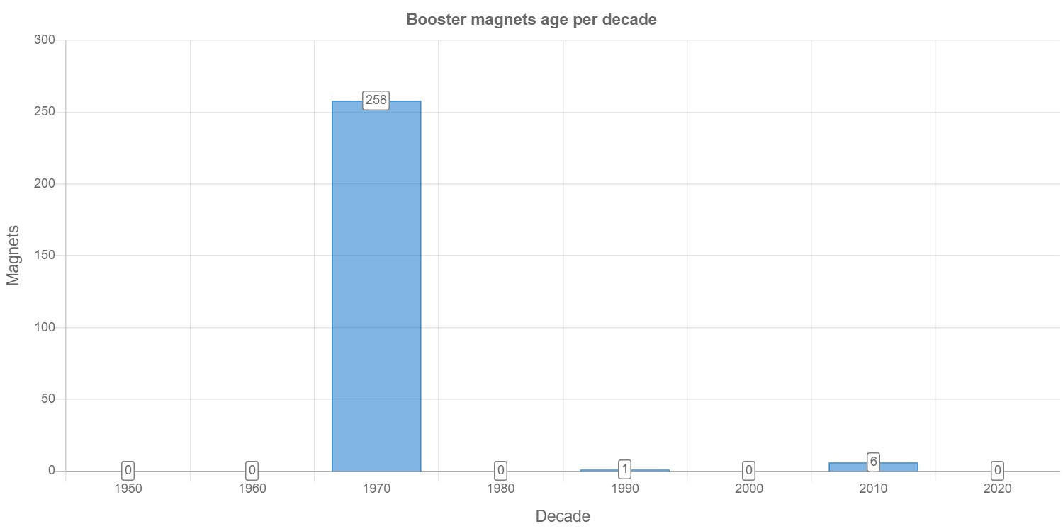
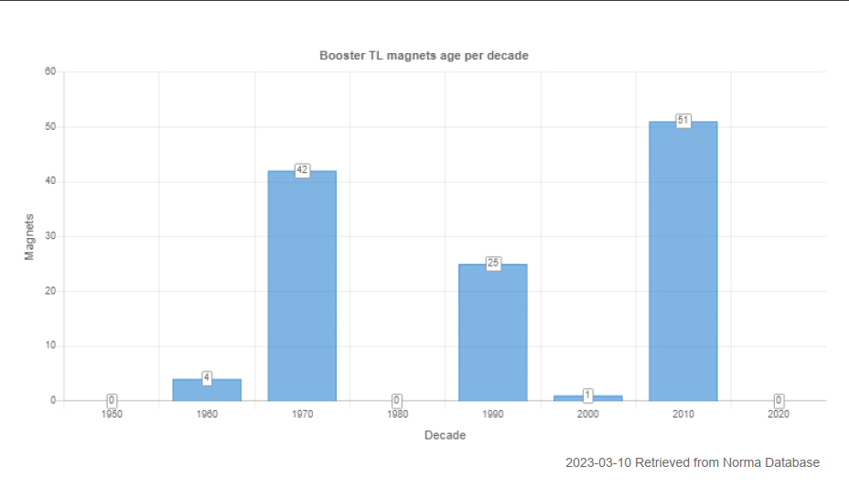
Magnet ageing PSB
PSB Ring Magnet Production by Decade
The ring magnets are predominantly original, the vast majority have never been removed from the machine.
192/260* of the magnet units are water cooled.
* 580/770 when considering multipoles e.g. combined Oct, Sex and Quads etc…
450 – 550 million cycles
26.4 millions with POPS-B
(~20 million @ 2 GeV)
+200 million up to 2040?
(Estimations from EPC & OP)
1950
1960
1970
1980
1990
2000
2010
2020
PSB TL Magnet Production by Decade
From the L4 > PSB > PS & ISOLDE many of the magnets have been exchanged during various upgrades. The majority of the remaining original magnets are air-cooled.
51/123 magnets are water cooled.

Slide 6
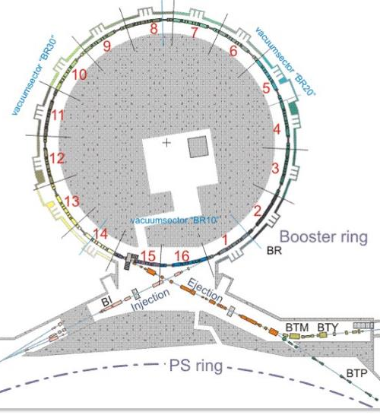
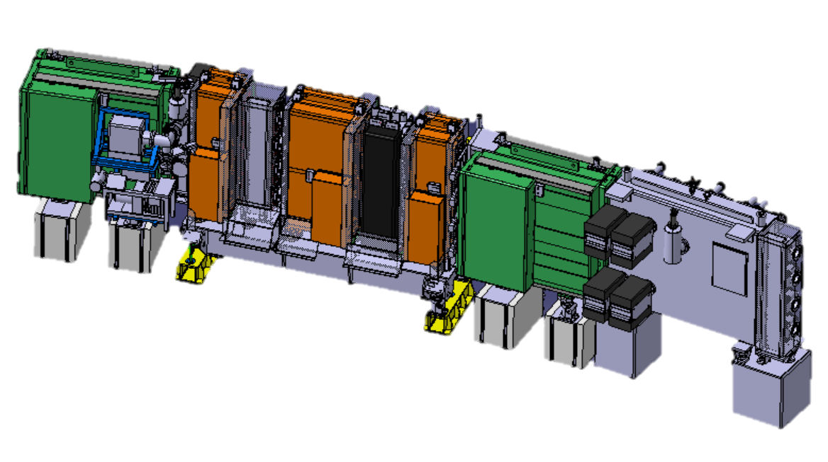
  Booster layout
16 periods,
2 Bending magnets
2 Focusing Quadrupoles
1 Defocusing Quadrupole

Slide 7
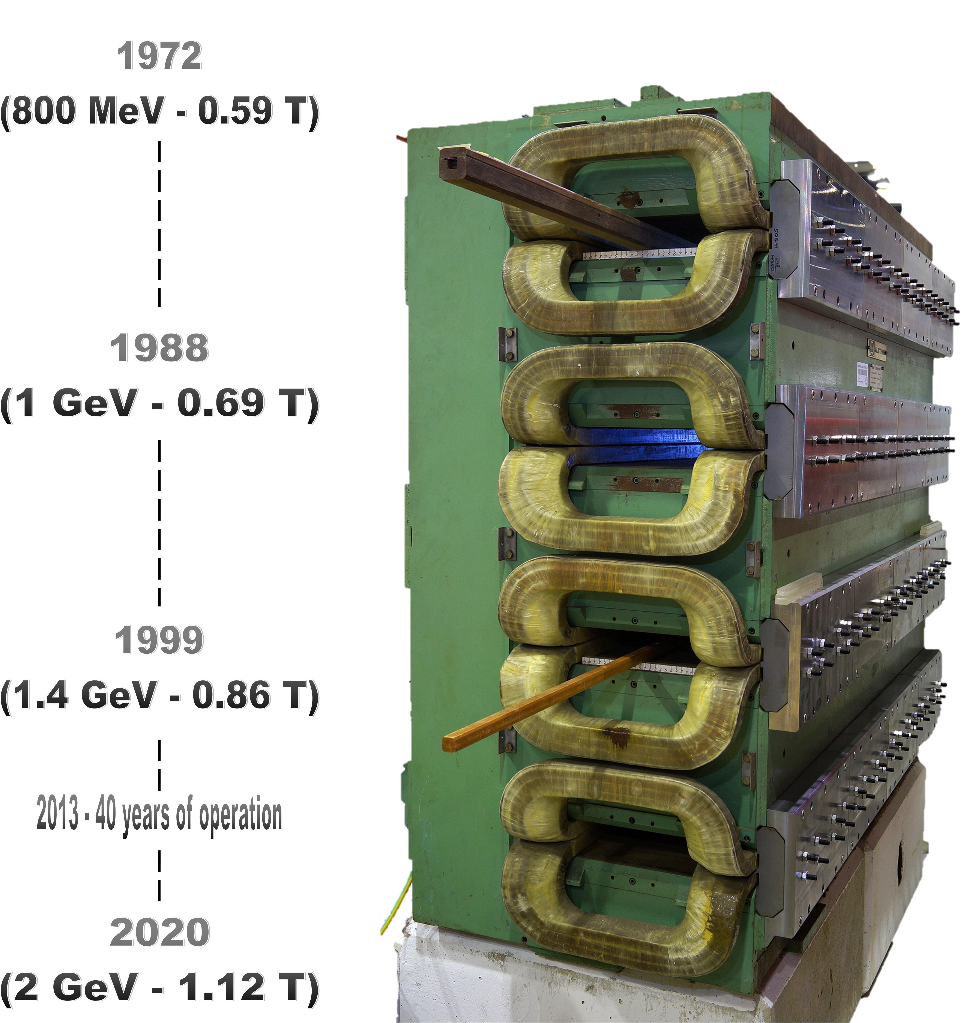
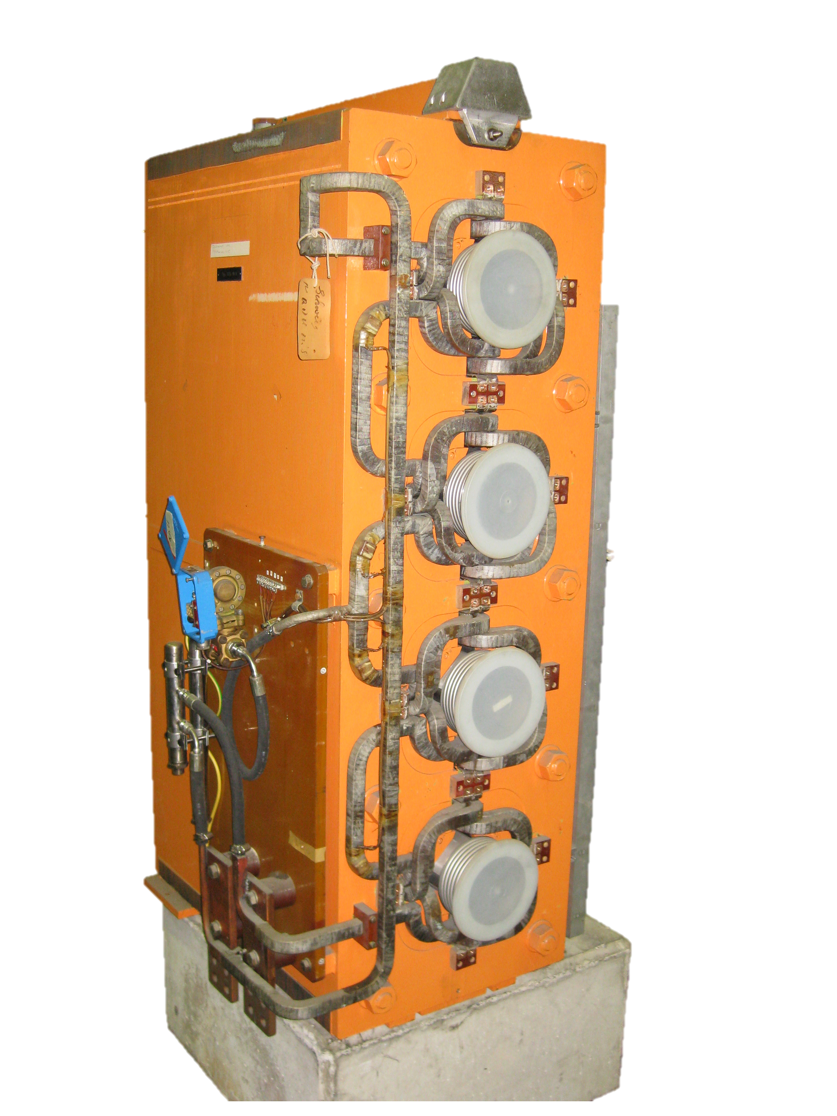
The PSB Upgrades
Proton
Beam Energy
Quad
Water Cooling
Vs.
1972
(DP 5 Bar, ~1.5 m/s)
|
|
|
|
|
1988
(???)
|
|
|
|
|
1999
(DP 11 Bar, ~2.2 m/s)
|
|
|
|
|
2020
(DP 13 Bar, ~2.6 m/s)
Minimum erosion below ~3 m/s
No erosion witnessed so far, no evidence that 2 GeV has accelerated the failures
DT ~ 25°C remaining constant
We have witnessed erosion, SPS AD

Slide 8
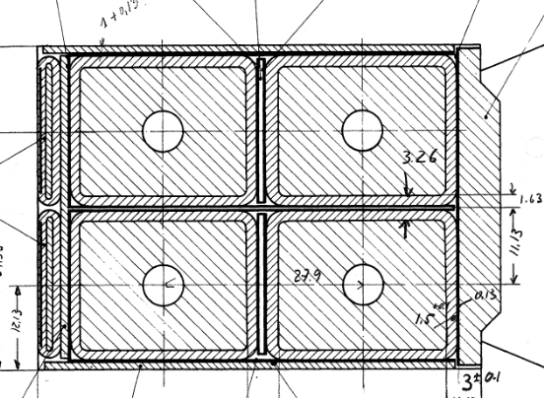
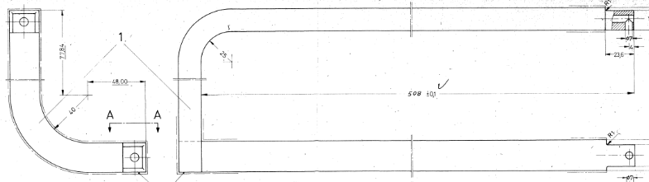
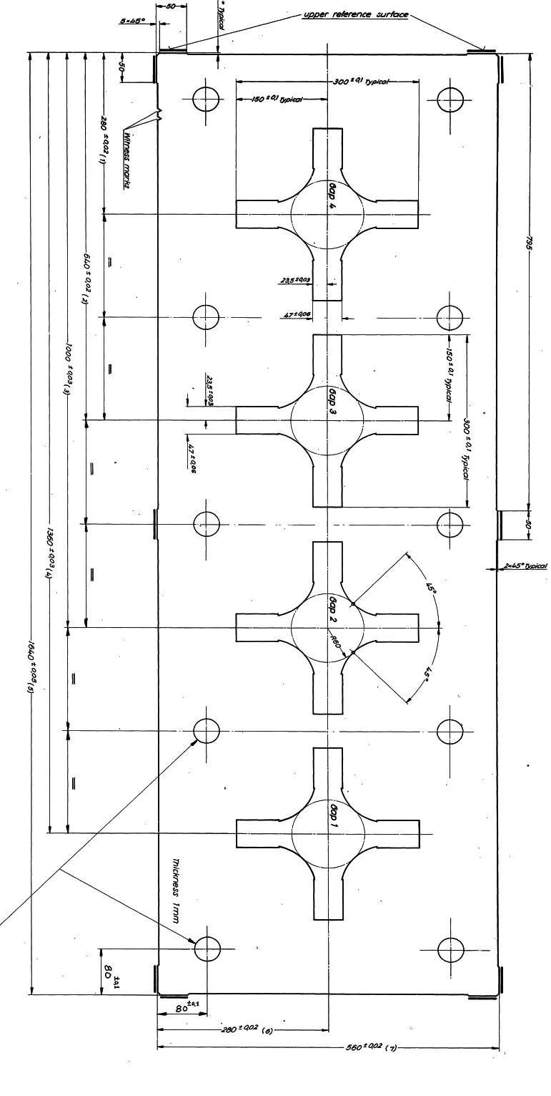
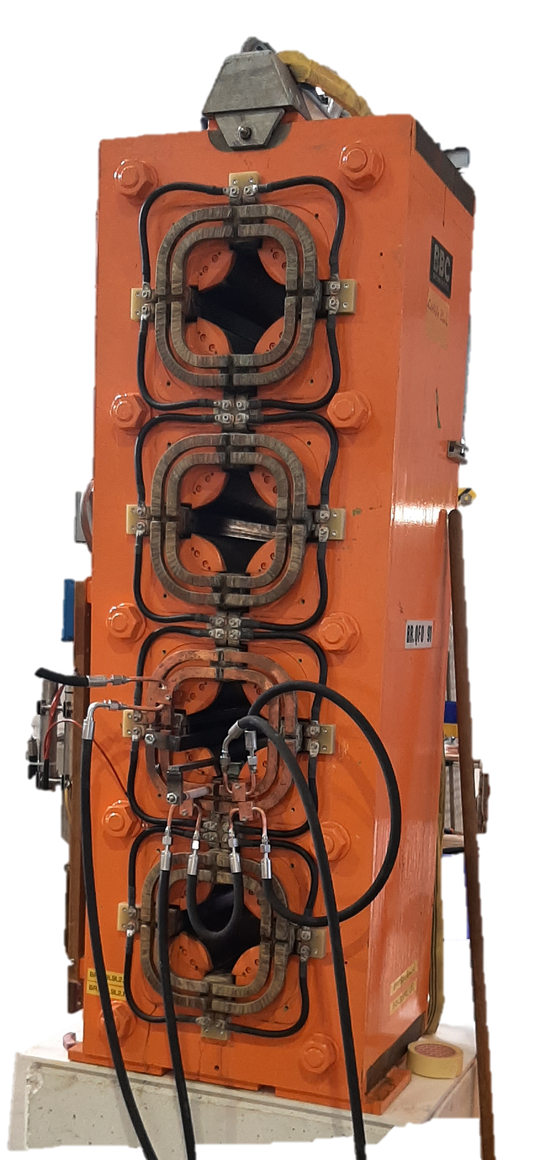
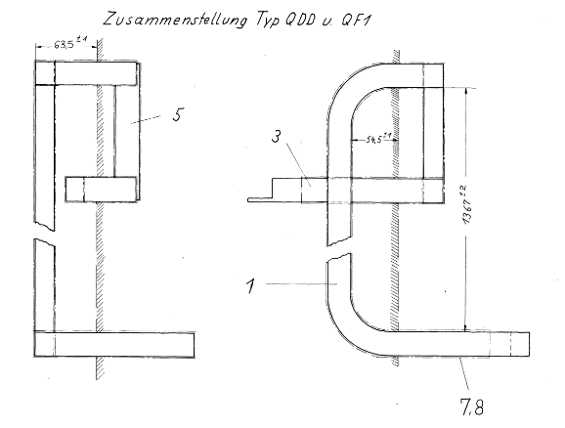
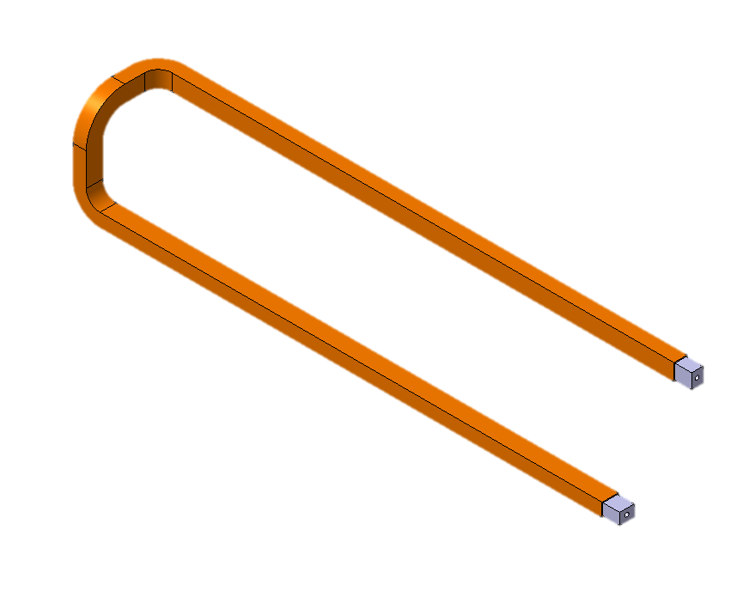
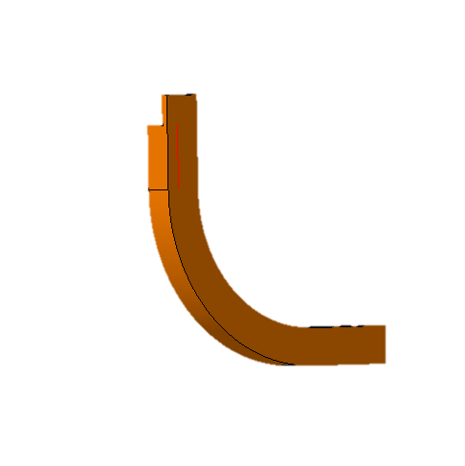
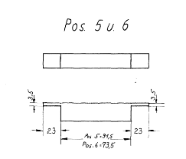
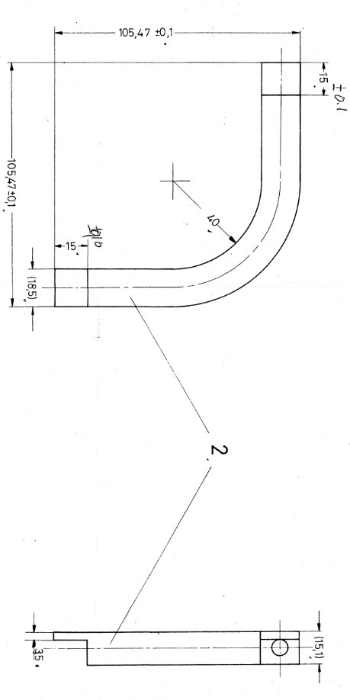
PSB quadrupole construction
Unique Construction!
Single lamination (no means to open the magnet)
Coil built-up turn by turn (~80 brazed connections per magnet, ~3840 in operation)**
Mica/glass fiber insulation tape with the whole magnet resin impregnated (dipping)
ZERO LEAKS UNTIL 2021 AND SIX SINCE!
** Additional undocumented brazed joints are being discovered

Slide 9
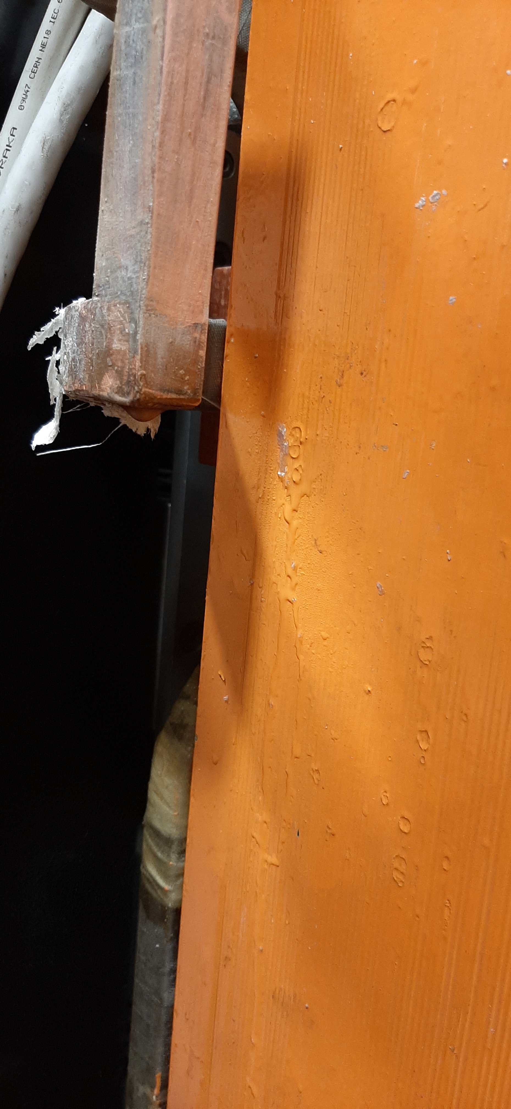
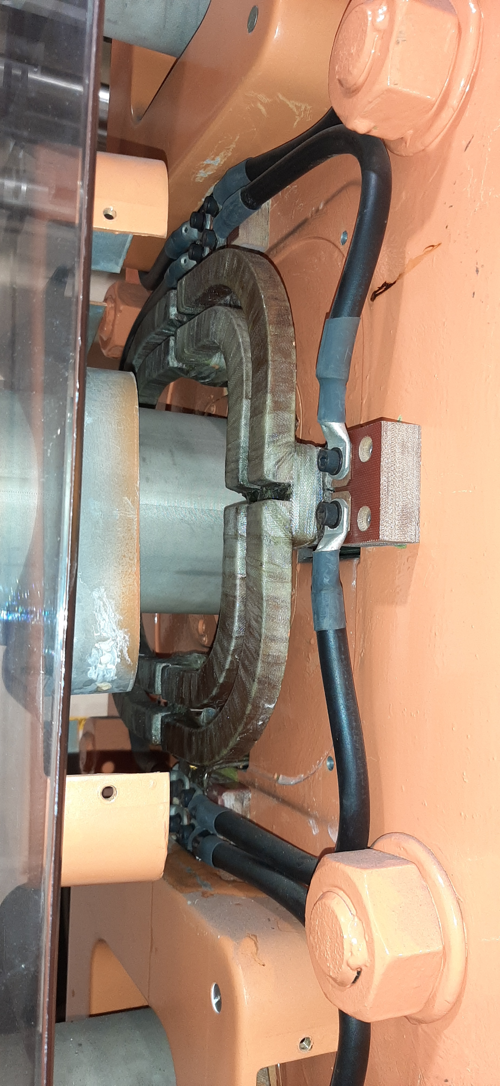
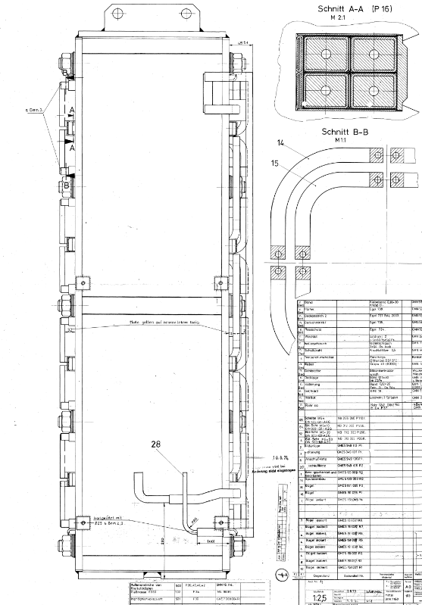
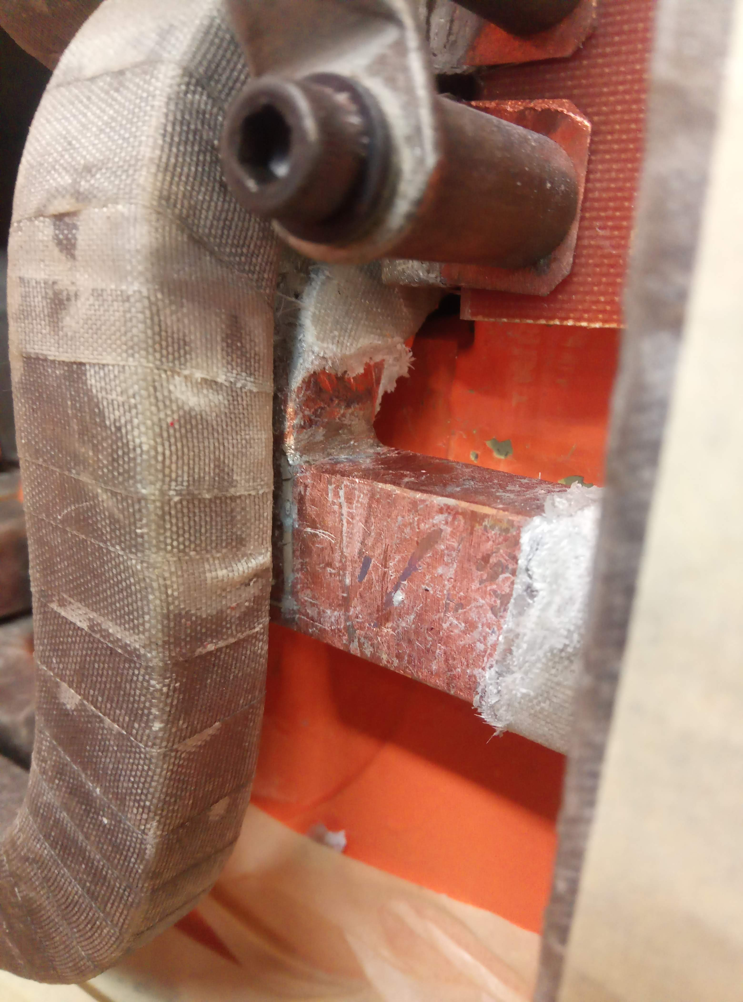
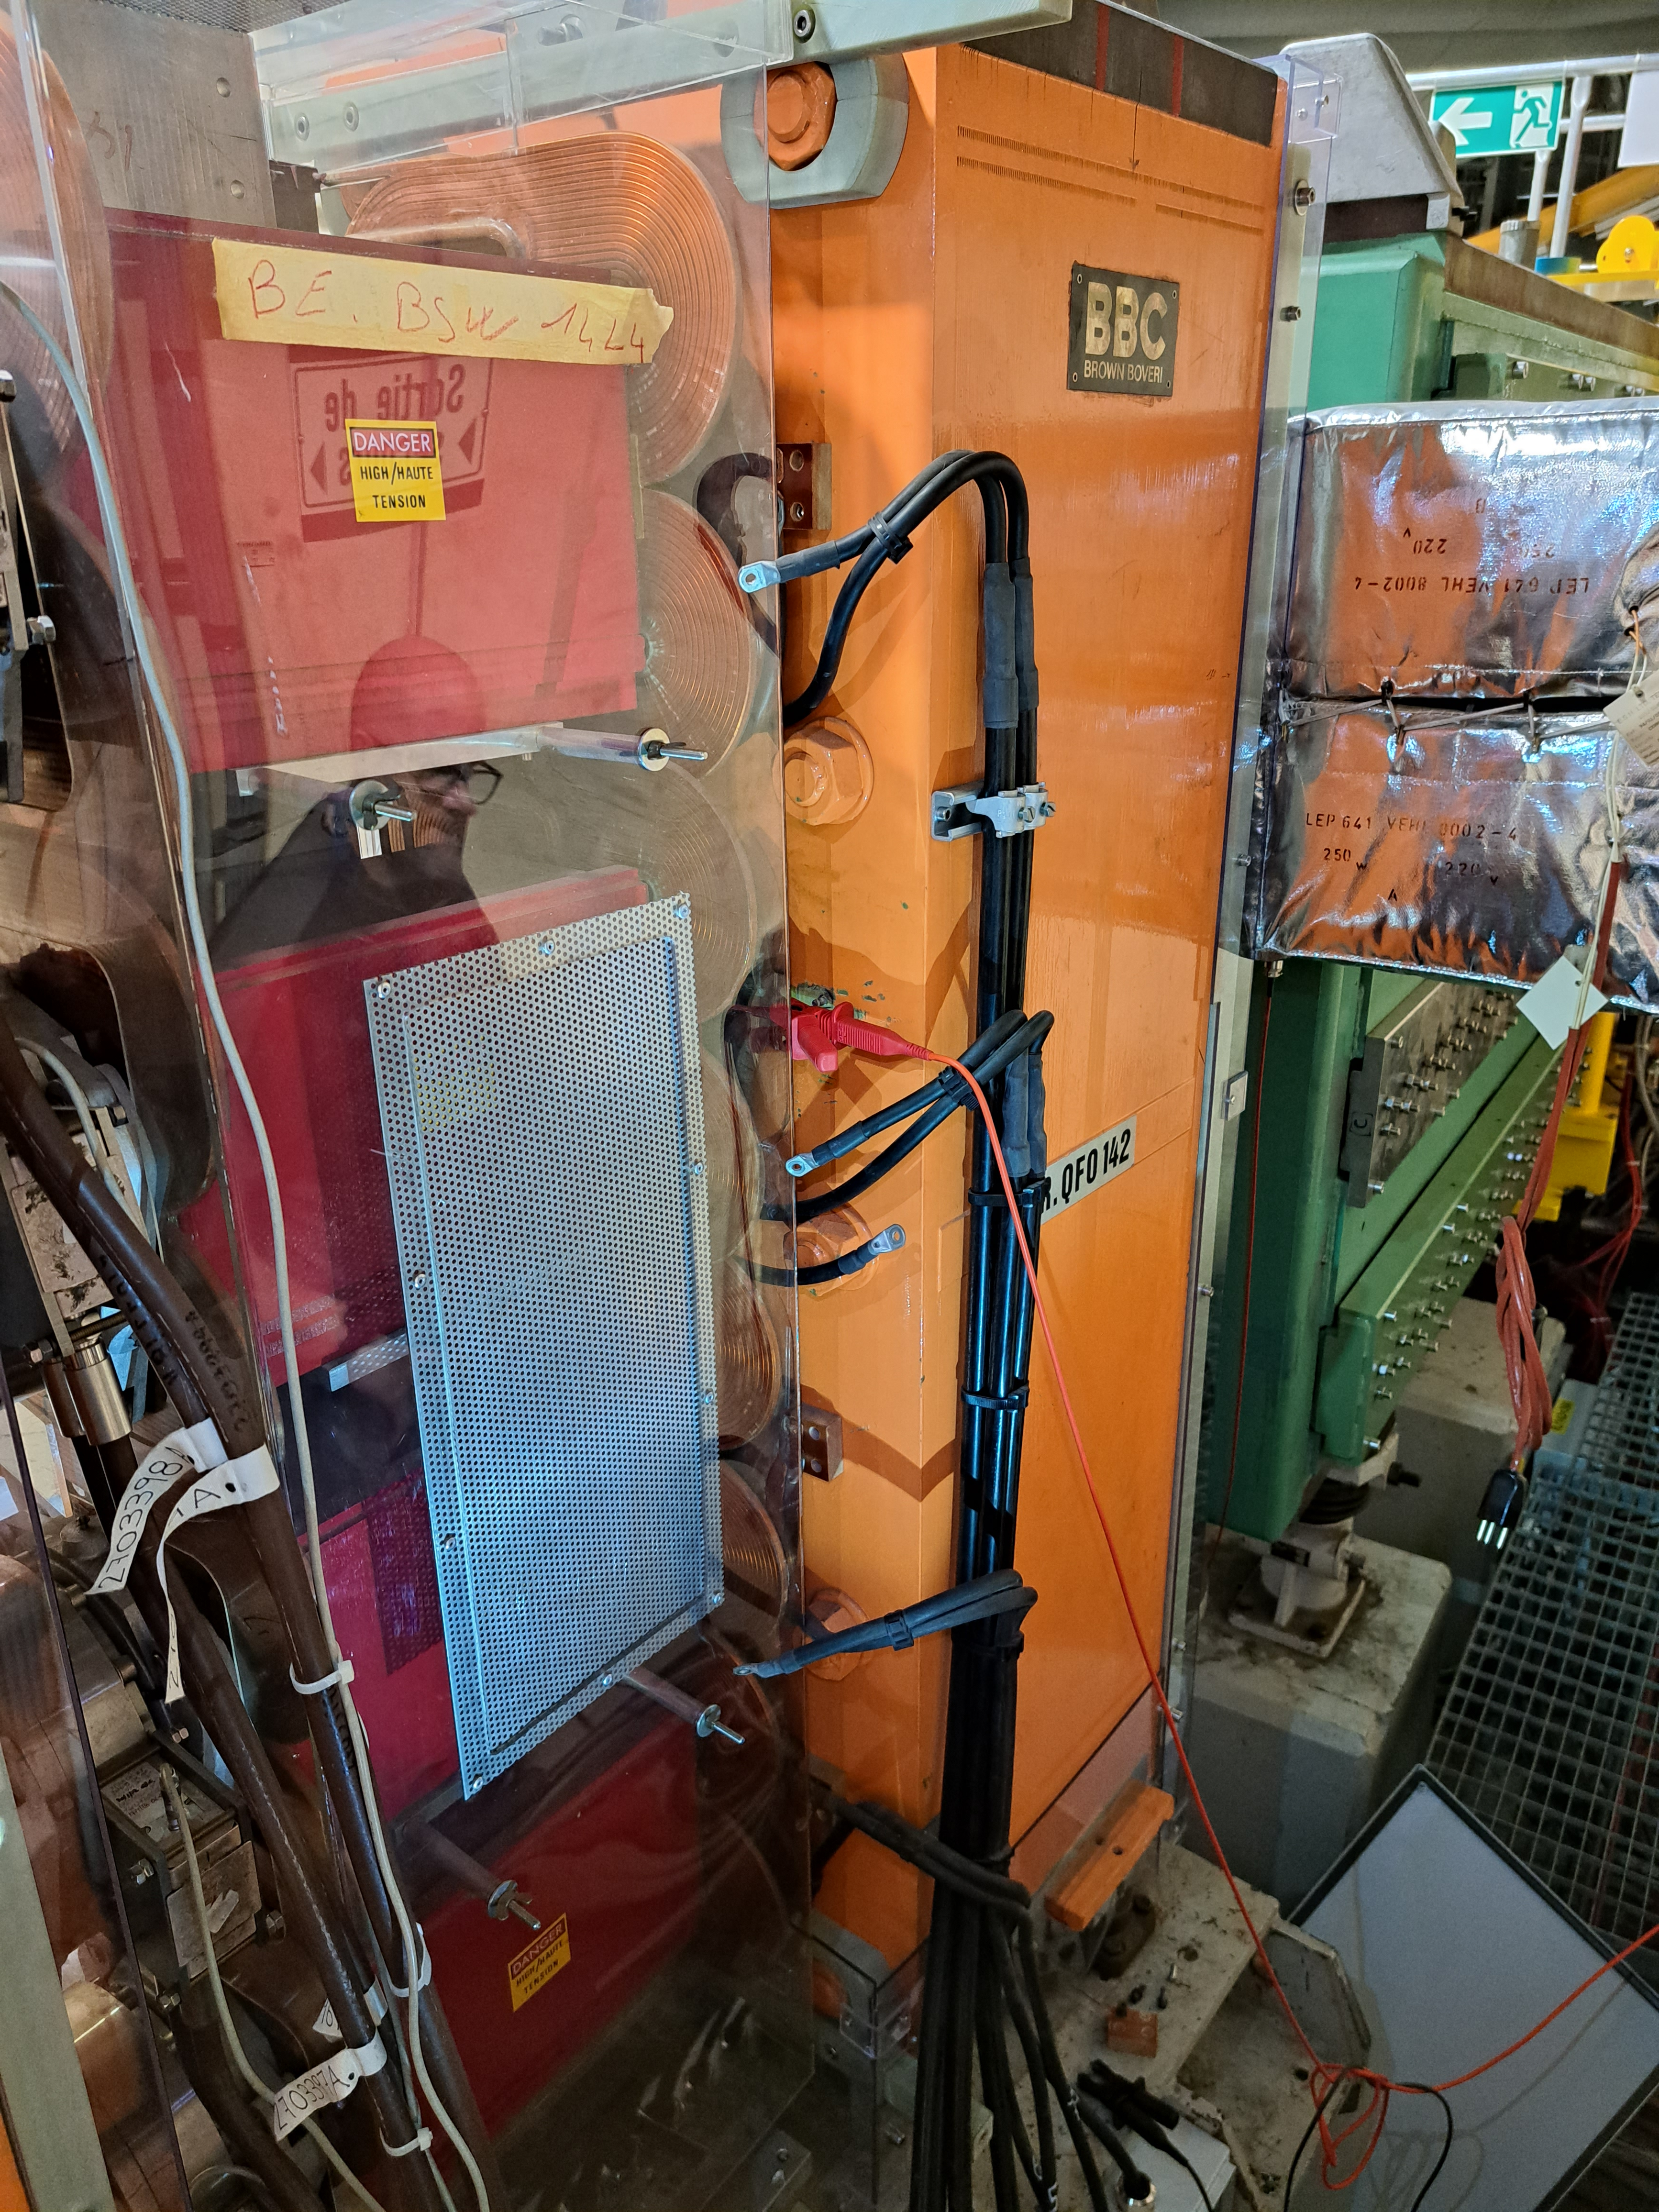
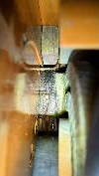
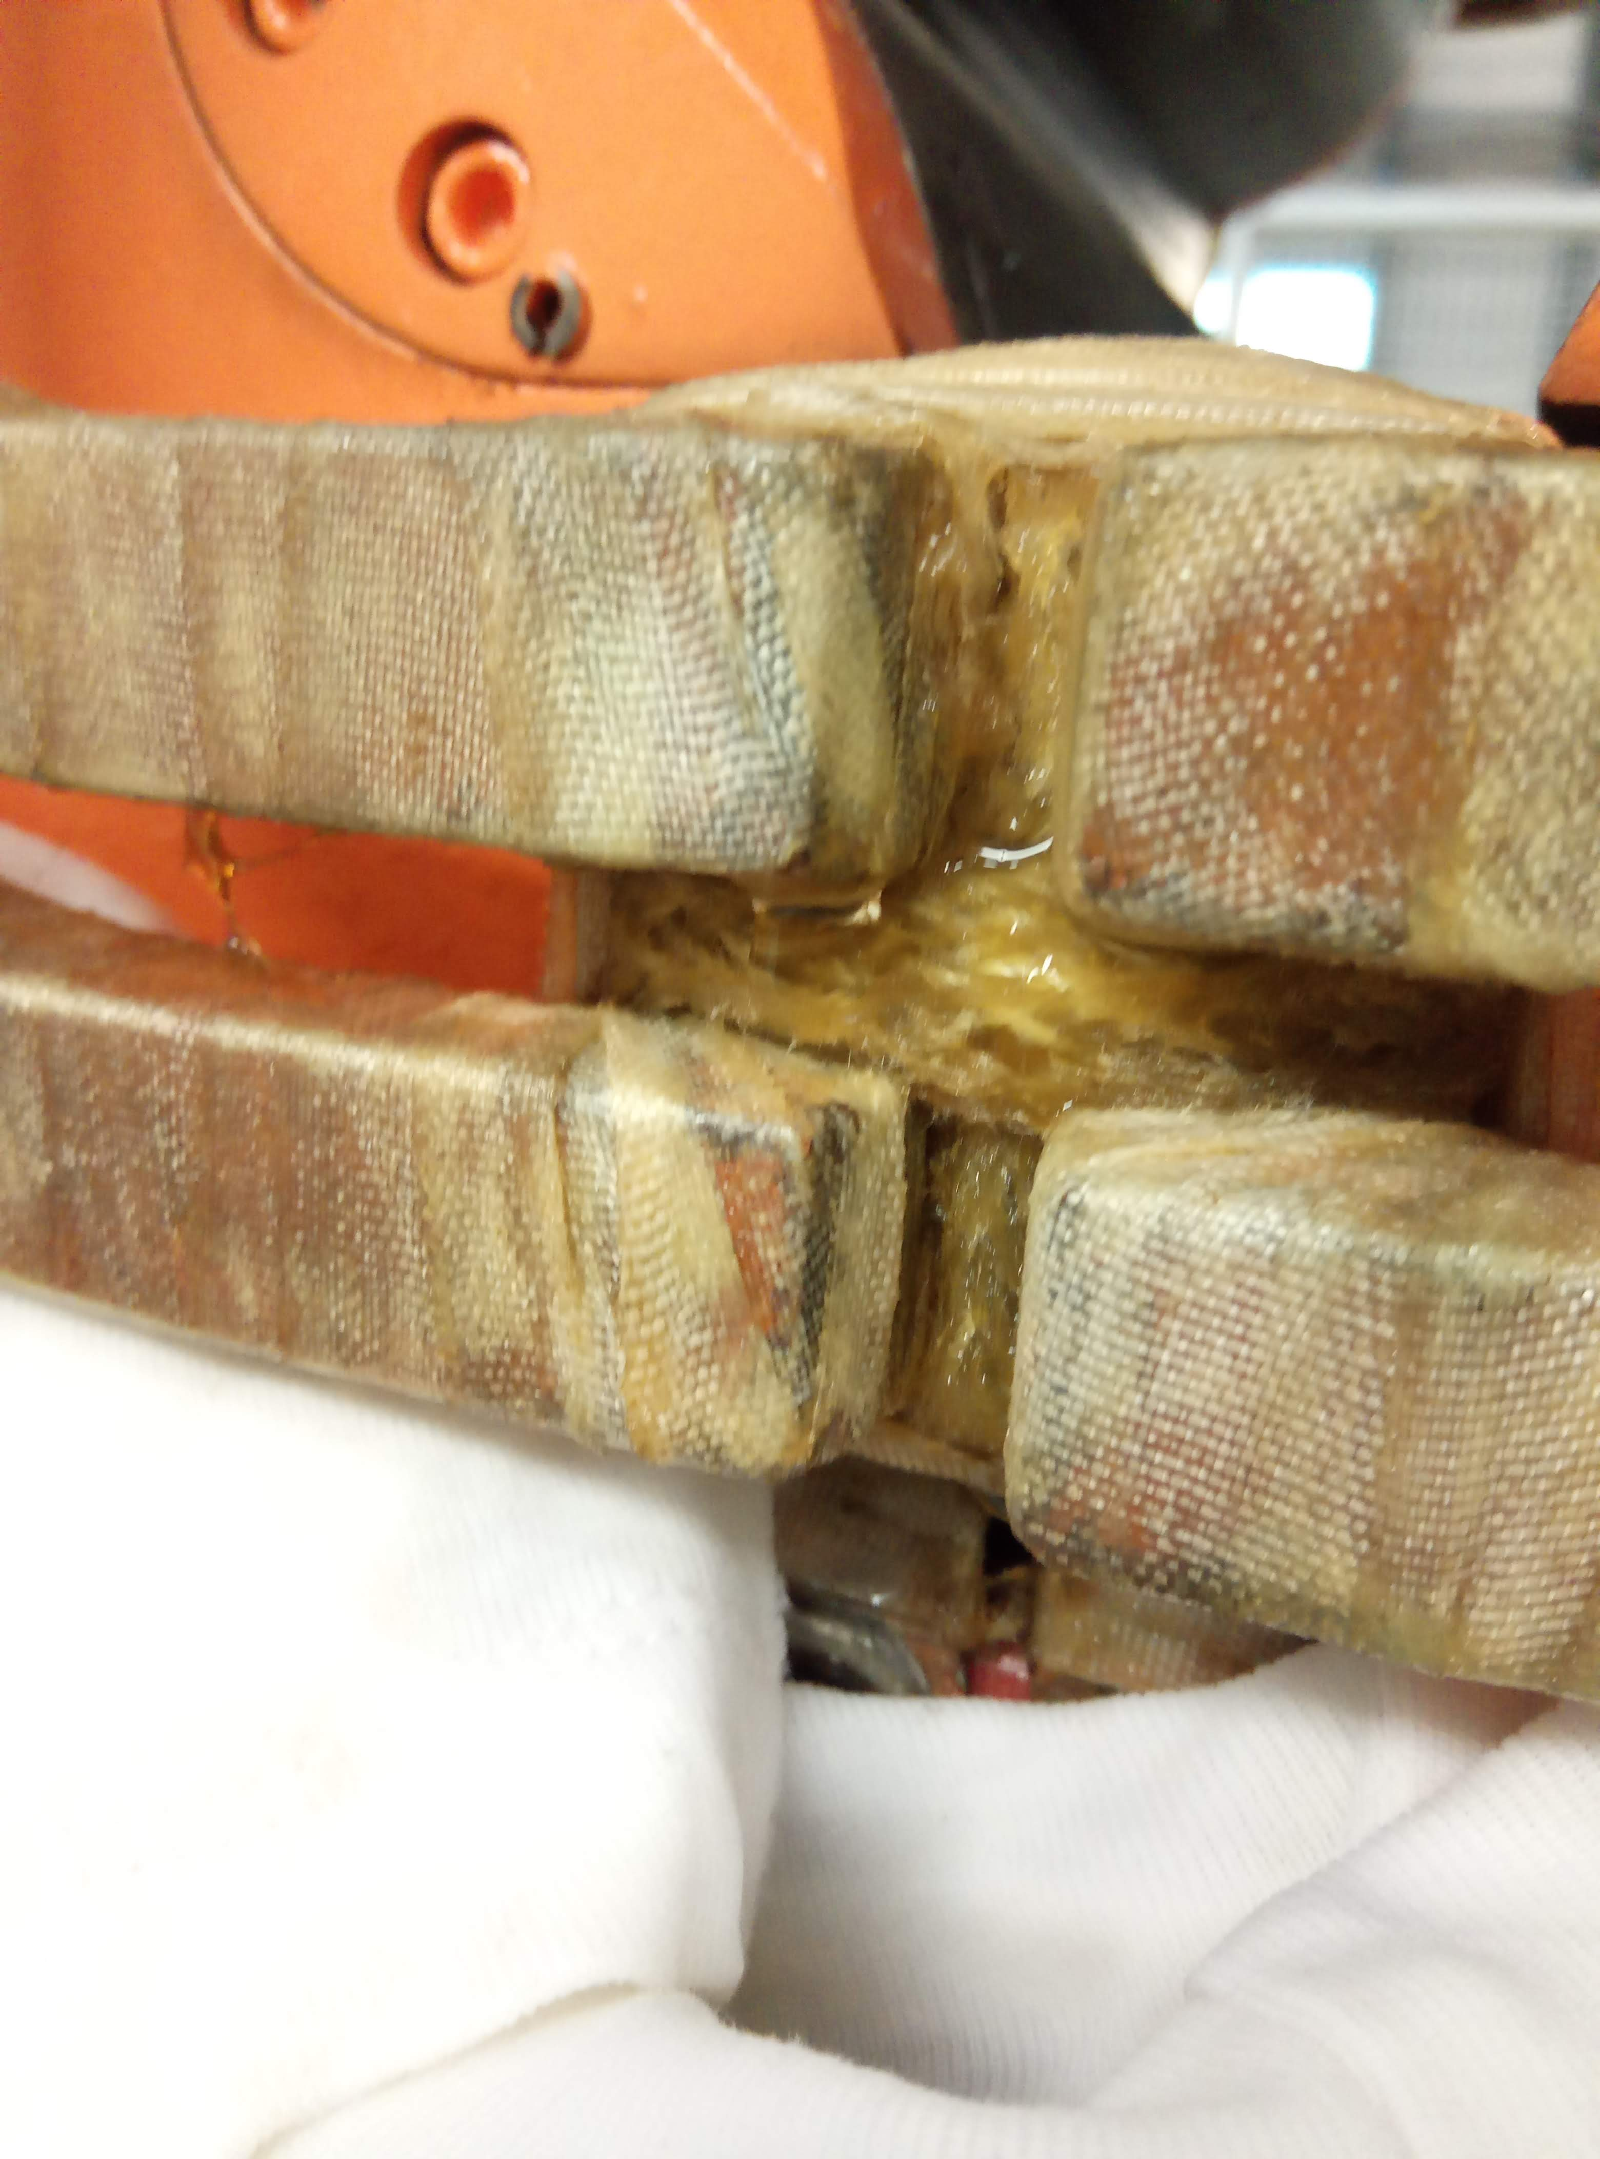
PSB quadrupole - Brazing NC Location
09/22
QDE5
“brazed end” R3
06/21
QFO161
“busbar”
11/22
QFO142
“brazed end” R3
12/22
QDE11
“Aperture link” R2-R3
04/23
QFO11
“brazed end” R2
(still in machine today)
11/21
QFO91
“brazed end” R2
*Non-conformity reports:
https://edms.cern.ch/document/2603476 (QFO161 - June 21)
https://edms.cern.ch/document/2664838 (QFO91 - Nov 21)
https://edms.cern.ch/document/2779972 (QDE5 - Sept 22)
https://edms.cern.ch/document/2812055 (QFO142 - Dec 22)
https://edms.cern.ch/document/2812056 (QDE11 - Dec 22)
https://edms.cern.ch/document/2884501 (QFO11 - April 23)

Slide 10
PSB quadrupole spares
Design Code | Old Code | Installed | Spare | Comment
PXMQNEC4WP | QFO LEFT | 16 | 2* | BR.QFO161 & BR.QFO91 removed from the ring during the YETS 21/22 #17 repaired (only where it leaked!) and certified magnet available in b361 for installation in place of the leaking QFO11. #30 repaired (only where it leaked!) and certified. Magnet available in b181 for testing purposes and eventual installation if needed.
PXMQNED4WP | QFO RIGHT | 16 | 1* | BR.QFO142 removed from the ring during the YETS 22/23 #27 ready to be brazed, waiting brazing validation before the repair is executed (tomography analysis of samples) – can be available within 1 to 2 weeks.
PXMQNFA4WP | QDE left | 8 | 1* | BR.QDE11 removed from the ring during the YETS 22/23 #11 ‘sample’ ready to be brazed, followed by resin repair once validated? - can be available within 1 to 2 weeks.
PXMQNFJ4WP | QDE right | 8 | 1* | BR.QDE5 removed from the ring during the YETS 22/23 #5 To be repaired, preparation of material on-going, copper now available forming to be completed – can be available within 2 weeks.
 |  | 48 | 5

Slide 11
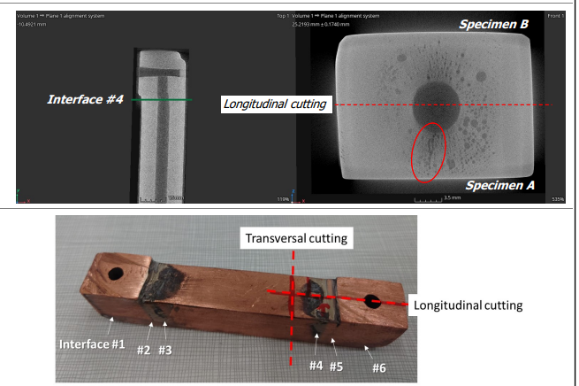
PSB quadrupole - samples
PSB Quad samples extracted and analyzed from:
PXMQNFJ4WP-B2000005 taken from the BR.QDE5 after 50 years of operation
PXMQNFJ4WP-B2000017 taken from the replacement BR.QDE5 which had never seen the beam
PXMQNEC4WP-B2000017 taken from the BR.QFO91 after 50 years of operation
PXMQNFA4WP-B2000011 taken from the BR.QDE11 after 50 years of operation
PXMQNED4WP-B2000027 taken from the BR.QFO142 after 50 years of operation

Slide 12
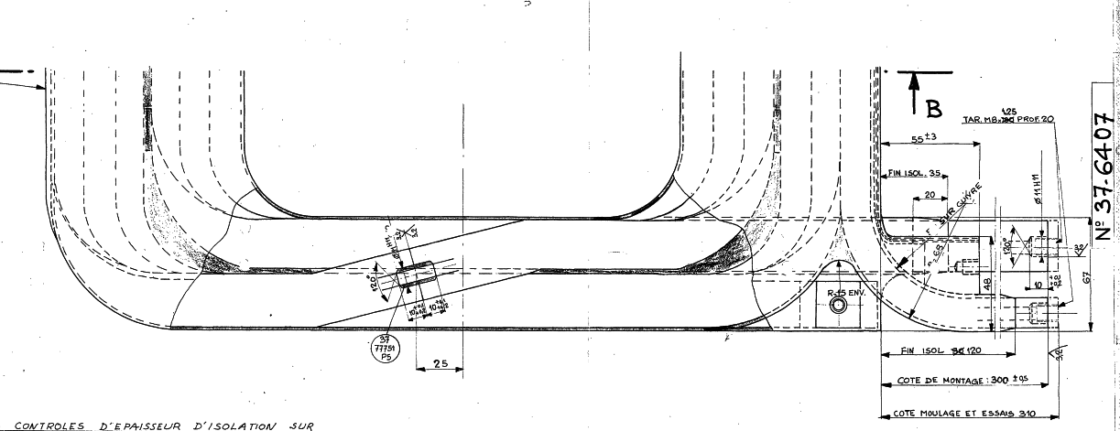
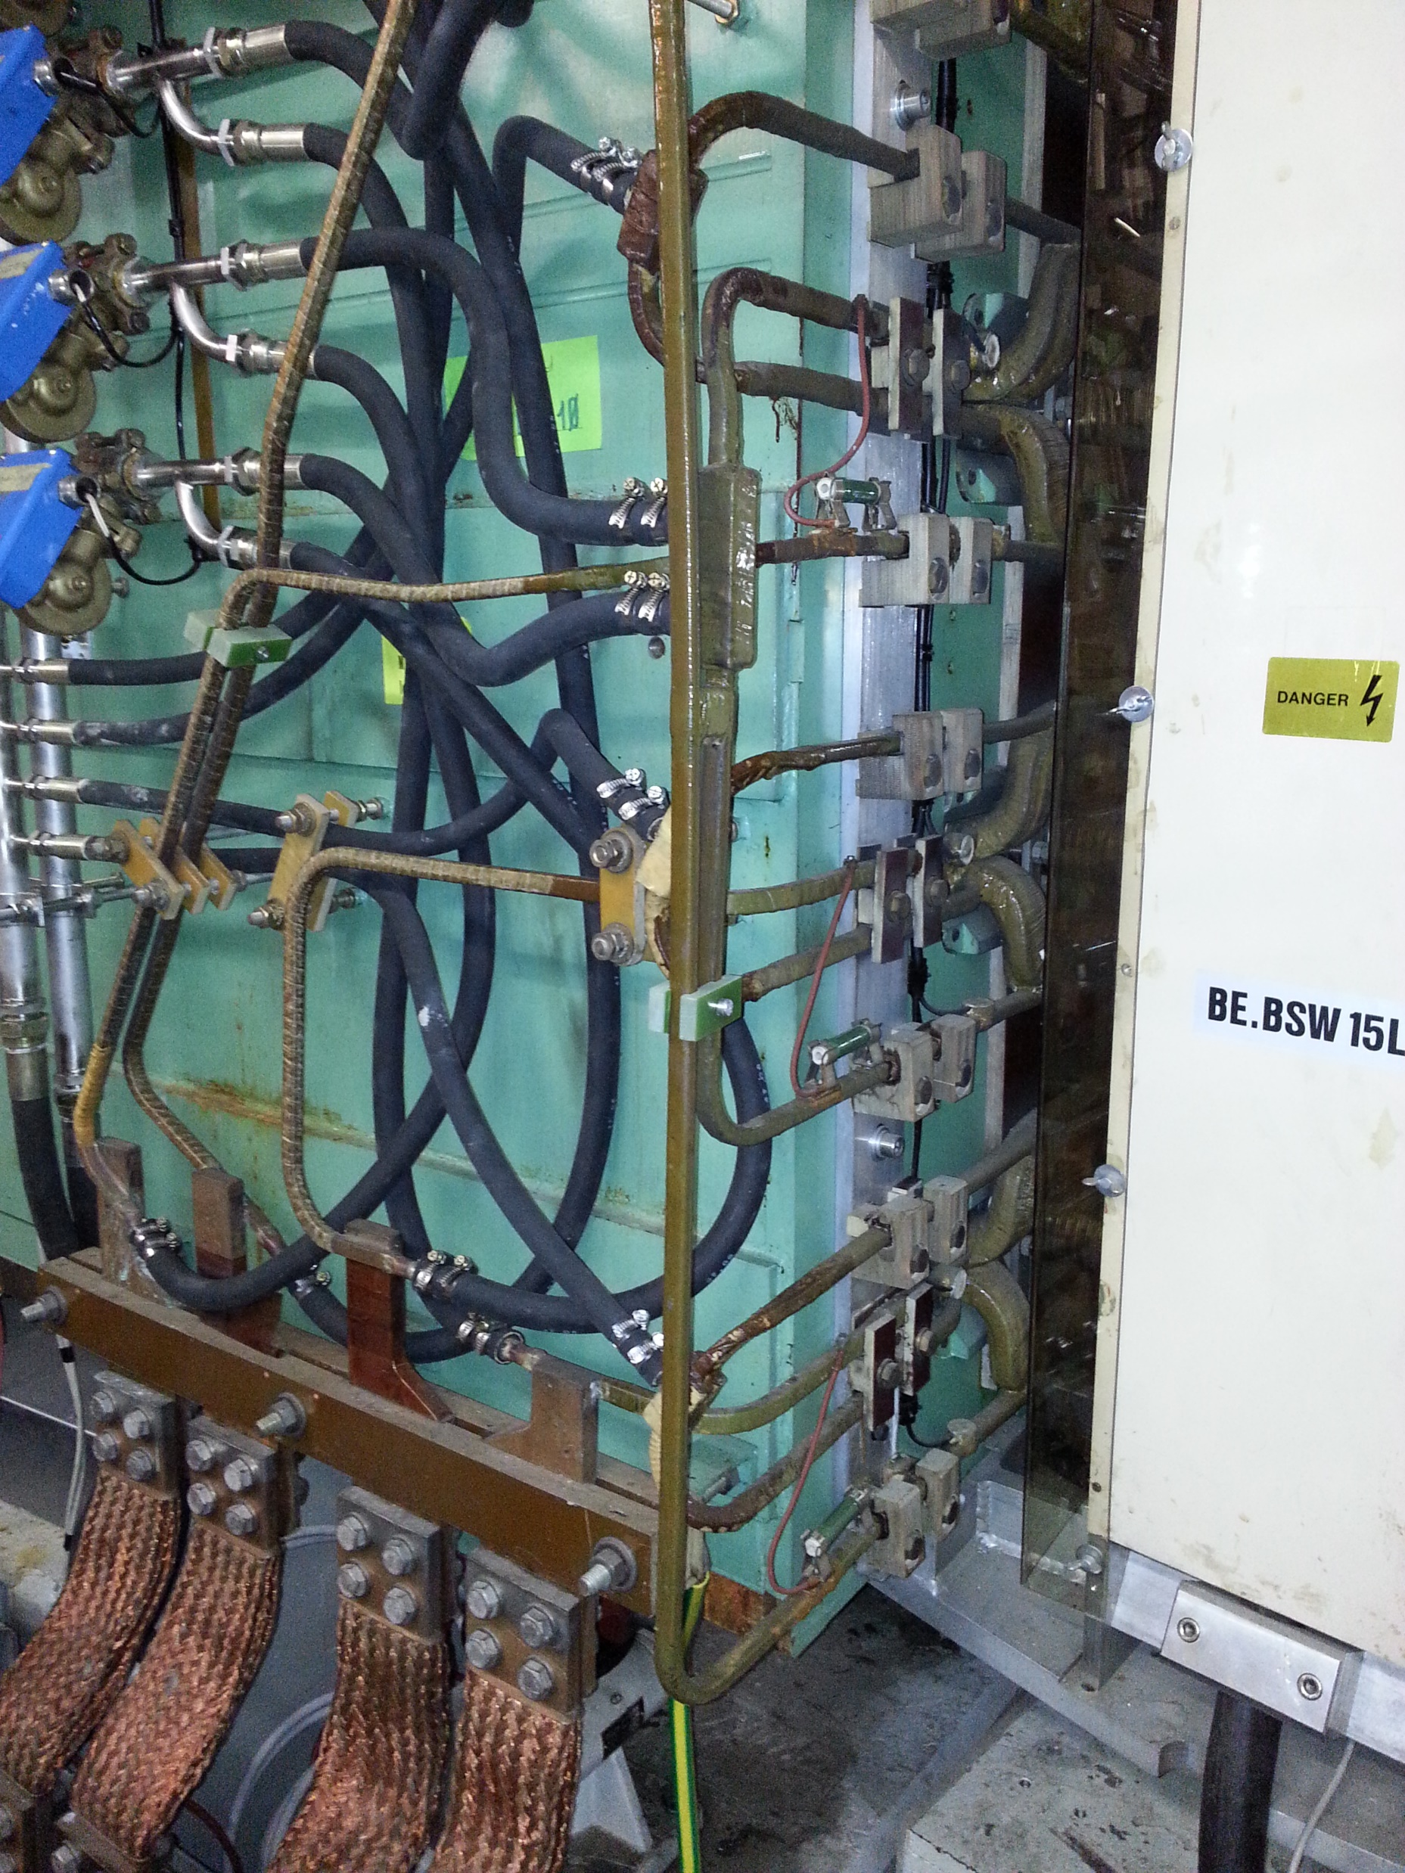
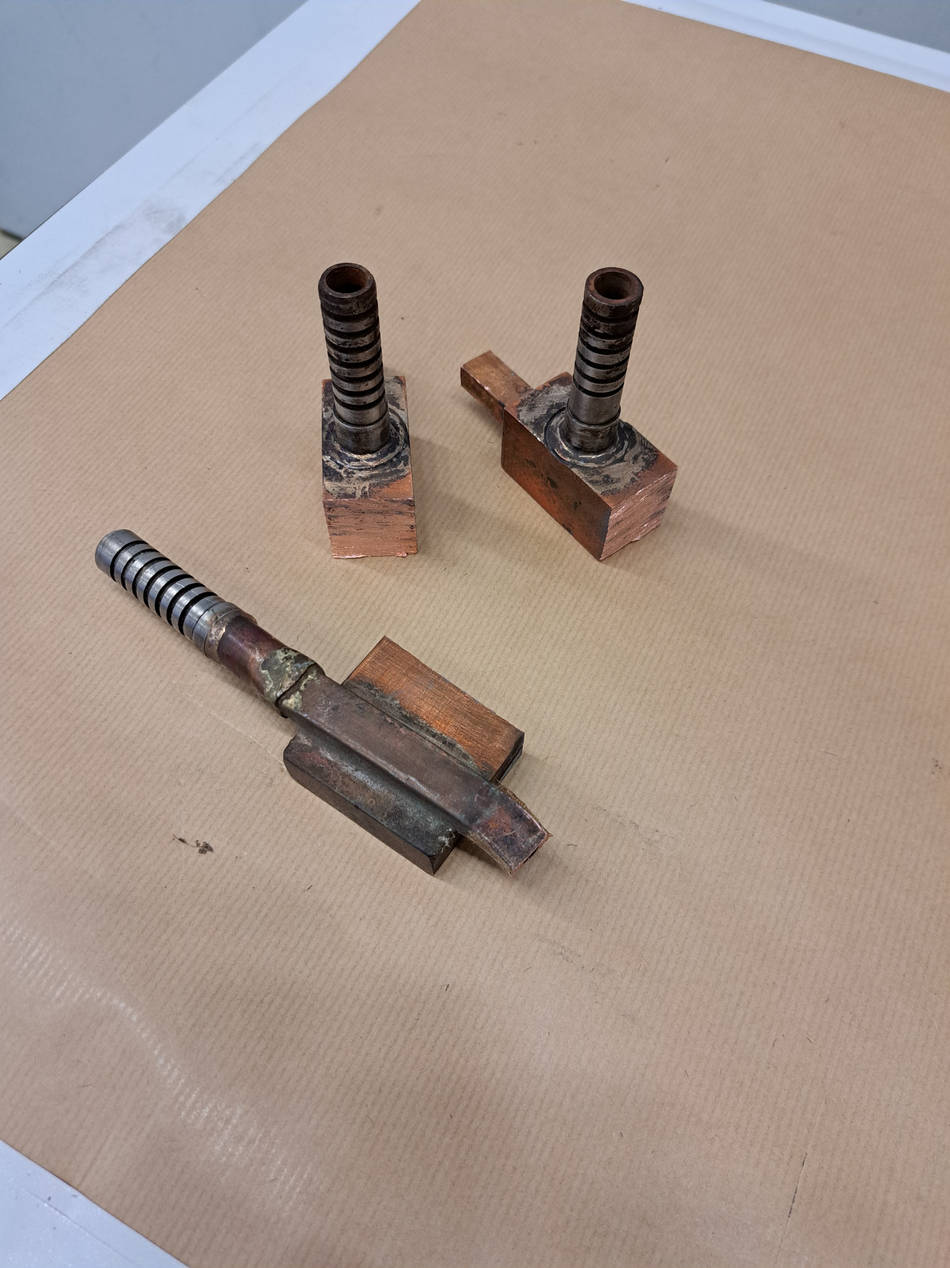
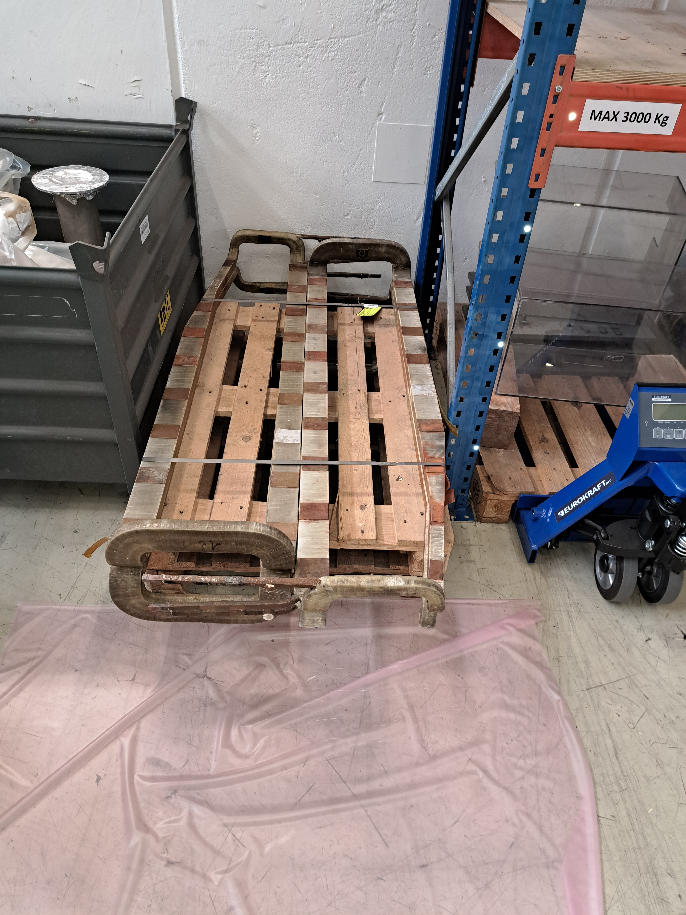
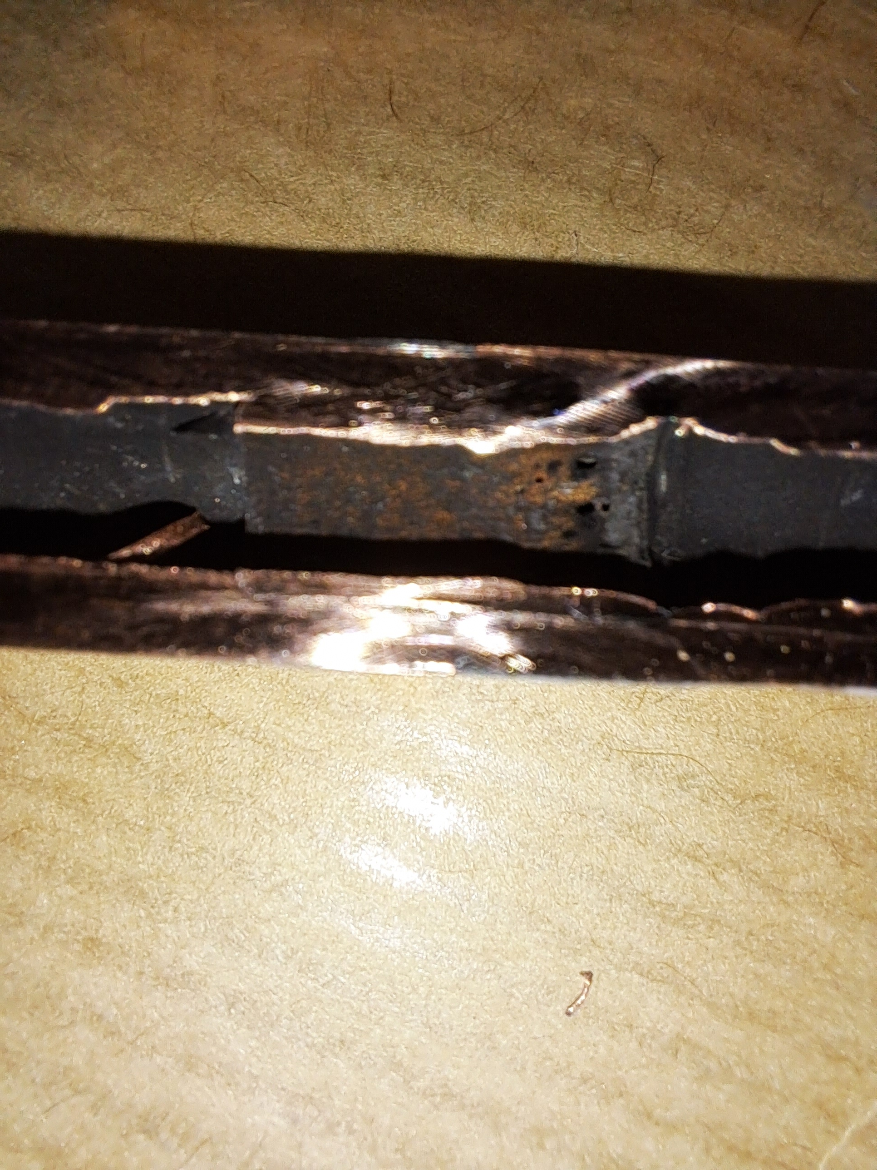
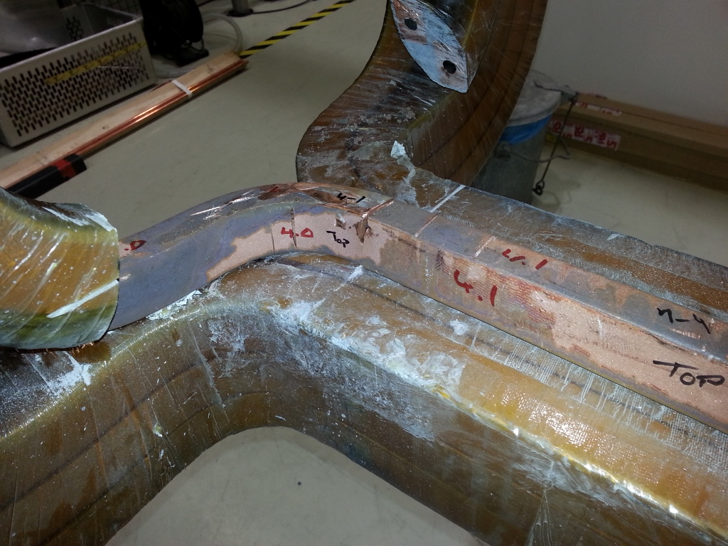
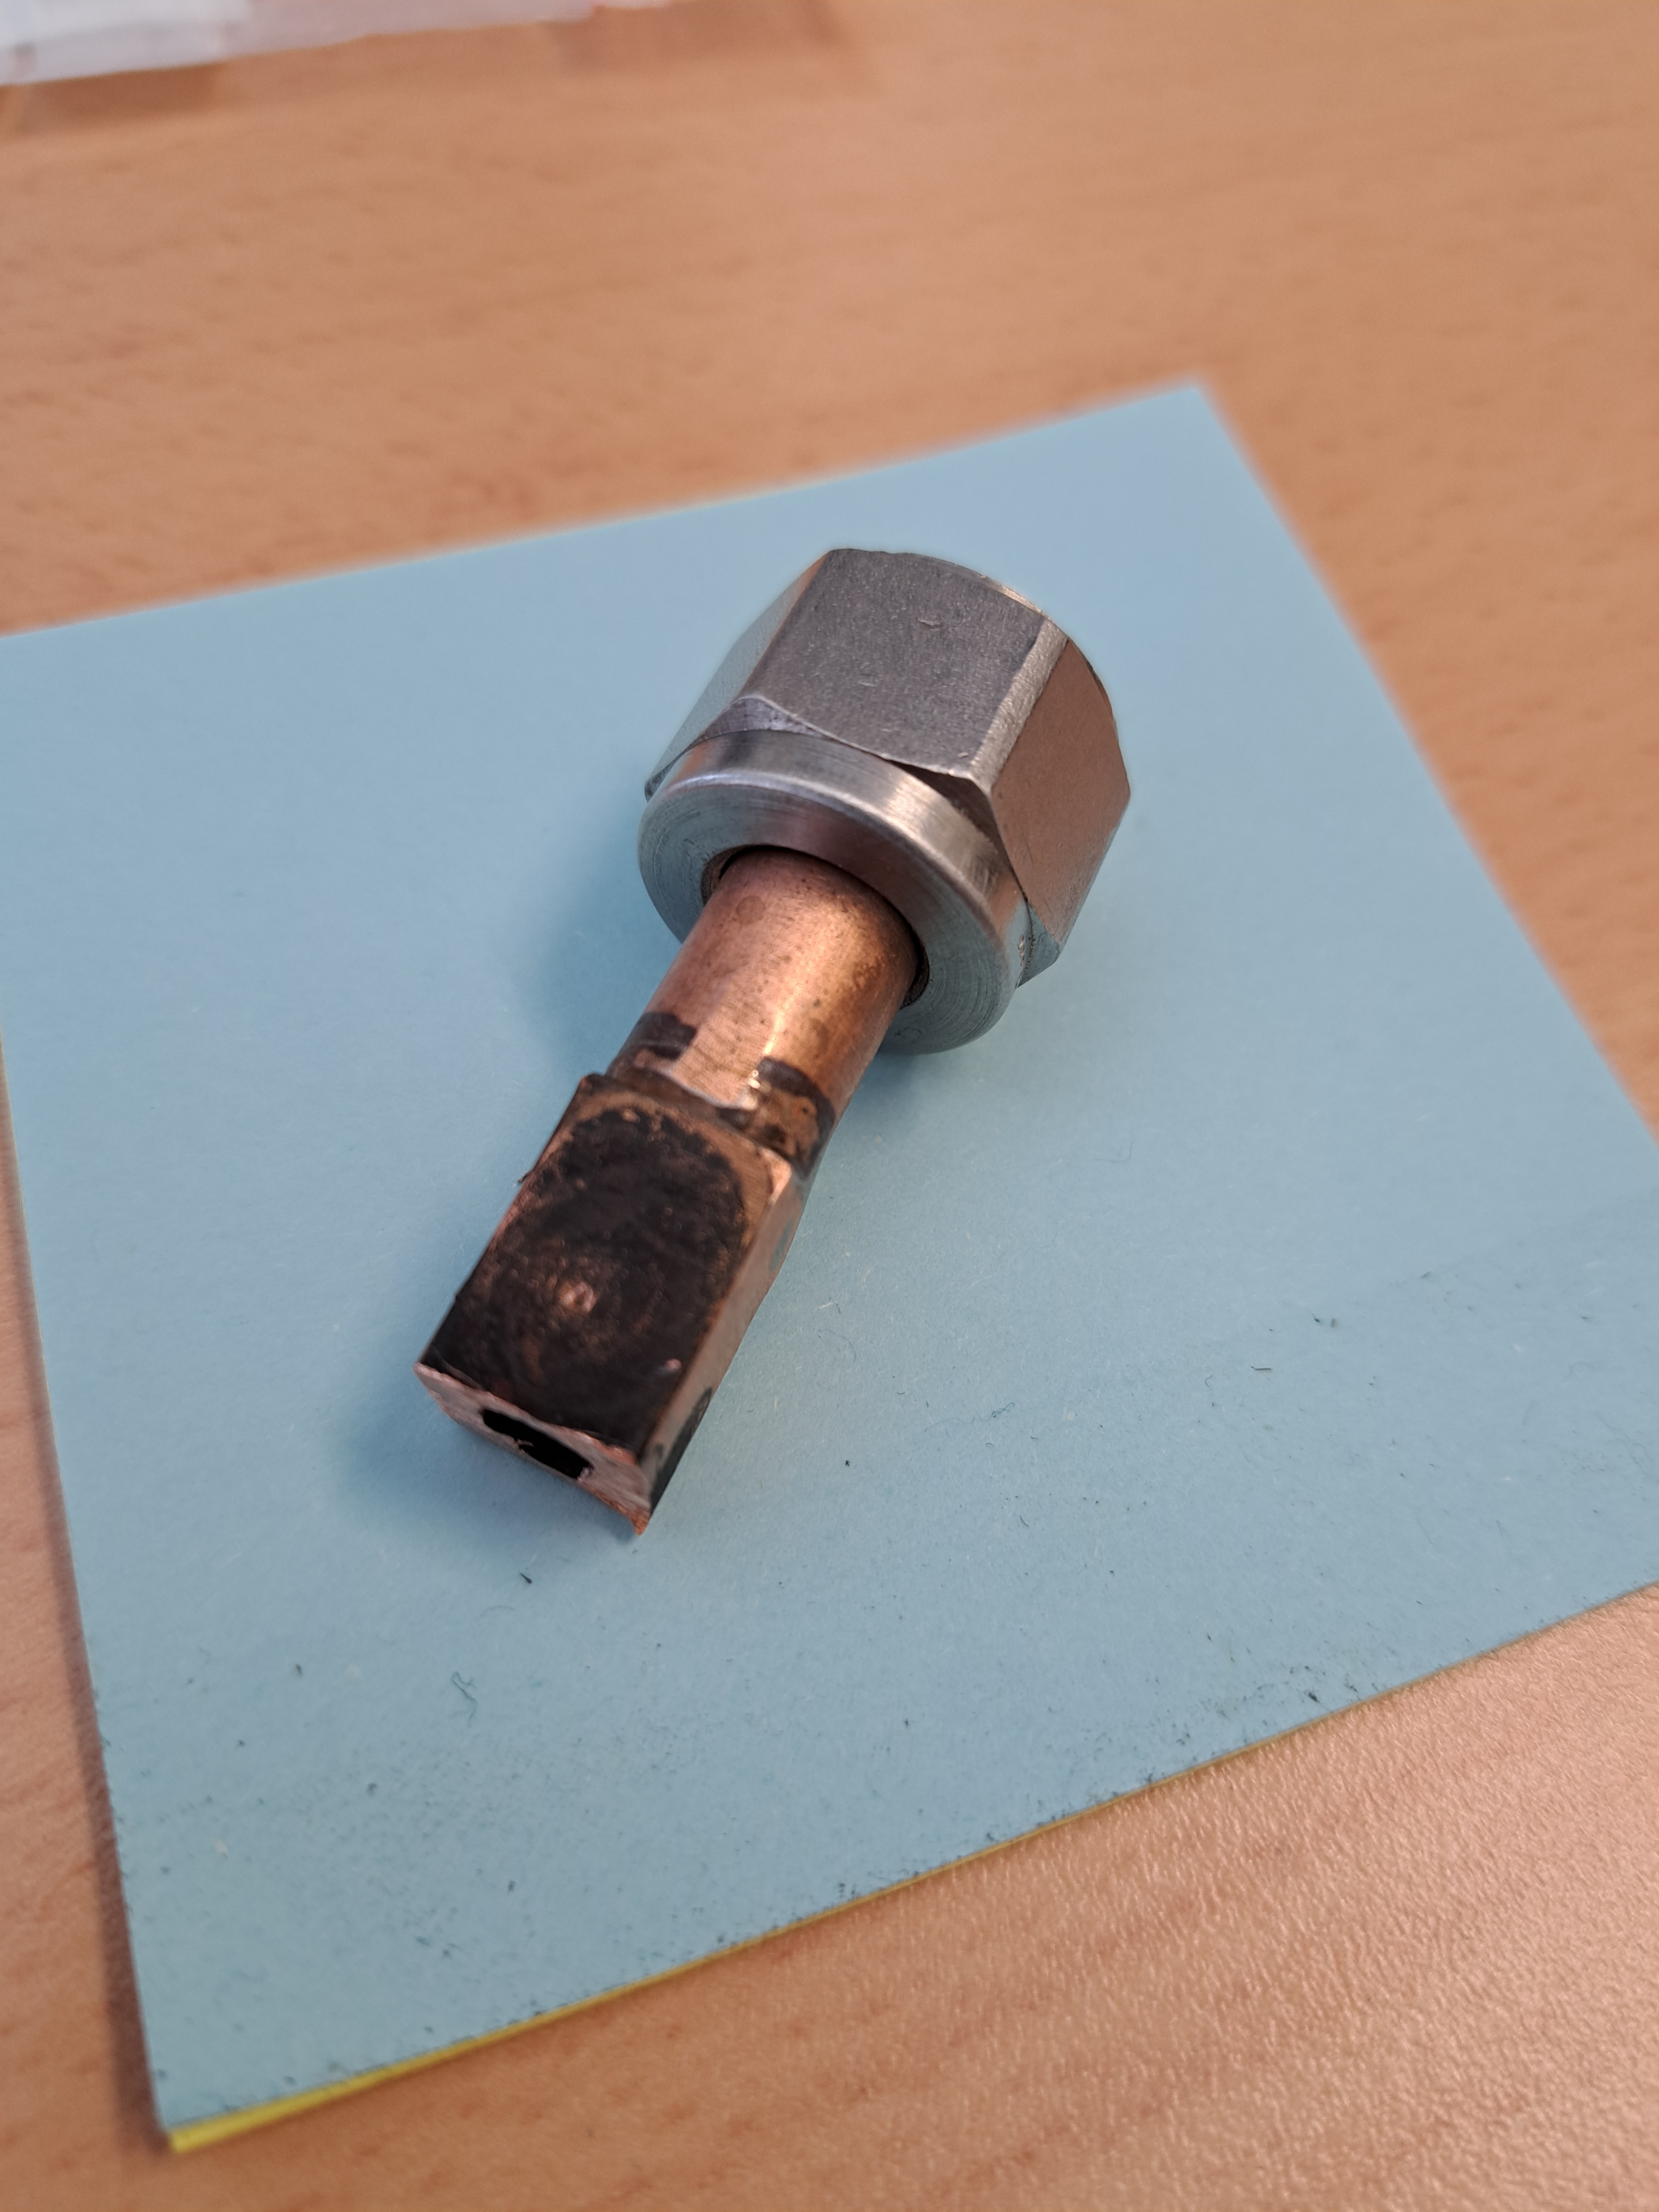
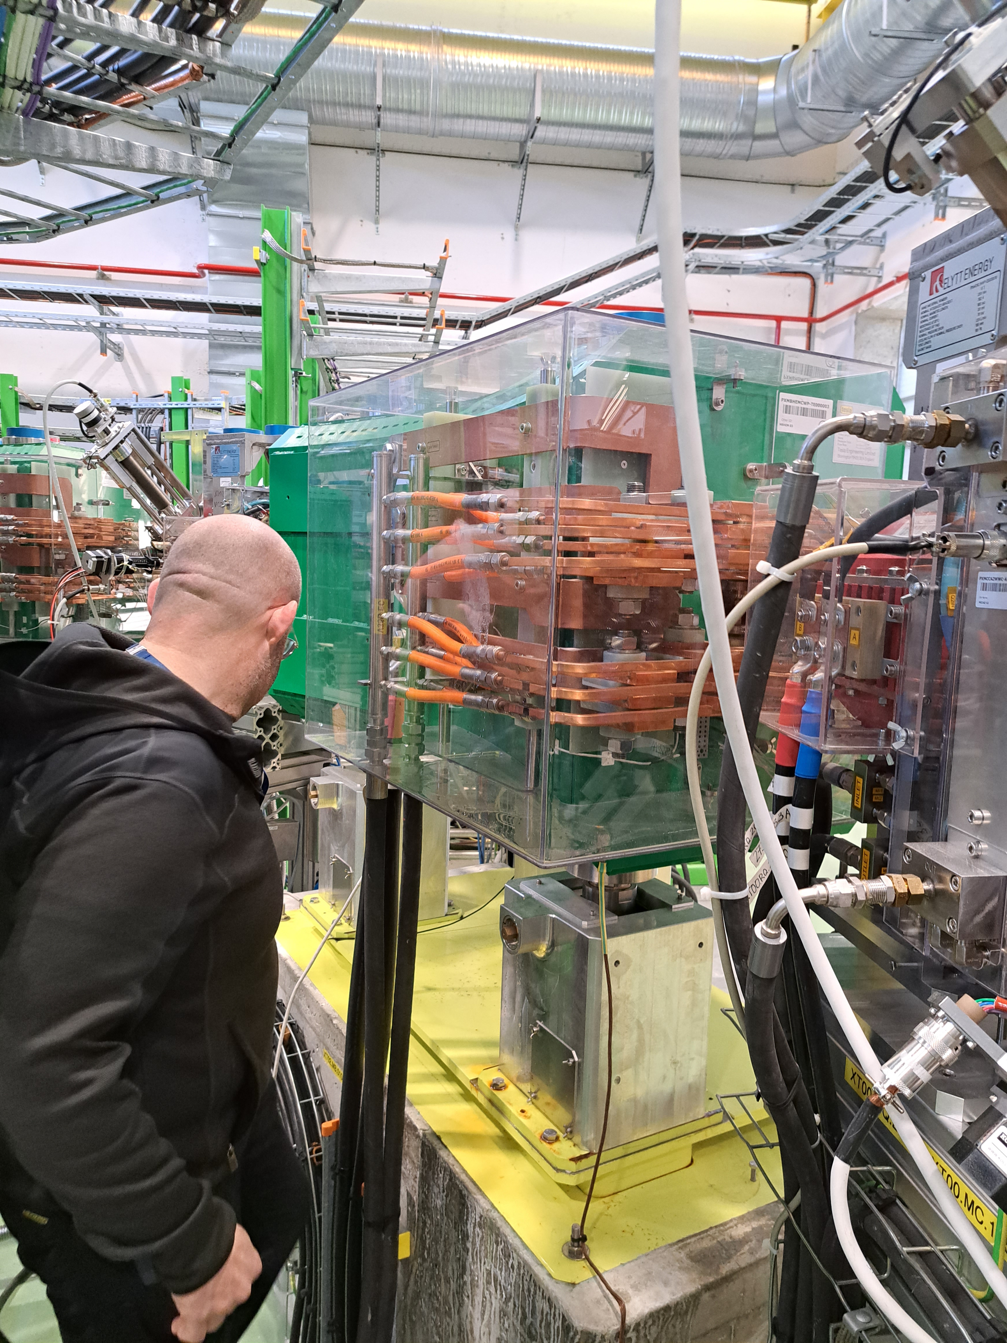
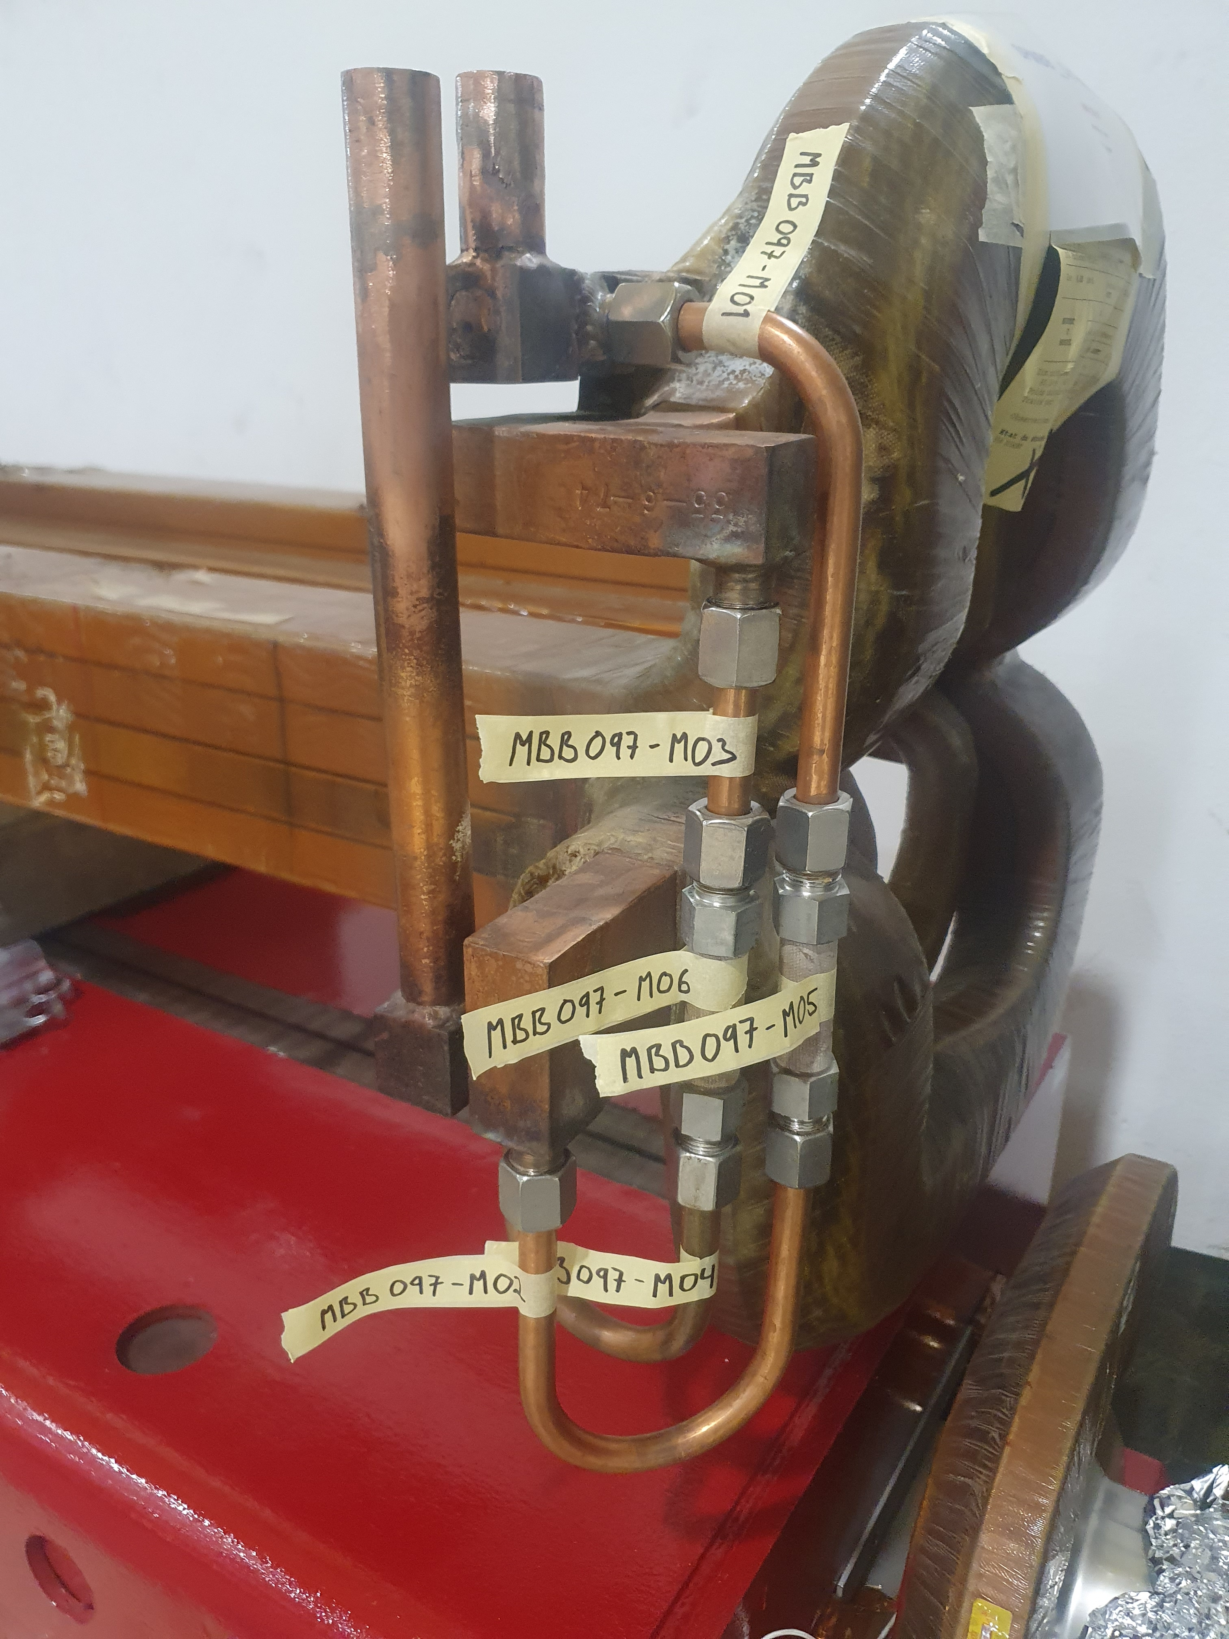
additional samples…
Old PSB Injection bending magnet external connections - Completed
Old PSB Injection bending magnet internal connections – on-going
HIE Isolde bending magnet external connection – completed
Failed SPS main bending magnet internal connections – on-going

Slide 13
PS Booster magnets Task Force
Subtask-3: Options including respective decision criteria, for in-situ and ex-situ patches and repairs of water leaks and other failures, including those that will induce PS Booster performance limitations.
Antony Newborough on behalf of TE/MSC
Gilles Favre on behalf of EN/MME

Slide 14
  Repair Strategy
  RP constraints
  Resources
  Machine Intervention
  Running without water / with force air or chilled gas cooling
  Conclusion

Slide 15
    Repairs strategy
Brazed connections
    In-situ
      Hard and soft brazing repair (where possible)
      Mitigation (water diversion)
      Resin moulding (where possible)
    Workshop repairs
      Hard brazing
      All accessible or only where it leaks?
      Epoxy repair
      Magnet rebuilding
    Repair comparison
    Minimum repair time estimation…
Connection end, 15 documented brazed connections, others have been found during the repairs.
Brazed end, 64 brazed connections.

Slide 16
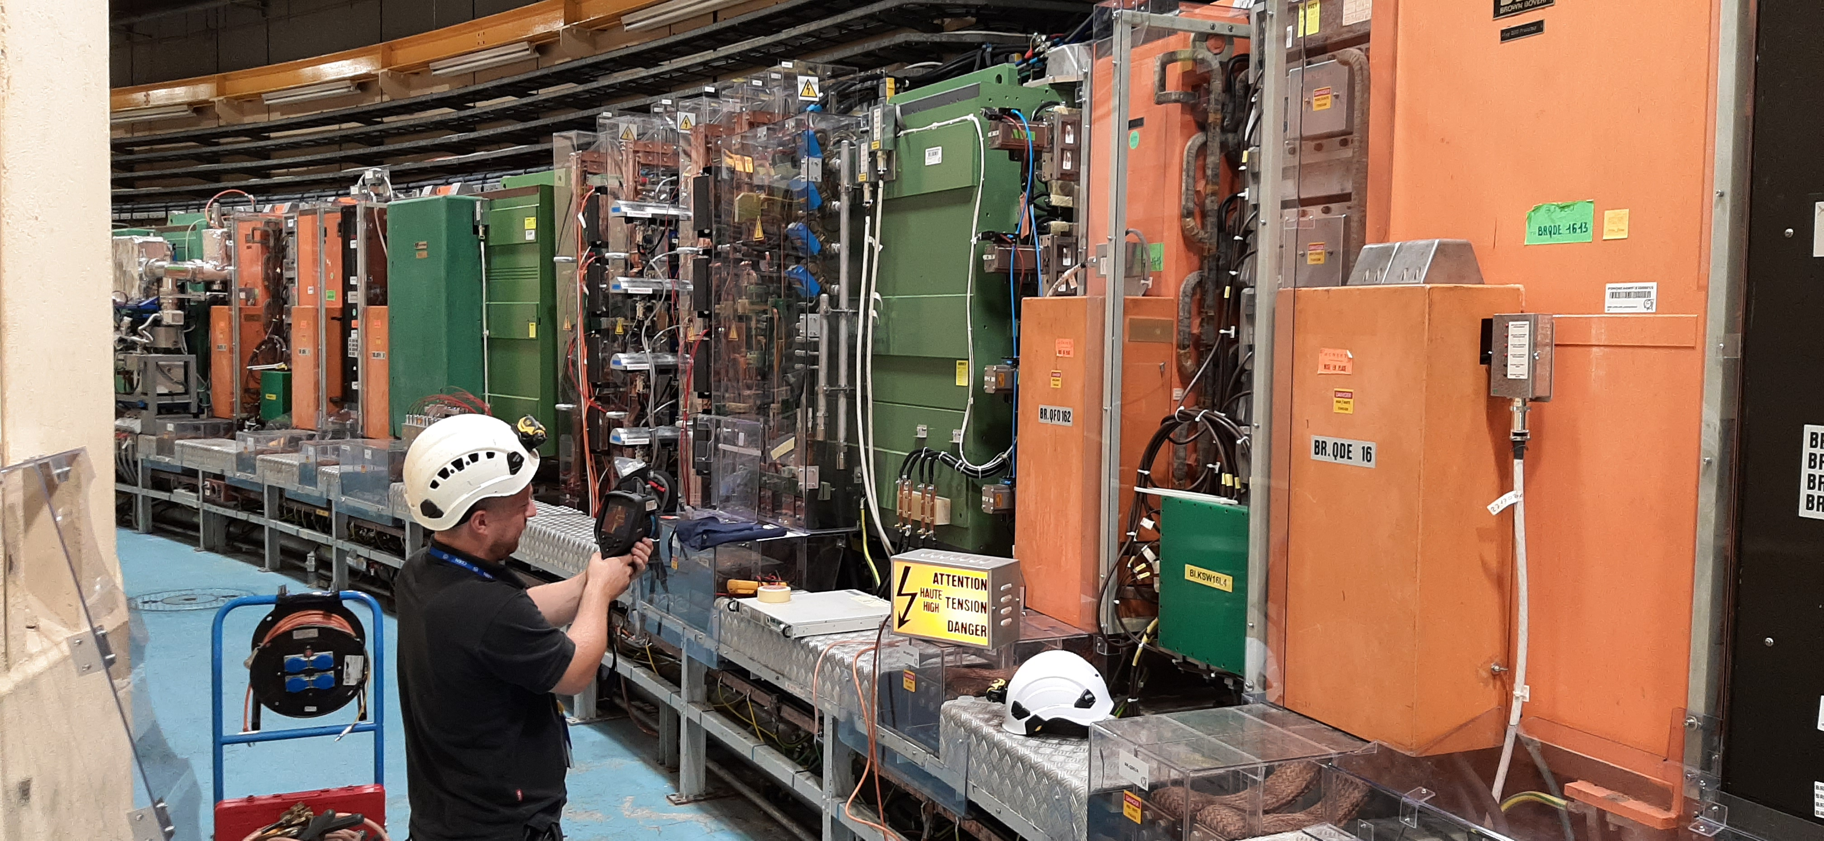
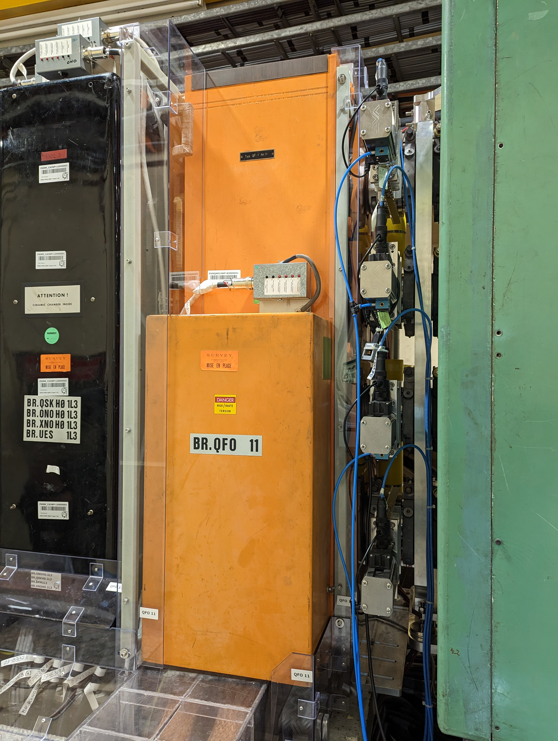
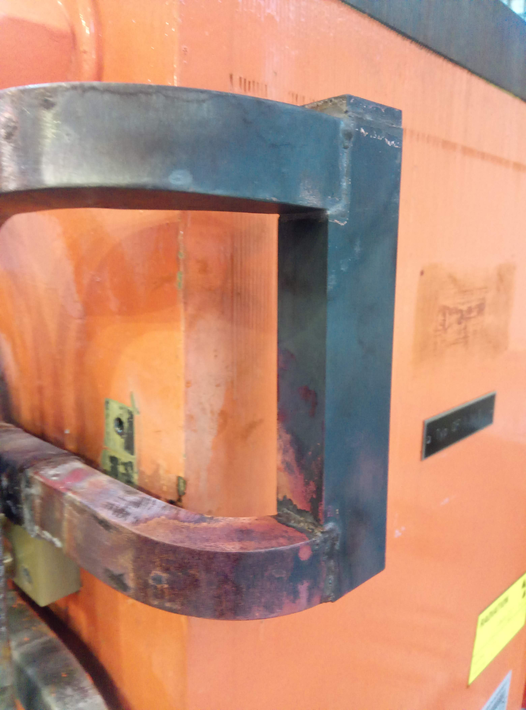
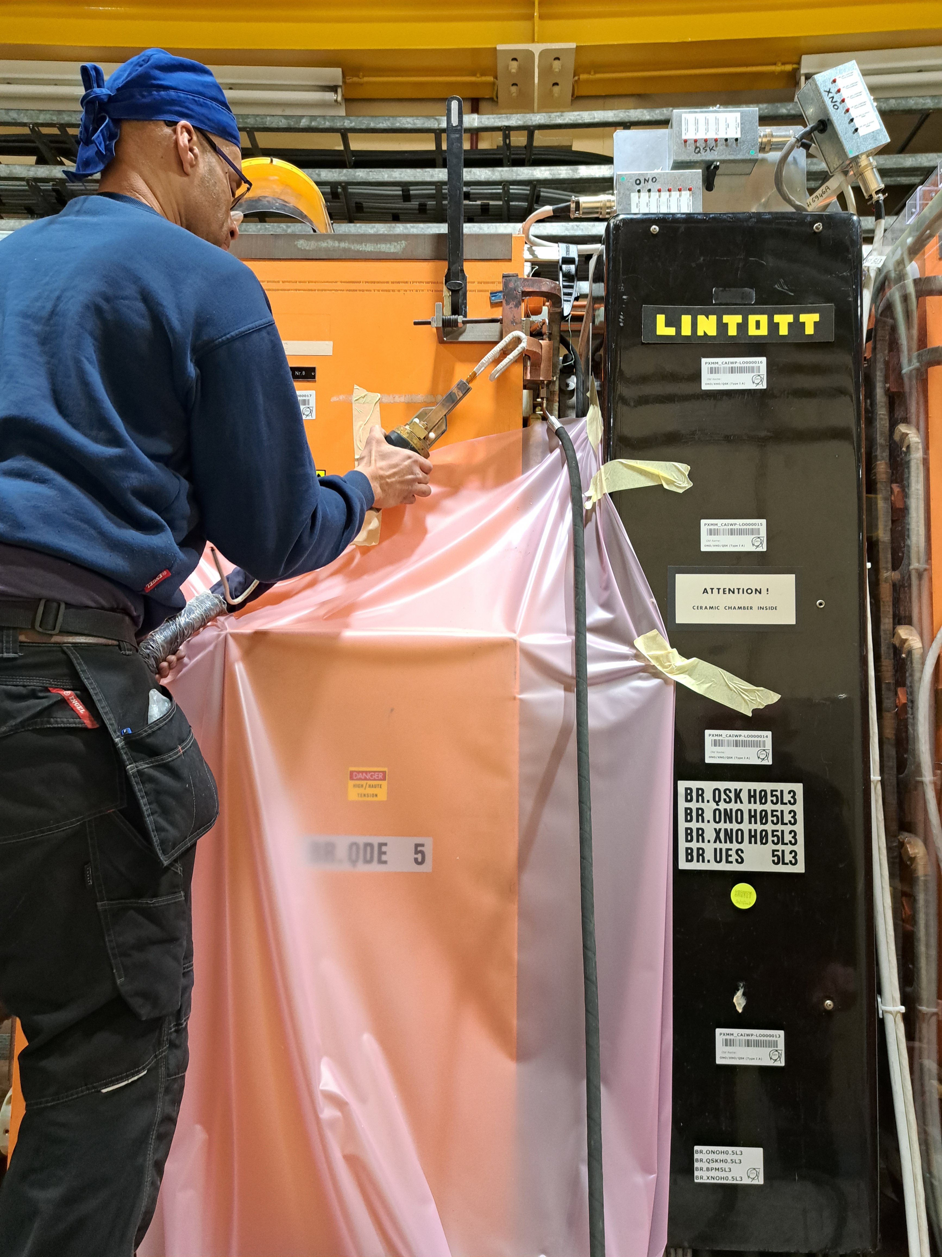
In-situ repairs - Hard and soft brazing repair
Access limited to most of the brazed connections making in-situ repairs impossible (8/80);
Trials to repair the few accessible connections have been completed during the sample extraction;
Brazing performed without flux while indirectly cooling the conductor to avoid heat transfer and damage to the interturn insulation;
Can be planned and completed in 1-2 days if parts are prepared in advance;
With the validation of the hard brazing, we no longer considering the soft brazing patching as performed on the BR.QFO161 during 06/21. If revisited, we still need to validate a repair procedure which has the complication of finding a compatible ‘safe’ flux.

Slide 17
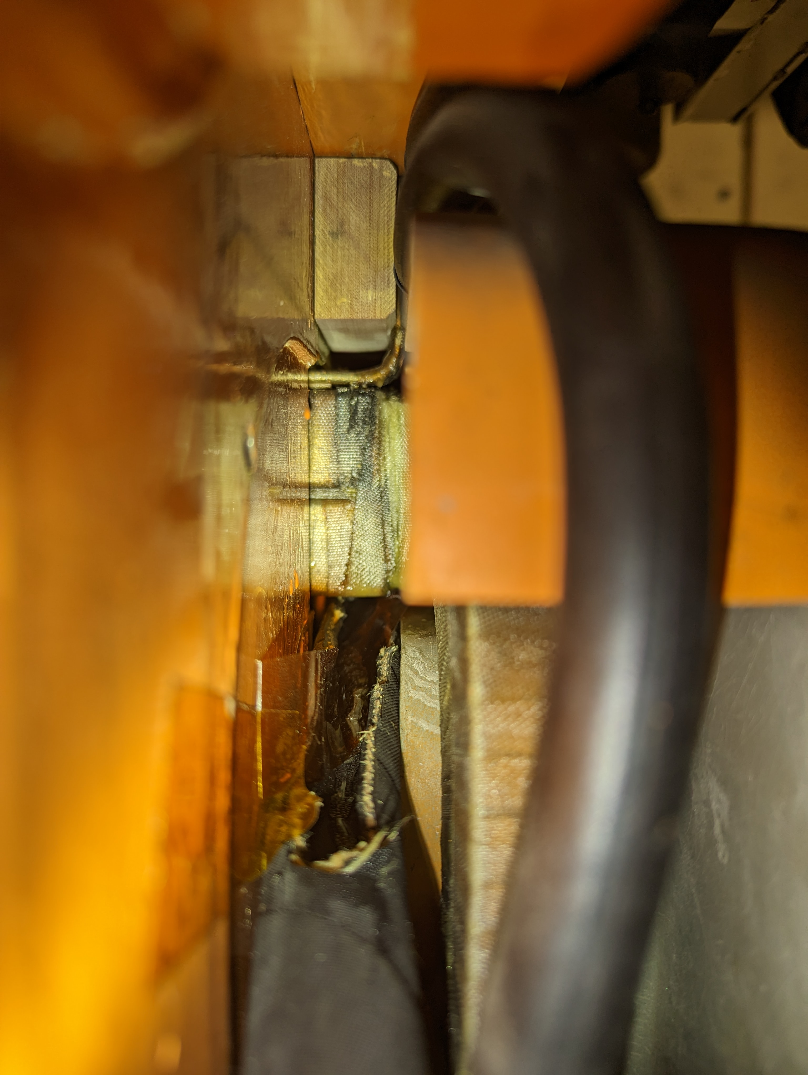
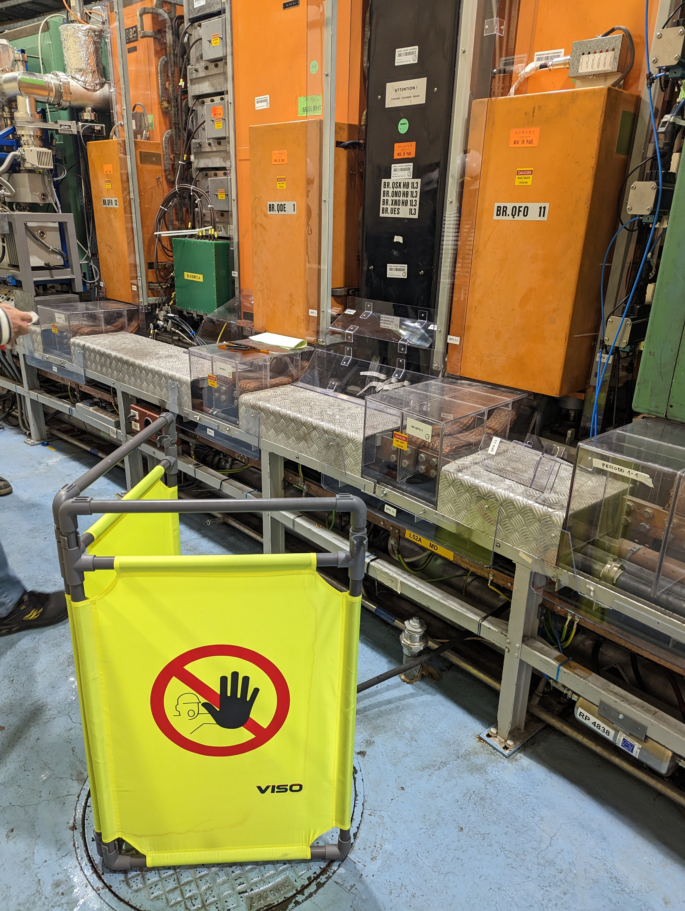
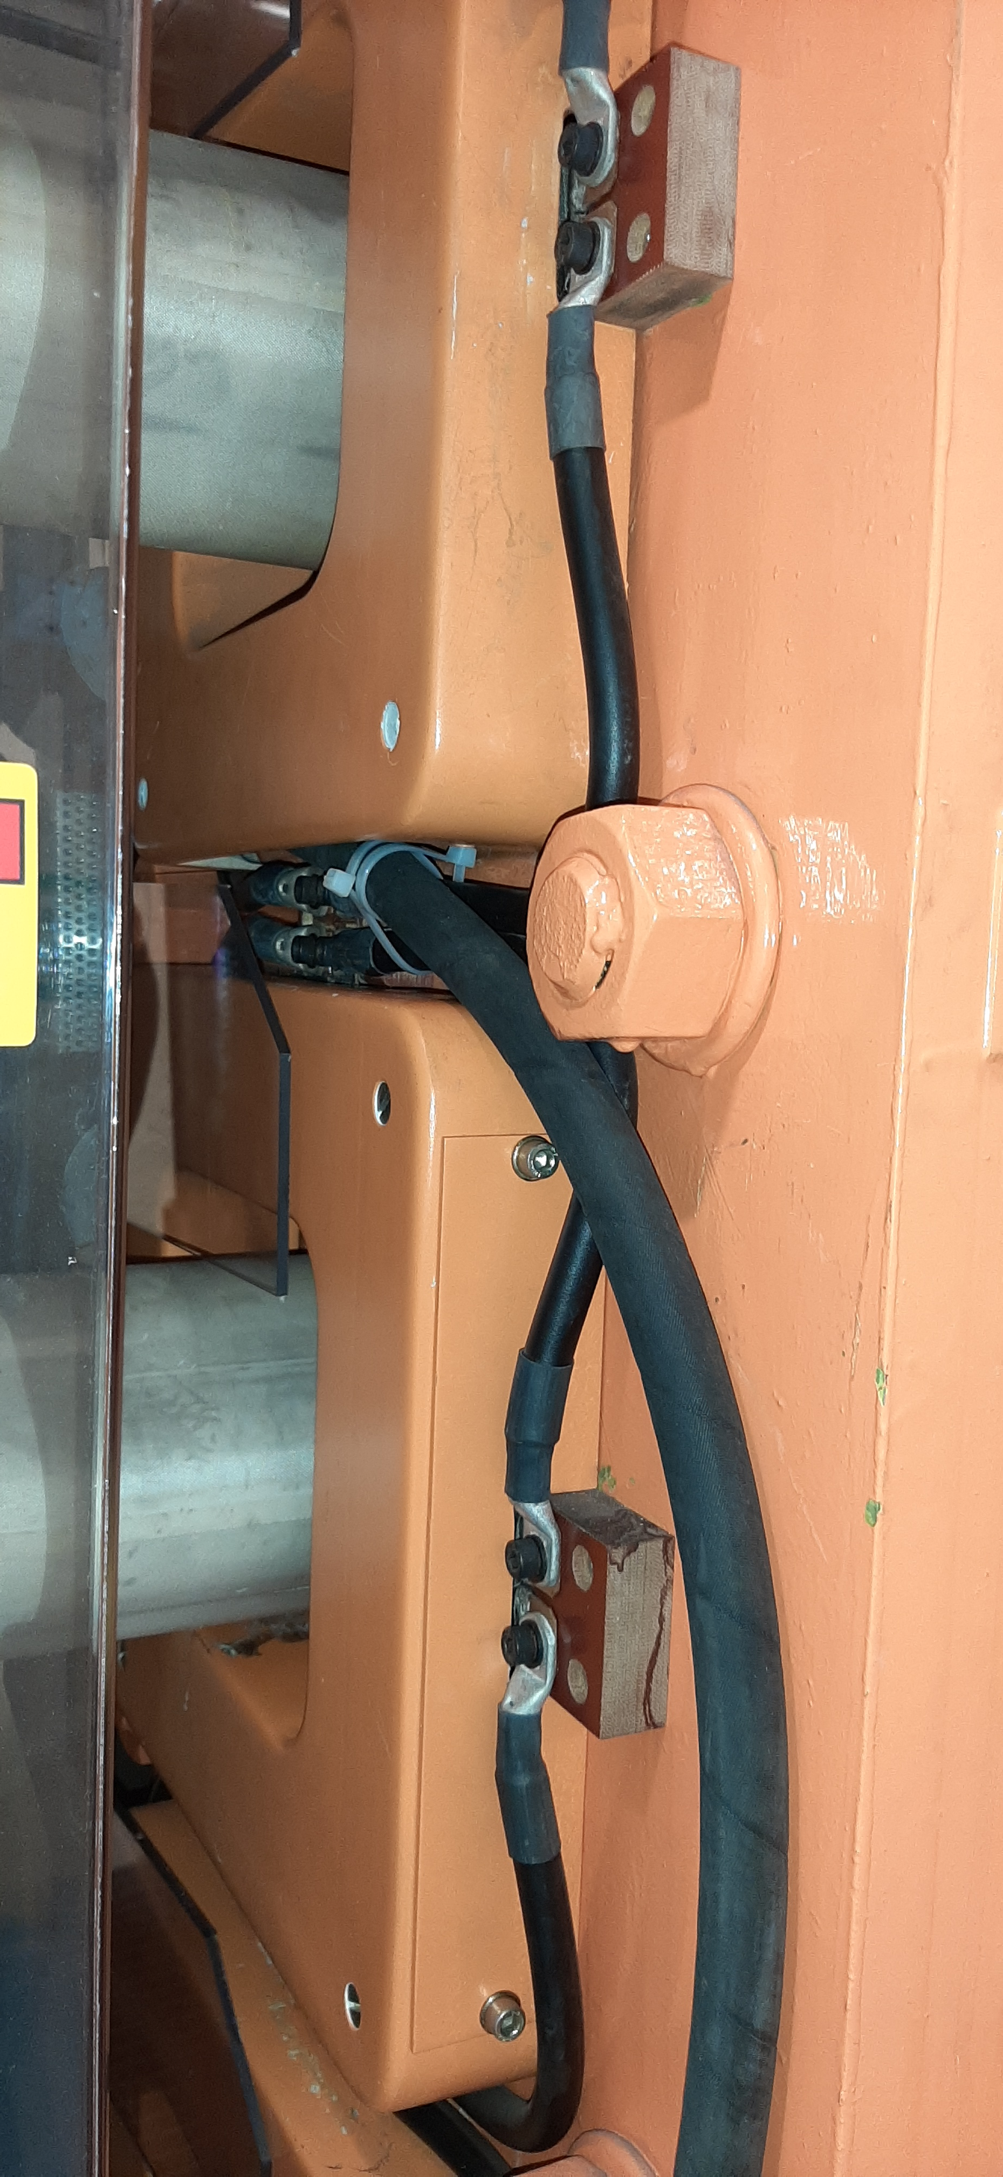
In-situ repairs – Mitigation (water diversion)
Water diverted to tunnel drain or floor;
Successfully performed on the BR.QDE5 Sept 22 till end of run and on-going with the BR.QFO11 which started in March 23;
Limited access (in cases only a few centimeters) makes implementation ‘bespoke’ in most cases;
While the leak remains, there is no guarantee that we do not witness an irreparable failure (short to ground or between turns);
A sudden increase of the leak could cause damage to the magnet and neighboring equipment;
As long as the magnet cooling is not compromised, and the leak is under control, operation may continue.

Slide 18
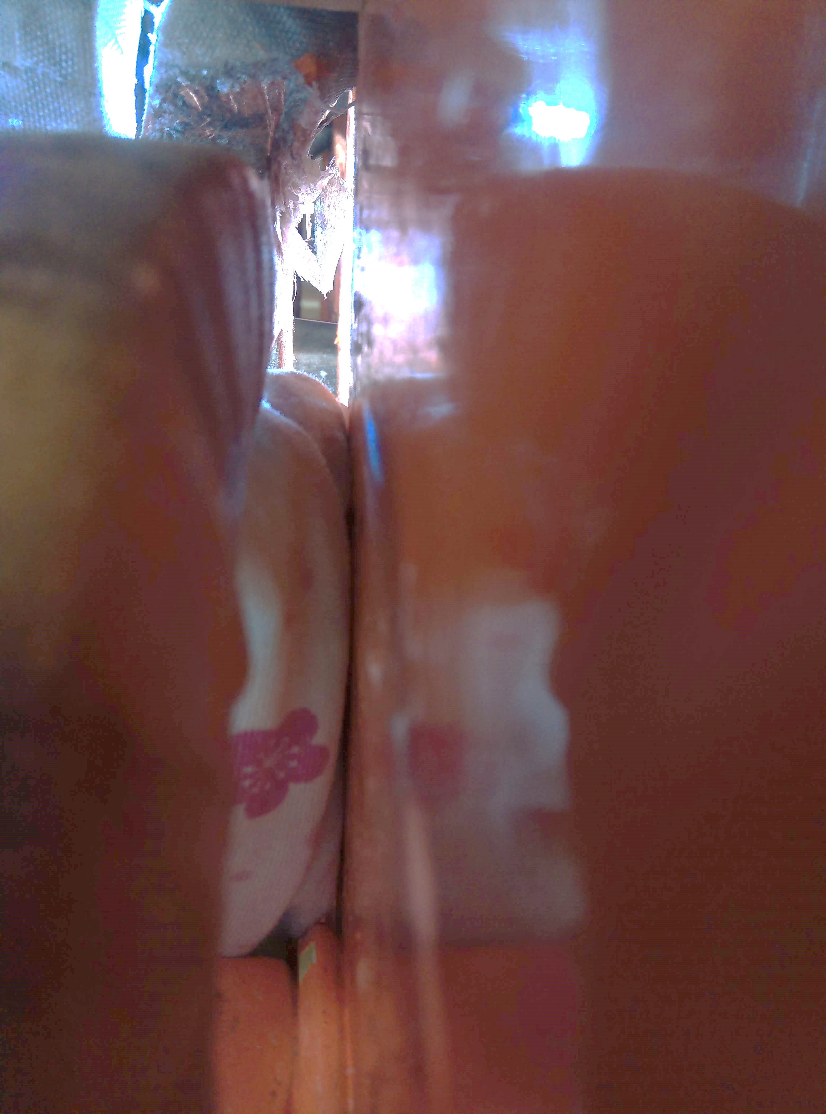
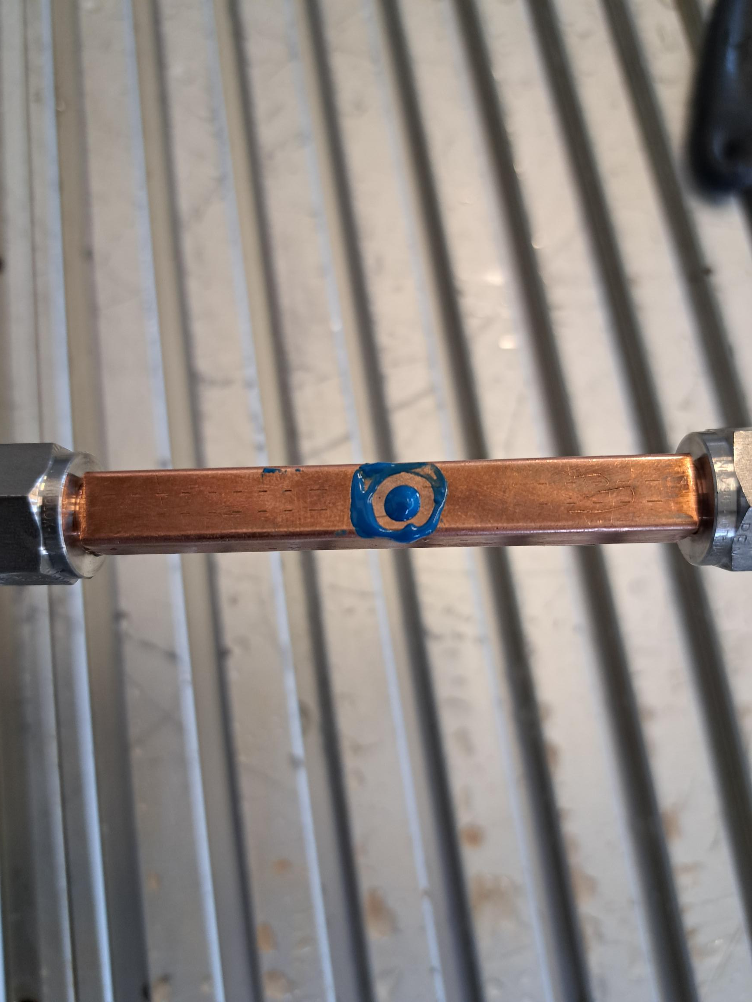
In-situ repairs – Epoxy repair
Limited access to most of the brazed joints (8/80) makes cleaning of the old tape and resin difficult or not impossible.
If poorly executed could make the problem worse causing irreparable damage (water between turns causing a short circuit etc…)
Time consuming (~3/4 days) to perform considering:
  Cleaning preparation
  Resin injection
  Resin curing
  Validation
Trials and validation on-going with MME (see slide).

Slide 19
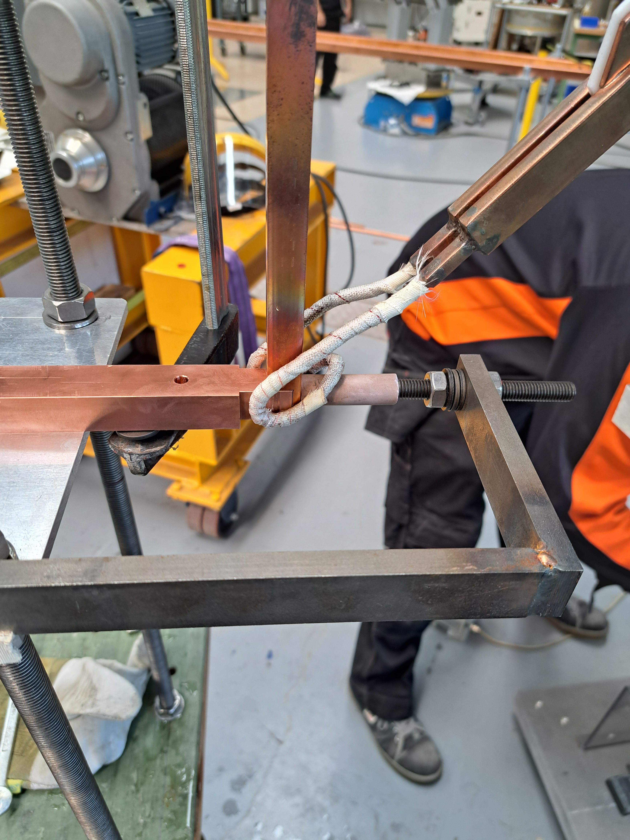
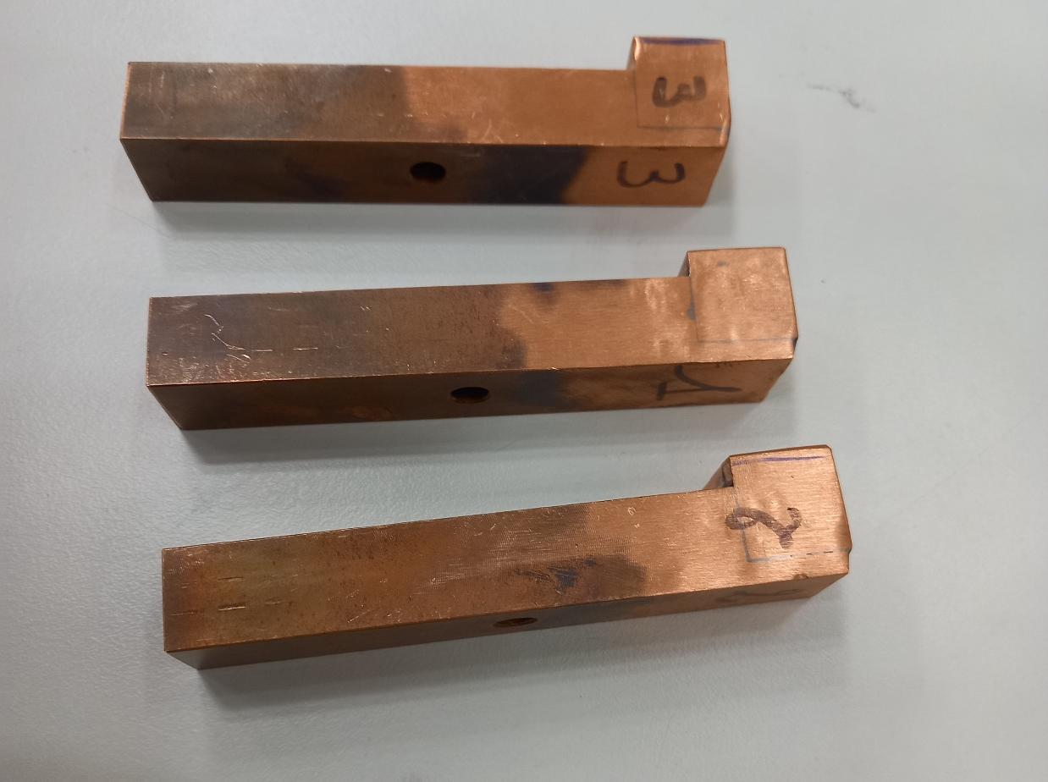
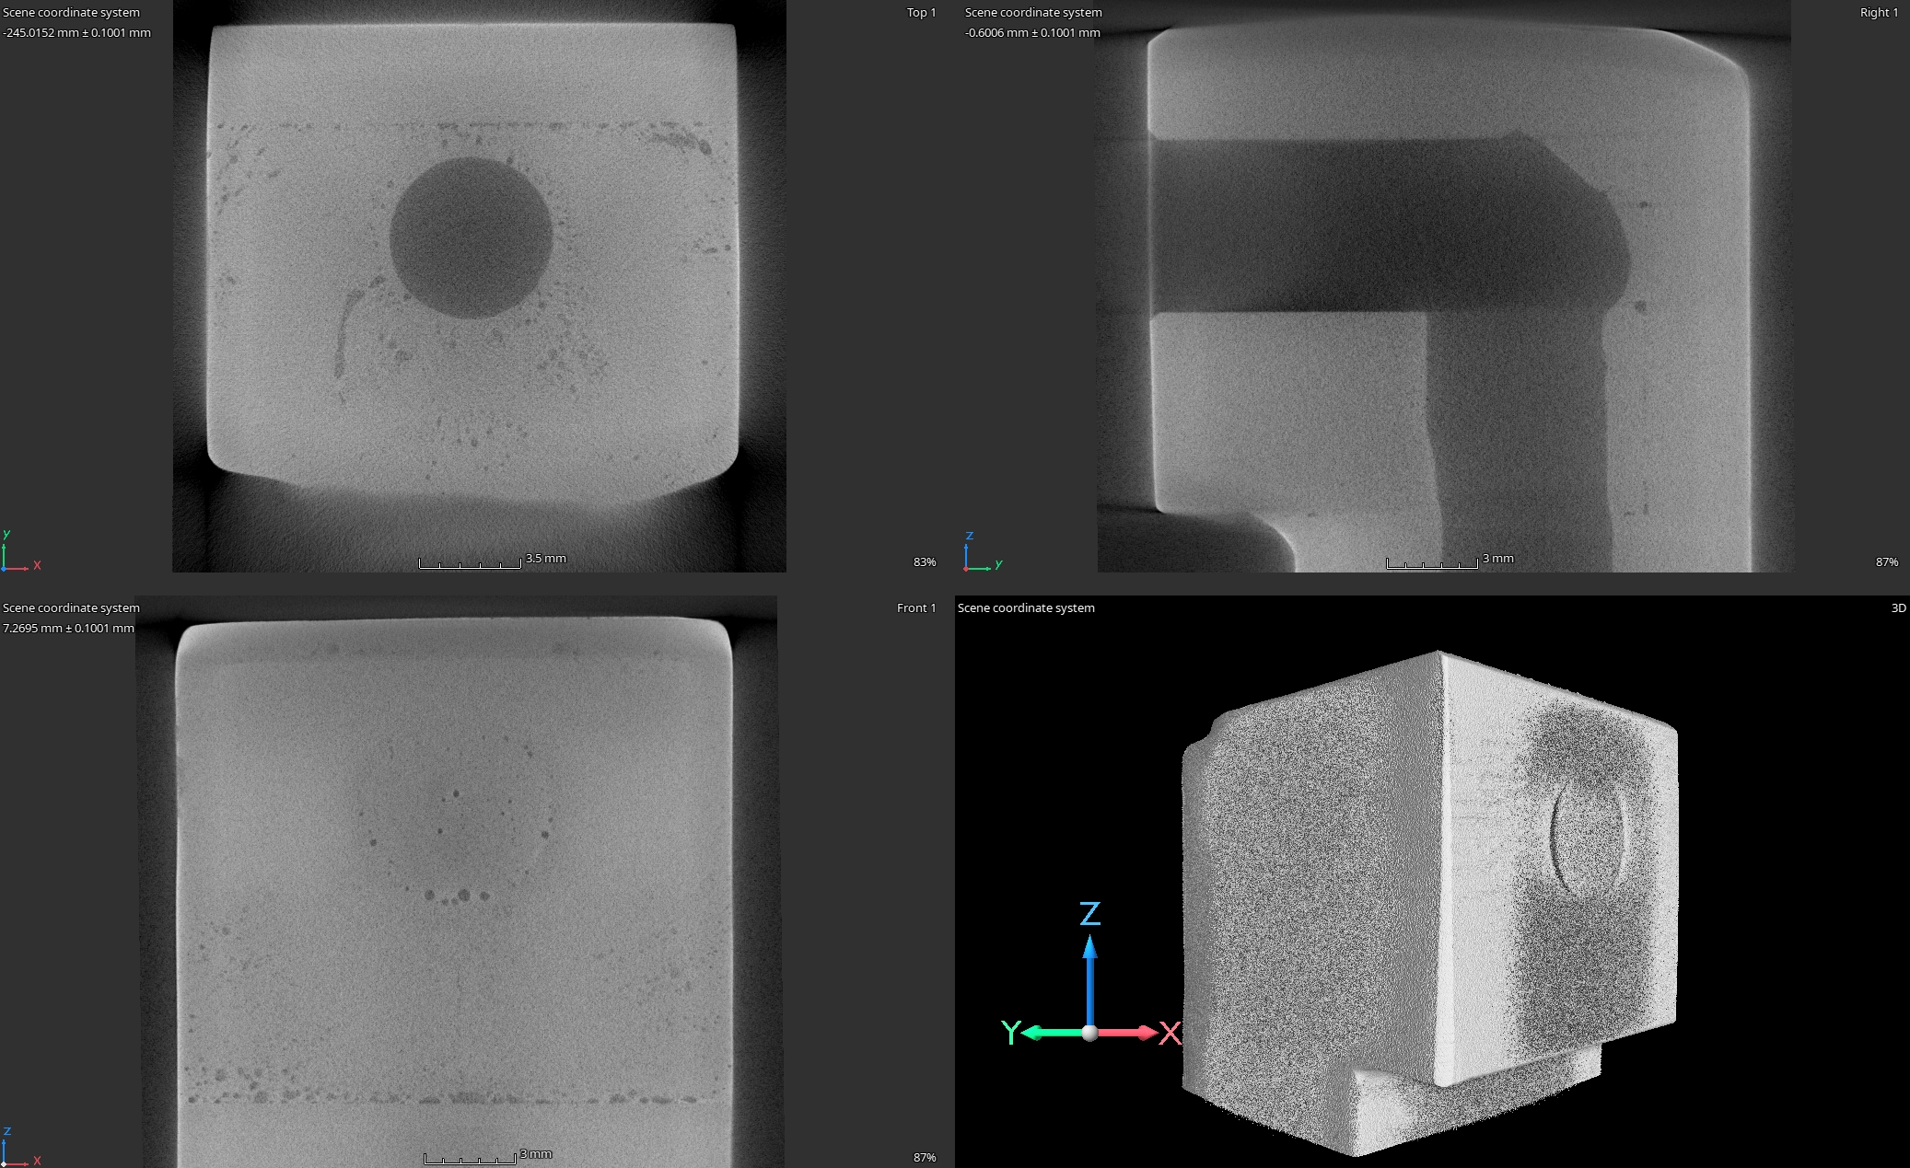
    Workshop repairs – Hard brazing
All but a few (~7/80) connections can be repaired by:
  Careful removal of the tape and insulation, both at repair and adjacent conductors;
  Cutting and or de-brazing of the failed connection;
  Production and adjustment of the new component;
  Induction brazing without flux while indirectly cooling the adjacent conductors to minimize the heat to the insulation/resin;
  Direct cooling with water to cool part;
  Verification of brazing leak tightness (water at 50 bar and helium leak test);
  Cleaning and drying in vacuum to remove all humidity before insulation verification and full certification.
  Base line solution for single repair (today)
Brazed end, 64 brazed connections.
Further validation of the brazing repair has been performed, allowing workshop repair of the leaking spare magnets to continue.

Slide 20
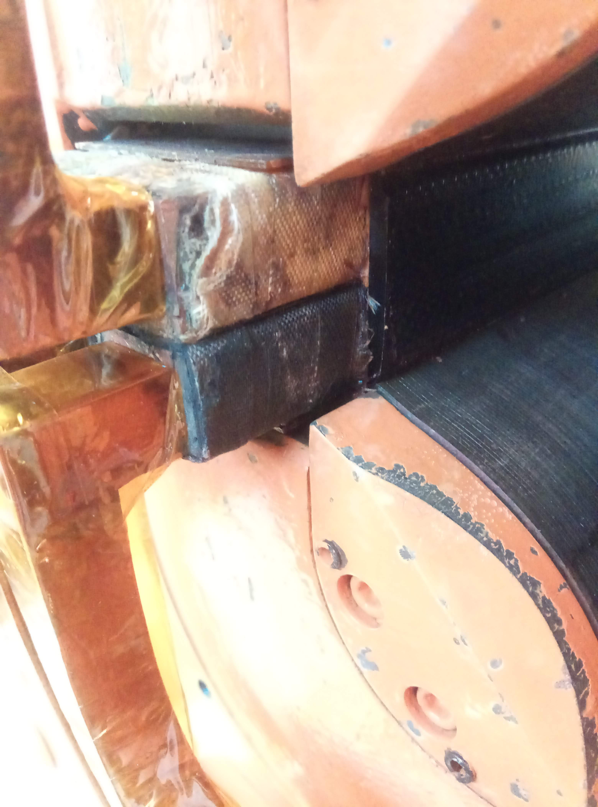
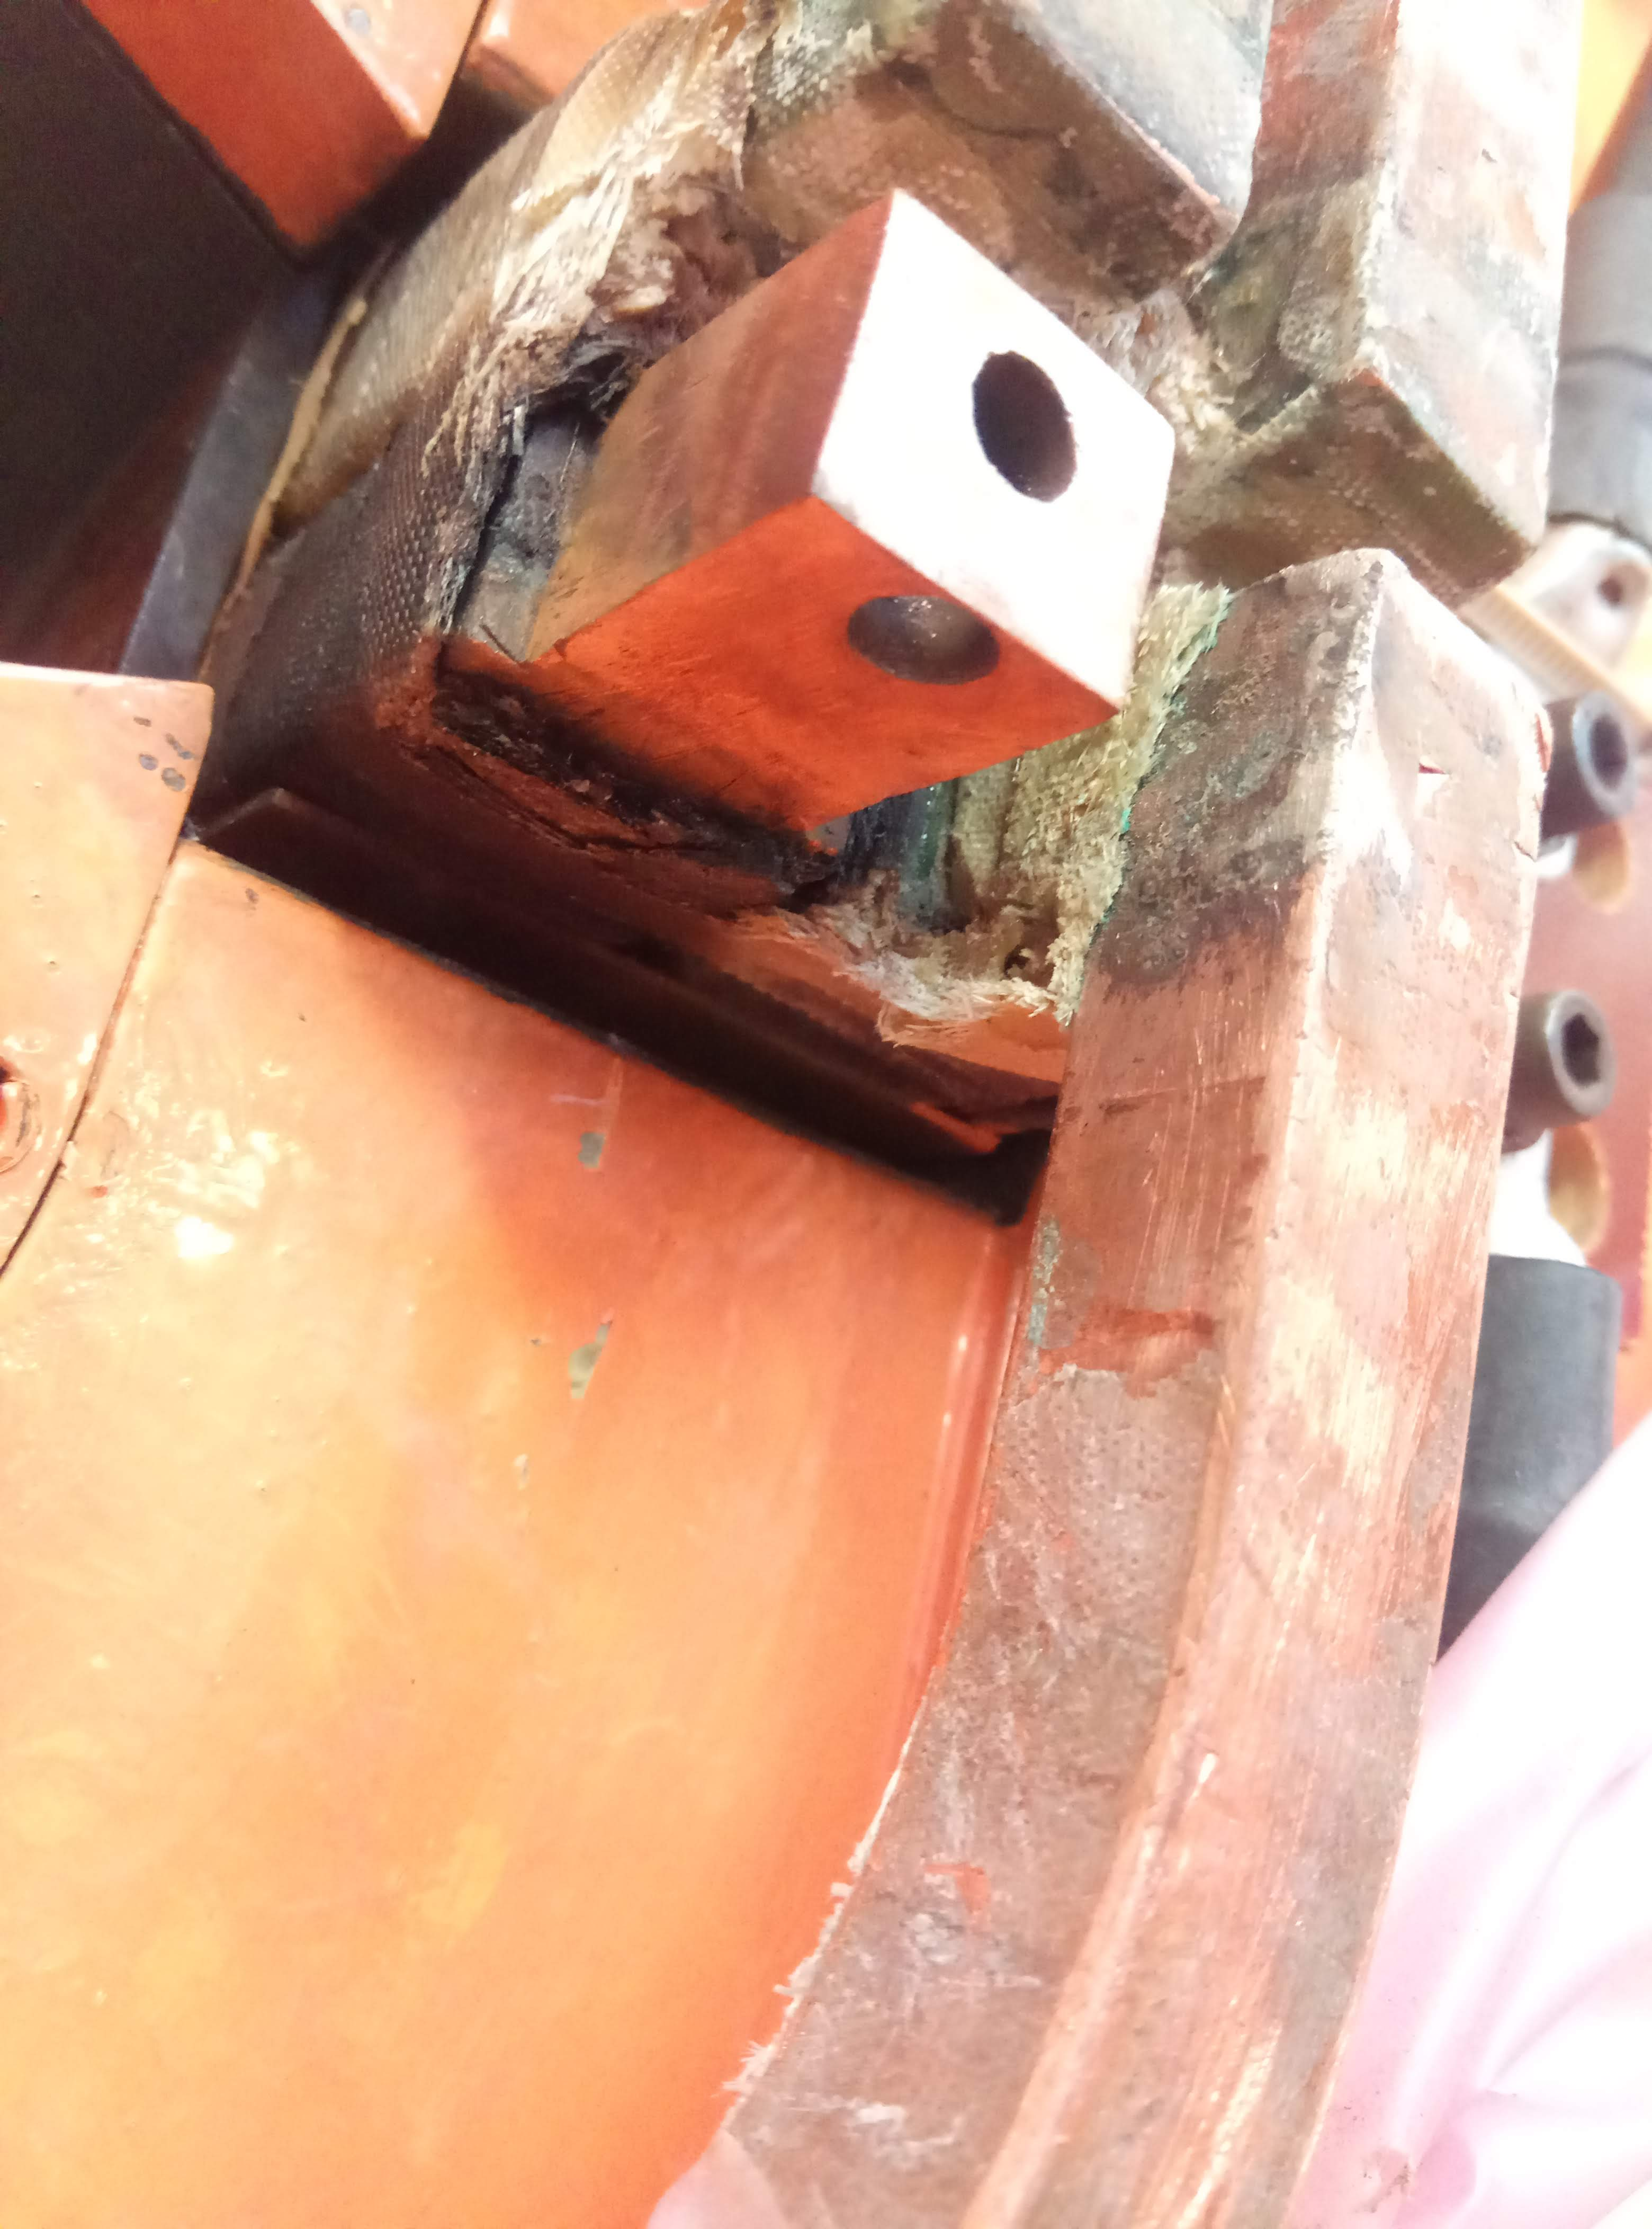
    Workshop repairs – Hard brazing
All accessible or only where it leaks?
  Several brazed connections are simply not accessible for a brazed repair;
  De-brazing & brazing is performed at ~800°C;
  Induction brazing concentrates heat and avoids accidental damage that can occur with flame brazing;
  Indirect cooling can minimize heat transfer and damage to adjacent turns. Impossible to not locally damage the insulation of the conductor being brazed;
  Each repair already comes with a certain risk that we damage the magnet beyond repair;
  Repairing adjacent conductors stacks the risk to have an insulation breakdown;
  If attempted, it is estimated to take several weeks (350 hours) to replace all accessible brazed connections;
TE/MSC does not recommend repairing all accessible brazed connections!
Damaged insulation from de-brazing and brazing.
While damage is limited to a single conductor the interturn insulation is somewhat maintained, however the ground insulation is still compromised.
Brazed end, 64 brazed connections.

Slide 21
    Workshop repairs – Epoxy Repair
Several of the brazed connections have been performed before installing the turns into the yokes and the possibility to perform a brazed repair remains limited or too risky (QDE11 extracted from the tunnel during the YETS22/23);
A local repair of an existing leak or a reinforcement of non-leaking joints could be performed with the application of epoxy from the outside;
The application of the epoxy can only be considered once the area has been cleaned of the original tape and resin;
On-going trials with MME are already giving promising results…
One part of the link remains accessible while the other is hidden behind a turn.
Connection end, 15 documented brazed connections, others have been found during the repairs.

Slide 22
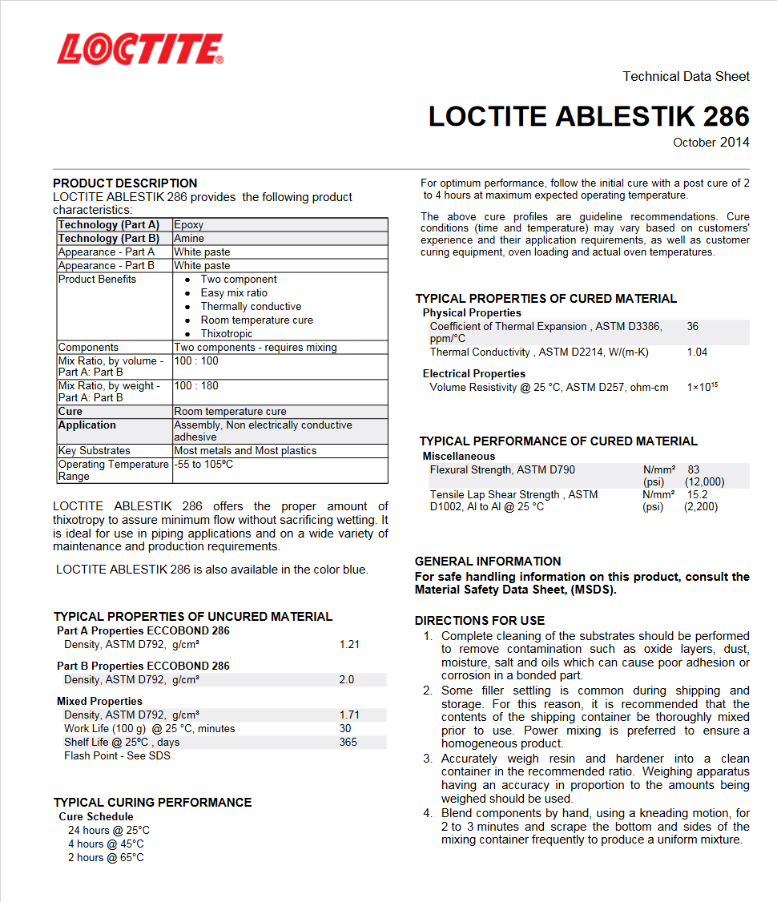
    Workshop repairs – Epoxy repair
The possibility to use epoxy is investigated when the “standard” solution de-brazing/re-brazing can not be implemented (access)
Repair strategy:
  Close the leak using a local epoxy drop
  Add a patch (moulding) to reinforce the repair if needed
Use of a two component, room temperature curing epoxy adhesive LOCTITE ABLESTIK 286 (Eccobond 286). Operating Temperature range: -55 to 105ºC
Courtesy of Sebastien Clement

Slide 23
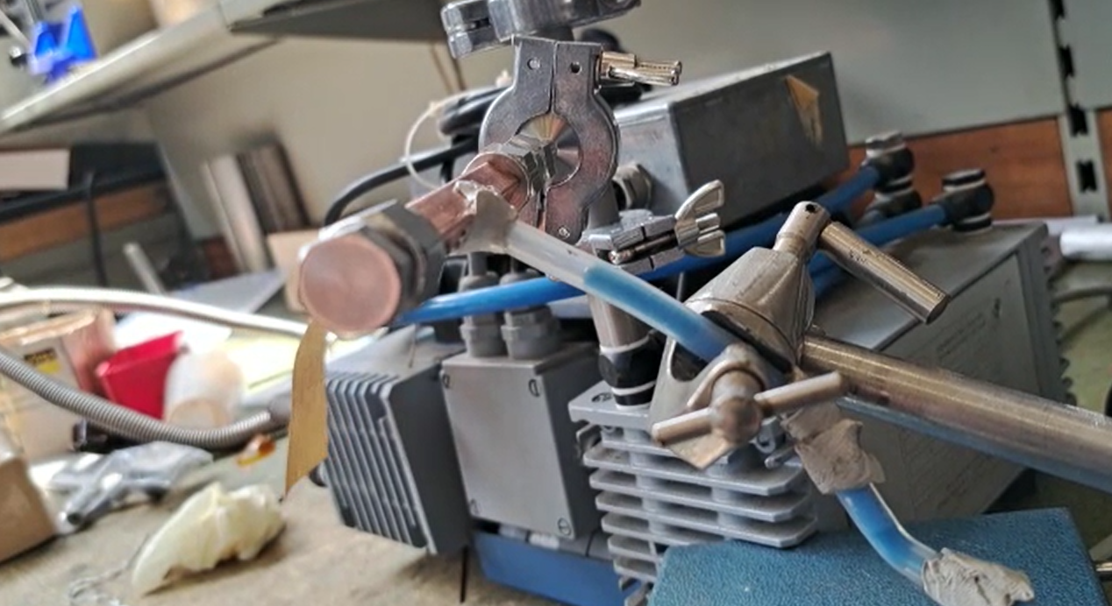
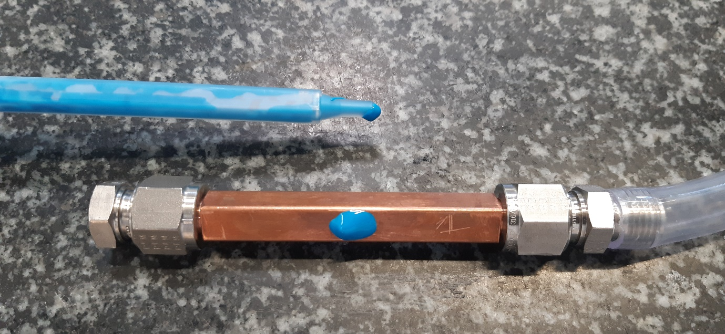
    Workshop repairs – Epoxy repair
Ongoing tests:
Simulation of a leak using calibrated hole of 0.2 mm diameter
two options tested for leak closing
  Option 1: Draw the epoxy through the leak using vacuum
  Option 2: Epoxy drop on surface (without vacuum)
Preliminary results
  Option 1: Epoxy + vacuum
    He leak test: leak tight 3.10⁻⁹ mbar.l/s
    Pressure test
      14 bar, 1 hour: no leak
      50 bar: no leak
  Option 2: Epoxy drop on surface
    Pressure test: awaiting results
Additional samples and tests are still to be validated, including:
Sample representing brazed configuration
thermal cycling of samples
Option 1: Draw the epoxy through the leak with vacuum
  Option 2: Place of a epoxy drop on the leak surface
  (without vacuum)

Slide 24
    Workshop repairs – Magnet rebuilding
See sub task 5

Slide 25
Repair Comparisons
Repair Method | Pros | Cons
Brazing | Definitive & reliable. Time saving compared to exchange (in-situ). | Limited for in-situ and workshop repairs. Heat can damage the insulation leading to irreparable damage. Risky and time consuming for complete repair.
Soldering patch | Quicker (no de-brazing). Lower temperature. | Material compatibility (safe fluxes). Less reliable compared to brazing. Short term solution. Limited in-situ and for workshop repair.
Resin | Possible solution when brazing can’t be performed in-situ or workshop. Could be faster than brazing to reinforce all connections (leaking or not). Less risk to insulation compared to brazing. | Little experience to date, still to be fully validated. Irreversible? Maybe be difficult to remove/clean in case it is not successful. Medium term solution? Risk to block cooling channel.
Mitigation | Quick to implement, <1 day. | Risk of degradation remains (eventual electrical failure possible). Short term solution. Requires monitoring.

Slide 26
    Minimum repair time estimation…
Two scenarios are considered based on the known brazing solution and the epoxy resin patch which is still to be validated, both solution assume the repair of a single leak on the end with 64 brazed connections:
The brazed solutions includes transport to our workshop and due to the nature of the repair a full certification will be performed;
The epoxy repair patch could be performed in the sous-sol of the PSB ring where only a partial certification/verification of the repair is performed.
Neither case includes the removal and reinstallation of the vacuum chamber which differs depending on the slot.
Repair Method | Step | Duration
Brazing | Transport to 181 Preliminary test Careful removal of insulation at leak and adjacent conductors to install the indirect water cooling. De-brazing, part adjustment and brazing. Pressure test, vacuum drying. Full Certification (with 1 day transport between 181, 867 & 361). | ½ day ½ day 1 day 1 day 1 day 3 days Total: 7 days
Epoxy Resin | Preliminary tests Careful removal of insulation and thorough cleaning of leaking quadrant. Local leak repair and curing (24 hrs) Resin injection and curing (24 hrs) Validation (insulation and pressure) | ½ day 1 day 1 day 1 day ½ day Total: 4 days

Slide 27

    Radio Protection
  Machine interventions have so far been limited to ALARA level 1 & 2
  Collective dose for the exchange of:
    BR.QFO161 - 127 µSv
    BR.QFO91 - 164 µSv
    BR.QDE5 – 94 µSv (with QFO152 and corrector magnets)
    BR.QDE11 - 40 µSv
    BR.QFO142 – 518 µSv (with BE.BSW magnets)
  Existing survey gives good estimation for expected dose rate
  A more complete survey measuring up and down stream at each level to be planned during the TS
  Generally the vacuum chamber is the hottest component which is eventually removed for workshop activities on the magnet. In the case of the QFO142, R1 was ~1mSv compared to a 1-200 µSv for R4.
  Cool down time to be determined.

Slide 28
    TE-MSC Resources
  Staff (available for machine interventions and workshop repairs)
    Antony Newborough - ‘Machine responsible’
    Alexandre Cretin - ‘Workshop responsible’
    Maxime Dumas – ‘Workshop supervisor’
  Industrial Support (available for machine interventions and workshop repairs)
    Brazing x 1 (2nd to be trained but also covered by Staff (AN + AC))
    Electrician x 3
    Mechanic x 3
    All personnel shared between PS complex operations!
  Tooling
    Induction brazing machine x 1 (A second could be ordered (60 kCHF) or the SPS machines to be validated as back-ups)
    Bending/forming/machining jigs (Mock-up study) – on-going with drawings under review
  Material
    Copper supply
      18.5 x 15.1, ID 7 mm – delivered
      24.6 x 19, ID 6 & 7 mm – July 23
    Tape
      Glass – in stock
      Mica – limited quantities available with delivery foreseen in July 23

Slide 29
    Machine Interventions
Reminder - Before the brazing leaks occurred only one quadrupole had been exchnged from the machine in 2015, since we have now changed six units each varying in time and complexity!
BR.QFO161 – Simple intervention, individual vacuum chambers, individual displacement of magnet, medium radiation level (127 µSv collective dose)
BR.QFO91 - Simple intervention, individual vacuum chambers, individual displacement of magnet, medium radiation level (164 µSv collective dose)
BR.QDE5 – Complex intervention, common vacuum chambers, displacement of neighbouring main quad and corrector stack, low radiation level (94 µSv collective dose)
BR.QDE11 - Simple intervention, individual vacuum chambers, individual displacement of magnet, low radiation level (40 µSv collective dose)
BR.QFO142 – Complex intervention, common vacuum chambers, common displacement of neighbouring BE-BSW magnets, high radiation level (518 µSv collective dose)
EN/ACE (Markus Albert) has compiled a planning for the exchange of the leaking BR.QFO11 magnet and a study is underway for all remaining magnets of the machine.

Slide 30

    Machine Interventions
Preliminary planning for exchange of BR.QFO11
Courtesy of Markus Albert
Assuming a normal working day
Optimization possible, for example allowing a certain level of co-activity or having spare vacuum chambers (VSC estimates 7 kCHF per magnet) could reduce time by a number of days.

Slide 31

    Machine Interventions
Complex triplet locations in sectors 14/15/16:
Presence of extraction bumpers (need to be lifted together with downstream QFO)
first experience during last YETS (QFO142)
Higher activation around extraction area (ring hot spot)
Bakeout of BE.SMH15L1 required after opening of vacuum sector BR10 (~5 days)
Conditioning of extraction kicker BE.KFA14L1 required after opening of vacuum sector BR30 (~2 days)
Curtesy Markus Albert EN/ACE

Slide 32


Degraded operation, alternative cooling?
Test have been performed to determine the rms current limits in case we need to run without water;
With natural convection (lab conditions) the QF and QD are limited to continuous operation at 700 & 750 A respectively;
Discussions with EN/CV are on-going to see what can be achieved with forced air-cooling.
This may only be possible if the decision is taken before an electrical failure occurs!
Coil limited to 60 °C
Yoke
Test over 80 hours

Slide 33
Conclusions:
The PSB quadrupole magnets have been extremely reliable over 50 years of operation, but now appear to be approaching end of life. The failure mechanism which seems irreversible and considering the magnet construction difficult and time consuming to repair definitively;
Due to the limited space, repairs in-situ are limited to the few (8/80) accessible brazed connections;
It has been shown that mitigation measures to divert the water to tunnel floor are possible but are considered as a relatively short-term solution;
Performing a ‘hard’ brazing repair is possible in some locations but comes with the risk of damaging the magnet irreparably. TE/MSC do no recommend preventively redoing all of the accessible brazed connections due to the risk and time required;
The first findings from the epoxy repair trial is promising and may be a suitable medium term repair solution for both leaking and non-leaking brazed connections;
Future interventions are to be planned in greater detail considering both installation complexity and radiological aspects. Optimization including procurement of spare vacuum chambers may reduce possible down time which in the worst cases could still be weeks rather than days.
The possibility to operate the magnets without water has been studied with improvements still possible with force air cooling.

