Slide 1
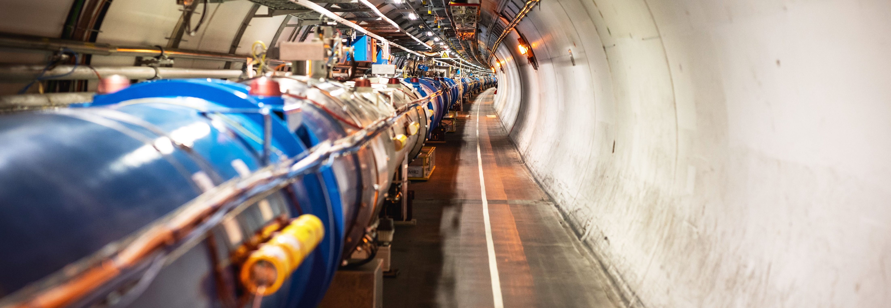
Report from
CERN International Relations
Emmanuel Tsesmelis
Principal Physicist and Head of Associate Member & Non-Member State Relations, CERN
Joint CERN-KEK Committee
KEK Tsukuba
7 December 2023

Slide 2
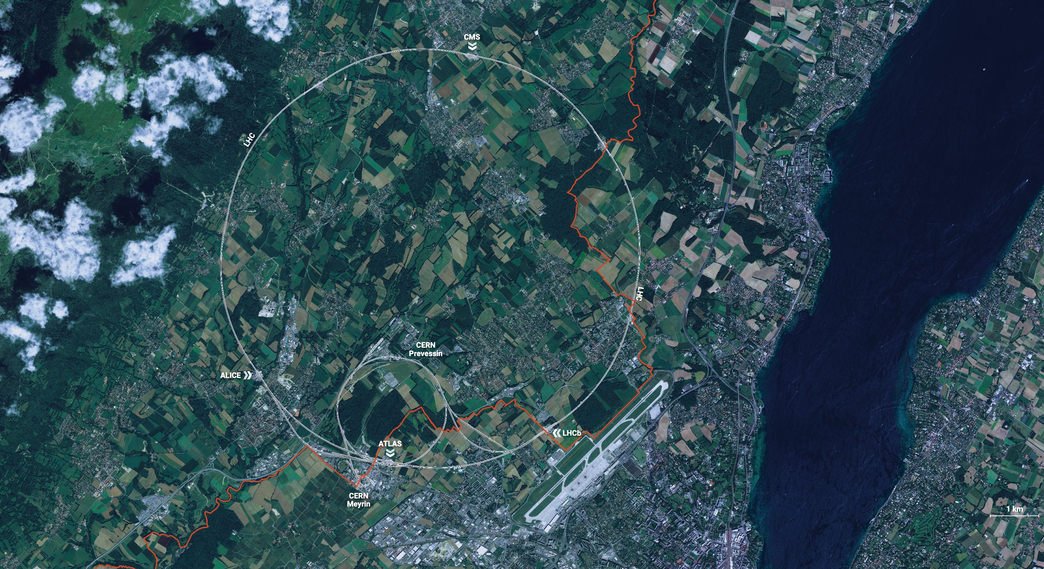
CERN is the world’s biggest laboratory
for particle physics.
Our goal is to understand the most fundamental particles and laws
of the universe.

Slide 3
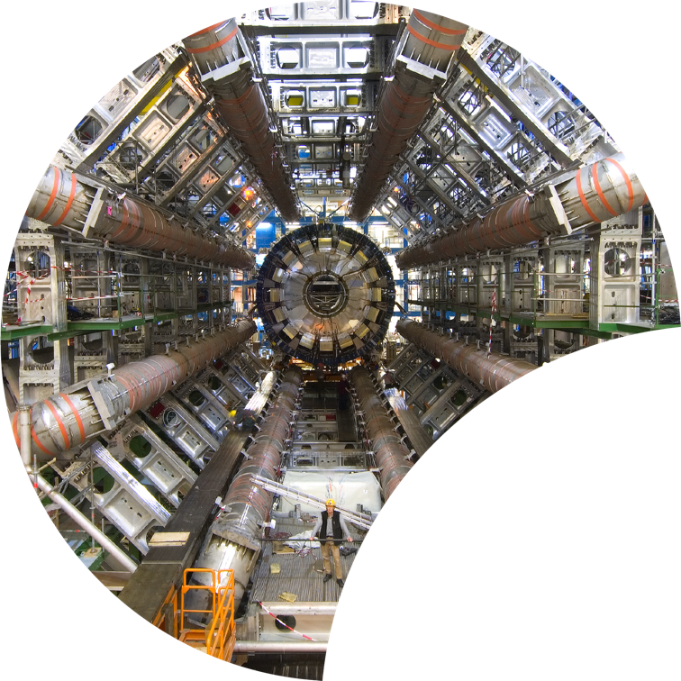
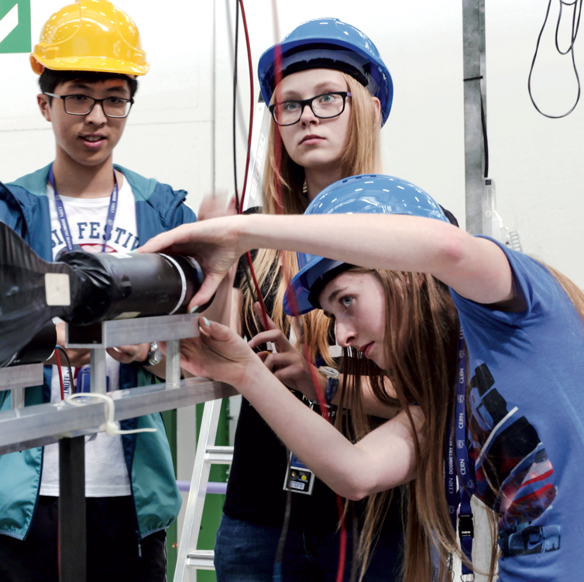
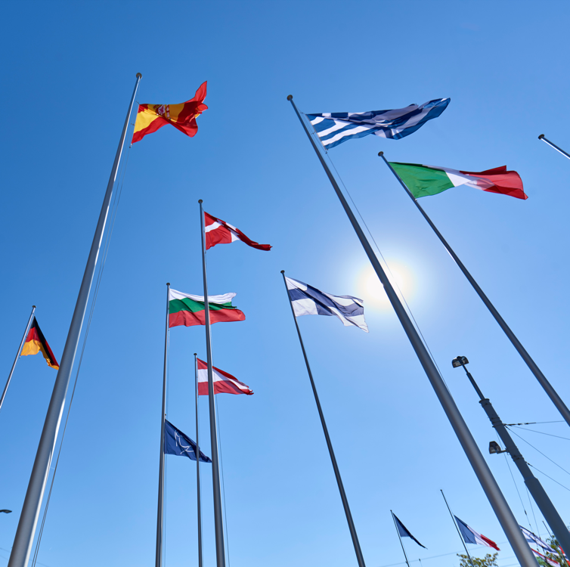
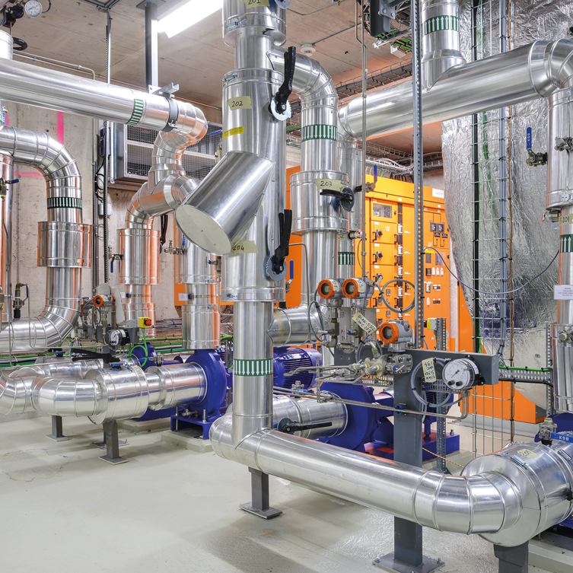

Four pillars underpin CERN’s mission
RESEARCH
EDUCATION
& TRAINING
COLLABORATION
TECHNOLOGY
& INNOVATION

Slide 4

Science for peace
CERN was founded in 1954 with 12 European Member States
CERN’s annual budget
is 1200 MCHF (equivalent
to a medium-sized European university)
23 Member States
Austria – Belgium – Bulgaria – Czech Republic
Denmark – Finland – France – Germany – Greece Hungary – Israel – Italy – Netherlands – Norway
Poland – Portugal – Romania – Serbia – Slovakia Spain – Sweden – Switzerland – United Kingdom
As of 31 December 2022
Employees:
2658 staff, 900 fellows
Associates:
11 860 users, 1516 others
3 Associate Member States
in the pre-stage to membership
Cyprus – Estonia – Slovenia
7 Associate Member States
Croatia – India – Latvia – Lithuania – Pakistan
Türkiye – Ukraine
6 Observers
Japan – Russia (suspended) – USA
European Union – JINR (suspended) – UNESCO
Around 50 Cooperation Agreements
with non-Member States and Territories
Albania – Algeria – Argentina – Armenia – Australia – Azerbaijan – Bangladesh – Belarus – Bolivia
Bosnia and Herzegovina – Brazil – Canada – Chile – Colombia – Costa Rica – Ecuador – Egypt – Georgia – Honduras
Iceland – Iran – Jordan – Kazakhstan – Lebanon – Malta – Mexico – Mongolia – Montenegro – Morocco – Nepal
New Zealand – North Macedonia – Palestine – Paraguay – People's Republic of China – Peru – Philippines – Qatar
Republic of Korea – Saudi Arabia – Sri Lanka – South Africa – Thailand – Tunisia – United Arab Emirates – Vietnam

Slide 5
A laboratory for people around the world
Distribution of all CERN Users by the country of their home institutes as of 31 December 2022
Geographical & cultural diversity
Users of 110 nationalities
22.5% women
Member States 7147
Austria 85 – Belgium 129 – Bulgaria 43 – Czech Republic 244 Denmark 49 – Finland 90 – France 844 – Germany 1225 Greece 119 – Hungary 73 – Israel 64 – Italy 1527
Netherlands 169 – Norway 79 – Poland 305 – Portugal 100 Romania 109 – Serbia 33 – Slovakia 70 – Spain 383
Sweden 103 – Switzerland 406 – United Kingdom 898
Associate Member States
in the pre-stage to membership 69
Cyprus 15 – Estonia 30 – Slovenia 24
Associate Member States 382
Croatia 38 – India 132 – Latvia 16 – Lithuania 14 – Pakistan 35
Türkiye 122 – Ukraine 25
Brazil, Chile and Ireland are candidate Associate Member States
Observers 2991
Japan 216 – Russia (suspended) 873 – United States of America 1902
Non-Member States and Territories 1271
Algeria 2 – Argentina 13 – Armenia 8 – Australia 21 – Azerbaijan 2 – Bahrain 4 – Belarus 18 – Brazil 122
Canada 199 – Chile 34 – Colombia 21 – Costa Rica 2 – Cuba 3 – Ecuador 4 – Egypt 20 – Georgia 32
Hong Kong 15 – Iceland 3 – Indonesia 5 – Iran 11 – Ireland 5 – Jordan 5 – Kuwait 4 – Lebanon 13 – Madagascar 1
Malaysia 4 – Malta 1 – Mexico 49 – Montenegro 4 – Morocco 19 – New Zealand 5 – Nigeria 1 – Oman 1
Palestine 1 – People’s Republic of China 333 – Peru 2 – Philippines 1 – Republic of Korea 147 – Singapore 2 South Africa 52 – Sri Lanka 10 – Taiwan 45 – Thailand 17 – Tunisia 2 – United Arab Emirates 7 – Viet Nam 1

Slide 6

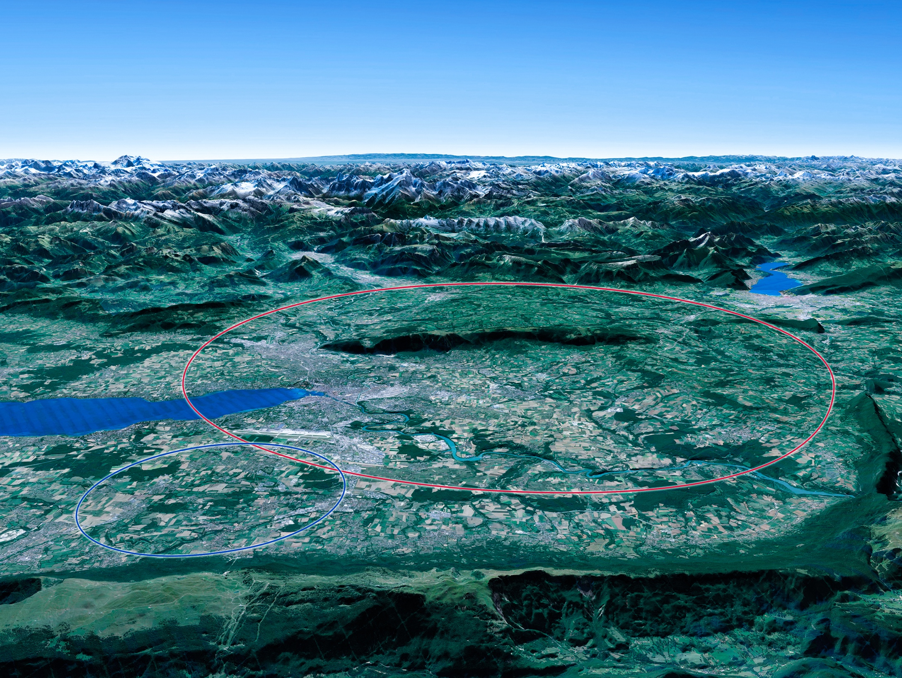

Scientific priorities for the future
Implementation of the recommendations
of the 2020 Update of the European Strategy
for Particle Physics:
• Fully exploit the HL-LHC
• Build a Higgs factory to further understand this unique particle
• Investigate the technical and financial feasibility of a future energy-frontier 100 km collider at CERN
• Ramp up relevant R&D
• Continue supporting other projects around
the world
LHC

Slide 7

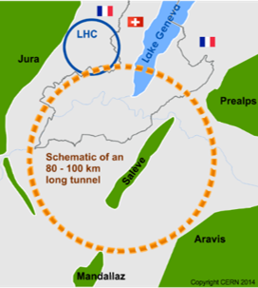
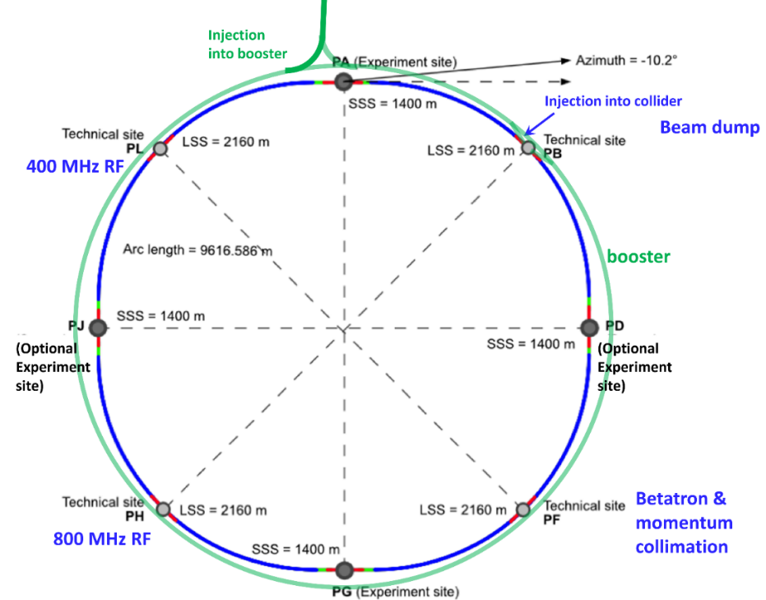
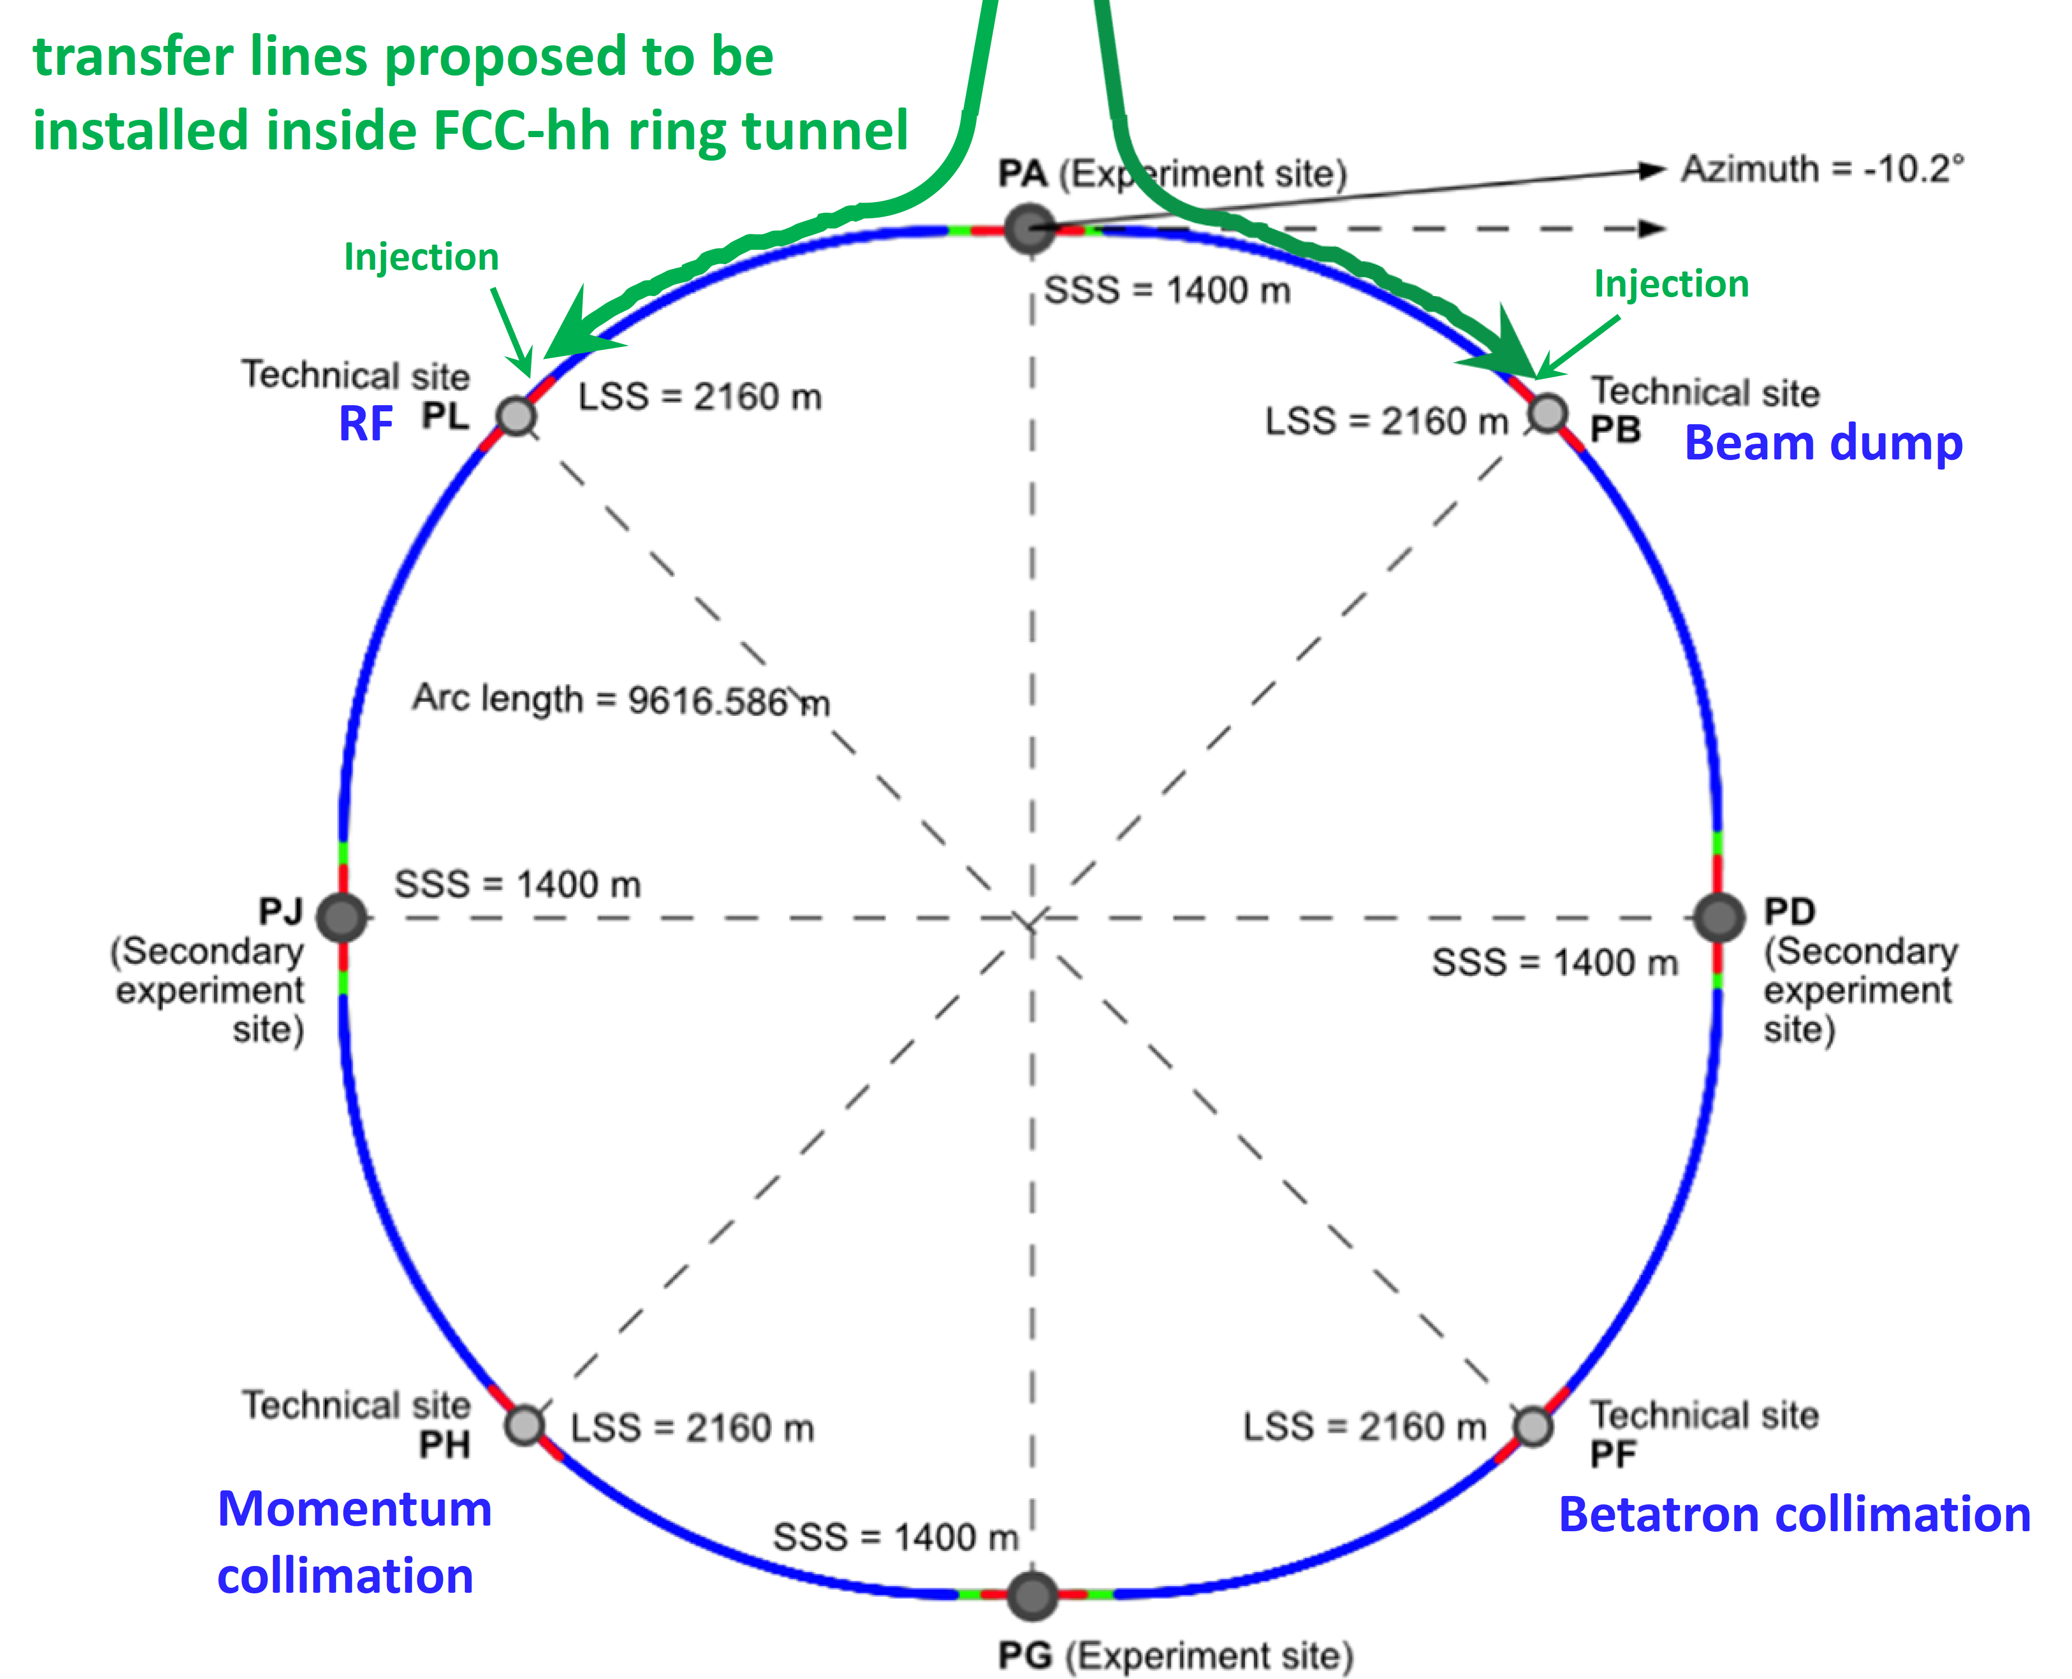
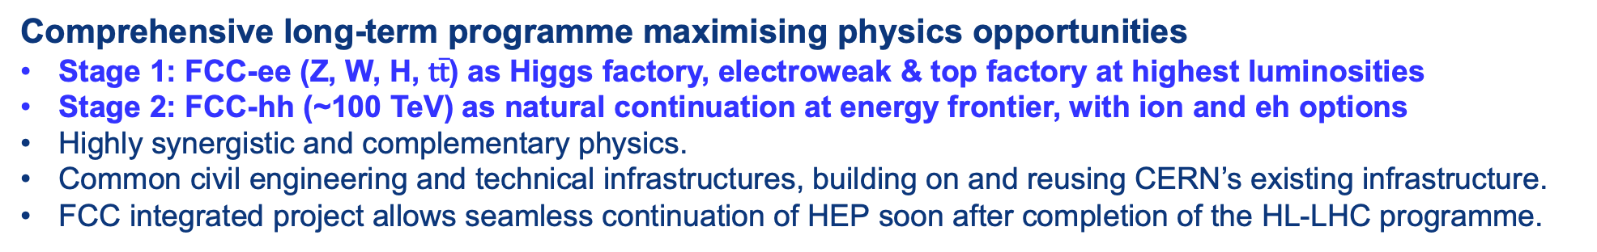
The FCC Integrated Programme
Inspired by Successful LEP – LHC Programmes at CERN
Comprehensive long-term programme maximising physics opportunities
Stage 1: FCC-ee (Z, W, H, $\text{t}\overline{\text{t}}$) as Higgs factory, electroweak & top factory at highest luminosities
Stage 2: FCC-hh (~100 TeV) as natural continuation at energy frontier, with ion and eh options
Highly synergistic and complementary physics.
Common civil engineering and technical infrastructures, building on and reusing CERN’s existing infrastructure.
FCC integrated project allows seamless continuation of HEP soon after completion of the HL-LHC programme.
FCC-ee
FCC-hh
2020 - 2040
2045 - 2063
2070 - 2095

Slide 8


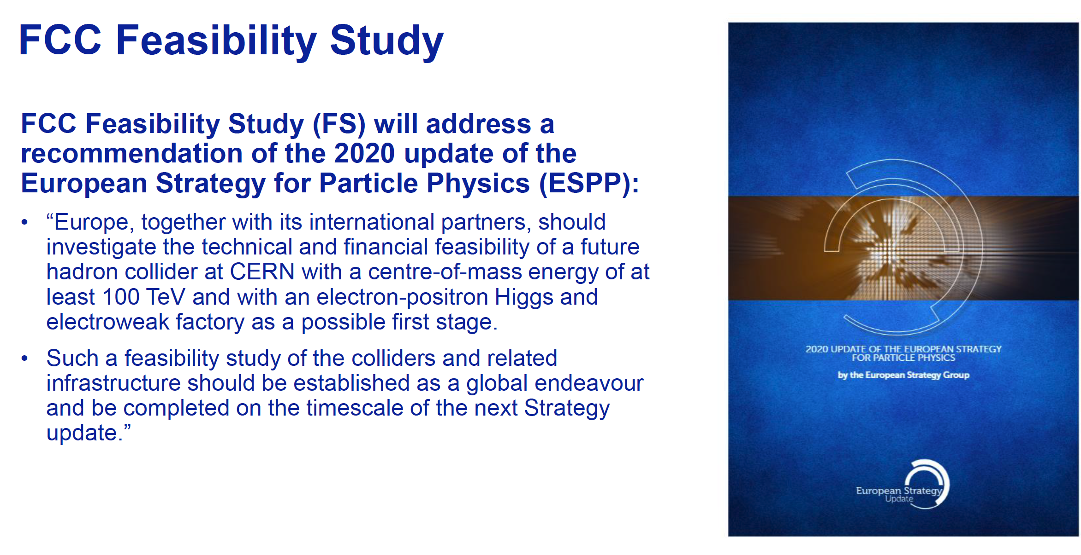
FCC Feasibility Study
Increasing international collaboration as a prerequisite for success:
links with science, research & development and high-tech industry will be essential to further advance and prepare the implementation of FCC
FCC FS is organised as an international collaboration.
The FCC FS and a possible future project will profit from CERN’s decades-long experience with successful large international accelerator projects, e.g., the LHC and HL-LHC, and the associated global experiments, such as ATLAS and CMS.

Slide 9
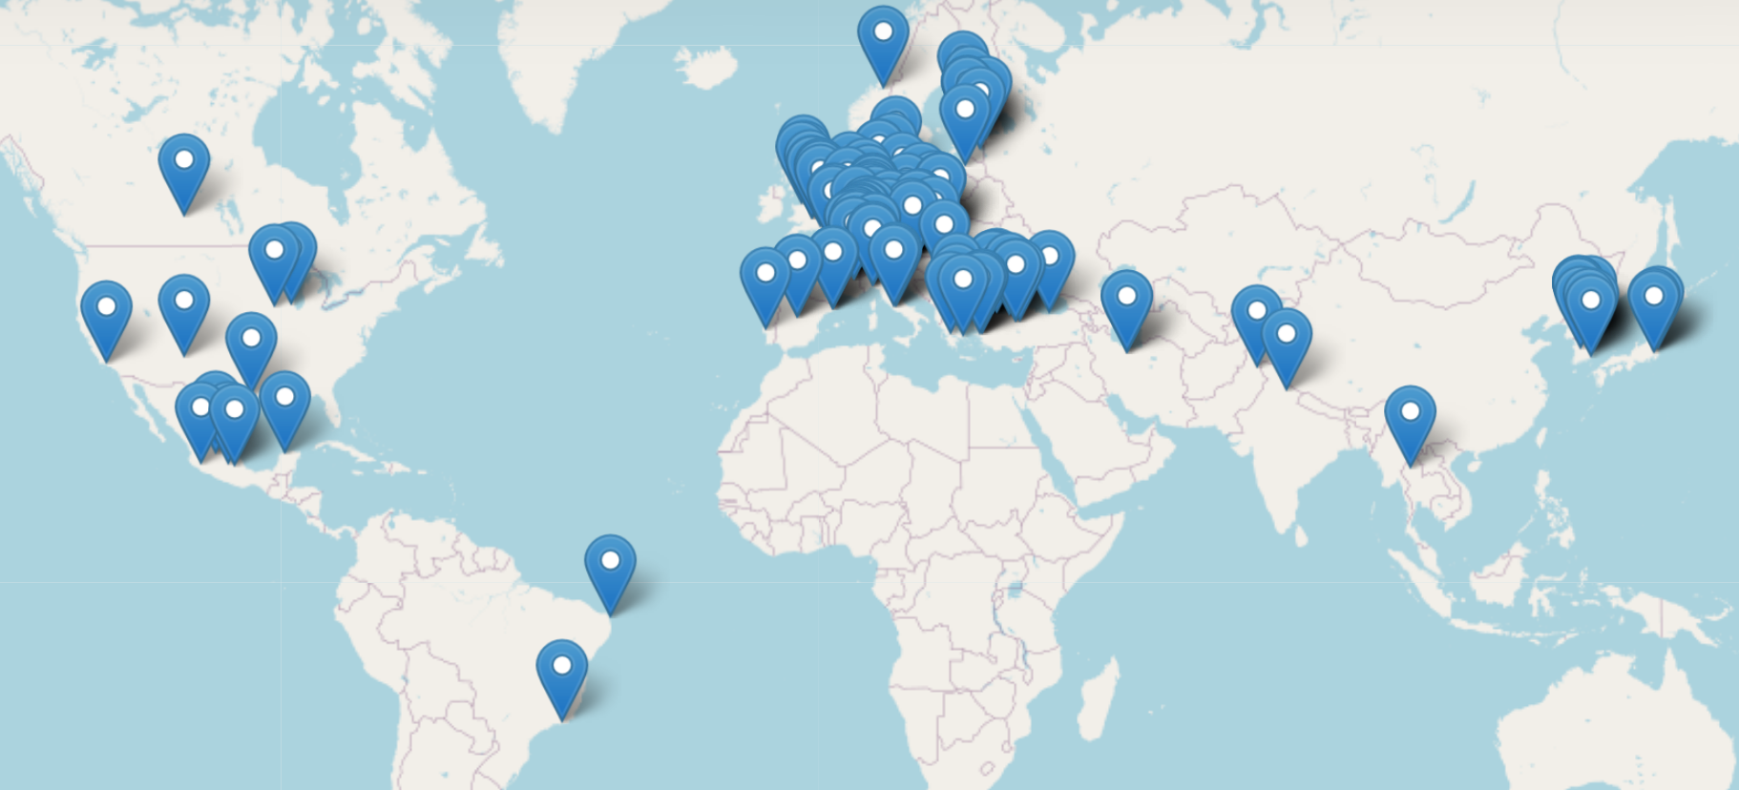
The FCC Collaboration
150 INSTITUTES 32 COMPANIES 34 COUNTRIES
Increasing international collaboration is a prerequisite for success
Aim of the FCC Feasibility Study is to increase further the collaboration
on all aspects, particularly on Accelerator and Particle/Experiments/Detectors (PED)

Slide 10
FCC and Japan
KEK, Ibaraki
  Memorandum of Understanding signed on 02 September 2014
  Addendum signed on 09 September 2014
    The scope of this collaboration is to perform electron-cloud studies for FCC-hh and FCC-ee as well as to perform beam-beam simulations for FCC-hh and FCC-ee. In addition, the institute will investigate high-field and fast-cycling SC magnet options, produce a complex FCC-ee injector design based on SuperKEB injector, perform vacuum-system studies and perform SRF developments for FCC-ee and FCC-hh.
  Appendix signed on 21 September 2016
UTOKYO, Tokyo
  Memorandum of Understanding signed on 22 November 2017
  Addendum signed on 22 November 2017
    The scope of this collaboration is to establish a report on sensitivity studies of the SUSY and HH production in FCC-hh as well as a report on the conceptual design of the muon detector and performance studies at high energy regions.

Slide 11
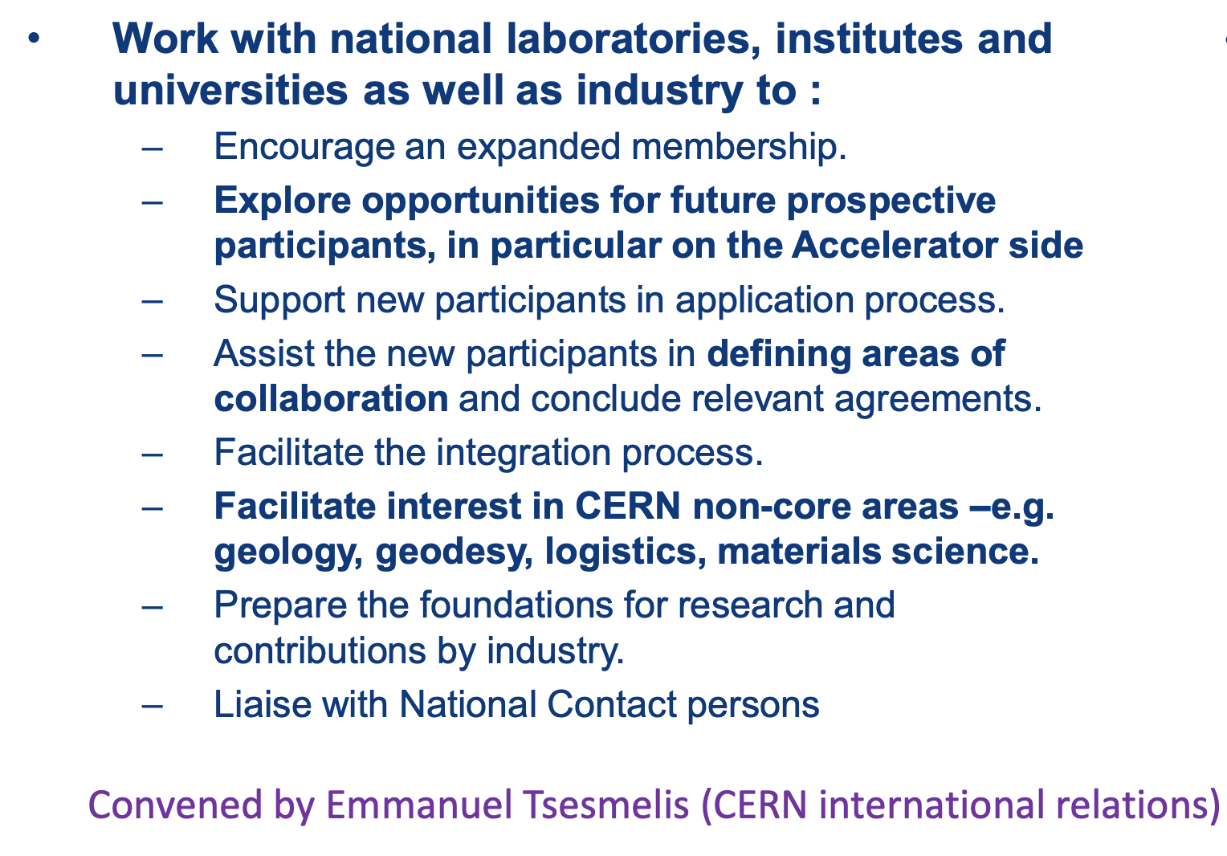
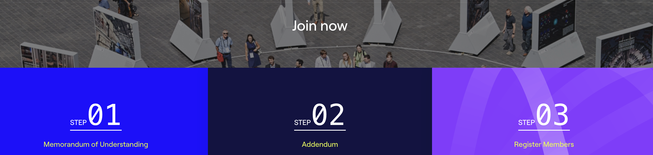
Building the FCC Collaboration
FCC Global Collaboration Working Group (FGC)
https://fcc.web.cern.ch/collaboration
Many possible synergies between
FCC and Japan accelerator/PED studies

Slide 12
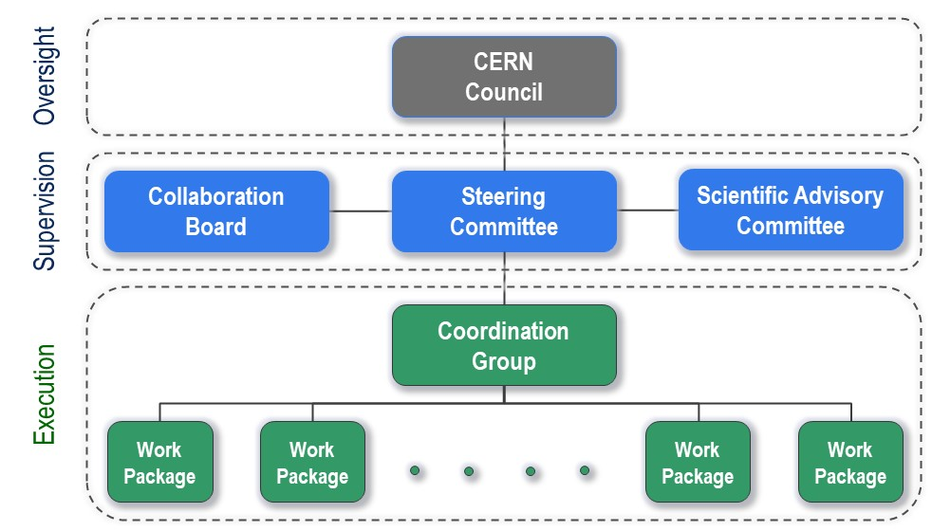
FCC Feasibility Study Organisational Structure
FCC Organisational Structure
  Ownership of the Feasibility Study by the Council.
  Effective and timely supervision.
  Integration of scientific and technical advice.
  Participation of stakeholders that can potentially make significant financial and technical contributions to a possible future project.
  Execution of Feasibility Study.

Slide 13
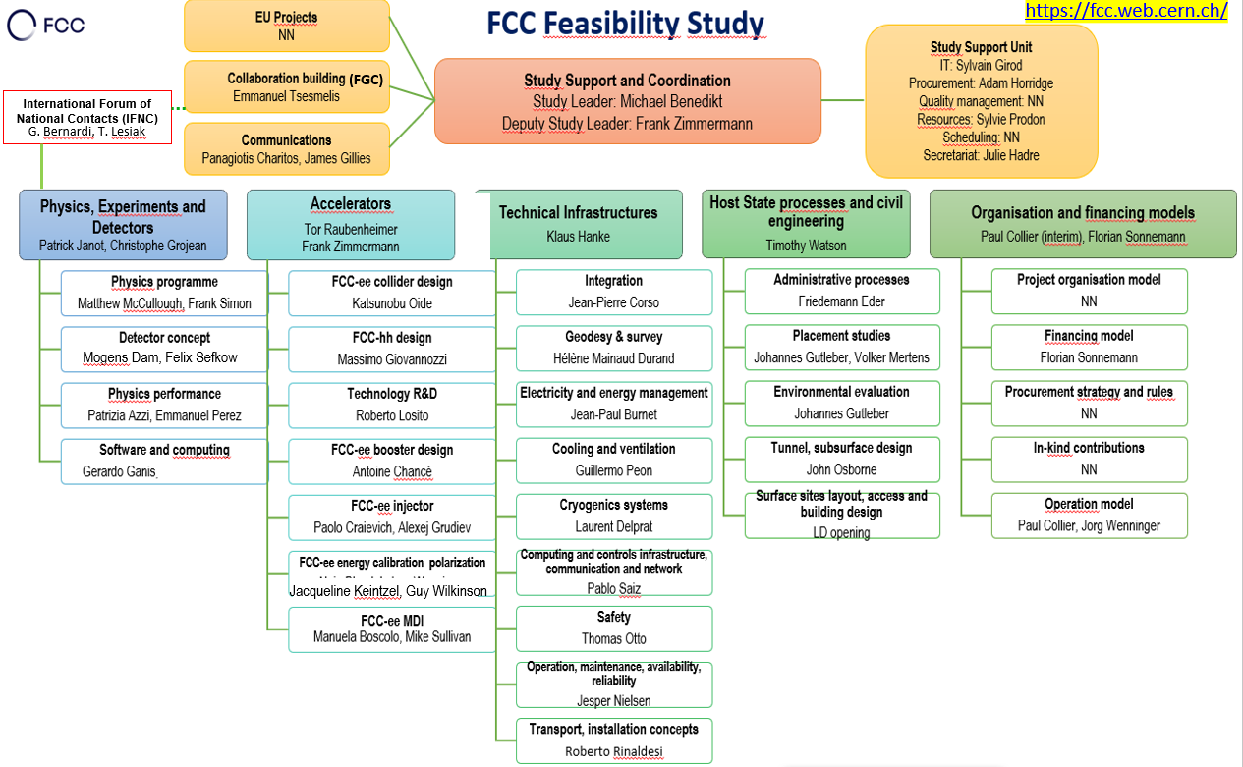
FGC and IFNC

Slide 14
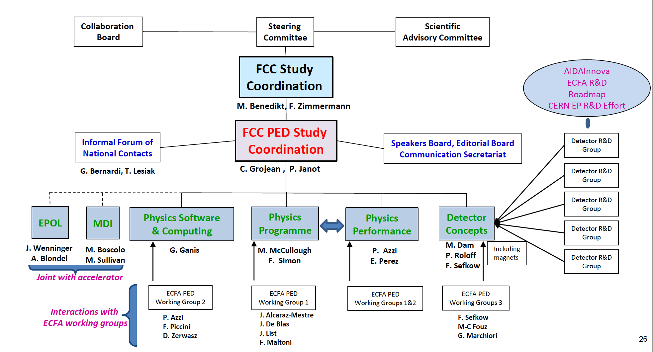
PED Organisation and Convenors
PED = Physics, Experiments and Detectors
Increasing international collaboration as a prerequisite for success:
links with science, research & development and high-tech industry will be essential to further advance and prepare the implementation of FCC

Slide 15
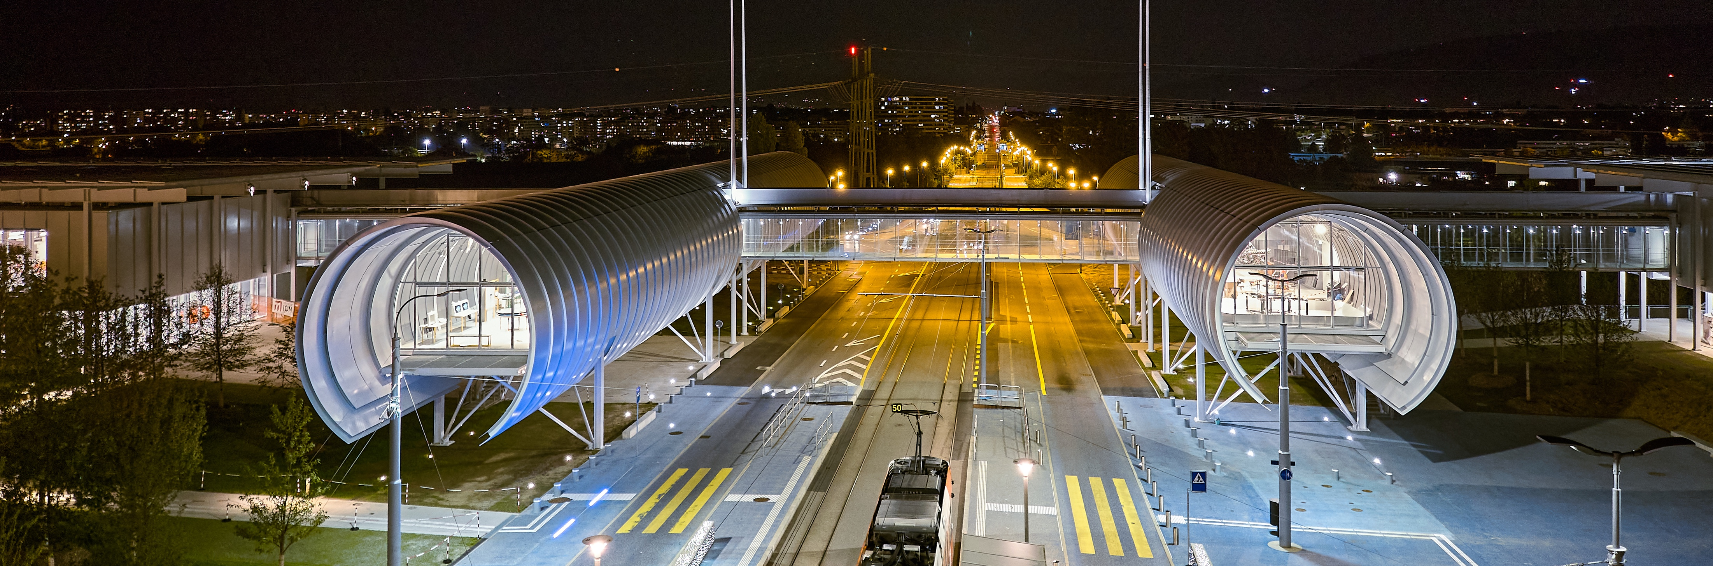
CERN Science Gateway
Date for CERN’s 70th anniversary celebration
1 October 2024
CERN’s new education and outreach centre for all
public aged 5-plus.
Inaugurated
7 October 2023.
Immersive exhibitions, education labs, events
and shows.
Notes:
Additional information:
Will engage citizens with the science, the discoveries, the technologies and the people working at CERN
Will inspire the next generation to explore a career in science and technology.
Building designed by Renzo Piano
Includes three exhibitions, two educational labs and a 900-seat auditorium, to be used for public events and scientific meetings and conferences
Fully funded by external donations
THIS IS THE LAST SLIDE IN THE “EDUCATION AND TRAINING” SECTION

